Slide 1

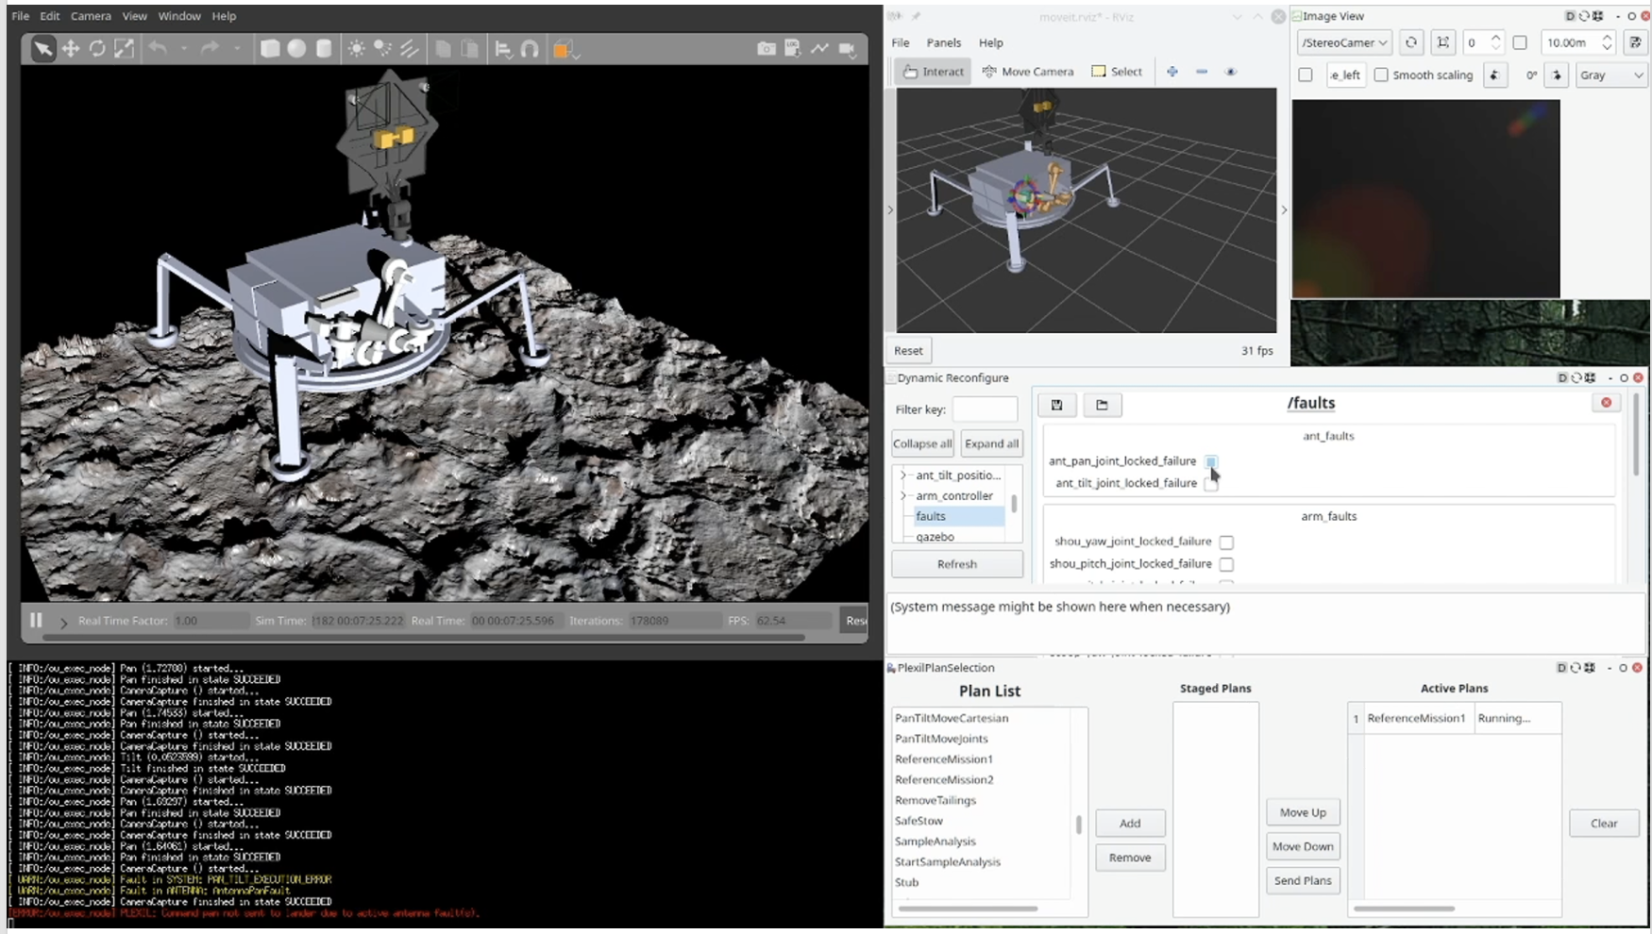

Ocean Worlds Autonomy Testbed for Exploration Research and Simulation
(OceanWATERS)
K. Michael Dalal, KBR Inc. at NASA Ames Research Center
Target: Icy Worlds (with focus on Europa)
Adaptable for other planetary bodies
Science:
Geology: characterize terrain, subsurface features, regolith composition, and external phenomena.
Biology: detect life signs (extinct, extant).
These are enabled via lander-proximity visual and terra-mechanical inspection and multiple, varied onboard analyses of regolith samples.
Objectives:
Develop a virtual lander autonomy testbed for use by SMD AISR:ARROW and COLDTech:Autonomy solicitation winners to demonstrate and evaluate autonomy technologies.
Virtually simulate representative capabilities of a lander mission on an Ocean World.
Screenshot of OceanWATERS: Gazebo simulator with lander on Europa-like terrain, ROS path-planning and image viewers, fault injection GUI, autonomy plan selector, and plan executive monitor.
Technology Accomplishments:
Developed a virtual lander autonomy testbed used by SMD Autonomy solicitation winners.
Worked with two ARROW and four COLDtech teams to demonstrate their autonomy capabilities.
Key Milestones:
Release as open-source software to facilitate research and collaboration.
Work with two ARROW and four COLDtech teams to demonstrate their autonomy capabilities.
CoIlaborators: Thomas Stucky (KBR), Chetan Kulkarni (KBR), Terence Welsh (Logyx), numerous alumni (NASA Ames Research Center, KBR).
Project start date: October 2018
Project end date: May 2024
TRL: 2 to 4
AISR:ARROW & COLDTech:Autonomy
© 2024 KBR. Government sponsorship acknowledged

Slide 2
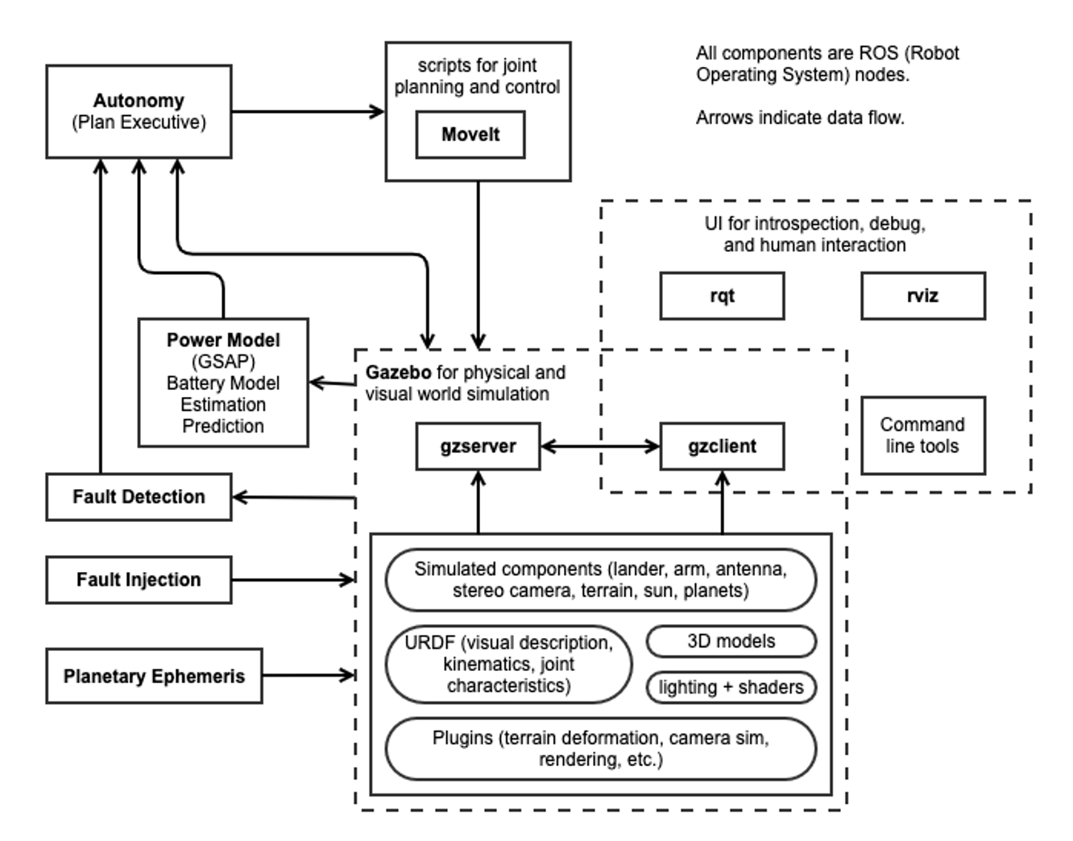
PSD Technology Development Specification Sheet (Software)
Technology Name: Ocean Worlds Autonomy Testbed for
Exploration Research and Simulation
(OceanWATERS)
Technology Type: Software testbed
PI, email, and Institution: K. Michael Dalal
michael.dalal@nasa.gov
KBR Inc. at NASA Ames
Program: AISR:ARROW (2020-2022)
COLDTech:Autonomy (2021-2024)
TRL: Start= 2 End= 4
Deployment: ground testbed
Intended target: Icy worlds, e.g. Europa, Enceladus, Titan
Detailed specifications:
Simulation software package that provides a visual and physical simulation of a lander on Europa.
The simulated lander has a pan/tilt antenna, stereo cameras, and a 7-joint arm with interchangeable end effectors.
Terrain models include a digital model of a portion of the Atacama Desert (Earth analog for ocean worlds).
A fault injection and detection framework simulates hardware degradation and failure.
Built using the open-source Robot Operating System (ROS), Gazebo simulator, and related tools.
Base layer of autonomy provided by the PLEXIL plan language/executive (open-source software by NASA Ames).
Lander’s battery power system modeled by the GSAP prognostics engine (open-source software by NASA Ames).
Ephemeris models provided by JPL’s SPICE toolkit (freely available).
Operating requirements: Linux (Ubuntu 20) computer with at least a 2 Ghz 4-core x86-64 CPU, 16GB RAM, and a mid-range Nvidia GPU. ROS Noetic, Gazebo 11.12+ and related tools; C++14, Python 3; PLEXIL and GSAP (open-source).
Computational burden: Not available.
Validation status: Used by 2 ARROW and 4 COLDTech teams as a testbed for their autonomy technologies.
Availability: Open-source at http://github.com/nasa/ow_simulator (licensed under NOSA v1.3).
© 2024 KBR. Government sponsorship acknowledged

