Slide 1
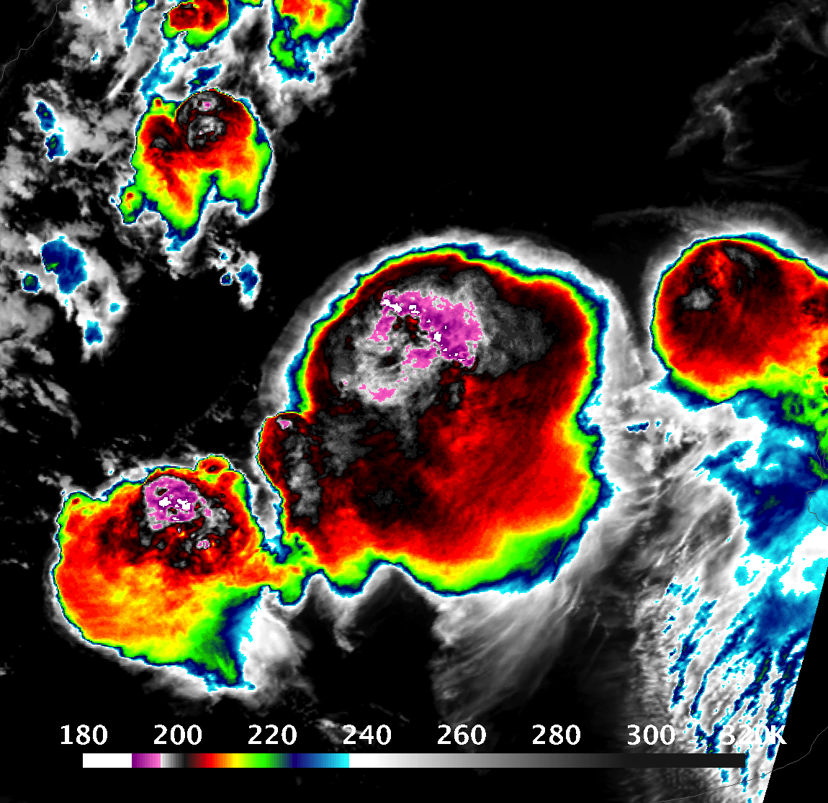

A Long-Term GOES Satellite Overshooting Cloud Top and Anvil Cloud Climatology Over South America Kristopher Bedka¹, Kyle Itterly², Benjamin Scarino¹, Konstantin Khlopenkov² and Douglas Spangenberg² ¹ Science Directorate, NASA Langley Research Center (LaRC), Hampton, VA ² Analytical Mechanics Associates, Hampton, VA
Contact: kristopher.m.bedka@nasa.gov

Slide 2
Purpose and Background
PURPOSE: Introduce a newly-developed deep convection climatology over South America derived from a 27-year record of hourly GOES infrared (IR) and MERRA-2 reanalysis data
BACKGROUND
GOES satellites have observed much of the Western Hemisphere with 4 km IR pixels since GOES-8 in 1994
From 1994-2017, GOES-8 to GOES-13 routinely observed CONUS at 15-30 min intervals, and certain high-impact weather events (e.g. hurricanes) at up to 5 minute intervals
South America was viewed ~hourly from 1994-2017, with the exception of 2006-2013 when GOES-10 and -12 were dedicated to South America to provide up to 15 min imaging
GOES-16 has observed S. America much more frequently (10-15 mins) with 2 km IR pixels

Slide 3
Purpose and Background
PURPOSE: Introduce a newly-developed deep convection climatology over South America derived from a 27-year record of hourly GOES infrared (IR) and MERRA-2 reanalysis data
BACKGROUND
GOES satellites have observed much of the Western Hemisphere with 4 km IR pixels since GOES-8 in 1994
From 1994-2017, GOES-8 to GOES-13 routinely observed CONUS at 15-30 min intervals, and certain high-impact weather events (e.g. hurricanes) at up to 5 minute intervals
South America was viewed ~hourly from 1994-2017, with the exception of 2006-2013 when GOES-10 and -12 were dedicated to South America to provide up to 15 min imaging
GOES-16 has observed S. America much more frequently (10-15 mins) with 2 km IR pixels
Despite the varying detail/quality of the GOES data record, anvils and overshooting cloud tops are very apparent and detectable. This enables development of high spatial resolution maps of convective storm frequency/intensity
The entire GOES satellite record over South America from 1995-2021 was processed at NASA Langley, under a NASA Applied Sciences Disasters program project, to develop an observational dataset for the research community and industry to study severe storms over the continent
Geostationary imagers reveal details of the convection diurnal cycle missed by most NASA low-Earth-orbiting satellites

Slide 4
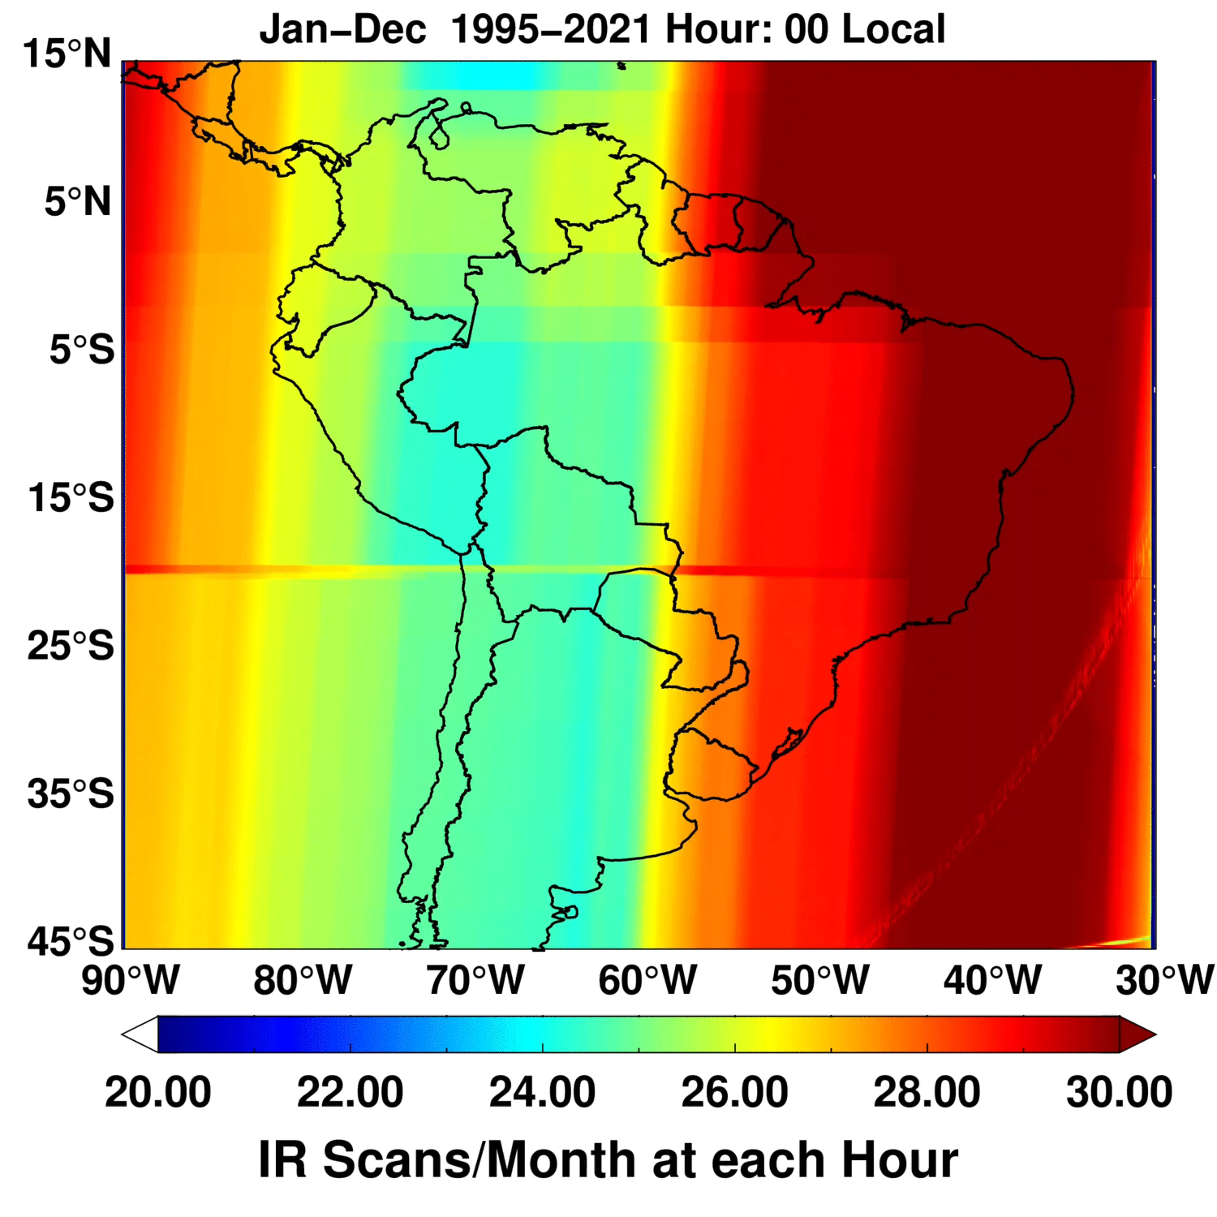
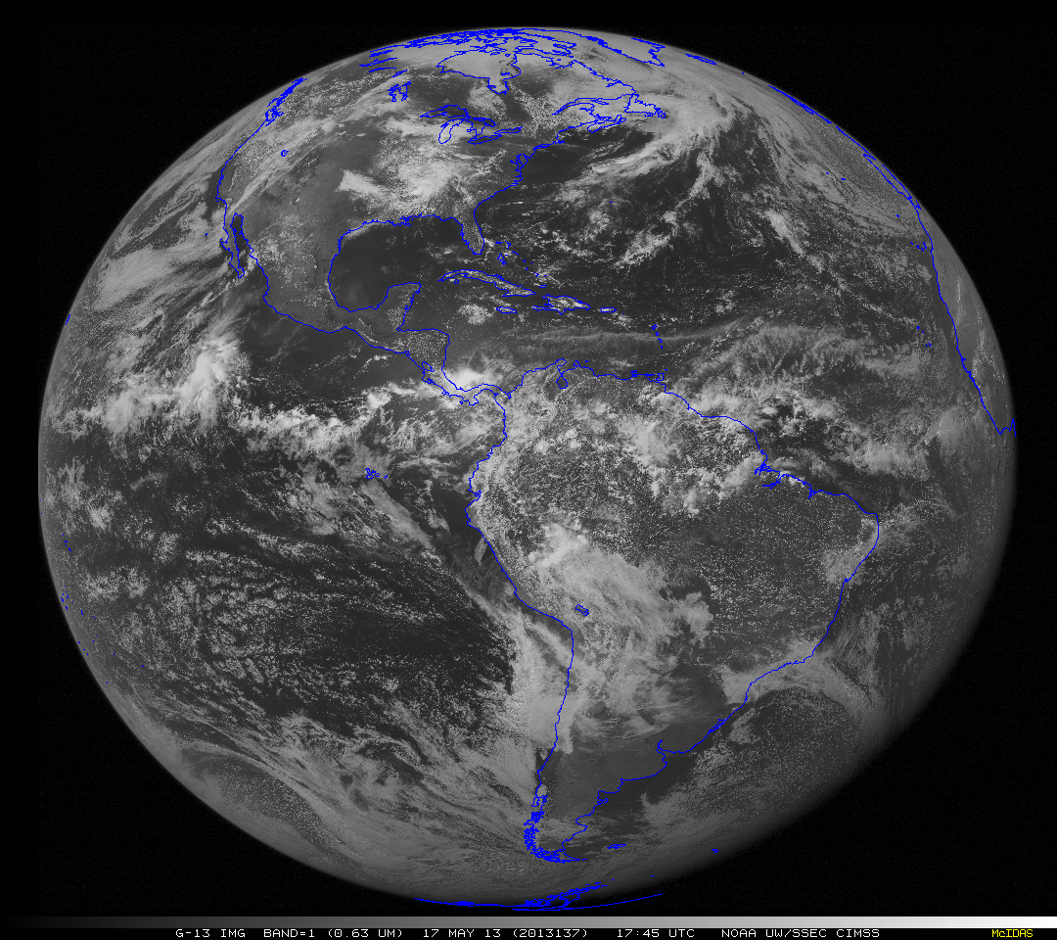
Example of Historical GOES Scan Patterns
Six Hour Animation of GOES-13 Scans: 17 May 2013
Historical GOES imagers have a very complex scanning pattern over the Southern Hemisphere
This is especially true when GOES operated in 7.5 min rapid scan mode, which sacrificed several Southern Hemisphere scans(or portions of scans) throughout a day. Some local hour bins have an average of just 24 out of ~30 scans/per month
This complexity coupled with reduced image quality at cold convective cloud temperatures for pre-GOES-13 satellites made development of our database a non-trivial effort
Learn More About GOES Scan Patterns At:
https://cimss.ssec.wisc.edu/satellite-blog/archives/13001
Animation Credit: UW-Madison CIMSS Satellite Blog

Slide 5
Methods
1) Acquire a subsetted (15° N to 45°S and 30° to 90° W) GOES data record from the UW-Madison SSEC Data Center using McIDAS-X
2) Resample imagery to a fixed grid with 28 (GOES-8 to -13) or 56 (GOES-16) pixels/degree
3) Spatially smooth and resample MERRA-2 tropopause temperature, and temperature and height profiles to the GOES pixel scale
4) Detect “anvil clouds” and cold spots embedded in the anvil
Anvil cloud detection: Numerical likelihood that a pixel is part of an anvil
Detection criteria: a region of IR temp up to 35 K warmer than the tropopause and cloud height ≥ 10 km, exhibiting spatial uniformity quantified with a spatial histogram analysis (Khlopenkov et al. (JGR, 2021))
Scarino et al. (AMT, 2020) found skillful anvil detection compared to the CloudSat 2B-CLDCLASS product (Young et al. (JGR, 2013))
Can fail at times with large cold cloud shields from mid-latitude cyclones
5) Determine overshooting top (OT) probability for embedded cold spots based on tropopause-relative and anvil-relative IR temps, and surrounding anvil properties
Cooney et al. (JGR, 2021) found 45-70% POD for GOES OT detections (OT prob ≥ 0.5) relative to NEXRAD echo top height
POD range is a function of the echo top reflectivity level (e.g. 10 vs. 20 dBZ) and altitude used to define overshooting
6) Estimate anvil and OT cloud top height, and parallax shift using MERRA-2 profiles
Parallax-correct GOES pixel locations based on cloud height, and assign pixels to local hourly bins
OT height based on Griffin et al. (JAMC, 2016) and a 4 K/km stratospheric lapse rate for GOES-8 to -13, 5.5 K/km for GOES-16
UTC to hourly time conversion based on day of year and pixel longitude
7) Aggregate OT/anvil detections at daily, monthly, and annual, and multi-annual scales, with hourly bins and 4 km pixel spacing
8) Record the 5 most intense temperature and height values per pixel per month to derive “99th percentile” intensity products

Slide 6
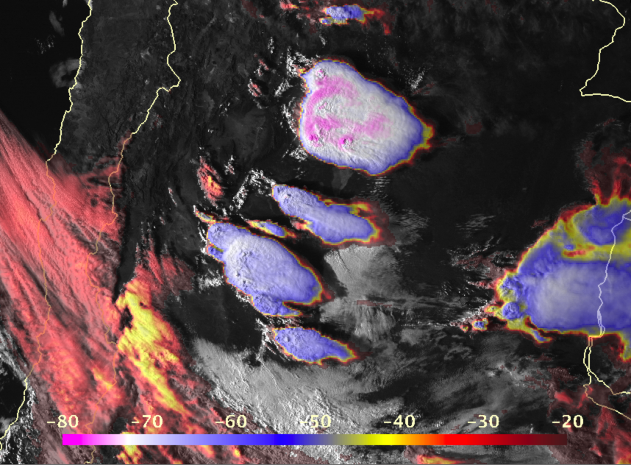
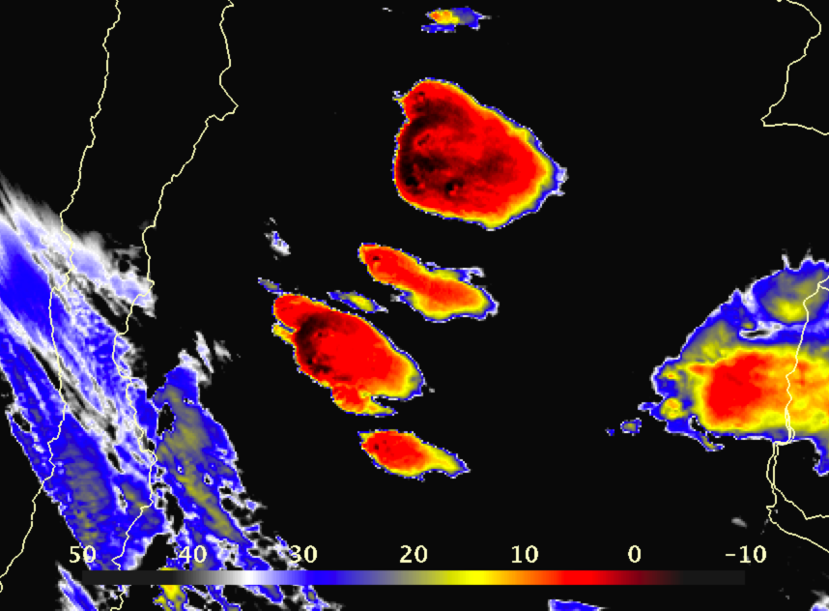
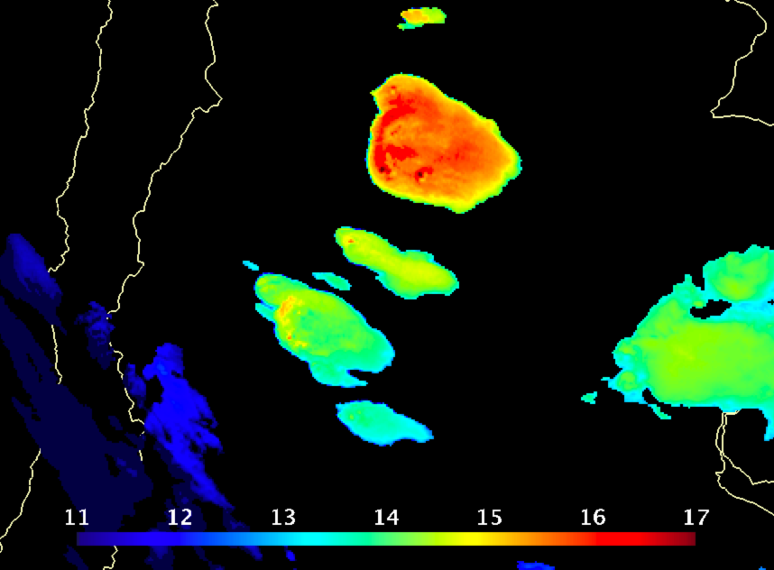
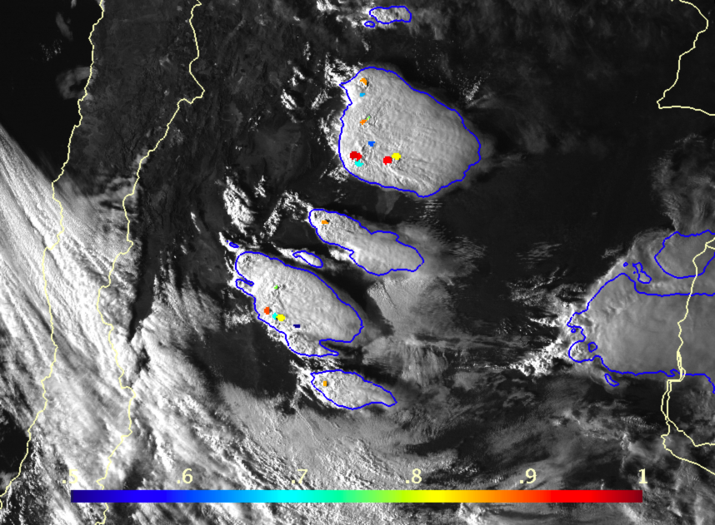
GOES-13 Infrared (°C) + Visible Sandwich: 31 October 2013 at 2045 UTC
GOES-13 Infrared - Smoothed MERRA2 Tropopause Temperature (°C)
Product Examples
Severe storms over northern Argentina observed by GOES-13
31 October 2013
Cloud Top Height (km)
IR Anvil Detection (Blue Contour)
Overshooting Top Probability ≥ 0.5 (Colored Dots) atop GOES Visible

Slide 7
GOES-13 Infrared (°C) + Visible Sandwich: 31 October 2013 at 2045 UTC
GOES-13 Infrared - Smoothed MERRA2 Tropopause Temperature (°C)
Product Examples
Severe storms over northern Argentina observed by GOES-13
31 October 2013
Cloud Top Height (km)
IR Anvil Detection (Blue Contour)
Overshooting Top Probability ≥ 0.5 (Colored Dots) atop GOES Visible

Slide 8
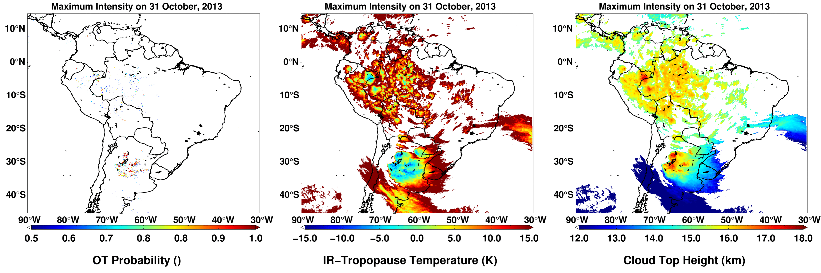
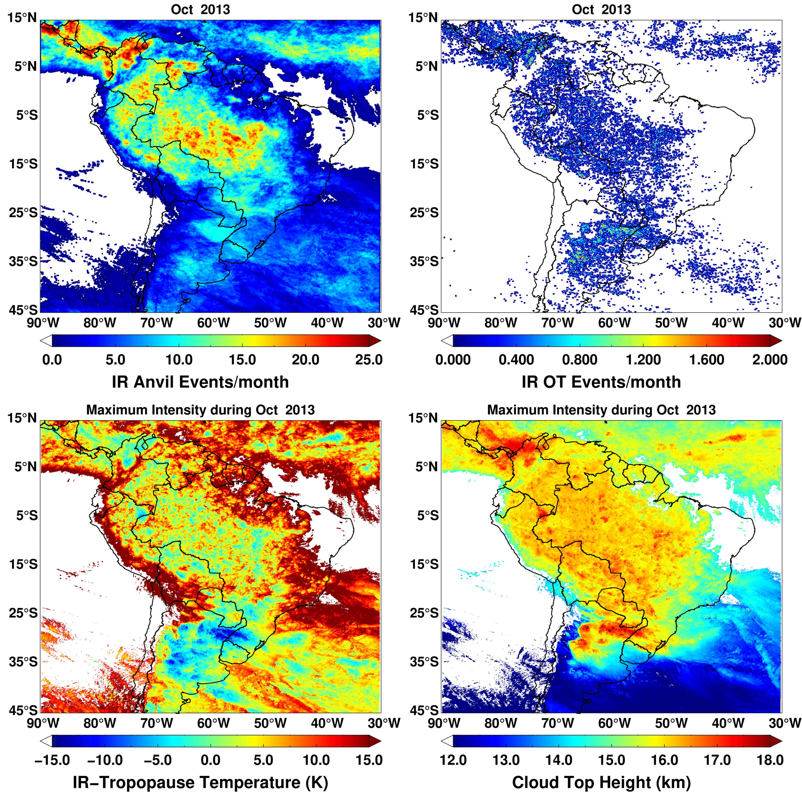
Daily Composite: 31 October 2013
Daily and Monthly Composite Products
Monthly Composite: October 2013

Slide 9
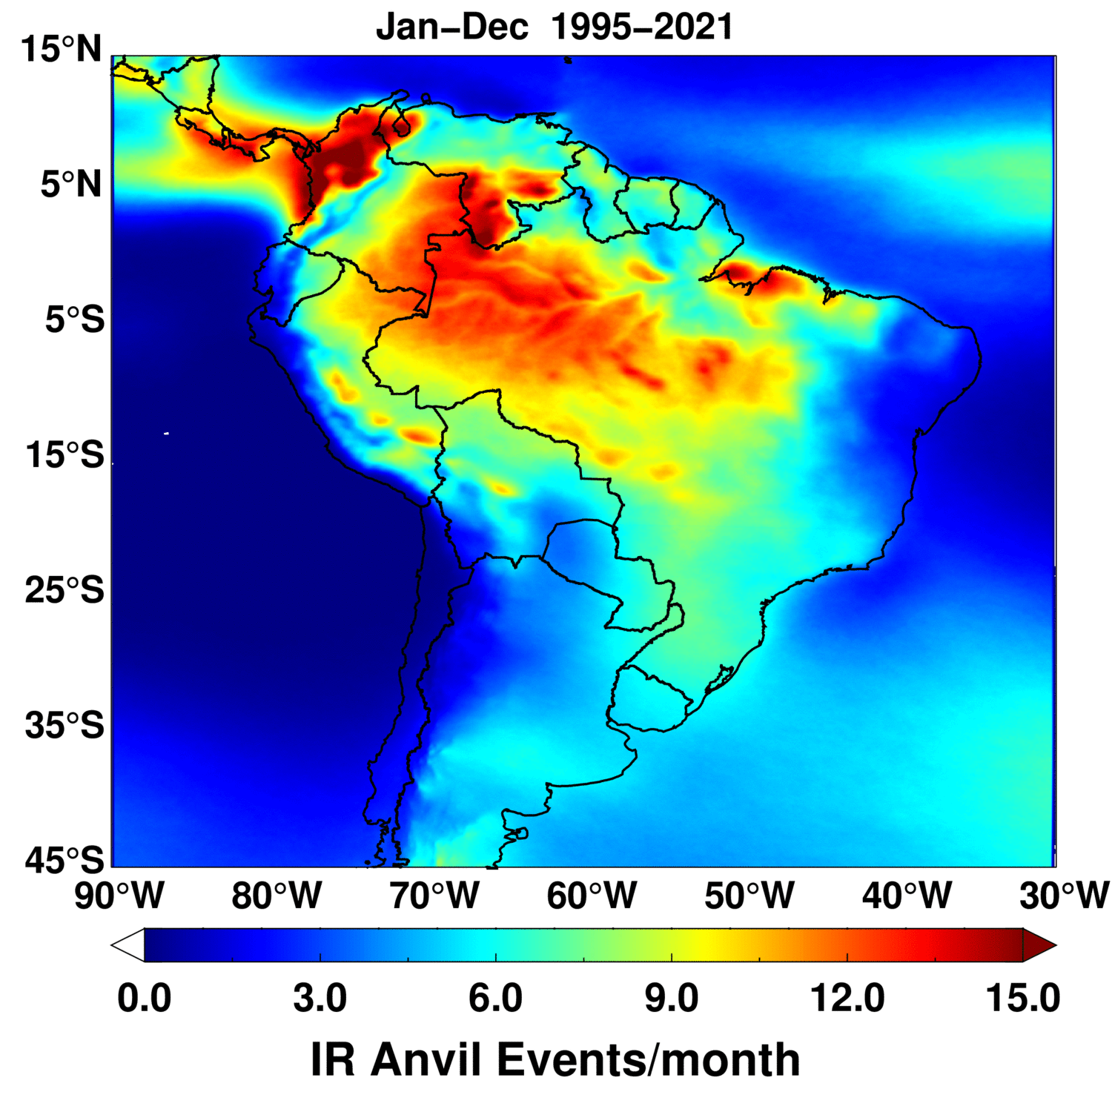
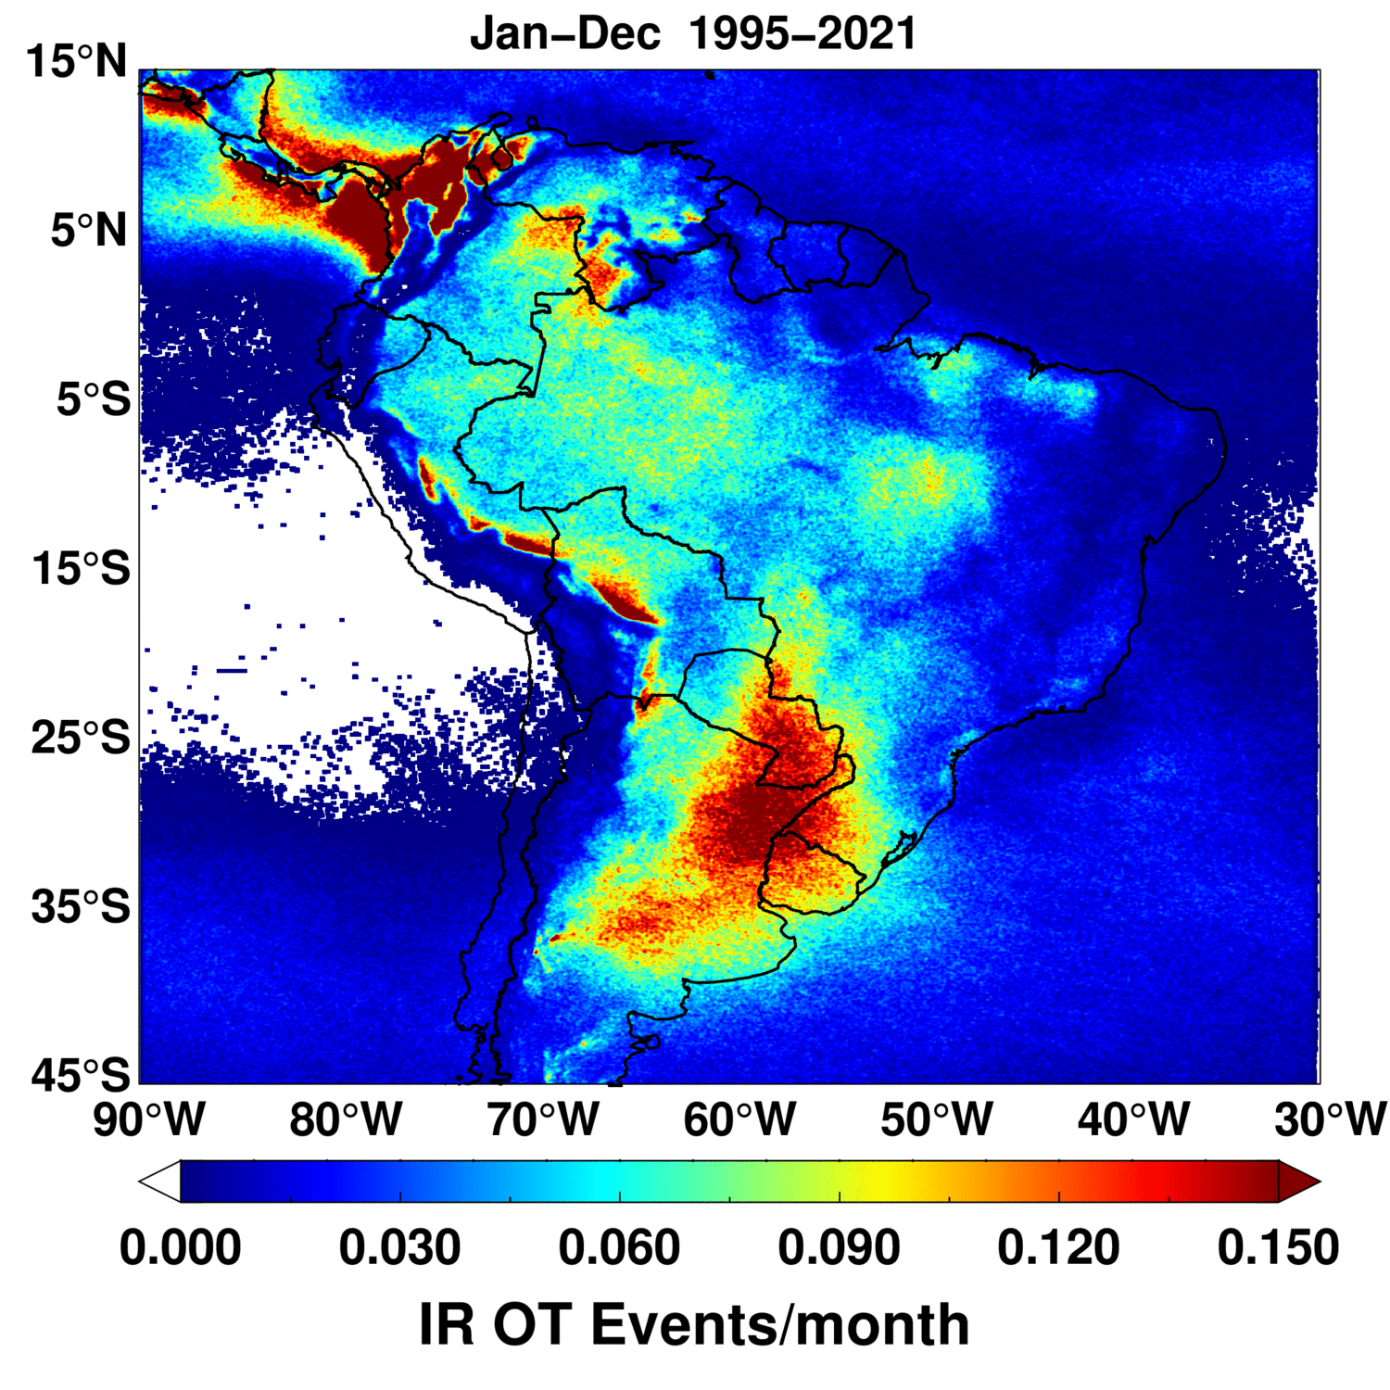
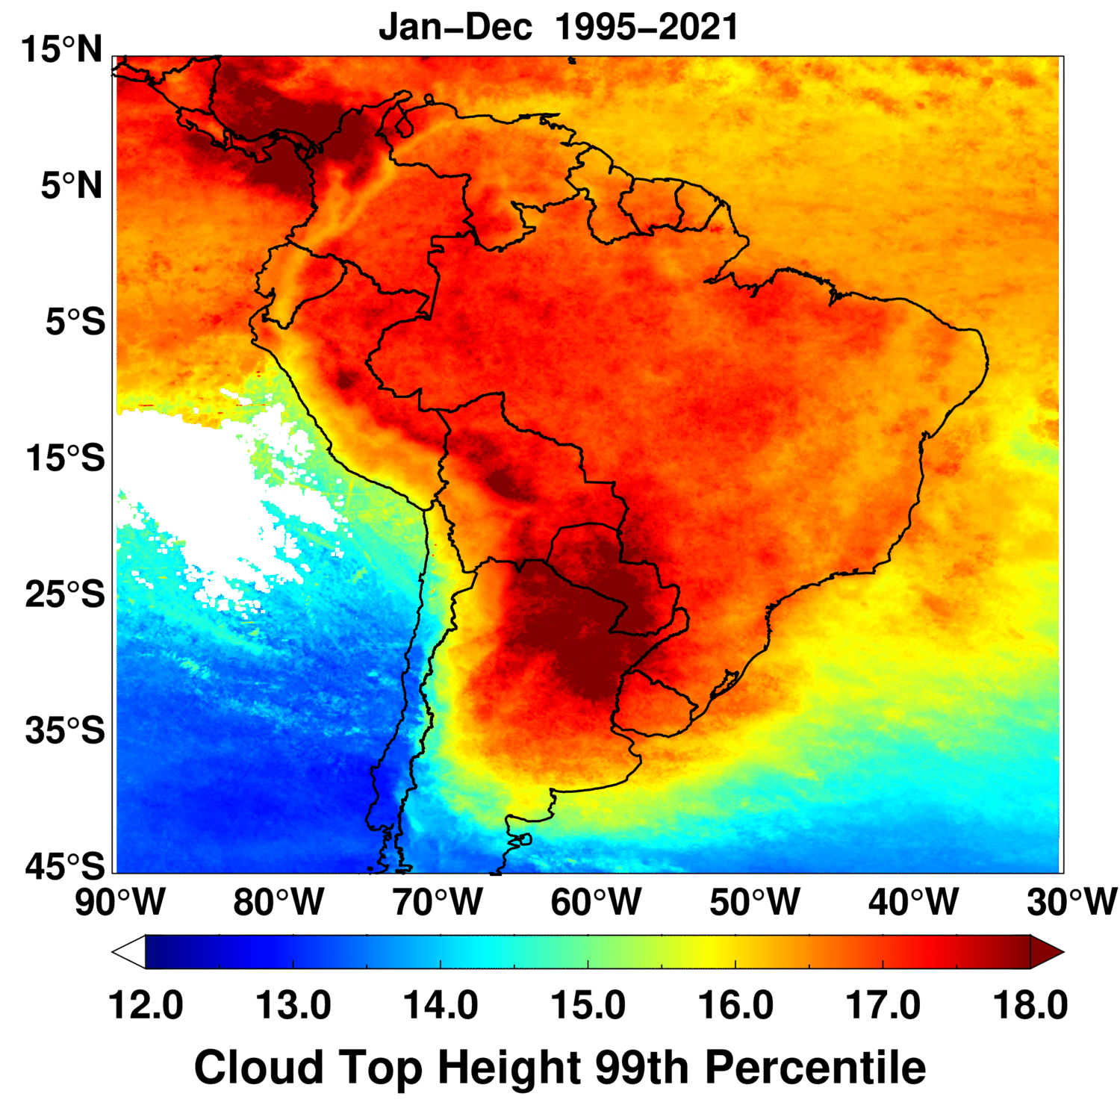
GOES South America Convection Climatology: 1995-2021
Where Do Storms Occur?
Where Are The
Most Intense Storms?
How High Do They Reach?
Anvil clouds are most frequent over the Amazon basin, northern Colombia, and northwest Venezuela. The Amazon river and its tributaries modulate regional convection frequency
Overshooting occurs more often over northern Argentina, Paraguay, Uruguay, and far southeastern Brazil, as well as Colombia and Venezuela. These patterns agree with detections of potential hailstorms from NASA GPM and TRMM microwave imager data
The deepest convection with maximum heights exceeding 18 km is primarily confined to N. Argentina, Paraguay, small regions in Bolivia and Peru, NW S. America and its offshore waters

Slide 10
GOES South America Convection Climatology: 1995-2021
Where Do Storms Occur?
Where Are The
Most Intense Storms?
How High Do They Reach?
Anvil clouds are most frequent over the Amazon basin, northern Colombia, and northwest Venezuela. The Amazon river and its tributaries modulate regional convection frequency
Overshooting occurs more often over northern Argentina, Paraguay, Uruguay, and far southeastern Brazil, as well as Colombia and Venezuela. These patterns agree with detections of potential hailstorms from NASA GPM and TRMM microwave imager data
The deepest convection with maximum heights exceeding 18 km is primarily confined to N. Argentina, Paraguay, small regions in Bolivia and Peru, NW S. America and its offshore waters

Slide 11
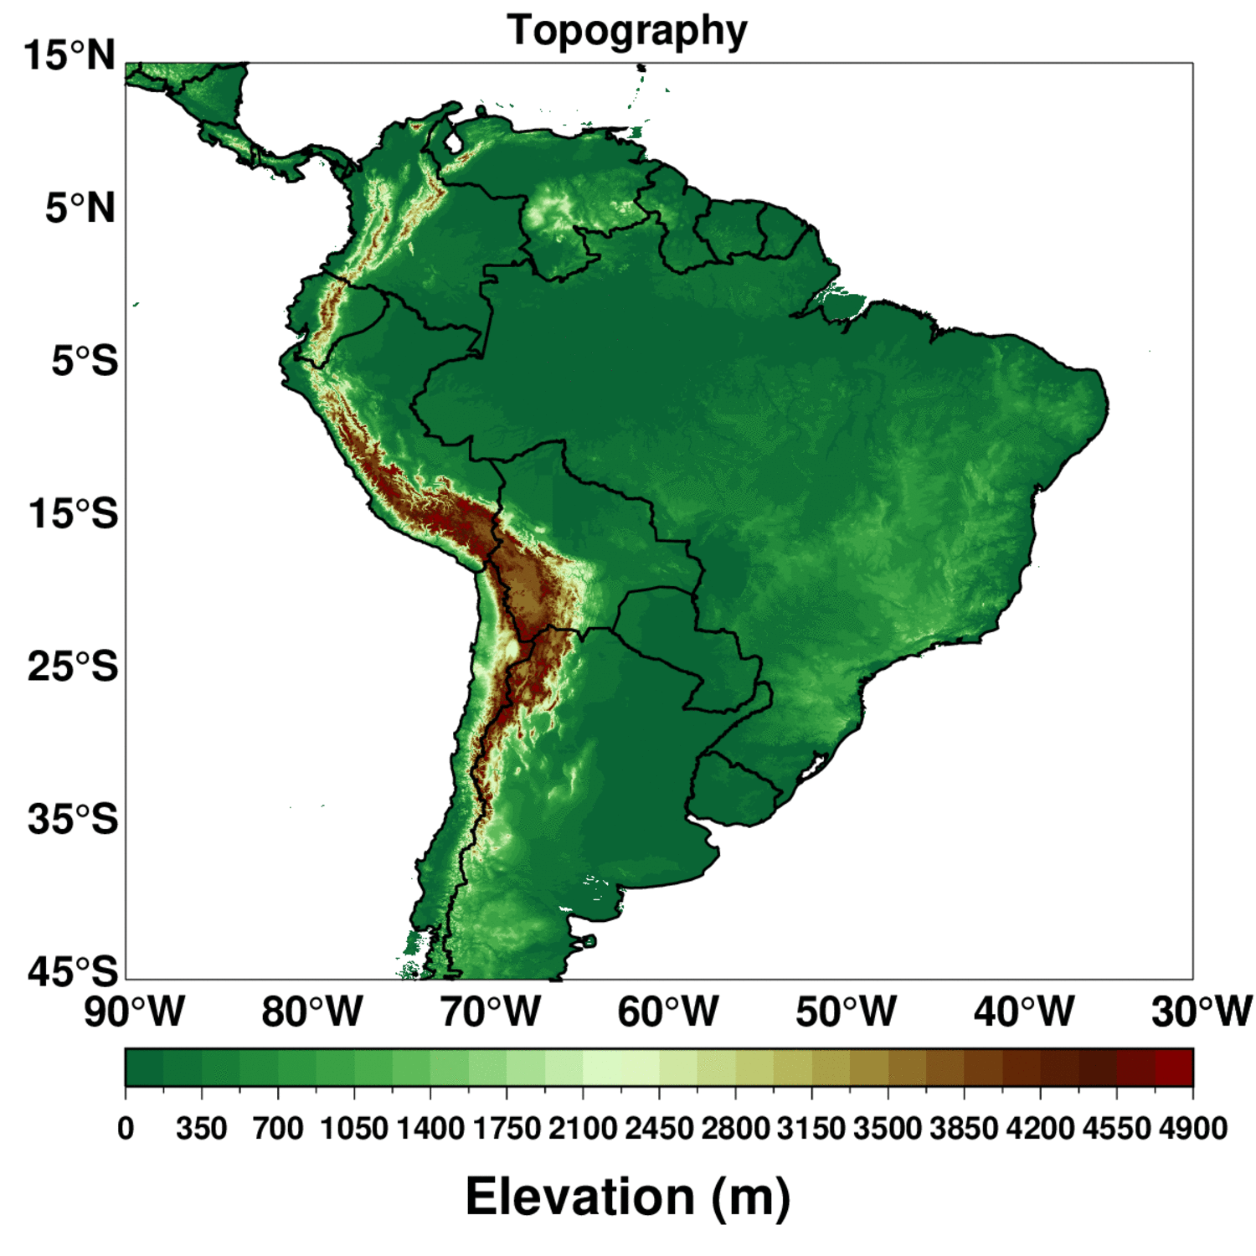
GOES South America Convection Climatology: 1995-2021
Where Do Storms Occur?
Where Are The
Most Intense Storms?
How High Do They Reach?
Anvil clouds are most frequent over the Amazon basin, northern Colombia, and northwest Venezuela. The Amazon river and its tributaries modulate regional convection frequency
Overshooting occurs more often over northern Argentina, Paraguay, Uruguay, and far southeastern Brazil, as well as Colombia and Venezuela. These patterns agree with detections of potential hailstorms from NASA GPM and TRMM microwave imager data
The deepest convection with maximum heights exceeding 18 km is primarily confined to N. Argentina, Paraguay, small regions in Bolivia and Peru, NW S. America and its offshore waters

Slide 12
GOES South America Convection Climatology: 1995-2021
GPM+TRMM Bang and Cecil (2019) Hail Feature Likelihood (%)
Blue Dots: Precipitation Features With Hail Likelihood Between 20 and 50%
99th Percentile Cloud Top Height
Available online at: https://cmr.earthdata.nasa.gov/search/concepts/C2196515446-GHRC_DAAC.html
Anvil clouds are most frequent over the Amazon basin, northern Colombia, and northwest Venezuela. The Amazon river and its tributaries modulate regional convection frequency
Overshooting occurs more often over northern Argentina, Paraguay, Uruguay, and far southeastern Brazil, as well as Colombia and Venezuela. These patterns agree with detections of potential hailstorms from NASA GPM and TRMM microwave imager data
The deepest convection with maximum heights exceeding 18 km is primarily confined to N. Argentina, Paraguay, small regions in Bolivia and Peru, NW S. America and its offshore waters

Slide 13
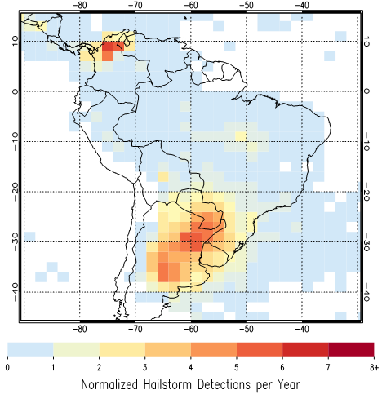
GOES South America Convection Climatology: 1995-2021
TRMM and GPM Normalized Hailstorm Detection Frequency From Sarah Bang and Dan Cecil
Per 2° Grid Box
GPM+TRMM Bang and Cecil (2019) Hail Feature Likelihood (%)
Blue Dots: Precipitation Features With Hail Likelihood Between 20 and 50%
99th Percentile Cloud Top Height
Available online at: https://cmr.earthdata.nasa.gov/search/concepts/C2196515446-GHRC_DAAC.html
Anvil clouds are most frequent over the Amazon basin, northern Colombia, and northwest Venezuela. The Amazon river and its tributaries modulate regional convection frequency
Overshooting occurs more often over northern Argentina, Paraguay, Uruguay, and far southeastern Brazil, as well as Colombia and Venezuela. These patterns agree with detections of potential hailstorms from NASA GPM and TRMM microwave imager data
The deepest convection with maximum heights exceeding 18 km is primarily confined to N. Argentina, Paraguay, small regions in Bolivia and Peru, NW S. America and its offshore waters

Slide 14
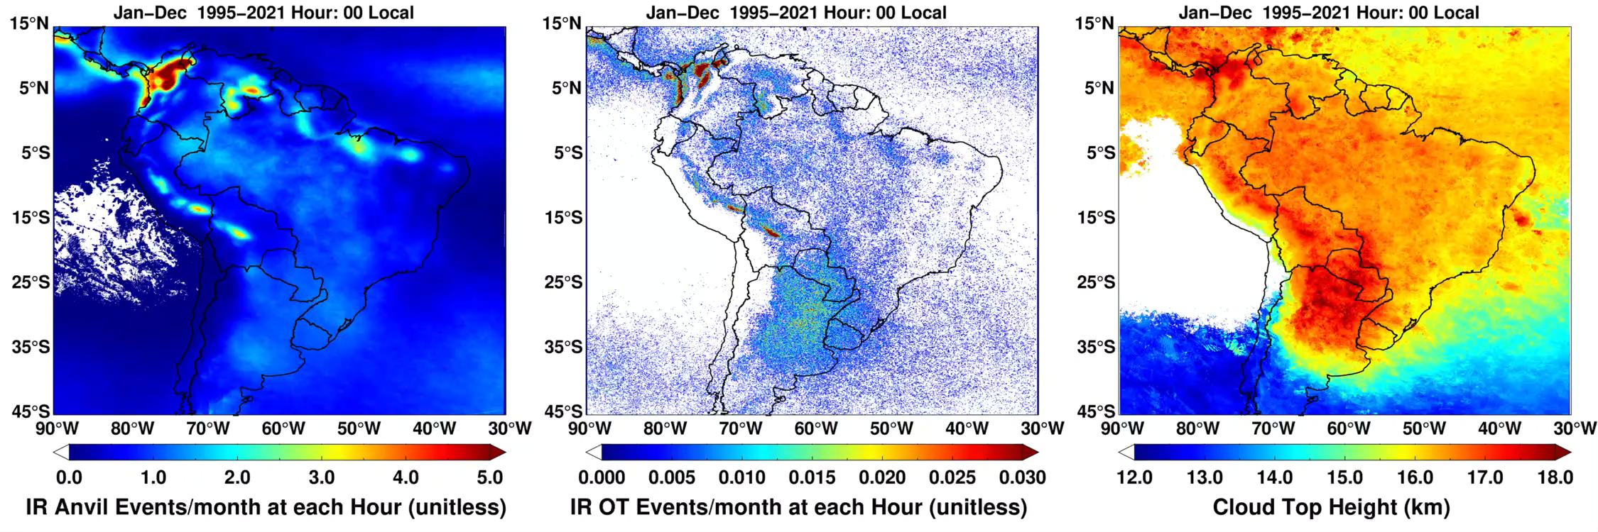
Mapping the South American Convection Diurnal Cycle With GOES
5
1
2
3
4
99th Percentile Cloud Top Height
Hourly geostationary satellite composites of storm frequency and intensity provides new insights into the South American convection diurnal cycle, at a higher spatial resolution than possible with other NASA satellites
Many features are clearly apparent: 1) Northern S. America squall line / sea breeze convection, 2) daytime max over Amazon land, and night-time max over the river, 3) nocturnal max in lee of Andes in Bolivia/Peru, 4) northern Argentina / SE Brazil nocturnal MCS activity, 5) maxima over Lake Maracaibo and Colombian lowlands (see locations above in upper-left panel)

Slide 15
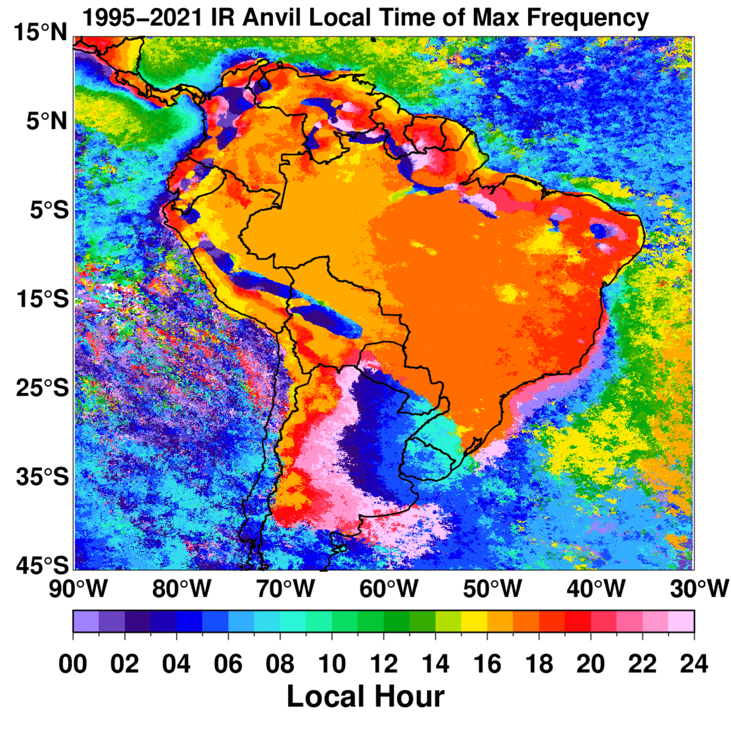
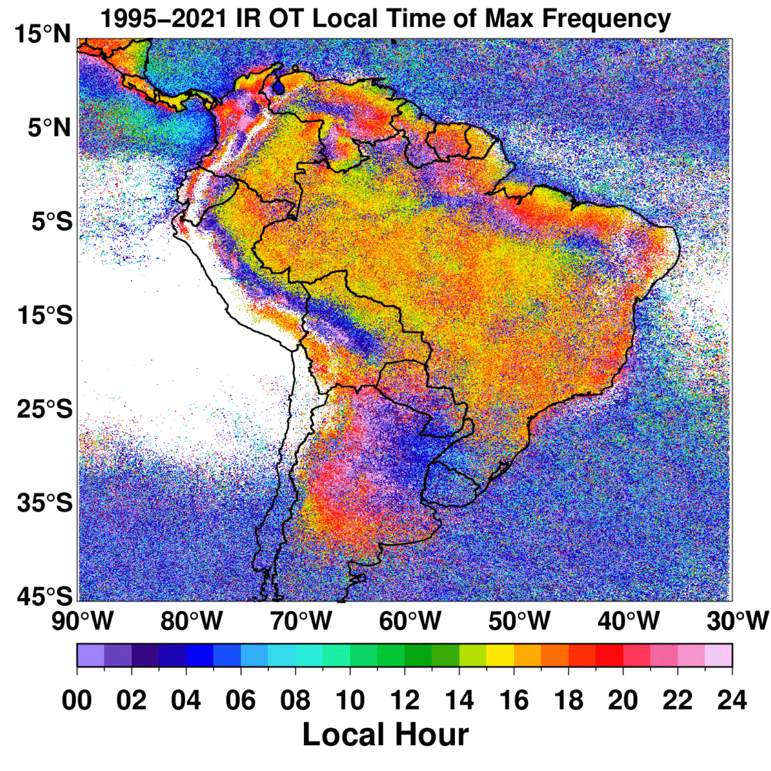
Mapping the South American Convection Diurnal Cycle With GOES
5
1
2
3
4
Hourly geostationary satellite composites of storm frequency and intensity provides new insights into the South American convection diurnal cycle, at a higher spatial resolution than possible with other NASA satellites
Many features are clearly apparent: 1) Northern S. America squall line / sea breeze convection, 2) daytime max over Amazon land, and night-time max over the river, 3) nocturnal max in lee of Andes in Bolivia/Peru, 4) northern Argentina / SE Brazil nocturnal MCS activity, 5) maxima over Lake Maracaibo and Colombian lowlands (see locations above in upper-left panel)

Slide 16
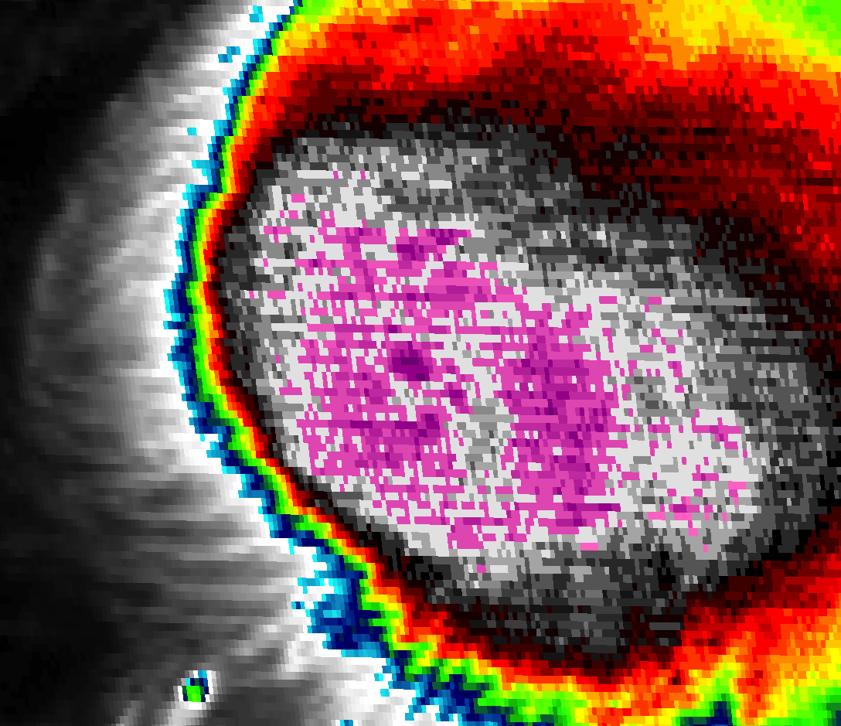
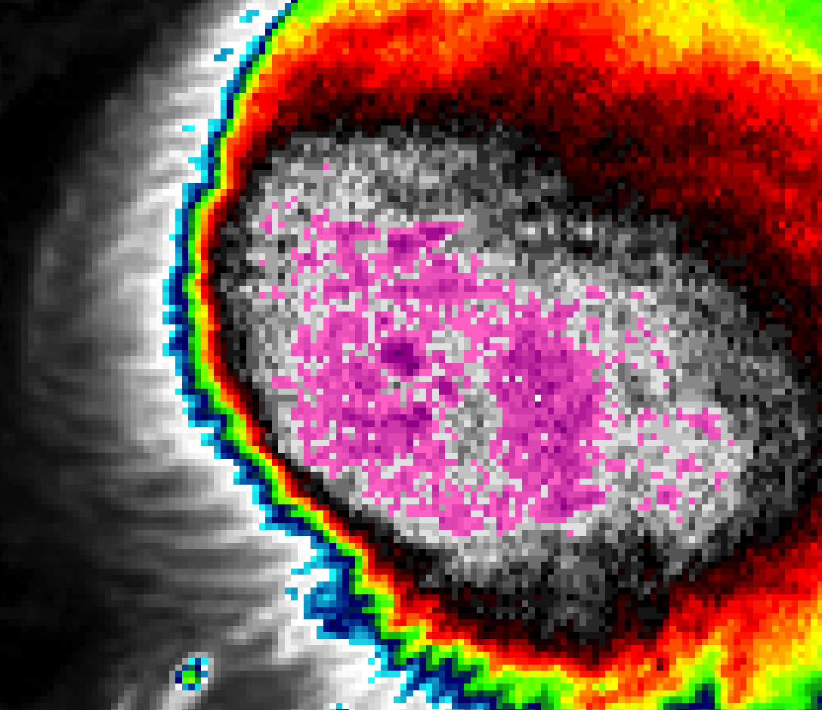
Challenges With Climate Trend Analysis: GOES-8 to -12 IR Temp Calibration
GOES-12 IR Temperature of a Tropical Storm
Before Calibration Fix
After Calibration Fix
GOES-8 to -12 has calibration issues at cold IR temperatures, which leads to striping that can cause false overshooting cloud top detections
We have developed an automated striping detection algorithm and used time-matched GOES-12 and GOES-13 data to develop corrections to image calibration that mitigated striping to the best of our ability
Despite our efforts, there still may be some minor issues with early GOES data that could impact trend analysis

Slide 17
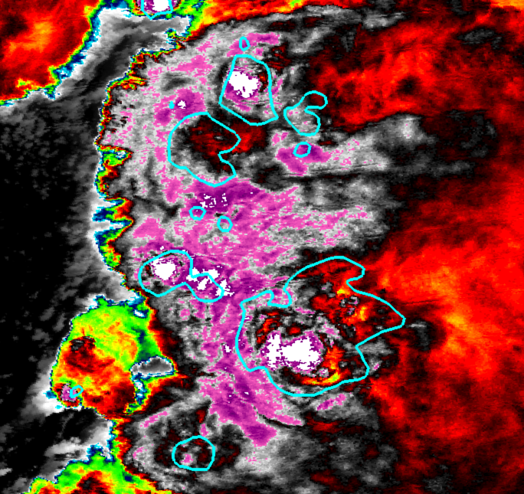
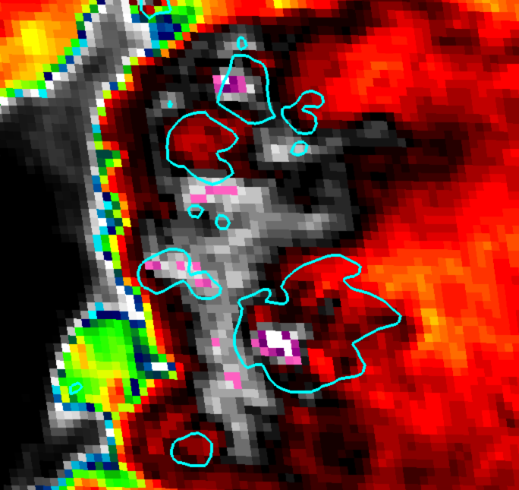
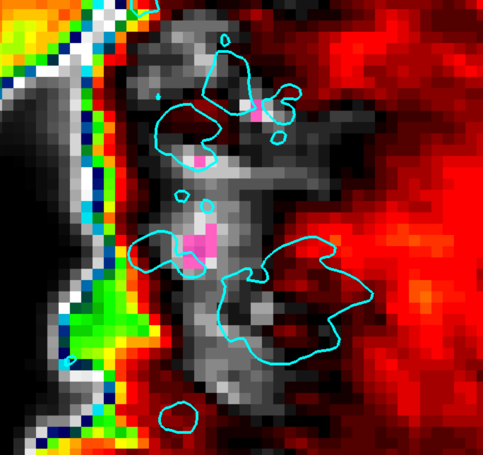
NPP-VIIRS
Challenges With Climate Trend Analysis: Changes in IR Pixel Size
NPP-VIIRS
GOES-16
GOES-16
GOES-13
Cooney et al. (JGR, 2021)
GOES-13
GOES-13 and GOES-16 IR BT difference derived for 15,000+ NEXRAD-observed OTs
GOES-16 colder on average: Mean T_{b} difference is ~1.8 K, but differences often exceed 5 K
Such differences significantly affect OT detection capability and climate signals across the GOES-13 to GOES-16 satellite transition

Slide 18
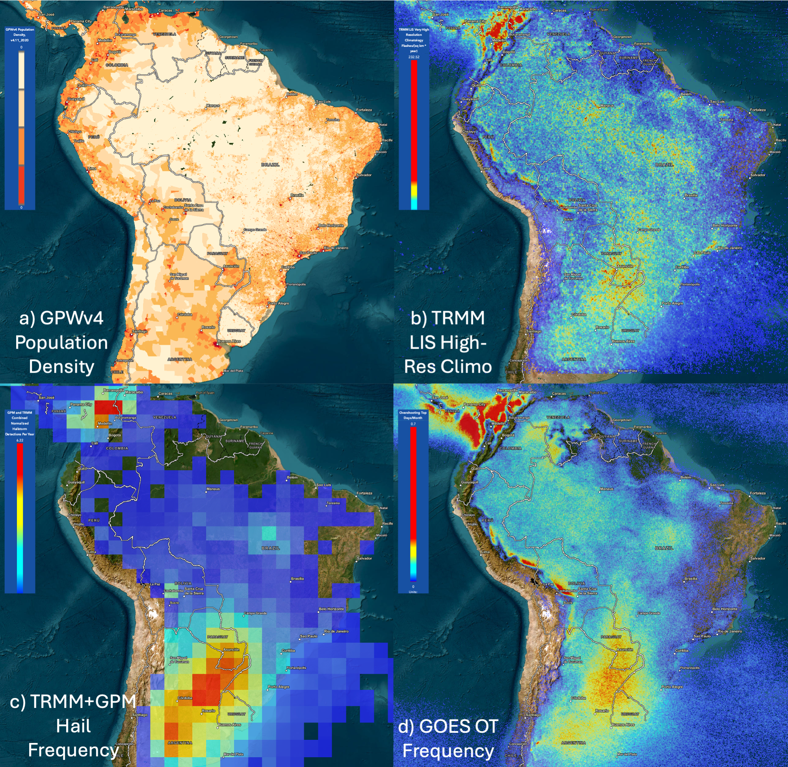
Convection Climatology Data Visualization and Availability
An initial version of an ArcGIS-based satellite convection climatology display and analysis tool has been developed in a collaborative effort between NASA Langley and Booz Allen Hamilton: https://satcorps.larc.nasa.gov/smash/
This Satellite Mapping & Analysis of Severe Hailstorms (SMASH) tool displays:
Recently developed GOES South America and Meteosat South Africa (Punge et al. 2023) OT and anvil climatologies
TRMM and GPM passive microwave imager hailstorm climatologies (Bang and Cecil 2019)
TRMM LIS High-Resolution Lightning Climatology (Albrecht et al. 2016)
Various socio-economic and basemap layers
We welcome collaborations with other groups who seek to make convection climatology data layers accessible for display on the SMASH tool
4 km GOES South America hourly+monthly, seasonal, annual, and multi-annual products soon to be released by the NASA Atmospheric Sciences Data Center (ASDC)
Daily 1995-2021 composite products not yet being served by ASDC but are available upon request
Journal publication describing methods/data in preparation

Slide 19
Summary
We developed a South American GOES anvil and overshooting cloud top (OT) climatology from 1995-2021 for use by the research community and (re)insurnance industry to study severe storms over the continent
The high spatial resolution and hourly timesteps reveal regional variability in the deep convection diurnal cycle with unprecedented detail
Datasets will soon be released by NASA after completion of remaining documentation
We are currently quantifying relationships between GOES OT properties, environmental ingredients, and passive microwave imager hailstorm characteristics
We seek collaborators and adopters of this dataset, and contributors to our ArcGIS convection climatology online data visualization framework
Contact: kristopher.m.bedka@nasa.gov

Slide 20
Backup Slides

Slide 21
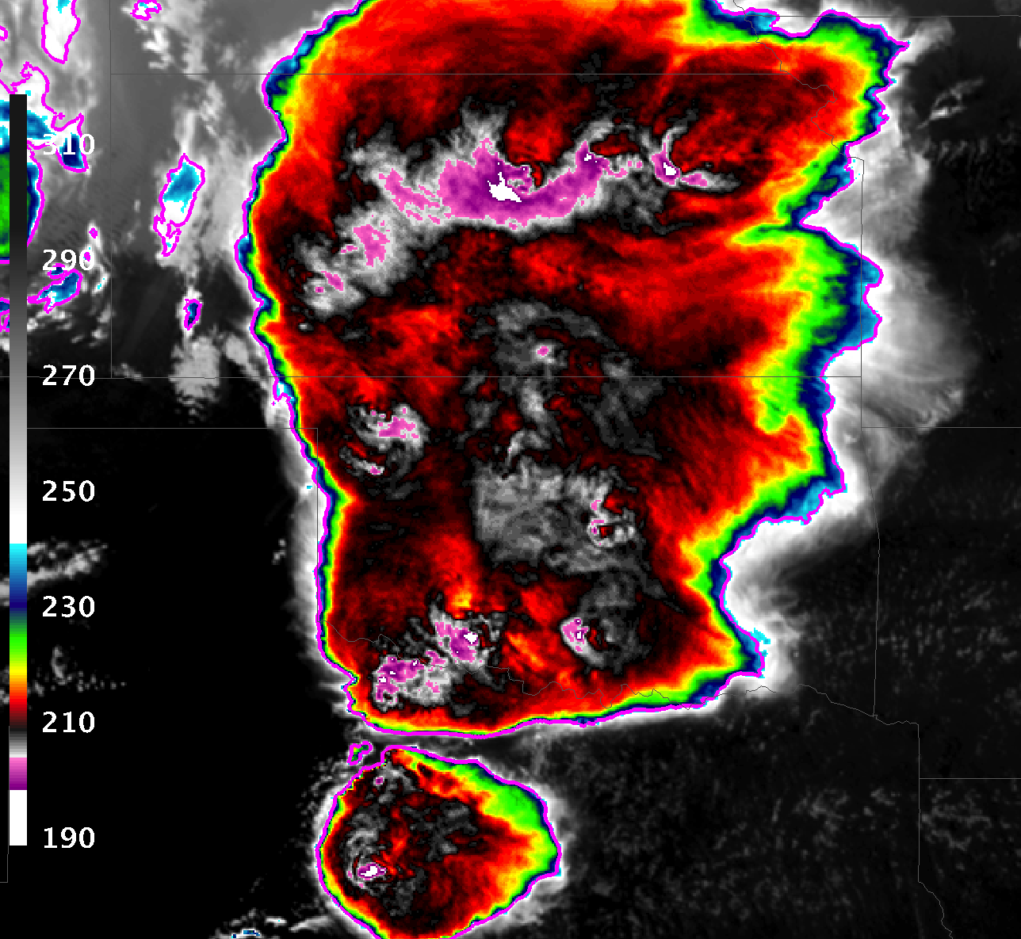
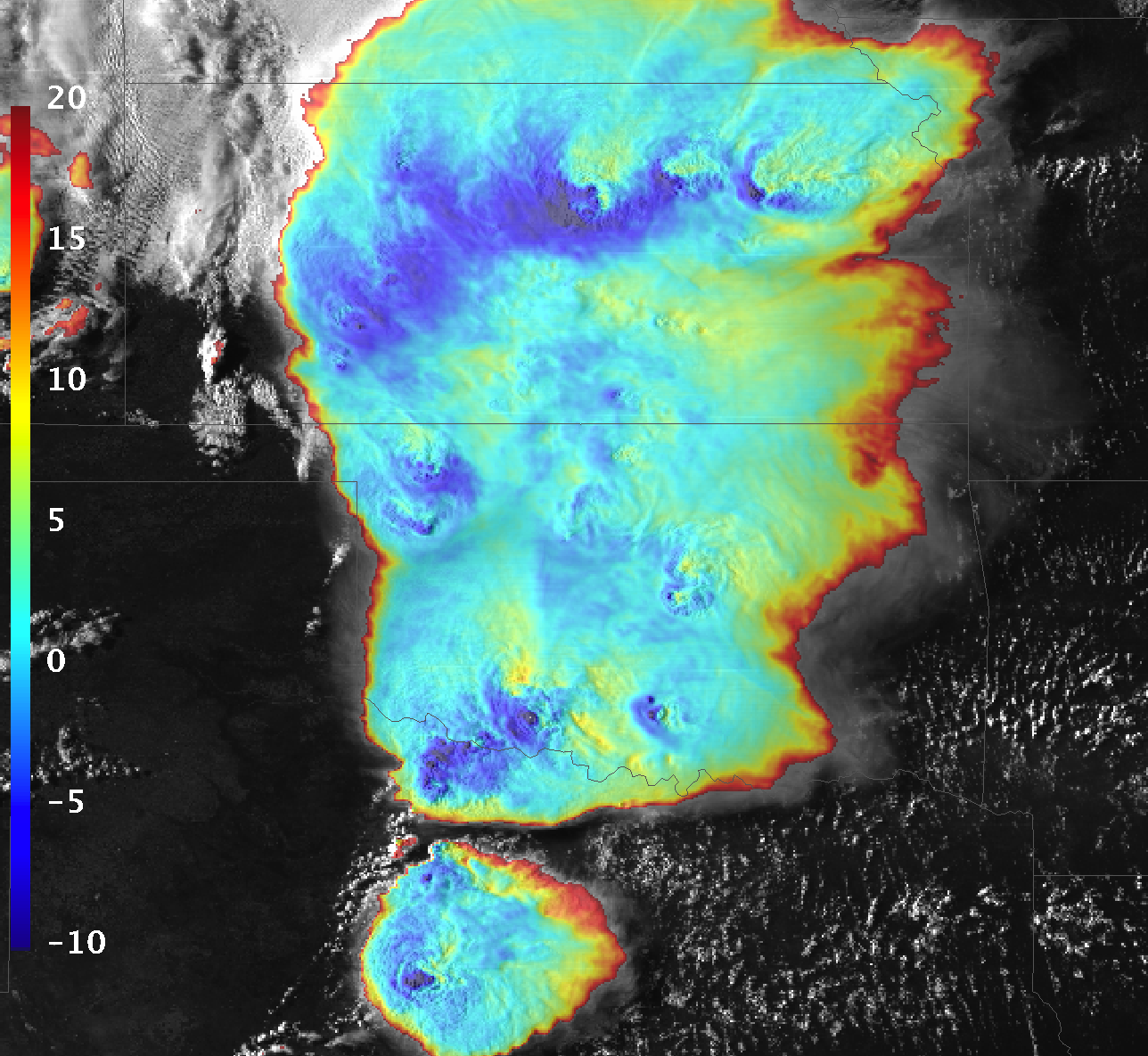
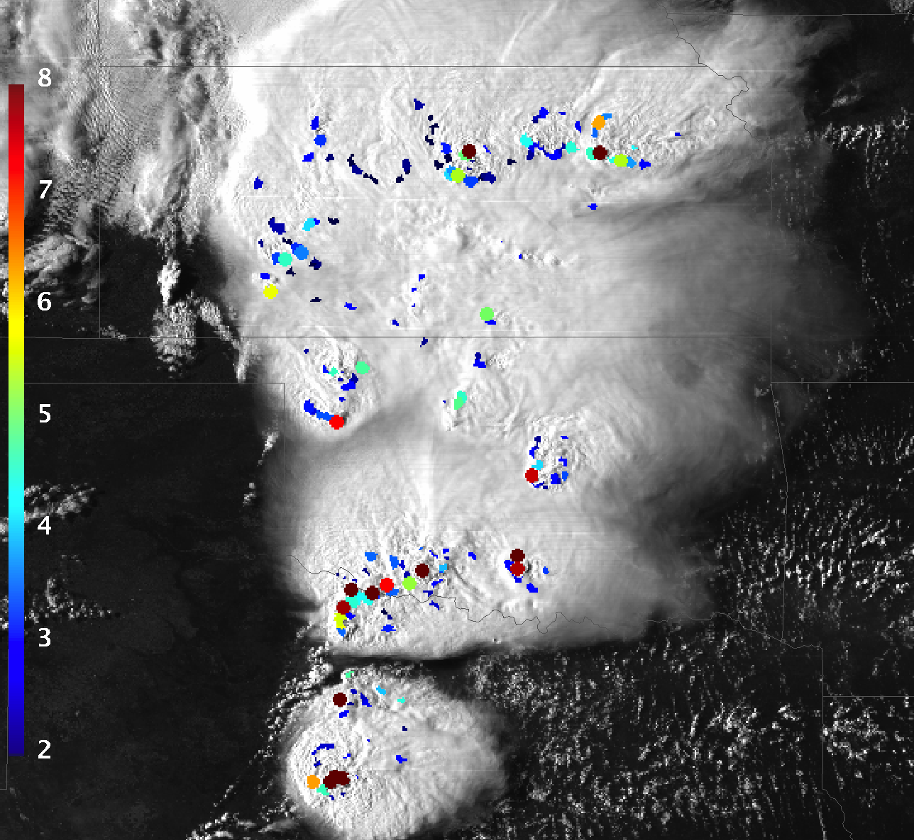
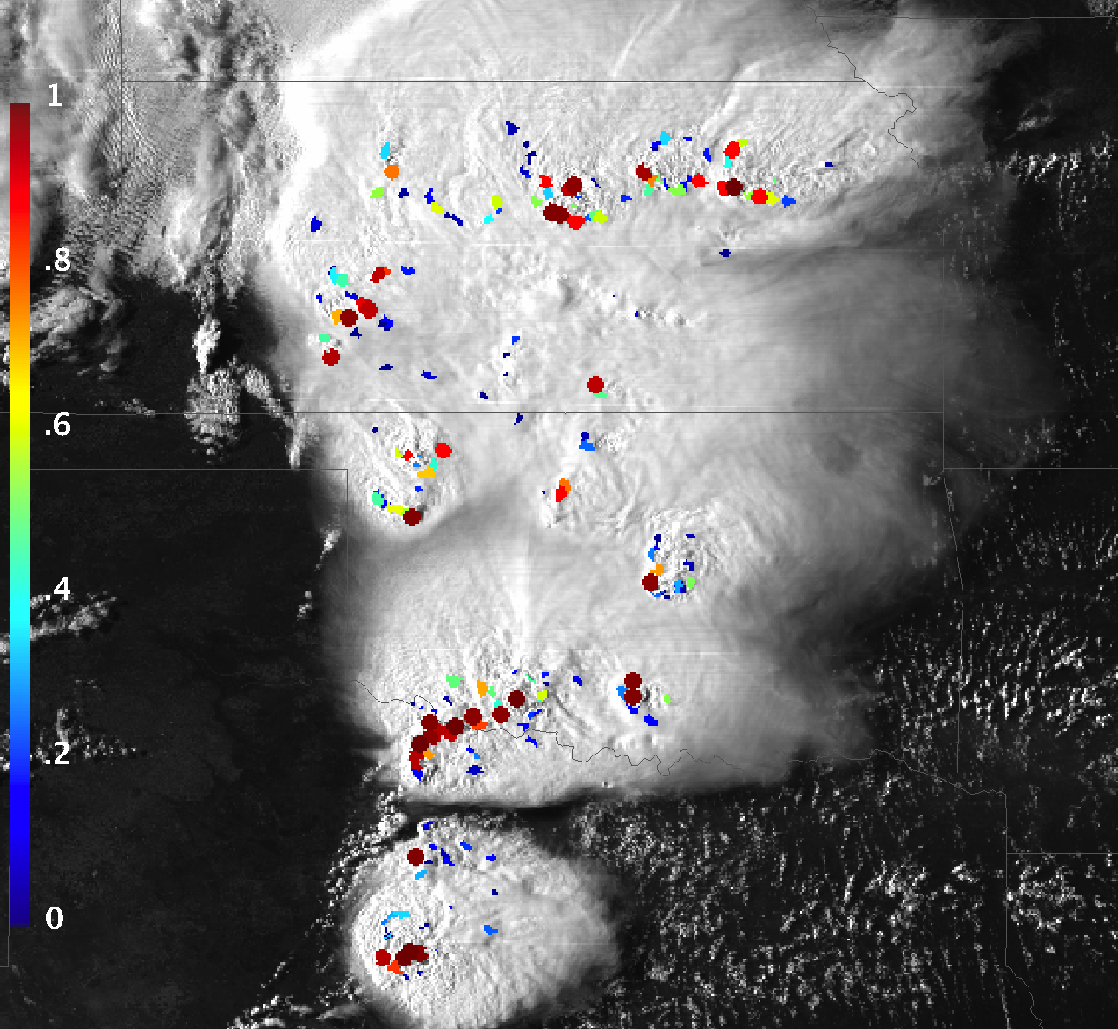
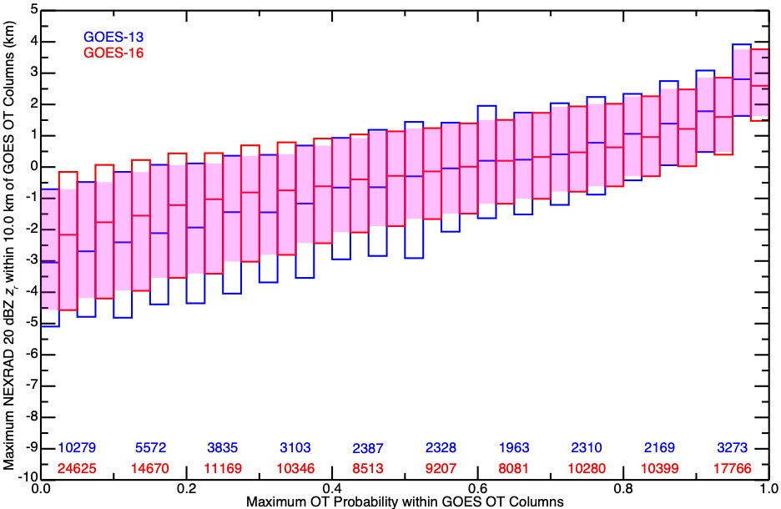
Automated Overshooting Cloud Top (OT) Detection and Validation
1) Normalize IR temperature using reanalysis tropopause temperature and identify convective anvil clouds
2) Identify cold minima embedded within anvils, and compute temperature difference relative to surrounding anvil
IR-Anvil BT Difference (K)
Magenta Contour
Anvil Detection
Scarino et al. (AMT, 2020)
Tropopause-Relative IR Brightness Temp
OT Probability
4) Perform quantitative validation of geostationary OT detection using NEXRAD precipitation echo tops
3) Use statistical functions based on human expert and NEXRAD OT identifications to combine IR-anvil,
IR-tropopause, anvil area, and anvil spatial uniformity to derive OT Probability
20 dBZ top above tropopause,
High GOES OT prob
20 dBZ top above tropopause,
Low GOES OT prob
20 dBZ top below tropopause,
Low GOES OT prob
20 dBZ top below tropopause,
High GOES OT prob
OT Probability

