Slide 1
Strategic Planning Process Moving Forward
Alesyn Lowry | Jonathan Bowie | Michelle Munk | Angela Krenn | Cris Guidi | Space Technology Mission Directorate| 10.25.2024

Slide 2
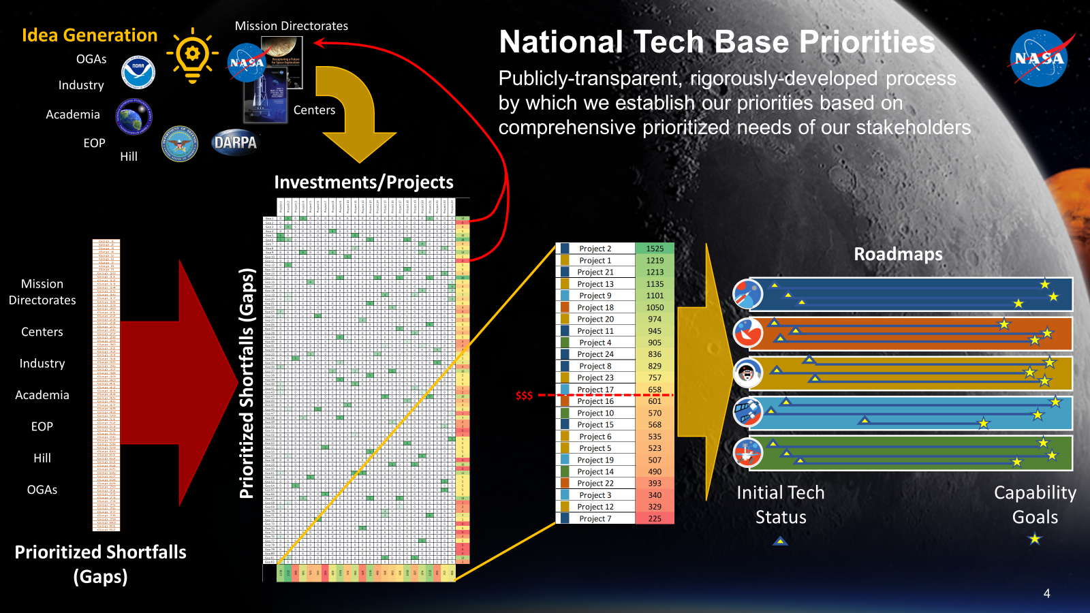
STMD Strategic Planning Process

Slide 3
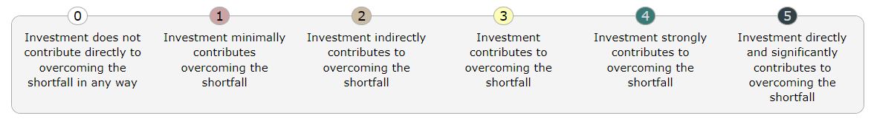
Connection Scores Process
Assessing the relevance of projects to solving shortfalls provides a few benefits
  Provides a value statement for projects with regard to shortfalls
  Assess areas of heavy investment vs light investment toward each shortfall
  Find shortfalls without any investment to be prioritized
STMD is currently evaluating the level of connection of each project to the shortfall(s)*
Initially using a few projects as forerunners to refine the process: HPSC, VSAT, SEP, DRACO, VERS HIAD
Current Process:
  Both the Subject Matter Expert and Program/Project provide score and justification
  Final adjudication provided by STMD Front Office
  Product will be a heatmap depicted on previous chart
*[Early Stage Projects not included in this assessment]

Slide 4
Example Projects
Priority | Avg Score | Shortfall ID (blue text if top 3 in category) | Category | SEP Conn Scores | VSAT Conn Scores | VERS HIAD Conn Scores
2 | 7.612 | 1596: High Power Energy Generation on Moon and Mars Surfaces | Power |  | 4
8 | 7.168 | 709: Nuclear Electric Propulsion for Human Exploration | Propulsion: Nuclear | 2
19 | 6.804 | 1558: High-Rate Communications Across The Lunar Surface | Communication and Navigation |  | 1
28 | 6.592 | 1568: Entry Modeling and Simulation for EDL Missions | Entry Descent and Landing |  |  | 5
36 | 6.415 | 610: Solar Electric Propulsion - High Specific Impulse | Propulsion: Non-Nuclear | 2
37 | 6.383 | 1563: Aerocapture for Spacecraft Deceleration and Orbit Insertion | Entry Descent and Landing |  |  | 3
41 | 6.275 | 1430: Small Spacecraft Propulsion | Small Spacecraft | 1
42 | 6.267 | 1588: Protect Earth from Destructive Natural Impacts (Planetary Defense) | Miscellaneous | 2
43 | 6.244 | 1565: Assessment and Validation Capabilities for Integrated Precision Landing Systems | Entry Descent and Landing |  |  | 1
47 | 6.220 | 844: Passive Dust Mitigation Technologies for Diverse Applications | Dust Mitigation |  | 2
56 | 6.136 | 1047: Active Dust Mitigation Technologies for Diverse Applications | Dust Mitigation |  | 1
69 | 5.932 | 1431: Access Beyond LEO for Small Spacecraft | Small Spacecraft | 1
71 | 5.922 | 611: Sub-kW and kW Class Electric Propulsion Systems | Propulsion: Non-Nuclear | 2
79 | 5.825 | 1583: Produce propellants and mission consumables from extracted in-situ resources | ISRU |  | 2
122 | 5.044 | 705: Low Power Nuclear Electric Propulsion | Propulsion: Nuclear | 2
126 | 5.016 | 544: Solar Electric Propulsion to Support Orbital Platforms | Propulsion: Non-Nuclear | 5
131 | 4.927 | 1564: Aeroshell In-Situ Flight Performance Data During EDL | Entry Descent and Landing |  |  | 5
132 | 4.916 | 767: Advanced designs for lightweight inflatable surface elements | Advanced Materials and Structures |  |  | 2
146 | 4.676 | 1567: Entry Capabilities for Small-Scale and Commercial Spacecraft | Entry Descent and Landing |  |  | 5
148 | 4.651 | 617: On-surface robotic assembly of vertical structures | Excavation Construction and Outfitting |  | 2
150 | 4.635 | 1408: Advanced deployable load-bearing structures | Advanced Materials and Structures |  | 5 | 1
153 | 4.544 | 513: Robotic Assembly and Construction of Modular Systems for Sustained In-Space Infrastructure | ISAM and RPOC |  | 2
173 | 4.142 | 612: In-Space Diagnostics for Electric Propulsion | Propulsion: Non-Nuclear | 4
181 | 3.881 | 1572: Performance-Optimized Low-Cost Aeroshells for EDL Missions | Entry Descent and Landing |  |  | 3

Slide 5
Example Connection Score
Project: ULA Vulcan Engine Reuse Scale (VERS) HIAD Technology Demonstration
Project Description
The company will continue to evolve a proven Hypersonic Inflatable Aerodynamic Decelerator (HIAD) technology design. ULA will develop a larger 10-meter HIAD that leverages a two-piece structure to enable effective load distribution for even larger inflatable decelerators.
Anticipated Benefits
VERS will provide large scale HIAD risk reduction and maturation for flight applications.
Prove out the manufacturing process and develop a solid supply chain
Expand current HIAD testing program to burn down risk of scaling up the HIAD diameter
Investigate HIAD enhancements to increase load capability and L/D
Shortfall: AMSC-767: Advanced designs for lightweight inflatable surface elements
Shortfall Description
Inflatable softgoods structures can provide greatly enlarged living volumes for crews on extended exploration missions with minimal launch/landing mass and volume. Large inflatable surface elements include habitats and ISRU commodity storage tanks. Inflatable softgoods can also be used to provide small volume elements such as pressurized transfer tunnels, inflatable airlocks, suitport enclosures, flexible dust tolerant hangars, rover covers or garages, etc. This shortfall includes the design, analysis, and test of these advanced inflatable designs. This technology can be utilized to provide needed systems for light weigh habitable elements of surface habitat and be delivered in a small launch/landing package.
Shortfall Author Score: 2
Project Management Score: 3
Final Score: 2 - Investment indirectly contributes to gap closure. Justification: The packaging involved in the HIAD test will be specific to that usage. The use case for surface inflatable elements will vary greatly on the pressures, packaging, and length of usage time. The lessons learned from the HIAD will benefit this shortfall closure indirectly.

Slide 6
STMD Strategic Planning Process

Slide 7

Investment Prioritization Process
Goal: Provide a quantifiable prioritization methodology to evaluate investments based on available credible data
STMD is investigating various approaches of a repeatable methodology on evaluating:
  Proposed new investments
  Existing investments, for continuation consideration
  Ultimately enable decision on use of limited annual funding available
Data Sources
    Inaugural STMD Shortfall Rank List
    Project Connection Scores
    Other Programmatic data
Desired Outcome: Utilize objective measures to evaluate Return on Investment

Slide 8
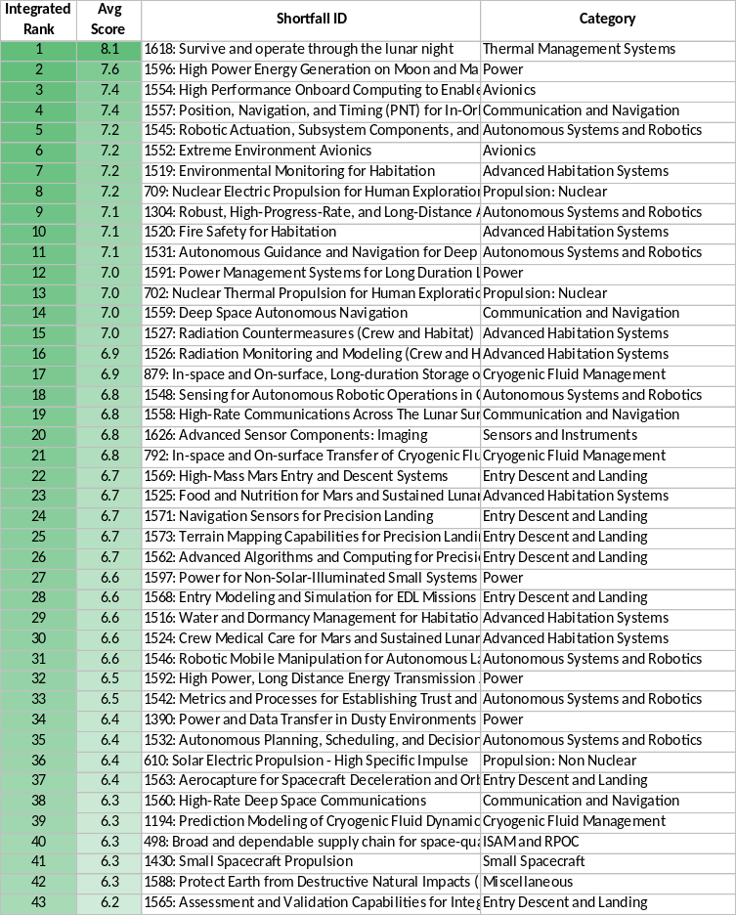
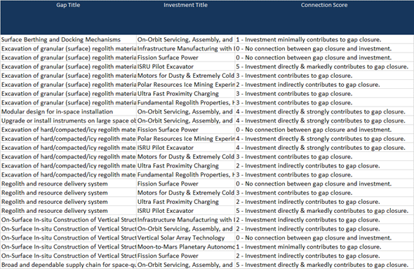
Investment Prioritization Process – Summary
“Technical Benefit” = Sum of (Connection Score x Inverse Rank of Shortfall)
Prioritized Shortfalls
X
Investment → Gap
Connection Scores
=
Technical
Benefit
Sum
Notional Data

Slide 9
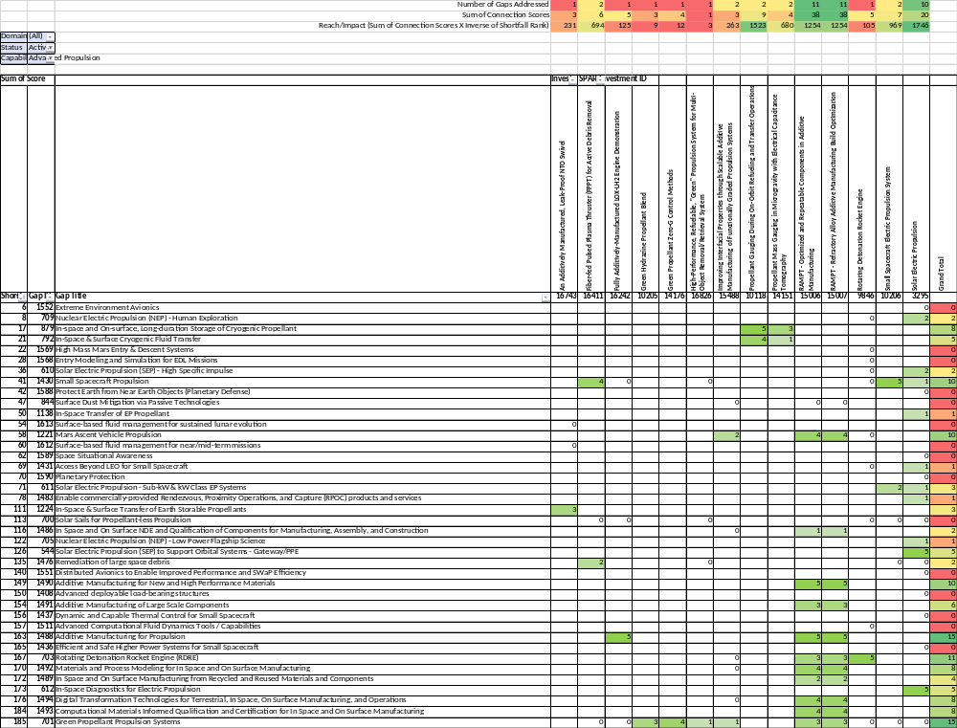
Investment-to-Shortfall Mapping Example
Project Composite Score = Sum of (Connection Score x Inverse Rank of Shortfall)
*
**
“Technical Benefit” = Sum of
{ [188 – shortfall rank ] x connection score }
Example for investment 10206:
    969 = (188-41)*5 + (188-71)*2
Two alternate options for investment relevance:
* # Shortfalls [Gaps] addressed
** Sum of Connection Scores
Shortfall Rank from Survey
Connection Scores
Notional Data
All data is notional

Slide 10
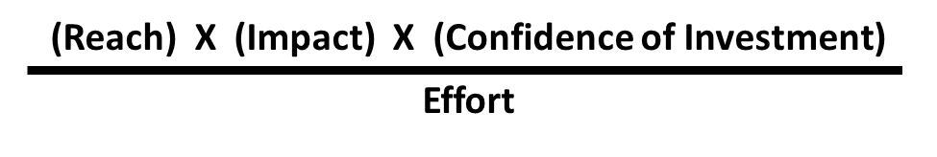
1st Approach: RICE* Method
Applying the RICE equation to fit the STMD Investment Prioritization activity
  Reach: Shortfall rank
  Impact: Connection Score – how well the investment closes the shortfall
  Confidence of Investment - Related to the development complexity and probability
    For complexity, potentially use GCD’s Advancement Degree of Difficulty (AD²) process
    For probability,
      May start with TRL “distance” (delta TRL: 3-6) and the given project start and end date in SPAR to produce an output to get the confidence of project meeting that schedule
  Effort - Time and money it takes to get to maturity
    Life Cycle Cost (LCC) or Estimated to Complete (ETC)
    Period of Performance (PoP) or Time Remaining
Technical Benefit
* RICE Prioritization Method: https://www.productteacher.com/articles/product-manager-guide-to-rice-prioritization

Slide 11
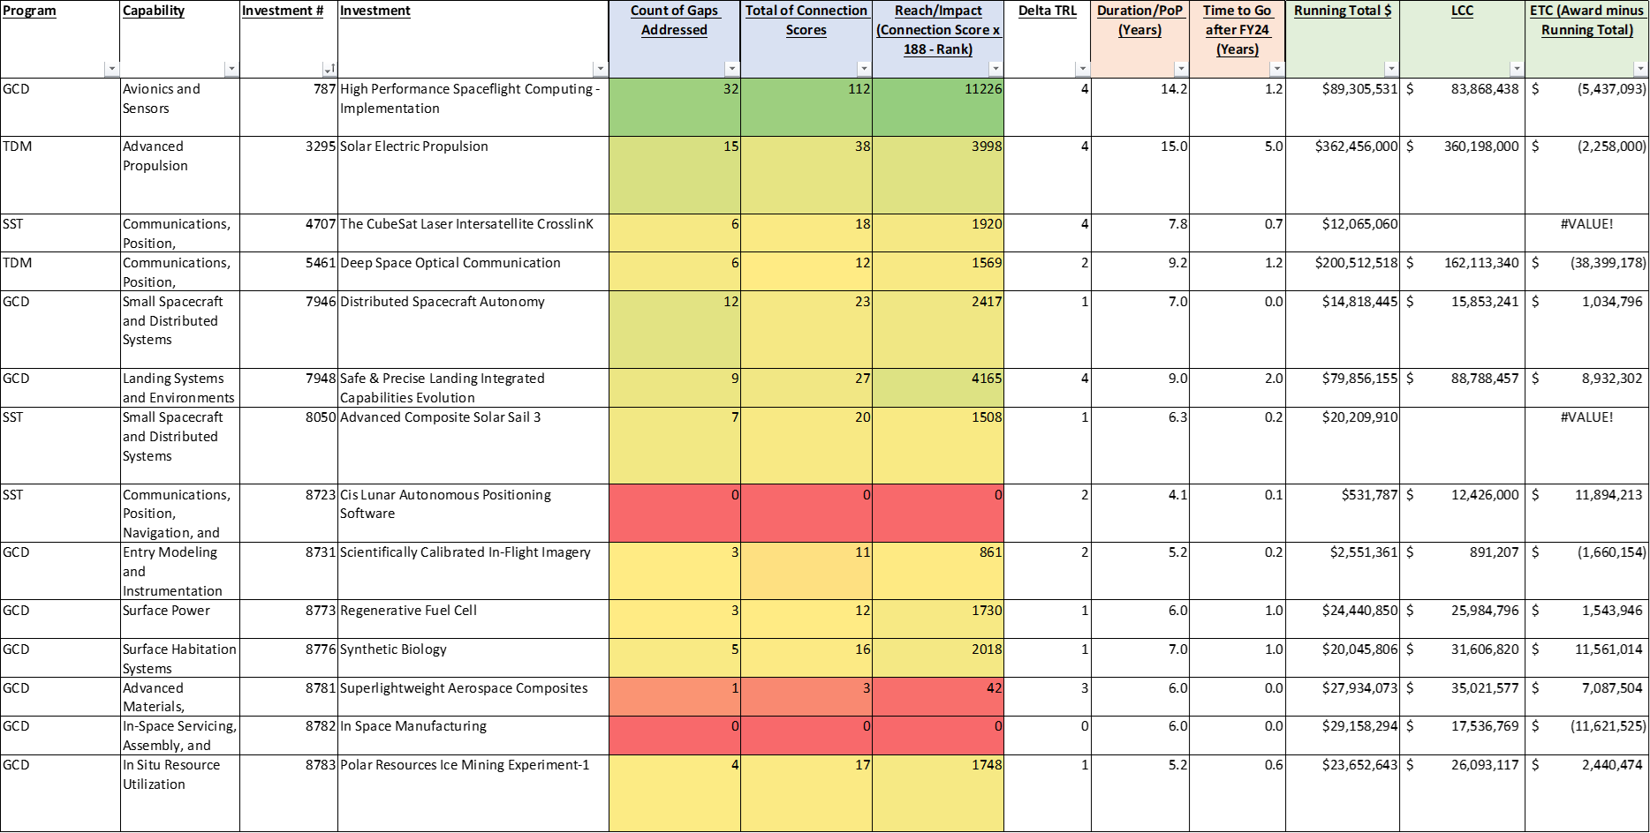
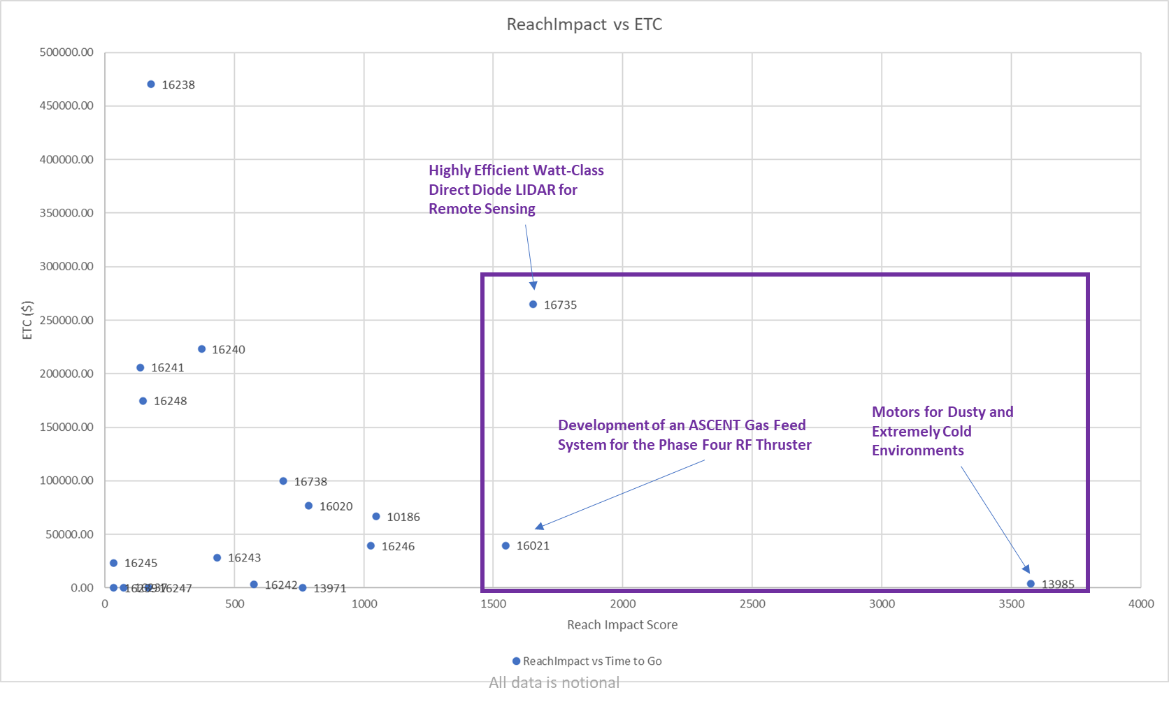
2nd Approach: Additional Investment Prioritization Attributes
Alternatives to a single numerical value:
  Sortable/Filterable Tables with additional programmatic Figures of Merit
    Sort and filter tables for specific attributes of interest
  Scatter Plots
    Scatter Plots enable examination of quadrants of interest for two attributes at a time
Notional Data
Enables greater visualization of strengths/weaknesses that may get lost in a single equation
All data is notional

Slide 12
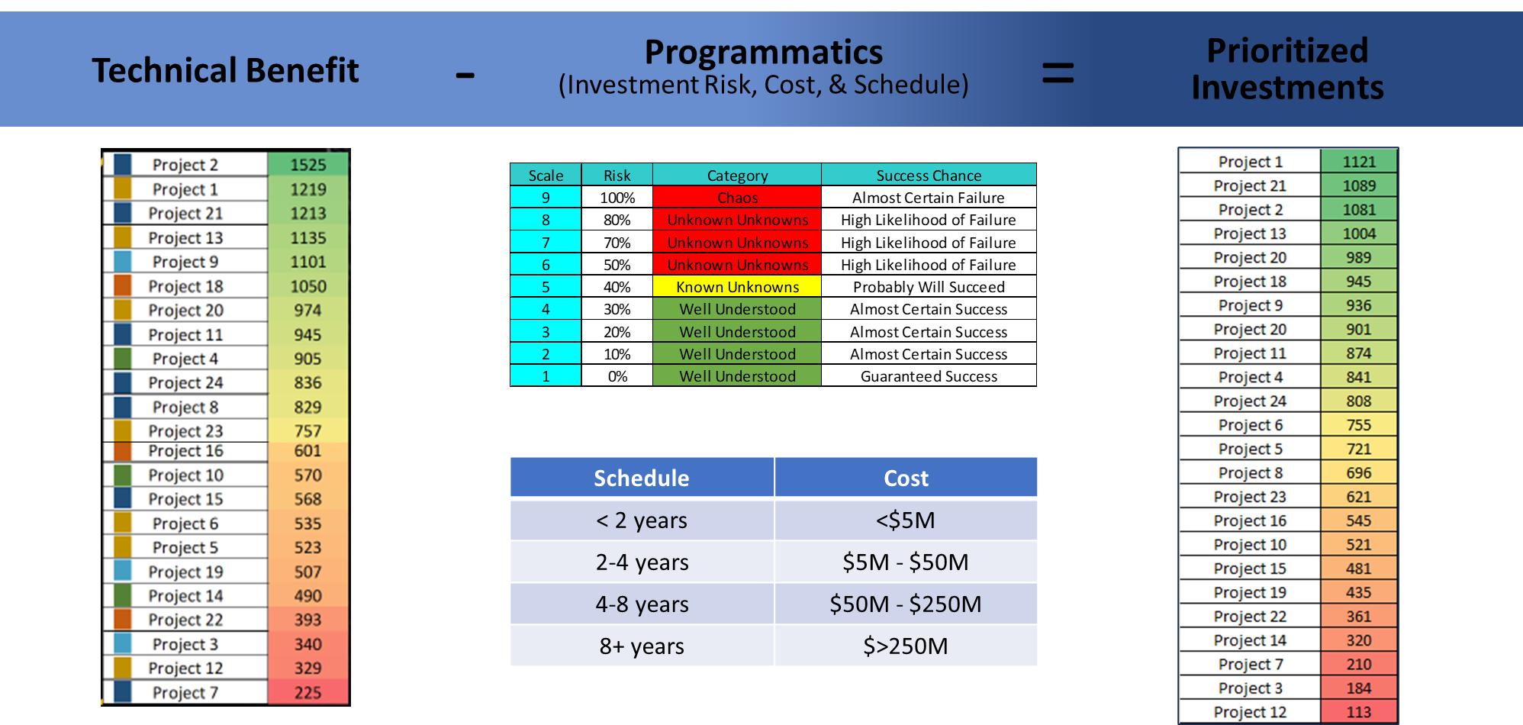
3rd Approach: Combining Technical Benefit and Programmatic Metrics
Modified National Research Council (NRC)* Method
Developing methodology for combining the Technical Benefit score with other programmatic attributes
  Programmatic attributes can include:
    Cost – Life Cycle Costs, Estimated Costs to Complete
    Duration - Total investment schedule, estimated time to complete
    Risk- Likelihood of success (e.g., “Advancement Degree of Difficulty” [AD2] metric)
    Maturity – Expected TRL advancement
  Exploring weighting options
    For example, NRC weighted Technical Benefit as 2/3 of total score, and Programmatics 1/3
    Can assign additional weights within Programmatics (e.g., Cost=40%, Risk=20%, Schedule=20%, Maturity=20%)
  Results in a single, combined score for prioritization
* NASA Space Technology Roadmaps and Priorities
12

Slide 13
Next Steps
STMD’s Strategic Planning process is still evolving.
  Plan to utilize lessons learned to inform next Shortfall survey effort.
  STMD recognizes the need for a process informed by objective data (incl. shortfall results) to inform investment decisions, but need to determine how numerical of an approach to take.
  Striving for a prioritization methodology that is intuitive, objective, repeatable based on available credible data.
Plan to continue refining and collecting a complete dataset and develop a plan to maintain data integrity.
  Complete the Connection Scoring for active investments to the 187 shortfalls.
  Determine what additional complexity/probability of success data to collect
  Validate ETC/LCC data.
  Potentially pursue “urgency” attribute, when roadmaps are available.
Intend to further evaluate the RICE equation
  Look at subsets of data and scatter plots to gain further insights and compare attributes.
    Example Scatter plots:
      Technical Benefit vs Cost
      Technical Benefit vs Schedule
      Technical Benefit vs Combined Programmatic Score
Regardless of approach, will still need “human in the loop” for decision-making.

