Slide 1
Stakeholder Webinar:
Civil Space Shortfall Ranking
2024 Feedback Results
NASA’s Space Technology Mission Directorate​
July 2024

Slide 2
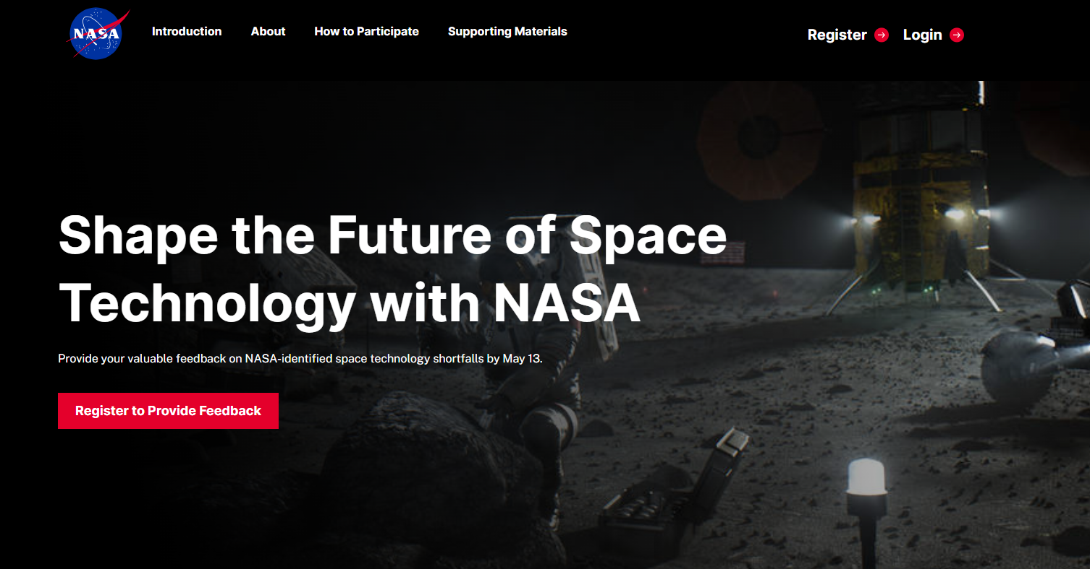

Spring 2024 Feedback Opportunity Background
In mid-April, STMD released an internal and external feedback opportunity to solicit feedback on 187 shortfalls to better understand civil space's most pressing and pervasive problems. STMD defines shortfalls as identified technology areas requiring further development to meet future exploration, science, and other mission needs.
Spacetechpriorities.org captured feedback from external stakeholders
NASA Spark captured feedback from the NASA workforce
Submissions scored the shortfalls with either:
  0, 1, 3, 5, 7, 9, N/A (blanks were treated as N/A)
Civil Space Shortfall Ranking

Slide 3





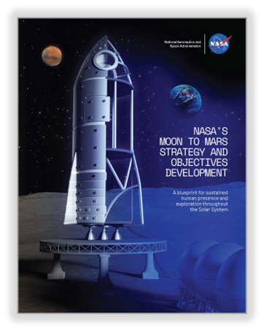



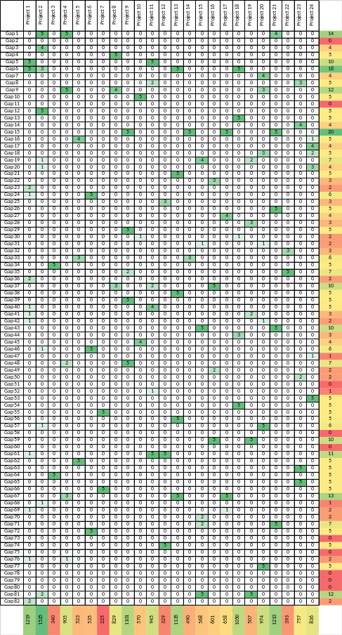
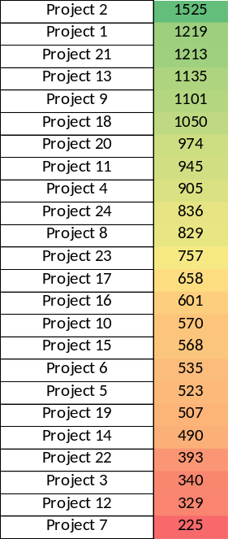





National Tech Base Priorities
Idea Generation
Mission Directorates
OGAs
Industry
Publicly-transparent, rigorously-developed process by which we establish our priorities based on comprehensive prioritized needs of our stakeholders
Academia
Centers
EOP
Hill
Investments/Projects
Projects
Roadmaps
Mission Directorates
Centers
Industry
Prioritized Shortfalls (Gaps)
Academia
$$$
EOP
Hill
OGAs
Initial Tech Status
Capability Goals
Prioritized Shortfalls (Gaps)

Slide 4
July 2024 Ranked Results Background
The inputs received are igniting meaningful conversations to help us and our stakeholders make smarter decisions
  STMD plans to use the integrated ranked list and annual updates as one of several factors to guide its technology development projects and investments, beginning with the fiscal year 2026 Planning, Programming, Budgeting, and Execution (PPBE) process
  To obtain the full ranking results, visit: www.nasa.gov/civilspaceshortfalls ​
  These results will inform the development of technology roadmaps
  Can be a useful tool for organizations across NASA and outside the agency
All stakeholder inputs were included and are valued
  NASA needs the whole tech base’s energy and innovation to deliver on new capabilities we can’t even imagine today
The ranked results are based on the numerical shortfall scores received and not responses to the open-ended questions
  The open-ended responses are still being processed
  We expect them to provide context to the results, uncover additional shortfalls, and more
When available, more information about the next feedback opportunity will be posted to www.nasa.gov/civilspaceshortfalls ​
If you have questions or concerns, please contact hq-techport@mail.nasa.gov
Civil Space Shortfall Ranking

Slide 5
Spring 2024 Feedback Opportunity Responses Received
*
Total Responses: 1,231
*
*
External Responses: 462
*
*
*
*
*
*
Organization(s) provided an official consolidated response
*
*
NASA/Internal Responses: 769
*
*
*
*
Civil Space Shortfall Ranking

Slide 6
Spring 2024 Feedback Opportunity Industry Responses Received
185 unique industry organizations provided feedback. The graph shows size of the companies represented. The top five represented sectors were Defense & Space Manufacturing (29), Aviation & Aerospace Component Manufacturing (21), Space Research and Technology (11), Software Development (8), and Research Services (6).
Distinct Companies:
185
Organization Size of Unique Industry Responses

Slide 7
Stakeholder Groups
STMD grouped, totaled, and averaged scores for nine stakeholder groups and applied pre-determined weights to determine the integrated shortfall ranking. The bullets further define and/or denote additional feedback included within each stakeholder group.
Internal Stakeholder Groups
Exploration Systems Development Mission Directorate (ESDMD)
Science Mission Directorate (SMD)
NASA Centers Ames Research Center Armstrong Flight Research Center Glenn Research Center Goddard Space Flight Center Headquarters Jet Propulsion Laboratory Johnson Space Center Kennedy Space Center Langley Research Center Marshall Space Flight Center Stennis Space Center
Other Mission Directorates Aeronautics Research Mission Directorate (ARMD) Space Operations Mission Directorate (SOMD) Space Technology Mission Directorate (STMD)
External Stakeholder Groups
Large Industry (> 500 employees), including: Federally Funded Research and Development Centers (FFRDCs) University Affiliated Research Centers (UARCs)
Small Industry (≤ 500 employees)
Other Government Agencies
Academia
Other, including: Non-profits Professional Societies Think Tanks General Public

Slide 8
2024 Ranking Methodology
External Feedback
Grouped feedback by organization
Averaged scores for each shortfall by organization
Grouped organizations by stakeholder group
Averaged scores for each shortfall for each stakeholder group
Average scores utilized to rank shortfalls from highest to lowest for each stakeholder group
*ESDMD and SMD provided ranked lists*
If an organization submitted an official consolidated response, the scores on that response were multiplied by a factor based on the size of the organization it represented
Integrated Ranked Shortfalls
Applied stakeholder group weights (determined by STMD)
NASA Feedback
Grouped feedback by NASA center
Averaged scores for each shortfall by NASA center
Grouped all feedback into the NASA Centers stakeholder group
Averaged scores for each shortfall
Obtained consolidated response for each NASA Mission Directorate
Grouped ARMD, SOMD, and STMD into Other MD stakeholder group; ESDMD & SMD left as standalone stakeholder groups
Averaged scores for each shortfall for each stakeholder group

Slide 9
Weighting Approach
The integrated list utilized weights that reflect STMD’s primary customers and their demand for future capabilities as well as other stakeholders’ roles in partnering to provide solutions for such capabilities
NASA inputs received ²/₃ of the overall weight and external scores received the remaining ¹/₃
STMD considered the following tenets of its investment strategy, in priority order, and developed the percentage weight for each stakeholder group
  Align with the Administration and the NASA Administrator’s priorities that address the Blueprint Objectives (Artemis)
  Focus on investments that support science priorities identified in the Decadal Surveys
  Foster creation and growth of the space economy through partnering with industry and supporting small business innovation
  Engage NASA’s workforce to deliver innovative solutions to the nation’s toughest technology challenges
  Encourage transformative, cross-cutting technologies that benefit NASA as well as other government agencies
  Empower a broad community of innovators and academia through emphasis on early-stage investments

Slide 10
July 2024 Integrated Ranked Shortfalls Overall Observations
#1 ranked shortfall in integrated list: Thermal-1618, survive and operate through the lunar night
  Was in the top 10 across all stakeholder groups
Agreement across stakeholder groups that the top 5 shortfalls are very important
Relatively broad consensus and support for the top 30 shortfalls
Diverse representation of capability areas in the top 20
  Advanced Habitation Systems (4 entries)
  Autonomous Systems and Robotics (4)
  Communication and Navigation (3)
  Power (2)
  Avionics (2)
  Nuclear Propulsion (2)
Bottom 20 were dominated by Advanced Manufacturing and Non-Nuclear Propulsion capabilities
Majority of Human Exploration and Science top priority shortfalls fall in the aggregate top quartile
  NASA center rankings were mixed in the aggregate top quartile compared to ESDMD and SMD rankings
Beyond the top quartile, the stakeholder priorities are largely mixed and likely align to their interests
  Shortfall rankings within many of the capability areas spanned a large range
  Cryogenic Fluid Management (1)
  Thermal Management Systems (1)
  Sensors and Instruments (1)

Slide 11
Integrated Shortfall Ranking (1-30)
Top 3 in Capability Category
Integrated Rank | Average Integrated Score | Shortfall ID | Category
1 | 8.1035 | 1618: Survive and operate through the lunar night | Thermal Management Systems
2 | 7.6118 | 1596: High Power Energy Generation on Moon and Mars Surfaces | Power
3 | 7.4345 | 1554: High Performance Onboard Computing to Enable Increasingly Complex Operations | Avionics
4 | 7.3831 | 1557: Position, Navigation, and Timing (PNT) for In-Orbit and Surface Applications | Communication and Navigation
5 | 7.2473 | 1545: Robotic Actuation, Subsystem Components, and System Architectures for Long-Duration and Extreme Environment Operation | Autonomous Systems and Robotics
6 | 7.2076 | 1552: Extreme Environment Avionics | Avionics
7 | 7.1961 | 1519: Environmental Monitoring for Habitation | Advanced Habitation Systems
8 | 7.1679 | 709: Nuclear Electric Propulsion for Human Exploration | Propulsion: Nuclear
9 | 7.1145 | 1304: Robust, High-Progress-Rate, and Long-Distance Autonomous Surface Mobility | Autonomous Systems and Robotics
10 | 7.0946 | 1520: Fire Safety for Habitation | Advanced Habitation Systems
11 | 7.0517 | 1531: Autonomous Guidance and Navigation for Deep Space Missions | Autonomous Systems and Robotics
12 | 7.0449 | 1591: Power Management Systems for Long Duration Lunar and Martian Missions | Power
13 | 7.0341 | 702: Nuclear Thermal Propulsion for Human Exploration | Propulsion: Nuclear
14 | 7.0315 | 1559: Deep Space Autonomous Navigation | Communication and Navigation
15 | 6.9684 | 1527: Radiation Countermeasures (Crew and Habitat) | Advanced Habitation Systems
16 | 6.9478 | 1526: Radiation Monitoring and Modeling (Crew and Habitat) | Advanced Habitation Systems
17 | 6.9465 | 879: In-space and On-surface, Long-duration Storage of Cryogenic Propellant | Cryogenic Fluid Management
18 | 6.8425 | 1548: Sensing for Autonomous Robotic Operations in Challenging Environmental Conditions | Autonomous Systems and Robotics
19 | 6.8039 | 1558: High-Rate Communications Across The Lunar Surface | Communication and Navigation
20 | 6.7919 | 1626: Advanced Sensor Components: Imaging | Sensors and Instruments
21 | 6.7837 | 792: In-space and On-surface Transfer of Cryogenic Fluids | Cryogenic Fluid Management
22 | 6.7199 | 1569: High-Mass Mars Entry and Descent Systems | Entry Descent and Landing
23 | 6.7110 | 1525: Food and Nutrition for Mars and Sustained Lunar | Advanced Habitation Systems
24 | 6.6953 | 1571: Navigation Sensors for Precision Landing | Entry Descent and Landing
25 | 6.6892 | 1573: Terrain Mapping Capabilities for Precision Landing and Hazard Avoidance | Entry Descent and Landing
26 | 6.6618 | 1562: Advanced Algorithms and Computing for Precision Landing | Entry Descent and Landing
27 | 6.5927 | 1597: Power for Non-Solar-Illuminated Small Systems | Power
28 | 6.5922 | 1568: Entry Modeling and Simulation for EDL Missions | Entry Descent and Landing
29 | 6.5842 | 1516: Water and Dormancy Management for Habitation | Advanced Habitation Systems
30 | 6.5694 | 1524: Crew Medical Care for Mars and Sustained Lunar | Advanced Habitation Systems

Slide 12
Integrated Shortfall Ranking (31-60)
Top 3 in Capability Category
Integrated Rank | Average Integrated Score | Shortfall ID | Category
31 | 6.5659 | 1546: Robotic Mobile Manipulation for Autonomous Large-Scale Logistics, Payload Handling, and Surface Transport | Autonomous Systems and Robotics
32 | 6.4985 | 1592: High Power, Long Distance Energy Transmission Across Distributed Surface Assets | Power
33 | 6.4521 | 1542: Metrics and Processes for Establishing Trust and Certifying the Trustworthiness of Autonomous Systems | Autonomous Systems and Robotics
34 | 6.4434 | 1390: Power and Data Transfer in Dusty Environments | Power
35 | 6.4170 | 1532: Autonomous Planning, Scheduling, and Decision-Support to Enable Sustained Earth-Independent Missions | Autonomous Systems and Robotics
36 | 6.4155 | 610: Solar Electric Propulsion - High Specific Impulse | Propulsion: Non Nuclear
37 | 6.3832 | 1563: Aerocapture for Spacecraft Deceleration and Orbit Insertion | Entry Descent and Landing
38 | 6.3135 | 1560: High-Rate Deep Space Communications | Communication and Navigation
39 | 6.3088 | 1194: Prediction Modeling of Cryogenic Fluid Dynamics and Operations | Cryogenic Fluid Management
40 | 6.2932 | 498: Broad and dependable supply chain for space-qualified robotic hardware, electronics, and associated software | ISAM and RPOC
41 | 6.2747 | 1430: Small Spacecraft Propulsion | Small Spacecraft
42 | 6.2668 | 1588: Protect Earth from Destructive Natural Impacts (Planetary Defense) | Miscellaneous
43 | 6.2439 | 1565: Assessment and Validation Capabilities for Integrated Precision Landing Systems | Entry Descent and Landing
44 | 6.2410 | 1608: Surface-based lunar logistics management for near/mid-term missions | Surface Systems
45 | 6.2297 | 1610: Surface-based food management for sustained lunar evolution | Surface Systems
46 | 6.2273 | 361: Surface Mating Mechanisms | ISAM and RPOC
47 | 6.2202 | 844: Passive Dust Mitigation Technologies for Diverse Applications | Dust Mitigation
48 | 6.2096 | 1438: Autonomy, Edge Computation, and Interoperable Networking for Small Spacecraft | Small Spacecraft
49 | 6.2061 | 1553: Foundational Technologies for Future Avionics Devices and Systems | Avionics
50 | 6.2023 | 1138: In-Space Transfer of Electric Propulsion Propellant | ISAM and RPOC
51 | 6.1992 | 1529: EVA and IVA Suit System Capabilities for Mars Missions | Advanced Habitation Systems
52 | 6.1786 | 1523: Earth Independent Human Operations within Habitat Elements | Advanced Habitation Systems
53 | 6.1779 | 1578: Extraction and separation of water from extraterrestrial surface material | ISRU
54 | 6.1514 | 1613: Surface-based fluid management for sustained lunar evolution | Surface Systems
55 | 6.1509 | 1586: Enhanced Access to Orbital and Suborbital Space for Flight Demonstration and Test | Miscellaneous
56 | 6.1362 | 1047: Active Dust Mitigation Technologies for Diverse Applications | Dust Mitigation
57 | 6.1356 | 1595: Energy Storage to Enable Robust and Long Duration Operations on Moon and Mars | Power
58 | 6.1308 | 1221: Mars Ascent Vehicle Propulsion | Propulsion: Non Nuclear
59 | 6.1197 | 1603: Situational Awareness Sensors and Tools for Astronauts | Sensors and Instruments
60 | 6.1171 | 1612: Surface-based fluid management for near/mid-term missions | Surface Systems

Slide 13
Integrated Shortfall Ranking (61-90)
Top 3 in Capability Category
Integrated Rank | Average Integrated Score | Shortfall ID | Category
61 | 6.0245 | 1609: Surface-based lunar logistics management for sustained lunar evolution | Surface Systems
62 | 5.9940 | 1589: Space Situational Awareness | Miscellaneous
63 | 5.9911 | 1561: Advanced Modeling and Test Capabilities to Characterize Dust Effects on Hardware | Dust Mitigation
64 | 5.9908 | 1577: Perform resource reconnaissance to locate and characterize resources and estimate reserves | ISRU
65 | 5.9710 | 1538: General-Purpose Robotic Manipulation to Perform Human-Scale Logistics, Maintenance, Outfitting, and Utilization | Autonomous Systems and Robotics
66 | 5.9451 | 1620: Conditioned stowage to maintain science and/or nutritional integrity | Thermal Management Systems
67 | 5.9391 | 1599: Quantum Sensors That Use Atoms, Ions, and Spins | Sensors and Instruments
68 | 5.9363 | 1580: Extraction and separation of oxygen from extraterrestrial minerals | ISRU
69 | 5.9320 | 1431: Access Beyond LEO for Small Spacecraft | Small Spacecraft
70 | 5.9286 | 1590: Planetary Protection | Miscellaneous
71 | 5.9220 | 611: Sub-kW and kW Class Electric Propulsion Systems | Propulsion: Non Nuclear
72 | 5.9065 | 1535: Autonomous Vehicle, System, Habitat, and Infrastructure Health Monitoring and Management | Autonomous Systems and Robotics
73 | 5.8983 | 1598: Quantum Sensors That Use Photons | Sensors and Instruments
74 | 5.8717 | 1566: Characterization of Plume Surface Interaction | Entry Descent and Landing
75 | 5.8643 | 1336: Robotic Mobility for Robust, Repeatable Access To and Through Extreme Terrain, Surface Topography, and Harsh Environmental Conditions | Autonomous Systems and Robotics
76 | 5.8302 | 1226: Cryogenic Liquefaction | Cryogenic Fluid Management
77 | 5.8287 | 1621: Cryogenic cooling for science instrumentation | Thermal Management Systems
78 | 5.8267 | 1483: Enable commercially-provided Rendezvous, Proximity Operations, and Capture (RPOC) products and services | ISAM and RPOC
79 | 5.8252 | 1583: Produce propellants and mission consumables from extracted in-situ resources | ISRU
80 | 5.7795 | 1625: Intelligent Multi-Agent Constellations for Cooperative Operations | Autonomous Systems and Robotics
81 | 5.7580 | 1576: Micrometeoroid-Robust Protection of In-space Observatories | Advanced Materials and Structures
82 | 5.7484 | 1619: High temperature heat rejection for nuclear applications | Thermal Management Systems
83 | 5.7072 | 1541: Intuitive and Efficient Human-Robot Interaction for Safe Teaming and Remote Supervisory Control | Autonomous Systems and Robotics
84 | 5.6803 | 1617: Autonomous on-surface maintenance and repair for sustained lunar evolution | Surface Systems
85 | 5.6619 | 680: Robust Robotic Intelligence for High-Tempo Autonomous Operations in Dynamic Mission Conditions | Autonomous Systems and Robotics
86 | 5.6023 | 1615: Common tools for on-surface maintenance and repair for reduced crew interaction | Surface Systems
87 | 5.6017 | 1518: Logistics Tracking, Clothing, and Trash Management for Habitation | Advanced Habitation Systems
88 | 5.5988 | 1575: Thermal and Vibrational Isolation for Ultra-stable Science Payloads | Advanced Materials and Structures
89 | 5.5786 | 1611: Surface-based end-of-life equipment management | Surface Systems
90 | 5.5381 | 1616: Dissipation of electrical charge on surface assets | Surface Systems

Slide 14
Integrated Shortfall Ranking (91-120)
Top 3 in Capability Category
Integrated Rank | Average Integrated Score | Shortfall ID | Category
91 | 5.5326 | 1522: Crew Health Countermeasures – Non-Exercise | Advanced Habitation Systems
92 | 5.5088 | 1485: In-Space and On-Surface Manufacturing of Parts/Products from Surface and Terrestrial Feedstocks | Advanced Manufacturing
93 | 5.4992 | 1432: Rendezvous, Proximity Operations, and Debris Remediation using Small Spacecraft | Small Spacecraft
94 | 5.4897 | 1528: Spacesuit Physiology | Advanced Habitation Systems
95 | 5.4553 | 1477: Mitigation of New Orbital Debris Generation | Orbital Debris
96 | 5.4513 | 1521: Crew Exercise and Sensorimotor Countermeasures | Advanced Habitation Systems
97 | 5.4441 | 672: Long-life thermal control for surface suits capable of extreme access | Thermal Management Systems
98 | 5.3922 | 1623: Advanced thermal modeling capabilities | Thermal Management Systems
99 | 5.3787 | 1555: Next Generation Avionics Architectures | Avionics
100 | 5.3439 | 1506: In-Space & Surface Transfer of High-Pressure Gases | ISAM and RPOC
101 | 5.3355 | 512: Cooperative interfaces, aids, and standards | ISAM and RPOC
102 | 5.3268 | 662: Robotic regolith manipulation and site preparation | Excavation Construction and Outfitting
103 | 5.3171 | 1585: Extraterrestrial surface environmental simulators, test facilities, and test sites | ISRU
104 | 5.2725 | 384: Excavation of hard/compacted/icy material | Excavation Construction and Outfitting
105 | 5.2711 | 1533: Autonomous Robotic Sample Identification, Classification, Collection, Manipulation, Verification, and Transport | Autonomous Systems and Robotics
106 | 5.2485 | 1574: Validated Performance Models for Planetary Parachutes | Entry Descent and Landing
107 | 5.2409 | 1581: Extraction and separation of extraterrestrial atmospheric resources and gaseous products/reactants | ISRU
108 | 5.2217 | 369: Excavation of granular (surface) regolith for ISRU commodities production | Excavation Construction and Outfitting
109 | 5.2127 | 376: Modular design for in-space installation | ISAM and RPOC
110 | 5.2125 | 1582: Extraction and separation of metals/metalloids from extraterrestrial minerals | ISRU
111 | 5.2061 | 1224: In-Space & Surface Transfer of Earth Storable Propellants | Propulsion: Non Nuclear
112 | 5.1952 | 1514: Atmospheric Metabolic Constituent Management for Habitation | Advanced Habitation Systems
113 | 5.1824 | 700: Solar Sails for Propellant-less Propulsion | Propulsion: Non Nuclear
114 | 5.1598 | 1624: Advanced thermal management technologies for diverse applications | Thermal Management Systems
115 | 5.1554 | 1627: Advanced Sensor Components for Heliophysics and Lunar-Based Astronomy | Sensors and Instruments
116 | 5.1497 | 1486: In-Space and On-Surface NDE and Qualification of Components for Manufacturing, Assembly, and Construction | Advanced Manufacturing
117 | 5.1095 | 581: ISRU System Modeling | ISRU
118 | 5.1006 | 385: Regolith and resource delivery system | Excavation Construction and Outfitting
119 | 5.0870 | 1434: Communication Technology and Capabilities for Small Spacecraft | Small Spacecraft
120 | 5.0865 | 1600: Enable Paradigm for System Science to Include Interactions Between Subsystems | Sensors and Instruments

Slide 15
Integrated Shortfall Ranking (121-150)
Top 3 in Capability Category
Integrated Rank | Average Integrated Score | Shortfall ID | Category
121 | 5.0666 | 1515: Atmospheric Non-Metabolic Constituent Management for Habitation | Advanced Habitation Systems
122 | 5.0443 | 705: Low Power Nuclear Electric Propulsion | Propulsion: Nuclear
123 | 5.0280 | 1262: Remediation of Small Debris | Orbital Debris
124 | 5.0274 | 707: Transformational Advanced Energetic Propulsion (AEP) | Propulsion: Non Nuclear
125 | 5.0194 | 379: Upgrade or Install Instruments on Large Space Observatories | ISAM and RPOC
126 | 5.0163 | 544: Solar Electric Propulsion to Support Orbital Platforms | Propulsion: Non Nuclear
127 | 4.9967 | 1614: Surface-based planning and scheduling technologies for sustained lunar evolution | Surface Systems
128 | 4.9962 | 1530: Aerial Robotic Mobility and Onboard Intelligence for Expanded Capabilities on Mars, Venus, and Titan | Autonomous Systems and Robotics
129 | 4.9858 | 1587: Wildfire Integrated Effect Chain | Miscellaneous
130 | 4.9389 | 1547: Robotic Systems for Sub-Surface Access | Autonomous Systems and Robotics
131 | 4.9270 | 1564: Aeroshell In-Situ Flight Performance Data During EDL | Entry Descent and Landing
132 | 4.9158 | 767: Advanced designs for lightweight inflatable surface elements | Advanced Materials and Structures
133 | 4.9120 | 1540: Intelligent Robots for the Servicing, Assembly, and Outfitting of In-Space Assets and Industrial-Scale Surface Infrastructure | Autonomous Systems and Robotics
134 | 4.9063 | 1539: Intelligent Robotic Systems for Crew Health and Performance During Long-Duration Missions | Autonomous Systems and Robotics
135 | 4.9054 | 1476: Remediation of Large Debris | Orbital Debris
136 | 4.8606 | 1550: Crew Audio/Visual Interfaces for Long Duration Missions Beyond LEO | Avionics
137 | 4.8445 | 1602: 3D/3D+ Imaging and Tomography of Complex Features and Dynamical Processes | Sensors and Instruments
138 | 4.8017 | 1480: On-surface Outfitting of Lunar Structures | Excavation Construction and Outfitting
139 | 4.7856 | 1543: Multi-Agent Robotic Coordination and Interoperability for Cooperative Task Planning and Performance | Autonomous Systems and Robotics
140 | 4.7840 | 1551: Distributed Avionics to Enable Improved Performance and SWaP Efficiency | Avionics
141 | 4.7776 | 1604: Find, Study Habitable Zone Earth-like Exoplanets and Search for Biosignatures | Sensors and Instruments
142 | 4.7660 | 1584: Produce manufacturing and construction feedstock from extracted in-situ resources | ISRU
143 | 4.7572 | 1570: Lander Capabilities for Soft Touchdown | Entry Descent and Landing
144 | 4.7544 | 1517: Metabolic Waste Management for Habitation | Advanced Habitation Systems
145 | 4.6999 | 425: On-Surface In-situ Construction of Vertical Structures | Excavation Construction and Outfitting
146 | 4.6761 | 1567: Entry Capabilities for Small-Scale and Commercial Spacecraft | Entry Descent and Landing
147 | 4.6694 | 1433: Position, Navigation, and Timing for Small Spacecraft | Small Spacecraft
148 | 4.6511 | 617: On-surface robotic assembly of vertical structures | Excavation Construction and Outfitting
149 | 4.6454 | 1490: Additive Manufacturing for New and High-Performance Materials | Advanced Manufacturing
150 | 4.6350 | 1408: Advanced deployable load-bearing structures | Advanced Materials and Structures

Slide 16
Integrated Shortfall Ranking (151-180)
Integrated Rank | Average Integrated Score | Shortfall ID | Category
151 | 4.5955 | 1549: Advanced Data Acquisition Systems for Diverse Applications | Avionics
152 | 4.5733 | 1601: Enable Observation of Whole Top-to-Bottom Dynamic Ecosystems | Sensors and Instruments
153 | 4.5437 | 513: Robotic Assembly and Construction of Modular Systems for Sustained In-Space Infrastructure | ISAM and RPOC
154 | 4.5432 | 1491: Additive Manufacturing of Large-Scale Components | Advanced Manufacturing
155 | 4.5333 | 1537: Free-Flying Systems for Robotic Inspection, Data Collection, and Servicing of In-Space Assets | Autonomous Systems and Robotics
156 | 4.5246 | 1437: Dynamic and Capable Thermal Control for Small Spacecraft​ | Small Spacecraft
157 | 4.5128 | 1511: Advanced Computational Fluid Dynamics Tools / Capabilities | Propulsion: Non Nuclear
158 | 4.4926 | 696: Enable Storable Propulsion Systems in Low Temperature Environments | Propulsion: Non Nuclear
159 | 4.4918 | 1400: On-surface robotic assembly of horizontal structures | Excavation Construction and Outfitting
160 | 4.4363 | 666: On-Surface In-situ Construction of Horizontal Structures | Excavation Construction and Outfitting
161 | 4.4023 | 1605: Peer Back Farther in Time to the Early Universe | Sensors and Instruments
162 | 4.3772 | 1607: Detect New Astronomical Messenger - Gravitational Waves | Sensors and Instruments
163 | 4.3541 | 1488: Additive Manufacturing for Propulsion | Advanced Manufacturing
164 | 4.3352 | 755: Cross-Discipline Cryogenic Fluid Management Technologies | Cryogenic Fluid Management
165 | 4.3234 | 1436: Efficient and Safe Higher Power Systems for Small Spacecraft​ | Small Spacecraft
166 | 4.3084 | 1534: Autonomous Robotics for Sustained In-Space Manufacturing Operations | Autonomous Systems and Robotics
167 | 4.2945 | 703: Rotating Detonation Rocket Engine (RDRE) | Propulsion: Non Nuclear
168 | 4.2749 | 1606: Observe Some of the Most Energetic Phenomena in the Universe | Sensors and Instruments
169 | 4.2665 | 1579: Extraction and separation of non-water volatile resources from Lunar regolith | ISRU
170 | 4.1533 | 1492: Materials and Process Modeling for In-Space and On-Surface Manufacturing | Advanced Manufacturing
171 | 4.1513 | 1495: Advanced Manufacturing for Improved Dimensional Control of Large-Scale Space Structures | Advanced Manufacturing
172 | 4.1431 | 1489: In-Space and On-Surface Manufacturing from Recycled and Reused Materials and Components | Advanced Manufacturing
173 | 4.1423 | 612: In-Space Diagnostics for Electric Propulsion | Propulsion: Non Nuclear
174 | 4.1280 | 1496: In-Space and On-Surface Manufacturing, Assembly, and Repair of Composite Structures | Advanced Manufacturing
175 | 4.0730 | 1622: Novel thermal technologies to improve environmental control of habitats | Thermal Management Systems
176 | 4.0204 | 1494: Digital Transformation Technologies for Terrestrial, In-Space, On-Surface Manufacturing, and Operations | Advanced Manufacturing
177 | 3.9682 | 1544: Resilient Agency: Adaptable Intelligence and Robust Online Learning for Long-Duration and Dynamic Missions | Autonomous Systems and Robotics
178 | 3.9458 | 1593: Lunar Surface Power Generation from ISRU Derived Resources | Power
179 | 3.9353 | 1487: In-Space and On-Surface Welding Technologies for Manufacturing, Assembly, and Construction | Advanced Manufacturing
180 | 3.8944 | 1513: Advanced Solid Propulsion Systems | Propulsion: Non Nuclear

Slide 17
Integrated Shortfall Ranking (181-187)
Integrated Rank | Average Integrated Score | Shortfall ID | Category
181 | 3.8813 | 1572: Performance-Optimized Low-Cost Aeroshells for EDL Missions | Entry Descent and Landing
182 | 3.8091 | 1052: EVA/IVA Support Propulsion Development | Propulsion: Non Nuclear
183 | 3.6367 | 1594: Martian Surface Power Generation from ISRU Derived Resources | Power
184 | 3.6049 | 1493: Computational Materials-Informed Qualification and Certification for In-Space and On-Surface Manufacturing | Advanced Manufacturing
185 | 3.4893 | 701: Green Propellant Propulsion Systems | Propulsion: Non Nuclear
186 | 3.4305 | 1536: Free-Flying Mobility Aids for Crew EVA | Autonomous Systems and Robotics
187 | 3.0722 | 1512: Modern Solid Motor Design and Analysis Tools / Capabilities | Propulsion: Non Nuclear

Slide 18
Integrated Top 30 Shortfalls Compared to Stakeholder Group Rank
Higher Ranking Shortfalls > Lower Ranking Shortfalls
Not Ranked (NR)
1
30
60
90
120
150
180
Stakeholder Group Rank
Integrated Rank | Shortfall ID | Category |  | Academia | Small Industry | Large Industry | OGA | Other | NASA Centers | ESDMD | SMD | Other MDs
1 | 1618: Survive and operate through the lunar night | Thermal Management Systems |  | 4 | 2 | 2 | 2 | 9 | 6 | 4 | 9 | 1
2 | 1596: High Power Energy Generation on Moon and Mars Surfaces | Power |  | 13 | 1 | 1 | 40 | 20 | 4 | 21 | NR | 16
3 | 1554: High Performance Onboard Computing to Enable Increasingly Complex Operations | Avionics |  | 80 | 28 | 21 | 27 | 13 | 3 | 34 | 1 | 56
4 | 1557: Position, Navigation, and Timing (PNT) for In-Orbit and Surface Applications | Communication and Navigation |  | 9 | 11 | 15 | 29 | 67 | 10 | 28 | NR | 3
5 | 1545: Robotic Actuation, Subsystem Components, and System Architectures for Long-Duration and Extreme Environment Operation | Autonomous Systems and Robotics |  | 34 | 27 | 28 | 63 | 10 | 40 | 13 | 9 | 49
6 | 1552: Extreme Environment Avionics | Avionics |  | 176 | 49 | 6 | 38 | 23 | 54 | 6 | 9 | 62
7 | 1519: Environmental Monitoring for Habitation | Advanced Habitation Systems |  | 20 | 101 | 72 | 75 | 61 | 49 | 17 | 19 | 13
8 | 709: Nuclear Electric Propulsion for Human Exploration | Propulsion: Nuclear |  | 43 | 131 | 23 | 4 | 52 | 32 | 7 | NR | 7
9 | 1304: Robust, High-Progress-Rate, and Long-Distance Autonomous Surface Mobility | Autonomous Systems & Robotics |  | 27 | 42 | 30 | 121 | 91 | 34 | 25 | 25 | 66
10 | 1520: Fire Safety for Habitation | Advanced Habitation Systems |  | 23 | 24 | 78 | 12 | 12 | 12 | 29 | 55 | 14
11 | 1531: Autonomous Guidance and Navigation for Deep Space Missions | Autonomous Systems & Robotics |  | 47 | 67 | 24 | 3 | 89 | 42 | 64 | 23 | 15
12 | 1591: Power Management Systems for Long Duration Lunar and Martian Missions | Power |  | 40 | 12 | 10 | 52 | 24 | 68 | 35 | NR | 27
13 | 702: Nuclear Thermal Propulsion for Human Exploration | Propulsion: Nuclear |  | 36 | 114 | 36 | 14 | 78 | 62 | 7 | NR | 11
14 | 1559: Deep Space Autonomous Navigation | Communication and Navigation |  | 62 | 129 | 27 | 5 | 120 | 38 | 64 | 23 | 10
15 | 1527: Radiation Countermeasures (Crew and Habitat) | Advanced Habitation Systems |  | 5 | 23 | 22 | 6 | 2 | 5 | 63 | NR | 6
16 | 1526: Radiation Monitoring and Modeling (Crew and Habitat) | Advanced Habitation Systems |  | 6 | 53 | 41 | 81 | 1 | 13 | 27 | 38 | 35
17 | 879: In-space and On-surface, Long-duration Storage of Cryogenic Propellant | Cryogenic Fluid Management |  | 21 | 37 | 3 | 95 | 22 | 1 | 59 | NR | 2
18 | 1548: Sensing for Autonomous Robotic Operations in Challenging Environmental Conditions | Autonomous Systems & Robotics |  | 42 | 17 | 26 | 90 | 16 | 44 | 14 | 26 | 57
19 | 1558: High-Rate Communications Across The Lunar Surface | Communication and Navigation |  | 25 | 73 | 29 | 77 | 162 | 20 | 5 | NR | 51
20 | 1626: Advanced Sensor Components: Imaging | Sensors and Instruments |  | 18 | 75 | 12 | 45 | 160 | 22 | NR | 18 | 68
21 | 792: In-space and On-surface Transfer of Cryogenic Fluids | Cryogenic Fluid Management |  | 17 | 29 | 4 | 51 | 26 | 2 | 62 | NR | 29
22 | 1569: High-Mass Mars Entry and Descent Systems | Entry Descent and Landing |  | 152 | 156 | 48 | 117 | 5 | 33 | 16 | NR | 12
23 | 1525: Food and Nutrition for Mars and Sustained Lunar | Advanced Habitation Systems |  | 8 | 32 | 116 | 41 | 45 | 30 | 11 | NR | 58
24 | 1571: Navigation Sensors for Precision Landing | Entry Descent and Landing |  | 14 | 62 | 37 | 23 | 4 | 31 | 45 | 28 | 9
25 | 1573: Terrain Mapping Capabilities for Precision Landing and Hazard Avoidance | Entry Descent and Landing |  | 30 | 31 | 9 | 12 | 8 | 11 | 45 | 28 | 53
26 | 1562: Advanced Algorithms and Computing for Precision Landing | Entry Descent and Landing |  | 54 | 65 | 45 | 23 | 3 | 25 | 45 | 28 | 8
27 | 1597: Power for Non-Solar-Illuminated Small Systems | Power |  | 85 | 26 | 5 | 39 | 125 | 47 | 93 | 12 | 20
28 | 1568: Entry Modeling and Simulation for EDL Missions | Entry Descent and Landing |  | 101 | 115 | 76 | 60 | 15 | 50 | 45 | 5 | 45
29 | 1516: Water and Dormancy Management for Habitation | Advanced Habitation Systems |  | 49 | 98 | 127 | 158 | 53 | 69 | 26 | 51 | 22
30 | 1524: Crew Medical Care for Mars and Sustained Lunar | Advanced Habitation Systems |  | 12 | 64 | 94 | 1 | 11 | 21 | 58 | NR | 17
ESDMD and SMD provided ranked lists (numbers shown above) in addition to shortfall scores (used for integrated list).
ESDMD and SMD did not score all shortfalls. Unscored shortfalls were also not ranked.
Notes:
ESDMD and SMD ranked lists containing ties, due to overlaps in shortfall content.
ESDMD and SMD ranked lists contained ties (e.g. SMD ranked three shortfalls number 28 and the next ranked shortfall is 31 on their ranked list).

Slide 19
Summary & Next Steps
Hearing from 1,200 stakeholders in the same format is extremely valuable and we continue to utilize this data to drive our planning and strategy across the organization
We will use what we learned this year and evolve the process next year and beyond
Information from the text responses will inform the next iteration of the shortfall description document
STMD will use the integrated ranked shortfall list as a tool
  It is one of several factors that will help inform and guide STMD’s investments
  It remains important for STMD to maintain balanced technology development portfolio across all capabilities and readiness levels
STMD remains committed to soliciting feedback on a regular basis
  As a result, the ranked shortfalls may change

Slide 20
BACK UP

Slide 21
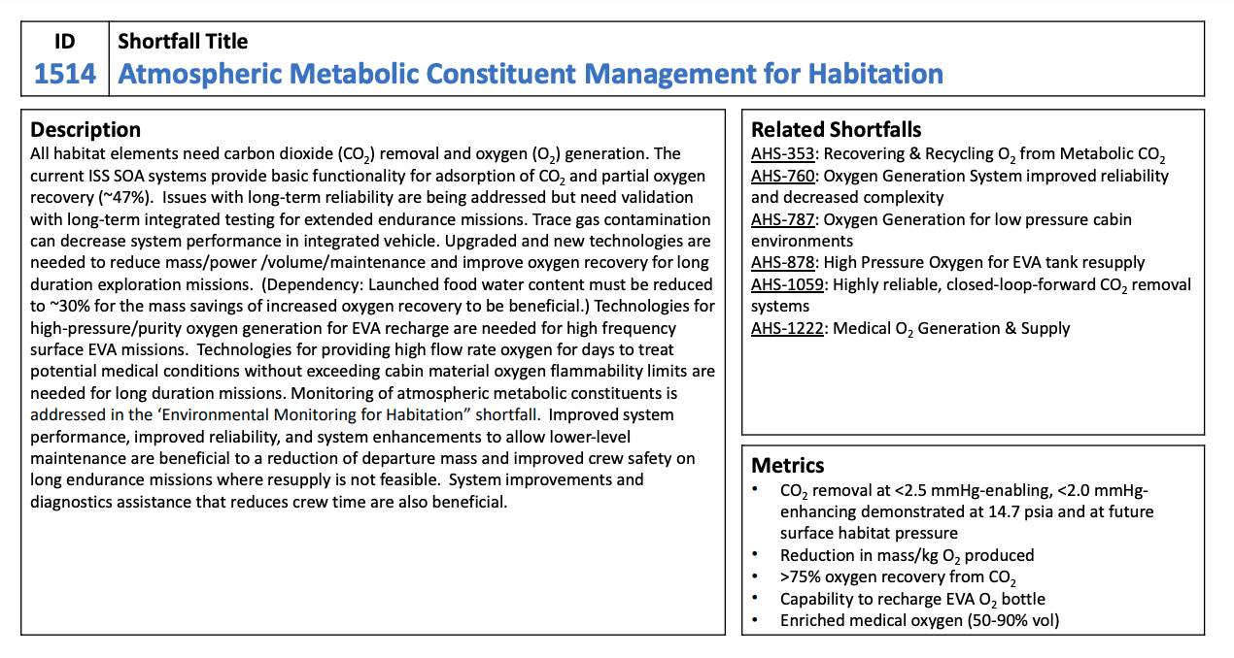
Civil Space Shortfalls
Capability Area | # of Shortfalls
Advanced Habitation Systems | 16
Advanced Manufacturing | 12
Advanced Materials & Structures | 4
Autonomous Systems & Robotics | 23
Avionics | 7
Communication & Navigation | 4
Cryogenic Fluid Management | 5
Dust Mitigation | 3
Entry, Descent & Landing | 13
Excavation, Construction & Outfitting | 9
In-Situ Resource Utilization | 10
In-Space Servicing, Assembly & Manufacturing | 9
Orbital Debris | 3
Power | 8
Propulsion | 18
Sensors & Instruments | 12
Small Spacecraft | 8
Surface Systems | 10
Thermal Management Systems | 8
Miscellaneous | 5
NASA compiled an initial list of 187 shortfalls organized into 20 capability areas
The shortfall description document and feedback form were organized accordingly
Shortfall: Identified technology area requiring further developments to meet future exploration, science, and other mission needs

