Slide 1


Recent progress in the International Laser Ranging Service (ILRS)
Claudia C. Carabajal, Michael Pearlman
With contributions from many others:
Toshimichi Otsubo, Mathis Blossfeld, Clément Courde, Ulrich Schreiber, Michael Steindorfer, Beatriz Vaquero, Shinichi Nakamura, Andrea Di Mira, Michael Haefner, Gro Grinde
23rd International Workshop on Laser Ranging (IWLR)
October 20th-26th, 2024
Kunming, China
Notes:
This is a report on the International Laser Ranging Service. I want to thank all of the authors who contributed to the report.

Slide 2
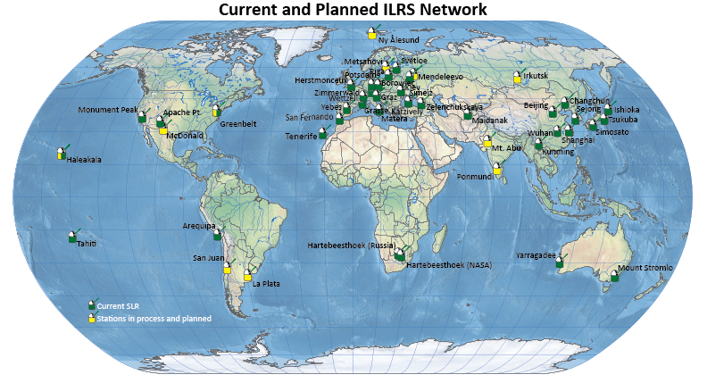
ILRS – Network
New Stations (2023-2024)
Yebes, Spain
Ishioka, Japan
Future Stations (2024-2027)
La Plata, Argentina
San Juan, Argentina
Metsähovi, Finland
McDonald, TX, USA
Ny Ålesund, Norway
Mt Abu, India
Ponmundi, India
Irkutsk (Tochka), Russia
Mendeleevo (Tochka), Russia
Other stations are undergoing significant upgrades
Gaps in geographic coverage remain
Different vintage Systems
Different weather conditions
Different staffing levels
Notes:
This is the current status of the ILRS network, showing the stations that are currently operational and new stations that are in process or those that are under major renovation. We note where a legacy system is operational while a new systems is in process (example Greenbelt). We have also removed the Russian stations operated under ROSCOSMOS that have ceased cooperation with the ILRS. Other Russian Stations continue to participate in the ILRS. We do not know what the long range situations will be. New stations added to the network are Ishioka and Yebes. Several others are underway.

Slide 3
ILRS – Network
JAXA developed a new SLR station in the Tsukuba Space Center (7306, Ibaraki, Japan), it has been operating since June 2023. Ranging precision is less than 1 cm for LAGEOS, it has recently passed quarantine.
Mt. Stromlo (7825, Australia) has been qualified after some repair/upgrade.
Yebes (7217, Spain) has recently passed quarantine.
Ishioka (Japan) has ranged to SARAL in December 2023 and Starlett in September 2024.
Several new stations in process. Irkutsk and Mendeleevo are candidates for the new Russian Tochka station.
Ny-Ålesund, Norway SLR station will be installed between the two VLBI telescopes. The dome was installed in April 2022, and the gimbal and telescope in February 2024. Operations are planned for early 2026.
San Fernando Station upgrade is underway; operations are expected to resume in early 2025.
Matera will have a new laser and is expected to be operational in 2026.
ILRS CB is beginning to evaluate ‘Station Survey and Plans’ results sent from the first group of 10 underperforming stations to better understand their operational challenges.

Slide 4
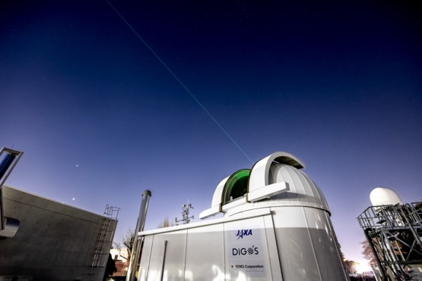
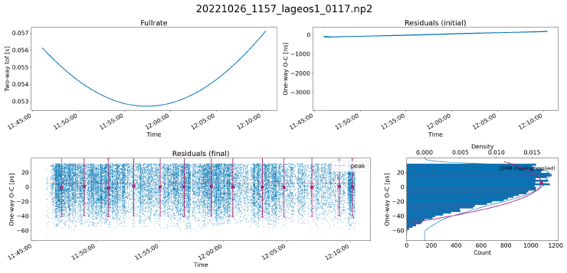
Tsukuba, Japan SLR Station
JAXA developed a new SLR station in the Tsukuba Space Center (Ibaraki, Japan)
Tsukuba station has been operating since June 2023
Ranging precision is less than 1 cm for LAGEOS
Satellite: LAGEOS-1
RMS: 6.04 mm
Shinichi Nakamura, JAXA
Notes:
The Tsukuba operated by JAXA has been in operation since June 2023

Slide 5

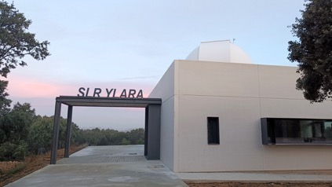
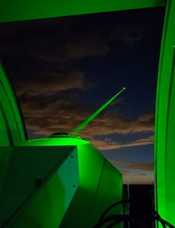
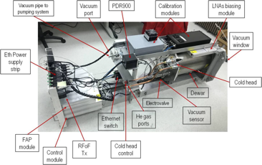

Yebes Observatory as GGOS Core Site
Credits: M. Gómez
Bea Vaquero
Yebes VGOS RT Performance
First observation, November 2014, tri-band receiver (S-X-Ka)
Broad band (2-14 GHz) observations: Yebes participates since the start of operations in June 2016 (Westford, GGAO, Wettzell, Yebes, KPGO)
Since 2020, regular observations biweekly
Other projects: VGOS-R&D, EU-VGOS, VGYG (Intensive), Fringe-Test support for new stations
YEBL Station (SLR)
Geodetic observations (ILRS) + Space debris (future)
Telescope assembly: 70 cm mirror, 3 Nasmyth foci, beam pointing accuracy ≤3’’, high slew rate 12°/s Az and El
Two configurations: piggy-back for SLR + Coudé path for other experiments
Two color capability: 532/1062 nm, 7/8.5 ps, 1 kHz
Under ILRS quarantine process
2 - 14 GHz VGOS geodetic receiver (by Yebes Obs.)
Notes:
The new SLR system at Yebes Observatory in Spain is undergoing testing and they anticipate operational status shortly. This will be a CORE site with the operational VGOS system (developed at Yebes) in operation since 2016. The main objective of the SLR is space geodesy; the station will support space debris tracking.
The SLR laser head is a piggy-back configuration although a Coudé focus is also available for other lasers applications, like the Space Debris laser tracking. The station has two color capability at 532 and 1064 nm.

Slide 6

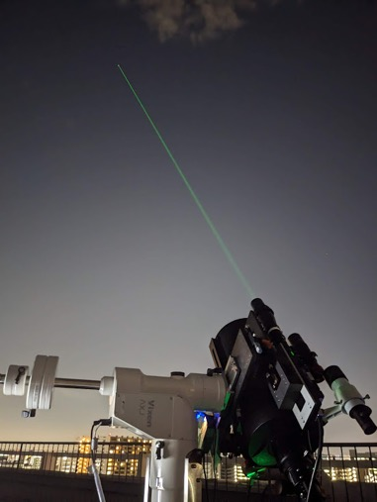
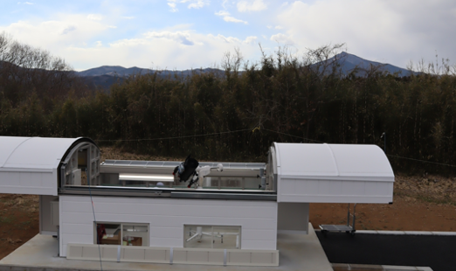





Omni-SLR@Ishioka
Deployment to GSI Ishioka
Sliding-roof container built, March 2024
Concepts
Compact
Low-cost
Multi-purpose
Tests at NIPR Tachikawa
First returns from LEOs, December 2023
Core institutes
Approved as an engineering station of ILRS with the CDP Pad Number “7317”.
Plans and Visions
To function as an SLR station.
To evaluate its quality and stability.
To be collocated with VLBI, GNSS, etc.
To explore applications (T&F, communications, etc).
To test it at Syowa@Antarctica (early 2027?)
To expand the worldwide SLR network.
To change the role of SLR.
1 ns, 10 kHz, 6 microJ CryLAS laser; Vixen AXJ mount; 20 cm RX telescope; Hamamatsu MPPC SPAD module; Swabian Time Tagger event timer, etc
being supported by other institutes and companies.
Toshimichi Otsubo
Notes:
The Omni-SLR Station in Ishioka has been approved as an ILRS Engineering station, but is also functioning as an SLR tracking station to support geodesy applications and augment Ishioka as a CORE site with existing VLBI and GNSS. The SLR has been developed as a compact, low cost, multipurpose system; the ability to slew the laser with the mount avoids a lot of optics and complications to the optical path. Plans are at some time on the future to move the SLR system to Syowa to test operations in Antarctica.

Slide 7
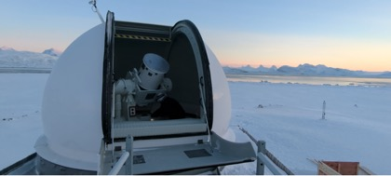
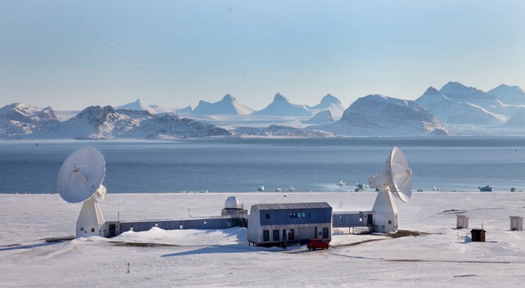

Ny-Ålesund, Norway – Core Site
The site at 79° North is equipped with two VLBI telescopes, currently contributing to both legacy and VGOS VLBI sessions.
Between the two VLBI telescopes, there will be installed a SLR. The dome was installed in April 2022, and the gimbal and telescope in February 2024. Operations are planned for early 2026.
Photo: Bjørn Owe Holmberg and Evan D. Hoffman
Key specifications:
Wavelength 532 nm
Pulse energy 2.5 mJ
Pulse width 50 ps
Repetition rate 2 kHz
Telescope Cassegrain 50 cm Coude path
Aircraft detection Airport
tower switch and ADS-B
Gro Grinde
Recent Progress at the International Laser Ranging Service
7
Notes:
The Ny-Ålesund, Norway site is located at 79° North.
It is equipped with two VLBI telescopes, currently contributing to both, legacy and VGOS VLBI sessions
Between the two VLBI telescopes, the instation of an SLR system, a NASA SGSLR, is underway to provide a CORE Site. Operations are planned for early 2026.

Slide 8
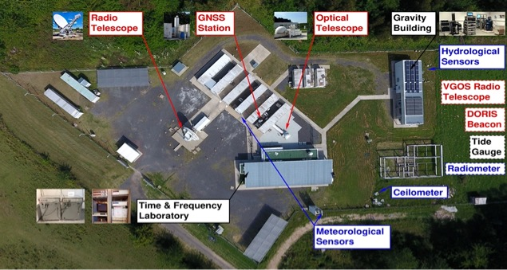
La Plata Station – SLR Upgrade Underway -Core Site
Michael Haefner – BKG/AAGO
Notes:
The SLR system formally at Concepcion has been relocated to the La Plata Station in Argentina and is now being upgraded to form a CORE site with the existing legacy VLBI, GNSS, and eventually DORIS. The SLR is projected to be on operation in 2025, and plans are afoot to upgrade the VLBI to VGOS.

Slide 9
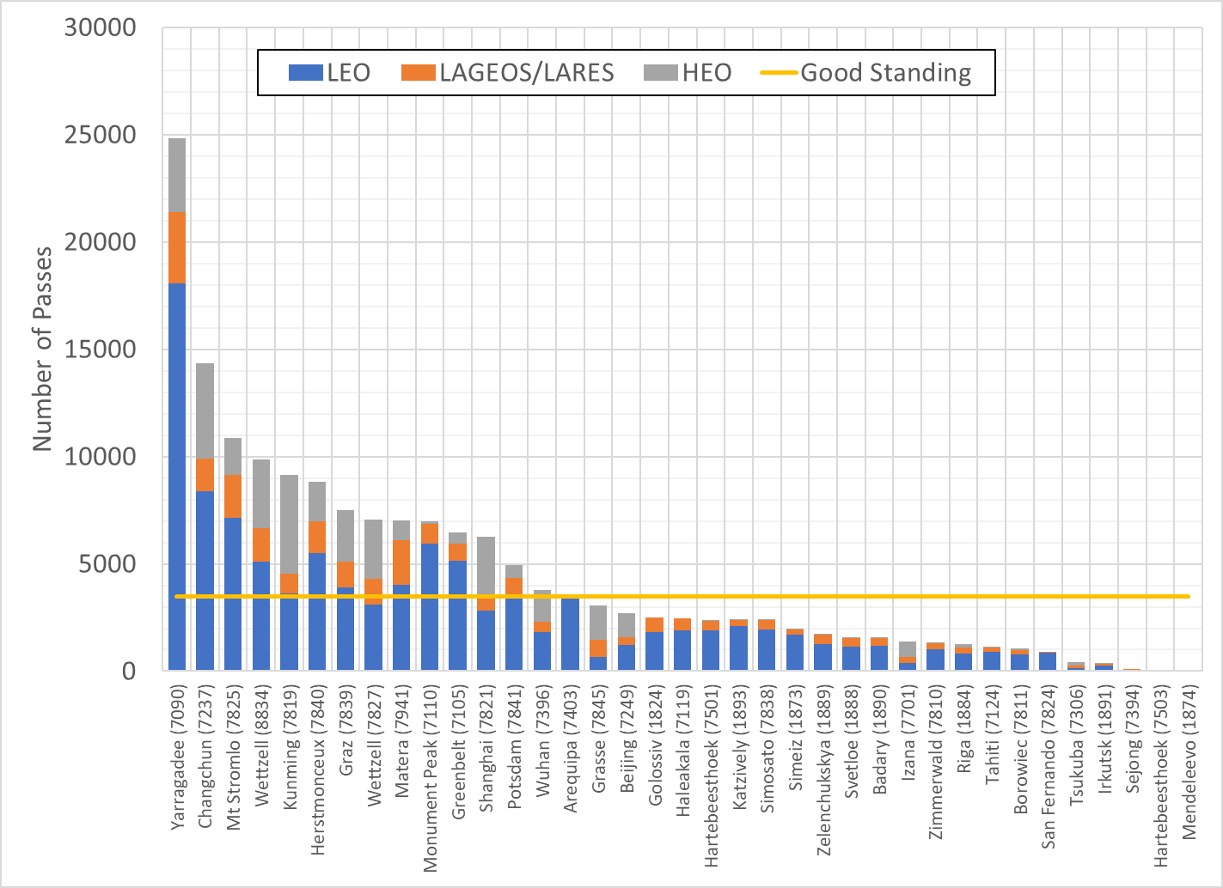
Stations Performance: Passes 2023
ILRS Network Performance - Total Orbital Passes, 2023
About 40% of the stations are meeting a 3500-pass standard*
Geodetic satellites (e.g. LAGEOS and LARES have high importance)
GNSS is becoming a larger user of SLR tracking data
3500 pass minimum guideline
*Station Performance Requirements currently under review
Notes:
This chart depicts the data volume performance of the SLR network stations in 2023. About 40% of the stations met the 3500 pass standard approved by the ILRS, which is currently under review to accommodate new satellites.
There is a large divergence in performance, but some of the stations on the right-hand side or not shown at all, are in the process of upgrades or replacement and we expect that they will be healthy performers in the future.
The ILRS has sent a Station Survey and Plan to those stations with low or nil performance to start a dialog to understand the issues inhibiting performance and how we might bring some technical help. Those surveys are currently under review.

Slide 10
ILRS – Network Performance – Minutes 2023
Network Performance in minutes (2023):
One calendar year = 525,600 minutes

Slide 11


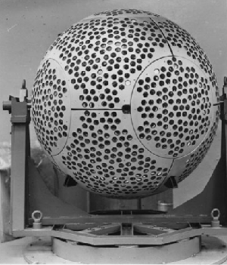

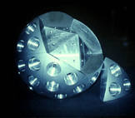
















SLR Satellite Constellation: examples
Geodetic
Satellite | LAGEOS-1 | LAGEOS-2 | LARES | Etalon-1/-2 | Ajisai | Starlette/Stella | LARES-2
Inclination | 109.8° | 52.6° | 69.5° | 64.9° | 50° | 50°/ 98.6° | 70.16°
Perigee (km) | 5,860 | 5,620 | 1,460 | 19,120 | 1,490 | 810/800 | 5,899
LEO
Satellite | Jason-3 | ICESat-2 | GRACE-FO | Sentinel-3A/3B | SWARM | SARAL | TerraSAR-X*
Inclination | 66° | 92° | 89° | 98.65° | 92° | 98.55° | 97.44°
Perigee (km) | 1,336 | 496 | 500 | 814.5 | 720 | 814 | 514
LEO
Geodetic
GNSS
Altimetry
SAR
Satellite | Sentinel-6A | SWOT
Inclination | 66.042° | 77.6°
Perigee (km) | 1,339 | 850
Geomagnetism and Gravity
HEO/ GNSS
Constellation | GLONASS | Galileo | BeiDou | QZSS | IRNSS | GPS-III (future)
Inclination | 65° | 56° | 55.5° | 45° | 29° | 55°
Perigee (km) | 19,140 | 23,220 | 42,161 | 32,000 | 42,164 | ~12,550
Notes:
The ILRS is now tracking more than 150 satellites with a wide range of applications. The most important application is space geodesy and the improvement in the International Terrestrial Reference Frame. Others include Oceanography, the global ice budget, gravity field, geomagnetism, satellite dynamics, and many others. New and expanded constellations of GNSS constellations are requiring more tracking time from the network.
Some new satellites are examining methods of satellite recovery after missions are over.
will be launched, with some having retroreflectors, and the ILRS will be tracking them.
We will be supporting Navigation applications, and providing validation for all GPS constellations.

Slide 12
New SLR Missions Support Exciting Space Applications
*
Mission | Sponsor/Country | Application | Launch date
MSS-1A | Macau University of Science and Technology/China | High precision surveying of the Earth’s geomagnetic and space environment with emphasis on lower latitude regions | May 21, 2023 No updates
HTV-X | JAXA/Japan | Transporting cargoes to the International Space Stations (ISS). Verifying the GPS orbits. Verifying JAXA developed SLR retroreflector Mt. FUJI on orbit. | TBD - 2025
NANO-FF 1/2* | Technical University of Berlin/Germany | Nanosatellites in Formation Flight (2U-CubeSats), to accurately monitor their relative positions, close proximity operations. | November 29, 2023 No updates
e-kagaku-1* | The e-kagaku Association of Global Science and Education/Japan | Student education, fostering space engineers of next generation. Data transmission and tracking for satellite systems. Demonstrating SLR using JAXA developed mini-Mt. FUJI retroreflectors. | Delayed to 2025
ALOS-4 | JAXA/Japan | InSAR and AIS Observing and monitoring disaster-hit areas, forests, sea-ice, and monitoring infrastructure displacement. Satellite checkout taking longer than expected. Tracking campaign to start mid-November. | June 30th, 2024
*Student Involvement in designing, building, and data analysis
Notes:
New missions are approaching the ILRS for support. Currently five new mission are awaiting approval bringing new applications and satellite configurations to the ILRS tracking roster. We are pleased that
we are seeing increased participation in satellite construction, operations, and data processing. Once fully approved these missions will join the ILRS roster.

Slide 13
ILRS – Missions
The JAXA ALOS-4 advanced Earth observation satellite, launched on June 30th, 2024 will be supported by ILRS with restricted tracking. The satellite will be observing the Earth's surface using its onboard phased array type L-band synthetic aperture radar (SAR). Tracking campaign planned for early November 2024.
Launch of the Ekagaku-1 satellite has been delayed to 2025.
New lunar retroreflectors on NASA’s Commercial Lunar Payload Services (CLPS) and Artemis missions are being prepared for deployment over the next few years. The Next Generation Lunar Retroreflector NGLR is anticipated to be on the Moon in early 2025; its ILRS support request is being reviewed.
QZS-5/6/7 from JAXA missions will be requiring support from the ILRS. Satellites have slightly different features and parameters than the other QZS satellites in the constellation. QZS-6 MSRF received being evaluated.
JAXA has been developing a Precision Orbit Determination (POD) algorithm called ”Precise Point Positioning (PPP) in Space" that realizes real-time PPP in orbit using MADOCA-PPP transmitted from the QZSS L6E signal. They plan to demonstrate this mission on the QPS-SAR satellite, a LEO small-satellite, in 2025. The mission is targeting centimeter-level orbit determination and requires a high precision reference and will be seeking tracking support from the ILRS.

Slide 14
ILRS – Missions (cont.)
WESTPAC tracking campaign is underway by selected stations (lead by the NEWG). WESTPAC may be resurrected if it is deemed useful for the geodetic constellation.
ESA GENESIS Mission co-locates in space all four of the Space Geodesy measurement techniques currently used for ITRF. Clément Courde (Observatoire de la Côte d'Azur, Nice, France) is the Chair of Satellite Laser Ranging Working Group (SLR WG); Mathis Blossfeld (TUM, Germany) is the Deputy. Missions, Networks and Engineering, Data Format & Procedures, Analysis Standing Commeetties and ILRS CB members participate in the SLR WG. The first meeting to define requirements was held early in September 2024. Follow up meetings will continue discussions on requirements and simulations to support them.
“Missions Tracking Reports” were requested from selected LEO missions supported. All currently under review by the ILRS. The intention here is to begin developing summary reports for general distribution.

Slide 15
ILRS – Missions (cont.)
Lunar Laser Ranging and Transponder activities: there are 6 lunar ranging Analysis Centers. Lunar ranging Stations include: Apollo (USA), Grasse (France), Matera (Italy), Wettzell (Germany) and stations in progress in China, Russian, and South Africa.
  5 reflectors on the Moon and new reflectors in a near future (2024-2025) on the Moon & on orbiter:
    NASA-NGLR-1&2
    ESA-MoonLIGHT & Lunar Pathfinder
    CNSA-Tiandu-1 & CAS-1
Science and application with Transponders:
  Ongoing:
    CSS-LTT (2022, underway) 2-way asynchronous
  Upcoming:
    ACES-ELT: European Laser Timing (ELT) experiment, part of the ESA's Atomic Clock Ensemble in Space (ACES) mission, launch in early 2025.
    LTT on CAS-1

Slide 16



SLR Tracking Campaign to Galileo Satellites
Galileo for Science Campaign underway, focused on elliptical orbit satellites (201 and 202). New Galileo -225 and -227 added to ILRS roster.
G4S_2.0 in a nutshell
Funded by the Italian Space Agency (ASI), aims to perform a set of measurements in the field of gravitation with the Galileo satellites of the Full Operational Capability (FOC) constellation, taking advantage of the accuracy of the on-board atomic clocks and, in particular, of GSAT0201 and GSAT0202 by exploiting their relatively high eccentricity (≅0.16). The campaign will last a total of two years.
Main goals of the G4S_2.0 project:
A new measurement of gravitational red shift
A measurement of relativistic precessions on the two satellites in eccentric orbit
Constraints on Dark Matter in the Milky Way
Relativistic Positioning System
Development of new models for non-gravitational forces
Development of a new accelerometer concept for a next generation of Galileo satellites
Research Institutes Involved:
ASI-CGS (Center for Space Geodesy) in Matera
Istituto di Astrofisica e Planetologia Spaziali (IAPS/INAF) in Roma
Osservatorio Astronomico di Torino (OATO/INAF) in Torino
Politecnico (POLITO) in Torino
Refer to the Project furnished SLR Campaign Website
Galileo For Science 2.0 is here.

Slide 17
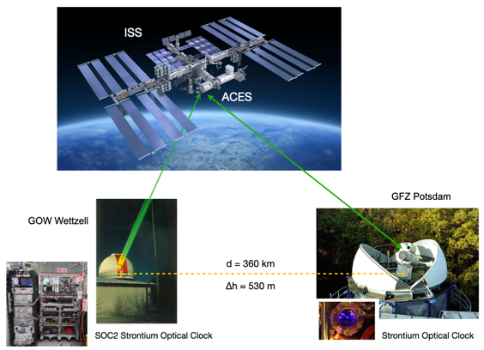
Common View Optical Time Transfer via a Free Space Link to the ACES H Maser in Orbit demonstrates Relativistic Geodesy
Linking two fully characterized optical clocks at different locations with SLR (Einstein Synchronization) provides height differences
There is a funded proof of concept project, where the SLR stations in Wettzell and Potsdam are each tied to an optical strontium lattice clock, demonstrating the feasibility of a physical height system.
By performing repeated clock comparisons over several days, we expect to recover the height differences of 530 m between the clocks from the gravitational effect of general relativity on the clock transitions in common view.
d = 360 km
∆h = 530 m
Additional experiments including the Grasse and other stations are planned for non-common view time transfer.
Optical Time Transfer makes distributed timescales highly coherent, which leads to reduced systematic errors
Ulli Schreiber and Lunar, Interplanetary Ranging and TT SC
Notes:
An experiment is planned to use Common View Optical Time Transfer via a Free Space Link to the ACES H Maser to demonstrate Relativistic Geodesy. In particular, the experiment will use clock synchronization between with the Wettzell and Potsdam stations and the ACES H Maser to measure the height difference between the two stations, demonstrating the feasibility of a physical height system. Additional experiments including Grasse and other stations are planned tor non common view time transfer. Stay posted.

Slide 18
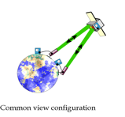
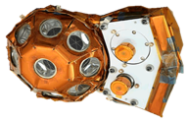
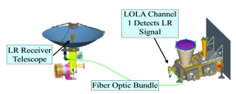


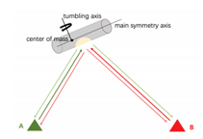
Transponders
Science and application with Transponder
Time & frequency transfer and clock synchronization between ground & space
Interplanetary laser ranging
Fundamental physics
Einstein’s gravitational redshift
Time variations of fundamental constants
Dark matter searches
Chronometric geodesy
Atmospheric propagation delay
Laser communication
Navigation
Past :
LASSO (1989-1992) 2way asynchronous
Messenger (2005) 2x1way asynchronous
MOLA-MGS (2005) 1way
T2L2 (2008-2018) 2way asynchronous
LRO (2009-2014) 1way
On-going :
Hayabusa2 (2015;2020) 1way ; 2x 1way synchronous
CSS-LTT (2022, underway) 2way asynchronous
Up-coming :
ACES-ELT : launch in early 2025
LTT on CAS-1
On-going tests on passive retroreflector
- Ground to ground time transfer with diffuse reflections (2021 space debris)
Lunar, Interplanetary Ranging and Time Transfer SC
Notes:
Two-way and one-way transponders activity has been underway since the LASSO experiment in the 1990 timeframe. As you can see on the Chart on the left, several are presently underway or upcoming.
Applications include include: Time & frequency transfer and clock synchronization between ground & space; Interplanetary laser ranging; Fundamental physics; etc. Lots of potential here.
Appl;ications include

Slide 19
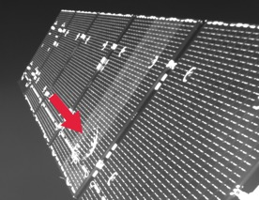
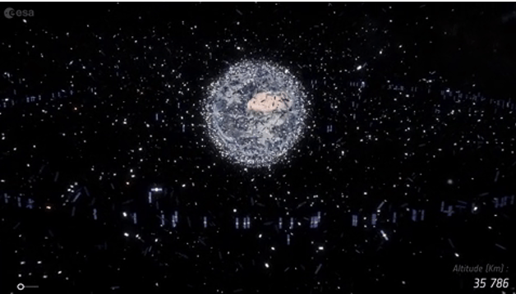

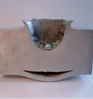
Space Debris (Current) Overview
SPACE DEBRIS Numbers (ESA) |  | TYPES & Origins
> 6,500 lauches | Since 1957 | Rocket bodies
9,000 / 2,500 satellites | active / inactive | Fragments
36,500 objects | Size: > 10 cm | Explosion
1,000,000 objects | Size: > 1 cm | Anti satellite missions
>100,000,000 objects | Size: > 1 mm | Collisions (2009, Iridium, Kosmos)
Velocity | ~7 km / sec | Toolbags (ISS, 2008)
Impact | Ø < 1 cm --> 20 cm crater | Heat shield (ISS, 2017)
Credits: ESA, 2016
Space Debris Study Group
Notes:
Some stations are also tracking space debris, mainly to deceased satellites without retroreflectors. Some of these stations have higher energy level lasers and high repetition rate operations.
For some stations debris tracking helps to fund their operations, also benefiting tracking for the geoscience applications.

Slide 20


Major Accomplishments - SLR
Recent improvements in the ILRS ASC operational products:
New operational products
    v180 → daily TRF+EOP product (satellites used: LAGEOS-1/-2, ETALON-1/-2; 1 day latency) → used for USNO Bulletin A
    v80 → weekly TRF+EOP product (9 days latency)
    v80(orb) → weekly orbit product (9 days latency)
    v280/v320 → weekly Station Systematic Error Monitoring SSEM-X (range bias) product (9 days latency) → used for Data Handling File (DHF) updates
  ILRS contribution to ITRF2020 update
  Mid-March 2024, the ILRS ASC provided the ILRS contribution to the ITRF2020 update (v85).
    Solutions are based on v180/v80 model setups.
    Solutions cover the time span 2021.0 until 2024.0.
  Inclusion of LARES-2 in the operational ASC products
    Currently, long-term mean range biases to update ILRS DHF are operationally computed (v320).
    Soon, we will start a test series of v180/v80 including LARES-2 as the 5th geodetic satellite.
  Update of SLRF2020 and new stations
    The SLRF2020 will be updated soon with refined and new coordinates.
Deutsches Geodätisches Forschungsinstitut (DGFI-TUM) | Technische Universität München
Notes:
SSEM =

Slide 21
Major Accomplishments - SLR
Publication of the SLRF2020 (SLR-based ITRF2020-like global TRF solution).
Publication/update of the ILRS Data Handling File (DHF) together with an update of the target signature model for geodetic spheres. This is a really important step forward, linking the technical developments done at the stations to the scientific analysis of SLR observations. It is absolutely beneficial for the quality of the ASC products in general.
Low costs SLR systems are being developed by private enterprises (DiGOS) and various Universities; potential for expansion of the current SLR network.
Notes:
Major accomplishments include Publications of the SLRF2020, Update of the ILRS Data Handling Files and the target signature models for the geodetic spherical satellites, new lower cost systems being developed that will facilitate expansion of the network, we continue to support missions with various applications, and we continue to keep the ILRS community connected through ILRS workshops, Virtually or in person.

Slide 22
ILRS – News and Events
News:
Contributed to the IAG Geodesist Handbook (July 2024).
ILRS GB news: Krzysztof Sośnica (Institute of Geodesy and Geoinformatics, Wrocław University of Environmental and Life Sciences, Poland) is a new appointed member of the ILRS GB (Representative of IAG Commission 1); we thank Urs Hugentobler (Technische Universität München, Germany) for his service to the ILRS.
Events:
Hosted the Virtual 2023 International Workshop on Laser Ranging (IWLR) during the week of October 16th-20th, 2023 (https://ilrs.gsfc.nasa.gov/lw23/index.html). Sessions on Missions & Applications, New technology/Systems and Operations, Analysis, Lunar Laser Ranging (LLR) and Space Debris were attended by more than 200 participants from 25 countries.
The 23rd International Workshop on Laser Ranging (IWLR) will be hosted in Kunming, China, during the week of October 20th-26th, 2024 (https://23rdworkshop.casconf.cn/).
The ILRS Specialized Workshop will be hosted in Arequipa, Peru, in 2025, dates TBD.
The Argentinean CONICET and German BKG (AGGO) in Argentina are possible hosts for 24th IWLR in 2026.It will be proposed at the 23rd IWLR in Kunming, China. CONICET offered the venue in the center of Buenos Aires, the Argentine capital.

Slide 23
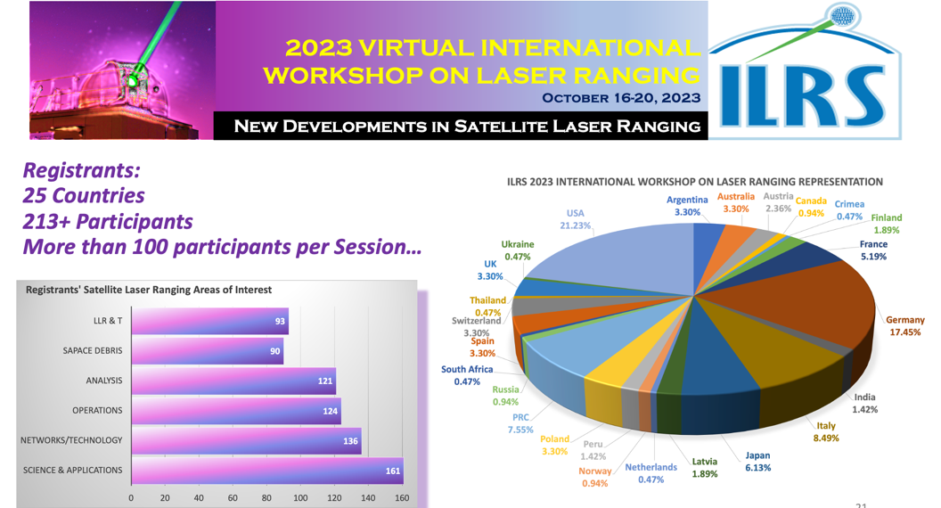
ILRS – Events: Virtual Workshops
Notes:
We held a successful 2023 Virtual International Workshop on Laser Ranging in October of 2023, highlighting development of new lower cost laser systems, with sessions on Analysis, Science an Applications, New Technology and Operations, Lunar Laser Ranging and Space Debris. We hosted over 200 participants from 25 countries.

Slide 24
Thank you!
Claudia Carabajal & Mike Pearlman
Claudia.C.Carabajal@nasa.gov
mpearlman@cfa.Harvard.edu

