Slide 1
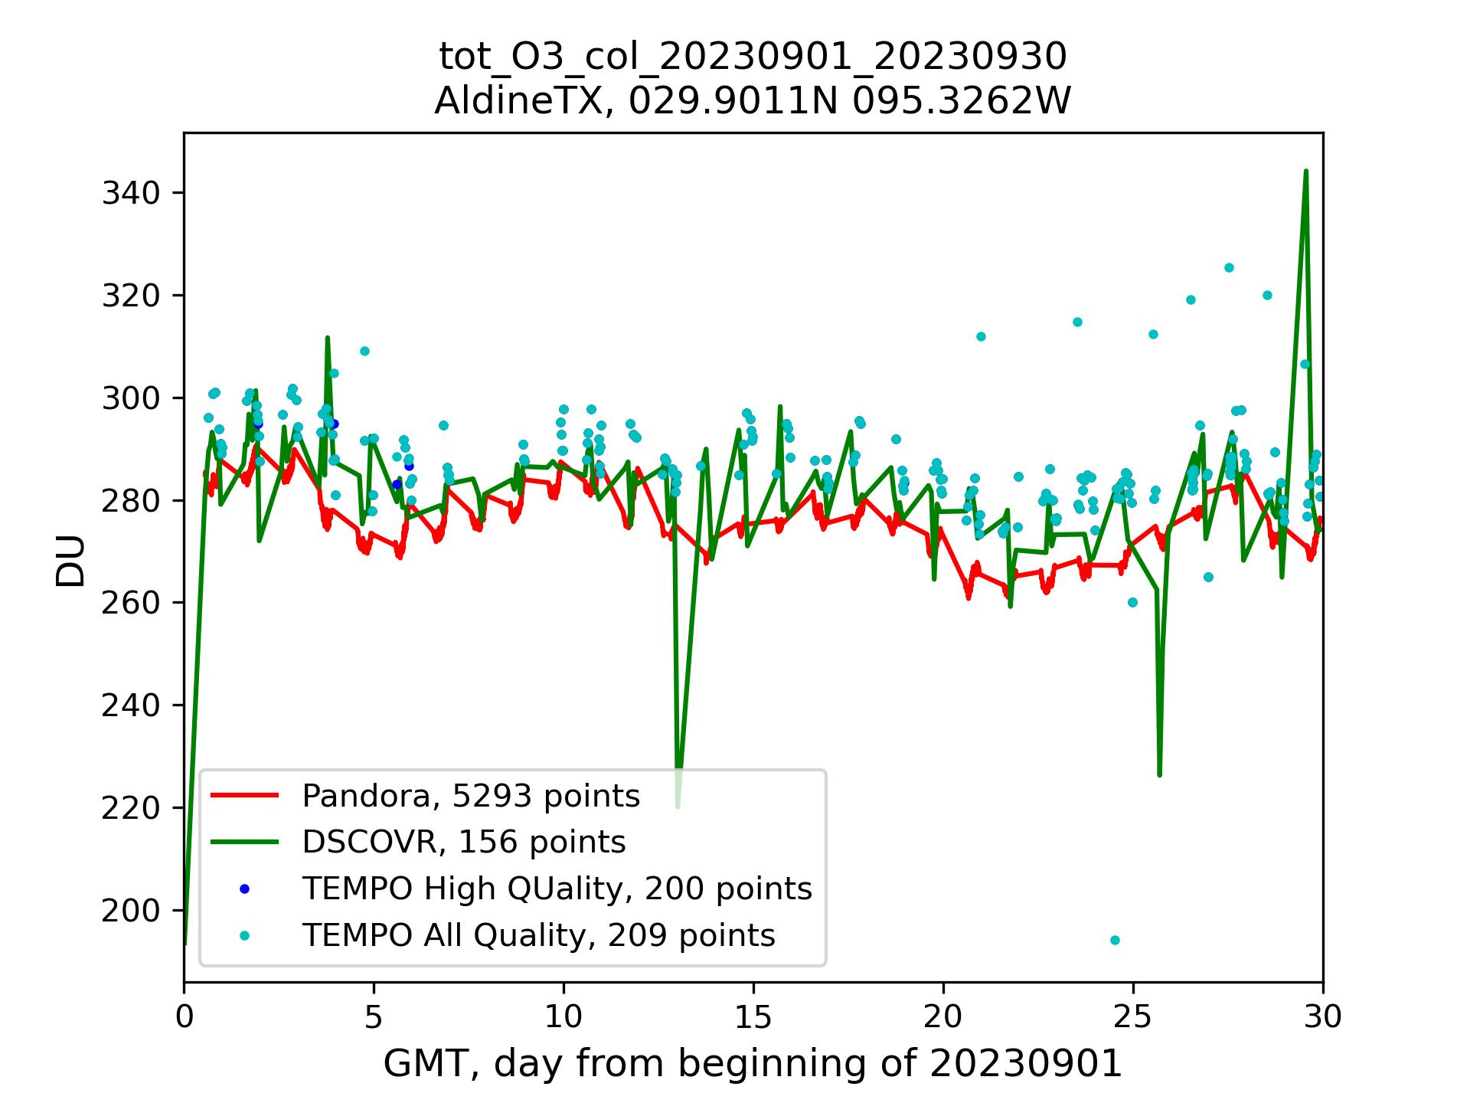
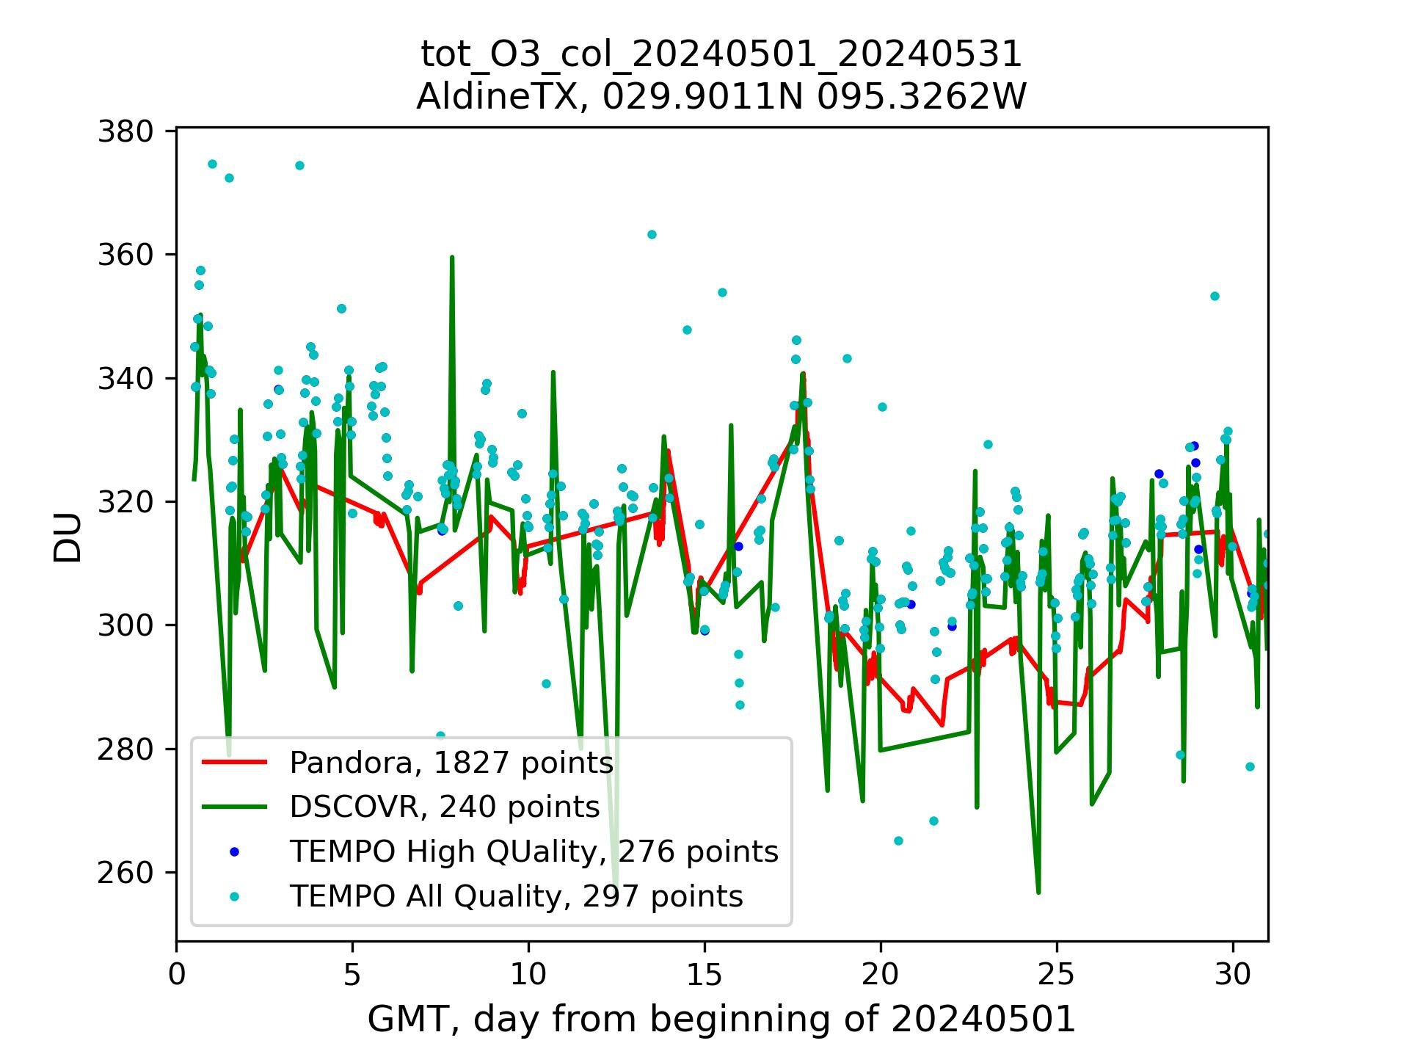
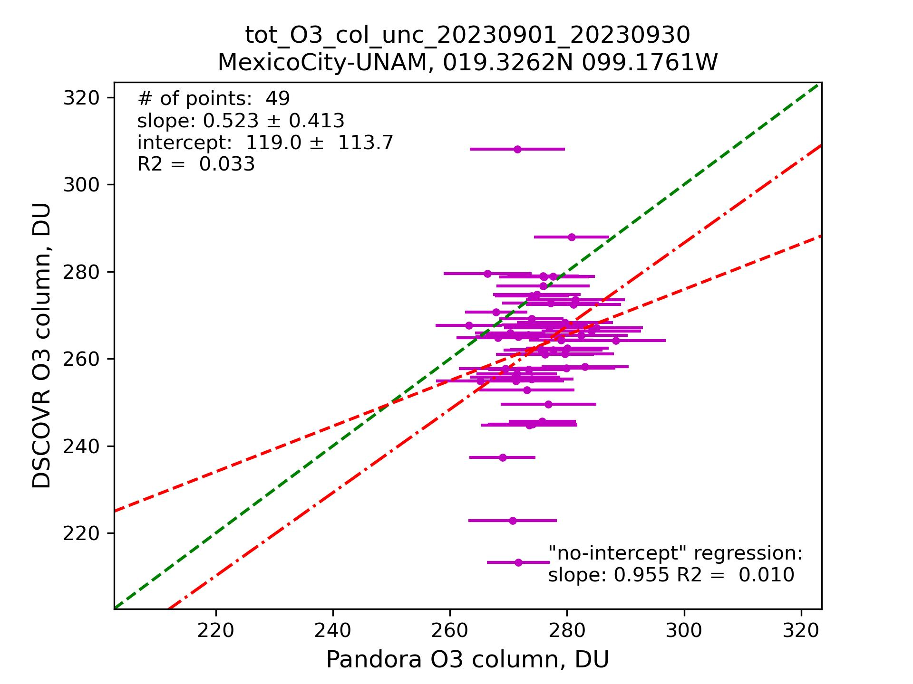
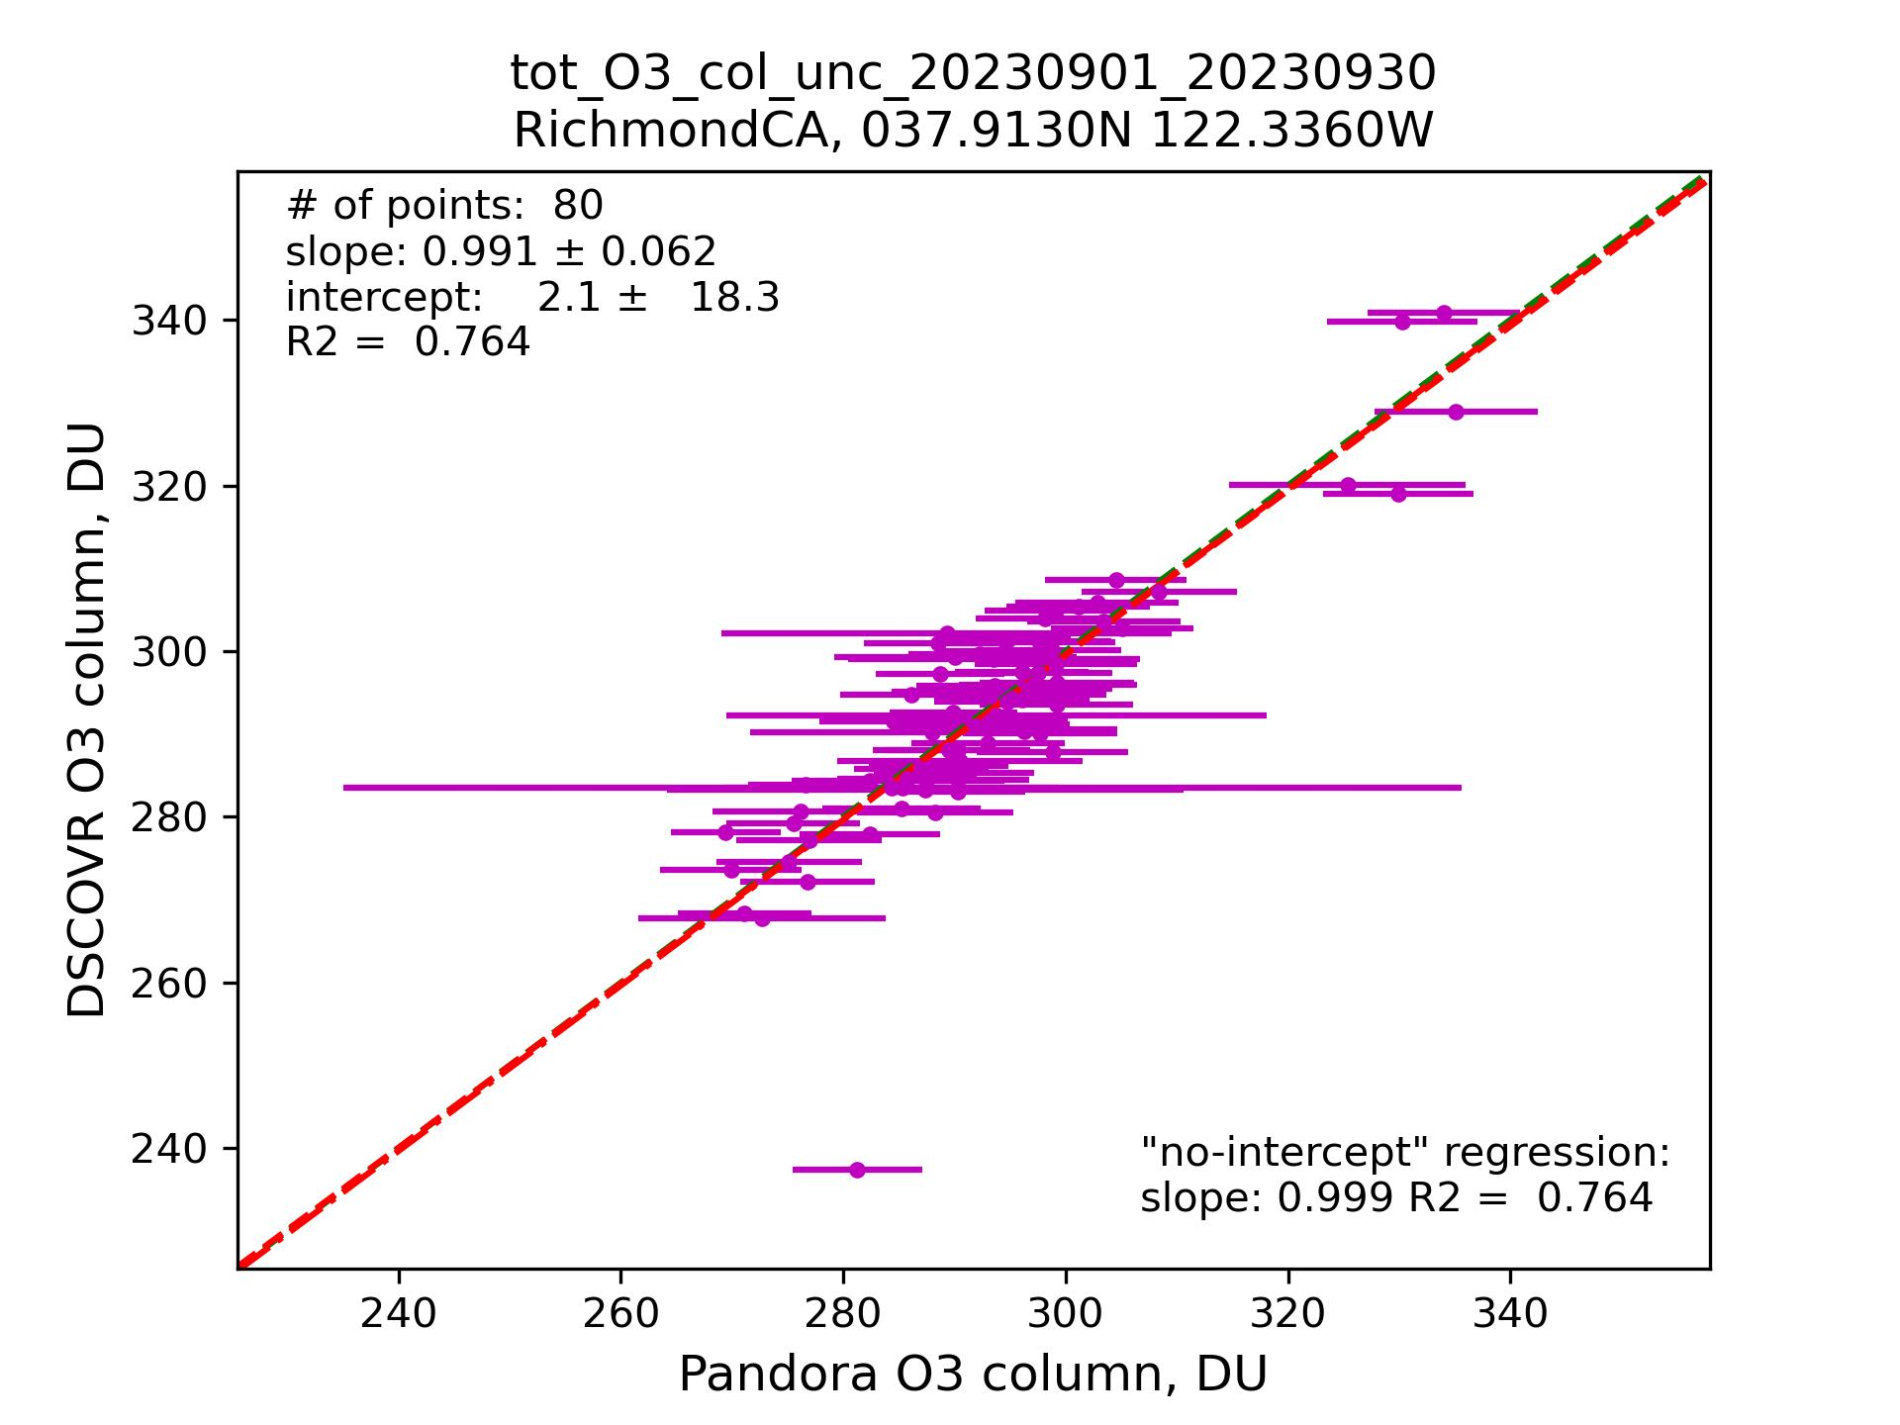
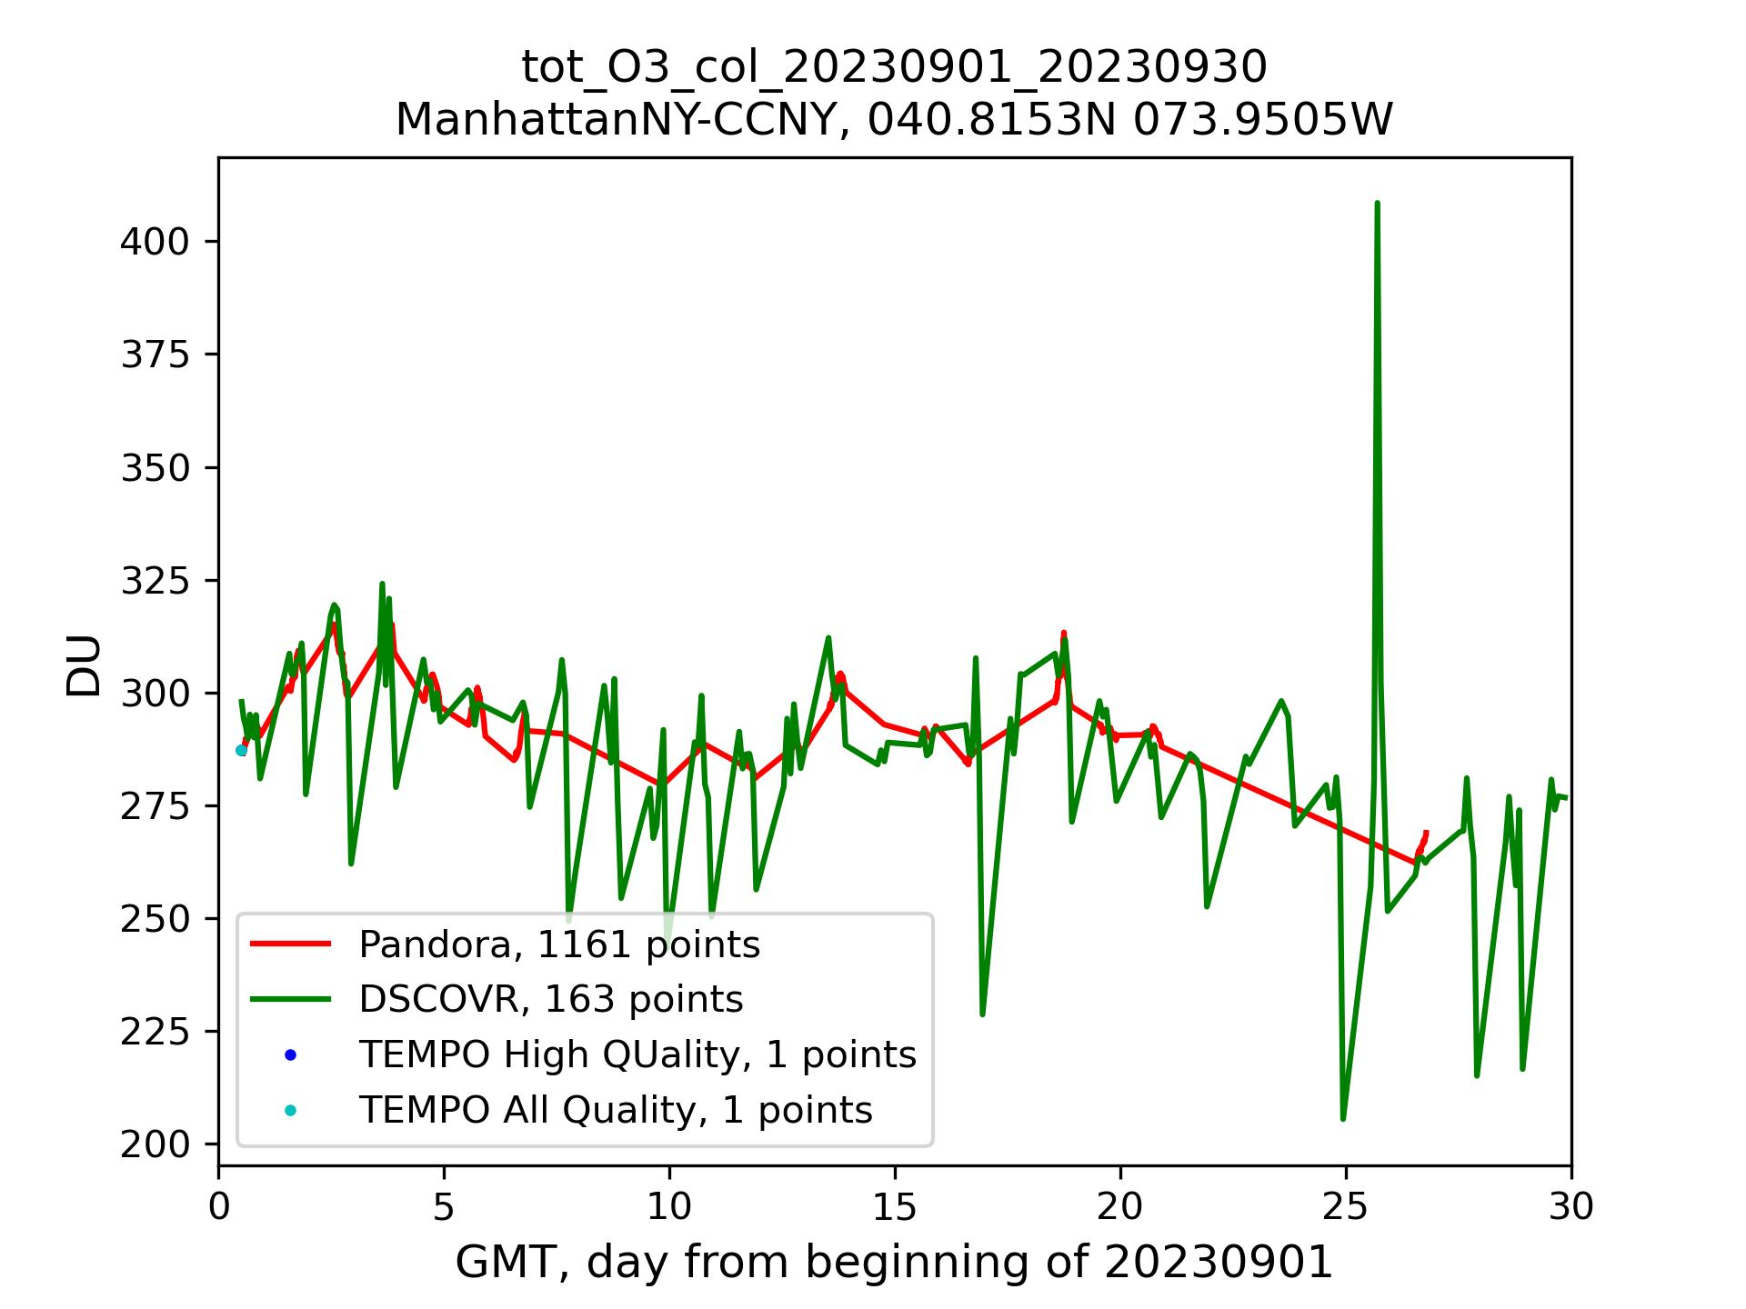
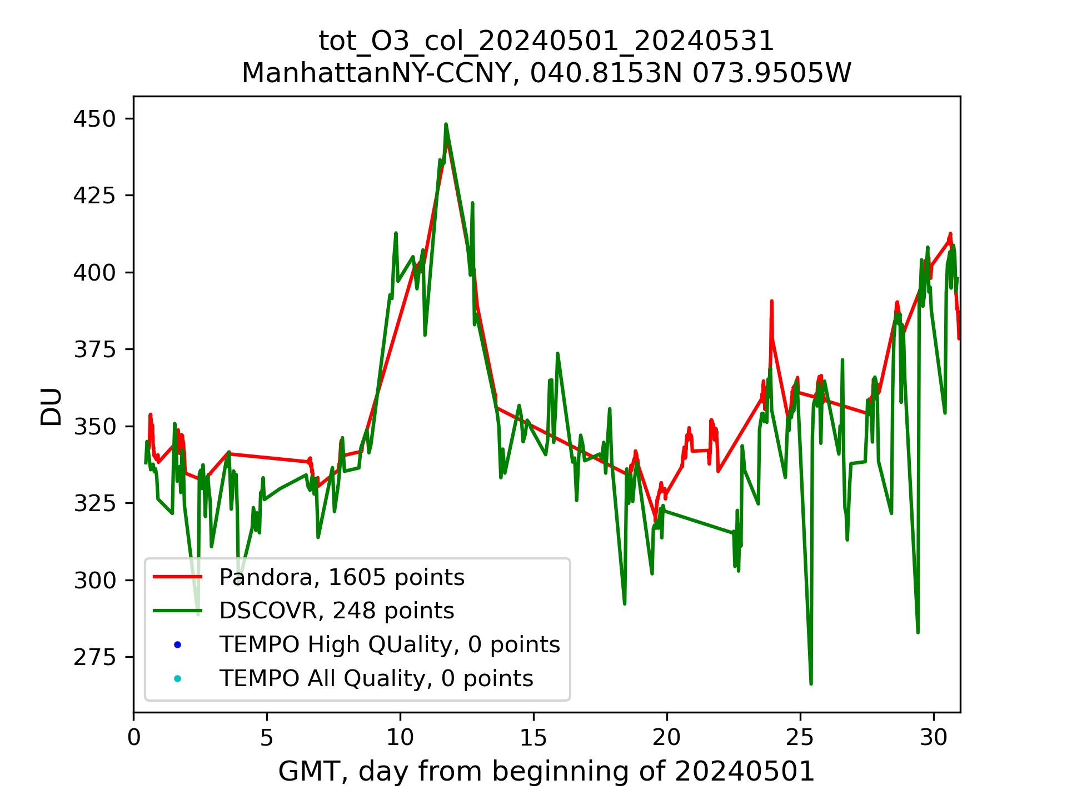
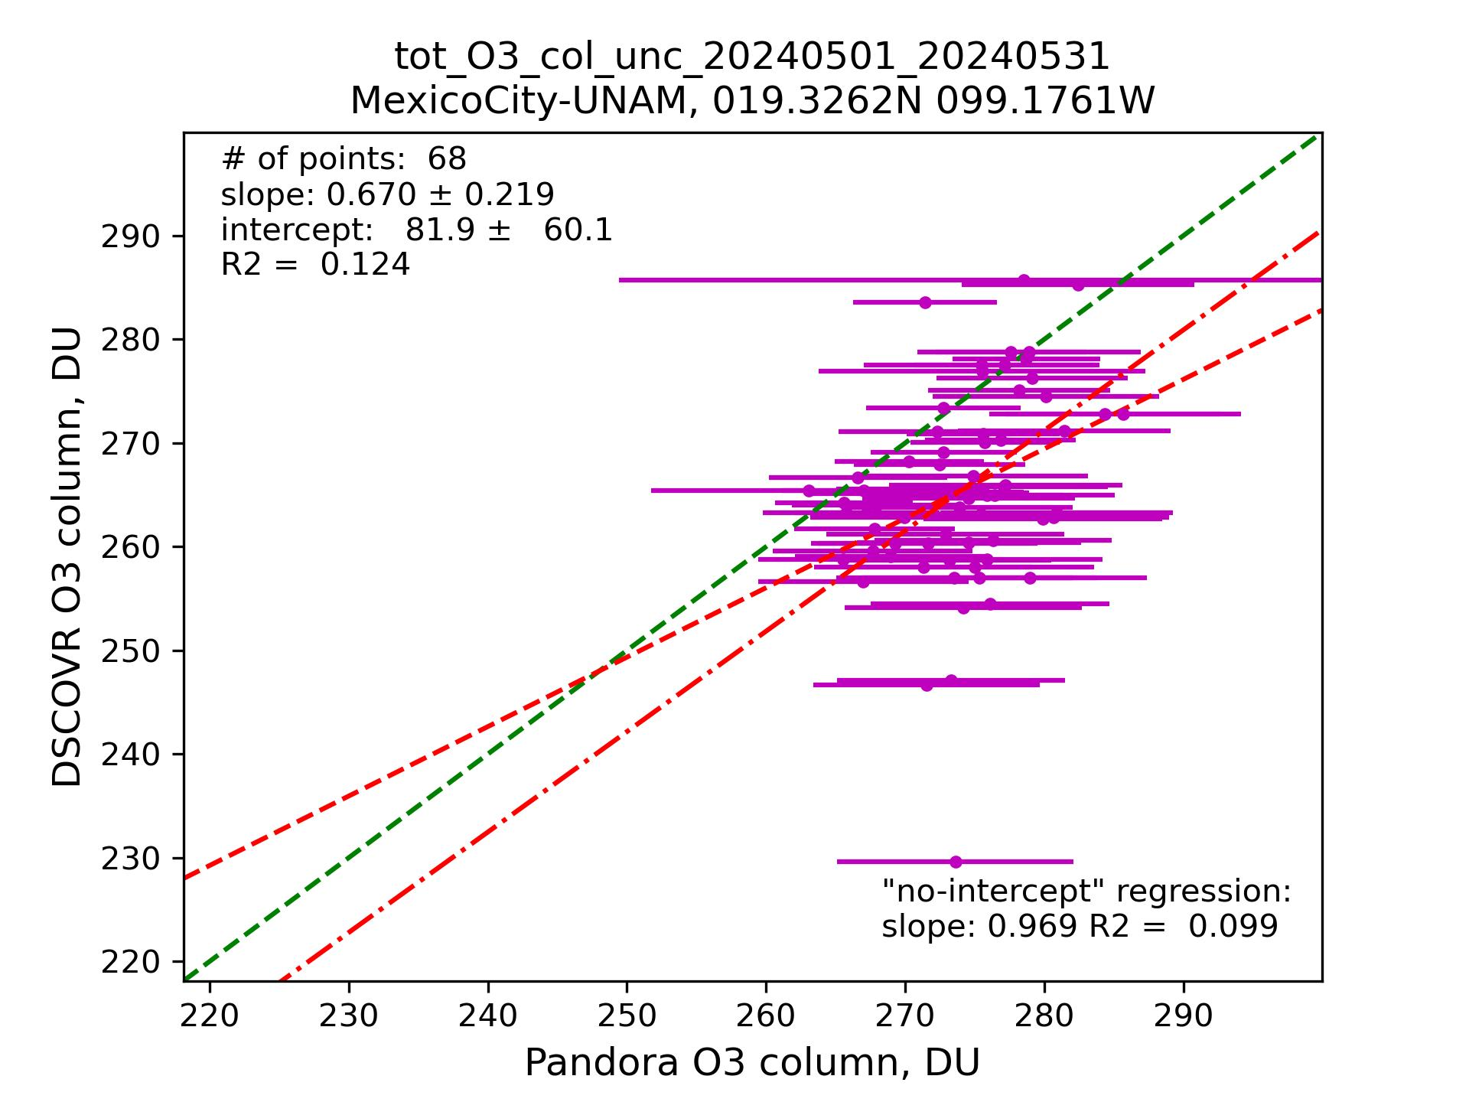
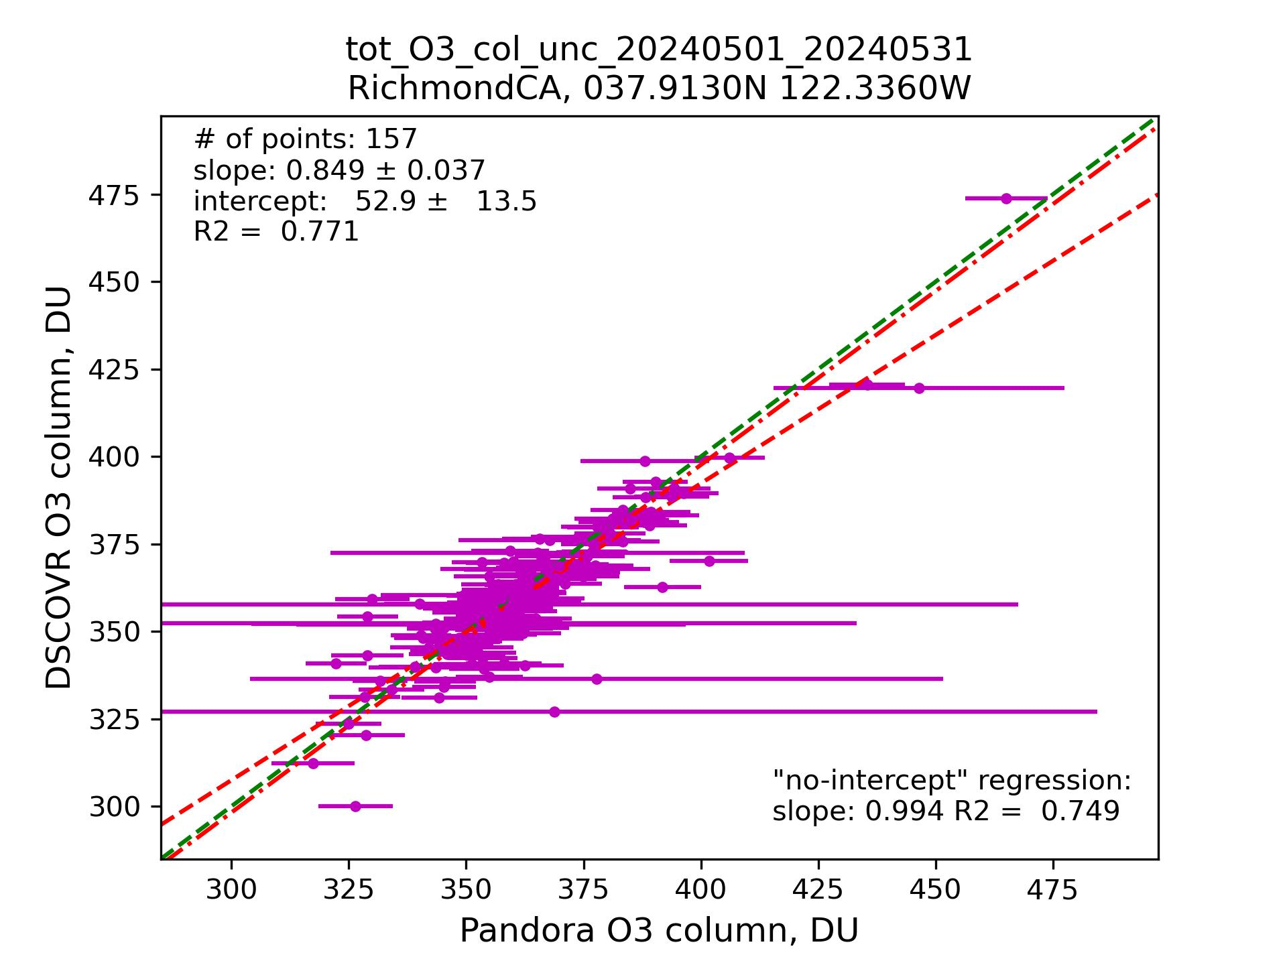
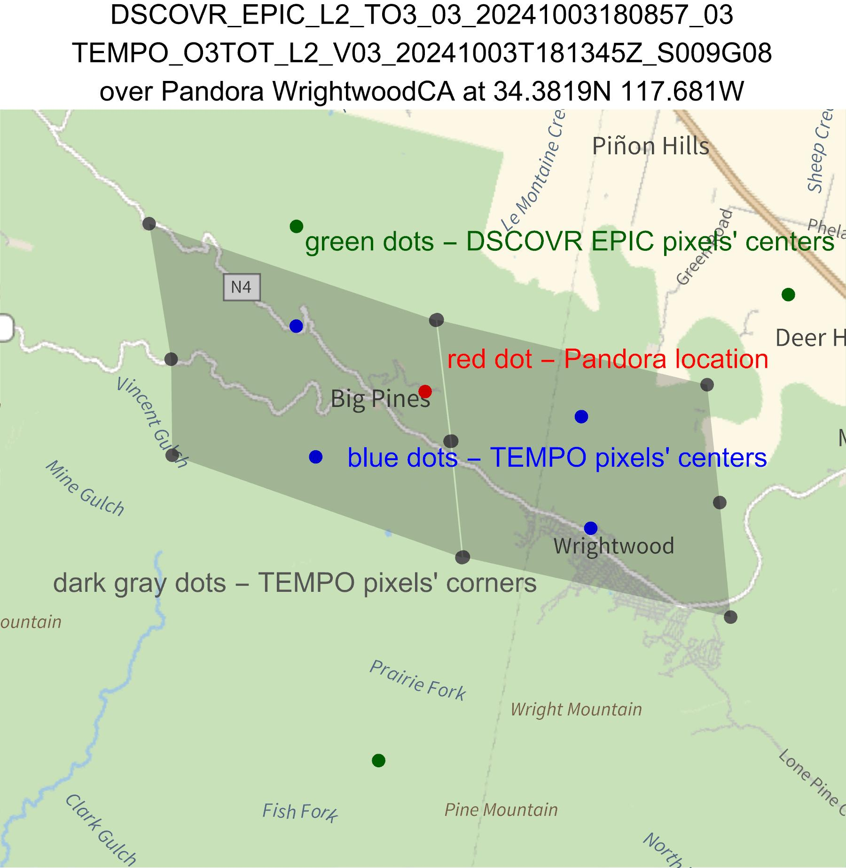
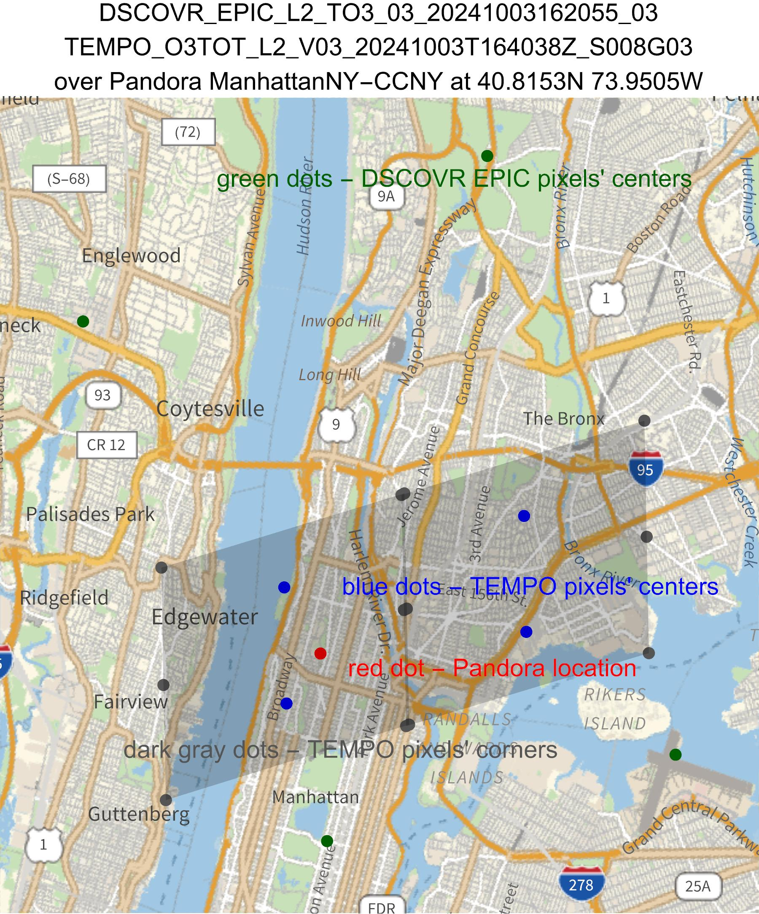
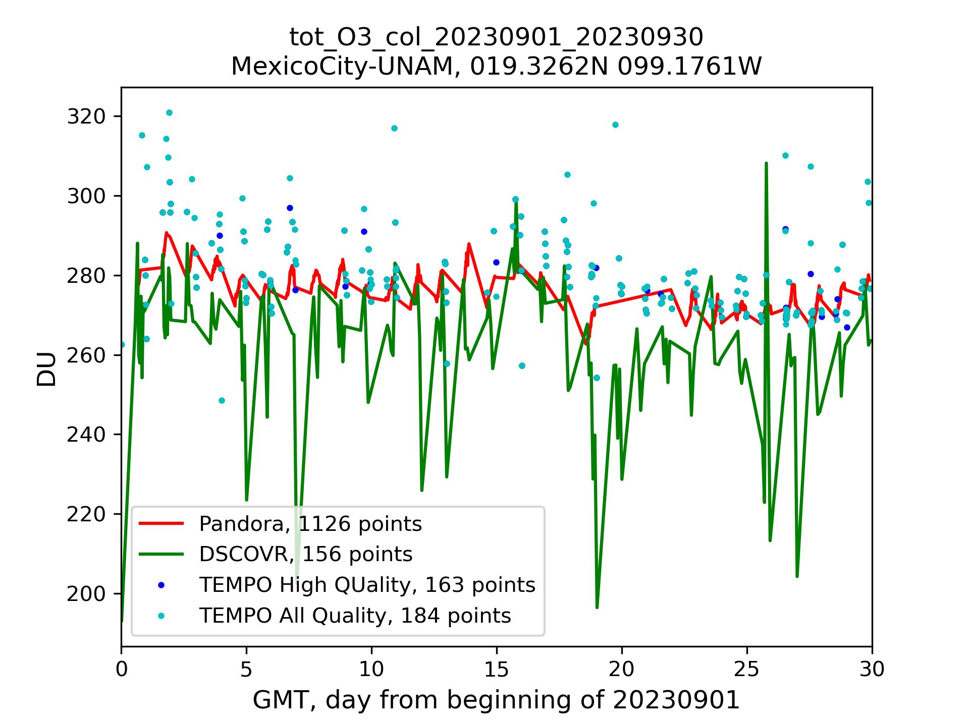
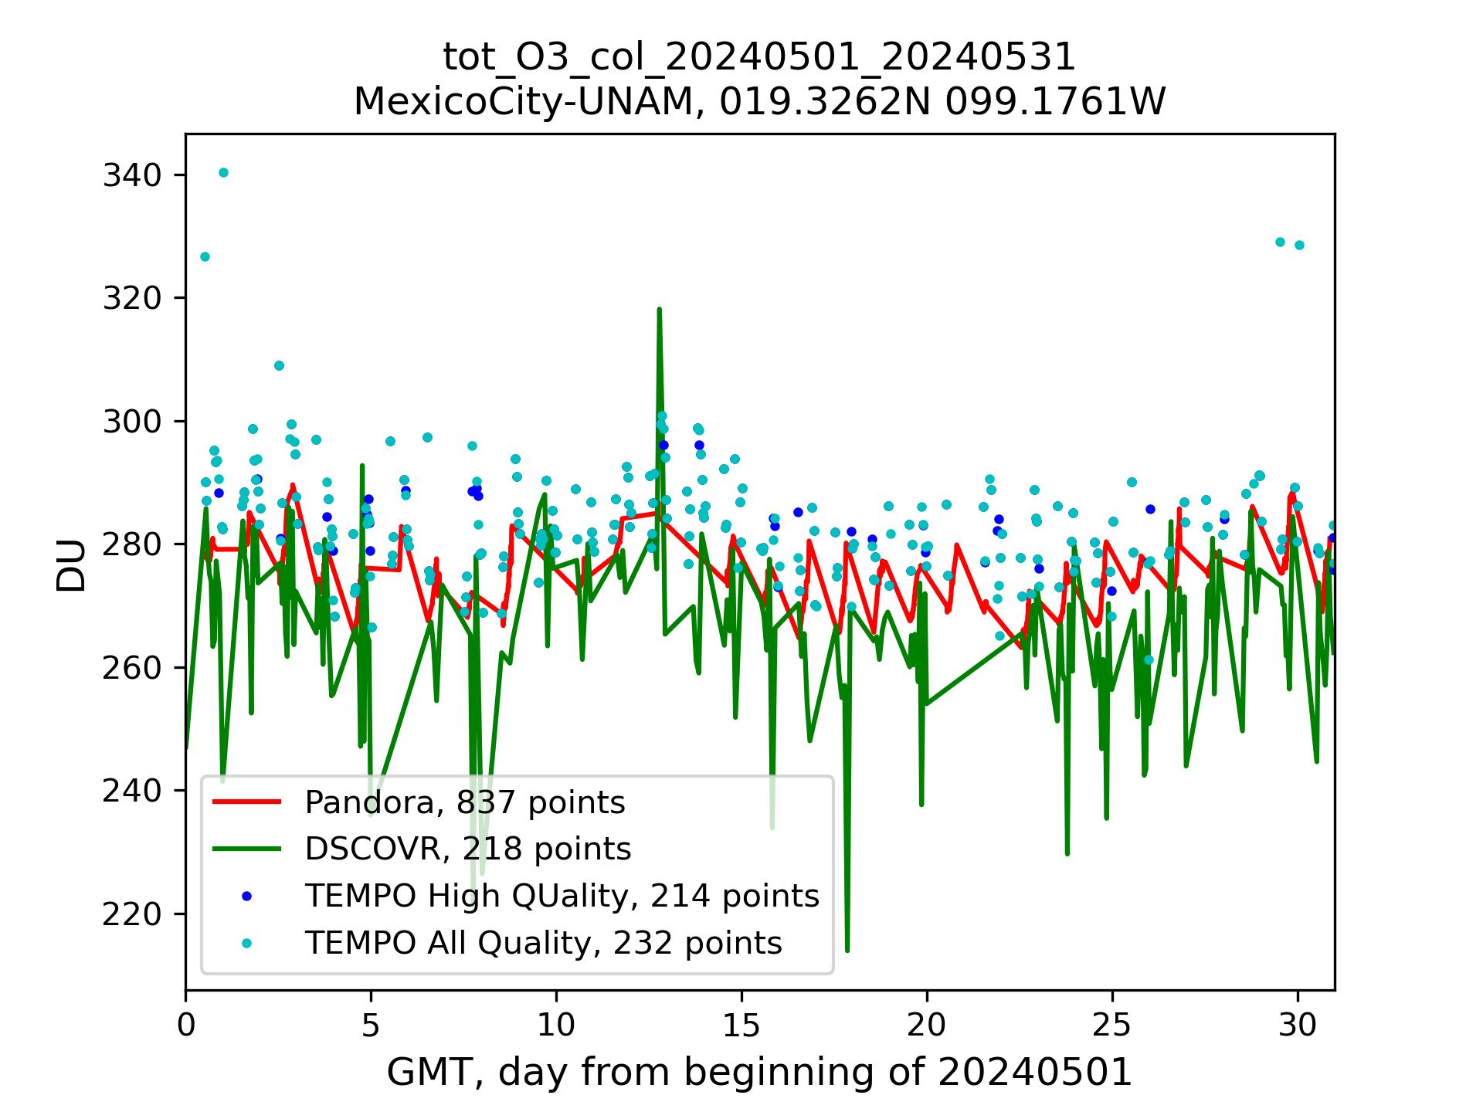
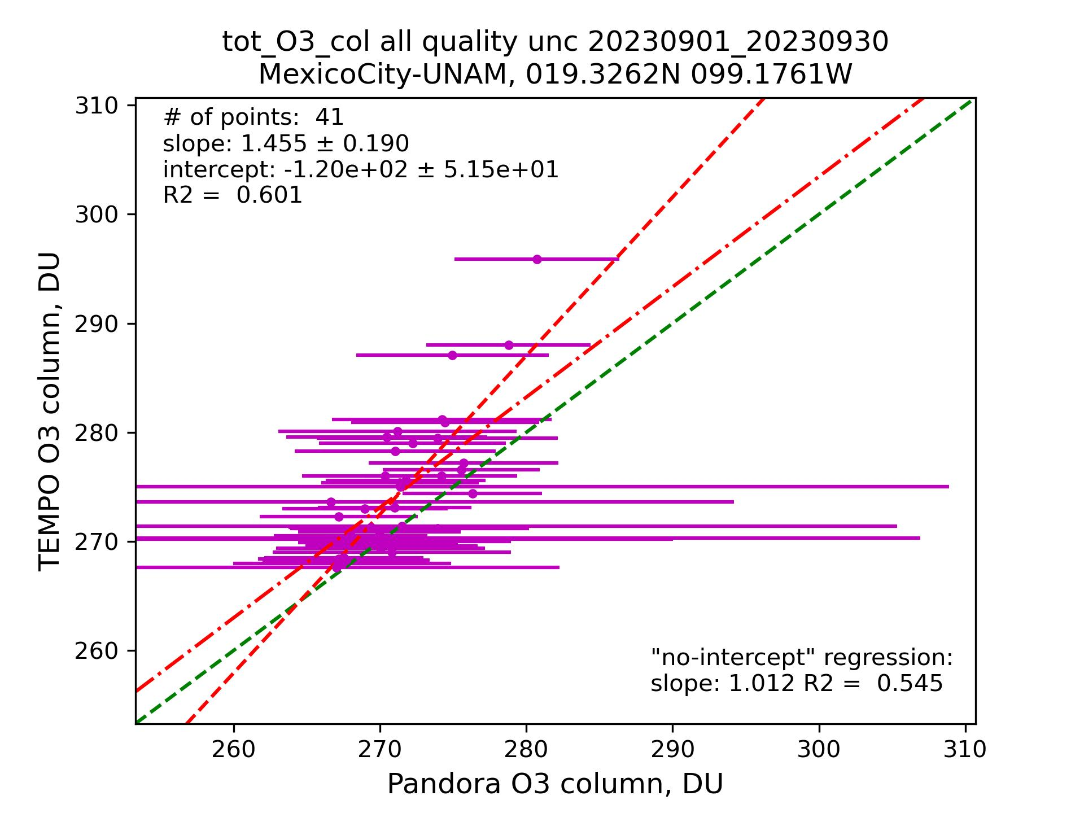
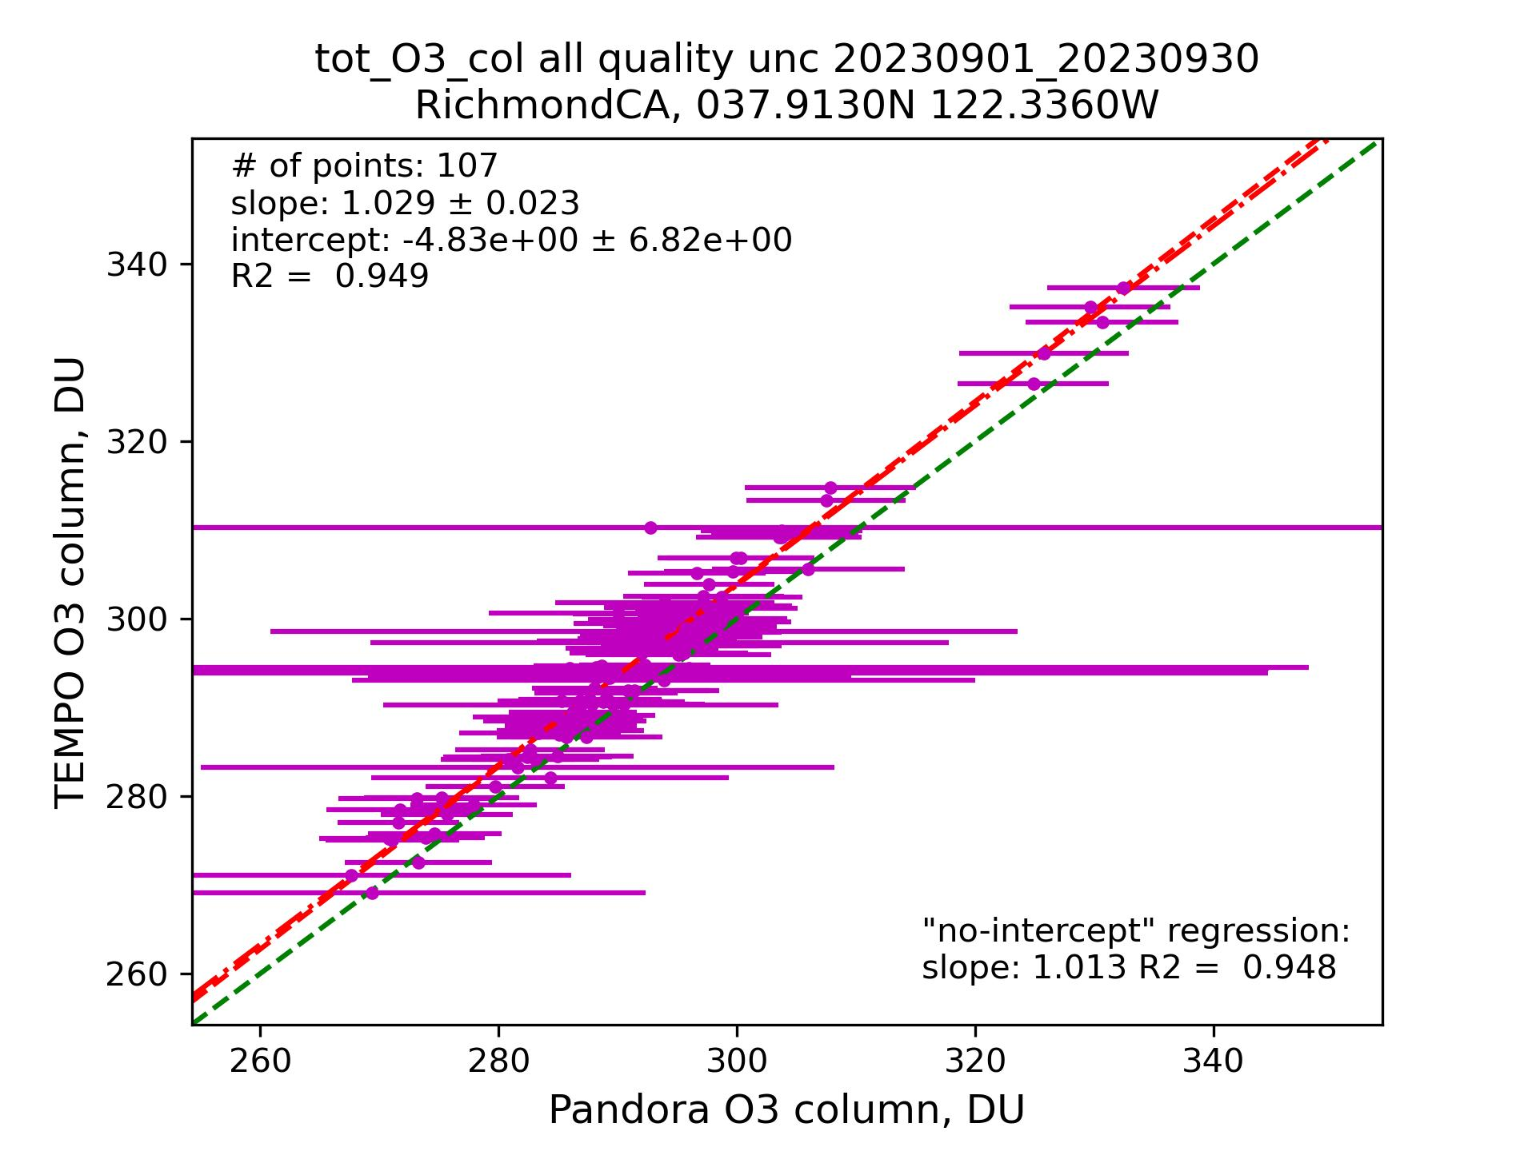
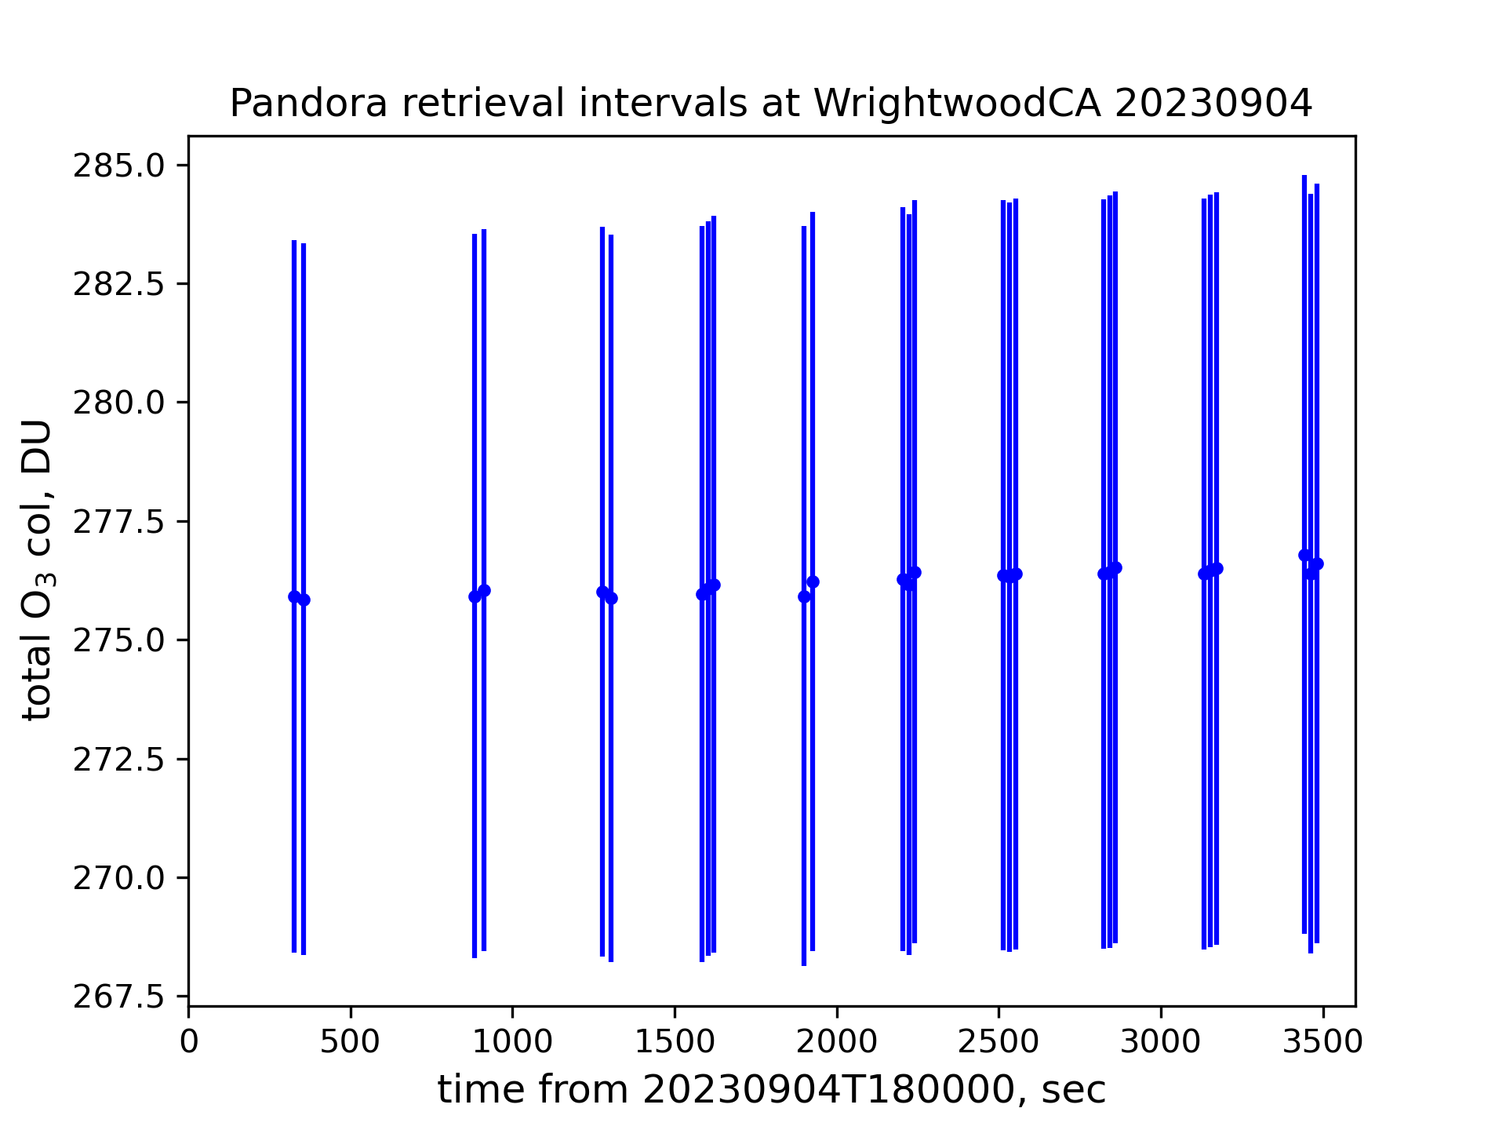
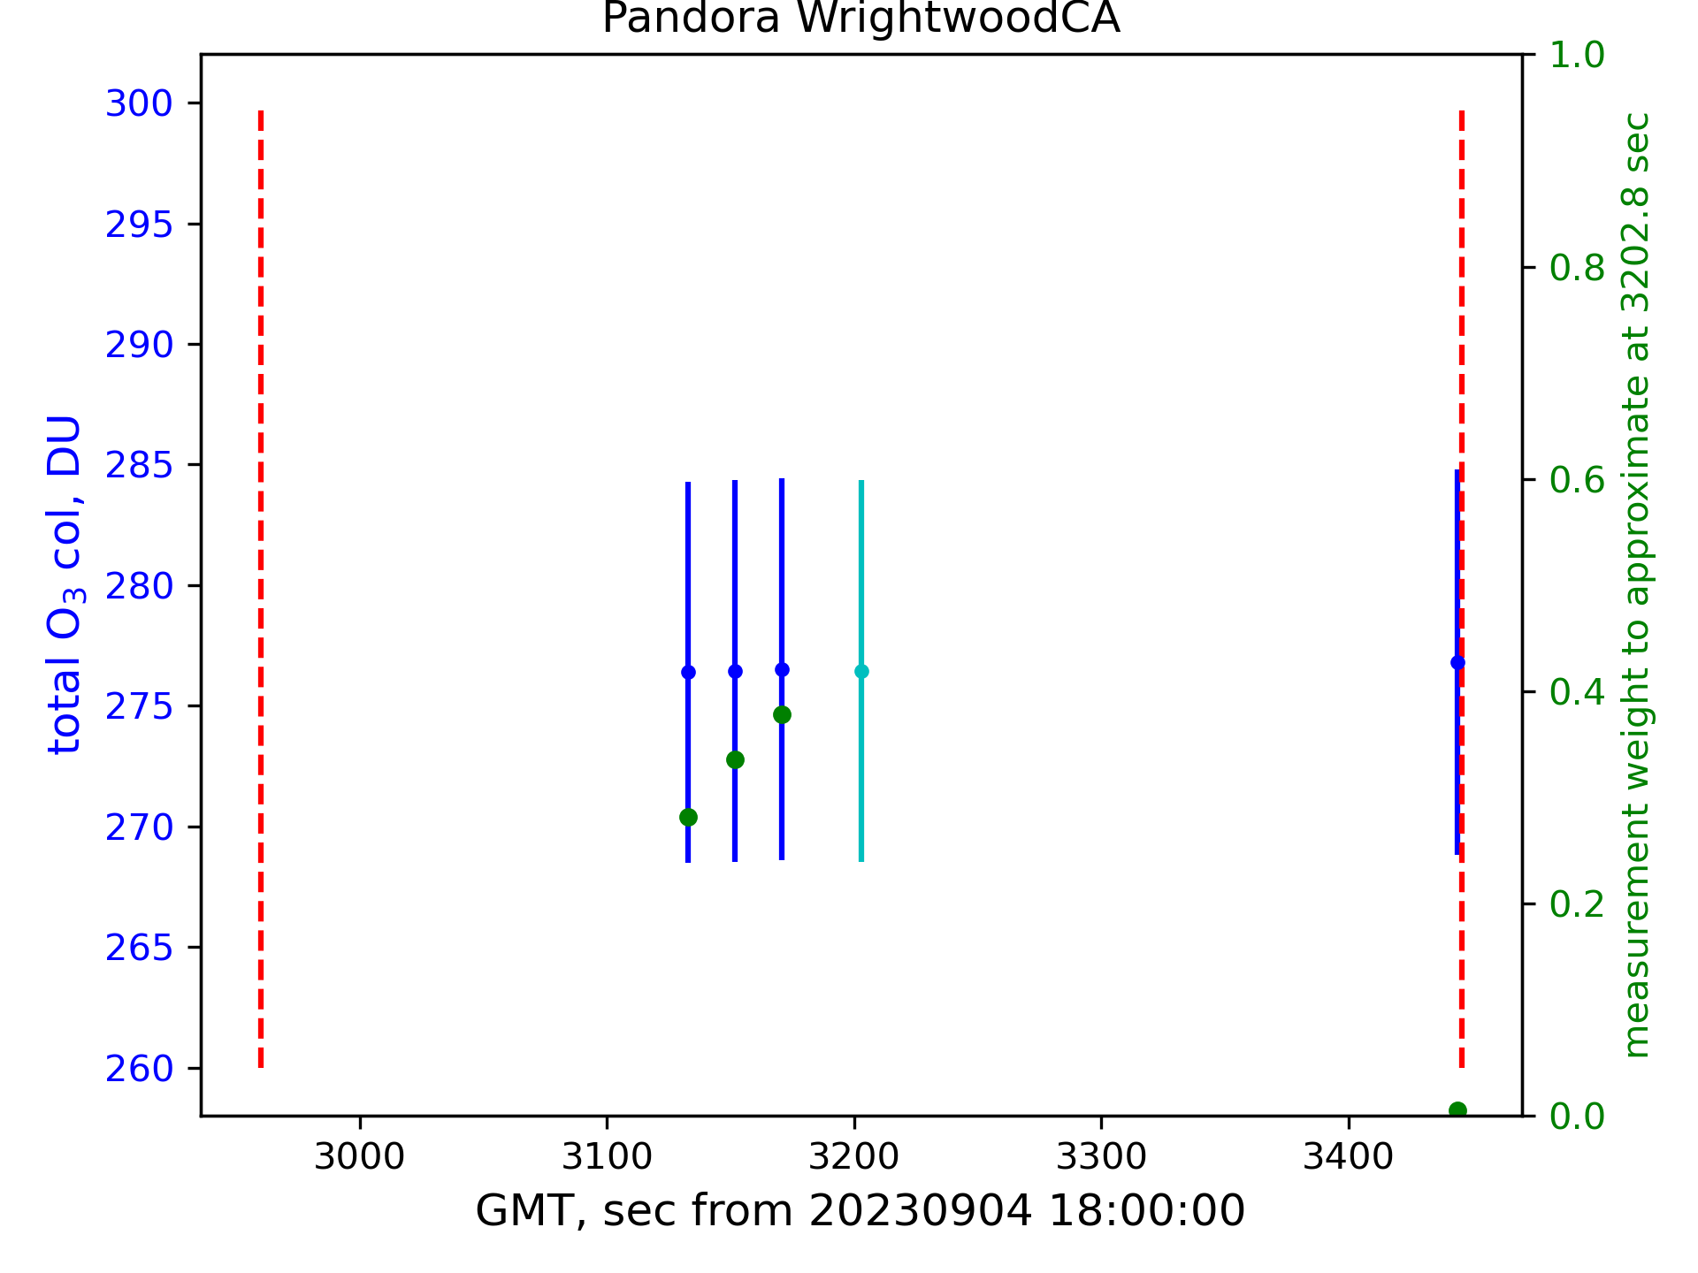
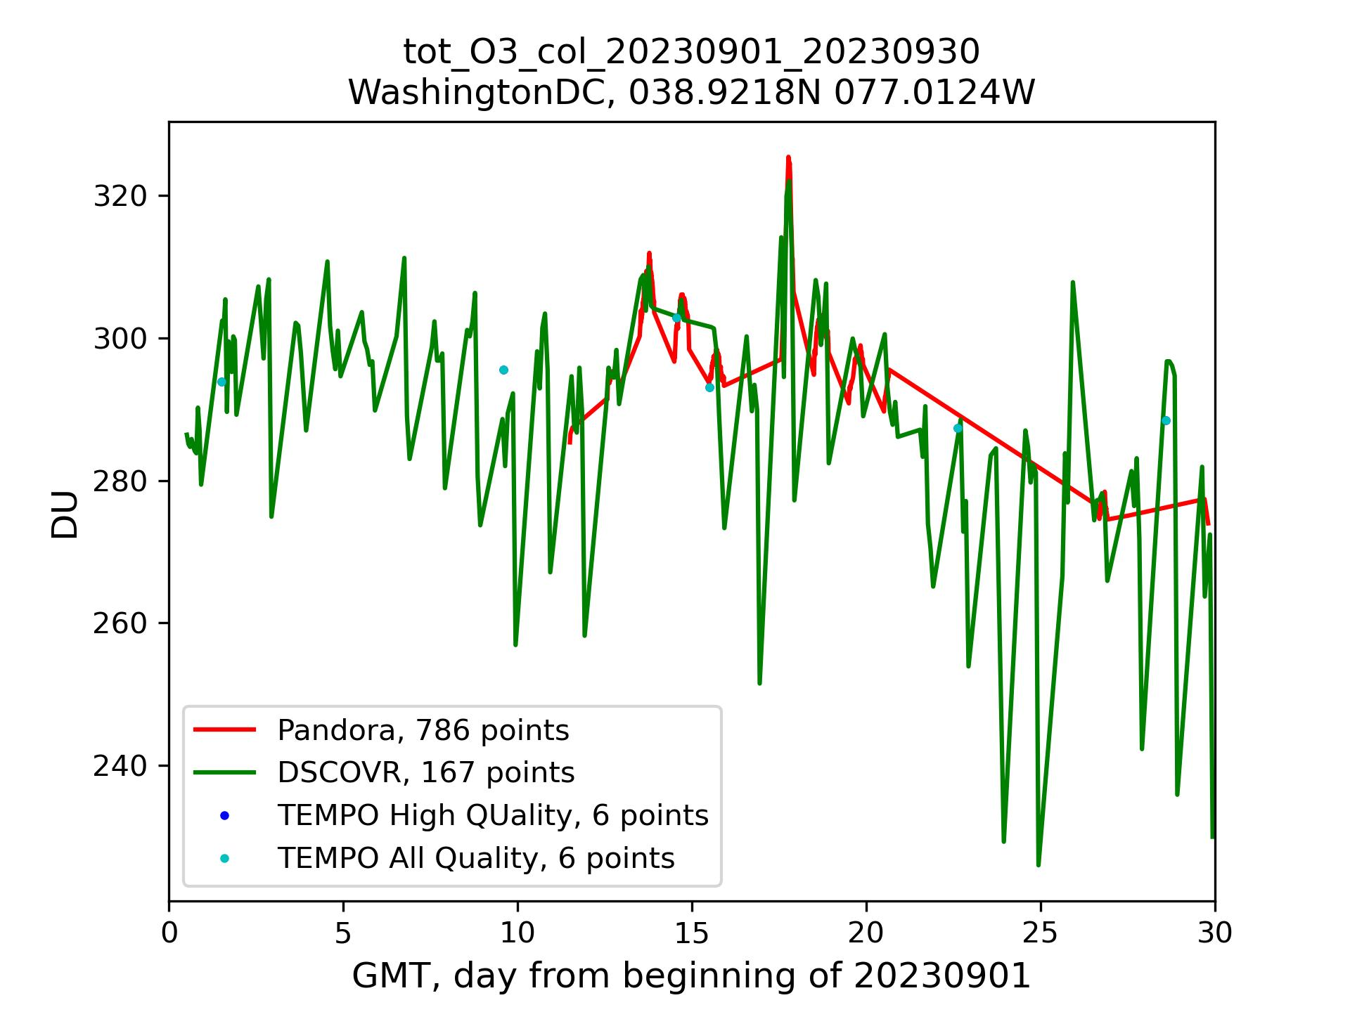
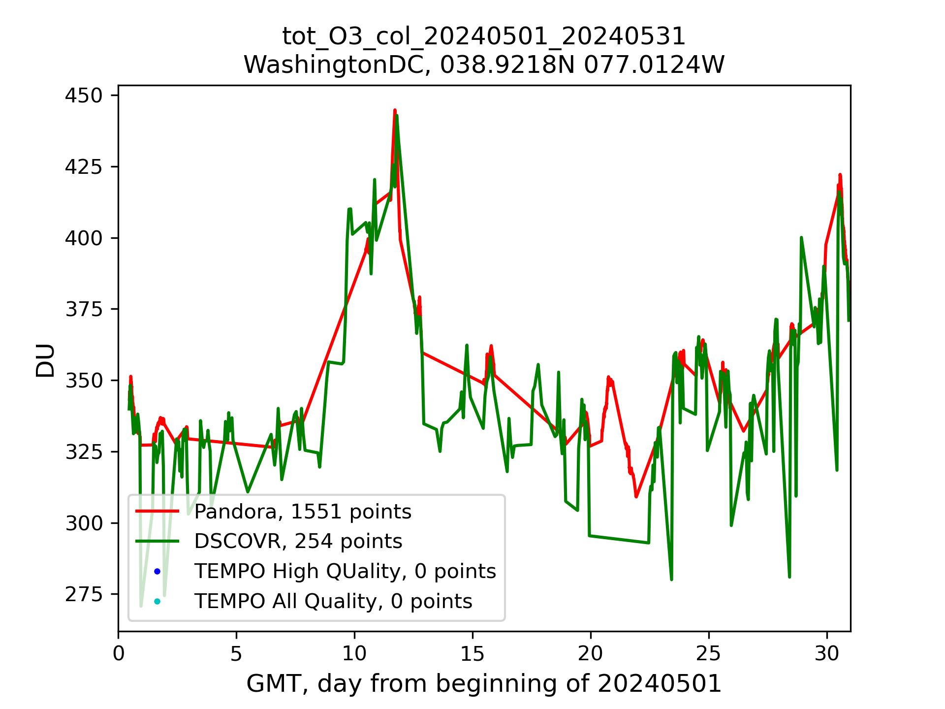
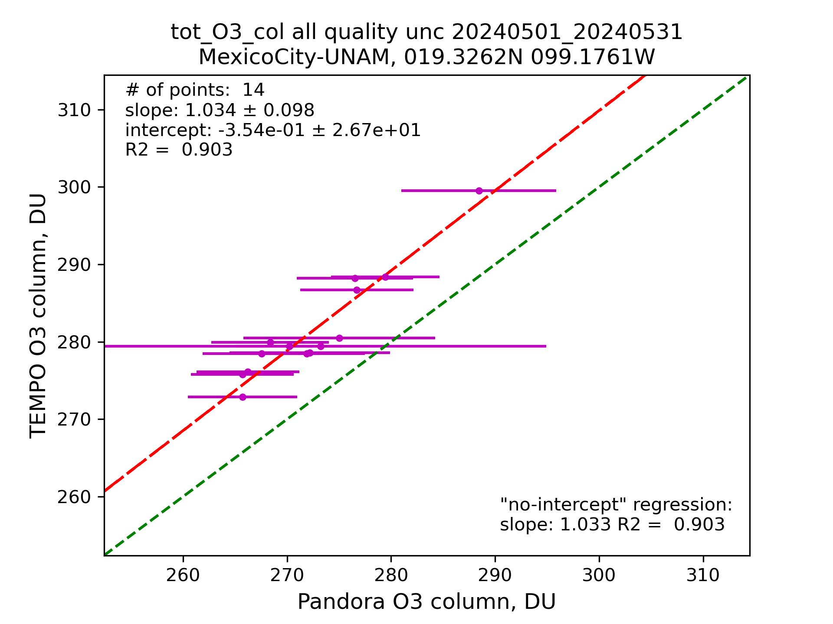
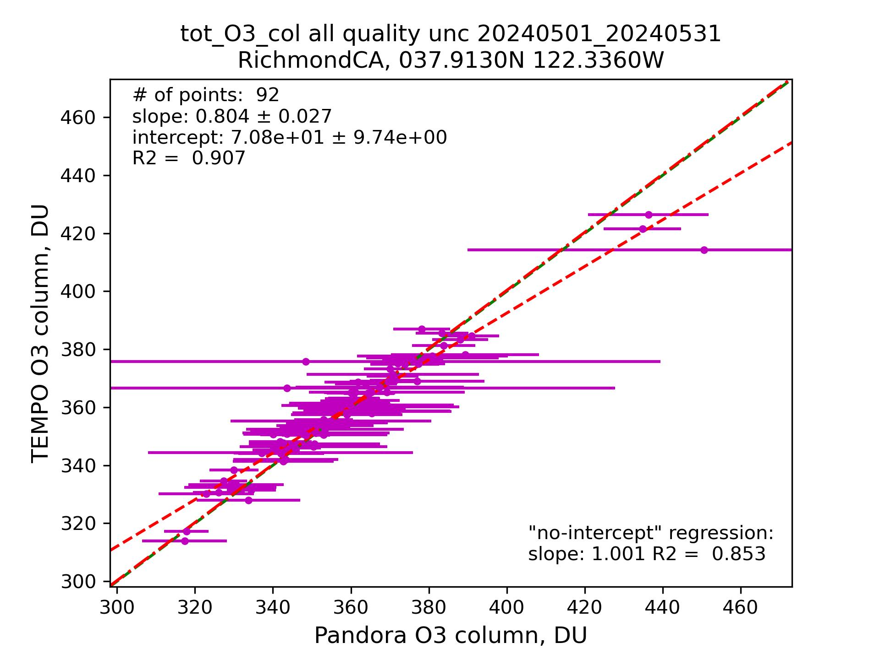
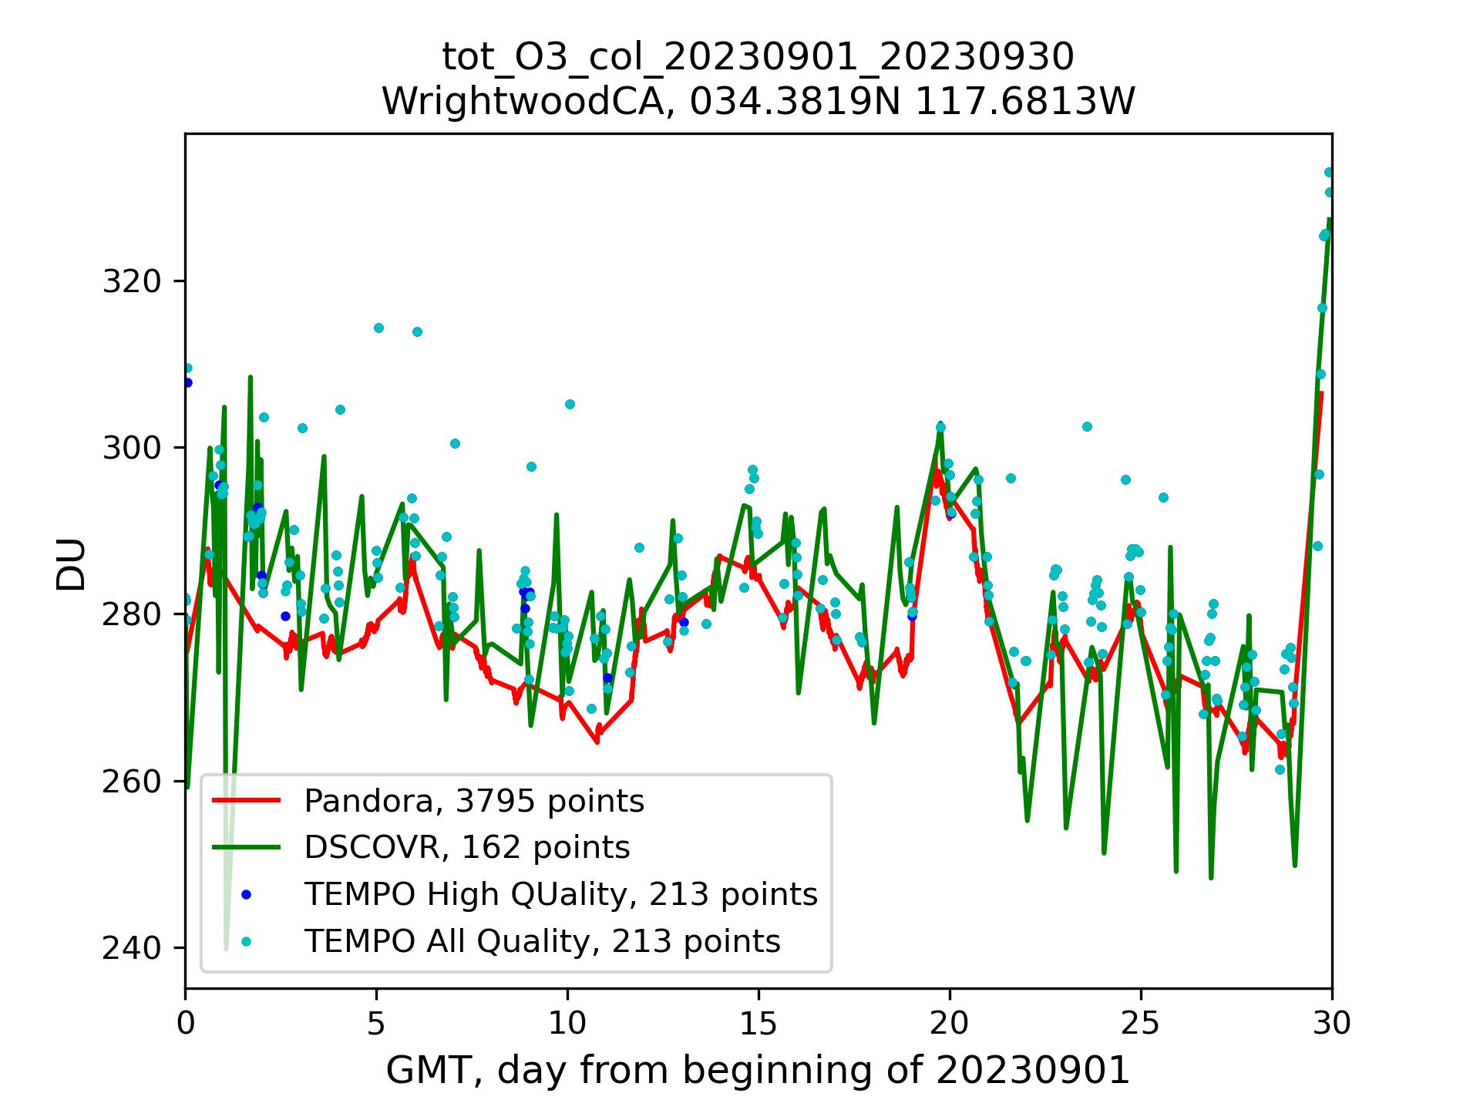
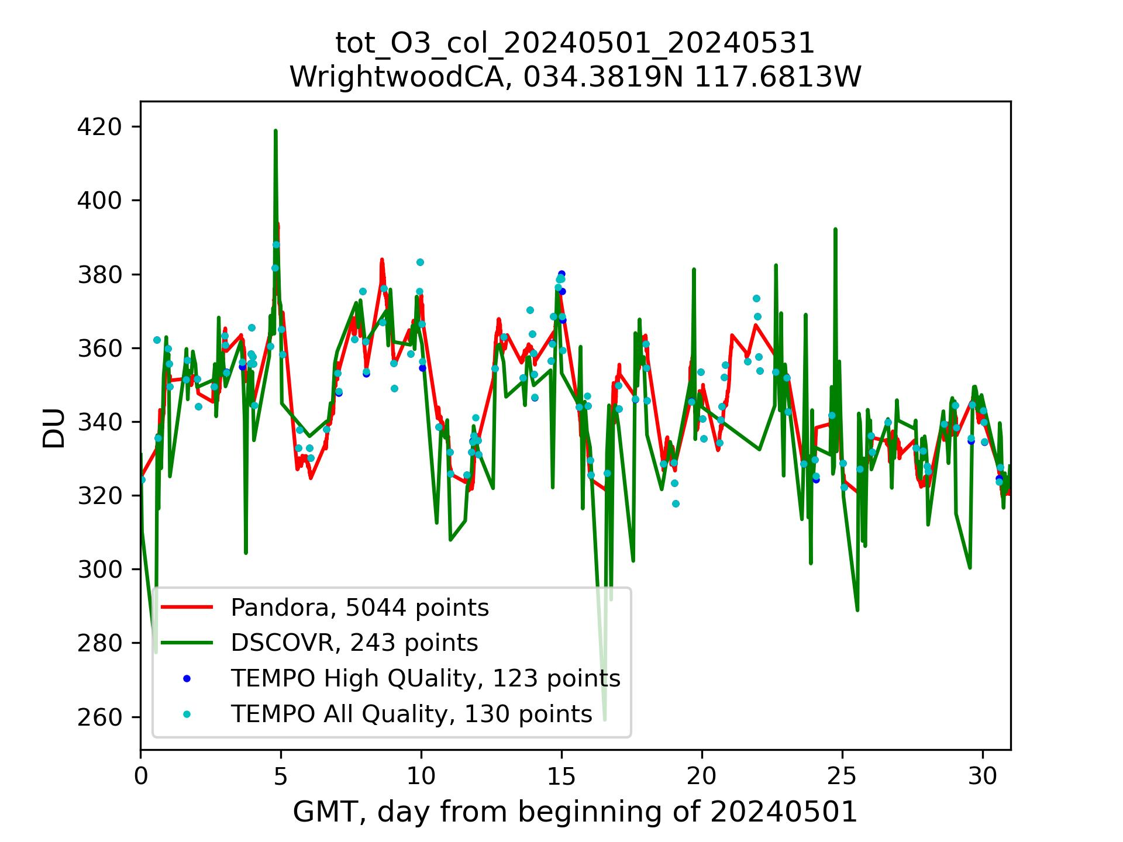
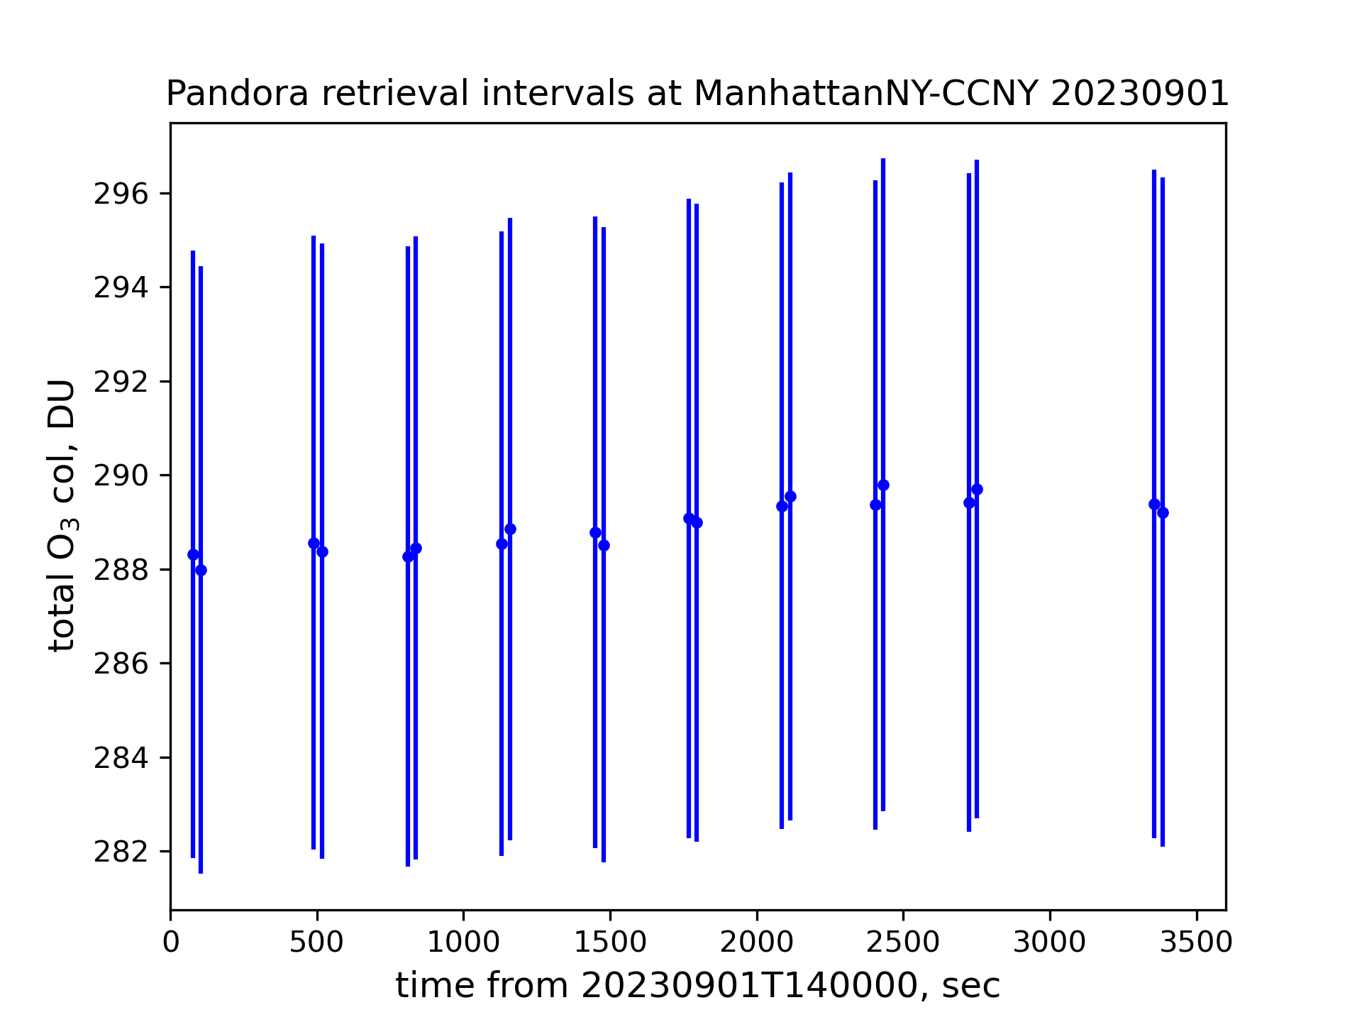
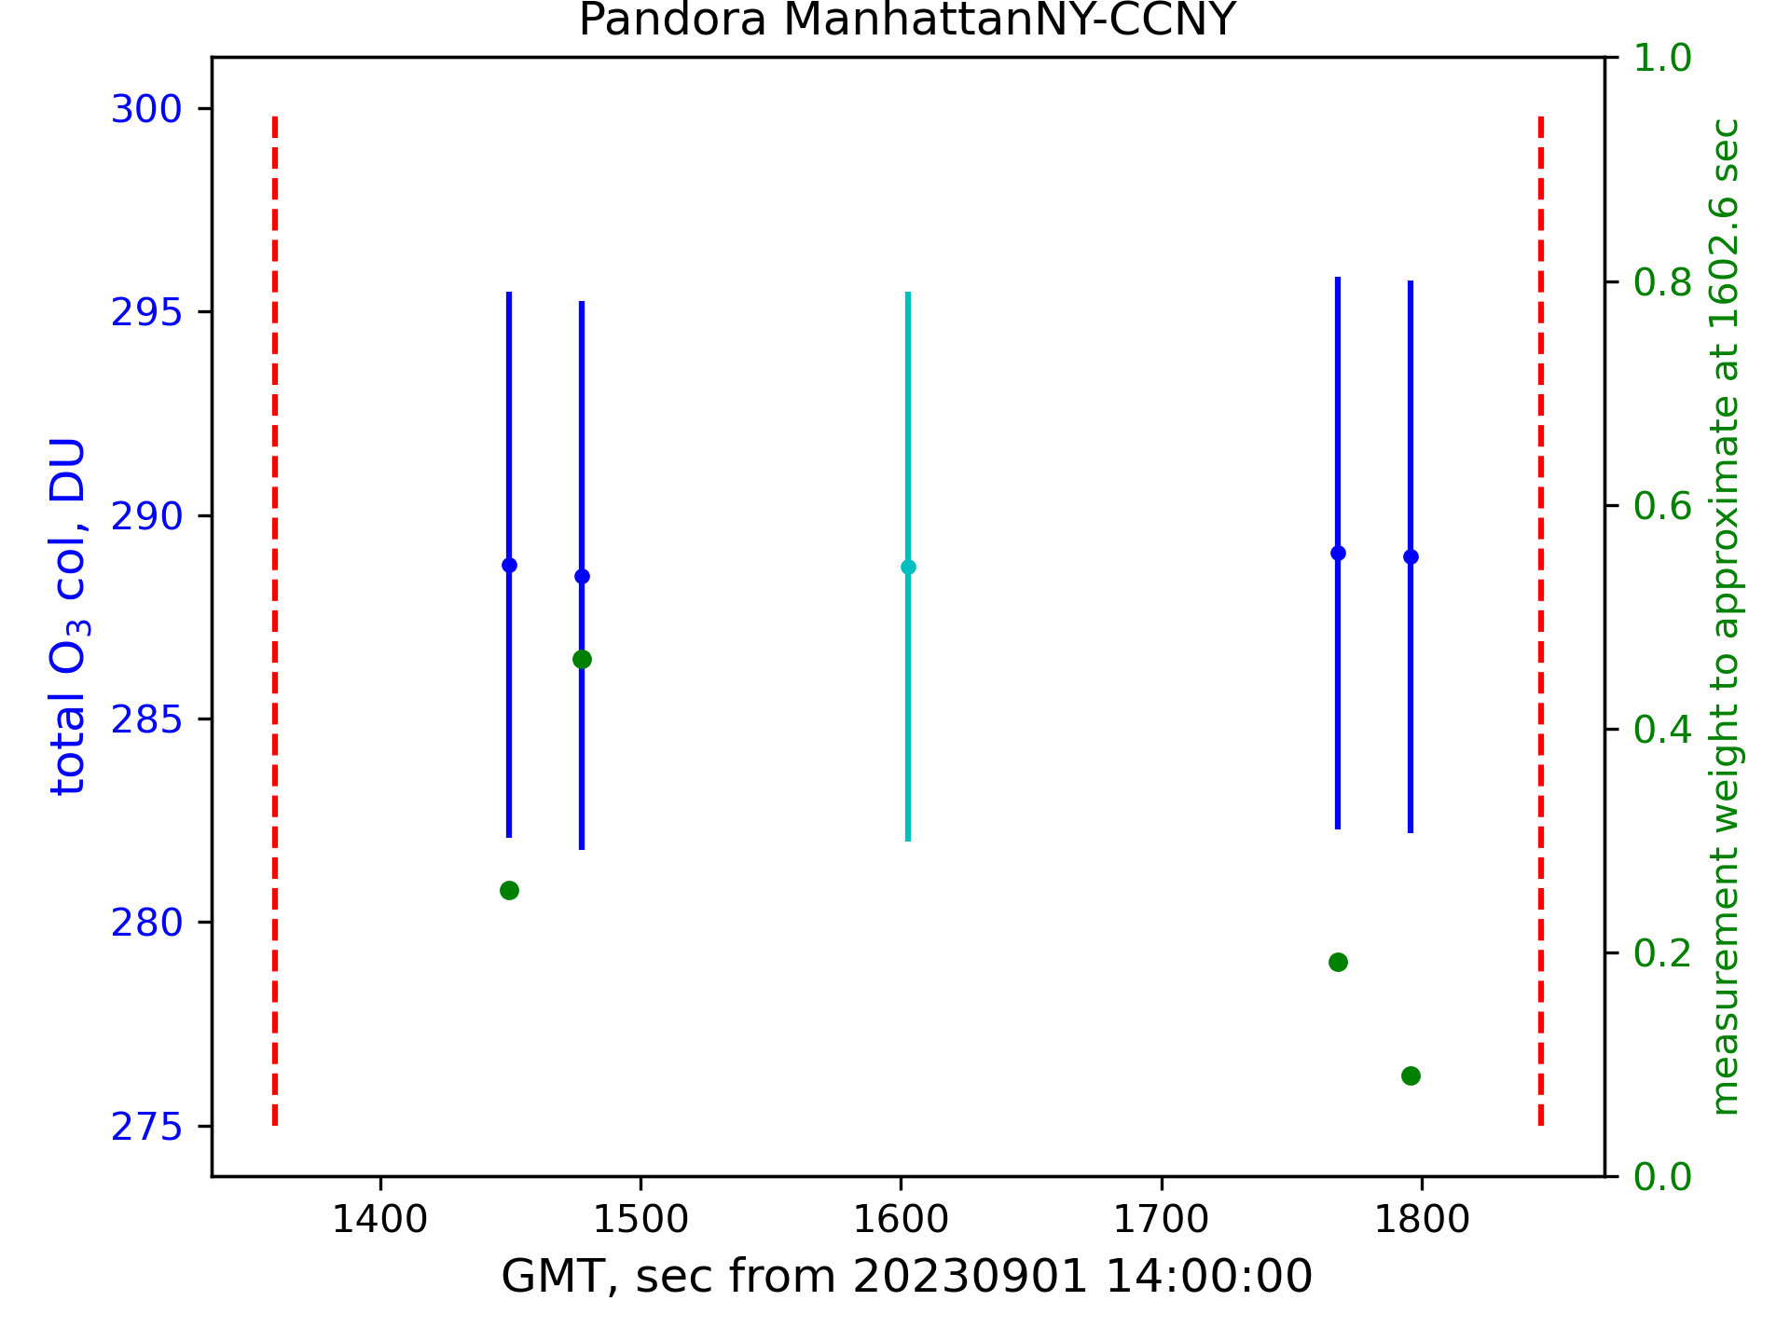
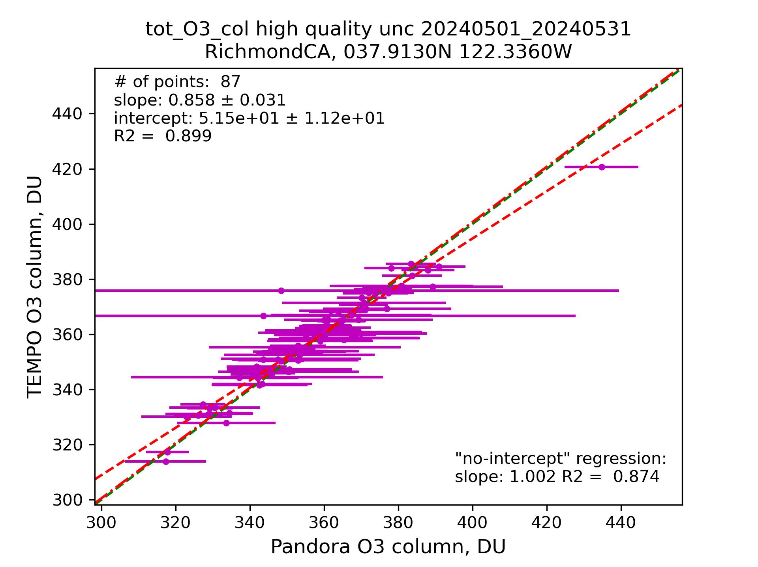
Comparison of ozone retrievals by TEMPO, DSCOVR, and Pandora – ASDC tools and results
Alexander Radkevich, Hazem Mahmoud, Daniel Kaufman
Atmospheric Science Data Center, NASA Langley Research Center
Introduction
Monitoring emissions of ozone is crucial for understanding the atmospheric composition and its impacts on air quality and climate. This study uses retrievals of ozone columns from space- and ground-based sensors with the main goals of (1) presenting programmatic tools comparing those retrievals and (2) evaluating the accuracy of retrievals by Tropospheric Emissions: Monitoring of Pollution (TEMPO) [1], a new mission with data made publicly available in May 2024 via the U.S. National Aeronautics and Space Administration’s (NASA’s) EarthData.
Instruments and data
The Tropospheric Emissions: Monitoring of Pollution (TEMPO) instrument is a grating spectrometer, sensitive to visible and ultraviolet light within spectral ranges of 290-490 nm and 540-740 nm and 0.6 nm spectral resolution. The TEMPO instrument is aboard the Earth-facing side of a commercial telecommunications satellite (Intelsat 40e) in geostationary orbit over 91˚ W longitude. This positioning allows TEMPO to maintain a continuous view of North America and TEMPO's light-collecting mirror can complete hourly east-to-west scans of the field of regard during daylight hours. High resolution measurements of radiance reflected by the Earth's back to the instrument's detectors enable retrievals of columns of ozone, nitrogen dioxide, and formaldehyde, each of which play important roles in the chemical dynamics of Earth’s atmosphere [2]. The retrieved columns are stored as Level 2 (used in this presentation) and 3 granules.
Mission objectives for TEMPO involve understanding the dynamics of air quality, pollution sources, and their impact on climate change. By providing near real-time data and comprehensive atmospheric composition measurements, TEMPO will assist scientists in studying pollution patterns, evaluating the efficacy of environmental policies, and predicting future trends in air quality.
In 2005 NASA initiated an effort at Goddard Space Flight Center (GFSC) to address this issue by starting to develop a cost-effective, compact, easy to deploy, ground-based, passive remote sensing spectrometer system capable of performing sun, moon and sky observations called “Pandora”. Pandora has continuously evolved since then with support from NASA and ESA and has been manufactured by SciGlob LLC, Elkridge, MD, USA since 2010. Soon Pandoras were distributed around the globe to form a validation network. In 2013 ESA joined NASA in funding this development through prime contractor LuftBlick OG, Innsbruck, Austria. Since 2018, this network is called “Pandonia Global Network” (PGN) and endeavors to ensure systematic processing and dissemination of the data to the greater global community in support of air quality monitoring and satellite validation. The PGN is carried out jointly by NASA and ESA as part of their “Joint Program Planning Group Subgroup” on calibration and validation and field activities [3]. Among other products, Pandora data include retrievals of ozone total columns. This study uses Level 2 versions of this data product.
The Deep Space Climate Observatory (DSCOVR) is a spacecraft which orbits between Earth and the sun around the neutral gravity point (Lagrange point 1) between the Earth and Sun, approximately one million miles from Earth. It was launched in February 2015 and carries, among other instruments, Earth Polychromatic Imaging Camera (EPIC). Due to DSCOVR’s unique position, always facing the Earth’s Sun-lit side, EPIC measures radiance reflected by the Earth. These measurements allows for retrievals of multiple atmospheric, ocean, and biosphere parameters including total and tropospheric ozone columns. L2 O₃ total product is used in this study.
Temporal features of Pandora retrievals
Temporal resolution of TEMPO varies with the rate of scanning, e.g., there are granules with timestamps 20230827T214434Z_S028G01and 20230827T215527Z_S029G01 covering the same part of North America within 11 minutes; however, nominal temporal resolution is 1 hour, e.g., granules 20240827T202615Z_S011G08 and 20240827T212615Z_S012G08 also cover the same area. DSCOVR EPIC frequency of observations also varies around the mean of 16 global granules per day. From Pandora, there may be tens of measurements per hour. The frequency of measurements depends on the product. Left panels of Fig. 1 show ozone measurements within an hour interval.
While direct comparison of non-simultaneous measurements from TEMPO and DSCOVR EPIC on one side and Pandora on the other side gives some qualitative understanding of their differences, it is highly desirable to bring them to the same times in a plausibly realistic way accounting for the volatile nature of the ozone columns. This study proposes the use of “running window” averages with Gaussian-like weights as described in Eq. (1):
, (1)
where sums are taken over Pandora times of measurements t_{m} within δt_{max} from the target time of interest t. The temporal features of Pandora retrievals are accounted by selection of product-dependent values of σ and δt_{max}. Right panels of Fig. 1 show examples of weights for actual Pandora measurements and hypothetical times of observations from satellites.
Co-locating Pandora stations satellite pixels
Ozone columns retrieved from satellite observations vary between neighboring pixels, see Table 1. For this reason, instead of using a Pandora station’s nearest neighbor, this study uses two different approaches for interpolating DSCOVR EPIC and TEMPO retrievals to Pandora locations. While interpolation of TEMPO data always uses 4 pixels surrounding Pandora station (point of interest, POI), interpolation of EPIC data involves pixels whose latitudes and longitudes deviates from the station within a certain margin (0.1° in this study), see Fig. 2.
Python notebooks’ structure and output
ASDC has created python notebooks [4] comparing O₃ total columns from corresponding TEMPO and DSCOVR EPIC products against Pandora retrievals. Besides importing necessary libraries and setting up access to NASA’s EarthData, the notebooks perform the following steps:
List of available Pandora stations is created, user is prompted to select one of them;
Appropriate Pandora data product is downloaded;
User is prompted to enter a timeframe of interest;
Pandora data file is read within the timeframe to form timeseries of columnar retrievals with quality flag (QF) of 0 (high quality). However, certain other QFs are also OK. Therefore, two timeseries are derived from TEMPO data – high quality only and acceptable quality. See the User Guide [5] for recommendations on the use of QFs;
Appropriate TEMPO and DSCOVR EPIC granules falling into the timeframe and covering Pandora location are found and downloaded by means of earthaccess library;
DSCOVR EPIC granule for pixels in the vicinity of the POI as described in the previous section;
The TEMPO granules are scanned for pixels surrounding the Pandora station, see Fig. 2, retrievals from those pixels are averaged with accounting for the quality flags (retrievals from low and bad quality pixels are discarded); the results of this and the previous steps are written into ASCII files to facilitate quality control;
Timeseries from all three instruments are plotted and saved;
Pandora retrieved columns are averaged to the TEMPO and DSCOVR EPIC times of observation;
Scatter plots showing Pandora vs TEMPO and Pandora vs DSCOVR EPIC along with a regression analysis are created.
Conclusion
Python notebook enabling interactive comparison of TEMPO, DSCOVR EPIC, and Pandora ozone columns retrievals was created and made available via the NASA Atmospheric Science Data Center (ASDC) GitHub page.
Results of this study show reasonable match between ozone total columns retrieved by both satellite sensors and Pandora. However, low coefficient of determination and significant intercept of general linear regression point to considerable discrepancy between retrievals by satellite and ground-based instruments. With respect to comparison against Pandora, DSCOVR EPIC and TEMPO data are of comparable quality. Site-dependent difference between satellite and ground-based retrievals may indicate to a problems with certain Pandora stations, e.g., MexicoCity-UNAM. Too few TEMPO retrievals over the East coast Pandora stations indicate to a problem with QF assignment algorithm. The use of all acceptable QFs in TEMPO data in addition to high quality QF does not lead to statistically different results.
References
https://tempo.si.edu/overview.html
https://asdc.larc.nasa.gov/project/TEMPO
Results: Timeseries
https://www.pandonia-global-network.org/home/about/about-pgn/
https://eospso.nasa.gov/missions/deep-space-climate-observatory
https://epic.gsfc.nasa.gov
https://github.com/nasa/ASDC_Data_and_User_Services/tree/main/TEMPO/L2_validation_codes
https://asdc.larc.nasa.gov/documents/tempo/guide/TEMPO_Level-2-3_O3TOT_user_guide_V1.0.pdf
Results: DSCOVR EPIC vs Pandora
Results: TEMPO vs Pandora
$$\begin{matrix}x_{int}\left(t\right)= \sum{x\left(t_{m}\right)w\left(t_{m}, t\right)}, & w\left(t_{m}, t\right)=\exp\left[−\frac{{\left(t −t_{m}\right)}^{2}}{2σ^{2}}\right]{\left(\sum{\exp\left[−\frac{{\left(t −t_{m}\right)}^{2}}{2σ^{2}}\right]}\right)}^{−1}, & \left|t −t_{m}\right|≤{δt}_{max}\end{matrix}$$
Table 1. Satellite surrounding Pandora RichmondCA. Bottom row – interpolation to POI.
Pandora measurement at 20240504T233811 - 465.1 ± 8.7 DU.
a) DSCOVR EPIC granule dated 20240504234026
b) TEMPO granule dated 20240504T235508Z_S016G06
latitude, deg N | Longitude, deg W | O3 col, DU
37.976074 | 122.387695 | 485.1
37.946777 | 122.255859 | 478.8
37.880859 | 122.343750 | 468.3
37.814941 | 122.431641 | 482.6
37.913 | 122.336 | 473.7
Latitude, deg N | Longitude, deg W | O3 col, DU | QF
37.915337 | 122.326065 | 458.4 | 0
37.895069 | 122.314812 | 453.7 | 0
37.919922 | 122.397499 | 458.7 | 0
37.899590 | 122.386131 | 457.9 | 5
37.913 | 122.336 | 456.9 | n/a
Figure 4. Scatter plots of total O₃ columns retrieved by DSCOVR EPIC and Pandora. Green dashed line – 1:1 reference, red dash-dot line – “no-intercept” regression, red dashed line – general form linear regression.
Figure 2. Spatial extents of TEMPO L2 pixels (quadrilateral of their centers, blue, containing the POI, red) and centers of DSCOVR EPIC pixels, green, within 0.1° deviation from the POI.
Figure 4. Timeseries of total O₃ columns retrieved by TEMPO, DSCOVR EPIC, and Pandora for September 2023 (left) and May 2024 (right). Encircled plots indicate occasions of too few or no TEMPO observations.
Figure 1. Hourly timeseries of Pandora gas columns (a) and (e) and their parts (b) – (d) and (f) used to compute average column at a random time of interest (cyan), see Eq. (1) with σ = 81 s and δt_{max} = 243 s.
Figure 5. Scatter plots of total O₃ columns retrieved by TEMPO and Pandora. Green dashed line – 1:1 reference, red dash-dot line – “no-intercept” regression, red dashed line – general form linear regression. Plots highlighted in yellow are for all acceptable QFs, highlighted in green – only high quality QFs.
American Geophysical Union Fall Meeting | December 12, 2024

