Slide 1
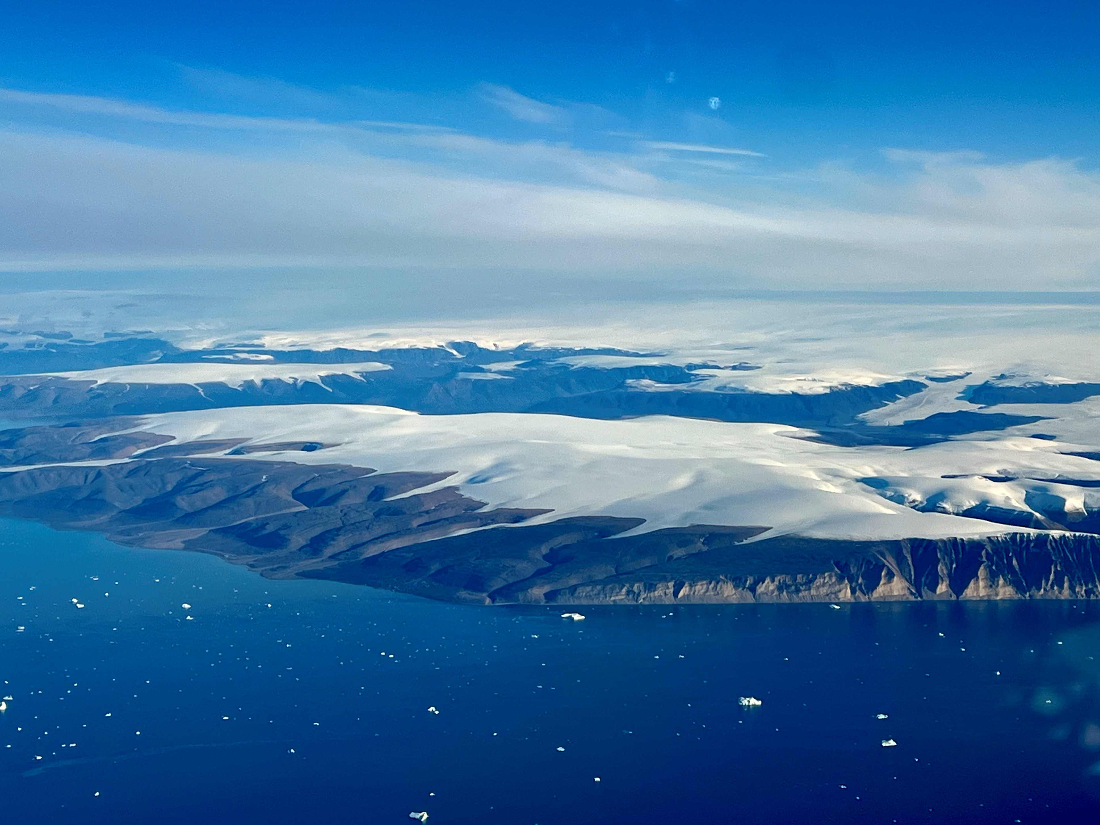



ARCSIX + future data analysis
Eva-Lou Edwards
QuIESCENT Arctic Workshop
October 23, 2024
M. Ottaviani
RF19
15 Aug 2024

Slide 2
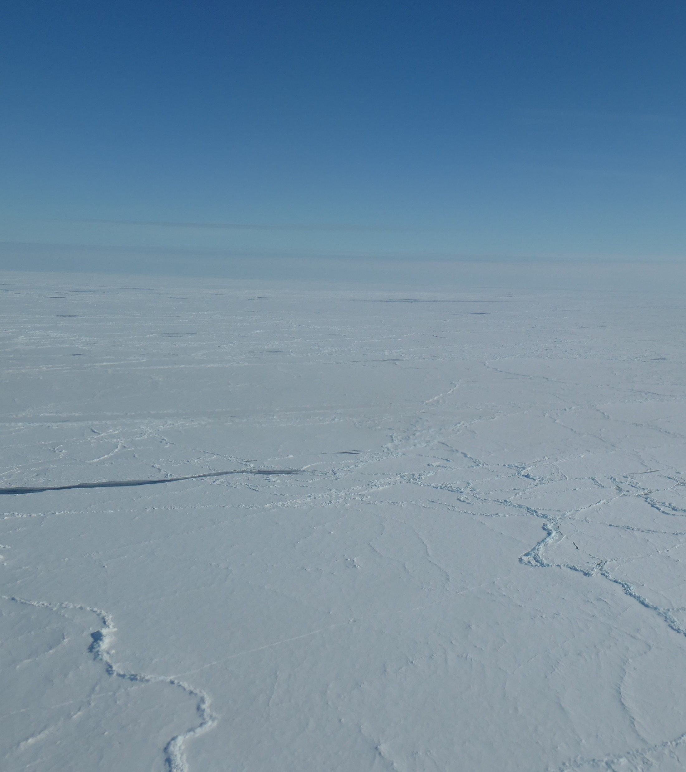
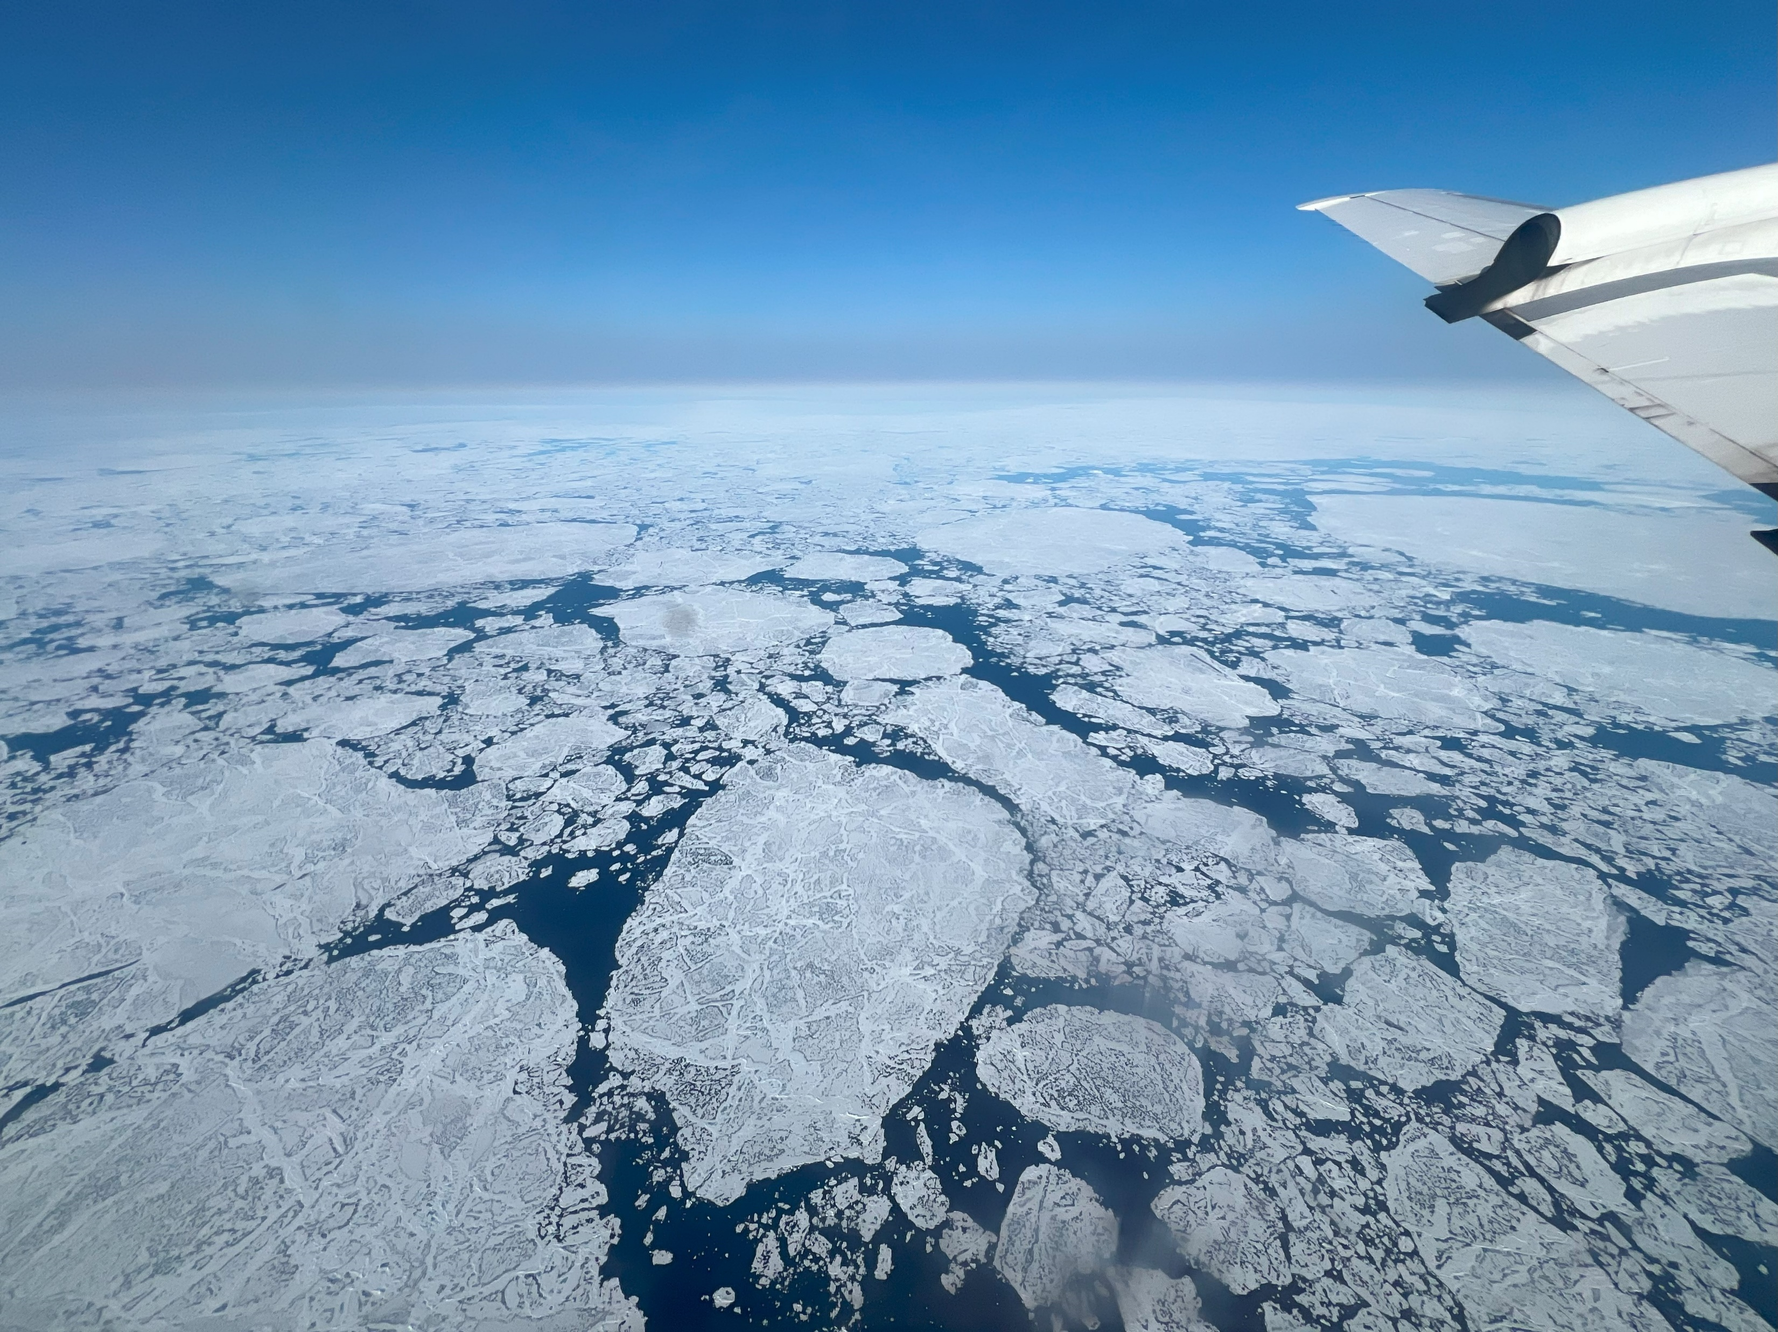
ARCSIX
Arctic Radiation-Cloud-Aerosol-Surface Interaction eXperiment
Deployment 1
May 24 – Jun 17 2024
Deployment 2
Jul 22 – Aug 16 2024
P. Zuidema
RF01
28 May 2024
M. Ottaviani
RF19
15 Aug 2024

Slide 3
Deployment 1
May 24 – Jun 17 2024
Deployment 2
Jul 22 – Aug 16 2024
“Quantify the contributions of surface properties, clouds, aerosol particles, and precipitation to the Arctic summer surface radiation budget and sea ice melt.”
P. Zuidema
RF01
28 May 2024
M. Ottaviani
RF19
15 Aug 2024

Slide 4
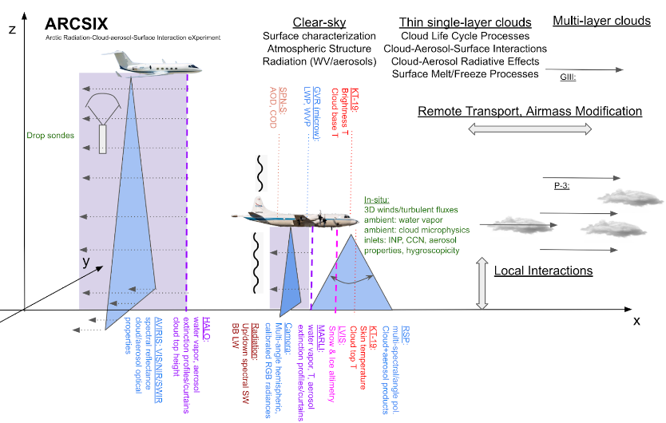
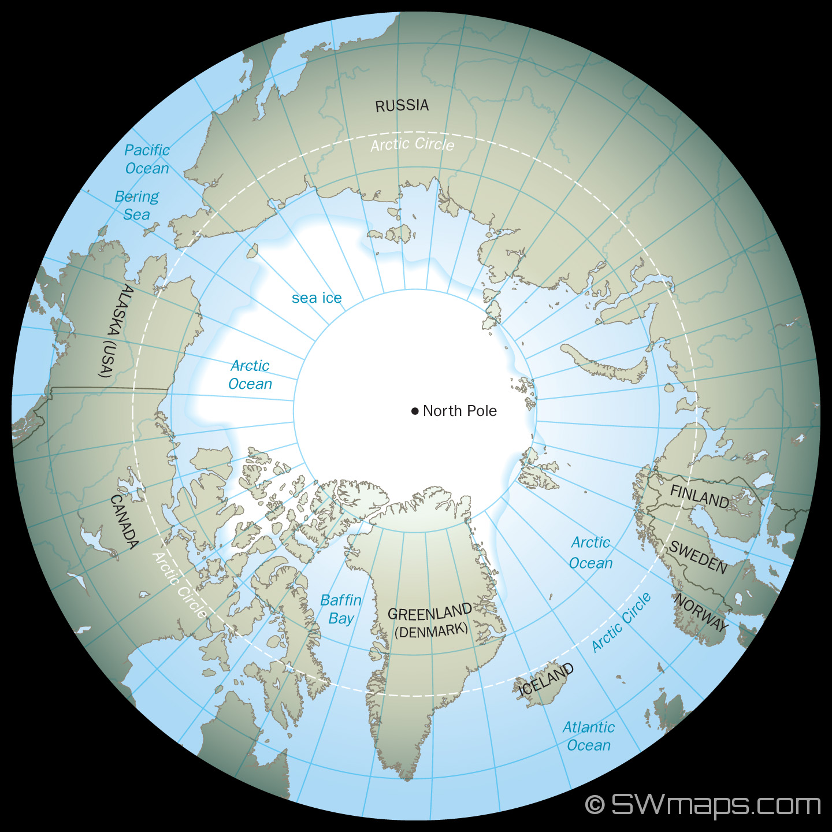
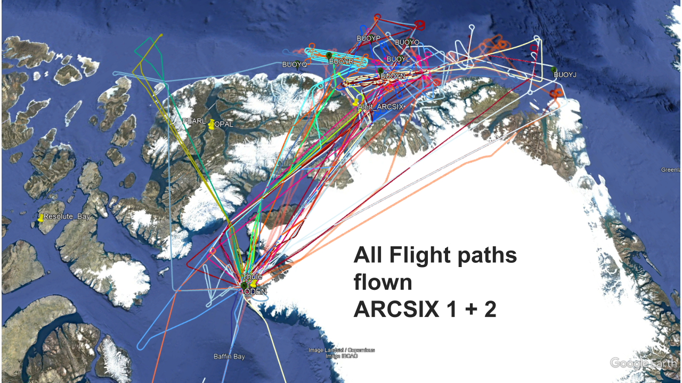
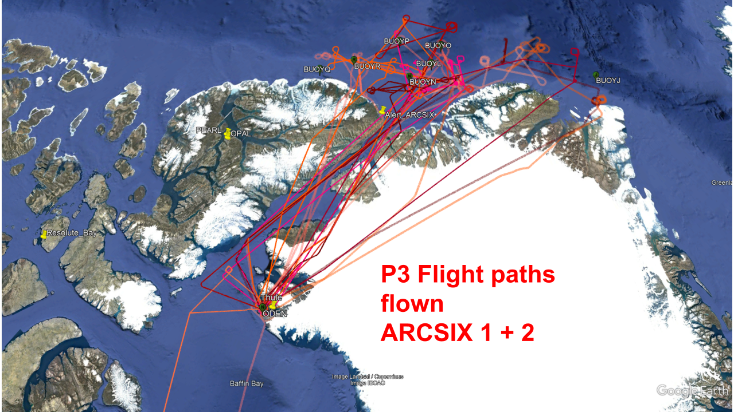
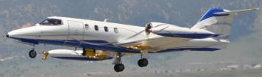
NASA Gulfstream III
NASA P-3
S. LeBlanc
S. Schmidt
19 RFs
~150 hours
SPEC Inc. Lear Jet
S. LeBlanc
NASA

Slide 5
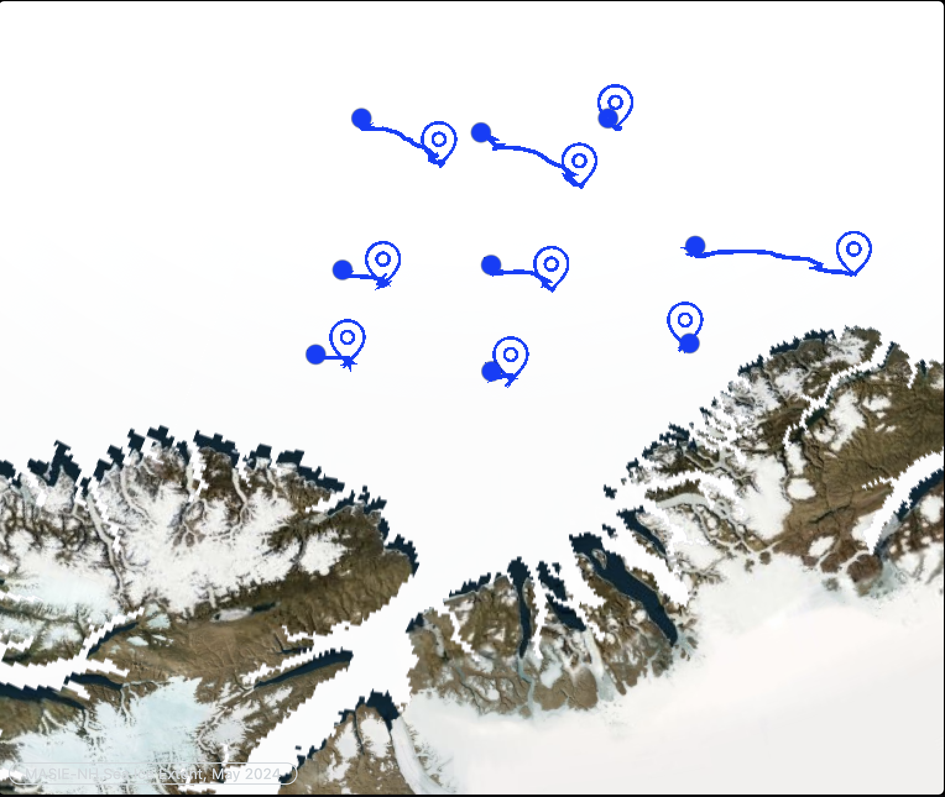
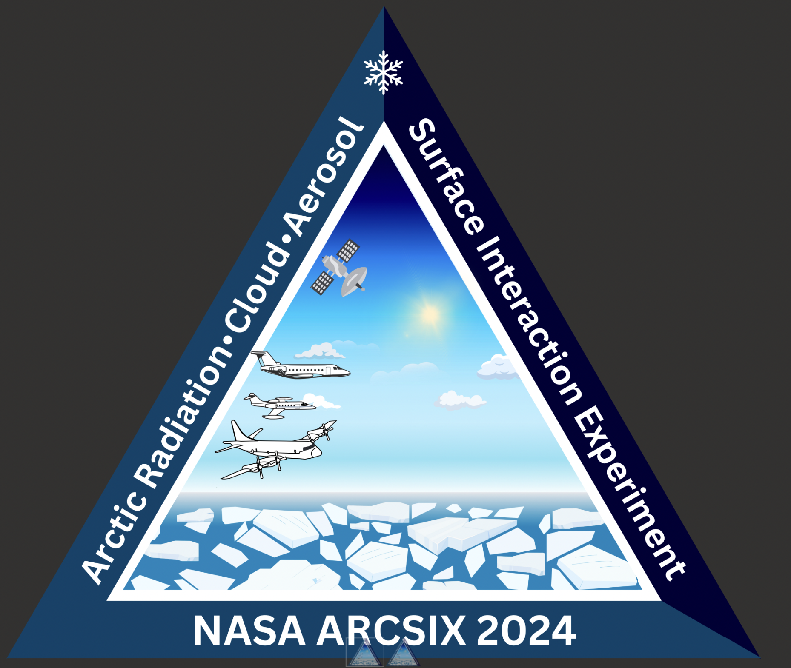
On the ground intelligence: Sea ice mass balance buoys
Data:
Sea ice thickness
Snow depth
Sunlight
Air temperature
Sea ice temperature profile
Slide from P. Taylor

Slide 6
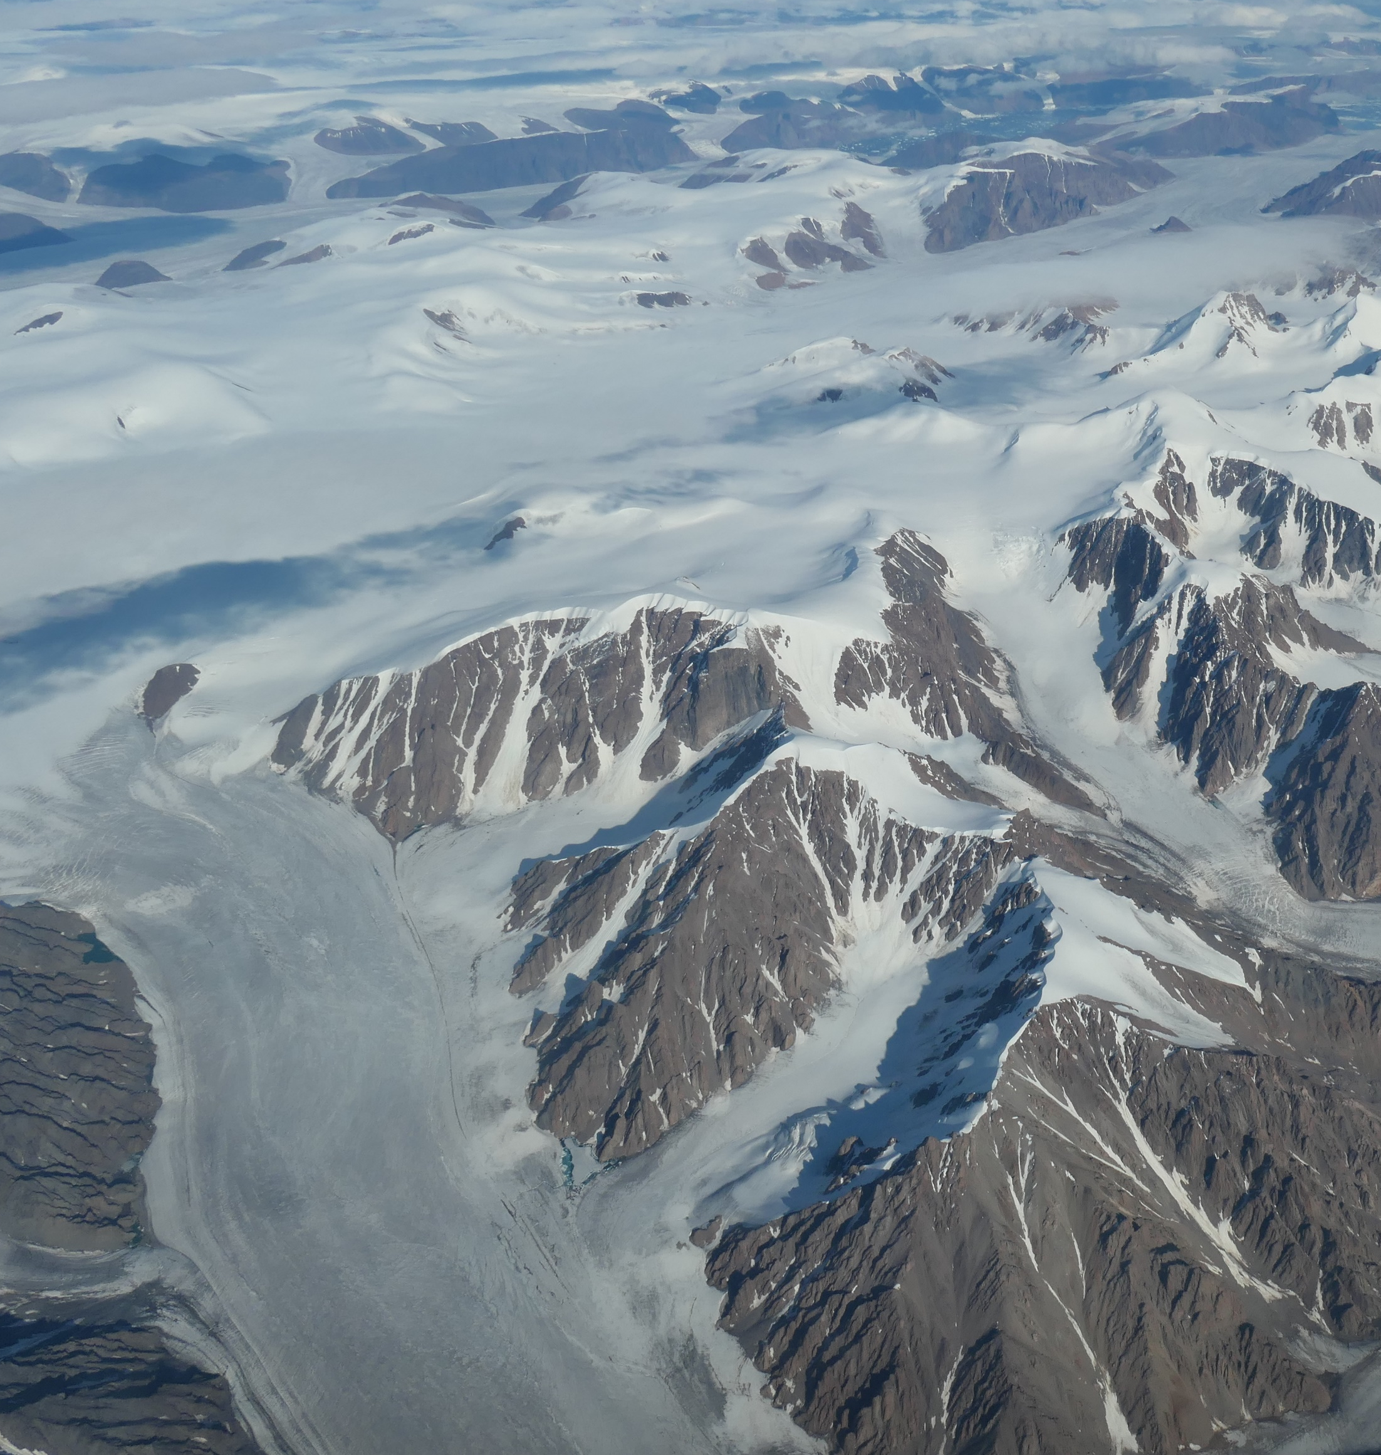
My post-campaign work will focus on the role of absorbing aerosols in the Arctic radiation budget.
smoke
dust
M. Ottaviani
RF19
15 Aug 2024
P. Zuidema
RF18
09 Aug 2024

Slide 7
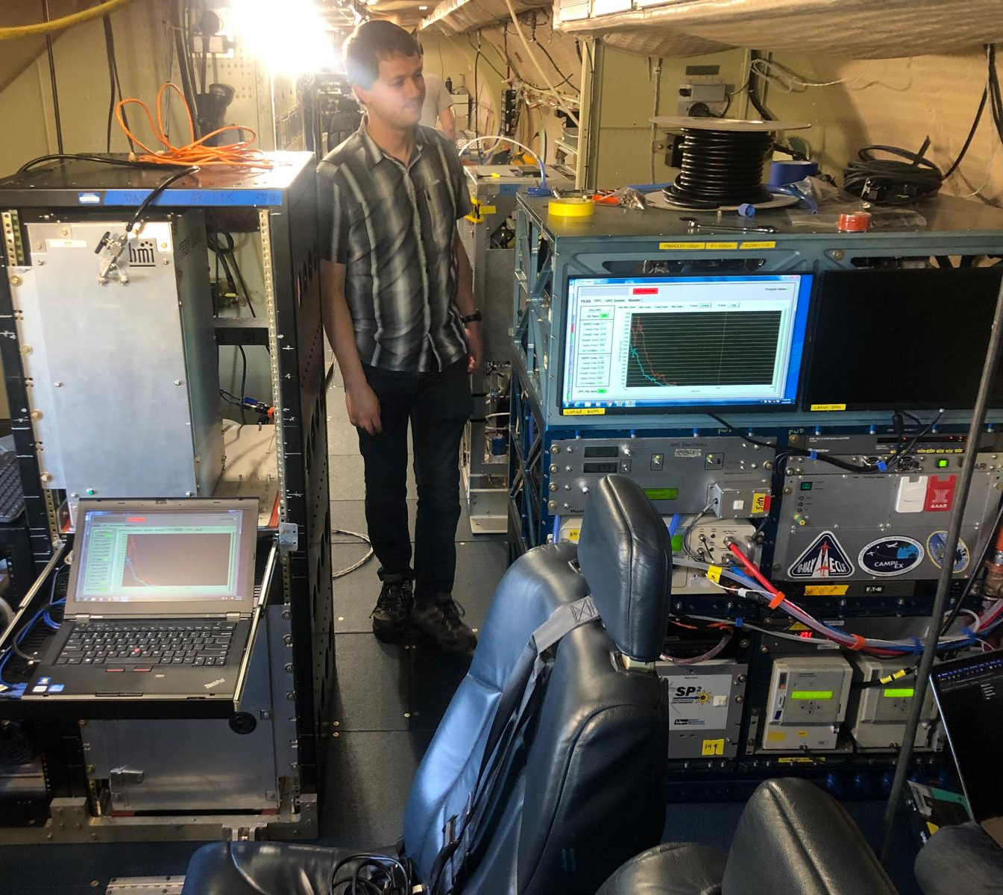
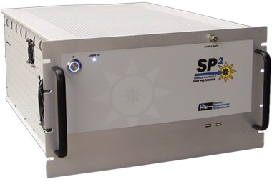
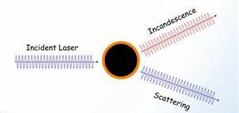
Black carbon (BC) particle mass concentrations are typically the main product derived from SP2 data.
SP2 = single particle soot photometer
DMT
E.L. Edwards
Brookhaven National Lab

Slide 8
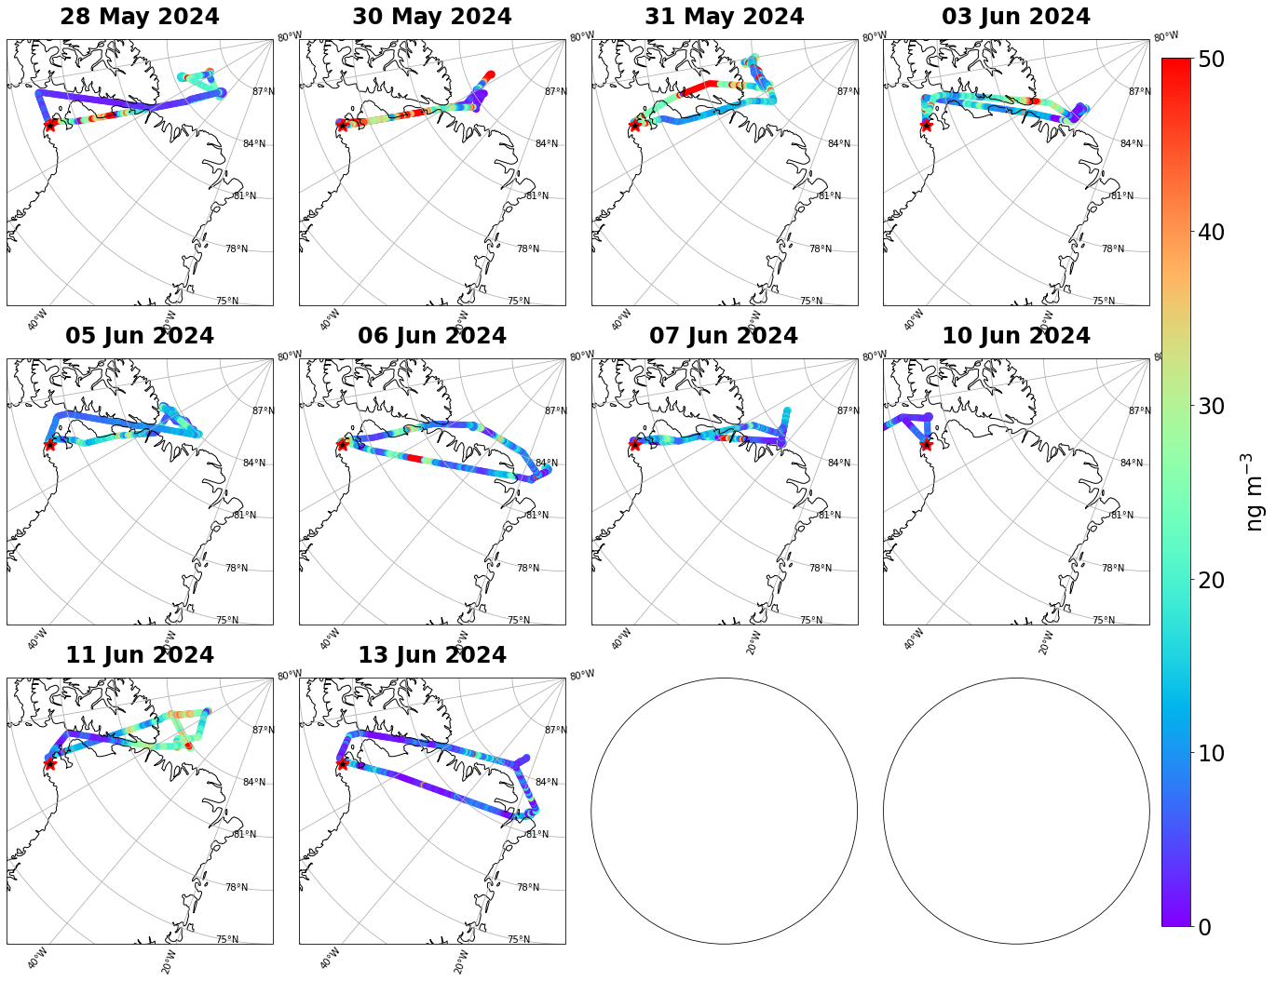
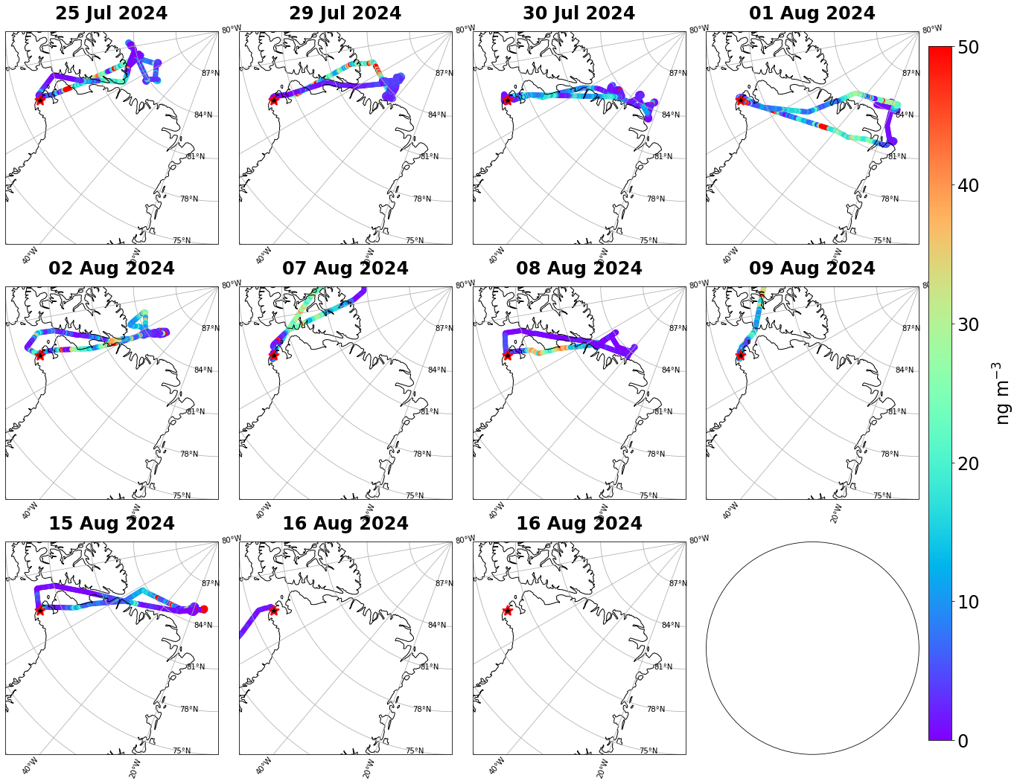
Estimated BC mass concentrations
Deployment 1
May 24 – Jun 17 2024
Deployment 2
Jul 22 – Aug 16 2024

Slide 9
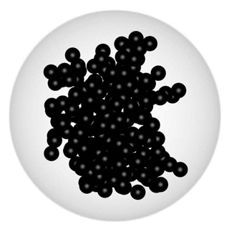
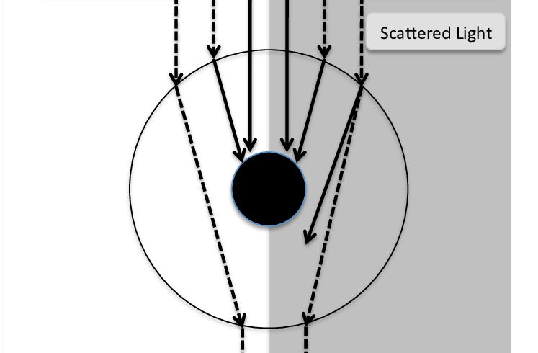
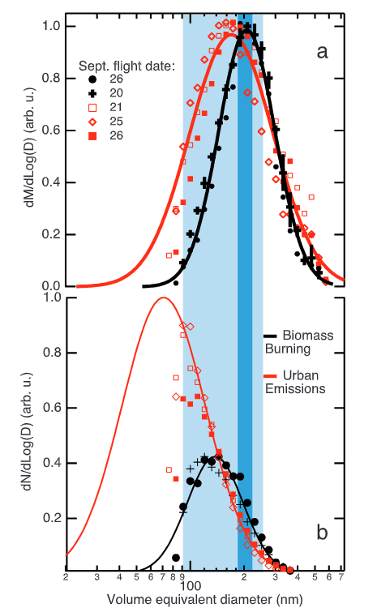
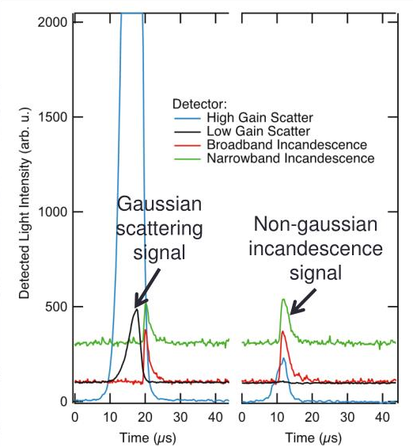
However, raw SP2 data can be used to derive additional absorbing particle properties.
Zhang et al. (2019), ACP
Schwarz et al. (2006), JGR
Lack et al. (2010), ACP
Absorption enhancement
Fraction of coated particles
  Mixing state information
Shell to core ratio
BC core mass and number distributions
Distinguish between absorption by dust and BC-containing particles
  Collaborate with ATOFMS (Univ. Michigan)
Compare properties in cloud-free air vs. cloud droplet residuals
Schwarz et al. (2008), JGR Atmospheres
ATOFMS = aerosol time of flight mass spectrometer

Slide 10
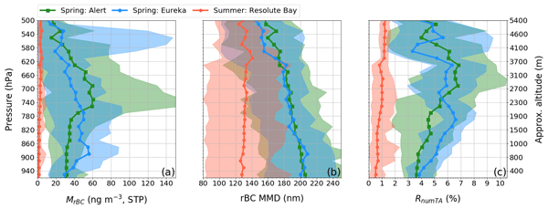
My project seeks to quantify:
- Vertical profiles of absorbing particle properties before and during the onset of sea ice melt.
- Relative contributions of dust and BC to absorption.
- Differences in absorbing particle properties in cloud droplets vs. those in adjacent clear air masses.
- Compare results to previous studies in the Arctic.
ARCSIX White Paper
Schulz et al. (2019), ACP

Slide 11
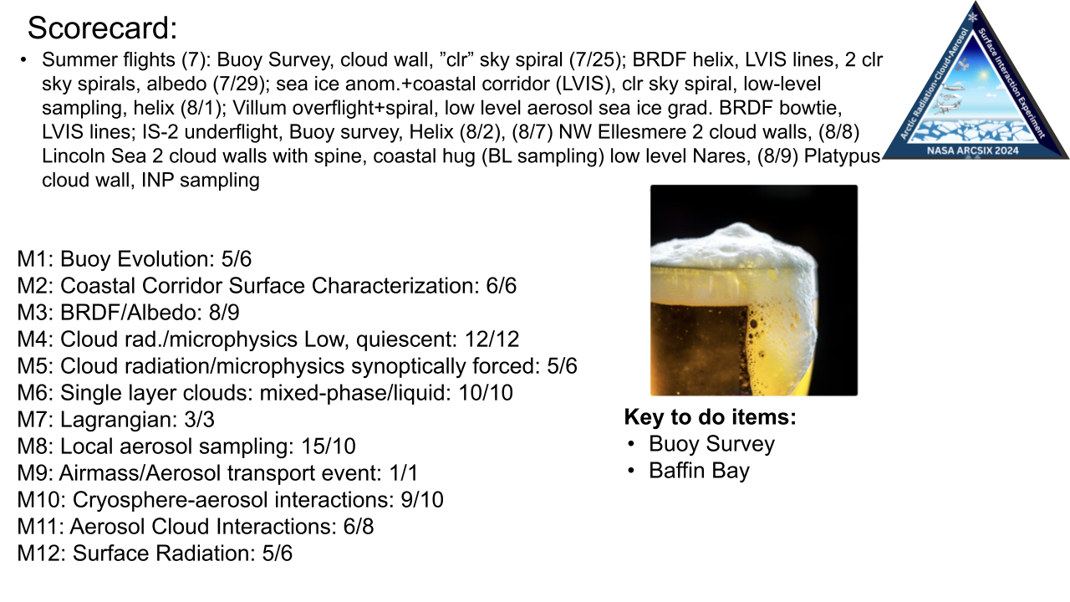
Thanks to Luke Ziemba, LARGE, and the ARCSIX team!
eva-lou.edwards@nasa.gov
Slide from L. Tarwater

Slide 12
Backup Slides

Slide 13
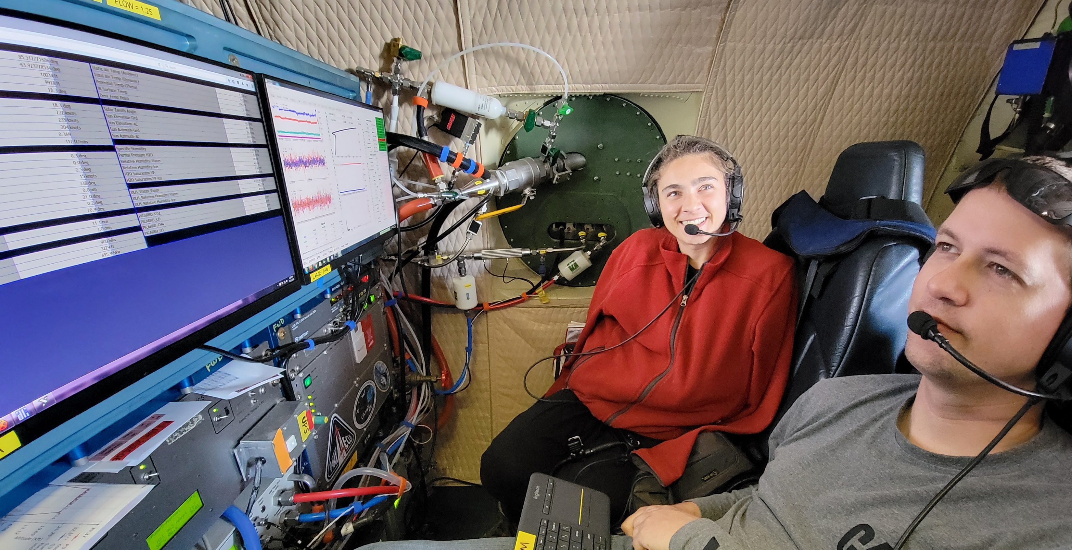
A. Wasilewski

