Slide 1
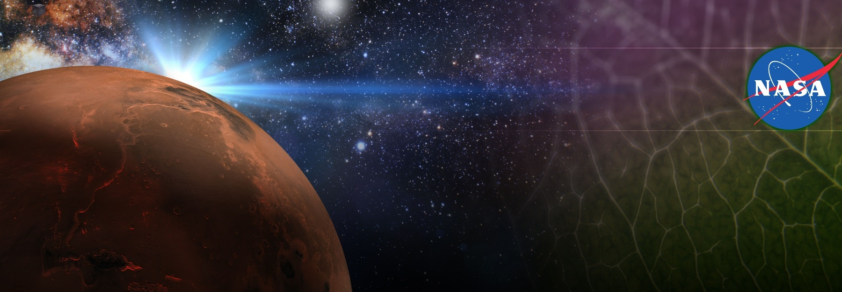
Space Crop Production Gaps and Challenges
Trent Smith, Matthew Mickens, Gioia Massa
Exploration Research & Technology Programs
NASA, Kennedy Space Center

Slide 2
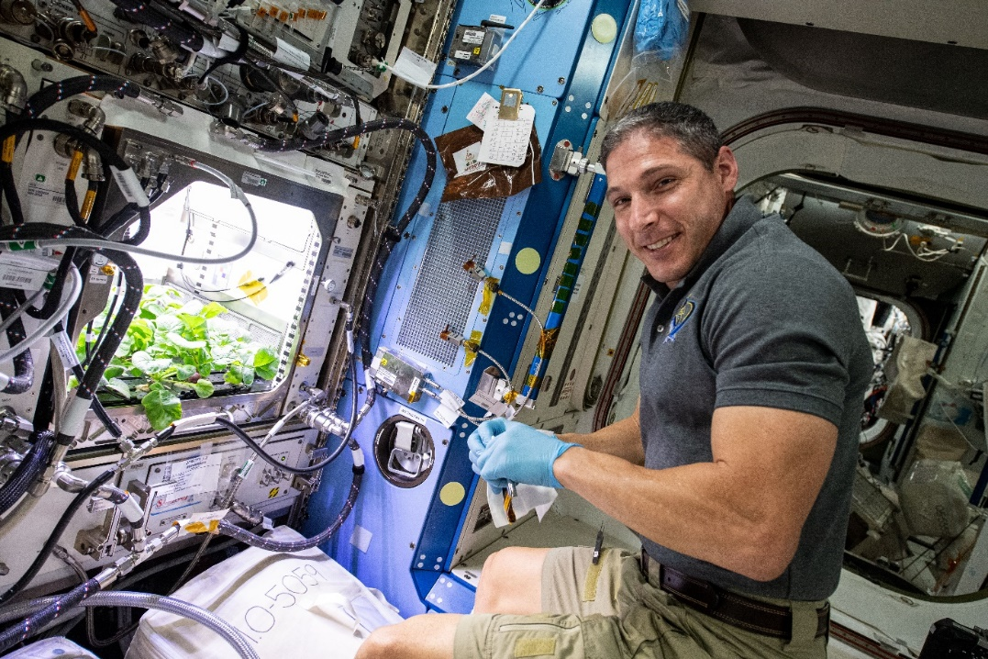
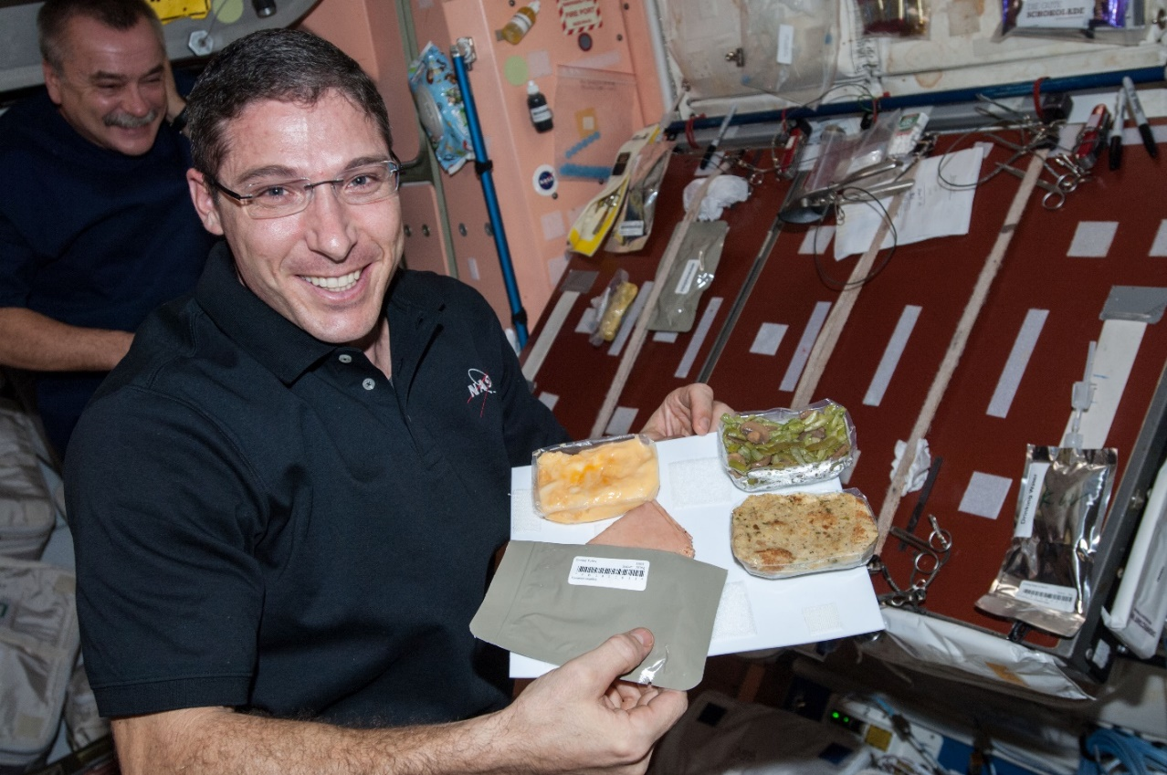
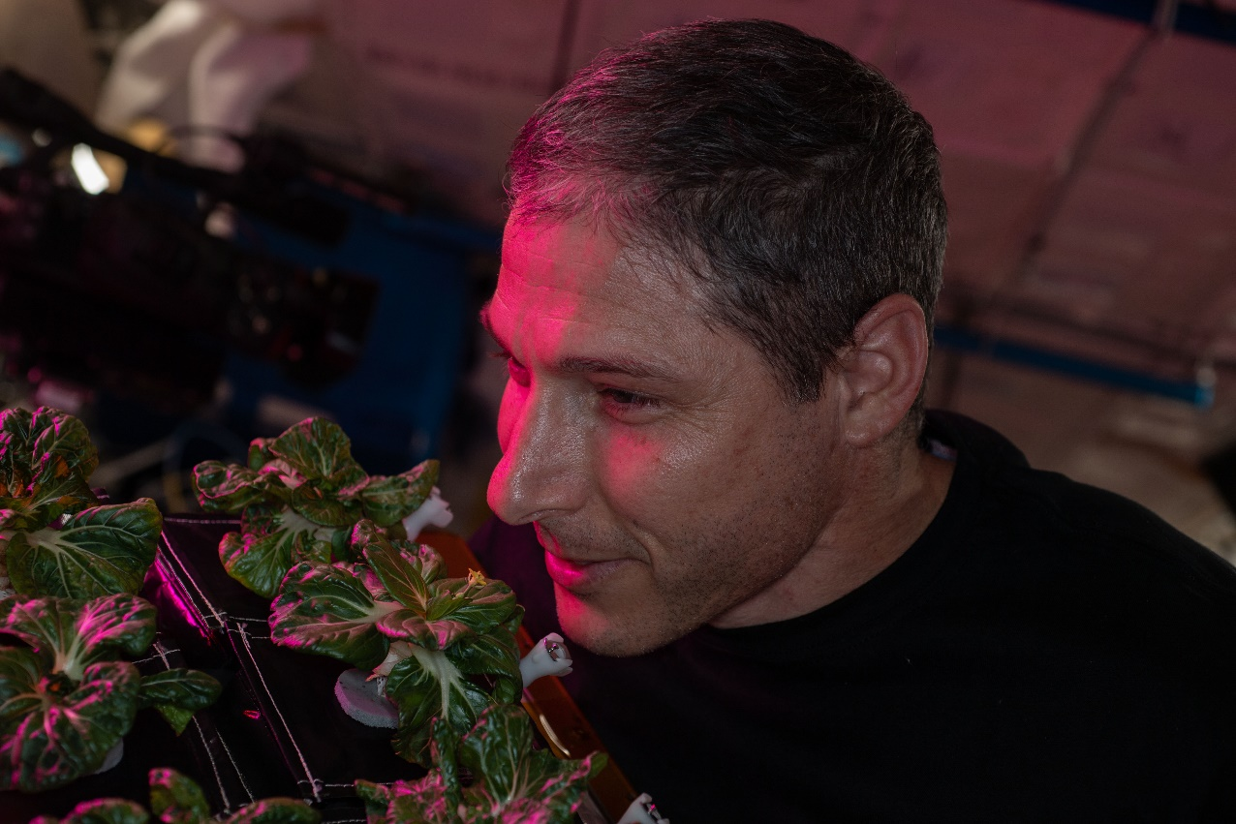
Why grow plants in space?
Food
Psychological well being
ECLSS

Slide 3
NASA’s Space Crop Production Vision
Ensure Food System Security on Long Duration Missions Beyond LEO
Near-Term Goal
Nutrient Supplementation of Prepackaged Food
Near term missions will rely on Physico-Chemical Regenerative ECLSS and Stowed Food with Supplemental Fresh Food
Long-Term Goal
Caloric Replacement to Facilitate Earth Independence
For future, longer duration habitation on the Moon or Mars, Bioregenerative Life Support including Plants can be expanded to increase Mission Autonomy and Earth Independence
Notes:
Ralph
Ensure Food System Security on Long Duration Missions Beyond Low Earth Orbit (LEO)
Food and nutrition are the first line of defense for crew health and performance
Provide safe, nutritious and acceptable fresh food
Add variety to crew diet
Enhance morale
* Food security is the condition in which crew have continuous access to sufficient safe and nutritious food which meets both their dietary needs and food preferences in order to maintain peak health and performance.
Nutrient Supplementation of the Prepackaged Food System - Needed for: Deep Space Transport
Fresh produce supplements vitamins (B₁, K, C) and bioactive compounds that degrade in the stored food system on multi-year exploration missions
“Pick-and-Eat” crops that require no processing and minimal preparation will provide variety, customization, and psychological appeal
Enable testing and demonstration of dependable crop production before reliance on system.
Limiting factors are vehicle resources mass, power, volume, water, air, crew time
Near Term Missions for NASA to Mars Will Rely on Physico-Chemical Regenerative ECLSS and Stowed with Supplemental Fresh Food
Caloric Replacement to Facilitate Earth Independence - Needed for: Long duration Surface missions on the Moon and Mars
Reduce up-mass associated with pre-packaged food
In addition to “pick and eat” crops, include staple crops that require processing and preparation
Bioregenerative capability will be required for long duration surface missions
For future, longer duration habitation on Mars or the Moon, Bioregenerative Life Support Including Plants can be Expanded to Increase Mission Autonomy and Earth Independence

Slide 4
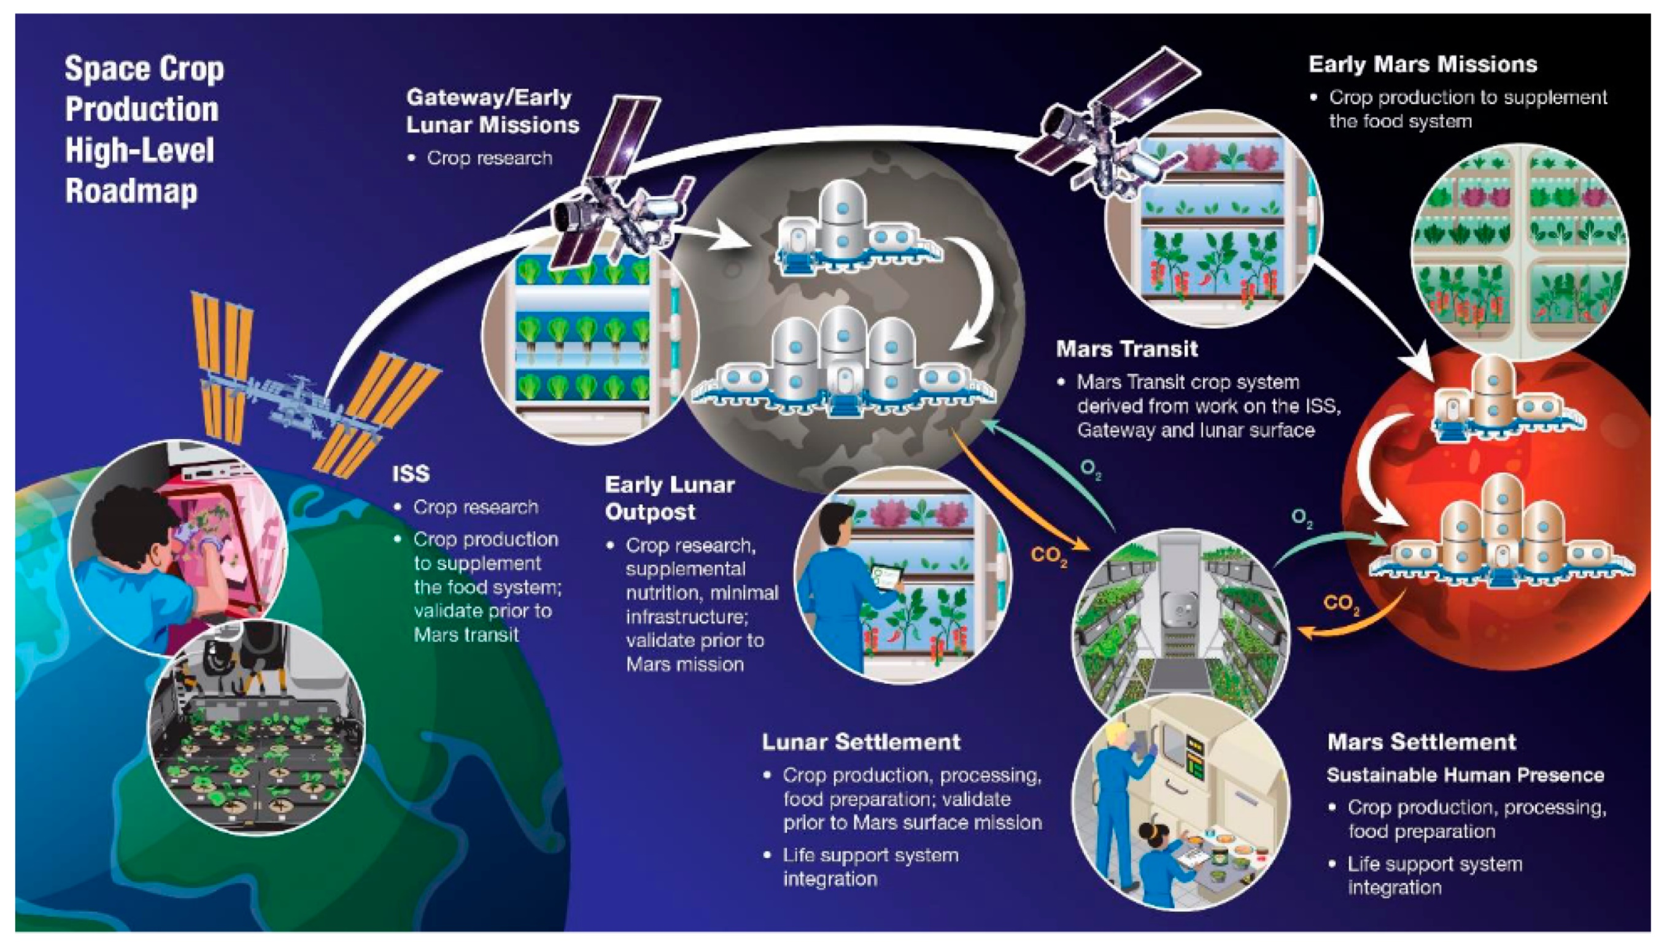
Douglas et al., 2021, Sustaining Astronauts: Resource Limitations, Technology Needs, and Parallels between Spaceflight Food Systems and those on Earth, Sustainability
Notes:
Figure
https://www.mdpi.com/sustainability/sustainability-13-09424/article_deploy/html/images/sustainability-13-09424-g001.png

Slide 5
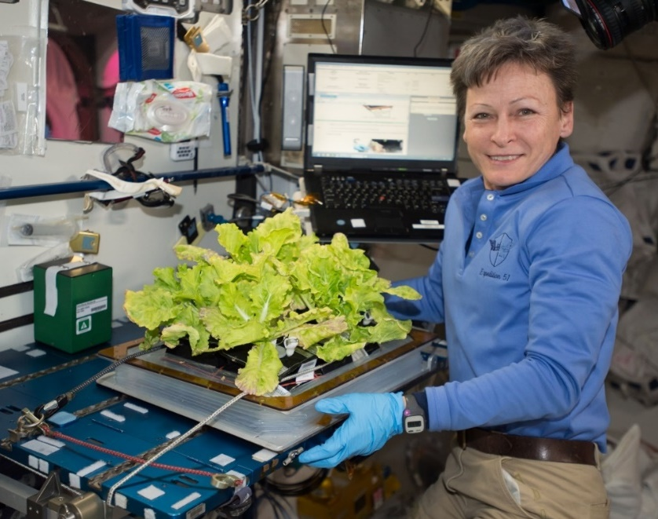
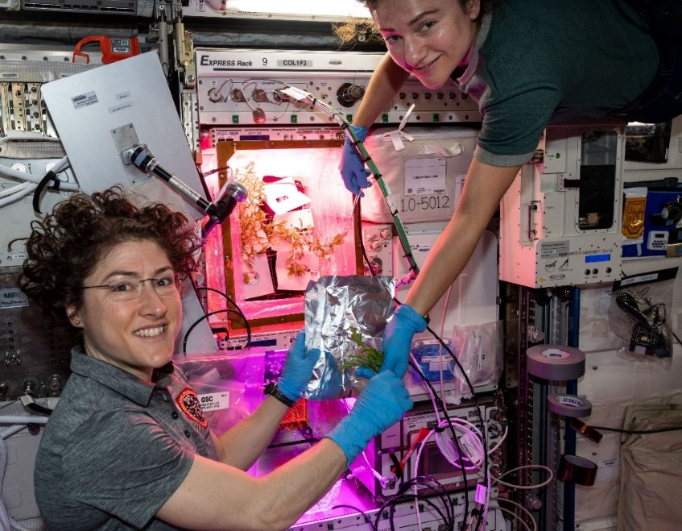
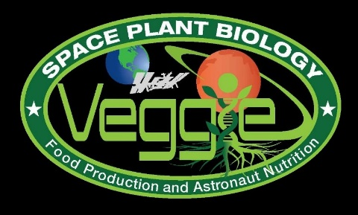
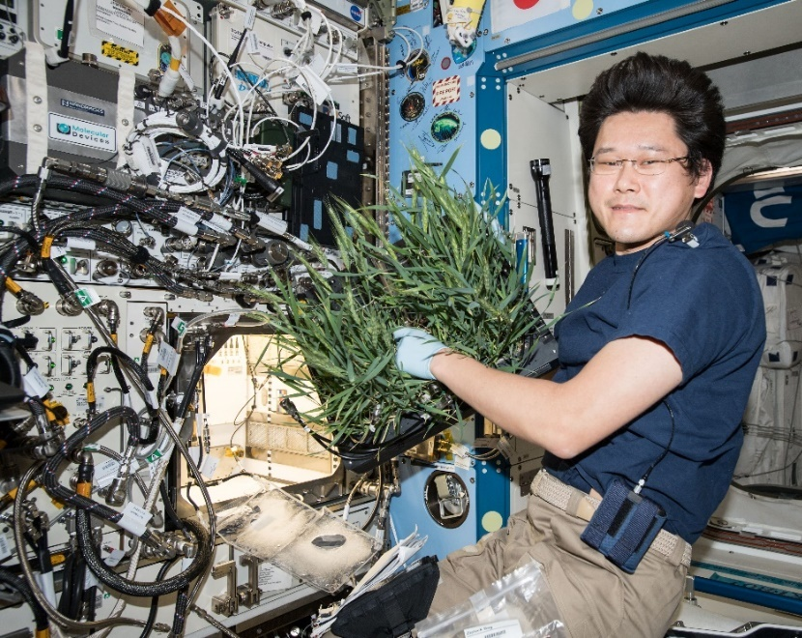
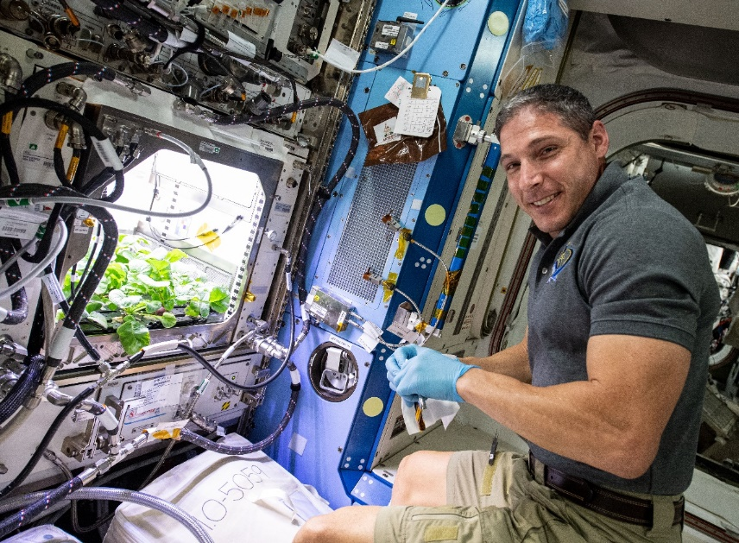
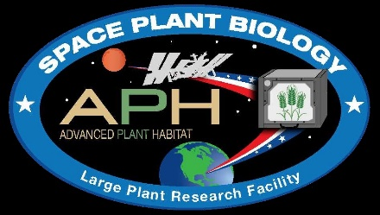
Current NASA Large Plant Research Capabilities On ISS
Notes:
Veggie and the Advanced Plant Habitat

Slide 6
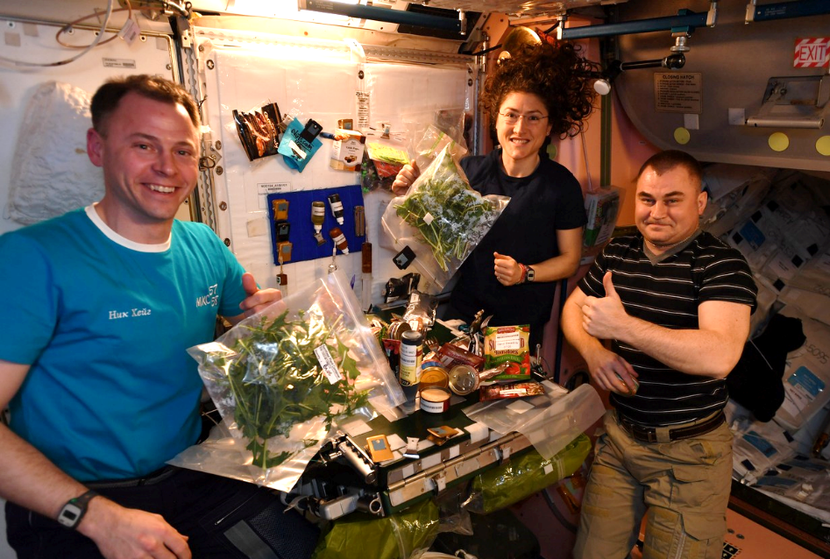
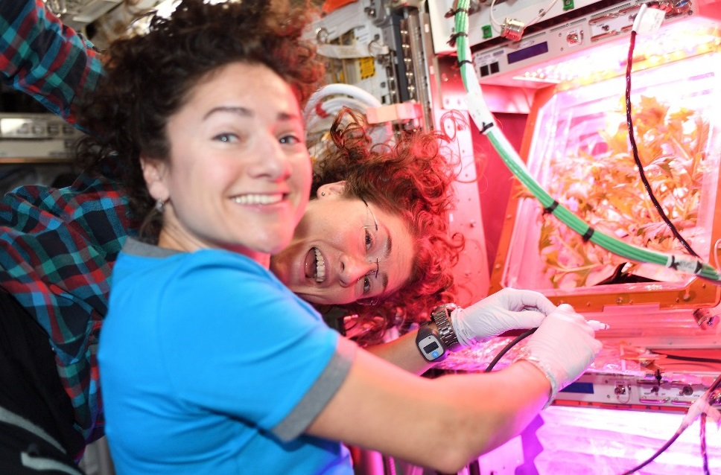
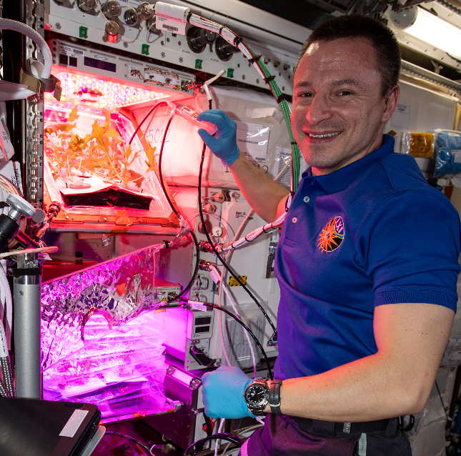
VEG-04 Crew Engagement

Slide 7
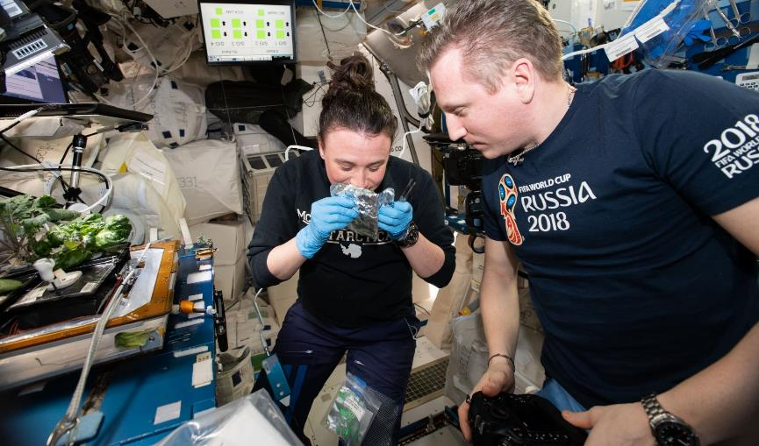
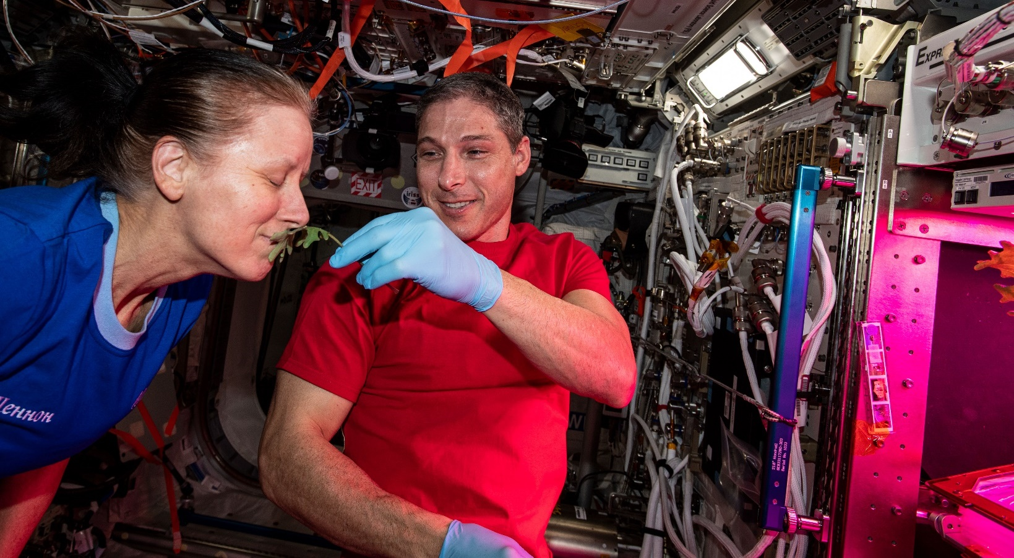
Plant Aromas Also Enhance Astronaut Experiences

Slide 8
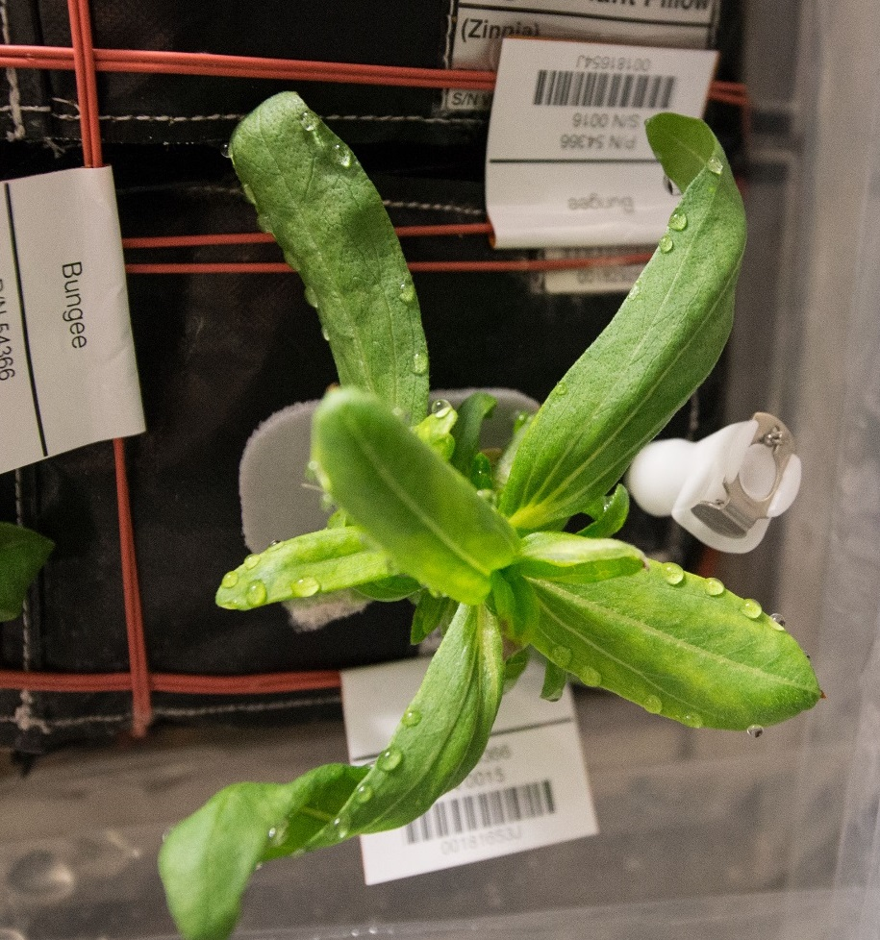
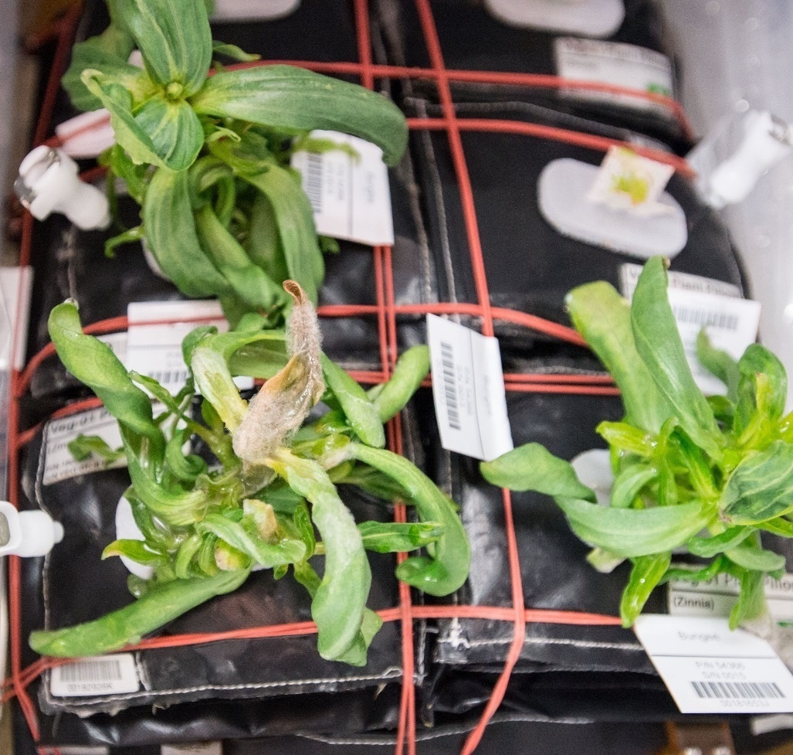
Ventilation and Water Issues & Consequences in Zinnia
Guttation and Leaf Curling
Fungal Development & Abnormal Growth

Slide 9
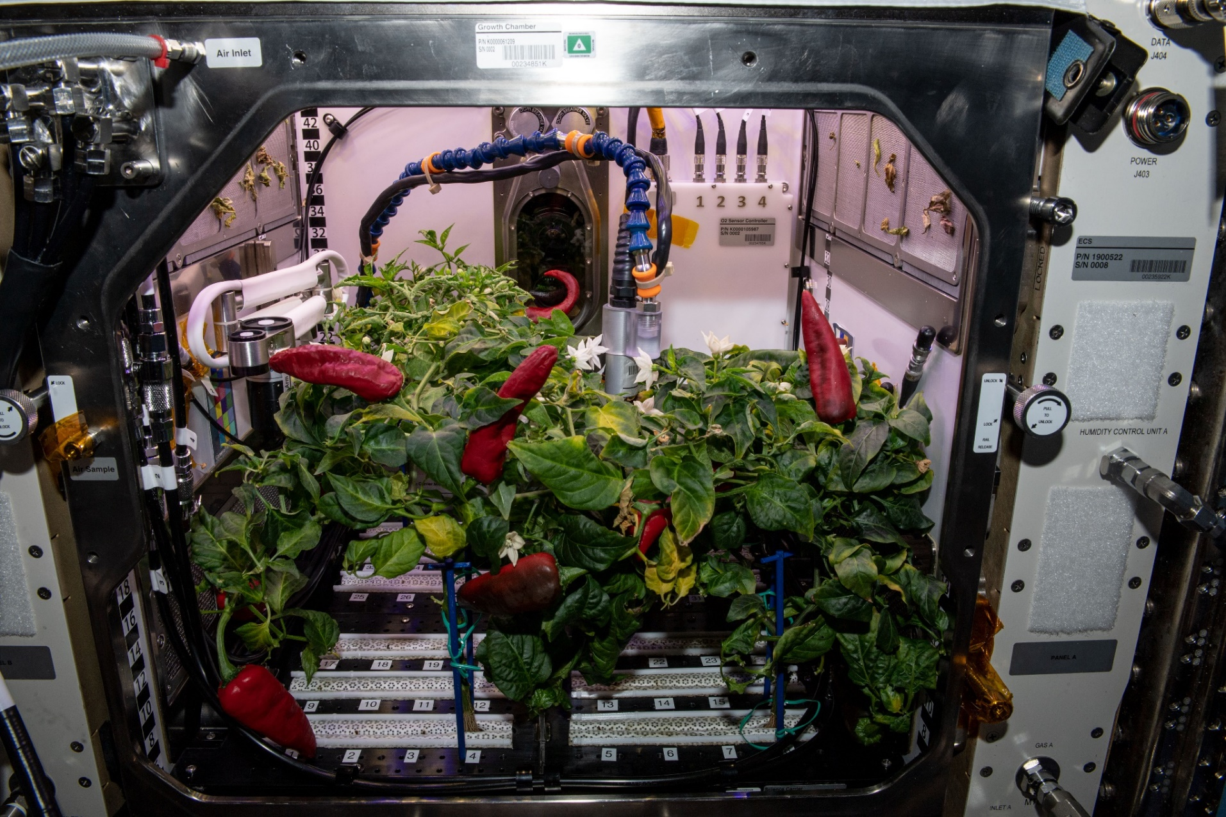
APH Crop Research
Española Improved Hatch Chile Peppers
PH-04 mission ran July – Nov. 2021

Slide 10
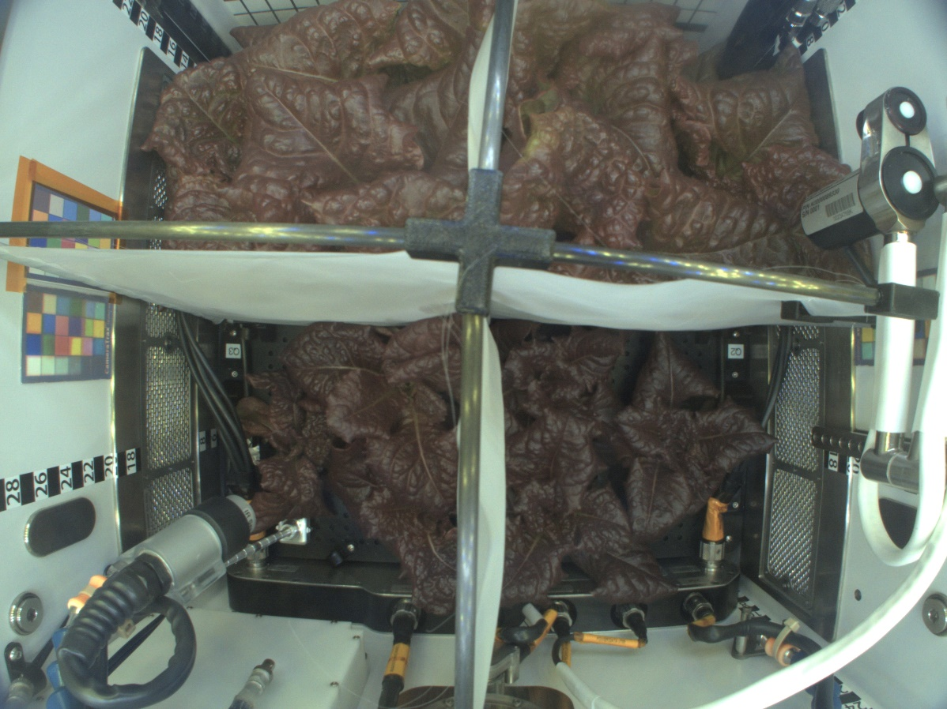
Upcoming APH Crop Research
Q4 Flood
Q1 Control
‘Outredgeous’ lettuce grown with different substrate moisture levels
PH-07 mission- launching Oct. 2024.
Q3 Wilt
Q2 Drought
PH-07 Science Verification Test

Slide 11
Key Crop Plant Takeaways
Data indicate astronauts enjoy growing and eating plants in spaceflight
Crop yield is similar between ground and flight when plants are not stressed¹
Some differences between ground and flight plant nutrient content, but these are not consistent between species or experiments ^{1, 2}
  Influenced by crop type, harvest scenario, other environmental conditions (e.g., light, stress)
Microbial counts and compositions vary between flight and ground-grown plants^{1, 2}
  Microbes typical of the space station environment are often associated with ISS-grown plants
  Human pathogens are rarely identified on space-grown plants and only below levels of concern to human health
Microbial communities vary between shoot and root tissues and but not as much between flight and ground ²
Plants adapt well to the space environment, and to date, space-grown crops are safe to eat, nutritious, and highly acceptable to astronauts ^{1,2}
Bunchek et al., 2024, Pick-and-eat space crop production flight testing on the International Space Station, J. Plant Interact.
Khodadad et al., 2020, Microbiological and Nutritional Analysis of Lettuce Crops Grown on the International Space Station, Front. Plant Sci.

Slide 12
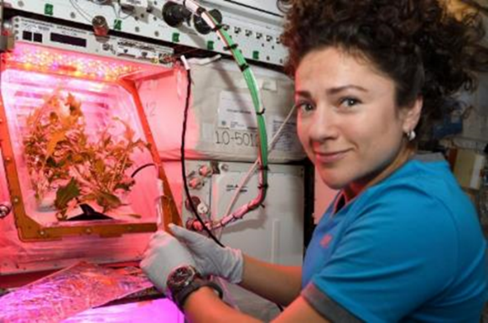
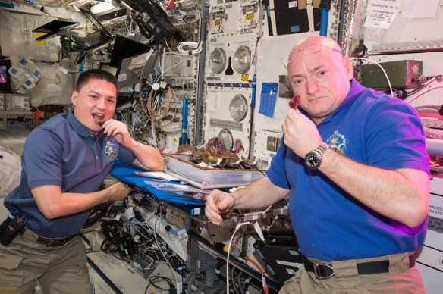
Examples of Knowledge Gaps for Space Crop Production
The library of crops tested is limited – we need to test a wider diversity of different crops and crop types for exploration
  One plant family should not make up >1/3 of the entire crop library
Plant Microbiome - Food Safety/Plant Health
  Crops will be grown hydroponically in space habitats near to mid-term. Many questions remain around hydroponic water and nutrient delivery, and few data exist for the hydroponic microbiome.
  Plant performance in exploration atmospheres (reduced pressure) is largely unstudied, including plant-microbial interactions, responses to pathogens, etc.
Deep-space radiation impacts on seeds and plants remain unknown

Slide 13
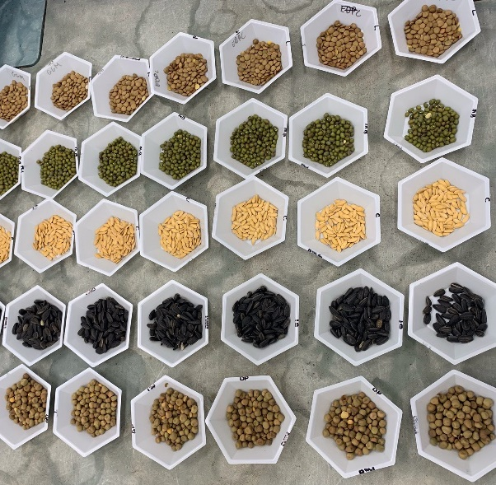
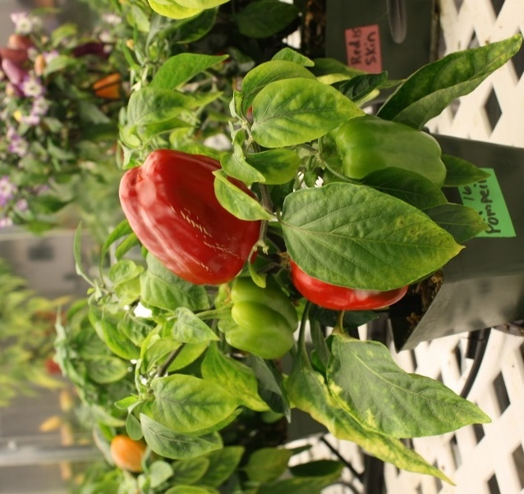
Selection Factors for Space Plants
Targeted breeding areas could fall into several categories:
Plant Growth and Development
  E.g., Compact size (low height and volume), high harvest index, uniform growth
Plant Physiology
  E.g., Stress tolerance, high sodium tolerance (e.g., urine recycling)
Produce Nutrition
  E.g., High normal levels of antioxidants and beneficial phytonutrients
Produce Organoleptic Acceptability
  E.g., Excellent, intense flavors, good texture, appearance, color, aroma
Postharvest
  E.g., Good shelf life, reduced processing, easy degradation of inedible biomass

Slide 14
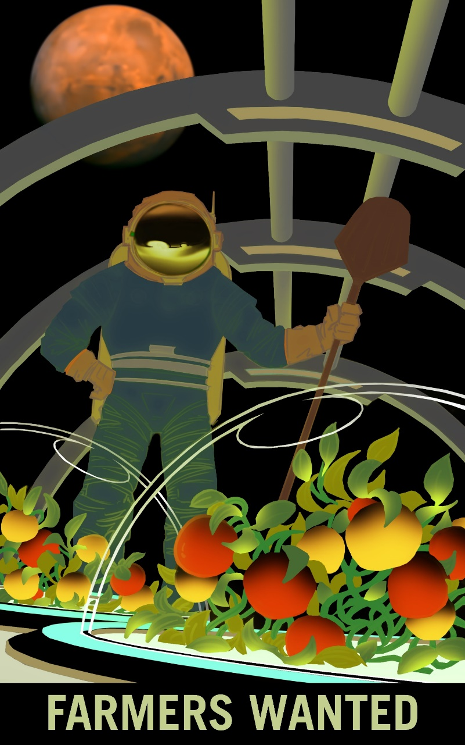
Thank you!
Space Crop Production team
NASA’s Space Biology Program, Human Research Program, Mars Campaign Office, STMD, SBIR/STTR Program

