Slide 1
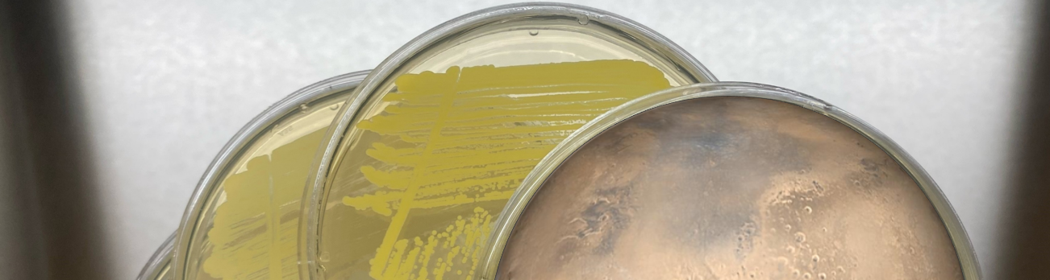

The Need for Earth-Based Experiments to Inform Microbial Evolution on Planetary Surfaces
Science and Planetary Protection in Advance of Human Missions
Virtual Seminar
31 October 2024
Chelsi D. Cassilly
Planetary Protection/Materials Engineer
Space Environmental Effects Team
Nonmetallic Materials and Space Environmental Effects Branch
NASA/MSFC/EM41
Chelsi.D.Cassilly@nasa.gov

Slide 2
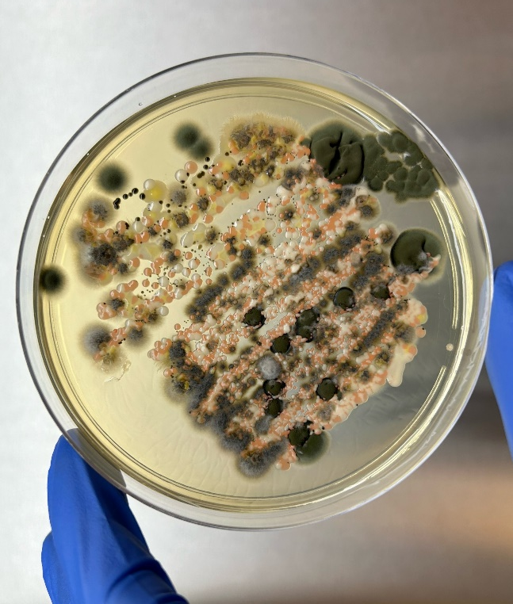
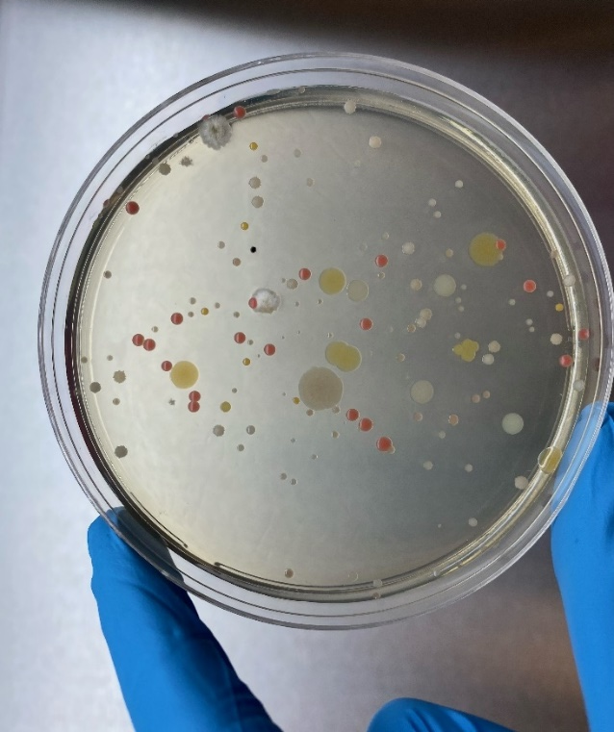
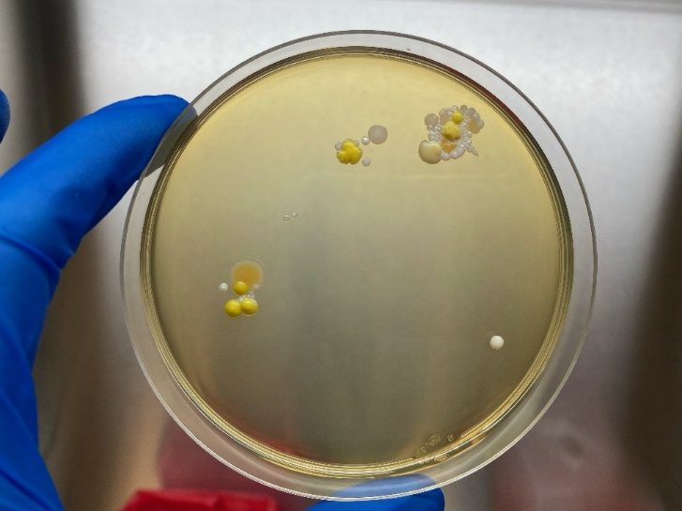
Introduction
The goal of forward planetary protection at NASA is to mitigate the risk of contaminating sensitive target bodies with biological life
  Typically microorganisms
Processes
Humans
Environments

Slide 3
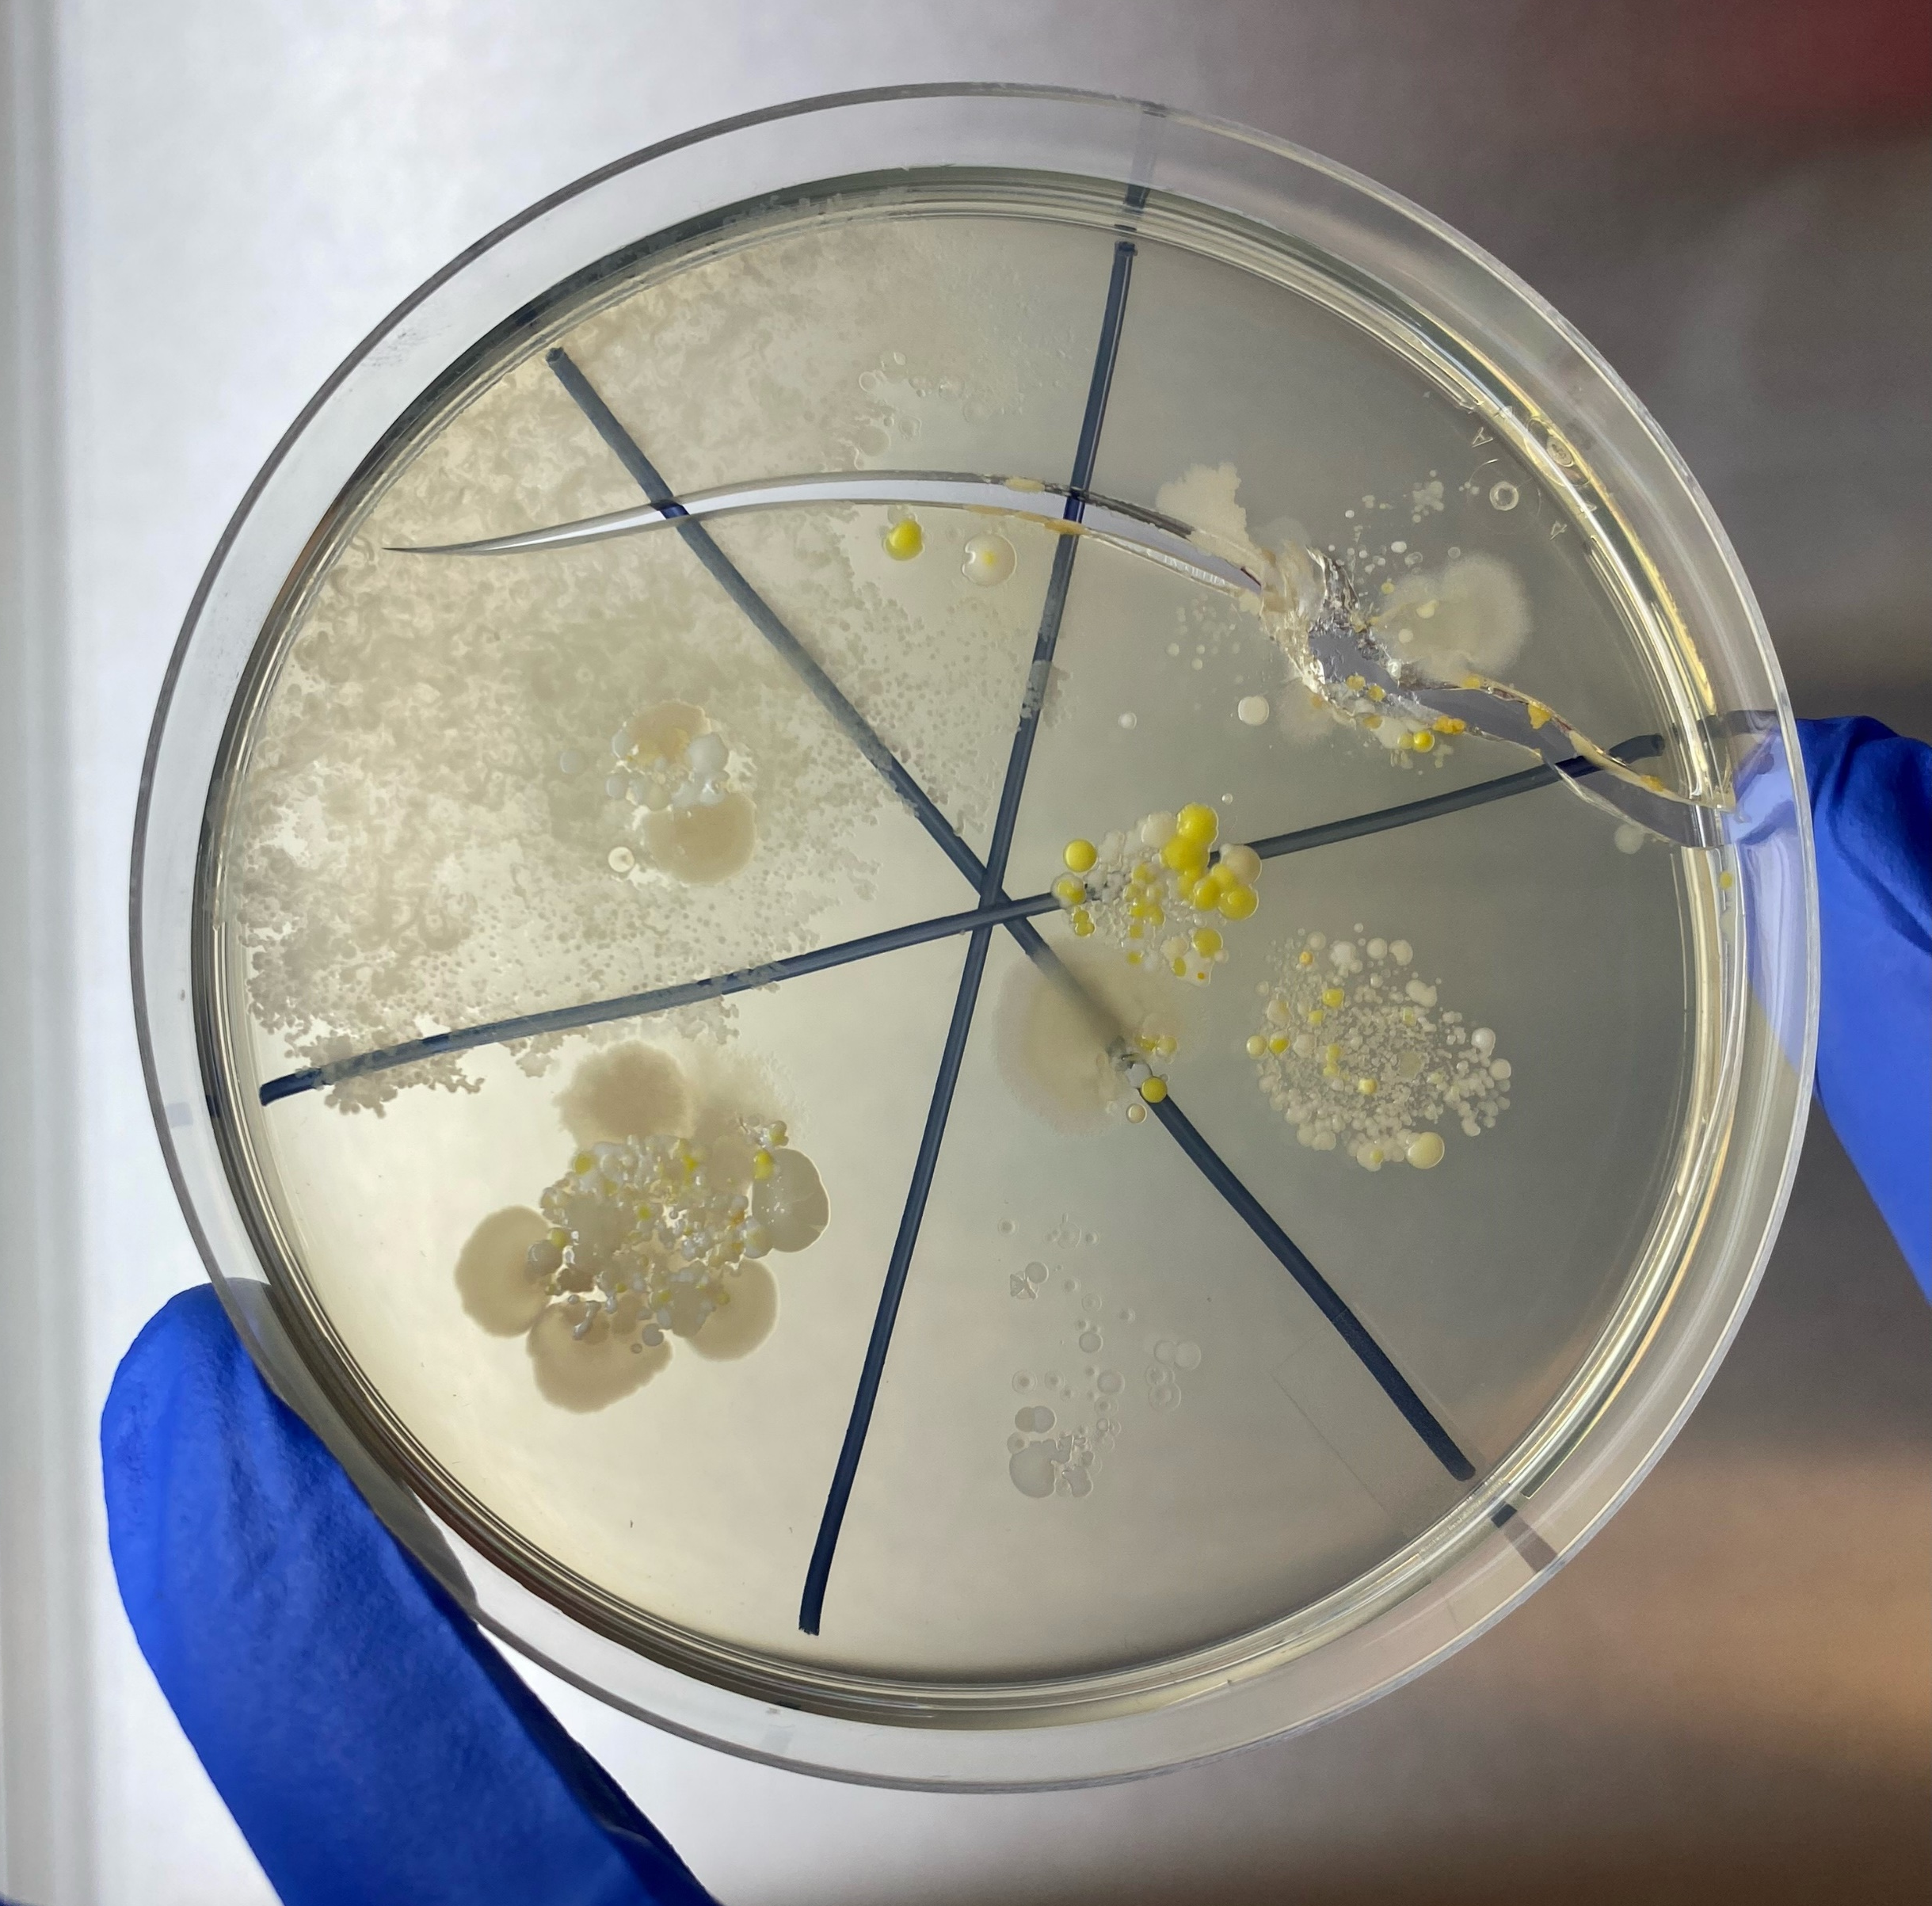
When Humans Go…
…microbes will too.
Human skin harbors millions of bacteria, fungi, and viruses
  Halotolerant and desiccation resistant
Microbes aboard the International Space Station evolve and adapt to life in low earth orbit
Possible harmful effects to crew and impacts to planetary or astrobiological science

Slide 4










Risks of Microbial Evolution
Microbes carried by humans will evolve to new environments even before landing on Mars, during the several month cruise phase.
Once landed, microbes will encounter different stressors within the crew habitats on Mars.
During extravehicular activities, venting, or other release events, microbes will find their way out onto the Martian surface.
The induced environments around crewed systems will create potentially-favorable conditions for microbes to continue evolving on Mars
Eventually, microbes may find their way beyond the close confines of the crewed area and continue evolving so as to fill new or distant niches on the Martian surface.

Slide 5
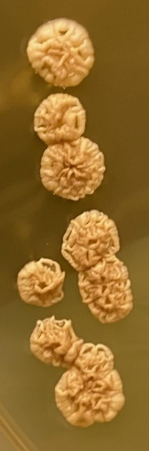
Examples of Evolution on Earth
Serial passaging by Richard Lenski shows dramatic changes E. coli undergoes within a laboratory setting
Michael Baym demonstrated the power of single mutations in microbial development of antibiotic resistance
Could we do similar experiments for space-like stressors? Space environments?
What experiments can we have the crew do during cruise phase to Mars?

Slide 6
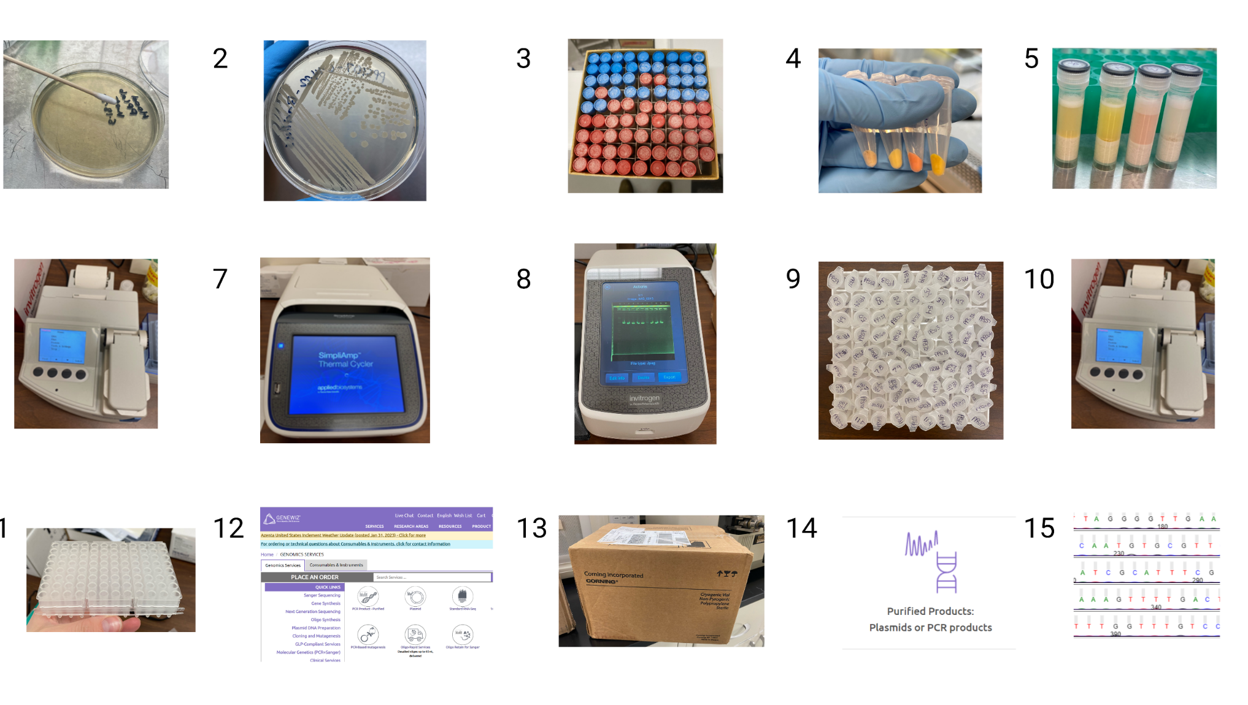
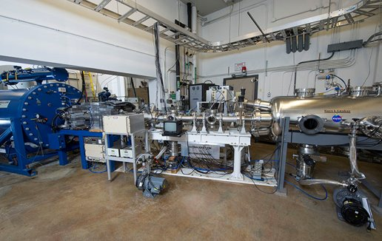
MSFC Cleanroom Microbial Library
Collected 95 microbial isolates from cleanroom environments at MSFC
Identified them using 16S or ITS commercial sequencing
Pelletron at MSFC

Slide 7
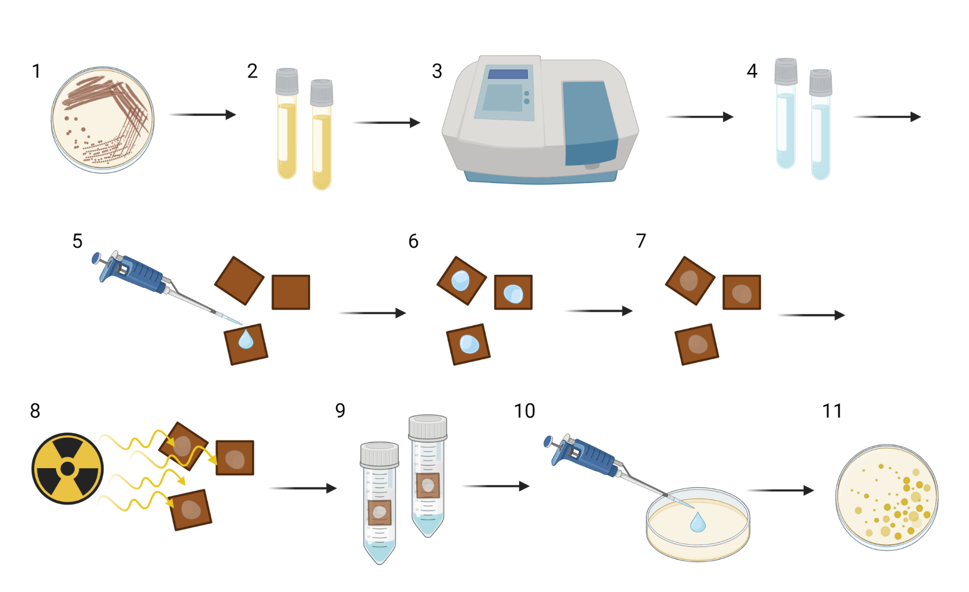
Exposure of Cleanroom Microbes to Simulated Space Environments
24
H⁺ Run 1
17
H⁺ Run 2
13
H⁺ Run 3
5
5
H⁺ Run 4|5
1
UV Run
Image created with Biorender
*experimental details can be found in abstract

Slide 8
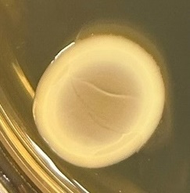
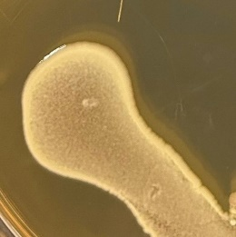
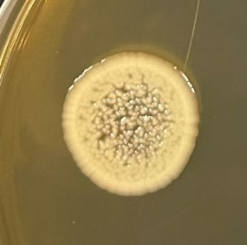
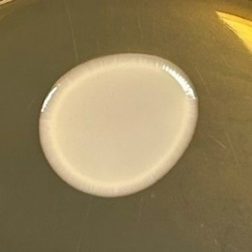
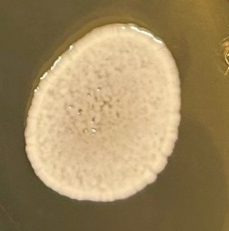
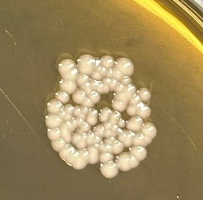
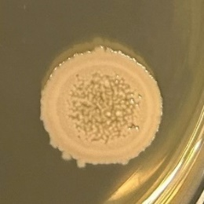
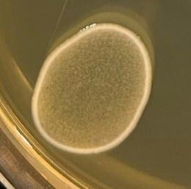
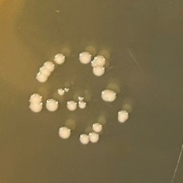
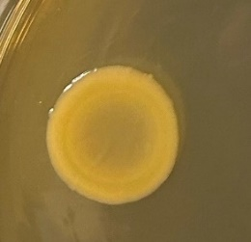
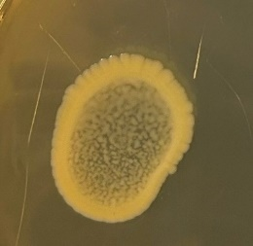
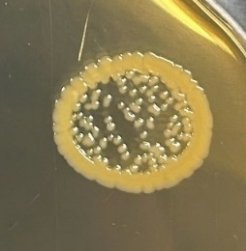
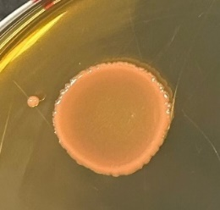
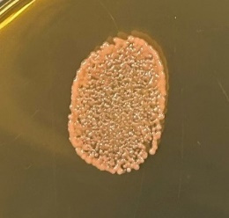
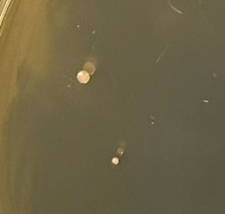
Four Isolates with Increased Ionizing Radiation Resistance
Inoculum Control Proton Rad
68
68
68
Run 3
Isolate # | Identity | Inoculum | Control | Proton Rad
PPS55 | Alkalihalobacillus gibsonii | + | - | -
PPS67 | Brevundimonas vesicularis/nasdae | + | - | -
PPS68 | Arthrobacter koreensis | + | + | +
PPS69 | Acinetobacter lwoffii or Prolinoborus fasciculus | + | + | minor
PPS72 | Paenarthrobacter nitroguajacolicus | + | + | +
PPS73 | Staphylococcus hominis | + | + | -
PPS74 | Brevundimonas sp. | + | minor | -
PPS77 | Janibacter hoylei | + | + | -
PPS111 | Bacillus licheniformis | + | minor | -
PPS114 | Bacillus atrophaeus | + | + | -
PPS117 | Mycetocola manganoxydans | + | + | +
PPS120 | Erwinia sp. | + | + | +
PPS125 | Neocylindroseptoria sp. | + | + | -
ATCC 13939 | Deinococcus radiodurans | + | + | minor
Negative | Water | - | - | -
72
72
72
117
117
117
120
120
120
DR
DR
DR
Control: ambient drying
Radiation: 100 keV protons at a fluence of 2x10¹⁵/cm² at ~10⁻⁶ Torr

Slide 9
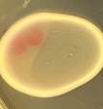
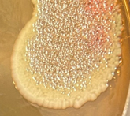
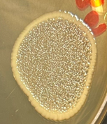
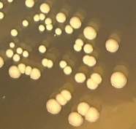
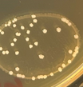
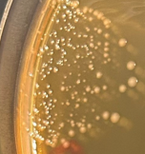
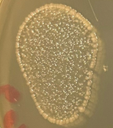
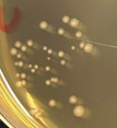
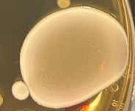
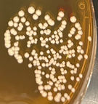
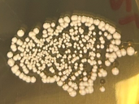
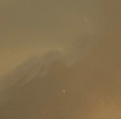
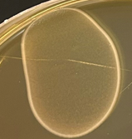
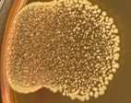
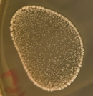
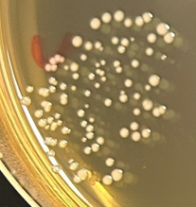
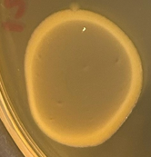

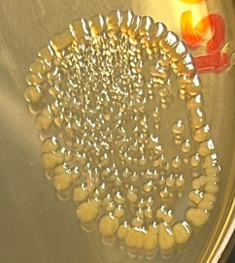
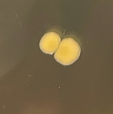
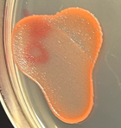
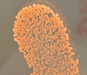
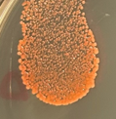
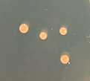
Four Isolates with Increased Ionizing Radiation Resistance
Inoculum Control Vacuum Proton Rad
68
68
68
68
69
69
69
69
Run 5
Isolate # | Identity | Inoculum | Control | Vacuum | Proton Rad
PPS68 | Arthrobacter koreensis | + | + | + | +
PPS69 | Acinetobacter lwoffii or Prolinoborus fasciculus | + | + | + | +
PPS72 | Paenarthrobacter nitroguajacolicus | + | + | + | -
PPS117 | Mycetocola manganoxydans | + | + | + | +
PPS120 | Erwinia sp. | + | + | + | minor
ATCC 9372 | Bacillus atrophaeus spores | + | + | + | +
ATCC 13939 | Deinococcus radiodurans | + | + | + | minor
Negative | Water | - | - | - | -
72
72
72
72
117
117
117
117
120
120
120
120
Control: ambient drying
Vacuum: ~10⁻⁶ Torr
Radiation: 100 keV protons at a fluence of 4x10¹⁵/cm² at ~10⁻⁶ Torr
DR
DR
DR
DR

Slide 10
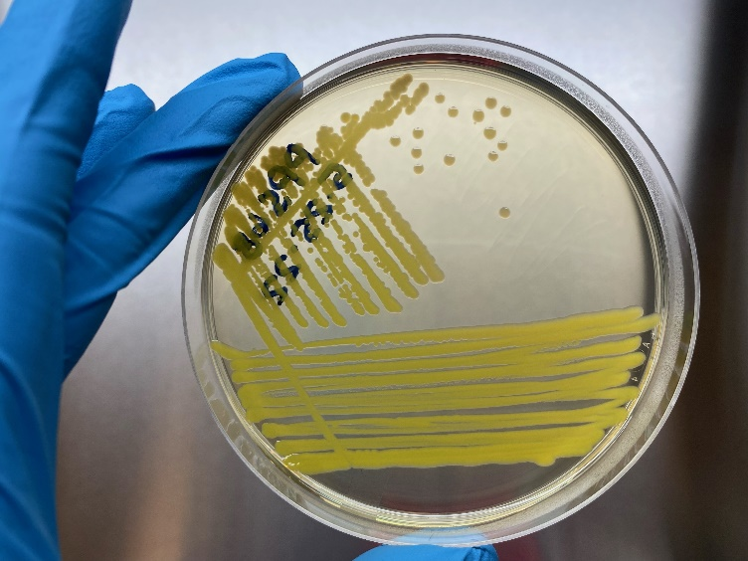
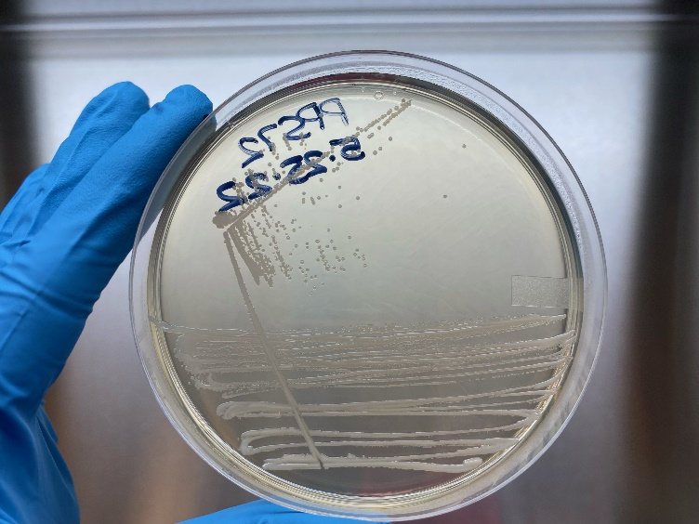
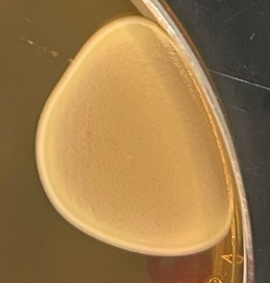







A. koreensis Demonstrates Resistance to UV
68
72
Inoculum Drying Control UV
68
68
68
DR
DR
DR
Arthrobacter koreensis
Paenarthrobacter nitroguajacolicus
117
120
UV: 254 nm wavelength light at an intensity of 80 W/m² at ~18 cm for 10 minutes
Four isolates sent for whole genome sequencing
Mycetocola manganoxydans
Erwinia sp.

Slide 11
Acknowledgements
NASA MSFC
  Jason Vaughn
  Dr. Peter Bertone
  Todd Schneider
  Dr. Erin Hayward
  Dr. Jarvis Caffrey
JPL
  Dr. Atul Chander
  Dr. Kasthuri Venkateswaran
NASA JSC
  Dr. Sarah Wallace
  Dr. Hang Nguyen
  Sarah Rommel
  Christian Castro
Rush University
  Dr. Stefan Green
  Kevin Kunstman
Jacobs/ESSCA
  Curtis Bahr
  Samantha Marcella
  Heather Morris
Funding by Jacobs Innovation Grants and NASA’s Office of Planetary Protection

Slide 12


Community Discussion
Short duration exposures are not enough
Larger and more gradual studies to replicate 1) cruise, 2) to surface habitats, 3) to induced surface environments, and finally true 4) Martian environments
No Earth-based experiment can perfectly replicate the Martian environment
We cannot test every possible microbe in simulation experimental regimes
Examine the evolutionary potential of the “usual suspects” on ISS or in other crewed environments
What else?

