Slide 1
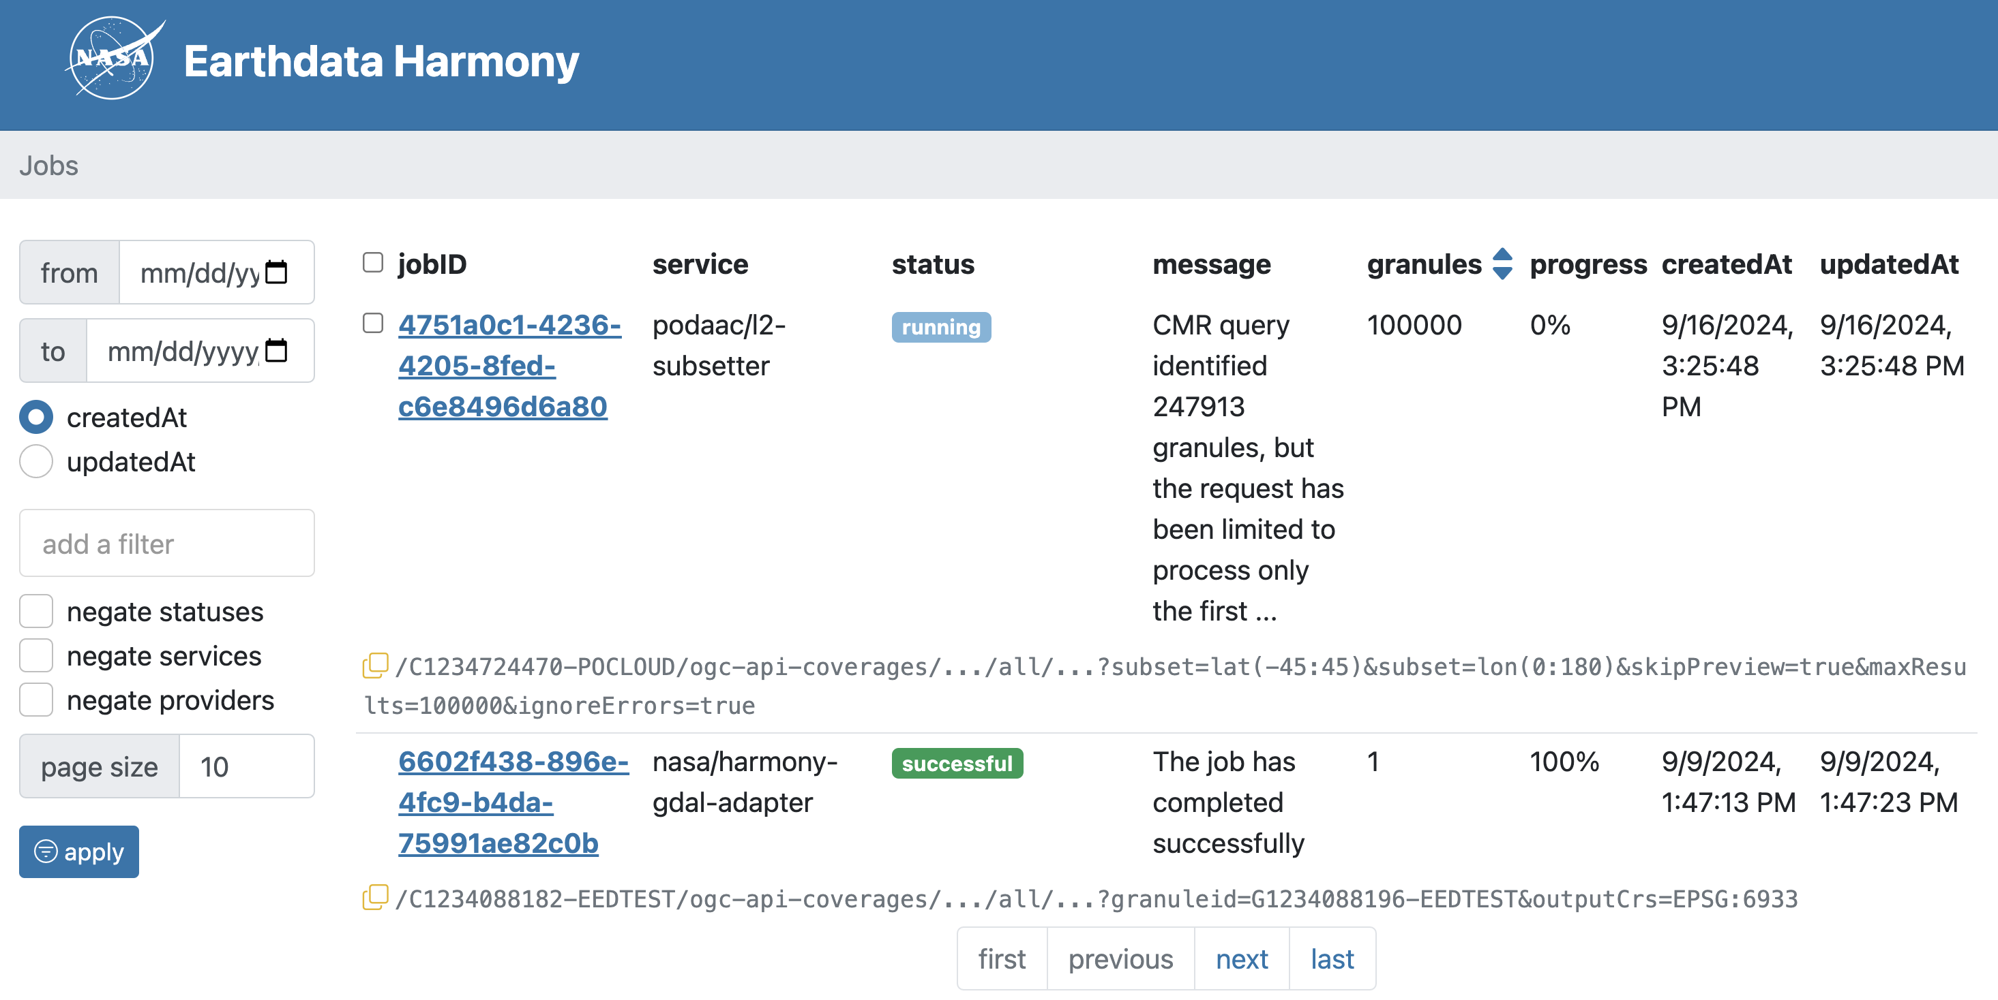
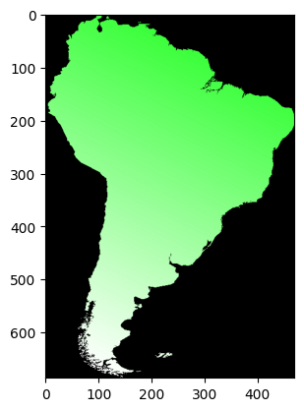
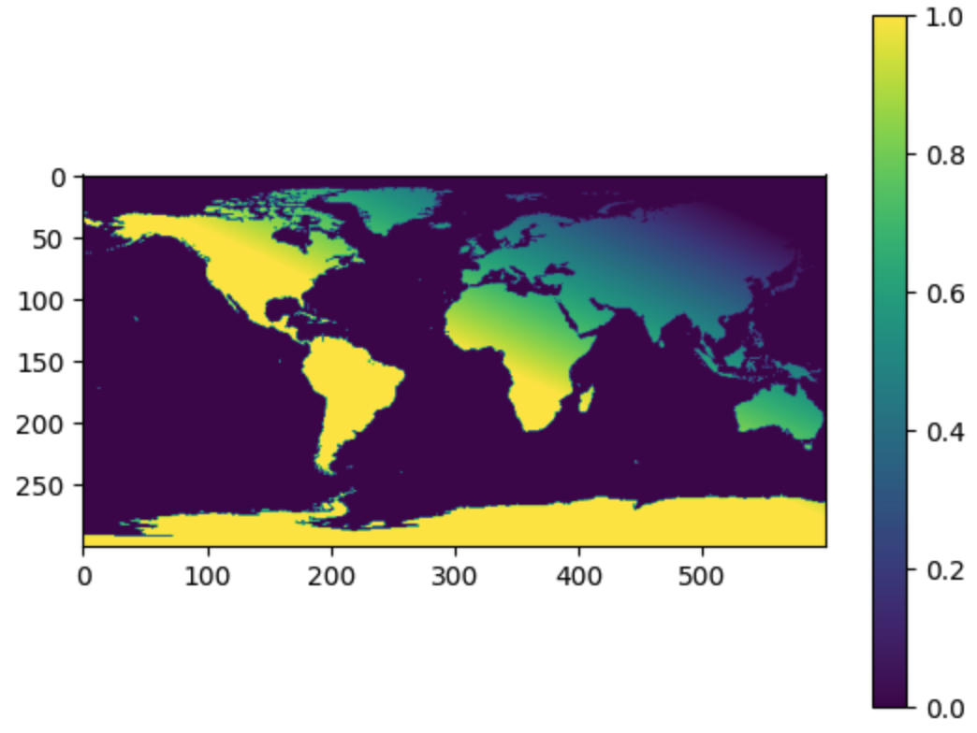
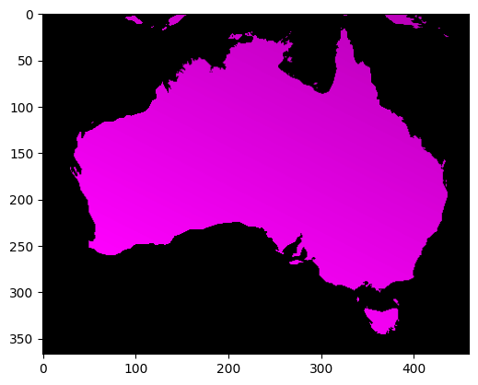
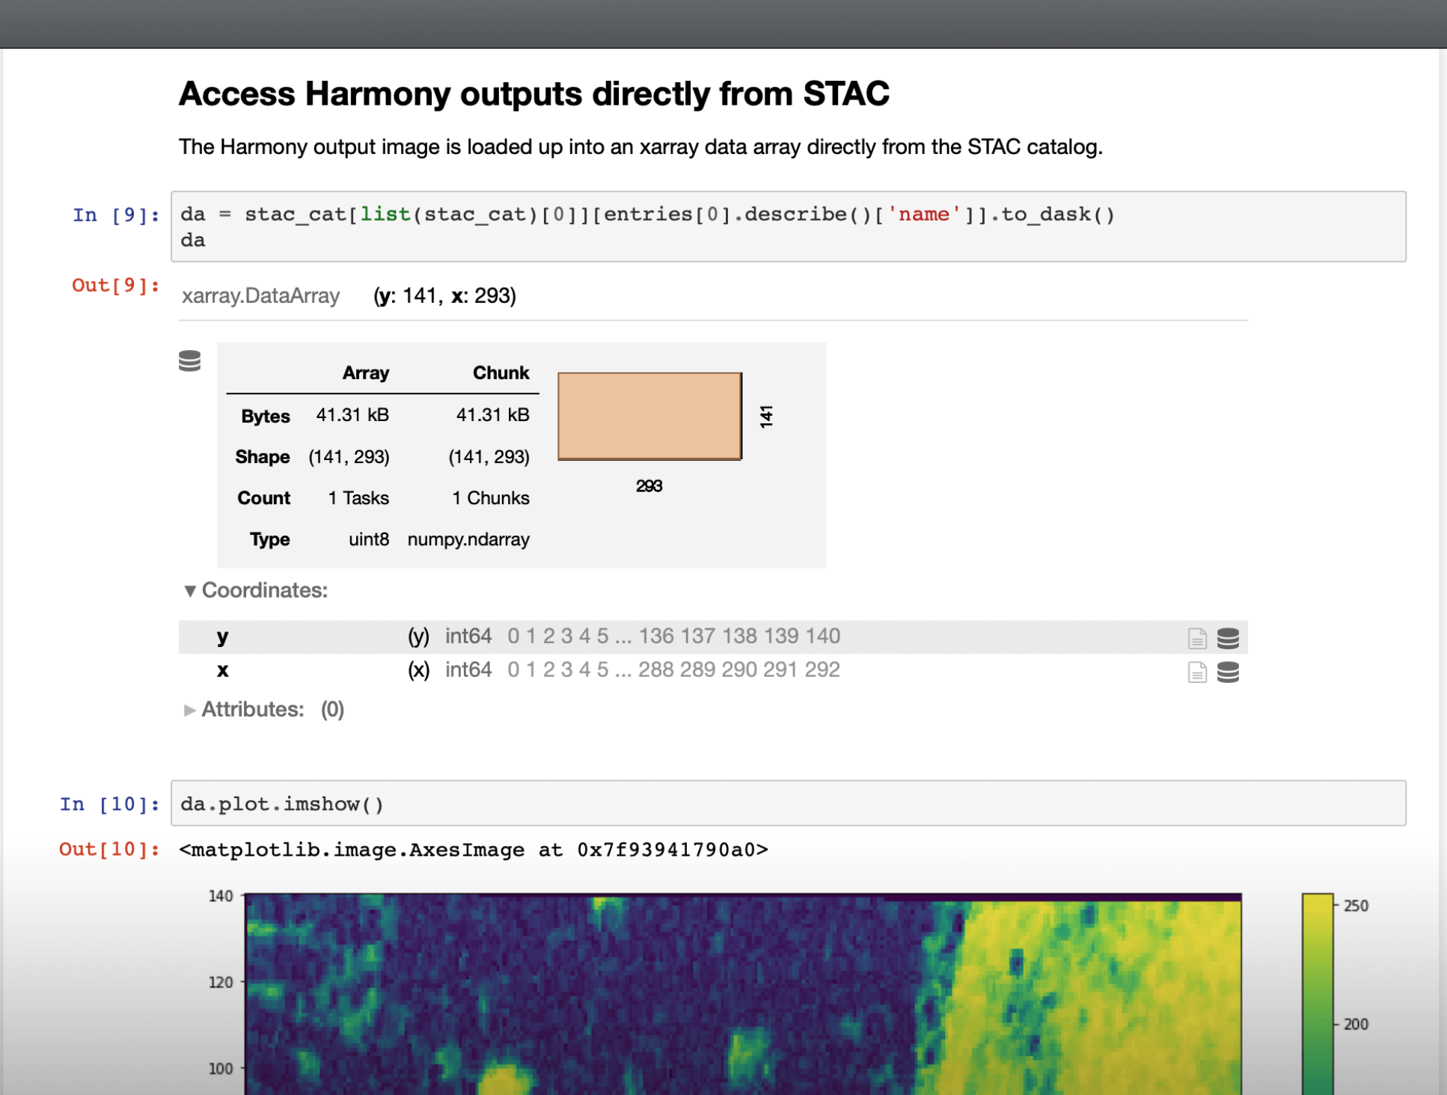


Harmony NASA’s System for Managing Data Transformation Service Workflows at Scale
James Norton, Christopher Durbin, Yonggang Liu, Emmanuel Babalola, Vincent Inverso
Fall AGU 2024 | December 12, 2024
Abstract ID: 1620922
Harmony Main
Harmony Services
Harmony allows users to easily access and transform Earth science data. It employs services from providers across the NASA Earth Science Data and Information System (ESDIS) community, supporting jobs from a single granule to millions of granules, at no cost to users.
Harmony
Core
Kubernetes Cluster
Public API Load Balancer
Private API Load Balancer
Harmony
Core
Microservices
dB
Workflow Management
Harmony can accommodate users with long running workflows. It provides a comprehensive workflow-management user interface that allows users to monintor and control the state of their workflows. Users can easily pause, resume, or cancel jobs.
Harmony Services
Harmony provides 20 (and counting!) core transformation services, allowing transformations such as
Subsetting
Spatial
Temporal
Variable
Dimension
Reformatting
Reprojection
Concatenation
Additionally, many of the core services can be chained together to allow multiple transformations, such as subsetting followed by reformatting.
How Does Harmony Scale?
Harmony is built on top of a Kubernetes cluster deployed in the cloud. It leverages proven technologies like the Cluster Autoscaler and the Horizontal Pod Autoscaler (HPA) to quickly spin up or down service workers as demand changes.
Kubernetes Cluster
Kubernetes Cluster
Prometheus
Cluster Autoscaler
HPA
HPA
Node 1
Node 2
Node N
Node 1
Node 2
HPA
Standards Based
Harmony provides Open Geospatial Consortium (OGC) standards based APIs backed by OpenAPI schemas. Harmony generates SpatioTemporal Asset Catalog (STAC) outputs to allow interoperability with STAC based clients. Additionally, Harmony provides a Python API to allow users to work with their familiar tools, like Jupyter notebooks.
Fair Queueing
Harmony employs a sophisticated fair queueing algorithm to distribute compute resources. This means big jobs can take advantage of all the resources until new jobs arrive, at which point the resources are shared evenly, so small jobs finish quickly.
query-cmr
Harmony STACs Up
Each service in a chain produces a STAC catalog linking to its result
These catalogs are the input to the next step in the chain
Services don’t need to know anything about other services in the chain
STAC
STAC
STAC
l2-subsetter
l2-subsetter
l2-subsetter
Harmony
Back-end
Service Worker
Pod
Work
Scheduler
STAC
STAC
STAC
Service
Queues
concise
Work
dB
STAC
Scheduler
Queue
Stephen Berrick
ESDIS Science Data Systems
Scan the QR code to learn more or go to:
https://harmony.earthdata.nasa.gov
This material is based upon work supported by NASA/GSFC under Raytheon Technologies contract number 80GSFC21CA001

