Slide 1

Diode Laser Hygrometer (DLH)
Measurements of Water Vapor on the Convair-580 during PONEX
Glenn Diskin, Josh DiGangi
Yonghoon Choi, Mario Rana
Dave Eckberg
NASA Langley Research Center
10/28/2024

Slide 2
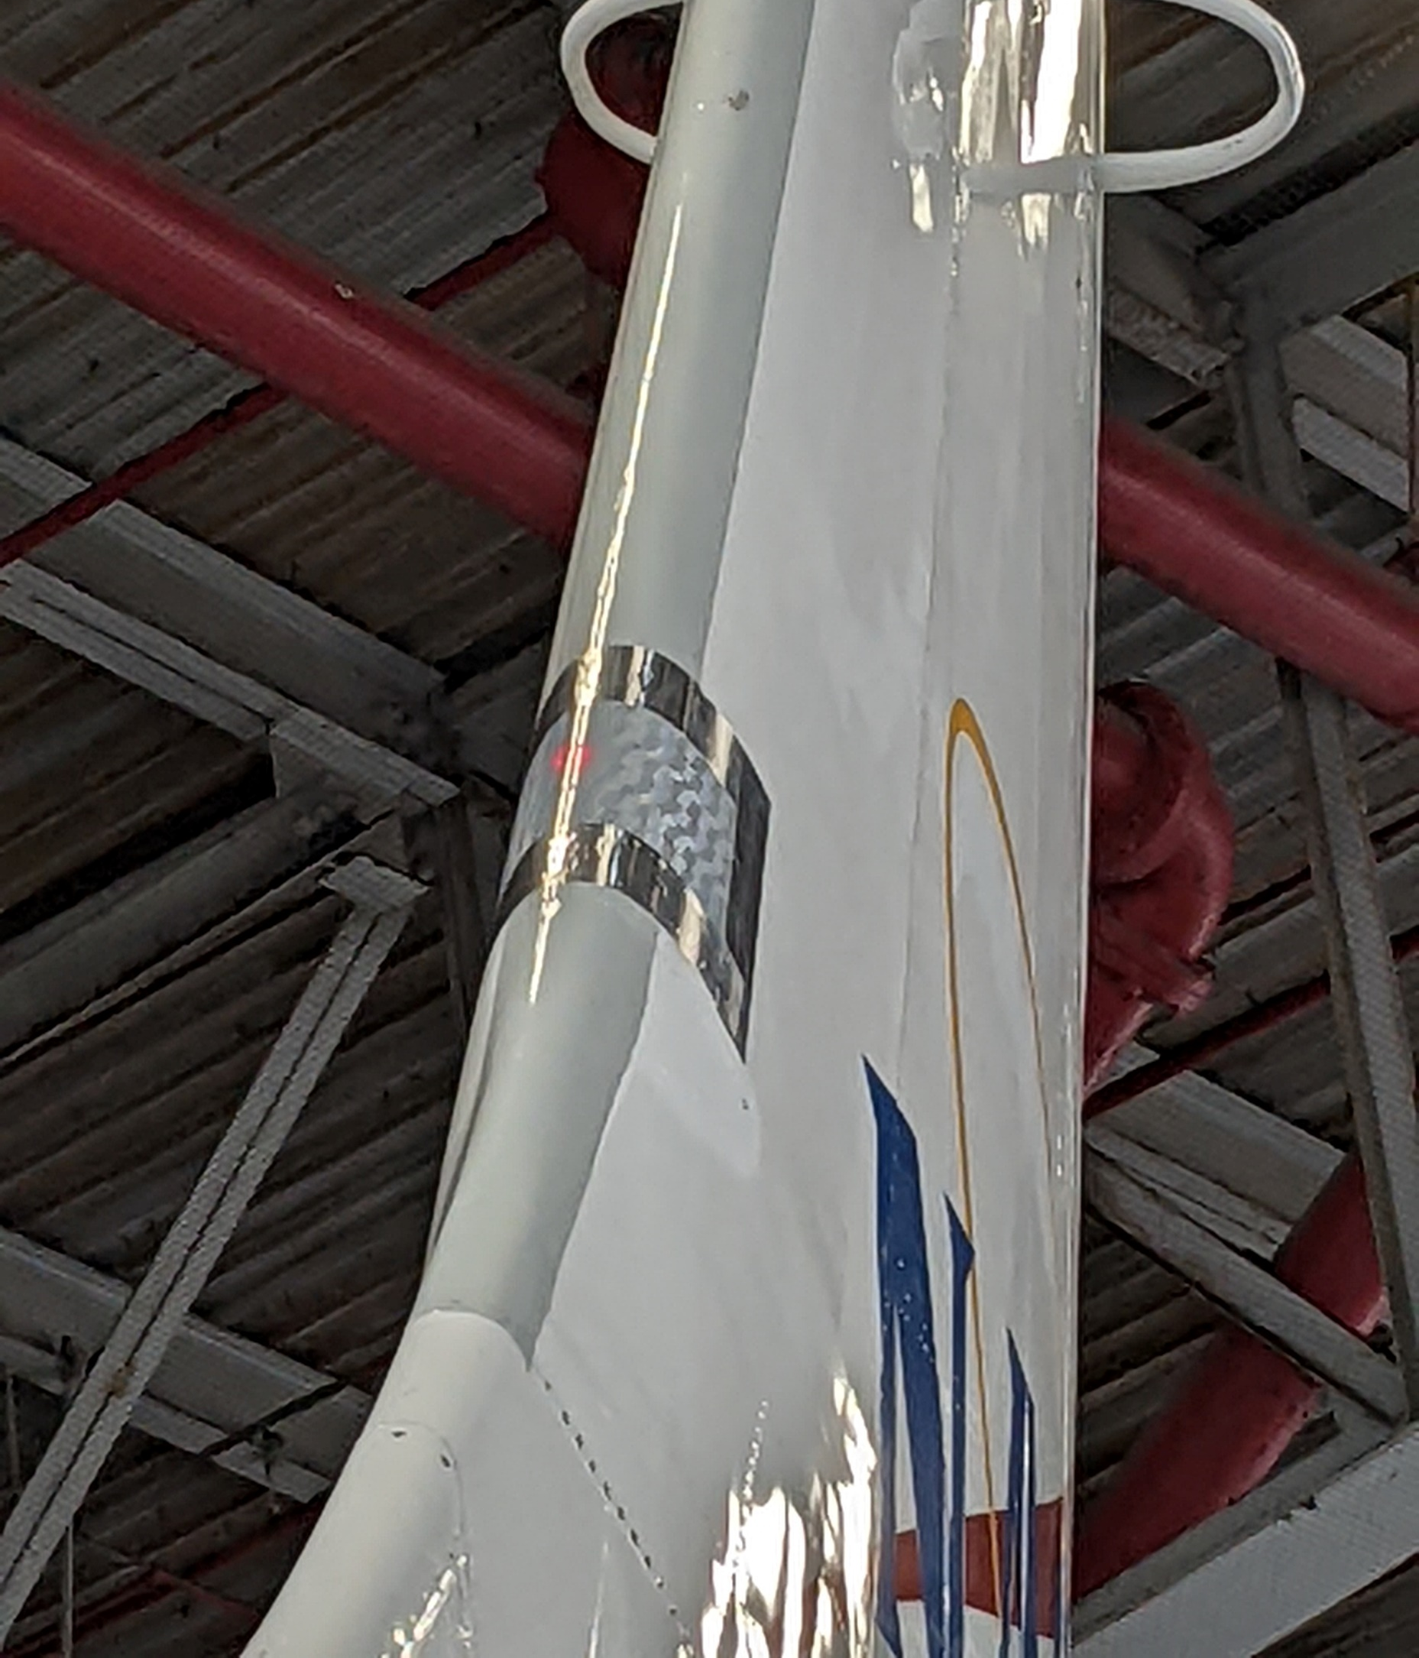
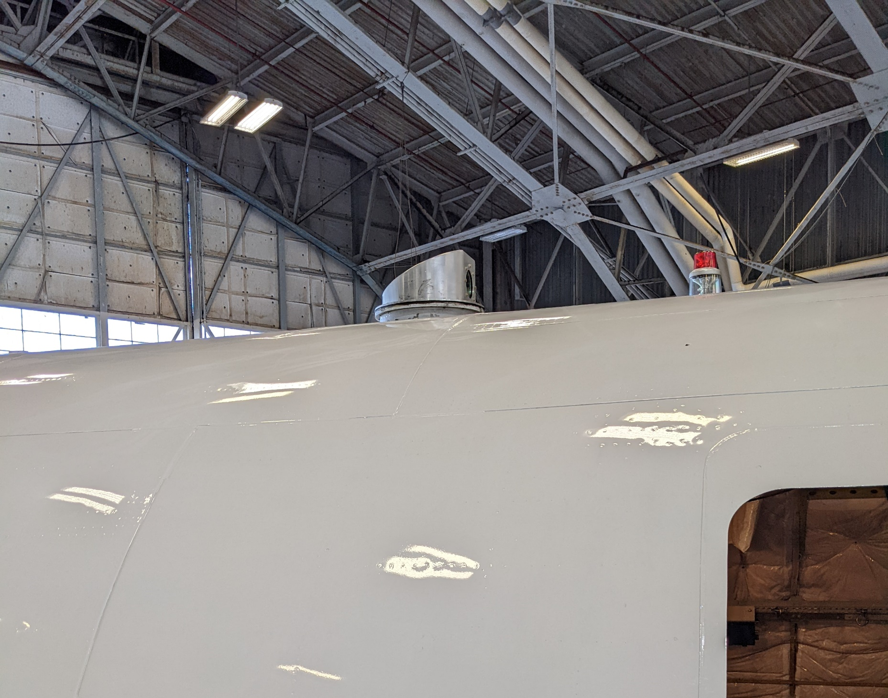
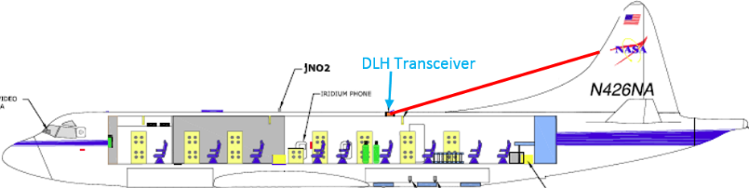

Diode Laser Hygrometer (DLH)
Open path near-IR laser spectrometer measures water vapor by differential absorption over an external path
Line-locked wavelength modulation spectroscopy @ 1.4 μm
Transceiver
Three absorption line with different line strengths
  Large measurement dynamic range
    < 1 ppmv to >4%
  Automatic line changes to optimize
  sensitivity, depending on conditions
Different versions for > 10 aircraft
over >25 years
Instrument performance
  Uncertainty: 5% (H2O(v)), 10-15% (RH)
  Precision: 0.1% or 0.05 ppmv
  Data rate: 1 Hz, 20 Hz,
  others upon request
Retroreflector on tail
laser transmit
laser return
“Tophat” transceiver on
P-3B zenith port
Reflector
Location of DLH external path (red) on NASA P-3B.

Slide 3
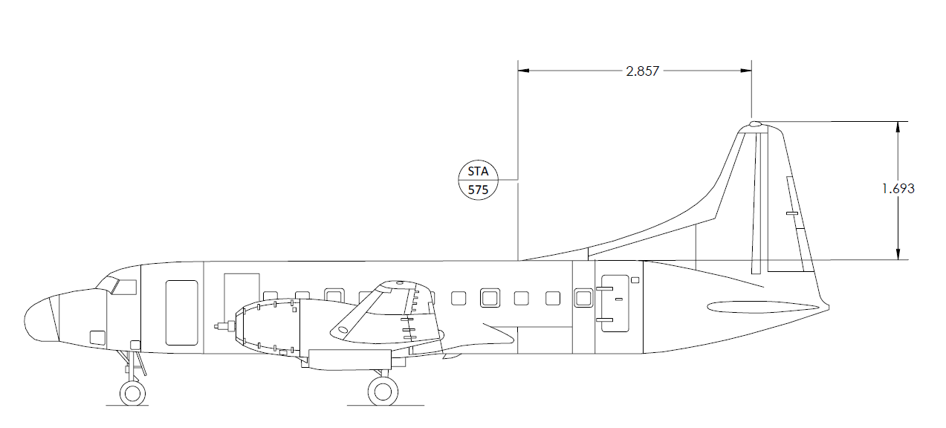
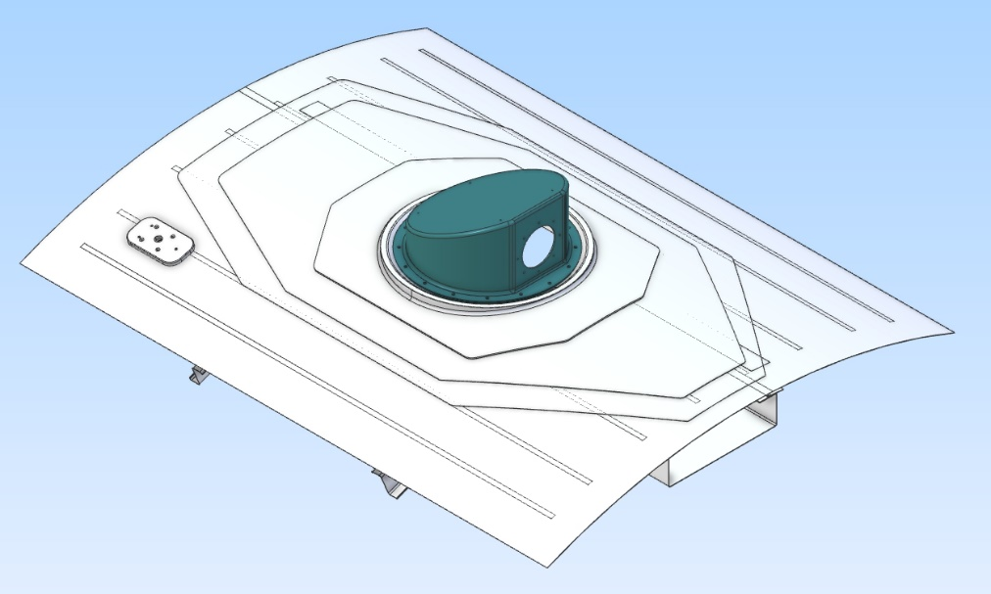
DLH on the Convair-580 for PONEX
Installation should be similar to that on the NASA P-3
  Likely can modify transceiver mounting hardware rather than building new
Sensitivity at low signal is proportional to pathlength
  Path on CV-580 is about 72% of that on P-3
  But the path on CV-580 is the same or longer than that on WB-57 during ACCLIP or on Global Hawk during ATTREX
  The 13m RT path on the CV-580 is easily sufficient to meet the measurement needs of PONEX
Expect to meet with CNRC and ECCC personnel in December to discuss details of DLH installation and operation
Optical Path ~13m RT

Slide 4
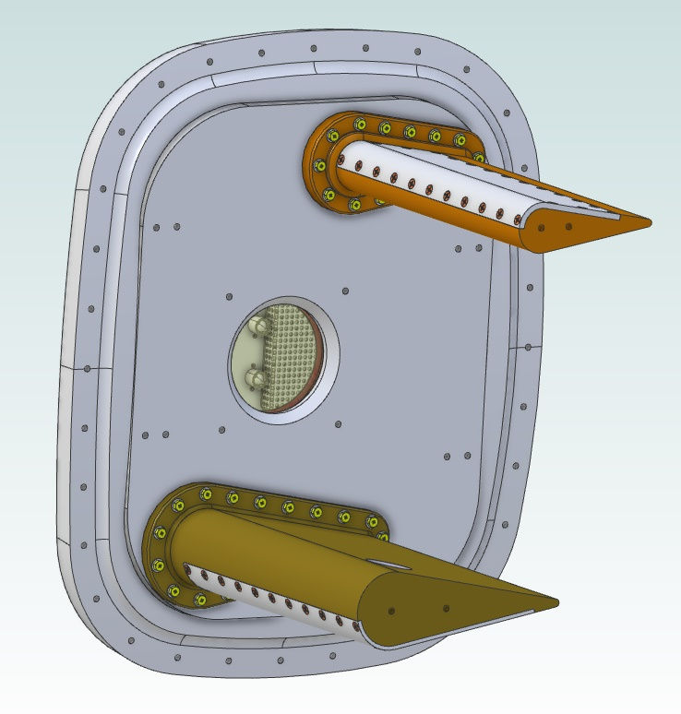
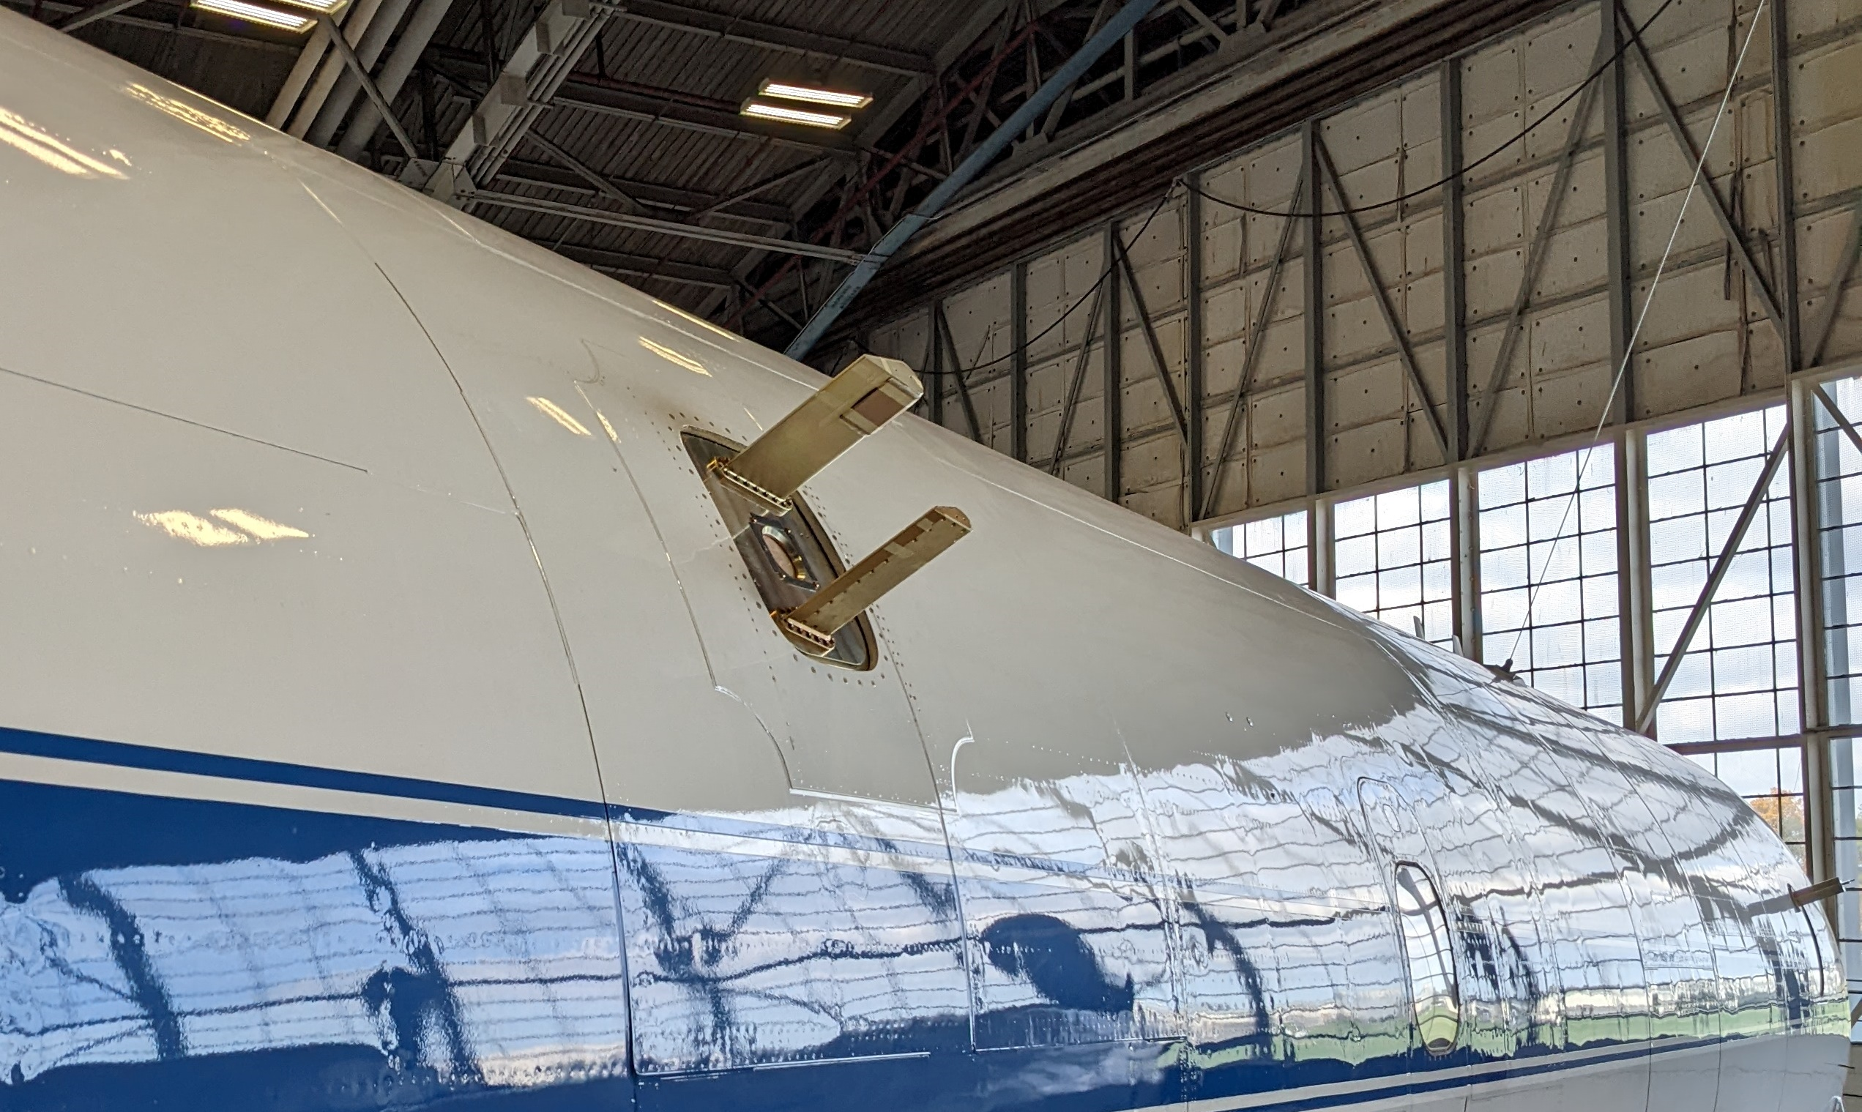
Diode Laser Hygrometer – Short Path (DLH-SP)
Background: DLH relies on a clear view between the optical transceiver and the retroreflector.
  When cloud optical density is too high, DLH is unable to make a measurement
  Dense liquid clouds can contaminate signal with backscatter, rendering optical path uncertain
  During icing conditions, the DLH retroreflector on the P-3 can become coated with ice, resulting in very low or no signal return, until the ice sublimates
New design combines traditional “long path” DLH with a
shorter path between two fins onto a DC-8 window
  On the P-3, only the short path is used
Same fundamental method as DLH
Advantages of shorter path:
  Essentially complete data coverage, even during
  icing or high OD cloud conditions
  More localized measurements
  Insignificant cloud scatter interference
Disadvantages of shorter path:
  Shorter path can result in lower precision
  Greater chance of interference from cabin leaks,
  other fuselage effects

