Slide 1
Developing a Dependable Multi-Agent Rover
Swarm Using cFS
Pavlo Vlastos*, Irfan Sljivo*, Corey Carter, Aaron Woodard
pavlo.g.vlastos@nasa.gov, irfan.sljivo@nasa.gov, corey.k.carter@nasa.gov, aaron.woodard@nasa.gov
GOVERNMENT RIGHTS NOTICE. This work was authored by employees of KBR Wyle Services, LLC under Contract No. 80ARC020D0010 with the National Aeronautics and Space Administration. The United States Government retains and the publisher, by accepting the article for publication, acknowledges that the United States Government retains a non-exclusive, paid-up, irrevocable, worldwide license to reproduce, prepare derivative works, distribute copies to the public, and perform publicly and display publicly, or allow others to do so, for United States Government purposes. All other rights are reserved by the copyright owner.

Slide 2
Table of Contents
The Vision
The Question
What is core Flight System (cFS)?
The Troupe Rover Swarm

Slide 3
The Vision
The future of space exploration and space infrastructure will require autonomous multi-agent systems.
  Satellites
  Rovers
  Others?

Slide 4
The Question
How do we develop a dependable multi-agent rover swarm using NASA’s core Flight System (cFS)?

Slide 5
What is the core Flight System (cFS)?
“The core Flight System (cFS) is a platform and project independent reusable software framework and set of reusable software applications. There are three key aspects to the cFS architecture: a dynamic run-time environment, layered software, and a component-based design. It is the combination of these key aspects that makes it suitable for reuse on any number of NASA flight projects and/or embedded software systems at a significant cost savings.“
https://cfs.gsfc.nasa.gov/
https://github.com/nasa/cFS

Slide 6
What is the core Flight System (cFS)?
Component-based design
Reuseable
Embedded software systems

Slide 7
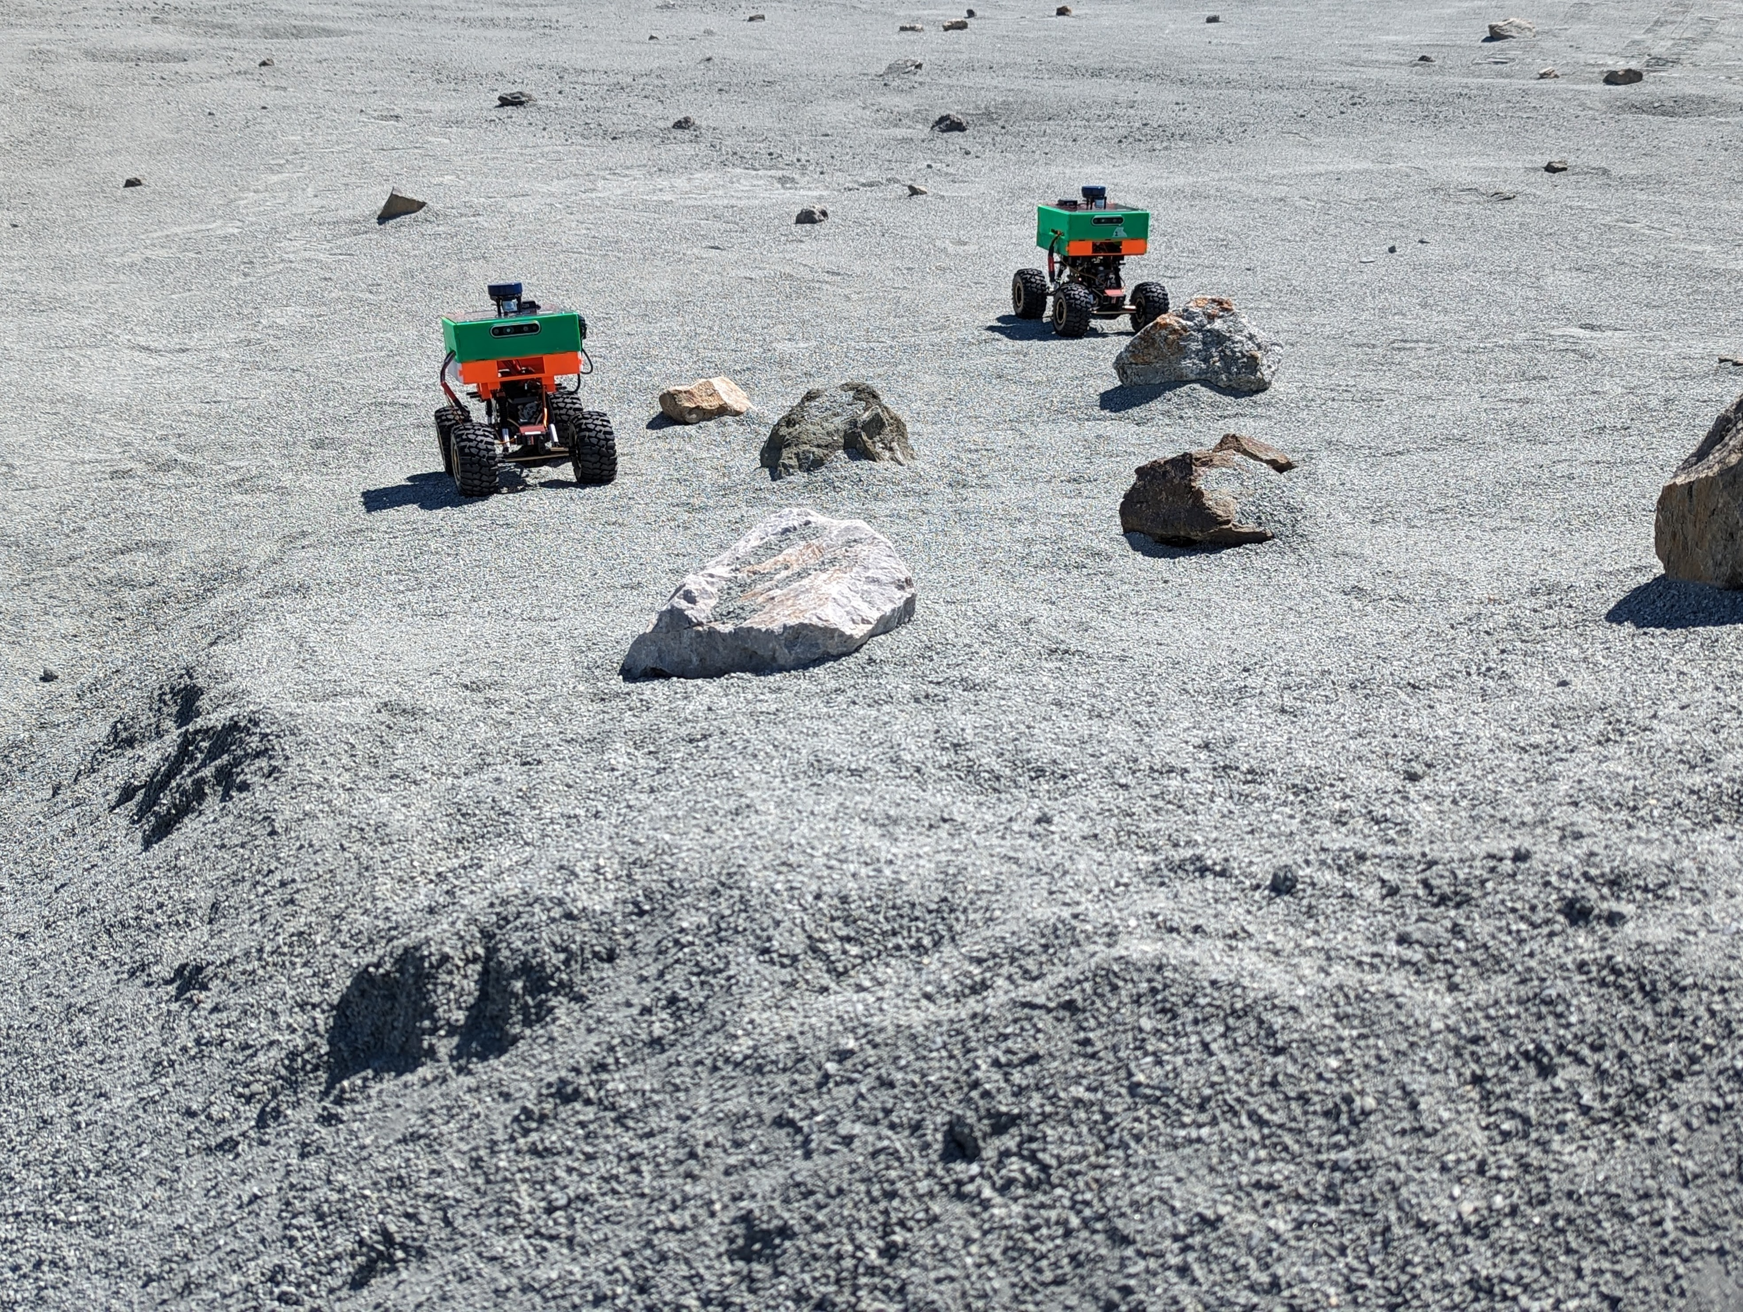
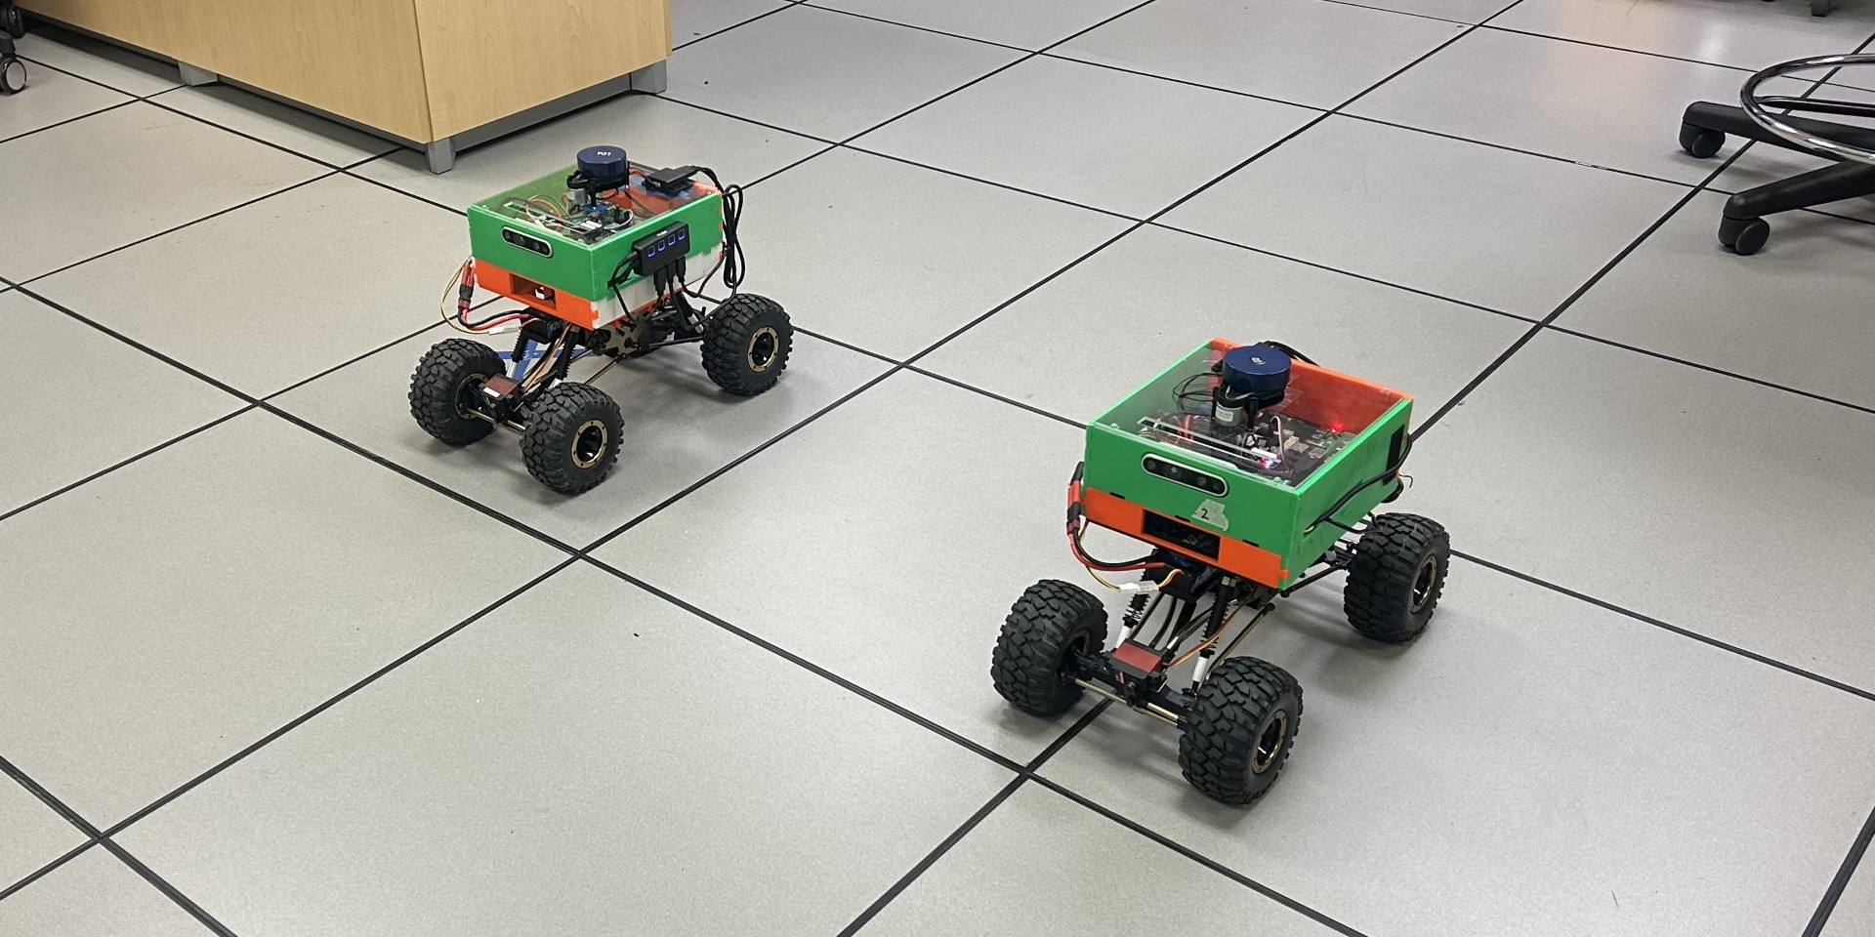
The Troupe Rover Swarm
Troupe aims to develop a swarm of autonomous rovers capable of mapping unknown terrain, and assure their high-integrity using the advanced V&V tools developed in the Robust Software Engineering (RSE) group at NASA Ames Research Center.

Slide 8
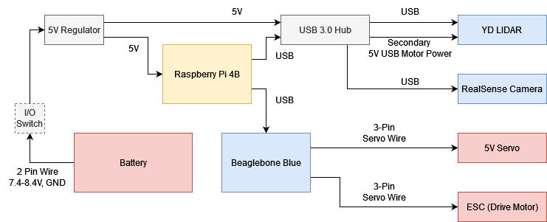
The Troupe Rover Swarm: Hardware
Simple power system
Raspberry Pi 4B running cFS
  Steering and throttle commands via MAVLink messages over USB UART
Beaglebone Blue running ArduPilot
LiDAR
Stereo Camera
BLDC motor for throttle
5V servo for steering

Slide 9
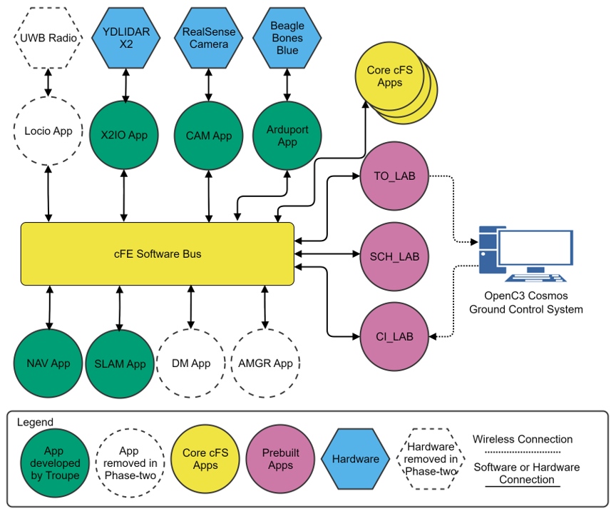
The Troupe Rover Swarm: Software
High-level cFS block diagram for a single Troupe rover
Publish/subscribe
  Messages are passed via shared memory on the core Flight Executive (cFE) software bus.
Some applications are manually-coded others are code-generated using MATLAB/Simulink and an external code interface (ECI).

Slide 10
Can we use Model-Based Development?
“Model-based development (MBD) provides a number of useful features in terms of project development. If implemented correctly, a system that uses MBD will have a more modular architecture, making it easy to swap out models and adapt a system as required. Troupe implemented MBD using Matlab/Simulink.”

Slide 11
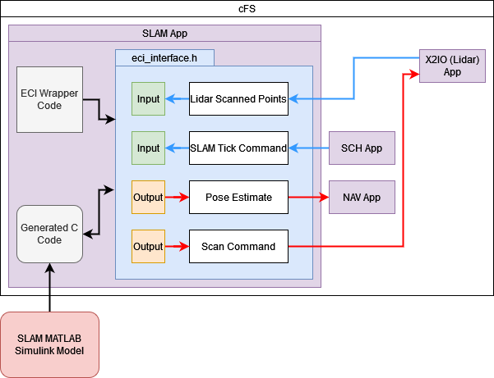
The Troupe Rover Swarm: Software
Example diagram of how the external code interface (ECI) is integrated into the cFS project via the eci_enterface.h header file.
This is how the information structure of the SLAM application and ECI interface are used to specify input and output messages.

Slide 12
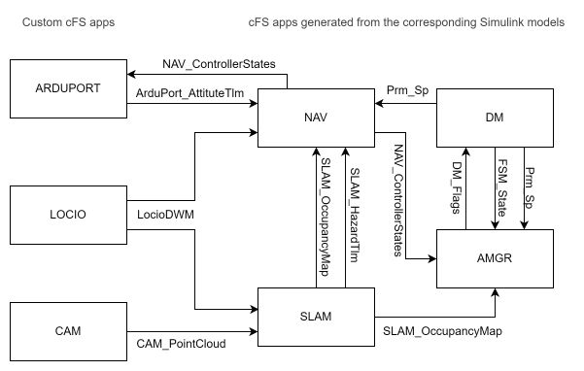
The Troupe Rover Swarm: Software
Phase 1 MBD Architecture:
  Code-generated cFS applications with MATLAB/Simulink:
    Decision Manager application
    Agent Manager application
    Navigation application
    SLAM application
  Manually-coded cFS applications:
    ArduPort application
    LOCIO application
    CAM application

Slide 13
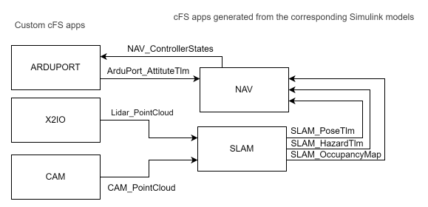
The Troupe Rover Swarm: Software
Phase 2 MBD Architecture:
  Code-generated cFS applications with MATLAB/Simulink
    Navigation application
    SLAM application
  Manually-coded cFS applications:
    ArduPort application
    LiDAR (X2IO) application
    CAM application

Slide 14
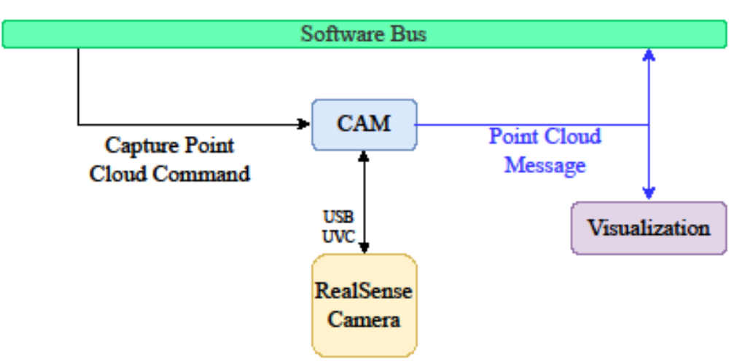
Software Component Testing
A block diagram example of isolated component testing of a manually-coded cFS application
We can run the cFS application on the target hardware (Raspberry Pi 4B)
We can make changes to the application source code.

Slide 15
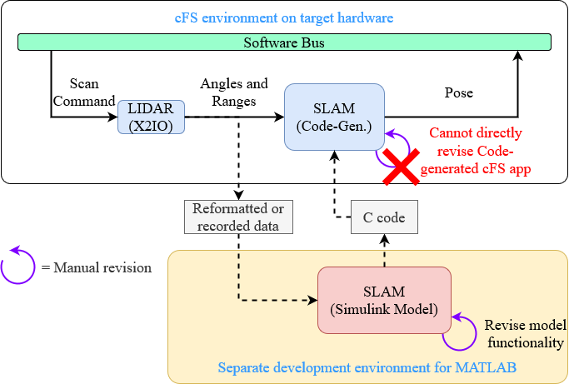
Software Component Testing
A block diagram example of a code-generated application (SLAM)
Requires input data to test
It is infeasible to revise generated code (instead you revise the Simulink model)
Code-generation is unidirectional
  The Simulink model does not change if you change generated source code
Performance differences between running Simulink model on desktop versus target hardware

Slide 16
Lessons Learned
Challenges in maintaining synchronization between model-based (MATLAB/Simulink) cFS applications and manually-coded cFS applications
Simulink was used to model entire cFS applications versus generating code for an underlying library that could be called by a cFS application
Code generation for a single application could exceed 10 minutes on a desktop computer
Some roadblocks for publishing generated-code for open source
Verification and testing of code-generated cFS applications had to be done in integrated testing environments with other cFS applications on the target hardware
Simulink code generation with dynamic memory allocation is restricted to certain instruction set architectures (ISA) that often do not match the target hardware
Code optimization of ARM or RISC-V is limited for certain code generation features

Slide 17
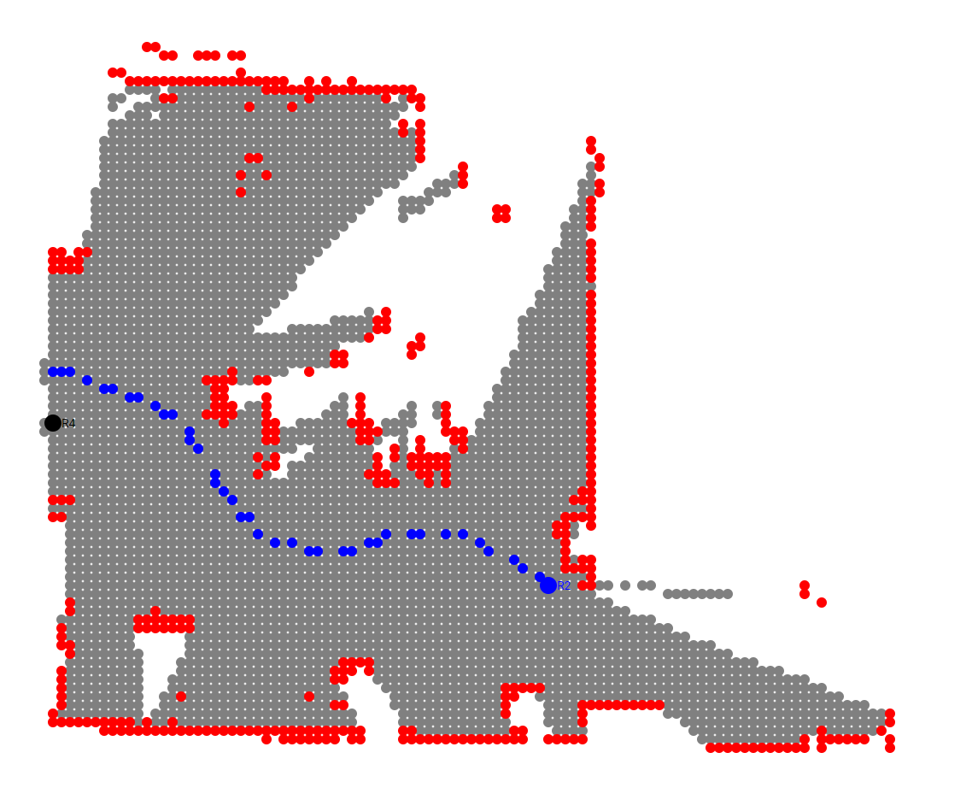
Results
Rovers are able to map testing environments using MATLAB/Simulinik code-generated SLAM cFS application
Demonstrated model-based development in multiple phases
Created 4 rovers capable of collaborative SLAM map merging
Iterating on new rovers version to leverage more powerful embedded hardware
10 x 10 m² occupancy map output from SLAM application. Red is occupied, gray is free, and white is unexplored.

Slide 18
Questions and Answers
Thank you!

