Slide 1
EV73 Human Systems Integration Team
NASA Marshall Space Flight Center (MSFC)
Tanya Andrews
MSFC EV73
Human Systems Integration Team Lead (Acting)
Systems Analysis and Human Systems Integration Branch, Deputy Chief
tanya.c.andrews@nasa.gov

Slide 2
EV73 - Systems Analysis and
Human Systems Integration at MSFC
The EV73 Systems Analysis Branch includes multiple disciplines and tools to assist projects in engineering analysis and design development.
  Systems Analysis
    Modeling & Simulation
    Mass Properties
    Imagery Analysis (Photogrammetry)
    Government Furnished Property Management
  Human Systems Integration (HSI) Team
    Human Factors Engineering (HFE)
    Integrated Logistics, Supportability and Sustainability Engineering (ILS)
    Technical Training
    Habitability
    Maintainability
The team is responsible for determining and levying appropriate HSI requirements on hardware fabricated and/or used on MSFC managed programs and projects. Additionally, the HFE team is responsible for verifying that designs and operations of that hardware meet the established requirements set.

Slide 3
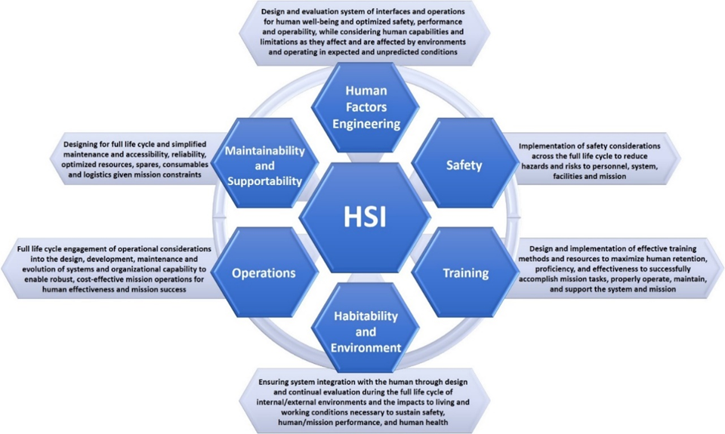
Human Systems Integration at MSFC
EV73
Functions
*Humans/Human Behaviors: users/operators; ground controllers; monitoring personnel; trainers; integration and test personnel; manufacturers; maintainers; assembly personnel; logistics personnel; automation/autonomous systems that mimic human decision making and action (where humans provide the requirements).
Safety, Training, and Operations knowledge exists at MSFC in other branches. EV73 also has extensive experience in Training and Operations.
NASA HSI Handbook

Slide 4
Human Systems Integration at MSFC
This work includes:
  HSI requirement development and verification.
  Support to projects developing new technology.
  Evaluation of concepts prior to official design analysis.
  Iterative design analysis throughout design cycles.
  Worksite analyses for the design and use of Ground Support Equipment (GSE).
  Worksite analyses for pre-launch assembly, integration and test activities.
  Virtual and Augmented Reality (VR/AR) assessments of hardware designs to identify areas for potential improvement.
  Integrated Logistics and Supportability Planning.
  Maintainability Assessments (HFE and Logistics).
  Manufacturability Assessments.
  The build of mockups and virtual models to support this work, resulting in valuable SME insight and design recommendations based on requirements and team experience.

Slide 5
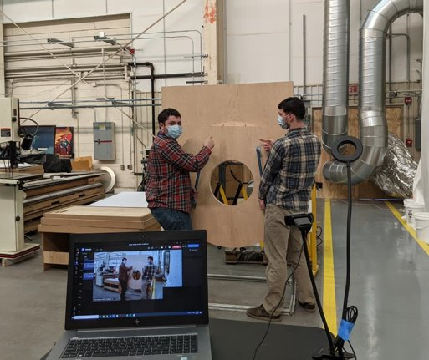
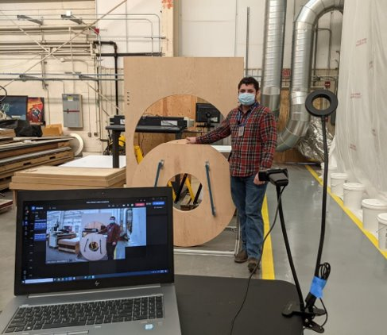
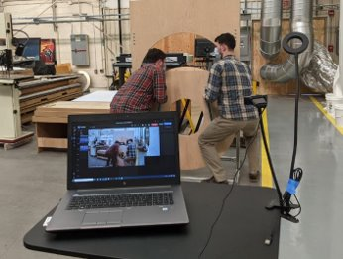
Collaboration with Remote Partners​
EV73 Human Factors collaborates with remote partners, via webcam, to participate in assessments, design evaluations and operations planning​
  Example below showing collaboration with KSC EGS to optimize assembly and maintenance operations planning and provide ground crew training for the SLS vehicle. ​

Slide 6

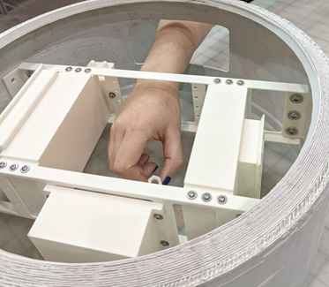
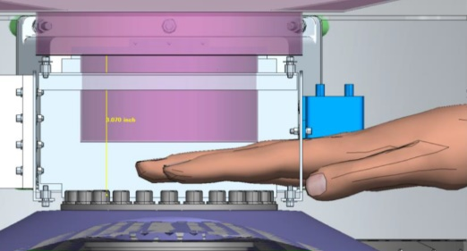
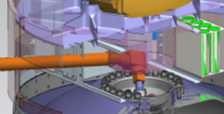
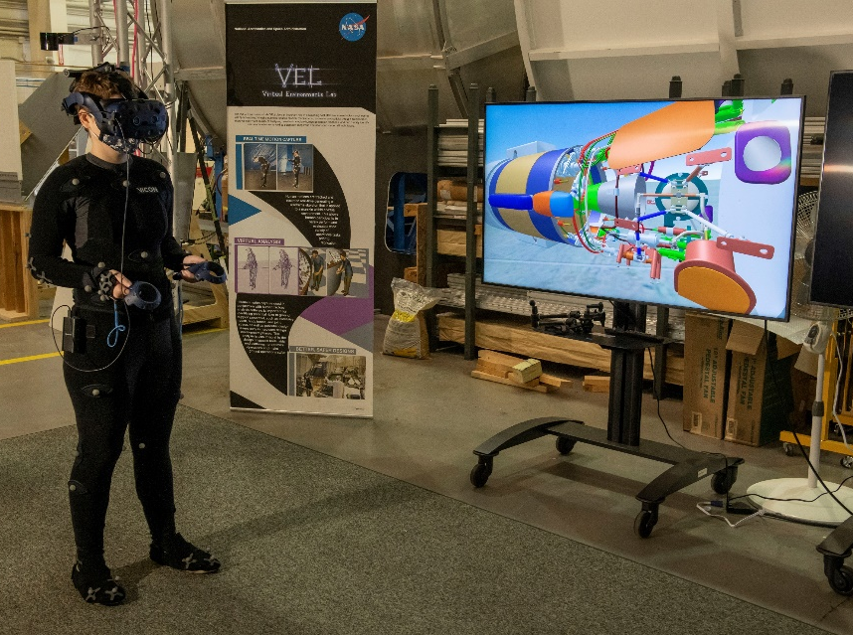
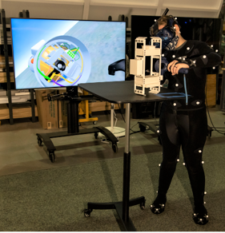
HFE Analysis Types
Physical Analyses use mockups to allow physical assessment of a design
Virtual Analyses using Process Simulate Human (PSH) to assess access, work envelope, reach, line of sight etc., for the required female and male percentiles, as well as, assessing tool fit and function.
25th Percentile Female
Mixed Reality Analyses merge real and virtual objects utilizing 3-D printed mockups within the VEL provides passive haptics and real dynamics to test subject performing assessment
75th Percentile Male
Virtual Reality Analyses allow users to interact with the model in a completely virtual world. This can be combined with Motion Capture to improve the assessment

Slide 7
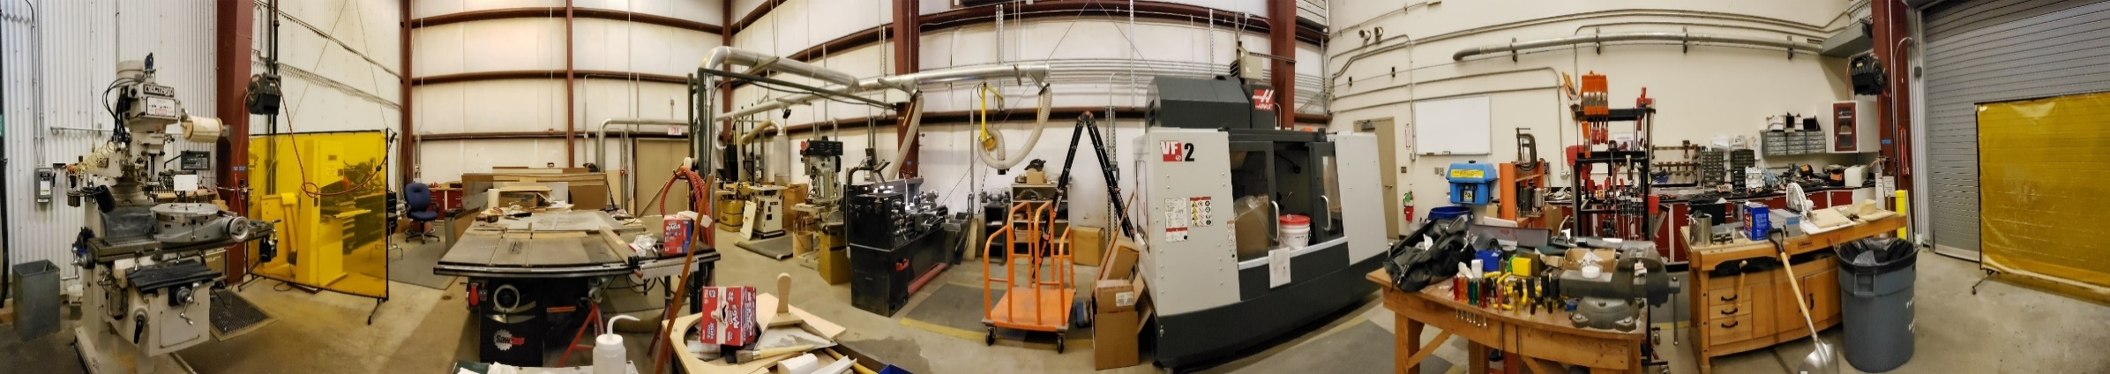
Fabrication Capabilities
In-house Mockup Shop capabilities enable the production of a wide variety of large and small scale mockups for projects, economically and rapidly by a team of engineers and technicians that are experts at selecting the correct methods and materials to support projects of all sizes and budgets.
Mockup Shop in Building 4649
3 Axis Knee Mill | CNC Router 4'x8' Bed | Drill Press
Horizontal Metal Lathe | Haas CNC 3 Axis Milling Center | Metal Shear
Spindle Sander | Table Saw | Wood Planer
Compound Chop Saw | Metal Brake | Sheet Roller

Slide 8
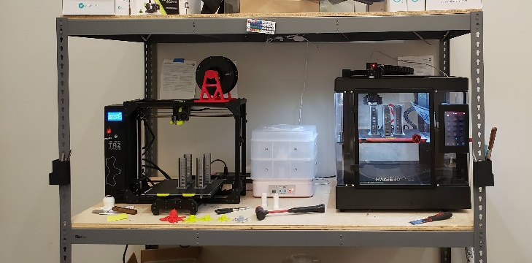
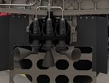
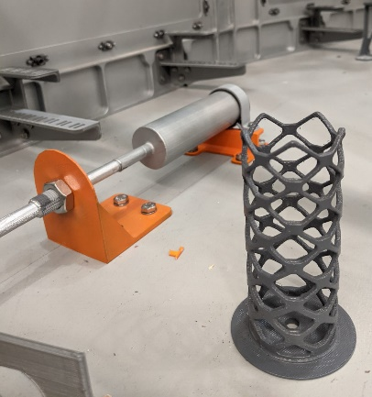
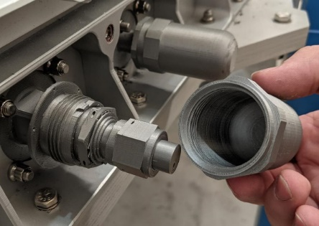
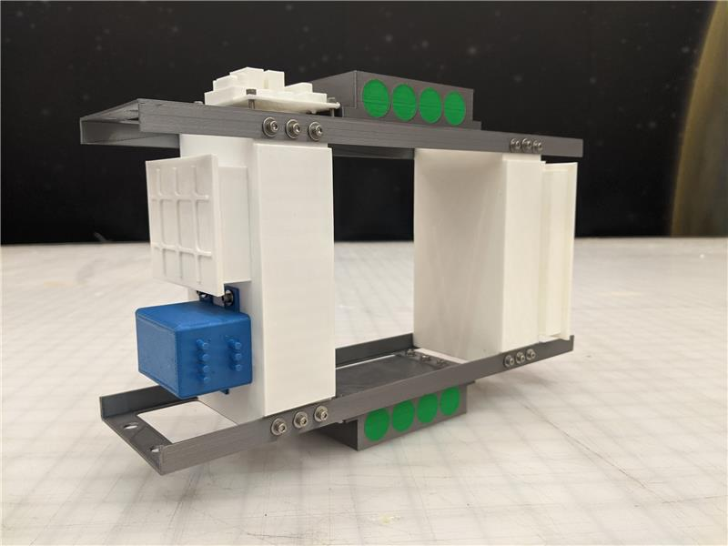
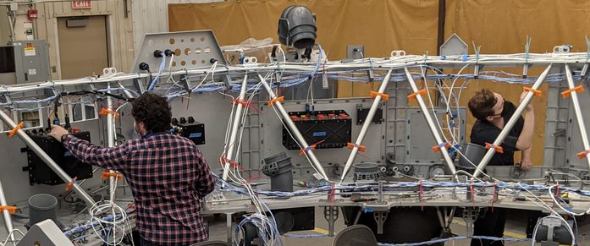
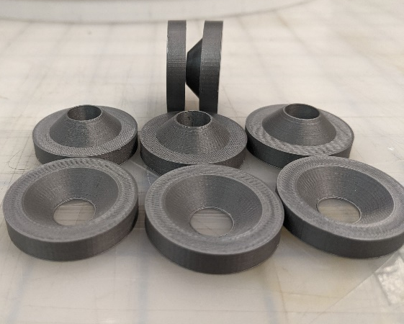
3-D Printing for Rapid Prototyping
3D Printing Station
Printer | Print Volume
LulzBot TAZ Workhorse | 280 mm x 280 mm x 285 mm (11.02 in x 11.02 in x 11.22 in)
Raise3D Pro2 | 305mm × 305mm × 300 mm (12 in × 12 in × 11.8 in)
Detailed Prints for SLS
SLS Thrusters
MAV Forward Structure
Truss Assembly
Examples of Integration of Detailed Printed Parts
MAV Separation Pucks

Slide 9
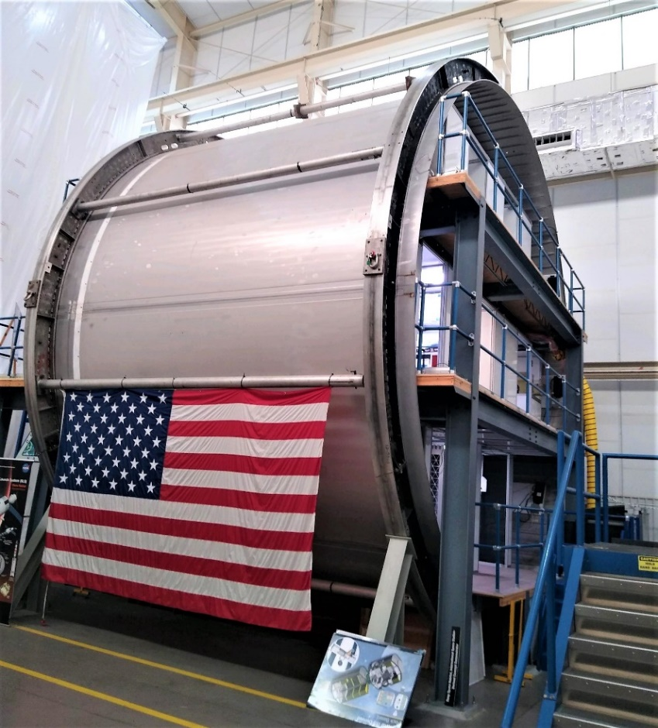
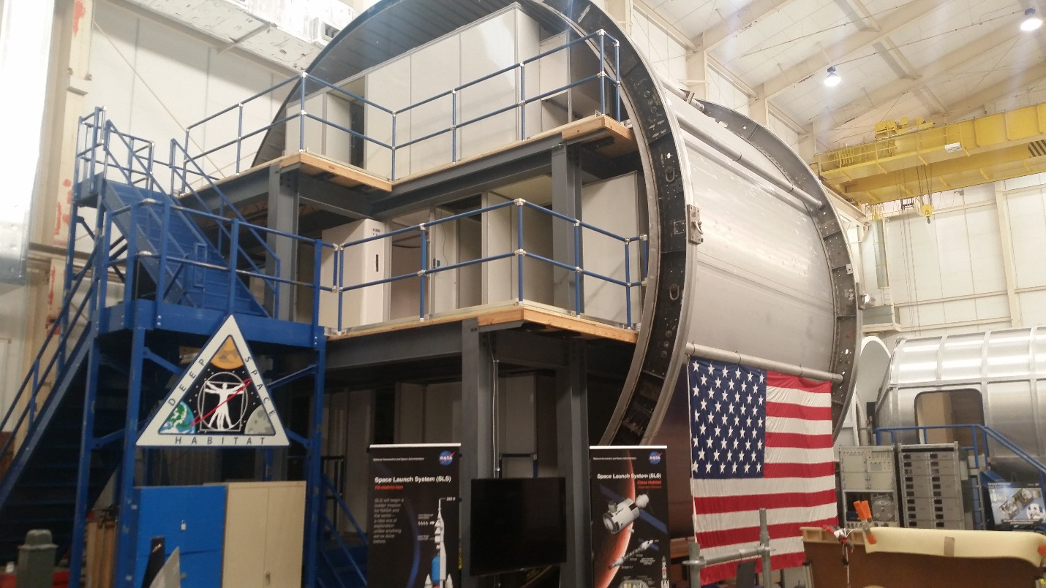

Deep Space Habitat (DSH) Mockup
The Deep Space Habitat mockup is a conceptual test bed that illustrated a variation of a NASA concept, derived from SLS, that could be used to support crewed exploration missions to the Moon, asteroids, and eventually Mars.
The mockup was 8.4 meters in diameter and had three levels, each providing mockup concepts of possible technology to be used on DSH. Multiple test beds were developed in this facility.

Slide 10
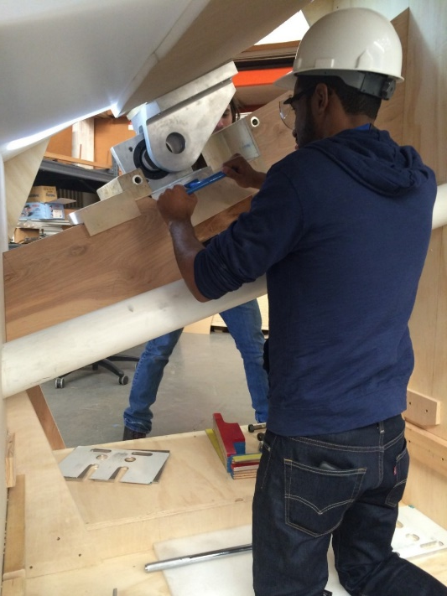
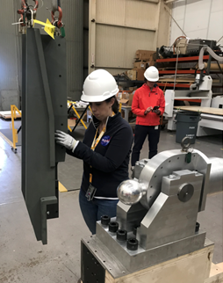
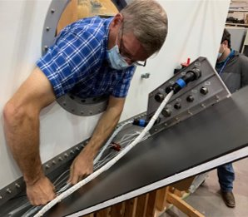
HSI Assessments using
Prototyping and Part Task Mockups
The HFE team studies and analyzes many flight and ground system hardware designs. These assessments are interactive and involve both VR and Prototyping Development to support Project needs. When initial analyses show areas of serious concern, a part task mockup can be constructed by the shop for a more thorough analysis.
A full-scale mockup is developed representing the specific area of concern in very high fidelity. Other, non-problematic, elements of the mockup are built to be functional, but at a lower fidelity, for cost savings.
A human factors engineering analysis is performed, working through all operations of the hardware. The hardware designers participate or are briefed on the findings. The physical mockup makes illustrating problems much simpler.
This process allows designers to make improvements to the design before fabrication starts.
Assessments of SLS Integration Activities

Slide 11
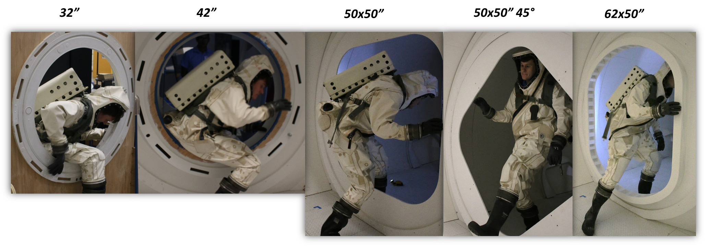
HFE Analyses of Hatch Sizes using Part Task Mockups
EV73 assessments of Hatch Configurations help to establish hatch designs

Slide 12
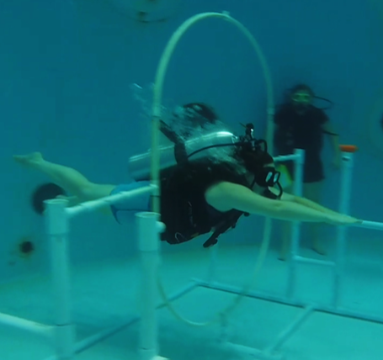
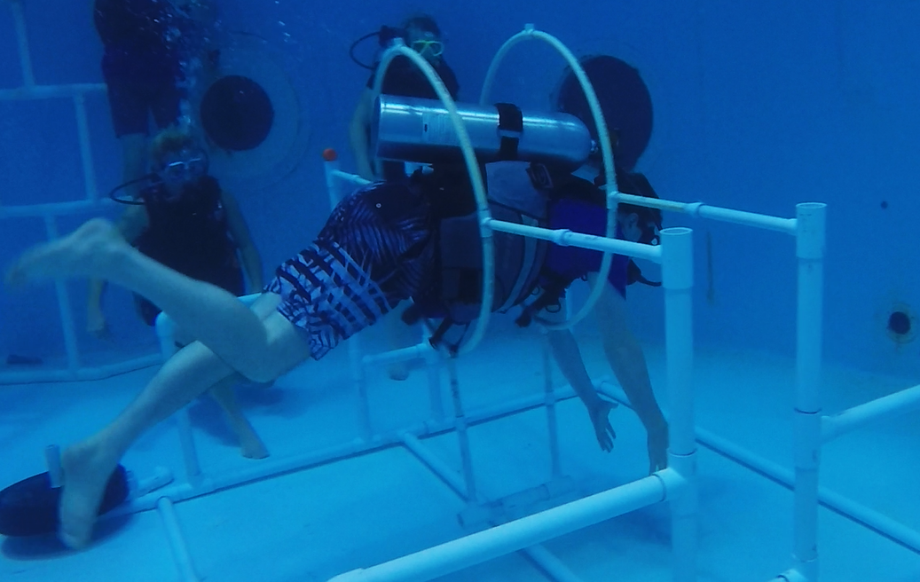
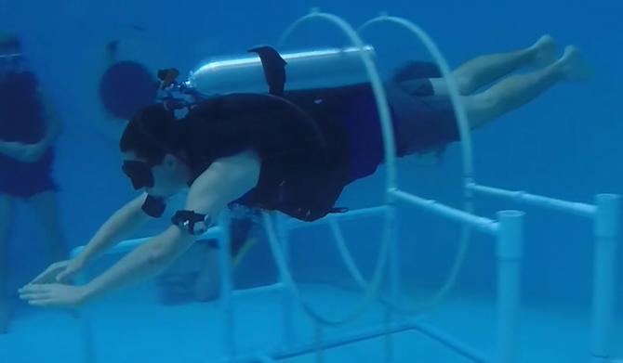
Microgravity HFE Hatch Size Analyses
EV73 microgravity assessments of Hatch Configurations underwater analyses

Slide 13
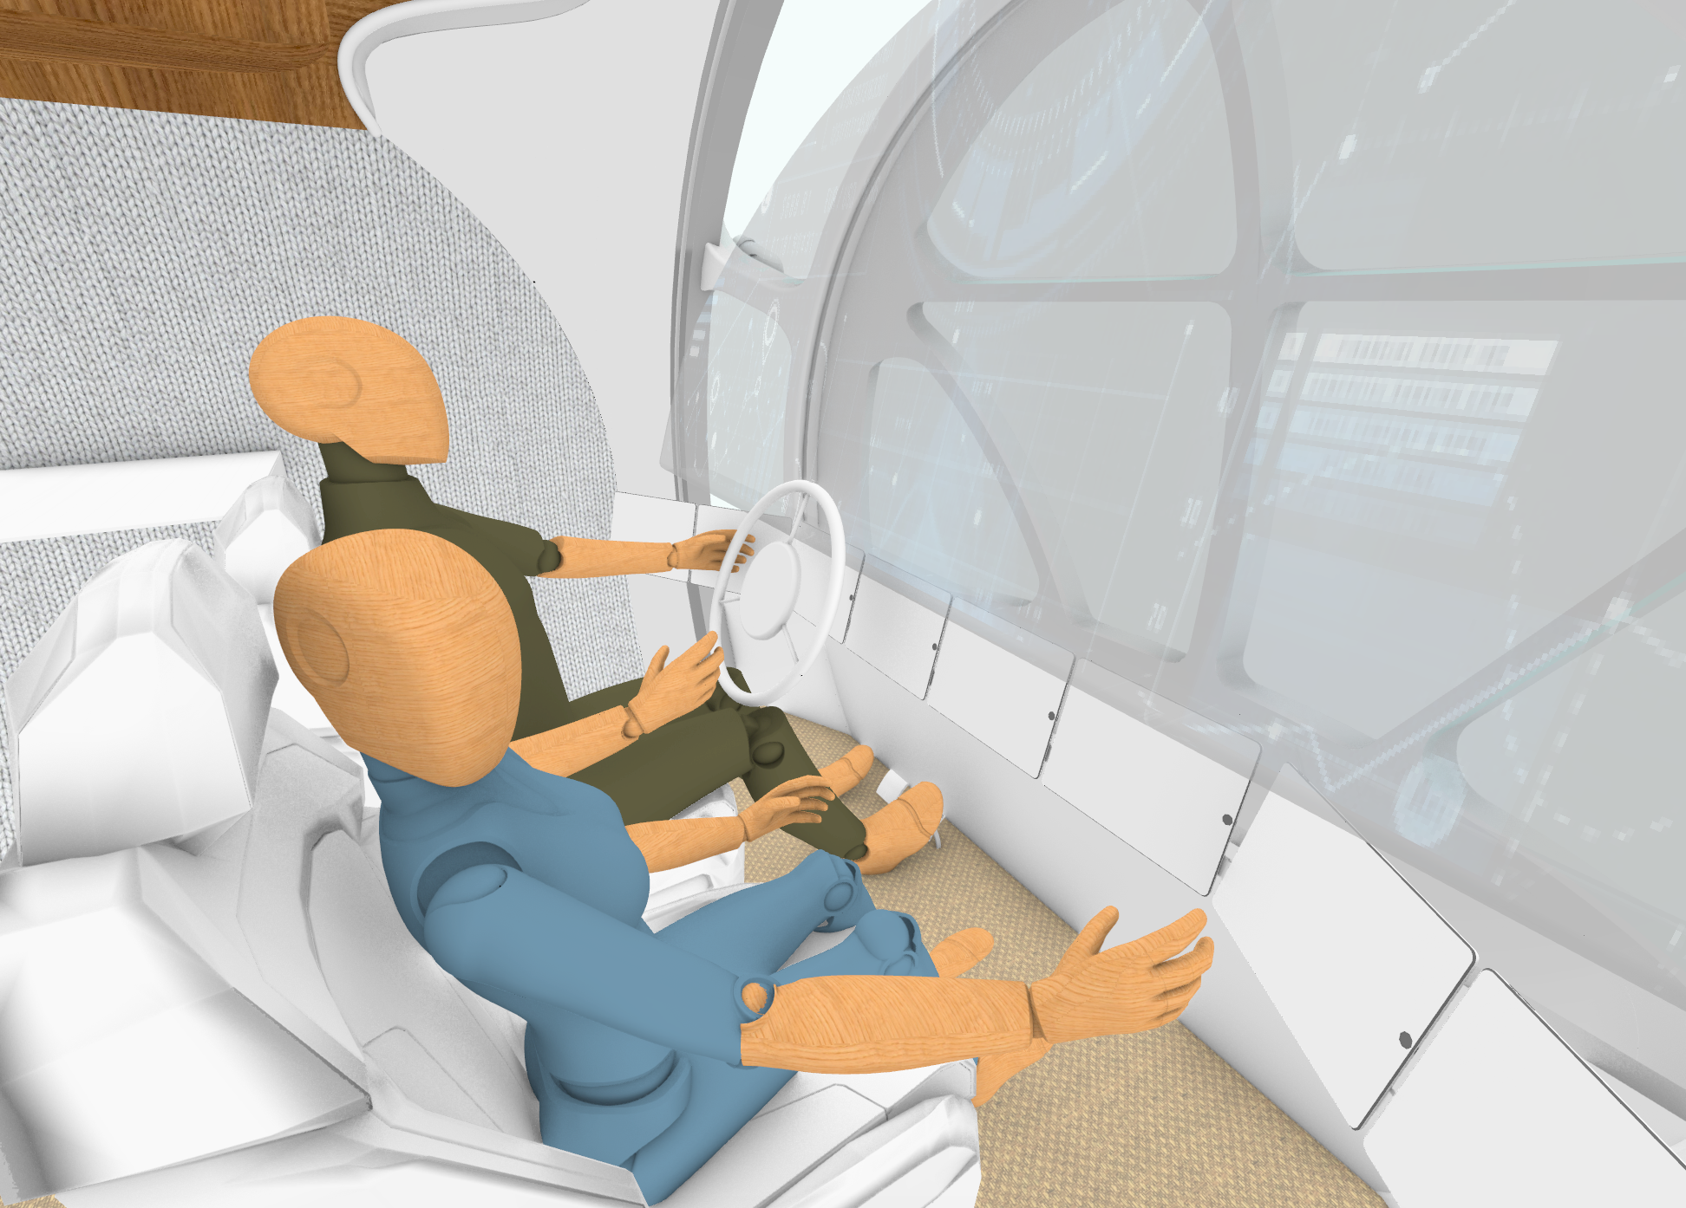
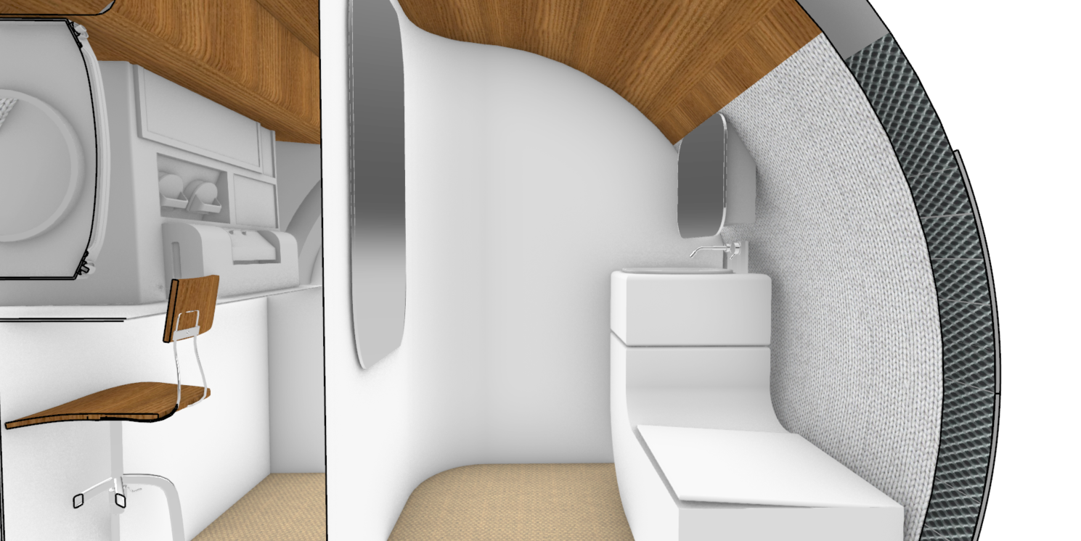
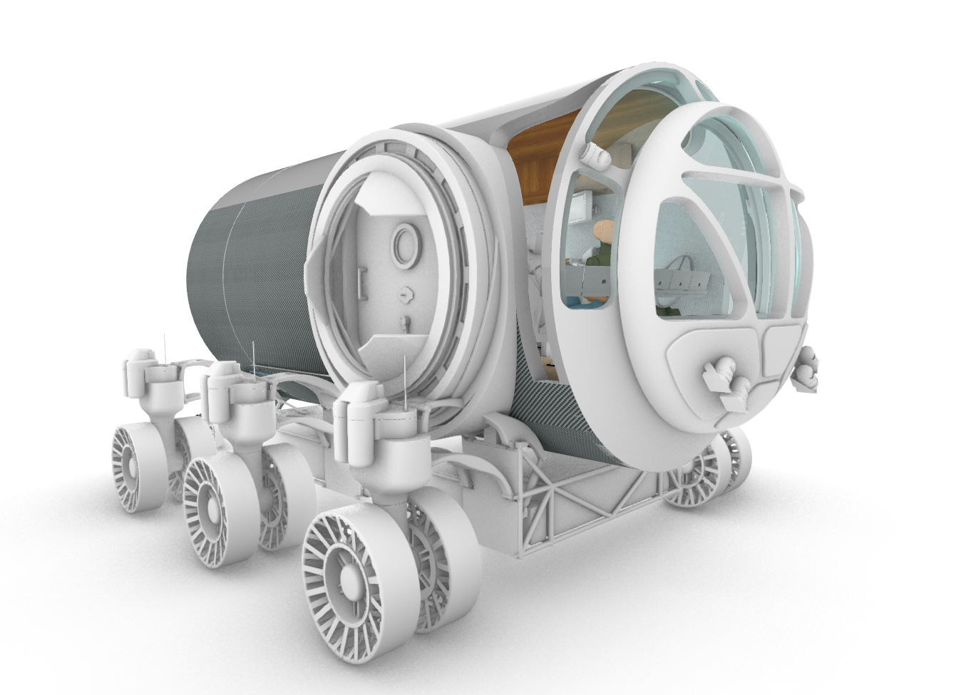
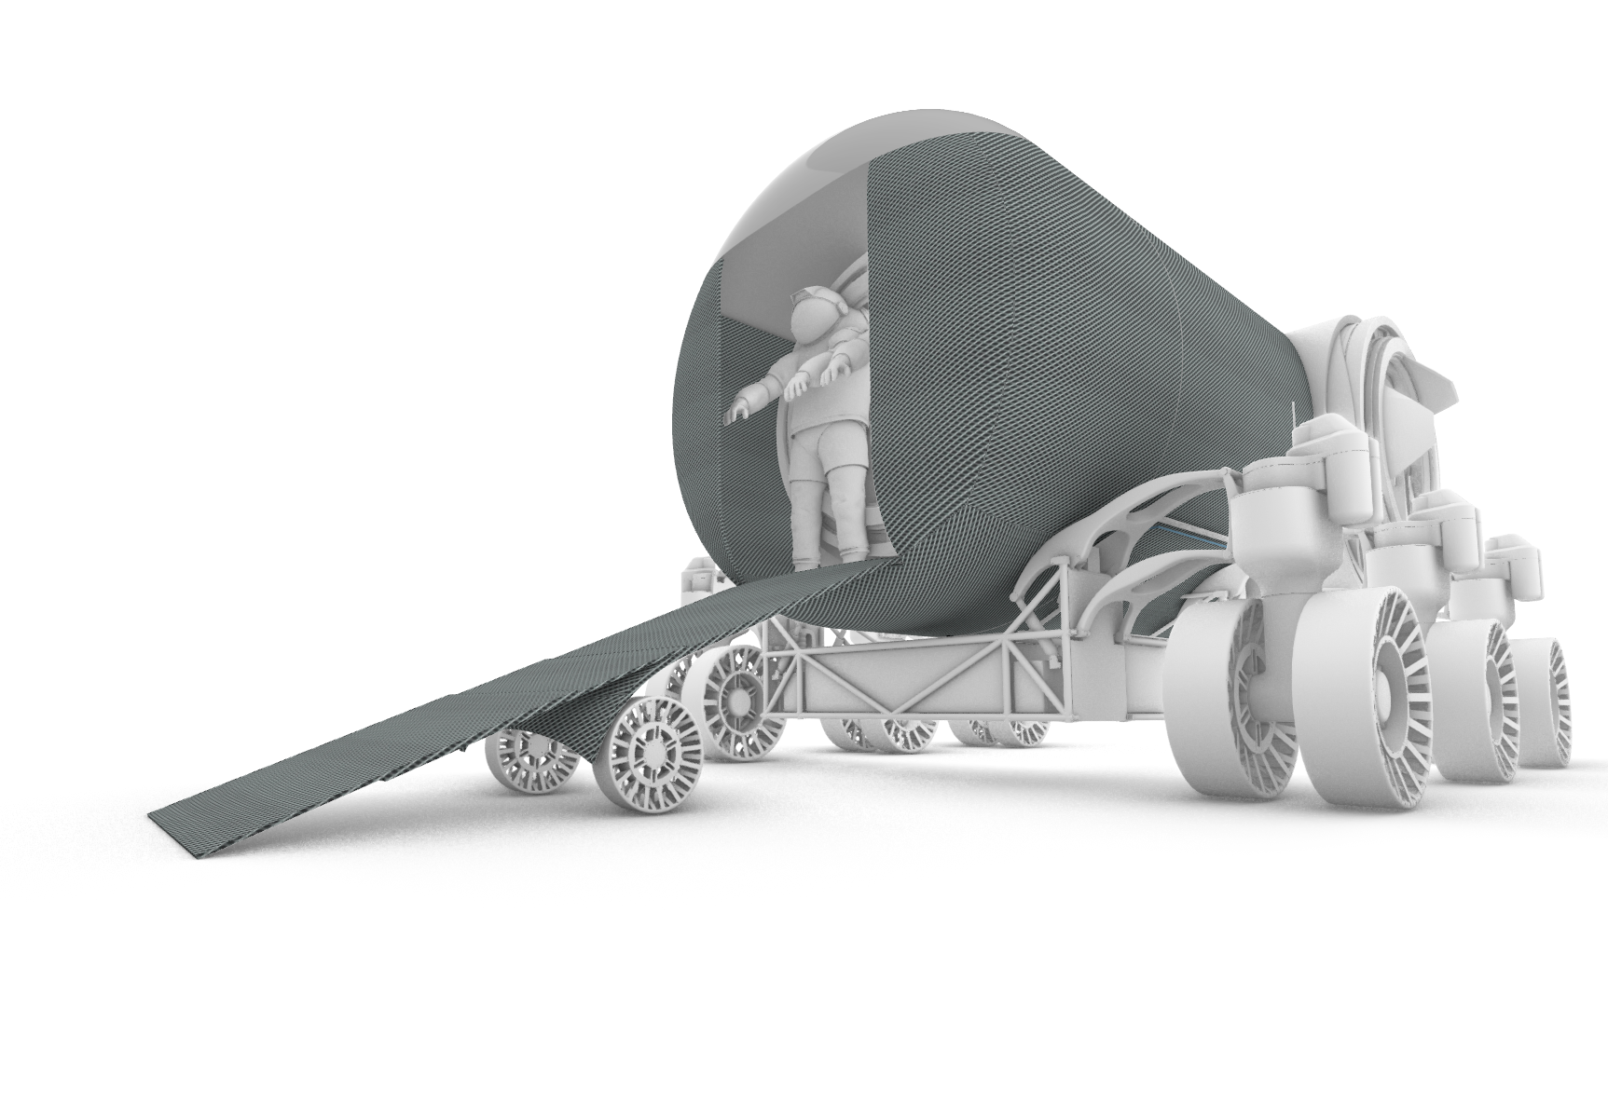
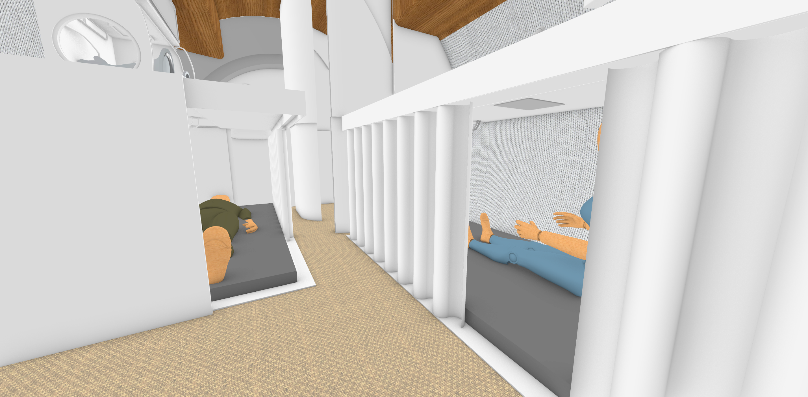
Advanced Concepts Office (ACO) Collaboration
Projects for ACO include the conversion of a Cygnus module to represent a Mars Exploration Mobile Laboratory.

Slide 14
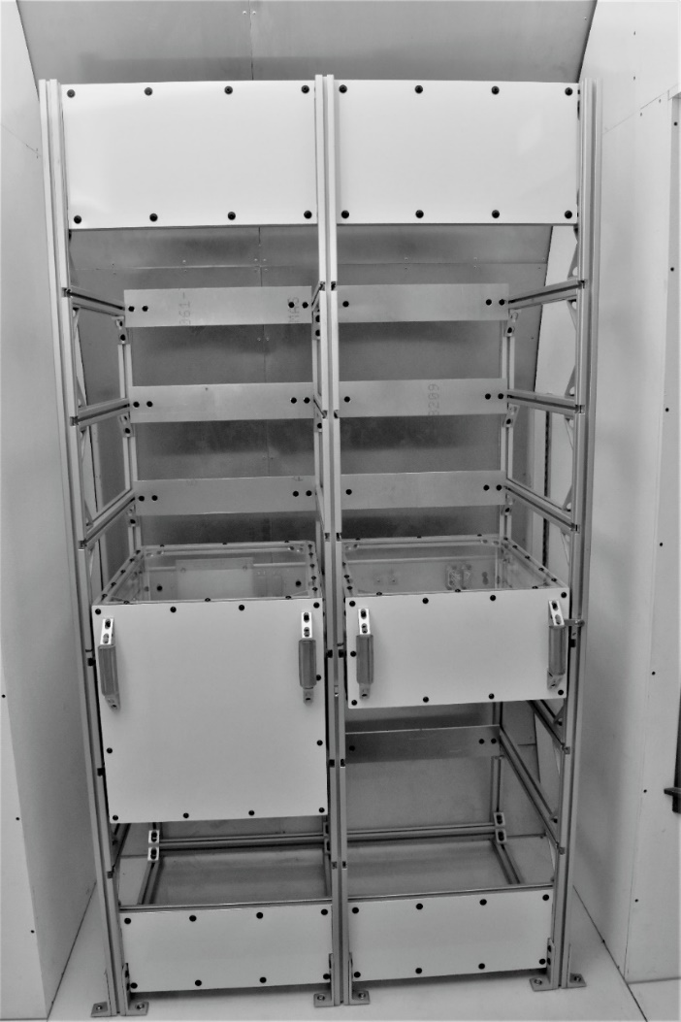
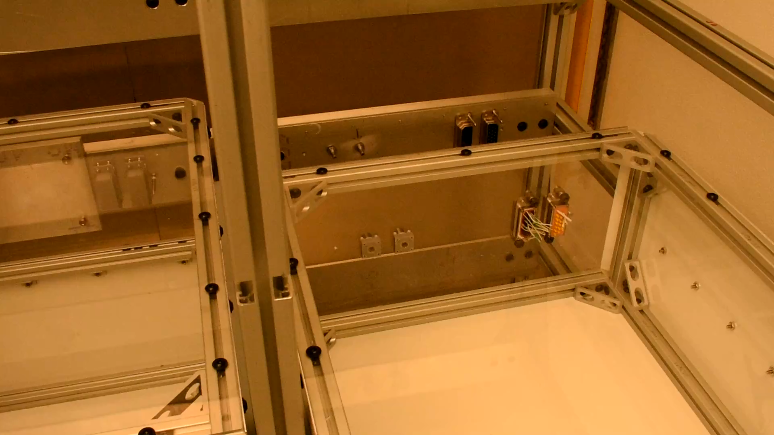
Payload Concept Mockups for ACO Assessments
The Gateway Pressurized Payload Facility double rack mockup illustrates a Blind Mate concept for cooling loop, power, and data. The concept of blind mating would allow robotic installation of payloads when the Gateway is unmanned.
A commercial partner is now developing this concept for use on Gateway.
Payload Blind Mate Video

Slide 15
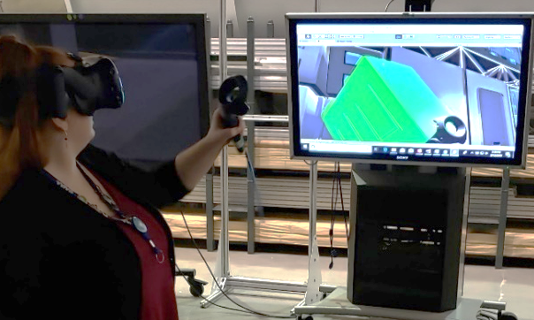
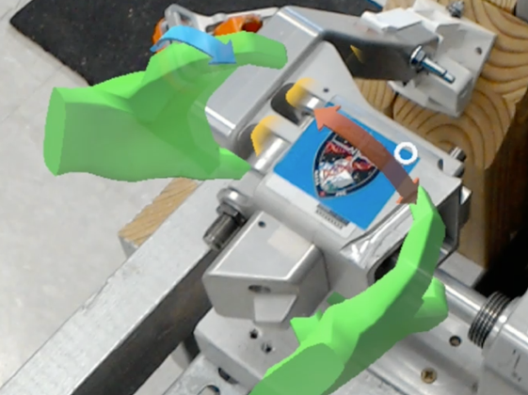
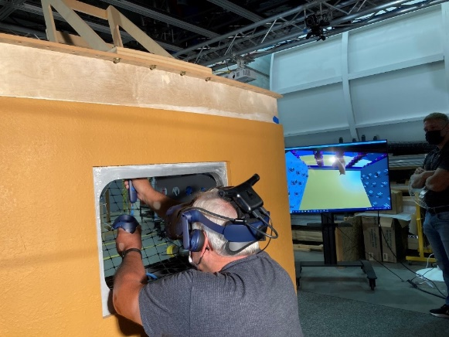
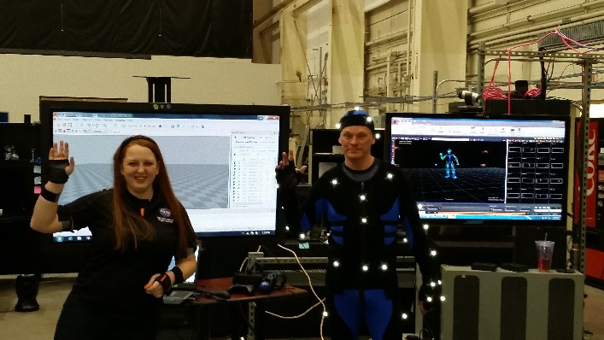
Systems Analysis XR at MSFC
XR: a term that encompasses virtual, augmented, and mixed reality
Augmented Reality (AR):
Virtual Reality (VR):
Overlays CG with real world
No interaction
Immersive experiences
Real-world content vs computer generated (CG)
Mixed Reality (MR):
Motion Capture (MoCap):
Overlays CG with real world
Incorporates interaction
Mockups make environment more realistic
Records the movements of people or objects
Translates movement into virtual format
Notes:
Virtual Reality (VR): Virtual reality allows immersive experiences, which can be created using real-world content (e.g. pictures), purely synthetic content (e.g. computer graphics (CG) models) or a hybrid of both (e.g. CG models with texture maps)
Augmented Reality (AR): Augmented reality overlays CG content onto the real world, but this content is not anchored to or part of the real world. The real-world content and the CG content do not interact with each other (e.g. the CG viewpoint does not change).
Mixed reality (MR): Mixed reality (sometimes referenced as hybrid reality) overlays CG content onto the real world, and it is anchored to and interacts with the real world in real-time (e.g. the CG content scales in size as the user changes viewpoint).
Motion Capture (MoCap): is the process of recording the movement of objects or people.
Sources:
AR: https://phys.org/news/2018-11-augmented-reality.html
MR: https://www.foundry.com/industries//vr-mr-ar-confused - https://www.vicon.com/what-is-motion-capturevirtual-reality
MoCap:

Slide 16
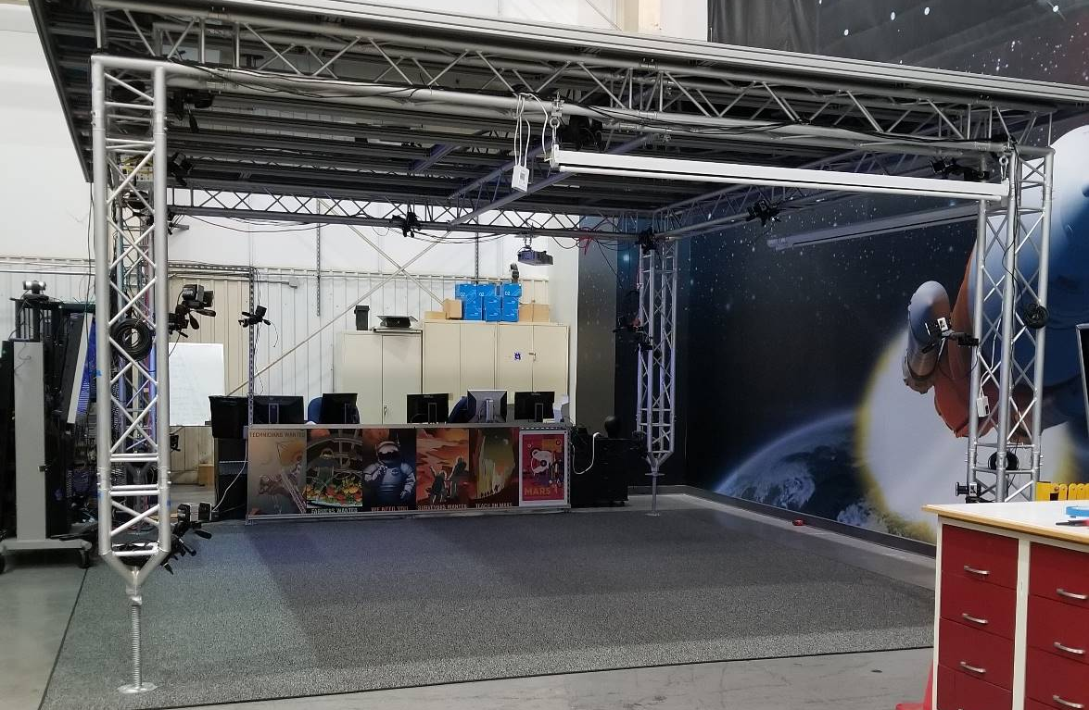
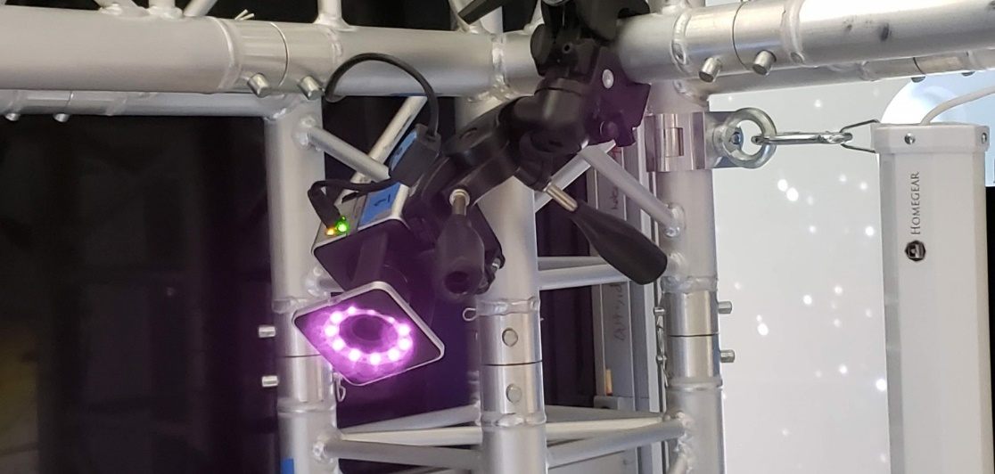
MSFC’s Virtual Environments Lab
20 Vicon MoCap Cameras

Slide 17
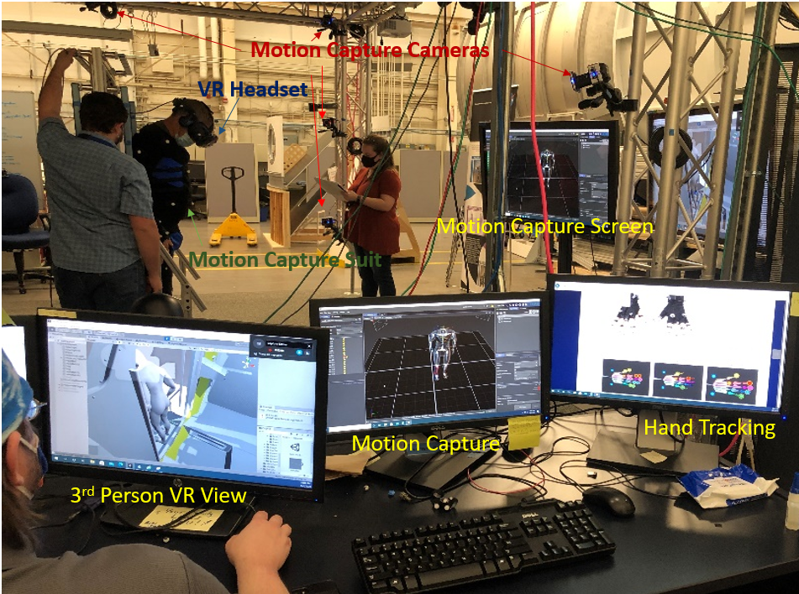
HFE Mixed Reality Assessment Setup
Physical Mockup
Merging Physical and Virtual:
Utilizing physical mockup within VR to provide passive haptics and real dynamics to test subject

Slide 18
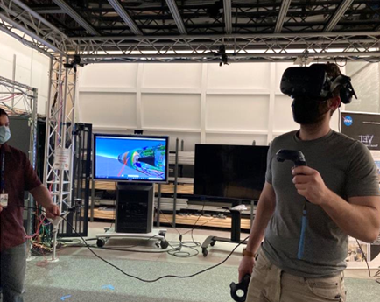
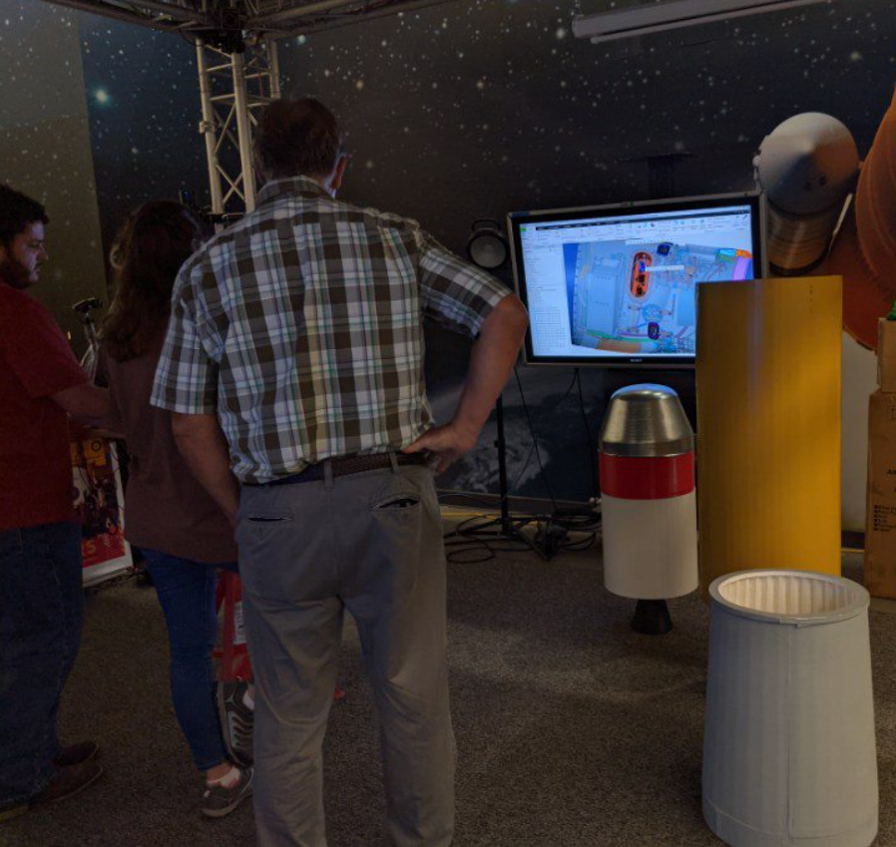
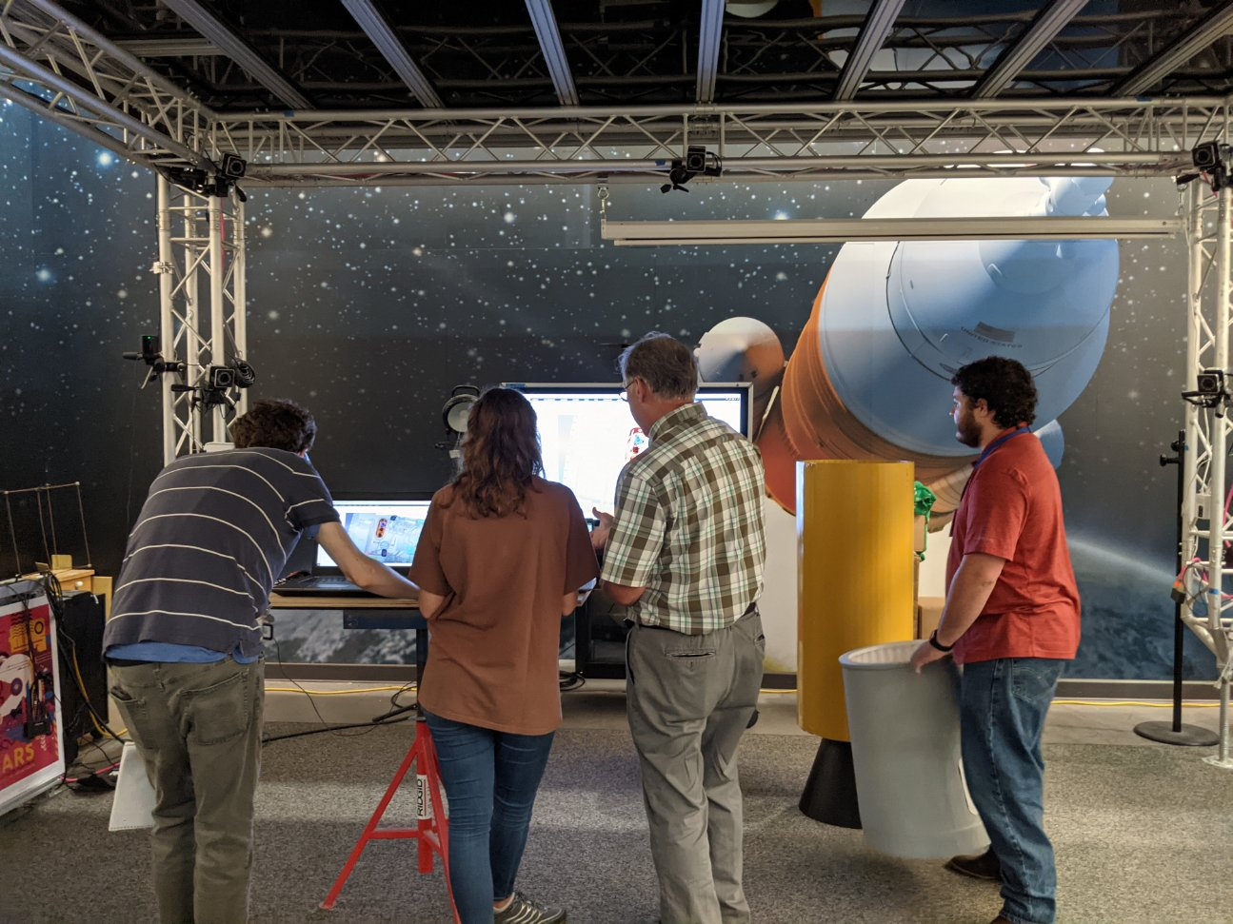
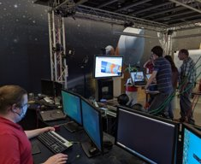
Advantages of Working within VR
Allows fast changing design layouts to be analyzed by various departments with minimal impact to cost or schedule.
Allows for more conceptual work to be tested within a limited budget.
Allows for VR use in early design cycles, saving time and budget.
Resulting HFE analysis improves usability and safety for the technicians assembling the vehicle and the astronaut crew at launch.
Collaborations with distant partners.

Slide 19
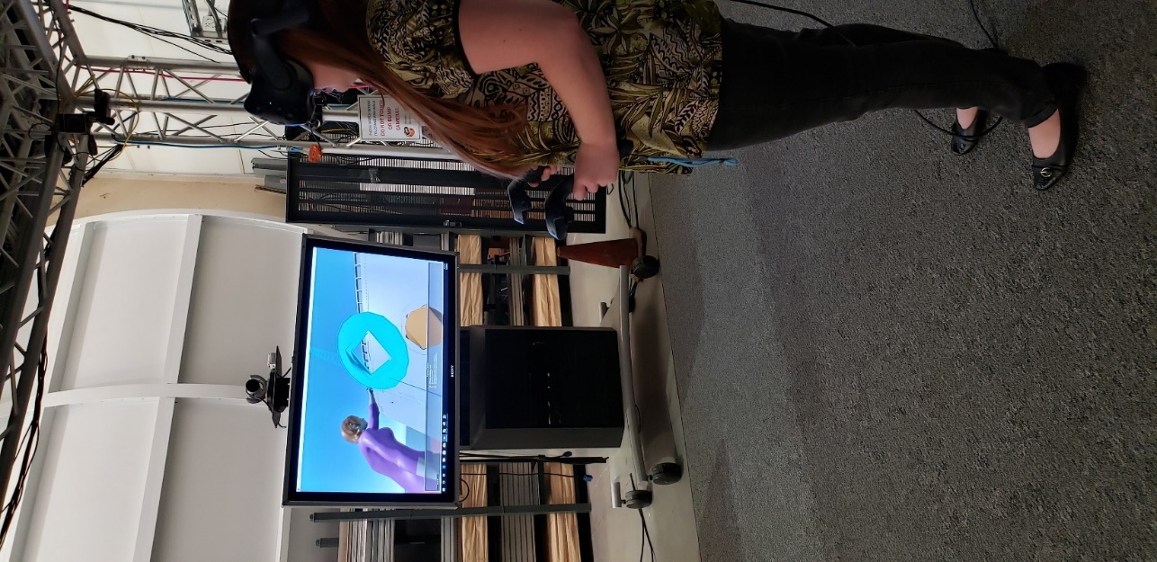

VR as an Engineering Design Tool
Visual Immersive experience into CAD models
  1:1 model size
  Adds depth to design reviews
A variety of tools within VR programs
  Routing paths for wiring or other utilities
  Video comparisons
Process Simulate Human (PSH)
  For VR Visualization of Engineering Models
    Tools like measurement and note taking
    Models can be pulled apart for examination
Assessing tool clearance, fatigue, & reach analysis in early stage of design
Notes:
Visual immersion into CAD models
Real size comparisons, 1:1
Can be utilized during design reviews to display and discuss design options
Routing paths for wiring or other utilities
Video comparisons
Process Simulate Human (PSH)
For VR Visualization of Engineering Models
Tools like measurement and note taking
Models can be pulled apart for examination

Slide 20
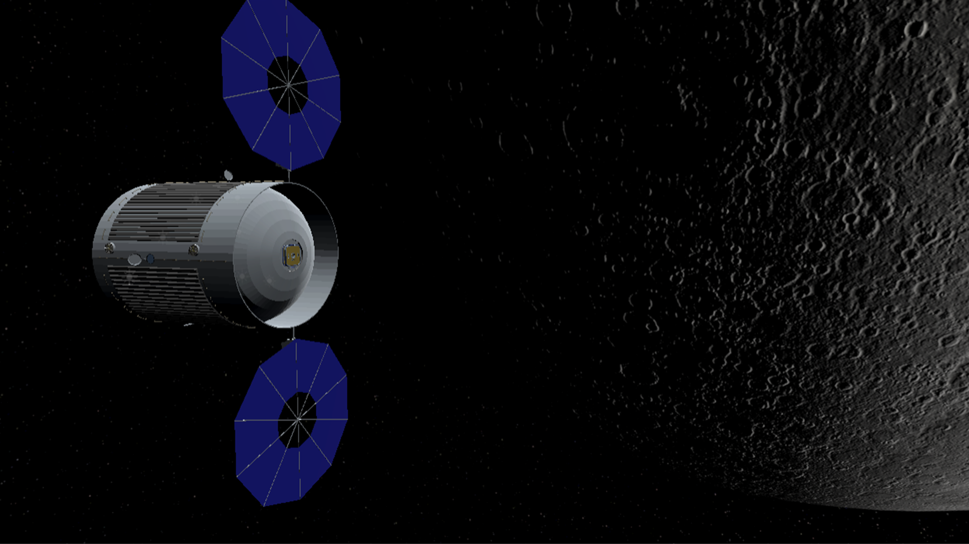
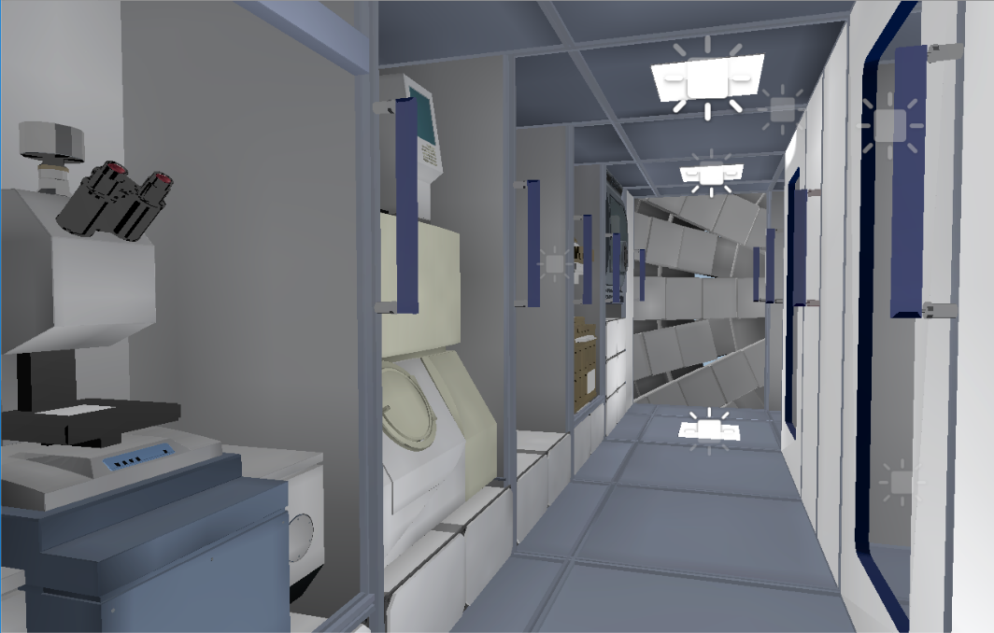
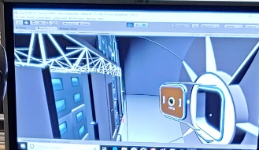
Microgravity Analysis in VR
Virtual DSH created though the conversion of an Existing Lightwave CAD model
using Unity 3D. This design reflects the design of the large SLS derived mockup and enables microgravity assessment not possible with mockup analyses.
Notes:
Used an existing Lightwave 2018 CAD model of the habitat and converted into a VR environment using Unity 3D
In VR we can see the full configuration, with domes on the end (ADD PICTURE) for storage and solar panels. There isn’t enough space/funding to practically add these features to the physical DSH mockup.
Less cost is typically associated with virtual mockups and assessments, which is advantageous because it requires less funding from the DSH budget
Physical microgravity simulation equipment is often very expensive and requires extensive physical infrastructure. We can incorporate virtual microgravity simulation in VR, which can allow engineers to better understand how their design will function in space and even allow for astronauts to better train for their time in space. This is also a very valuable educational tool.

Slide 21
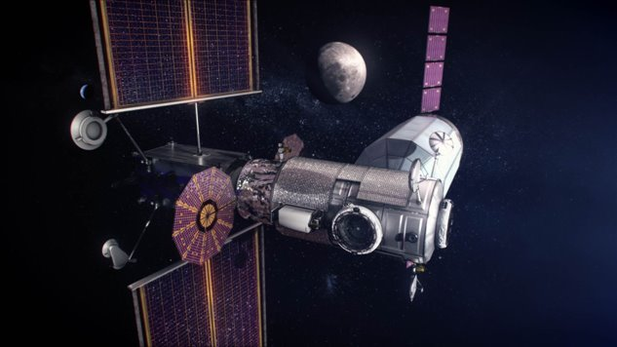
ILS Technical Disciplines – Integral Part of Systems Engineering​
​
Supportability Engineering
21
ILS applied for Sustainment in Mission Operations Phase
  System/Design Interface ​
  Maintenance Planning ​
  Manpower and Personnel ​
  Supply Support ​
  Support Equipment ​
  Technical Data ​
  Training and Training Support ​
  Computer Resources Support ​
  Facilities ​
  Packaging, Handling, Storage and Transportation (PHS&T) ​

Slide 22
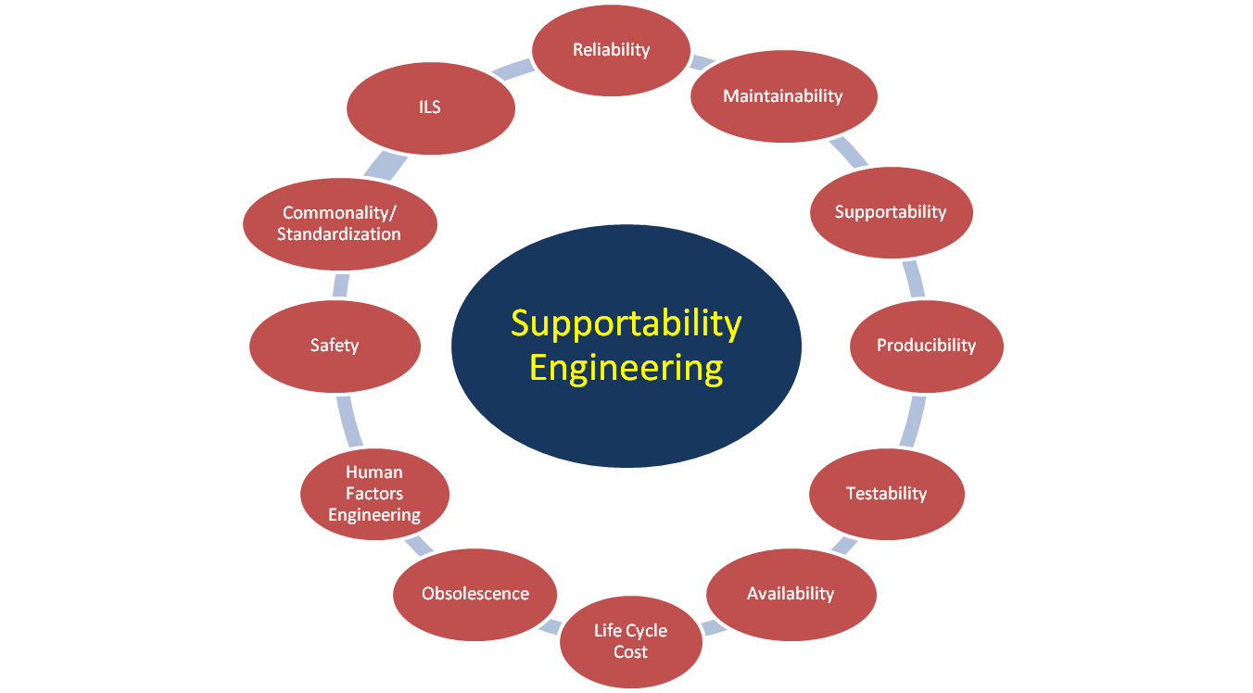
Supportability Engineering
Supportability Engineering
22
The interaction and relationship of the systems engineering process to ensure that supportability influences the definition and design of the system.
  Interrelationship of design characteristics for Reliability, Maintainability, Human Factors, and Integrated Logistics Support (ILS).
  Reduces life cycle cost and ensures operational availability (Ao).

Slide 23


Supportability Engineering Design Influence
Supportability Engineering
23
23
Design influence is accomplished through inclusion of supportability and maintainability as part of the system’s design. Examples:
  Robust fault diagnostic capability
  Optimal location of maintenance items
  Modules/habitats component commonality
  Extra-Vehicular Activity for contingencies
  Safing – simple and isolatable
  Compatible interfaces for robotic maintenance
  Maintenance of critical ground equipment
  Modularity for easy remove and replace
  Sparing interchangeability
  Improved inherent reliability
  Life extension solutions

Slide 24



Sustainment and Moon to Mars
24
Supportability Engineering
24
Sustainment activities include:
  Maintenance Trend Analysis
  Supportability assessments
  Integrated architecture of systems’ product support data
  Analysis of failures
  Sparing philosophies
  Supply chain risk management
  Surface habitat maintainability
  Surface transportation planning
  Long-duration space flight maintenance
  Persistent diagnostics and inventory status
  Robotic maintenance capabilities
  Operational Availability (Ao) metrics
  Obsolescence and life extension solutions
  Disposal planning, planetary and space

Slide 25
EV73 - Systems Analysis and
Human Systems Integration at MSFC
Contact Information
Branch Chief
  Andy Phillips
  andy.phillips@nasa.gov

