Slide 1
A brief history of COTS and MIL-SPEC parts, risk and reliability
Jesse Leitner, Chief SMA Engineer, NASA GSFC
Jesse “dot” “Leitner” at “nasa.gov”
Adapting Mission Assurance Workshop
Nov. 15, 2024

Slide 2
Outline
History in electronic parts
How were the findings in the mid 90’s forgotten?
Volume and statistical process control vs lot control
JEDEC and AEC
MIL-SPEC holes and misuses result in problems
  JANS BJTs
  M55681 capacitors
  M123-screened capacitors
  M55342 resistors
  Boutique processor
  Upscreening failures
  Hybrid DC/DC converters
  RHA MOSFETs
Summary and Conclusions

Slide 3
The advent of the MIL-SPEC system
In the mid-20th century, commercial parts reliability centered around repair and return rates for electronic products and parts regularly failed in application
The MIL-SPEC system was formed, which combined prescriptive part designs with associated quality and test requirements across a standard environment along with continuous reliability testing to give high confidence in parts even without high volume production and process controls
  The system was responsive to failure mechanisms that were appearing in the MIL-SPEC part designs, but it placed firm barriers against making changes in the parts to contain obsolescence and prevent new reliability threats from emerging
  The system largely centered around a standard set of concerns, such as corrosion, broken wire bonds, contamination, delamination, etc.

Slide 4
Growth of commercial electronics
Commercial electronics demand grew and surpassed that of military electronics, driven largely by computers
  Parts were originally derived from the MIL-SPEC designs, but sans the costly design features (e.g. hermetic ceramics) and tests (e.g., 2Vr conditioning)
  Parts were prone to occasional failures without the focused protections
As demand for electronics exploded, the demand for reliability followed shortly, especially in markets such as automotive and medical
  Industry recognized the outdated and costly practices that were used in the MIL-SPEC system and focused more on improving the designs, pointed protections, and process controls rather than re-adding the obsolete, non-relevant practices
  By about 1995, commercial electronic parts had largely equaled or surpassed MIL-SPEC parts in reliability and this fact was acknowledged across much of industry and in many elements of parts leadership within the government

Slide 5
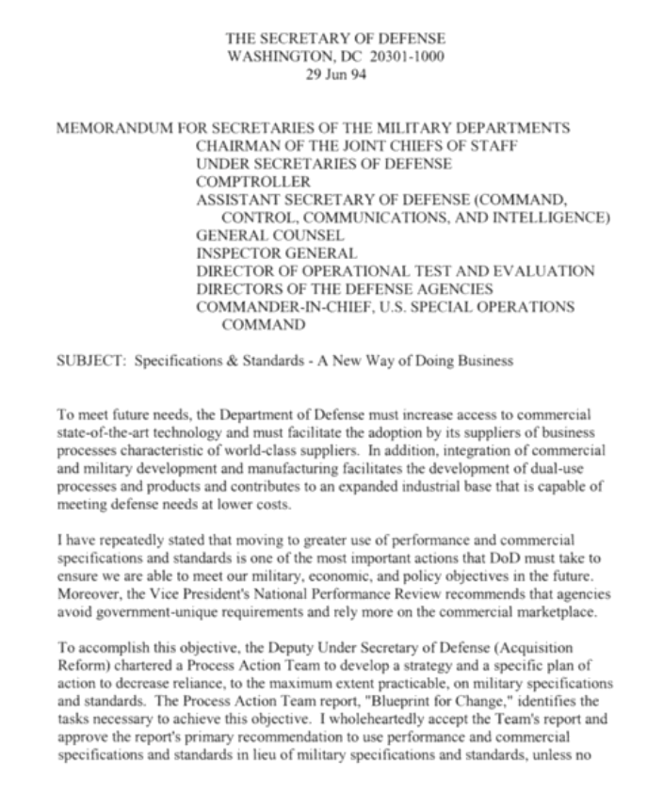
The Perry Memorandum (1994)
The ”Perry Memorandum” was released in June 1994, entitled A New Way of Doing Business, per direction of Defense Secretary William Perry
  Recognized the cost and availability constraints as well as technological limitations brought about by the MIL-SPEC system.
  Directed the broad use of commercial practices
  Required MIL-STDs to be rewritten as MIL-PRFs (performance based)
  Required waivers to use MIL-STDs
  Required PMs and acquisition decision makers to challenge requirements
  Directed first choice in an order of precedence to be the use of a commercial part*
*Note that using a commercial part screened to MIL-SPECs does not meet even the spirit of this requirement since a MIL-SPEC part comes off the shelf with such screening

Slide 6
The recognition of commercial part reliability
The 1994 SHARP* Commercial and Plastic Components in Military Applications workshop, hosted by NSWC Crane, concluded that commercial microcircuits were as (or more) reliable than MIL-SPEC microcircuits but there were two problems to work out:
  The fact that “COTS” parts were rated (at the time) 0ºC – 70ºC & ”industrial grade” (another form of COTS) parts were rated -40ºC – 85ºC, while military grade were rated from -55ºC – 125ºC would require that COTS parts be “uprated” for operation at the full MIL temperature range. This would require detailed discussions with the manufacturer and a range of tests. This led to
    the perpetual mantra that COTS parts are not designed for military and space applications**
    the resulting conclusion that testing would always be required to assure such parts in a military application even after the aforementioned premise disappeared.
  The notion that the typical availability lifetime for a COTS part was far shorter than a typical weapon system lifetime
* Sustainable Hardware and Affordable Readiness Practices
**It is often suggested that radiation hardness is a critical notable example of how COTS parts are not designed for the space environment, but in fact, (1) COTS has no direct connection to radiation hardness or lack thereof, (2) < 10% of parts counts need be considered for radiation, and (3) most “space grade” MIL-SPEC parts are not radiation hardness assured

Slide 7
The “Designed for Space Applications” Myth
Most “space grade” (JANS) parts are not designed for space applications.
  They are original JEDEC semiconductor designs that have been put through a series of tests deemed in the 60’s to be important to survive the military temperature range and an extended ground development period.
  Most do not have any form of radiation hardness assurance (RHA)
  Most that do have RHA are no different than their non-RHA counterparts except for lot-specific radiation testing
The tests representative of space-grade have virtually no relationship to the space environment, but they are representative of problems encountered with part design and manufacture from the mid-20th-century.
Such tests are often incompatible with modern technology parts and many are designed for parts that have ”built-in” derating (i.e. parts that are required to perform for extended periods at multiples of part rating levels).
The relevant question for selecting any part is whether the application range is well within the definition and limitations of the datasheet rated values

Slide 8
About MIL-SPEC ”upscreening” of COTS parts – what did Swift tell us?
Why would it ever make sense to apply a 30-50-year-old test to a recently designed and manufactured component?
Can you make a poorly-selected part high quality or high reliability by applying tests to it?
Why did we not learn this lesson from Swift (2004)? Can we learn it today, 20 years later?
  “SWIFT BAT parts engineering successfully executed a parts control and test program that assured that all parts met or exceeded Grade 3 [sic] program requirements, including radiation tolerance. There were a few scattered failures during parts testing, but the subsequent failure analyses revealed that the failures were due to mishandling or improper testing at the board or box level.”
  But yet, “Design engineers elected to select plastic parts, which allowed the use of state-of-the-art devices that provided the advantages of lower power, volume, and weight. However, commercial-grade parts are designed for a very different set of operating conditions than those found in a space application. A full and thorough evaluation is needed for any part type proposed for space flight use like the ones used on the SWIFT BAT project.” ---- is this really the lesson we should have learned?
Broad sweeping statements are used even when context is available

Slide 9
Prescription -> Performance per Perry
The MIL-SPEC QPL (Qualified Product List) transitioned to the QML (Qualified Manufacturer List), which resulted in now having commercial and military products manufactured on the same lines
  Helped military parts then “catch-up” to reliability of commercial parts
  Intended largely to phase in commercial practices to military parts
MIL-PRFs were written from the MIL-STDs, with more encouraging language about manufacturers having the opportunity to perform their own tests to demonstrate that previously mandated standard tests could be removed or changed
Toward the late 90’s demands for commercial electronics grew in volume and scope and there was no longer a basis for manufacturers to broadly set temperature ranges
Thus, by around 2000, the “COTS” and ”industrial” labels no longer implied specific temperature ranges except with the very few manufacturers that had well established lines across COTS, industrial, and MIL, strategically keeping them separated
The ranges then became based on the demand and performance limitations and often commercial parts began to meet or exceed the MIL ranges in many cases.
  Most importantly – the datasheet and mission requirements are key points of consideration instead of broad labels
  Despite this transition, the aerospace community has still held onto labels and used them to make broad assertions, resulting in costly decisions

Slide 10
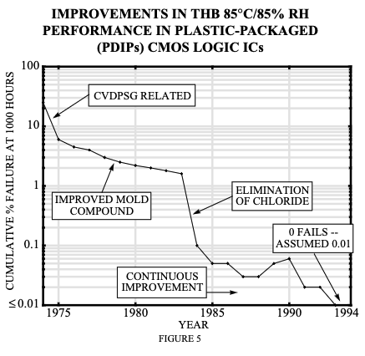
Corrosion in Plastic Encapsulated Microcircuits Evolution
Schultz & Gottesfeld, 1994 (NEPP)
Corrosion problems in plastic parts were almost entirely eliminated by 1994 through standard commercial practices

Slide 11
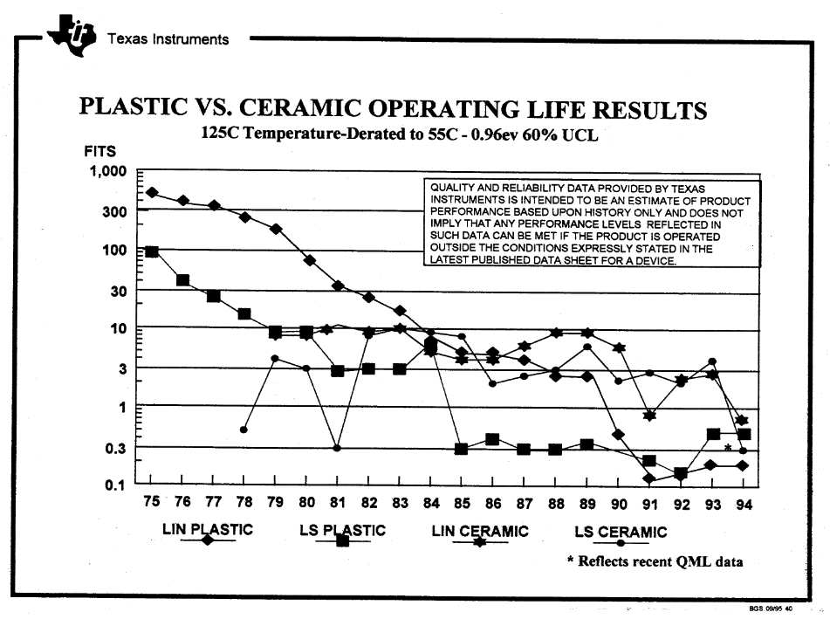
TI PEMs reliability evolution
Presented by TI at 4th Annual Commercial and Plastic Components in Military Applications Workshop, Nov 1995
Plastic became more reliable than hermetic ceramic in 1984

Slide 12
QPL -> QML
When the MIL-STDs transitioned to MIL-PRFs, there were three major changes in the documents
  Removal of many of the requirements to perform continuous reliability testing of parts
  More encouraging language for manufacturers to justify removing or changing tests shown to be non-value-added
  The Standard Evaluation Circuit concept (representative of actual part) was introduced to evaluate the capability of alternative methods for manufacturing and test and to monitor product performance.
A few manufacturers embraced the new opportunity, but most did not take advantage, likely because there was little financial basis to do so.
Not long after the introduction of QML, some issues with FPGAs at the time prompted MIL parts leadership to reinstate MIL-SPEC testing
Effectively, the MIL-PRFs became the new MIL-SPECs as written, and QML did not solve the problems around parts cost, availability, and innovation as they were intended
Furthermore, there was little follow-up as per the original plan to evaluate the effectiveness of meeting the original intent of changing to QML
  The problems that existed that prompted the Perry Memo continued, and continued to expand
Recommendations for an order of precedence starting with commercial parts, followed by QML parts, then MIL-SPEC parts were not heeded

Slide 13
The damages resulting from 217
The inappropriate use of MIL-HDBK-217 all but assured that there would be no escape from the MIL-SPEC system for parts
  Incorrectly defining commercial parts failure rates as ten times greater than than the highest-grade MIL parts is unwarranted for current commercial parts and not supported by actual in-service space systems experience
Long after its demise, the convenience it provided to crank out highly desirable mission reliability numbers would never be overcome
  Numerous software tools were developed that exacerbated the problem
The broad adoption, particularly across the space community, formed an indelible backdrop for assurance practices, particularly associated with parts.
Even for those that understood the fallacies and its underlying assumptions and limitations, a prevailing sense that it promotes good practices would maintain its cultural force
Somehow this cultural acceptance instilled within the space community the misguided notion that reliability of a complex system could be estimated and assured through levels of testing and government prescription and intervention for the electronic parts within
  Even though the document itself stated otherwise

Slide 14
The self-fulfilling prophecy of MIL-STD testing
The findings across the community that commercial parts were as or more reliable than their MIL-SPEC counterparts were quickly buried and forgotten.
The broad assertion that testing is needed for using all commercial parts in military applications that was originally based on generic temperature ranges that have since gone away has transitioned to the mantra that testing is needed to remove infant mortals and assure reliability. Current commercial practices employing appropriate in-process screens and statistical process controls obviate that assertion.
The MIL-STD tests that were designed around the MIL-SPEC parts became the perceived right answer to test commercial parts that have departed greatly from the original MIL-SPEC designs
While many MIL-STD tests are of value to be applied to current parts, many are incompatible and result in occasional or frequent failures or nonconformances. The part manufacturers can best establish the relevance of such tests.
Thus, applying incompatible tests can cause broad test discrepancies and even assertions that parts that are working reliably in stressful applications are high risk, as indicated in the following NASA lesson learned: https://llis.nasa.gov/lesson/23502 based on the misperception that the collection of decades’ old tests are representative of space applications.
Such results that involve many “test discrepancies” and “failures” provide the misguided perception that the parts are at fault and that the screening is effective. Instead, these tests have been misapplied to commercial parts.
In fact, it is not the space application that many commercial parts are not designed for; it is the testing regimes that were deemed ”necessary for space”.

Slide 15
Lot Control vs High Volume Statistical Process Controls
Lot control is an approach for manufacturing parts that is centered around individual lots and that depends heavily on end of line testing, focused and extensive quality requirements, and traceability. Each lot is effectively a new build, thus providing little assurance of performance in another lot. Therefore, lot traceability is essential. Reliability can only be established indirectly as a by-product of the extensive quality requirements and a proven part design since there would not be sufficient data to establish reliability directly. Occasionally, there are manufacturing problems in lots that are not addressed in the quality specifications, which often result in field failures. This is the approach in the MIL-SPEC system because of the limited volume of usage.
High-volume, statistically-process-controlled (SPC) manufacturing involves continuous production and in-line testing to assure uniformity across all production lots without a focus on individual lot characteristics. Combined with field feedback and process control metrics such as DPPM, DPPB, CpK, or AQL, reliability can be assured directly.

Slide 16
JEDEC
JEDEC was originally formed as an industry group to develop standards for microelectronics
Originally, the Joint Electron Device Engineering Council, the group is now the JEDEC Solid State Technology Association
The standards are used to support manufacturers in the manufacturing process and are updated regularly to keep up with changes in technology and assure reliability, cost-effectiveness, and benefits to consumers
Manufacturers whose processes center around JEDEC standards are likely to produce parts that meet quality and reliability thresholds that are intended and marketed for their pertinent parts
Some are derived from MIL-STDs and, like MIL-STDs, are intended for use by manufacturers in the manufacturing process (MIL-STDs more for end-of-line testing and JEDEC STDs for in-process testing), but like MIL-STDs they are often misapplied by government users as tools to screen and qualify parts that have already been established and on the market

Slide 17
Automotive Electronics Council (AEC)
AEC was conceived at a JEDEC meeting in 1992 by representatives from Ford, Chrysler and Delco-GM
At the time automotive electronics business was a shrinking element of the global electronics market and thus not getting sufficient attention from the manufacturers
They decided to combine forces to form their own automotive qualification group with their own set of standards pertinent to their industry (many borrowed from MIL and JEDEC standards).
While this group worked together to standardize, they maintained the group as a voluntary industry group focused on qualification of electronics and avoiding any aspects of pricing or competitive aspects.
With the explosive use of automotive electronics and massive volume of production, combined with the demands in highly stressful applications with zero tolerance for failure under safety considerations, the AEC system became arguably the most powerful (and only) system to assure reliability, availability, and affordability of parts
As with JEDEC, tests from AEC are often misapplied in an attempt to screen or qualify parts that have already been fully qualified and established.

Slide 18
MIL-SPEC holes and misuses result in problems
Hasn’t our tried-and-true MIL-SPEC-driven system always delivered the results we want?

Slide 19
JANS hermetic transistors
Late in development of a major satellite, an in-circuit failure of a JANS2N3637 bipolar junction transistor (BJT) in a TO-39 package was encountered that was traced to corrosion in one of the bondwires.
  Failure analysis and residual gas analysis (RGA) of the failed part revealed the presence of moisture and atmospheric ingress.
Within a few weeks of this event a similar failure was encountered involving a JANS2N2222a BJT in a TO-18 package on a different project experienced by the same prime contractor.
  This part showed elevated moisture in the internal cavity. It appears that some parts in the lot had elevated hydrogen that may have then been involved in a chemical reaction prompted by handling of the part and weakness in the seal.
Both these parts problems prompted the project to replace dozens of parts without any proof or indication that the replacement parts were from better lots than the original lots, at the cost of multiple millions of dollars and a significant launch delay. The pressure to do so was understandable and there may not have been any other choice politically speaking.
In both cases on the same project, the reliance on part hermeticity and RGA combined with fine and gross leak testing cost the project an enormous amount of money, months of schedule usage, and elevated the risks to the project substantially due to the excessive amounts of rework, without any certainty in the improvement of the lots.
The “partial hermeticity” in each case likely trapped moisture and contaminants to cause ideal conditions for corrosion.
On the other hand, corrosion failures of high-volume plastic encapsulated parts have been a rarity since ”best practice” manufacturers perfected the use of passivation layers and removed chlorine and phosphorous from molding compounds.
Impact: > $10M + six-month launch slip

Slide 20
JANS BJT Laser hole problem
During thermal vacuum testing late in I&T, after hundreds of hours of testing involving the part, a JANS 2N2222 failed due to corrosion internal to the part.
Failure analysis indicated an aggressive solvent had entered the part through a hole created by an errant laser etching process.
The part had been leak tested, but the test was ineffective.
The laser-etched hole permitted corrosive solvents to enter the part and get trapped inside, causing corrosion.
Variants of the laser etching problem had existed for over 10 years, but this was never addressed because the parts were compliant to the JANS requirements.
  Sampling never statistically significant enough to catch it

Slide 21
MIL-PRF-55681 capacitor latent defect
A national asset civil spacecraft began experiencing excessive leakage currents on an instrument, months after being on-orbit, driving automatic transitions into safe mode
A lengthy investigation could not confirm root cause, however it was suspected at the time that a conductive anodic filament (CAF) in the bare printed circuit board created a short path within the A side electronics.
  Note that CAF requires moisture as a carrier
Following the recommendations from the A side ARB investigation, the instrument was swapped to the B side electronics to resume science collection
Approximately 5 months after resuming nominal operations on the B side, the problem began to repeat itself.
Boards were brought out of storage and not long after power-up, the board being tested on the ground started to exhibit the leakage current reflective of the on-orbit behavior.

Slide 22
MIL-PRF-55681 capacitor latent defect (2)
  Many attempts were made to power cycle the boards, induce recovery, or otherwise affect the profile, with mixed results.
  A thermal camera was placed over the board to watch for hot spots, revealing glowing spots on multiple capacitors.
  Ultimately, it was revealed that there was a manufacturing flaw in the lot of capacitors (Level 1, 55681) that was only apparent after installation.
  A thorough review and reachback exercise identified that the problem had existed over 10 years and had caused problems in multiple prior missions during I&T, and caused the ultimate failure of another instrument on a different NASA mission a few years before.
  Furthermore, shortly afterward, two separate commercial missions experienced full mission failure due to the same flaw.
  Two years later, two DoD missions experienced major mission degradation or failure due to the same manufacturing problem
  All parts were compliant to MIL-PRF-55681, but the problem didn’t materialize until the thermal shock of installation occurred
Impact: > $1B, several mission failures

Slide 23
M123 screened capacitors
A prolific, successful standard component manufacturer was performing a sampled DPA on their shelf parts prior to beginning the next production line
They discovered cracks in some capacitors, prompting a deeper look across all their parts, including those in assemblies, indicating a systemic problem
As with numerous traditional space community organizations, the company considered MIL-PRF-123 (M123) screening as a necessary “space-grade” practice, even to screen parts well outside of the M123 ”catalog” range
  The catalog range defined limits in part performance above which the tests would likely be too severe
  This practice had become standard across many part types as performance needs had surpassed the MIL-SPEC limits
The company had been using this approach successfully for decades with the same manufacturers who had perfected the approach (which involves a lot of costly trial and error)
However, this time, that manufacturer was too expensive and too high a delivery time and a manufacturer was chosen that had not built these parts before with this screening
Many missions were paused, including several with imminent launch dates
Impact: > $10’s of M, lessons not learned

Slide 24
M-55342 thin film resistor problem
A recent project required the use of 15,000 thin film resistors spanning a variety of different part numbers
Although M-55342 resistors have been used in the millions over the years, they are still manufactured under lot control rather than high-volume production
Testing revealed multiple problems with performance and reliability across multiple part numbers and lot date codes (part failures and noise issues)
The engineering unit, assembled with automotive resistors, performed through environmental testing without any issues
  All resistors in flight units were replaced with automotive parts
Manufacturer had stated years before that their MIL-SPEC resistors would not be robust enough for an automotive application because the manufacturing yields fluctuate too much to assure quality comparable to the yield control that is enforced by IATF 16949 QMS.
This high-volume use of low volume parts in a demanding application was certain to result in such issues.
Impact: > $1M

Slide 25
Boutique processor failures
One of the space community’s trusted workhorse processors was updated
  Intermittent failures occurred
  Several quality issues identified
  Variability in wafer yield indicates poor process control
The processor is a boutique, low-volume product without sufficient manufacture and usage to establish reliability and respond to early field failures
Extensive testing is not only costly but it cannot make up for the limited volume of production
  Many years would likely be required to work out the manufacturing issues
This processor was the traditional space community’s primary investment and loss of confidence in the current revision has prompted a near-emergency situation in NASA and other agencies
The problem is much more an artifact of the low-volume, boutique approach in manufacturing than it is of manufacturer-specific quality issues.
Impact: > $1M

Slide 26
MIL-STD Upscreening causes on-orbit part failures
The project selected COTS DC/DC converters to achieve performance unavailable from other similar converters
Project screened the hybrids to Level 1 requirements, MIL-PRF-38534, Class K based on our misguided premise that COTS parts need to be screened to make them reliable.
About a year into operations, the first converter failed on-orbit.
Approximately four years after launch, one of the remaining critical converters failed, ending the mission, fortunately during extended mission.
Review of the part’s data sheet indicates a tolerance to 500g constant acceleration of the parts.
However, MIL-PRF-38534 demands a 3000g constant acceleration test, which was ultimately performed on all the parts as a screen, regardless of the limits in the parts’ data sheet.
Hybrid DC/DC converters have large magnetics connected to an alumina substrate that is subject to wear under excessive mechanical stress, so this is the most likely explanation for premature wear of the parts.
It should be noted that there was no relevance of a 3000g constant acceleration test for the usage of these parts.
Impact: Unnecessary demise of mission still collecting valuable science, failure to learn proper lesson

Slide 27
Upscreening COTS capacitors severely disrupts major instrument development
A major project selected niche low-volume low equivalent series inductance (ESL) COTS capacitors for broad use in an instrument application
For fear of tin whiskers and based on material restrictions, the tin-lead variants were chosen, limiting to a narrower production volume without assured reliability.
The parts were procured with a source control drawing adding numerous MIL-STD tests, including voltage conditioning for 96 hours at twice rated voltage and 125 deg C in an attempt to screen in reliability to the parts
  Note that rated voltage on COTS parts is the voltage that should not be exceeded to avoid damaging the parts
While the low volume niche aspect of the parts drove variability both within lots and lot-to-lot, the overtesting performed likely exacerbated the weaknesses in the parts, resulting in many failures and performance issues.
Impact: > $1M

Slide 28
QML DC/DC converter triad
For decades the traditional space community has entirely relied on hybrid DC/DC converters from the 2 or 3 manufacturers at a given time that were qualified (and willing) to produce Class K (level 1) and Class H (level 2) converters, with an almost unyielding propensity for Class K, even without an actual basis in reliability improvement
Many of the tests in MIL-PRF-38534 were rooted in transistor testing from the mid-20th century and carried over to hybrids, based on similarities
  However, this predated the hybrid DC/DC converter, whose design and construct are fundamentally incompatible with many of the tests used in 38534, such as the 3000g constant acceleration screen
  Thus, hardly a year goes by without at least one converter from the triad having its line shut down because of some type of qualification failure (even if there were no associated part failures in the field)
  The parts already had a 30-40-week lead time, if not more, but when one line is shut down, the lead time is greatly amplified.
Impact: > $10M, uncountable schedule delays

Slide 29
RHA MOSFET susceptibility issue
Starting in 2009, it was discovered that a large swath of the available radiation hardness assured n-channel MOSFETs have not been demonstrating the assured tolerance to total ionizing dose
The wafers were tested after manufacture as required in MIL-PRF-19500, but in many cases placed into storage and packaged sometimes years later, and during the storage time, were significantly losing their resistance to TID and showing other vulnerabilities
This is a combined MIL-SPEC hole with the problem associated with low-volume production
Since in general the space community does not radiation test parts that come with sufficient RHA, this problem tends to be nefarious in nature, although the parts sold are fully compliant with the spec.
Is this the only place where this is happening? It is also notable that thousands of affected parts are flying in space and there have been no reported failures on orbit.
No high-volume part would have the die or wafer sit in storage for over 30 days before packaging
Impact: TBD

Slide 30
Notable literature
1993 Pecht, Agarwal, Quearry, Plastic Packaged Microcircuits: Quality, Reliability, and Cost Issues, IEEE Trans on Reliability
1994 Schultz and Gottesfeld, Reliability Considerations for Using Plastic Encapsulated Microcircuits in Military Applications
1995 4th Annual SHARP workshop: https://apps.dtic.mil/sti/pdfs/ADA310596.pdf
1997 Pecht et al, Assessment of the Qualified Manufacturer List
1997 Rolfe, Brown, and Nash, Defense Electronics Product Reliability Requirements
1999 Hakim, Do we need a PEM reliability model?

Slide 31
Summary and Conclusions
By the mid-1990’s there was broad agreement in the government electronics community that commercial parts were at least as reliable as MIL-SPEC parts without any additional testing applied to them
The predefined temperature ranges associated with labels COTS, industrial, and MIL-SPEC that were dominant through the mid 90’s led to
  an assumed need to uprate all COTS parts for use in military applications
  the notion that COTS parts are not designed for military applications
  The assertion that COTS parts must go through a screening and qualification process in order to be reliable in military applications
Both the understanding about reliability of commercial parts and the directions of the Perry Memorandum were quickly forgotten
MIL-SPEC parts have set a baseline accepted risk that involves billions of dollars of losses in money and missions while being declared “more reliable” than COTS parts
  all the while the growing programmatic risks and problems with MIL-SPEC parts have become intractable
While the current baseline risk posture associated with MIL-SPEC parts may be considered acceptable, it is time to recognize that the technical risk posture is the same or lower for commercial parts, while the programmatic risk posture is enormously lower

Slide 32
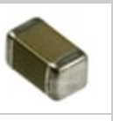
Part Evolution
4.5 mm
6.4 mm
4.5 mm
6.4 mm
1.45 mm
2 mm
1.5 mm
1.5 mm
1.45 mm
CDR35BX474AKUS
0.47uF, 50V
TTI: 100MOQ/$2.60ea
G311P838AFX475K2R1
4.7uF, 50V
TTI: 50MOQ/$278ea
GRT21BC71H475KE13L
4.7uF, 50V
Digikey: 1MOQ/$0.27ea

Slide 33
COTS in this presentation
COTS is used in this presentation broadly with the definition provided
The phrases “allowing the use of COTS” or “opening the door to using COTS” and similar, do not imply indiscriminate use or selection of any part, in the same way that “recommending the use of MIL-SPEC parts” does not involve indiscriminate use of any part.
  The point being that use of COTS itself should not have a negative connotation and should never be used as a basis for a ban or “lowest order of precedence” requirement
  COTS essentially means two things: the government does not control the production and the user cannot have control or knowledge of most internal constituents.
  COTS parts should be selected based on well-established criteria conveyed in the NESC COTS report and related documentation, and these criteria assure reliability, minimal variability, and traceability to raw materials even under continuous improvements. Absolute reliance on all parts to be perfect should be broadly avoided.
If there is a sense that government control is sufficient to assure part reliability or radiation hardness assurance, one need not look farther than
  The RHA MOSFET issue that has survived for over 15 years
  The ceramic capacitor issue that caused failures or major degradation of at least 6 missions on-orbit
  The thin film resistor issue on CGI
  …
The market demand for safety and reliability combined with high volume are much more powerful than a finite collection of historical specifications for assuring reliability

