Slide 1
SMA for highly constrained projects
Jesse Leitner, Chief SMA Engineer
NASA GSFC
Notes:
What do our colors really mean?
Yellow (Warning)
Management awareness/attention needed
Items usually get discussed at Division/Directorate meetings
Red (Critical)
Impact is significant and management awareness/attention needed
Items usually get discussed at Directorate/Center meetings

Slide 2
Outline
  What is a constrained project?
  Top priorities
  What is quality and why do we care?
  The two sides of quality
  Quality vs Reliability
  Streamlined reliability
  Risk
  Modernizing Risk Classification
  SMD Class D MAR
  EEE/EEEE parts

Slide 3
Top Priorities for constrained projects
Safety first*
  Do not injure people or the public
  Do not damage your host
  Do not cause collateral damage
  Do not damage the environment
Protect your ability to learn from failure and success
  In many cases this should be higher priority than meeting other mission objectives
  Think about how you can maximize the assurance that you’ll obtain enough data to figure out what happened
  Develop a notional “black box”
*damaging yourself is in the realm of “hardware safety” but it is in the category of programmatics, design, and reliability, not safety, since it is not more important than designing and testing a reliable system (e.g., if you bolt yourself into your car it might protect you in a collision, but if your car catches fire or you fall into the lake …)

Slide 4
What is a constrained project?
A constrained project is one that doesn’t have the time and/or money to perform all traditional practices
Many constrained projects do not start out as constrained
Most D and below projects are constrained at the start.
Even Class A missions often move into this category late in development

Slide 5
What is quality and why do we care?
Quality is the totality of features and characteristics of a product or service that bear on its ability to satisfy given needs.
  In many cases quality is defined by specifications that do not actually link to performance
  In some cases, such specifications are egregiously more stringent than the application warrants
    We can coin this term misguided quality when the second half of the quality definition does not apply
Quite simply, we need quality as a means to get reliability (or safety) and to assure consistency
  Quality on an individual product tells us that it is a good reproduction of previous working versions and that it is built as designed
  A developer’s quality practices tell us that we can expect future versions to be representative of the previous versions
But remember, no level of quality can make up for a bad design, and thus quality is in no way sufficient to obtain reliability
Furthermore, if we forget that reliability is the end game, we might lose sight on what’s important and top priority

Slide 6
Two sides of quality
Features of the product
  This is the essential element of quality because it represents the system in front of you
  Determined by observation and testing to the extent possible
Paperwork to show it
  Certifications
  Certificates of conformance
  Test data with signatures
  WOAs and travelers
  This provides confidence in internal and ”molecular” aspects that could be the source of various types of latent defects
  This is for the trust part. You can either trust or require paperwork, or a mix of both
  Paperwork itself is never sufficient to guarantee a high level of quality

Slide 7
Quality and Reliability
As mentioned earlier, quality is the totality of features and characteristics of a product or service that bear on its ability to satisfy given needs.
The reliability of a system is its ability to perform (or the probability to successfully perform) the necessary functions within expected life cycle exposure conditions for a required period
  Reliability of a system is established through
    A design that has minimal sensitivity to normal disturbances on the system
    Established past history of the same product
      Similar products may be used as a basis but the translation to the current product may be complex
  We often do not have access to design details for many products, which leads to reliance on
    Knowledge of the developer’s capability to develop reliable products
    Use of a proven design and tight control of variability to establish the reliability basis or claim

Slide 8
Quality and Reliability (cont’d)
Sometimes the original definition for quality of a given commodity or product is no longer meaningful
  Technology and manufacturing have changed
  Evolution of the product design has surpassed the quality definitions
In many cases, manufacturers use the term reliability to represent quality
  This is a practice that is based on past MIL-SPEC definitions.
  One key reason for it is that when there is not sufficient volume to establish reliability, quality is the only tool you are left with
  Often the quality definition for a product loses its meaning over time (due to, e.g., manufacturing changes)
  The conflation of quality and reliability is a major contributor to the retention of outdated practices

Slide 9
Is Quality just reliability on Day 1?
This is a common statement
It can be correct, but not always
The quality requirements would have to be well-aligned with the design, the design itself would have to be proven reliable, and meeting the quality requirements would have to be sufficient on their own to assure that the system functions reliably.

Slide 10
Misguided quality
Imposing stringent and excessive numbers of requirements relative to what is needed to achieve required performance and reliability
Blindly enforcing extensive requirements on manufactured hardware without considering effects of existing assembly vs that of rework
Using flight and/or qualification unit testing requirements that greatly exceed mission requirements, thus providing misleading results or overstressing or reducing the life of flight hardware
Misapplying stringent, but proven, requirements or tests to application areas outside of their original intent and design

Slide 11
Streamlined reliability highlights

Slide 12
Costly processes with minimal mission risk payoff for 10-year missions
Use of level 1 or level 2 MIL-SPEC parts as a minimum or level 1/level 2 screening and qualification of non-MIL-SPEC parts or strict level 3 screening
Rigid application of most stringent printed circuit board specs
  Multiple layers of PCB coupon approvals
Re-qualification of qualified devices
Overly strict enforcement of workmanship requirements
Misguided quality: enforcement of stringent requirements with minimal effect on performance or lifetime.
Part-level radiation testing of every part and specific lot used

Slide 13
Cost-effective variants for low-risk mission
Fault-tolerant and resilient architecture
  Design to accommodate failures but don’t design to expect failures
Perform robust risk management with strict interpretations of risk
  Risk should always have context
  Concern/worry list may be maintained without context
Extensive but intelligent use of COTS EEE parts
  Do not change out parts from proven designs
  Do not assume MIL-SPEC or “NASA-screened” parts to be “highest reliability” choice

Slide 14
What is Risk?
Definition: the combination of
  a) the probability (qualitative or quantitative) that an undesired event will occur, and
  b) the consequence or impact of the undesired event
  c) a factual context or scenario that exists to cause the risk to be present
  In short, risk is an expectation of loss in statistical terms based an existing condition.
Categories of risk (consequences)
  Technical (failure or performance degradation on-orbit)
  Cost ($ it will take to fix the problem)
  Schedule (time to fix the problem)
  Safety (injury, death, or collateral damage)
programmatic
Notes:
It is important to be explicit about what we mean when we say risk. This will be clear when we contrast risk with “possibility”.

Slide 15
Anatomy of a Risk
Context
Impact/Criticality
Concern
Statistics
Uncertainty
Structured risk statement
Likelihood
Consequence

Slide 16
What is risk classification?
Establishment of the level of risk tolerance from the stakeholder, with some independence from the cost
  Cost is covered through NPR 7120.5 Categories
If we were to try to quantify the risk classification, it would be based on a ratio of programmatic risk tolerance to technical risk tolerance
  For Class A, we take on enormous levels of programmatic risk in order to make technical risk as close to 0 as possible. The assumption is that there are many options for trades and the fact is that there must be tolerance for overruns.
  For Class D, there will be minimal tolerance for overruns and a greater need to be competitive, so there is a much smaller programmatic risk “commodity” to bring to the table
The reality is that the differences between different classifications are more psychological (individual thoughts) and cultural (longstanding team beliefs and practices) than quantitative
In the newly released NPR 8705.4A, the practices associated with classifications are denoted “expectations”, not formal requirements, not requiring waiver, but rationale for deviations to stakeholders in an “Assurance Implementation Matrix”

Slide 17
Risk Classification
(NPR 7120.5 Projects)
Class A: Lowest risk posture by design
  Failure would have extreme consequences to public safety or high priority national science objectives.
  In some cases, the extreme complexity and magnitude of development will result in a system launching with many low to medium risks based on problems and anomalies that could not be completely resolved under cost and schedule constraints.
  Examples: HST and JWST
Class B: Low risk posture by design
  Represents a high priority National asset whose loss would constitute a high impact to public safety or national science objectives.
  Examples: GOES-R, TDRS-K/L/M, MAVEN, JPSS, and OSIRIS-REX
Class C: Moderate risk posture by design
  Represents an instrument or spacecraft whose loss would result in a loss or delay of some key national science objectives.
  Examples: LRO, MMS, TESS, and ICON
Class D: Cost/schedule are equal or greater considerations compared to mission success risks
  Technical risk is medium by design
  Many credible mission failure mechanisms may exist. A failure to meet Level 1 requirements prior to minimum lifetime would be treated as a mishap.
  Examples: LADEE, IRIS, NICER, and DSCOVR

Slide 18
Risk Classification (GSFC)
(Non-NPR 7120.5 Projects)
NPR 7120.8 “class” – Allowable technical risk is high
  Some level of failure at the project level is expected; but at a higher level (e.g., program level), there would normally be an acceptable failure rate of individual projects, such as 15%.
  Life expectancy is generally very short, although instances of opportunities in space with longer desired lifetimes are appearing.
  Failure of an individual project prior to mission lifetime is considered as an accepted risk and would not constitute a mishap. (Example: ISS-CREAM)
“Do No Harm” Projects – If not governed by NPR 7120.5 or 7120.8, we classify these as “Do No Harm”, unless another requirements document is specified
  Allowable technical risk is very high.
  There are no requirements to last any amount of time, only a requirement not to harm the host platform (ISS, host spacecraft, etc.).
  No mishap would be declared if the payload doesn’t function. (Note: Some payloads that may be self-described as Class D actually belong in this category.) (Example: CATS, RRM)
7120.8 and “Do No Harm” Projects are not Class D

Slide 19
The left-hand-side vs right-hand-side
The left-hand side of risk classification represents the mission attributes that are used to classify a mission, such as
  National/science priority
  Limited flight opportunities (e.g., planetary windows)
  Cost
  Lifetime
  Partnerships
The right-hand side of risk classification represents the recommended practices, based on the assigned classification
  Workmanship
  Parts approach
  Printed circuit board approach
  Etc
In risk classification, the flow is only from left to right
  The use of Class C practices does not indicate any type of lifetime
  The use of Class A practices does not indicate any type of priority
  Etc.

Slide 20
Risk Classification vs Technology state of the art
DNH 7120.8 D C B A
Classification
0
20
Age of Technology (yrs)

Slide 21
Risk Classification vs Assurance Methodology Focus
Notional view
Note: application of strict workmanship requirements supplants DfM and DfR efforts, and hinders technology maturation.
DNH 7120.8 D C B A
Classification
New technologies, and tech demos should be down here
DfM/DfR
Technology Maturation
Strict workmanship reqmts/verification and extensive screening
Assurance emphasis

Slide 22
Summary of expected assurance practices
Practice | A | B | C | D | 7120.8/DNH
GMIPs | Extensive | Extensive | Limited | Minimal | Almost none
ARB/FRB/MRB voting | Voting on all | Voting on major | Participating | Participating | Open
EEE parts | Level 1 | Level 2 | Level 3 | COTS | COTS
PCB reqmts | DS, ES, 3/A | DS, ES, 3/A | D, E, 3 | D, E, 3 | Class 2 or 3
PCB coupons | Independent | Independent | Supplier only | Supplier only | commercial
SPFs | Fully redundant | Mostly redundant | Selective redundancy | Mostly single string | Mostly single string
workmanship | S | S | No S | No S | commercial
Radiation | Lot-specific TID testing for SPF parts or board-level testing in high TID +rad-tol-design | Strategic testing, board level testing + rad-tol design | Rad-tol design, limited piece part approvals when board level analysis or testing not available | Rad-tol design, no piece part approvals | Based on lifetime and environment
Lifting | Standard suite of 6 practices | Standard suite of 6 practices | Standard suite of 6 practices | Vendor practices | Vendor practices
oversight
insight

Slide 23
Top level comparison of select practices
 | Class D/7120.8/DNH | Class B
Env test | TAYF, small margins. Ex: EMI- self-compat | TAYF + bullet proof + high margins. Ex: EMI-CS testing
Parts | Commercial, no extra screening | Screened to level 1 and 2 (extremely costly)
Workmanship | Use of experienced techs | Following strict requirements
Quality inspection | Minimal, selective | Extensive and intrusive
Printed circuit boards | Best effort Class 2 and 3 | Class 3/A, DS, strict interpretation
Developer practices and oversight vs insight | Use of developers’ own practices and commercial practices, selective insight | Discouragement of commercial practices, highly prescriptive, extensive oversight
MRB/ARB/FRB | Developer runs, NASA participates | NASA has voting/override authority

Slide 24
Oversight vs insight
Oversight is the approach where the NASA organization with management authority has approval rights for most major decisions with a project
  Requirements are most prescriptive
  Inspections are most extensive
  NASA personnel are voting members of the various boards
  Workflow is often stopped for approval
  Oversight is in conflict with most forms of commercial practices and, in fact, generally prevents the use of commercial practices
  Well-aligned with cost-plus contracts
Insight is the approach where the NASA organization with management authority has access to information about the work being performed and is invited to participate in discussions involving various unplanned activities but does not approve decisions
  Requirements are more objectives-based
  Inspections are very limited
  NASA personnel participate on boards but don’t approve decisions
  Well-aligned with fixed price contracts.
Generally A&B missions are aligned with oversight, while C&D missions are aligned with insight, whether it is purposeful or not.

Slide 25
Note on choosing elevated practices
Choosing Assurance levels above the recommended levels for the given classification should be undertaken only with a careful risk-trade analysis as such an approach is not as simple as “paying a bit more for more reliability”.
  Practices that exceed the available resources are likely to drive up programmatic and technical risk by reducing the resources available to complete the most important elements needed for success – finishing the test campaign and thorough resolution of problems encountered in integration and test.
  Furthermore, such practices often involve overtesting or unrealistic testing that may prompt irrelevant failures or actual overstressing of flight hardware.
The practices that involve greater levels of workmanship controls, restrictions on parts and materials, and inspection generally conflict with the technology maturation process (which requires flexibility and responsiveness to testing results and problem resolution).
  Therefore, the importance of a technology demonstration or a mission that involves immature technologies is not an appropriate justification for selecting more stringent assurance activities in most areas.
  In these cases, the assurance emphasis should be placed on design for manufacturability and design for reliability, as opposed to screening, workmanship controls, and inspection.

Slide 26
Current Risk Classification limitations and shortfalls
Approach is almost entirely based on piece-parts
Largely, classification is dialed up or down based on classical “levels of assurance”
  Number of specifications
  Stringency of specifications
  Level of oversight (insight)
  Amount of screening performed
  Amount of testing above operational levels performed
There is no correlation between levels of assurance and actual performance or reliability
Most importantly, there is no means for products that have little to no government piece-part level controls, but that perform reliably and consistently to achieve higher classification
  This applies to most ubiquitously-used standard components such as star trackers, reaction wheel assemblies, IMUs, etc.
  This will apply to a growing number of full spacecraft
    Time will come soon that spacecraft that have consistent repeat performance will be classified lower than spacecraft that are either one-of-a-kind or limited history but with extensive piece-part controls
We are incentivizing continued use of old piece-part-centric practices rather than finding efficient, innovative, modern approaches of developing reliable missions

Slide 27
Risk Class vs Design Lifetime vs Lifetime
Mission | Year | Risk Class | Planned Lifetime | Actual lifetime | Why ended
EO-1 | 2000 | C | 1 | 17 | fuel expended
GOES-L | 2000 | A | 10 | 10 | outdated
TDRS-H | 2000 | B | 11 | 22+ | active
NOAA-L | 2000 | C | 2 | 13 | “critical anomaly”
GOES-M | 2001 | A | 5 | 12 | thruster issues
Aqua | 2002 | A | 6 | 20+ | active
NOAA-M | 2002 | C | 2 | 11 | two instruments failed
TDRS-I | 2002 | B | 11 | 20+ | Valve issue, took 6 months to get to GEO
RHESSI | 2002 | D | 2 | 16 | communication problems
TDRS-J | 2002 | B | 11 | 19+ | active
ICESat | 2003 | C | 3 | 7 | laser failure
Aura | 2004 | B | 6 | 18+ | active
Neil Gehrels Swift | 2004 | C | 2 | 17+ | active (thermoelectric cooler failed shortly into mission, but successful operational workaround was put in place)
NOAA-N | 2005 | C | 2 | 17+ | active
GOES-N | 2006 | B | 10 | 16+ | active (USSF now)
ST-5 (3 S/C) | 2006 | C | 90 days | 100 days | demo complete
Fermi (GLAST) | 2008 | C | 5 | 14+ | active
GOES-O | 2009 | B | 10 | 10 | replaced (now on-orbit spare)
NOAA-N’ | 2009 | C | 2 | 13+ | active
LRO | 2009 | C | 3 | 13+ | active
GOES-P | 2010 | B | 10 | 12+ | active
SDO | 2010 | B | 5 | 12+ | active
Glory | 2011 | C | 3 | 0 | launch failure
NPP-Suomi | 2011 | B | 5 | 10+ | active
TDRS-K | 2013 | B | 15 | 9+ | active
MAVEN | 2013 | B | 2 | 7+ | active
LandSat-8 | 2013 | B | 5 | 9+ | active
LADEE | 2013 | D | 100 days | 223 days | objectives completed
TDRS-L | 2014 | B | 15 | 8+ | active
GPM | 2014 | B | 3 | 8+ | active
DSCOVR | 2015 | D | 2 | 7+ | active
MMS (4 S/C) | 2015 | C | 5 | 7+ | active
SMAP | 2015 | C | 3 | 7+ | Primary radar payload failed 7 months into mission – SEGR in the SAA, but team was able to get most science from the radiometer
GOES-R | 2016 | B | 15 | 6+ | active
OSIRIS-REx | 2016 | B | 7 | 5+ | active
ASTRO-H | 2016 | C | 3 | 0 | attitude control failure
NICER | 2017 | D | 1.5 | 5+ | active
JPSS-1 | 2017 | B | 7 | 4+ | active
TSIS | 2017 | C | 5 | 4+ | active
TDRS-M | 2017 | B | 15 | 5+ | active
GOES-S | 2018 | B | 15 | 4+ | active
GEDI | 2018 | C | 2 | 3+ | active
ICESat-2 | 2018 | C | 3 | 3+ | active
Solar Orbiter | 2020 | C | 7 | 2+ | active
JWST | 2021 | A | 7 | 0+ | active
Lucy | 2021 | B | 12 | 0+ | active
LCRD | 2022 | D | 2 | 0+ | active
GOES-T | 2022 | B | 15 | 0+ | active

Slide 28
New elements in GPR 8705.4A
Standard component classifications based on the most recent number of times a component/assembly/system operated successfully for a certain number of years out of the total number of attempts
Collective mission classification of multiple classified identical items

Slide 29
Standard component classification in GPR 8705.4A
Components (assemblies through full spacecraft buses) classified holistically based on most recent performance at commensurate lifetimes
  No piece-part-based Ps
  Changes do not affect classification (changes, different environments, minor anomalies, etc. factor into acceptance, not classification)
Class A components
  Minimum 10 recent flights at 7-year lifetime or longer, number of successes out of last 20 flights divided by 20 >= 0.95 (or 100% for between 10 and 19 flights)
Class B components
  Minimum 10 recent flights at 5-year lifetime or longer, number of successes out of last 10 flights divided by 10 >= 0.90
Class C components
  Minimum 5 recent flights at 3-year lifetime or longer, number of successes out of last 5 flights divided by 5 > 0.80
Class D components
  Fully qualified per the GEVS requirements in the GOLD rules
While this is not a formal reliability calculation (which would require mission specific data), it provides strong evidence of a reliable design

Slide 30
Collective classification of multiple identical standard products
There is a growing number of mission concepts that involve the use of multiple products such that one or more can fail, while still meeting mission performance requirements
The extreme version of this involves missions that for various reasons would prefer (or even require) multiple spacecraft in lieu of one large spacecraft, but cannot afford the resources required for more than one spacecraft at the mission risk classification
The only way to “raise” the classification through collective use of the same product is if the base product design has a formal classification that is based on some measure of reliability.
To compute the classification of a collection of the identical objects, start with the following point reliability estimates
  B: 0.9
  C: 0.8
  D: 0.66
Next, use standard combinatorial reliability techniques to calculate a combined recent reliability estimate
Finally, determine the collective classification based on the standard component reliability definition, considering past mission lifetimes and overall score

Slide 31
Findings
The only connection between risk classification and lifetime is the fact that a small subset of Class C and D missions are fundamentally limited in utility or funding to operate
While design lifetimes are generally driven by radiation, no mission lifetimes were limited by radiation, even though most missions have lasted 3 or more times their design lifetimes
GSFC failed to recognize the enormity of the Swift mission results
  First GSFC mission to fly a large percentage of COTS parts (~40%)
  Sense at the time was that the mission would be lucky to last 2 years, based on parts and radiation
  Mission parts level set at “3” and even after 17 years of operation with no parts failures* or notable radiation events, GSFC still considers level 3 high risk and only reserved for missions where failure is an option
  No others have tried the Swift approach since and the results are often downplayed or simply ignored
  There have been no on-orbit failures at all of level 3, level 2, or COTS parts used as is, even with extensive usage, but there have been several failures of level 1 parts (MIL-SPEC and upscreened COTS that were overtested) on-orbit.
*A thermoelectric cooler was DOA for undetermined causes

Slide 32
GMIPs are a risk trade
As with most other SMA practices, GMIPs increase risk while buying it down
The key is to have risk buy-down outweigh risk increase
The more constrained the project the more likely GMIPs will result in a net increase in risk
  Most importantly the following should be considered while imposing GMIPs on such a project
    Criticality of the item (is the item itself a single point failure?)
    Past experience with the product
    Past findings on previous versions of the product
    Past experience with the vendor/manufacturer
    The potential to interrupt a development flow
By definition, GMIPs cannot be performed on COTS products. If a GMIP is performed internal to a product, then the product is not COTS.

Slide 33
GMIPS: increasing vs decreasing risk
Decreasing Risk | Increasing Risk
Catch serious* nonconformances at the earliest possible stage | Interrupt development flow
Motivate the assembler to pay close attention to detail | Prompt rework for many nonconformances that do not entail risk
Document stages of development for future problem resolution | Prompt pre-emptive and sometimes undocumented rework
 | Remove time available for completing testing and problem resolution
 | Increase possibilities for pandemic exposure
*serious meaning nonconformances that provide credible elevated risk of failure in testing or operation

Slide 34
Class D Principles: Dos & Don’ts
Do:
  Streamline processes (less formal documentation, e.g., spreadsheet vs. formal software system for waivers, etc.)
  Focus on tall poles and critical items from a focused reliability analysis
  Tolerate more risk than A, B, or C (particularly schedule risk)
  Capture and communicate risks diligently
  Rely more on knowledge than indirect requirements
  Put more decisions into the hands of the engineers on the floor.
  Have significant margin on mass, volume, power (not always possible, but strongly desirable)*
  Have significant flexibility on performance (level 1/level 2) requirements (not always possible, but strongly* *desirable)
Don’t:
  Ignore risks!
  Reduce reliability efforts (but do be more focused and less formal)
  Assume nonconforming means unacceptable or risky
  Blindly eliminate processes
While the impression may be that a Class D is higher risk from the outside, if implemented correctly (and consistent with the intention), in reality the extra engineering thought about risk may actually reduce the practical risk of implementation.
*outside scope of MAR

Slide 35
SMD Class D MAR

Slide 36
Significant departures from common practices (1/3)
Inherited items process
  Allows a holistic, risk-based process based on
    Prior history
    Changes from previous (in H/W, S/W, operation, environment)
    Past anomalies
  Allows prior processes to be used without waivers
  Decisions to use or impose additional tests, etc., based on risk
GMIPs (consistent with NPR 8735.2B)
  No predefined set of GMIPs
  Based on upfront negotiation considering
    assessment of developer’s own inspection points
    developer identified risks
    project identified risks; and furthermore in response to events, such as failures, anomalies, and process shortfalls that prompt a need for further inspection.
  Will be coordinated with the project to maximize efficiency and minimize schedule impact

Slide 37
Inherited items process principles
(apply to products used within their bounds and qualification ranges)
Changing processes for a proven product is unlikely to improve, but more likely to degrade the product
Changing processes for a proven product is most often not possible to do and doing so or attempting to do so will not only increase risk, but will substantially increase cost and development time
GMIPs inserted into a standard build only cause a distraction from the standard build process and should only be attempted if there is a history of quality escapes that have entailed mission risk that GMIPs have caught for the product. Review of records for common standard components has not revealed any such escapes.
Changing parts or part screening practices for a proven design or system will add both risk and cost to the system and likely will not be feasible
Reliability analyses are needed only if a design is unproven
The MAR requirements can be categorized as safety, quality, or reliability, but the purpose of quality requirements is to achieve reliability
  Established standard products are already proven reliable and thus should not be assessed from a piece-part, one-of-a-kind design perspective

Slide 38
Significant departures from common practices (2/3)
Workmanship
  Workmanship standards (industry and NASA) provided as guidance, developer standard practices allowed
EEE parts
  Follows NASA-STD-8739.10 for Class D: Level 4 = COTS parts with no additional screening
  Guidance provided to consider:
    Prior usage of the part and qualification for the specific application
    Manufacturing variability within lots and from lot to lot for parts
    Traceability and pedigree of parts
    Reliability basis for parts.
    Parts stress/application conditions

Slide 39
Significant departures from common practices (3/3)
Radiation
  Emphasis on radiation-tolerant design
  Part-by-part analysis and testing otherwise
Printed Wiring Boards
  Use own preferred standard
  Project retains coupons or spare boards until mission disposal

Slide 40
Minor departures from common practices
ARB/MRB/FRB
  Government notified and invited to participate in type I (form, fit, function)
  Type II – Government given access to, but timely notification not required
Reliability
  Project completes reliability analysis (e.g., FTA, FMEA) for faults that may lead to injury to personnel or the public, or produce orbital debris, or that may affect host platforms
  Parts stress and derating analysis per EEE-INST-002 or comparable
Software assurance
  NASA-STD-8739.8 required
Software safety
  Safety critical elements determined from the hazard analysis and range requirements
GIDEP: project shall take action to mitigate the effects of alerts on the project

Slide 41
Other elements
Lifting
  Vendor practices if command media exist
  NASA-STD-8719.9 for all others
ESD: ANSI/ESD S20.20-2007
Lead-free and whisker controls required
Assurance Plan for new digital electronic designs (FPGAs, ASICs, etc)
Planetary Protection for outside of earth orbit
Cybersecurity and Command Link Protection
  FIPS 140-2 compliance (being superseded by NIST 800-53)
  NASA-STD-1006A

Slide 42
What kinds of risks are acceptable?
Those tied to compressed schedules and tight development constraints as long as there is a solid plan and acknowledgement of the challenging elements
The use of new, modern, innovative approaches at development
The use of yet-to-be-established standard or COTS components that are the only solution
  Use of standard and COTS components outside of their qualified environment, or that are as of yet unproven when they constitute the only viable solution
    Risk should be acknowledged with a plan for addressing or accepting
  Note: Use of standard and COTS components that have been proven in the same environment for same time frame is lower risk than any piece-part assured approach
The use of new select new technologies when necessary to advance science, with a viable plan for maturation and incorporation

Slide 43
EEE/EEEE parts considerations

Slide 44
NESC COTS study
Originally formed to support the Commercial Crew Program and its heavy use of COTS
Turned to focus on the overall problem of selection, evaluation, screening, qualification, and usage in robotic and human-rated space systems
Phase 1 introduced several new ways of looking at COTS and key terminologies to help the agency understand ways to use COTS successfully
Phase 2 (in final independent comment disposition) has extensively dispelled myths and established a framework for new approaches to use COTS parts reliably
  Reliable usage centers around the concept introduced in the Phase 1 study, the Industry Leading Parts Manufacturer (ILPM), and the specific selection of Established parts
This presentation was largely motivated and informed by the NESC COTS study, but it goes well beyond the findings and message of the study

Slide 45
ILPM
ILPM: a COTS manufacturer that produces high quality and reliability parts that do not require additional screening and lot conformance testing, common in today’s requirements for using “non-standard” parts in space
Implements a “Zero Defects” program, as described in AEC-Q004 or a similar source.
Designs parts for manufacturability, testability, operating life and fielded reliability.
Manufactures parts on automated, high-volume production lines with minimal human touch labor.
The manufacturer understands and documents all manufacturing and testing processes and the impacts and sensitivities of each process step on product characteristics and quality.
The manufacturer’s end-product testing includes 100% electrical verification of datasheet parameters.
The manufacturer implements rules for removing outlier parts and removing abnormal lots; these rules may apply either in-process or with finished parts.
The manufacturer implements a robust change system that assures all major changes are properly qualified and that customers are notified of major changes
The manufacturer implements a robust Quality Management System acceptable for spaceflight.
Each organization should maintain its own list of ILPMs

Slide 46
Established Part
Produced using processes that have been stable for at least one year so there are enough data to verify the part’s reliability;
Produced in high volume. High volume is defined as a series of parts sharing the same datasheet having a combined sales volume over one million parts during the part’s lifetime;
100% electrically tested per datasheet specifications, minimally at typical operating conditions and is in production prior to shipping to customers. Additionally, the manufacturer must have completed multi-lot characterization over all operating conditions cited in the part's datasheet, prior to mass production release. Thus, production test limits are set for typical test conditions sufficient to guarantee that the parts will meet all parameters’ performance specifications on the datasheet;
Produced on fully automated production lines utilizing statistical process controls (SPC), and undergoes in-process testing, including wafer probing for microcircuits and semiconductors, and other means as appropriate for other products, e.g., passive parts. These controls and tests are intended to detect out of control processes and eliminate defective parts at various stages of production.

Slide 47
COTS parts
Parts for which the part manufacturer solely establishes and controls the specifications for performance, configuration and reliability, including design, materials, processes, and testing without additional requirements imposed by users and external organizations. They are typically available for sale through commercial distributors to the public.
Manufacturers design for reliability and employ continuous improvement processes and advanced manufacturing techniques
Manufacturers perform their own qualification tests based on how the parts are manufactured and how they are intended to be used
Reliability is established by volume
  Reliability is essential to stay in business, so it is self-controlled and stable
  Low volume parts have questionable and uncertain reliability, and thus must be assured by additional means
Vendor screening and testing processes assure uniformity and that each part performs as intended, while avoiding damaging or degrading parts through additional handling, use of unknown test equipment, and overtesting
  Parts not going through vendor screening and testing processes have uncertain linkage back to the historical usage needed to form a basis for reliability
High-volume parts from reputable vendors that go through 100% vendor electrical testing/screening covering all datasheet parameters have the best opportunity for reliable usage, when used well within rated limits (including radiation) because testing is most closely linked to actual manufacture and usage.

Slide 48
MIL-SPEC parts
Originated in DoD out of the need for tight uniformity and interchangeability of parts across the world
Quality specifications were defined to cover the most extreme range of conditions
The government controls the drawings, requirements, and specifications of such parts.
Reliability is often declared based on accelerated testing combined with many stringent requirements and other forms of extreme tests
Some specs/requirements included based on past lessons learned or past indicators of infant mortality
Originally, MIL-SPECs were the only reasonable approach to procure parts that were necessary to function reliably.
Thus MIL-SPECs were the best existing source to obtain parts to use in space systems
  The government monitored parts manufacturing and testing
  Failure rates from highly-accelerated tests were used to predict reliability and verify that issues were not appearing in manufacturing.
In general, MIL-SPEC parts arbitrarily link to reliability* because they are assured by quality specifications that may not represent actual usage or manufacture, and may overtest parts by using standard screening practices. Since reliability is a by-product, it is far from guaranteed
*Many MIL-SPEC parts go through regular reliability testing to assure reliability; however, the reliability is of minimal relevance to typical use and does not address periodic flaws that escape the MIL-SPECs that actually result in failures

Slide 49
NASA-screened COTS parts
COTS parts that are outside of the MIL-SPEC “catalog” parameters that are screened and/or qualified (level 1 or 2) using MIL-HDBKs via a document such as EEE-INST-002.
Reliability is equivalent to that of COTS parts except that MIL-SPEC tests are applied to the parts, often resulting in overtesting relative to the part application and to its datasheet. Thus, this option provides the greatest uncertainty for reliability, especially if the COTS parts are low volume.

Slide 50
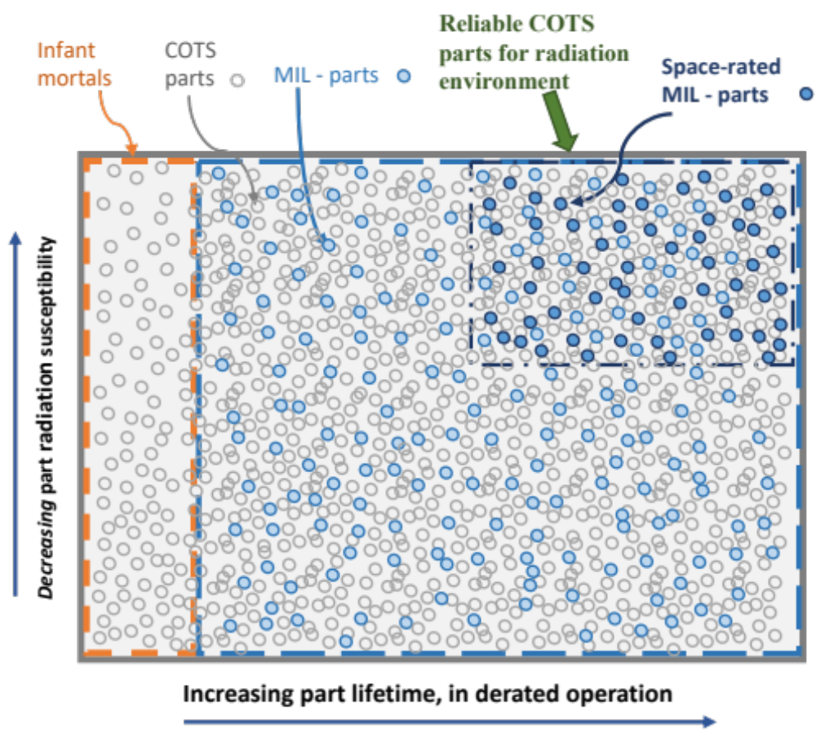
The Infinite “Space” View of COTS

Slide 51
Why have COTS been perpetually deemed “unreliable” or “low-grade”
The COTS definition is infinite
  This is exacerbated by an infinite number of definitions
    COTS is often a “label” used at a manufacturer with a local definition
  “Reliability” defined by the worst elements in the broad category
MIL-HDBK-217
  Arbitrary “failure rates” (PEMs 60-600x MIL-SPEC without any current foundation)
  Approach (along with similar handbooks) has become engrained across the traditional aerospace contractor community
  Standard “probability of success” (Ps) requirements have demanded its use
Issues with the plastic used in PEMs in the 70’s and 80’s.
  Took time to work through challenges to get the materials and manufacturing right
  e.g. moisture in the plastics were interacting with aluminum, resulting in corrosion
  Problem was solved in the late 80’s and PEMs ultimately surpassed hermetic ceramics in part-level reliability (failure rates)
Myths about COTS vs radiation

Slide 52
Why have COTS been perpetually deemed “unreliable” or “low-grade” (cont’d)
There was a semi-conscious decision dating back to the 70’s that all electronic parts flying in space must be rad-hard (by some definition),
  radiation problem is best solved at the part level,
  experiences in developing Skylab that concluded that given the immature manufacturing processes at the time it was much better to maximize part assurance practices at the time of manufacture then to add processes later or catch problems in testing.
Class S part was born
  Over time, “Class S” became conflated with other MIL-SPEC classifications and radiation hardness was subsequently conflated into the mix,
    Trapped the community into the mantra that only “Class S” parts can be flown in space; anything else would be a disaster.
    Had the unfortunate additional consequence that if a failure of a “Class S” part occurred, it was clear that all had been done, and there was no need to take things any farther to challenge whether part of the “Class S” mantra had contributed to the problem.
  A “Class S vs COTS” notion would perpetuate. In parallel, commercial manufacturing processes were improving and far surpassing this MIL-STD-based control system, which was frozen in time at its inception and unaffected by commercial markets or improving technologies.

Slide 53
Origin of the space grade part
There was a semi-conscious decision dating back to the 70’s that all electronic parts flying in space must be rad-hard (by some definition),
  radiation problem is best solved at the part level,
  experiences in developing Skylab that concluded that given the immature manufacturing processes at the time it was much better to maximize part assurance practices at the time of manufacture then to add processes later or catch problems in testing.
Class S part was born
  Over time, “Class S” became conflated with other MIL-SPEC classifications and radiation hardness was subsequently conflated into the mix,
    Trapped the community into the mantra that only “Class S” parts can be flown in space; anything else would be a disaster.
    Had the unfortunate additional consequence that if a failure of a “Class S” part occurred, it was clear that all had been done, and there was no need to take things any farther to challenge whether part of the “Class S” mantra had contributed to the problem.
  A “Class S vs COTS” notion would perpetuate. In parallel, commercial manufacturing processes were improving and far surpassing this MIL-STD-based control system, which was frozen in time at its inception and unaffected by commercial markets or improving technologies.

Slide 54
Intelligent use of COTS parts
Always use parts within the limits of their datasheets
  Respect the datasheet!
AEC-qualified parts (not just “for automotive use”) from leading manufacturers, produced under IATF 16949 will maximize reliability
Use familiar parts when possible
Avoid an approach that prompts you to use more parts as often happens with capacitors
Conservative derating is good practice, but excessive and forced derating may result in need for many extra parts, a mass or space problem, or a weaker design with less margins.
Use parts that the manufacturer declares to be for reliable use
Use parts that have been established for over a year and in high volume production
Buy parts from authorized distributors
  There is no purpose in MIL-SPEC distributor restrictions when buying COTS parts
There are many great options for “enhanced space” COTS parts for microcircuits and discretes
Avoid requiring the tightest performance and tolerances from passive parts
Strive for flexible resistance values (ranges) in current sensing applications
Be sure that parts only offered with pure tin have matte tin finish, when available.
  Give preference to manufacturers that use JEDEC tin whisker acceptance testing or similar approach
Often increased performance and modern design and manufacturing drive increased reliability
In some cases, you can only use what’s available against the guidance – accordingly assess and acknowledge the risk and explore reasonable mitigations

Slide 55
Radiation
Radiation hardness (RH) is a multi-dimensional property of any part that describes intrinsic abilities to tolerate various radiation environments
  Effects to be concerned with include total ionizing dose, total non-ionizing dose, and single-event effects – all of which depend on the mission, environment, application, and lifetime
Radiation concerns are the same whether a part is COTS, MIL-SPEC, or NASA-screened COTS
Overattention to radiation at the piece-part level has often supplanted the far more important concept of radiation-tolerant design (leading to a mission failure)
  Note that some radiation effects can only be accurately characterized at the part-level, though that does not necessarily verify whole-of-system performance. In some cases, the fact that the radiation effects are only apparent at the part level is actually due to attenuation of the effect in the circuit. The understanding of this attenuation is one facet of radiation-tolerant design.
All parts have a particular level of radiation susceptibility, but only some parts have details in their data sheets, and those details, when present, may be inadequate for a given mission, environment, application, and lifetime. Furthermore, piece part performance is often not indicative of circuit performance.
Why is there less concern about radiation in MIL-SPEC parts?
  Often in the space community, the MIL-SPEC term is used only to represent the small “space-grade” subset.
Does RH of parts in one lot imply the same level of hardness in another lot?
  Only if RH is in the datasheet (COTS or MIL-SPEC)
    Any part without RH in the datasheet is not optimized or even controlled for RH, and thus requires further consideration for suitability
    Furthermore, RH relative to some conditions (e.g., SEE) may provide no indication of RH to others (e.g., TID)
  However, if it can be confirmed that the part has not changed, one can consider the attributes of the part and the environment to determine whether there are new risk factors in the different lot (COTS or MIL-SPEC). There is no valid reason to discard knowledge obtained from prior lots of the part of the same construct.
Is past use of the exact same part in space in the same environment (MIL-SPEC or COTS) sufficient to guarantee its future use?
  No, because the concern is overall radiation tolerance of the design, not radiation hardness of the parts. The previous design may have been radiation tolerant, while the current design may not be.
Radiation is a system-level problem that we have been traditionally (and unfortunately) largely addressing at the part level

Slide 56
Radiation: what do we care about?
How a part performs in a worst-case exposure in a radiation chamber (i.e., guaranteed minimum dose to single-event resilience)
  Rad-hard (i.e., radiation-hardness-assured) parts are the answer
  Wafer-lot-specific radiation testing of non-RHA parts
How parts perform in a circuit within a spacecraft or instrument in space
  Radiation-tolerant circuit designs/circuit protections
  Shielding
  Operational constraints
  Experience with susceptible part types in the environment
    CMOS/MOSFETs
    Processors
    Memory
    etc
  Testing to fill gaps for unknown parts
Traditional space approach: “1 is needed for 2” will freeze us in the past as oldspace

Slide 57
What should be done about radiation?
Using new parts and new technologies will demand a new approach for radiation
Any expectation that all or most parts will be rad-hard or tested for radiation from their current lots will simply cause many to collapse under their own weight (including many that have been in space successfully for decades)
Any expectation that radhard parts are necessary and sufficient for successful on-orbit operation will lead to disappointment (as in SMAP)
Use good design practices
  Protect and derate your MOSFET!
  Implement TMR on FPGAs
  Be sure your processor circuit is resettable
  Employ EDAC and protect your memory
Use familiar parts
  New sensitive part types (CMOS, processors, MOSFETs, memory, etc) in critical applications should invoke testing or sufficient protection
Use components that have flown in similar environments
Learn from on-orbit experiences! Do not use ground-testing as your primary means for radiation assurance – it will provide a hard barrier against moving forward for many mission concepts.

Slide 58
Context for Risk in Parts
COTS
Parts with special features that are difficult to manufacture consistently (never available on MIL-SPEC)
  e.g., extra-low ESR and ESL ceramic capacitors
Parts used in brutal operating regimes
  High-voltage (particularly > 3 kV)
  Cryo
Low volume and hand-produced parts
  Lack a basis for reliability and often do not have optimized manufacturing processes
Parts used in extremely sensitive (poor) designs (based on variability of parameters not in part spec)
Parts used in applications in which the environment is unknown
Parts from unknown or poor-performing vendors (no recent examples)
No “hi-rel” or automotive parts available
MIL-SPEC
All risk-contexts for COTS, plus:
Low-volume parts
Lead time and costs can reduce system-testing resources
Designed for old manufacturing processes and broad environments
When used broadly, they can bring false hope and extensive problems may ensue
Processes will miss new manufacturing flaws
Performance and reliability not driven by the need to stay in business
Performance limitations may lead to weak designs
NASA-screened COTS
All risk-contexts for COTS, plus:
Parts are often overtested since MIL-SPEC testing regimes are not related to actual usage and parts are often not designed or optimized for such regimes
False hope that screening is relevant to operation
False hope that screening, testing, and qualification increase reliability or quality
The prospect for burying a problem or reduced lifetime into a part by the “overtest by design”.
Note that the contexts for risk in COTS parts all arise from mission performance requirements that would be present no matter which parts approach is used, so they apply to all cases.

Slide 59
Reliable COTS
Verify part meets Mission Environment, Application, and Lifetime requirements
  Radiation verified at the part level (RHA in the datasheet is one approach), circuit level (circuit design, fault tolerance, circuit protections), or system level (shielding, fault tolerance)
Use parts from an ILPM
Use Established parts
Recognize contexts for risk
Respect the datasheet (processing, testing, and usage)
  Do not screen parts outside of datasheet levels
Do not repeat manufacturer tests
Low field failure rate or DPPM
Relationship with manufacturer for transparency and trust

Slide 60
What are the key drivers for using COTS?
(Not necessarily all at once)
The need to employ technologies from the past 15 years
The need for parts that are available
The need for parts that are affordable
The need for parts that are the most reliable
The need for parts that meet mission requirements

Slide 61
Risk Mitigation vs Risk Avoidance
Risk mitigation
  Understand actual risks associated with the parts used, COTS or MIL-SPEC
  Understand and control, when necessary, the risk factors associated with COTS
  Assure usage of COTS is consistent with their manufacture and datasheet restrictions
Risk avoidance
  Ban the use of anything that may involve risk in some scenario, rather than when there is a context for risk in the current scenario
  Do not perform the function if it requires COTS because COTS are unfamiliar and require a different approach.
  Using MIL-SPEC parts when established COTS are better fits does not avoid risk; it just converts a fear to a design-based risk.

Slide 62
Current Conflicts
MIL-SPECs, by definition, fundamentally limit technology
  The broad environmental ranges required and the ability to tolerate many forms of overtest (inherently a derating), drive firm “catalog limits”, which have been in place since inception
  There are not and will not be well-defined “parts categories” to cover many new classes of electronics technology
The use of MIL-SPECs to accept and qualify COTS parts conflicts with many of the premises of COTS parts
  MIL-SPECs involve many test levels that are not based on the actual manufacturing processes or application use of the parts
  COTS parts are optimized to levels laid out in their data sheets, which would very often be different from MIL-SPEC testing levels (neither necessary or sufficient for properly characterizing the parts for acceptance)
    MIL-SPEC testing levels can overtest COTS parts, resulting in misleading data and/or reduced reliability and damage to parts

Slide 63
Soon there will be no choice
Instruments are appearing for high end missions that cannot be manufactured with MIL-SPEC parts or parts that can be effectively screened into compliance using EEE-INST-002
  It is a virtual certainty this will be the case for the next major flagship space telescope
Fully COTS spacecraft are soon to be ubiquitous and over time, some will stand out as long-term reliable
  As long as we continue to equate EEE-INST-002 screening and qualification with reliability, we will continue to misrepresent reliable systems based on COTS as “unreliable”.
  Such spacecraft will always be frowned upon for usage within NASA
Availability of MIL-SPEC parts, especially level 1 and many types of space-grade, is becoming a growing challenge, in addition to the growing excessive costs.

Slide 64
Conclusions
GPR 8705.4A includes some modernizing elements that begin to transform the philosophy of risk classification being largely about control of piece parts to one that considers holistic performance and reliability of system designs to classify them
This approach enables GSFC, and ultimately NASA, to incentivize novel and innovative approaches to build reliable systems efficiently rather than to reward them for exercising traditional processes for piece-part control that may have little to no effect on the risk or reliability of the mission.
Furthermore, it puts in place a technical foundation and structure to support the current wave of concepts that involve the use of multiple “lower-class” spacecraft to enable a higher-class mission.
GPR 8705.4a is now baselined
  Working with OSMA to institutionalize concepts at the Agency level

Slide 65
Example COTS space experiences
The SpaceCube

Slide 66

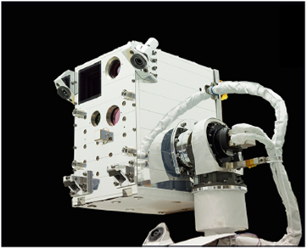
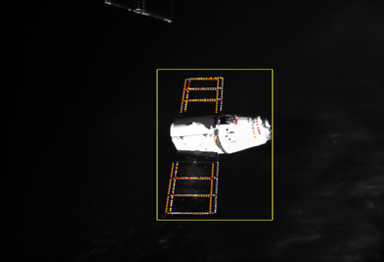
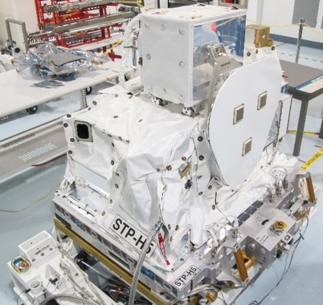
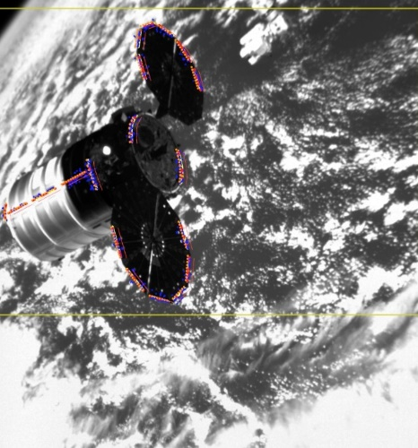
Example: Raven Payload
Objective:
To advance the state-of-the-art in rendezvous and proximity operations (RPO) hardware and software by:
Providing an orbital testbed for servicing-related relative navigation algorithms and software
Demonstrating relative navigation to several visiting vehicles:
  Progress
  Soyuz
  Cygnus
  HTV
  Dragon
Demonstrating that both cooperative and non-cooperative rendezvous can be accomplished with a single similar sensor suite
Visible Camera
Infrared
Camera
$20M+ payload reliant on confidence in the SpaceCube computer, which in this case was pre-populated with 99% COTS Parts, and then thoroughly tested.
LIDAR
Raven
(Deployed Configuration)
SpaceCube v2.0
Cygnus Tracking
Raven installed on STP-H5
(Stowed Configuration)

Slide 67
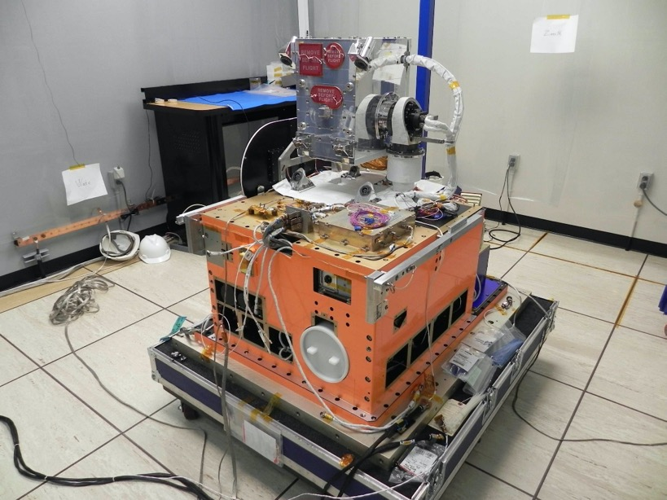
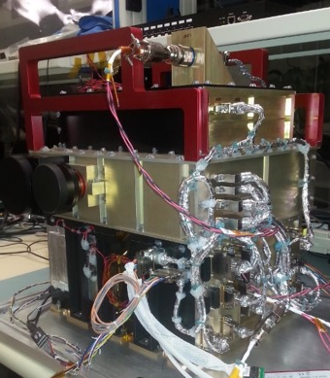
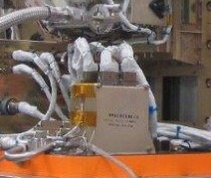
Example: STP-H5 ISS Payload
26% COTS Parts
SSPD Raven
ISEM, SpaceCube Mini
99% COTS Parts
SpaceCube v2.0 EM
1% COTS Parts
SpaceCube v1.0 CIB
Photo Credit: DoD STP
The Space Test Program-H5 (STP-H5) external payload, a complement of 13 unique experiments from seven government agencies, is integrated and flown under the management and direction of the Department of Defense’s Space Test Program.
2/2017 - Current

Slide 68
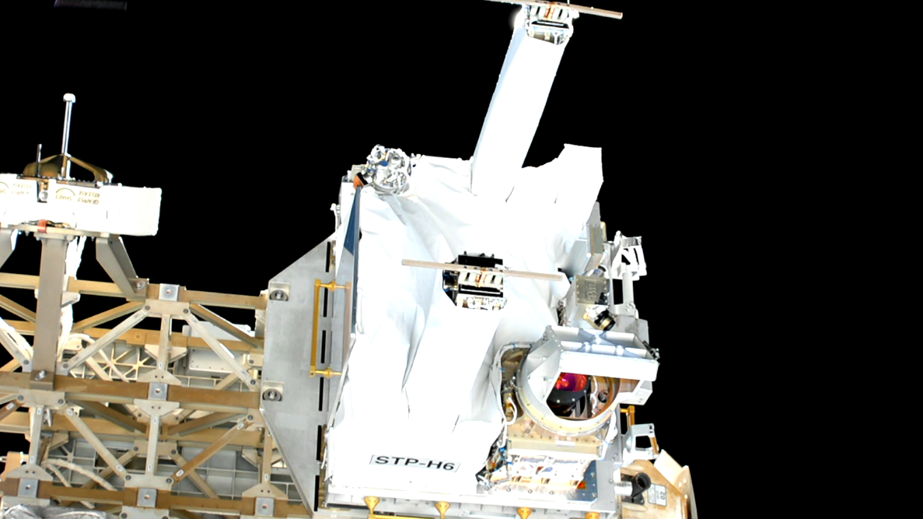
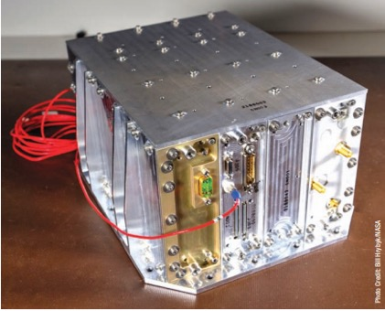
Example: STP-H6 Payload
99% COTS Parts
SpaceCube v2.0 NavCube
1% COTS Parts
SpaceCube v1.0 CIB

Slide 69
SpaceCube Time-on-orbit (Oct 2021)
Project | Version | Part Req | BOM Count | Operation Months | Xilinx Quantity | COTS % | COTS Months
RNS | v1.0 | 2+ | 3700 | 0.0833333 | 4 | 1% | 3.08333
MISSE-7 | v1.0 | N/A | 3100 | 90 | 4 | 2% | 5580
SMART | v1.5 | N/A | 1000 | 0.0333333 | 1 | 95% | 31.6667
STP-H4 CIB | v1.0 | N/A | 1500 | 30 | 2 | 1% | 450
STP-H4 ISE2.0 | v2.0-EM | N/A | 1250 | 30 | 3 | 98% | 36750
STP-H5 CIB | v1.0 | N/A | 1500 | 46.933333 | 2 | 1% | 704
STP-H5 ISEM | v2.0 Mini | N/A | 1000 | 46.933333 | 1 | 26% | 12202.7
STP-H5 Raven | v2.0-EM | N/A | 1500 | 46.933333 | 3 | 99% | 69696
RRM3 | v2.0 | N/A | 1429 | 36.666667 | 2 | 65% | 34057.8
STP-H6 CIB | v1.0 | N/A | 1500 | 31.833333 | 2 | 1% | 477.5
STP-H6 GPS | v2.0 | N/A | 1157 | 31.833333 | 2 | 65% | 23940.3
Restore-L Lidar | v2.0 | 3 | 2000 |  | 2 | 0% | N/A
STPSat6 | v2.0 Mini | N/A | 1500 |  | 1 | 98% | N/A
Totals | Units Flown | 11
 | Specific brand FPGAs | 26
 | Specific-brand FPGA Device-Years | 83
 | Part Years | 57213
 | COTS Parts Years | 15324
Also to note: We flew many COTS components on some of these projects:
ISE2.0, SMART, and ISEM all flew COTS cameras that were ruggedized. SMART flew COTS SATA drives.
Raven flew a $5 USB interface card to an IR sensor
STP-H5 and -H6 have CHREC Space Processors (CSPs) that were 95% COTS components. See references for more info on CSP results (no failures to date)
RRM3 suffered a failure (outside of SpaceCube) that may have involved a specific COTS part, but the part was used in a stressing condition that any part would eventually fail.
NavCube Commercial vendor populated PWBs

Slide 70
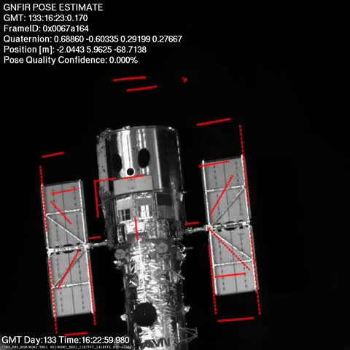
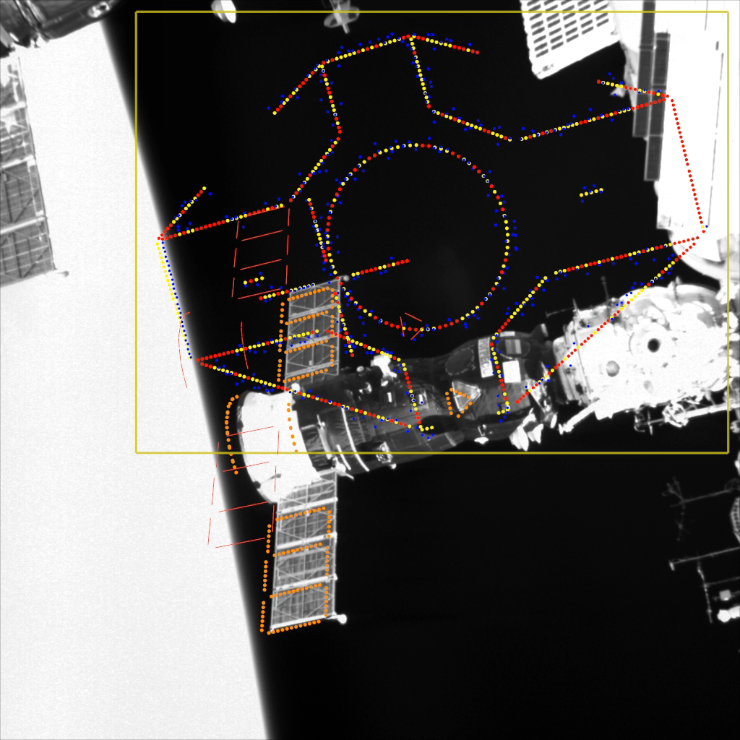
Side-by-Side Comparison – Proper use of COTS
Platform:
SpaceCube v1.0
Parts:
Level 1 and Level 2 Parts
Application:
Relative Navigation System
Hubble Space Telescope Real-Time Tracking using 3x visual cameras
Identical Rigorous Design and Test Philosophy
Platform:
SpaceCube v2.0
Parts:
Commercially screened Parts (i.e. COTS)
Ability to use any level of parts
Application:
Raven Relative Proximity Ops
ISS visiting vehicle real-time tracking using visual, Lidar, and IR instruments

Slide 71
General principles for DNH projects
Avoid costly requirements that buy down little to no risk at high expense, such as
  EEE parts upscreening/MIL-SPEC parts
  High-end printed circuit board reqmts
  GMIPs without consideration of risk
  Avoidance of commercial practices
  Avoidance of new technologies
  Strict workmanship requirements
  Numerous protective barriers
  Highly conservative practices (high cost and programmatic risk)
Freely depart from longstanding practices when they don’t apply
Do not place too much attention to piece parts, especially at the expense of system-level testing
  Use a “right-to-left” approach

Slide 72
Left-to-right vs Right-to-Left Development
  Left-to-right
    Piece-parts-centric, broad requirements
    System testing as resources remain
    Least test-as-you-fly driven
  Right-to-left
    System test dominates
    Use proven components as much as possible
    Piece-parts focused on criticality and knowledge of parts
    Most test-as-you-fly driven
Primary focus on resources put into
Piece parts and screening
System test is subject to remaining resources
Piece parts and components based on history, secondary to system test
System test is primary focus

Slide 73
Challenge: Elements of a DNH program
Program-level reliability
  More science for less money if some individual projects are allowed to fall short of goals
Requirements commercially-driven and/or based on knowledge-driven assessment of risk
  Nothing required solely because we’ve always done
Focus is on system-level testing
  Piece part activities based on objective determination of risk
Testing centered on test like you fly
  avoid tests that prompt failures that are unlikely to be encountered on-orbit
Maximize system-level testing hours
  Intermediate testing and barriers of protection based on risk

Slide 74
Approach to Implementation
Lean Project Management
Part time PI/PM
Lean Engineering Team
  MSE
  Electronics
  Mechanical
  Software
  0.1 senior mentor
Risk-based SMA
  Part time CSO
  Part time QE

Slide 75
Robust Design
Assessment of tall poles, critical items, and credible faults
Design for manufacturability
  Not consistently employed
Fault and radiation tolerant design
  (selective) redundancy
  Fault-tolerant design
  Design for minimum [acceptable*] risk
  Ability to reset
  Design for graceful degradation
*A stakeholder may decide that local mission-success-related risks that are unpalatable are acceptable to achieve the long-term greater good

Slide 76
Sound risk management
Capture risks based on existing threats to performance and reliability
Consider all possible sides of each risk and trade risks in a balanced way
  Avoid over-attention and mitigation to some risks at the expense of others
Apply requirements based on the best understanding of risk at the time
Characterize risk for nonconforming items to determine suitability for use and avoid scrapping or rebuilding items without understanding risk of use
Avoid the common “ugly = risky” determination

Slide 77
Prime DNH concept attributes
High-risk, high-payoff science proof of concept
Low-cost implementation option (cubesat, ISS payload, CAPsat)
Short-term achievement potential
Feed-in or high-risk rejections from larger missions
Prior experience on A/C, sounding rockets, etc
Motivated PI who pushes boundaries, challenges conventions

Slide 78
Inherited items for cubesats
Many standard CubeSat components now exist
Substantial reliability benefits for using previously qualified items
However, these give rise to constraints that may increase the system design challenge
In general, it may be desirable to treat the cubesat itself as an “inherited” or COTS item
  Ensure mission success and reliability through holistic assessment, rather than piece parts approvals (alternate approach)

Slide 79
Where do risks come in at launch?
Unresolved risks carried in the project
System-level testing not completed
System doesn’t function as expected at launch
Few hours of failure-free operation at launch
All problems not resolved by the time of launch
Known risks at time of launch may be realized

Slide 80
Current status
Cubesat version of GEVS complete and incorporated in handbook
Handbook is complete and baselined
Supplemental file maintained as GSFC-HDBK-8007 Addendum (unofficial)
  Contains updates based on cubesat development and operations learning

Slide 81
Summary
Cubesats demand a unique approach due to a unique set of constraints
Two approaches are suggested here
  Prioritizing mission success activities by ratios of programmatic risk to technical risk and programmatic resources to technical risk
  Holistic assessment of the cubesats, where piece parts are secondary contributing elements
The Cubesat mission success handbook is baselined and, through an unofficial addendum is maintained as a living and growing reference.

Slide 82
Backup slides

Slide 83
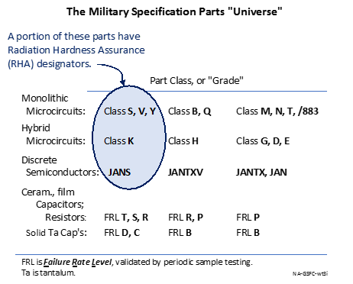
RHA in the MIL-SPEC “universe”
Note that V, Y, K, and JANS parts are not required to have radiation hardness assurance guarantees.

