Slide 1

IMC 2024
NASA’s Space Environments Testing Management Office (SETMO)
Reliability Centered Maintenance (RCM) Program Advancement
Ellen Sydnor, SETMO’s Maintenance Program Manager
Notes:
Good morning, my name is Ellen Sydnor and I am here to present on how NASA’s Space Environments Testing Management Office (aka SETMO), is advancing the technical capabilities’ maintenance practices towards a reliability centered maintenance program.
I want to thank the IMC committee for accepting my abstract and for giving me the opportunity to speak to about how SETMO is advancing the Maintenance Program at some of NASA’s critical facilities.

Slide 2
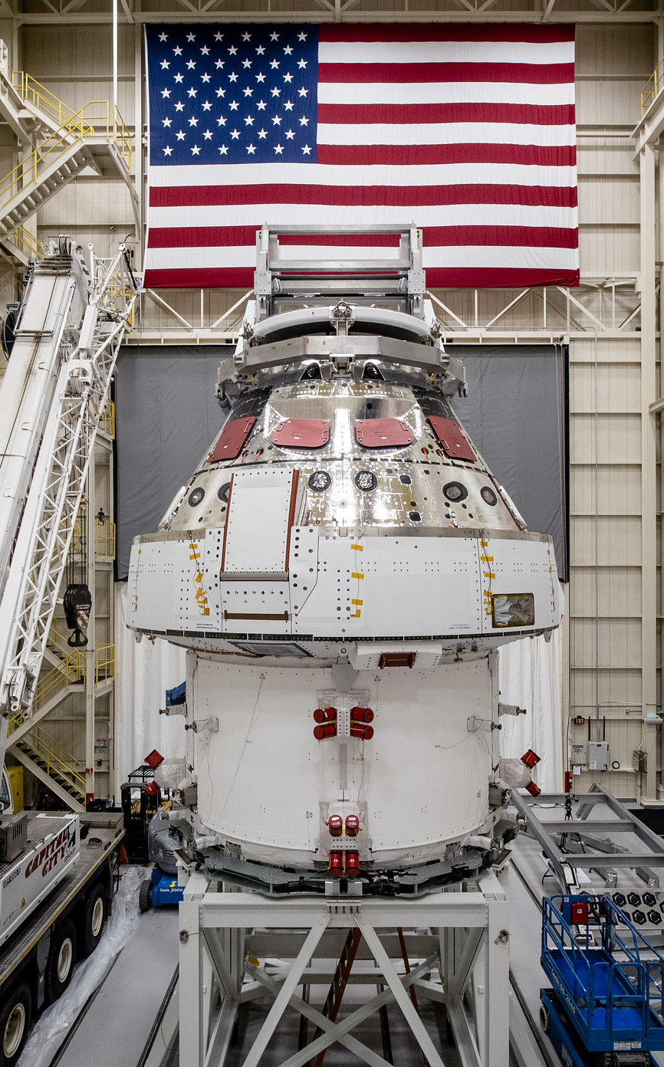
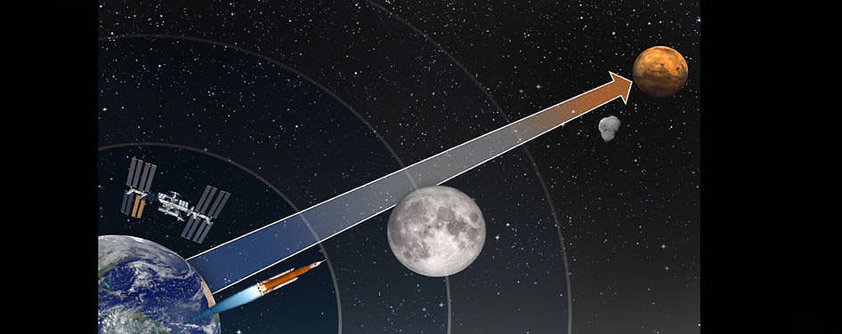
SETMO’s Reliability Centered Maintenance
Program Advancement
Agenda
SETMO’s Portfolio Overview
Challenges
Change - Where to Start
  Evaluate
  Identify
  Recommend
  Implement
Results
Summary
Orion Spacecraft for Artemis I Mission Preparing for Testing at NASA’s SEC
Notes:
The presentation will include:
An OVERVIEW of SETMO
I’ll describe the maintenance CHALLENGES
Address the approach to start making CHANGES
The IMPLEMENTATION strategy, and
Wrap up with the Results and Summary and have time for questions and answers

Slide 3
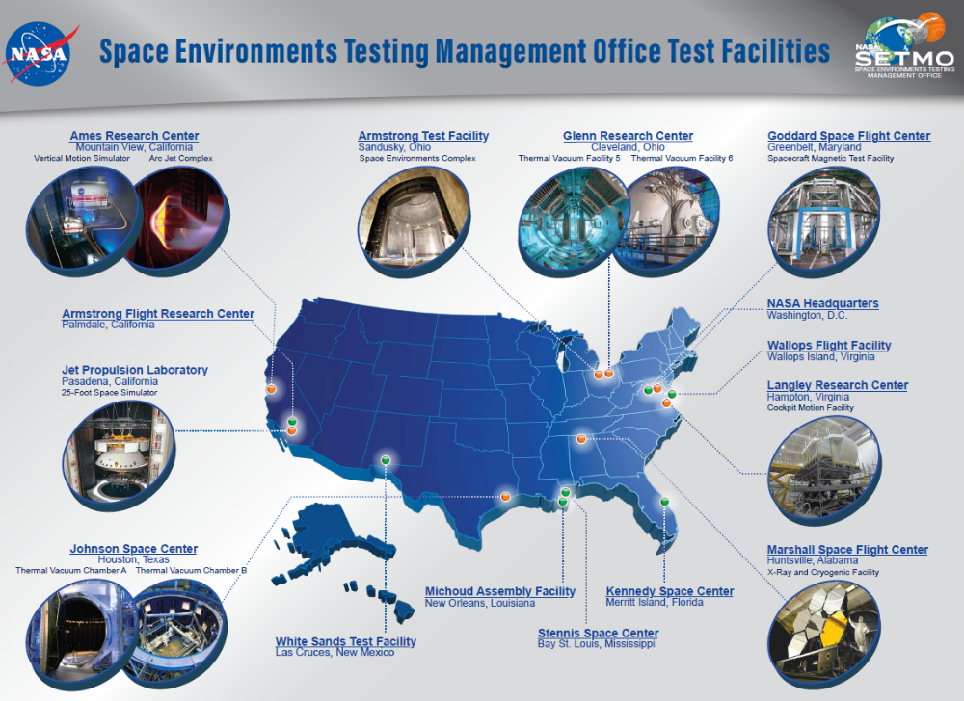

Overview – SETMO’s Portfolio
SETMO_{Est.2020}
Vision
Leading the Way in Space and Flight Simulation Testing for the Agency and Nation
Mission
Actively Managing and Advancing SETMO’s Testing and Simulation Capabilities to Strategically Align and Support NASA’s Evolving Missions and National Aerospace Enterprise
Sustaining the Nation’s
KEY
Space-Testing Facilities
Notes:
NASA’s Space Environments Test Management Office (SETMO) is one of five technical capability portfolios within the Agency. Even though it was established in 2020, the program has roots going back to 2005
SETMO manages over 170 capability components across the Agency responsible for critical space and simulation testing facilities across NASA’s field centers nationwide

Slide 4
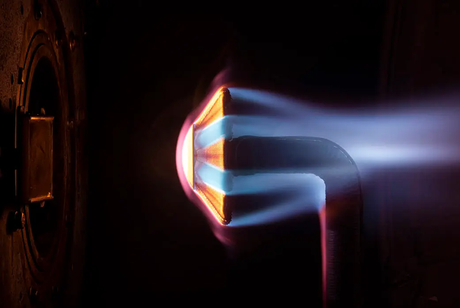
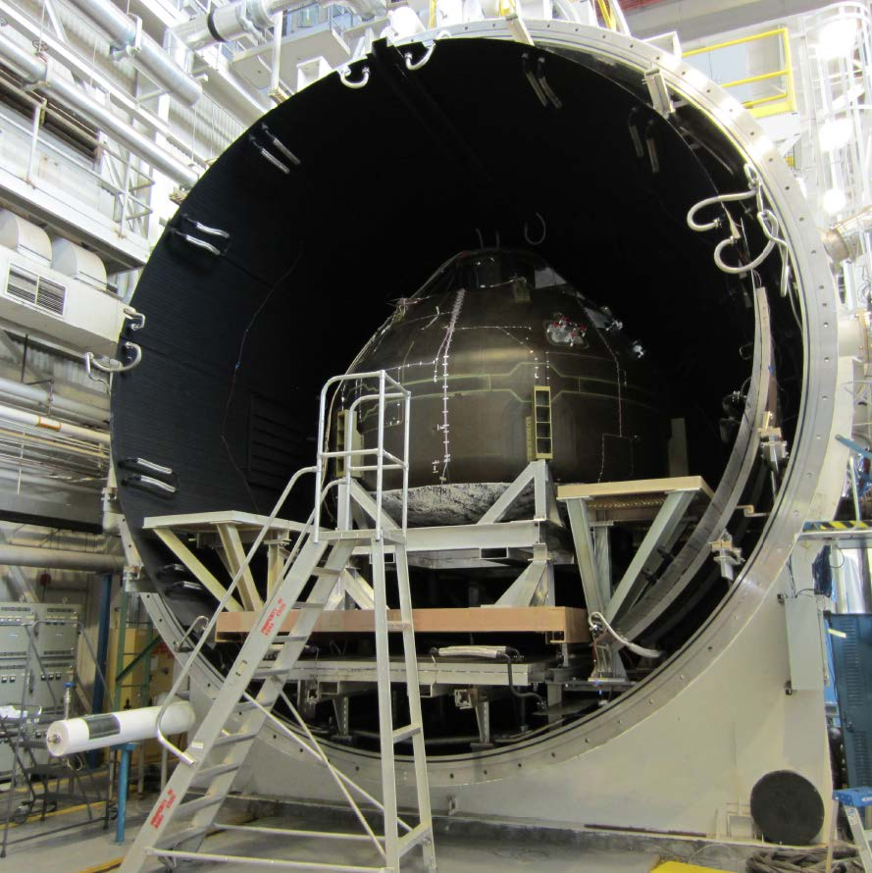
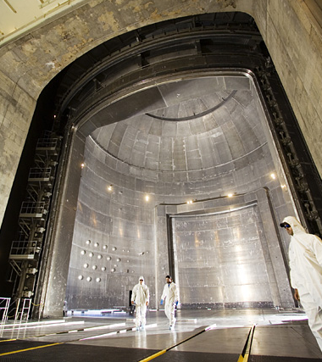

Overview – SETMO’s Tier 1 Technical Capabilities
  High Enthalpy Testing – Produces flight entry conditions to test thermal protection systems for validation and qualification for spacecraft.
  Ames Research Center – Arc Jet Complex
  Space Environments Testing – Unique large-scale facilities that replicate extreme environments for testing spacecraft, instruments, space technology component development & qualification, and human testing in a vacuum environment.
  Glenn Research Center – Thermal Vacuum Facilities VF-5 & VF-6
  – Space Environments Complex (SEC)
  Marshall Space Flight Center – Sunspot Thermal Vacuum Facility
  & Thermal Vacuum Chamber V20
  Johnson Space Center – Thermal Vacuum Chambers A & B
Flight Simulation - Motion based and stationary flight test capabilities that provide high-fidelity simulation research and investigations for air and space vehicles.
Ames Research Center – Vertical Motion Simulator
Langley Research Center – Flight Simulation Facilities
Arc-Jet Complex
Thermal Vacuum Chamber
V 20
Space Environments Complex Space Power Facility
Flight Simulation Facility
Cockpit Motion Simulator
Notes:
SETMO’s portfolio has 3 distinct capabilities categories: High Enthalpy, Space Environment Testing and Flight Simulation
SETMO has categorized the facilities into two groups: Tier 1 and Tier 2. The 10 Tier 1 facilities are typically larger, more complex and receive O&M funding from SETMO. The Tier 2 facilities are smaller, less complex and obtain their funding from the Nasa Centers and/or from test or research programs that use the facility, which encompasses over 43 ground test capability components.
​
The initial focus for the maintenance improvements started with SETMO’s Tier 1 capabilities, which are: (briefly describe technical capability – where it is located and what testing the facility performs,

Slide 5
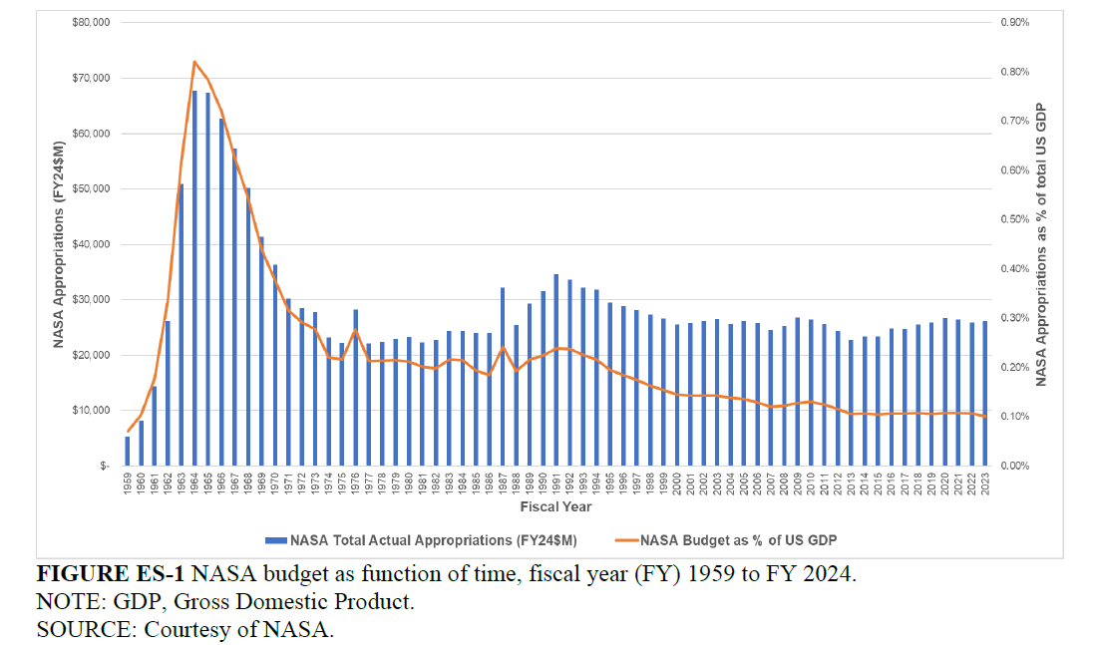
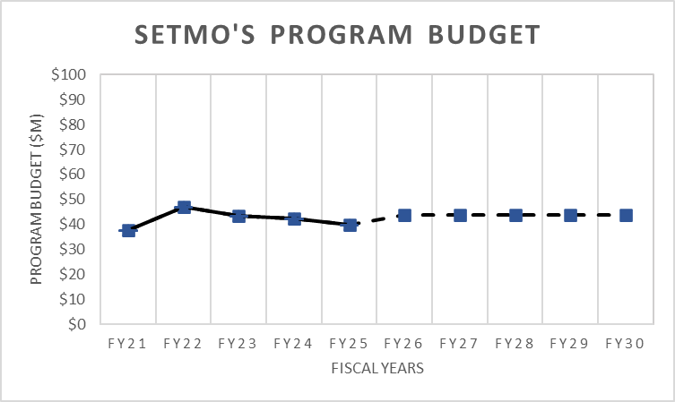
Challenges – Change Drivers
NASA at a Crossroads: Maintaining Workforce, Infrastructure, and Technology Preeminence in the Coming Decades (2024)
  Many of SETMO testing capabilities date back to the Apollo era of space exploration.
  Flat and/or declining maintenance budgets increase risk to test.
  No dedicated maintenance team for complex research testing equipment.
    Operators and maintainers have dual roles.
    Testing and mission/customer focus takes priority.
    Periods of high and low utilization.
    Maintenance is mostly reactive and ad hoc.
1959
2024
Projected Budget
In 2020, SETMO began addressing these challenges to improve the maintenance practices at the Tier 1 technical capabilities by introducing a more disciplined RCM approach.
Notes:
Some of you may have heard Dr. Joel Carney, OSI’s Assistant Administrator and Erik Weiser, FRED Director, speak about how 83% of NASA’s facilities are beyond their design life, the staggering amount of deferred maintenance costs, and how unplanned maintenance consumes up to 30% of the annual budget. SETMO’s technical capabilities are included in those numbers.
Flat and/or declining maintenance budgets increase risk to test, and the estimated maintenance gap continues to grow due to increased inflation, labor costs, and aging facilities.
One notable difference between the Center’s institutional and SETMO’s technical capabilities' maintenance program is that the Center’s maintenance program has a dedicated maintenance organization that performs maintenance on the Center’s assets whereas SETMO’s technical capabilities operators are the maintainers. Their primary focus and priority is on the mission and how the testing operations can successfully accomplish the mission; maintenance typically has had a lower priority.
All the facilities have high and low periods of utilization rates and need to be available to meet testing demands which has led to several challenges: One, workforce retention, and the second being how to optimize the maintenance strategy based on varying utilization cycles.
This has resulted in the maintenance practices being mostly being reactive and ad hoc
In late 2020, SETMO’s leadership recognized this challenge and created a position within the SETMO team to improve the maintenance practices starting with the Tier 1 capabilities by introducing a more disciplined RCM approach to maintenance.

Slide 6
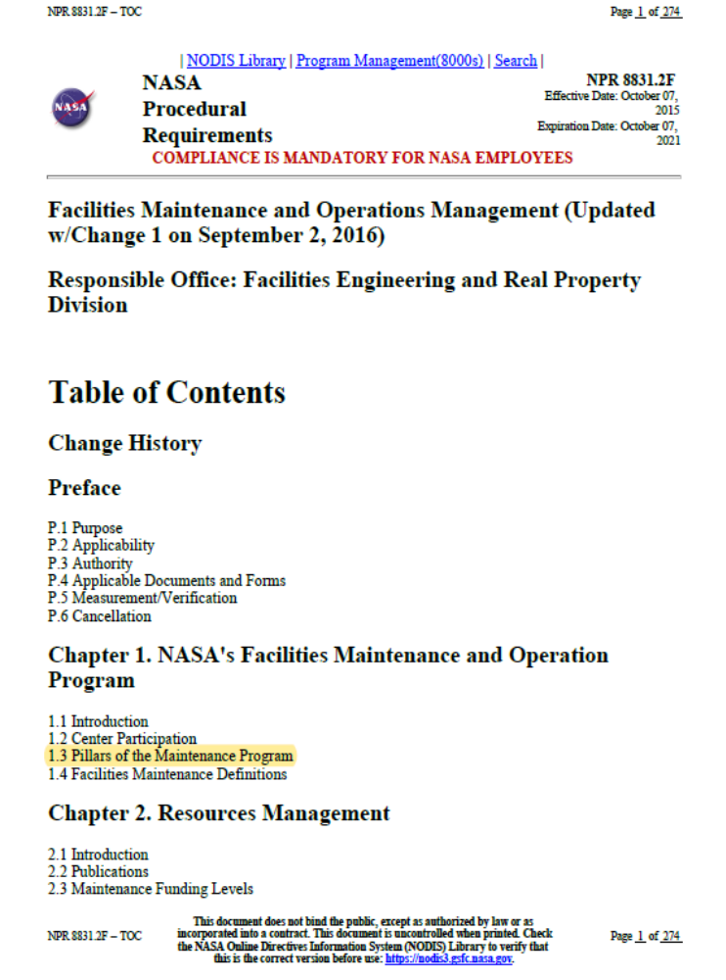
Change – Where to Start
  Establish a Baseline
  Evaluate the critical Technical Capabilities against applicable elements in NASA’s Procedural Requirements (NPR) 8831.2F “Facilities Maintenance & Operations Management”.
  Identify notable best practices, gaps, and deficiencies
  Recommend how RCM principles can be incorporated into maintenance practices.
  Implement recommendations based on evaluation findings.
Safety
Management
Execution
Employee Development
Computerized Maintenance Management System (CMMS)
Reliability Centered Maintenance (RCM)
Reliability Centered Building & Equipment Acceptance
Notes:
- Understanding why test facilities are maintained the way they are, and where and what improvements are most beneficial and cost-effective is the first step to obtaining higher maintenance effectiveness.
- SETMO commissioned a maintenance program evaluation to document a critical baseline reference point and to understand, at least for its Tier 1 Capabilities, current maintenance practices, how they compare to NASA standards and industry best practices and gain expert opinions on potential improvement areas.
- The evaluation used the NASA NPR 8831.2f (NPR) standard as a comparison basis for each SETMO Tier 1 facility. The NPR documents current NASA maintenance & operation program standards. Primary areas of evaluation included the NPR Pillars: of Safety, Management, Execution, Employee Development, Computerized Maintenance Management System (CMMS), Reliability Centered Maintenance (RCM), and Reliability Centered Building and Equipment Acceptance (RCB &EA).
- Other NPR Pillars and subjects that did not apply to the operation and maintenance of test facilities or that were considered in other evaluation methods were excluded from the evaluation.

Slide 7
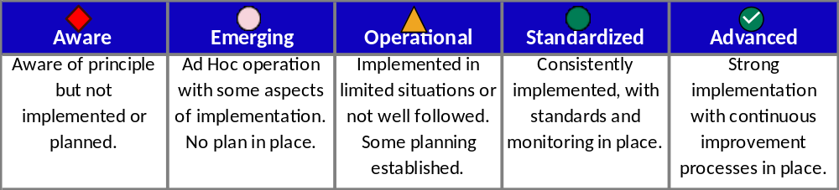
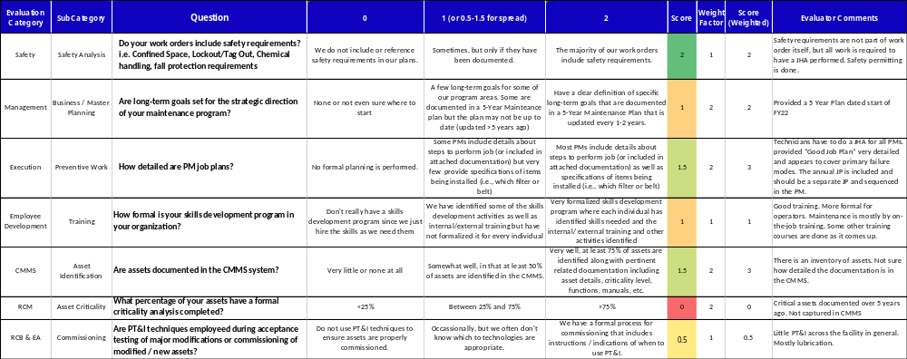
  Evaluation Tool
Maturity Index Definition
SAMPLE
Notes:
An evaluation scorecard was developed to provide an accounting against each major category and sub-categories – Ask the audience if they have ever used this type of tool to perform baseline evaluations.
- Maturity level names were taken from an existing Agency-wide Condition Based Monitoring Assessment report that was performed in 2020. The definitions were re-worked to relate to the maintenance management evaluation. The thought was to use and apply the same terminology so that there is commonality between the two reports.
- The scorecard is a MS Excel based tool
- 85 questions w/predetermined weights that were based on the Contractor’s Asset Mgmt experience, industry best practices and relative importance to an RCM program
- The raw scores align with the maturity level
- The output score maps to a maturity level for each category and sub-categories
Here is an example of data extracted from one of SETMO’s tier 1 technical capabilities – I selected a question from each major category so that you can see a sampling of them.
Go over some of the questions to demonstrate how the evaluators used the tool.

Slide 8
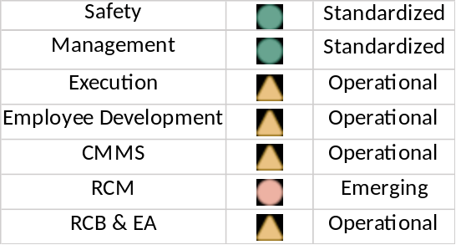
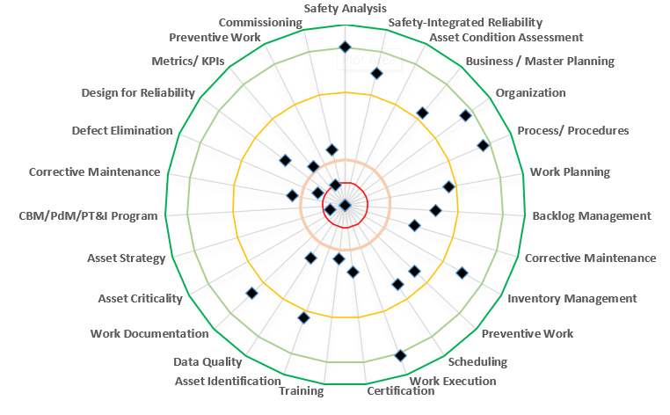
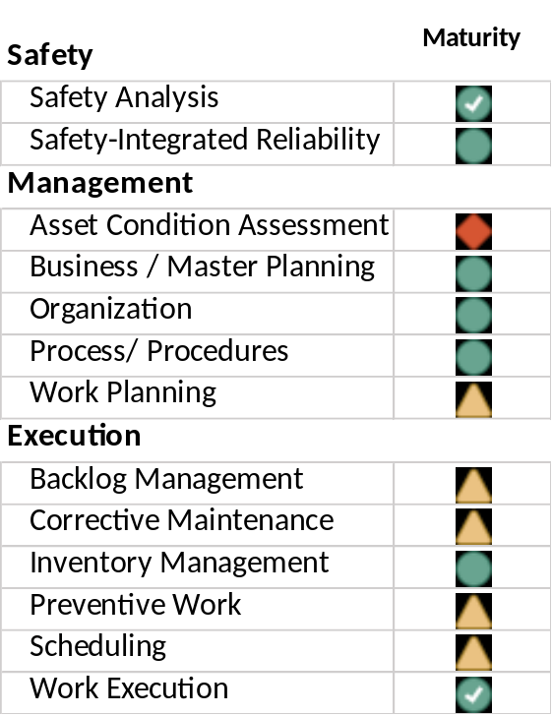
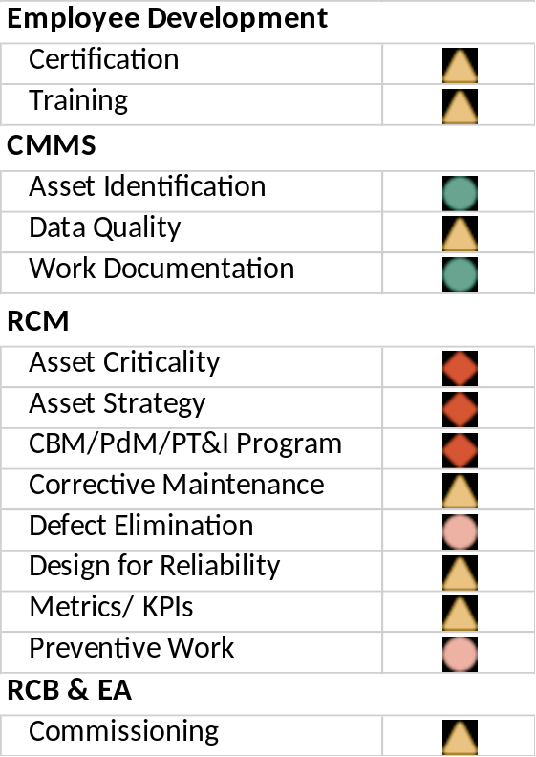
Evaluation Results
Score Overview
Composite Scores by Group
Maturity
Operational
Implemented in limited situations or not well followed. Some planning established.
Notes:
- Here are the overall results from the example shown in the previous chart. The results identified the strengths and weaknesses in each category and subcategory.
- The output from the evaluation tool provides a high-level summary and shows the composite scores by each group. You can see on the left how the breakdown for each major category and how they are mapped to a maturity index.
- The radar chart on the right shows a different view of each subcategory and the maturity level. It provides a visual of the maturity of each element; the goal is to achieve results that are in the outer green rings to get to a standardized or advance maturity level.
- The overall maturity level for the technical capability in this example is Operational.
A preliminary report with the findings and recommendations was developed, discussed and presented to each Tier 1 facility so that they could provide clarification or additional information that may have been missed previously. Following that discussion, a final report was developed that identified best practices., gaps and areas for improvement.

Slide 9
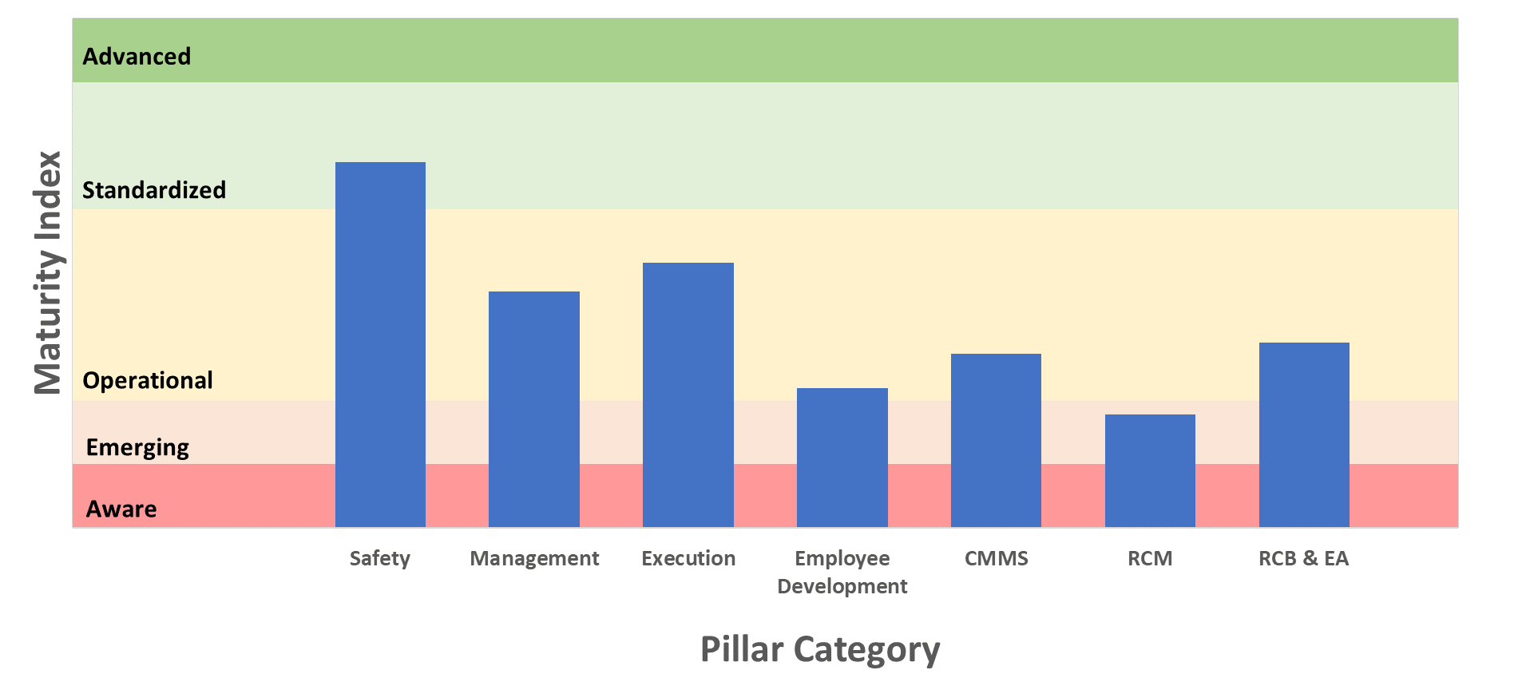
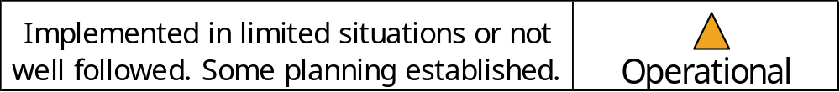
Overall Results
  Findings Summary
  Facilities have good safety practices!
  Lack of short and long-term maintenance goals/program planning.
  Operators are the maintainers – they know the equipment well!
  Time required to complete is not estimated/evaluated for use in future scheduling.
  Limited awareness of modern maintenance practices and the use of advanced technologies and methods.
  Maintenance records, processes, and costs are not well documented and/or kept in logbooks.
  RCM principles are not generally understood or followed.
  PT&I opportunities are rarely considered or included during the design phase or utilized during acceptance testing.
Tier 1 Facility Evaluation Outcome – Average Composite Scores
Evaluation Category
Notes:
- A maintenance management evaluation for each Tier 1 capability was performed –
- Looking across at all of SETMO’s Tier 1 technical capabilities, here is the average composite score in each category.
- There were quite a few findings on best practices and areas for improvement.
Before I elaborate on each category, I want to point out that you will notice that each band of maturity level has a different widths.
The maturity ranges are different sizes due to the varying complexity and effort required to progress through the maturity levels. For example, moving from Aware to Emerging is generally easier because it involves implementing a few changes to the process and plan, without the necessity for these changes to be fully successful. However, transitioning from Emerging to Operational requires more defined and implemented processes, which is a more demanding step.
When reaching the Standardized level, consistency and formalization become crucial. These stages require more time and a broader range of competencies, reflecting the increased effort and complexity involved in achieving higher maturity.
I want to touch on some of the notable observations regarding each category:
SAFETY as it relates to maintenance– Overall the technical facilities hold a high regard for safety. One facility received an Advance maturity level score, and another facility was in the higher band of the Operational level – all the others were in the Standardized area, which is great! There were many instances of Job Hazards Analysis (JHAs) and lock-out/tag-out steps noted in their maintenance plans.
MANAGEMENT – This category looked at short and long-term maintenance planning, job planning and executing and analysis. Overall, there was a lack of or inadequate annual and 5-yr. maintenance program planning. Where planning occurred, it mainly concentrated on upgrade and replacement of risk-to-test equipment. There were no goals to address maintenance mgmt. and/or execution improvements. Additionally, some of the lower maturity levels did not have formally documented processes and procedures for maintenance execution workflows.
EXECUTION – This category was in the mid to upper portion of the Operational maturity level that considered the success of work execution and scheduling, backlog mgmt. and inventory management. The Operators are the Maintainers, which is positive because they know their equipment best; the negative side is that they must balance testing and maintenance; which in most cases testing and customer focus takes priority. Another finding was that the facilities performed work scheduling daily or weekly and held regular maintenance meetings. The maintenance task decisions were typically made based on the perceived potential risk to test impact no with a formally documented priority or classification system based on actual data. The time to repair, or complete maintenance activities are currently not captured, which makes it difficult for future planning.
EMPLOYEE DEVELOPMENT – There was a widespread lack of awareness of modern maintenance practices and the use of modern technologies. All of the technical capability's personnel participated in the standard NASA and OSHA mandated training with evidence of completion maintained by NASA. Another finding that was common was that maintenance processes, best practices, and execution training were not consistently applied. Finally, the O&M folks lacked a general understanding of RCM and NASA’s 8831.2F standard.
CMMS – this category considered the use of maintenance management systems to identify assets, document work and provide accurate reports – there were a number of instances where maintenance data is either not collected or noted in logbooks. A few technical capabilities used on-of-a-kind developed software tools to track maintenance work to a varying degree, which were limited in functionality. The facilities that use Maximo, used it in limited capacities to track work performed; labor and cost are not tracked, and reports are limited.
RCM - considered the use of RCM principles to develop a systematic approach to evaluate facility equipment and resources to choose maintenance strategies that result in a high degree of facility reliability and cost-effectiveness. Notable findings included:
• Preventive maintenance job plans have been created at most facilities.
Facilities do not perform RCM analysis, root cause analysis, or FMEAs to determine optimum maintenance strategies.
The only metrics that were tracked were the ones that SETMO requires (Availability, Downtime).
• Three facilities track additional metrics including Open PM Work orders, Closed PM Work Orders, PM compliance, and Cancelled PM’s.
RCB & EA –Reliability Centered Building and Equipment Acceptance otherwise known as Commissioning, considered whether PT&I techniques are integrated into acceptance testing and commissioning processes. A couple of observations that were common to the Tier 1 technical capabilities were:
• Facilities use commissioning and acceptance tests to validate operation prior to use of new and upgraded assets.
• PT&I opportunities are rarely considered or included during the design phase or utilized during commissioning/acceptance testing phases.
So when all the technical capability’s scores were averaged, the maturity level score was OPERATIONAL. The technical capability’s maintenance practices and planning were implemented inconsistently and or in limited situations.

Slide 10
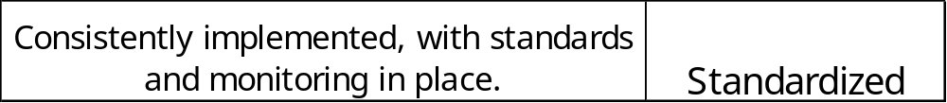
Recommendations
  Top Five
  Set common expectations for Facility maintenance programs.
  Improve annual and 5-year maintenance program planning.
  Apply RCM principals to improve maintenance efficiency, reduce risk and probability of failures.
    Incorporate Tiered maintenance
    Identify critical equipment
    Perform streamlined RCM analysis
    Determine optimal mix maintenance strategies
    Mature to use Condition Based Maintenance
  Increase utilization of modern CMMS technology.
  Improve maintenance performance and cost tracking.
Tier 1 Facility Evaluation Outcome – FUTURE STATE GOAL
Evaluation Category
Notes:
The future state goal that SETMO would like to see for all technical capabilities is in the “STANDARDIZED” level in the next 3-7 years. Because Safety was already at the Standardized level, achieving the Advance level is a goal to be reached in that timeframe.
There were some common themes throughout the Tier 1 technical capabilities that resulted in overall recommendations and from a high-level perspective, the top 5 recommendations were:
1. Set common expectations for Tier 1 Technical Capability’s Maintenance program
- Each Tier 1 facility evaluated has an independent and unique maintenance program based mostly on local management and engineering knowledge. Many of the programs have been operated in the same manner since early in each facility’s history relying on tribal knowledge that has been passed down for decades. The standards and objectives applied to the research assets at the test facilities can be improved to better align with the NPR 8831.2f.
Improve annual and 5-year maintenance program planning.
- Maintenance planning is essential to identify long-and short-range facility requirements based not only on mission impact but ensuring that SETMO’s maintenance programs continue to progress towards proactive modes of operation versus reactive modes. As most of you know that not only is reactive maintenance expensive, but it requires correspondingly a lot more maintenance management that could be better spent in program planning, proactive maintenance, and work order evaluation. It also promotes a way to advance to new maintenance technologies and practices.
By having the Tier 1 technical capabilities apply RCM principals will improve maintenance efficiency, reduce risk, maintenance costs and probability of failures. Other benefits include improved documentation. When RCM principles are put into practice consistently with standards and monitoring in place, the maintenance tasks will achieve the maximum, efficient use of resources focusing on defined critical systems and testing priorities – this is where SETMO wants the technical capability facilities to achieve!
Increasing the way the technical capabilities use a CMMS was an important recommendation that needs to be implemented across the board. Having a single repository of all work associated with an asset, that includes accurate information that ranges from manufacture, condition code, criticality, and maintenance on an asset is vital to a successful RCM program.
This last recommendation of improving maintenance performance and cost tracking can be a challenge, but once costs are understood, facilities can formulate plans to eliminate unnecessary cost or validate increased spending against performance improvements if they have data to validate that. When maintenance work is tracked along with the equipment history, it can be used as a means of determining failure patterns and forecasting equipment failures, which can influence spare part inventory levels…

Slide 11
Recommendations
  Top Five
  Set common expectations for Facility maintenance programs.
  Improve annual and 5-year maintenance program planning.
  Apply RCM principals to improve maintenance efficiency, reduce risk and probability of failures.
    Incorporate Tiered maintenance
    Identify critical equipment
    Perform streamlined RCM analysis
    Determine optimal mix maintenance strategies
    Mature to use Condition Based Maintenance
  Increase utilization of modern CMMS technology.
  Improve maintenance performance and cost tracking.
Tier 1 Facility Evaluation Outcome – FUTURE STATE GOAL
Evaluation Category
Notes:
Looking at the results, I wanted to start tackling these categories that had the lowest maturity levels so that we could focus bringing the maturity levels up.

Slide 12


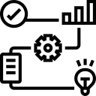
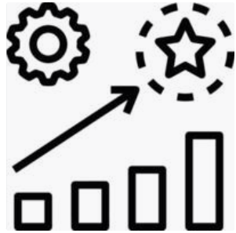
Implementation
  Training
  Strategic
  Planning
  Execution
  Continuous Improvement
  NPR 8831.2F
  Roadmap Planning
  RCM Fundamentals
    System boundaries & asset definition
    Asset identification
    Equipment condition assessment
    Asset criticality tiering
    RCM analysis
    Job plan development
  CMMS
  PT&I Techniques
  Metrics/KPIs
  Collect & assess information
  Incorporate evaluation results
  Develop a vision & mission
  Identify goals, activities, & outcomes
  Formulate workforce training & succession plans
  Inventory assets
  Evaluate equipment condition
  Perform criticality ranking/tiering
  Conduct RCM analysis starting with high-critical assets
  Measure & record performance
  Periodically evaluate the effectiveness of implementation
  Annual plan review & update
  Participate in Community of Practice events
  Perform periodic evaluations to measure progress
Notes:
The RCM implementation to advance the Tier 1 maintenance programs started with training.
- I began with communicating the NPR requirements, provided guidance on how to apply the NPR to the technical capability facilities.
- Then Roadmap planning was introduced so that the facility managers and their team could begin thinking about what they wanted their 5-year maintenance roadmap to look like
- Teaching the RCM fundamentals was essential to establishing the basics that will be used to lay the foundation of good RCM principles
- the sub-elements of the training were broken down into several components
- Training on Maximo was performed so that they can see the benefits of a single repository for all maintenance work, including historical; a means of schedule work and resources,
All these training elements were taken into consideration when we transitioned into Strategic Planning
- This information was used along with the evaluation results to work with the Tier 1 facility managers and teams to develop a vision, mission and to identify goals, and activities to determine the outcome of where they wanted to advance their maintenance programs.
- Their strategic plan included workforce training and succession plans to ensure the necessary expertise for facility O&M that considers attrition, new missions, and technologies.

Slide 13
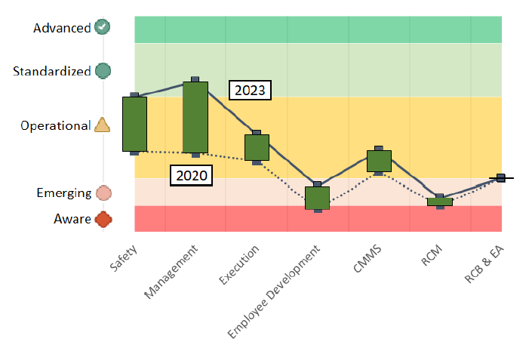
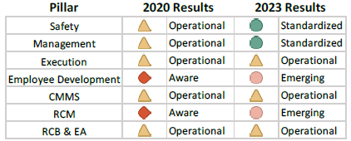
Results
NASA Ames Research Center’s
Arc Jet Complex
Category
2020 Results
2023 Results
Notes:
The evaluation tool that was used to establish a baseline is also being used to measure progress. The NASA Ames Arc Jet Complex began their RCM journey about a 1-1/2 before the other tier 1 technical capabilities and this chart shows marked improvement in the short amount of time RCM was introduced to the facility. A rise in maturity level is noted in each category.
Major observations:

Slide 14
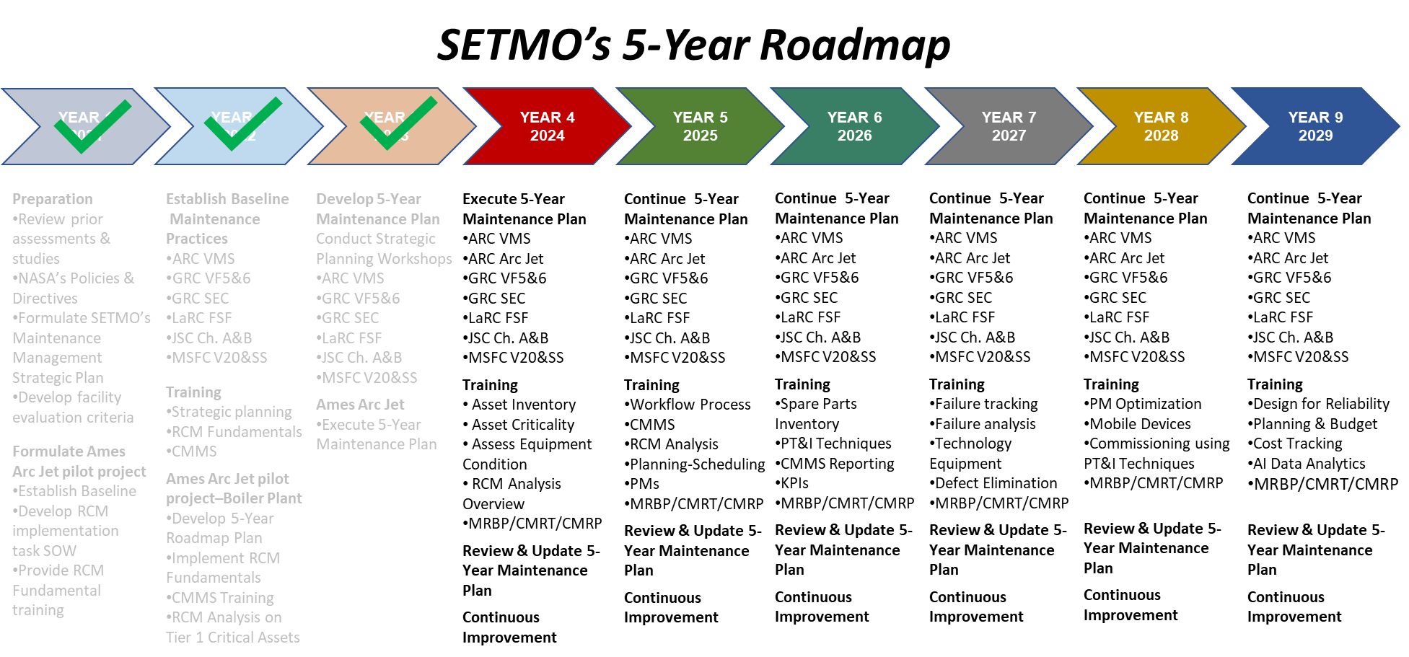

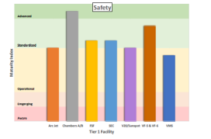
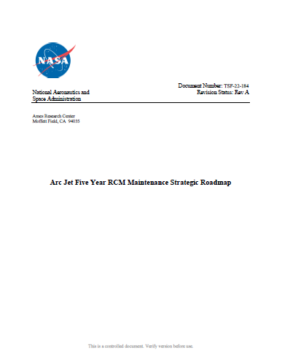
Advancing SETMO’s Maintenance Program
Summary
Established a SETMO Maintenance Management Strategic Plan of action with Management commitment.
Evaluated the critical Technical Capabilities and achieved baseline with actual data - not impressions or perceptions.
Asset Identification
Provided training and facility specific hands-on asset inventory guidance to establish RCM fundamentals with excellent participation!
Condition Assessment
Criticality Analysis
Collaborated with and developed unique 5-Year maintenance roadmaps for each facility to advance from current level to long-term goals.
Ensuring that all aspects of SETMO’s technical capabilities are mission ready by advancing the maintenance practices towards a reliability centered maintenance program!

Slide 15

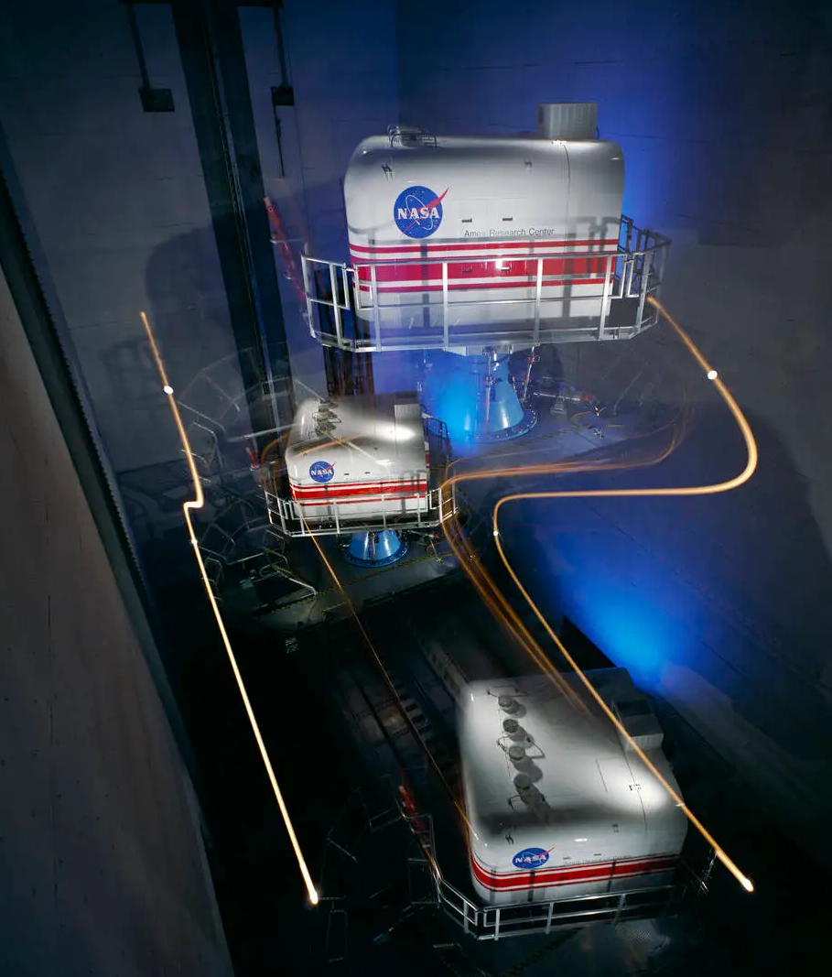
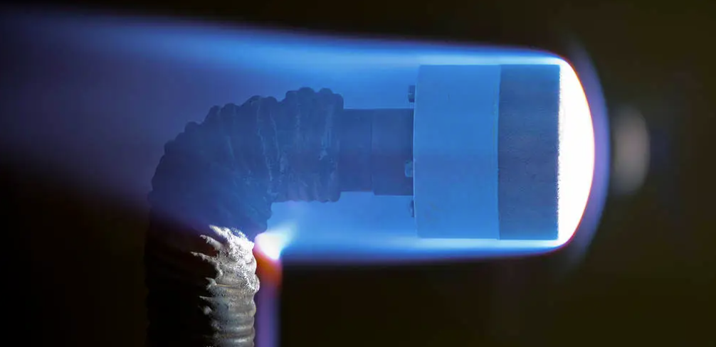
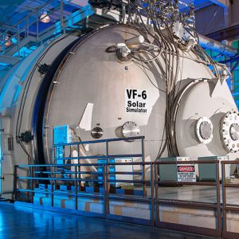
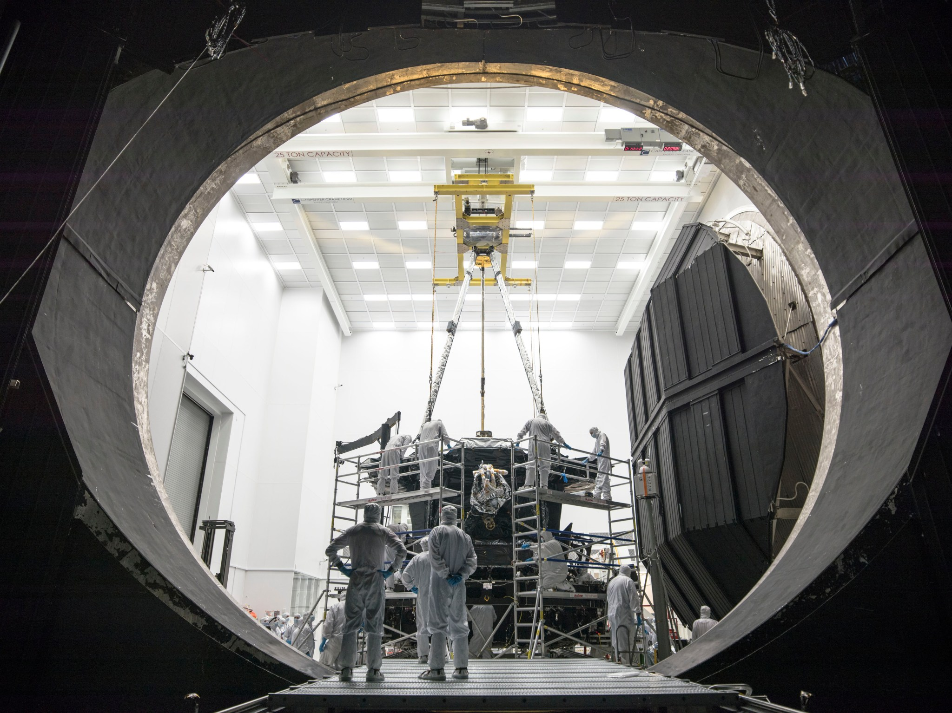
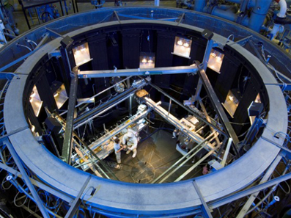
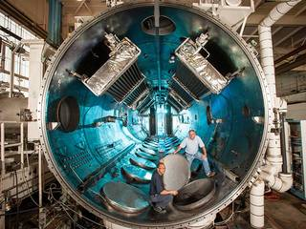
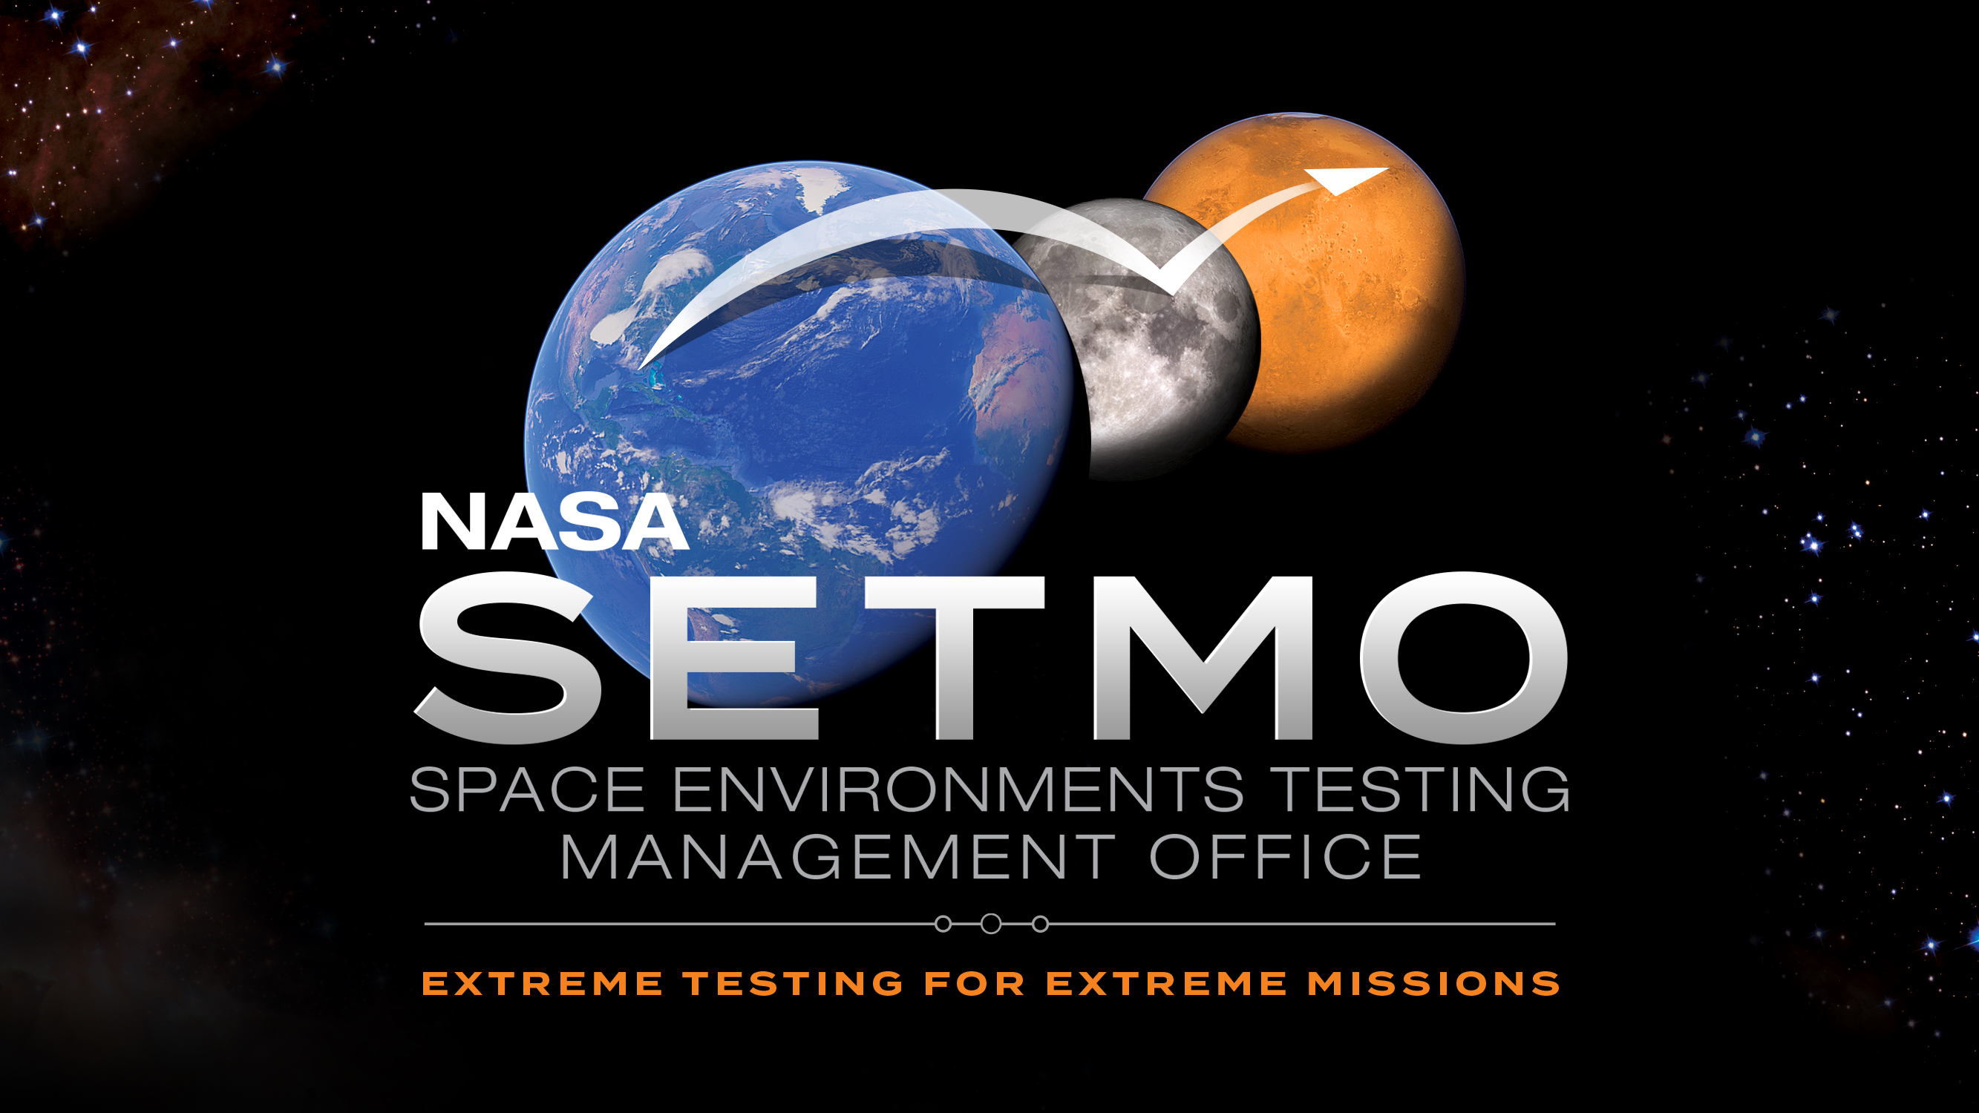
*NASA Owned Facilities Only
QUESTIONS?

