Slide 1
“How We Are Planning a
Facility To Receive Mars Samples”
Alvin L. Smith, Ph.D., PMP
SRP Project Manager
November 14, 2024
Astromaterials Research & Exploration Science
NASA Johnson Space Center
    This document has been reviewed and determined not to contain export controlled technical data.

Slide 2



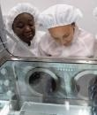
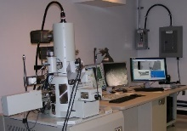

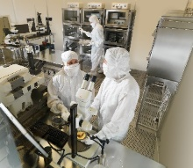
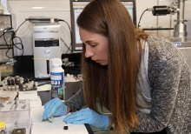
Mars Sample Return Campaign—Following the Samples
Mars Sample Return Program
1 2 3 4
Long-term Curation and Science
Mars 2020 Sample Caching
Collect samples of rock, regolith, and atmosphere
Cache samples on the surface for retrieval
Sample Retrieval Lander (SRL)
Retrieve samples cached by Mars 2020 rover
Launch samples into orbit around Mars
Earth Return Orbiter (ERO)
Capture and contain samples in Mars orbit
Safely return samples to Earth for recovery at landing site
Sample Receiving Project
Recover and transport contained samples to receiving facility
Safety assessment and sample containment
Initial sample science and curation
Primary transitions in sample custody
    This document has been reviewed and determined not to contain export controlled technical data.

Slide 3
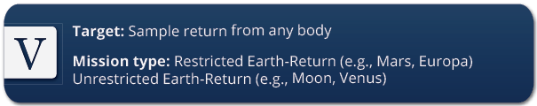
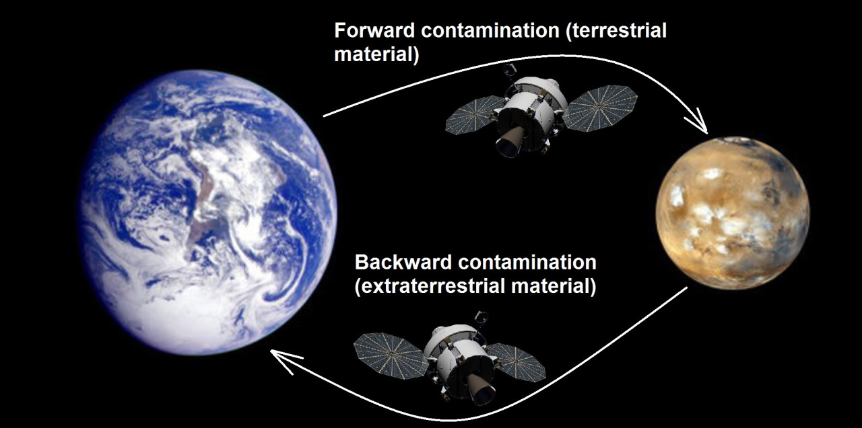
Why Is Mars so Special? - Restricted Earth Return Missions
NASA’s Planetary Protection (PP) policy calls for the imposition of controls on biological contamination for certain combinations of mission type and target body. There are five categories.
Category V missions, sample return missions.
“Restricted Earth return,” missions from bodies that have a scientific potential for life. Need containment throughout the return phase of all returned hardware which directly contacted the target body.
Need to conduct timely analyses of any unsterilized sample collected and returned to Earth, under strict containment, and using the most sensitive techniques.
    This document has been reviewed and determined not to contain export controlled technical data.
Notes:
The highest degree of concern is expressed by the absolute prohibition of destructive impact upon return, the or unsterilized material from the body, and the need for containment of any unsterilized sample collected and returned to Earth. Post-mission, If any sign of the existence of a nonterrestrial replicating entity is found, the returned sample must remain contained unless treated by an effective sterilizing procedure. Category V concerns are reflected in requirements that encompass those of Category IV plus a continuing monitoring of project activities, studies and research (i.e., in sterilization procedures and containment techniques).

Slide 4
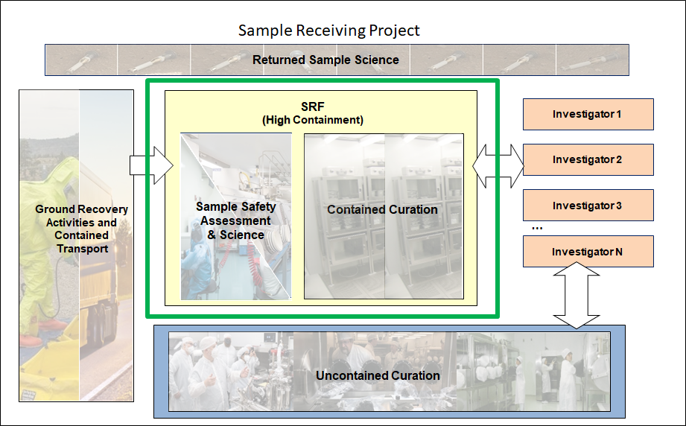
Sample Receiving Project Scope
    This document has been reviewed and determined not to contain export controlled technical data.
Notes:
So our overall project scope for this SRP really hinges on our ability to maximize the return science on these samples. And this is an perspective that is captured across the entire project from:
ground recovery where we take custody for the flown hardware, and samples and transport them to the facility.
To building and designing an SRF capable of meeting with the stringent planetary protection containment requirements where some elements the sample safety assessment and initial curation must happen inside containment as identified by the green box.
When the samples are safe for release either by test or by sterilization they can then leave the facility to be distributed to outside laboratories to principal investigators, through a competitive process and can further study these samples, completing the science objectives in uncontained environments and facilities.

Slide 5
Sample Receiving Project Scope
Achieve Science Objectives
Complete its scientific objectives
Planetary Protection
Category V Restricted Earth Return
Facilities
Provide facility(s) for science, curation, and planetary protection
Ground Recovery
Take responsibility of the flown hardware, samples, and landing site artifacts and securely transport to SRF
Sample Curation
Curation of flown hardware, samples, CK artifacts
    This document has been reviewed and determined not to contain export controlled technical data.
Notes:
So our overall project scope for this SRP really hinges on our ability to maximize the return science on these samples. And this is an perspective that is captured across the entire project from:
ground recovery where we take custody for the flown hardware, and samples and transport them to the facility.
To building and designing an SRF capable of meeting with the stringent planetary protection containment requirements where some elements the sample safety assessment and initial curation must happen inside containment as identified by the green box.
When the samples are safe for release either by test or by sterilization they can then leave the facility to be distributed to outside laboratories to principal investigators, through a competitive process and can further study these samples, completing the science objectives in uncontained environments and facilities.

Slide 6
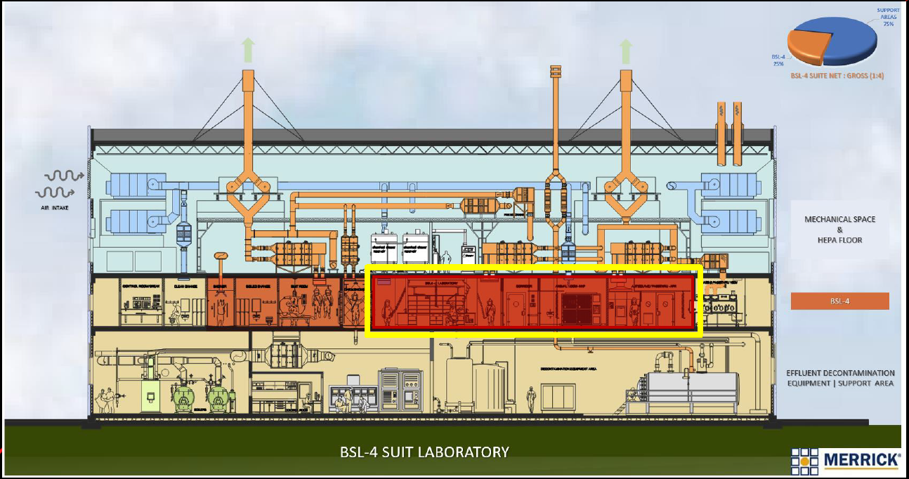
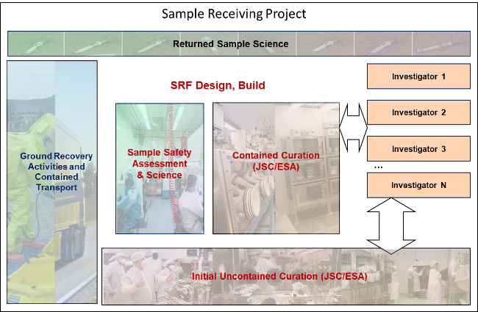
Key High Containment Concepts for the SRF
High Containment Area
SRP Scope
Spacecraft Receiving
Hardware Deintegration
Pristine Isolators
Open Sample Tubes
Basic Characterization
————
Preliminary Examination
Sample Safety Assessment
Select Science
Sample Sterilization
Sample Storage
Example of Traditional BSL-4 Suit Laboratory
Sample Catalog
Allocation of Safe Samples
Scientific Results
    This document has been reviewed and determined not to contain export controlled technical data.

Slide 7
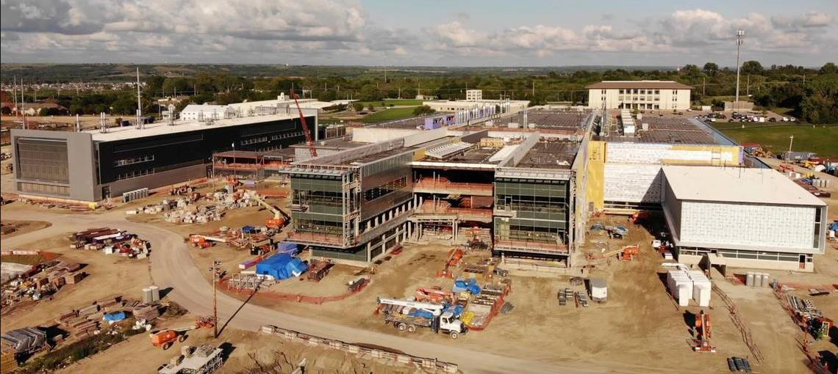
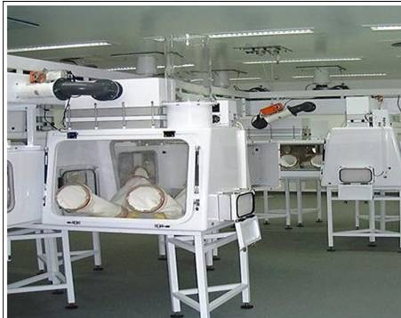
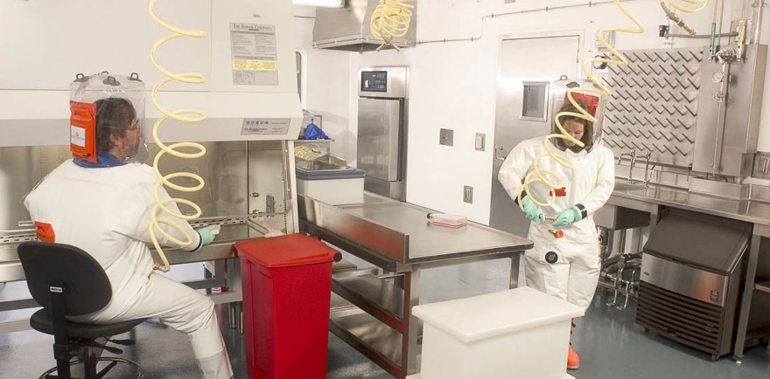
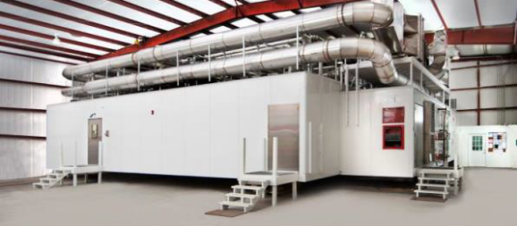
TRADE SPACE: SRF Modality Options
Existing BSL-4 and BSL-3 facilities
New Traditional, Fixed High-Containment Facility (Suit and Cabinet Facility)
New Modular High-Containment Suit Facility
Hybrid (New + Existing facilities)
Existing/New Traditional High Containment Facility (BSL-3, BSL-4)
Cabinet Facility
Suit Facility
Modular Suit Facility
    This document has been reviewed and determined not to contain export controlled technical data.

Slide 8
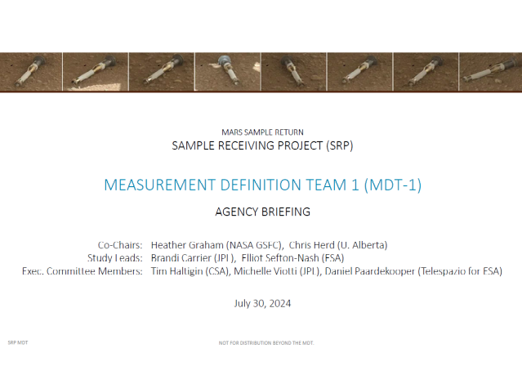
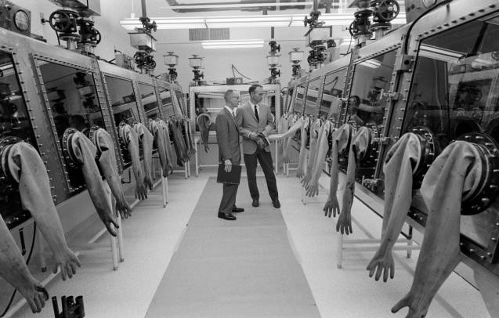
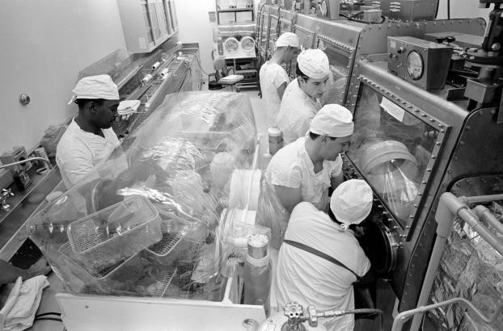

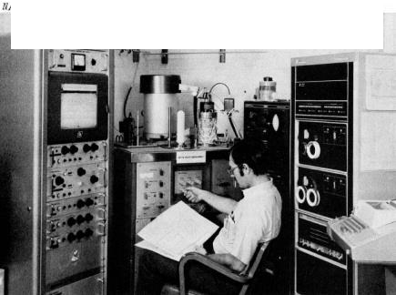
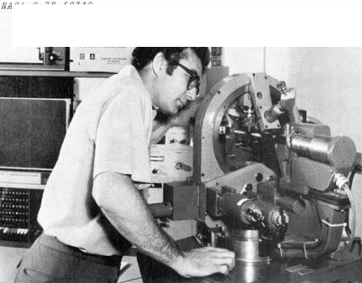
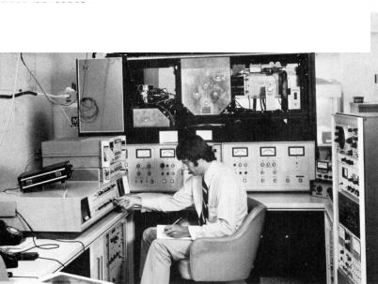




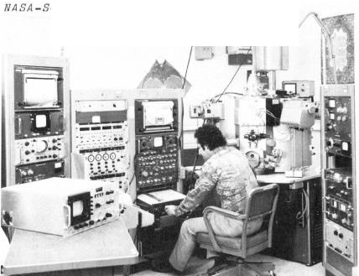
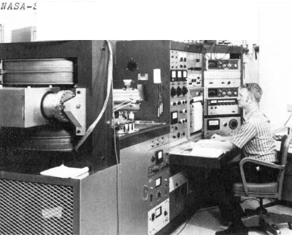
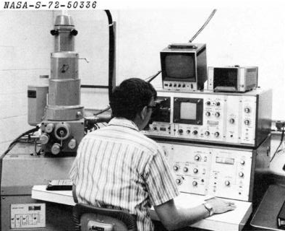

Science Measurements in High Containment
Measurement Definition Team (2024)
Apollo Lunar Receiving Laboratory, (~1967)
Thermal Analyzer/Mass Spec.
Single-Crystal X-Ray Diffractometer
Ion Microprobe Mass Analyzer
Tasks
Describe an Overarching Investigation Strategy for Activities Inside and Outside the SRF
Define Measurement Traceability Matrices
Provide a Reference SRF Instrument Set and Interface Requirements
Propose a Concept of Operations for Activities inside the SRF
Electron Microprobe
Mass Spectrometer
Scanning Electron Microprobe
    This document has been reviewed and determined not to contain export controlled technical data.

Slide 9
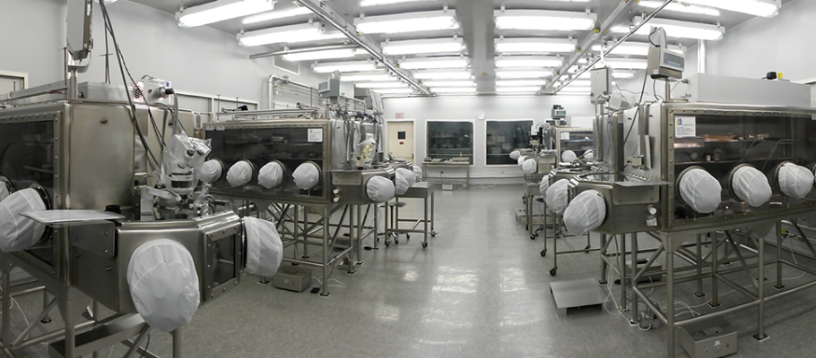
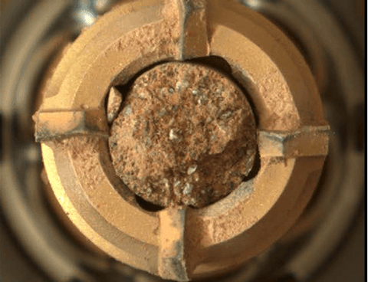
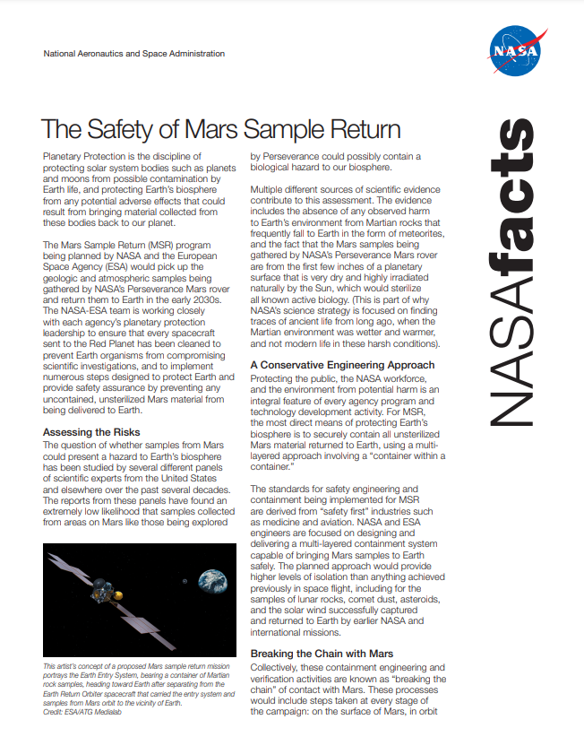

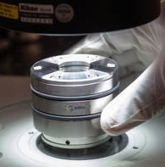
SRP Primary Goal
Enable safe and rapid release of returned samples to world-wide labs for scientific investigations
Mars Sample Tube
Safety of Mars Sample Return Fact Sheet
    This document has been reviewed and determined not to contain export controlled technical data.
Notes:
Receive the contained MSR samples at a secure BSL4 facility
Extract the samples from the returned flight hardware, complete basic characterization/preliminary examination
Support execution of the Sample Safety Assessment / Conduct initial sample characterization sufficient to support the sample sub-division needed for both sample safety assessment and the scientific sample allocation process.
Execute the Sample Safety Assessment Protocol.

Slide 10
    This document has been reviewed and determined not to contain export controlled technical data.

