Slide 1
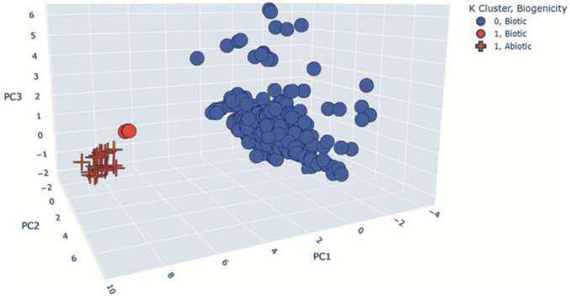
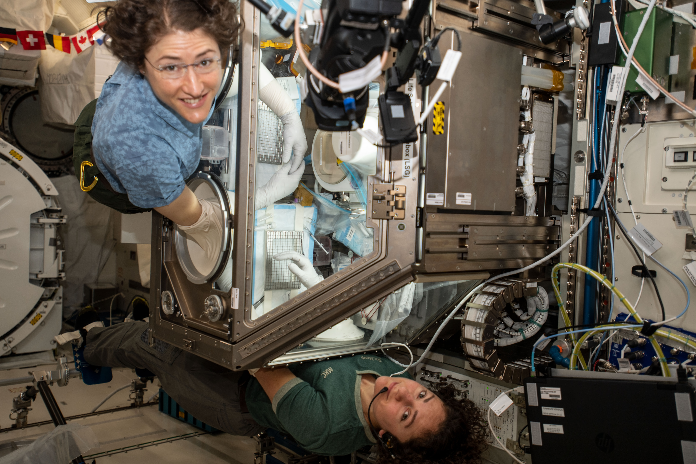
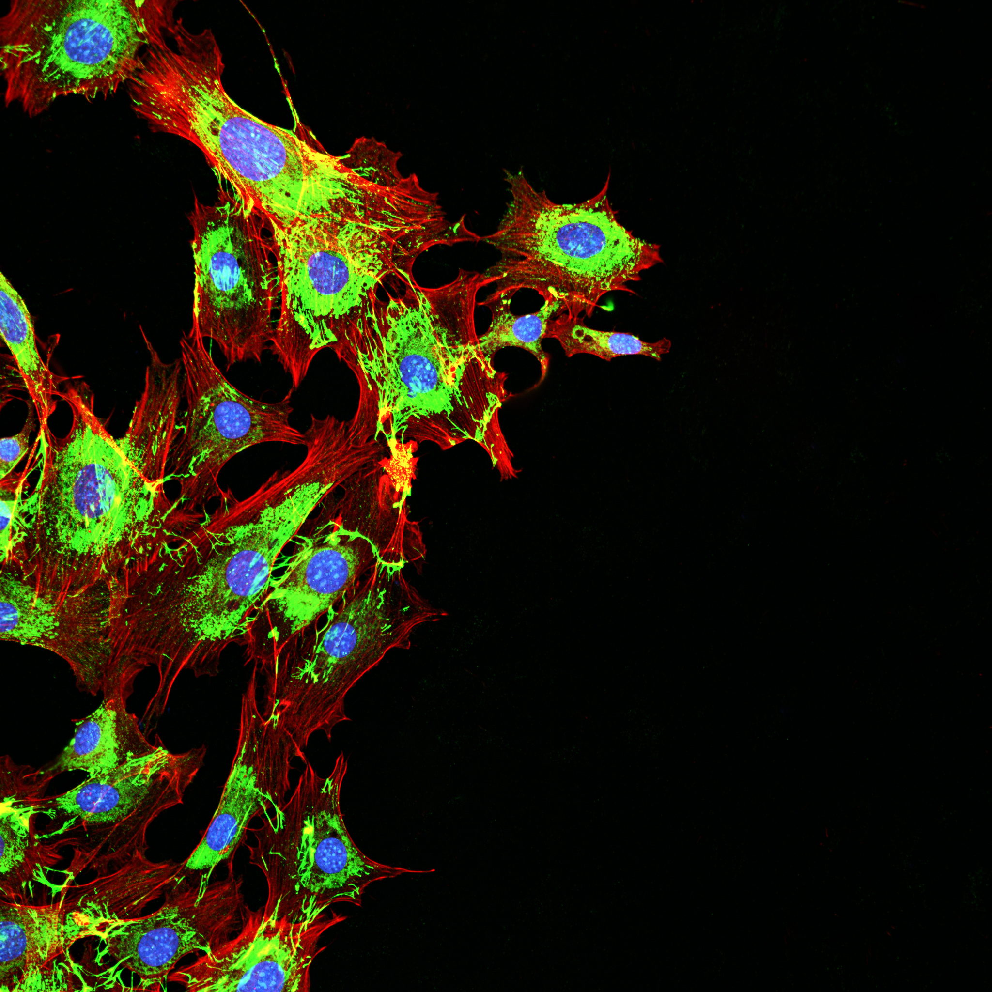
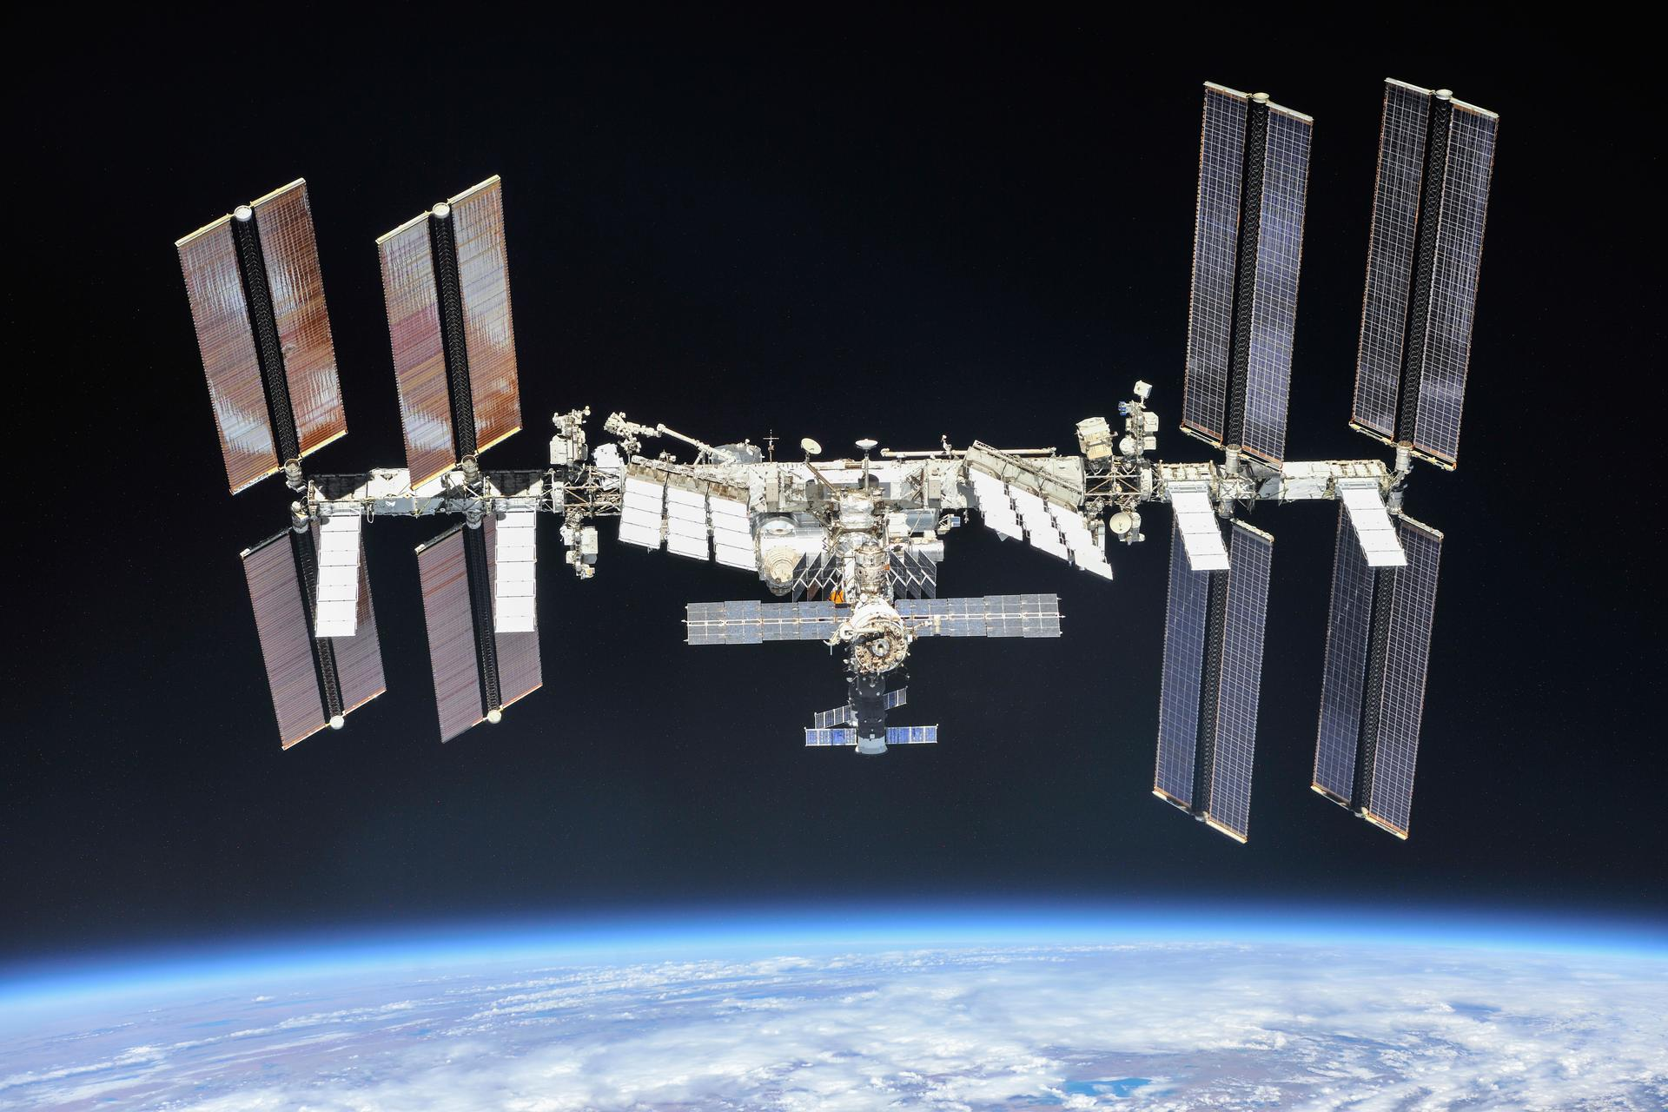
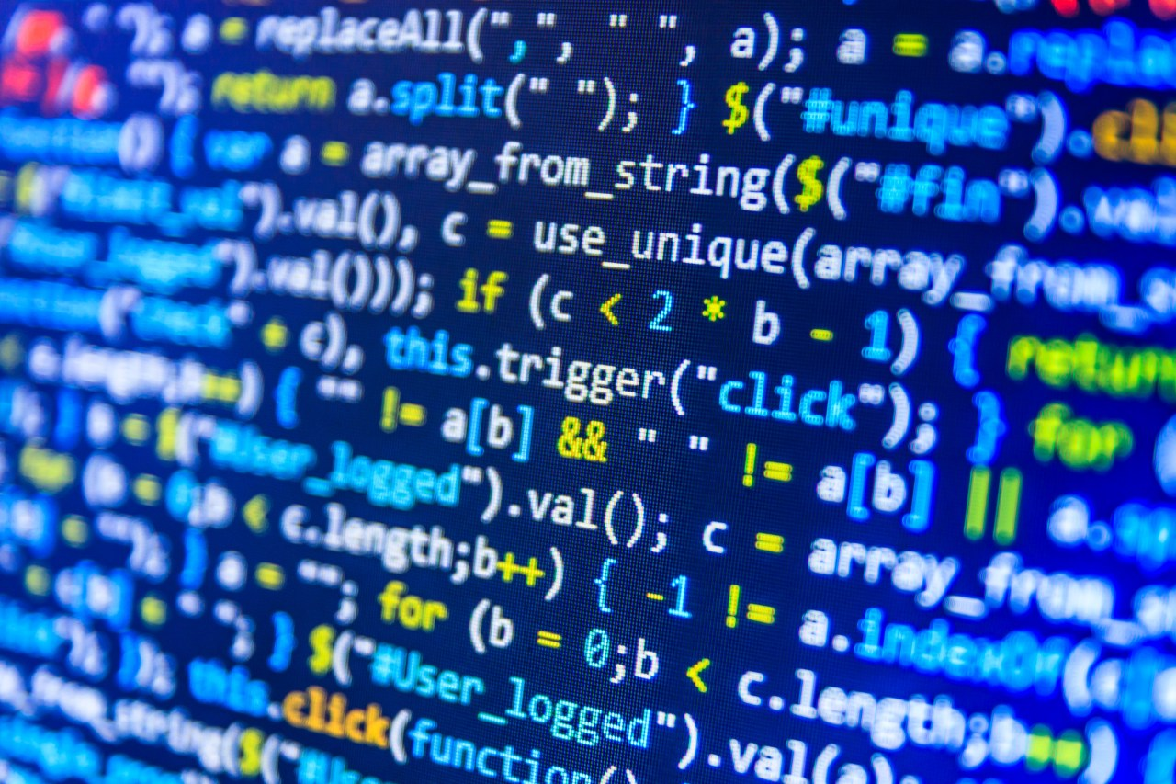
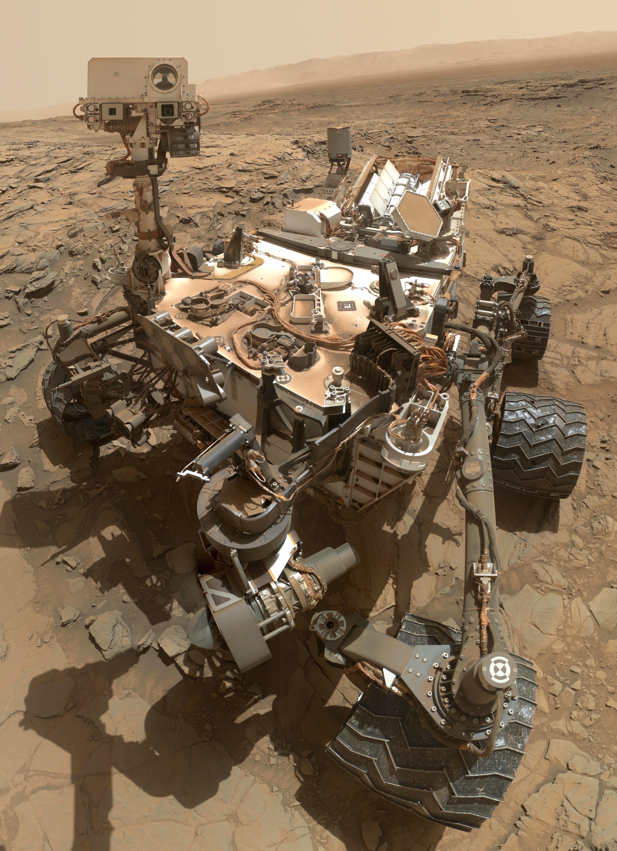
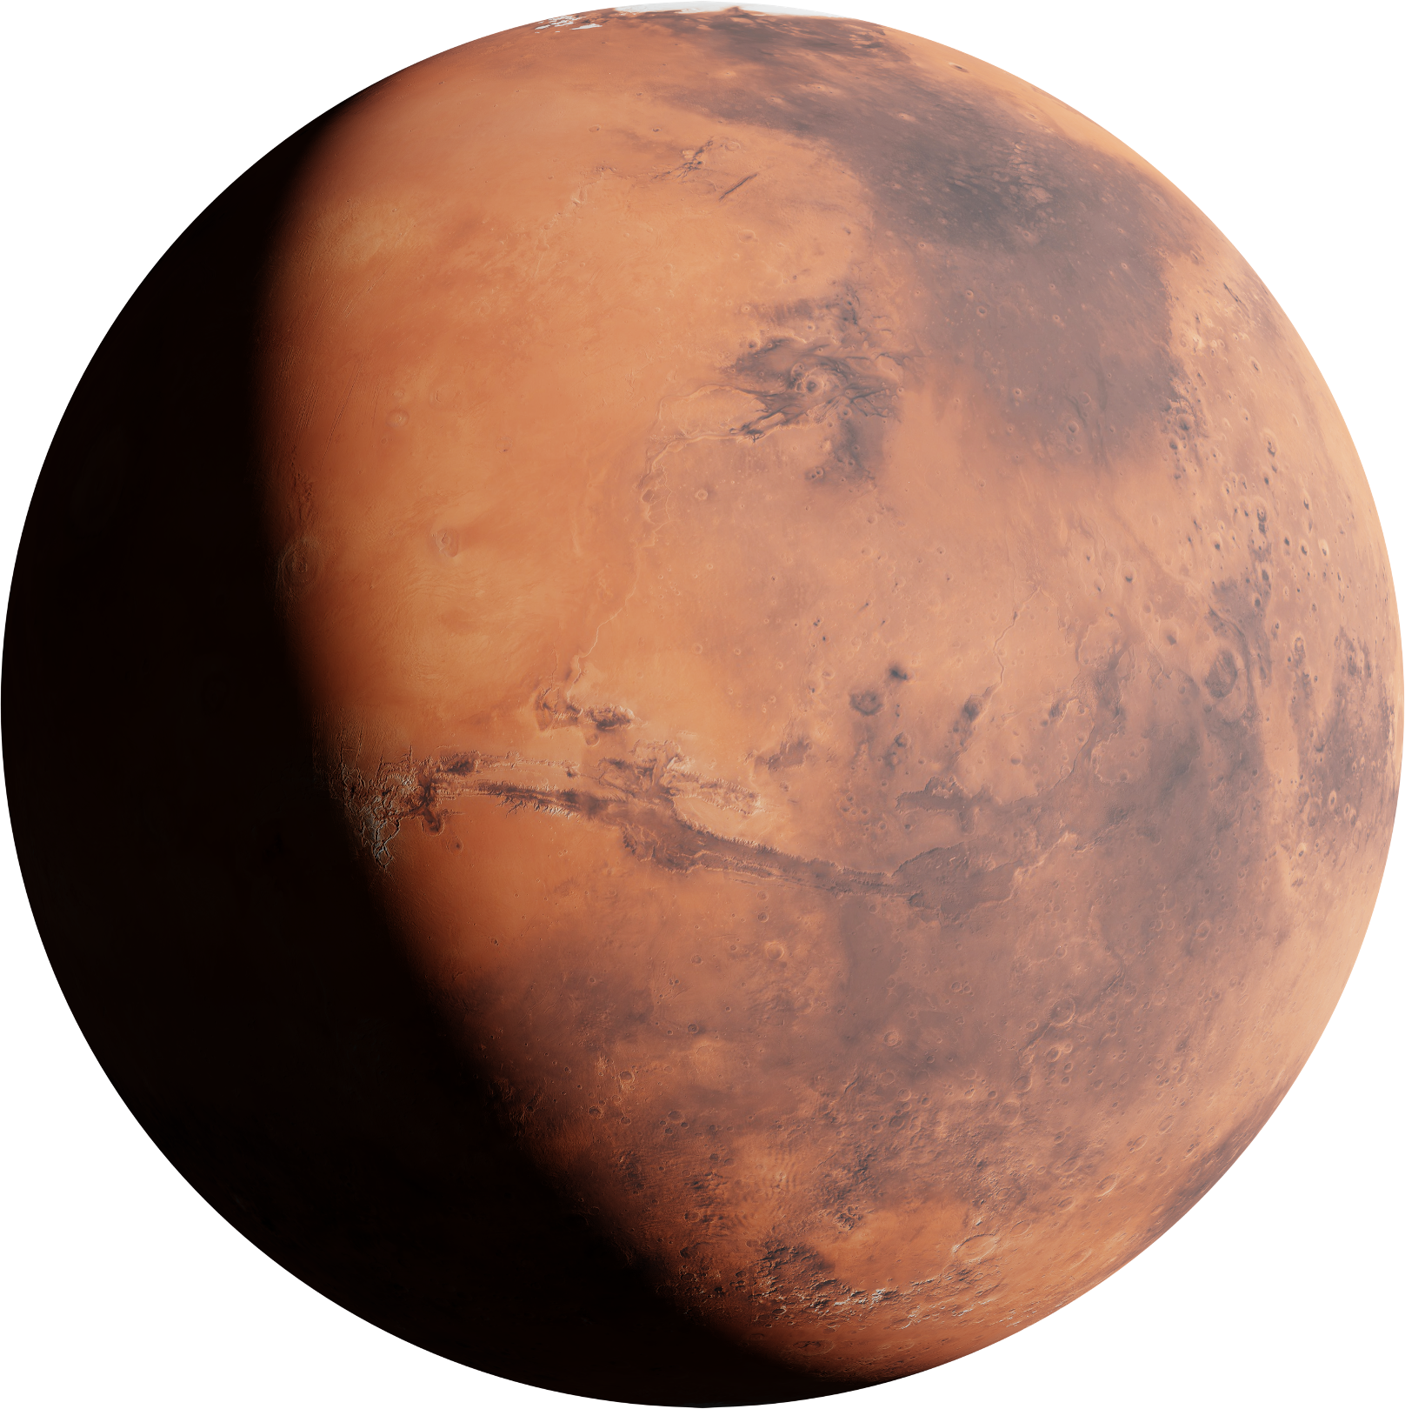
Dr. Mary Beth Wilhem
ExCALiBR
Extractor for Chemical Analysis of Lipid Biomarkers in Regolith
WELCOME
Lipids are important organic molecules for life, and NASA is interested in studying them on missions to the Moon, Mars, and icy worlds. These molecules can form naturally without life and can last a long time, making them useful in the search for extraterrestrial life. However, current lab methods for analyzing lipids are complex and require a lot of materials, making them unsuitable for use directly on missions. To solve this, NASA is developing a small, automated system called ExCALiBR. It will extract and analyze lipids from soil samples, using fewer materials and boosting accuracy, for potential deployment on landers or crewed missions.

Slide 2
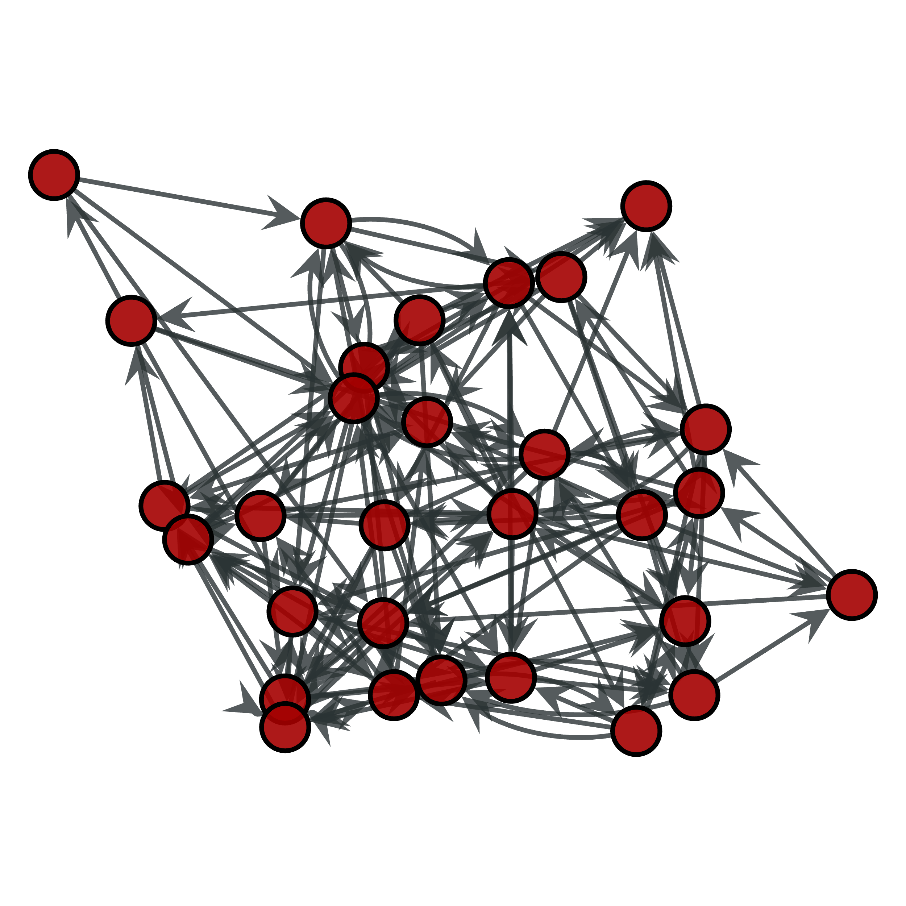
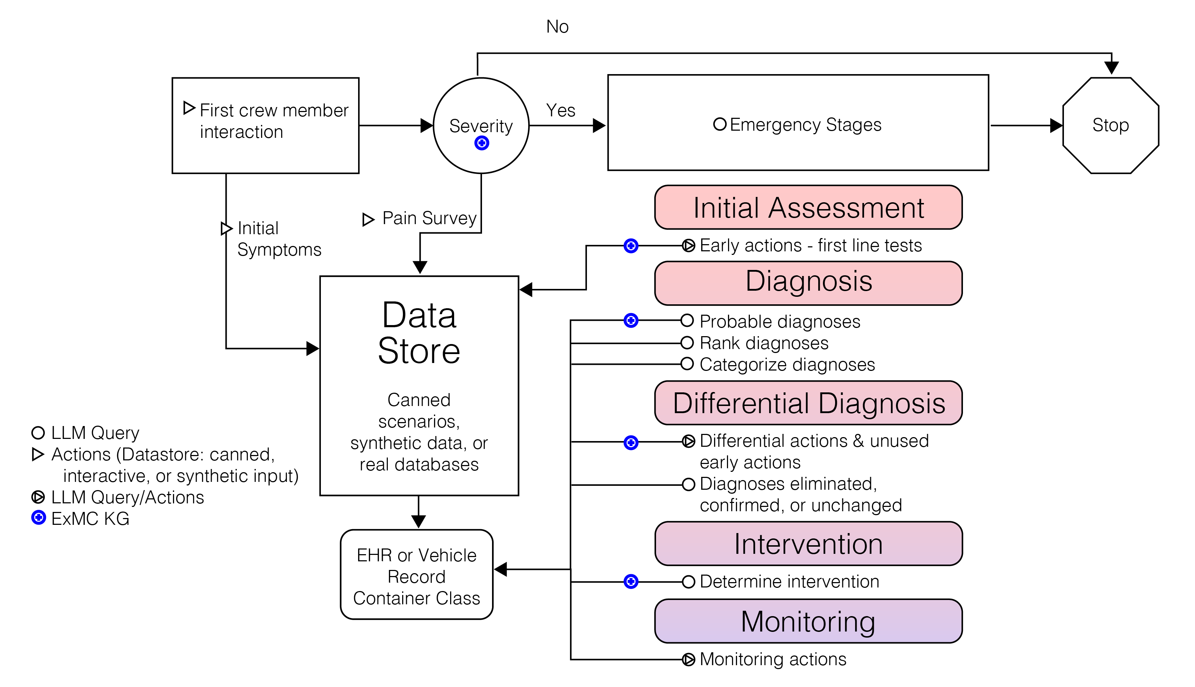
Dr. Mary Beth Wilhem
ExCALiBR
Extractor for Chemical Analysis of Lipid Biomarkers in Regolith
AI/ML
Lipids are important organic molecules for life, and NASA is interested in studying them on missions to the Moon, Mars, and icy worlds. These molecules can form naturally without life and can last a long time, making them useful in the search for extraterrestrial life. However, current lab methods for analyzing lipids are complex and require a lot of materials, making them unsuitable for use directly on missions. To solve this, NASA is developing a small, automated system called ExCALiBR. It will extract and analyze lipids from soil samples, using fewer materials and boosting accuracy, for potential deployment on landers or crewed missions.

Slide 3



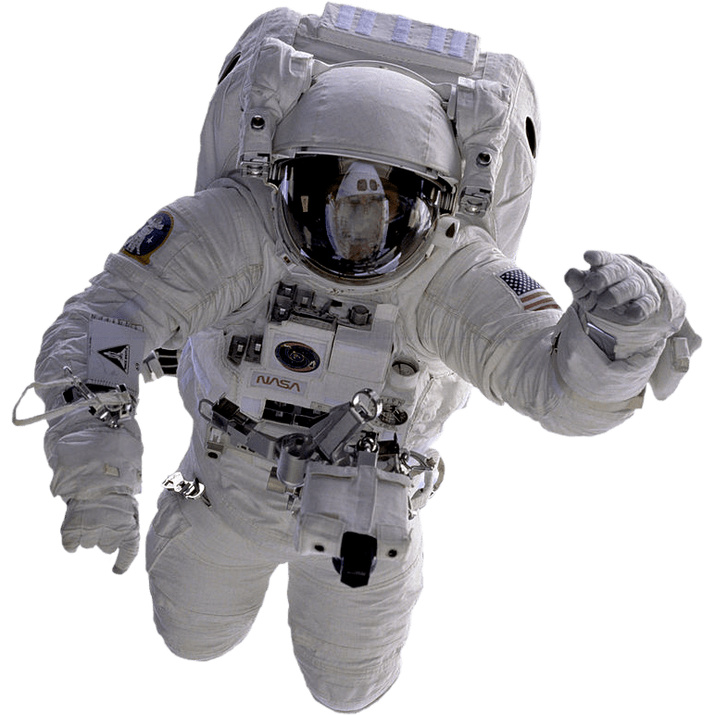
Dr. Charlotte Nelson
ExMC
AI-Driven Clinical Decision Support System
AI/ML
The framework utilizes Large Language Models (LLMs) to determine the stage of a medical scenario and take actions such as running tests and prescribing medications.
Contains harmonized diagnostic, treatment, and observation knowledge. Information extracted from ISS MedKit, HRP Medical Conditions, Evidence Reports, and NASA Spaceflight Human-system Standard Volume 1: Crew Health. Early results suggest the integrated MDM-KG as a potential CDSS solution for ExMC Earth Independent Medical Operations (EIMO) for deep space missions.

Slide 4
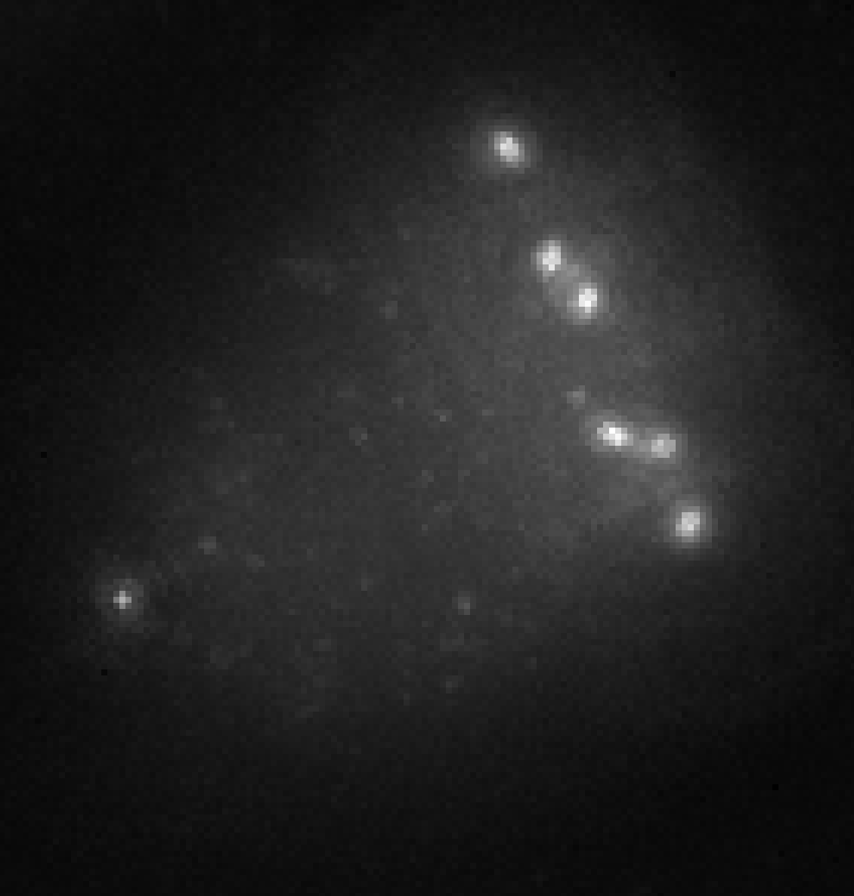
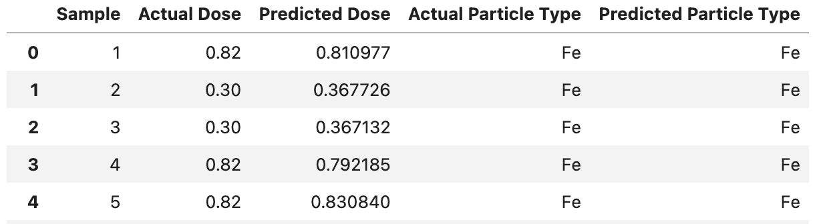
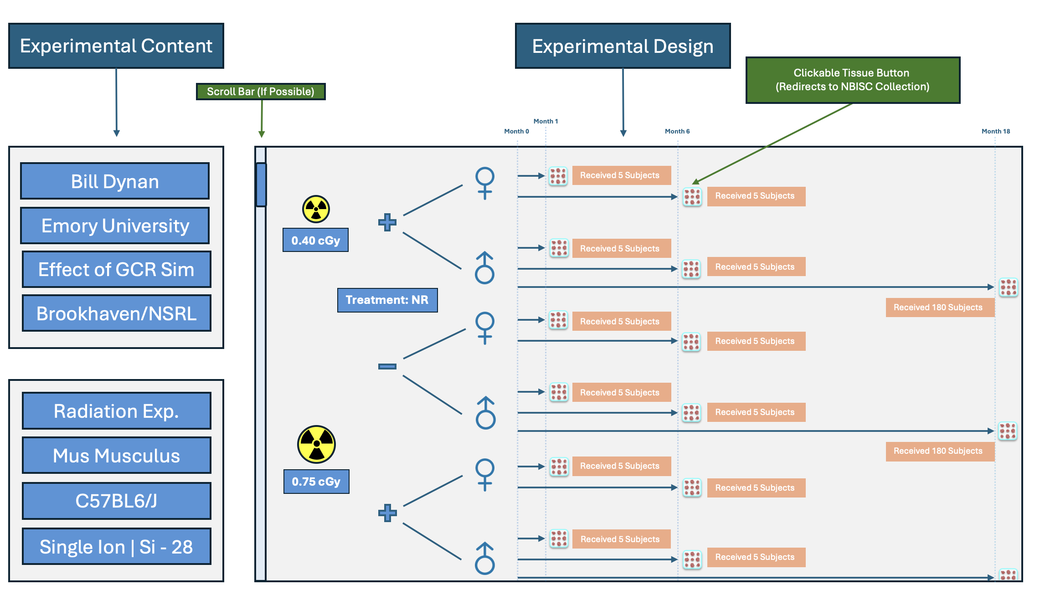
Automated Image Analysis
OSDR
NASA Open Science Data Repository
AI/ML
The NASA Open Science Data Repository (OSDR) enables access to space-related data from experiments and missions that investigate biological and health responses of terrestrial life to spaceflight. The goal of OSDR is to enable multi-modal and multi-hierarchical fundamental space life science data be reused toward basic science, applied science, and operational outcomes for space exploration and knowledge discovery. These data include ‘omics, phenotypic, physiological, behavioral, hardware, environmental telemetry; raw, processed; tabular, text, code, bioimaging, and video.
AI-Generated Graphical Abstracts

Slide 5

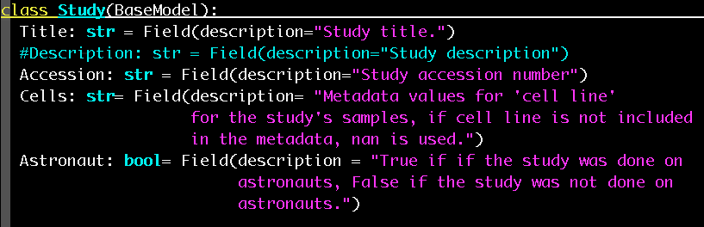
Data Standardization Toolkits
AI for Life Science
Artificial Intelligence for Life in Space
AI/ML
Automated Image Analysis
Computational analysis of biological data spans a variety of approaches including statistical methods, bioinformatics approaches, mathematical modeling, and artificial intelligence (AI) and machine learning (ML) methods. Each of these approaches has strengths and weaknesses and must be evaluated according to the biological question and data type(s). ML approaches have shown promise for deriving meaningful patterns from complex, heterogeneous, multi-modal biological datasets. Broadly, ML methods are designed to create a mathematical model to fit patterns in a dataset.
AI-Generated Graphical Abstracts
Data Standardization Toolkits

Slide 6
AI for Data Curation
Scientific Data Alignment & Verification
Data Standardization Toolkits
AI/ML
We are developing a suite of AI-powered tools to streamline data curation and enhance the accessibility of scientific information and biosamples. These tools offer key capabilities such as automated data alignment, which auto-populates relevant metadata from incoming datasets using a standardized template. Additionally, the suite includes metadata tagging that generates context-specific metadata for each study and automated graphical abstracts that create visual summaries of research. A conversational agent powered by a large language model (LLM) is also integrated, enabling efficient data retrieval and user assistance.
Data Standardization Toolkits

Slide 7
THANK YOU

