Slide 1
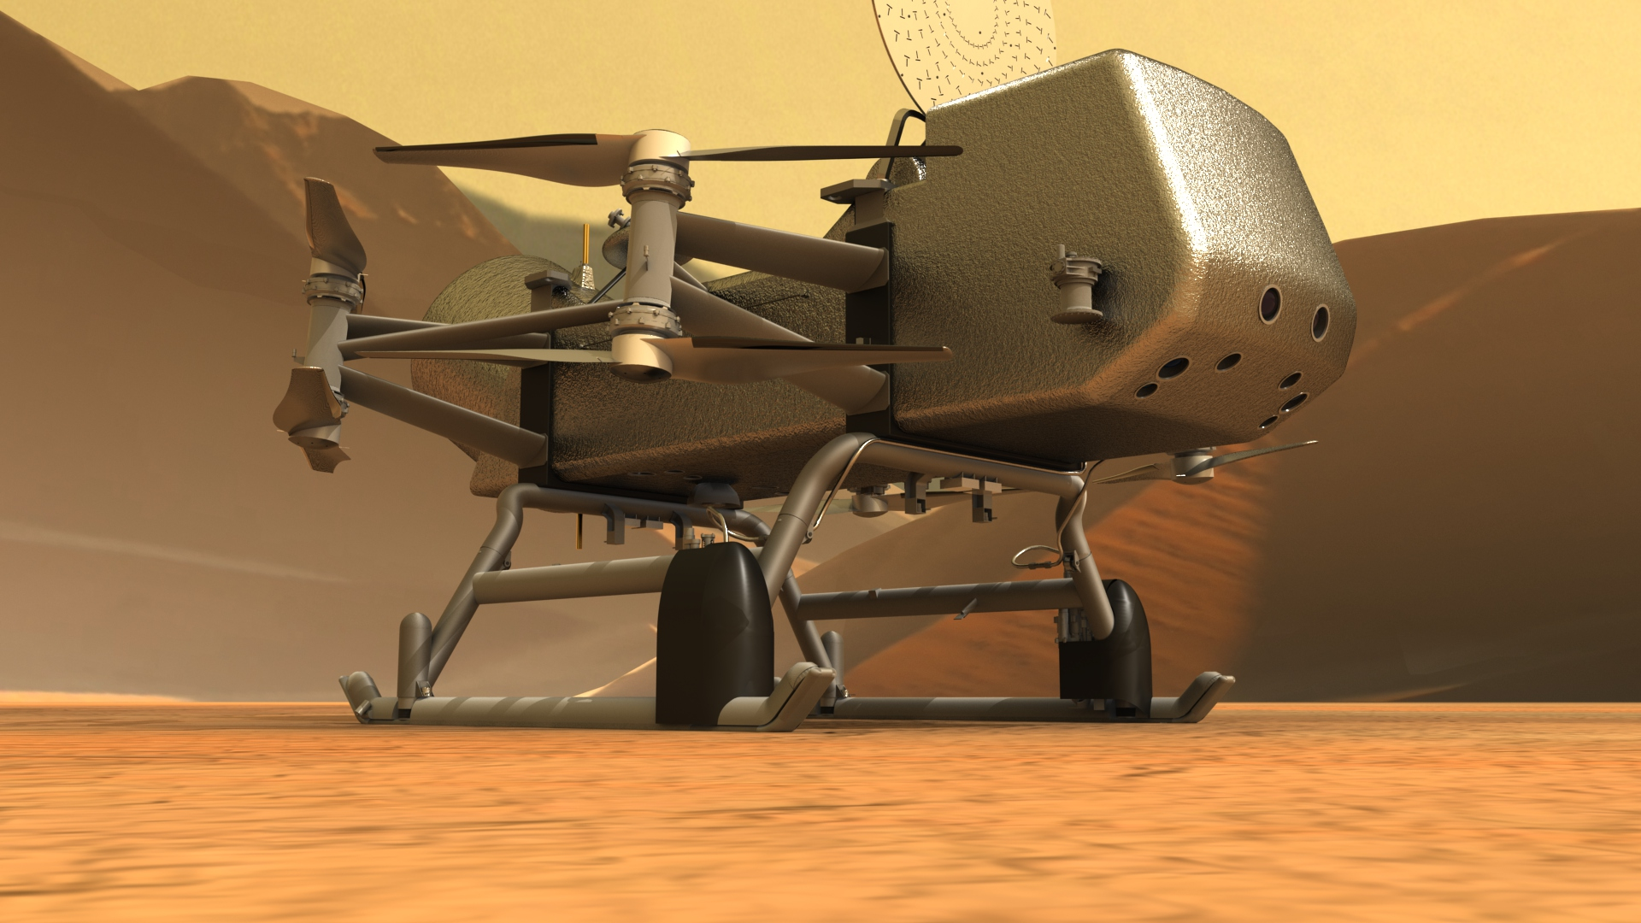
Icarus Application to Dragonfly Heatshield
^{Prakash Shrestha}
AMA, Inc. at NASA Ames Research Center
Joseph C. Schulz and Eric C. Stern
^{NASA Ames Research Center}
Ablation Workshop
JHU-Applied Physics Laboratory, Laurel, MD

Slide 2
Layout
Introduction: Dragonfly system and Icarus
Computational Setup
  Grid generation
  Boundary condition
  Aerothermal environment
  Verification
Results
  Bondline Temperature Analysis
  MPI Performance
  TPS Mass loss analysis
Summary
Current and Future Work

Slide 3
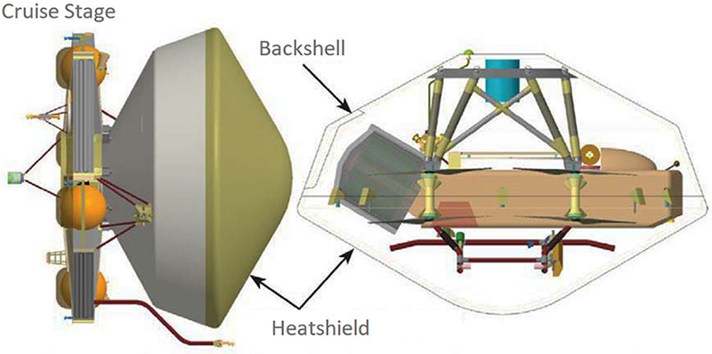
Introduction: Dragonfly System and Icarus Solver
Dragonfly is one of the most ambitious science missions NASA has ever attempted: sending a car-sized, nuclear-powered octocopter to explore the surface of a distant ocean world.
The main focus is on demonstrating Icarus capability to conduct material-response modeling of its heatshield design.
Icarus: Finite-volume, three-dimensional multi-material response tool for thermal modeling of thermal protection system (TPS) materials. More info on Schulz 2023
Icarus Applications: Heatshield sizing, material physics, material model validation with experiment, and uncertainty quantification
Flow
JHUAPL
JHUAPL
Notes:
Dragonfly may be the most ambitious science mission NASA has ever attempted: sending a car-sized, nuclear-powered octocopter to explore the surface of a distant ocean world.

Slide 4
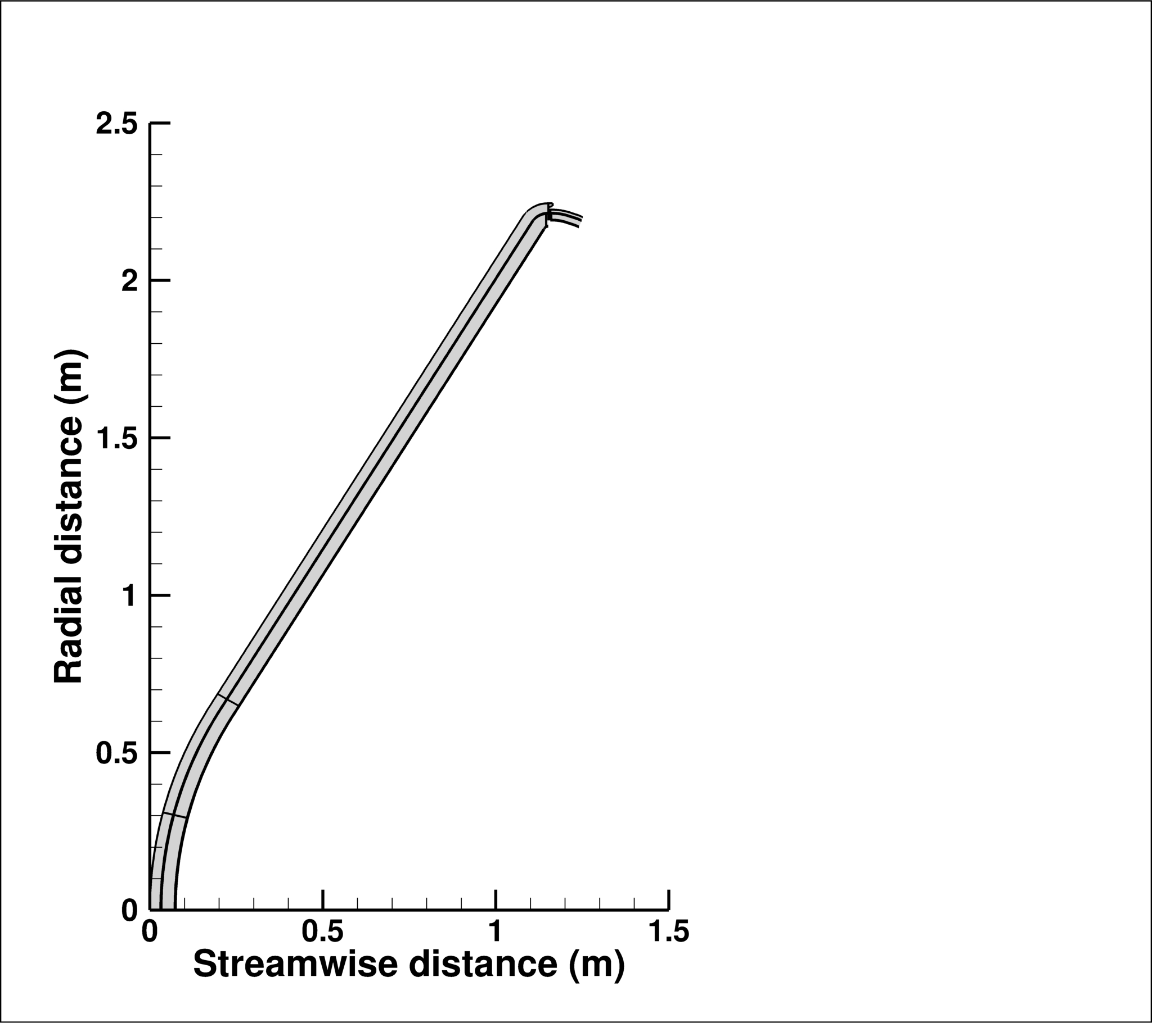
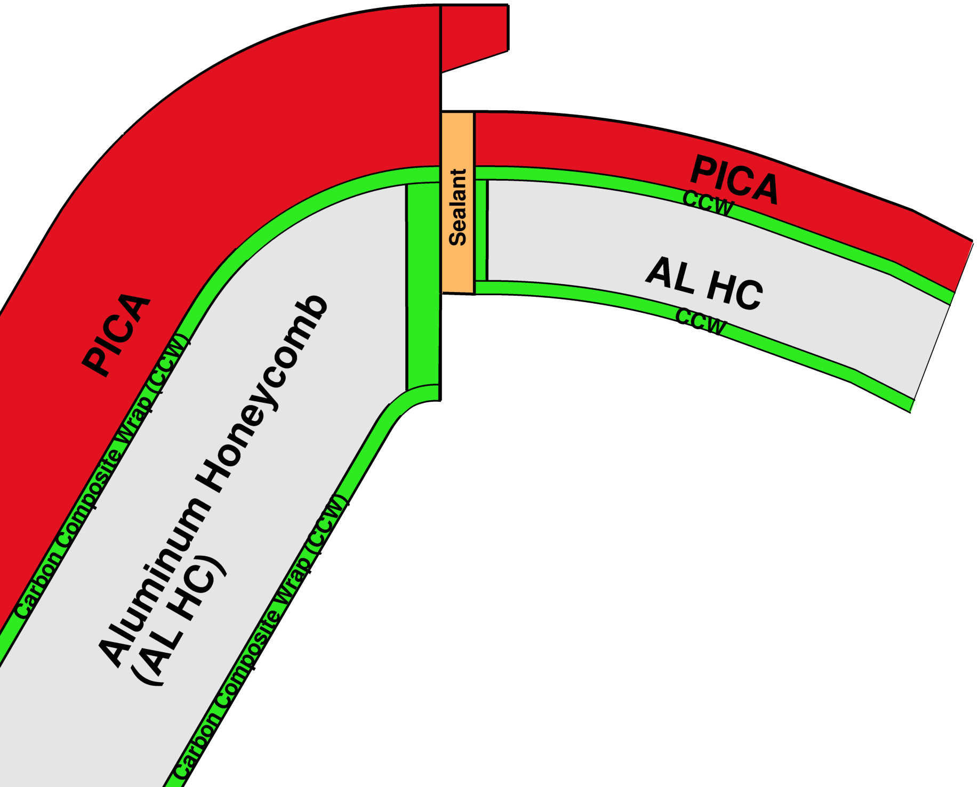
Material Setup: TPS and sub-structure designs
Heatshield: PICA acts as the TPS material for Aluminum (AL HC) substructure wrapped by carbon composite wrap (let us denote it as CCW). Silica-based sealant is used between heatshield and backshell
Backshell: SLA-561V protects the AL HC substructure, which is also wrapped by carbon composite. PICA is used for now while SLA material database is being worked on
Shoulder PICA tile
Al HC
No Gap filler used for now
Sphere PICA tile
Nose PICA tile

Slide 5
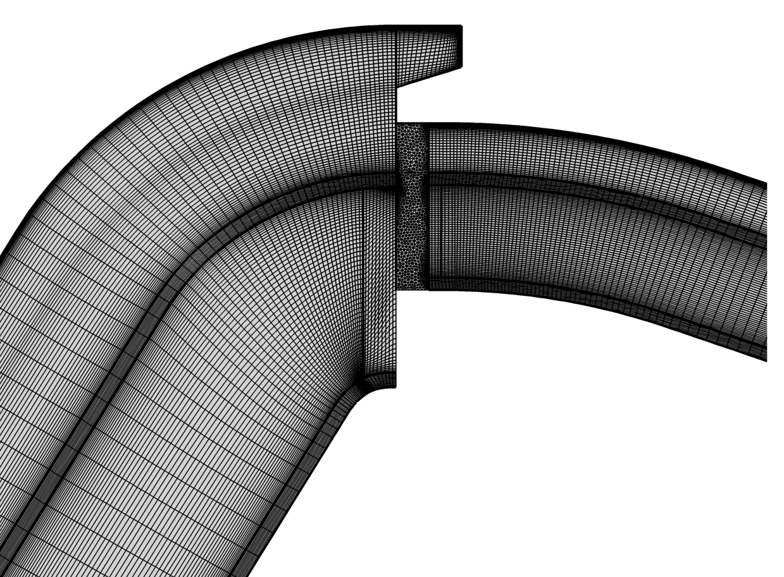
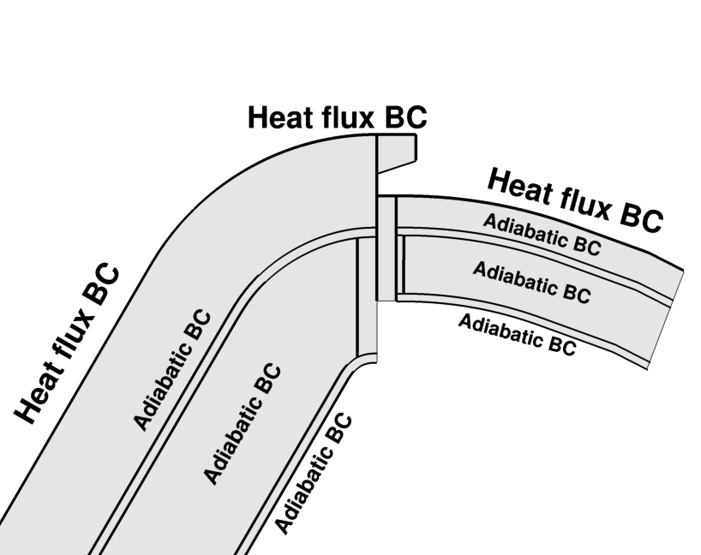
Computational Setup: Grid and Boundary Conditions
Grid generation:
The total number of cells: 65,000
Mesh refinement near the inter-material
region
Near-wall spacing: 10 microns
Boundary conditions
Heat-flux boundary condition on
heat-shield surfaces including tooth
Wall convective and radiative fluxes with wall pressure as inputs to Icarus
1000 trajectory points

Slide 6
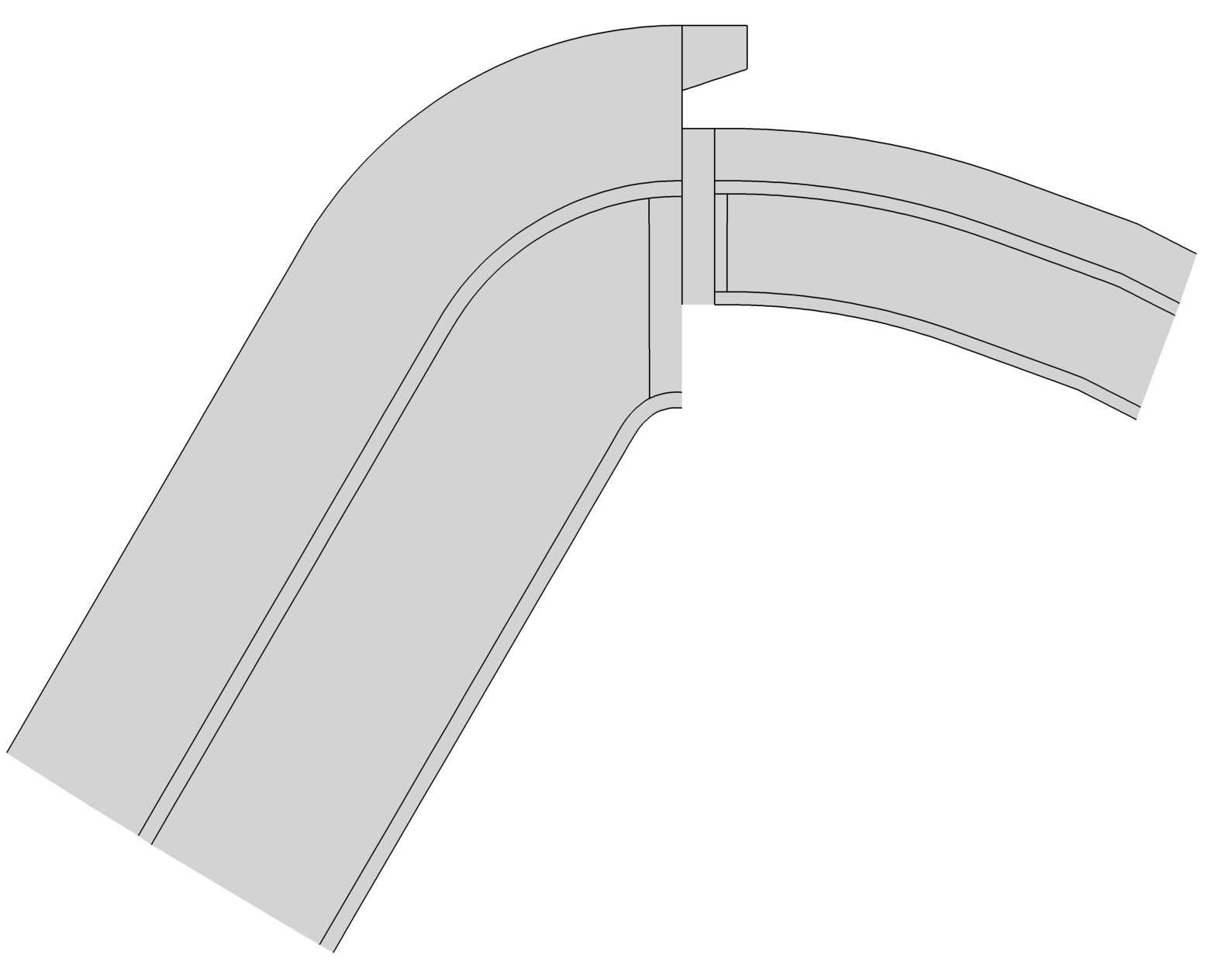
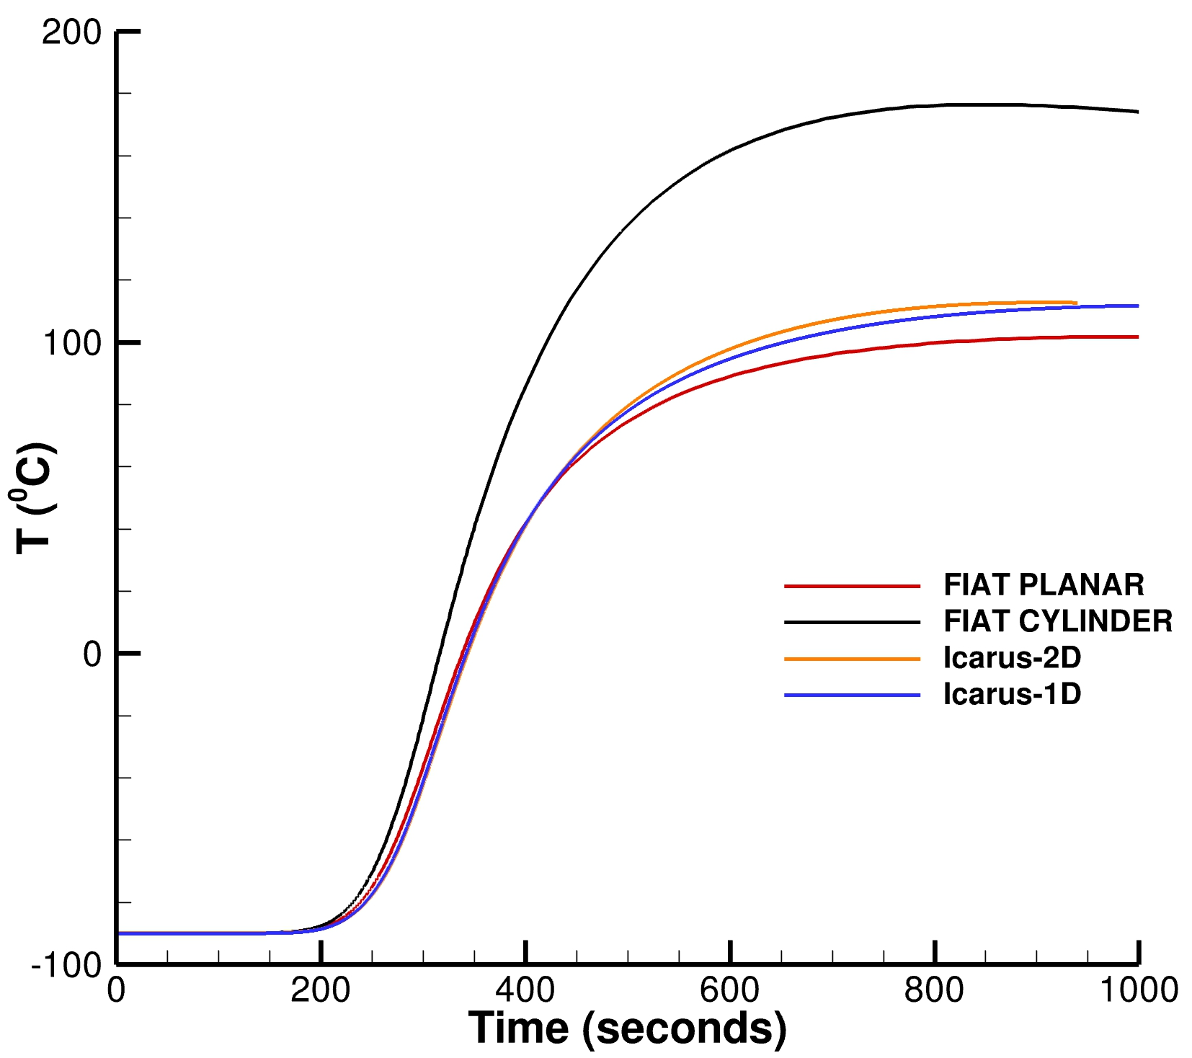
Results: Truncated Domain (Verification)
FIAT, Icarus-1D and Icarus-2D simulations are carried
out using isotropic thermal conductivity properties of CCW
Icarus-2D simulations are carried out using a domain
truncated ahead of shoulder for computational
efficiency as well as the full heatshield
For both axisymmetric domains:
  FIAT planar, Icarus-1D and
  Icarus-2D agree well at the
  selected bondline point
  Heat conduction as expected
  is 1-D normal to the surface
This comparison shows that Icarus
and FIAT is consistent in terms of
their respective setup
Bondline Point

Slide 7
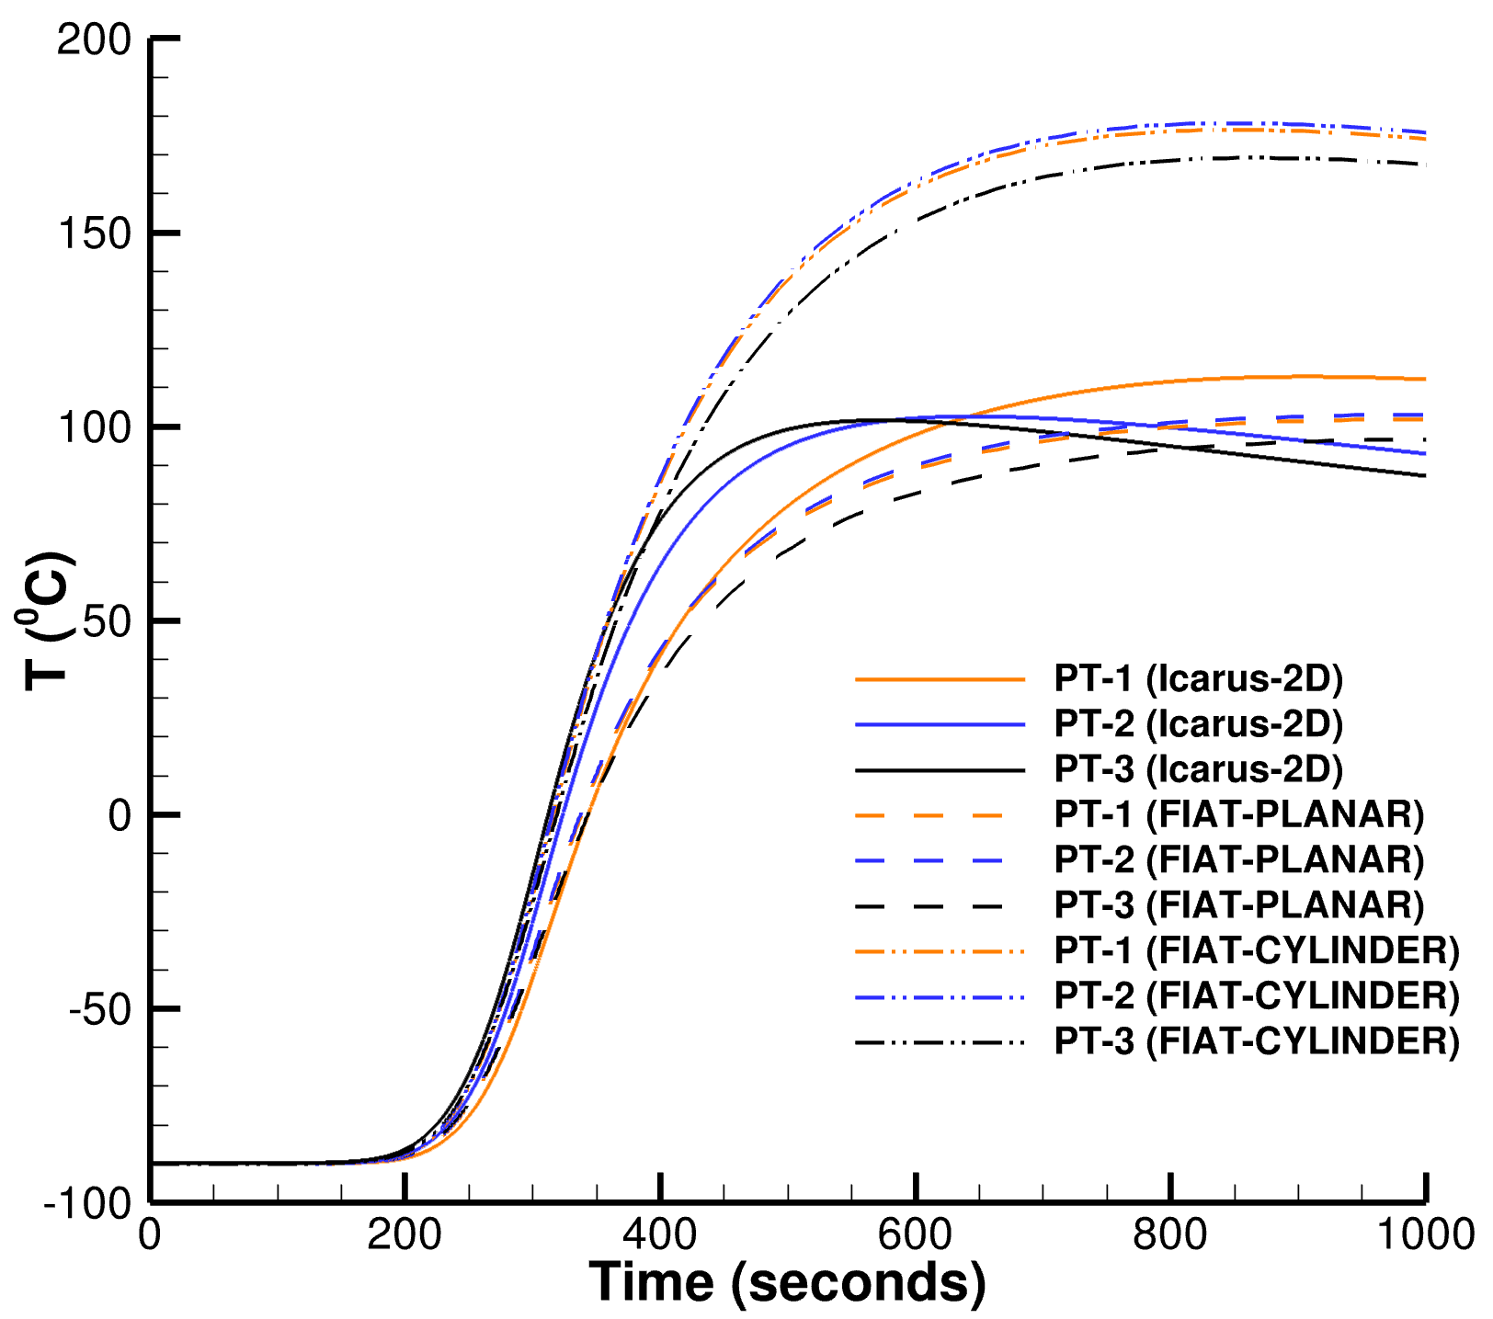
Results: Truncated Domain (Near-Shoulder TC Behavior)
Similar bondline point analysis is carried out
at Points 2 and 3 (near shoulder). Icarus-2D and
FIAT computations are performed
Except for Point 1 (studied before),
Points 2 and 3 have their temperature
traces close to the cylindrical FIAT
assumption up to 400 seconds
(shoulder area is cylindrical)
Later, their temperature traces get
closer to the planar FIAT assumption
This finding could be important from
FIAT PLANAR based TPS sizing
analysis around the shoulder
However, cooling is due to heat
diffusion from these points
3
2
1

Slide 8
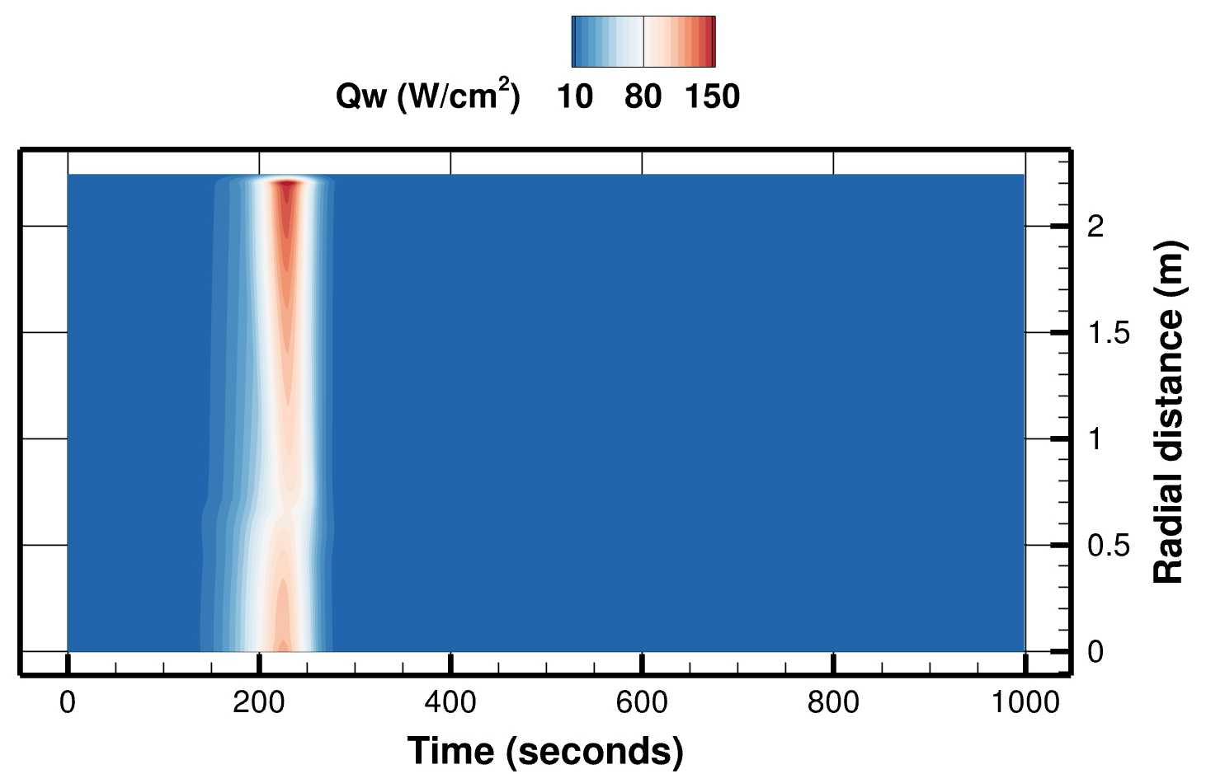
Aerothermal Environments Obtained from DPLR
Spatio-temporal aerothermal environment was obtained from DPLR
Peak heating is observed around the shoulder. Thus, the actual proposed design has thicker CCW around the shoulder

Slide 9

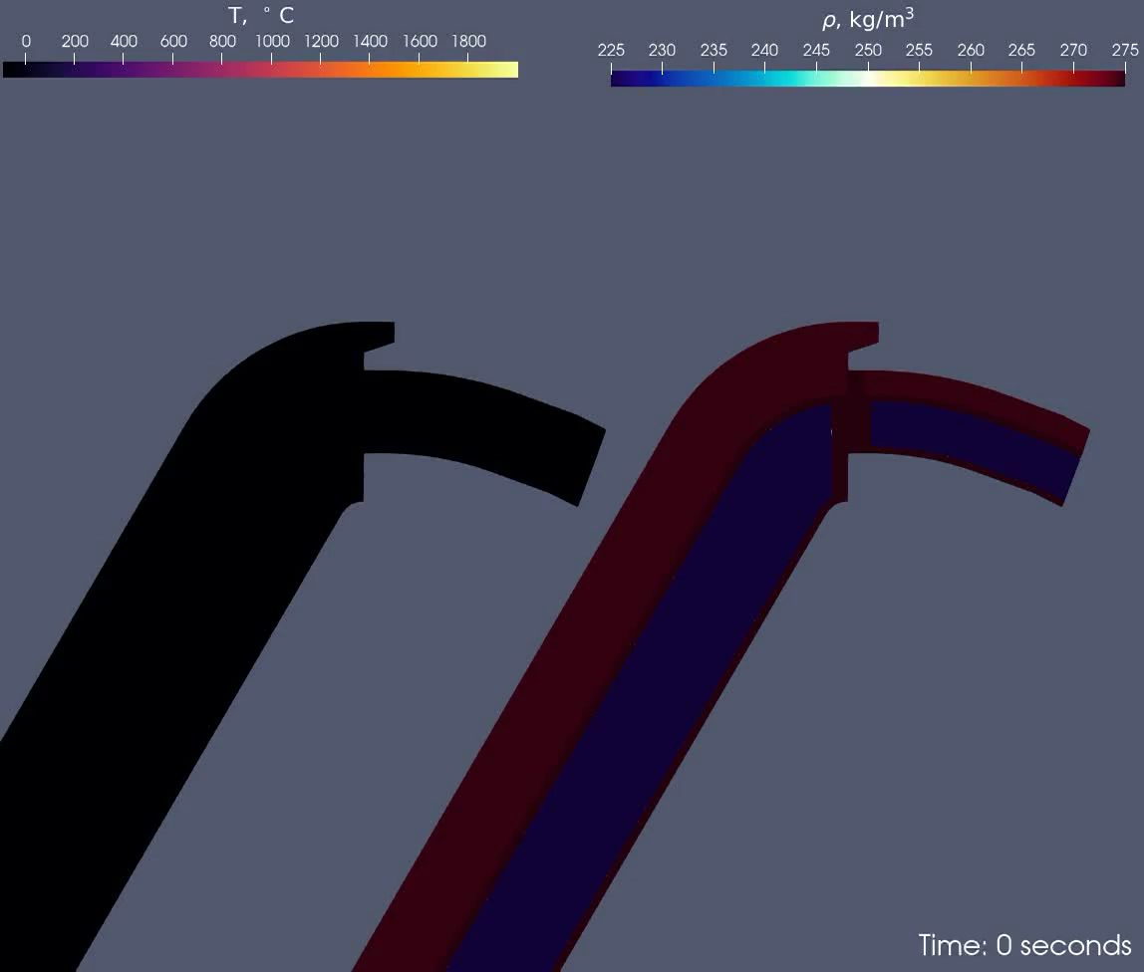
Results: Temperature and Density near Shoulder and Stagnation PT.
Side view
Spatio-temporal evolution of temperature and density near the shoulder location is shown. An isotherm of 450 K shows its movement with time inside PICA
The cure temperature of the carbon composite wrap facesheet ~ 450 K

Slide 10
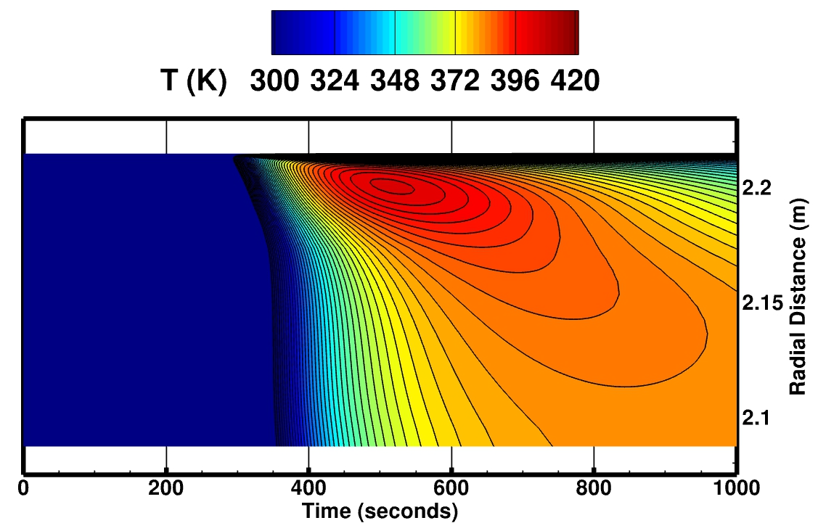
Results: Bondline Temperature Analysis with Truncated Domain
The peak heating bondline region is around shoulder at around 2.23m from the stagnation point and within 500-600 seconds
With time, heat is conducted away from the shoulder. For verification and demonstration, K of CCW was isotropic. Practically, its K is orthotropic.
K = thermal conductivity

Slide 11
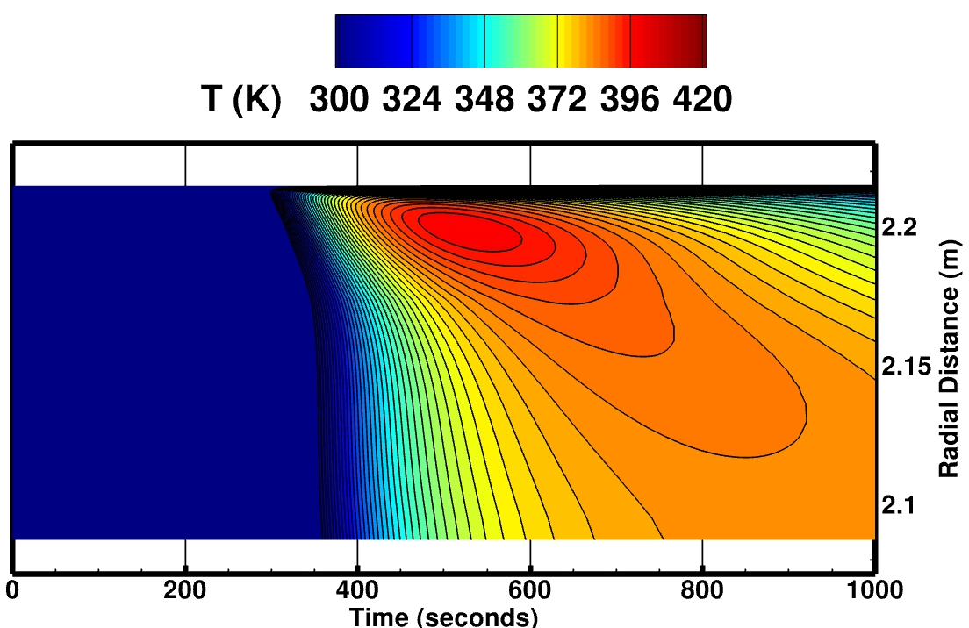
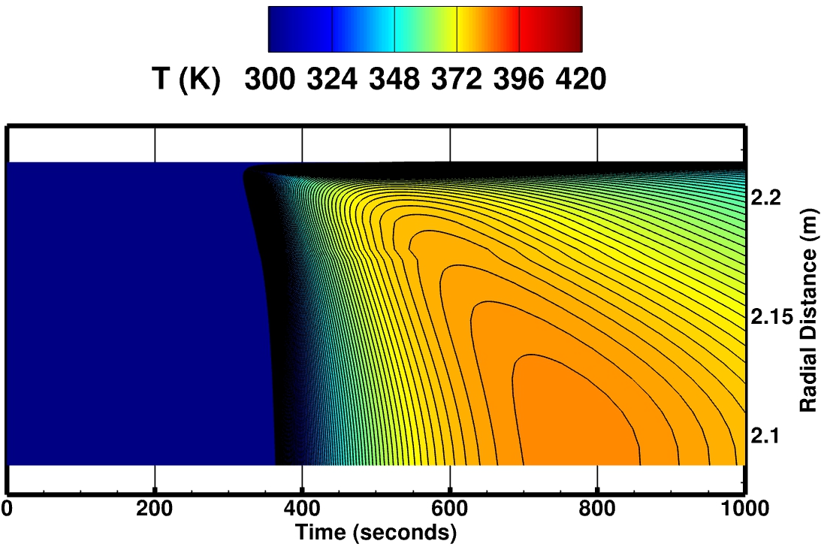
Results: Effects of In-plane K properties of CCW
In-plane K of CCW on the heatshield has significant effects on bondline heating
So far, isotropic CCW properties have been used. However, the actual ratio of in-plane K and through-the-thickness K is close to 20.
Therefore, if ⍺ is a multiplier to the actual in-plane K value of CCW, the peak heating shift towards the lower end of the heat shield with time
⍺ = 0.1
Isotropic
⍺ = 1.0

Slide 12
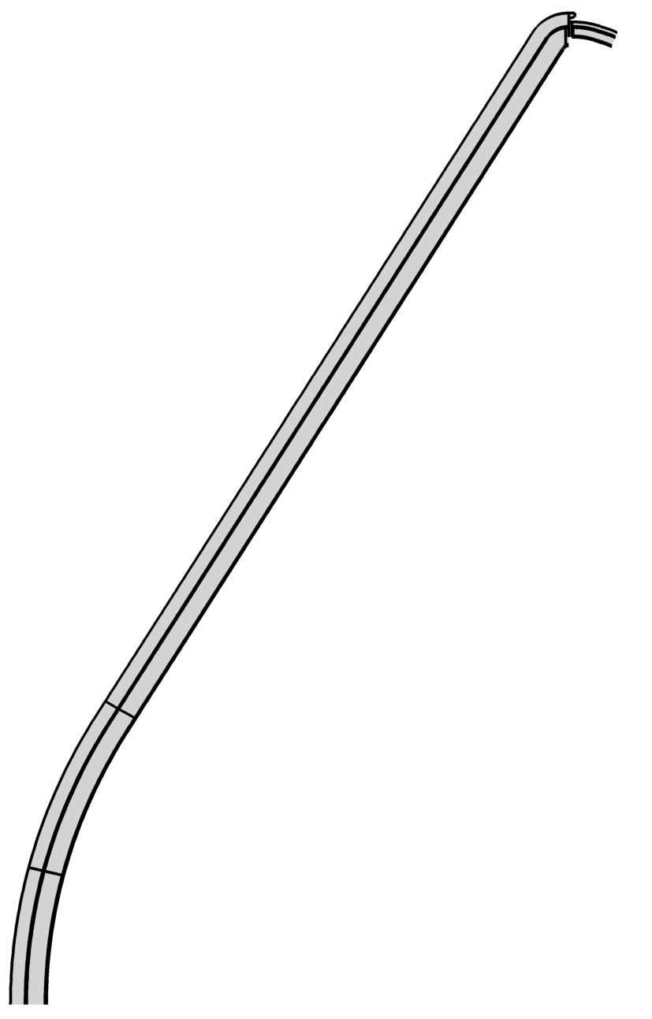
Transition From Truncated to Full Heatshield
Due to the significant effects of CCW in-plane K properties, the truncated domain may not provide
accurate bondline temperature evolution with time and
radial distance
Furthermore, nose and sphere tiles may likely affect the overall bondline heating

Slide 13
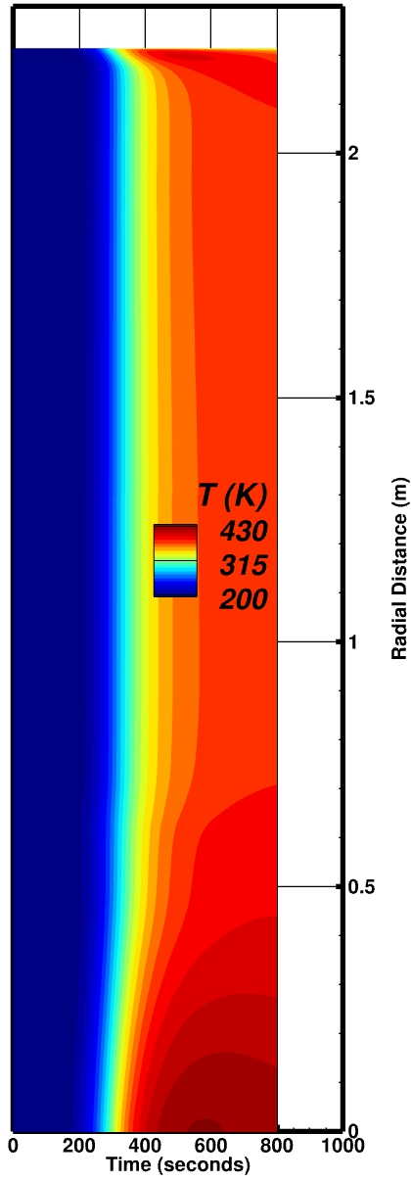
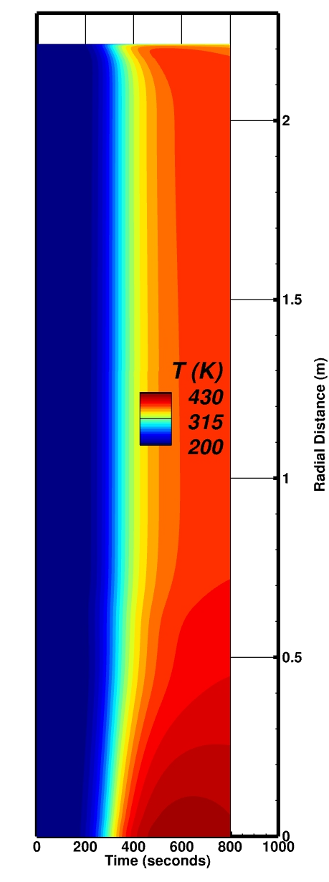
Results: Bondline heating using the full heatshield
Orthotropic CCW does not
have the local maxima of
bondline heating
All PICA tiles are
assumed same
(Base PICA)
Local maxima
Base PICA Setup: Isotropic CCW
Base PICA Setup: Orthotropic CCW
Φ = Φ3
Φ = Φ2
Base PICA
Φ1 = Φ2 = Φ3
Φ = Φ1
Φ: angle between through-the-thickness (TTT) and flow directions (unit: degrees)

Slide 14
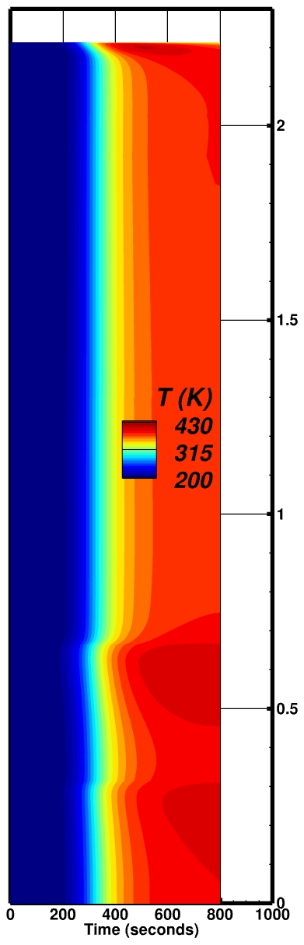
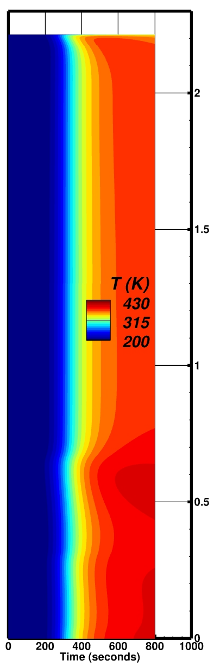
Results: Bondline heating using the full heatshield (different PICA tiles)
Orthotropic CCW does not
have the local maxima of
bondline heating as before
All PICA tiles are
oriented differently
Local maxima
Local bondline heating is observed at inter-PICA-tile regions
Thus, these points need to be investigated as well
Nose-Tiles-based PICA Setup: Isotropic CCW
Nose-Tiles-based PICA Setup: Orthotropic CCW
Φ = Φ3
Φ = Φ2
Φ = Φ1
Φ1 ≠ Φ2 ≠ Φ3

Slide 15
Results: Bondline heating using the full heatshield with different PICA tile setups
Base PICA Setup: Isotropic CCW
Base PICA Setup: Orthotropic CCW
Nose-Tiles-based PICA Setup: Isotropic CCW
Nose-Tiles-based PICA Setup: Orthotropic CCW

Slide 16
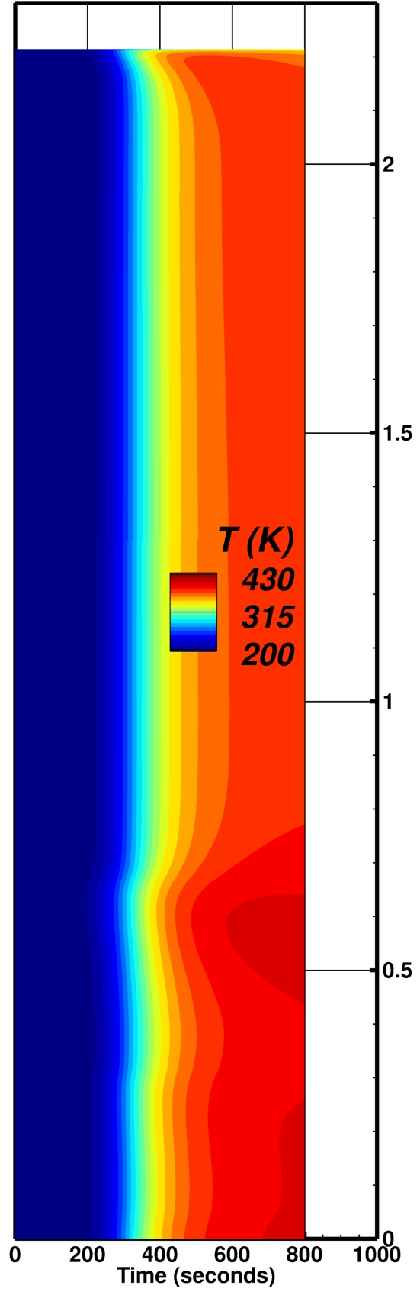
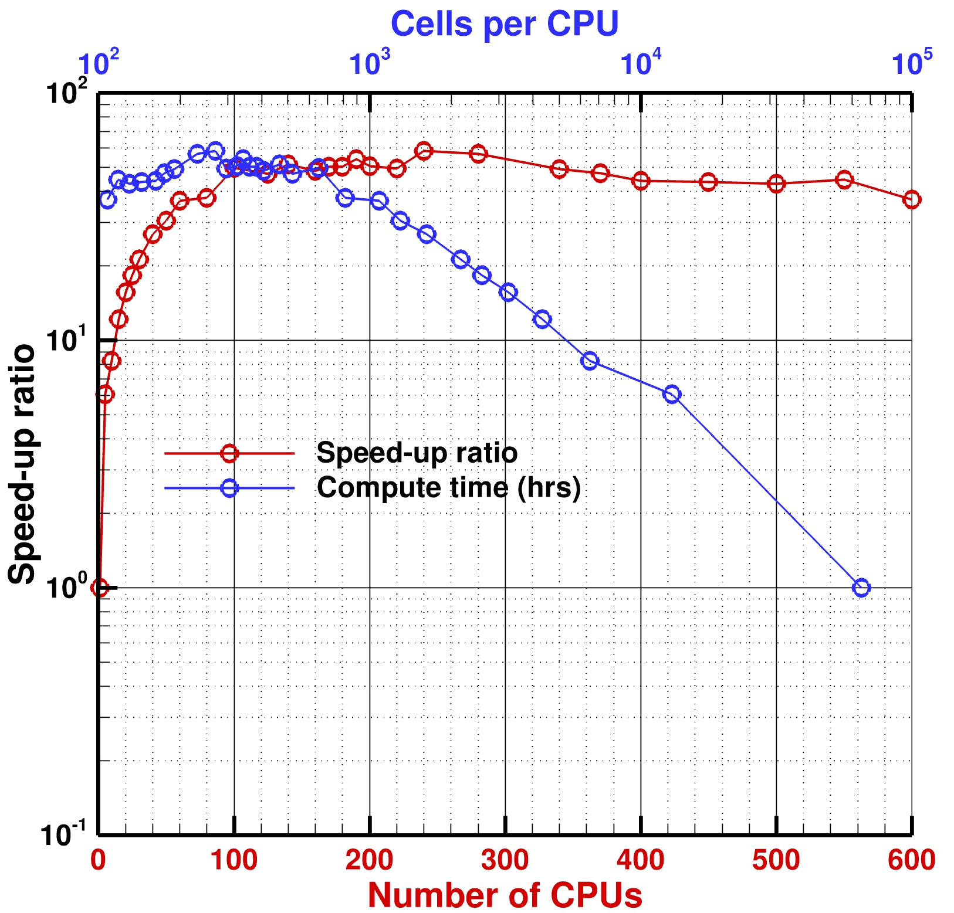
MPI Performance: Nose-Tiles-based PICA Setup: Orthotropic CCW
Optimal cells per CPU ~300-600
Serial Run
Parallel Run: 200

Slide 17

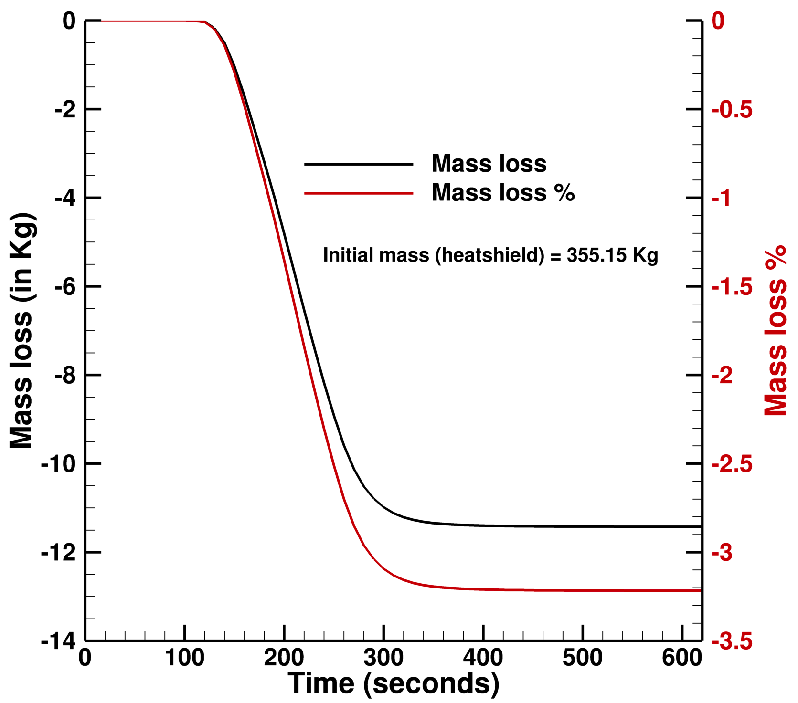
TPS Mass Loss Analysis
PICA ablates due to thermal decomposition of phenolic resins under high heating aerothermal environments imposed
This mass loss is critical to understand a spatial shift in the center of gravity for flight stability and performance
This mass loss study is helpful in determining the shifted C.G. location for this type of NASA missions
$mass loss=current heatshield mass −virgin heatshield mass$
$mass loss\% =\frac{mass loss}{virgin heatshield mass}$*100%
Initial mass (heatshield)
with RTV Gap fillers ~ CBE mass!
Notes:
CBE: Current Best Estimate

Slide 18
SUMMARY
1-D and axisymmetric material-response simulations are carried out using FIAT and Icarus based on one of the high heating margined aerothermal environments from DPLR with verification
In-plane K CCW properties are found to have significant effects on bondline heating with radial distance (from the stagnation point) and time
However, most interestingly, the local maxima of bondline heating is observed around the inter-PICA-tile regions (nose and sphere tiles) of the full heatshield domain.
Isotropic thermal conductivity property of CCW is found to be most conservative
Speed-up ratio for this simulation has been up to 50-60 on NAS’s Skylake nodes.
Mass loss analysis was also shown as demonstration capability of Icarus for this complicated material response simulation

Slide 19
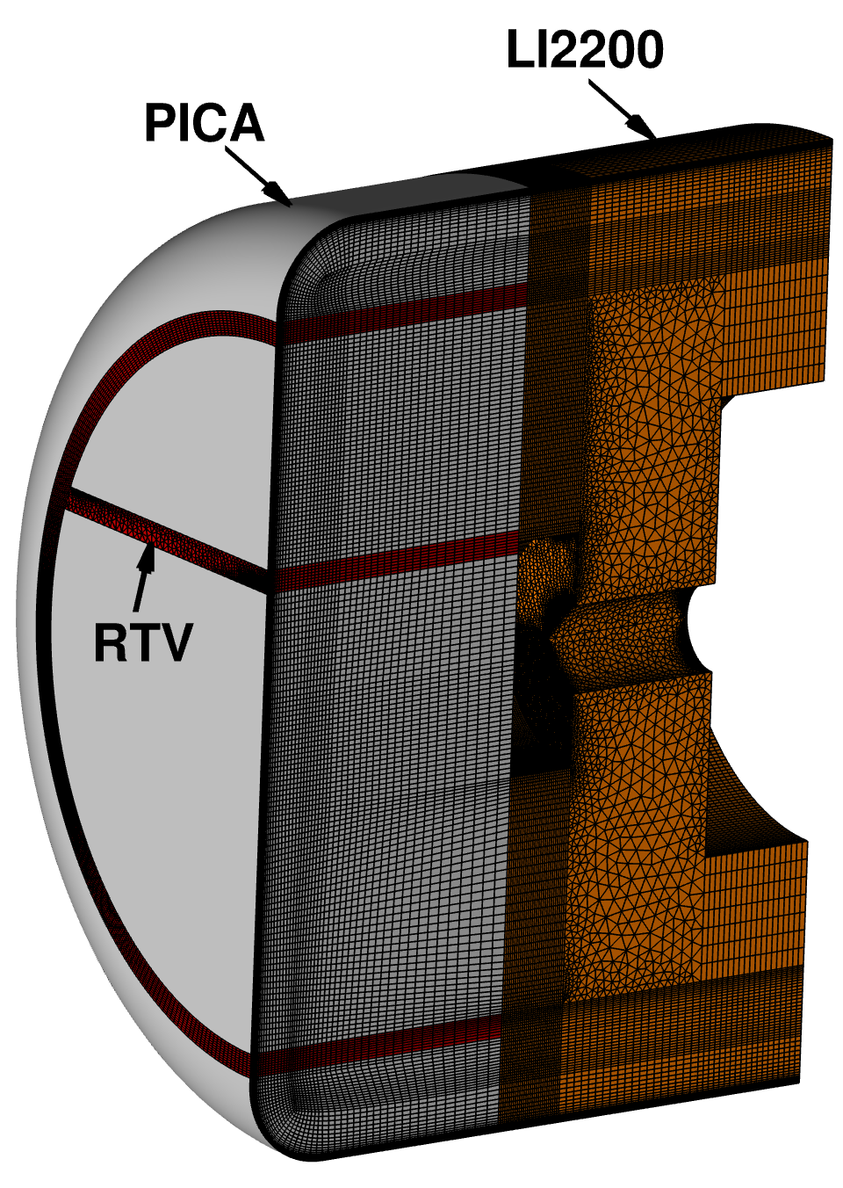
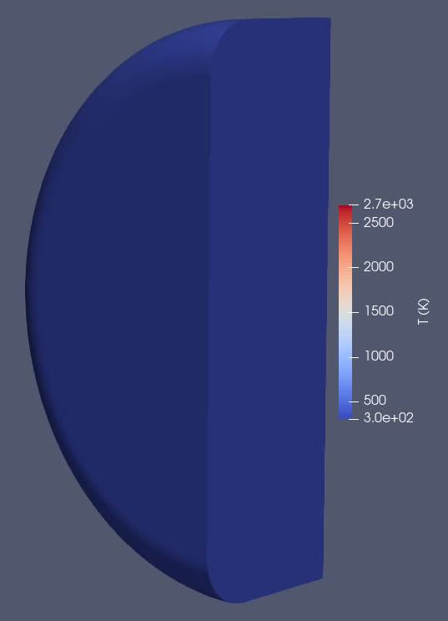
Current and Future Work
For verification of RTV material database, Icarus simulations using 3-D and 2-D domains of PICA-RTV-LI2200 are being worked on
An actual-CAD-based 3-D Icarus simulation, that is ran using two sphere PICA tiles between which RTV gap filler is present, is being analyzed using structured mesh. This work will then be followed by unstructured mesh-based simulations.
Fully unstructured-mesh-based Icarus simulations will be carried out to eventually perform similar simulations on to the entire Dragonfly heatshield, i.e. complete 3-D analysis with more surface complexities involved.
TC
2.6M cells!
INITIAL TEST:
PICA + RTV

Slide 20
THANK YOU

