Slide 1
“How We Will Curate Astromaterials from a Restricted Planet”
Andrea D. Harrington, Ph.D.
NASA MSR Curation Lead
November 14, 2024
Astromaterials Research & Exploration Science
NASA Johnson Space Center

Slide 2
NASA Astromaterials Acquisition & Curation Office
The Astromaterials Acquisition and Curation Office at NASA Johnson Space Center (JSC) is charged with “the curation of all extraterrestrial materials under NASA control, including future NASA missions” as per NASA Policy Directive (NPD) 7100.10F + derivative NPR “Curation of Extraterrestrial Materials.”
The Directive goes on to define Curation as including “…documentation, preservation, preparation, and distribution of samples for research, education, and public outreach.”
  As a part of documentation and preservation, the Curation Office also coordinates sample capture, containment, and transportation to the curation facility.
A major part of the Curation Office’s charge is to integrate requirements, develop implementation strategies, and deliver a facility capable of meeting Mission goals while satisfying requirements levied by the Project, Planetary Protection, the Agency, and Regulatory Authorities.
The MSR Collection is unique in many ways.
  Mission infrastructure – Sample returned in multiple layer of containment and in individual tubes not designed to be easily opened.
  Geological diversity – Collection will be made up of gas and varied solid samples (e.g., cores and regolith comprised on igneous, sedimentary, carbonaceous, and potentially biological materials.
  Management of the Collection – The Collection will be jointly managed by both NASA and ESA Curation during the project and potentially beyond.

Slide 3
Curation of Astromaterials is More than Storage
Curation begins with the initial planning and design of the sample return mission, and is carried through every aspect of the mission due to:
  Heritage Knowledge – By carrying over information from past missions, lessons learned can be put in place to try to ensure a more successful mission. Two prime examples:
    Material Compatibility with Contamination Control Requirements
    Proper budgeting (time and financial) for manufacturing of scientific blanks
  Sufficient Contingencies and Contamination Knowledge (CK) Samples – This is the only way to ensure that the science return on samples, particularly if something unexpected happens.
  Enable Objective-Driven & Opportunity Science – Characterize and allocate samples to accomplish Project science goals and early science.
  Enable Future Science – Conserve a representative quantity of pristine samples for future generations of scientists with innovative ideas and more advanced analytical equipment.
Proper curation ensures short and long-term science objectives are achieved.

Slide 4
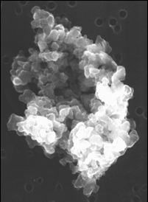
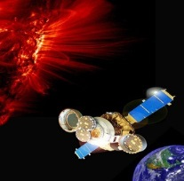

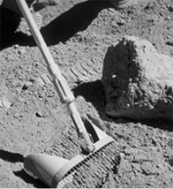
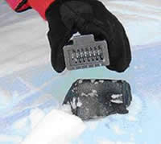
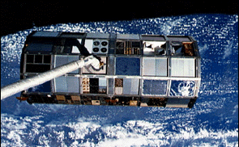
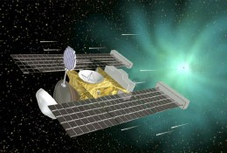
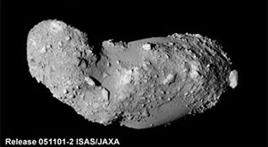
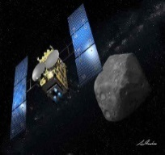

JSC’s Astromaterials Acquisition & Curation Office
Lunar
(1969)
Apollo program lunar rocks and soils; Luna samples
Meteorite
(1977)
Antarctic Search for Meteorites (ANSMET) program
Cosmic Dust
(1981)
Cosmic dust grains from Earth’s stratosphere from high altitude aircraft
Microparticle Impact Col.
(1985)
Space exposed hardware from spacecraft
Genesis
(2004)
Genesis solar wind samples at Earth-Sun L1 point
Stardust
(2006)
Cometary and interstellar samples from Comet Wild 2
Hayabusa
(2012)
Samples collected from JAXA asteroid mission to Itokawa
Hayabusa II
(2020)
Subset of samples collected from JAXA asteroid mission to (162173) 1999 JU₃
OSIRIS-REx
(2023)
Asteroid sample return from 101955 Bennu
Our Near Future . . .
Our More Distant Future . . .
Artemis
(~2026)
Lunar polar region;
Lunar rocks, soils, and volatiles
Moon
(2020s)
Non-volatile-rich farside/polar sample return
Next New Frontiers Call
Comet
(2020s)
Cold curated (?) surface sample return from a comet
Next New Frontiers Call
Phobos
(late 2020s)
10% of a JAXA mission to bring back Phobos material
JAXA sample return mission
MMX
Mars
(~2030+)
Various Mars Sample Return
Over 50 years in the planning (est. 1964)
Authority from NPD 7100.10F + derivative NPR

Slide 5
JSC’s Astromaterials Acquisition & Curation Office
Lunar
(1969)
Apollo program lunar rocks and soils; Luna samples
Meteorite
(1977)
Antarctic Search for Meteorites (ANSMET) program
Cosmic Dust
(1981)
Cosmic dust grains from Earth’s stratosphere from high altitude aircraft
Microparticle Impact Col.
(1985)
Space exposed hardware from spacecraft
Genesis
(2004)
Genesis solar wind samples at Earth-Sun L1 point
Stardust
(2006)
Cometary and interstellar samples from Comet Wild 2
Hayabusa
(2012)
Samples collected from JAXA asteroid mission to Itokawa
Hayabusa II
(2020)
Subset of samples collected from JAXA asteroid mission to (162173) 1999 JU₃
OSIRIS-REx
(2023)
Asteroid sample return from 101955 Bennu
Our Near Future . . .
Our More Distant Future . . .
Artemis
(~2026)
Lunar polar region;
Lunar rocks, soils, and volatiles
Moon
(2020s)
Non-volatile-rich farside/polar sample return
Next New Frontiers Call
Comet
(2020s)
Cold curated (?) surface sample return from a comet
Next New Frontiers Call
Phobos
(late 2020s)
10% of a JAXA mission to bring back Phobos material
JAXA sample return mission
MMX
Mars
(~2030+)
Various Mars Sample Return
Over 50 years in the planning (est. 1964)
Authority from NPD 7100.10F + derivative NPR

Slide 6
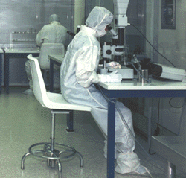
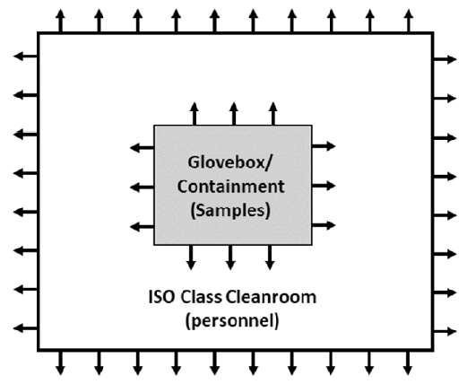
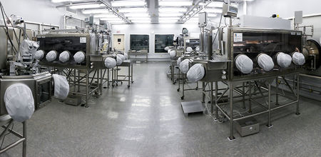
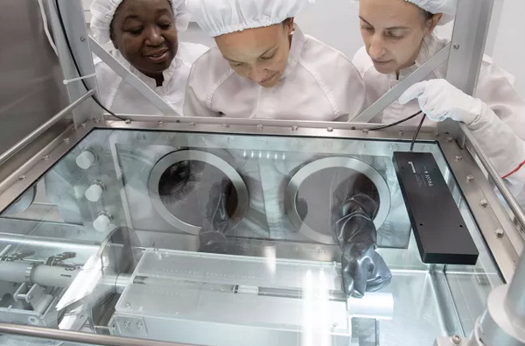
Pristine Facility Implementation Strategies
Cleanroom in Full Bunny Suits
Properly handling, examining, and curating Martian samples also requires that the samples be protected from terrestrial contamination so Planetary Protection (PP) and Science investigations are not impeded.
Cosmic Dust Laboratory JSC
BSC-III
Gloveboxes
Positive Pressure Environment(s)
Apollo Laboratory JSC

Slide 7
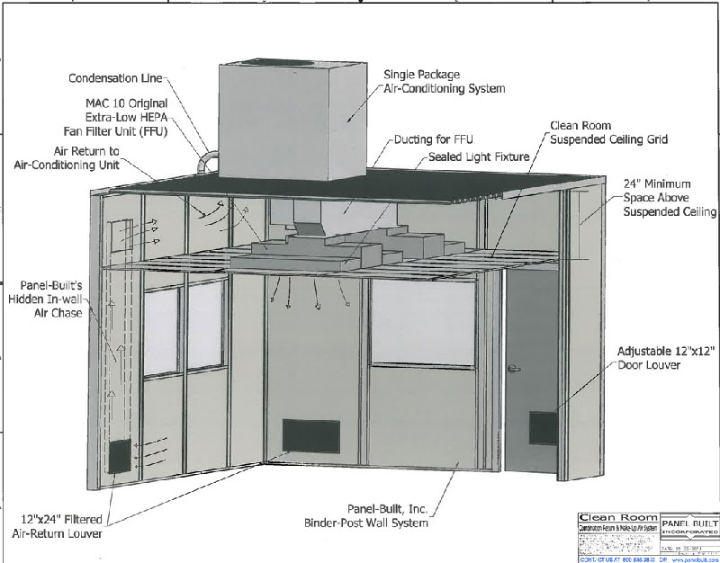
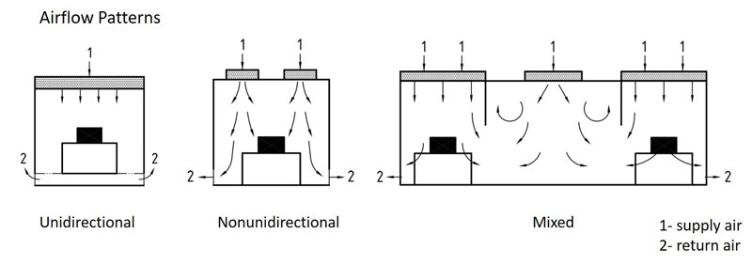
Pristine Facility Implementation Strategies
Cleanroom in Full Bunny Suits
Cosmic Dust Laboratory JSC
BSC-III
Gloveboxes
Apollo Laboratory JSC

Slide 8
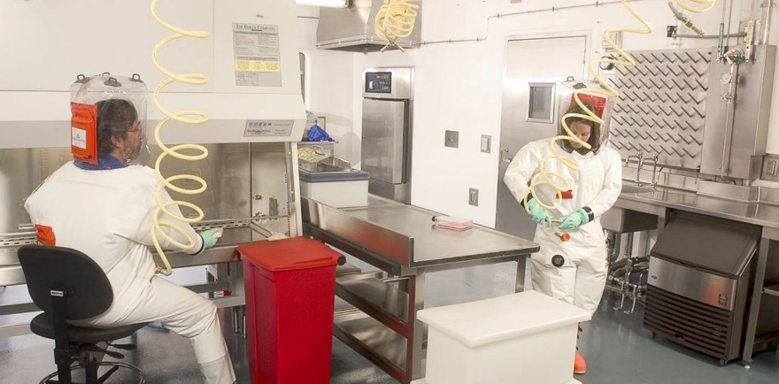
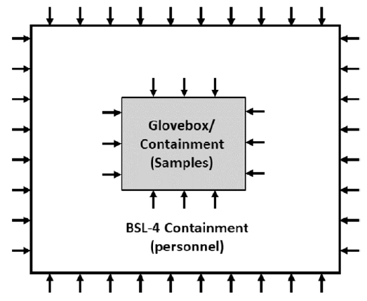
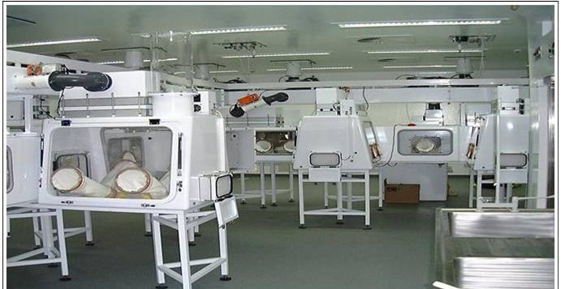
High-Containment Facility Implementation Strategies
Personnel in Pressure Suits
Traditional high-containment facilities are designed to protect scientists and the community from exposure to known hazard(s).
Shope (USA)
BSC-III
Biosafety Cabinet (BSC)-III Cabinet Line
Negative Pressure Environment(s)
Porton Down (UK)

Slide 9
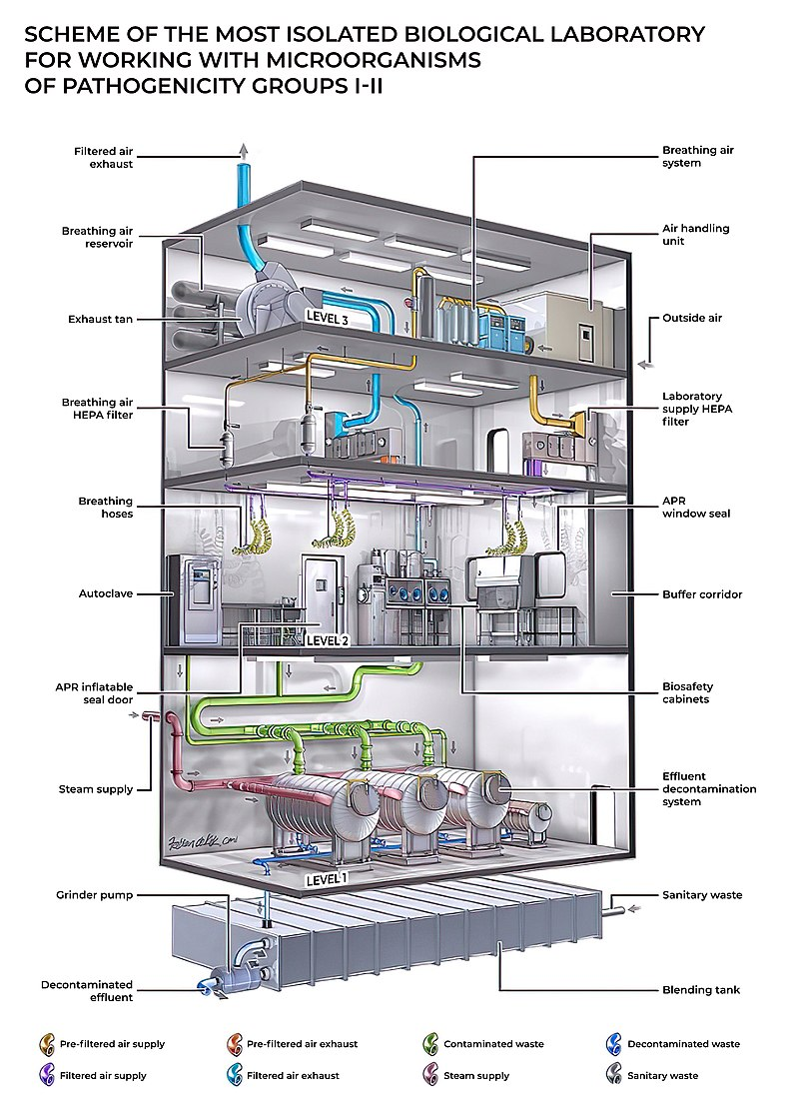
High-Containment Facility
Personnel in Pressure Suits
Shope (USA)
BSC-III
Biosafety Cabinet (BSC)-III Cabinet Line
Porton Down (UK)

Slide 10
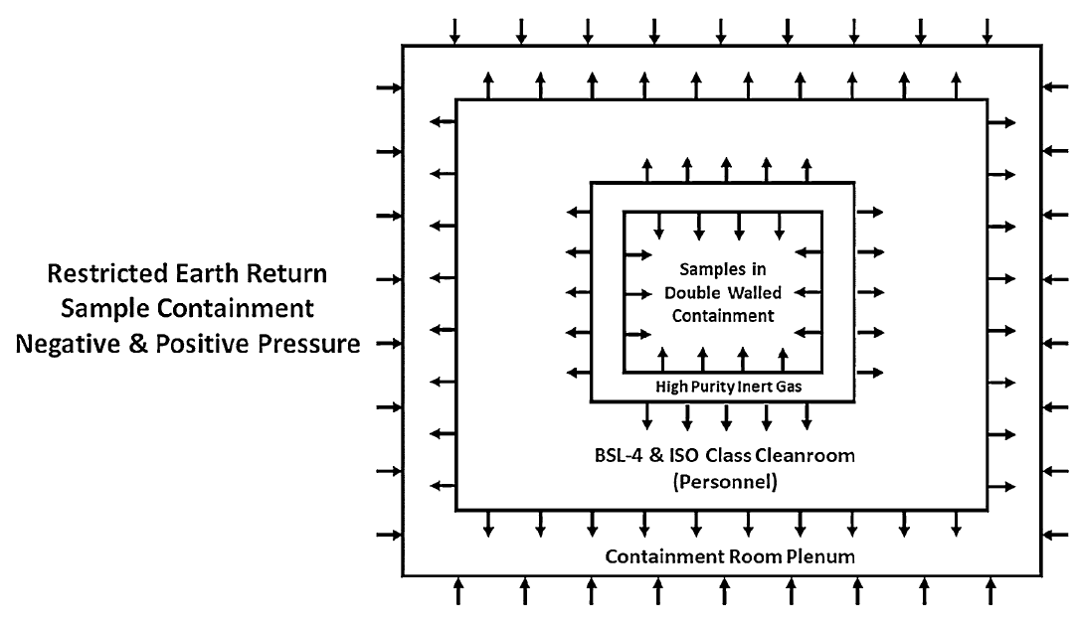
This combined effort requires the integration of both negative and positive pressure environments to meet the needs of PP and contamination control (CC).
Pristine Cleanroom Facilities within High-Containment
Combined facility and specialized isolator approach
BSC-III Cabinet within a Pristine Glovebox
Outermost layer is negative pressure/containment to offer the greatest protection.
This measure may be necessary to ensure sample pristinity is not lost to sterilization in an off-nominal event.
Innermost layer is negative pressure/containment to offer the greatest protection.

Slide 11

MSR SRF Capabilities
Receive Spacecraft
Provide High-Containment & Contamination Control
Accommodate highest priority instrumentation
Fully operational by sample arrival
Enable rapid of release of samples
Hardware Disassembly
Sample Tube
Pre-Basic Characterization
Samples Opened and
Basic Characterization
Sample Safety Assessment, Preliminary Examination, and/or Select Early Science
Samples Picked and/or subdivided
Allocated Sample
Sterilization Process
(Irradiation or Heat)
Global Safe Sample Distribution for
Earth-based Science Investigations
This document has been reviewed and determined not to contain export-controlled data

Slide 12
MSR SRF Capabilities
Receive Spacecraft
Provide High-Containment & Contamination Control
Accommodate highest priority instrumentation
Fully operational by sample arrival
Enable rapid of release of samples
Hardware Disassembly
Sample Tube
Pre-Basic Characterization
Curation led activities
Samples Opened and
Basic Characterization
Sample Safety Assessment, Preliminary Examination, and/or Select Early Science
Samples Picked and/or subdivided
Allocated Sample
Sterilization Process
(Irradiation or Heat)
Global Safe Sample Distribution for
Earth-based Science Investigations

Slide 13
Sample Handling Technology Product Breakdown Structure
Level 2
Elements
Sample Receiving Facility
Level 3
Systems
Sample Handling
Double-Walled Isolator
Level 4
Subsystems
Earth Entry System (EES) Deintegration
Orbiting Sample (OS) Deintegration
Secondary Seal System
Gas Extract System
Solid Core Removal System
Remote Manipulation System
Sample Containers
Level 5
Components
Sample Tube Isolation Container (STIC)
Mechanized Puncture Assembly (MPA)
Linear Actuation Sample Transfer (LAST) Mechanism
Secondary Outer Containment Case (SOCC)
Headspace Gas Capture System
Tube Machining System (TMS)
Chipless Rotary Inline Severer
Gross Movements
Fine Movements
Core Dissection Tray (CDT)
Sample Storage Containers
NASA Led Activities
ESA Led Activities

Slide 14
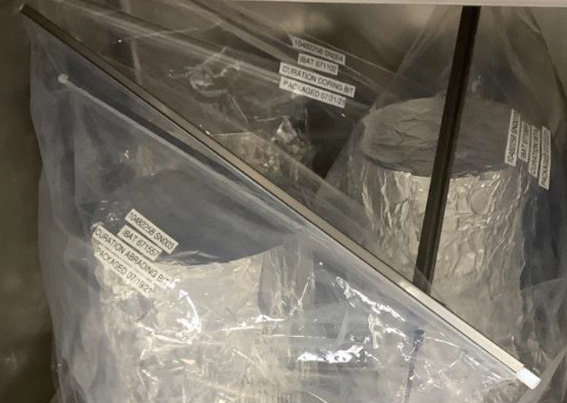
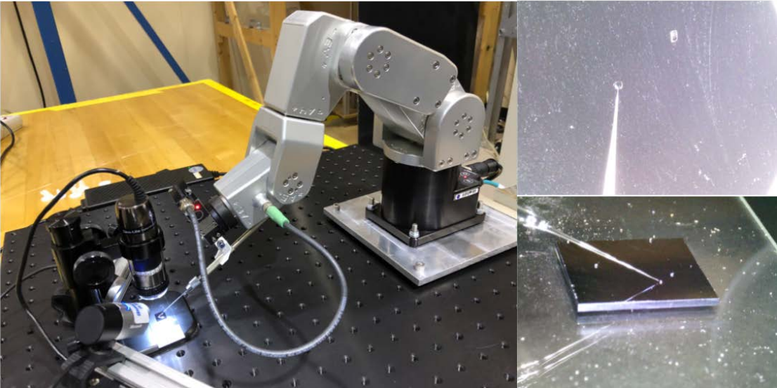
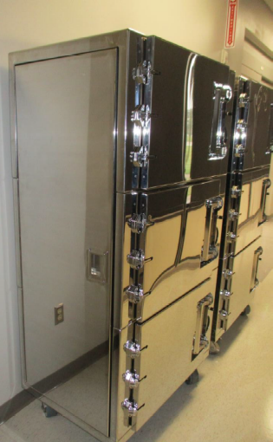
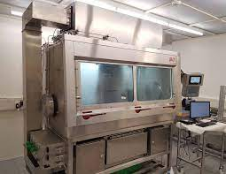
Mission Enabling Technology Development in Curation
Other Astromaterial Collections
Bag Spring Clamps vital for ANGSA
Bag Spring Clamps
MSR Collection
Microparticle Handling
Inform Mars sample manipulation
Isolation Cabinets
MSR CK (JSC)
Isolation cabinets to be utilized by OREx
OSIRIS REx (JSC)
Gloveboxes
Inform Mars core dissection and best practices in contamination control
Double Walled Isolators
MSR CK (JSC)
DWI and SRF could enable future Restricted Earth Return missions and/or handle samples with potential chemical hazards
Apollo Laboratory (JSC)
MSR Sample (ESA/Thales Alenia)

Slide 15
Highlight of Overarching SRF Considerations
Structural Constraints
Personnel Safety
PP Requirements
CC Requirements
Preliminary Examination Requirements
Science Requirements
Construction Timeline
Operational Timeline
Adaptability to Changing Needs
Facility Fair Use/Access to Samples
Partnership/Reutilization Opportunities
Cost Effectiveness (short and long-term)
Pristine Sample Conservation
Upon completion of the assessment studies, the preferred modality and refined requirements would be utilized for site-specific design but will not be finalized until NASA’s completion of the National Environmental Policy Act (NEPA) process.
Mars Sample Receiving Facility (SRF) Assessment Study (MSAS) –
Assess the utilization of 4 modality options and accommodation potentialities
Time
Cost
Balancing
Risks/Benefits
European Extraterrestrial Sample Infrastructure (EETSI) System Study –
Delivers preliminary designs, costs, and schedules for a new traditional fixed SRF and SCF
Capability

Slide 16
Closing Highlights
NASA and ESA are taking a “safety first” approach to designing and engineering every step of Sample Receiving Project (SRP).
  Complementary NASA/ESA SRF studies will inform site-specific design.
  Conducting R&D activities (e.g., DWI) to comply with Planetary Protection and Contamination Control objectives.
MSR should be seen as a mission enabling endeavor
  Future technology development will lay the foundation for other, even more complex sample return missions
    Restricted Earth Return Facilities
    Clean and contained processing and storage technology
  Technology developed for the Mars2020 Contamination Knowledge collection has become curation standards at JSC

