Slide 1



An Introduction to Mars Sample Return (MSR) and Curation
Andrea D. Harrington, Ph.D.
MSR Curation Lead
Astromaterials Acquisition and Curation Office
NASA Johnson Space Center
November 12, 2024

Slide 2
High-level Overview
MSR Background
  Campaign and Samples
Sample Receiving Project
  Planetary Protection
  Sample Receiving Facility
Curation Background
  What is curation?
  Collections at JSC
  Curation Strategies and Best Practices
Research and Technology Development in support of SRF
Closing
This document has been reviewed and determined not to contain export-controlled data

Slide 3
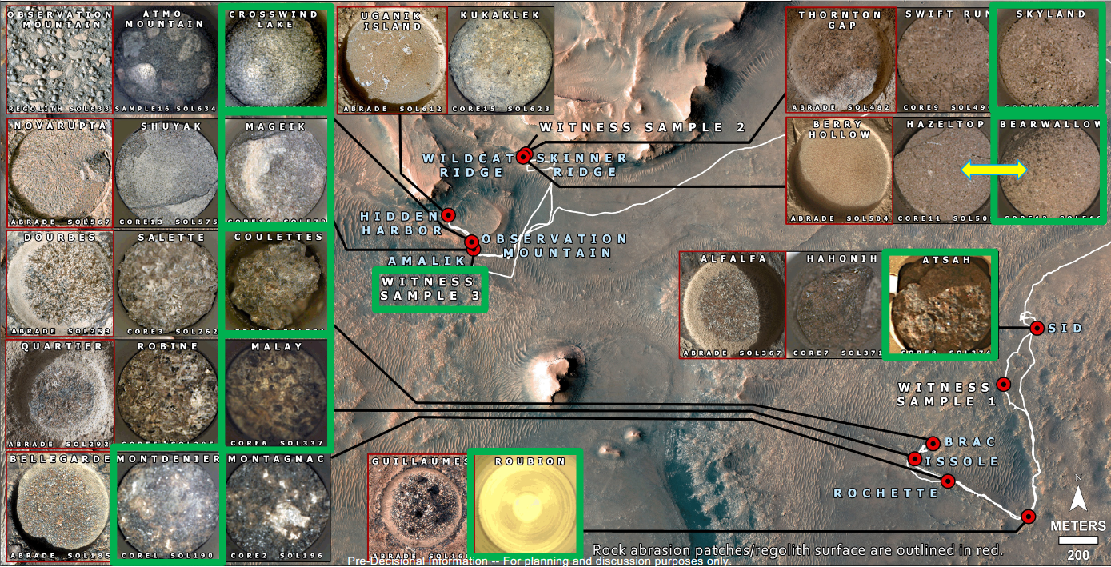
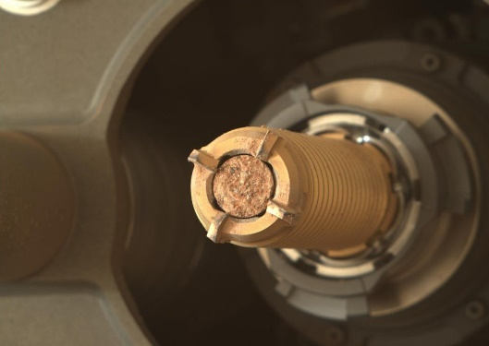
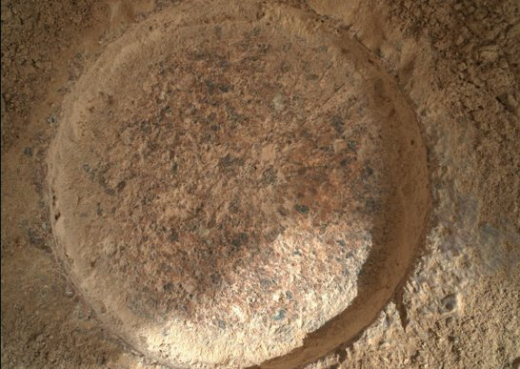
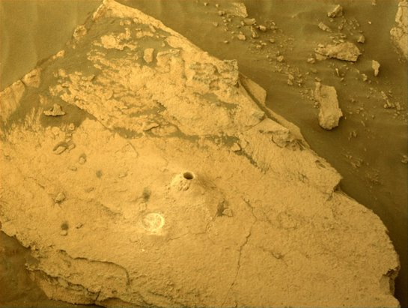
Introduction
Mars Sample Return (MSR) is a joint venture between NASA and ESA.
The Campaign will notionally return between 10-26 geologically diverse samples (plus witness tubes) able to answer an array of science objectives.
One of the high priority science objectives is to “assess and interpret the potential biological history of Jezero Crater, including assessing returned samples for the evidence of life.​” (iMOST Report)
Green highlights tubes cached at Three Forks
First samples from Delta Front Campaign
This document has been reviewed and determined not to contain export-controlled data

Slide 4


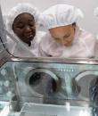


Sample Receiving Project
Mars Sample Return Program
1 2 3 4
Currently Under Evaluation
Mars 2020 Sample Caching
Collect samples of rock, regolith, and atmosphere
Cache samples on the surface for retrieval
Sample Retrieval Lander (SRL)
Retrieve samples cached by Mars 2020 rover
Launch samples into orbit around Mars
Earth Return Orbiter
(ERO)
Capture and contain samples in Mars orbit
Safely return samples to Earth for recovery at landing site
Sample Receiving Project
(SRP)
Recover and transport contained samples to receiving facility
Safety assessment and sample containment
Initial sample science and curation
This document has been reviewed and determined not to contain export-controlled data

Slide 5

MSR SRF Capabilities and Priorities
Receive Spacecraft
Provide High-Containment & Contamination Control
Accommodate highest priority instrumentation
Fully operational by sample arrival
Enable rapid of release of samples
Hardware Disassembly
Sample Tube
Pre-Basic Characterization
Samples Opened and
Basic Characterization
Sample Safety Assessment, Preliminary Examination, and/or Select Early Science
Samples Picked and/or subdivided
Allocated Sample
Sterilization Process
(Irradiation or Heat)
Global Safe Sample Distribution for
Earth-based Science Investigations
This document has been reviewed and determined not to contain export-controlled data

Slide 6
Foundational Information
Planetary Protection Guidelines
  Mars Sample Return (MSR) as a Planetary Protection Category V, Restricted Earth return due to the scientific opinion that Mars is of significant interest to the process of chemical evolution and/or the origin of life.
  “Adopt appropriate measures” to “avoid […] harmful contamination and also adverse changes in the environment of the Earth resulting from the introduction of extraterrestrial matter.” [Article IX of the UN Outer Space Treaty]
Implementation Strategies for meeting Planetary Protection Guidelines
  Mars Sample Receiving Facility (SRF) must provide high-containment (Biosafety Level (BSL)-4 equivalent).
  Samples should be deemed abiotic and/or safe via the execution of a Sample Safety Assessment before they can be released from the SRF without sterilization.
This document has been reviewed and determined not to contain export-controlled data

Slide 7
Foundational Information
Planetary Protection Guidelines
  Mars Sample Return (MSR) as a Planetary Protection Category V, Restricted Earth return due to the scientific opinion that Mars is of significant interest to the process of chemical evolution and/or the origin of life.
  “Adopt appropriate measures” to “avoid […] harmful contamination and also adverse changes in the environment of the Earth resulting from the introduction of extraterrestrial matter.” [Article IX of the UN Outer Space Treaty]
Implementation Strategies for meeting Planetary Protection Guidelines
  Mars Sample Receiving Facility (SRF) must provide high-containment (~Biosafety Level (BSL)-4 equivalent).
  Samples should be deemed abiotic and/or safe via the execution of a Sample Safety Assessment before they can be released from the SRF without sterilization.
This document has been reviewed and determined not to contain export-controlled data

Slide 8
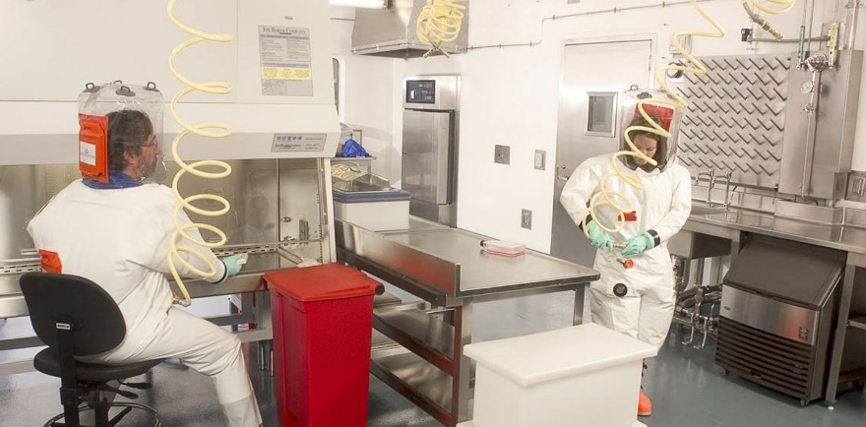
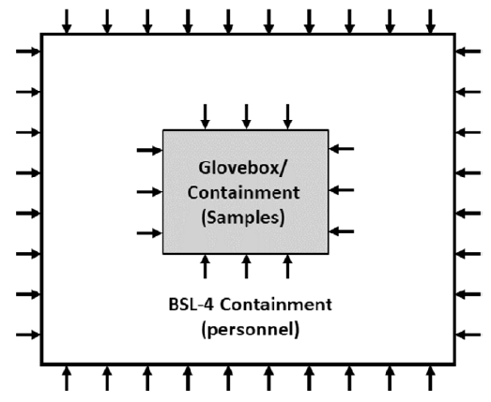
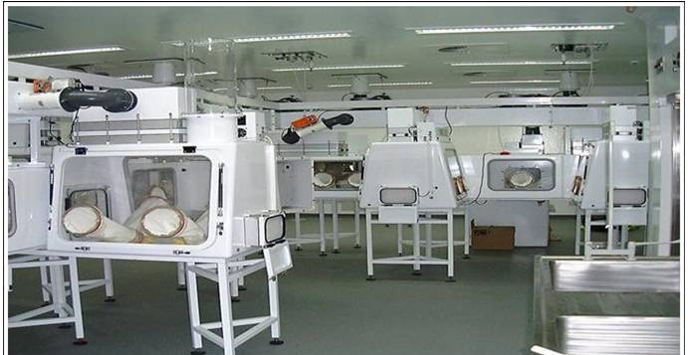
High-Containment Facility Implementation Strategies
Personnel in Pressure Suits
Traditional high-containment facilities are designed to protect scientists and the community from exposure to known hazard(s).
Shope (USA)
BSC-III
Biosafety Cabinet (BSC)-III Cabinet Line
Negative Pressure Environment(s)
Porton Down (UK)
This document has been reviewed and determined not to contain export-controlled data

Slide 9
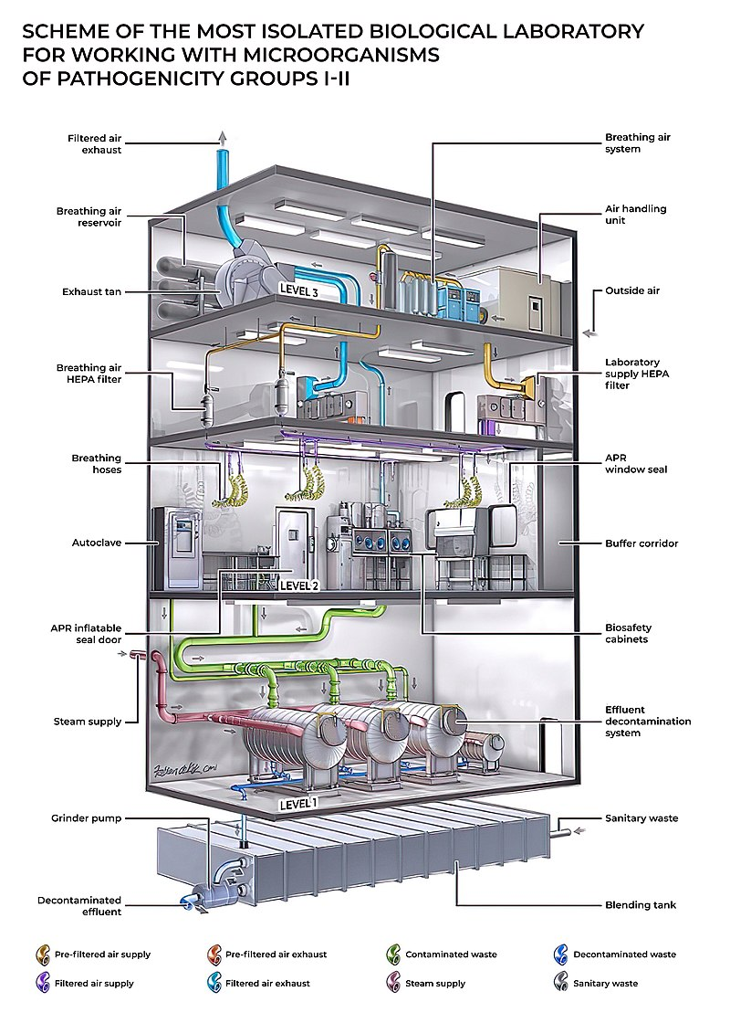
High-Containment Facility
Personnel in Pressure Suits
Shope (USA)
BSC-III
Biosafety Cabinet (BSC)-III Cabinet Line
Porton Down (UK)
This document has been reviewed and determined not to contain export-controlled data

Slide 10
Foundational Information
Planetary Protection Guidelines
  Mars Sample Return (MSR) as a Planetary Protection Category V, Restricted Earth return due to the scientific opinion that Mars is of significant interest to the process of chemical evolution and/or the origin of life.
  “Adopt appropriate measures” to “avoid […] harmful contamination and also adverse changes in the environment of the Earth resulting from the introduction of extraterrestrial matter.” [Article IX of the UN Outer Space Treaty]
Implementation Strategies for meeting Planetary Protection Guidelines
  Mars Sample Receiving Facility (SRF) must provide high-containment (~Biosafety Level (BSL)-4 equivalent).
  Samples should be deemed abiotic and/or safe via the execution of a Sample Safety Assessment before they can be released from the SRF without sterilization.
This document has been reviewed and determined not to contain export-controlled data

Slide 11
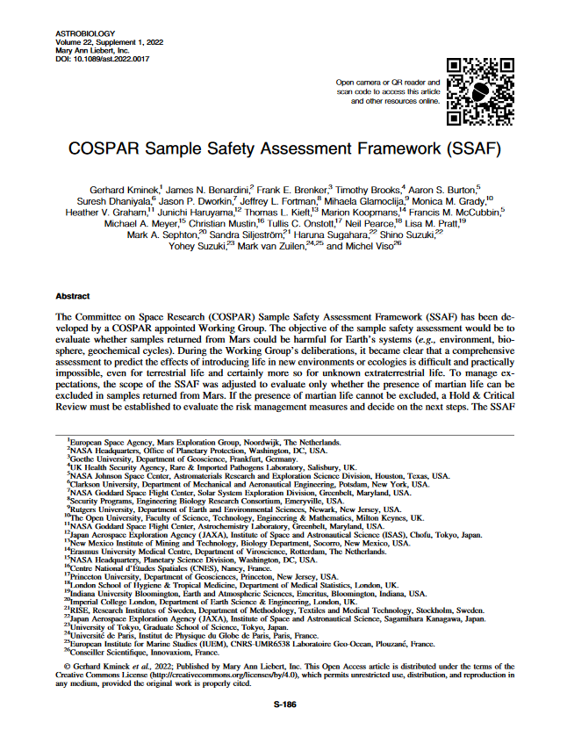
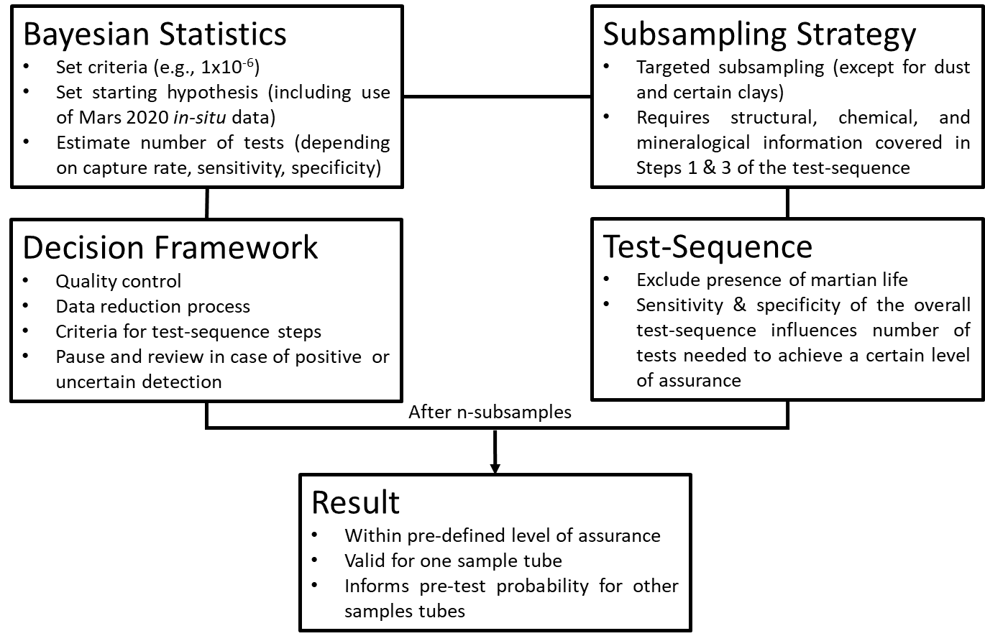
The Sample Safety Assessment Framework
Framework to “evaluate only whether the presence of Martian life can be excluded in samples returned from Mars.”
  Considers only carbon-based life
It is a Framework – detailed Protocol still tbd
This document has been reviewed and determined not to contain export-controlled data

Slide 12
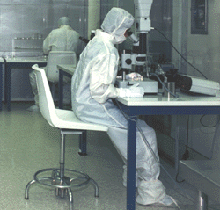
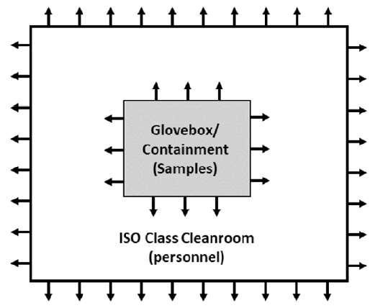
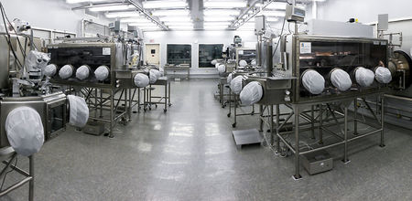
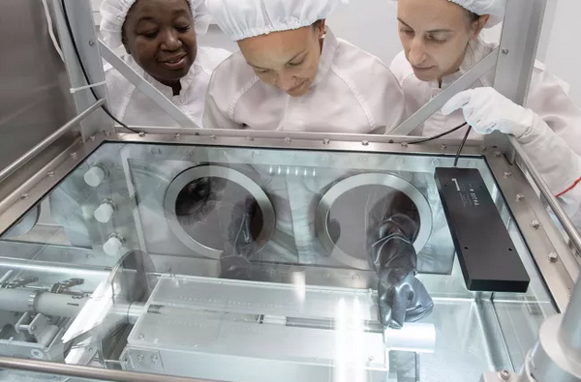
Pristine Facility Implementation Strategies
Cleanroom in Full Bunny Suits
Properly handling, examining, and curating Martian samples also requires that the samples be protected from terrestrial contamination so Planetary Protection (PP) and Science investigations are not impeded.
Cosmic Dust Laboratory JSC
BSC-III
Gloveboxes
Positive Pressure Environment(s)
Apollo Laboratory JSC
This document has been reviewed and determined not to contain export-controlled data

Slide 13
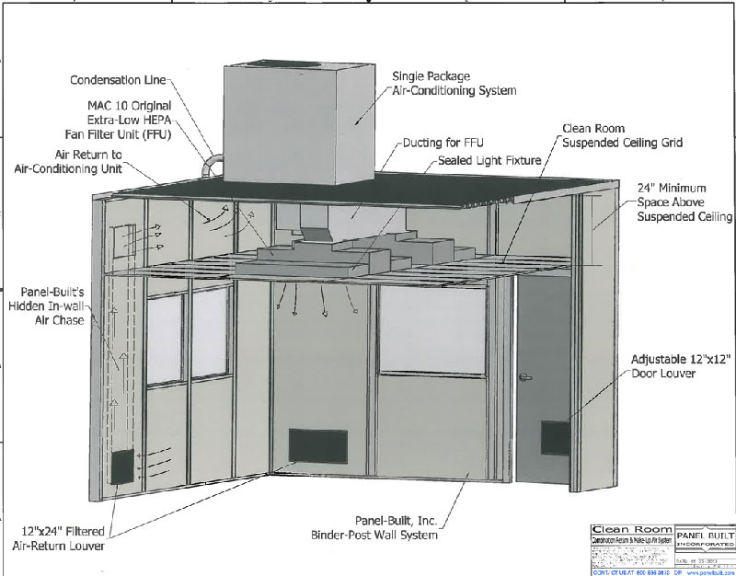
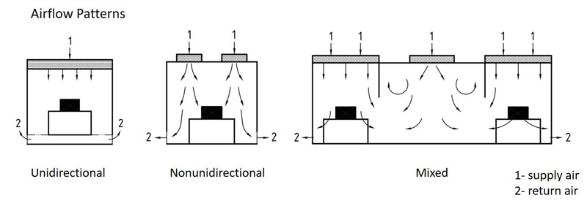
Pristine Facility Implementation Strategies
Cleanroom in Full Bunny Suits
Cosmic Dust Laboratory JSC
BSC-III
Gloveboxes
Apollo Laboratory JSC
This document has been reviewed and determined not to contain export-controlled data

Slide 14
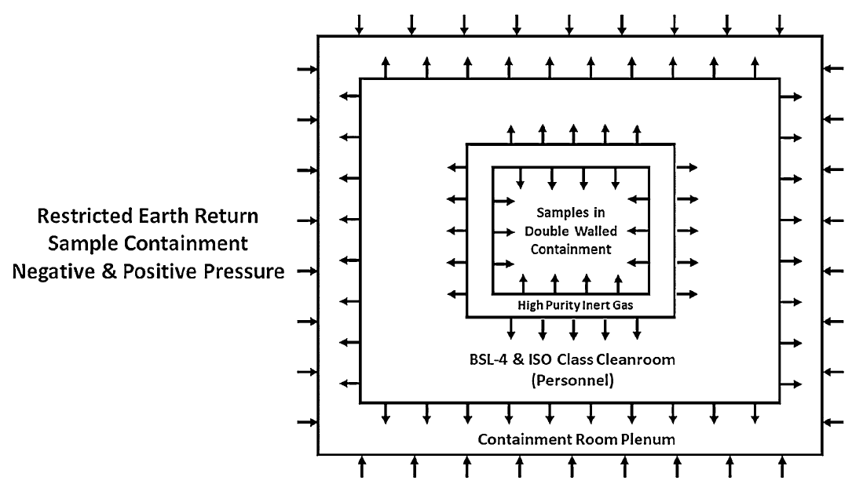
This combined effort requires the integration of both negative and positive pressure environments to meet the needs of PP and contamination control (CC).
Pristine Cleanroom Facilities within High-Containment
Combined facility and specialized isolator approach
BSC-III Cabinet within a Pristine Glovebox
Outermost layer is negative pressure/containment to offer the greatest protection.
This measure may be necessary to ensure sample pristinity is not lost to sterilization in an off-nominal event.
Innermost layer is negative pressure/containment to offer the greatest protection.
This document has been reviewed and determined not to contain export-controlled data

Slide 15
MSR SRF Capabilities and Priorities
Receive Spacecraft
Provide High-Containment & Contamination Control
Accommodate highest priority instrumentation
Fully operational by sample arrival
Enable rapid of release of samples
Hardware Disassembly
Sample Tube
Pre-Basic Characterization
Curation led activities
Samples Opened and
Basic Characterization
Sample Safety Assessment, Preliminary Examination, and/or Select Early Science
Samples Picked and/or subdivided
Allocated Sample
Sterilization Process
(Irradiation or Heat)
Global Safe Sample Distribution for
Earth-based Science Investigations
This document has been reviewed and determined not to contain export-controlled data

Slide 16
Highlight of Overarching Considerations for the SRF
Structural Constraints
Personnel Safety
PP Requirements
CC Requirements
Preliminary Examination Requirements
Science Requirements
Construction Timeline
Operational Timeline
Adaptability to Changing Needs
Facility Fair Use/Access to Samples
Partnership/Reutilization Opportunities
Cost Effectiveness (short and long-term)
Pristine Sample Conservation
Upon completion of the assessment studies, the preferred modality and refined requirements would be utilized for site-specific design but will not be finalized until NASA’s completion of the National Environmental Policy Act (NEPA) process.
Mars Sample Receiving Facility (SRF) Assessment Study (MSAS) –
Assess the utilization of 4 modality options and accommodation potentialities
Time
Cost
Balancing
Risks/Benefits
European Extraterrestrial Sample Infrastructure (EETSI) System Study –
Delivers preliminary designs, costs, and schedules for a new traditional fixed SRF and SCF
Capability
This document has been reviewed and determined not to contain export-controlled data

Slide 17
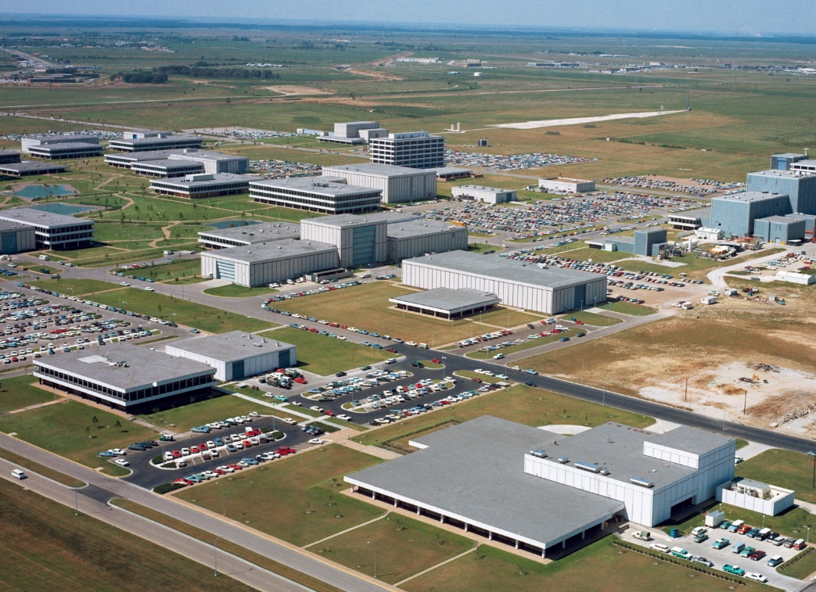
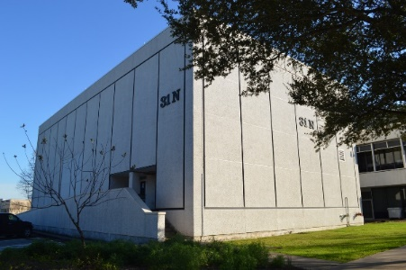
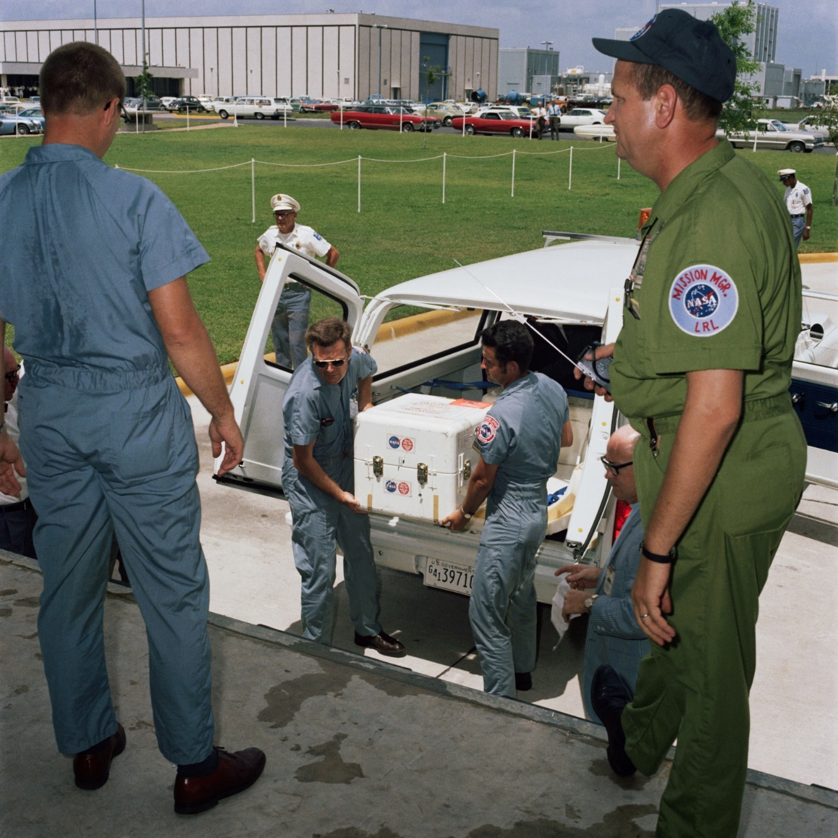
Apollo Lunar Receiving Lab
The 84,326 ft² (7,834 m²) LRL facility was designed to the following functional requirements:
Prepare sample return containers and astronaut geologic hand tools before flight
Provide biological quarantine of astronauts, spacecraft, equipment, and samples
Receive sample return containers and conduct preliminary sample characterization
Support sample curation: cataloging, sample storage, re-packaging and distribution of lunar samples to the scientific community for analysis
Perform biohazard clearance testing and time-sensitive primary scientific analyses
B31
B37
1967 Site Aerial Photo
This document has been reviewed and determined not to contain export-controlled data

Slide 18
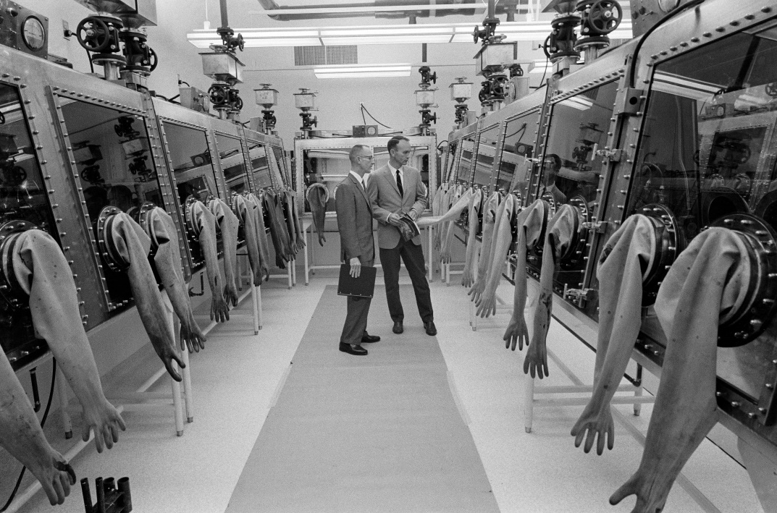
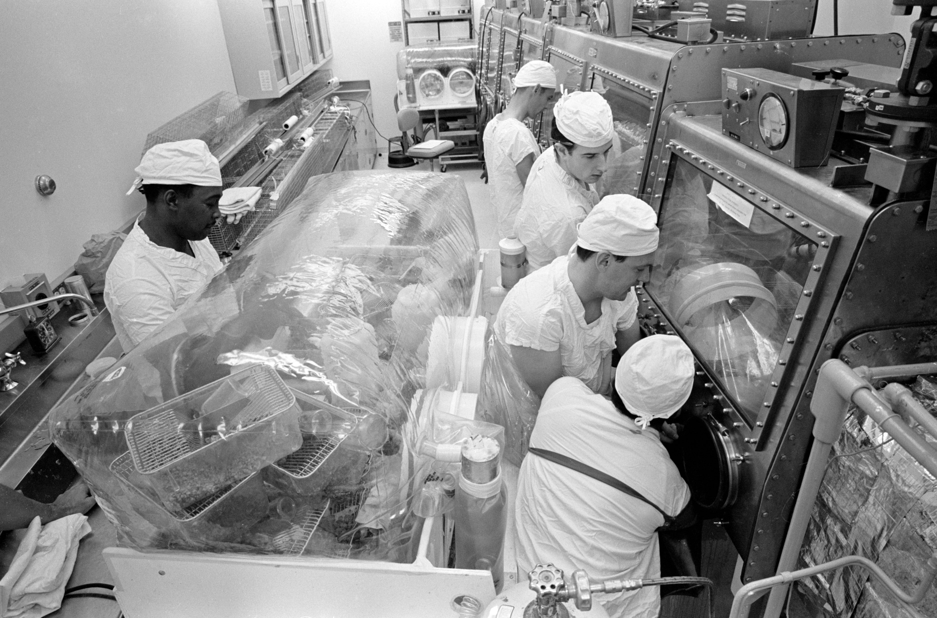
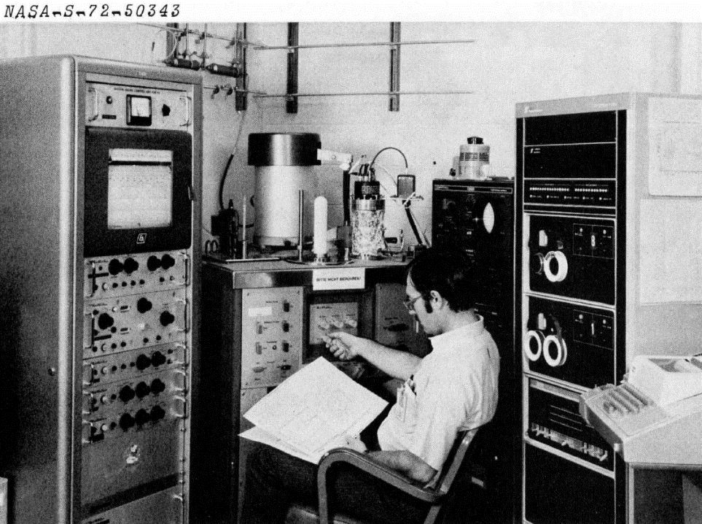
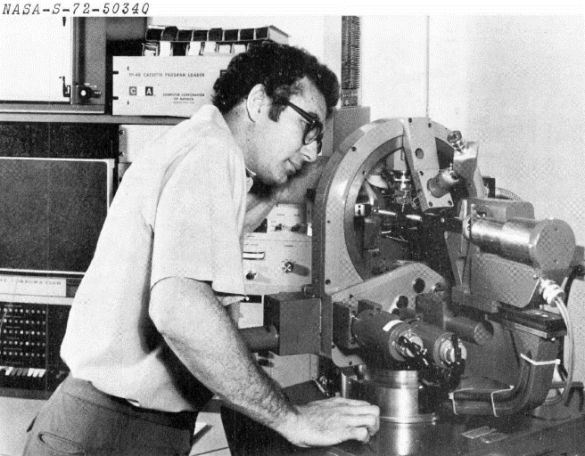
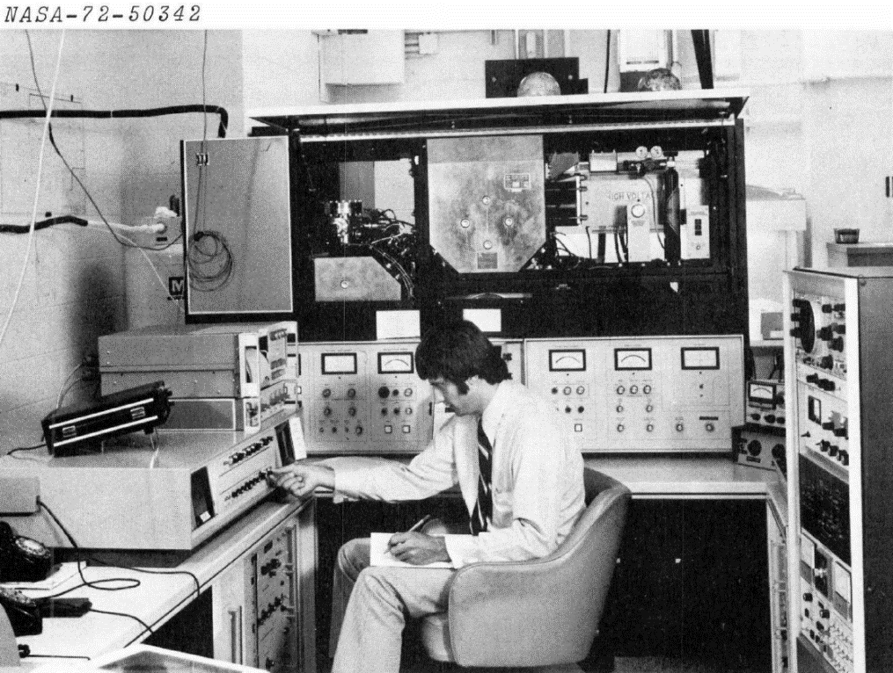
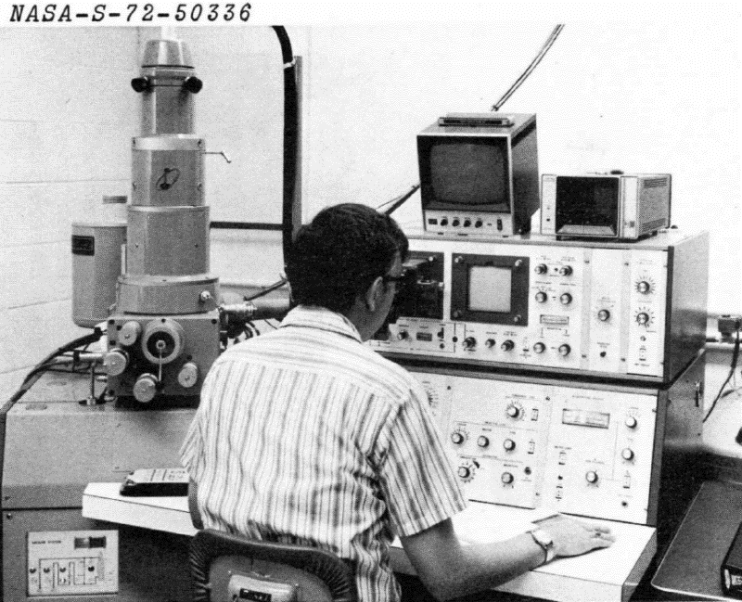
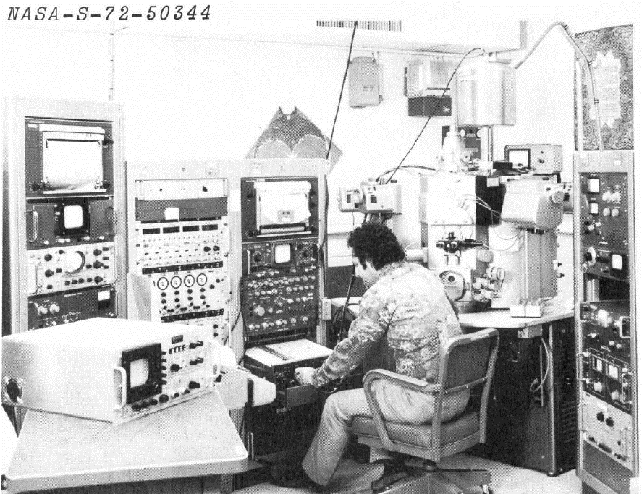
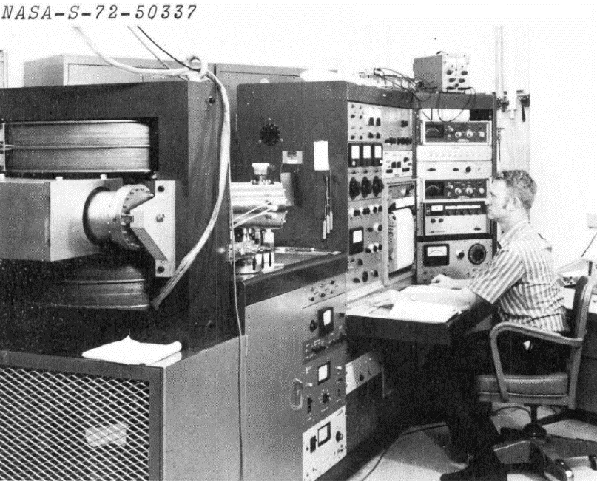
Apollo Lunar Receiving Lab
Thermal Analyzer/Mass Spec.
Single-Crystal X-Ray Diffractometer
Ion Microprobe Mass Analyzer
B31
Electron Microprobe
Mass Spectrometer
Scanning Electron Microprobe
B37
1967 Site Aerial Photo
This document has been reviewed and determined not to contain export-controlled data

Slide 19
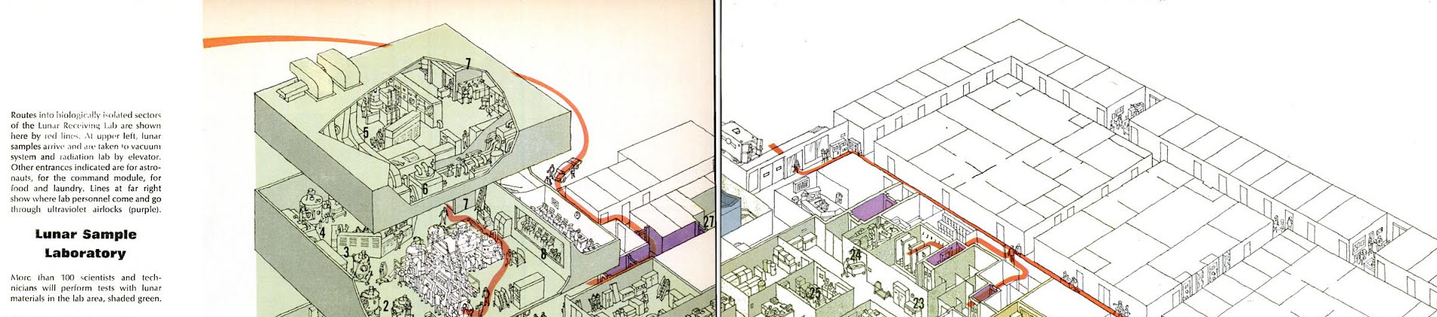
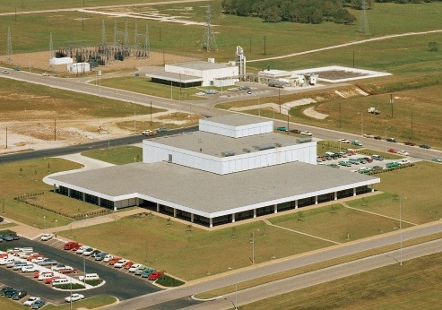
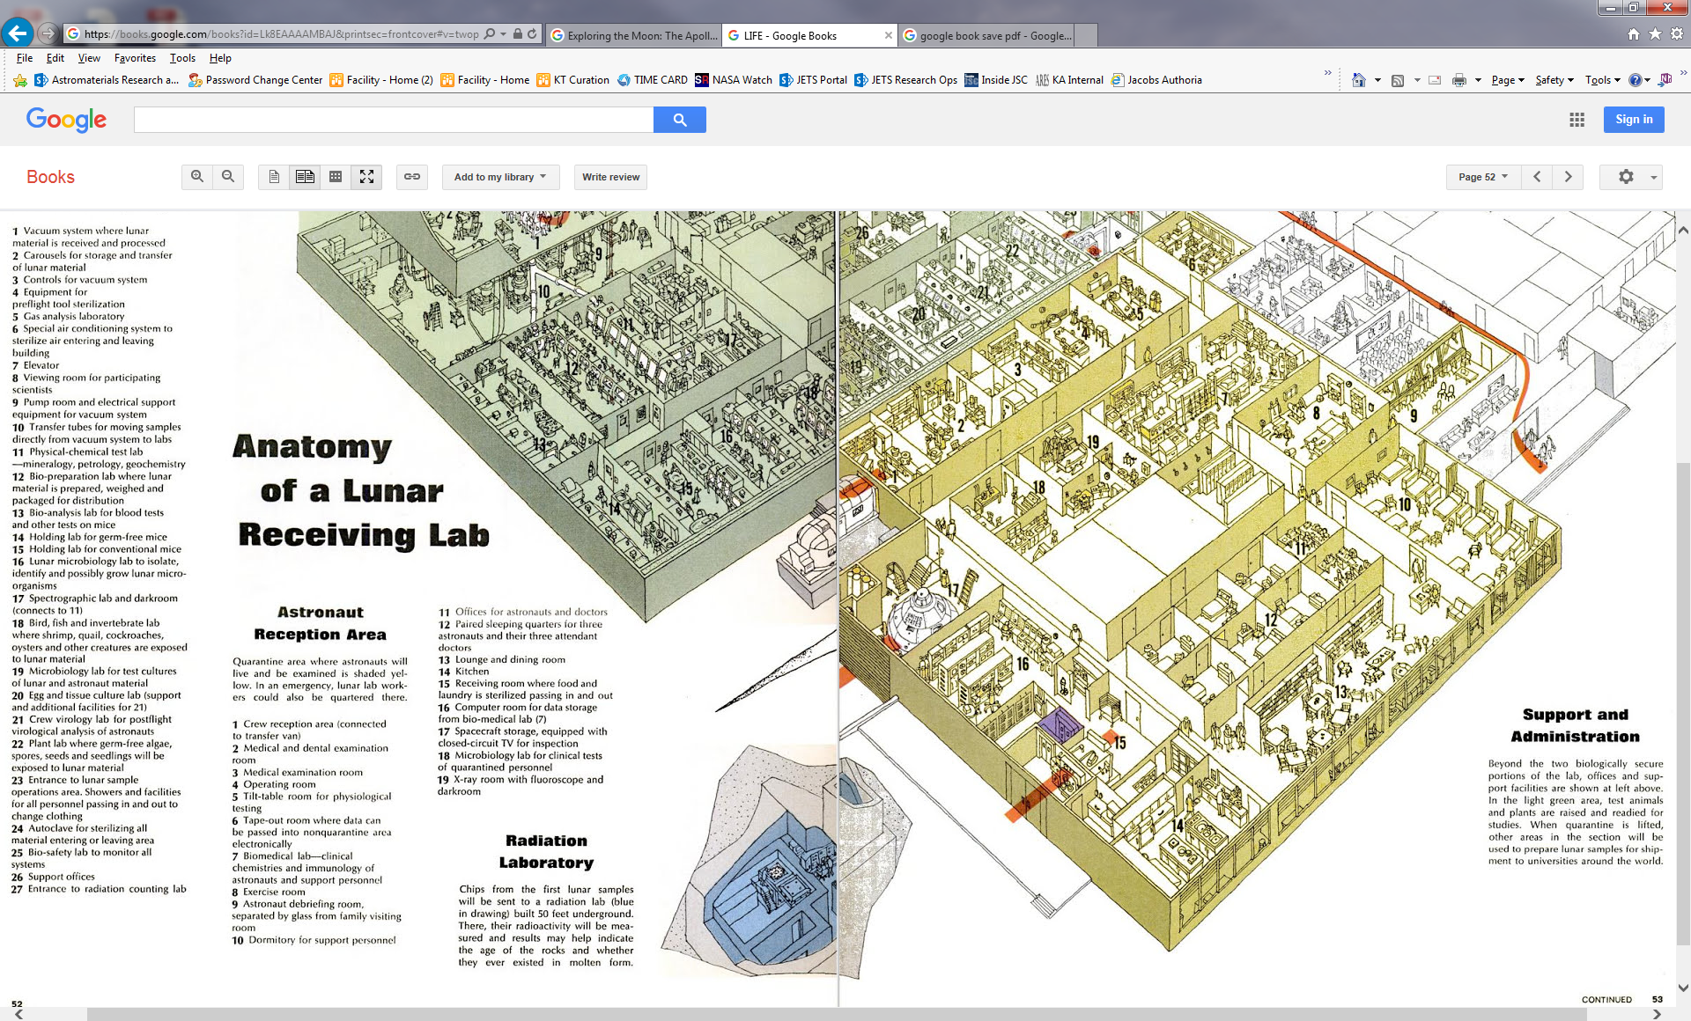
Life Magazine
July 4, 1969
This document has been reviewed and determined not to contain export-controlled data

Slide 20
NASA Astromaterials Acquisition & Curation Office
The Astromaterials Acquisition and Curation Office at NASA Johnson Space Center (JSC) is charged with “the curation of all extraterrestrial materials under NASA control, including future NASA missions” as per NASA Policy Directive (NPD) 7100.10F + derivative NPR “Curation of Extraterrestrial Materials.”
  The MSR Collection will be the first to be jointly managed by NASA and ESA.
The Directive goes on to define Curation as including “…documentation, preservation, preparation, and distribution of samples for research, education, and public outreach.”
  As a part of documentation and preservation, the Curation Office also coordinates sample capture, containment, and transportation to the curation facility.
A major part of the Curation Office’s charge is to integrate requirements, develop implementation strategies, and deliver a facility capable of meeting Mission goals while satisfying requirements levied by the Project, Planetary Protection, the Agency, and Regulatory Authorities.
  The Curation Office does NOT generate Planetary Protection requirements.
This document has been reviewed and determined not to contain export-controlled data

Slide 21
Curation of Astromaterials is More than Storage
Curation begins with the initial planning and design of the sample return mission, and is carried through every aspect of the mission due to:
  Heritage Knowledge – By carrying over information from past missions, lessons learned can be put in place to try to ensure a more successful mission. Two prime examples:
    Material Compatibility with Contamination Control Requirements
    Proper budgeting (time and financial) for manufacturing of scientific blanks
  Sufficient Contingencies and Contamination Knowledge (CK) Samples – This is the only way to ensure that the science return on samples, particularly if something unexpected happens.
  Enable Objective-Driven & Opportunity Science – Characterize and allocate samples to accomplish Project science goals and early science.
  Enable Future Science – Conserve a representative quantity of pristine samples for future generations of scientists with innovative ideas and more advanced analytical equipment.
Proper curation maximizes science return on the samples by ensuring both short and long-term science objectives are achieved.

Slide 22
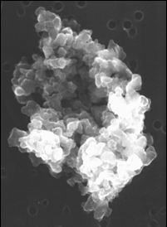
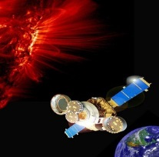

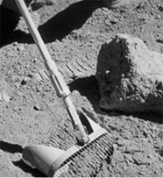
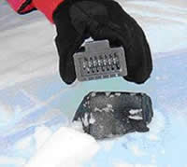
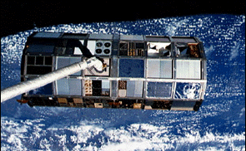
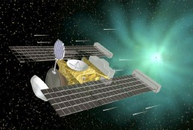
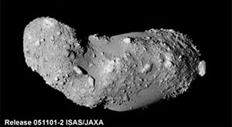
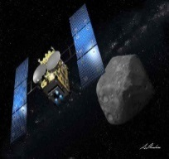

JSC’s Astromaterials Acquisition & Curation Office
Lunar
(1969)
Apollo program lunar rocks and soils; Luna samples
Meteorite
(1977)
Antarctic Search for Meteorites (ANSMET) program
Cosmic Dust
(1981)
Cosmic dust grains from Earth’s stratosphere from high altitude aircraft
Microparticle Impact Col.
(1985)
Space exposed hardware from spacecraft
Genesis
(2004)
Genesis solar wind samples at Earth-Sun L1 point
Stardust
(2006)
Cometary and interstellar samples from Comet Wild 2
Hayabusa
(2012)
Samples collected from JAXA asteroid mission to Itokawa
Hayabusa II
(2020)
Subset of samples collected from JAXA asteroid mission to (162173) 1999 JU₃
OSIRIS-REx
(2023)
Asteroid sample return from 101955 Bennu
Our Near Future . . .
Our More Distant Future . . .
Artemis
(~2026)
Lunar polar region;
Lunar rocks, soils, and volatiles
Moon
(2020s)
Non-volatile-rich farside/polar sample return
Next New Frontiers Call
Comet
(2020s)
Cold curated (?) surface sample return from a comet
Next New Frontiers Call
Phobos
(late 2020s)
10% of a JAXA mission to bring back Phobos material
JAXA sample return mission
MMX
Mars
(~2030+)
Various Mars Sample Return
Over 50 years in the planning (est. 1964)
Authority from NPD 7100.10F + derivative NPR
This document has been reviewed and determined not to contain export-controlled data

Slide 23
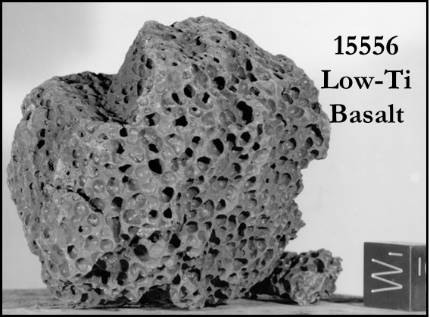
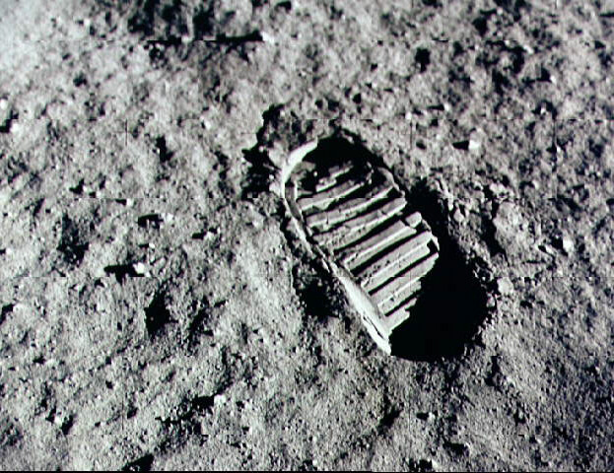
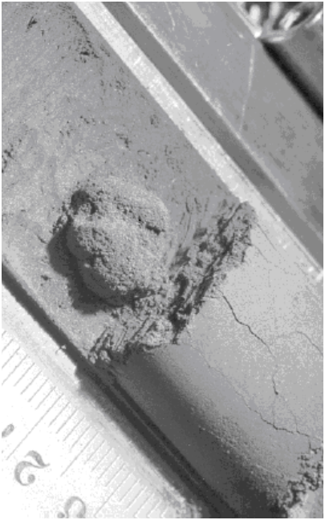
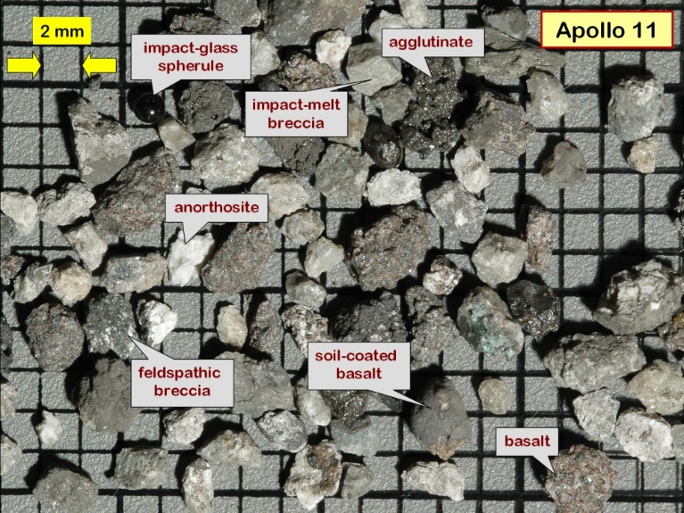
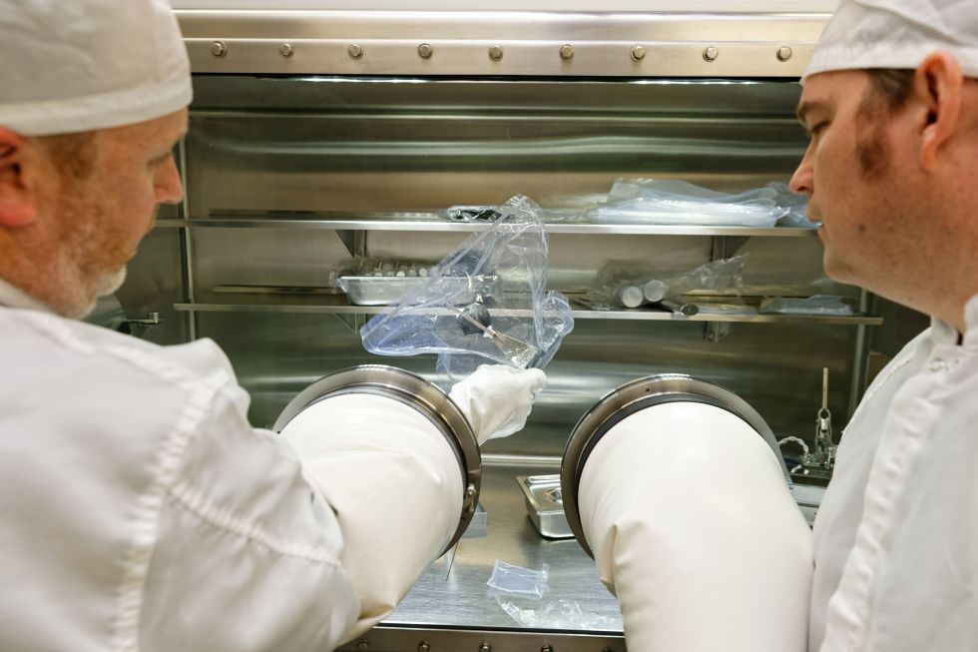
APOLLO SAMPLE COLLECTION (1969-1972)
The Apollo missions collected 382 kg (2200 samples) of rock, soil, and cores from 6 geologically diverse locations on the Moon
Only sample suite collected by astronauts, and the only suite collected with geologic context.
Lunar lab complex is our largest suite of clean rooms and ancillary labs (ISO 6-7)
  Clean room, storage and working areas designed to minimize contamination from the environment and other samples
This document has been reviewed and determined not to contain export-controlled data

Slide 24
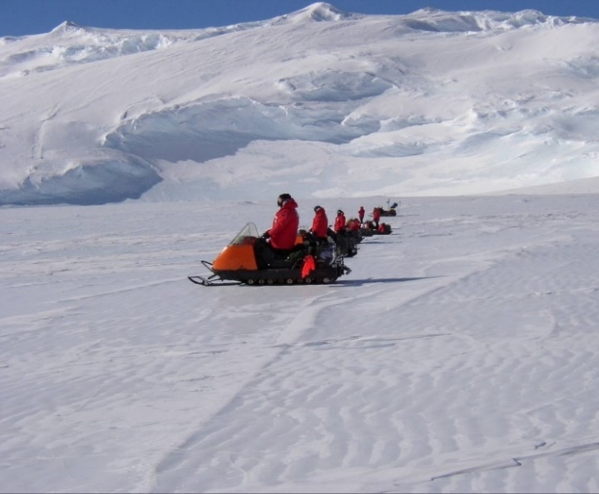
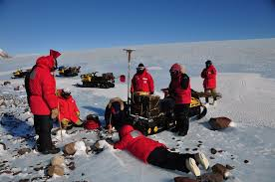
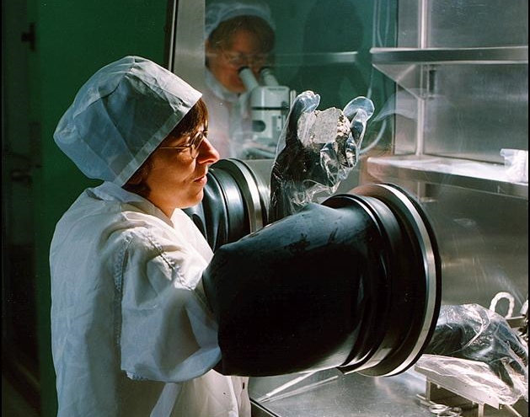
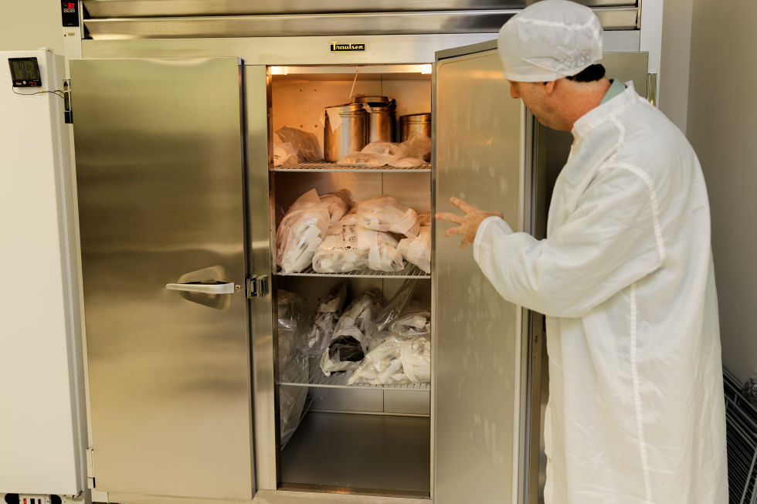
ANTARCTIC METEORITE COLLECTION (1977 - Present)
For 40 years, teams of scientists have collected meteorites in the Trans-Antarctic Mountains
Collection locations are blue ice fields where meteorites entrained in glaciers have been exposed by sublimation.
Samples found by systematic searches of open ice fields and moraines.
Meteorite lab complex is similar to the lunar labs (ISO 7), but only “special” meteorites are worked on in cabinets, others are processed in air.
This document has been reviewed and determined not to contain export-controlled data

Slide 25
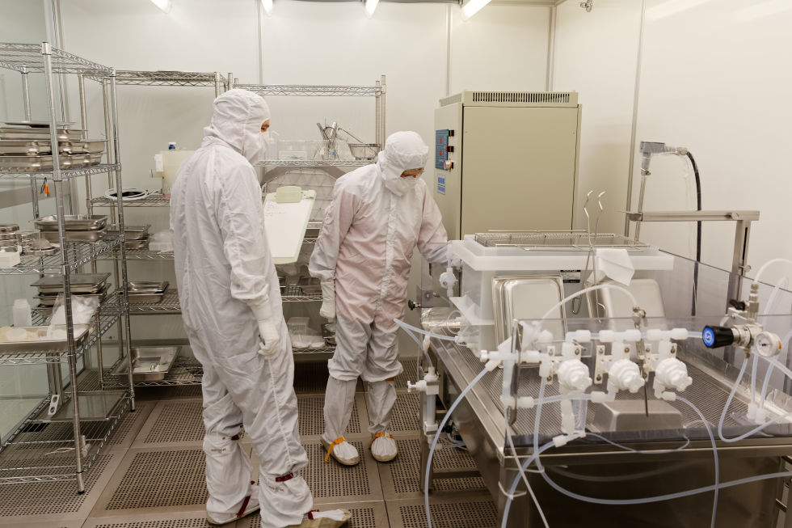



GENESIS SOLAR WIND SAMPLES (2004)
NASA mission that collected solar wind at Earth-Sun L1 location for 28 months.
Multiple detector arrays to sample different solar wind regimes
Had an “off nominal” landing
Highlighted the importance of planning for worst case scenarios.
Assembled and curated in JSC curation’s best clean room (ISO 4), a vertical laminar flow modular cleanroom (a retrofit lunar lab).
Cleaning techniques developed
Ultimately most of the science results were achieved
This document has been reviewed and determined not to contain export-controlled data

Slide 26



Genesis ISO 4 Laboratory
NASA’s Cleanest Room
Constructed 1999

Slide 27



Stardust Comet + Interstellar Grains (2006)
NASA mission that collected particles from the coma of comet Wild 2; interstellar particles were collected during the cruise phase of the mission.
Estimated that many 1000s of comet particles were collected; 100s of interstellar particles
Particles were captured by impacts into aerogel.
Stored in a dedicated ISO class 5 clean room.
New sample handling techniques developed to extract the tracks.
This document has been reviewed and determined not to contain export-controlled data

Slide 28




OSIRIS-REx Sample Collection (2023)
An asteroid-study and sample return mission that visited and collected samples from 101955 Bennu, a carbonaceous near-Earth asteroid.
Samples were collected in a Touch and Go Sample Acquisition Mechanism (TAGSAM) and returned to Earth on September 24, 2023
Stored in a dedicated ISO class 5 low organic clean room.
New tools and hardware were designed and developed by a multidisciplinary curation team to successful disassemble and safely store the previous sample.
This document has been reviewed and determined not to contain export-controlled data

Slide 29






Mars Sample Return CK Collection (Genetic & CC Data)
  Biological CK
    Swabs
    Wipes
  Flight Vacuum Bake-Out Witness Plates
  Flight Replicates
    Sample Tubes
    Drill Bit
    Coring Bit
    Abrading Bit
    Drillable Blank
  Environmental Witness Plates & Foils
    SIH Flow Benches
    Assembly Rooms
    Organic
    Inorganic
  SIH Witness Items
    Gloves
    Wipes
  Flight Replicates
    SHERLOC Cal Target
    7 Sample Tube Assemblies
    7 Glove Assemblies
    7 Sample Tube Storage
    Volume Station Assembly
    Seal Dispenser Assembly
    7 Hermetic Seal Assemblies
    2 Cover Assemblies
    2 Witness Tube Assemblies
  Material Samples
  Final Solvent Rinses
    Hexane
    Isopropanol
    Acetone
    Ethanol
    DI Water
This document has been reviewed and determined not to contain export-controlled data

Slide 30

MSR CAMPAIGN CK COLLECTION PLANNING
New CK Laboratory Suite in upcoming B31 Annex
  ISO 7 Storage Room with ISO 5 Stainless Steel Flow Bench
  ISO 6 Ultra-Clean Storage Room with Custom Designed Low-Organic Outgassing Desiccators/Isolators
  ISO 5 Ultra-Clean/Low-Organic Outgassing Processing Room with Additional Glovebox
  ISO 6 Biological Storage with a BSCII Cabinet for Processing Allocations
Developing the database for the CK Collection catalogue
  Includes cross-referencing and cataloguing ~1TB of data provided by the project (pertinent sample data tracking flight items from manufacturing to cleaning to installation)
This document has been reviewed and determined not to contain export-controlled data
30

Slide 31

Physical Security of the Samples
Building is designed to protect the samples from natural and unnatural disasters
This document has been reviewed and determined not to contain export-controlled data

Slide 32




Remote Storage Facility
Store a subset of the collection at a remote location
Static nitrogen storage
Requires bi-annual maintenance visits.
This document has been reviewed and determined not to contain export-controlled data

Slide 33



Analytical Capabilities
There are several different categories here:
In lab curation techniques – optical microscopy, FTIR
In Curation techniques (separate labs, but curation controlled) – Raman, XCT, XRF
We are co-located with the JSC astromaterials research group, giving us access to advanced instrumentation
SEM, EPMA, SIMS, TEM, TIMS, ICPMS, FIB, FTIR, XRD
Used in both sample characterization and contamination knowledge/control
This document has been reviewed and determined not to contain export-controlled data

Slide 34







Subdivision of Samples
Macro Cutting Techniques:
Chipping (hammer and chisel or rock splitter)
Wire Saw (>200’ spool of diamond (or other) impregnated wire)
Band or disc Saws
Laser Cutting: Wafer Dicer
Micro Cutting
Ultramicrotome
Focused Ion Beam (FIB)
Minimize Sample Alteration Examples
Saw blade heating and particulate shedding
Wire Saw impregnated diamond or other shedding materials, but low heat
Laser cutting: melts sample, heat transfer, and outgassing
This document has been reviewed and determined not to contain export-controlled data

Slide 35




Sample Storage and Processing
Curation employs a variety of sample storage and processing options of positive pressure isolators, gloveboxes and desiccators
Currently sample are stored and processed in an inert gas that is plumbed to each of the collection labs from the curation house high purity Nitrogen system.
TSI Water-Tight Isolators
Terra Universal Desiccators
Advanced Curation Glovebox
Lunar Storage Gloveboxes
Lunar Processing Glovebox
This document has been reviewed and determined not to contain export-controlled data

Slide 36

Curation Cleanroom Testing
Curation performs periodic testing and verification of the inorganics, organics and air quality of the cleanrooms to ensure the cleanrooms remain within required specifications.
Inorganic Witness Plates
  8-inch ultrapure polished semiconductor silicon wafer
  24 hours exposure time (vertical in cleanroom air)
  Vapor Phase Decomposition Inductively Coupled Plasma Mass Spectrometry (VPD ICP-MS) analysis; currently outsource to Balazs™ NanoAnalysis
  35 elements with reporting limits ranging from 10⁸ to 10¹⁰ atoms/cm²
Organic Witness Plates
  Two 8-inch ultrapure polished semiconductor silicon wafer
  24 hours exposure time (vertical in cleanroom air)
  Thermal Desorption Gas chromatography mass spectrometry (TD-GC-MS) at Balazs™ NanoAnalysis
  Reporting limit of 0.1 ng/cm2
  Predominately measures organic compounds from C6 to C28
This document has been reviewed and determined not to contain export-controlled data

Slide 37

Curation Cleanroom Testing
Curation performs periodic testing and verification of the inorganics, organics and air quality of the cleanrooms to ensure the cleanrooms remain within required specifications.
Airborne Volatile Organics
  Proprietary Balazs Adsorbent Tube connected to a pump at 100 mL/min.
  6 hours expsoure (cleanroom air)
  Thermal Desorption Gas chromatography mass spectrometry (TD-GC-MS) at Balazs™ NanoAnalysis
  Reporting limit of 0.1 ng/L
  Better measurement of hydrocarbon load and volatile organic compounds
This document has been reviewed and determined not to contain export-controlled data

Slide 38
Curation Precision Cleaning of Gloveboxes, Tools, and Containers
Preclean: Gross Cleaning and Metal Degreasing
  Isopropanol Alcohol (IPA) wipes (70% IPA / 30% DI water)
  Degreasing: Brulin 815 GD diluted with UPW and/or 3M HFE 7100-DL (or other high purity filtered chemicals similar to Freon 113)
  Ultrasonic Baths and Rinsing: Ultrapure Water (1967 to 1994: Used Freon 113)
Final Clean: Precision Cleaning
  Surfactant: Oakite Liqui-Det or Brulin 815 GD diluted with UPW and ultrasonic bath
  Pressurized Spray 100% IPA (pressurized to 80 PSI with house GN2)
  Heated (70°C) UPW ultrasonic bath
  Final Rinsing: Ultrapure Water (1967 to 1994: Used Freon 113 as final cleaning agent)
  Particulate Level Verification by collecting UPW rinse water and using a liquid particle counter or use of a filter under an optical microscope
  Total Organic Carbon (TOC) level using UPW rinse water in a GE/SUEZ M9 Sievers TOC analyzer
This document has been reviewed and determined not to contain export-controlled data

Slide 39
Cleanroom Consideration Summary
Astromaterials Cleanroom are ultraclean and more similar to semiconductor cleanrooms than pharmaceutical cleanrooms
Construction Materials (building, cleanroom, gloveboxes, containers, etc.) are restricted based on preservation of the geologic sample collection
Restricted Materials Lists and fewer amounts of different materials leads to easier tracing of contaminates
Humans and some equipment are the most contaminating to our sample collection; enough space is required to not disturb airflows to clear away contaminating particulates.
Genesis mission had low organic requirements and it was very difficult to meet. Contamination control for Mars Sample Return will be difficult due to low organic requirements; unique and novel designs will be required to meets the mission goals.
This document has been reviewed and determined not to contain export-controlled data

Slide 40
Cleanroom Consideration Summary
Large equipment may need to be cleaned in-place and enough space needs to be designed to accommodate precision cleaning and validation methods.
Material testing and selection must begin before commencing the design phase and continue through the construction submittal process when new materials require further selection, scrutiny, and testing.
Custom FFUs are attributed to the significantly reduced organic results along with careful selection of cleanroom HVAC system components, flooring, walls, and paints.
As seen in Genesis organic data, we anticipate even lower organic results in 2 years as newly installed materials continue to outgas
This document has been reviewed and determined not to contain export-controlled data

Slide 41
Curation Capabilities Summary
Curation is an ever-expanding enterprise and with each new sample return mission, new tools, skills, and technology must be developed to successfully curate samples for the science community.
Variety of different clean rooms (ISO 4-7), different sample storage and working conditions
  Ultimately, the sample needs drive the lab capabilities, but cost, space, and time plays a factor
  Colocation allows shared infrastructure and personnel
Huge variety of sample types:
  Large rocks, small rocks, bulk regolith, core samples, individual mm-particles, embedded mm-particles, solar wind atoms, and spacecraft parts.
Requires a diversity of sample handling capabilities:
  Processing in cabinets, processing on flow benches, band saws, wire saws, thin sections, micro-manipulation, microtome, FIB sectioning, keystoning (aerogel), etc.
This document has been reviewed and determined not to contain export-controlled data

Slide 42

Research & Development in Support of SRF Design & Ops
Double Walled Isolator (DWI) Design – Modified BSCIII
Sample handling - Robotic and/or Remote Manipulation
Sample Tube and Subsample Isolation Containers for Analyses Outside SRF
High-Containment suit and infrastructural material contamination control testing
Quantify contamination loads of existing BSL-4 facilities
Instrument accommodations
Sample sterilization
Infrastructural cleaning and sterilization procedures
Rendering of the ESA Double-Walled Isolator, TJ Archi.
Close collaboration between NASA/ESA’s Curation, Science, and PP Teams
This document has been reviewed and determined not to contain export-controlled data

Slide 43
Closing Highlights
Proper prioritization of the considerations will enable a highly capable, fully operational SRF by October 2033.
NASA and ESA are taking a “safety first” approach to designing and engineering every step of Sample Receiving Project (SRP).
  Complementary NASA/ESA SRF studies will inform site-specific design.
  Conducting R&D activities (e.g. DWI) to comply with Planetary Protection and Contamination Control objectives.
The nature of SRP planning requires effective communication across Agencies (national and international), Centers, the scientific community, and the general public.
This document has been reviewed and determined not to contain export-controlled data

