Slide 1


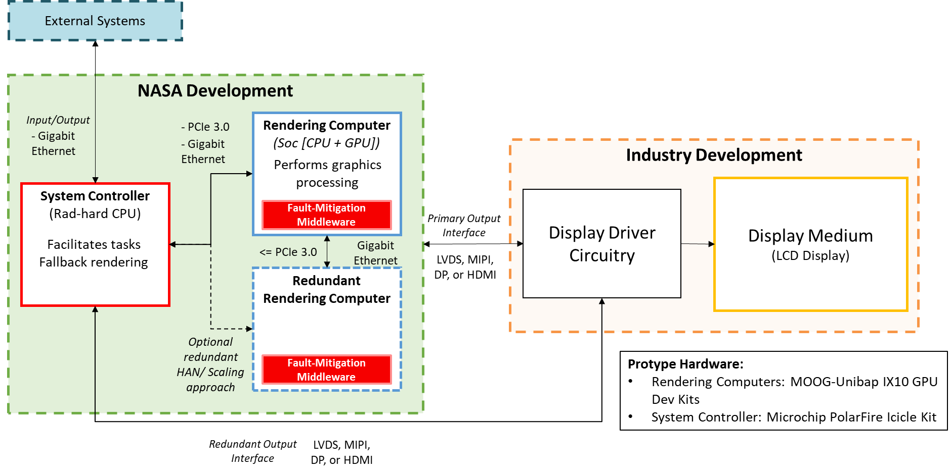
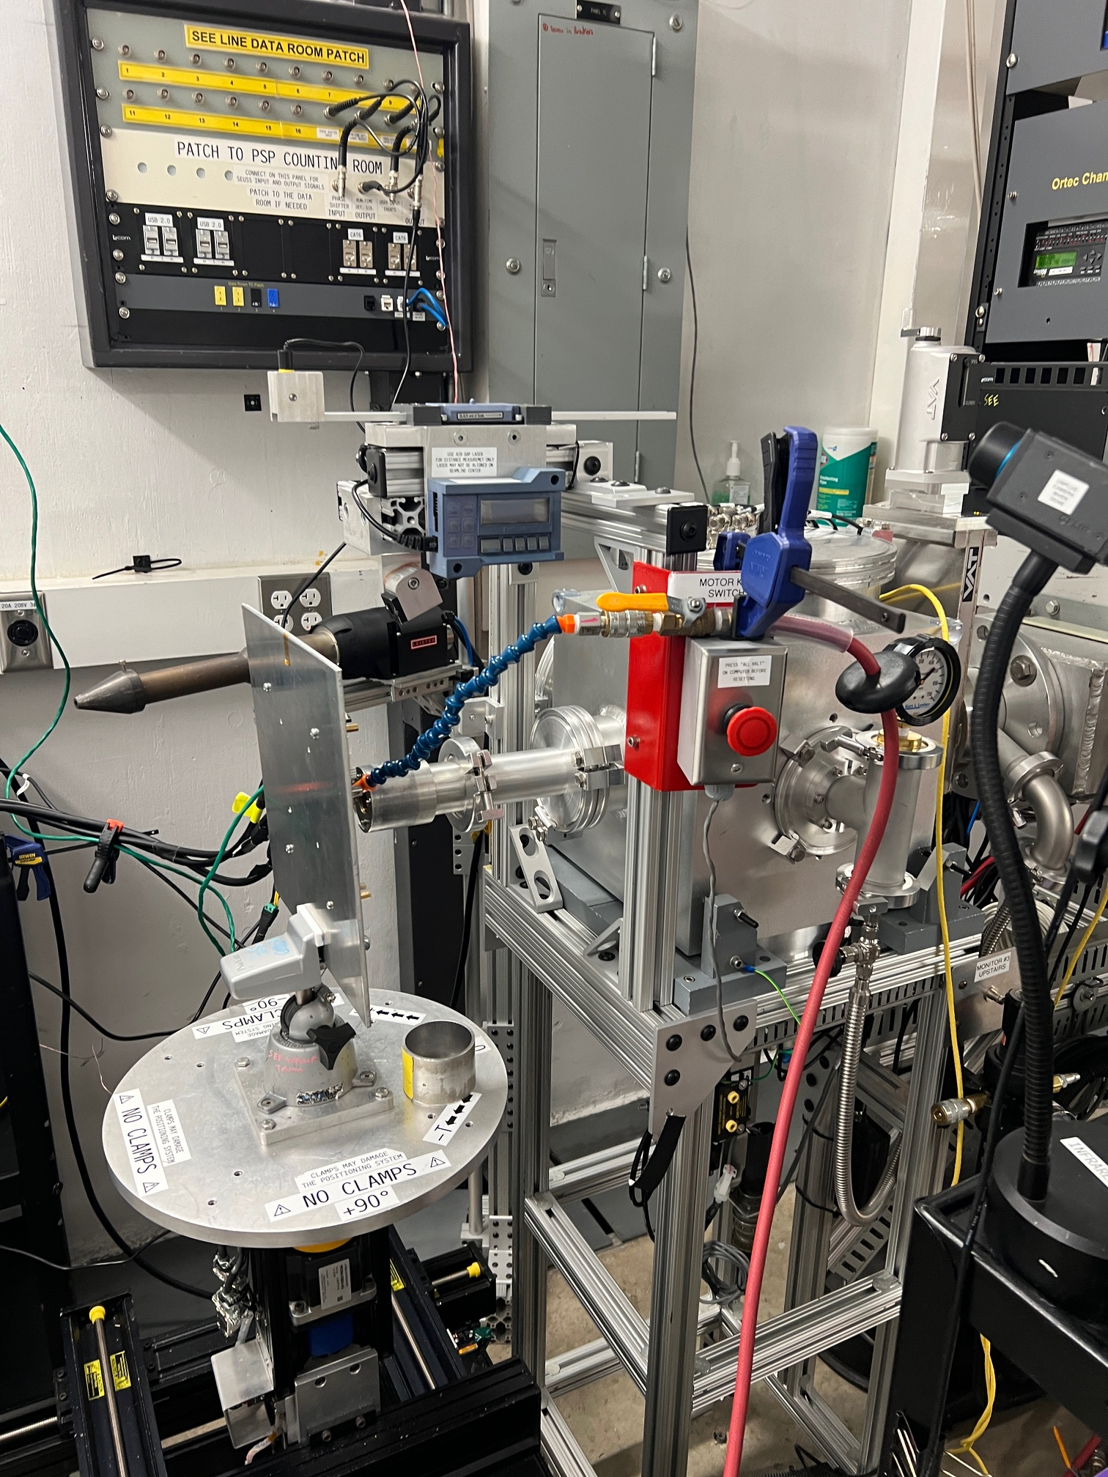


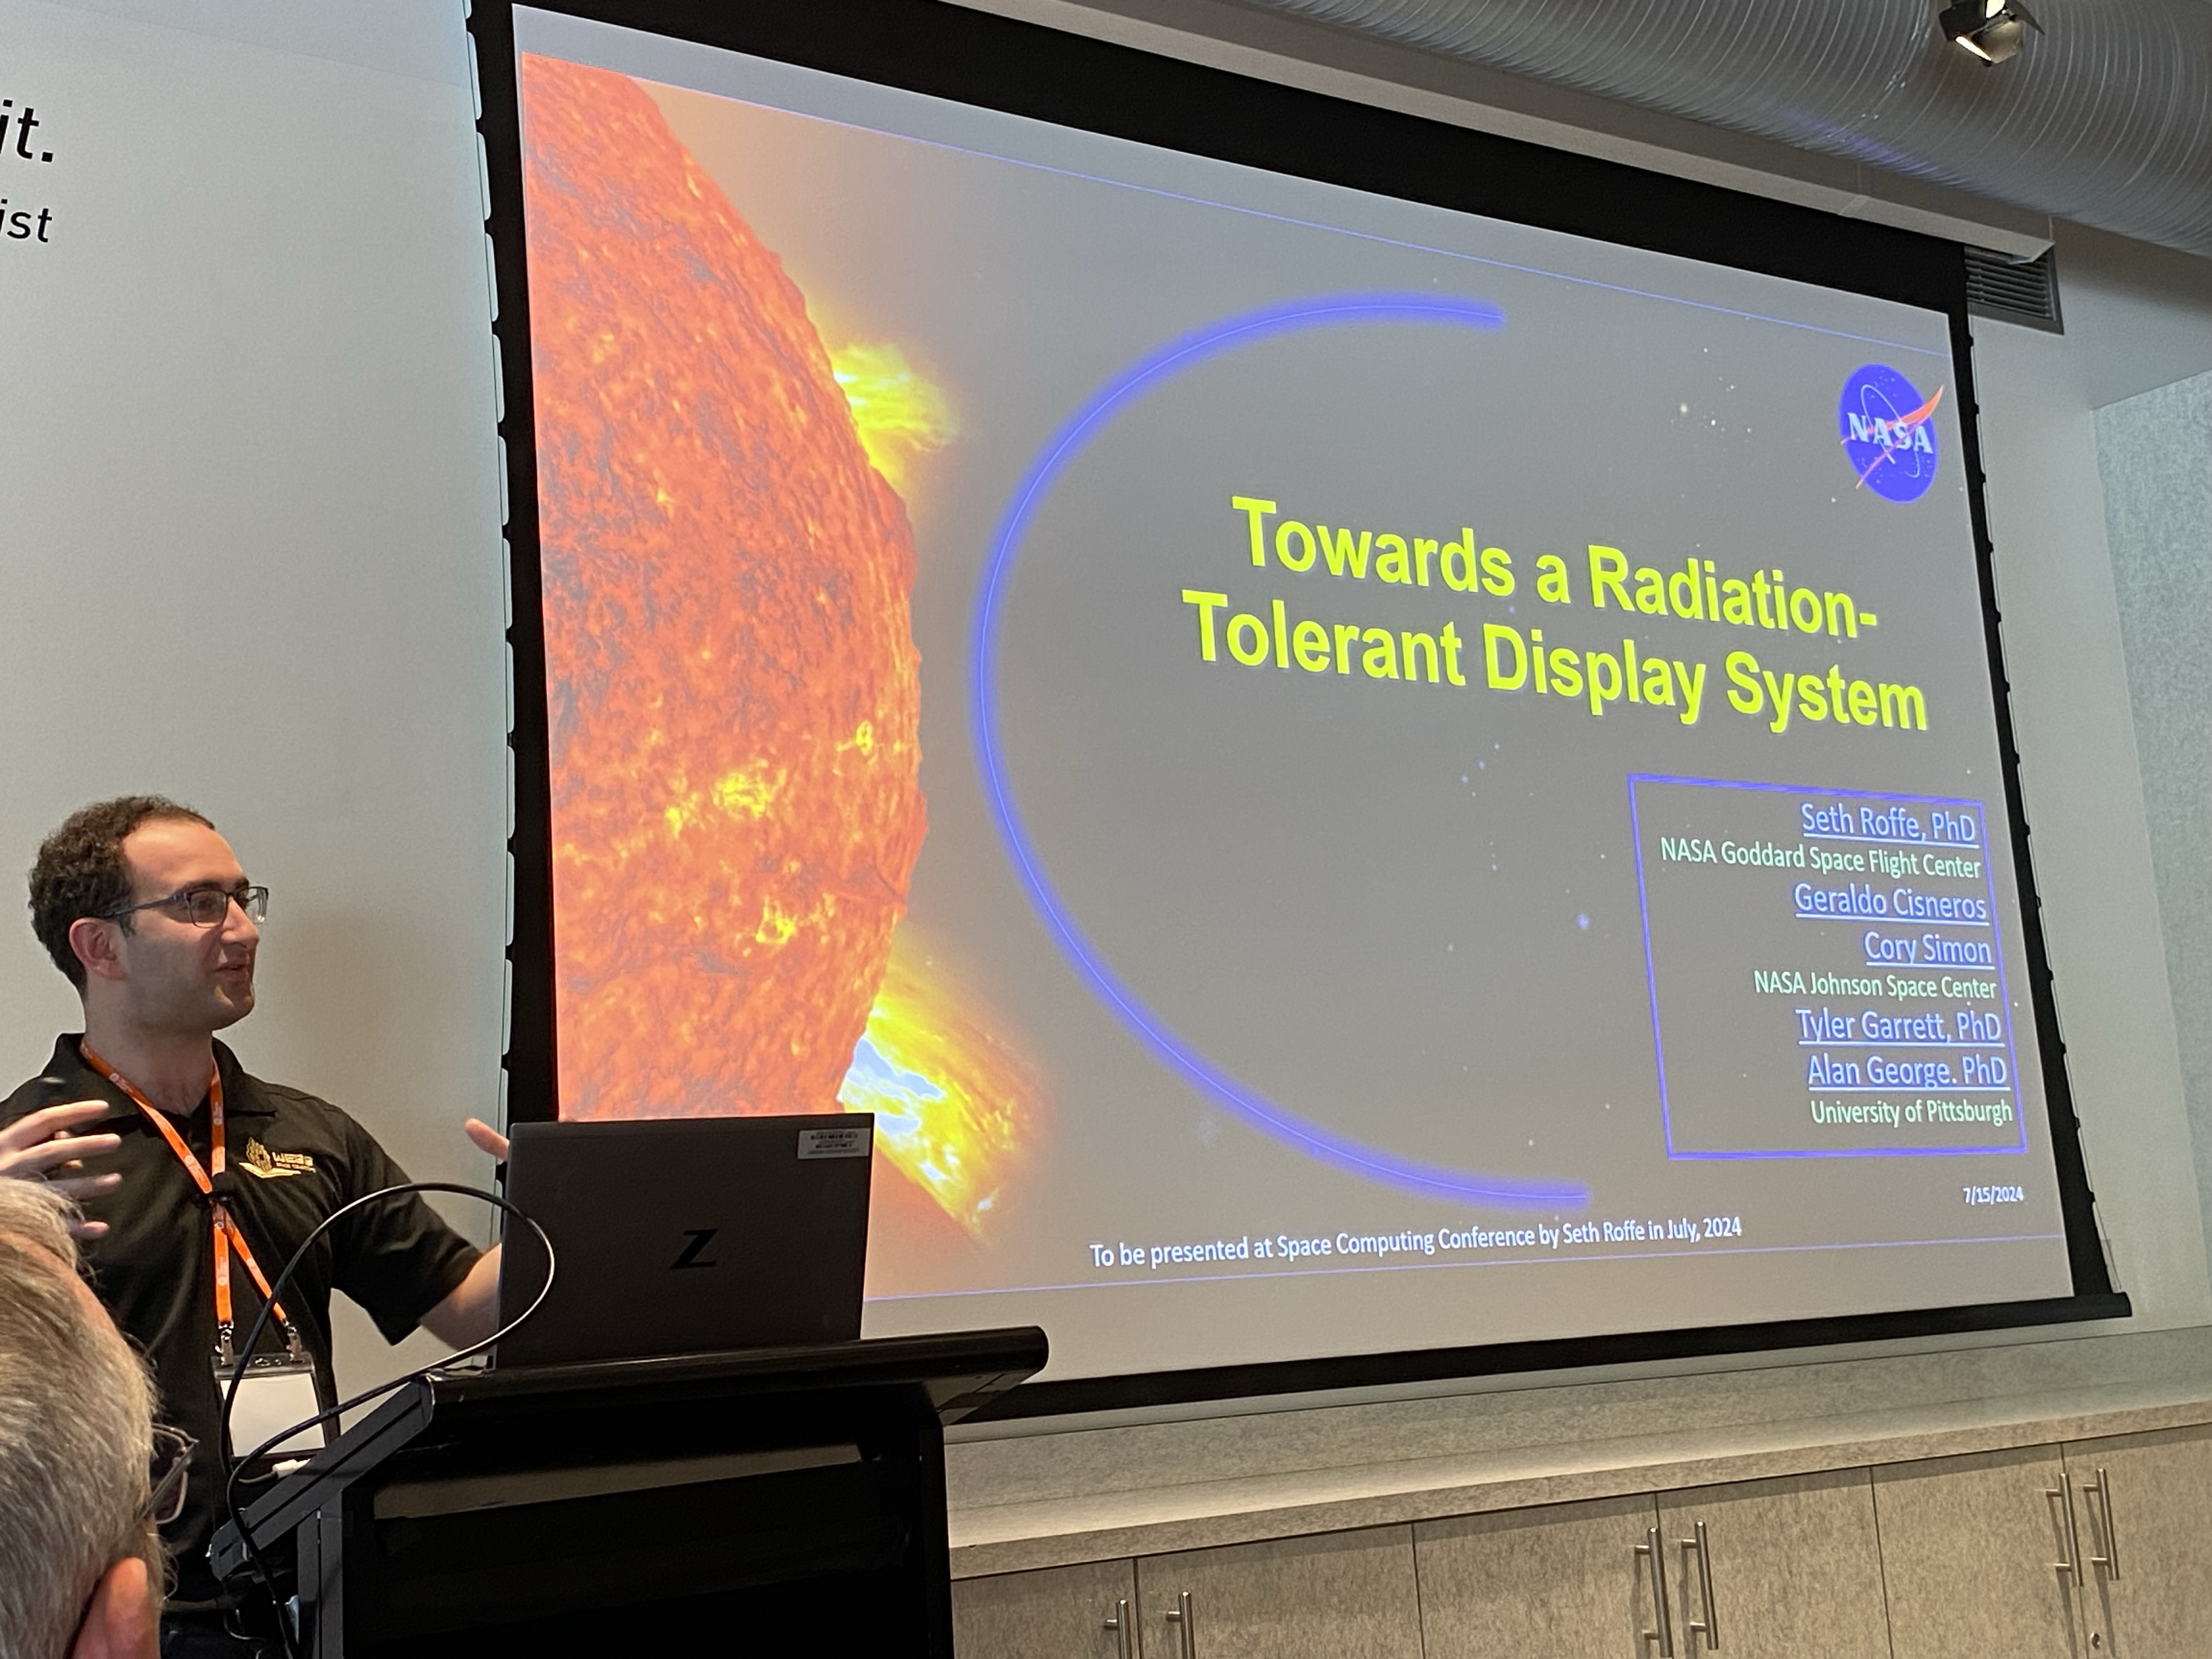


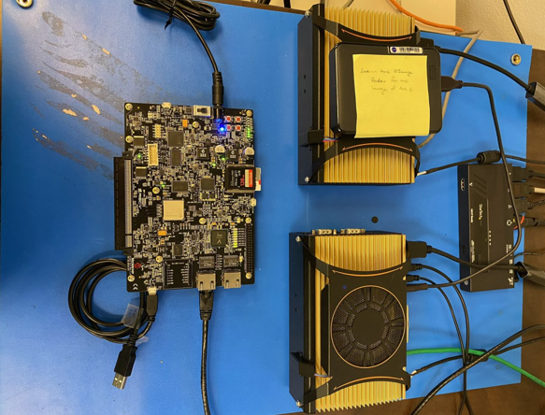
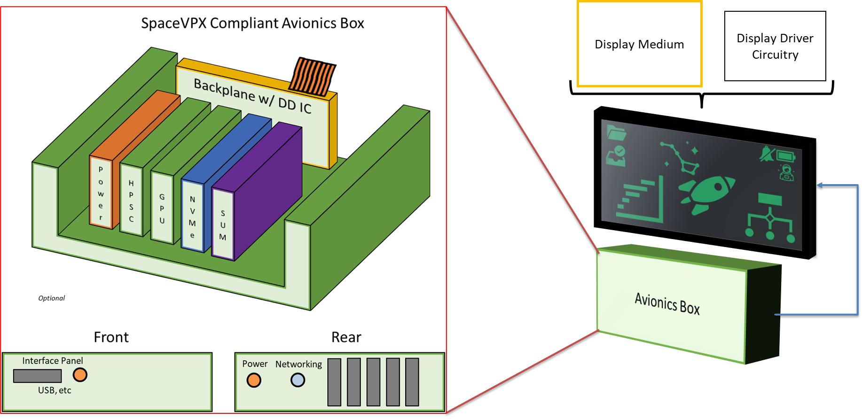
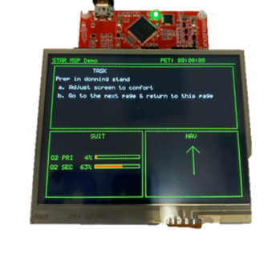
Radiation-Tolerant Displays
TBD
PM / PI Info EV3 | Geraldo Cisneros | geraldo.a.Cisneros@nasa.gov
EXECUTIVE SUMMARY
The Radiation Tolerant Displays project aims to develop a reference design for a display system that can withstand and mitigate the effects of radiation in deep space. Radiation Tolerant Displays seeks to deliver on this goal through a collaboration across industry and agency and by building upon the Mars Campaign Office’s (MCO) Project Polaris Radiation Tolerant Displays effort.
Innovation & BENEFITS
The display system architecture is being developed to support all deep-space missions from the Moon to Mars. Currently, no radiation-tolerant display system exists. This project will leverage advancements from NASA-funded and SBIR projects, to provide a system that will reliably deliver critical information and data to crew members exactly when they need it, enhancing both crew safety and operational efficiency. With a scalable, modular design and a combination of COTS and rad-hardened components, this system will be highly available, performant, and easy to maintain, reducing the need for resupply missions. This results in lower mission costs by minimizing resupply mass and, ultimately, a more sustainable approach for deep-space exploration.
Collaboration
NASA Goddard Spaceflight Center
Spectrum Displays
Arquimea
Troxel Aerospace (SBIR)
Radiation-Tolerant Display System Architecture Block Diagram
Outcomes & Infusion
Radiation-Tolerant Display benchtop prototype
Vendor developed radiation-tolerant display units
Radiation testing of vendor provided display units
Radiation Test results and reports
Cost-sharing provided by EHP, Gateway, and MCO
Presented at NASA Electronic Parts and Packaging (NEPP)
Presented at IEEE Space Computing Conference
Reference design for a Radiation-Tolerant Display System
NEXT STEPS
Continue maturing benchtop prototype with engineering and flight like models
Pursue cost-sharing and infusion
Partner with industry for the development of a radiation-tolerant display panel
Hold system capability demonstrations
Radiation-Tolerant Displays Benchtop Prototype (Processing Elements)
Radiation-Tolerant Display Configurations
DAA# | #############
NTR# | ############, ############

