Slide 1
Using Airborne Passive Microwave Observations for Cloud and Precipitation Science
Presenting author: Corey G. Amiot¹
Co-authors: Timothy J. Lang², Clay B. Blankenship², J. Brent Roberts², Rachael A. Kroodsma³, Benjamin T. Johnson⁴, Mircea Grecu³, and Ian S. Adams³
¹NASA Postdoctoral Program, NASA Marshall Space Flight Center
²NASA Marshall Space Flight Center
³NASA Goddard Space Flight Center
⁴UCAR Joint Center for Satellite Data Assimilation
NPP Symposium Presentation
November 2024

Slide 2
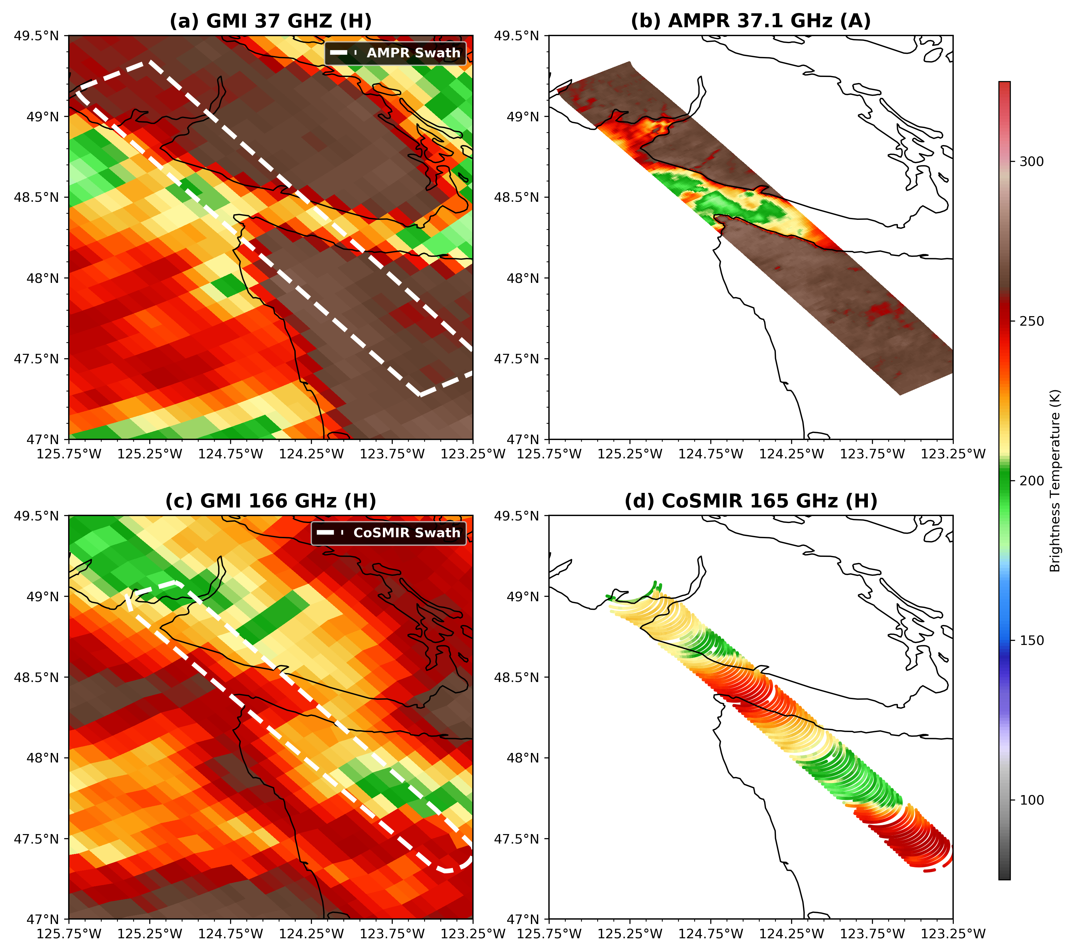
Purpose
Background & Radiometers
Radiometer Data Mergers & Testing
Applications & Ongoing Analyses
Clouds and precipitation affect global water cycle and energy budget (e.g., Reid et al. 2023)
Compared with spaceborne sensors, airborne sensors can provide finer-scale data and dedicated sampling
  Resolve finer-scale atmospheric features
  Some drawbacks, including limited horizontal and vertical coverage
Results from airborne campaigns may be applicable to spaceborne platforms
  E.g., frequency overlaps between airborne and spaceborne radiometers
Source: Lang et al. (2021)

Slide 3
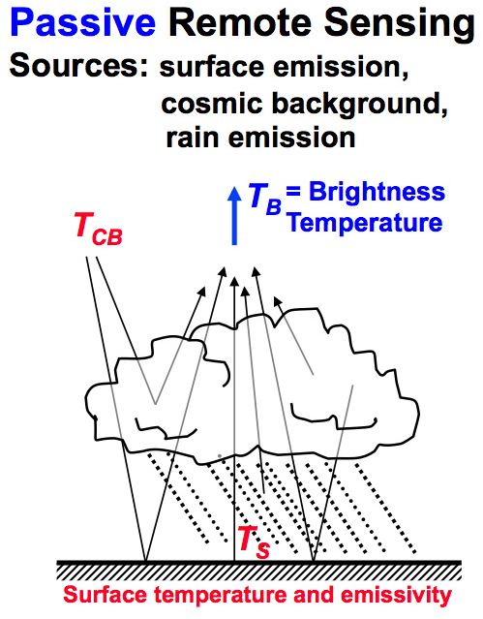
Passive Microwave Observations
Background & Radiometers
Radiometer Data Mergers & Testing
Applications & Ongoing Analyses
All surfaces with temperature > 0 K emit radiation; however, exact emission efficiency (emissivity) might not be known in advance
Assume surface is a perfect emitter of radiation (i.e., a blackbody); observations can be reported as a brightness temperature (T_{b}) value
Surfaces that have a lower emissivity will yield a lower T_{b} due to these assumptions, all else being equal
Includes reflected + scattered radiation
  Example of oceanic scene on right
Source: NASA GPM (2024)

Slide 4
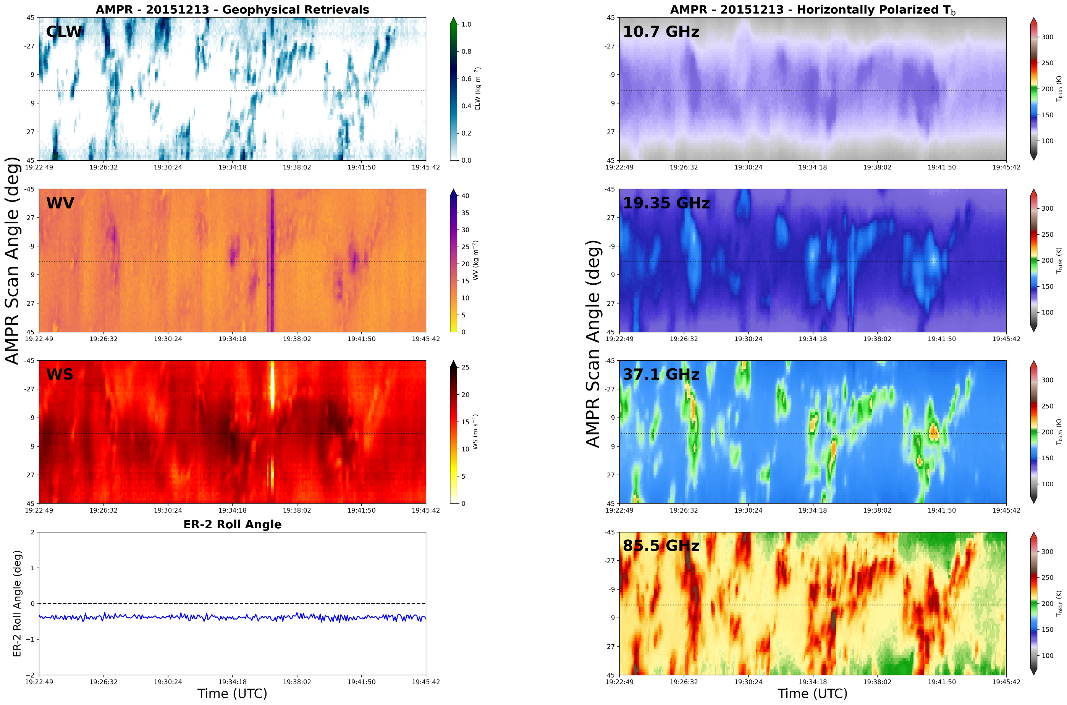
Passive Microwave Retrievals
Background & Radiometers
Radiometer Data Mergers & Testing
Applications & Ongoing Analyses
Integrated and near-surface atmospheric properties may be retrieved using brightness temperature (T_{b}) combinations from microwave frequencies (e.g., Wilheit and Chang 1980; Wentz and Spencer 1998; Wentz and Meissner 2007; Hong and Shin 2013)
Lower frequencies become attenuated less quickly
Higher frequencies increasingly sensitive to precipitation, clouds, and water vapor
Retrievals include: columnar cloud liquid water path (CLW), total precipitable water vapor (WV), and 10-m wind speed over water (WS) (e.g., Wentz and Meissner 2000, 2007; Biswas et al. 2017; Amiot et al. 2021)
Example of AMPR retrievals during OLYMPEX/RADEX

Slide 5
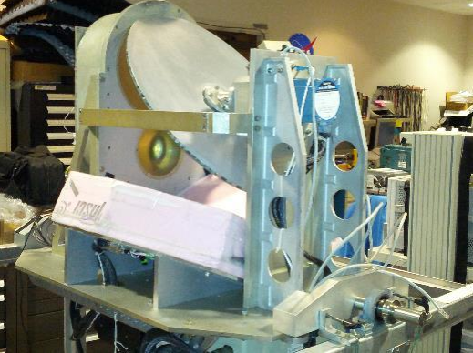
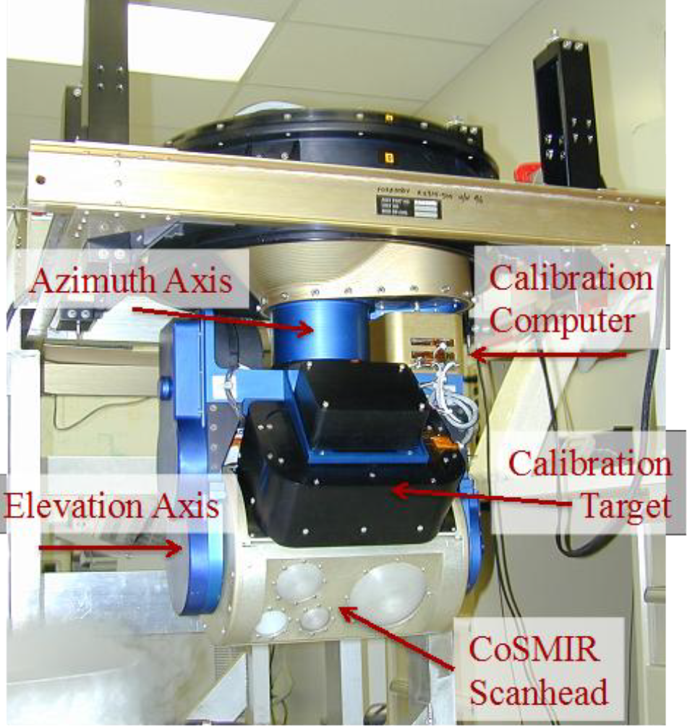
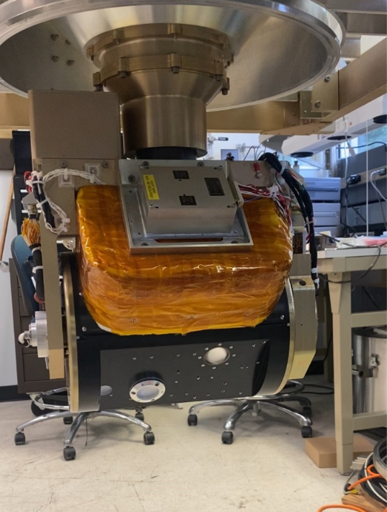
Overview of Radiometers
Background & Radiometers
Radiometer Data Mergers & Testing
Applications & Ongoing Analyses
Source: GHRC (2023)
Source: Kroodsma et al. (2023)
Source: NASA ASP (2024)
Advanced Microwave Precipitation Radiometer (AMPR), NASA MSFC
Covers 10.7–85.5 GHz
90° cross-track scans beneath aircraft
Retrieves: cloud water and ice contents, precipitation, atmospheric water vapor, and near-surface ocean winds
Conical Scanning Millimeter-wave Imaging Radiometer (CoSMIR), NASA GSFC
Covers 50.3–183.31 GHz
Conical and cross-track scans
Retrieves: info about clouds and precip, both liquid and ice
Compact Scanning Submillimeter-wave Imaging Radiometer (CoSSIR), GSFC
Covers 170.5–684.0 GHz
Conical and cross-track scans
Retrieves: info about clouds, especially sensitive to ice

Slide 6
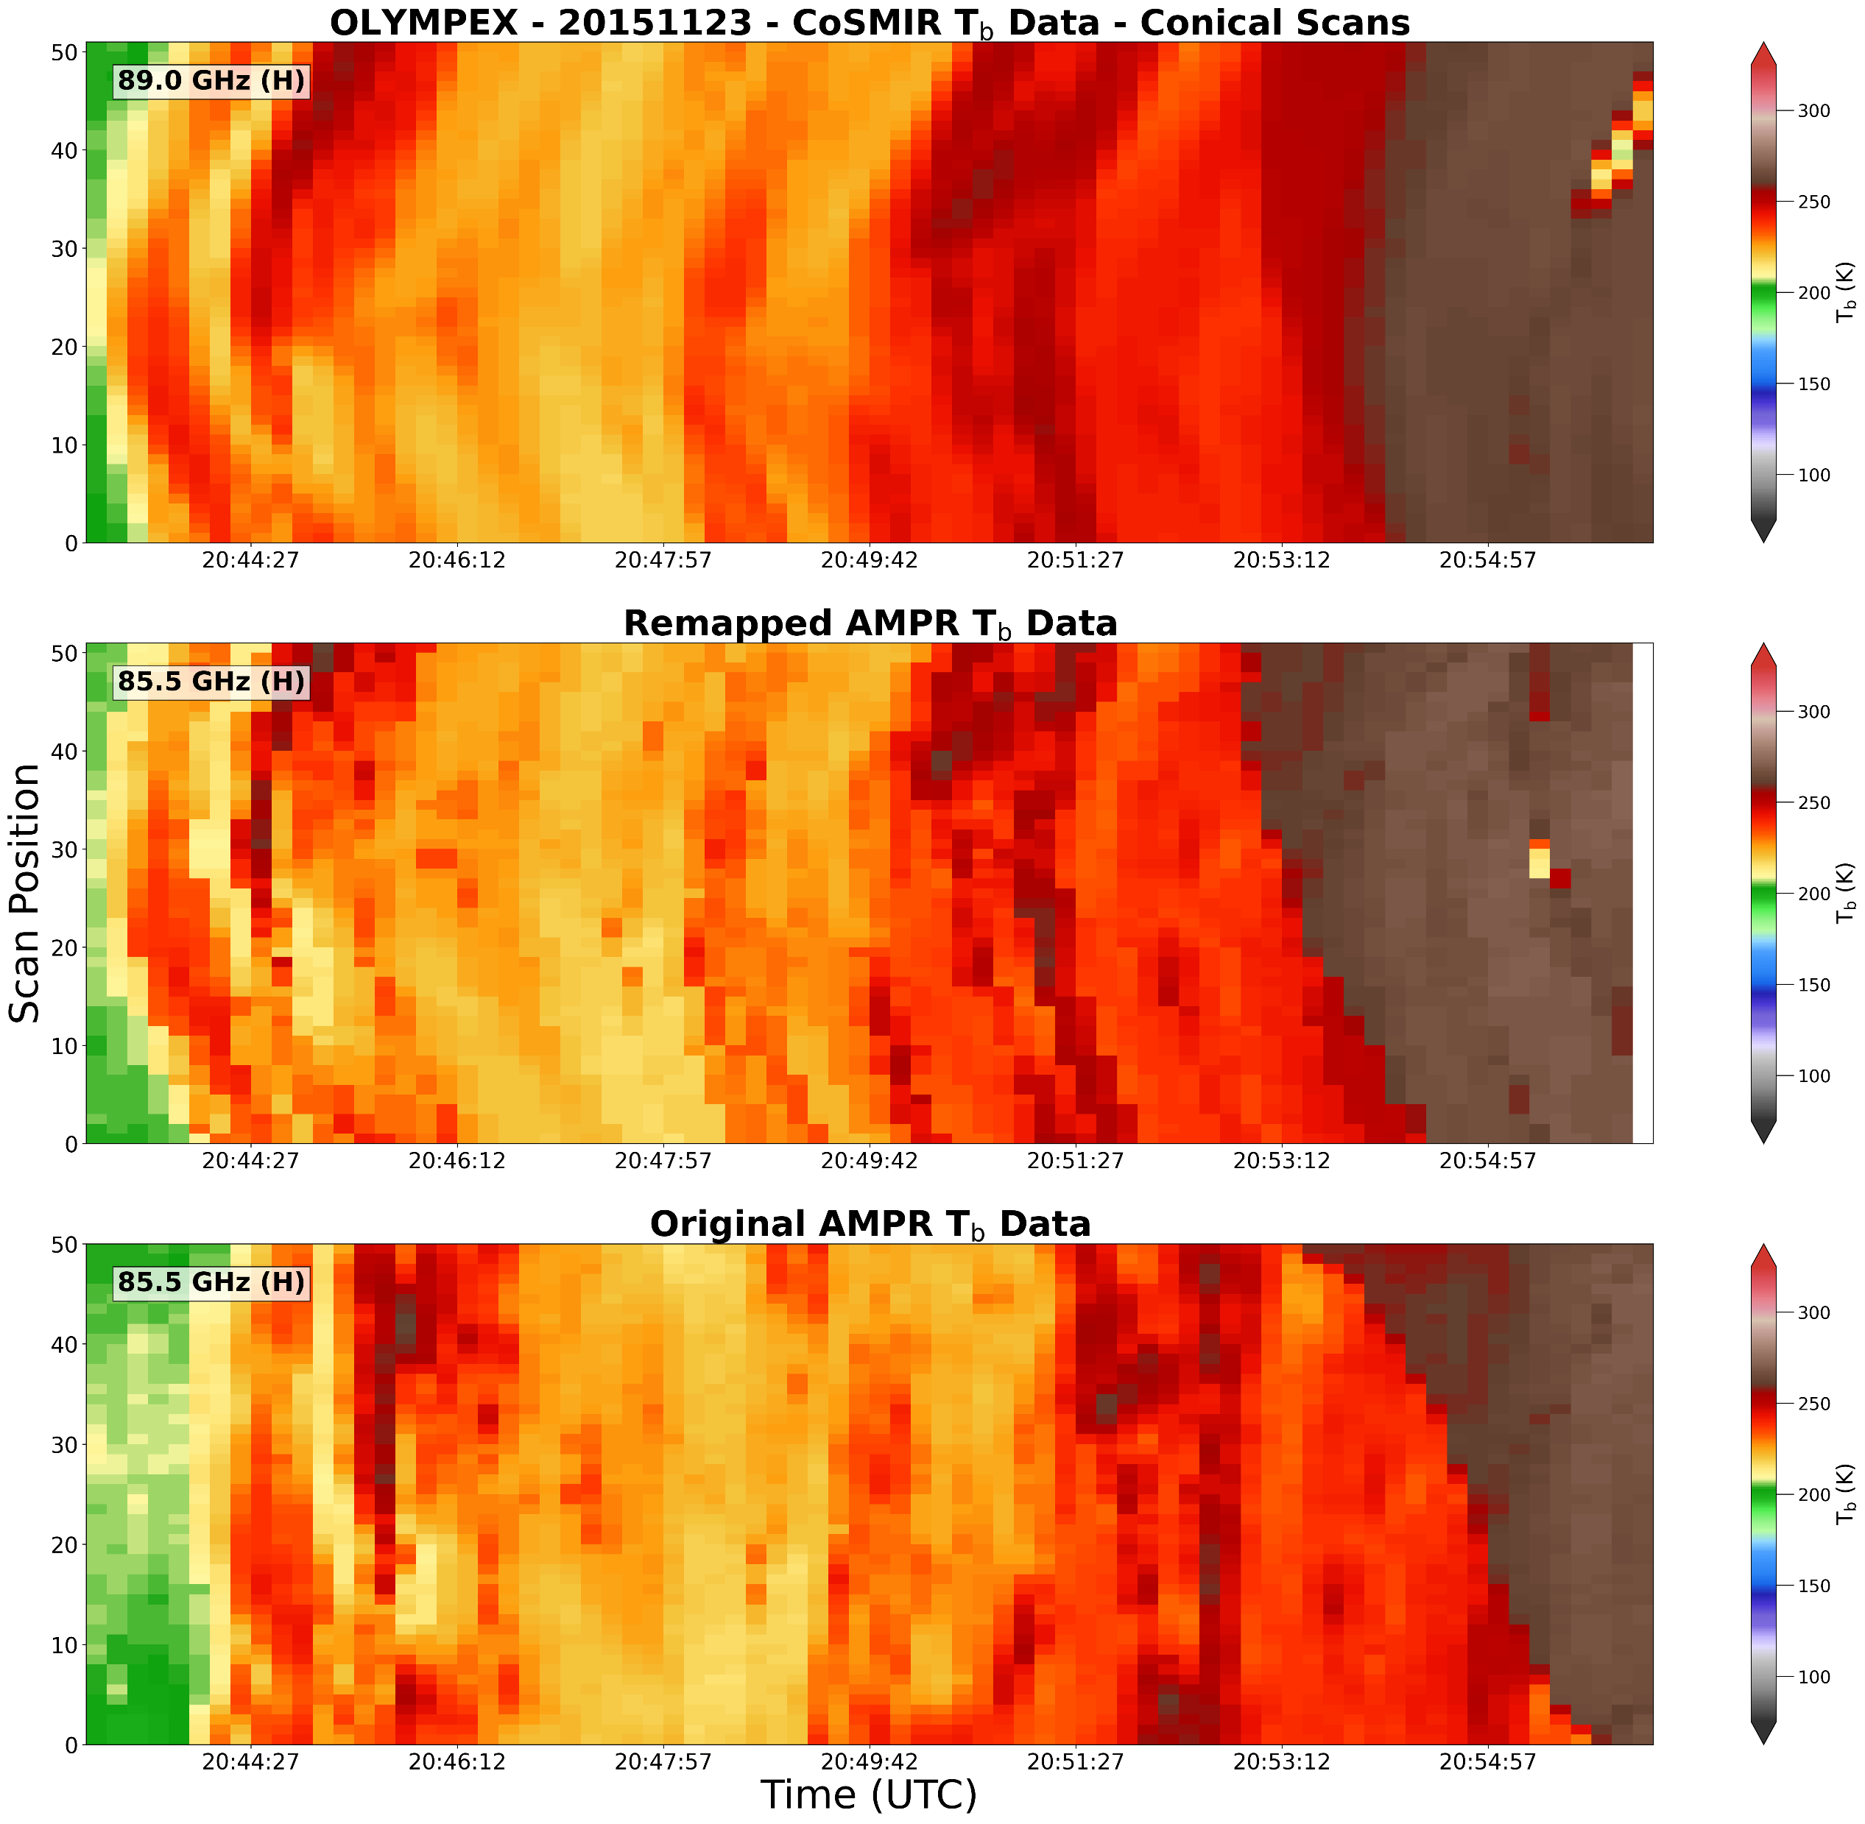
Merging Radiometer Data
Background & Radiometers
Radiometer Data Mergers & Testing
Applications & Ongoing Analyses
CoSMIR/CoSSIR for background lattice
  Narrower swath during OLYMPEX/RADEX
  Applies for cross-track and conical mergers
Identify flight segments of interest and use nearest-neighbor method to match AMPR pixel with CoSMIR/CoSSIR pixel
  Find tandem flights when on separate aircraft
Keep track of properties for all pixels
  E.g., resolution, EIA, beamwidth, etc.
Right: conical CoSMIR (top) and original AMPR (bottom) T_{b} data along with the remapped AMPR T_{b} data (middle)
  Top two panels would go into merged product

Slide 7
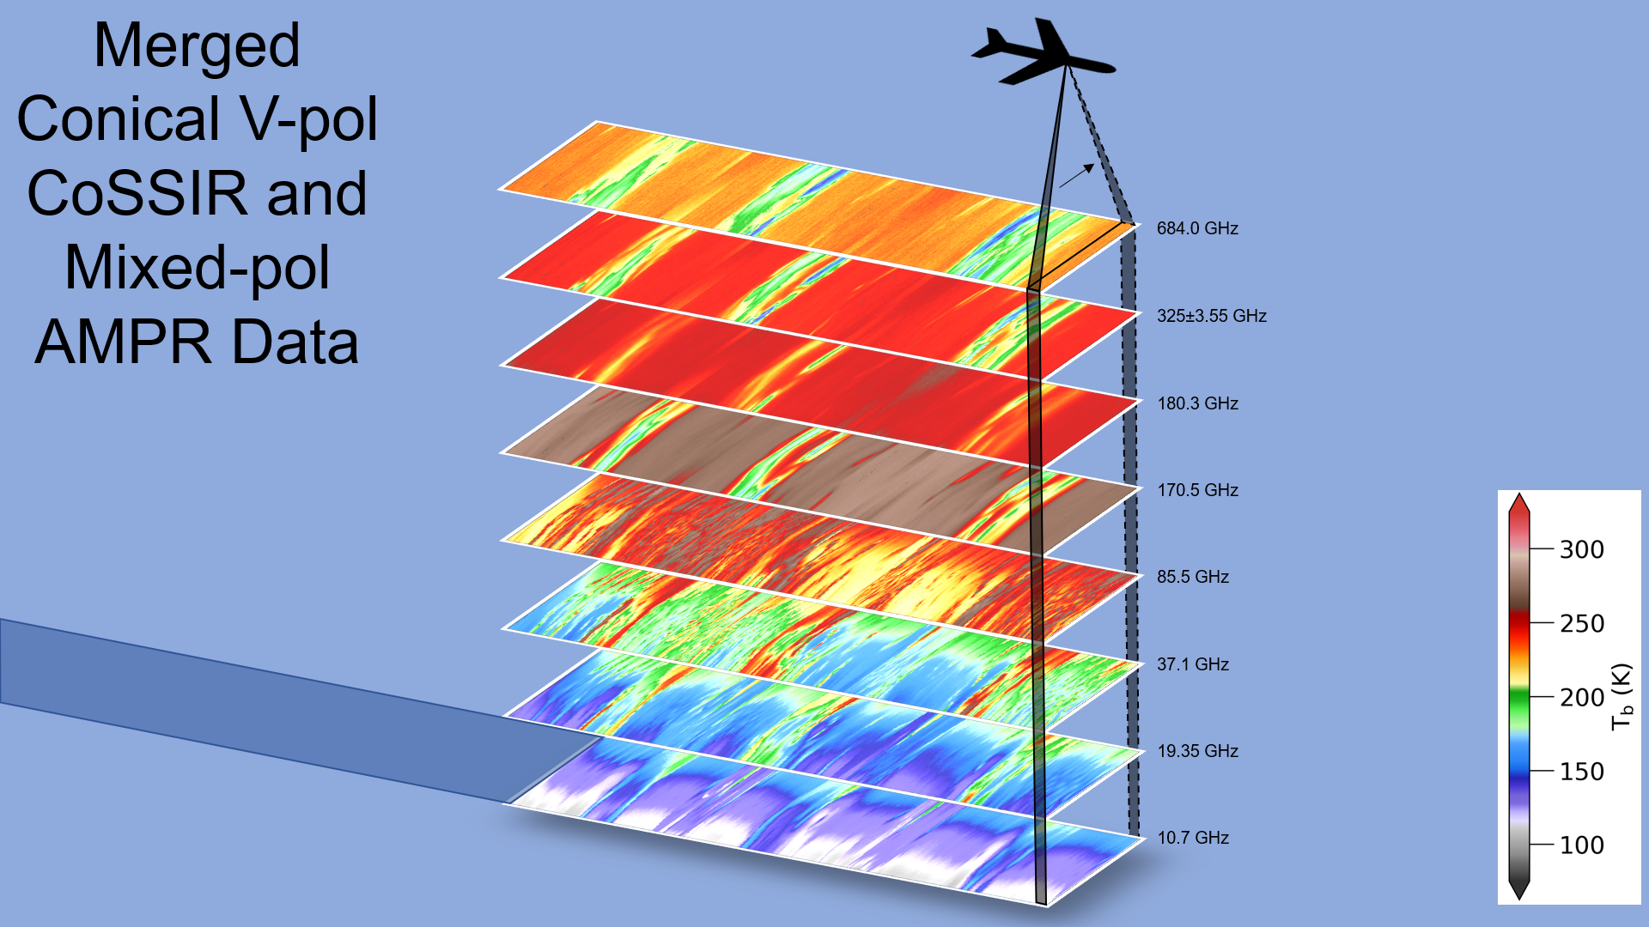
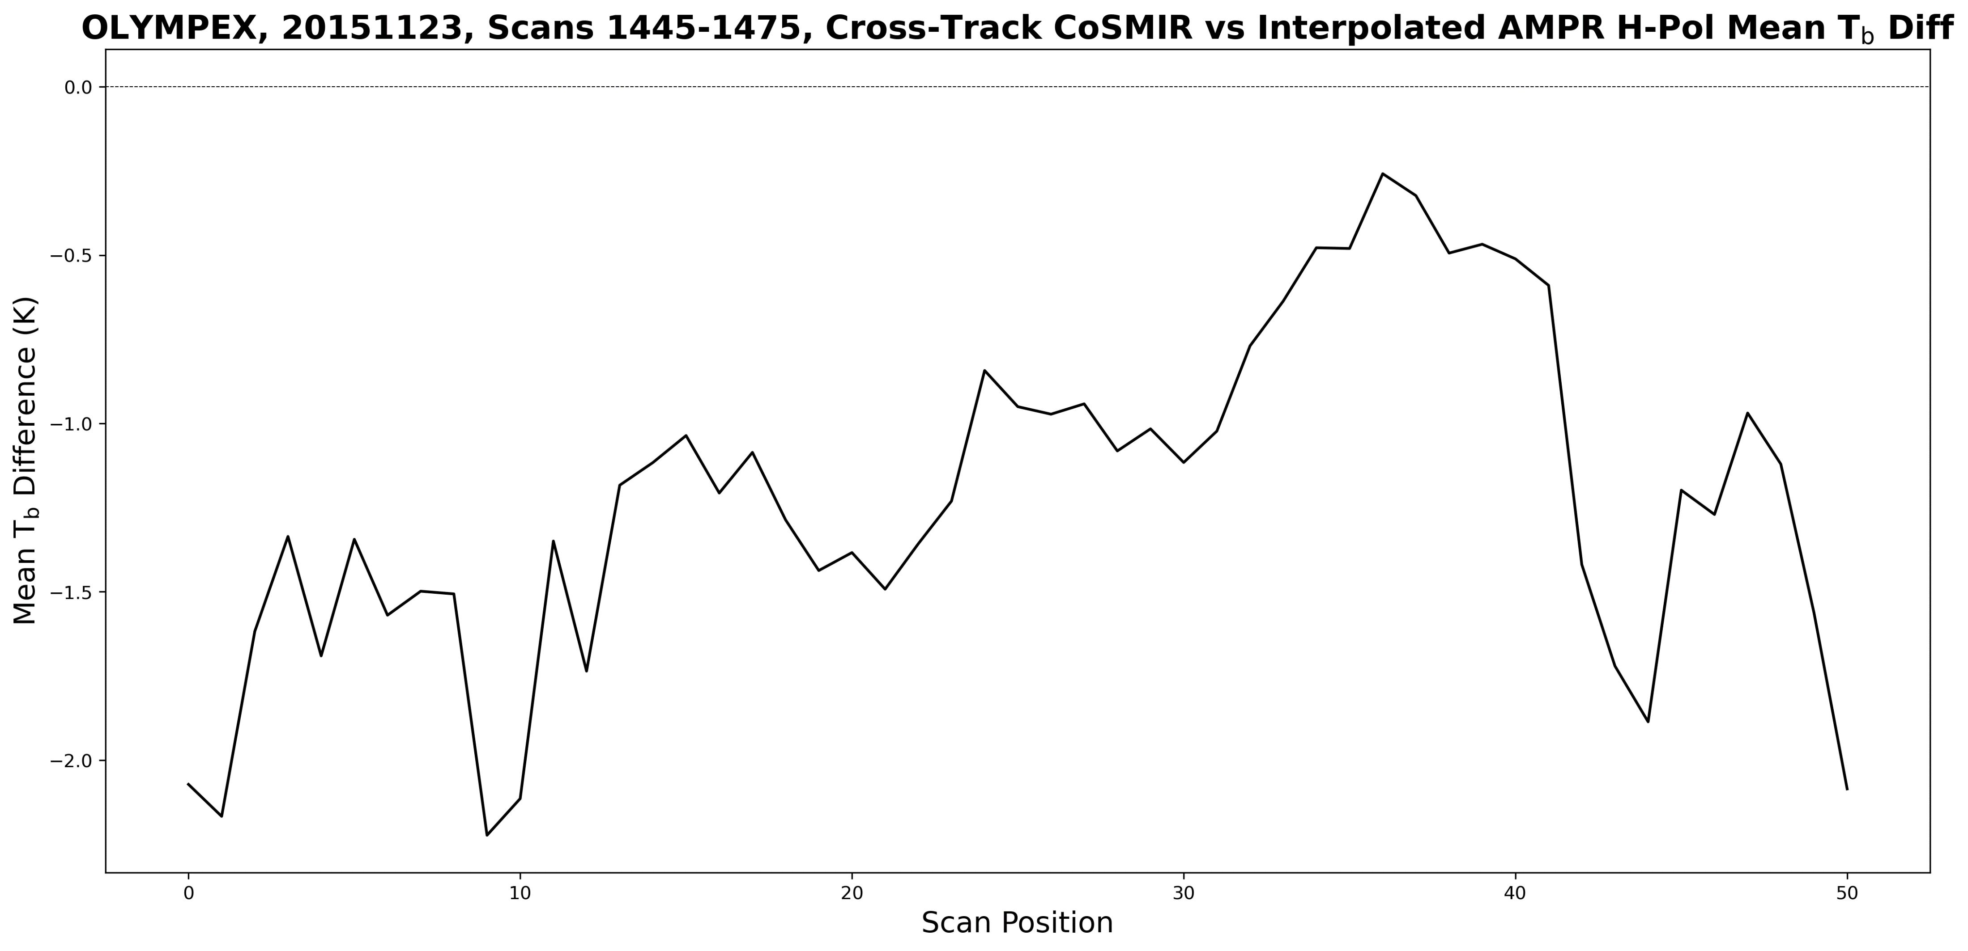
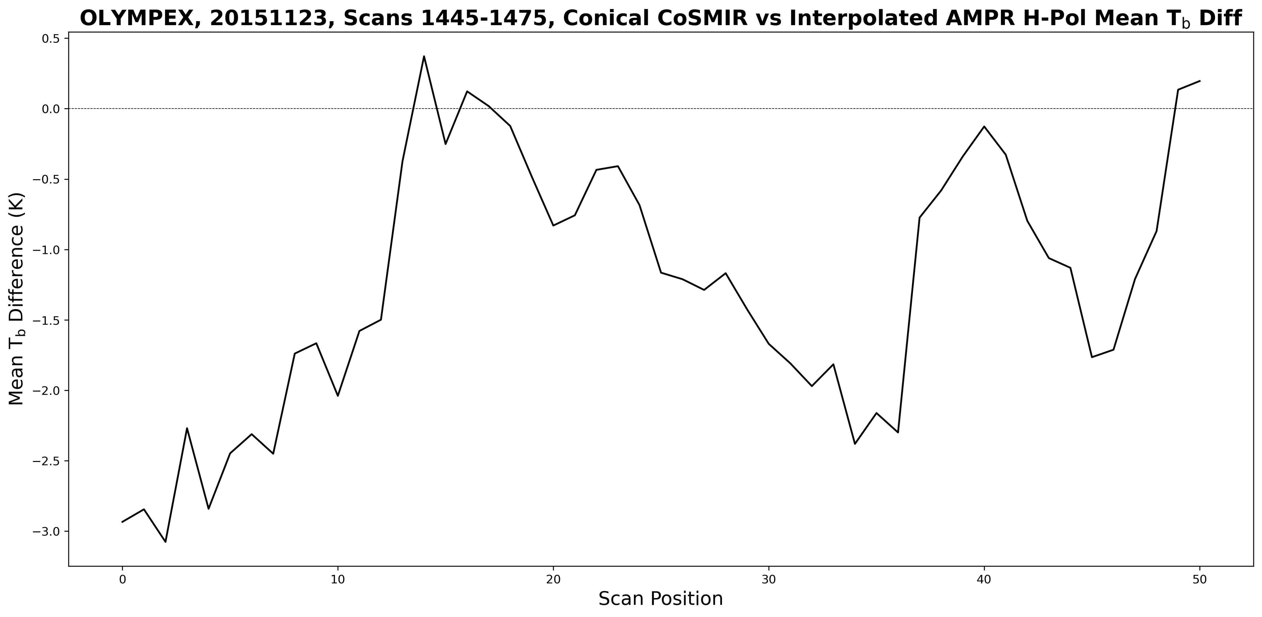
Merging Radiometer Data
Background & Radiometers
Radiometer Data Mergers & Testing
Applications & Ongoing Analyses
Mean clear-air T_{b} differences between 85-GHz AMPR and 89-GHz CoSMIR generally < 2 K (<3 K) for cross-track (conical) data mergers
AMPR-CoSSIR merger during ~90-min flight segment from IMPACTS 2023

Slide 8
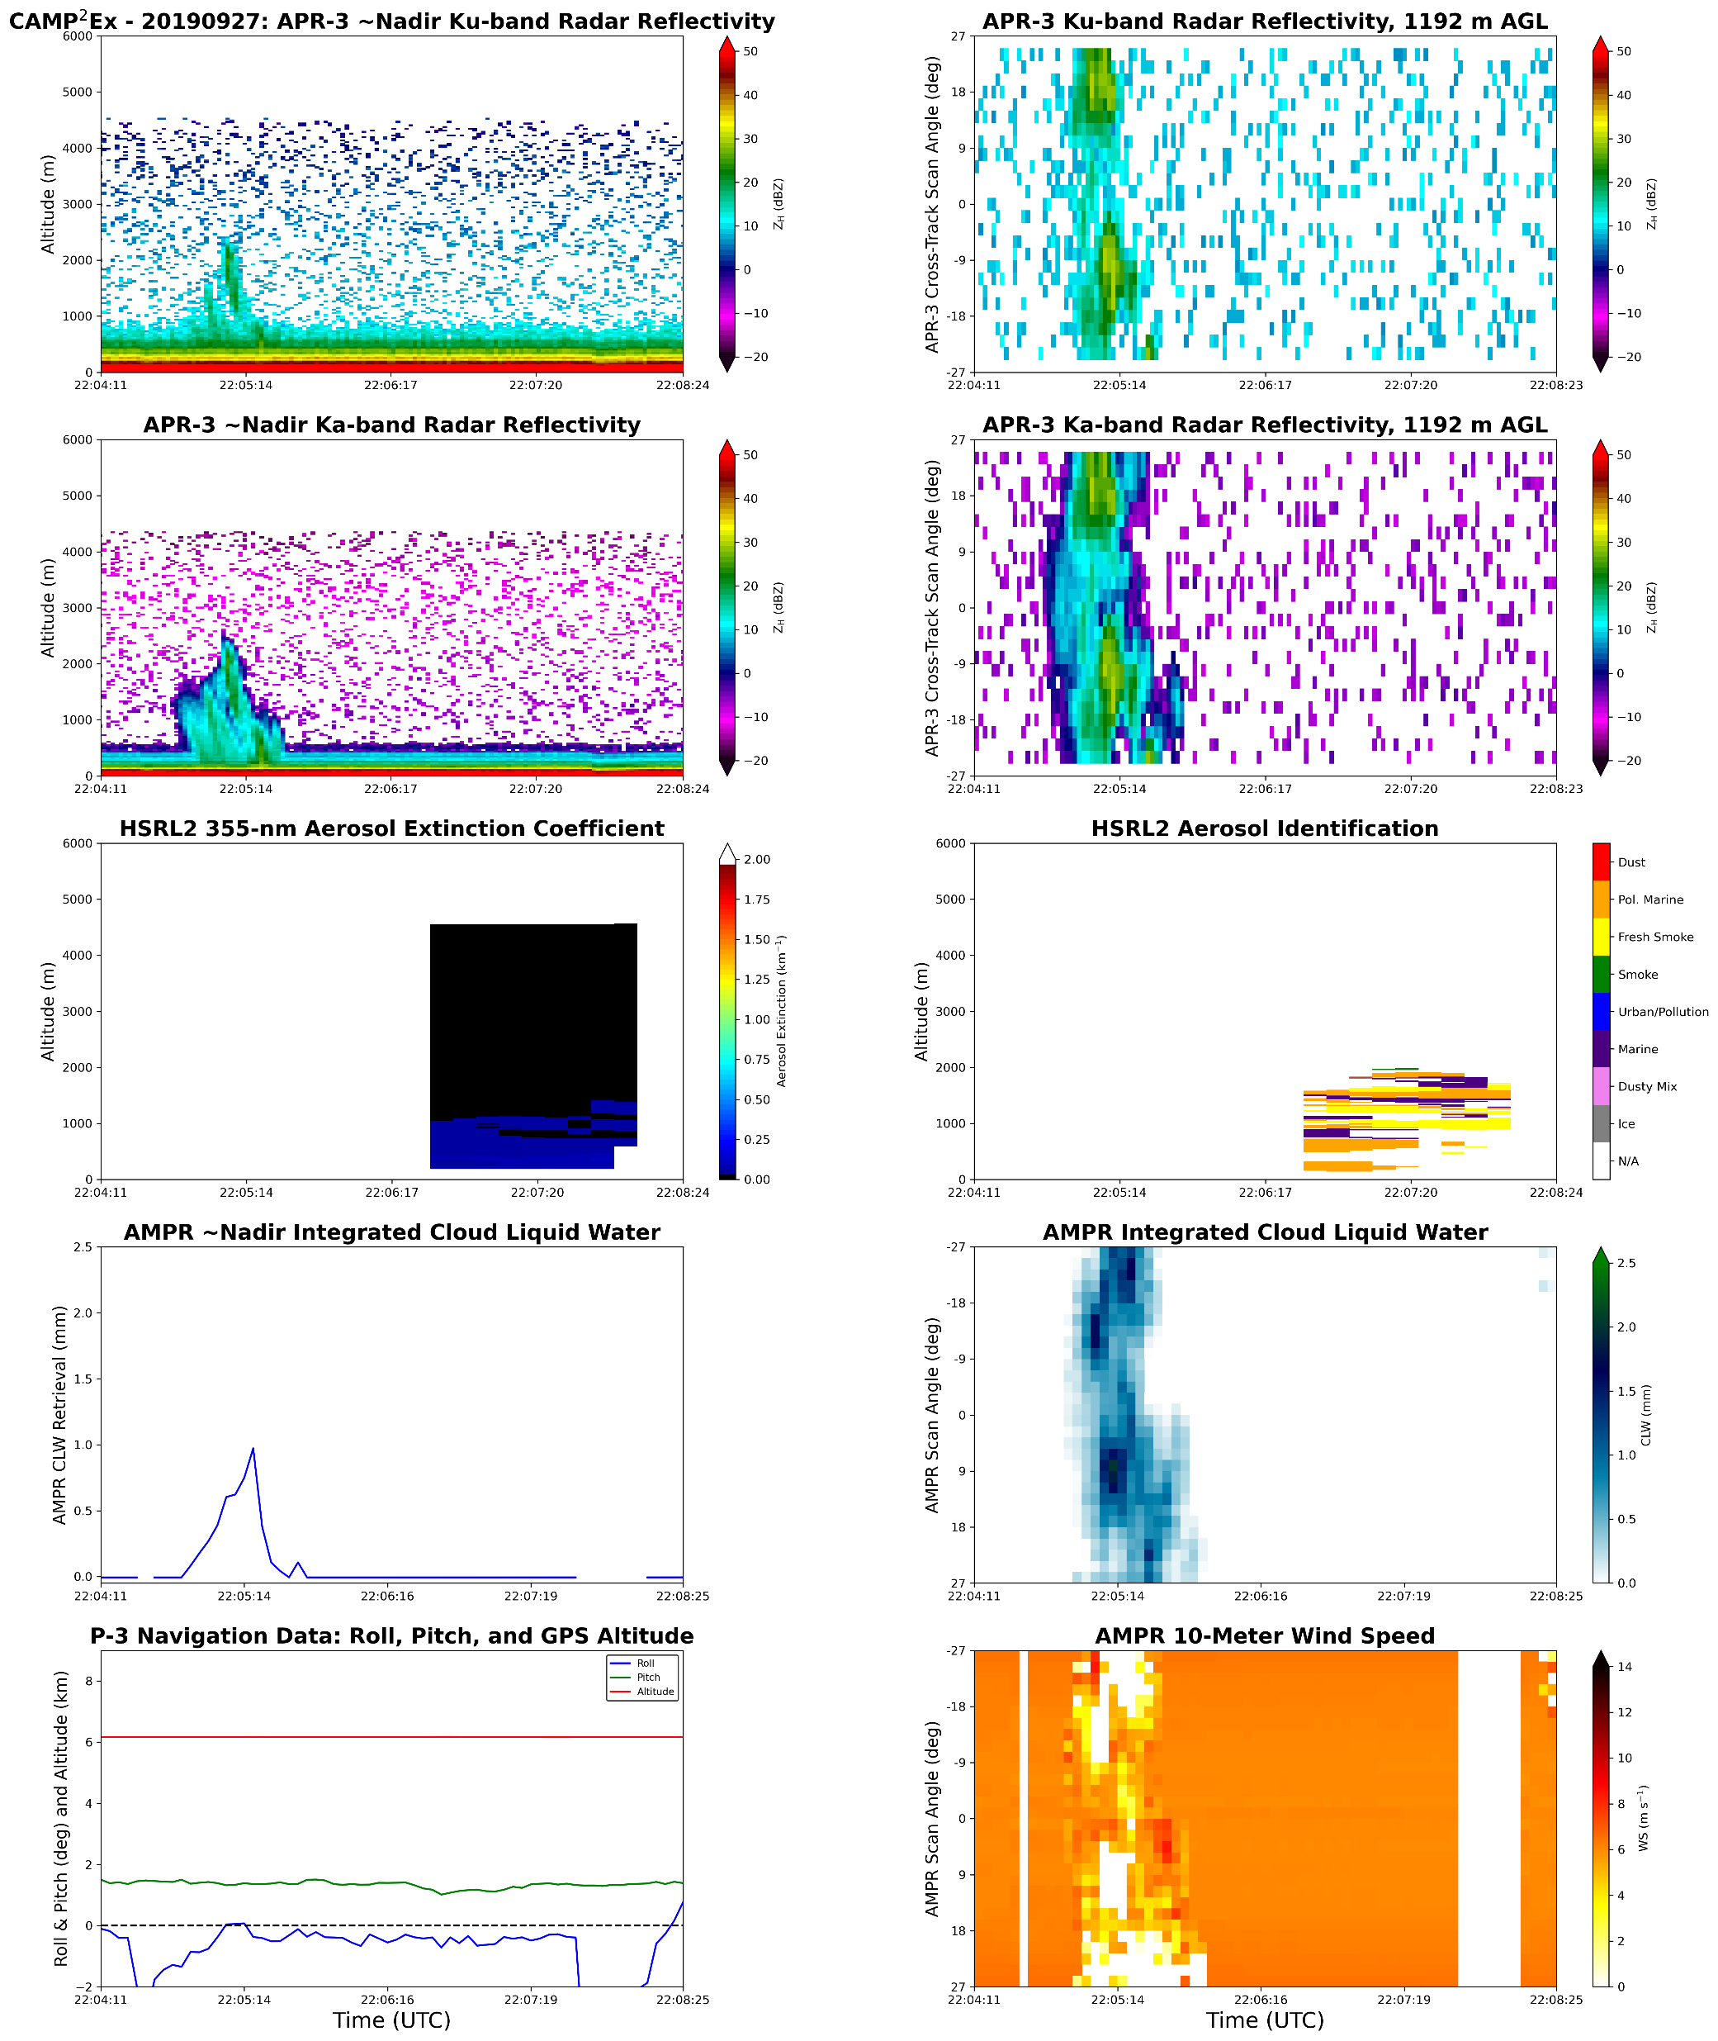
Applications of Merged Dataset
Background & Radiometers
Radiometer Data Mergers & Testing
Applications & Ongoing Analyses
Better understanding of processes often unresolved with spaceborne radiometers
  However, results may be applicable to spaceborne platforms
Can combine retrievals and T_{b} data with radar reflectivity to gain more in-depth perspective on given cloud and/or precipitation region
  Powerful when examined in environmental context (e.g., from atmospheric soundings)
Relevance to Earth Science Decadal Survey and NASA’s 2022 Strategic Plan
  GPM, INCUS, and AOS missions

Slide 9
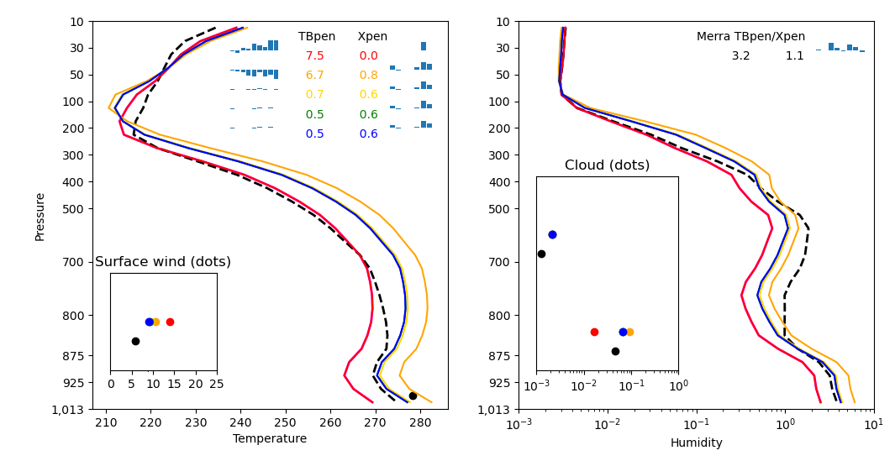
Ongoing Analyses
Background & Radiometers
Radiometer Data Mergers & Testing
Applications & Ongoing Analyses
Geophysical retrievals (e.g., cloud liquid water and near-surface winds) using adapted radiative transfer model + 1DVAR
Examine and quantify trends in these retrievals and T_{b} around edges of precipitation regions
Finalize applications across four NASA airborne campaigns
This work has been supported by an appointment to the NASA Postdoctoral Program at NASA Marshall Space Flight Center, administered by Oak Ridge Associated Universities under contract with NASA
Contact email: corey.g.amiot@nasa.gov

