Slide 1
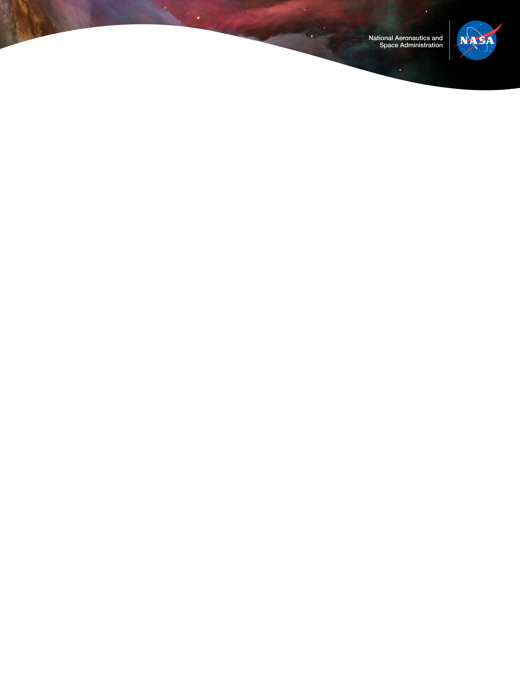

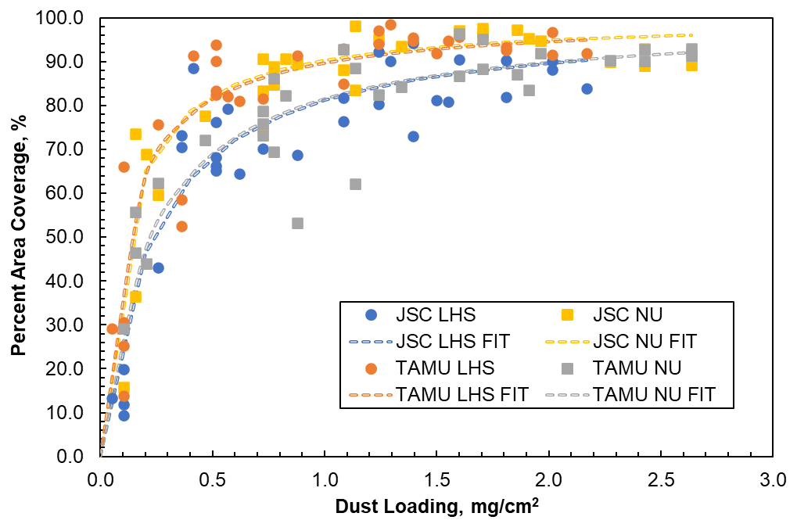
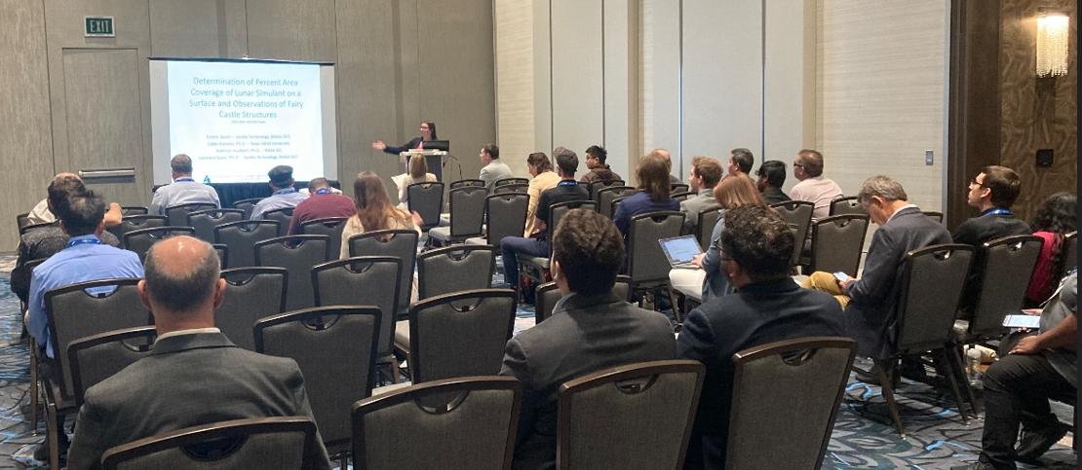
Lunar Dust level sensor & Effects on Surfaces (LDES) Percent Area Coverage of Lunar Simulant on a Surface and Fairy Castle Structures
12/10/24
Task owner: Emma Quick | emma.j.goodman@nasa.gov PI: Dr. Katy Hurlbert | katy.m.hurlbert@nasa.gov PM: Ashton Archer | ashton.r.archer@nasa.gov
EXECUTIVE SUMMARY
With NASA’s goal of returning humans to the Moon, it has become increasingly important to understand the impact of lunar regolith on spacecraft systems. The ability to measure the level of dust coverage on a surface is essential. Developing an accurate technique to determine percent area coverage (PAC) is challenging due to the unique and complex layering of the dust particles on the surface, creating fairy castle structures that form complex towers, bridges, and buttresses using the smallest of dust particles as building blocks. For this study, these structures have been simulated using a unique dust distributor device and imaged with a scanning electron microscope (SEM). The results show the dusted surface’s complex topology, thus demonstrating the difficulty with determining the percent area of dust coverage. Implications for dust buildup on spacecraft, even at the microscopic level, can include degraded heat transfer and altered optical properties, making continuation of this research critical to support future human exploration of the Moon.
Innovation & BENEFITS
This lunar dust simulant deposition study was performed with two different simulants, with the goal being to determine the percent area coverage of a dusted surface using imagery techniques. Additionally, a scanning electron microscope (SEM) was used to image dust deposited on SEM sample stubs. The point of SEM imagery was to visually detect the fairy castle structures that form on dusted surfaces even on a microscopic level.
The innovation with this study is the philosophy of determining a percent area coverage of a dusted surface using image analysis. The goal was to develop calibration curves for each dust type that could be used to convert from an areal dust density (dust loading, mg/cm²) to a percent coverage. Image analysis of dusted microscope slides was performed on-site as well as by Texas A&M University. Broadly, images were studied on a pixel-by-pixel basis where a threshold value determined if a pixel was light enough to be considered “dust.” Pixels that were dark were considered background, and thus the percent coverage is defined as the light pixel area divided by the total pixel area. With this information, calibration curves showed the relationship between dust loading and dust percent area coverage.
The other area of great benefit and innovation with this project is the capturing of fairy castle structures with a scanning electron microscope. Fairy castle structures have never before been imaged at the microscopic level. The images obtained from this study are unique and show the ability of tiny dust particles to stick to one another with just one or two points of contact.
Collaboration
Collaboration Partners
Texas A&M University (TAMU), Digital Image Processing
Calibration curve showing relationship between PAC and dust loading for LHS-1D and NU-LHT-4M simulants determined on-site and by TAMU.
Outcomes & Infusion
Results show there is a sharp increase in PAC as a function of dust loading such that even at small dust loadings samples read as nearly 100% covered.
The calculated PAC values from the two different analysis groups (on-site and TAMU) do not line up perfectly. There is a discrepancy based on dust type. There is not currently enough data to determine if one analyst is more “correct” than the other.
Implication is that even surfaces that may not appear covered to the naked eye might be dusty, and they might be forming fairy castle structures.
Formation of fairy castle structures results in modifications to the surface’s characteristics such as its optical properties and its ability to transfer heat.
Fairy castle formation likely also impacts the percent area calculation because they introduce larger gaps and channels in dust buildup that would not be experienced in “gravel-packing” (three or more points of contact between particles).
Percent area coverage may not be the best way to characterize the amount of dust on a surface because it is a 2-dimensional parameter describing a 3-dimensional phenomenon.
Project was documented in a paper published via the ASCEND conference in Las Vegas, Nevada, in 2024.
The work was presented by Emma Quick at this conference.
NEXT STEPS
Recalibration of the lab’s balance and modification of the dust loading measurement to reduce human error followed by another experiment.
Explore way to quantify the presence of fairy castle structures rather than relying on SEM images.
Use property data of the two dust types to determine if one of the two analysts produces results that align with what might be expected for a dust type.
Explore other SEM techniques that would allow for imaging a sample at an angle rather than with just a top-down view.
Explore other methods to characterize the amount of dust on a surface that incorporate 3-dimensional effects.
Scanning electron microscope image of fairy castle structures forming with LHS-1D lunar dust simulant. Image by Leonard Suess.
DAA# | 20240007706
NTR# | NA

