Slide 1

Contracting Quality Early in the Lifecycle Using AS9145 Data Deliverables
A recommended practice developed by the Aerospace Industries Association’s (AIA) Joint Strategic Quality Council (JSQC)
November 13, 2024
Jeannette Plante
NASA Headquarters, Office of Safety and Mission Assurance
Mission Assurance Standards and Capabilities Division

Slide 2







JSQC Charter 2024
Joint Strategic Quality Council (JSQC) – The Joint Strategic Quality Council is a collaborative, non-competitive partnership, improving performance through mutually beneficial quality assurance initiatives.
*
*
*
*Major Defense Acquisition Program Contractors

Slide 3

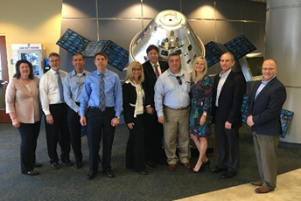



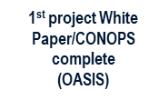
Joint Strategic Quality Council Journey
Purpose: JSQC Collective Strategic Plan / Provide better value to the Warfighter
March 2019 F2F
Kennedy Space Center
AAQG/IAQG engagement
AIA/JSQC presentation to CQSDI
JSQC partnership and tempo remains strong through COVID
NASA engagement
AIA V/R Standard
JSQC Standard tempo
NAS 412 Revision (R3)
NOV 2017 first AIA white paper published (OASIS)
AAQG Customer Major Noncompliance Standard
NAS 3306 Released
DCMA Inst. 8210.1 Rev. D
IAQG and DCMA initiated partnership (2012)
OCT 2017 Introduction to AIA (Mr. Shields brief)
NAS 413 Released
AAQG/ AS9018 – OASIS Standard Released
Initial discussions on
potential opportunities
EQC Initiated
DCMA Man. 2303-01 Revision
DCMA Man. 2301-06 Revision
NAS 412
Revision (R2)
DCMA publishes article on JSQC
NAS 413 Revision (R1)
DCMA Launch
Joint Strategic Quality Council
CY
3-4Q
2015
2016
2017
2018
2019
2020
2021
2022
2023
2024
All parties have been collaborating for over a decade

Slide 4
Contracting Quality Early/Handbook
Project Objective:
Ensuring quality early in a program results in fewer defects, less schedule risk, and ultimately lower total cost of execution. Establish and publish industry best practice. Obtain DoD/NASA concurrence to implement on future programs.
Lead
Brian Tenney, Lockheed Martin
Team Members:
Government
Craig Bennett, DCMA
Jeannette Plante NASA
Antonio Petito DoD
Albert Ismalov DoD
David Karr AFMC
Industry
Lockheed Martin (Jose Lafon/ Heather Rennerfeldt/ Barry Benczowski)
RTX (Don Desfosse)
Rolls Royce (Kyle Hummel)
Project Goals and Deliverables
- White paper: Benefits/CDRL
- DoD/NASA adoption of guidance
- Standard incorporated in a contract

Slide 5
Late-cycle QA finds and reacts to nonconformities. Late-cycle problems are more costly to resolve.
Reactive remedies risk latent defect escapes that affect Safety.
Why do we do it? The FAR biases Government QA towards late-cycle QA.
Great for COs but less effective for Cost, Schedule, and Regulatory targets
- PM&P Unavailable
- Constraints Not Addressed: Regulatory, Customer Requirements, QMS
- Unreliable sources
- Long Lead Times
- Undeclared Changes
- Risk Tolerance Unknown
- Poor Product Substitution
- Critical Item(s) Unknown
Supply Chain
Success Target
Product Nonconformity
RCCA looks into the past
Process Issue
Product Design
- Immature
- Underdefined
- Repurposed/Unfit for Purpose
- Contains errors
- Unreliable
- Unreliable/Unqualified
- Key Characteristics Incomplete
- Poor Path to Production
- Systemic Weakness(es) (e.g., No LL feedback, QMS element)
RCCA costs and delays are perceived as a Quality problem regardless of the root cause.
RCCAs often stop at proximate cause and don’t perceive early lifecycle activities.
Notes:
The FAR asks a leading question: Does the product conform? This biases Government QA towards product assessments and thereby to a reactive approach that depends on lagging indicators.
Aligns with basic COs’ interests: Did we get what we asked for? Do we pay the bill?
Less alignment with PMs’ interests: Can we meet our risk targets? Safety, Technical, Cost, Schedule, Regulatory

Slide 6
Root Cause can be created very early in the lifecycle. “If QA had only been involved early in the development….”
What does that really mean? What work is that?
AS9145, Requirements for Advanced Product Quality Planning and Production Part Approval Process, first published in 2016
- PM&P Unavailable
- Constraints Not Addressed: Regulatory, Customer Requirements, QMS
- Unreliable sources
- Long Lead Times
- Undeclared Changes
- Risk Tolerance Unknown
- Poor Product Substitution
- Critical Item(s) Unknown
Supply Chain
Success Target
Product Nonconformity
Process Issue
Product Design
- Immature
- Underdefined
- Repurposed/Unfit for Purpose
- Contains errors
- Unreliable
- Unreliable/Unqualified
- Key Characteristics Incomplete
- Poor Path to Production
- Systemic Weakness(es) (e.g., No LL feedback, QMS element)

Slide 7
Perception is new/more requirements = more cost
New paradigms not easily embraced in AS&D contracting
APQP/PPAP Elements
Plans: Project Management, Supply Chain Management, Production (PPAP)
APQP Applicability and Scope, Performance Targets *
Requirement Constraints: Customer, Regulatory, QMS
Process Flow Diagram, BOM
Analyses: Feasibility, Capability, Capacity, PFMEA, Tolerance, Measurement Systems (MSA), Resources
Specifications & Documentation: Design, Requirements, Packaging & Labeling,
Control Plan: Critical Items*, Key Characteristics*, Flow Diagram, MSA, Packaging, Resources
Design Verification and Validation*
Risk Identification and Elevation*
First Article Inspection Report (FAIR)
First-party QA, Response to NCs
Reviews and Milestones, Deliverables and Approvals
* Attuned to safety as a performance target
Product Production Approval Process (PPAP) record is a collection of documentation, specifications, and analyses that provides evidence of the suitability and control of a production process for a given design, set of requirement constraints, and set of Target criteria (e.g., FFF, cost, schedule, risk tolerance).
The above elements correlate to the existing AS9100 model and are not new or emerging techniques.
Notes:
Industry trend is to perceive requirements as cost drivers rather than a cost-savers (LL, standardization).
Contracts developers are looking to trim costs. New Standards look like cost adders.
Color of Money: Cost model for late-cycle QA is known, not well known for APQP.
AS&D sector can’t easily propose a requirements swap of this type within an acquisition competition. Not an “alternate standard”.

Slide 8
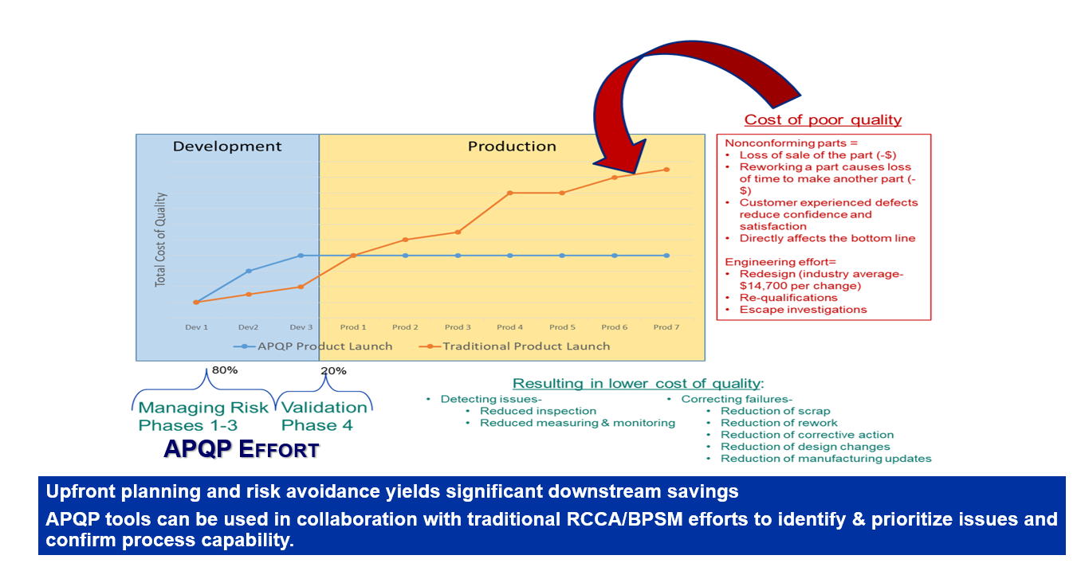
Cost of quality assurance function vs Cost of poor quality:
Expect highly complex system developments to have unplanned quality costs due to weak early lifecycle Quality involvement, especially for new, low-volume builds where Qualification replaces First Article Inspection.
Cost of poor quality is not a budget line item, difficult to show “savings” when using AS9145.
Growth in adoption of AS9145 by industry indicates the late vs early QA swap has a net cost advantage.
Cost of quality assurance function vs Cost of poor quality
Trends in late-cycle QA cost reduction:
Risk-based surveillance
Supplier-managed MRBs
Delegated 2nd Party QA
Source: Boeing/Kohring
Notes:
Cost of quality assurance function vs Cost of poor quality:
It is likely that highly complex system developments will have unplanned quality costs due to weak early lifecycle Quality involvement, especially for new, low-volume builds where Qualification replaces First Article Inspection.
Cost of poor quality is not a budget line item. Acquirers’ budget curves and review agenda don’t accommodate early lifecycle QA. (Due to FAR Part 46?)
Growth in adoption of AS9145 by industry indicates the late vs early QA swap has a net cost advantage.

Slide 9
JSQC Team’s Approach: Transition both the Acquirer and the Supplier simultaneously into adopting AS9145.

Slide 10
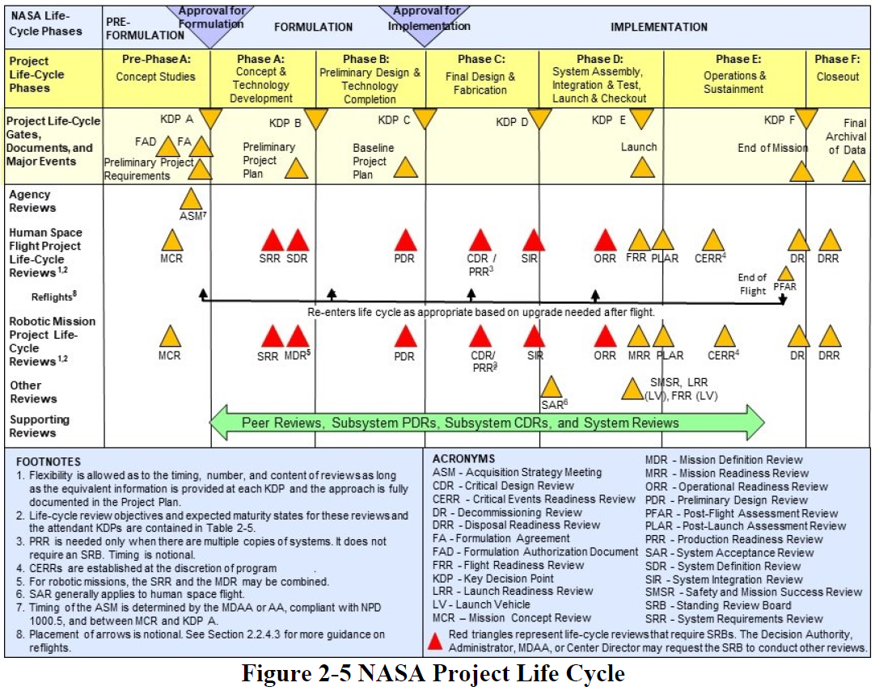
Compel Programs to report AS9145 results during Dev phases.
Programs use DRDs to pull data in from supply chain.
Notes:
NASA uses a standardized model for lifecycle reviews (LCR) and milestone gates within its Project Management approach (NPR 7120.5).
Standardized deliverables are used to monitor development progress and risk growth.
Lifecycle deliverables are used by PMs to “make the case” that success targets are being met.
The deliverable content is pulled in from internal (NASA analyses and QA) and external activities (supply chain).

Slide 11
Deliverable Requirement Descriptions (DRDs) are directive and prescriptive means for acquiring data.
AS9145 DRDs introduce acquirers and suppliers to better planning techniques.
Phase-in approach: full conformity to AS9145 will not be required (though can distinguish a more mature supplier!)
AS9145 DRD Starter Pack
No. | Title | Relevant Requirements in AS9145
1 | Industrial Base and Supply Chain Risk Inventory | 4.1.5
2 | Manufacturability Risk Inventory | 4.3.2.2, 4.4.6, 4.5.4 (PFMEA)
3 | Engineering/Design Adequacy | 4.4.4.1(DFMEA), 4.4.3 (Design V&V Plan)
4 | Design-to-Manufacturing Plan | 4.5.5(Process KC identification), 4.6.3(MSA)
5 | Statistical Process Control | 4.6.5 (SPC)
Notes:
Deliverable Requirement Descriptions (DRDs) are prescriptive types of requirements used in government contracts that drive delivery of data from the supply chain to the Project Office, at specific times.
DRD content will be used by the Project Office as part of their contract oversight.
DRD content will be used by the Program Offices to monitor the Project’s health, maturity, and risk.
DRD content is the output, or evidence of use, of specific development and product realization techniques.
Introducing DRDs that align with AS9145 will provide benefits and insights without the burden of demonstrating full conformity with the standard.

Slide 12
DRD Content Example
2: Manufacturability Risk Inventory
The contractor shall submit evidence of a manufacturing risk assessment in the form of a documented Manufacturing Risk Assessment. The assessment shall include an assessment for each assembly or raw material; COTS parts do no need to be assessed. Each part that is identified as high risk (e.g., immature verification and validation methods for raw or processed materials, unknown reliability for novel constructions, immature or lack of verification methods or metrology, immature or low availability of capital equipment or fixturing, or a new assembly that is more than 50% different from something already produced) must have risk assessment. Include parts where production capacity cannot be verified to meet requirements. The sourcing risk assessment shall include likelihood and consequence severity ratings (e.g. 1 to 5), and a summary of planned risk mitigations for each risk. Industrial base risks that are of particular relevance should be considered for inclusion. The assessment shall identify the methods used for internally identifying / eliciting risks, the associated criteria for assessment, and any requirements detailing when risks require associated handling / mitigation actions. The supplier shall present the Manufacturing Risk Assessment at each Milestone Review. Products deemed high risk must have an associated risk analysis/assessment (e.g. PFMEA).
The manufacturing risk baseline shall be updated and reported at quarterly technical reviews and at each major program review as long as high-risk items remain. In addition, the supplier shall provide detailed status to the customer of any mitigation steps that are not meeting plan. The supplier shall flow down this manufacturing risk management requirement to their sub-tier suppliers who are producing raw materials or assemblies.
Reference:
Department of Defense Manufacturing and Quality Body Of Knowledge - Section L.1 Manufacturing Management Requirements
Department of Defense Early Manufacturing and Quality Engineering Guide – Section 1.2 Early Manufacturing Overview
Department of Defense Early Manufacturing and Quality Engineering Guide – Section 3.7 Manufacturing Feasibility Assessments
Department of Defense Producibility and Manufacturability Engineering Guide – Section 6.1.1 Manufacturing Feasibility Assessments
AESQ RM13145 APQP and PPAP within Aerospace – Section 5.10 Assess Feasibility
Does not bias RFPs only to current industry users of AS9145
Acquirers will have to blend this content into their preferred format.
JSQC is exploring how DoD and NASA Handbooks can push this content to RFP teams.
Deliverable | Milestone Review Presentation
Specification | Contractor format
Date of First Submittal | At Systems Requirements Review
Date of Subsequent Submittal | At each Milestone Review
Notes:
Each DRD has a standard format
DoD already has extensive guidance for employing AS9145 techniques, but how to get RFP teams to use them? (guidance is relatively new; May 2024).

Slide 13
Take Aways
Poor early lifecycle QA is a likely risk to late-cycle cost and schedule stability for low volume, highly complex hardware developments.
AS9145 organizes early lifecycle best QA practices into a standard approach and is attuned to safety performance targets.
Chicken or the egg? Acquirers and suppliers will have difficulty introducing AS9145 into an RFP/Proposal if both “sides” aren’t positioned to do so simultaneously.
A small group of DRDs can be used to phase in a more common usage of early lifecycle QA.
DoD handbooks are promoting AS9145 techniques and can be used for increasing knowledge about how and when to use them.
JSCQ Task Group is pursuing opportunities for inserting the recommended DRD language into RFP tools used by the DoD and NASA.

