Slide 1

JWST Optics Lessons Learned for Probe Missions
Lee Feinberg
JWST Telescope Manager
HWO Principal Architect

Slide 2
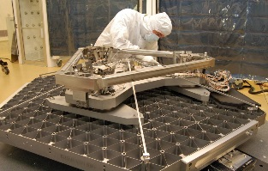
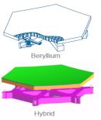
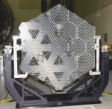
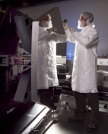
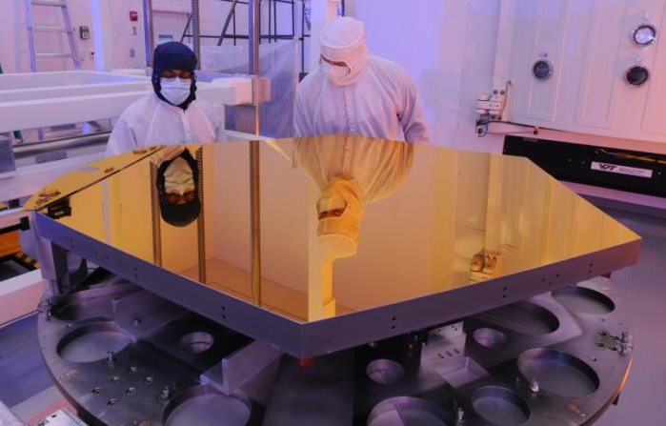
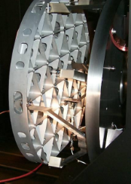
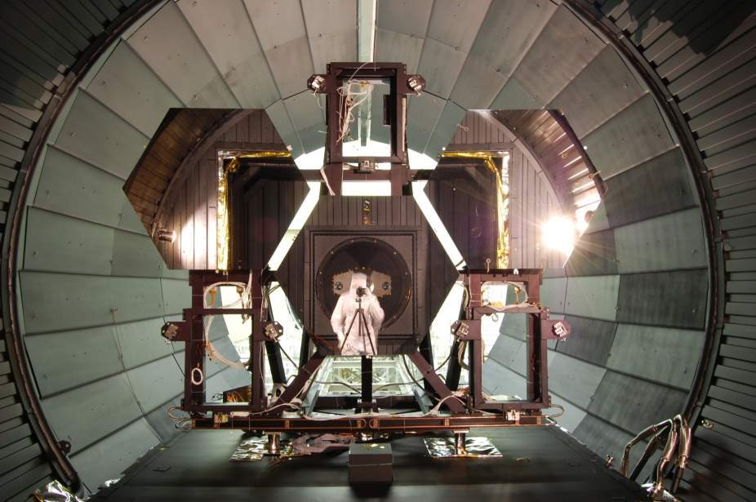
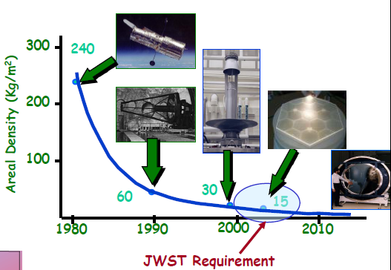
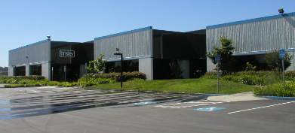
JWST Mirror Technology Flow
1996
1998
2000
2002
2004
2006
2008
2010
2012
2014
2016
2018
2020
Advanced Mirror System Demonstrator (AMSD)
Collaboration among 3 government agencies
15Kg/m2, 1.2M diameter segments
Technology
Readiness
Level-6 Demonstrated:
All key requirements and environments demonstrated
OTE
Complete
Launch
Medium
Authority
Glass (ULE)
Low
Authority
Beryllium
Onset of
James Webb Space Telescope
AMSD Phase 1:
8 Mirror Designs
AMSD Phase 2:
3 mirrors developed
AMSD Phase 3/Six Sigma Study
Be manuf. and process improvements
OTE Optics
Review
(OOR):
Beryllium
Selected
Engineering Design Unit.
Subscale
Beryllium
Mirror Demonstrator
(SBMD):
.5 meter diameter,
PM Manufacturing of 18 segments
Primary Mirror
Segment Assemblies Complete
Machining
Facility
Complete
Cryo Testing
Low Areal Density Mirrors Identified as Key Enabling Technology for
25 Square Meter Space Telescope
NGST Mirror
System Demonstrator
(NMSD): Other architectures
that were not successful
Polishing
Facility
Complete

Slide 3
Relevant Optics Lessons Along the Way
TRL6 testing (or TRL5) should be to the environment and you won’t know this early. Margin in the design can avoid this risk
  After AMSD and team began flight design, loads went up after first couple loads analysis
  Required redesigning structure (ribs, mounts)
  Necessitated an EDU be built and taken to acoustics for TRL6
Mounts and bonding were extremely challenging, should part of TRL-6
  Launch and Ascent temperatures need to be bracketed – this was a major issue right up to launch for JWST
  Entire lifecycle thermal stresses need to be understood
  Flexures are complicated, balance thermal and launch
Staffing a large manufacturing effort was not easy, we had attrition and challenges
Need a good estimate of facilitization up front: Facilitization is the first early cost, occurs while ramping up phasing, if you underestimate it then it will use up significant reserves

Slide 4
Relevant Optics Lessons Along the Way
Stress was a key consideration with beryllium. Led us to add a whole early effort on testing coupons with varying polishing parameters and heat treating
Metrology is always hard and time consuming, needs to be included in TRL6 (probably TRL5)
Scaling from .5m to 1.2m to 1.3m didn’t uncover a lot of surprises, the bigger surprise had to do with more refined understanding of loads and environments using CLA
Early studies of bottlenecks in process was helpful in faciltization.
Assembling the telescope needs to be thought through early as it can impact the design
  Can you get mirrors off once mounted, can you reach shims, etc
Practice, practice, practice. Pathfinders, AMSD, EDU were all immensely helpful.
The decision to choose beryllium was primarily for CTE at 50K and thermal conductivity to meet our EE stability requirement
  We wound up descoping the stability requirement later
  Important to really understand your ultimate performance specs so you make the right technical decisions early
System margins are incredibly important: mass, volume, power etc
  In the end, the choice of beryllium wound up being critical to dealing with mass constraints early in the program
  This doesn’t just apply to opitcs, it applies to thermal margins, etc

Slide 5
Documented lessons learned from JWST
JWST lessons learned are being published:
Spotlight eBook, JWST Lessons Learned, in progress, expect in January
Selections, JWST Lessons Learned + JATIS Systems Engineering Lessons Learned (JATIS, Menzel et al) + JATIS Stabilty Lessons Learned (JATIS, Feinberg et al)
Chart summary of JWST lessons learned talks are online (video and charts):
  HWO Face to Face, Fall 2023 (Feinberg + Rigby talks)
  Day 2 - HWO Working Groups - Google Drive

