Slide 1


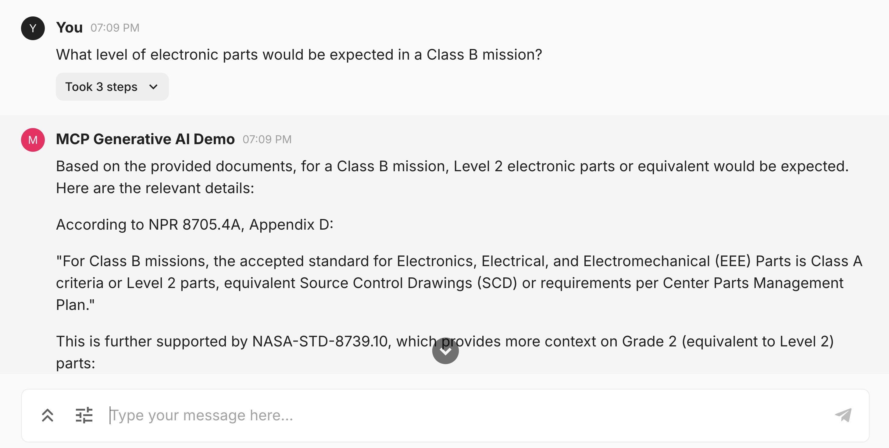
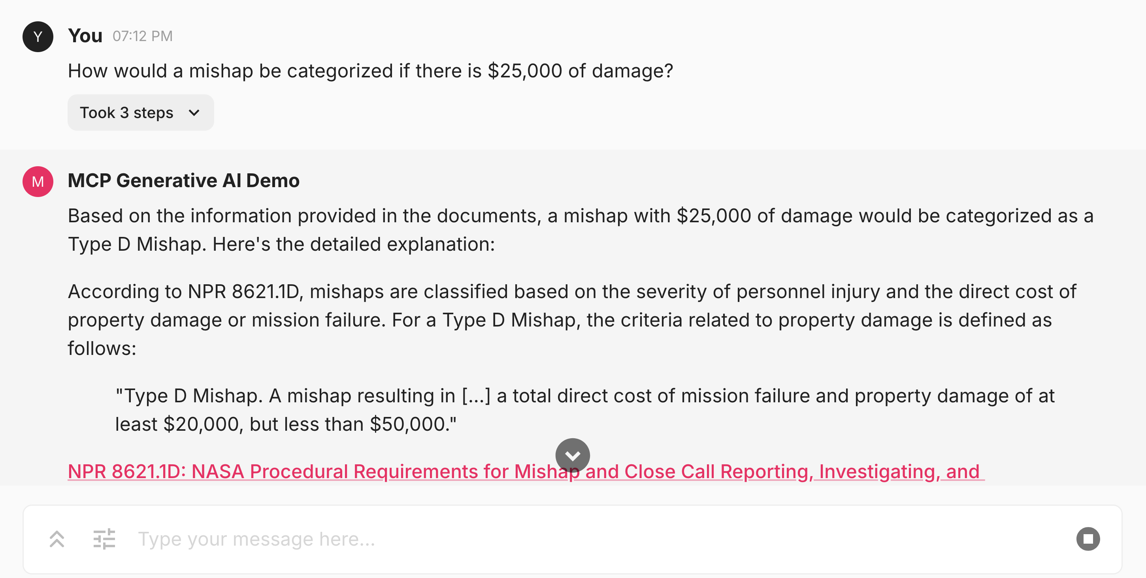
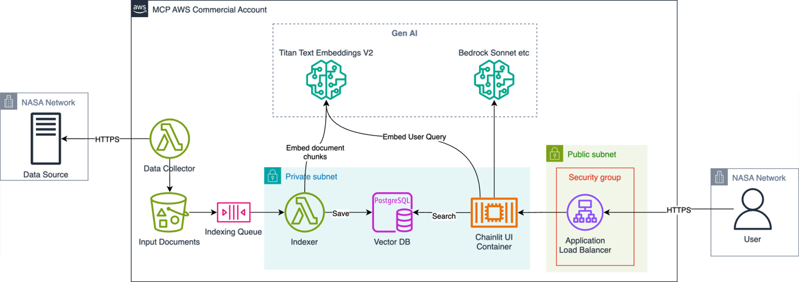

Atlas: Navigating NASA’s Knowledge Universe with AI-Powered Natural Language Queries
Jason Gilman¹, Andrew Pawloski¹, Joseph Foster²
¹Element 84, ²NASA Goddard Space Flight Center
Introduction
How Atlas Works
Atlas In Action
Atlas is a generative AI assistant prototype, allowing anyone within the agency to pose natural language questions using a chat interface. Developed through rounds of feedback and iteration with NASA as part of the NASA 2040 Agency wide initiative, Atlas uses LLM technology to answer technical and scientific questions with high levels of accuracy.
Atlas’ data sources were chosen by NASA 2040 initiative to learn what content employees felt was not accessible and which GenAI might help.
Atlas uses Retrieval-Augmented Generation (RAG) to answer questions using relevant portions of source documents. RAG involves a pre-compute step where an LLM identifies semantic concepts in each source document, a process called ”vector embedding.” Atlas uses these embeddings to find documents semantically similar to a user query. Finally, those documents are passed to an LLM along with the user’s questions and a prompt instructing the LLM to generate a helpful answer.
Atlas is designed to outperform off-the-shelf RAG solutions through improved document preparation, optimized chunking strategies, fine-tuned prompts, and incorporated subject-matter expert feedback in its iteration processes.
Goals
Demonstrate utility of Generative AI to answer natural language questions about important NASA topics
Streamline and improve employee access to large, dense, and complicated resources
Provide accurate and clear answers without ambiguous, unclear, or hallucinated text
Ne
Atlas Architecture
Challenges/Lessons Learned
What’s Next
Getting clean text from disparate source documents
Measuring quality
LLM hallucinations
Handling structured and unstructured data types
Debugging “black box” LLM behavior
Completeness vs clarity
High cost of GPUs
LLM parameters and variability
General NASA security requirements
Additional data sources
  NIST Publications
  FIPS Books
  Acquisition Regulations
  Travel Regulations
Knowledge graphs
Role-based access control
BYO documents (upload feature)
Balance answer completeness vs succinctness
Data Sources
NASA Directives
NASA Procedural Requirements
NASA Standards
Space Act Agreements
Contact: AGCY-MissionCloud@mail.nasa.gov

