Slide 1
Human Systems Integration & Engineering (HSI&E)
NASA Marshall Space Flight Center (MSFC)
Josh Moorhouse
MSFC EV73
Human Factors Engineer, VEL Lead
joshua.c.moorhouse@nasa.gov
Becky MacLaren
Amentum | Supporting MSFC EV73
Human Factors System Engineer
rebecca.a.maclaren@nasa.gov

Slide 2
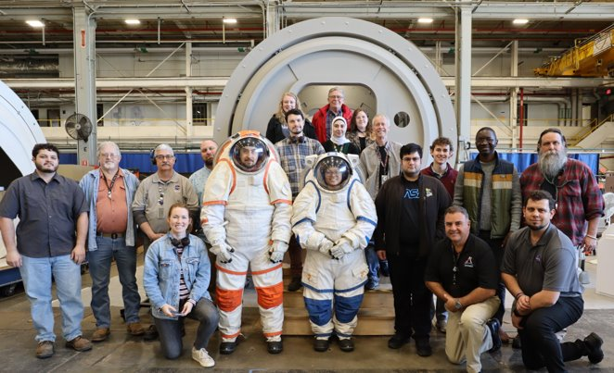
HSI&E Team​ Structure
Systems Analysis & Human Systems Integration Branch (EV73)​
The Human Systems Integration & Engineering (HSI&E) Team has 2 sub teams:​
  Human Factors Engineering (HFE)​
  Integrated Logistics, Supportability, and Sustainability Engineering (ILS)

Slide 3
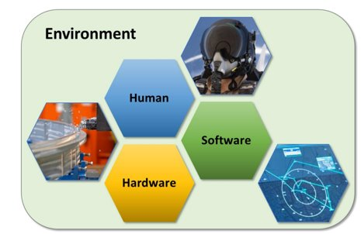
What is HSI?​
Human Systems Integration (HSI) is a systems engineering discipline ​
HSI applies knowledge of human capabilities and limitations throughout the design, implementation, and operation of hardware and software. ​
HSI focuses on:​
  Integration of humans into the system​
  Development processes to enhance human system design​
  Reduce life cycle costs​
  Optimize total system performance

Slide 4
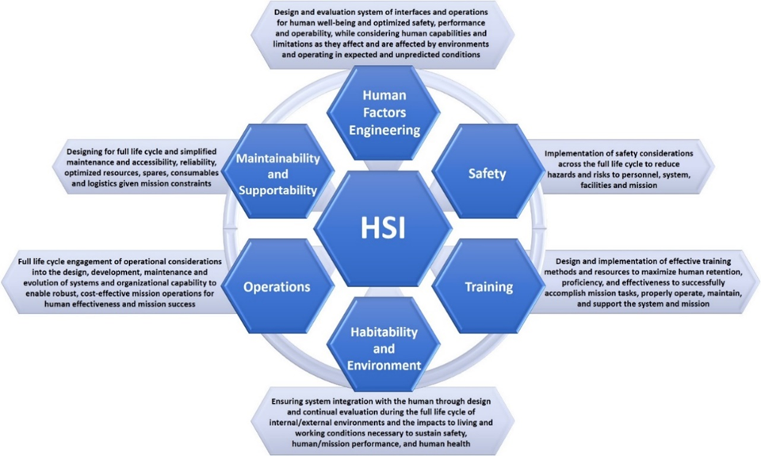
HSI&E at MSFC
EV73 Functions
EV73 Partners

Slide 5
HSI&E Assessments
Purpose of assessments:
  Design Influence
  Requirement Verification
Assessment type is typically based on the functions needed:
  Volumetric?
  Reach?
  Work volume?
  Visual access?
  Weight accuracy?
  Functional?
Time and cost also plays into the selection of assessment style
PSH
VEL
Mockups

Slide 6
Process Simulate Human (PSH)
Human Modeling Tool

Slide 7
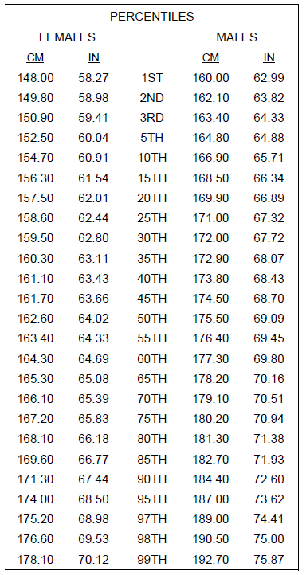
PSH
Process Simulate Human (PSH) is a Siemens product.
PSH is a human modeling software that provides the ability to insert manikins into CAD designs and posture them for specific tasks.
ANSUR II for anthropometric measurements
  “2012 Anthropometric Survey of U.S. Army Personnel: Methods and Summary Statistics”
SLS program:
  5th percentile female → 95th percentile male
  5’0” → 6’2”
Commercial partners:
  1st percentile female → 99th percentile male
  4’10” → 6’4”

Slide 8
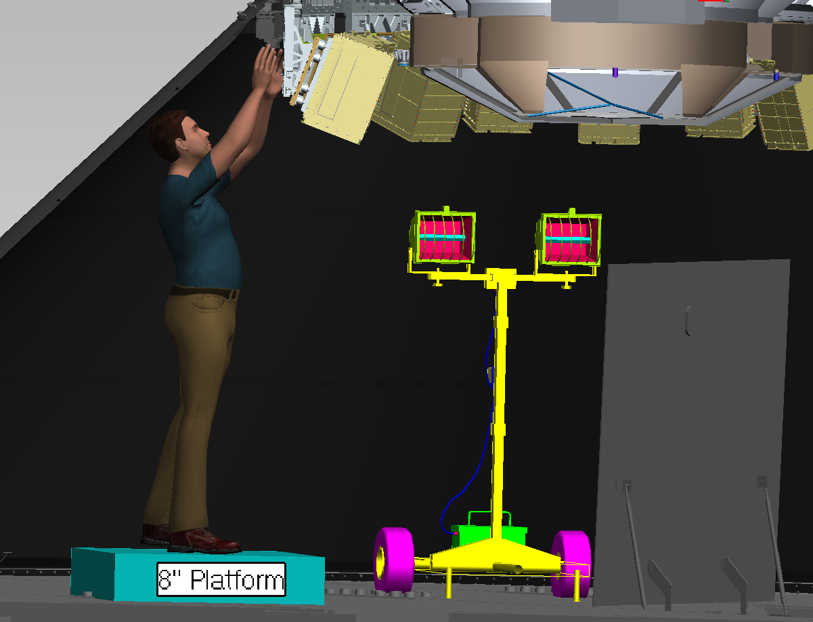
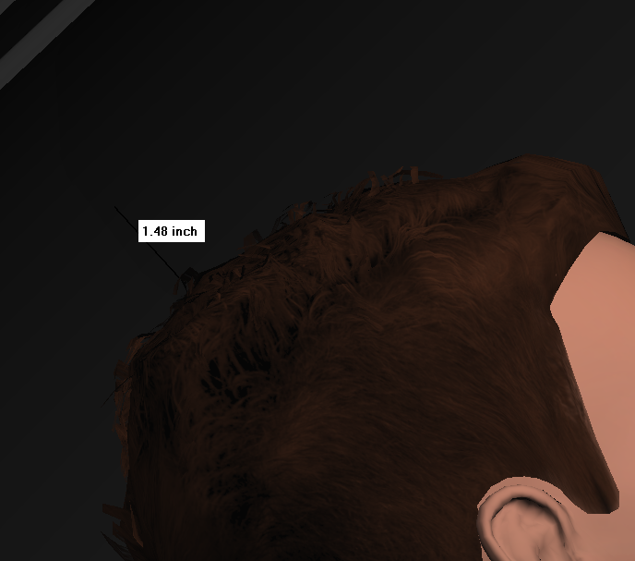
PSH Example #1 – 95th percentile male

Slide 9
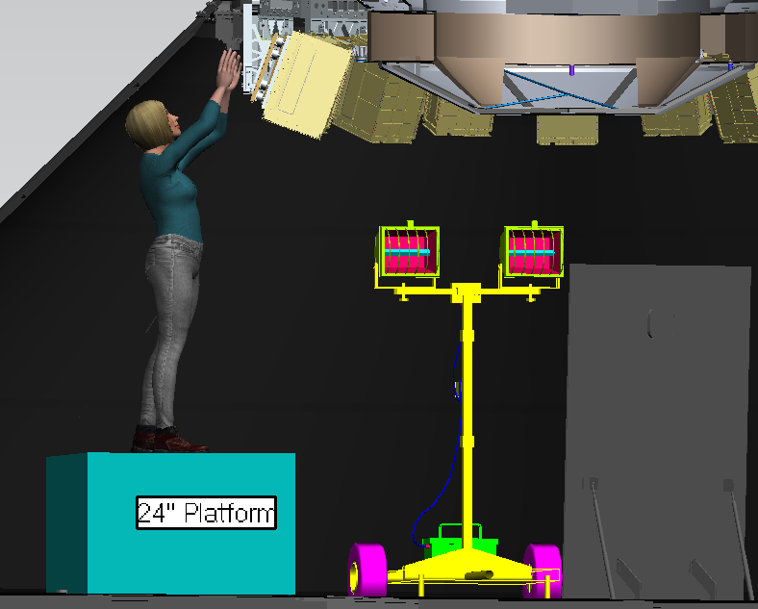
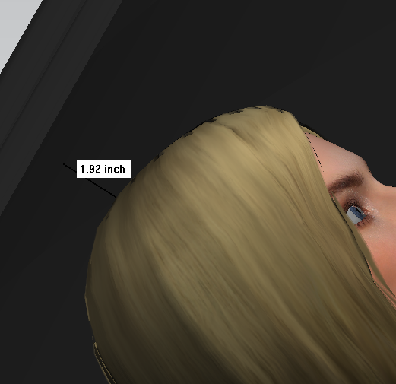
PSH Example #1 – 5th percentile female

Slide 10
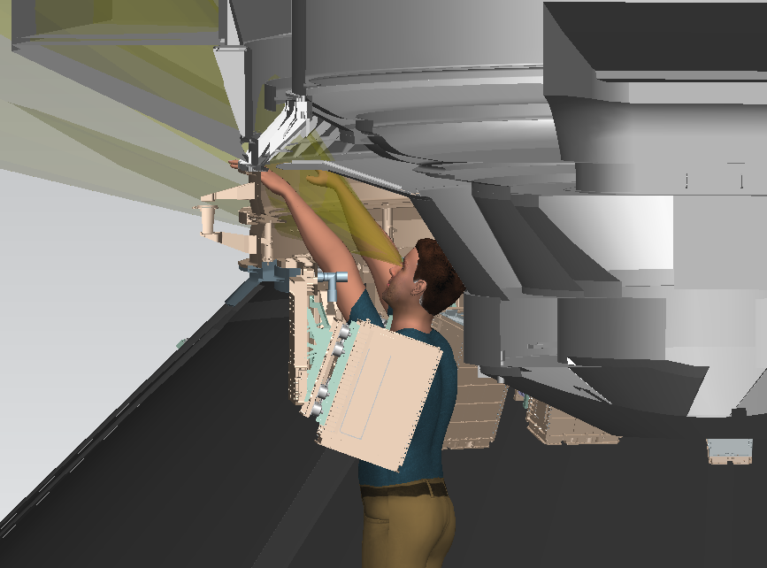
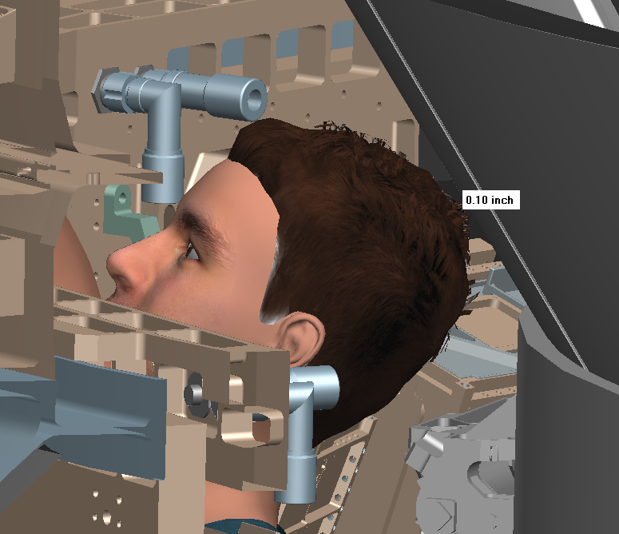
PSH Example #2 – 95th percentile male

Slide 11
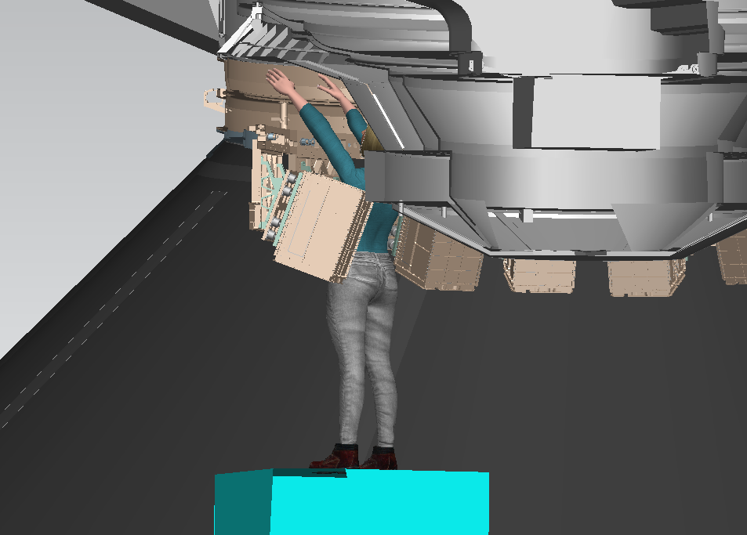
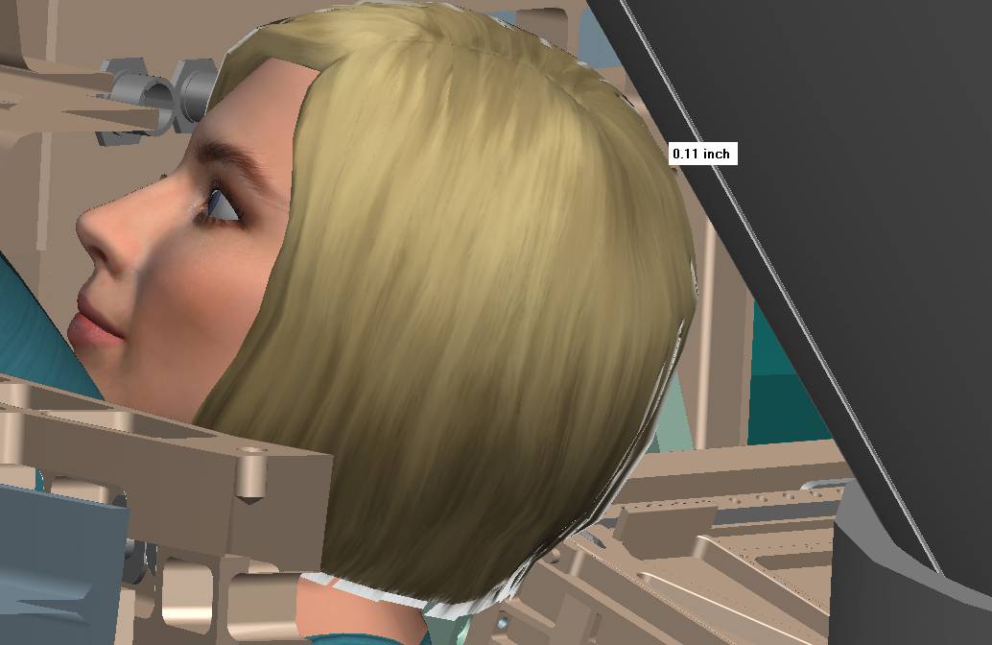
PSH Example #2 – 5th percentile female

Slide 12
Virtual Environments Lab (VEL)
Extended Reality (VR/MR/AR) & Motion Capture

Slide 13
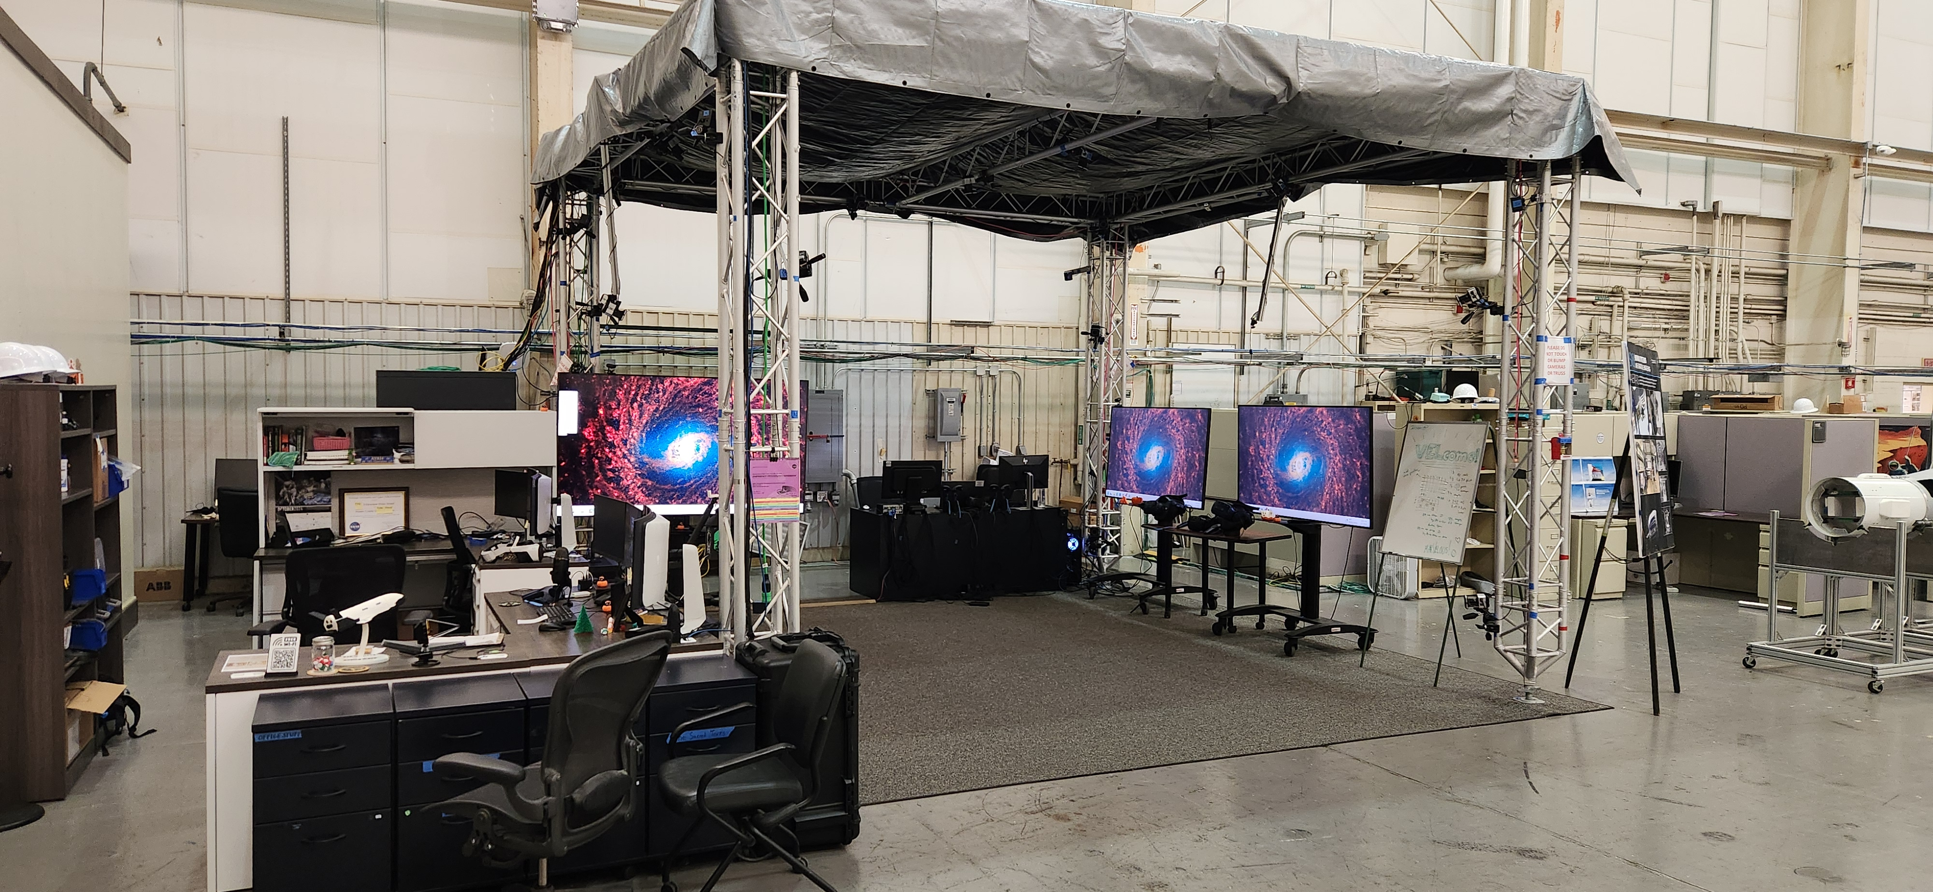
Virtual Environments Lab (VEL)

Slide 14
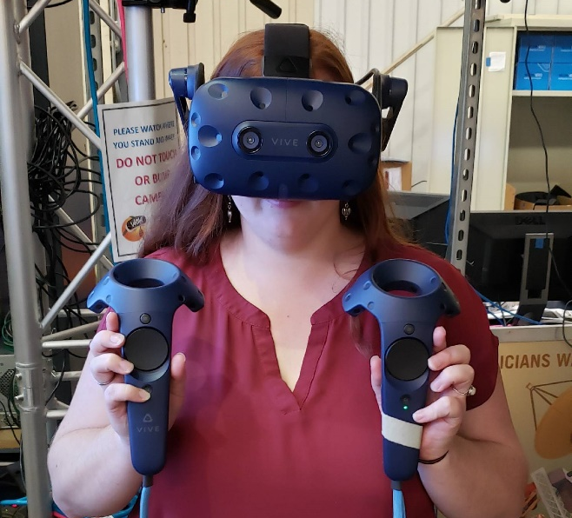
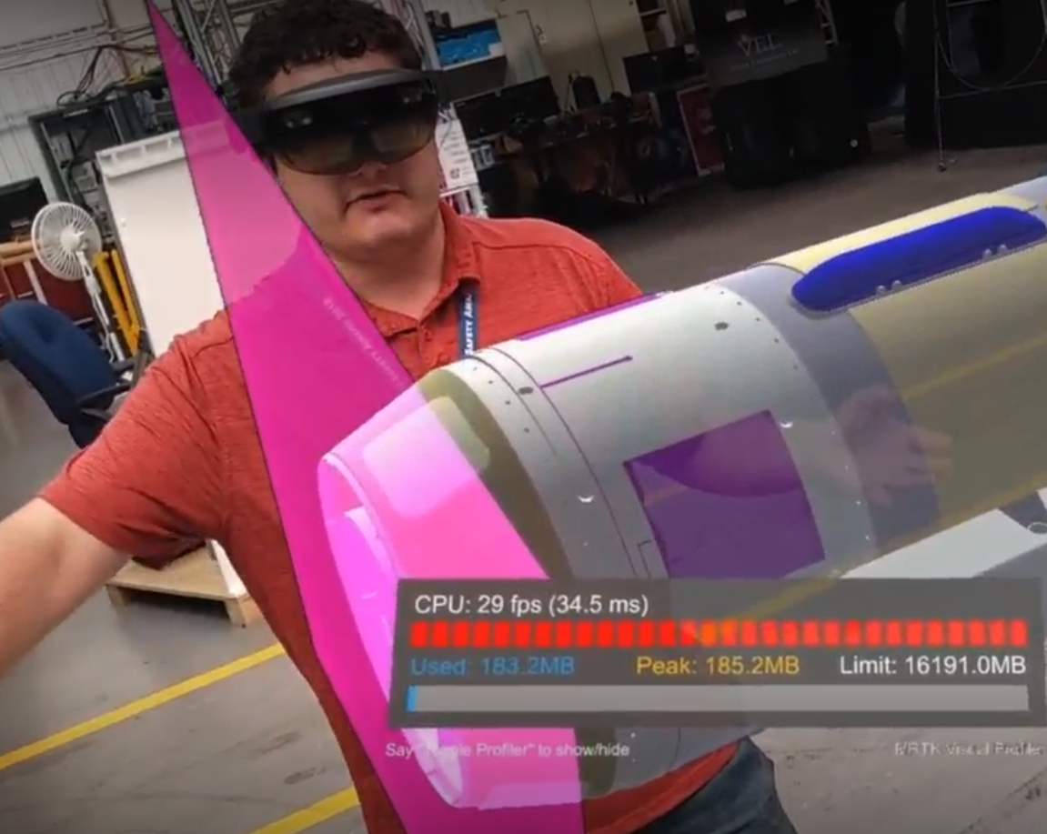
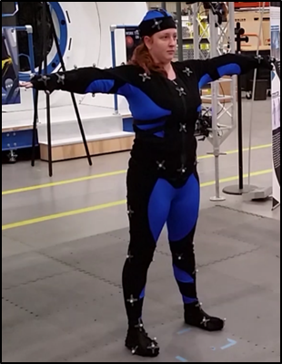
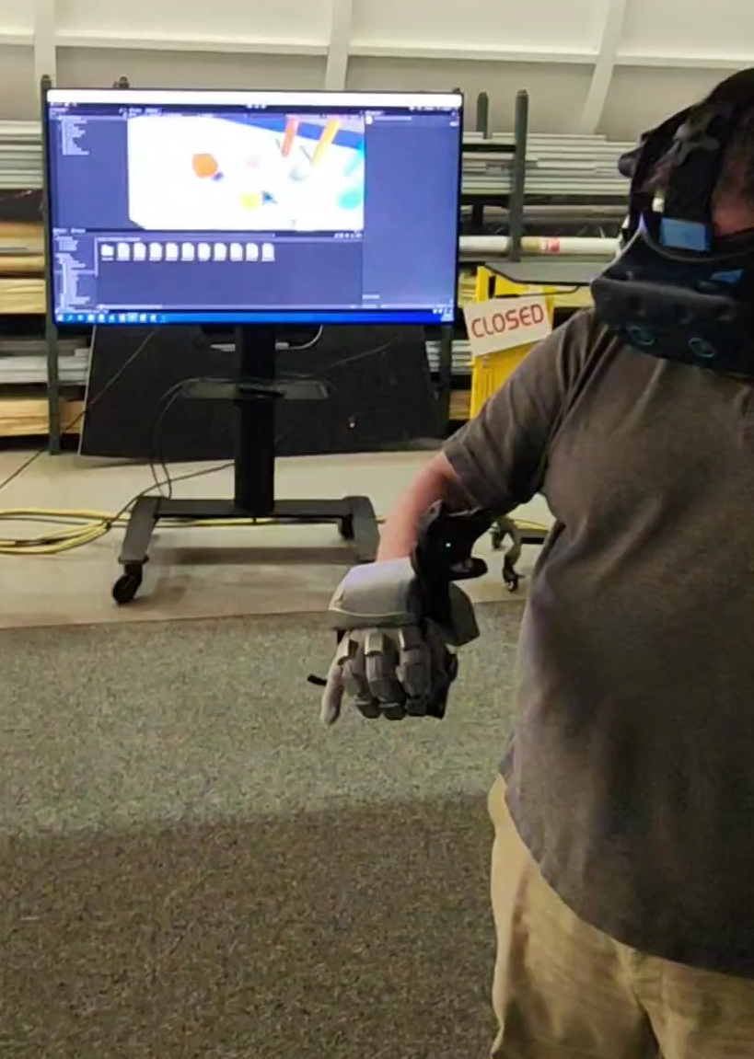
Virtual Environments Lab (VEL)
Augmented Reality (HoloLens)
Virtual Reality
(HTC Vive, Varjo XR4)
Haptic Feedback Gloves (SenseGloves)
Motion Capture (Vicon)

Slide 15
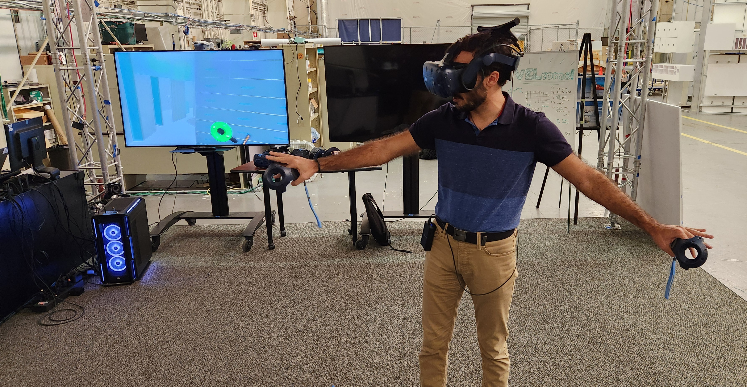
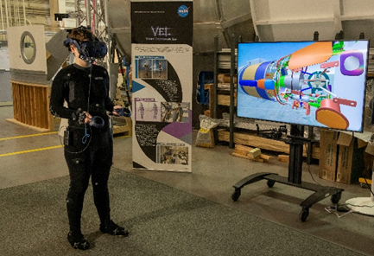
XR as an Engineering Design Tool
Virtual Environments Lab (VEL)
Virtual reality (VR) is used for early, conceptual designs
VR and motion capture are used for design reviews

Slide 16
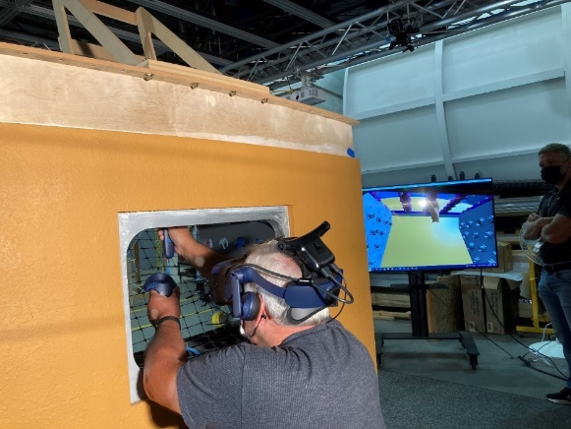
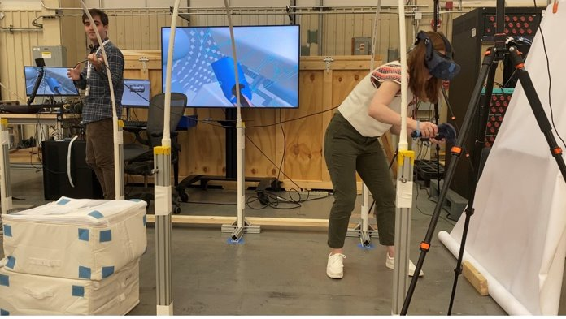
Virtual Environments Lab (VEL)
XR to support Human Factors Engineering Assessments
VR is commonly used to support HFE Assessments
Combining low-fidelity mockups with high-fidelity CAD in VR to provide a physical boundary where needed

Slide 17
Fabrication & Mockups
Part Task Demonstrators

Slide 18
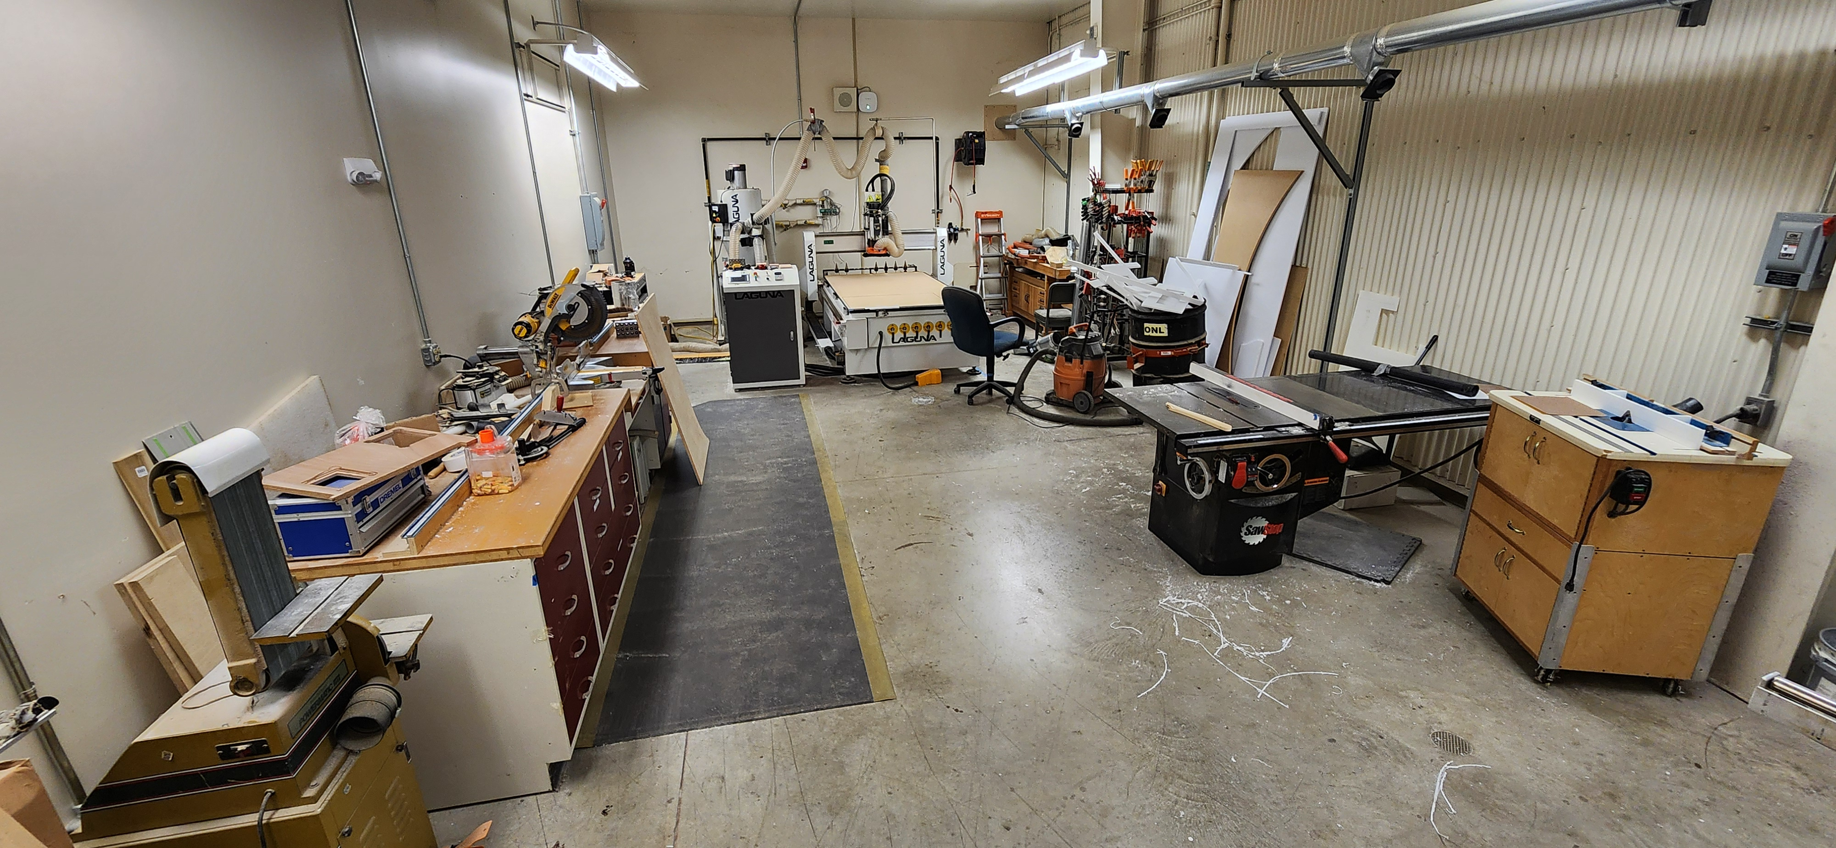
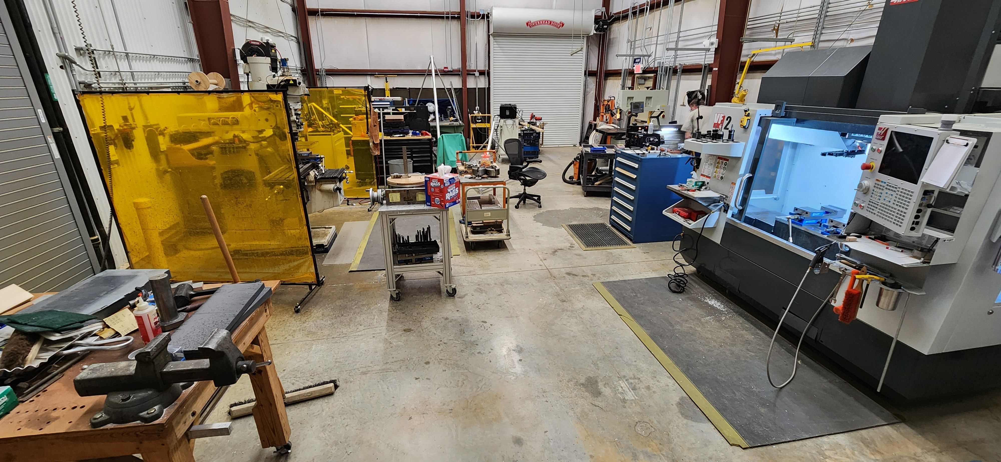
Mockup Fabrication
Wood shop:
CNC Router, 4’x8’ bed
Table saw
Compound chop saw
Metal shop:
CNC 3-Axis Mill
3 Axis Knee Mill
Horizontal Metal Lathe
Welding

Slide 19
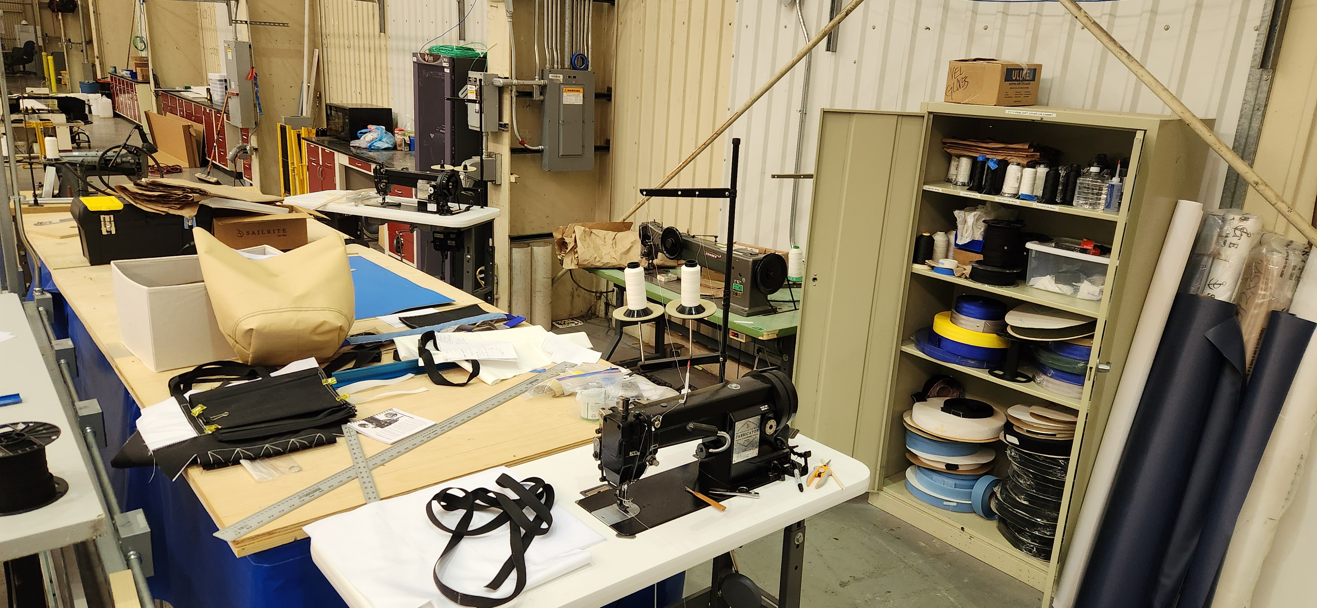
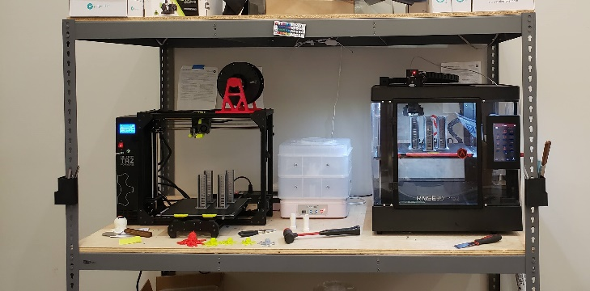
Mockup Fabrication
Soft goods:
Sailrite Fabricators
3D Printing:
LulzBot Taz Workhorse
Raise3D Pro2
Formlabs Form3

Slide 20
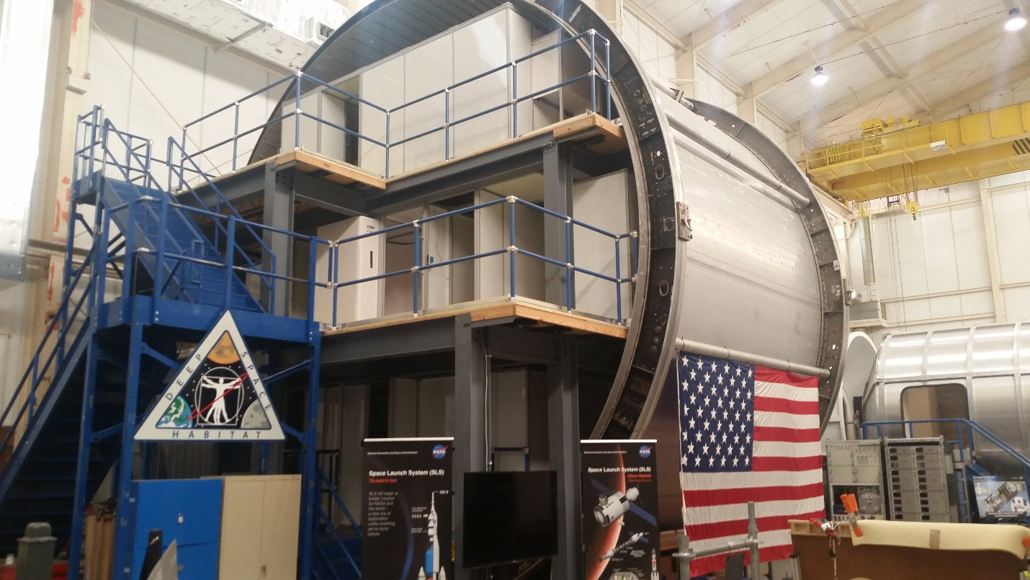
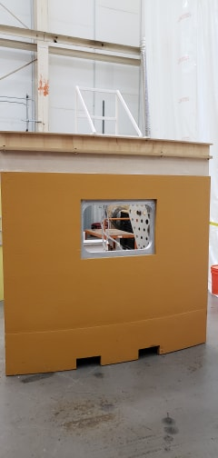
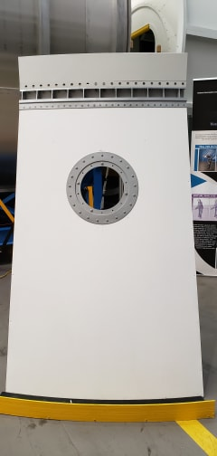
Mockup Fabrication
SLS Part Task Mockups
8.4m Deep Space Habitat Mockup

Slide 21
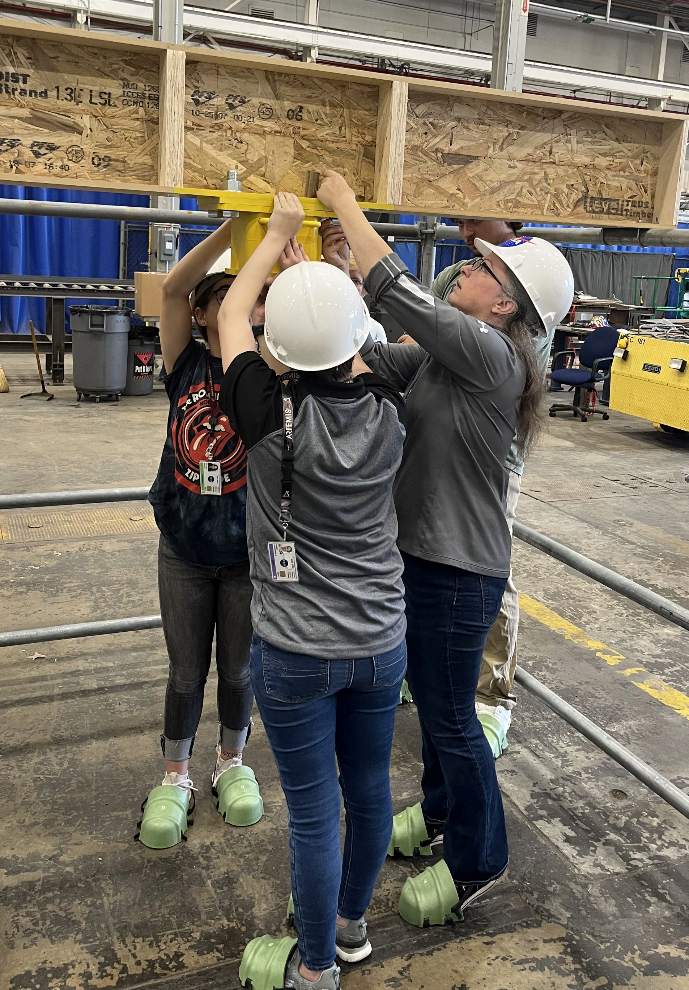
Mockup Assessments
Full-scale mockups are used for both design influence and requirement verification
  Design Influence: Mockups are typically used, and modified/updated, several times throughout the design process
  Verification: Mockups are used for requirement verification via demonstration.
Mockup fidelity is based on the needs of the task to be assessed:
  Volumetric? (Work volume, reach volume, tool clearance, etc.)
  Weight? (Lifting, pulling, etc.)
  Functional? (Electrical mates, component installation)

Slide 22
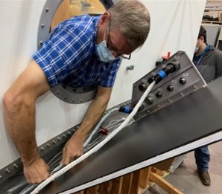
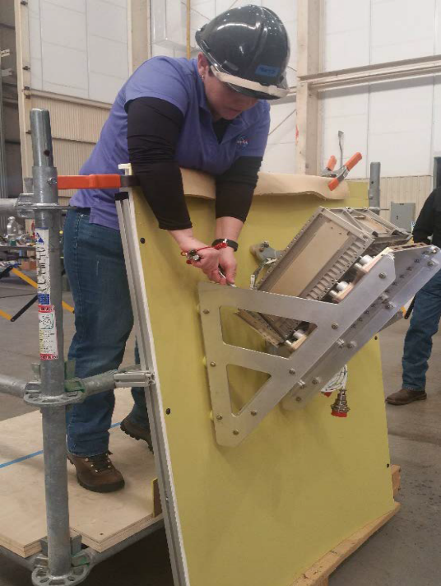
Mockup Assessments
Tasks assessed:
  Installations
  Physical Mates
  Electrical Mates
  Tool clearance? Work volume? Reach access? Visual access?

Slide 23
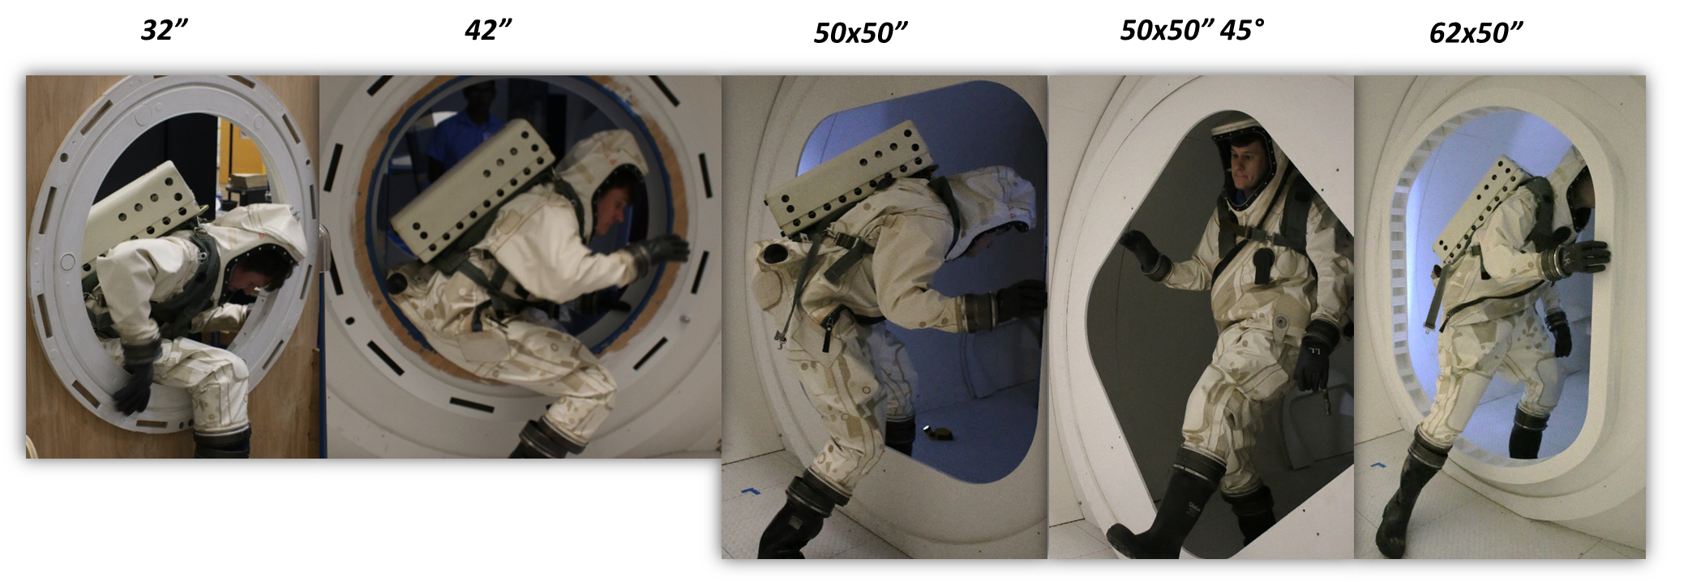
Mockup Assessments
Ingress/Egress activities
Translation activities
  Volume? Visual? Safety? Comfort?

Slide 24
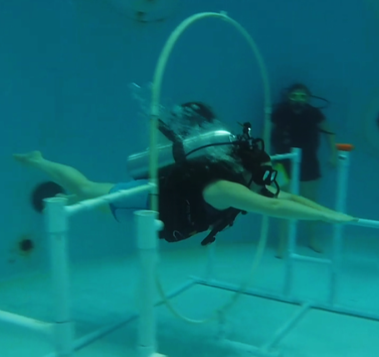
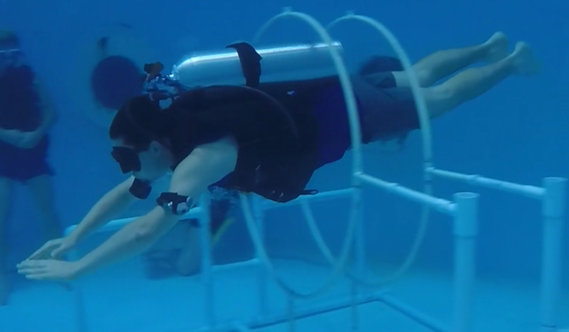
Microgravity Assessments
Translation in a microgravity environment (neutral buoyancy)
Assessments using the Underwater Astronaut Trainer (UAT) at the U.S. Space and Rocket Center
Hatches in docked and undocked configurations.

Slide 25
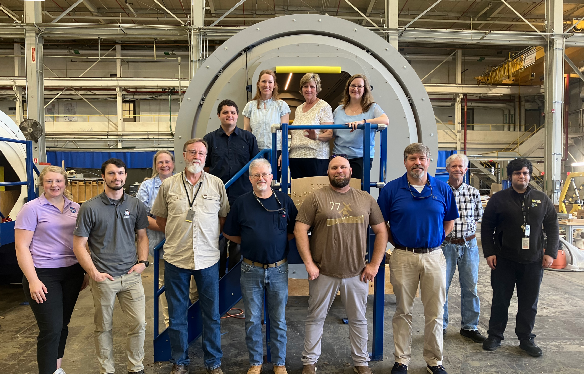
Collaboration at MSFC
Human Systems Integration (HSI) is vital to all design work:
  Habitation
  Ground operations
  Ground support equipment (GSE)
  Lunar lighting environment
  And more!
Bringing in HSI&E team early in the design lifecycle saves time, money, and effort.

Slide 26
Thank You!
Please contact Josh at Joshua.c.Moorhouse@nasa.com to learn more about NASA internships.
https://www.nasa.gov/learning-resources/internship-programs/
Please contact Becky at Rebecca.a.maclaren@nasa.gov to learn more about Amentum (formerly Jacobs) internships.
https://jseg.space/launch-your-career

