Slide 1
Differential absorption lidar for searching water sources on Mars
Zhaoyan Liu ª, Joel F. Campbell ^{b}, Bing Lin ^{b}, Jirong Yu ^{b}, Jihong Geng ^{c}
ªNASA Ames Research Center, Moffett Field, CA94035, USA;
^{b}NASA Langley Research Center, Hampton, VA23681, USA;
^{c}AdValue Photonics, Inc., Tucson, AZ85706, USA.

Slide 2
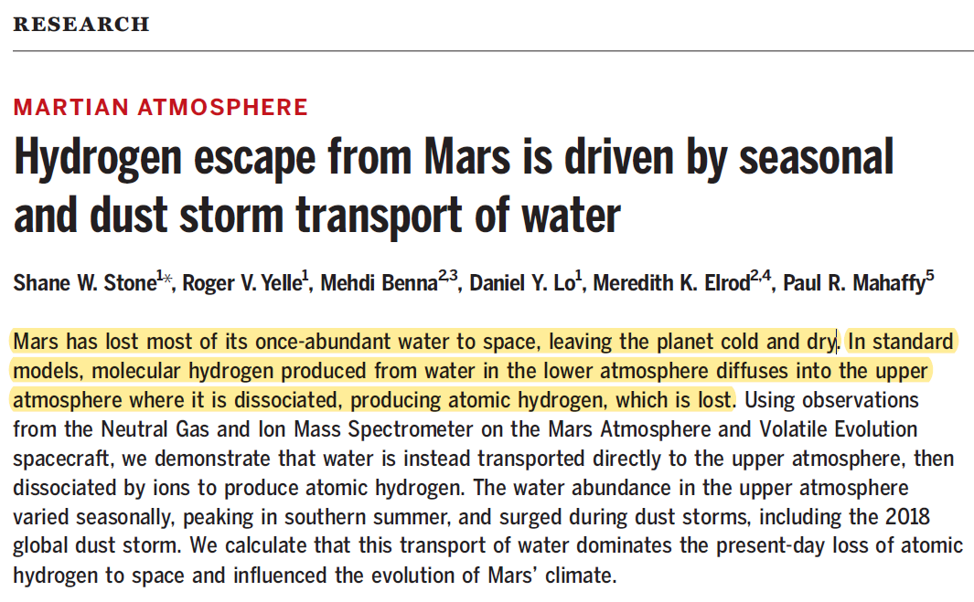
Water Lost on Mars
Stone et al., Science 370, 824–831 (2020)

Slide 3
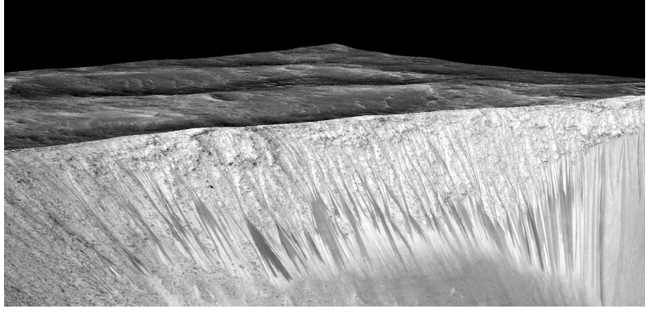
Water on Mars Surface
Mars once had enough water to cover its surface, likely forming rivers, lakes, and possibly even oceans.
Today, observational evidence indicates that while much of this water has been lost to space or locked in ice, traces of water still exist on Mars’ surface, primarily as frozen ice at the poles and possibly as seasonal briny flows in some areas.
Streak lines – hydrated salt: likely a mixture of magnesium perchlorate, magnesium chlorate and sodium perchlorate
The inventory of water on Mars is much greater than scientists had thought

Slide 4
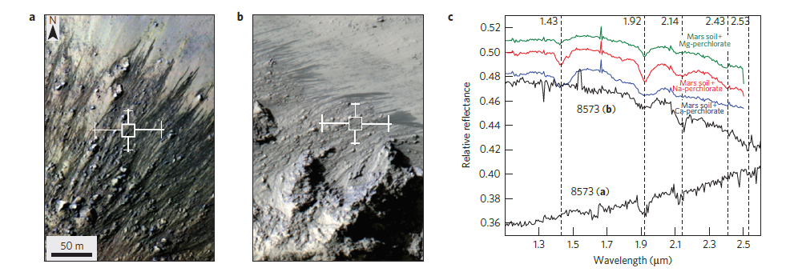
Water on Mars Surface
HiRISE Images
CRISM Spectra
Black spectra correspond to the area in a and b.
Colored spectra are results from spectral mixing between the Martian soil and a variety of slats
Ojha et al., 2015: Spectral evidence for hydrated salts in recurring slope lineae on Mars, Nature Geosci., DOI: 10.1038/NGEO2546

Slide 5
Water Vapor in High Atmosphere
Figure 2. Seasonal map of atmospheric temperature and H₂O mixing ratio during the second half of MY34 and MY35. The data are plotted in function of L_{s} and altitude for the Northern (left) and the Southern (right) hemispheres.
There is an observational gap between the surface and 20 km. It is unclear what the H₂O level would be near the source on ground, but it is anticipated to be greater than 100 ppm.
Belyaev, et al. (2021). Geophysical Research Letters, 48, e2021GL093411.

Slide 6
Water Vapor in High Atmosphere
Figure 1. Example ACS MIR spectra and profiles of the retrieved quantities. H₂O volume mixing ratio (VMR) is around 150 ppm below ~50 km, and the measurement is not available below ~20 km. VMR is expected to be larger than 150 ppm near ground over source regions.
Belyaev, et al. (2021). Revealing a high water abundance in the upper mesosphere of Mars with ACS onboard TGO. Geophysical Research Letters, 48, e2021GL093411.

Slide 7
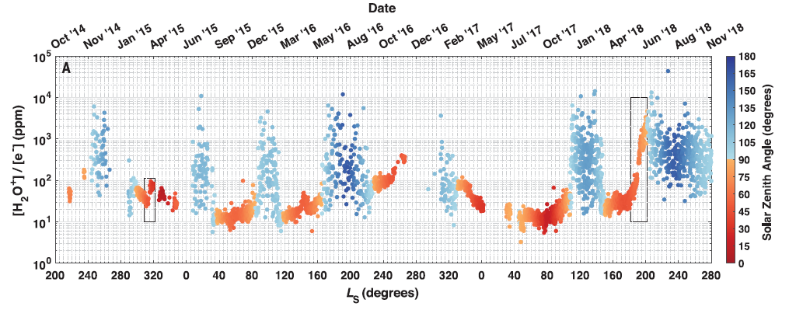
Strong Diurnal Variations Highlight Need for Active Remote Sensing – Lidar
Variation of H2O ions measured using NGIMS. Mean [H2O+]/[e−] for each MAVEN orbit (A) between October 2014 and November 2018. The value of the solar zenith angle is indicated by the color of the circle, as indicated in the colorbar. The transition from red to blue for [H2O+]/[e−] corresponds to the shift from day to night.
Lidar can provide observations both day and night over complex terrains.

Slide 8
Water Vapor Absorption Spectrum
Max absorption cross section = 1.89x10⁻¹⁷ (cm²/molecule) at λ_{max} = 2.6305967 μm

Slide 9
Absorption Line in 2.7 μm Band
Selection criteria: prioritize strong absorption for H₂O, while maintaining minimal absorption for CO₂.

Slide 10
Absorption Line in 2.7 μm Band
Online
Offline
Absorption cross sections at ground level for H₂O and CO₂, with the CO₂ values scaled up by a factor of 10⁸.

Slide 11
Online Wavelength Selection
Absorption remains low at high altitudes and increases as altitude decreases. The AOD is below 0.01 above approximately 27 km and reaches 0.1 below around 14 km. This wavelength selection is advantageous for detecting water sources near the surface.

Slide 12
Simulation Results
AOD ~ 1.08

Slide 13
Simulation Results
For lower laser pulse energies, daytime measurements yield larger errors than nighttime measurements due to the increased influence of solar background noise relative to signal shot noise.
Relative error remains below 0.1 when the laser energy is reduced to approximately 50 µJ.
Setup is adequate for detecting water sources where X_{H2O}​ is expected to be higher.

Slide 14
Table 1. Parameters used in simulations
Parameters
Laser Receiver
Pulse energy 1 mJ Telescope 0.3 m
Pulse duration 500 ns Detector (DRS APD) QE 0.675
PRF 2000 Hz Throughput 0.325
Satellite height 240 km Surface reflectivity 0.161 (sr⁻¹)

Slide 15
Absorption Line Selection in 1.8 μm Band
Online
Offline
From a practical perspective, a laser operating in the 1.8 μm band may be easier to develop than one in the 2.7 μm range. Master oscillator and power amplifier (MOPA) fiber lasers have been demonstrated to generate greater than 1 mJ pulses at 1.97 μm and 2.05 μm. It is anticipated mJ level MOPA fiber lasers can be developed near 1.8 μm.

Slide 16
Online Wavelength Selection
Due to the lower peak absorption of the selected line in the 1.8 μm band, the online wavelength must be closer to the absorption center to achieve a similar AOD. Consequently, this measurement is slightly more sensitive at higher altitudes compared to 2.652613 μm presented earlier.

Slide 17
Sensitivity Comparison

Slide 18
Summary
Observational gap between the surface and 20 km, a critical region for understanding water transport and loss on Mars
Explored the feasibility of using differential absorption lidar (DIAL) to fill the gap and locate water sources
Selected two water vapor absorption lines at 1.839954 μm and 2.652598 μm
Simulations indicate that, with a laser pulse energy of 0.05–1 mJ at a 2000 Hz repetition rate, a 0.3 m telescope, and a HgCdTe APD detector, it is feasible to measure water vapor in Mars' lower atmosphere.
This method could help identify water sources and reveal mechanisms driving water evaporation and atmospheric injection.

Slide 20
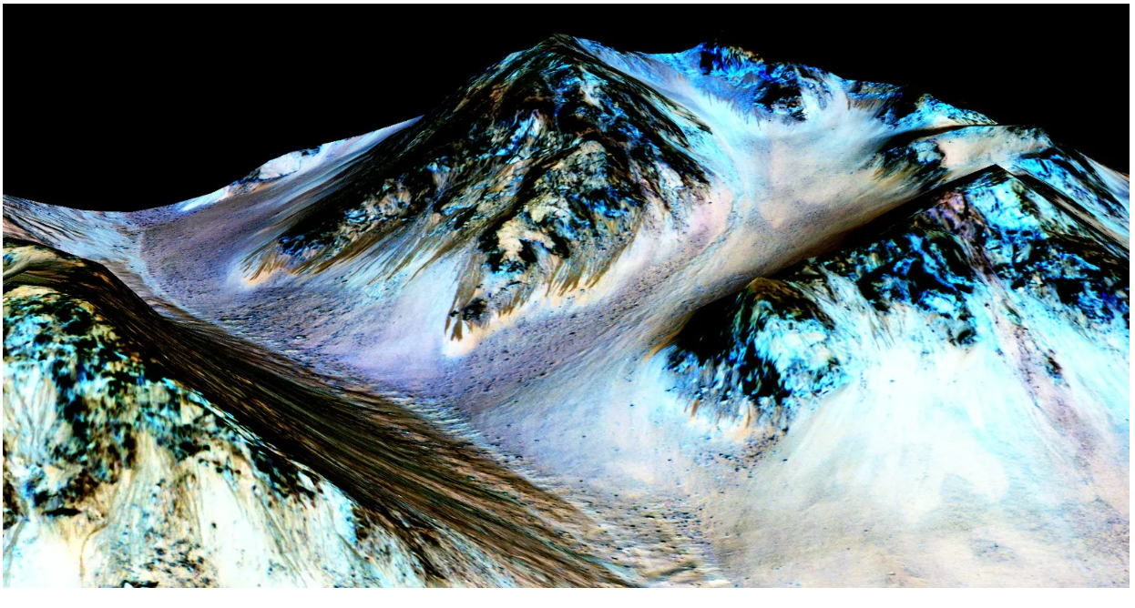
Water on Mars Surface
Recently, planetary scientists detected hydrated salts on these slopes at Hale crater, corroborating their original hypothesis that the streaks are indeed formed by liquid water.
False color image on a Digital Terrain Model (DTM) of the same site produced by High Resolution Imaging Science Experiment (Univ of Arizona).

