Slide 1

Service Provider Technical Interchange
Date: 11/20/2024

Slide 2
Workshop Objectives
Facilitate two-way interactions between DIP team and the service provider community
Discuss high-level technical approaches for the platform and services focusing on:
  Data Governance
  Quality of Services
  Cybersecurity
  Interoperability
Share perspectives on these topics and exchange ideas to drive further enhancement
Each topic will include a 30 min discussion consisting of a presentation by the DIP team and industry/FAA representatives, followed by an open discussion

Slide 3
Agenda
Time (PST) | Topic |  | Presenter | POC
10:00 – 10:10 | Welcome and introduction |  | Yoon Jung | NASA
10:10 – 10:20 | DIP Strategic Partnership Plan |  | Swati Saxena | NASA
10:20 – 12:30 | Technical Interchange
10:20 – 10:30 | Data Governance | DIP Presentation | Mohana Gurram | NASA
10:30 – 10:40 |  | Industry Presentation | Ed Freeborn | Unmanned Experts (UMEX)
10:40 – 10:50 |  | Q/A - Open discussion
10:50 – 11:00 | Quality of Services | DIP Presentation | Pallavi Hegde | NASA
11:00 – 11:10 |  | Industry Presentation | Don Berchoff | TruWeather Solutions
11:10 – 11:20 |  | Q/A - Open discussion
11:20 - 11:30 | Break
11:30 - 11:40 | Cybersecurity | DIP presentation | Mohamad Refai | NASA
11:40 - 11:50 |  | Industry Presentation
11:50 - 12:00 |  | Q/A - Open Discussion
12:00 – 12:10 | Interoperability | DIP Presentation | Mohana Gurram | NASA
12:10 – 12-20 |  | Industry Presentation
12:20 - 12:30 |  | Q/A - Open Discussion
12:30 - 12:40 | Summary and Wrap-up |  | Swati Saxena | NASA

Slide 4
Ground Rules
Please turn off your mic and camera (for bandwidth issue)
There will be Q&A times throughout the session and at the end
  Our questions for you posted in https://arc.cnf.io/sessions/r9pz/#!/dashboard
  You can post questions
    in the same Conferences.io link or
    in the MS Teams chat box
Video recording, slides, and discussion summary will be available on DIP website after the workshop
There will be one 10 min break

Slide 5
DIP Strategic Partnership Plan

Slide 6

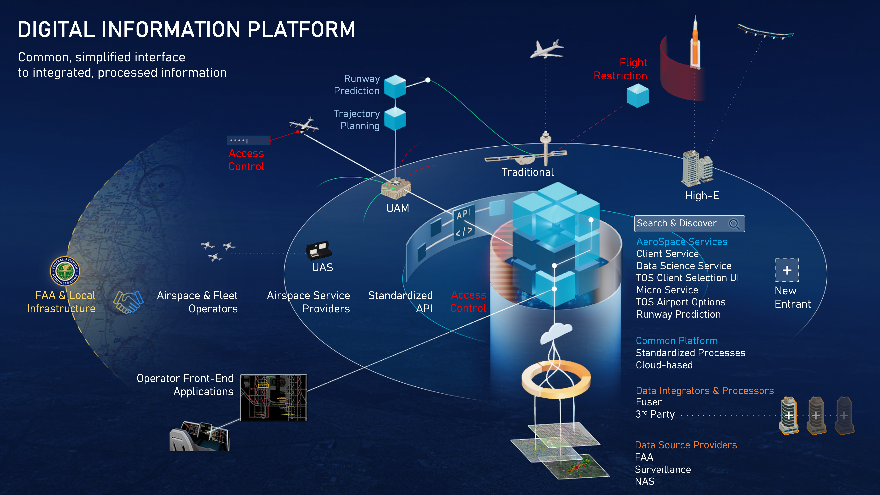
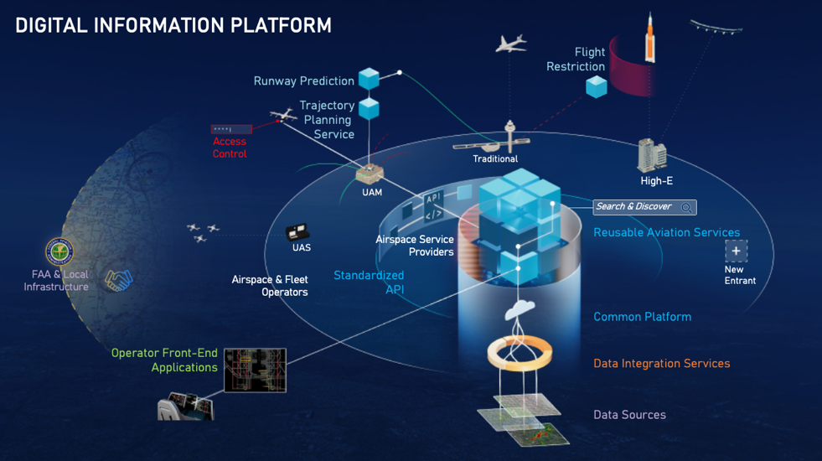






Digital Information Platform (DIP)
for NASA’s Sustainable Flight National Partnership (SFNP) Mission
Development and demonstration of a digital service-oriented framework to enable increasingly safe and sustainable operations for today and the future airspace system
Service-Oriented Cloud Based Infrastructure Supporting FAA’s Info-Centric NAS
Predictive Services with ML Capabilities
Building reusable data integration services and AI/ML based predictive services for safe and sustainable operations.
Reference Platform
Informing platform interoperability requirements and best practices to enable innovative ecosystems
SFNP Operations Demos
Demonstrating sustainability benefits derived using DIP services in today’s NAS

Slide 7

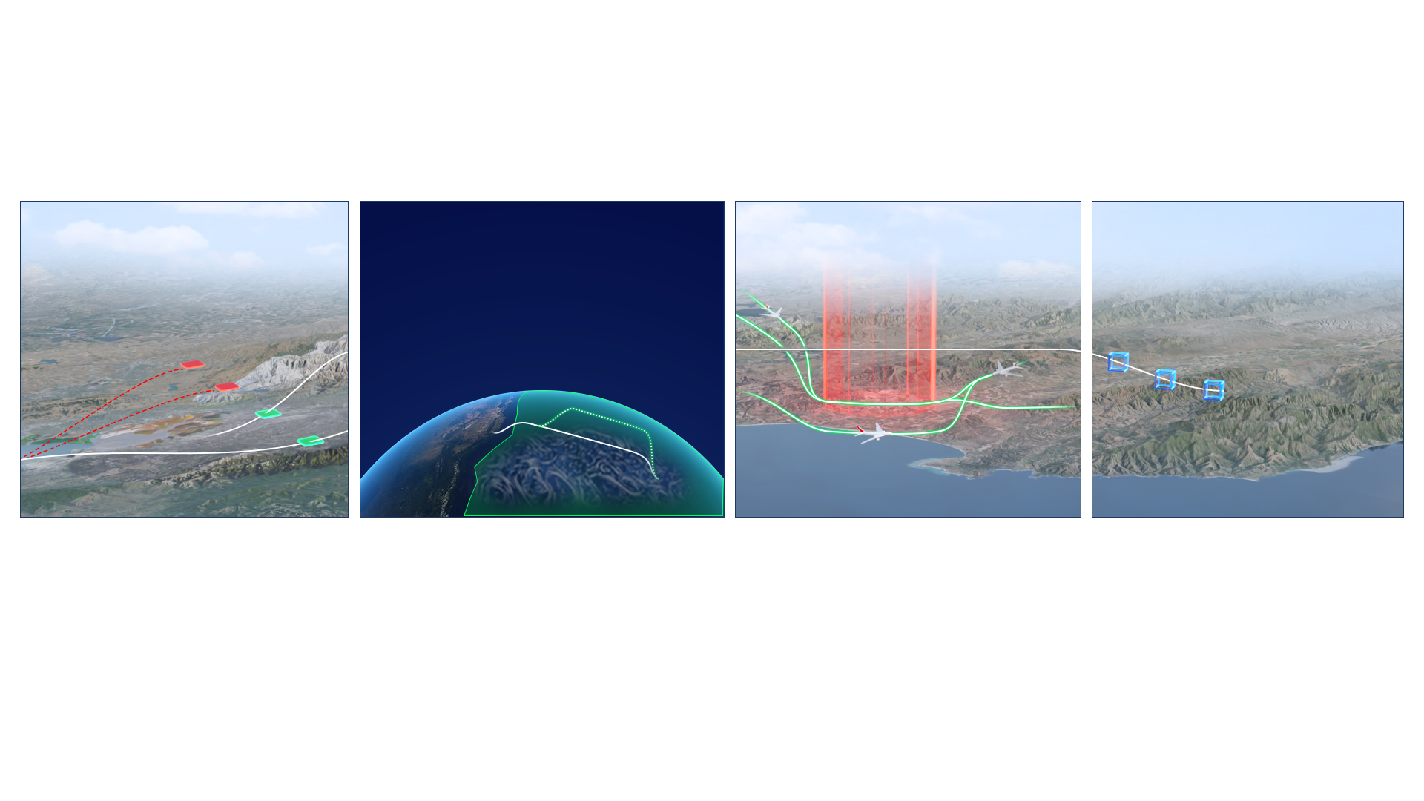
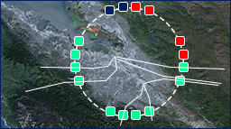
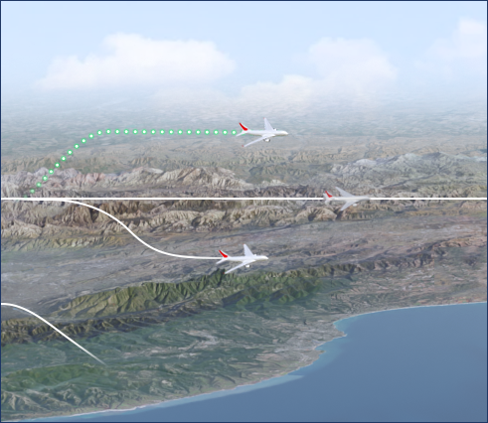






Aviation Services for Efficient Rerouting
ATM-X – Digital Information Platform
Pre-Departure Rerouting
Oceanic Rerouting
Fleetwide Disruption Management
Capstone Demo
Oceanic Re-Routing
Oceanic FIR
FY 22-25
Operator and ATC digital services in a metroplex and a complex multicenter environment
FY 23-27
Integrated Pre & Post Departure Rerouting to inform FAA future messaging requirements (FF-ICE)
FY 24-28
Fleet-wide rerouting services for intelligent disruption management recover strategies
FY 25-30
4D trajectory optimization through an end-to-end digital workflow across NAS users
Utilizing NASA, FAA, and airline operator assets to support increasingly efficient aviation operations
Notes:
FF-ICE: Flight and Flow Information for a Collaborative Environment

Slide 8


DIP Partnership With Service Providers
Partners will have access to the DIP and other partner services available on the DIP Reference Platform.
DIP partnership needs are tied to the Sustainable Flight National Partnership (SFNP) operational demonstrations series.
DIP will continue to seek partnership opportunities with service providers to support the demos and/or support interoperability and cybersecurity use cases via external services and platforms.
Possible mechanisms to partner with DIP:
  Non-reimbursable Space Act Agreement (SAA),
  SBIR contracts,
  Other NASA funding mechanisms such as University Leadership Initiative (ULI)
Last Updated: Oct 2024

Slide 9
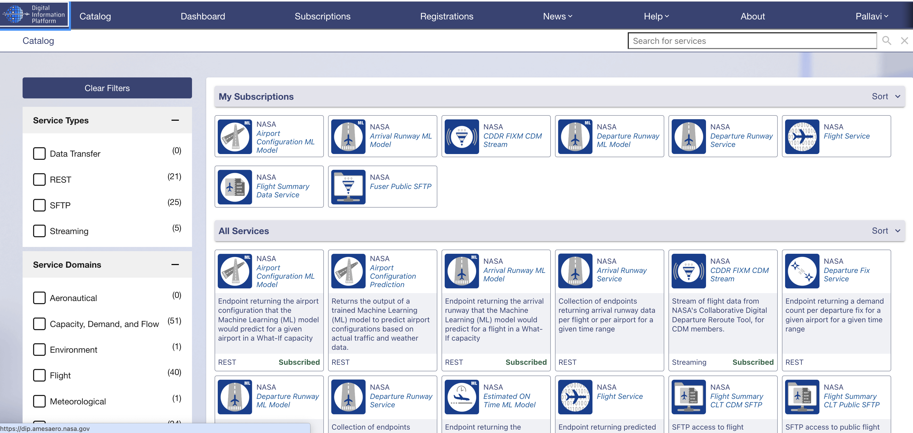
Reference Platform
CDDR Use Cases and Benefit Mechanisms
This is a snapshot of the current user interface of the Platform. Service Catalog lists all the services registered with the Platform

Slide 10
NASA Services on the Platform
CDDR Use Cases and Benefit Mechanisms
Streaming Services
E.g., Fuser FIXM public and CDM services
Streaming services are pub/sub connections
Fuser provides real-time update of processed data from SWIM data sources and integrated with NASA Airport surface orchestrator
Data Access REST Services
E.g., TMI, flight data, runway times, taxi times, timeline
Data Access services that provide near real-time data from Fuser data
Services return an actual, detected or modeled values of time or runway or fix (except for TMI service)
Machine Learning (ML) REST Services
E.g., airport configuration, runway, and taxi times
ML models available for what-if applications
(input request returns a predicted value)
ML services are services to build modeled values in the Data Access services
Archival Services
E.g., SFTP for Flight summary, TMI and Fuser files
Access to archived files of Fuser and TMI services
Up to 6 months of data
Transfer amount is capped
Non-NASA services will be registered on the platform through partnership

Slide 11
Technical Interchange Topics
Discuss technical approaches
    Data Governance
    Quality of Services
    Cybersecurity
    Interoperability

Slide 12
Data Governance

Slide 13
Definition and Scope
Definition: A set of Guidelines, Policies and Processes to collect, store, protect and use data, also includes defining the roles and responsibilities of those involved in managing data.
Scope
Authentication and Authorization Policies
Data Compliance Policies
Data Governance Guidelines
Non-NASA Partner Entity Service Availability Policies
Note
DIP relies on AWS Policy Management Tools to Define and Enforce Policies on DIP resources.

Slide 14
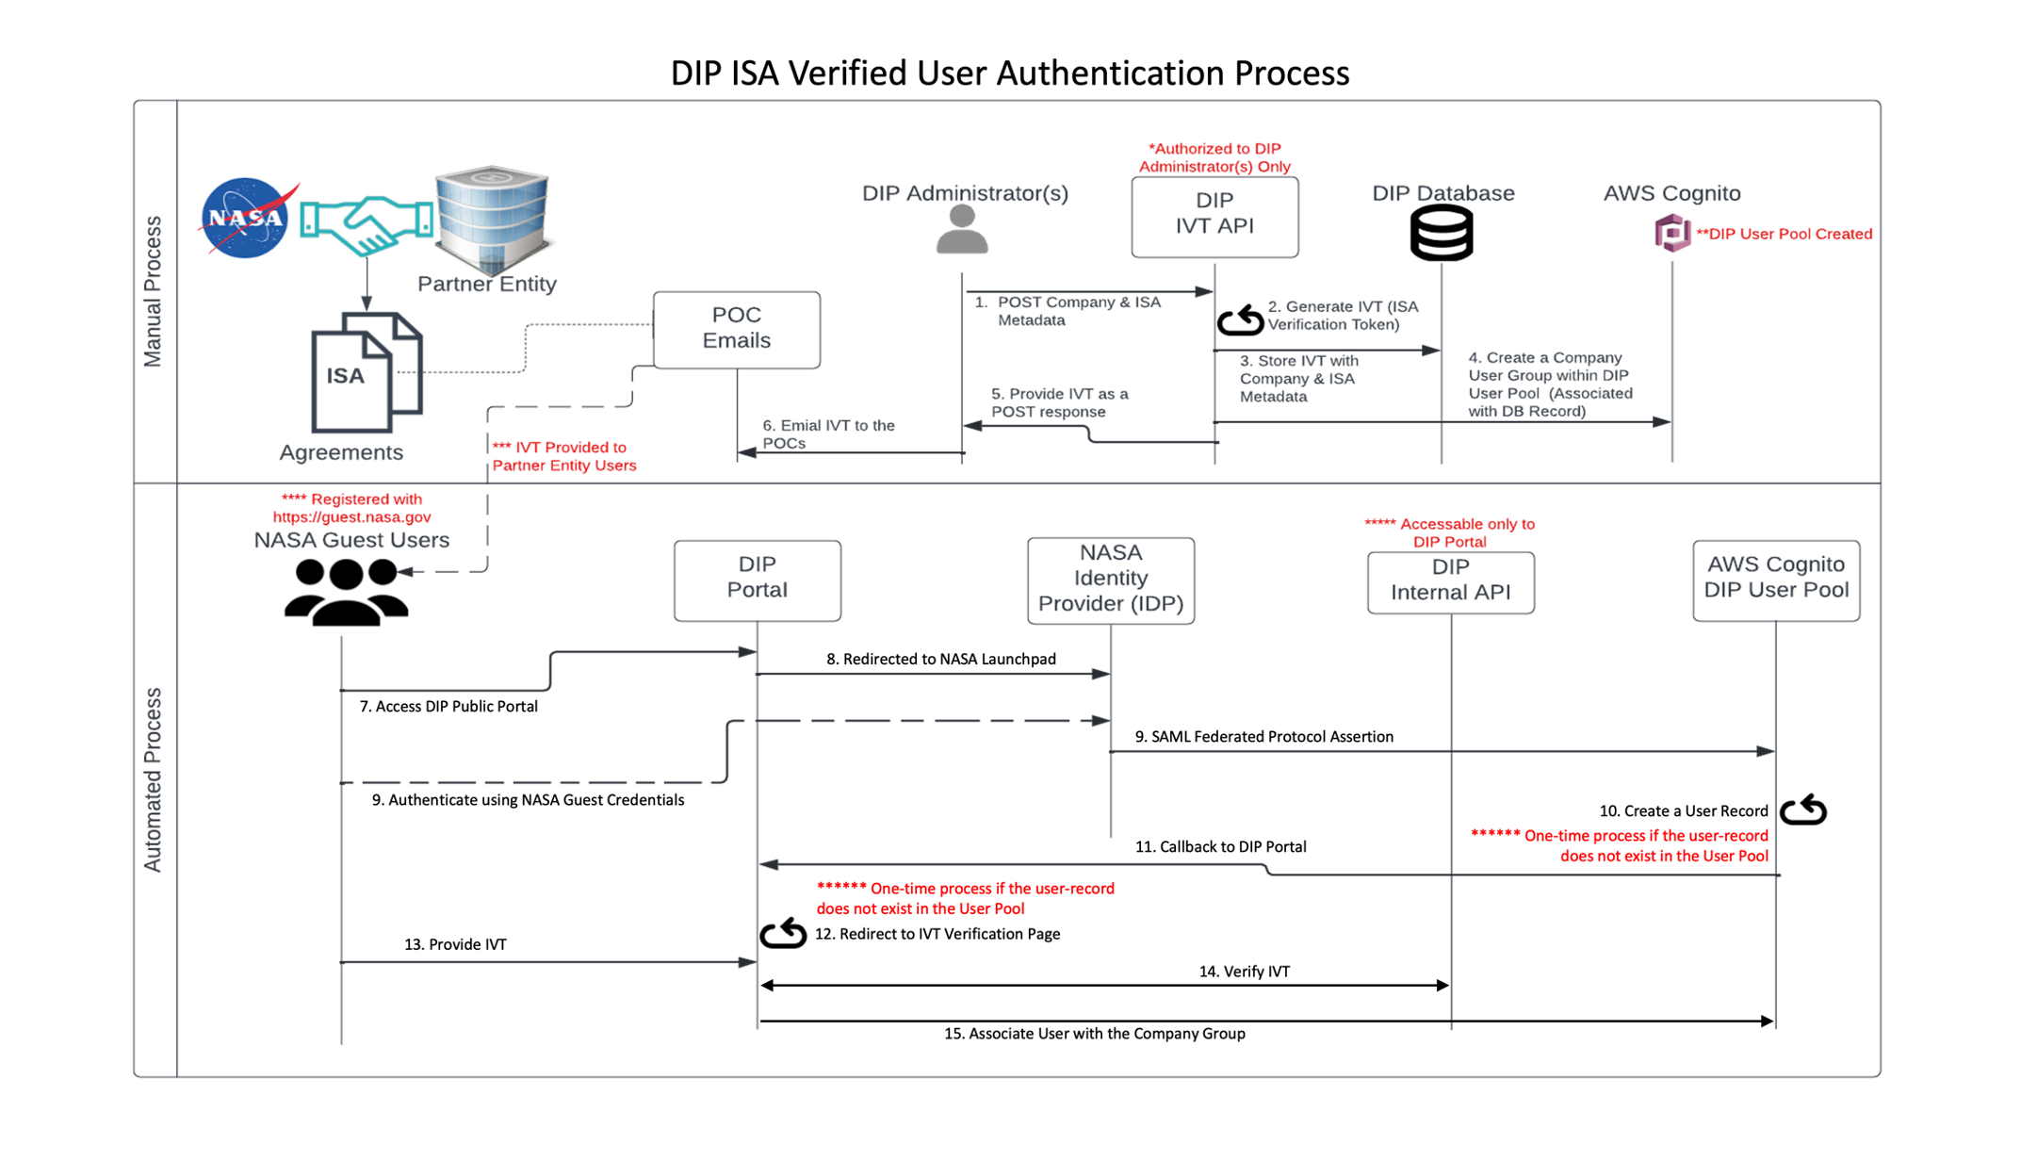
Authentication
The following process defines the steps required to address User Authentication aspect of DIP Governance Policies.
Key Takeaways
Users will require NASA Guest Account to access DIP resources.
Users associated with Invitation Verification Tokens (IVTs) are grouped as Partner Entity Users.
Partner Entities with Interconnection Security Agreements (ISA's) have more privileges than Public Users in terms of resource access.

Slide 15
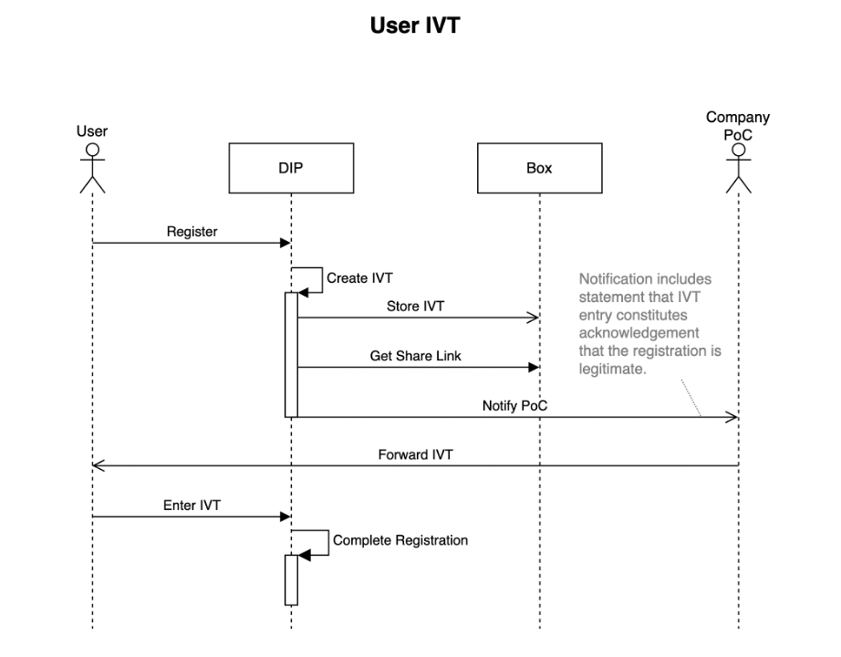
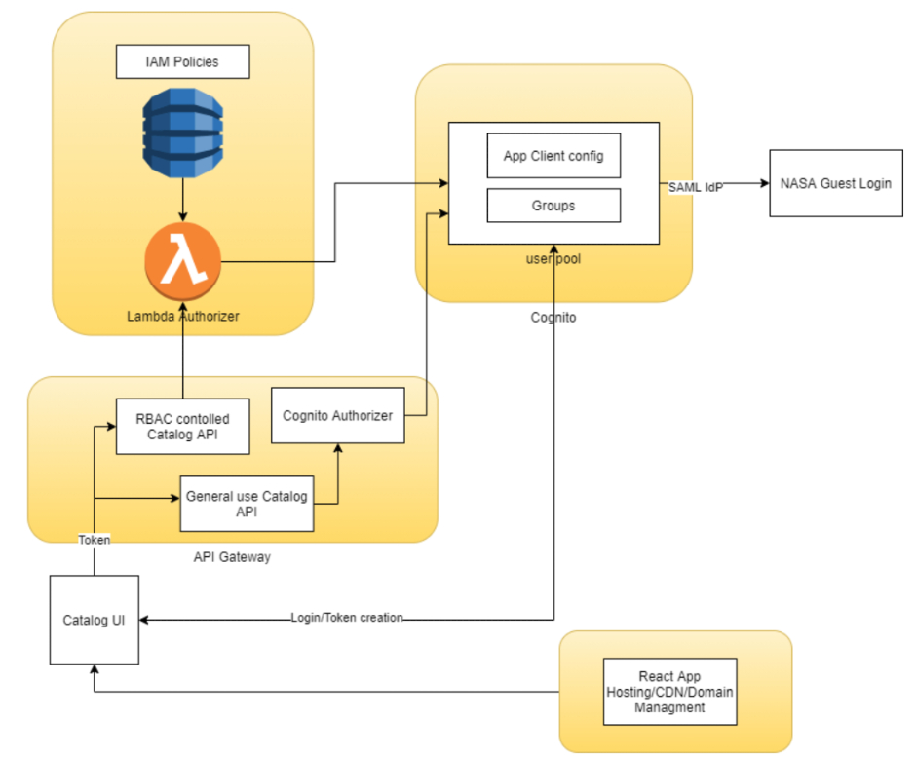
Authorization
The following Data Flow diagrams provide an overview of the IVT Procurement and Authorization process.
User Authorization
Key Takeaways
IVT is shared by all Users associated with a Partner Entity.
Users associated with a Partner Entity are grouped together using AWS Cognito user pool.
User Authorizations are managed by AWS Custom Lambda Authorizers.
RBAC (Role Based Access Control) model is used to manage authorizations at a granular level.

Slide 16
Data Compliance
Following categorizations provide an overview of the Data Sensitivity Governance aspect.
Data Sensitivity
Public Data: Data cleared for Export Control by NASA.
Data with Low Sensitivity: Data managed by authorization rules to be accessible to Service Provider managed selective entities.
Data with Moderate Sensitivity: Data managed by authorization rules to be accessible to selective entities managed by Agencies and Consortiums like FAA, NASA etc.
API and Security Standards
All data in transit is encrypted using standard PKI practices.
All Data in Storage is secured as per the Security Plan Policies defined by NASA and Infrastructure providers like AWS.
API's accessible on DIP platform are compliant to Open-API standards.
API updates follow a standard naming convention for version control management.
Archive data is accessible via standard protocols like SFTP, and APIs are compliant with REST standards.
PII Data
DIP system does not allow any sensitive PII data to be associated with its resources.
DIP only allows and manages following non-sensitive PII data.
  Name
  Email
  Team Name
  Company/Organization/Partner Name
Semantic Data Standards
A subset of APIs accessible via DIP are compliant to FAA data standards like FIXM.

Slide 17
Data Quality Governance
Following Metrics and Guidelines provide an overview of the Data Quality Governance aspect.
Metrics
Completeness: Provide metrics on missing intervals of data.
Timeliness: Metrics associated with time taken to collect, process and made available to use.
Consistency: Metrics to verify if data stored across multiple storage spaces have same data values for same records.
Validity: Metrics on continuous compliance to data syntax, format and standards.
Reliability: Metrics on interruptions to store data as well as access data across data resources.
Usability: Metrics indicating the consumption of data in different formats, to identify the preferred used formats among customer groups.
Sample Guidelines
Completeness
    Archive Data: 2-3 Days.
    Streaming Data: 60 Seconds.
Timeliness
    Archive Data: One Week.
    Streaming Data: Less than a Second.
Consistency
    Archive Data: 100%
    Streaming Data: NA
Validity
    Archive Data: 100%
    Streaming Data: 100%
Reliability
    Archive Data: 2-3 Hours.
    Streaming Data: NA

Slide 18
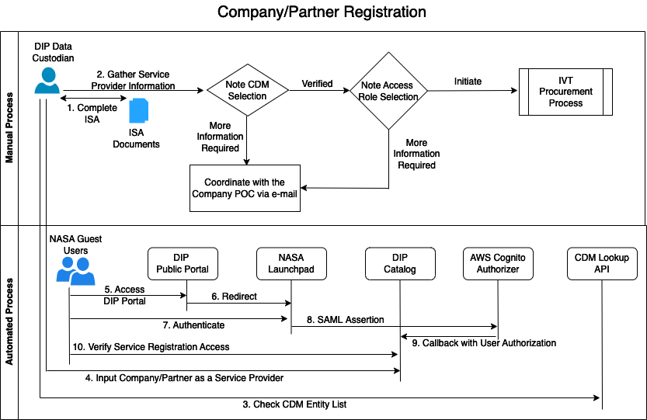
Partner Entity Service Availability Policies
The following process diagram illustrates the sequence of steps involved for a Company entity to be associated with the DIP platform.
Key Takeaways
DIP Data Custodian manually registers a Company/Partner Entity with DIP.
DIP Data Custodian verifies Partner Entities association with CDM (Collaborative Decision Making).
DIP Data Custodian assigns Partner Entities access control privileges.

Slide 19
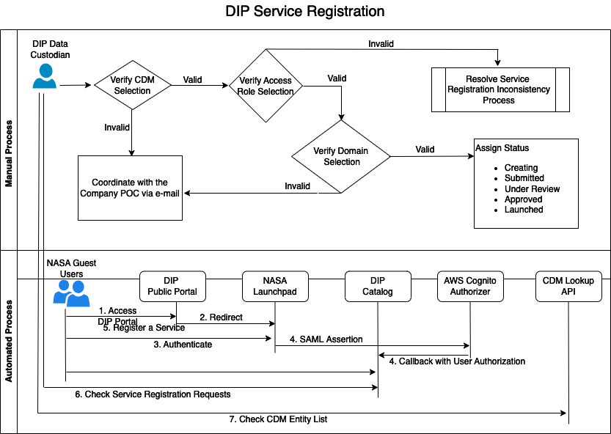
Partner Entity Service Availability Policies
The following process diagram illustrates the sequence of steps involved for a Company entity to provide Services via DIP platform.
Key Takeaways
Partner Entity Users can register their Services with DIP after the Company registration process is completed.
DIP Data Custodian verifies registered Service association with CDM (Collaborative Decision Making) selection.
DIP Data Custodian verifies registered Service access control selections.

Slide 20
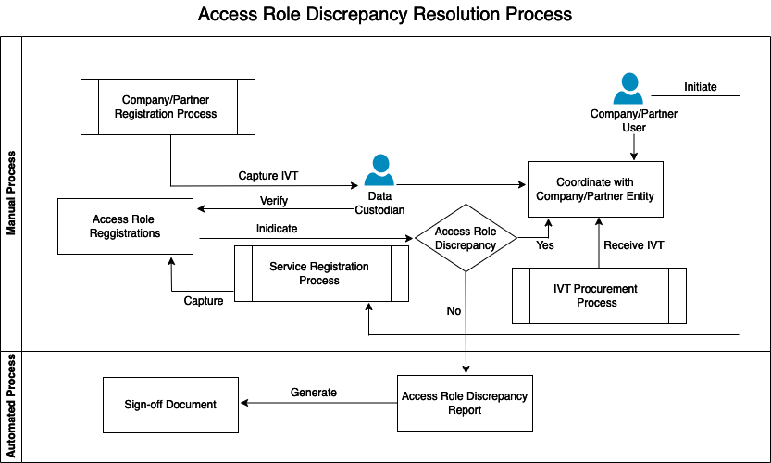
Partner Entity Service Availability Policies
The following process diagram illustrates the sequence of steps involved for the DIP Data Curator to align Service registration Access Roles with associated Company registration Access Roles.
Key Takeaways
DIP Data Custodian manually interacts with the Partner Entity POC (Point of Contact) to address Service Registration discrepancies with the Company Registration privileges.
DIP Data Custodian generates Discrepancy Reports and Sign-off documents.

Slide 21
Discussion Points
    Any recommended data principles used by your Organization to define Governance Policies?
    What Data Governance Policies that are critical to your Organization?
    What roles and responsibilities are defined as part of Data Governance in your Organization?

Slide 22
Quality of Services

Slide 23
Quality of Services
Definition: Quality of service (QoS) is the description or measurement of the overall performance of a service.
Scope
The DIP Platform follows quality guidelines and processes to ensure that Platform delivers quality services to DIP users.
These quality guidelines aim to ensure that the services provided align with both the DIP sub-project objectives and the goals of the stakeholders.
The Metrics associated with defining these guidelines depend on the type of Service
    Metrics for Prediction Services
      Machine Learning (ML) Services
    Metrics for Data Services
    Generic metrics for all Services

Slide 24
Model Evaluation Basics
Model evaluation is the process that uses quantifiable metrics to analyze the performance of the model.
Understanding how the model interprets the data is very crucial!
Machine Learning models can be categorized into two main types:
1: Regression models
Continuous output; use a metric based on calculating some sort of distance between predicted and ground truth.
Common Metrics for evaluating Regression models are:
  Mean Absolute Error (MAE)
  Mean Squared Error (MSE)
  Root Mean Squared Error (RMSE)
  R² (R-Squared)
2: Classification models
Discrete output; use a metric that compares discrete classes in some form. Classification Metrics evaluate a model’s performance and tell you how good or bad the classification is, but each of them evaluates it in a different way.
Common Metrics for evaluating Classification models are:
  Accuracy
  Confusion Matrix (not a metric but fundamental to others)
  Precision and Recall
  F1-score
  AU-ROC
Notes:
Predictive modeling is a statistical method used to predict future events by analyzing past data.
It involves creating a mathematical model that processes relevant input variables to produce a predicted outcome. Machine learning algorithms are applied to train and refine these models, enhancing decision-making accuracy.

Slide 25
DIP Metrics for ML Models
DIP focused on the following metrics for the Prediction Services registered on the Platform
  Regression Models - Median Absolute Deviation (MAD) residual and Median Absolute Error (MAE)
  Classification Models - Accuracy
 | Regression | Classification
Models | Estimated On Taxi In Taxi Out | Airport Configuration Arrival Runway Departure Runway
Metrics | MAD residual Median Absolute Error Mean Absolute Error Percent within +/- X minutes Mean Squared Error Root Mean Squared Error | Accuracy Precision Recall F1-score Fraction in configuration

Slide 26
Classification Models and Metrics
Digital Information Platform hosts many ML Models/services developed by NASA and DIP.
DIP continuously evaluates models and tracks their performances.
There are numerous metrics available for Classification models in DIP, some of evaluated metrics are listed below for KDFW Airport.
Classification Models | Metrics | Values
Arrival Runway | Accuracy Precision Recall | 73% 72% 73%
Departure Runway | Accuracy Precision Recall | 91% 91% 91%

Slide 27
Regression Models and Metrics
There are numerous metrics available for Regression models in DIP, some of evaluated metrics are listed below for KDFW Airport.
Regression Models | Baseline MAE | Mean Absolute Error (MAE) | Baseline RMSE | Root Mean Square Error (RMSE) | Baseline MAD | Median Absolute Deviation (MAD)
Estimated On |  | 61s |  | 137s
Taxi In (unimpeded AMA*) | 187s | 168s | 254s | 219s | 211s | 194s
Taxi In (unimpeded Ramp) | 124s | 40s | 489s | 50s | 74s | 31s
Taxi Out (unimpeded AMA) | 79s | 81s | 99s | 98s | 71s | 31s
Taxi Out (unimpeded Ramp) | 68s | 60s | 82s | 82s | 104s | 67s
AMA: Airport Movement Area

Slide 28
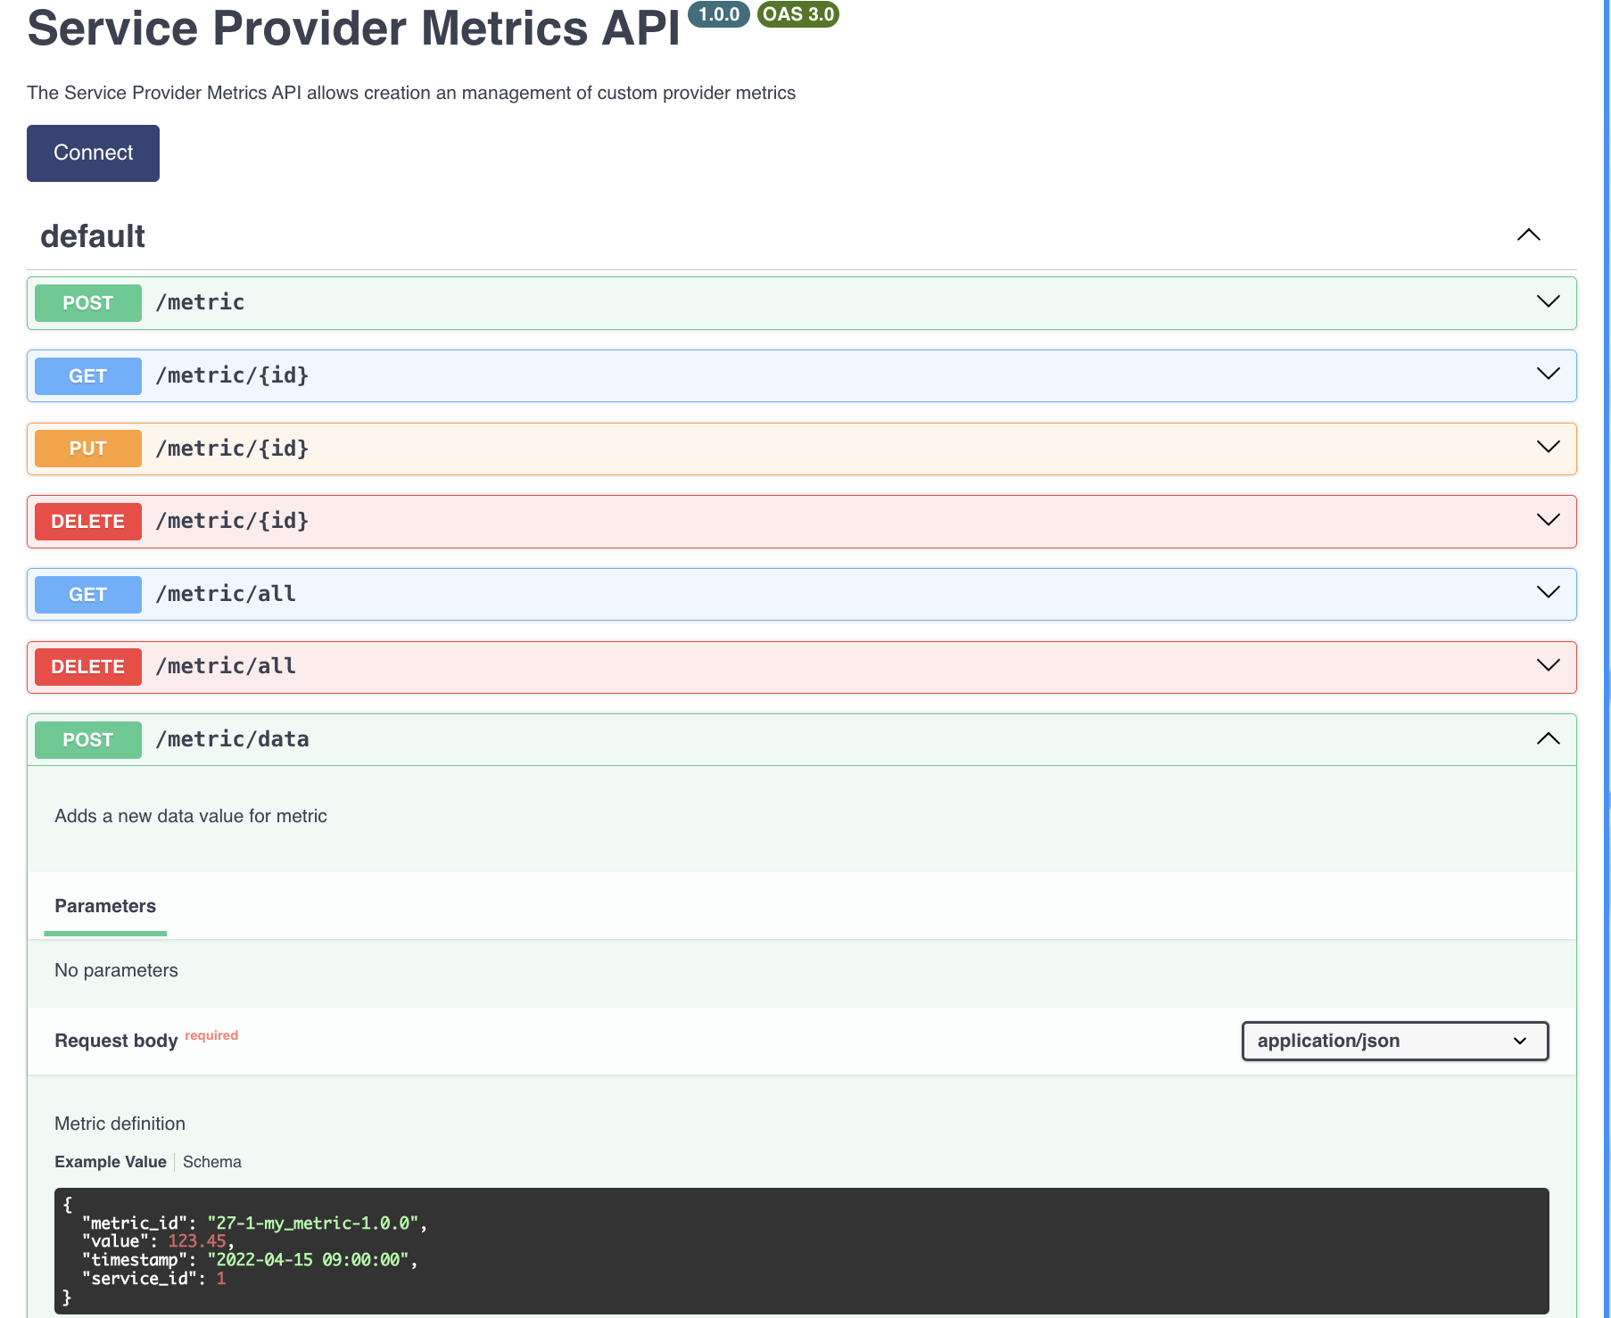
Service Provider Metrics Ingestion
Service Provider Metrics API
Service Providers can report Metrics associated with the service using Metrics API
Metrics submitted for services are reported on the Monitoring (QoS) Dashboard and visible to all the users registered on the Platform

Slide 29
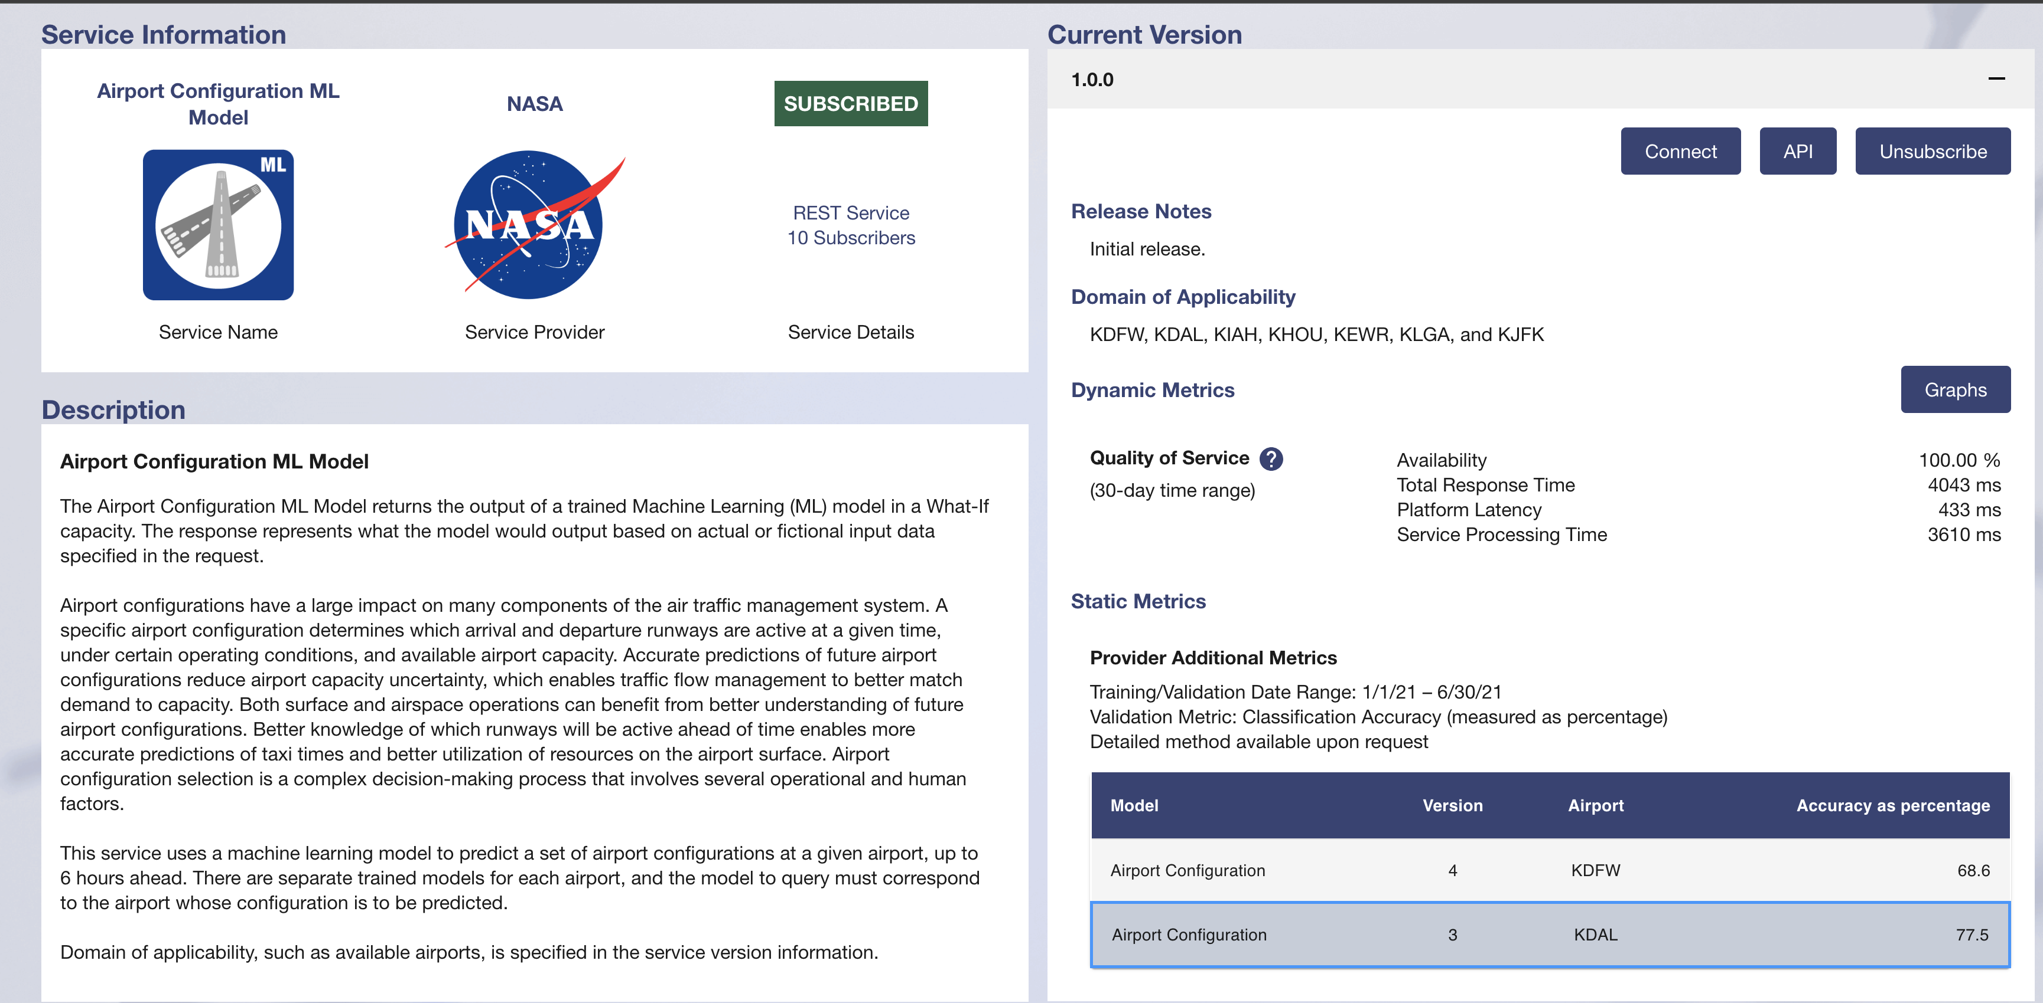
Metrics for ML Services Reported on the Platform
Classification Model

Slide 30
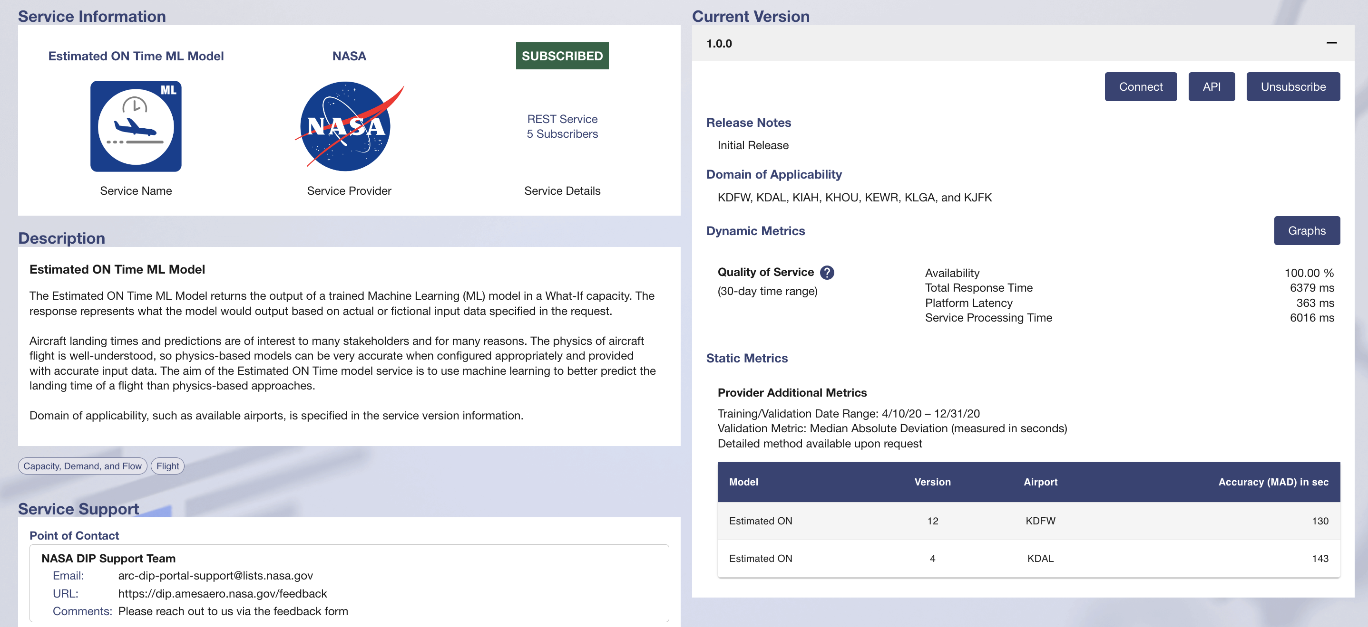
Metrics for ML Services Reported on the Platform
Regression Model

Slide 31
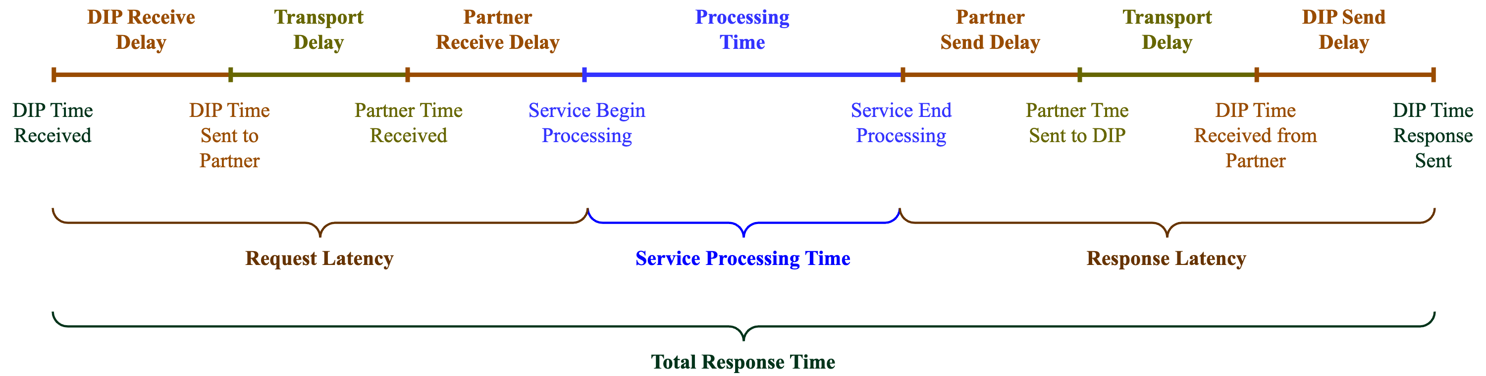
Quality of Service (QoS) Metrics on the Platform
Metrics | Description
API Availability | The percentage of the times an API is operational and accessible to users
Total Response Time | The total time it takes for the Service to respond to a request (i.e., time response received – time request submitted)
Platform Latency | The delay between sending the request and start of processing; similarly, for response handling, it is the delay between when service sends response and DIP forwarding to consumer
Service Processing Time | The time the service takes to process the request

Slide 32
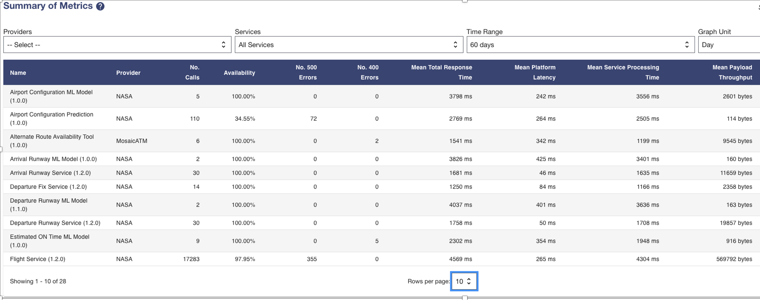
Quality of Service (QoS) Dashboard on the Platform
Monitoring dashboard reports QoS metrics collected for all services registered on the Platform

Slide 33
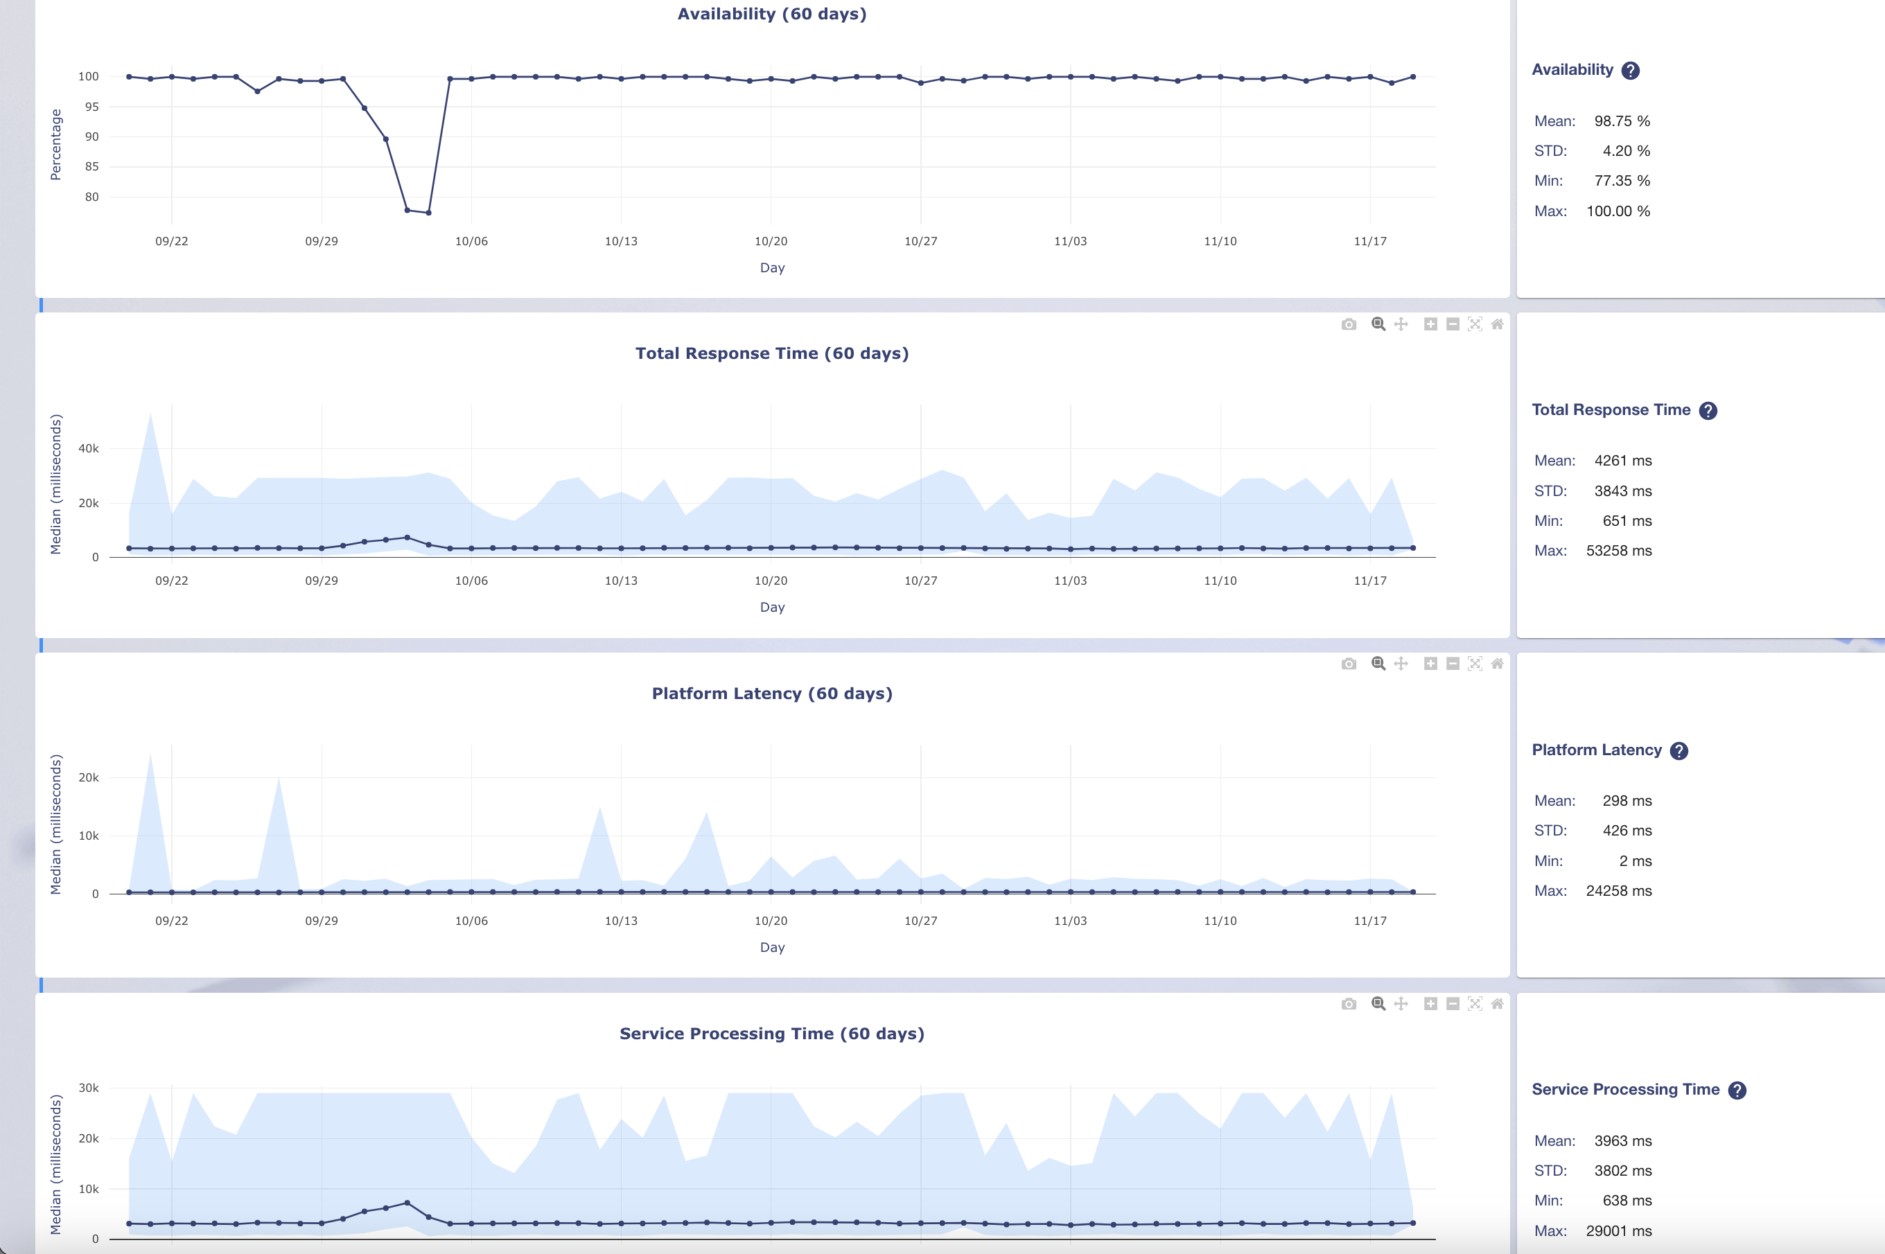
Quality of Service (QoS) Metrics on the Platform
Metrics
Availability
Total Response Time
Platform Latency
Service Processing Time

Slide 34
Discussion Points
What are your approaches to ensure service quality?
What set of metrics is your entity capturing to assess the quality of an ML Model as a Service?
  What KPIs do you consider in your evaluation?
  Do you perform risk-based analysis? Key Risk Indicators (KRIs)
What set of metrics is your entity capturing to assess the quality of Data Service?
What set of generic metrics is your entity capturing to assess the quality of a Service?

Slide 35
Cybersecurity

Slide 36
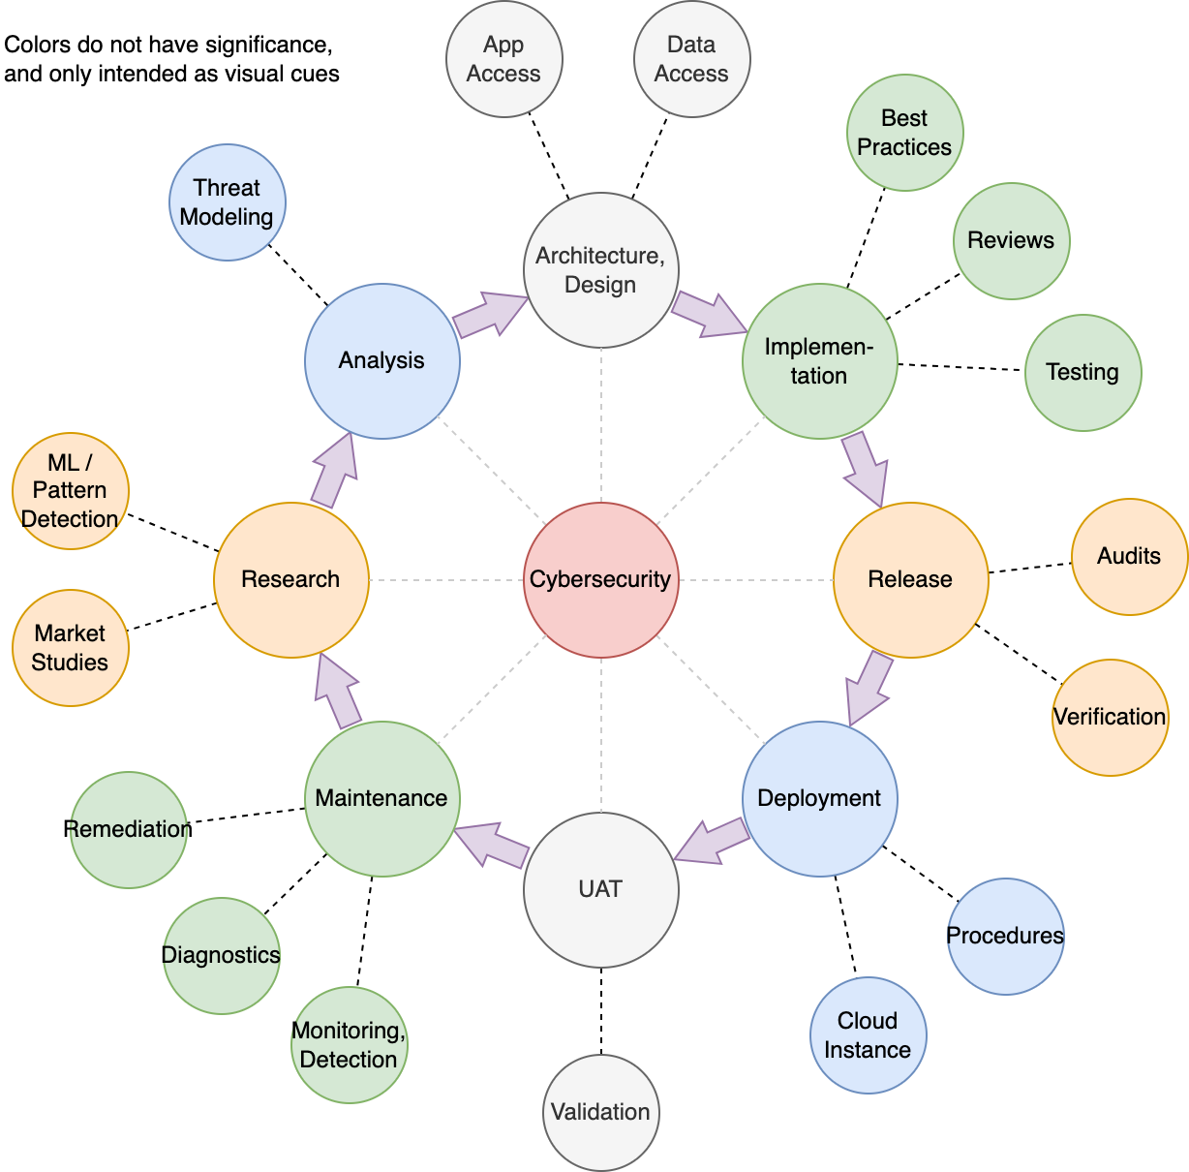
Cybersecurity Throughout the Lifecycle
CYBERSECURITY AREAS
Project Boundaries
  Classify data assets, assess impact of loss
  Assess partnerships & data sharing
Systems Security Engineering
  Create cybersecurity requirements
  Develop processes for operations
  Implement security tests & automation
Cybersecurity Research & Development
  Support novel cybersecurity research
Cybersecurity at the Organization Level
  Security is as strong as the weakest link
Notes:
An example of project boundaries is the separation between DIP Catalog and NASA Services, the latter is treated same as partner providers. This goes back to the logical and physical partitioning mentioned in the zero trust slide.

Slide 37
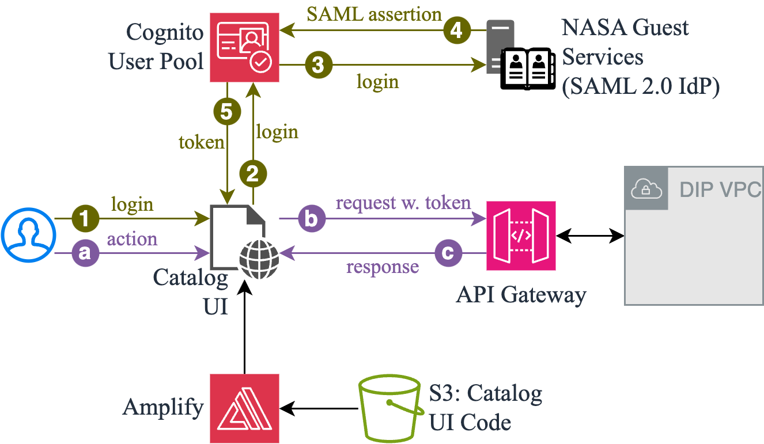
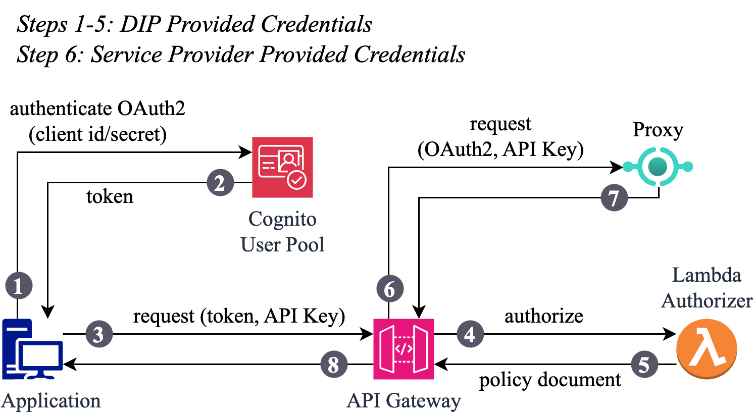
Authentication & Authorization
CATALOG
SERVICES
Scope determines accessibility

Slide 38
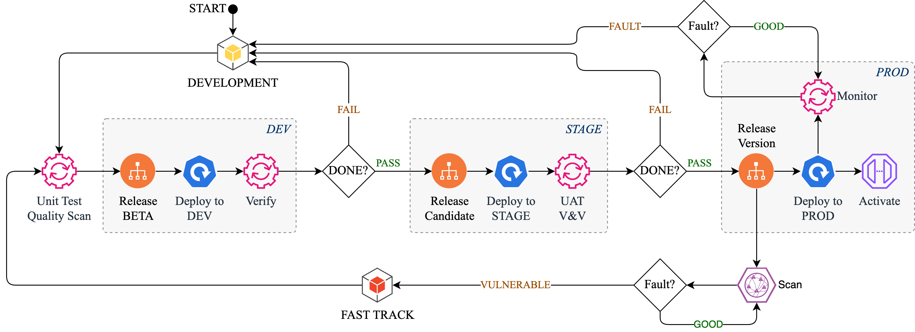
Cybersecurity Testing
Code is continuously scanned for quality during development
Authentication and Authorization is tested in DEV and STAGE
Continuous monitoring is implemented in PROD
Vulnerability scanning is periodically performed on version deployed to PROD

Slide 39
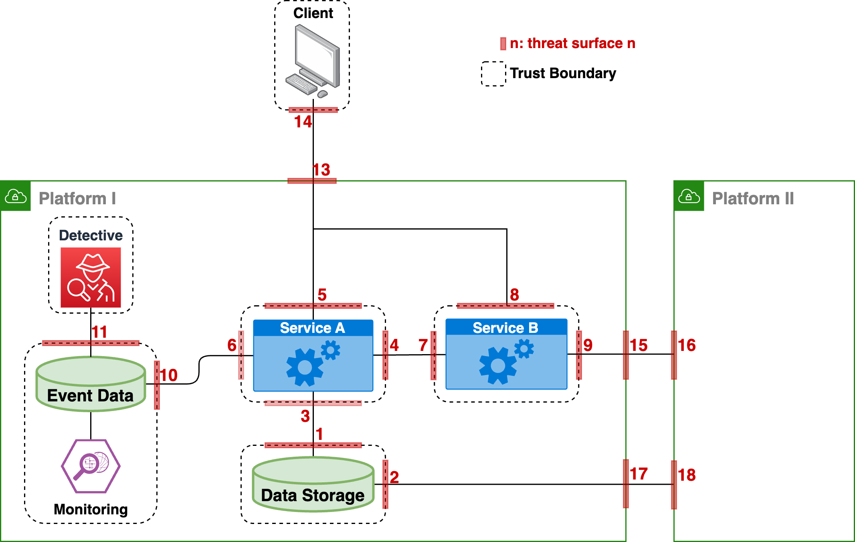
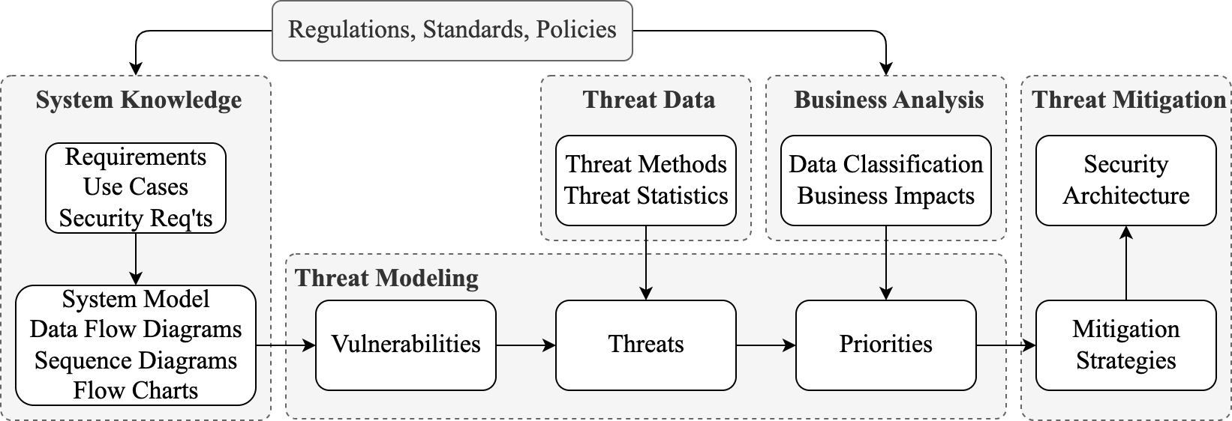
Cybersecurity Approach
TRUST BOUNDARIES
Each entity has a trust boundary
Data flow ⇾ attack surfaces
Many threat surfaces
  Prioritization is essential
  Security architecture reduces complexity
THREAT MODELING
Threat data provides types and likelihood
Business analysis determines priority
Mitigation starts with security architecture

Slide 40
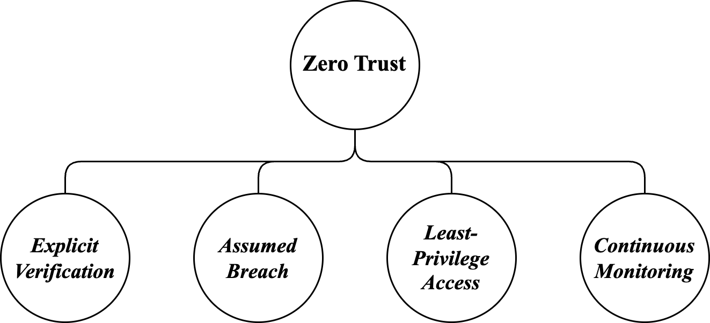
Zero Trust
Partition system logically and physically
Verify explicitly at each trust boundary
Limit data access to minimum required
Monitor system continuously and identify anomalous behavior

Slide 41
Discussion Points
    How do you assess the effectiveness of your cybersecurity? Do you use a maturity model, risk-based management, or other approach?
    Do you use automation in your cybersecurity? What do you automate?
    How do you validate your cybersecurity implementation?
    What are your requirements for data at rest encryption (apart from PII)?

Slide 42
Interoperability

Slide 43
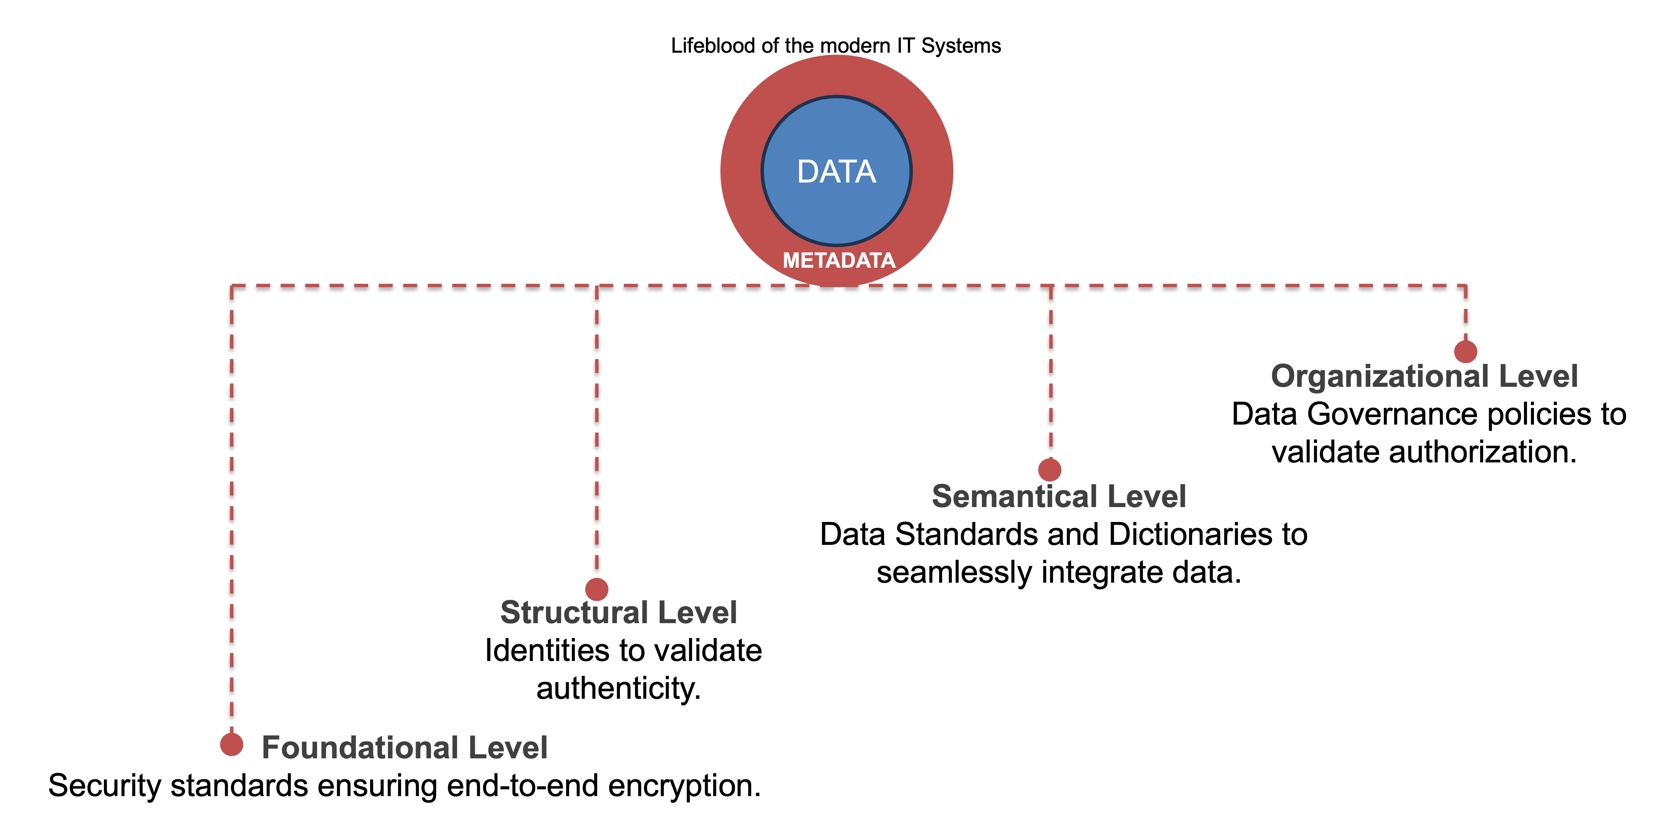
Interoperability
Definition
Ability for disparate software systems to connect and exchange data relying on standards and protocols.

Slide 44

Foundational Level
CIA Triad
Security Standards and Protocols
CIA-Triad Compliant
CIA-Triad Compliant
Platform A
Data
Platform B
Metadata
Confidentiality: How to ensure end-to-end encryption of the Data and Metadata?
Integrity: How to ensure immutable truthful nature of the Data and Metadata?
Availability: How to ensure the SLA between Platforms are honored?
Platform-A
Network
Boundary
Platform-B
Network
Boundary

Slide 45



Structural Level
Identities
Validate Authenticity
CIA-Triad Compliant
Applications
Services
What standards can be leveraged to Identify a User across platforms?
What standards can be leveraged to Identify an Application/Service across platforms?
How to ensure the User/Application/Service Identity information is transparent across platforms?
How to verify the User/Application/Service Identity authenticity not only across platforms but also by Services within a platform?
Platform A
Data
Platform B
Metadata
Users
Platform-A
Network
Boundary
Platform-B
Network
Boundary

Slide 46



Semantic Level
Data Architecture
Data Standards and Specifications
Weather
Data
Flight
Data
Applications
CIA-Triad Compliant
Services
How to ensure data standard compliance across platforms?
Any frameworks to leverage for the development of adaptable transformers/de-transformers?
Any frameworks to leverage for the development of query languages across data standards and their specifications or dictionaries?
Platform A
Data
Platform B
Metadata
FIXM
iWXXM
Users
Platform-A
Network
Boundary
Platform-B
Network
Boundary

Slide 47
Organizational Level
Governance
Authorization Policies
Weather
Data
Flight
Data
CIA-Triad Compliant
Services
How to ensure data quality policies are transparent across platforms?
What data principles can serve as foundation to define policies across platforms?
How to measure and monitor policy compliance metrics across platforms?
How do we exercise shared decision making over resource authorization policies across platforms?
Platform A
Data
Platform B
Metadata
Governance
Policies
Governance
Policies
FIXM
iWXXM
Platform-A
Network
Boundary
Platform-B
Network
Boundary
Monitoring
Sharing
Exercising

Slide 48
Service Discovery
Ecosystem Service Discovery
Services Across Platforms
Services
Services
Frameworks that enable federated search across multiple indexes across platforms.
Frameworks that enable recommended service-suites across platforms for aviation specific use cases by taking advantage of LLMs.
Frameworks to address data-disparity and merging federated search results.
Platform A
Platform B
Query Federator
Platform-A
Network
Boundary
Platform-B
Network
Boundary

Slide 49
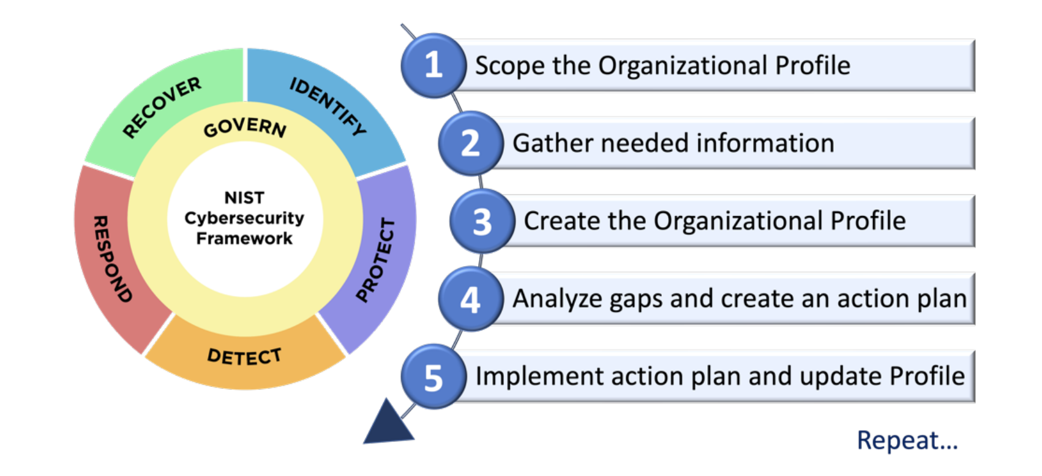
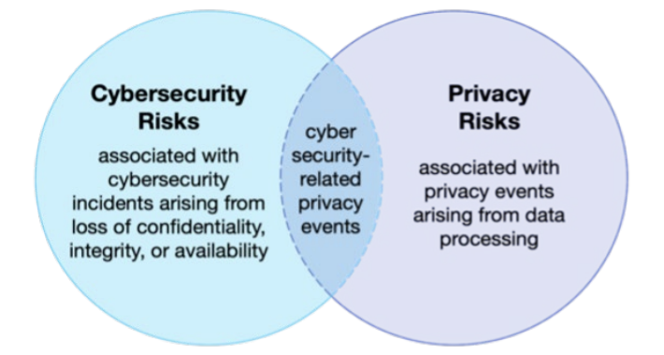
Security Data
Security Incidents Data
Ecosystem of Platforms Context
Assuming the sensitive nature of the incident data logs, what policies can be defined to mitigate the risk of compromising the security of the entire ecosystem of platforms?
Any platform agnostic frameworks to leverage for the collection and monitoring of the incidents data across the ecosystem of platforms that can identify and assess potential risks.
How to define roles and responsibilities across the ecosystem to ensure the compliance of governance policies is enforced to mitigate the impact of an incident.
NIST CSF

Slide 50
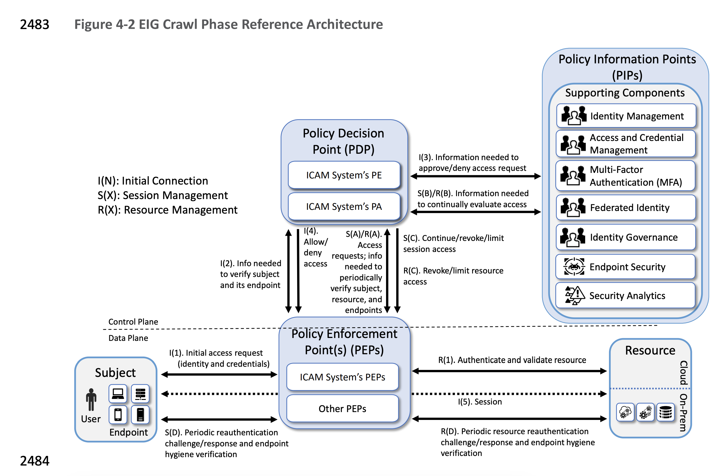
Zero Trust Architecture (ZTA)
Definition
Zero trust (ZT) is the term for an evolving set of cybersecurity paradigms that move defenses from static, network-based perimeters to focus on users, assets, and resources. A zero trust architecture (ZTA) uses zero trust principles to plan industrial and enterprise infrastructure and workflows.
ZTA Principles
No User/Application can be trusted unless explicitly verified across platforms.
Minimum Access Granted/Revoked on demand.
Operate under the assumption that Network Security is already compromised.
NIST ZTA Reference Architecture, Enhanced Identity Governance (EIG)

Slide 51
Discussion Points
    How User/Application Identity transparency is managed when your Service is accessed via a different Platform?
    Does your Service or the System of Services (Platform) adhere to Zero-Trust Principles?
    Any cross-platform governance use cases that your organization is addressing?

Slide 52
Q & A
Please post your questions either in the chat box or the Conferences.io link
https://arc.cnf.io/sessions/r9pz/#!/dashboard

Slide 53
Wrap up

Slide 54
Participation in DIP Ecosystem
Platform Access Level
Becoming an Official Partner with DIP
Onboarding Process

Slide 55
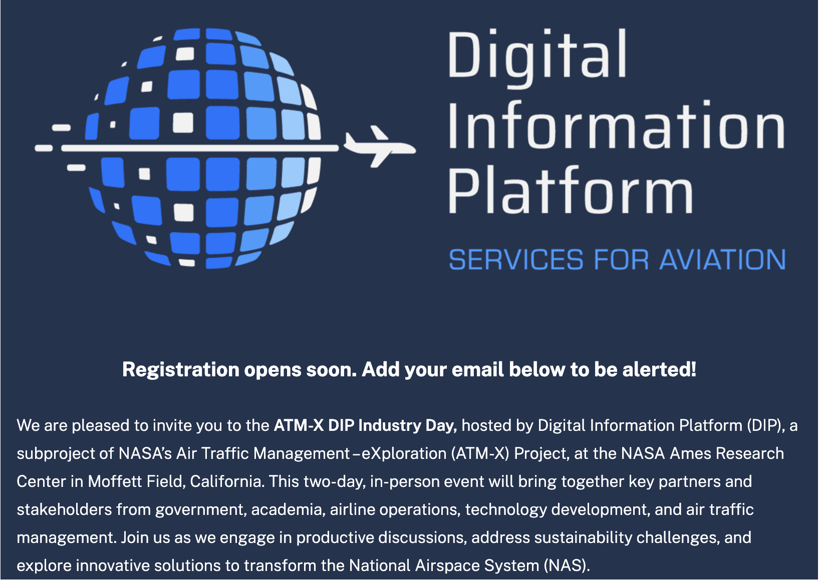
Upcoming – ATM-X DIP Industry Day
COMING
SOON
Date: March 5 & 6, 2025
Place: NASA Ames Research Center, Moffett Field, CA
Visit https://nari.arc.nasa.gov/events/dip-industry-day for more information and look for email for registration details

Slide 56
Contact info
Please email to ARC-DIP-EXT@mail.nasa.gov for questions or comments
Visit https://nari.arc.nasa.gov/atmx-dip for more information regarding DIP sub-project and future events

Slide 57
Thank you!

Slide 58
Quality Guidelines

Slide 59
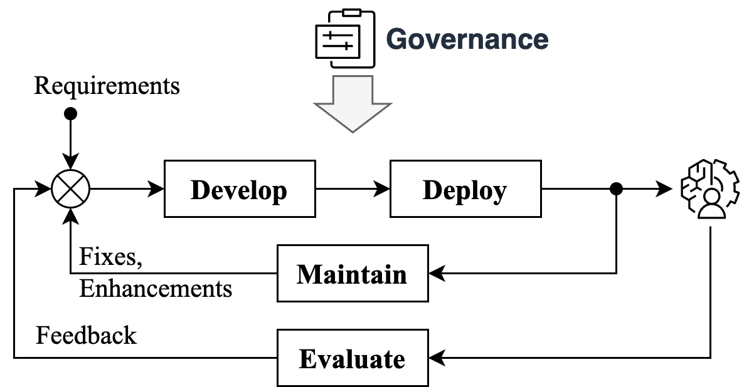
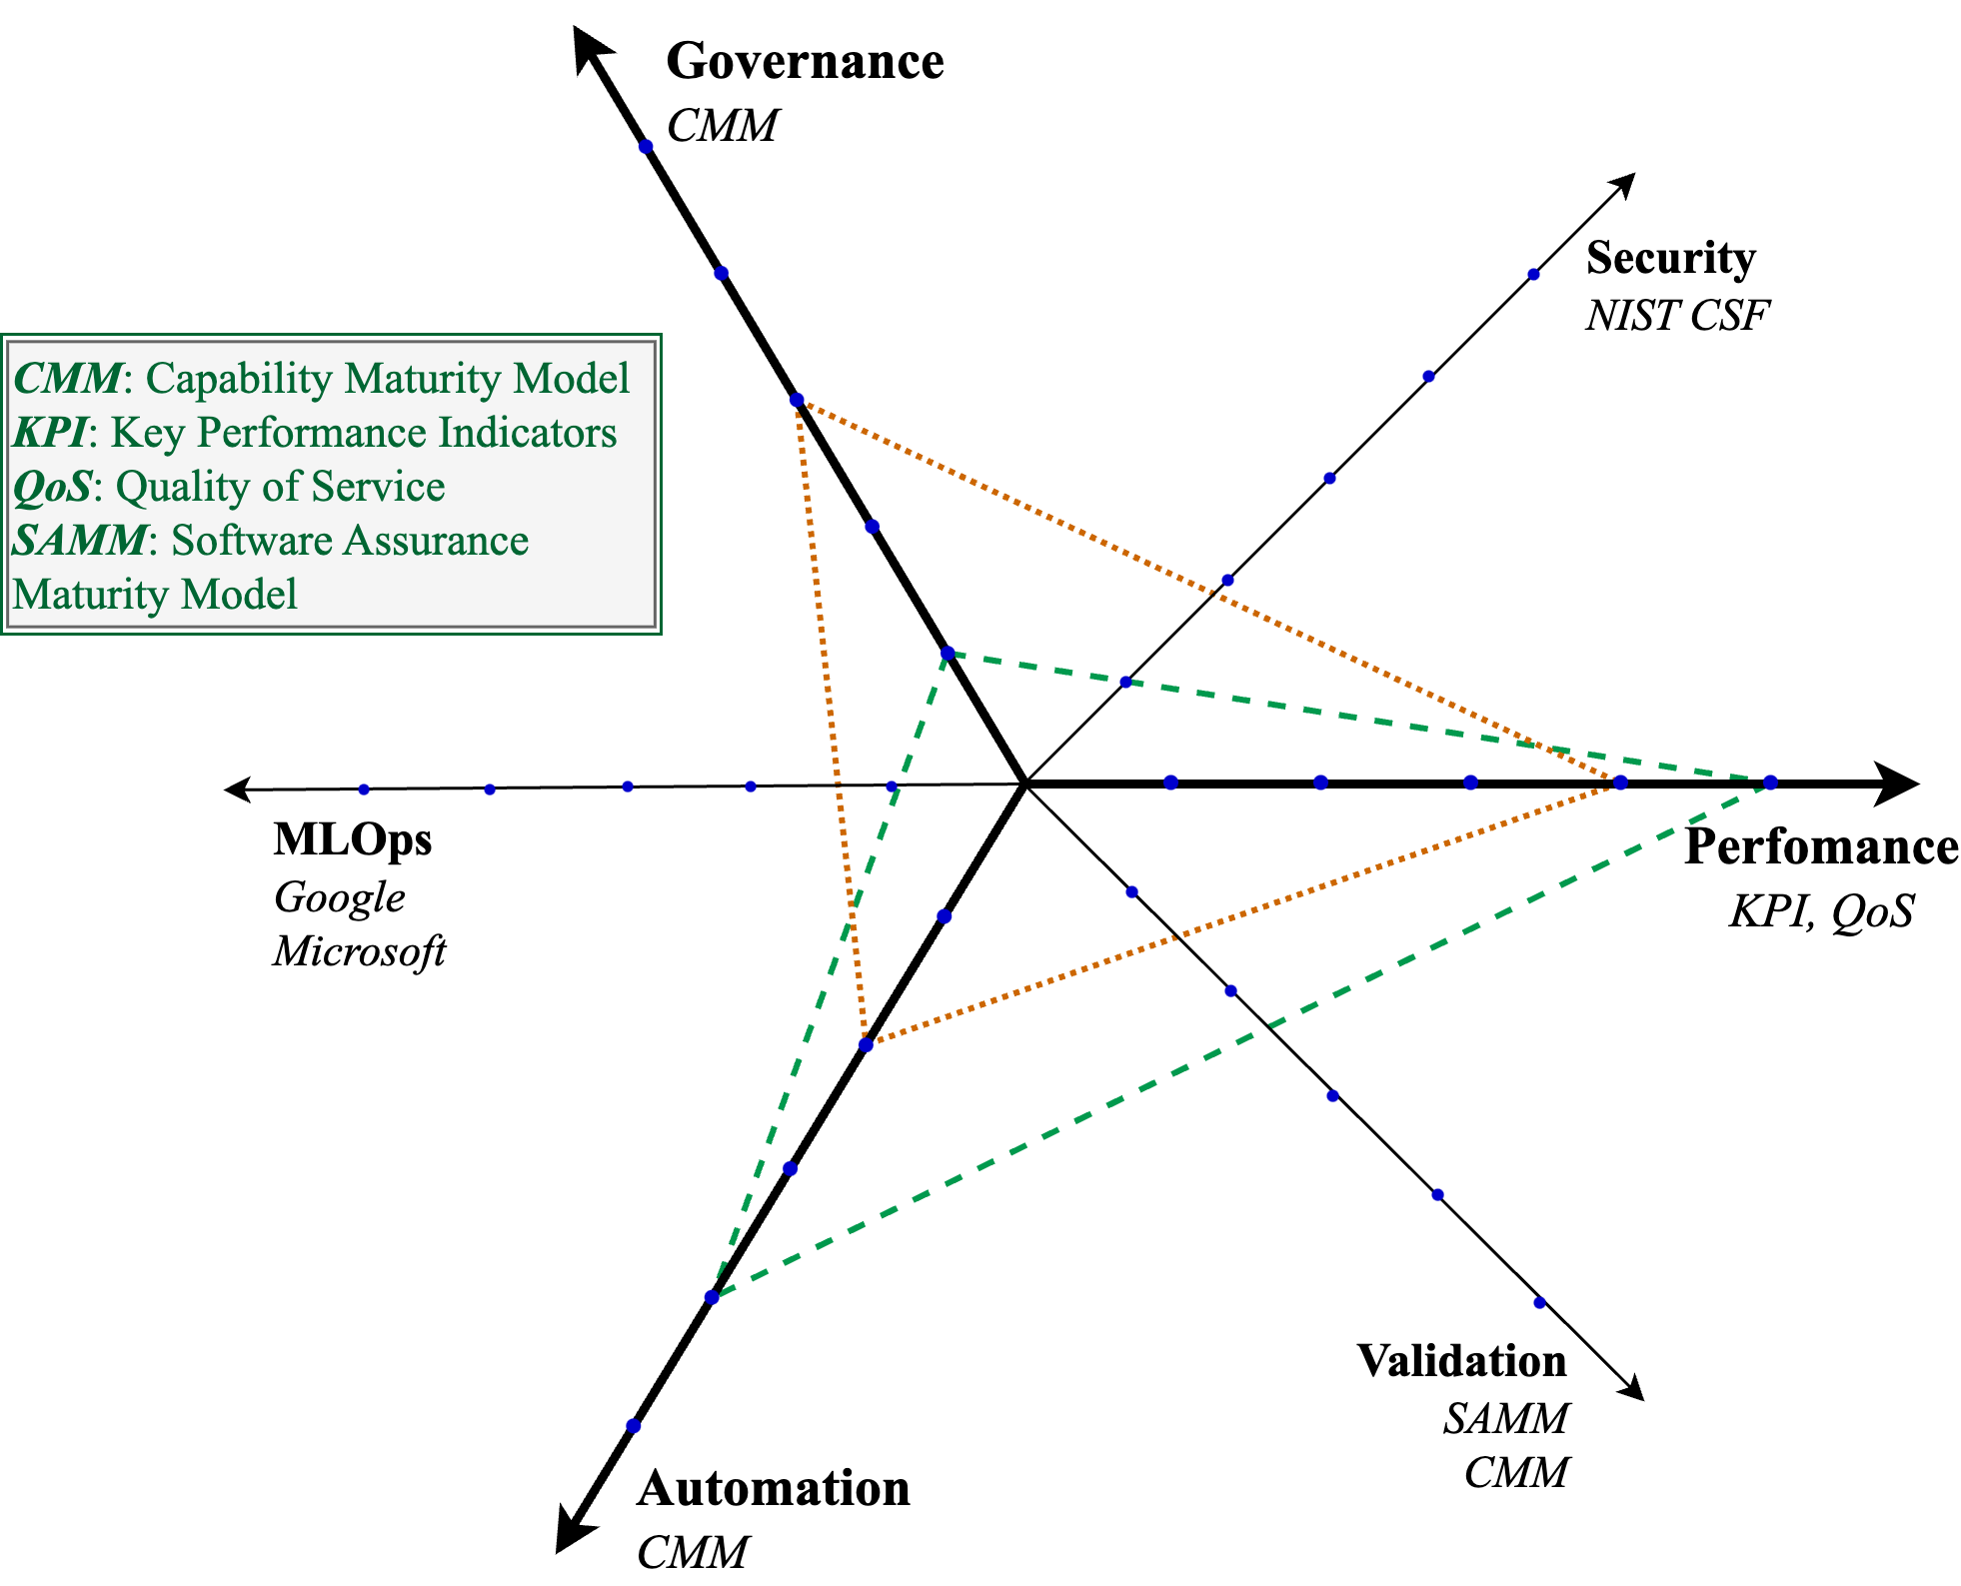
Maturity
Multi-dimensional
  Various maturity models
  Measured at different times (production, pre-production)
  Measured at different scopes (organization, service)
  Different cost/benefits
How to define overall levels?
Focus on performance
  Measured in production
  Integrated into analytics pipeline
Role of risk management
Maturity is multi-dimensional, measured at different scopes

Slide 60
Maturity Levels
Maturity Level | Stage Characteristics
Integration | Test connectivity, authentication, and API spec
Beta | Model and logic ready for evaluation Registered w. DIP; may use a limited sample set
Level 1 | Simulations with expanded sample set Maturity metrics meet service goals
Level 2 | Shadow mode simulations with live data Maturity metrics meet service goals
Level 3 | Integrated shadow mode simulations Maturity metrics meet integrated analytics goals
Beyond Maturity | Risk management Key Risk Indicators
Maturity is defined from perspective of demonstration or analytics integration readiness

Slide 61
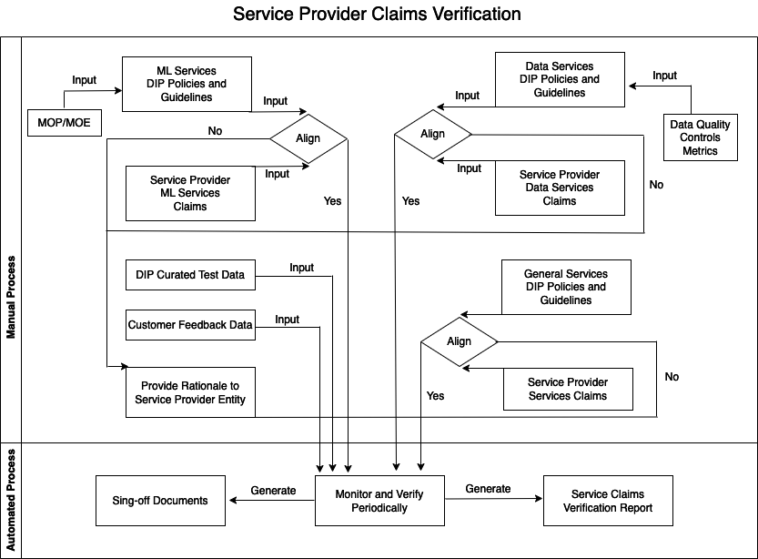
Service Claims Verification
The following process diagram illustrates the sequence of steps involved for the DIP Data Governance Leads to verify the quality metrics claimed by the Service Provider entities

Slide 62
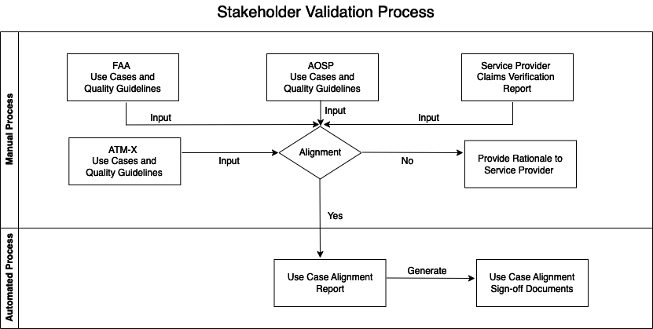
Stakeholders Service Alignment Validation
The following process diagram illustrates the sequence of steps involved for the DIP Management to validate Provider entities Services as per the stakeholder/customer objectives.

Slide 63
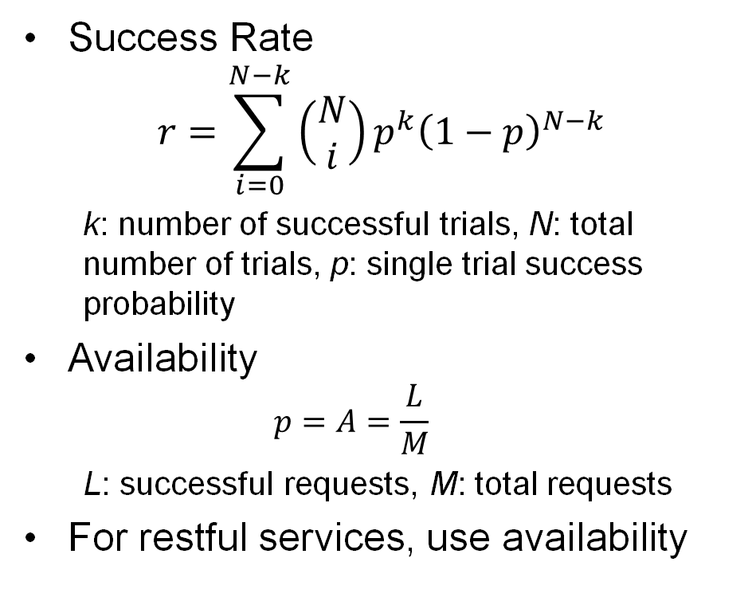
Maturity Metrics
Metrics
Success Rate & API Availability
Success Rate: likelihood that at least k of N trial will succeed
QoS
  Availability
  Response Time
KPI
  Accuracy
  Fuel Savings
  Others
KRI: the next stage after maturity levels
Success Rate
$$r=\sum_{i=0}^{N−k}{\left(\begin{matrix}N \\ i\end{matrix}\right)p^{k}{\left(1−p\right)}^{N−k}}$$
  k: number of successful trials, N: total number of trials, p: single trial success probability
Availability
  $$p=A=\frac{L}{M}$$
  L: successful requests, M: total requests
For restful services, use availability
Notes:
Maturity of a service depends on the success rate. When we evaluate service maturity and experiment multiple trials for each service, there can be failures. The probability is called the success given availability

Slide 64
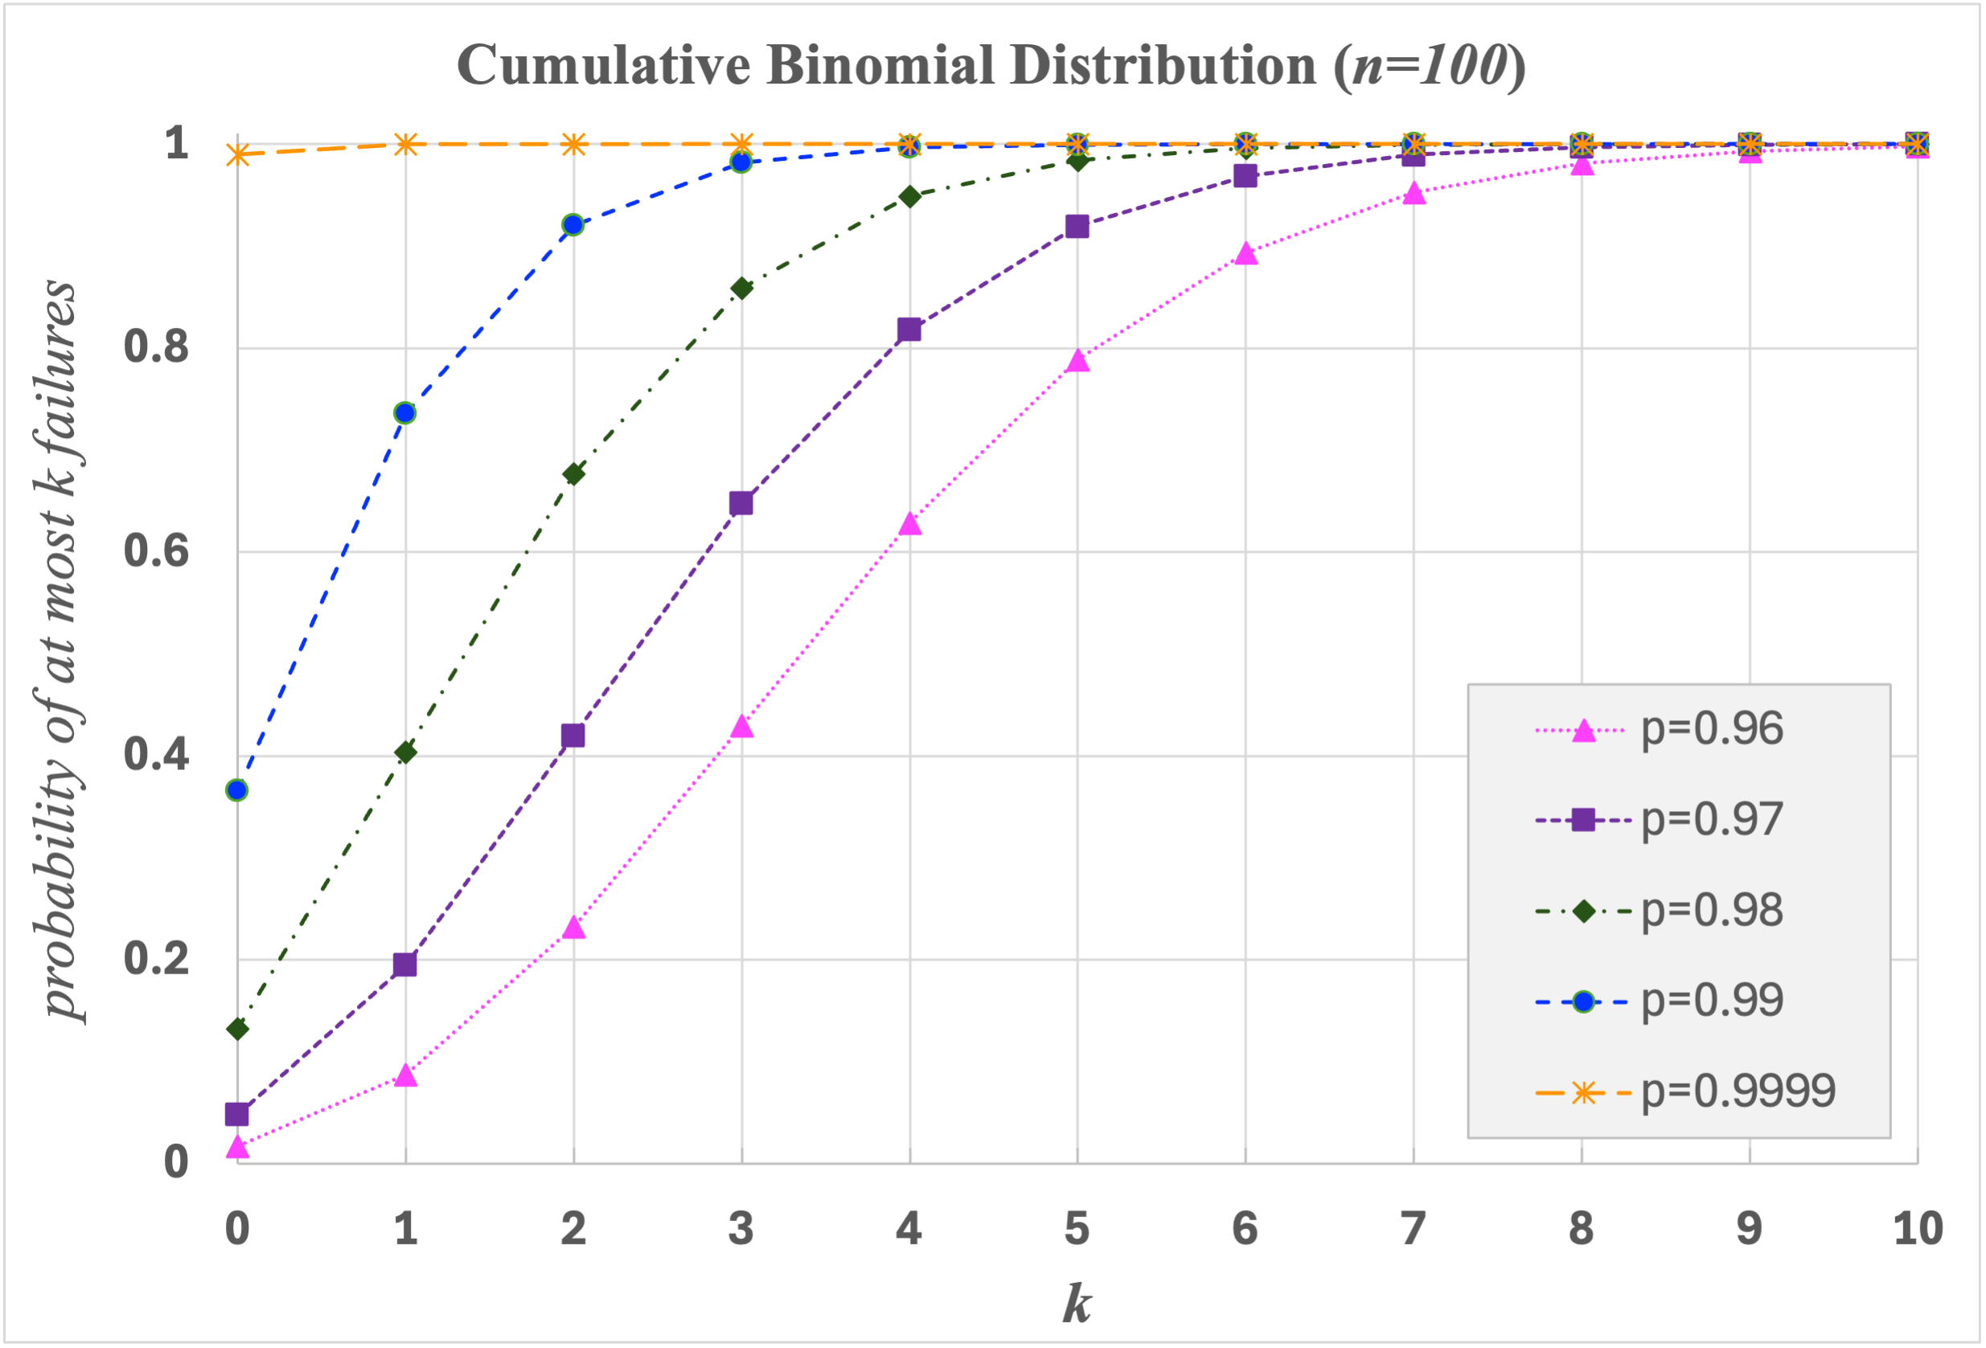
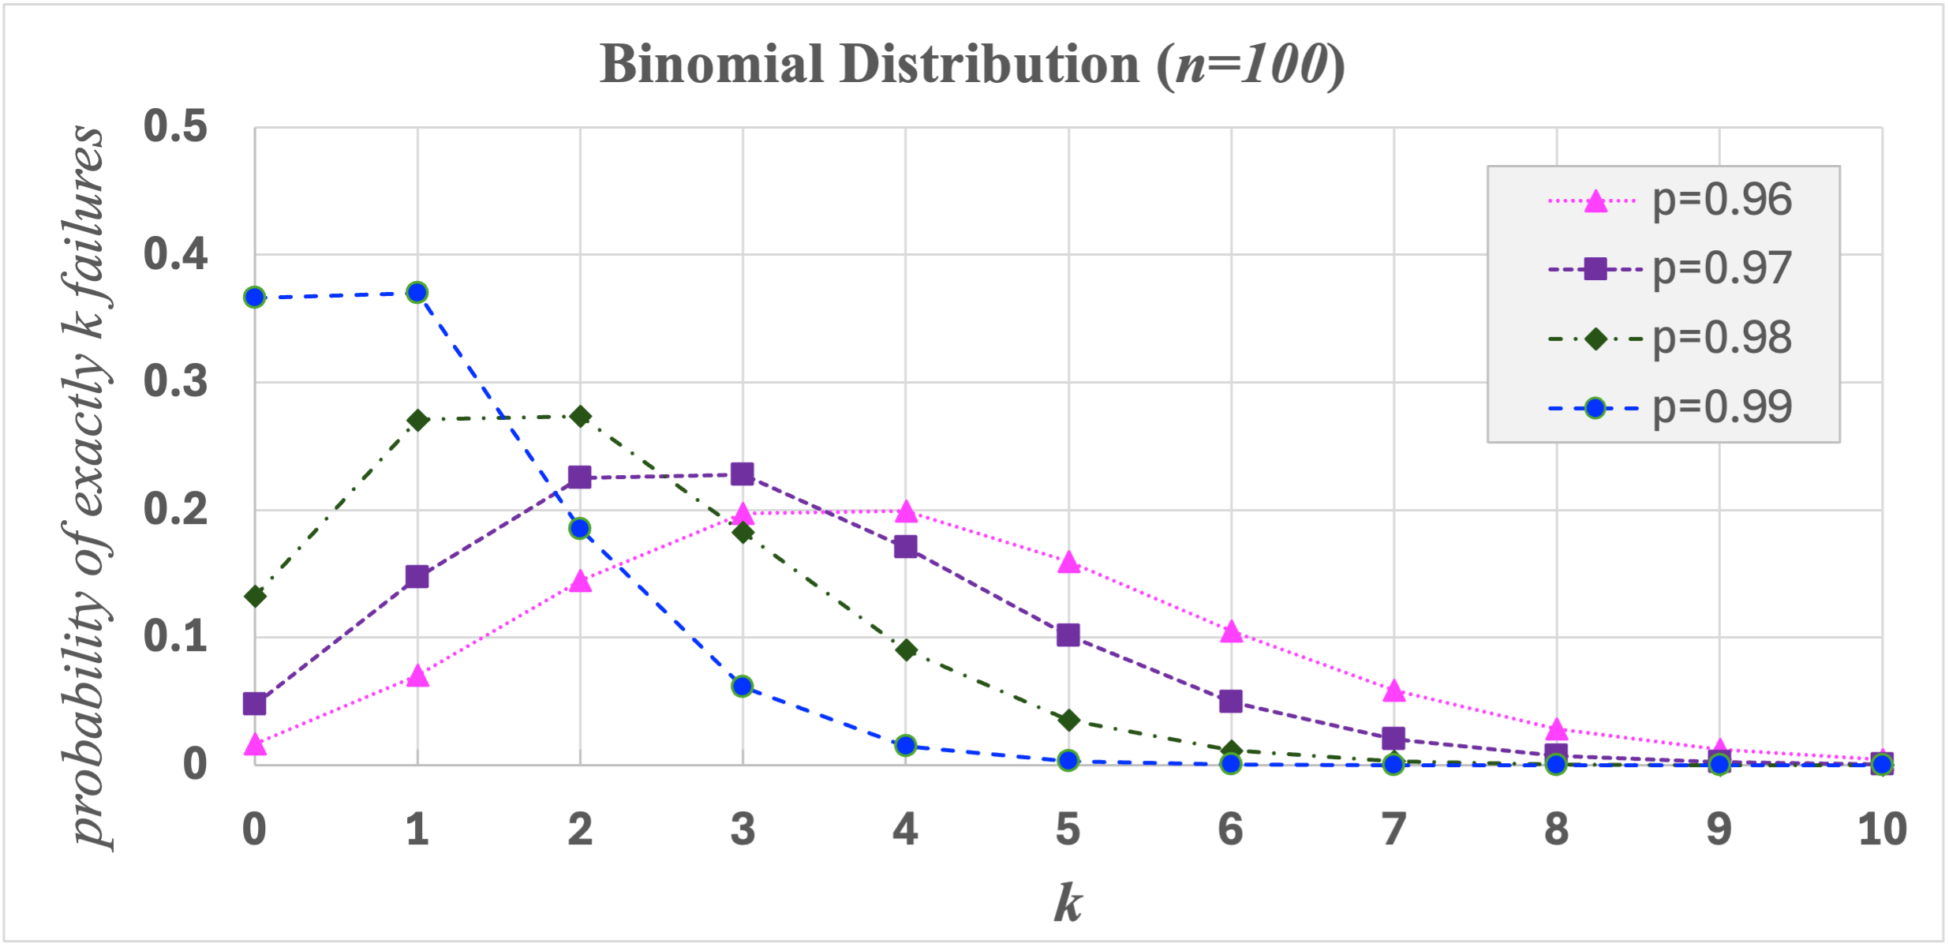
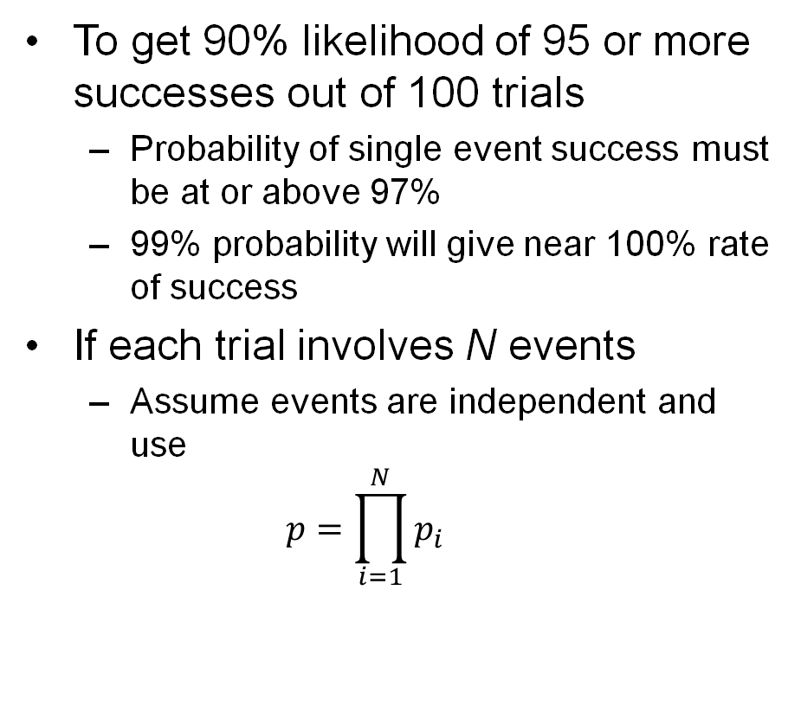
Maturity Metrics - Example
To get 90% likelihood of 95 or more successes out of 100 trials
  Probability of single event success must be at or above 97%
  99% probability will give near 100% rate of success
If each trial involves N events
  Assume events are independent and use
  $$p=\prod_{i=1}^{N}{p_{i}}$$

Slide 65
Maturity Assessment Guidelines
Measurable Metrics
Processes & Documentation
Develop KPI monitoring
  Develop KPI analytics
  Develop reporting modules
  Identify KPI thresholds
  Report KPI metrics
Define QoS thresholds
  DIP measures & reports QoS metrics
Automation pipeline
Monitoring and reporting
Security and data governance
Validation and stress testing

Slide 66
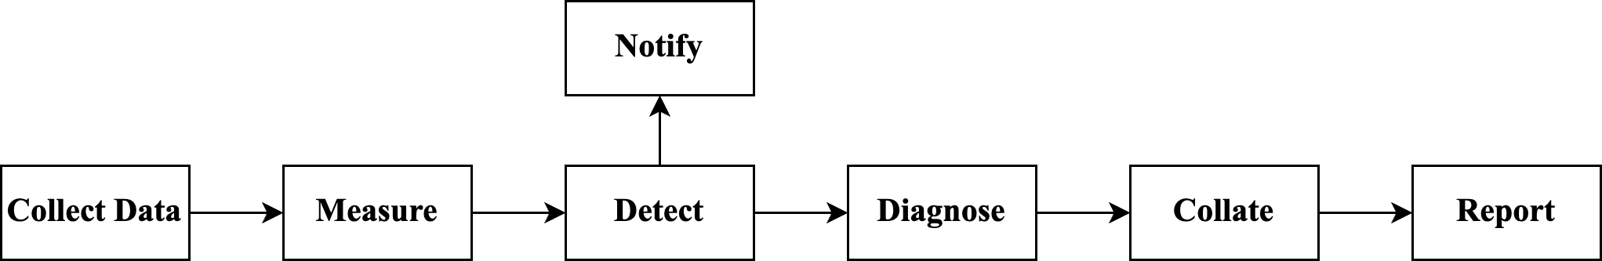
Operations and Maintenance
Monitoring
  Quality of Service Metrics
  Off-nominal event detection
Performance Dashboard
  Statistics
  Graphics
Third party library scanning
Code quality checking
Anomalous event response
Fast-track remediation cycle

Slide 67
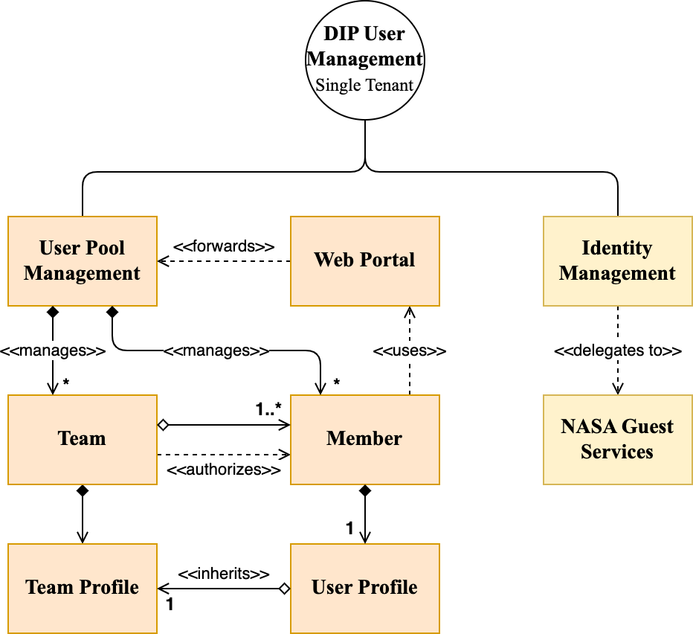
Tenant Model
DIP Tenant model
  Identity management delegated to NASA Guest Services
  Single tenant model
    Users as members of a team
    Team profile determines authority for all team members
Tenant model in general
  Impacts data governance procedures
  Used for identity and user pool management
  Can also apply to service information management

