Slide 1
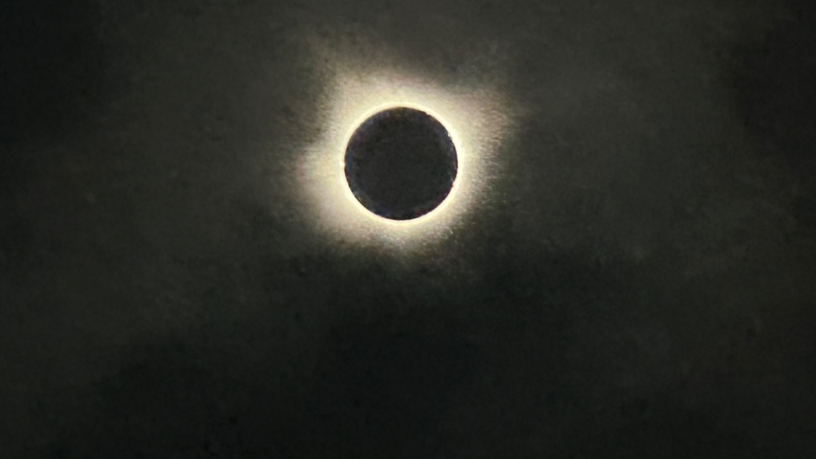

Solar coronal phenomenon: Imaging spectroscopy
TEAM:
Amy R. Winebarger (NASA MSFC)
P. S. Athiray (UAH/MSFC)
Sabrina L. Savage (NASA MSFC)
Ken Kobayashi (NASA MSFC)
Patrick R. Champey (NASA MSFC)
David E. McKenzie (NASA MSFC)
Genevieve D. Vigil (NASA MSFC)
MaGIXS team
Biswajit Mondal
NASA Postdoctoral Program
Marshall Space Flight Center
Email: biswajit.mondal@nasa.gov
NPP virtual Symposium
20 Nov 2024

Slide 2
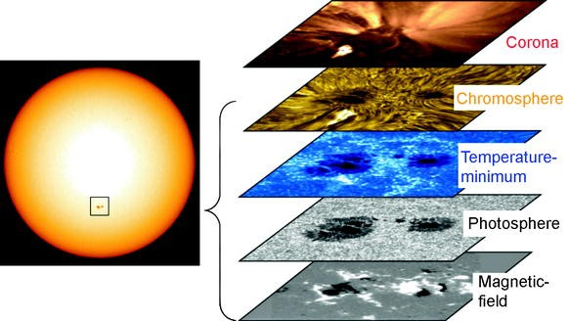
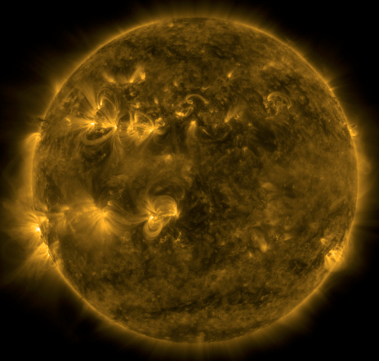
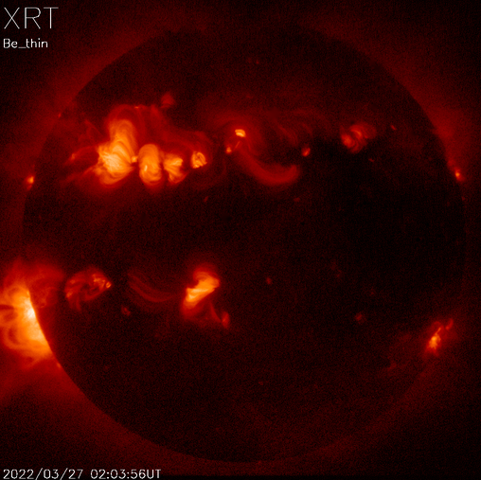
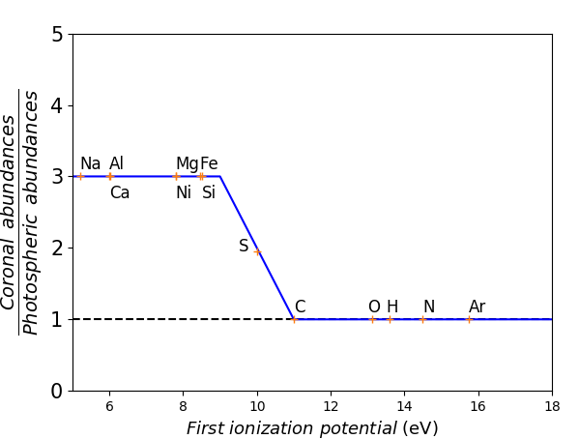
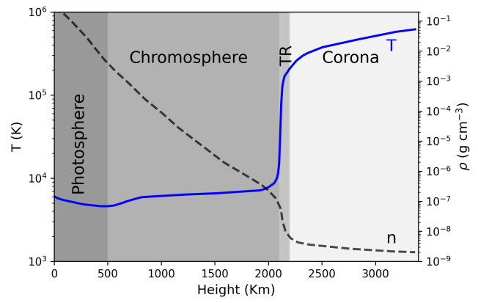
Introduction
Visible wavelength
EUV
X-ray
Credit: helioviewer.org
Coronal heating problem
Elemental Abundance anomaly or FIP effect
~10⁶ K
Temperature
~10³ K

Slide 3
Supporting theories and how to probe them

Slide 4
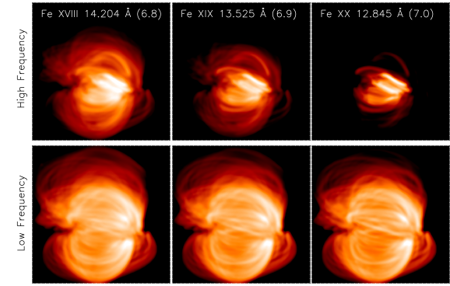
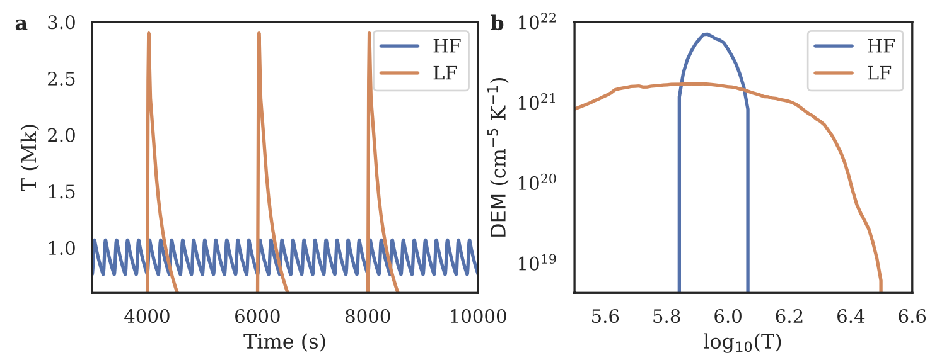
Nanoflare heating
In early 1980’s, Parker suggested that the non-flaring solar corona could be heated by nanoflares.
Direct detection of individual nanoflares are difficult.
Used indirect methods, e.g., Differential Emission Measure (DEM) or existence of hot plasma etc.
Klimchuk et al (2006, 2015)

Slide 5
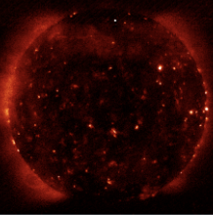
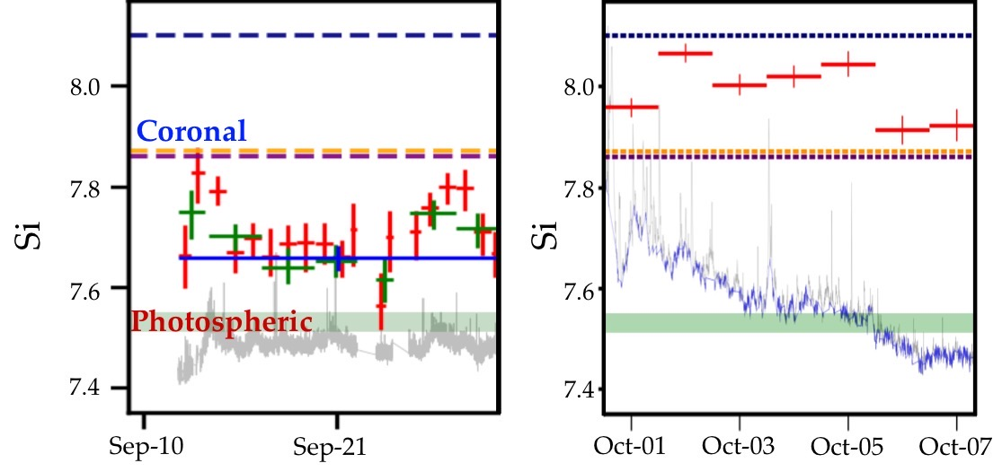
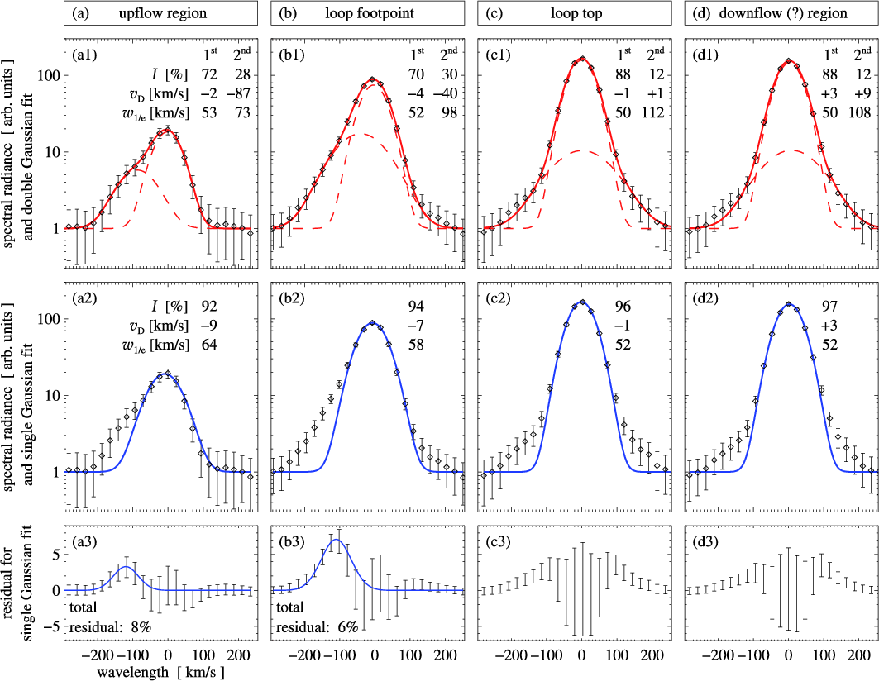
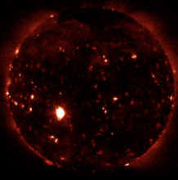
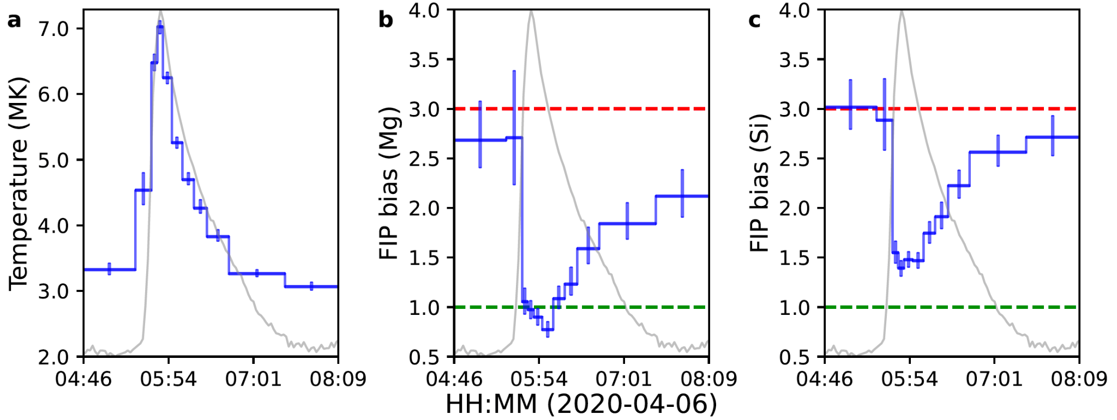
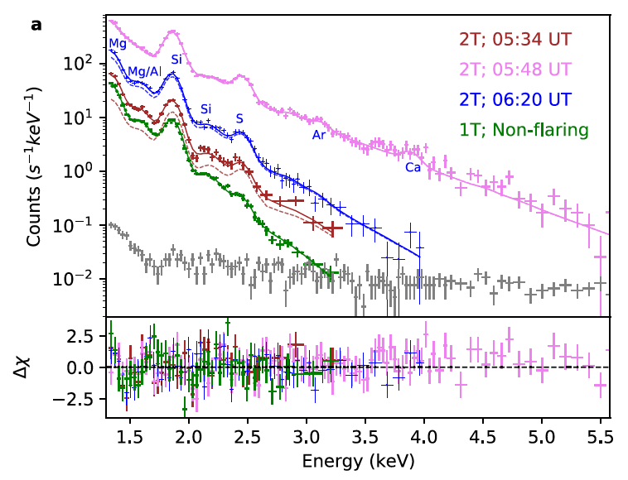
Elemental abundances measured in X-ray wavelength
XBP
AR
Average T = ~2 MK.
Intermediate abundances.
Average T = ~3 MK.
Coronal abundances
Vadawale, et al, (2021)
Mondal, et al, (2023b)
During Solar flares
Mondal, et al, (2021)

Slide 6
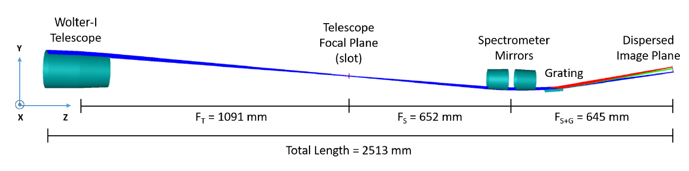
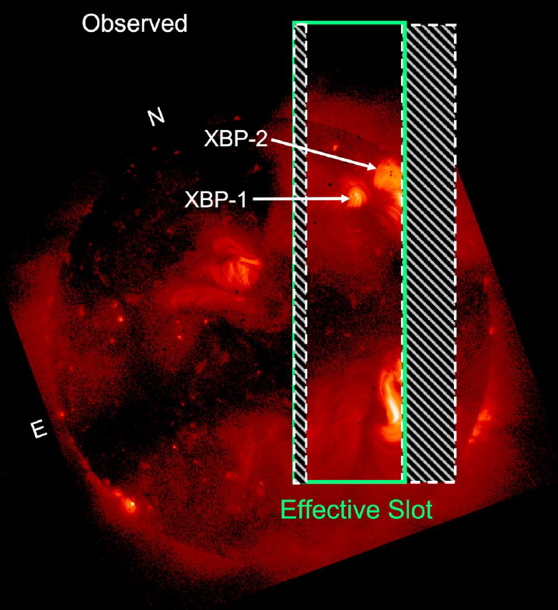
Imaging spectroscopy: Marshall Grazing Incident X-ray Spectrometer (MaGIXS)
Different regions of the Sun are different in terms of emission structure
To understand the special variation of the plasma parameters, imaging X-ray spectroscopic observation in soft X-ray energy range is essential.
Champey et al. 2022
Savage et al (2023)

Slide 7
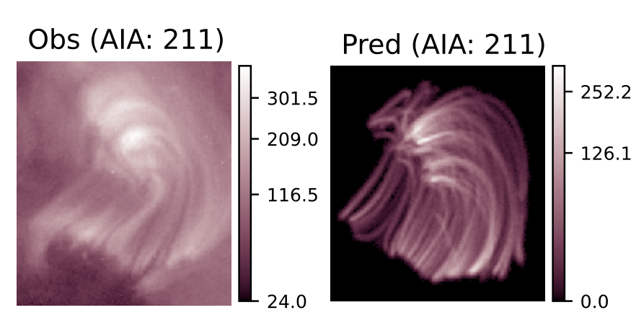
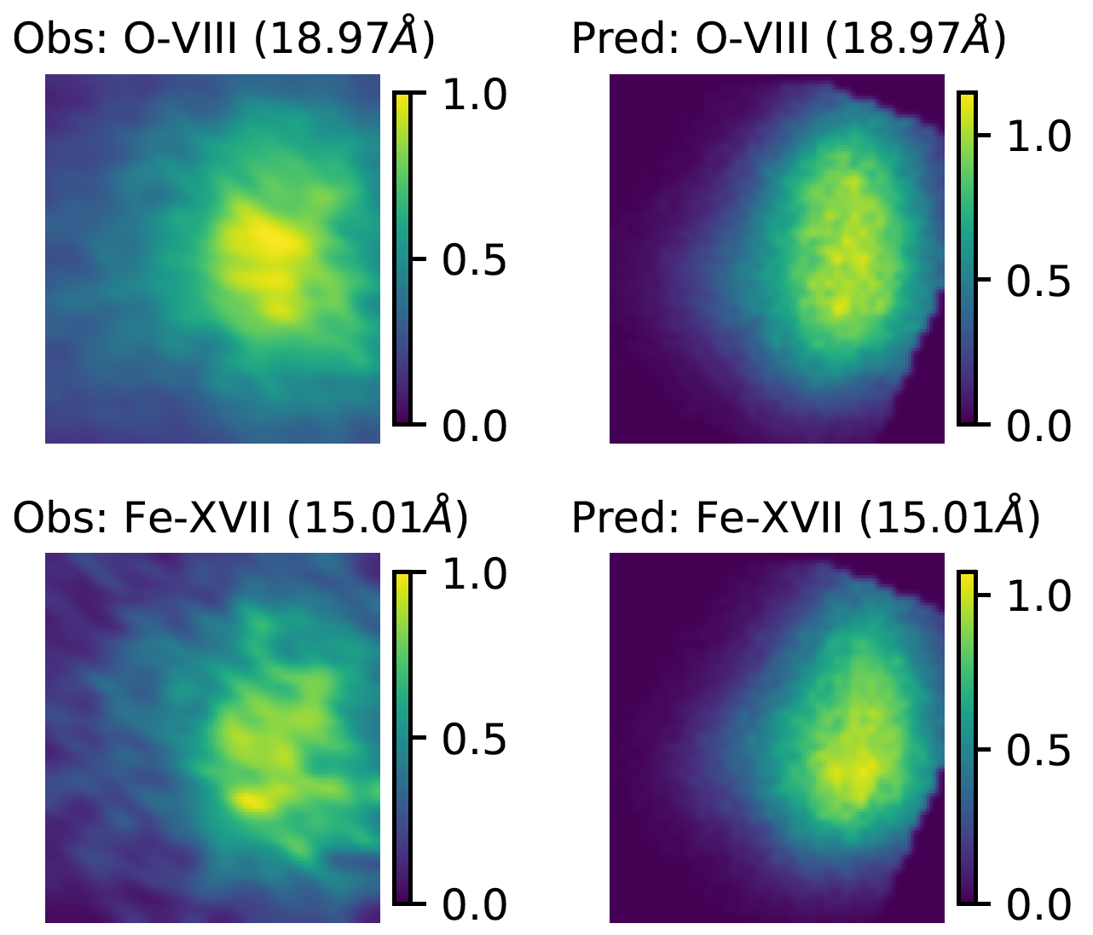
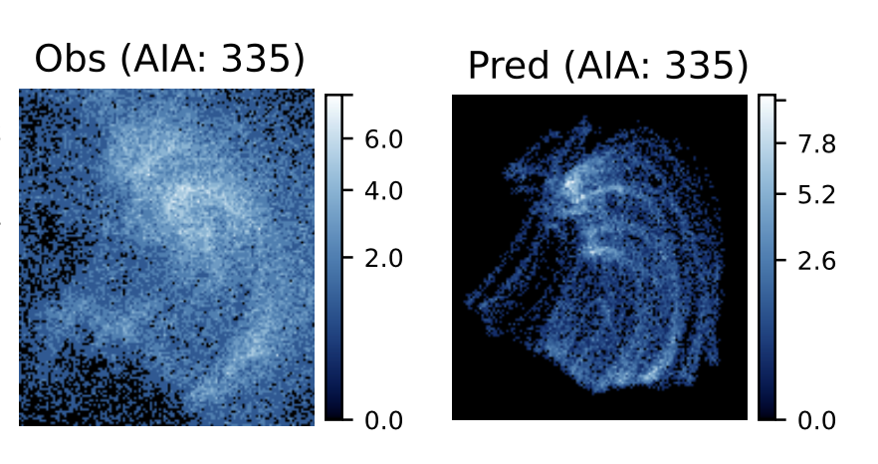
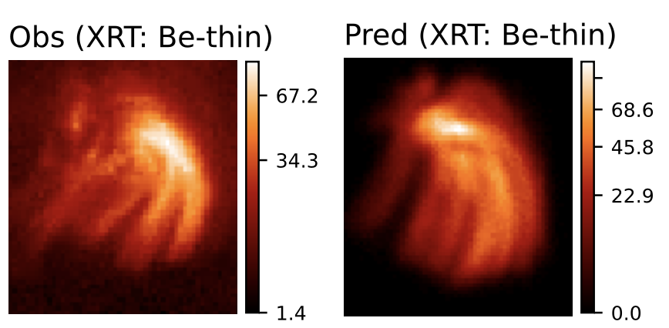
Nanoflare heating of an XBP observed by MaGIXS
DN/s
DN/s
Derived from MaGIXS
Simulated
Observed by AIA & XRT
Simulated
Mondal et al, ( 2024)
Average delay = 1500 - 3000 s -> smaller than the cooling time.
Average Poynting flux = ~5e5 erg/cm2/s
MaGIXS and XRT are more sensitive.

Slide 8
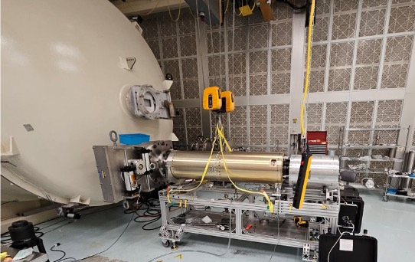
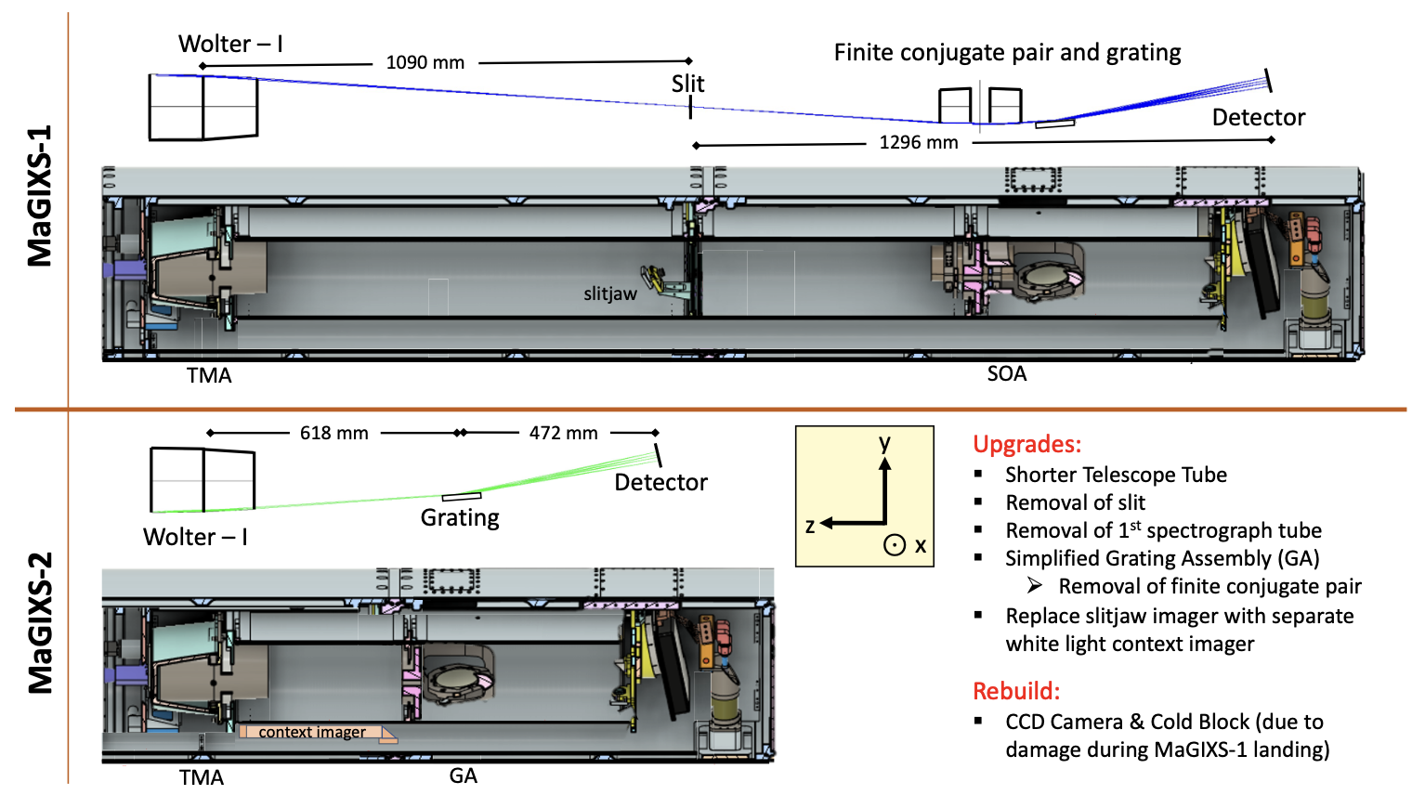
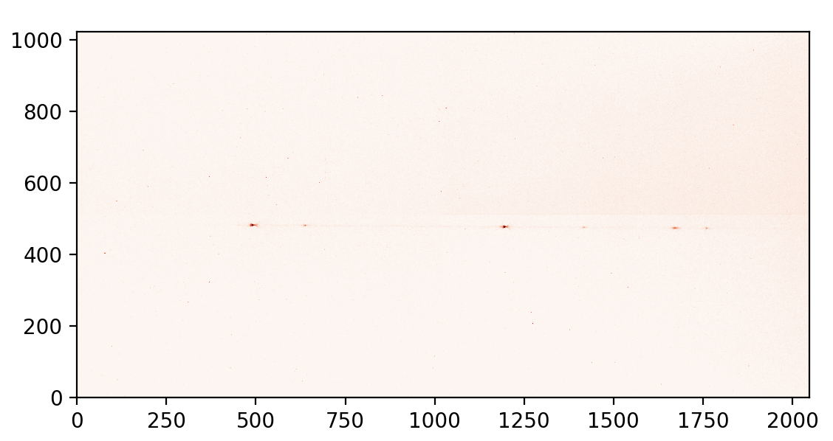
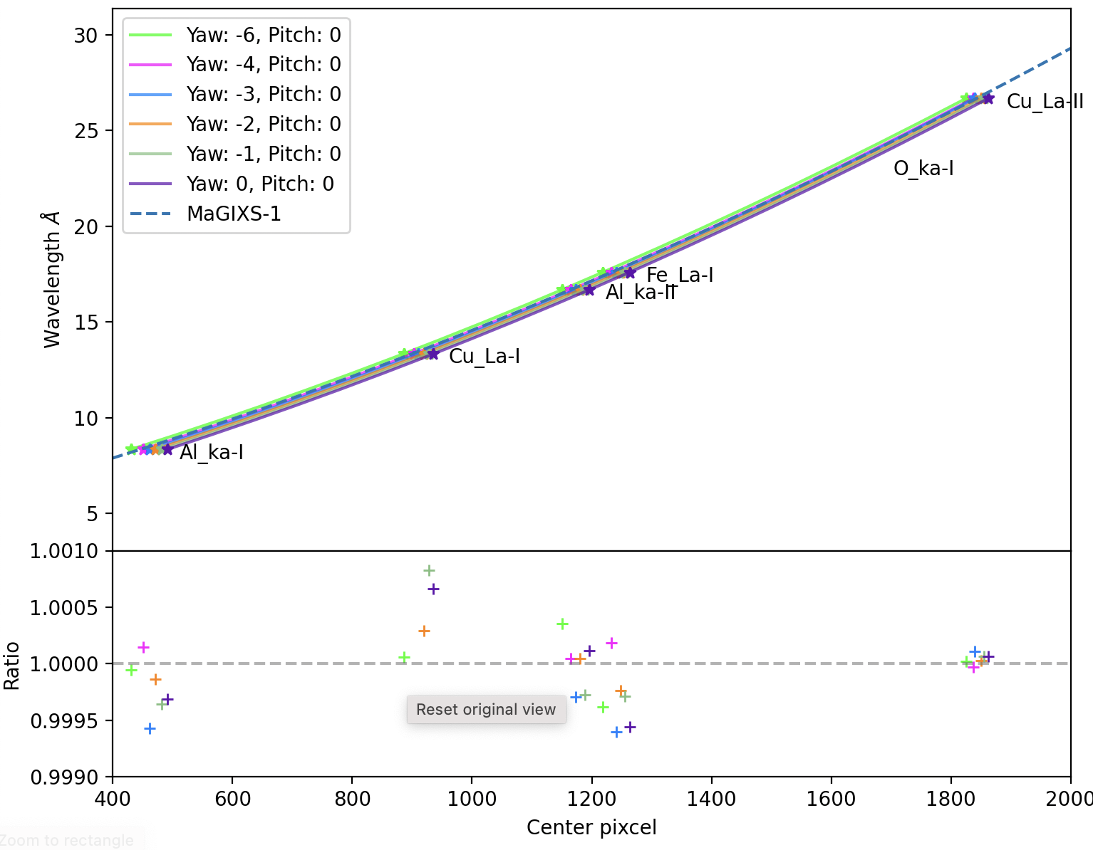
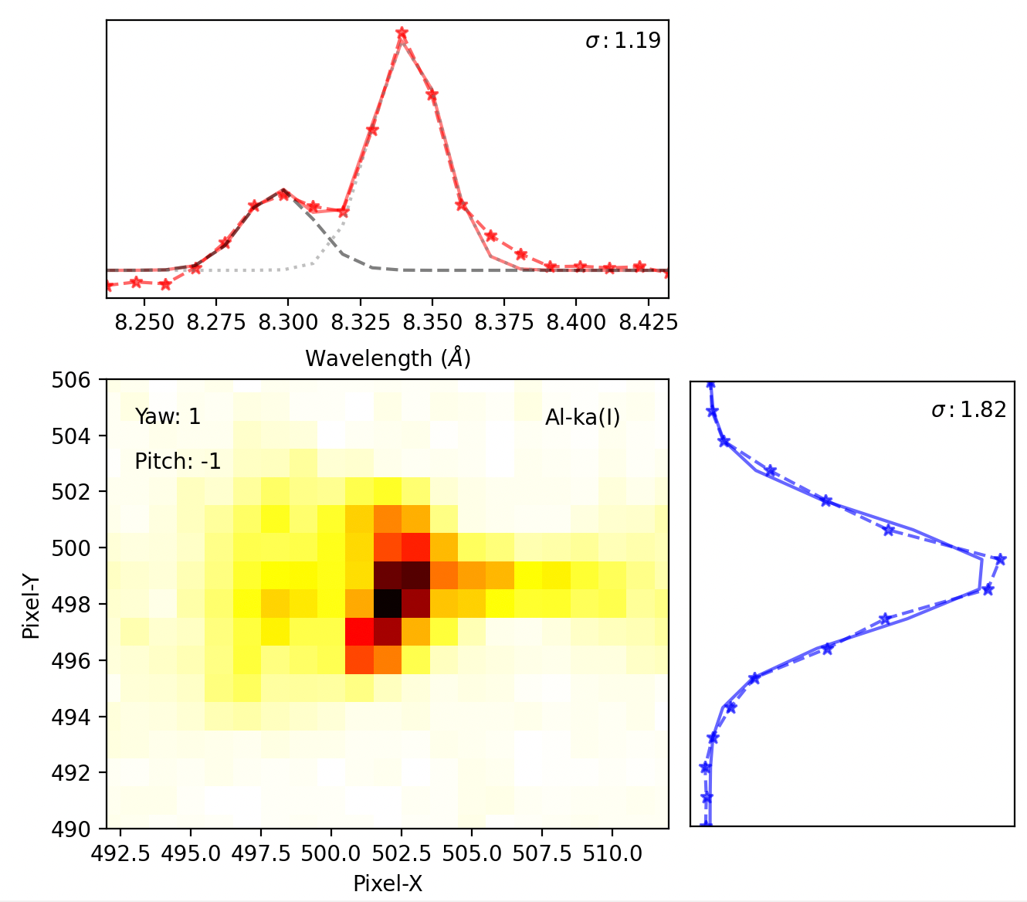
Second flight: MaGIXS-2
MaGIXS-2 calibration setup
Wavelength calibration
PSF measurement

Slide 9
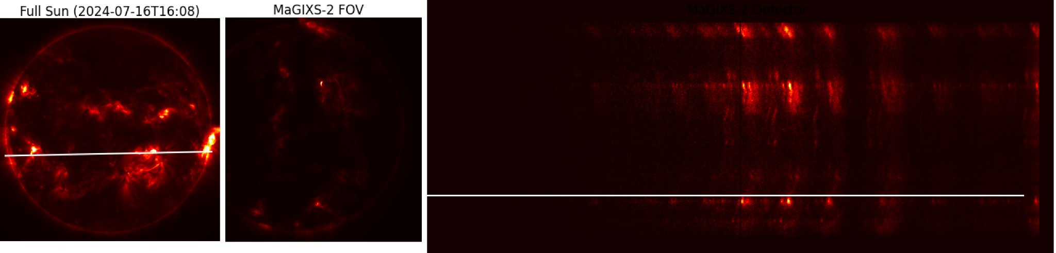
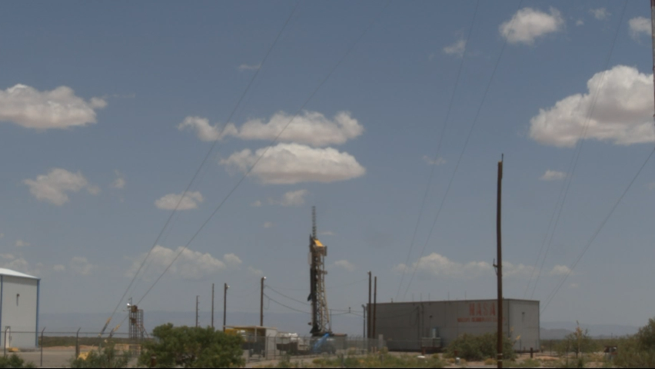
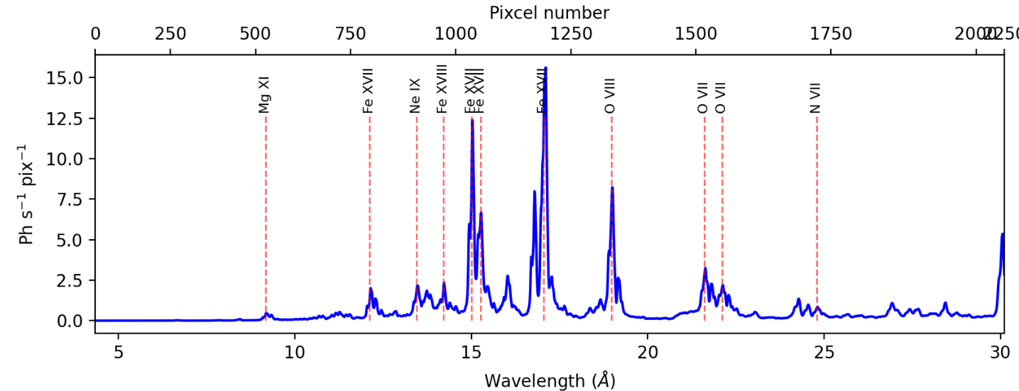
MaGIXS-2 Launch preparation on July 16

Slide 10
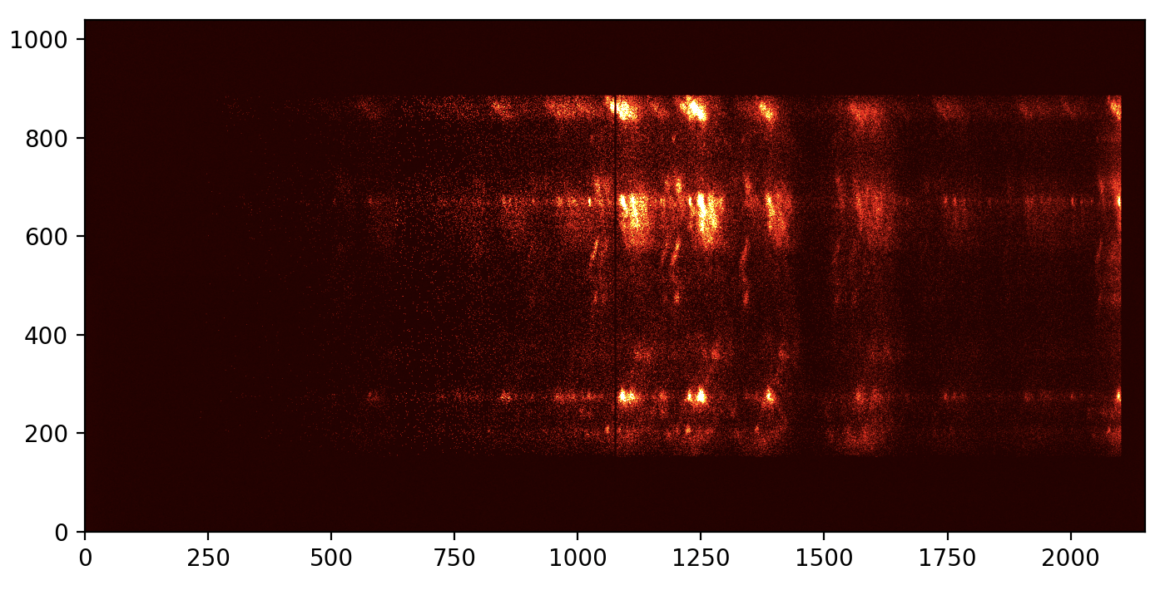
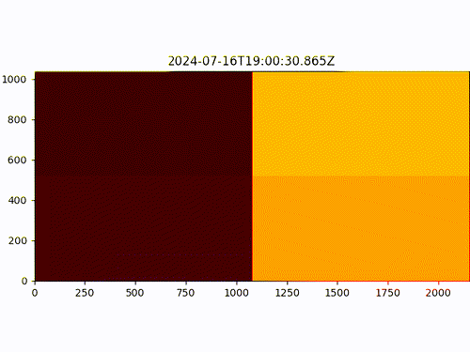
MaGIXS-2 Launch preparation on July 16
Prediction
Flight observation

Slide 11
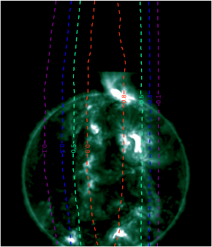
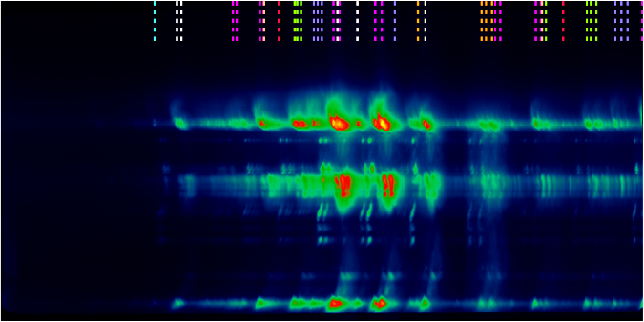

MaGIXS-2 data summary
Flaring AR
XBP
AR
AR

Slide 12
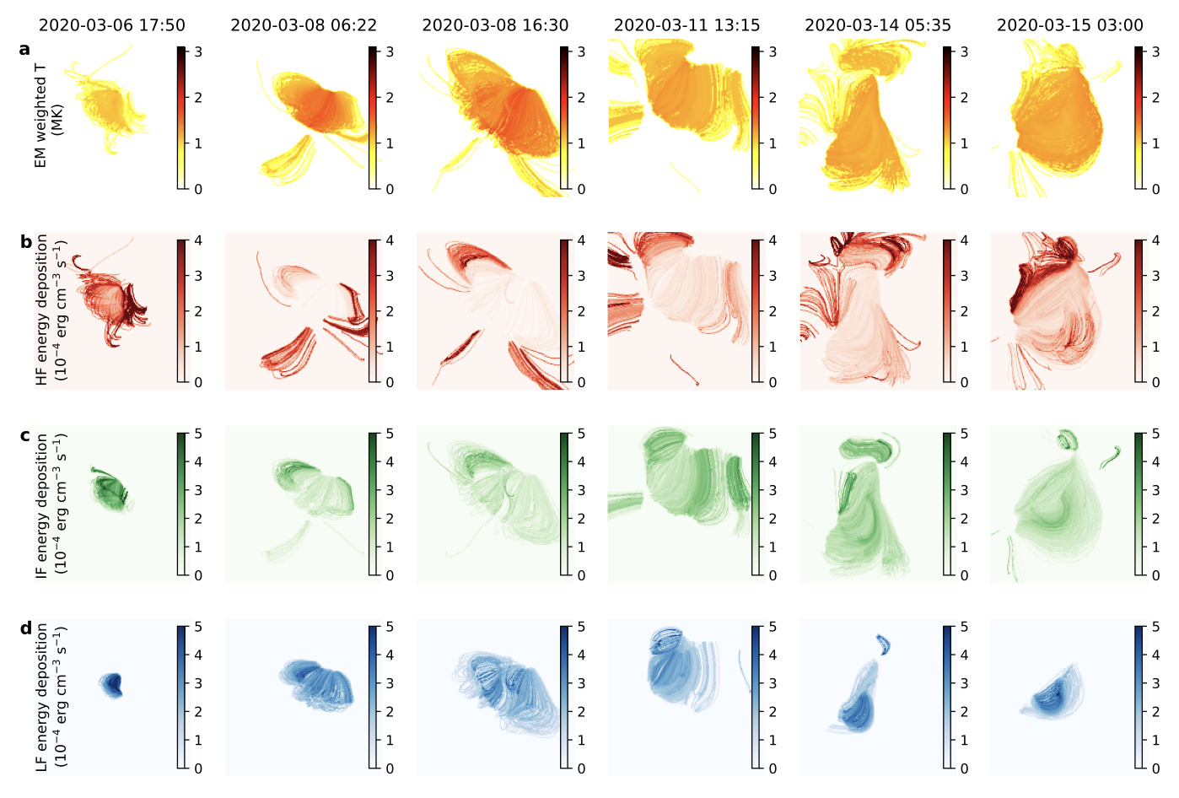
Heating is different over time and space: Long term imaging spectroscopic observation
Mondal et al, ( 2024b, submitted)
Thank You for your attention!

