Slide 1
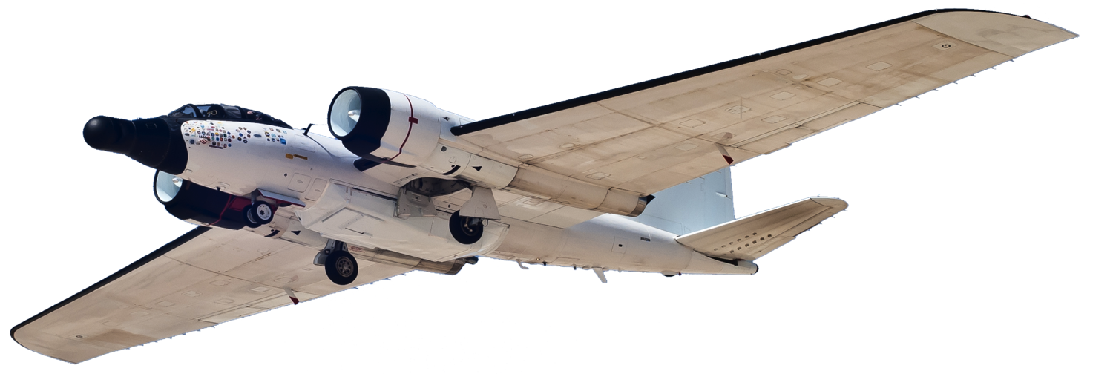
NASA’s WB-57F High Altitude Research Aircraft is Looking Up: A Flexible and Capable Heliophysics Platform for Coronal Observations During Total Solar Eclipses
American Geophysical Union Fall Conference 2024
Peter Layshock, Program Manager
13 December 2024

Slide 2
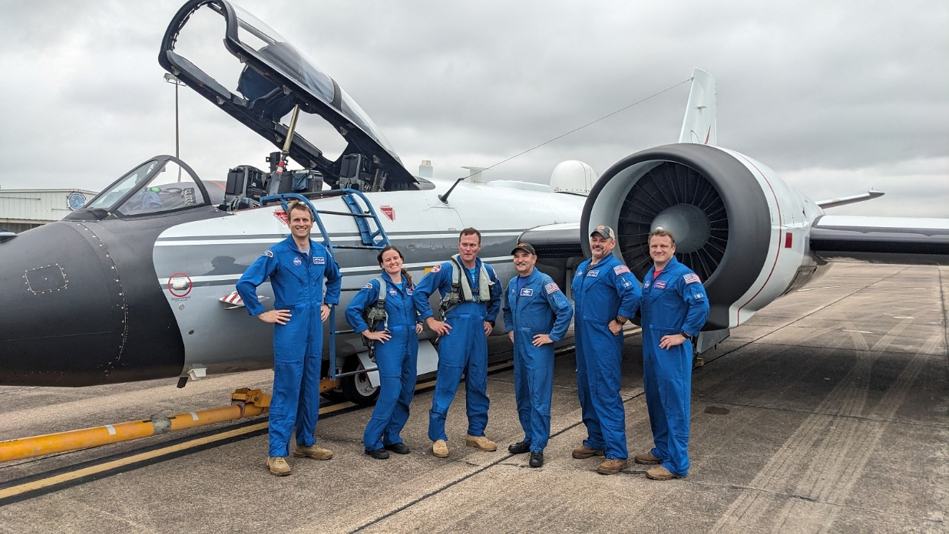
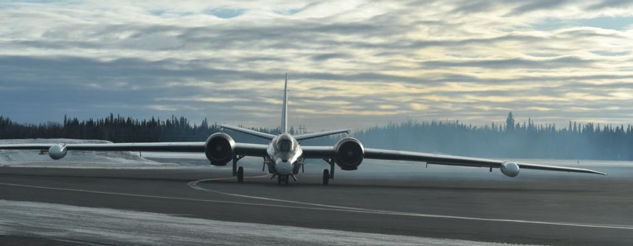
Agenda
Aircraft Specifications
Role/History at NASA
Payload Opportunities
Engineering/Operations
Eclipse Observation
Atmospheric Research

Slide 3
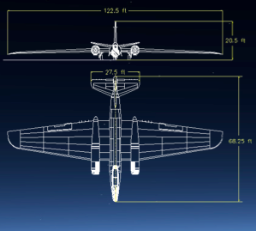
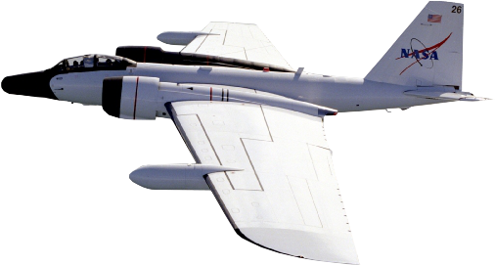
WB-57 Specifications
Range (nm)
900
Time on Station (hrs)
Transit (hrs)
2:30
700
1:00
2:00
500
2:30
1:30
3:30
300
PERFORMANCE
Aircraft ceiling | 63,000+ feet
Endurance | 6.5 hours
Range | 2,500 miles
Max. payload | 8,800 pounds
Airspeed @ 60kft | 410 knots (Max: Mach 0.8)
Aircrew | 2
Wingspan | 123 feet
1:00
4:30

Slide 4
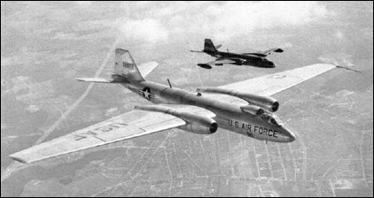
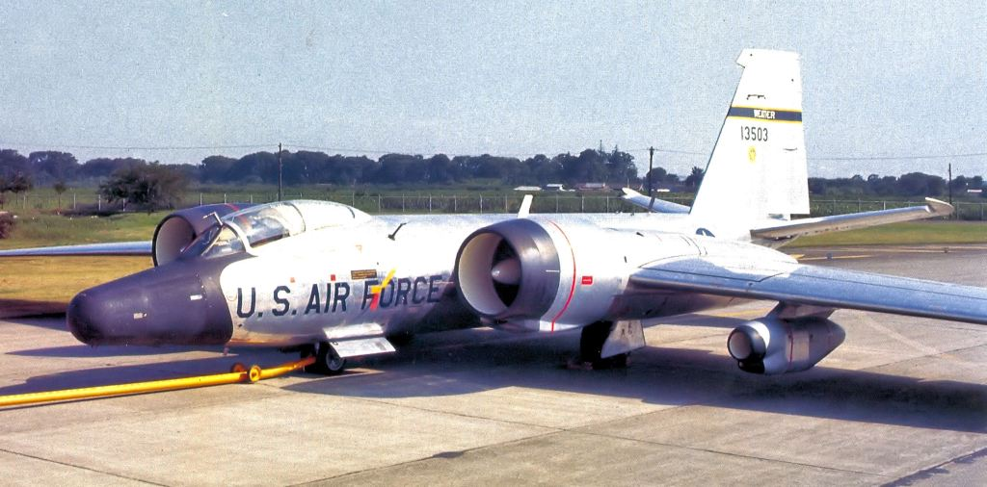
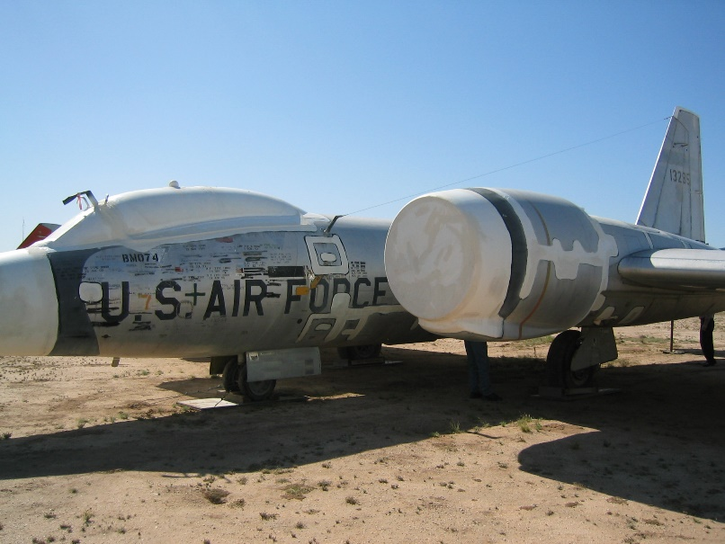
WB-57 at NASA
The B-57 “Canberra” has a long legacy as a conventional bomber from the 1950s
Long-wing, high altitude variants were developed in the 1960s for reconnaissance and sampling
NASA began flying the –F model in 1968 and still operates the last three such aircraft in the world

Slide 5
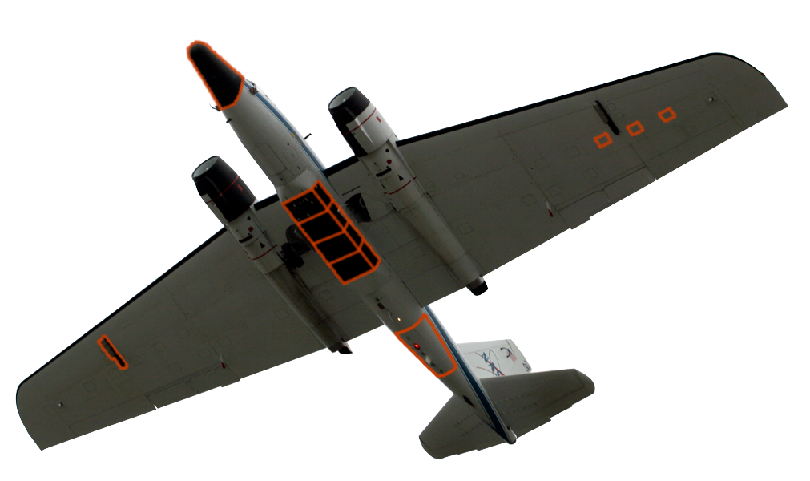
Payload Integration Opportunities
Tailored Sensor Solutions
A
Unique, bespoke solutions to sensor placement/integration challenges on airborne platforms
No “standard payload” constraints
Sensor package(s) compiled to meet each mission’s requirements.
Platform capable of integrating, testing and employing customer sensors in a multitude of configurations
Multiple air-to-ground communication and instrument control options: Voice, BLOS & LOS datalinks.
Multiple payload power options: 110V 400Hz, 110V 60Hz, & 28VDC.
D
B
C
E
Sensor Integration Options
 | Reconfigurable/removable, pressurized nose cone
 | 2x wing-mounted hard points; compatible with ER-2 SPEAR & U2 Super Pods
 | 12’ bomb bay (3’ or 6’ Universal Pallet System); 1000lb capacity per 3’ space
 | 20x small sensor hatches; ten hatches per wing
 | Tail cone
A
B
C
D
E

Slide 6
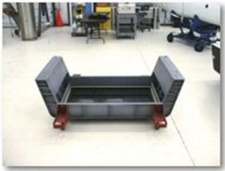
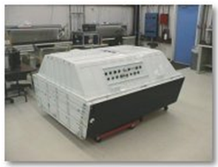
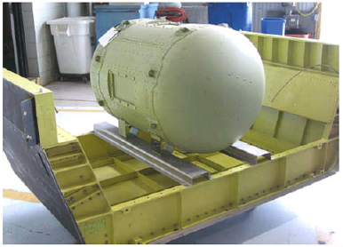
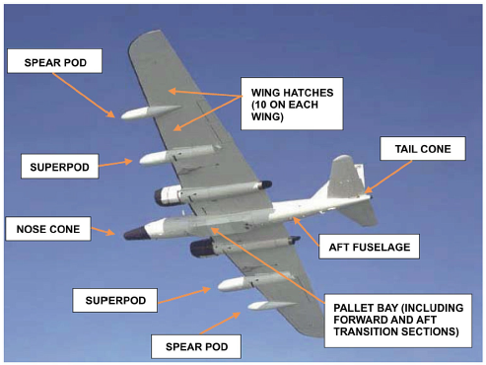
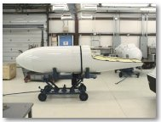
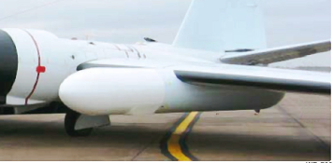
Pallet Bay and Wing Pods
3-Ft Unpressurized Pallet
6-Ft Pressurized Pallet
15 psi Pressure Container on 3-Ft Pallet
Super Pod
Spear Pod

Slide 7
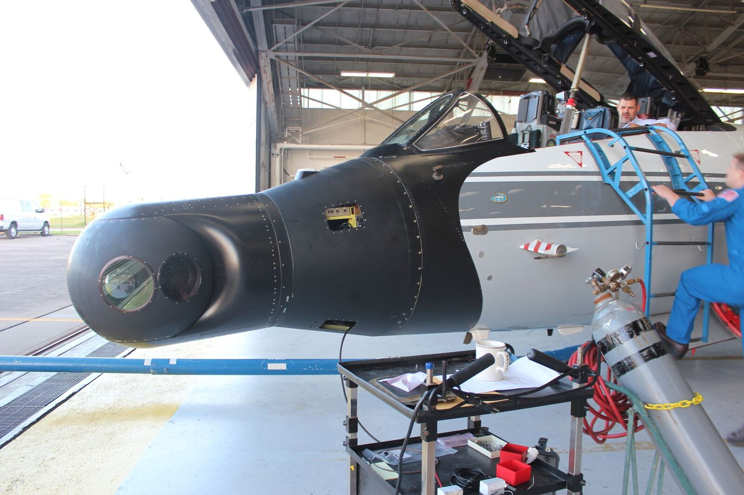
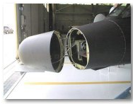
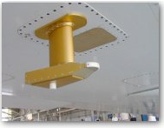
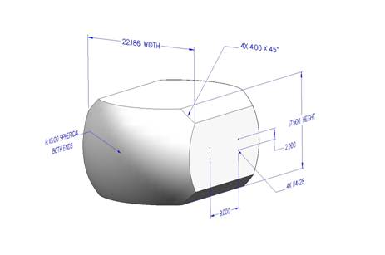
Nose and Wing Hatches
Courtesy SwRI/Amir Caspi
Wing Hatch
Nose Cone
Stabilized Payload Ball
4 axis gimbal, stabilized to 5 µradians
Physical:
Dimensions: 32 in ball diameter
Weight: set by Weight/CG restrictions of aircraft
Environmental monitoring of ball (Temp, Pressure, Humidity)
Pressure controlled to match cabin (5 psi minimum)
Power availability:
28 V DC
120V - 400 Hz AC
Data I/O: Gig-E, Serial, Coaxial

Slide 8
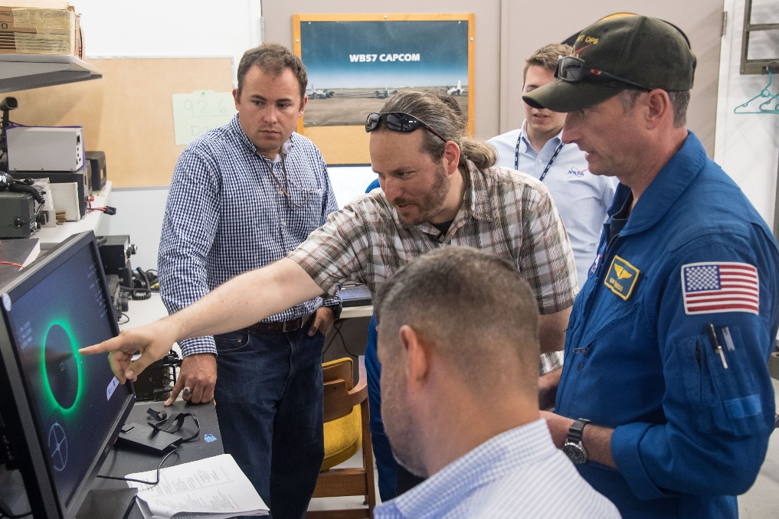
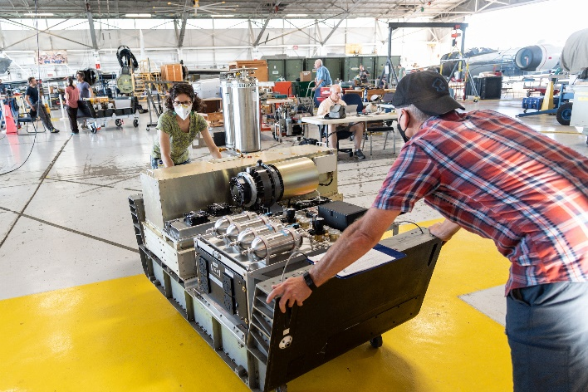
Payload Controls and Engineering
Dedicated rear-seat payload operator ensures real-time support/troubleshooting of scientific instruments
High-bandwidth satellite link between aircraft and ground stations support constant data feed and coordination with operator
NASA maintains in-house airworthiness for payload integration, ensuring full control over approval process

Slide 9
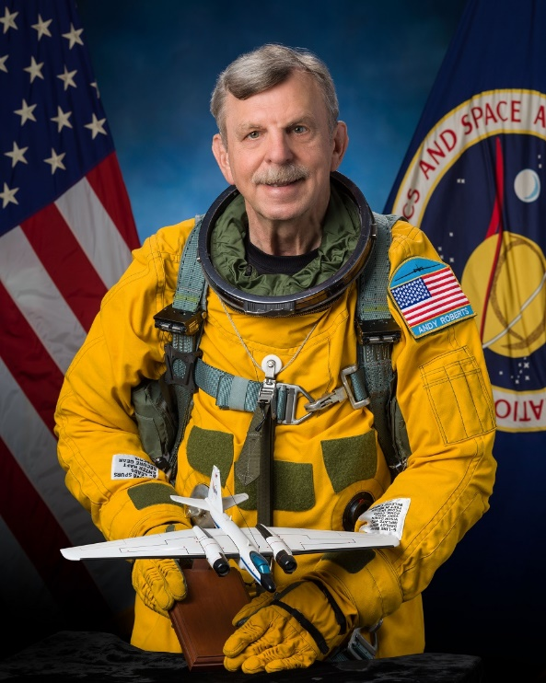
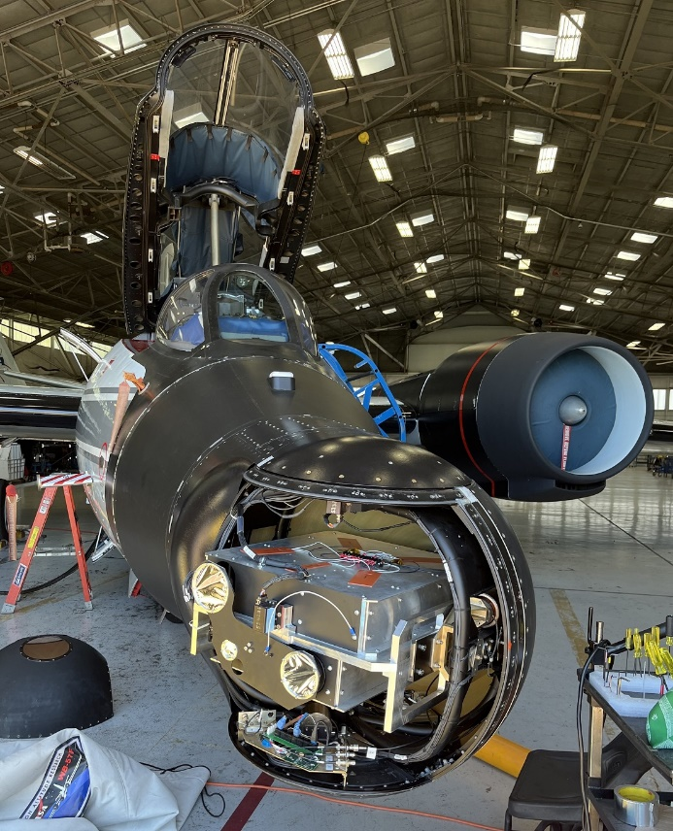
2024 Solar Eclipse Observation
AUG 2022: TESS conference introduction between Dr. Shadia Habbal, Adi Ding and Andy Roberts of WB-57/NASA Airborne Science
Fall 2022: UH submittal of NASA grant proposal
Winter 2022 – Summer 2023 preliminary engineering discussions
Spring 2023: Awardees notified
AUG 2023: grant funding received; full engineering and operations planning commences
MAR 2024: Airworthiness approval granted; equipment shipped from UH
MAR-APR 2024: Instrument inspection, assembly, ground testing, and final airborne testing
8 APR 2024: Eclipse Day

Slide 10
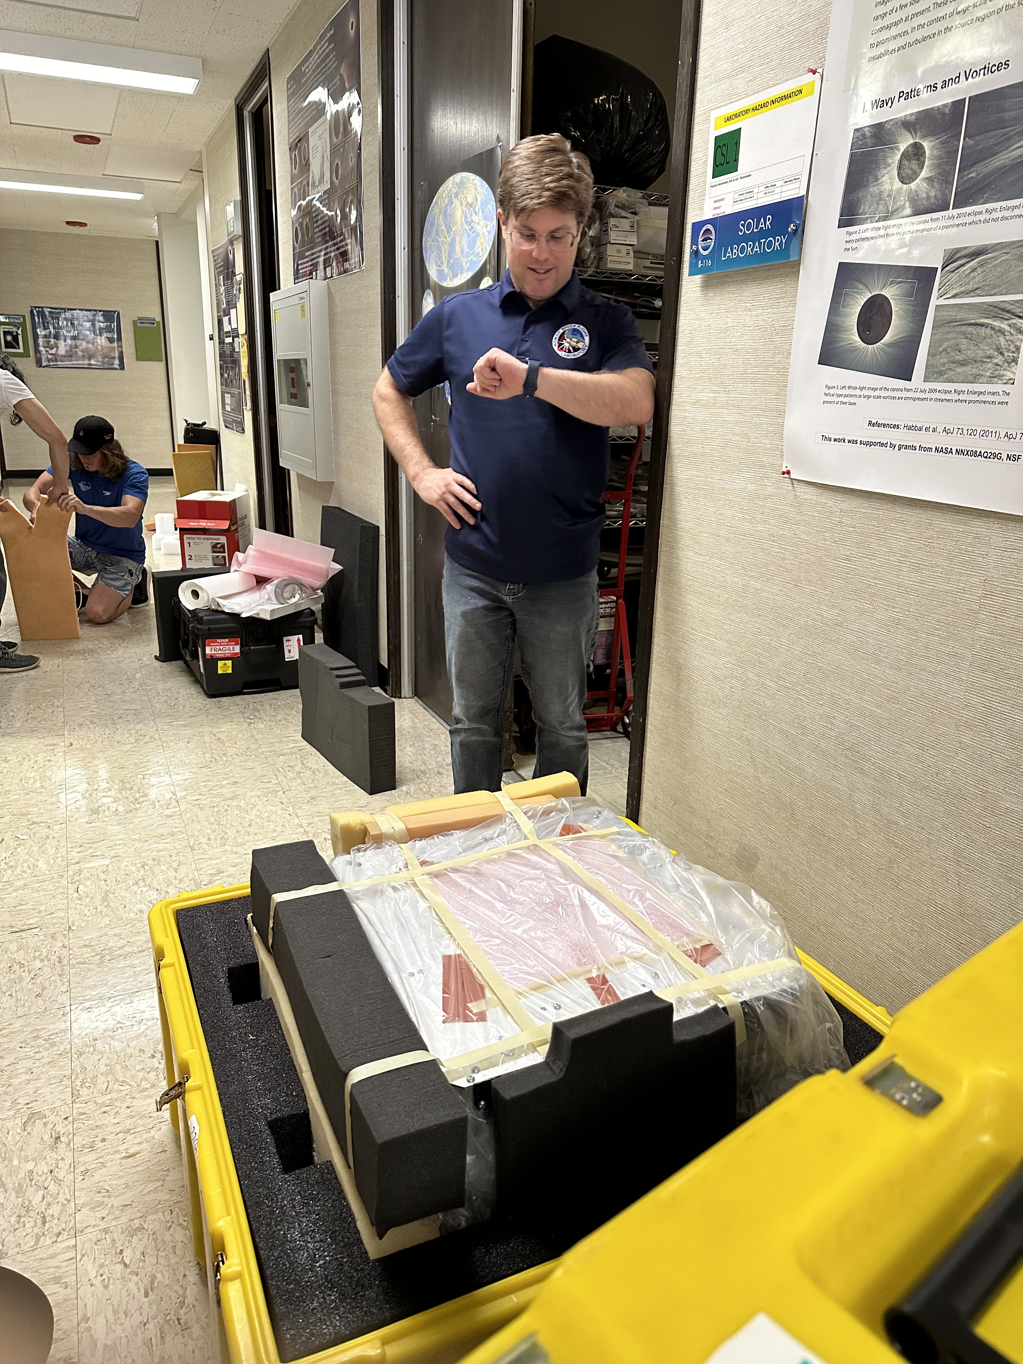
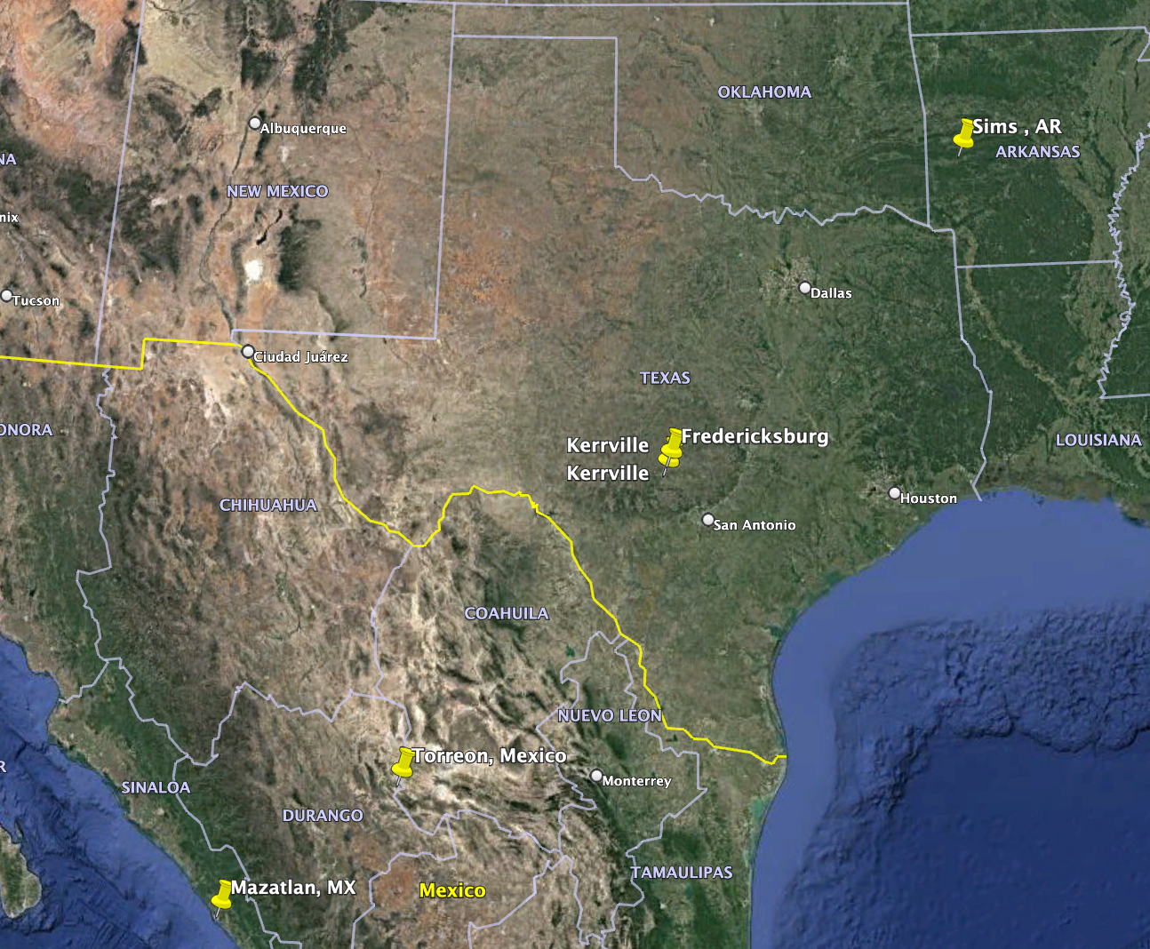
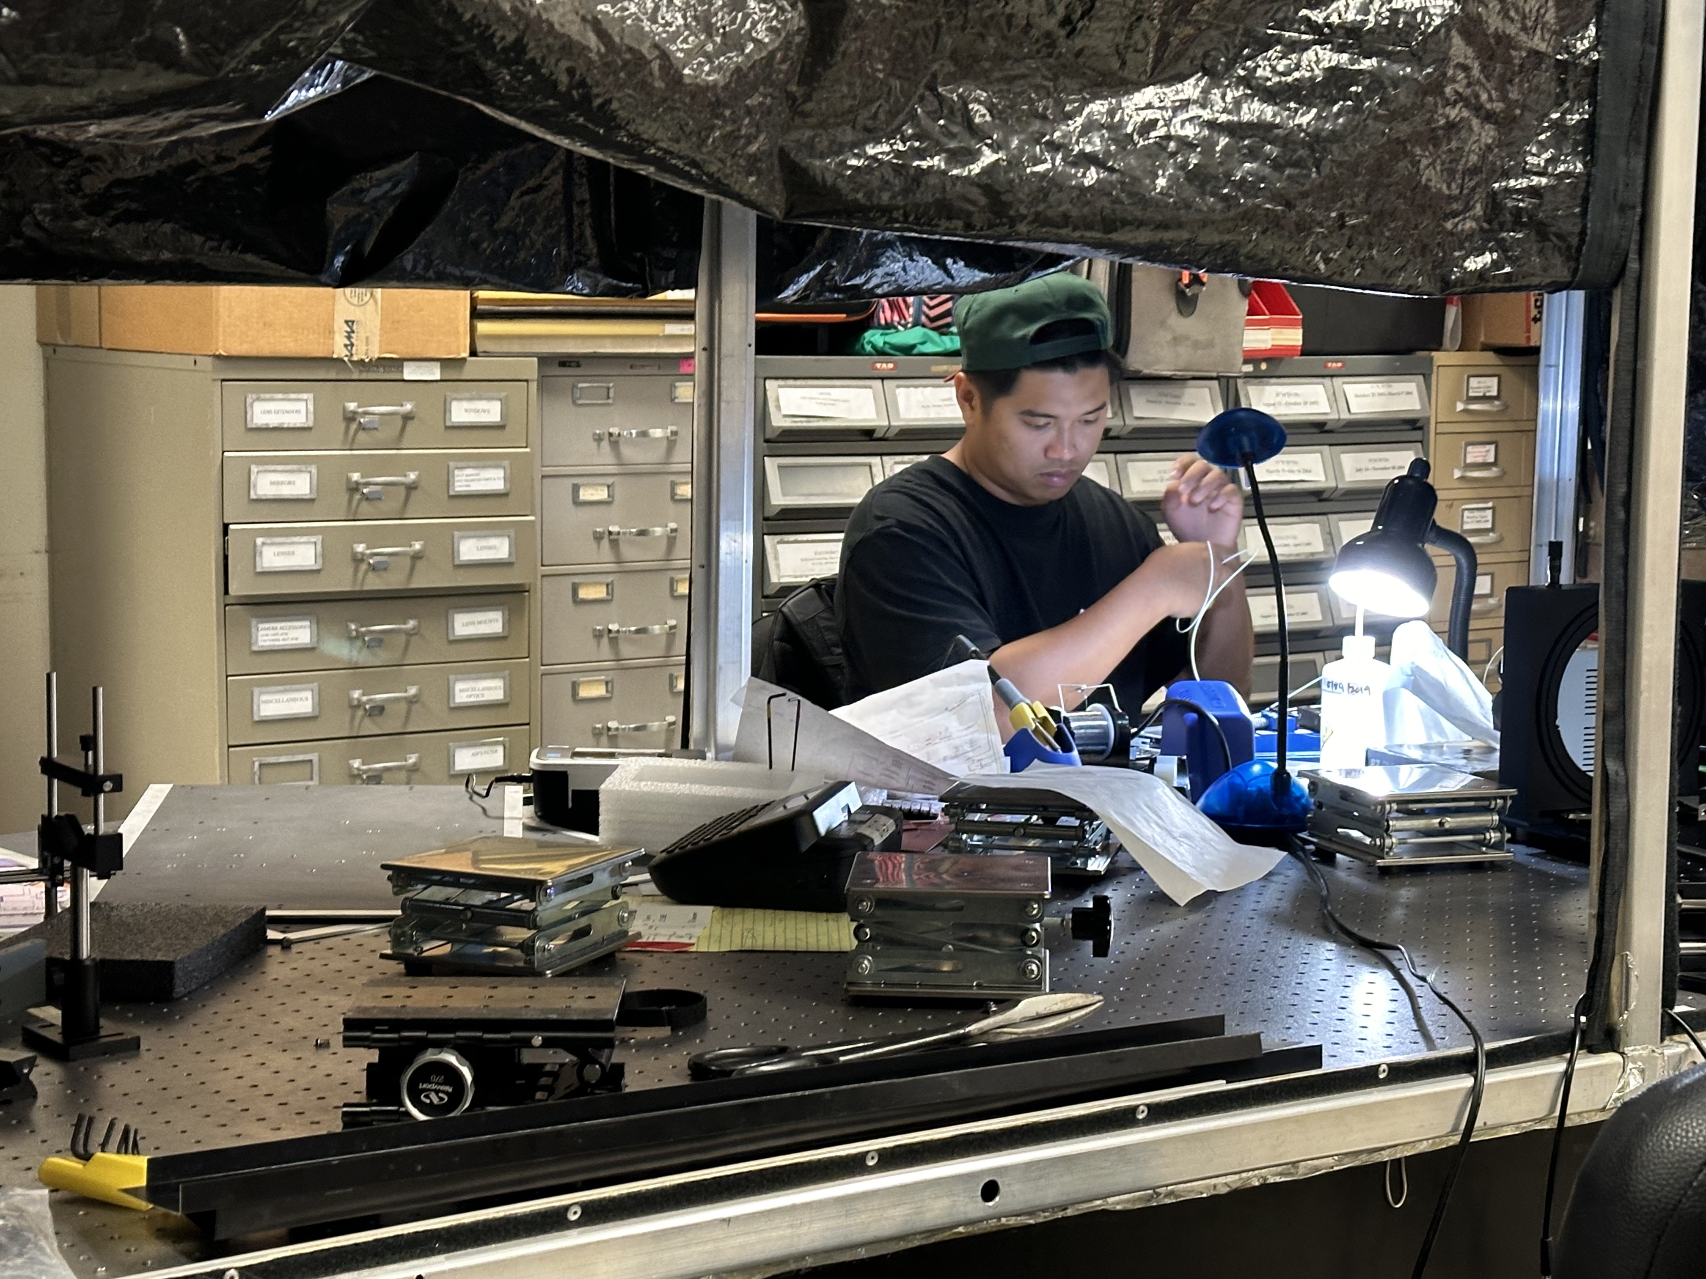
Observation Plan
In an effort to mitigate risk of cloud cover obscuring eclipse observation, aircraft and kites augmented conventional ground stations
kite
WB57

Slide 11
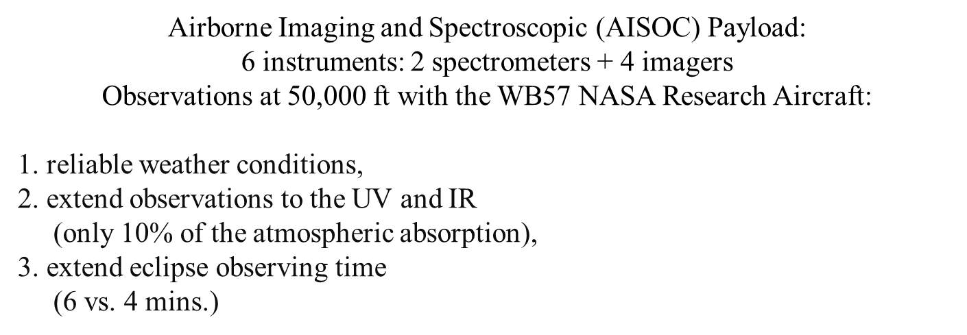
Aircraft Configuration

Slide 12
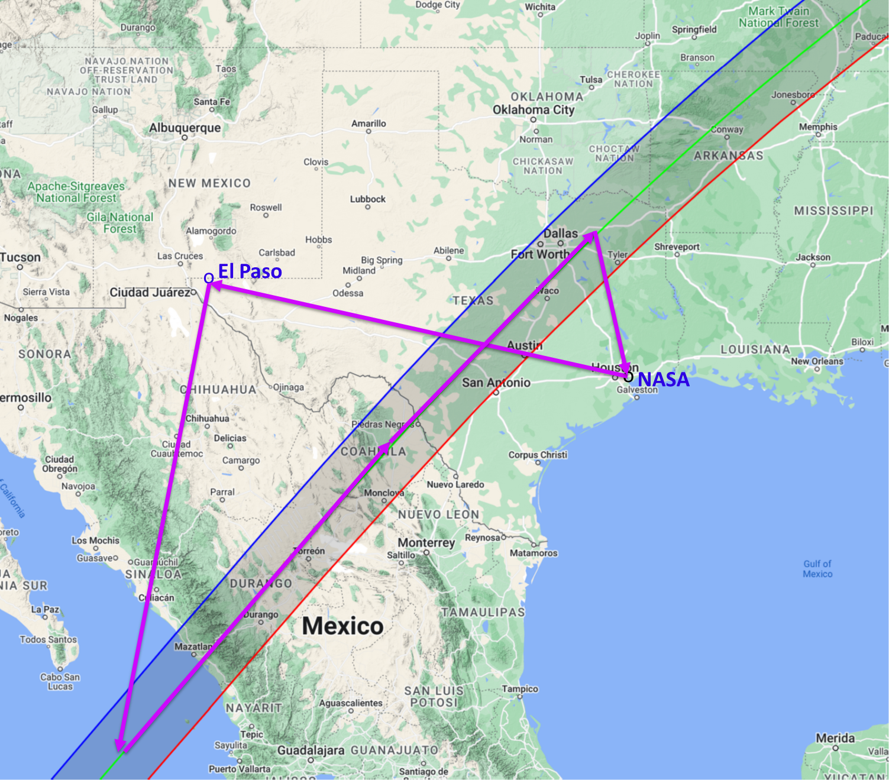
Eclipse Observation
Due to weather uncertainty, the UH eclipse aircraft was repositioned to El Paso, Texas several days ahead
Both WB-57 aircraft rendezvoused over the Pacific near Mazatlán, Mexico for the correct positioning and timing
The WB-57 team met all primary mission objectives on both aircraft and this mission serves as a proof-of-concept for future astrophysics research

Slide 13
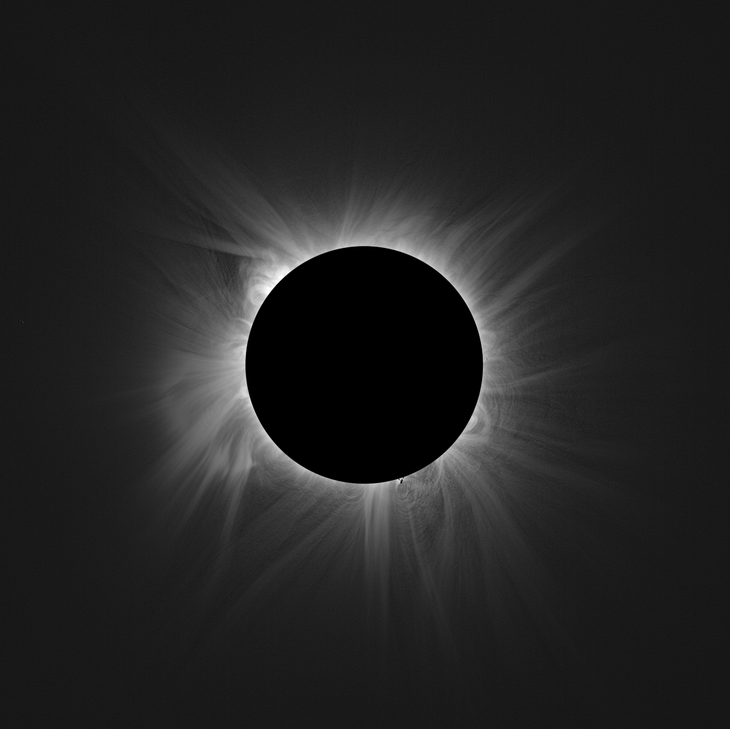
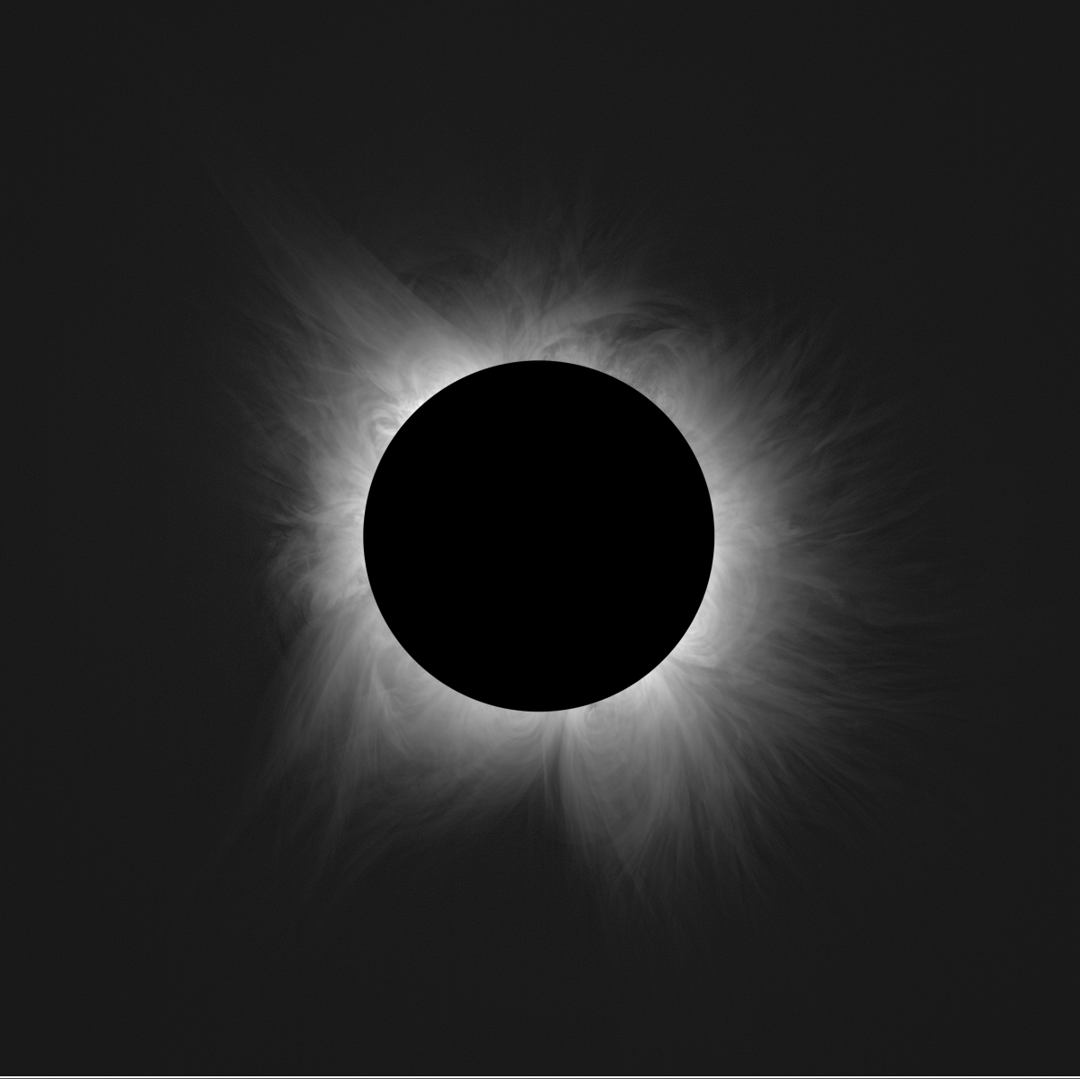
A New Perspective…
Fe X
Fe XIV
Fe X + Fe XIV
Courtesy UH IfA/Shadia Habbal

Slide 14
Sincere thanks to all who made the 2024 eclipse observation a success, and a model for future research:
Dr. Shadia Habbal, University of Hawai’i, and team
Dr. Amir Caspi, Southwest Research Institute, and team
Dr. Bharat Kunduri, Virginia Tech, and team
Dr. Madhulika Guhathakurta, NASA Heliophysics
Mr. Andrew Roberts, NASA Airborne Science Program (ret)

