Slide 1

AES NASA TIM
11-19-2024

Slide 2
  Migration of Legacy Systems To Cloud

Slide 3
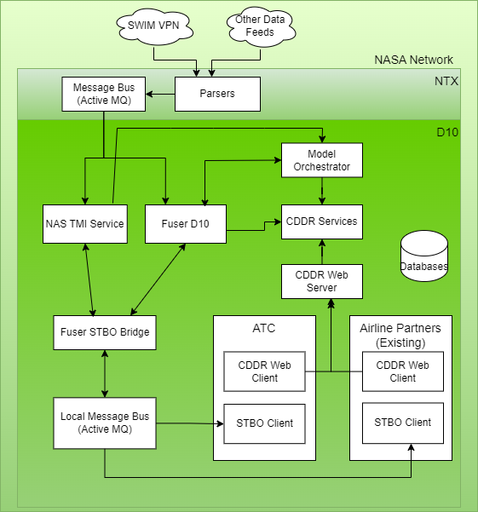
DIP CDDR Architecture Prior to Cloud Integration (Legacy)
All components run North Texas Research Station (NTX) or the D10 TRACON
Parsers and GUFI service run at NTX
Fuser, NAS Model Orchestrator,
D-STBO Client, CDDR services, CDDR Display, and other supporting components run in D10
No components in the cloud

Slide 4
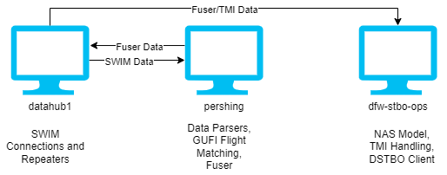
Legacy Setup Short Comings
Low distribution of processes
Environment required extremely high-powered machines
Filtered to D10 data
Limited flexibility in adding new Airports/Centers for modeling
Inability to share Clients outside of NTX network
Tight coupling between Client and Server processes running on the same system

Slide 5
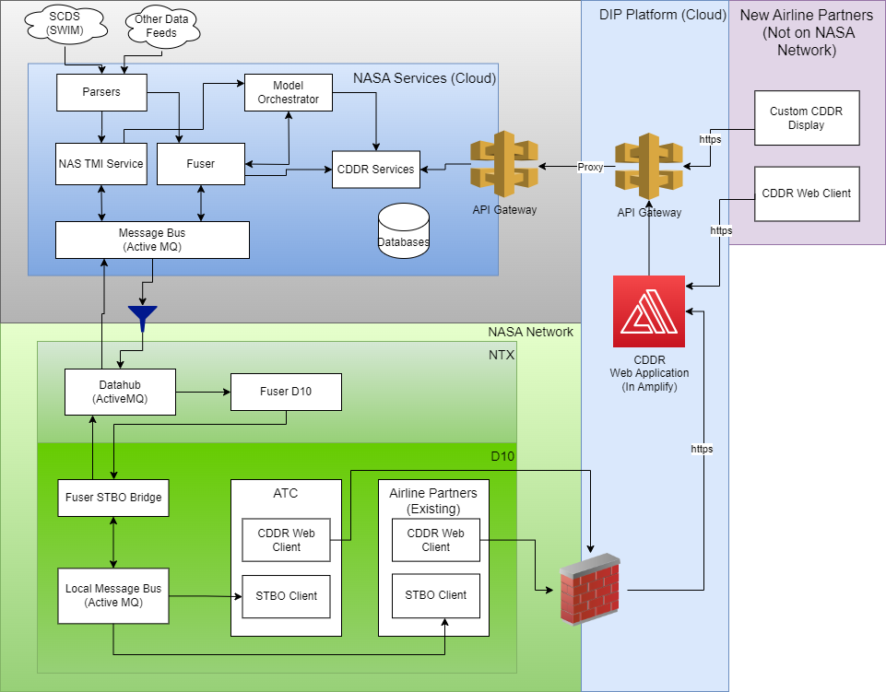
DIP CDDR Cloud Integration
Pros
  CDDR web client accessible over the internet
    Secured with SSL, Tokens, white- listing, and NASA DNS
  CDDR Services available via API Gateway
  Fuser set up is common for CDDR and Platform usage
  Expandable to new sites with much less effort
Cons
  Message flow to/from legacy STBO clients is now more complicated

Slide 6
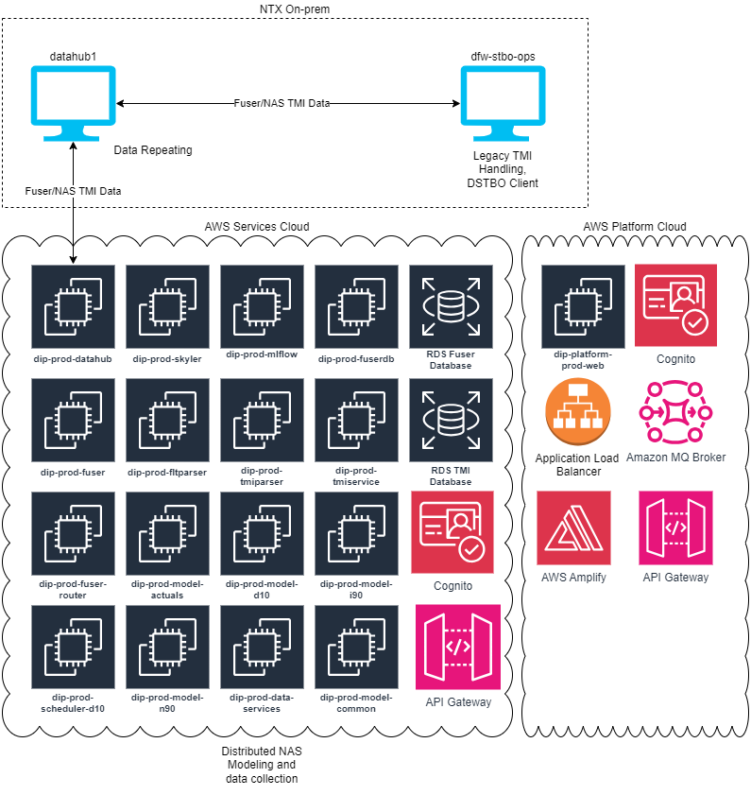
DIP Cloud Setup
Majority of processes moved to an AWS cloud environment with limited processes, specific to D10 running on-prem
Highly distributed cloud environment
  Related processes encapsulated into different EC2 instances
  Reduced need for high powered systems
  Reduced risk of catastrophic on-prem server failures
  Increased complexity
Flexibility to scale architecture to include new Airports/Centers
Distributed AWS environments allow for de-coupling of Client and Server processes
Reduced risk with increased control of what is exposed between environments
Reduced processes and data flows to on-prem systems, limited to only what the D-STBO requires

Slide 7
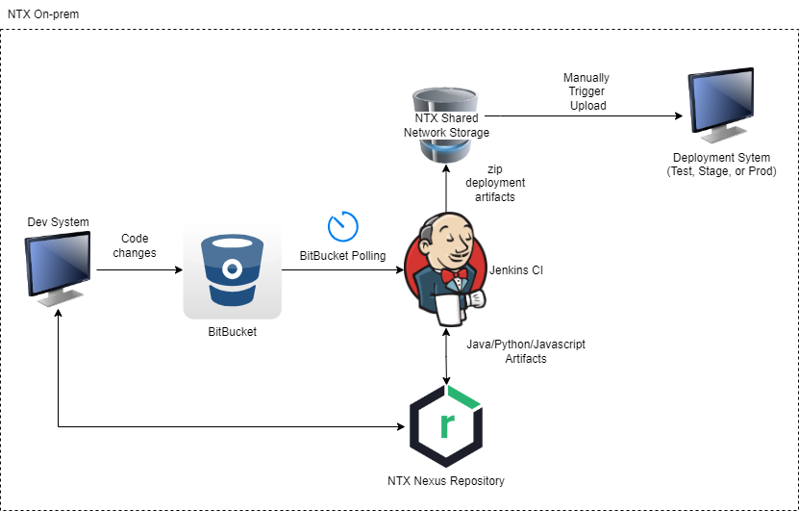
Code Deployment – Before

Slide 8
Code Deployment – Before
Automated build processes using Jenkins CI/CD
Artifacts shared via Nexus repositories
Deployment artifacts are cached to shared network mount
Deployment and configuration of operational system is all done manually
Limited vulnerability scans

Slide 9
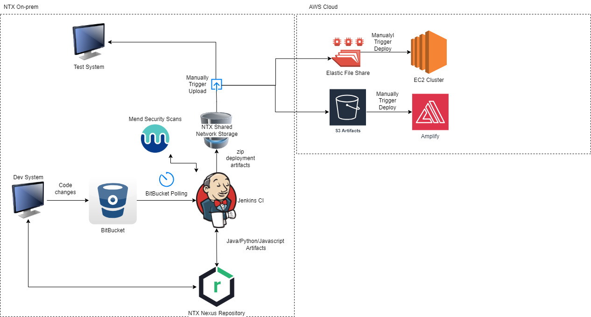
Code Deployment - New

Slide 10
Code Deployment – Improvements and Modifications
Dependency vulnerability scanning integrated into Bitbucket and Jenkins CI/CD processes
  Using Mend (formerly Whitesource)
Proactively addressing vulnerabilities prior to deployment
Deployment artifacts are cached in an on-prem shared network mount, AWS Elastic File Share, and AWS S3 buckets
Deployment leverages Cloud Development Kit to manage changes to the AWS environment
Deployment to the cloud leverages utility scripts to consistently setup and install environments on all the distributed EC2 instances

Slide 11
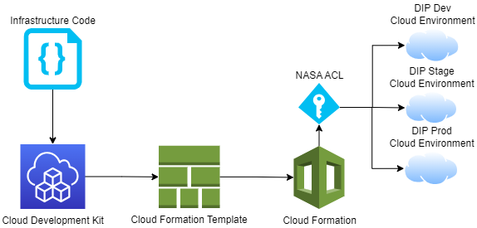
Cloud Development Kit (CDK)
CDK is an Infrastructure as Code (IaC) utility
Describe the AWS environment in code, CDK converts to Cloud Formation Templates
Allows AWS environment changes to be captured in version control
Guarantees consistent architecture deployment across all AWS environments
Reduces risk of introducing manual bugs
Allows quick tear down and re-creation of AWS environments
Support generating environments ‘diffs’ to compare and evaluate changes
Notes:
Lesson learned stage

Slide 12
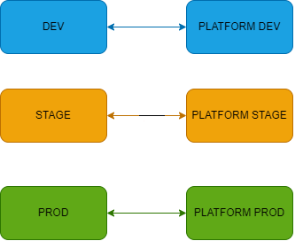
CDK Investment Pays Off
VPC Migration
  Required to move for security reasons
  New VPCs created in all accounts with NASA owned/managed IP addresses
  Complete re-creation of all AWS resources, security groups
  CDK investment saved us a ton of time.

Slide 13
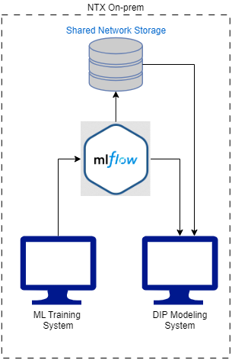
MLFlow On-prem
MLFlow is an opensource server for tracking Machine Learning Model artifacts and statistics
All ML model processes can query the MLFlow server to receive information about the latest trained ML model and the model location
Backed by a shared network drive so that all models may be available to all DIP modeling systems

Slide 14
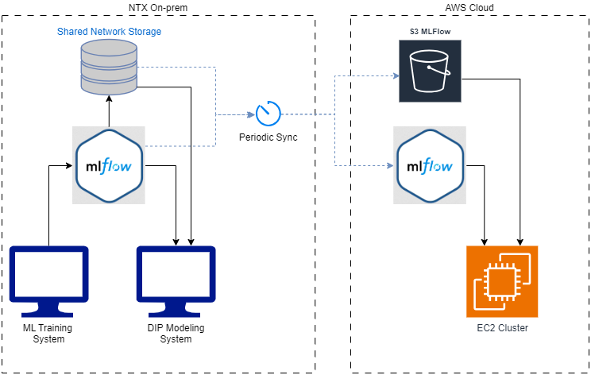
MLFlow On Prem and In the Cloud
MLFlow instance at NTX is not accessible from the AWS environment
A second MLFlow server is setup in AWS to provide ML model access to the distributed AWS environment
Data is synced every 6 hours
  MLFlow tracking database is pushed to the AWS instance of MLFlow
  ML models from the shared network drive are pushed to S3
  Sync process transcribes file paths from the shared network drive to the expected S3 locations

Slide 15
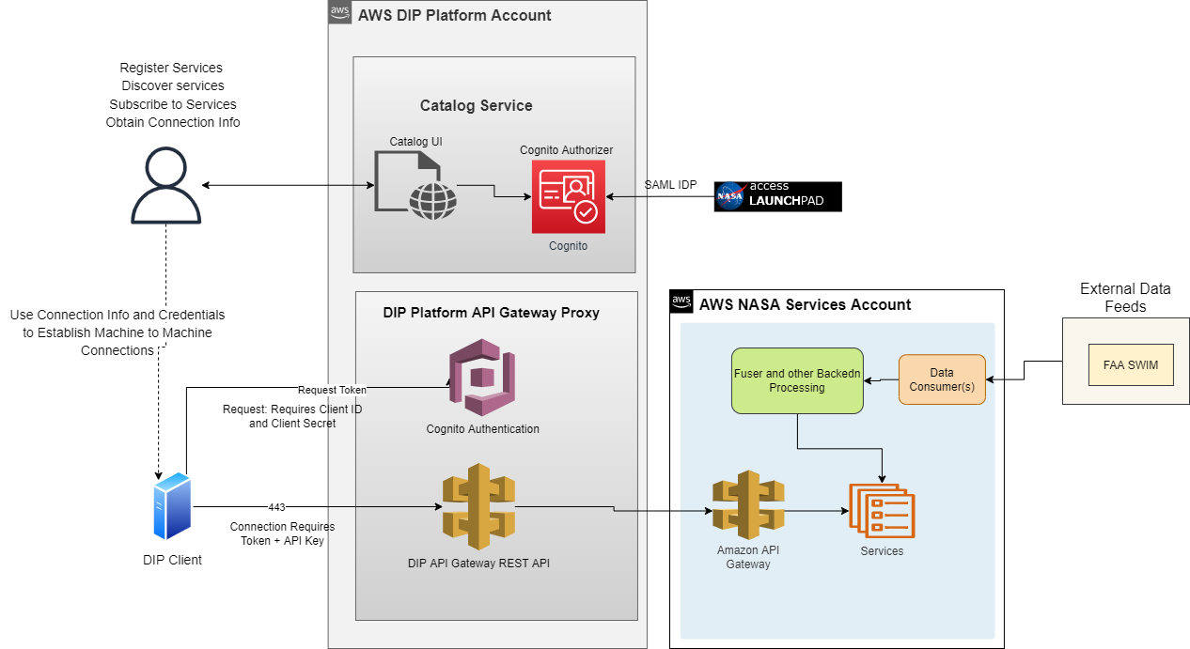
Platform High Level Architecture

Slide 16


Additional NASA Services in The Cloud
CDDR Use Cases and Benefit Mechanisms
Streaming Services
E.g., Fuser FIXM public and CDM services
Streaming services are pub/sub connections
Fuser provides real-time update of processed data from SWIM data sources and integrated with NASA Airport surface orchestrator
Data Access REST Services
E.g., TMI, flight data, runway times, taxi times, timeline
Data Access services that provide near real-time data from Fuser data
Services return an actual, detected or modeled values of time or runway or fix (except for TMI service)
Machine Learning (ML) REST Services
E.g., airport configuration, runway, and taxi times
ML models available for what-if applications
(input request returns a predicted value)
ML services are services to build modeled values in the Data Access services
Archival Services
E.g., SFTP for Flight summary, TMI and Fuser files
Access to archived files of Fuser and TMI services
Up to 6 months of data
Transfer amount is capped
Non-NASA services will be registered on the platform through Service Provider partnership

Slide 17
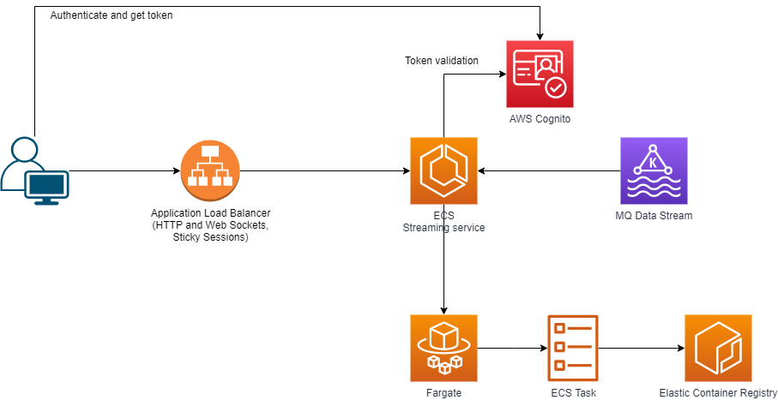
Fuser Data Streaming
CDDR Use Cases and Benefit Mechanisms
Node.js Service running in ECS
Utilizes Socket.IO library (web sockets++)
Cognito Authentication (JWT)
  Signature validation with Cognito RSA public key
  Custom Scope validation
Endpoints Exposed by Application Load Balancer
Consumes from Amazon MQ
Broadcasts over socket to all connected clients
Tried WebSockets via API Gateway (failed)
  Could not keep up
  Worked with AWS solution experts on ways to speed it up with no success
  Ultimately all roads lead to a PostToConnection call that is the bottleneck
17
Notes:
Pallavi = they were interested on more on data streaming in general.

Slide 18
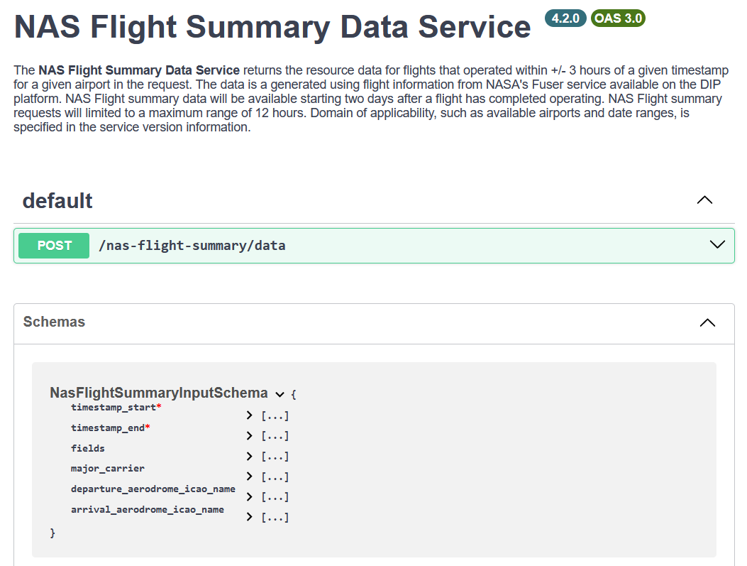
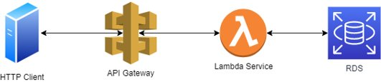
Data Access APIs
CDDR Use Cases and Benefit Mechanisms
Data Access APIs created to provide data from database tables/views to Platform users
Database queries written to populate with parameters from request and return data expected in response
18

Slide 19
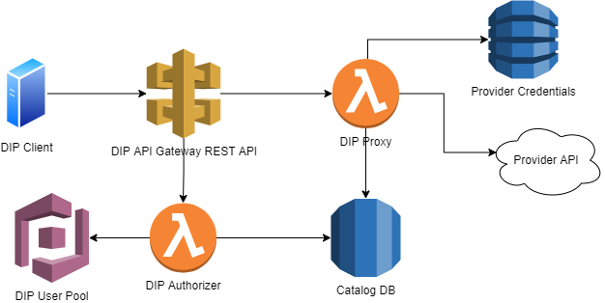
Authorizer and Proxy
Authorizer determines if a DIP API consumer should be allowed/denied access
Proxy forwards requests to the Provider API, with Provider Authentication credentials

Slide 20
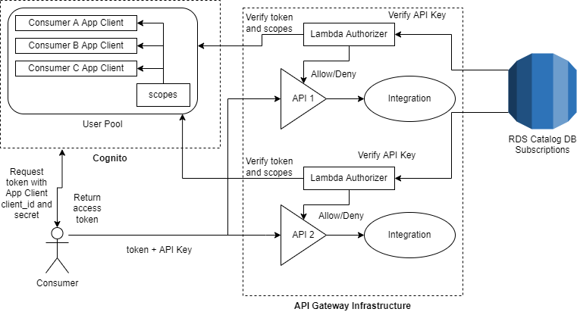
Authorizer
Lambda Authorizers are an API Gateway capability utilizing custom code
Verify Cognito Access token
Verify OAuth Scopes in token match API requirements
Verify consumer API Key has a Subscription to the API
Return Allow or Deny IAM Policy

Slide 21
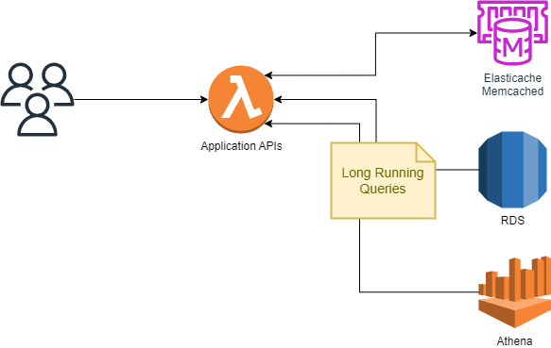
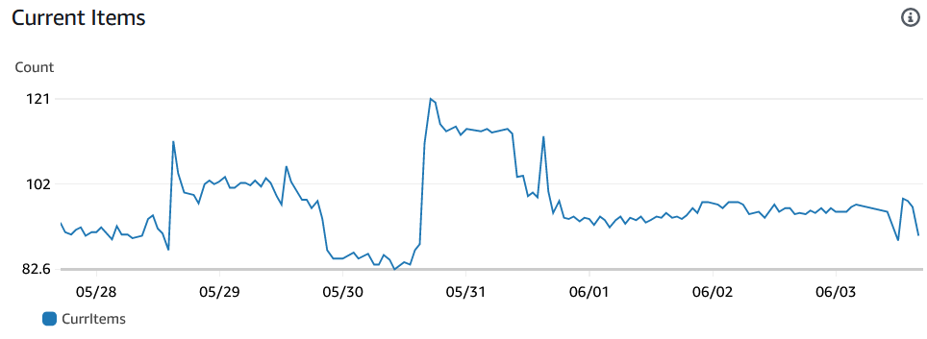
Performance Improvements - Caching
ElastiCache
  AWS Managed Cache Infrastructure based on Memcached
    Fully Managed, Metric tracking, Patching
  Simple in-memory Key/Value pairs with expiration
  Super fast (single digit ms response usually)
  Use cases: cache repeatable, expensive query results

Slide 22
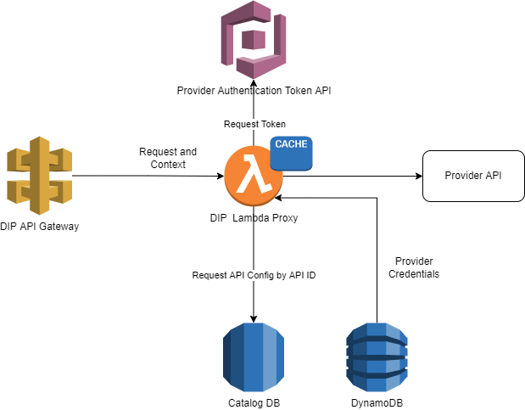
Proxy
Proxy receives full HTTP Request from DIP API Gateway with API ID
Builds a target URL based on configured Provider API base URL and path/query parameters
Requests access token from Provider authentication provider (if not cached)
Makes HTTP request, returns response to DIP API Gateway
Cache is managed by provider token expiration date/time

Slide 23
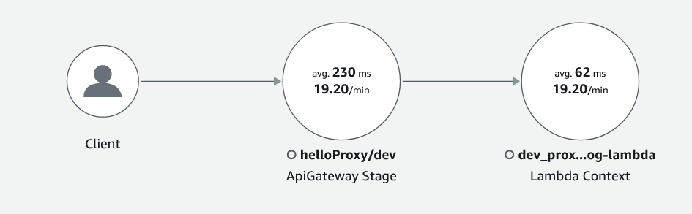
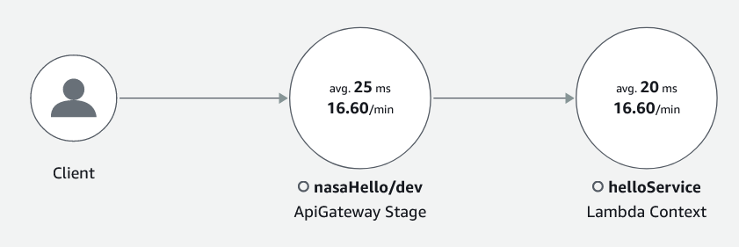
Proxy Performance
Minimal overhead
~60ms execution time for proxy calling nasaHello backend test service
~25ms of that is waiting for an async response from the backend service
Proxy is serverless, unbounded concurrent executions can be provided to scale

Slide 24
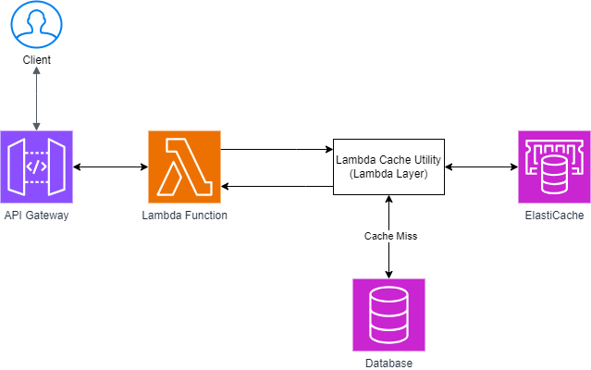
Performance Improvements - Caching
Service Support for Caching:
  Lambda Layer: A new utility package (DIP Lambda Cache Utility) deployed as a Lambda Layer.
  Lambda Handlers: Lambda handlers import this layer to interact with ElastiCache.
  Cache Hit: Returns cached result to the client.
  Cache Miss: Queries the database, caches the result, and returns it to the client.

Slide 25
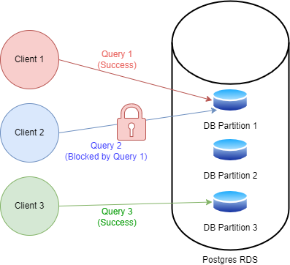
Performance Improvements – Databases
DIP requires a database architecture to support non-blocking high read/write IO capabilities to support SA-1 and Platform related services
Performance Problems
  Analysis query failures and timeouts
  Critical processes running out of memory
  Bottlenecked loading and reading of data
  Platform Data Access API failures
  High overhead scheduling database access for resource intense queries
  Risk of data loss from database failures

Slide 26
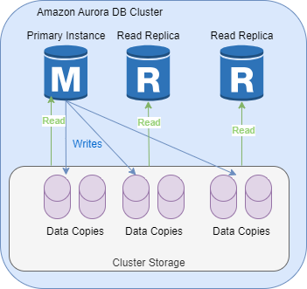
Performance Improvements – Databases
  Amazon Aurora Postgres I/O Optimized (Implemented Solution)
    Flexible cluster architecture and storage
    RDS Proxy support
    Meets non-blocking I/O needs
    More Affordable
      no extra I/O event cost
      Pay only for the storage used
    Supports auto scaling

Slide 27
Rate Limiting and Throttling
Two control levers for limiting API Access
  Rate: number of requests allowed for short duration (10 seconds)
    Limits burst concurrency
  Quota: number of requests per longer time frame, like a month
    Limits overall number of calls
Both are specified in a Usage Plan assigned to the service consumer subscriptions

Slide 28
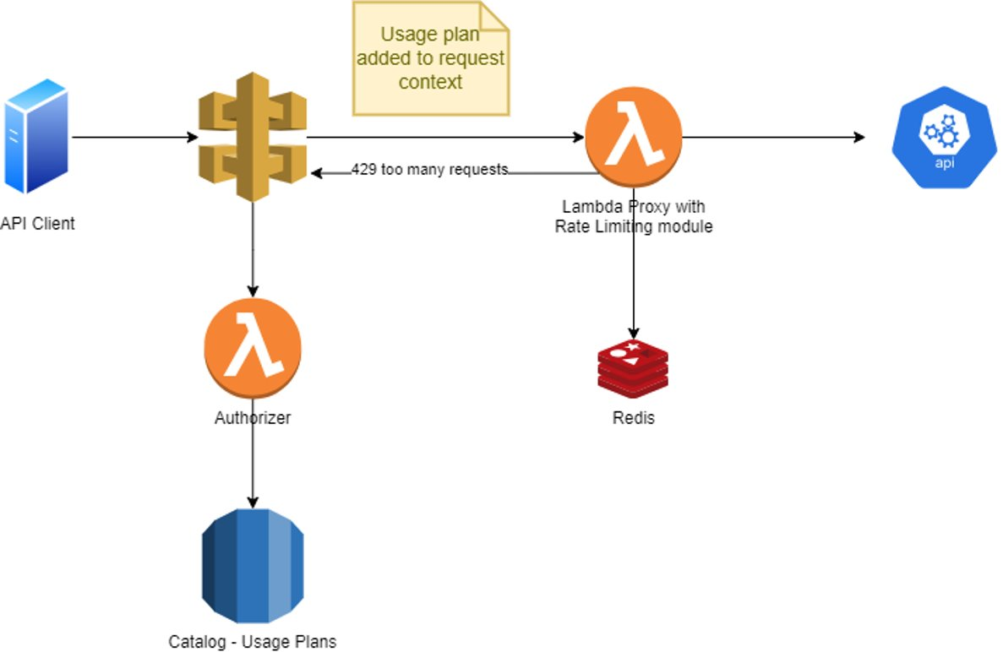
Rate Limiting and Throttling
Rate Limiting and Throttling happen in the REST API Proxy Lambda
-Redis key atomic increment and expiration used for both
-Usage plan is loaded by the Authorizer lambda, added to request context, and cached. Avoids a database hit in the proxy.

Slide 29
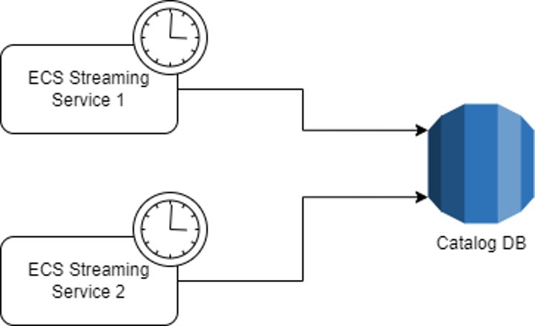
Streaming Connection Limiting
-Distributed connection limiting for streaming services
-Tracks connections across multiple service instances using a periodic scan, as well as event triggers (connect, disconnect)
-Fault tolerant, checks for orphan connections
-Integrated with streaming Auth to refuse connection if over connection limit
-Database always has current connections and filters being used
Part of DIP Usage Plans

Slide 30
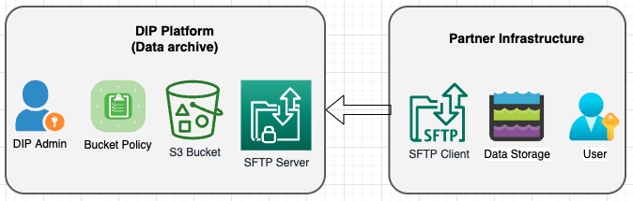
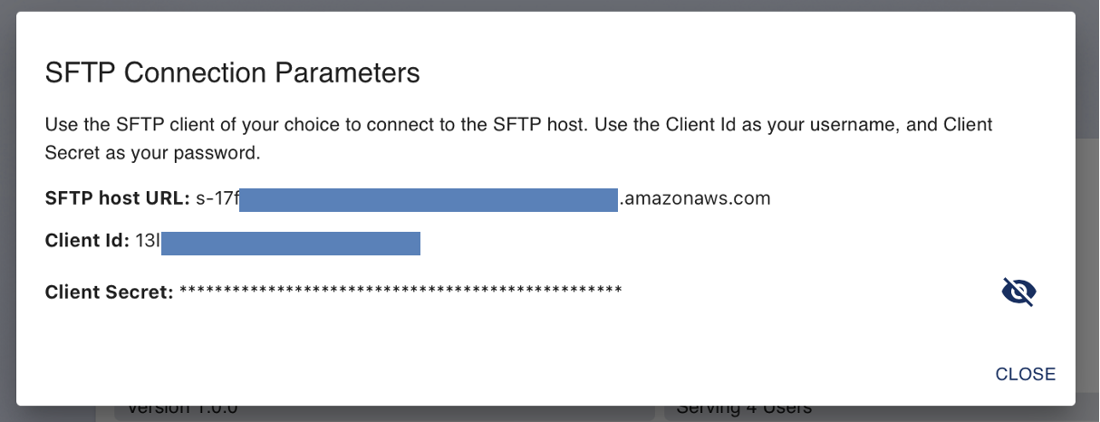
CDDR Use Cases and Benefit Mechanisms
“Secure File Transfer Protocol” (SFTP) Service
As an alternative (or addition to) to direct S3 access, buckets may be exposed to consumers over SFTP using AWS Transfer. ​
Advantages over direct S3 access​ Consumer does not need an AWS account​
    Uses a standard protocol (SFTP)​
    IAM Role and Policy based​
    Can use existing DIP Catalog client id and secret for authentication​
    Use standard SFTP tools
      Command line
      WinSCP, etc
SFTP Service for accessing historical data archives
Files stored in Parquet format in AWS S3 buckets
6month worth of data
Data transfer is limited to 1.25TB /24h or 5.0TB /180day period
Access information in the Connect window
  SFTP URL
  Client ID as username
  Client Secret as password
30
Notes:
Pallavi – Separate feeds, data isolation, permissoins, etc

Slide 31
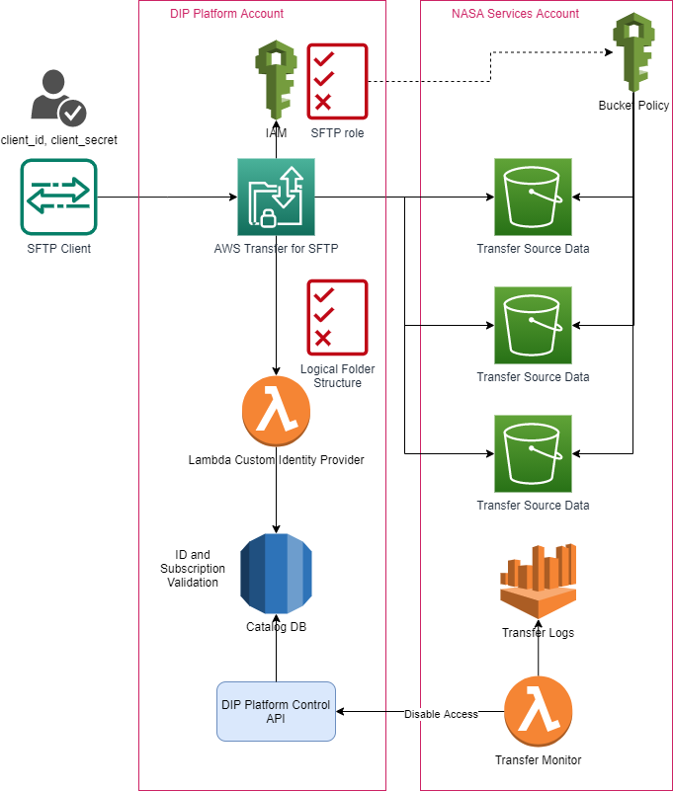
SFTP Design
Authorization flow
  Consume provides their client id and secret as credentials
  Client id and secret are verified against the Catalog database
  Custom identity provider lambda uses a generated policy to restrict bucket access to subscribed data sources
  Consumer only sees S3 buckets they are allowed to access as folder in their SFTP client

Slide 32
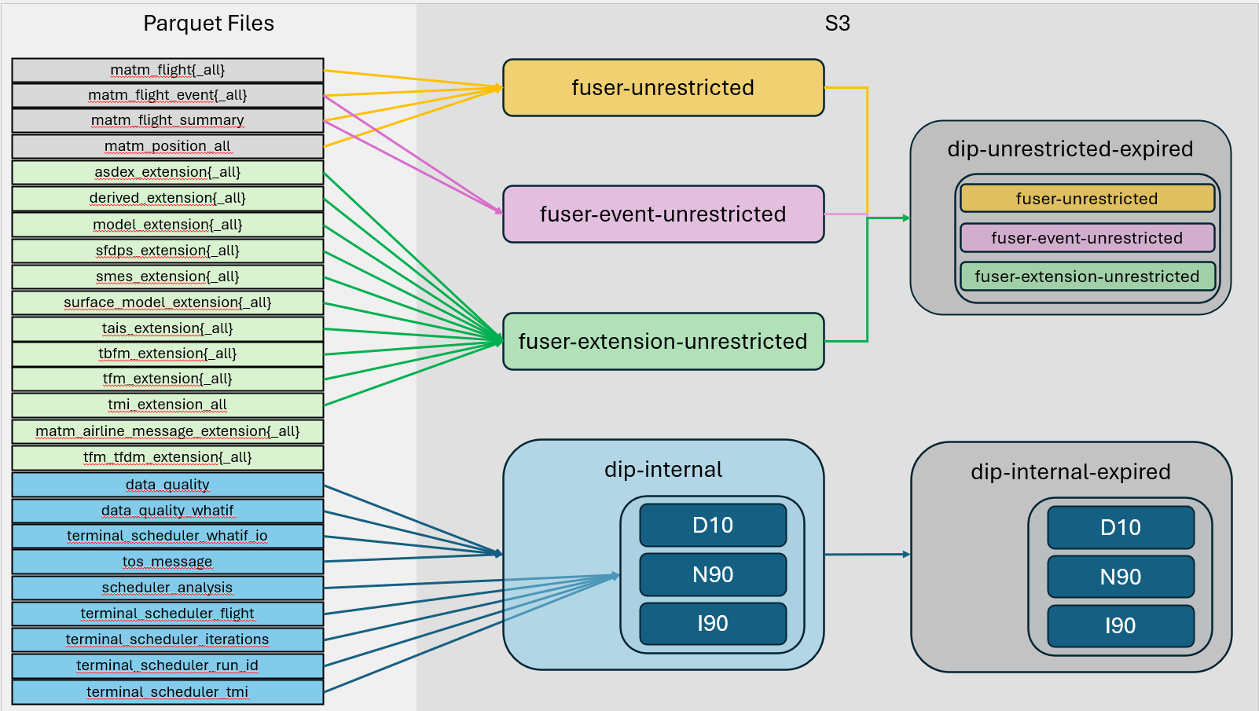
S3 Bucket Structuring

Slide 33
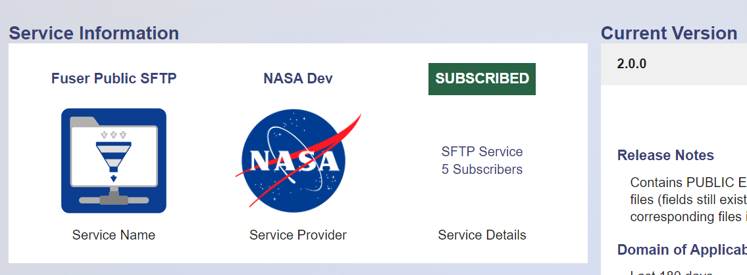
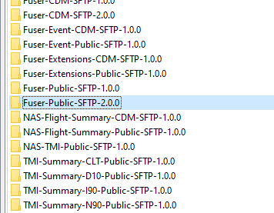
SFTP Virtual Path Exposure
Service name and version used as virtual path Folder path
Service defines the underlying S3 location of the data
Catalog
SFTP Client

Slide 34
  Monitoring

Slide 35
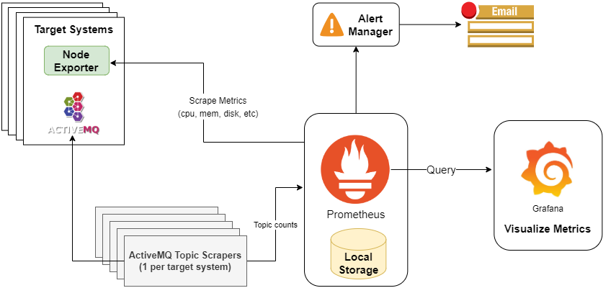
Grafana Monitoring

Slide 36
Grafana Monitoring On-prem
Grafana is a visualization tool for monitoring metrics provided by Prometheus
Prometheus is a tool for aggregating and storing metrics
On-prem systems self report status’ such as CPU, memory, network usage, etc.
Scraper processes are used to capture topic health to a file
Prometheus captures and collates the self reporting status and health files
Prometheus is limited in the data formats it can ingest
Prometheus will trigger alerts under certain conditions
Grafana provides real time visualization and metrics querying capabilities

Slide 37
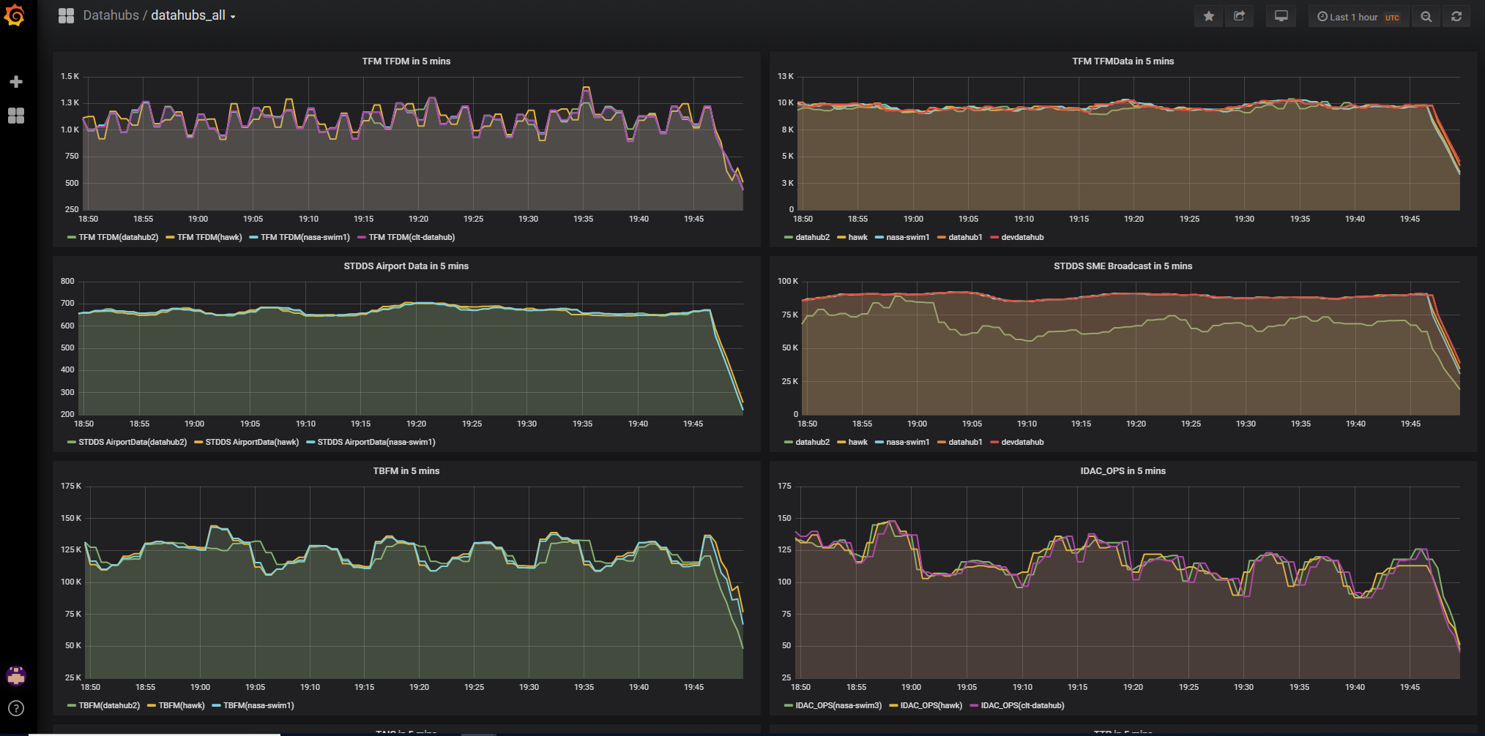
Grafana Example
Monitors feeds over time
Allows us to compare feeds from multiple sources (ex. ACY and OEX)

Slide 38
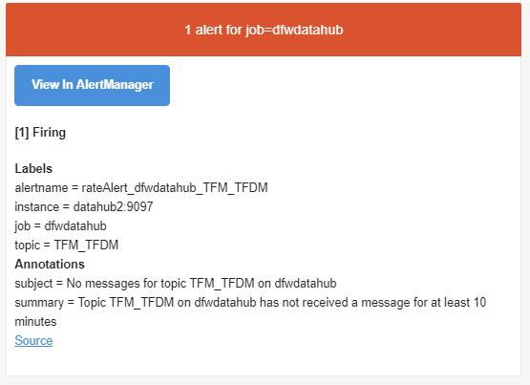
Prometheus Monitoring Emails
Email alerts sent when checks fail
Additional emails are sent when alerts are resolved

Slide 39
Status Reports
System Status Reports
One email is generated for operational machines, and another for development systems
Email reports general status, disk space available, memory usage, CPU loading, and a summary of error counts from each system
Error and caution conditions are highlighted in red for easy identification
Warehouse Status Reports
Email reports statistics describing the volume of data warehoused from each operational database
Statistics that may indicate a data creation or archiving issue are highlighted in red for easy identification
Archiving Status Reports
Email reports counts of newly archived data files in a predetermined set of expected storage locations
Counts that may indicate a data creation or archiving issue are highlighted in red for easy identification
Status reports emailed daily

Slide 40
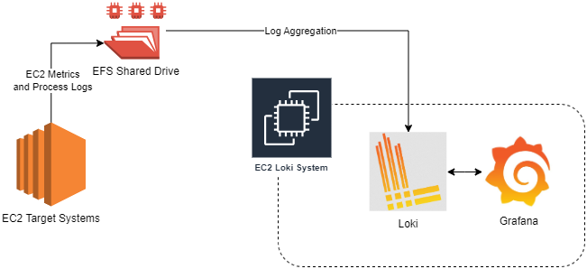
Loki Monitoring - AWS

Slide 41
Grafana Loki Log Monitoring - AWS
The on-prem Prometheus and Grafana instances are not capable of reaching AWS EC2 instances directly without firewall updates
A dedicated EC2 instance was created to monitor all other EC2 metrics and log files
All EC2 processes write to a shared EFS mount which Loki can monitor and analyze
Grafana, backed by Loki, can be used to created custom queries and perform real time searching and monitoring of process logs

Slide 42
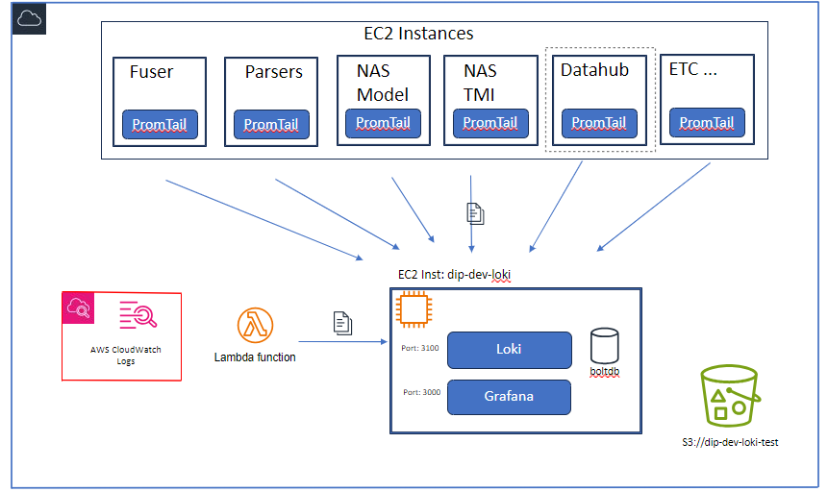
Grafana Loki Logging
Centralized Logging
EC2 logging
Cloudwatch logging
Common query interface (Grafana)

Slide 43
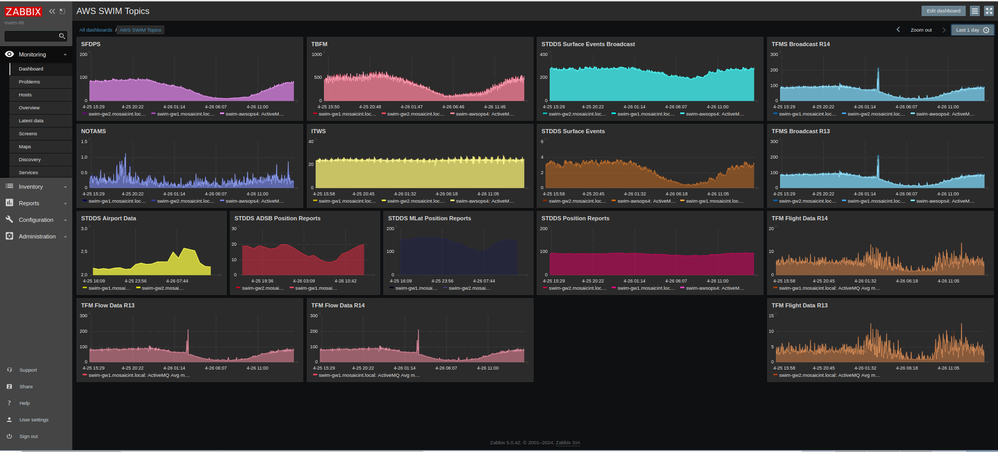
Future Work
Consolidate monitoring and alerting
  Might need a different tool like Zabbix
Monitoring of entire flow for root cause analysis
Assign severities to different flows

