Slide 1



Sherlock Data Warehouse
NASA Ames Research Center
Presenters :
Pallavi Hegde (Sherlock Lead)
Nikita Aggarwal (Sherlock Developer)
John Schade (ATAC Lead)

Slide 2

Outline
  Sherlock Introduction and Overview
    High-level Architecture
    Data sources
    Capabilities
    User Engagement
  Sherlock data in use – use cases
  User Interface demo
  Sherlock Onboarding
  Q/A

Slide 3
Agenda
Introduction |  | 5 mins | Confesor
Sherlock Introduction and Overview | High-level Architecture Data sources Capabilities User Engagement | 15mins | Pallavi
Sherlock Use Cases |  | 8 mins+12mins | Pallavi + John
Sherlock Demo | Open Data Portal | 8 mins | Nikita
Sherlock Onboarding & wrap up |  | 2 mins | Pallavi
Q & A |  | 10 mins

Slide 4
Sherlock Overview
Pallavi Hegde

Slide 5
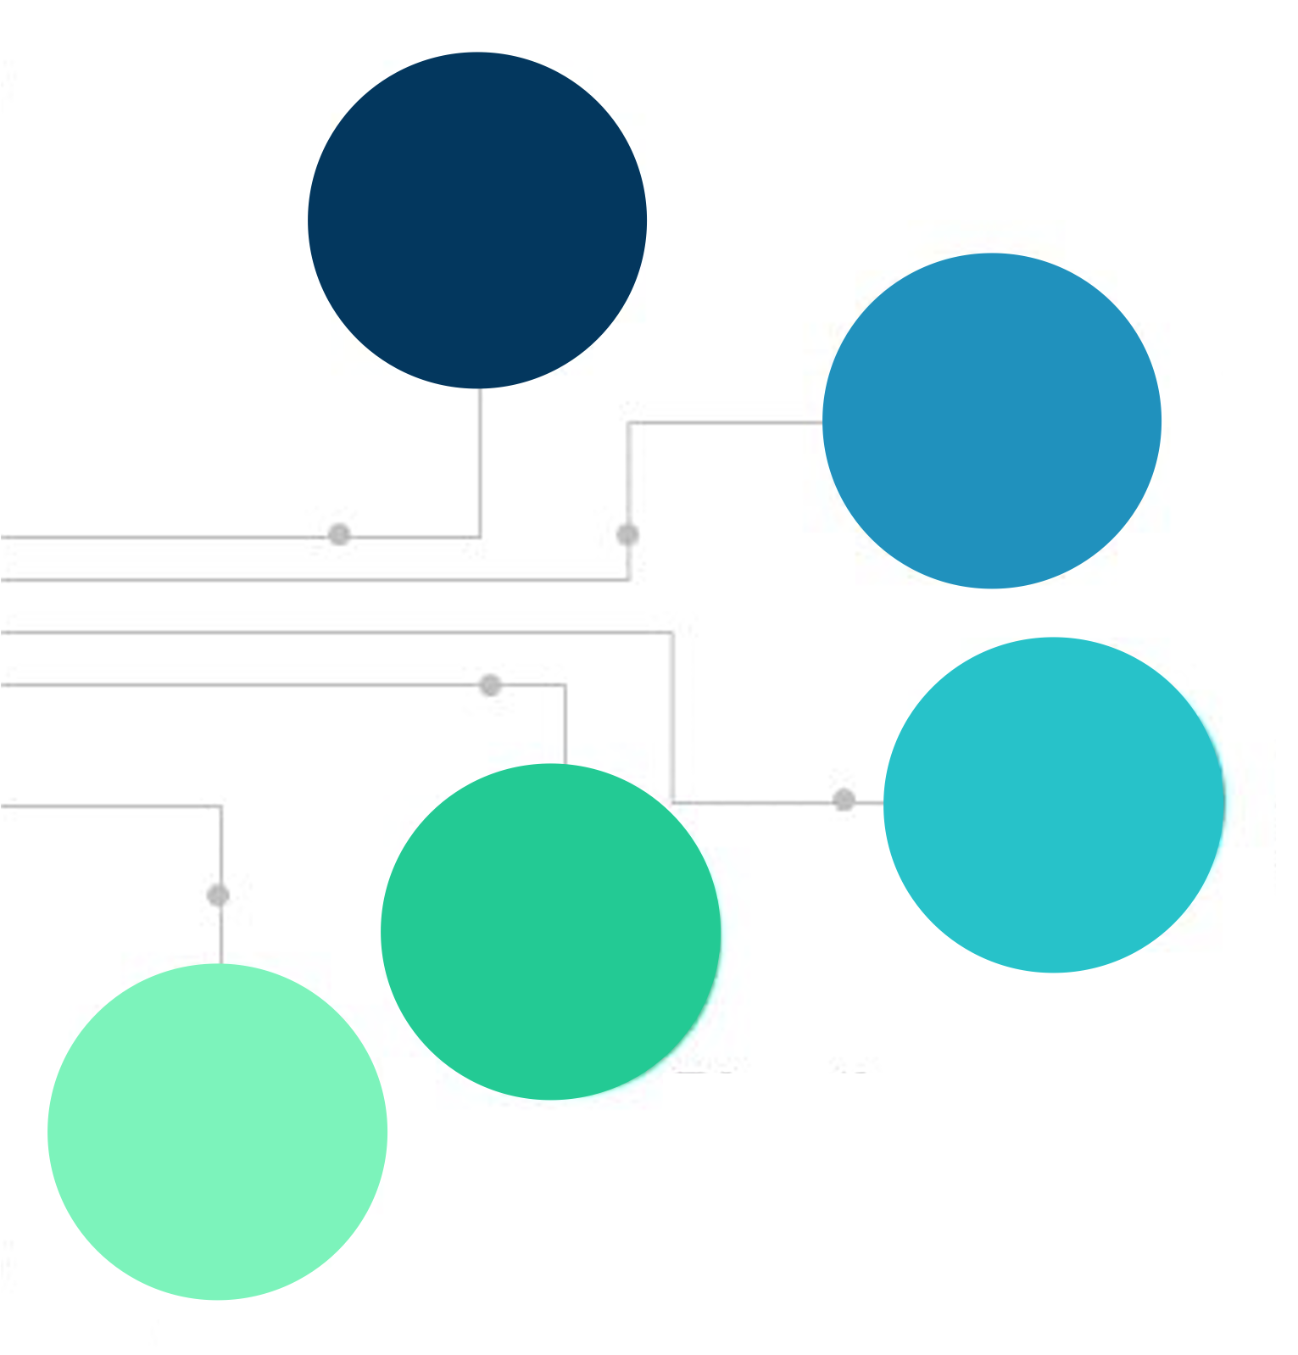

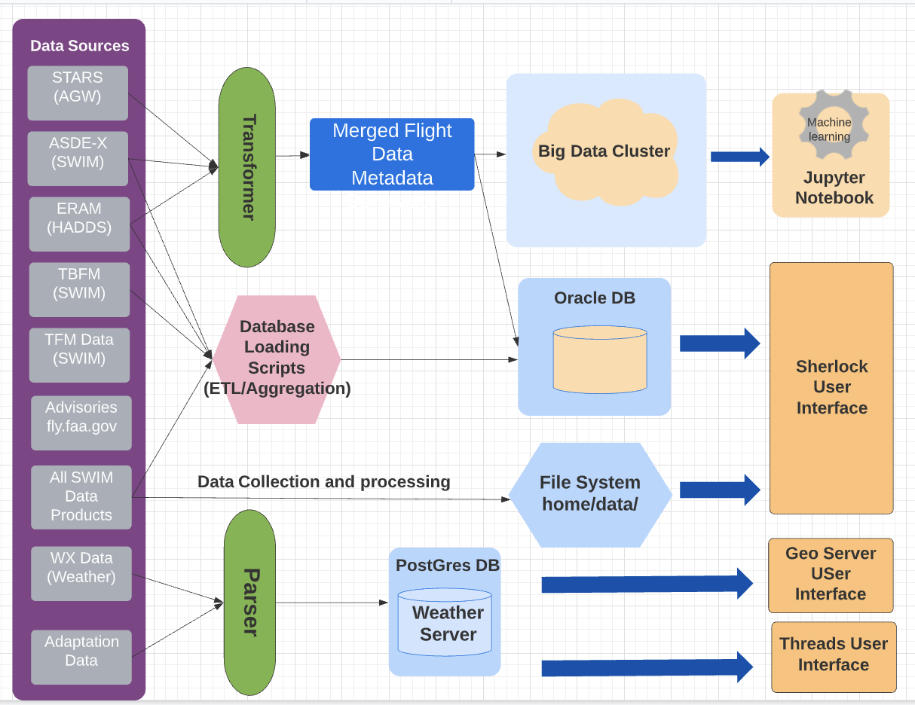




Sherlock Overview
Sherlock is a data warehouse designed for storing and retrieving all types of air traffic management data. It includes a compute platform to handle extensive data processing and facilitate research. It supports NASA internal research and development to improve data capture and storage
Warehouse for Aviation Data
ATM flight, weather, geospatial, and traffic flow-related data products
Processed and Merged Data(ATAC)
Integrated flight data merged from multiple sources
Big Data System
Distributed data processing engine for big data analytics and complex searches
User Interface
Centralized User Interface for data search and download & data visualization
Open Data Portal
Access to public facing data through the platform
Notes:
Sherlock Data Warehouse is the primary data facility provided by Code AF. Sherlock is a data warehouse for all types of air traffic management-related research and development.
Sherlock Provides a platform for data collection, archiving, processing and delivery.
Sherlock Facilitates an infrastructure for big data analytics and machine learning.
Bigdata cluster sandbox access for analysis and development
ML samples for researchers
Supports project specific data and data access
Hosts Open Data Portal for external outreach

Slide 6
Sherlock Overview
Sherlock has access to many ATM flight, weather, and traffic flow-related data products.
Sherlock Datawarehouse provides a platform for data collection, archiving, processing and delivery.
It also provides an infrastructure for big data analytics and machine learning.
Sherlock User Interfaces | Data Storage
Sherlock User Interface https://sherlock.datawarehouse.arc.nasa.gov/data_access/ Sherlock Open Data Portal https://sherlock.opendata.arc.nasa.gov/sherlock_open/ Geo Server https://geowiz.arc.nasa.gov/geoserver/web/wicket/bookmarkable/org.geoserver.web.demo.MapPreviewPage?1&filter=false THREDDS Data Server https://geowiz.arc.nasa.gov/thredds/catalog.html | File system Oracle DB, Postgres DB, Mongo DB Big data System- HDFS AWS
Notes:
Sherlock is a data warehouse for all types of air traffic management-related research and development. It has many terabytes of air traffic flight, weather and traffic flow-related data products.
It also provides an infrastructure for big data analytics and machine learning

Slide 7
FAA SWIM data in Sherlock
FAA System Wide Information Management (SWIM) Program
National Airspace System (NAS)-wide information system that supports Next Generation Air Transportation System (NextGen) goals
Offers a single point of access for aviation data, with producers of data publishing it once and users accessing the information they need through a single connection
Flight data |  | Availability
STDDS/ASDE-X | Surface data | 2015 to Present
TAIS | TRACON data, including VFR flights | 2017 to Present
SFDPS | En route flight data | 2015 to Present
TFM Data | NAS-wide flight data, flow constraints | 2015 to Present
TBFM | Operational metering data | 2016 to Present
Airport data
APDS | Airport Data Service, Runway Visual Range info | 2015 to Present
NOTAM | Notices to Airmen | 2016 to Present
ATAC Data
IFF/EV/RD | Processed Flight Data | 2014 to Present
Notes:
System Wide Information Management (SWIM) Program
National Airspace System (NAS)-wide information system that supports Next Generation Air Transportation System (NextGen) goals
Facilitates the data sharing requirements for NextGen
Enables increased common situational awareness and improved NAS agility to deliver the right information to the right people at the right time.
Offers a single point of access for aviation data, with producers of data publishing it once and users accessing the information they need through a single connection

Slide 8
Weather Data in Sherlock
Weather data |  | Availability
ITWS | Terminal convective weather | 2010 to Present
CIWS | Convective weather forecasts | 2009 to Present
METAR | Airport current surface weather conditions | 2009 to Present
RR | NOAA Rapid Refresh forecasts | 2011 to Present
CWAM | Convective Weather Avoidance Model | 2011 to Present
TAF | Terminal Aerodrome Forecast | 2013 to Present
PIREP/AIREP | Pilot reports/Air reports | 2013 to Present
ASM | Weather advisories | 2020 to Present
Obsolete weather data (stored but no longer updated) |  | Availability
WITI (Derived) | Weather Impacted Traffic Index | 2009 to 2022
RUC | NOAA Rapid Update Cycle forecasts | 2009 to 2012
CCFP/TCF | Simplified convective weather polygons | 2010 to 2018

Slide 9
Other Data Products in Sherlock
Flight Data (parsed) |  | Availability
TFM Flow | NAS-wide Traffic Management Flow data | 2021 to Present
ATCSCC Advisories | Raw advisory details from FAA’s Air Traffic Control System Command Center | 2007 to Present
OPSNET Delays | Reportable delays provided daily through FAA's Air Traffic Operations | 2012 to Present
Obsolete Parsed Data (stored but no longer updated) |  | Availability
ASDI | Number of radar tracks and aircrafts on an hourly basis | 2004 to 2006
ATIS | Advance non control airport/terminal area and meteorological information to aircraft | 2012 to 2015
Operational TMA | Airport flow, airport landing, metering usage | 2009 to 2016
NASA Project data |  | Availability
Freddie & Smart Mobility | Flight operations, positions, surveillance data | 2022 to Present
UAM - X5 | Flight simulations | 10/2023
DIP - Fuser | Fused and mediated Flight data from SWIM sources | 2022 to Present
NExCT CE1 | Simulation data | 4/2024 to 6/2024
Adaptation data |  | Availability
ERAM | En Route Automation Modernization | 2010 to Present
NFDC | National Flight Data Center | 2007 to Present

Slide 10
Sherlock Capabilities
Documentation
ML Model Samples
Data Storage
New Data Sources
Sherlock Viewer
On-premises
Cloud(AWS)
Data pipelines
Cloud (AWS)
On-premises
Web APIs
Web APIs for accessing the data programmatically
Open Data Portal
*public data access
User Interfaces
User Interface
*Data access and download
Data Catalog and User Guide
Machine Learning(ML) Dictionary and ML Models sample code
Freddie & Smart Mobility
UAM X5
XTM Client
Visualization of track points
DIP-Fuser Data
Freddie
NExCT CE1
Notes:
Recent developments in the last year or two is showcased in this chart

Slide 11
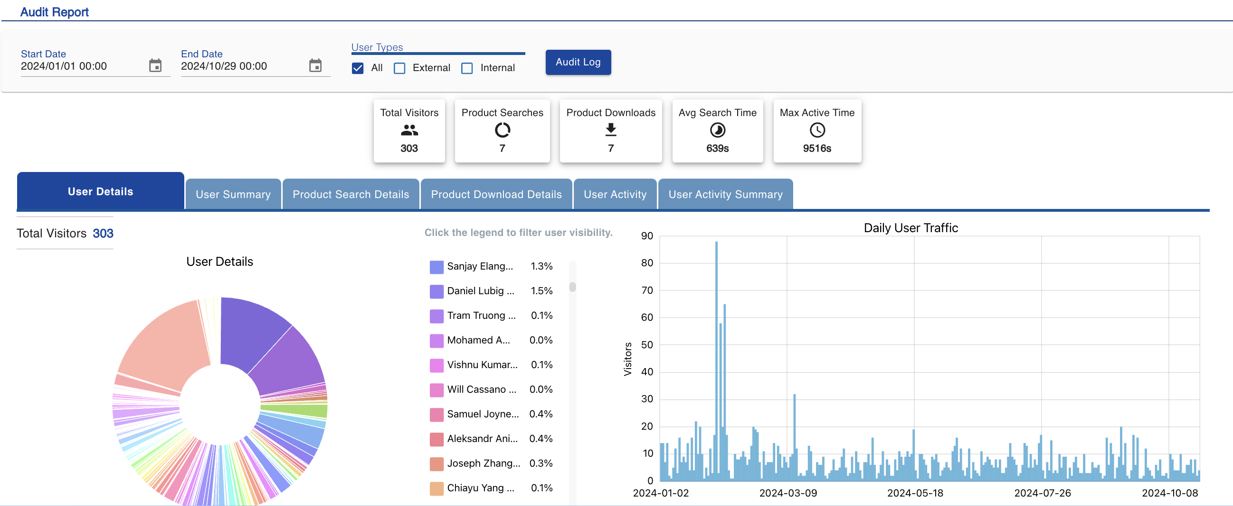
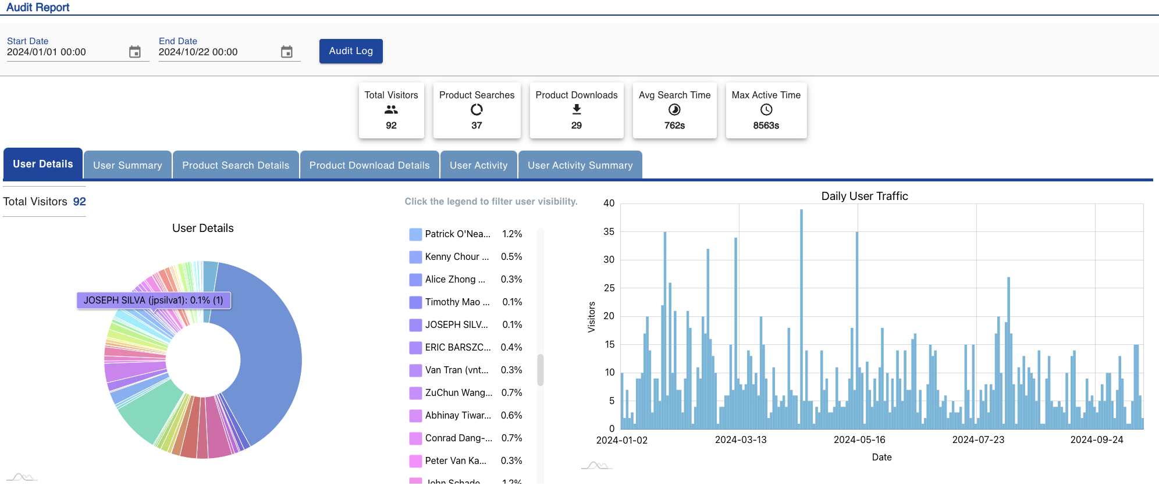
User Engagement
Open Data Portal - 303 Active users in FY24
NASA researchers
NASA SBIR users
Industry Stake Holders + FAA
Academia
(Professors and Students)
92 Active internal users in FY24

Slide 12
Sherlock Data
Use Cases

Slide 13
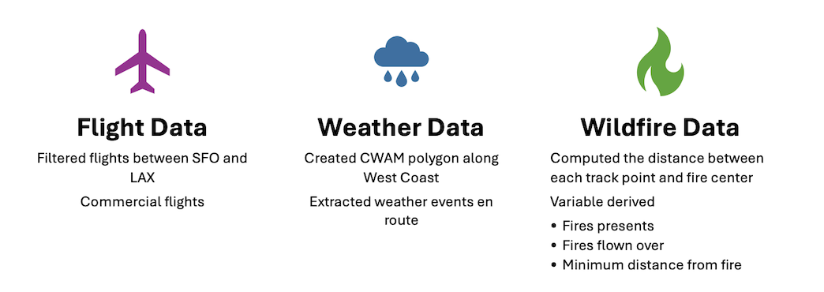
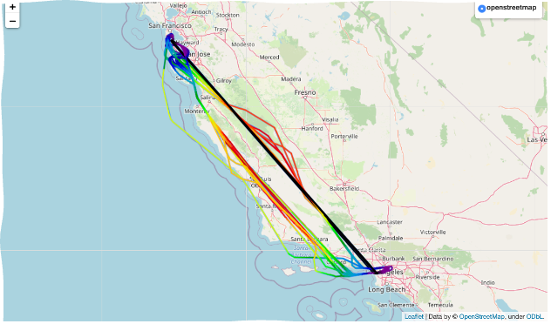

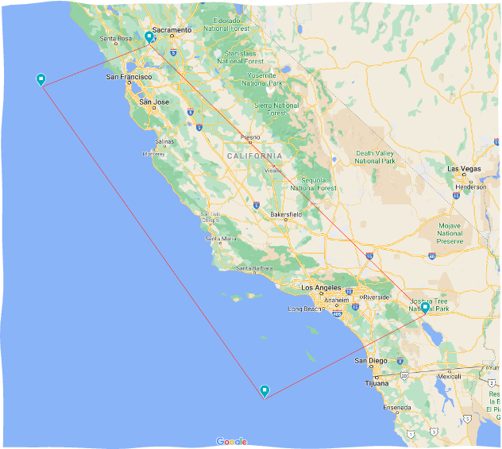
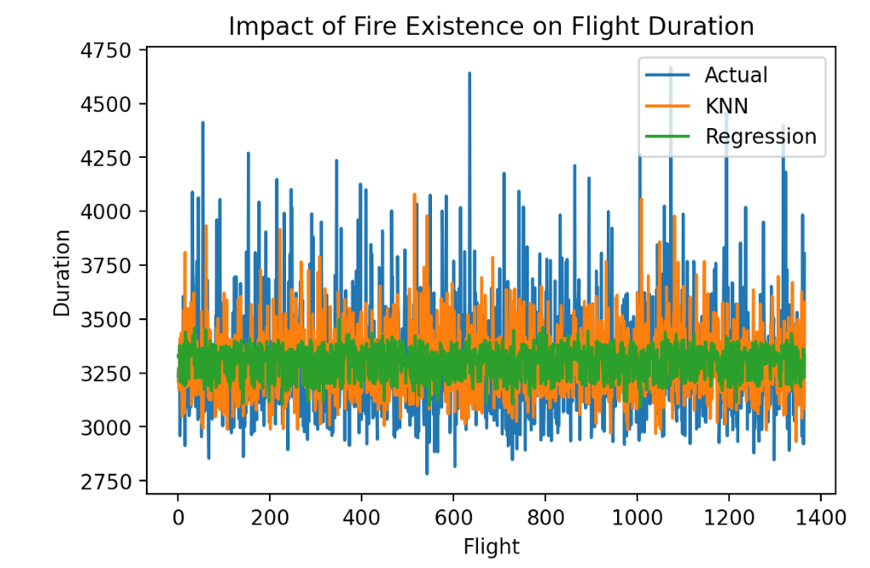
Wildfire Impact on Flight Travel
Use case - 1
Application: Predict flight time impact between SFO and LAX due to wildfires
Data Sources:
Sherlock
IFF, RD and CWAM
Fire.ca.gov
Wildfire Data

Slide 14
VFR & IFR Flights data processing
Use case - 2
Count number of Visual Flight Rules traffic (VFR) Flights in the Dallas Fort Worth area within a certain radius and altitude using PySpark /Python
Process Flight data by merging IFF and RD data files
Filter VFR aircrafts with 1200 Beacon Code and geometric filter on airport
Filter within 20-mile radius or distance from the airport
Read Data
Process
Data
Filter Data
Analyze
Data
VFR vs IFR traffic behavior
This approach was used in the recent AIAA paper – Analysis and prediction of VFR vs IFR traffic behavior

Slide 15
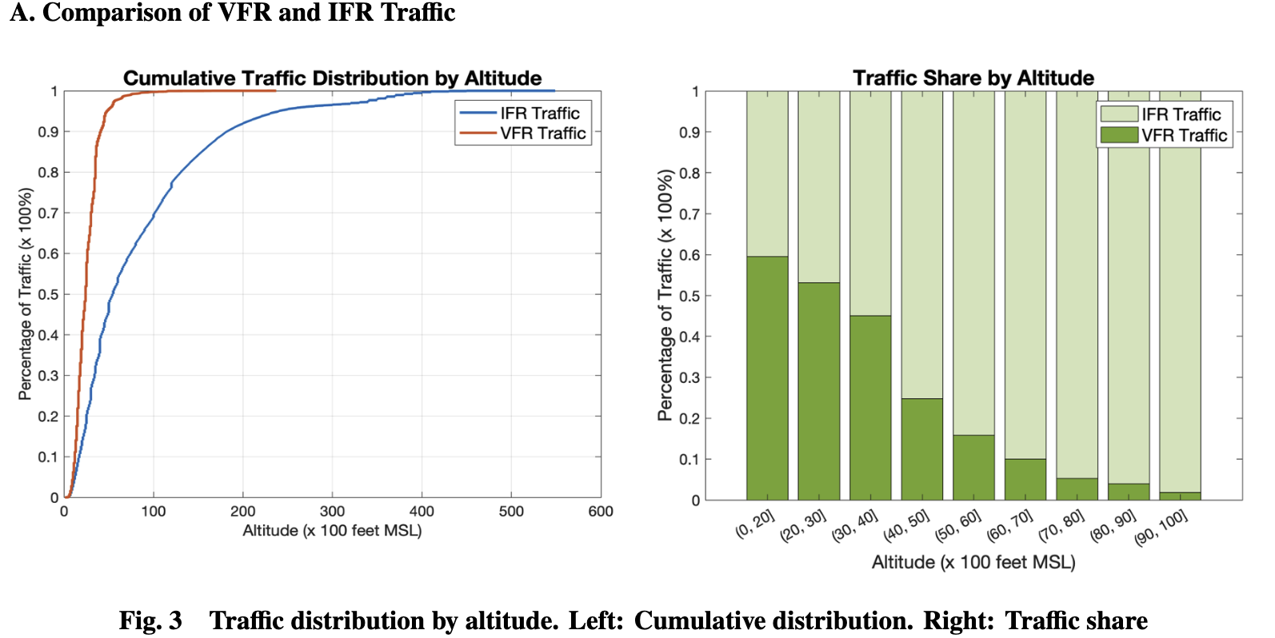
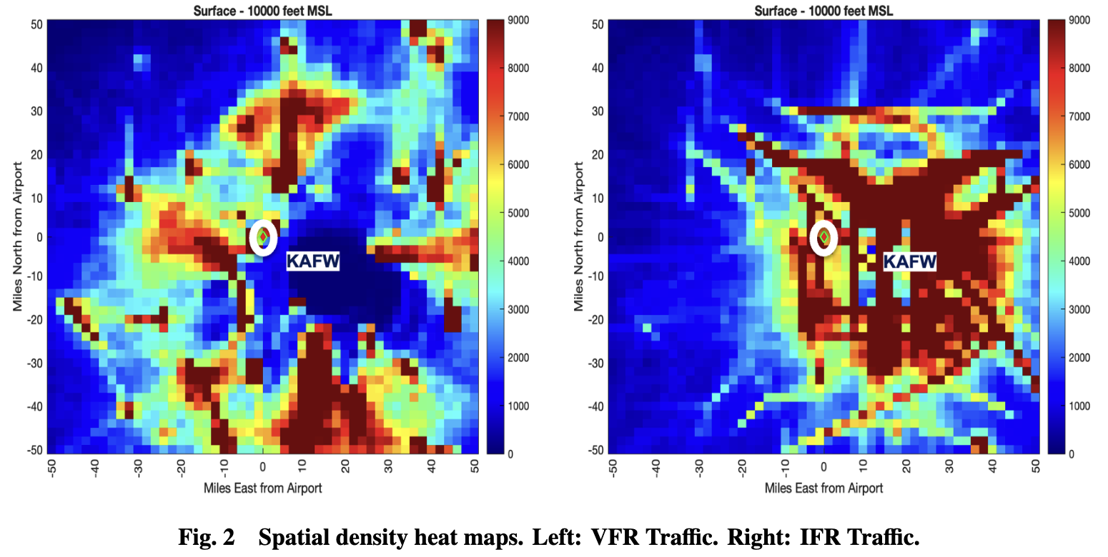
Analysis and prediction of VFR vs IFR traffic behavior
Use case - 2
Anlalyse Visual Flight Rules traffic (VFR) behavior, compare it with Instrument Flight Rules(IFR) traffic and develop traffic prediction methods to support Autonomous aircraft flight operations
Uncertainty associated with VFR traffic spatial and temporal density in the vicinity of a regional airport. The method was extended to IFR traffic and then used to compare the behavior of VFR traffic with IFR traffic. Historical Sherlock traffic data was used to generate spatial density heatmaps around a regional airport at different altitude bands. These were used to develop spatio-temporal occupancy maps that capture the probability of interacting with VFR traffic or IFR traffic at a given place and time
Vishwanath Bulusu∗, Husni Idris† and Aastha Acharya
NASA Ames Research Center, Moffett Field, CA, USA
(PAAV - Pathfinding for Airspace with Autonomous Vehicles)

Slide 16
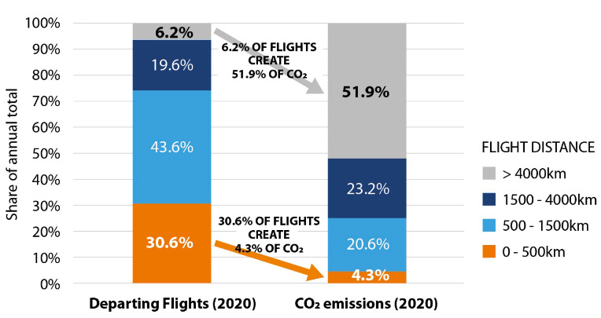
Greenhouse Gas Emission Estimations using the Sherlock Data Warehouse
Use case - 3
Motivation
Analyze and present the utilization of aircraft in the U.S. and the greenhouse gas emissions that they create. Commercial passenger and cargo aviation flight data, captured in the Sherlock data warehouse over the five years from 2016 to 2020, is used to estimate the miles flown by major aircraft models. The estimates for aggregate annual number of flights are validated against data published by the Bureau of Transportation Statistics The corresponding fuel usage is estimated using the International Civilian Aviation Organization (ICAO) fuel use tables and carbon dioxide emissions are calculated using a fuel-use multiplicative factor
Data
Sherlock Flight data
Fuel consumption data from ICAO fuel use tables
Application
Greenhouse Gas Emission Estimations for 2016–2020 using the Sherlock Air Traffic Data Warehouse
John E. Melton, Susie Go, and Gregory G. Zilliac
Ames Research Center, Moffett Field, CA

Slide 17
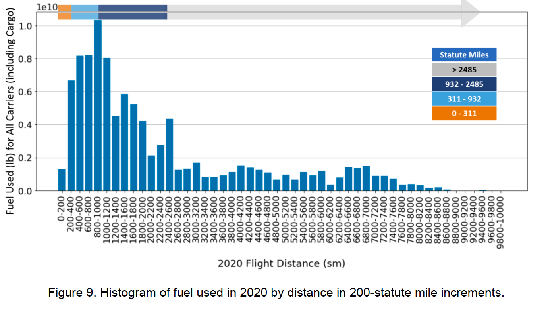
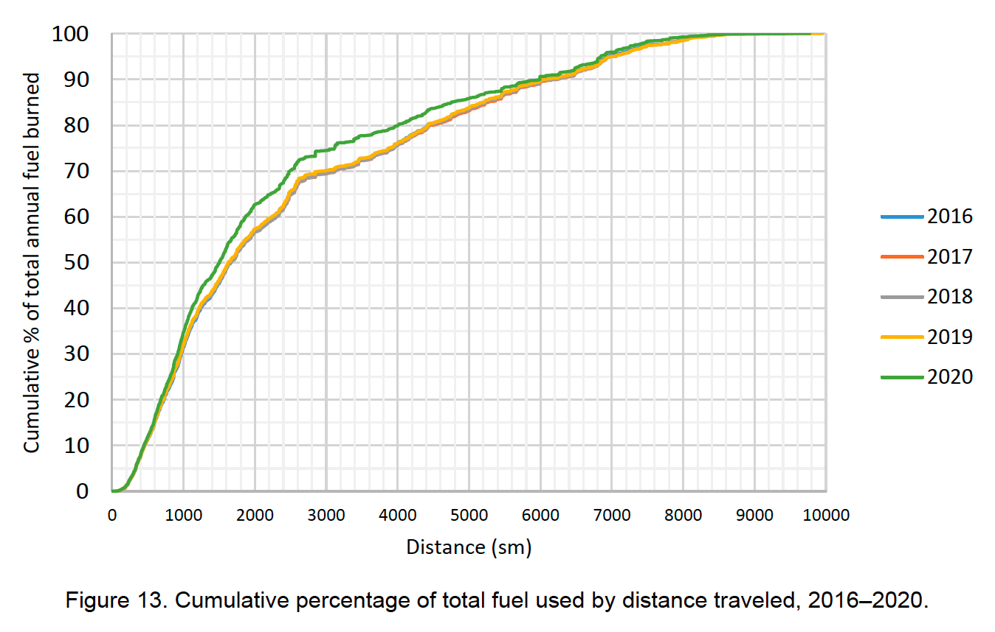
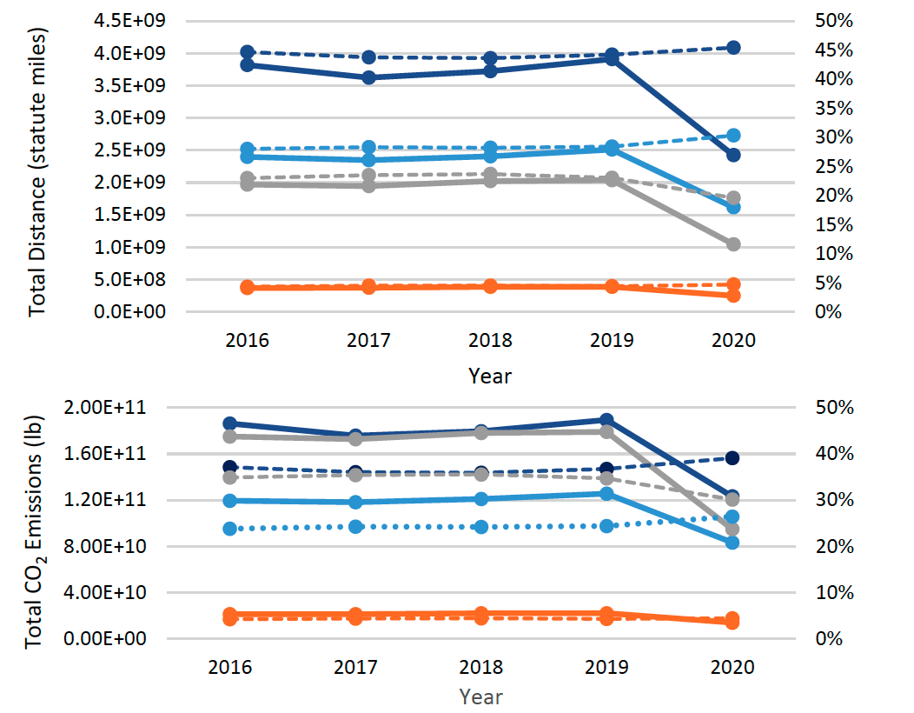
Greenhouse Gas Emission Estimations for 2016–2020
using the Sherlock Data Warehouse
Use case - 3
Analysis
Small number of long-haul flights create a large fraction (30%) of carbon dioxide
emissions, while a relatively large number of short flights (less than 311 statute miles)
contribute a small net amount (less than 5%) of carbon dioxide emission.
https://www.researchgate.net/publication/363258003_Greenhouse_Gas_Emission_Estimations_for_2016-2020_using_the_Sherlock_Air_Traffic_Data_Warehouse

Slide 18
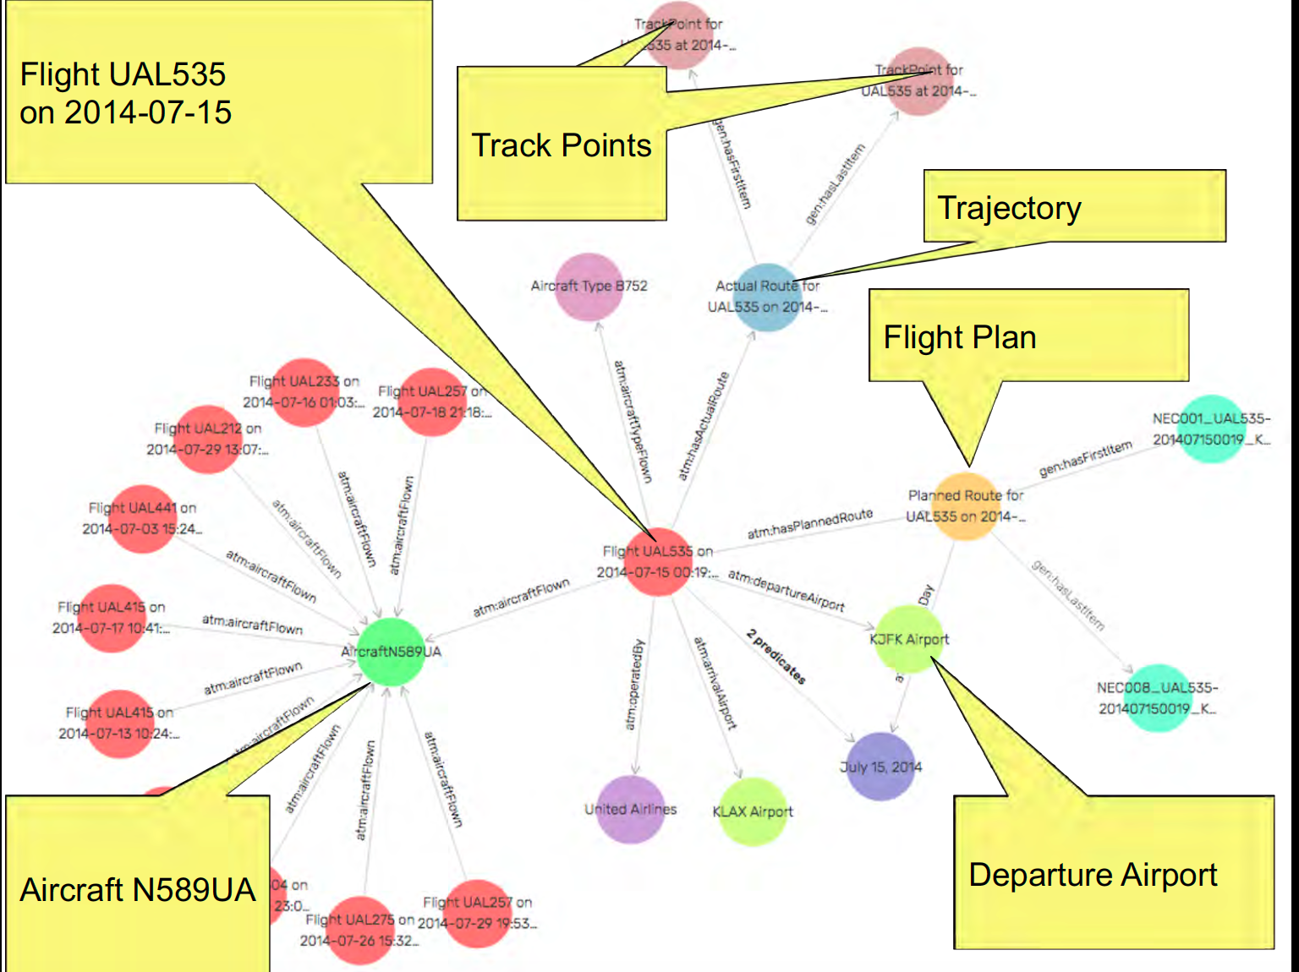
ATM Knowledge Graph
Use case - 4
Sherlock Sources
ASDI: Flight track data
TFM Advisories: GDPs, reroutes, Ground Stops,…
METAR/TAF: Airport weather observation & forecast data
ERAM adaptations: NAS infrastructure data
(facilities, routes, SIDs/STARs, fixes, airways, sectors,…)
Rick Keller
https://data.nasa.gov/ontologies/atmonto/NAS
Knowledge Graph merges/integrates/unifies data from multiple sources into one large graph structure to enable
cross-source querying
Result
Query Sherlock as a unified database
Visualize and navigate through the data graph
Download integrated data

Slide 19
ATAC Data and Data Usage
John Schade
jes@atac.com

Slide 20
Analysis-Ready Data Products from ATAC
Background – ATAC joined the Sherlock Team in 2015 to accelerate NASA’s aviation research efforts by enhancing Sherlock Data Warehouse Products to increase their readiness level for analysis and NASA research use cases.
Integrated proven capabilities and process flows based on ATAC’s work with the FAA’s Performance Data Analysis and Reporting System (PDARS) into Sherlock.
Available products include:
  Analysis-ready track, flight plan, sectorization, and metadata for 100 individual facilities –including VFR flights available on a next day basis (IFF, RD, EV, SRZ)
  CONUS End-to-end trajectories, flight plans, and metadata available within 10 days
  Performance Reports – available daily for individual facilities
  Aggregated Trend Databases –Updated Daily
  LADD filtered data/reports for Sherlock Open Data Portal – updated quarterly
  Real-time track, flight plan, event, and metadata available for real-time use cases
Documentation:
  https://sherlock.datawarehouse.arc.nasa.gov/api/docs/#/description/atac

Slide 21
Post Processed ATM Performance Reports/Data in Sherlock​
ATAC Facility Reports | Scope (Facility Type) | Description | Availability
Go Arounds | TRACON/Terminal | Counts, runways, altitude, return time | 2020 to Present
Turns to Final | TRACON/Terminal | Overshoots, glideslope speed/altitude deviations, turn on angle | 2020 to Present
Fix Passing | TRACON/Terminal | Fix/Waypoint throughput | 2020 to Present
Runway Usage | ATCT/Surface | Runway throughput, arrival/departure rates | 2016 to Present
Taxi Time | ATCT/Surface | Taxi out, taxi in time | 2016 to Present
Instantaneous Counts | ARTCC/Enroute | Number of aircraft in sectors in 15-minute bins, summary statistics | 2015 to Present
Sector Stats | ARTCC/Enroute | Sector count, flight Time/distance, and transitions between sectors | 2015 to Present
Sector Activity | ARTCC/Enroute | Sector entries/exits/counts in 15-minute bins | 2015 to Present
Field10 Reroute | ARTCC/Enroute | Diversions and reroutes | 2015 to Present

Slide 22
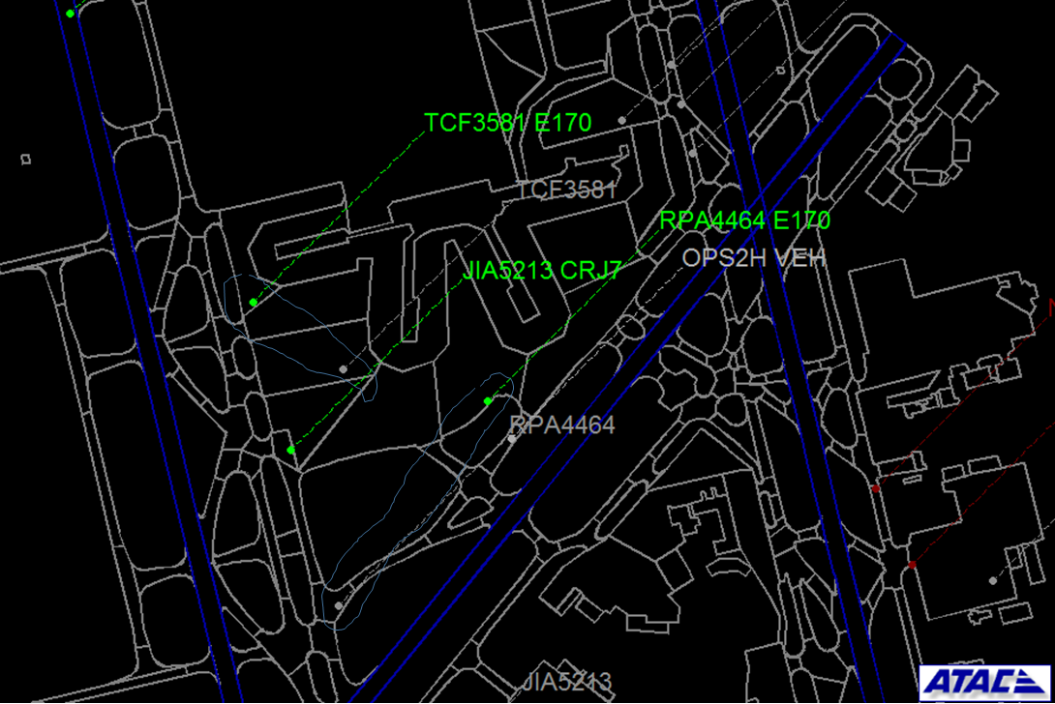
Fast Paced Simulation Validation and Post Analysis Process
Use case - 5
Convert simulation output data into ATAC/ Sherlock ASDE-X track data formats
Develop new/ reuse existing Sherlock reports for creating a validation and post-analysis dashboard
Playback capability to compare simulated flights with real flights
Application: Playback of simulated vs actual operations data to support simulation validation
Data Used: Sherlock end-to-end trajectory data, SOSS simulation output data

Slide 23
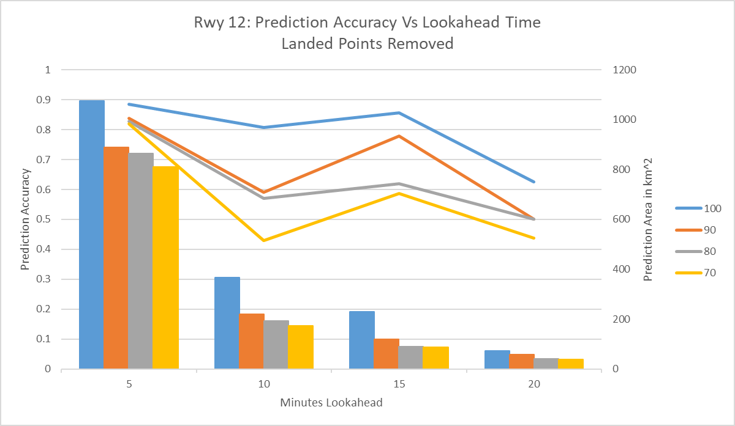
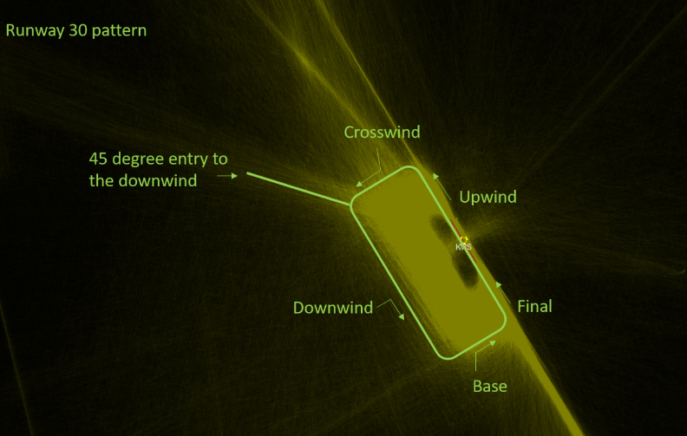
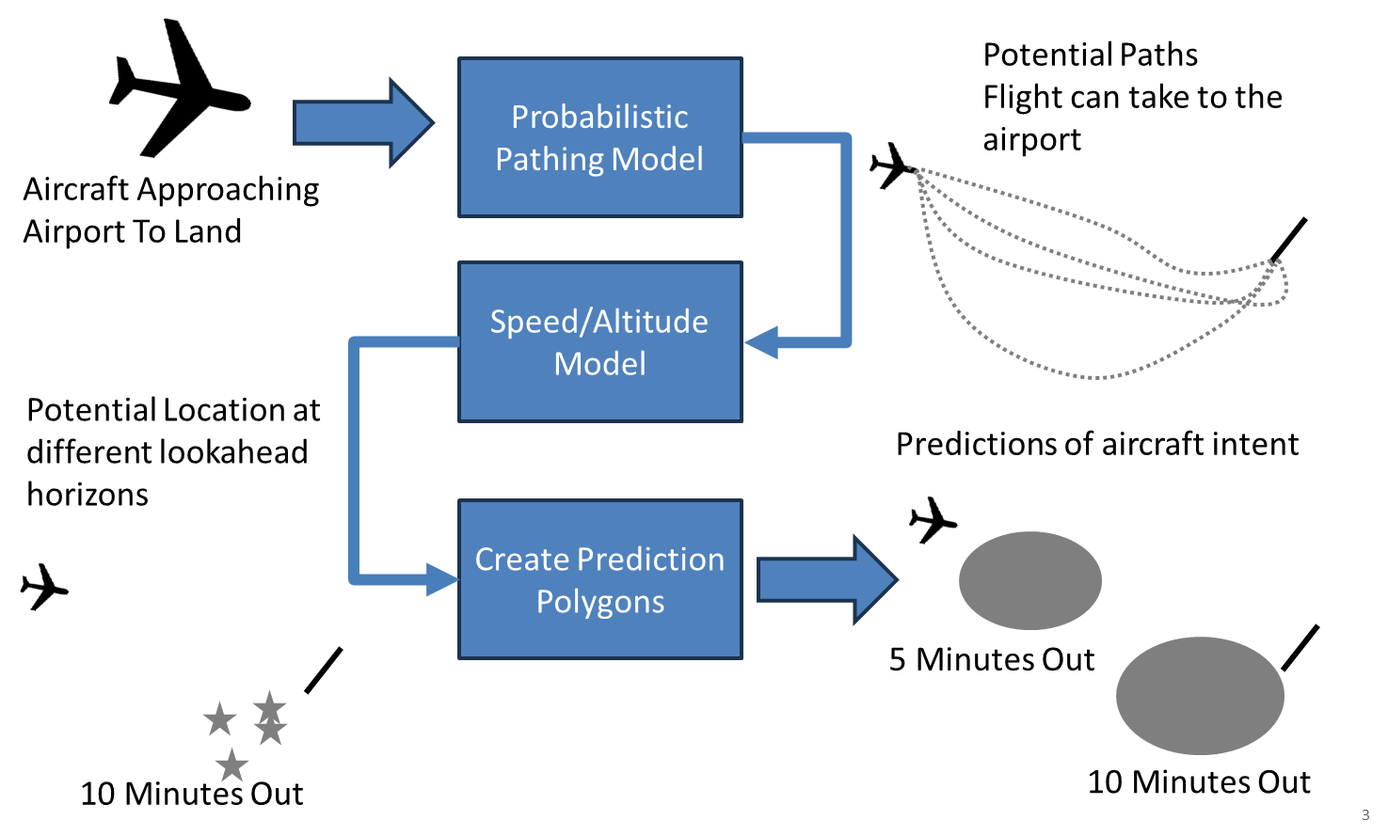
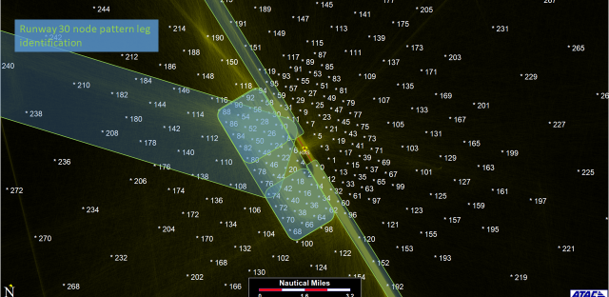
(TPIP) Traffic Pattern Intent Prediction Tool
Use case - 6
Application: Predict the flight path of traffic around small and medium sized airports
Data Used: trajectory data (Sherlock), airport layout definitions, Airspace fix definitions

Slide 24
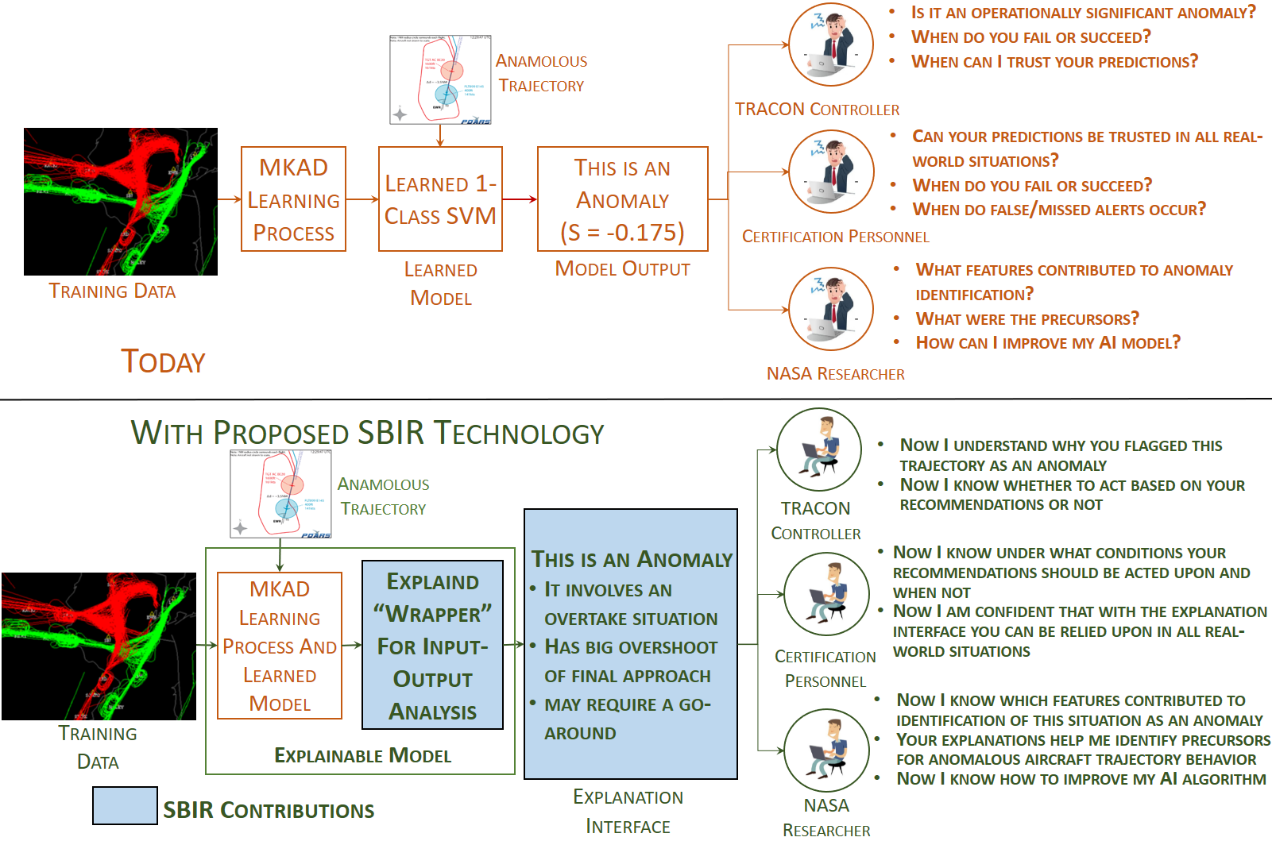
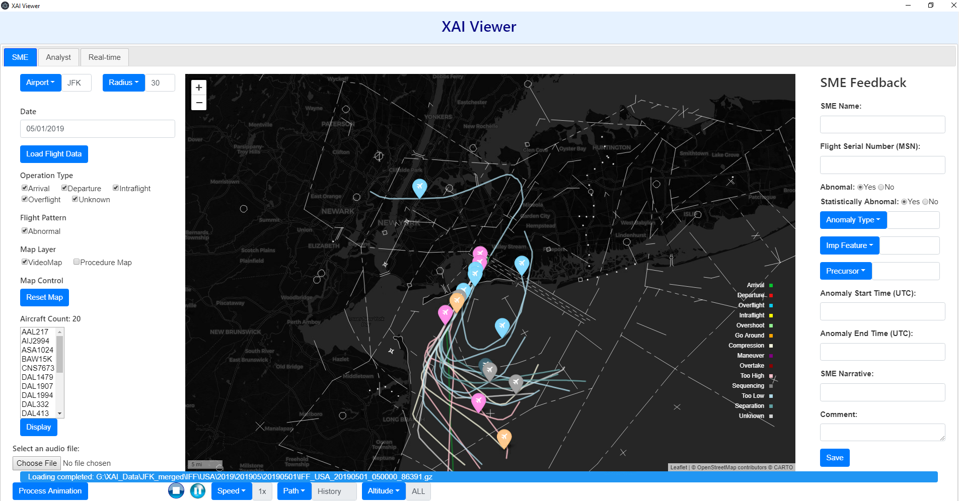
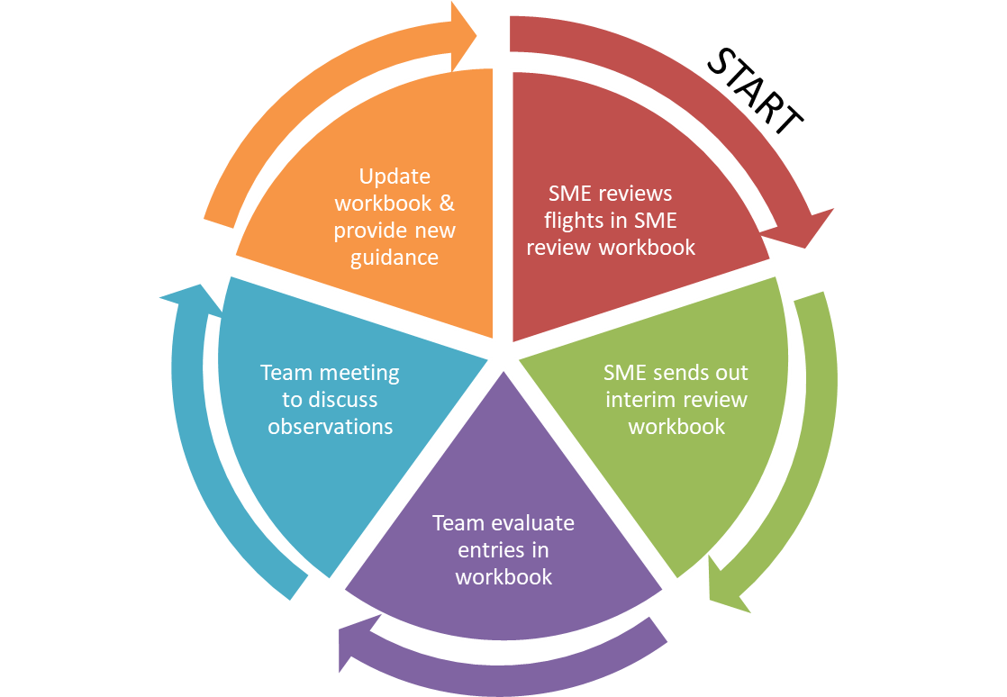
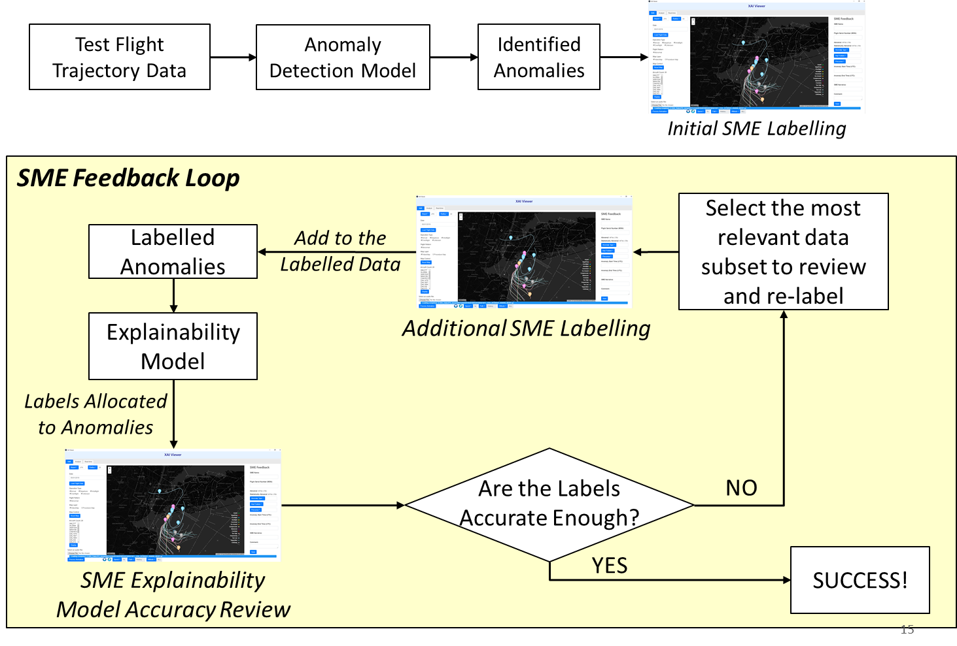
Explainable AI (XAI)
Use case - 7
Why XAI?
Application: Provides human-understandable explanations for machine learning models
Data Used: Sherlock end-to-end trajectory and flight summary data, Sherlock METAR weather data
Use Case: Anomaly Detection in Flight Tracks
  XAI model provides human-understandable explanations for the identified anomalies
Machine learning model output

Slide 25
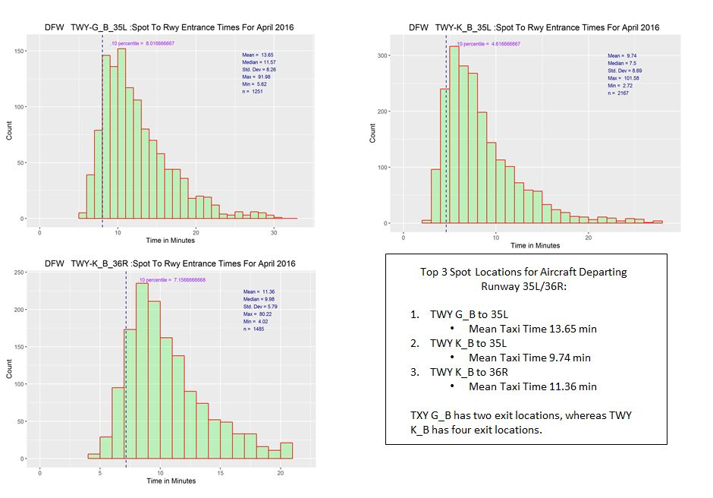
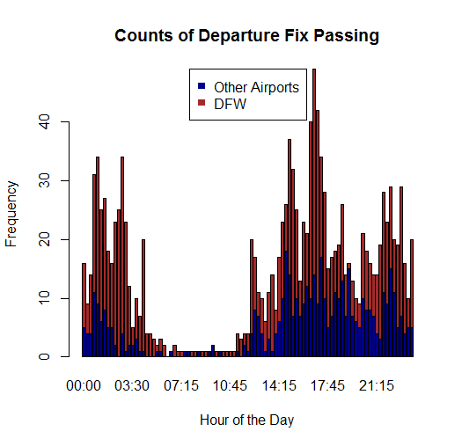
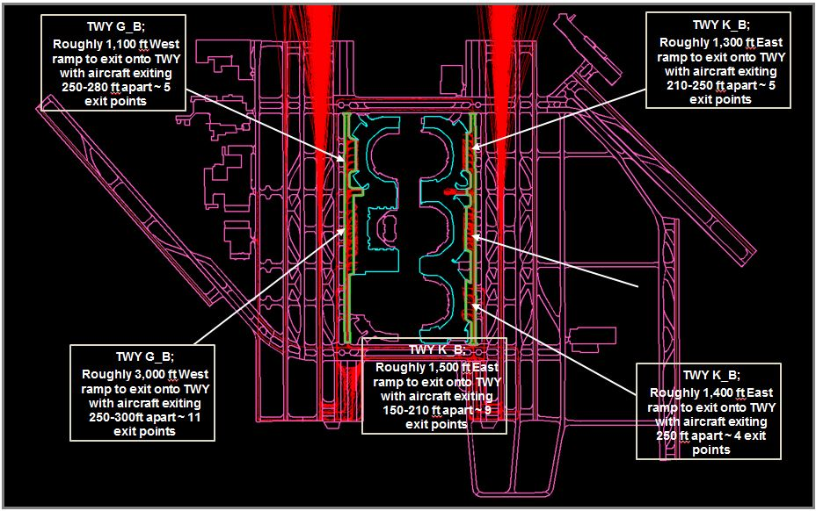
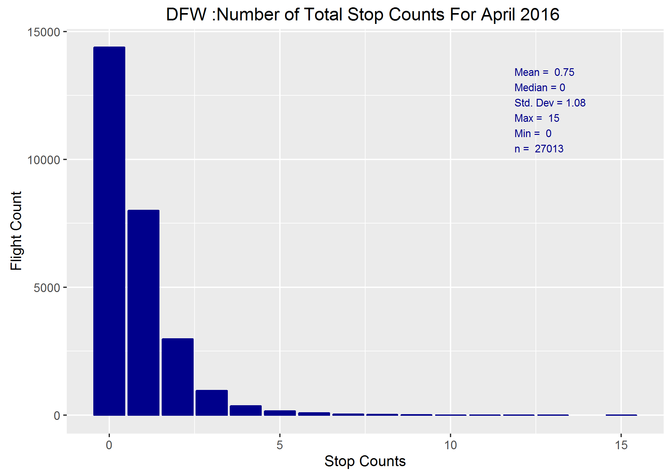
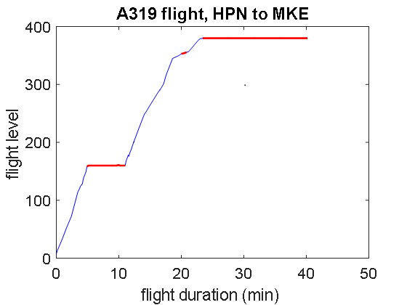
Historical Departure Operations Characterization
Use case - 8
Application: Characterization of departure operations at study metroplex sites
Data Used: Sherlock end-to-end trajectory data, Skyview airport layout definitions, Airspace fix definitions
Taxi Time Variability by Spot
Identify Most Used Spots
Flight Level Offs
Number and Duration of Taxi Stops

Slide 26
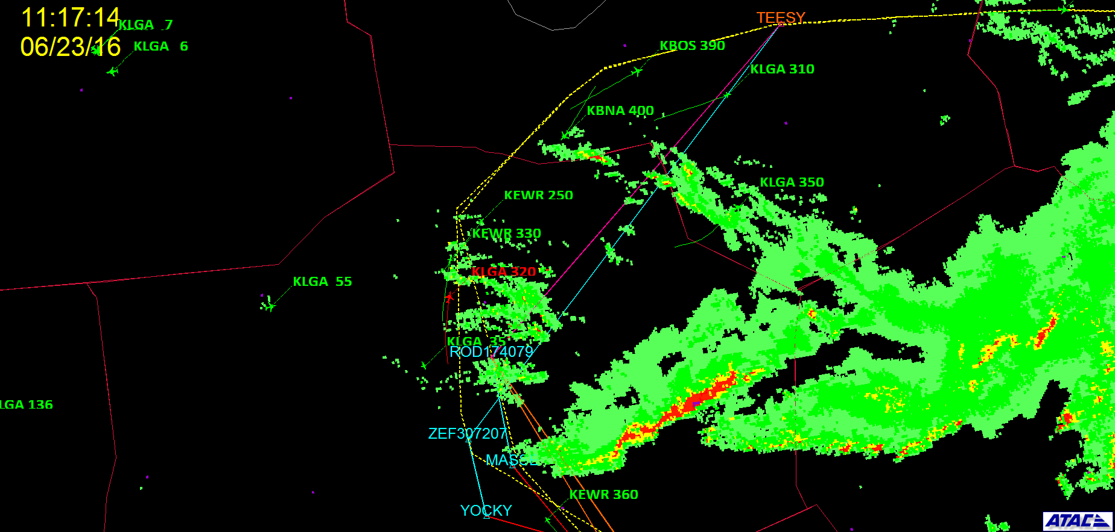
Convective Weather Rerouting Scenario Analysis
Use case - 9
Application: Convective Weather Avoidance Rerouting Research – Cognitive Walkthrough Slides
Data Used: Sherlock end-to-end trajectory data, NOWRAD Weather data, also exploring Sherlock CIWS data

Slide 27
Sherlock Demo
Open Data Portal
https://sherlock.opendata.arc.nasa.gov/sherlock_open/
Nikita Aggarwal

Slide 28
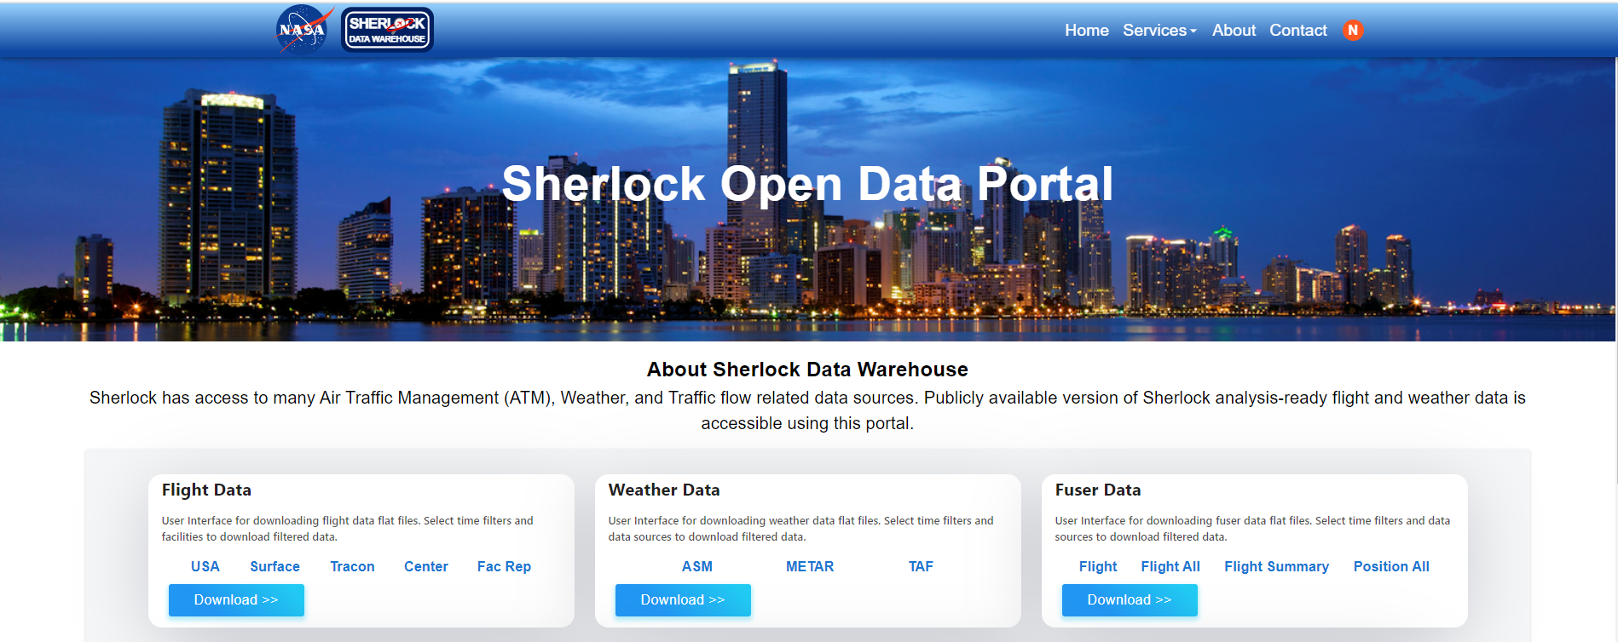
https://sherlock.opendata.arc.nasa.gov/sherlock_open/

Slide 29
Open Data Portal - Data Sources
Flight Data
Facility Reports
Fuser Flight Data
Weather Data
IFF
EV
RD
Flight track points, events and summary
ASDEX Reports
TRACON Reports
Center Reports
Runway throughput, taxi time, go arounds, sector activity and more
ASM
METAR
TAF
Advisories, weather observations and expected conditions
MATM Flight
MATM Flight All
MATM Flight Position All
MATM Summary
Fused data from SWIM sources

Slide 30
Sherlock Onboarding
Sherlock Open Data Access
Go to https://guest.nasa.gov/ to create a NASA Guest account
Refer to onboarding doc from the Open Data portal https://sherlock.opendata.arc.nasa.gov/sherlock_open/

Slide 31

Q & A

