Slide 1
Celestial Navigation in Cislunar Space with autoNGC
Andrew Liounis, Sun Hur-Diaz, Chris Gnam, Grant Hecht, Mike Romeo
NASA/GSFC
Richard LeBouef, Anne Long
A.I. Solutions
Liam Greenlee
Aurora Engineering
Tiger Hou, Samuel Cornwall, Siegfried Eggl
University of Illinois
Cislunar Security Conference 2024
December 4, 2024

Slide 2
Agenda
What is Celestial Navigation?
What is autoNGC?
Upcoming Demonstration on the CAPSTONE Spacecraft
Conclusion/Future Work

Slide 3
Agenda
What is Celestial Navigation?
What is autoNGC?
Upcoming Demonstration on the CAPSTONE Spacecraft
Conclusion/Future Work

Slide 4
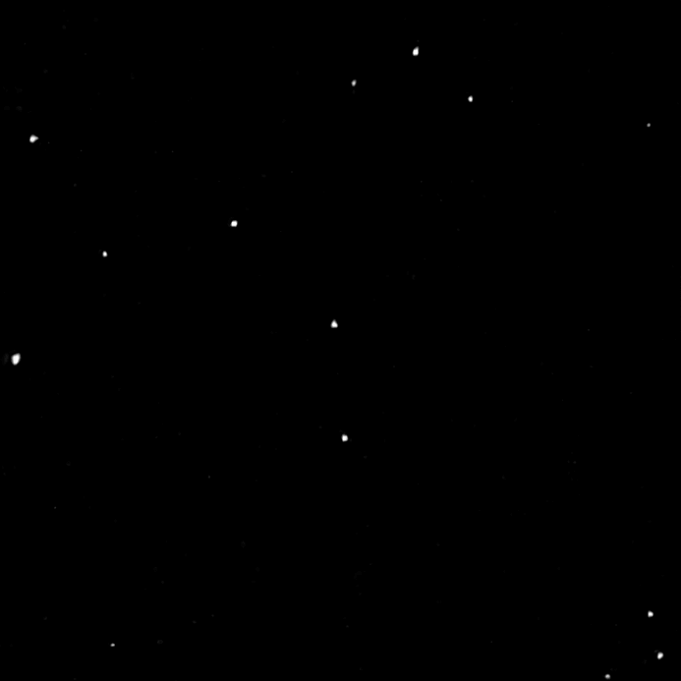
What is Celestial Navigation
Bearing observations of solar system objects against a background of stars
Makes use of parallax
Changes in the location of the target or the camera can produce detectible changes in the bearing measurement
Stars provide a strong inertial fix on the pointing of the camera producing stronger measurements
Asteroid 12 Victoria as observed in MapCam on OSIRIS-REx 222 million kilometers from the asteroid.
Credit https://www.asteroidmission.org/?attachment_id=2337#main

Slide 5
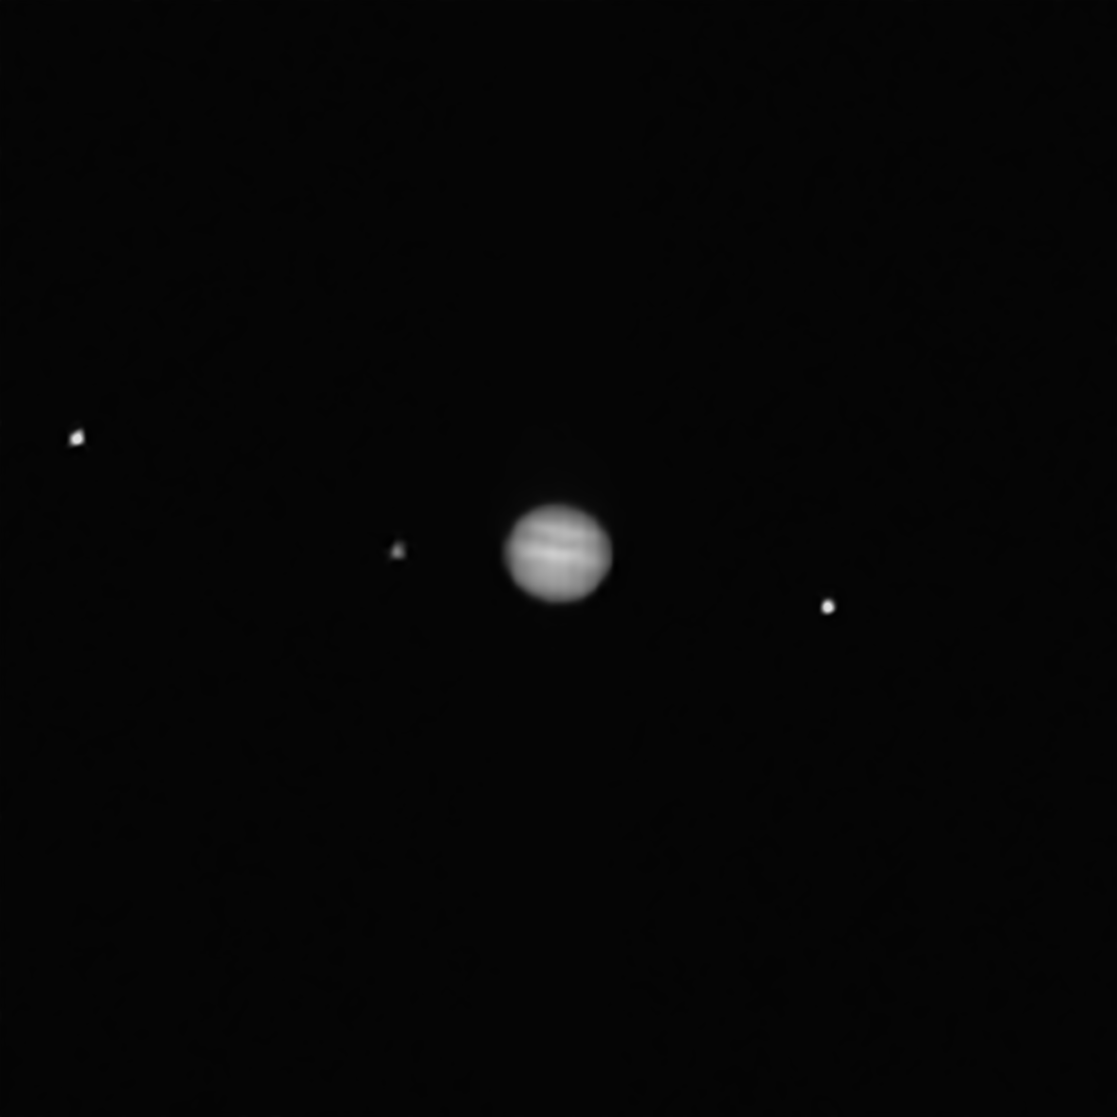
What is Celestial Navigation
Using observations of multiple bodies (either in a single image or over time processed in a filter) can allow for triangulation of the spacecraft’s location
Other variants exist (including computing the angle between a star and an object’s horizon).
Jupiter plus moons as observed in PolyCam on OSIRIS-REx 67 million kilometers from Jupiter.
Credit https://www.asteroidmission.org/?attachment_id=1922#main

Slide 6
Celestial Navigation Steps
Identify Stars
Apply median filter
Flatten image
Threshold flattened image
Label thresholded image
Fit PSF to labeled blobs
Pair to catalog directions using a priori attitude knowledge and RANSAC
D. Lang, D. W. Hogg, K. Mierle, M. Blanton, and S. Roweis, “Astrometry.net: Blind Astrometric Calibration of Arbitrary Astronomical Images,” The Astronomical Journal, vol. 139, no. 5, p. 1782, 2010.

Slide 7

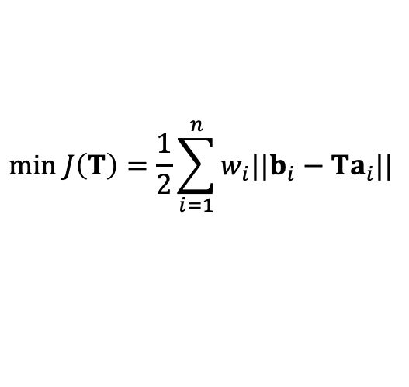

Celestial Navigation Steps
Identify Stars
Solve for precise Attitude
$$min J\left(T\right)=\frac{1}{2}\sum_{i=1}^{n}{w_{i}||b_{i}−Ta_{i}||}$$
b_{i}
a_{i}
$$K\overline{q}=λ\overline{q}$$
T
$$K=f(b_{i}, a_{i}, w_{i})$$
P. B. Davenport, “A vector approach to the algebra of rotations with applications,” Tech. Rep. NASA-TM-X57187, NASA Goddard Space Flight Center, 1968.

Slide 8
Celestial Navigation Steps
Identify Stars
Solve for precise Attitude
Identify solar system targets in the field of view using refined attitude, a priori position, and centroid fitting

Slide 9
Agenda
What is Celestial Navigation?
What is autoNGC?
Upcoming Demonstration on the CAPSTONE Spacecraft
Conclusion/Future Work

Slide 10


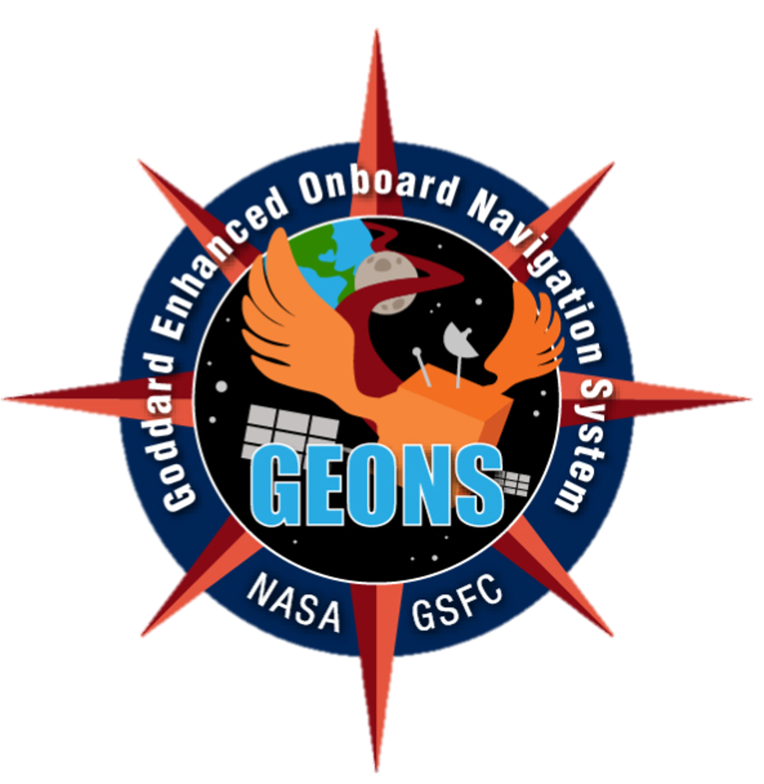
What is autoNGC?
An onboard software application suite built on the core Flight System (cFS) and flight hardware that performs real-time autonomous spacecraft navigation, guidance, and control (NGC)
Where am I?
How do I get to where I want to go?
Low SWaP Hardware and Modular Implementations
How do I stay on the planned path?
Resilience Across Multiple Orbit Regimes
Goddard Image Analysis and Navigation Tool (GIANT)
Why autoNGC?
Reduces reliance on over-subscribed ground assets and costly ground operations
Enables new mission capabilities
Low latency mission operations
Complex missions at far distances, e.g., Touch-and-Go (TAG) Guidance
In-situ planning and execution
Distributed Systems Missions (DSMs)
Dynamic replanning/reallocation of orbital assets
Fault Tolerant Autonomy
Heritage Design
Elements
autoNGC Attributes
Goddard Enhanced Onboard Navigation System (GEONS)
Plug-n-Play Customizable Architecture
Core Flight System

Slide 11
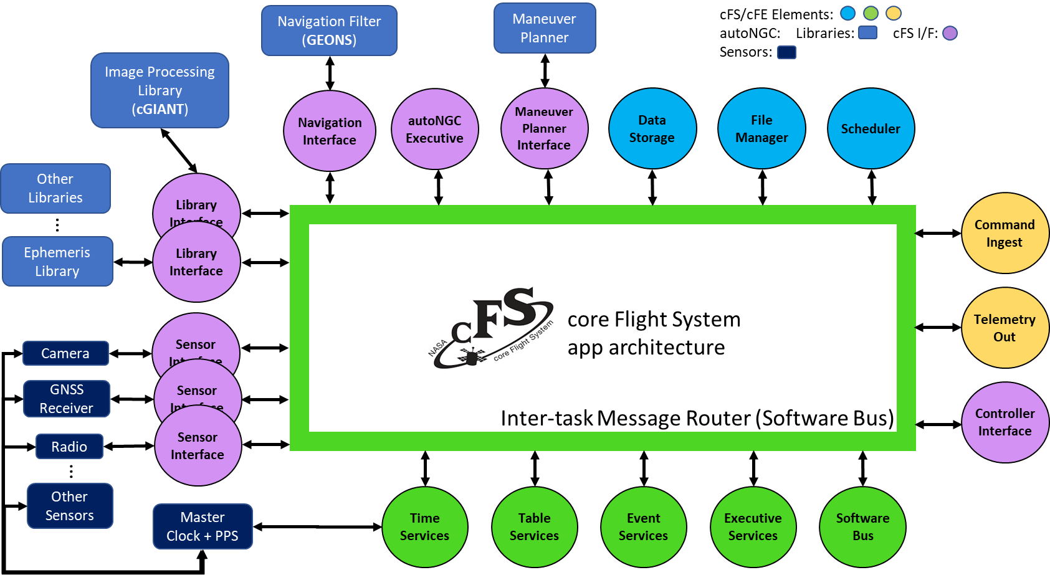
autoNGC Flight Software on cFS Architecture

Slide 12
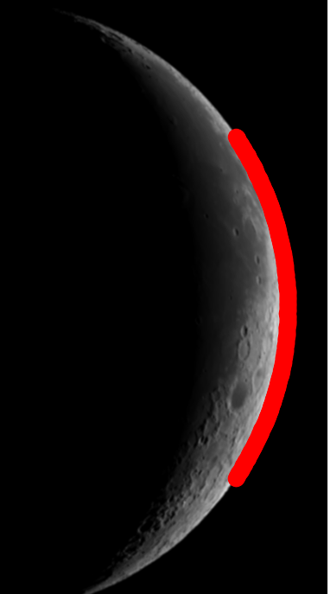
cFS Goddard Image Analysis and Navigation Tool (cGIANT)
C++ library that performs autonomous onboard image processing for precision optical navigation (OpNav) without ground-in-the-loop delays
State-of-the-art algorithms with ground heritage on OSIRIS-REx
Enables navigation relative to bodies whose trajectories and shapes are not well known
Sub-pixel level measurements of
Center-finding line-of-sight
Limb-based line-of-sight and range to target
Surface feature navigation for known surfaces
Precision attitude estimation using star fields
Celestial navigation
Autonomous limb-based shape modeling
A shape model of Bennu built autonomously using cGIANT
Limb observations of Vesta extracted using cGIANT
Moon limb observations extracted using cGIANT

Slide 13
Goddard Enhanced Onboard Navigation System (GEONS)
Performs navigation for 1+ user satellites or surface assets, individually or simultaneously, estimating absolute and relative orbital states, clock errors, and additional parameters
UD-factorized extended Kalman Filter, 4th/8th order RK integrator, realistic process noise models for onboard real-time navigation – 20+ years flight heritage
Currently supporting: Terra, MMS, GPM, NICER/SEXTANT
Measurement Models:
Nominal and weak signal GNSS, WAAS
1-way forward TDRSS/DSN/GN
2-way DSN/GN
Crosslink
Celestial object bearing angles
Terrain Relative Navigation
Limb/Centroiding
Accelerometer
X-ray pulsar
Dynamics models
High fidelity gravity potential and relativistic corrections
Solar system bodies
Harris-Priester atmospheric density
SRP with spherical or multi-plate
Eclipses
Measured acceleration
Impulsive and continuous thrust maneuvers

Slide 14
Agenda
What is Celestial Navigation?
What is autoNGC?
Upcoming Demonstration on the CAPSTONE Spacecraft
Conclusion/Future Work

Slide 15
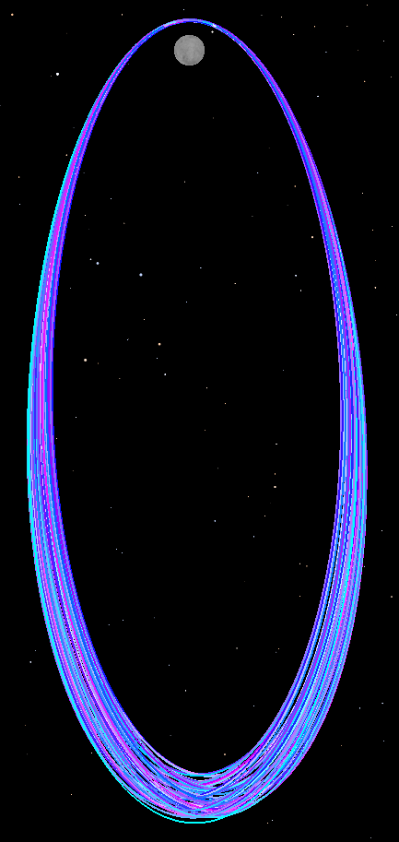
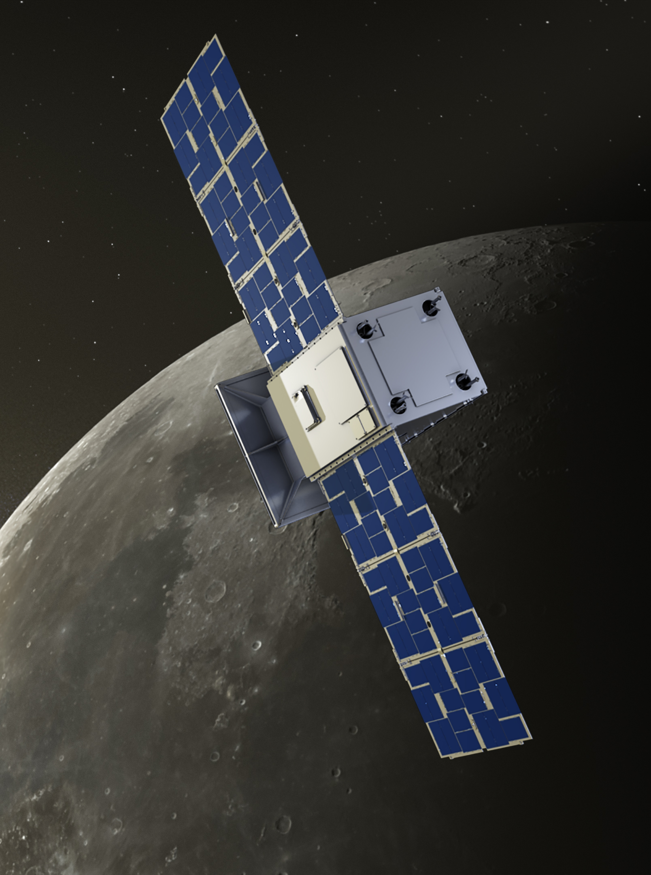
CAPSTONE Demonstration
Earth-Moon Rotating Frame
Cislunar Autonomous Positioning System Technology Operations and Navigation Experiment (CAPSTONE)
Small satellite in a near rectilinear halo orbit at earth-moon L2 built by Terran Orbital Corporation and flown by Advanced Space
Technology demonstration of NRHO station keeping and cross-link navigation with LRO
Nominal mission successfully completed in March 2024
Extended mission to serve as testbed for autonomy, navigation, and interoperable, standards-based communications in cislunar space
Orbit Period ~6.5 days
Perilune: ~3500 km
Apolune: ~70,000 km

Slide 16

CAPSTONE cFS Architecture
SCH
TLM
Out
GSFC
cFS Apps
Inter-task Message Router (Software Bus)
CAPSTONE
Spacecraft Avionics
SC
autoNGC
cFS Apps
core Flight System v7.1
App Architecture
File SFTP
Filesystem
DS
CMD
Ingest
Adv Sp
cFS Apps
Commands
Camera Images
Star Tracker Images
Accelerometer Data
1-Way DTE
2-Way DTE
Crosslink
Libraries
Limb I/F
CelNav I/F
MathLib
GEONS I/F
NGC Predict
Ephem I/F
RWLockLib
TimeLib
cGIANT
GEONS
Ephemeris Library

Slide 17
CAPSTONE CelNav Experiment
On a regular cadence (TBD) capture images using one of the star trackers of solar system bodies (excluding the earth and moon)
Attempt to pick optimal target sequence in coordination with research being pursued with University of Illinois.
Using cGIANT, process the images to extract attitude knowledge from the observed star field and a bearing measurement to any observed solar system objects.
Process the observables of the solar system objects in GEONS to estimate the spacecraft’s location.

Slide 18
CAPSTONE CelNav Performance Simulation
In preparation for the experiment, we have conducted simulations to get an idea of our expected performance for various concepts in a NRHO orbit like CAPSTONE is in.
These are not the parameters for CAPSTONE, rather for a representative spacecraft.
We do not consider observations of Earth or the Moon in this simulation, which would dramatically improve performance.
We intend to perform future analysis with these bodies as potential targets, as well as incorporating other potentially available measurements.
Key simulation parameter | Value
Orbit | NRHO
Observation cadence | 1 hour
Targets | Comets and asteroids
Measurement accuracy | 25 μrad 1σ

Slide 19
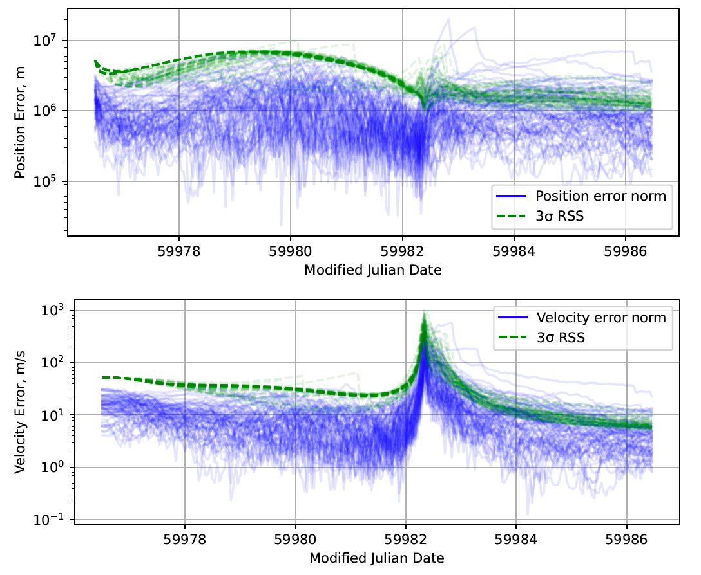
CAPSTONE CelNav Performance Simulation
Preliminary results show we can achieve performance of ~500-800 km and 2-3 m/s 1σ

Slide 20
Agenda
What is Celestial Navigation?
What is autoNGC?
Upcoming Demonstration on the CAPSTONE Spacecraft
Conclusion/Future Work

Slide 21
Conclusions
CAPSTONE flight demonstration expected to happen in spring of 2025
Once working, this capability could be used for the duration of the CAPSTONE extended mission.
We are looking at the application of the technique to deep space navigation as well, perhaps making use of the OSIRIS-APEx mission to Apophis for a ground demonstration.

Slide 22

autoNGCSummarySheet.pdf

