Slide 1
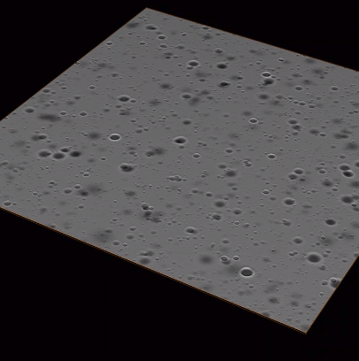
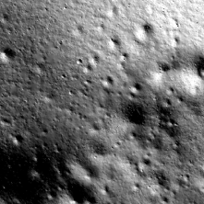
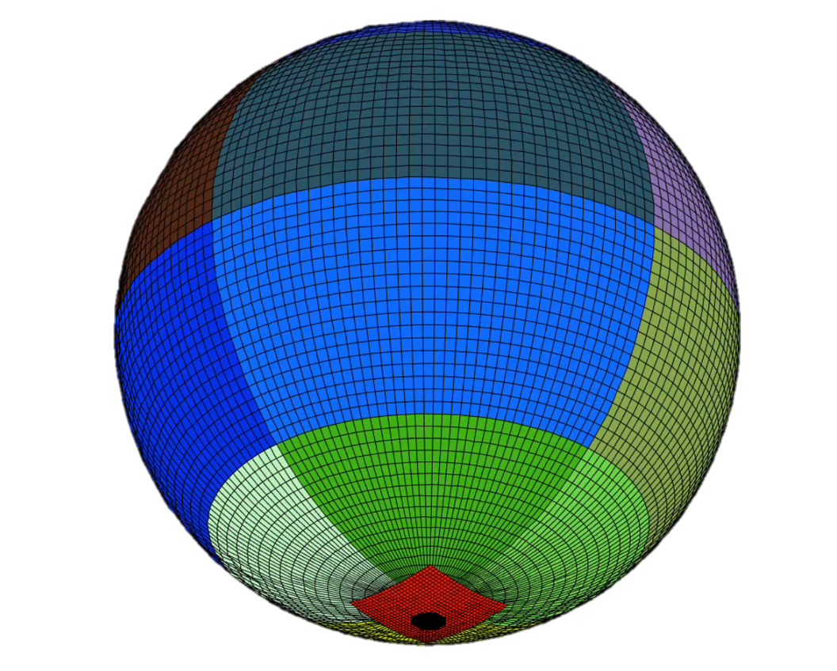

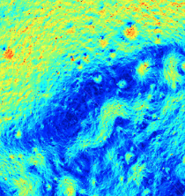
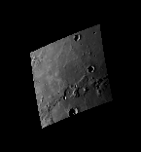
The LuNaMaps Team | AGU24 | December 10, 2024

Slide 2
Outline
Introduction
Building Digital Elevations Models
Pre-built Maps
Map Validation
TRN Validation
Synthetically Enhanced Digital Elevation Models

Slide 3
Outline
Introduction
Building Digital Elevations Models
Pre-built Maps
Map Validation
TRN Validation
Synthetically Enhanced Digital Elevation Models

Slide 4

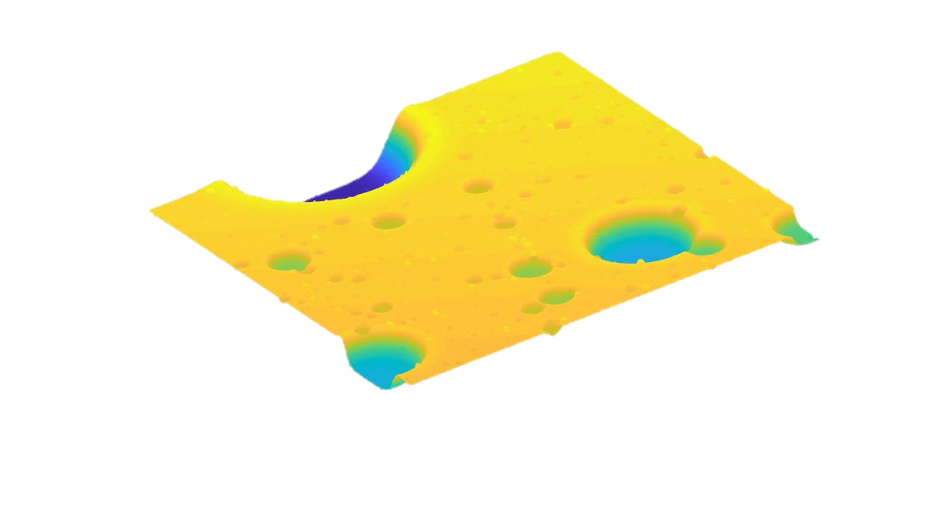
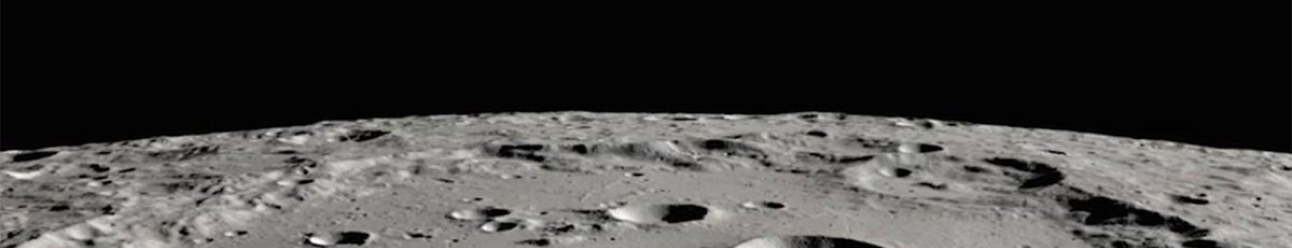
The Need for Better Lunar Map Products
TRN
Currently there are no lunar orbiters that can provide navigation solutions to landers or surface assets
Landers must rely on Terrain Relative Navigation (TRN) for precision landing
TRN systems use a reference map to localize the spacecraft in lunar coordinates
Hazard Detection and Avoidance (HDA) systems can quickly scan surface for hazards and perform divert maneuvers
HDA system development needs realistic terrain models
Powered Descent Initiation
Descent image
Ref. Map
Hazard Detection
3D Digital Elevation Map
Divert to hazard-free site
Controlled landing

Slide 5
Outline
Introduction
Building Digital Elevations Models
Pre-built Maps
Map Validation
TRN Validation
Synthetically Enhanced Digital Elevation Models

Slide 6
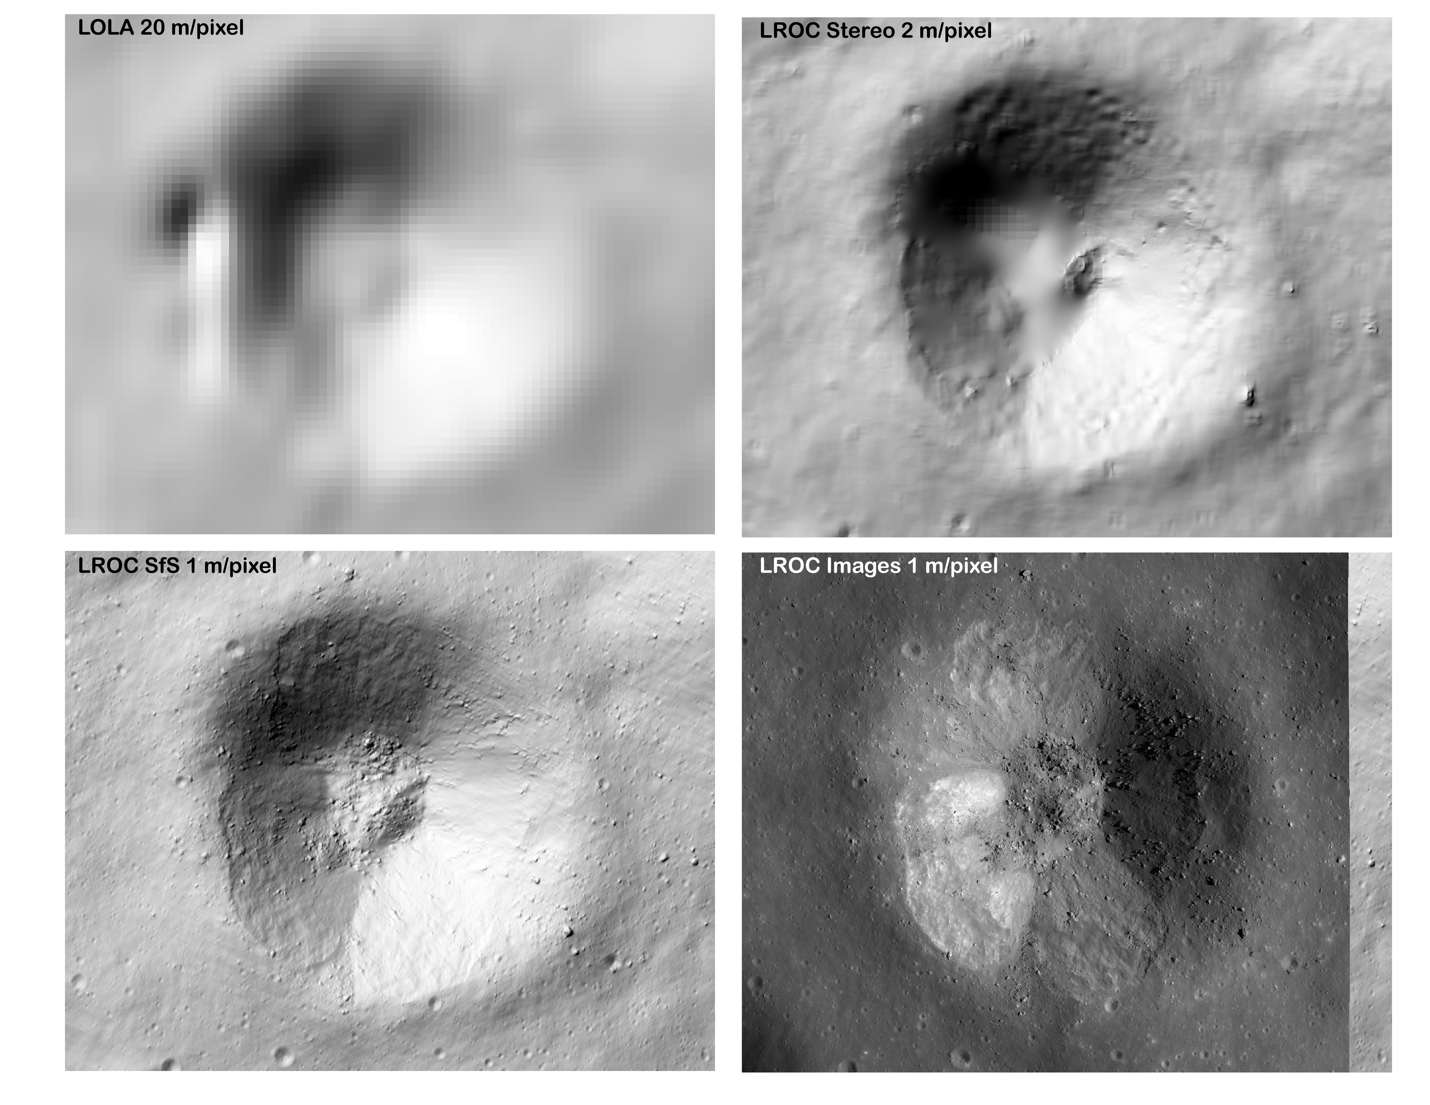
Ames Stereo Pipeline
A suite of free and open-source automated geodesy and stereogrammetry tools designed for processing stereo images captured from satellites (around Earth and other planets), robotic rovers, aerial cameras, and historical images, with and without accurate camera pose information.
ASP produces cartographic products, including digital terrain models (DTMs, synonymous with digital elevation models, DEMs), ortho-projected images, 3D models, and bundle-adjusted networks of cameras. These data products are suitable for science analysis, mission planning, and public outreach.

Slide 7
Semi-automated Ground Track Digital Elevation Model Construction
Semi-automated pipeline of python scripts, USGS ISIS + Ames Stereo Pipeline (ASP) wrappers, and geospatial libraries (gdal, xarray, geopandas)
Published and ongoing applications to the Moon and Mercury
Successfully applied to large (e.g., 16x16 km, 300x300 km) regions and 2500+ LROC or MDIS NAC images
Can run in distributed environment
Identify images and calibrate
Pre-process images and down-select
Start from input LDEM/SLDEM at 5-100 m/pix
Find overlapping images (shapes)
Bundle-adjust (BA) images (iterate)
Compute Shape-from-Shading (SfS) DEM
SFS DEM @ target resolution + ancillary products (validation)
Calibrate and project on DEM
Select subset for optimal coverage
Set paths, crs, target resolution, region of interest
Filter bad and shadowed images
Register images to a priori DEM (IA)
Main steps of our SfS pipeline
Notes:
Can we get the same plot for Connecting Ridge site?

Slide 8
Outline
Introduction
Building Digital Elevations Models
Pre-built Maps
Map Validation
TRN Validation
Synthetically Enhanced Digital Elevation Models

Slide 9
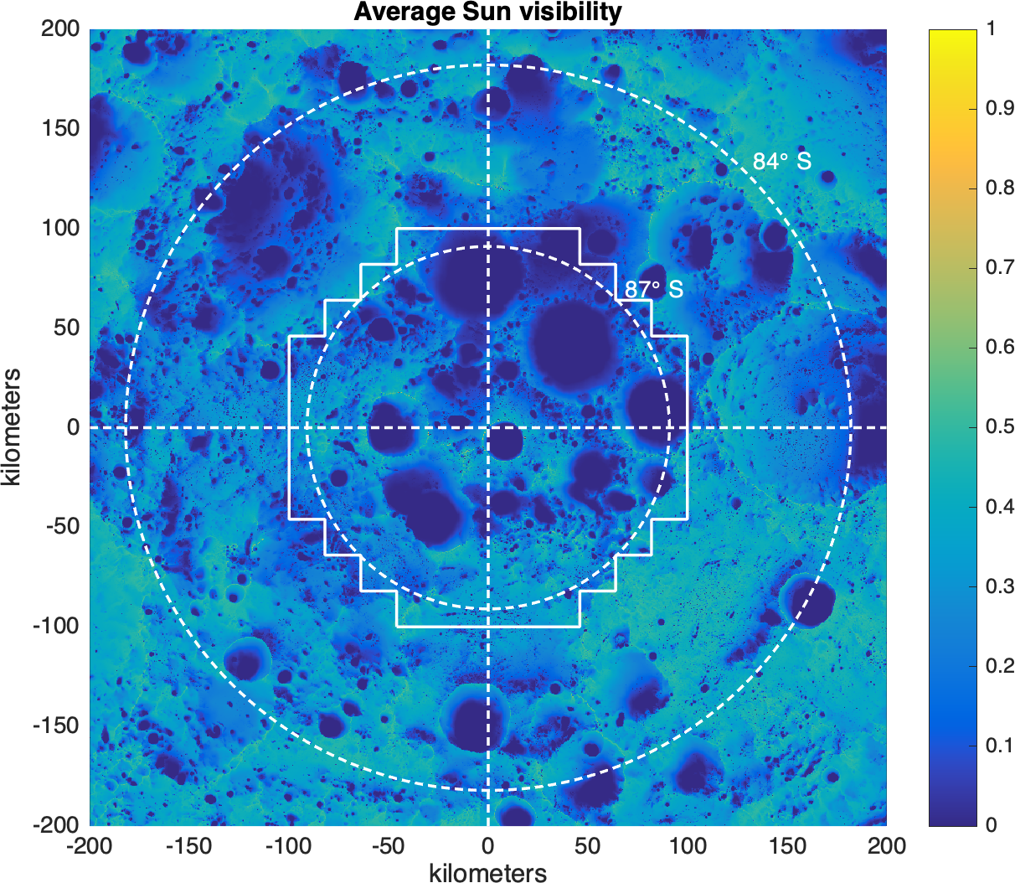
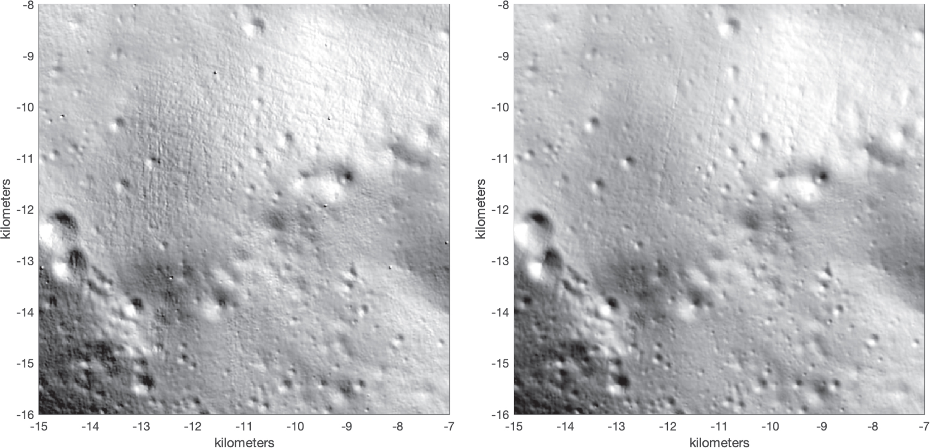
Pre-built maps
The project built high-quality digital elevation models of the lunar surface at key points of interest.
Cleaned and higher-resolution LOLA DEMs of the south pole:
  80º – 87º south 20 m/pix: https://pgda.gsfc.nasa.gov/products/90
  87º – 90º south 5 m/pix: https://pgda.gsfc.nasa.gov/products/81
  Specific Sites 5 m/pix: https://pgda.gsfc.nasa.gov/products/78
1 m/pix shape from shading DEM of the Apollo 16 site:
  Will soon be available at the Planetary Data System (PDS) Cartography and Imaging Sciences Node Annex
Additional sites may be released after evaluation of data sensitivity

Slide 10
Outline
Introduction
Building Digital Elevations Models
Pre-built Maps
Map Validation
TRN Validation
Synthetically Enhanced Digital Elevation Models

Slide 11
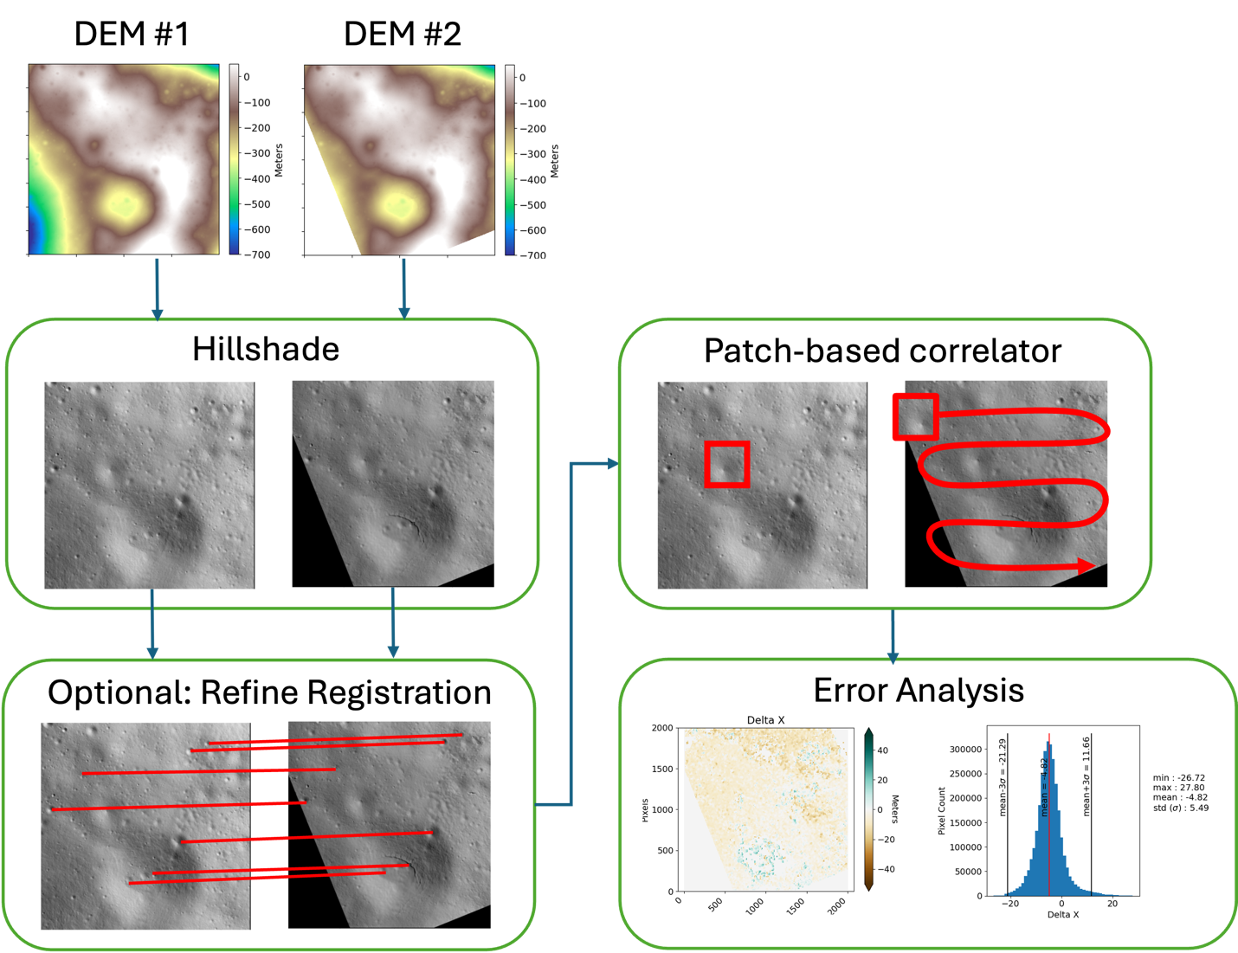
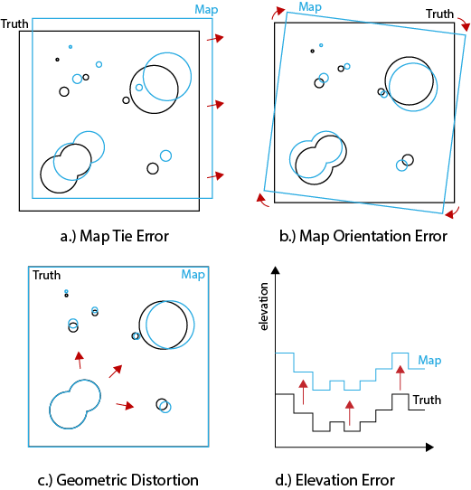
Map Validation
Compare maps from generated using different techniques/data sets.
For more details visit poster “Exploring the Effect of Map Distortion on Optical Terrain Relative Navigation” in session G31B on
Tools available open source at https://github.com/nasa-jpl/landmark_tools

Slide 12
Outline
Introduction
Building Digital Elevations Models
Pre-built Maps
Map Validation
TRN Validation
Synthetically Enhanced Digital Elevation Models

Slide 13






LuNaMaps TRN Validation Pipeline
Goal: Determine if it’s possible to derive concrete metrics or parameter ranges that relate DEM quality to TRN system performance.
  Use a combination of camera images and lidar measurements
  Use different TRN algorithms and implementations and different simulation pipelines
  Use different quality maps and different kinds of map errors and deformations
Maps
Create Lunar digital elevation maps of varying quality using LOLA altimetry data
Measurements
Test various TRN methods on the maps to generate results
Estimation
Analysis
Complete parametric runs to see how map quality affects TRN performance
Use observed and computed measurements in filter to generate state estimations

Slide 14
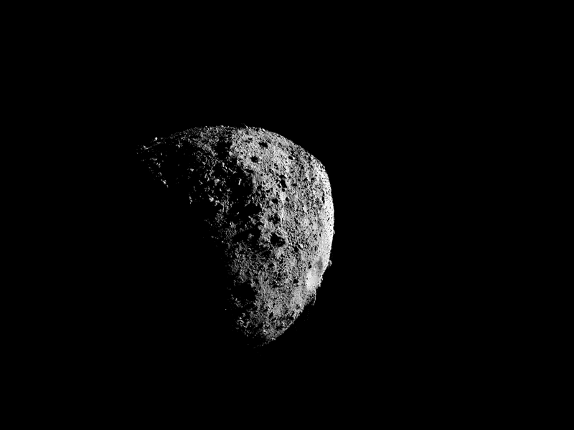
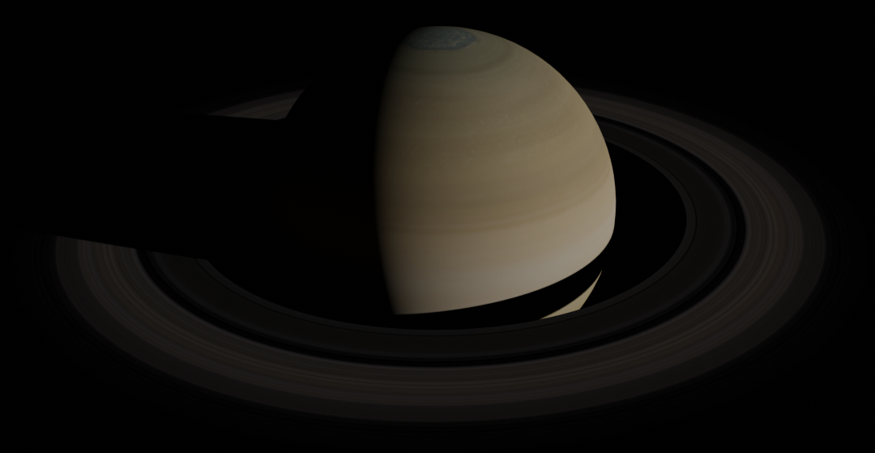
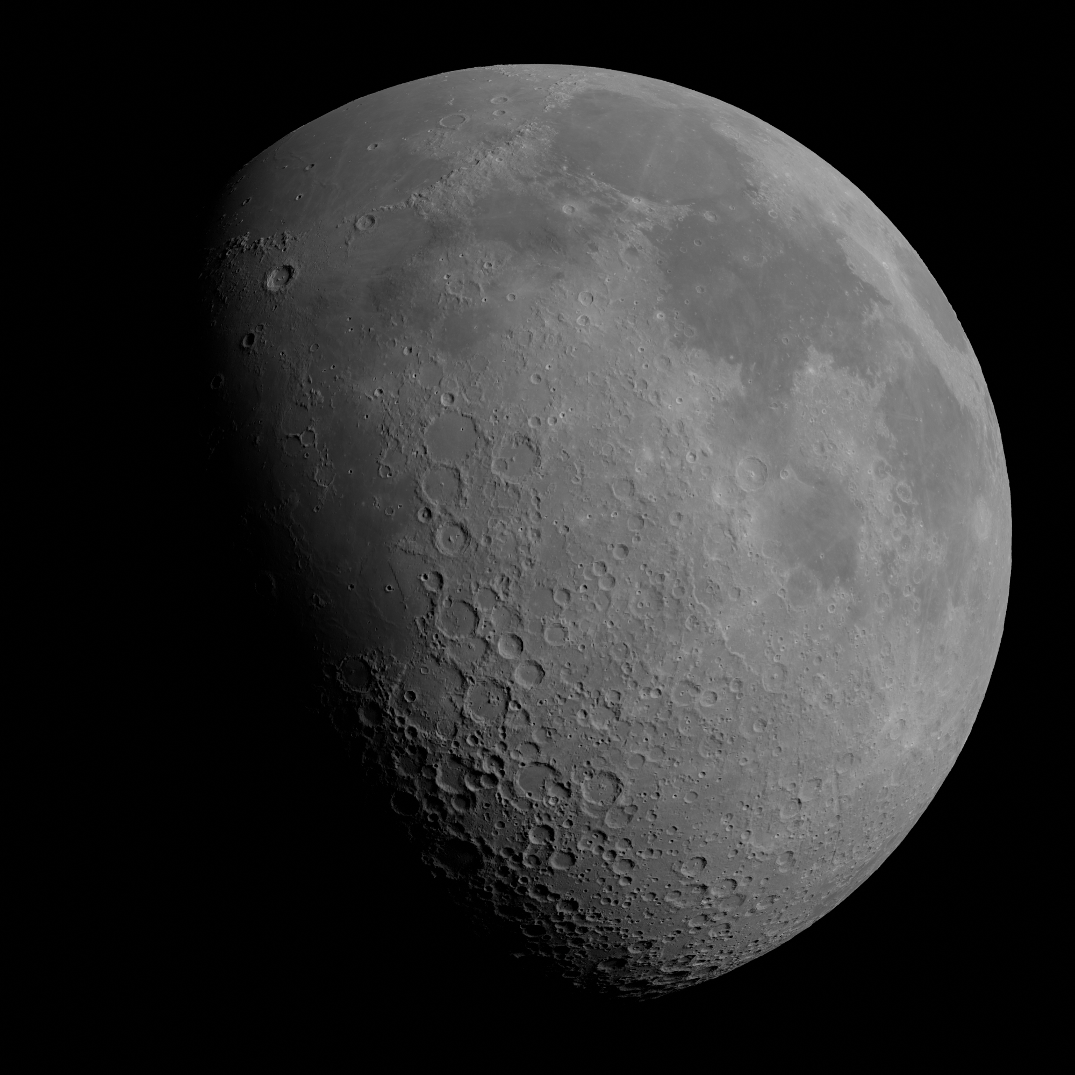
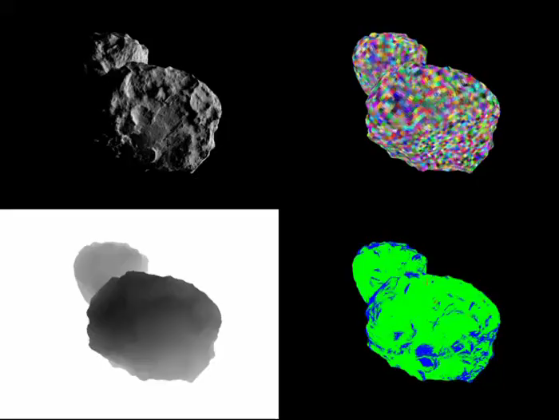
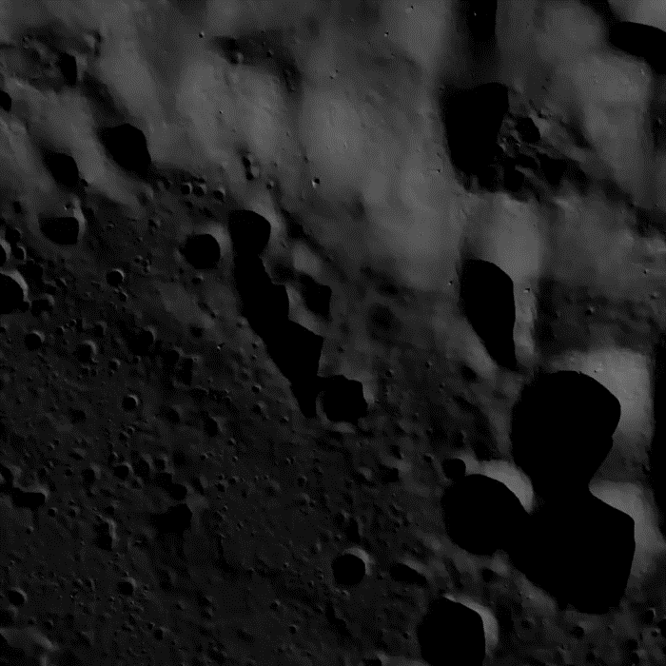
Vira – Rendering Tool
Bennu rendered with OSIRIS-Rex SPK/CK kernels
Textured Saturn with Rings
SLDEM2015 + LDEM60S DEMs wrapped with WAC albedo
67P SPC Maplets Level-of-Detail System
Lunar Descent Images

Slide 15
Outline
Introduction
Building Digital Elevations Models
Pre-built Maps
Map Validation
TRN Validation
Synthetically Enhanced Digital Elevation Models

Slide 16
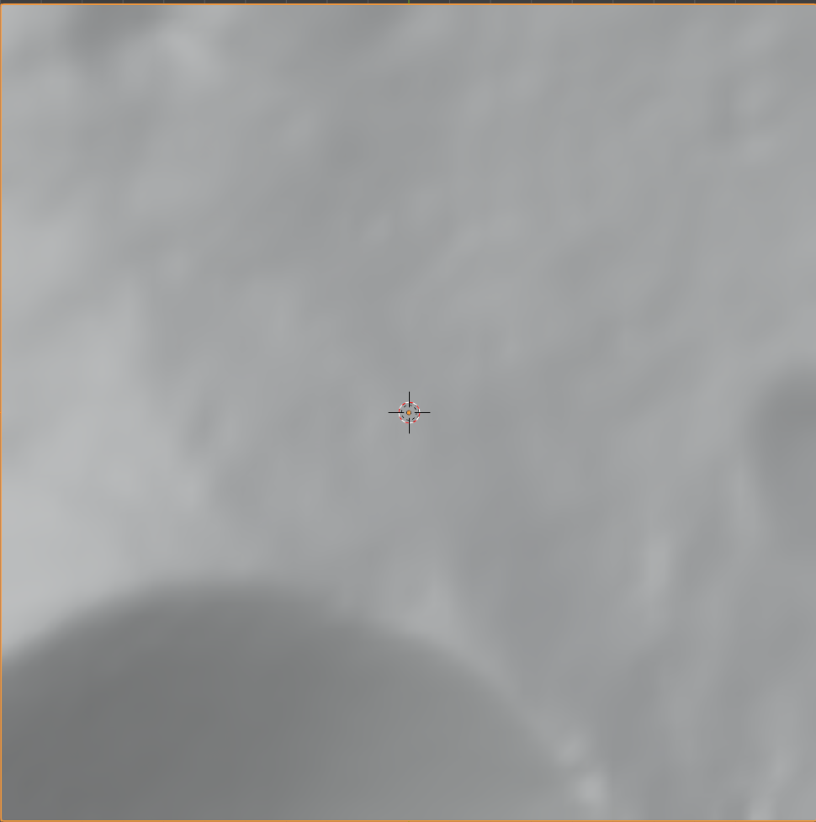
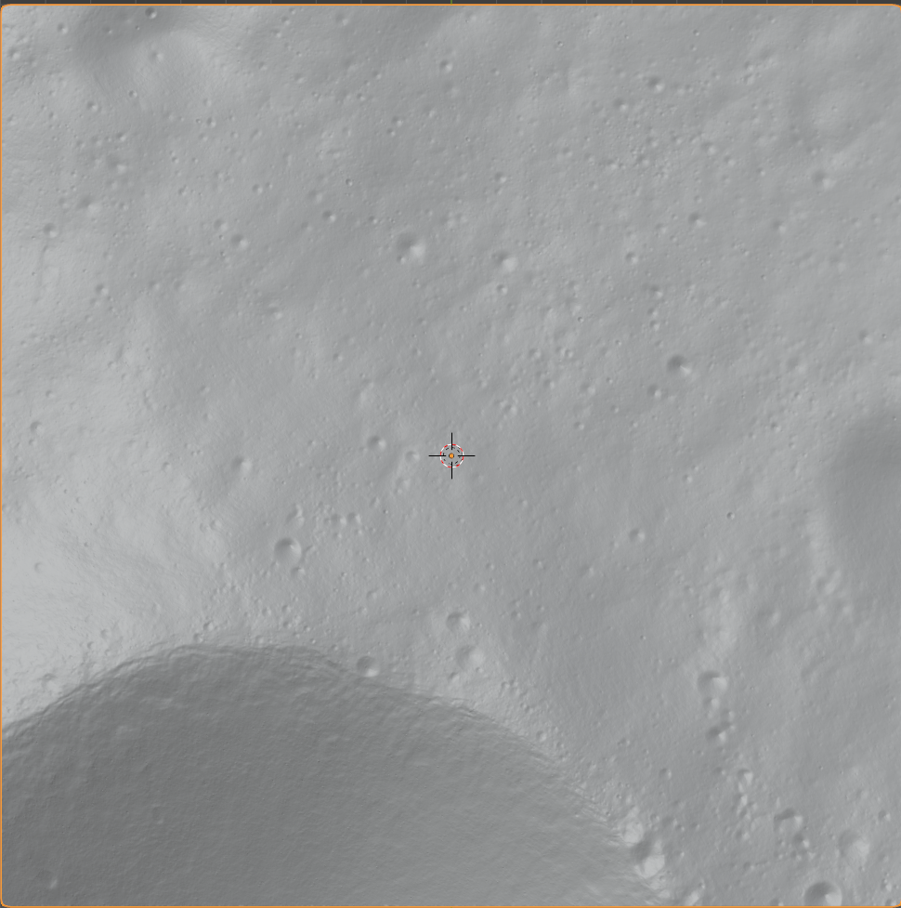
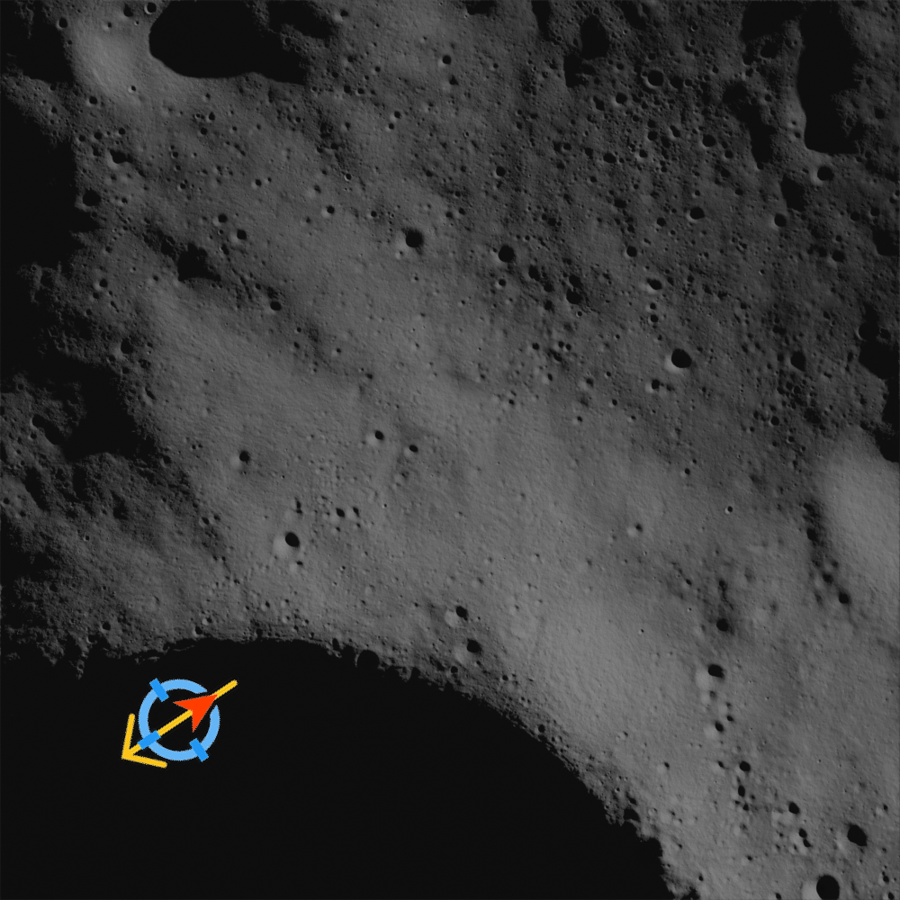
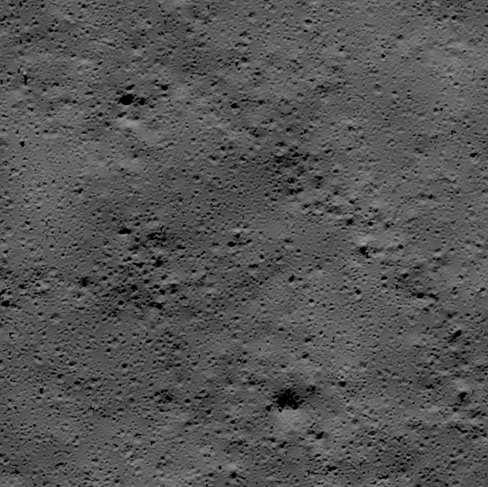

LuNaSynth: Synthetic Lunar Terrains for Autonomous Navigation
Terrain Creation Process
Enhance lunar digital elevation maps (DEM) to create high resolution maps for autonomous navigation
  Sculpt craters into the DEM using current best empirical distributions of crater profile and crater placements
  Add a rock field from empirical rock distributions in representative terrains. Use procedural rocks and scanned rocks models from Apollo missions and terrestrial lunar analog sites.
Implementations available at https://github.com/nasa-jpl/lunasynth and https://github.com/NeoGeographyToolkit/synthterrain
Base DEM
Detailed DEM
Rendered Terrain
Sample output
Rendered terrain
Rock field ground truth
December 10, 2024
AGU24
16

Slide 17
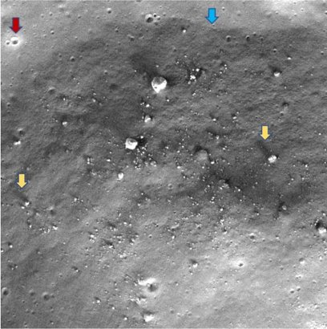
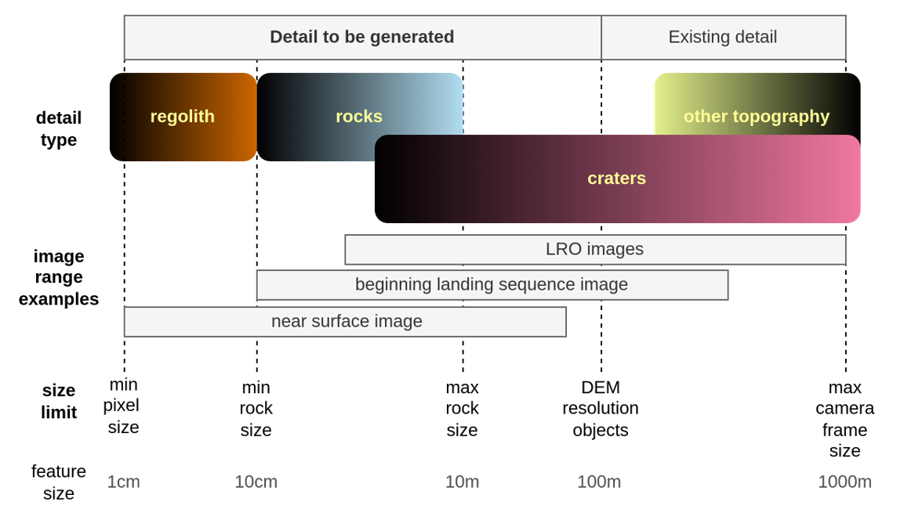
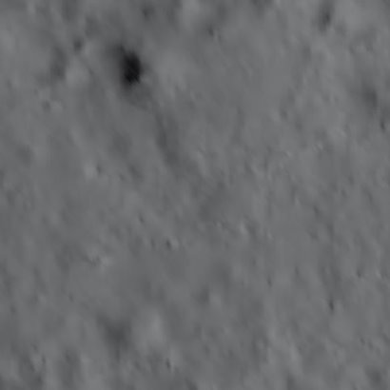
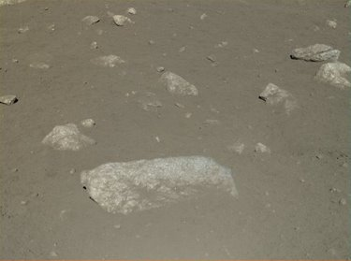
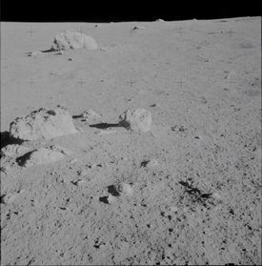
Generation Process: from large scale DEM to regolith detail
Example of existing level of detail
Examples of desired level of detail
December 10, 2024
AGU24
17

