Slide 1



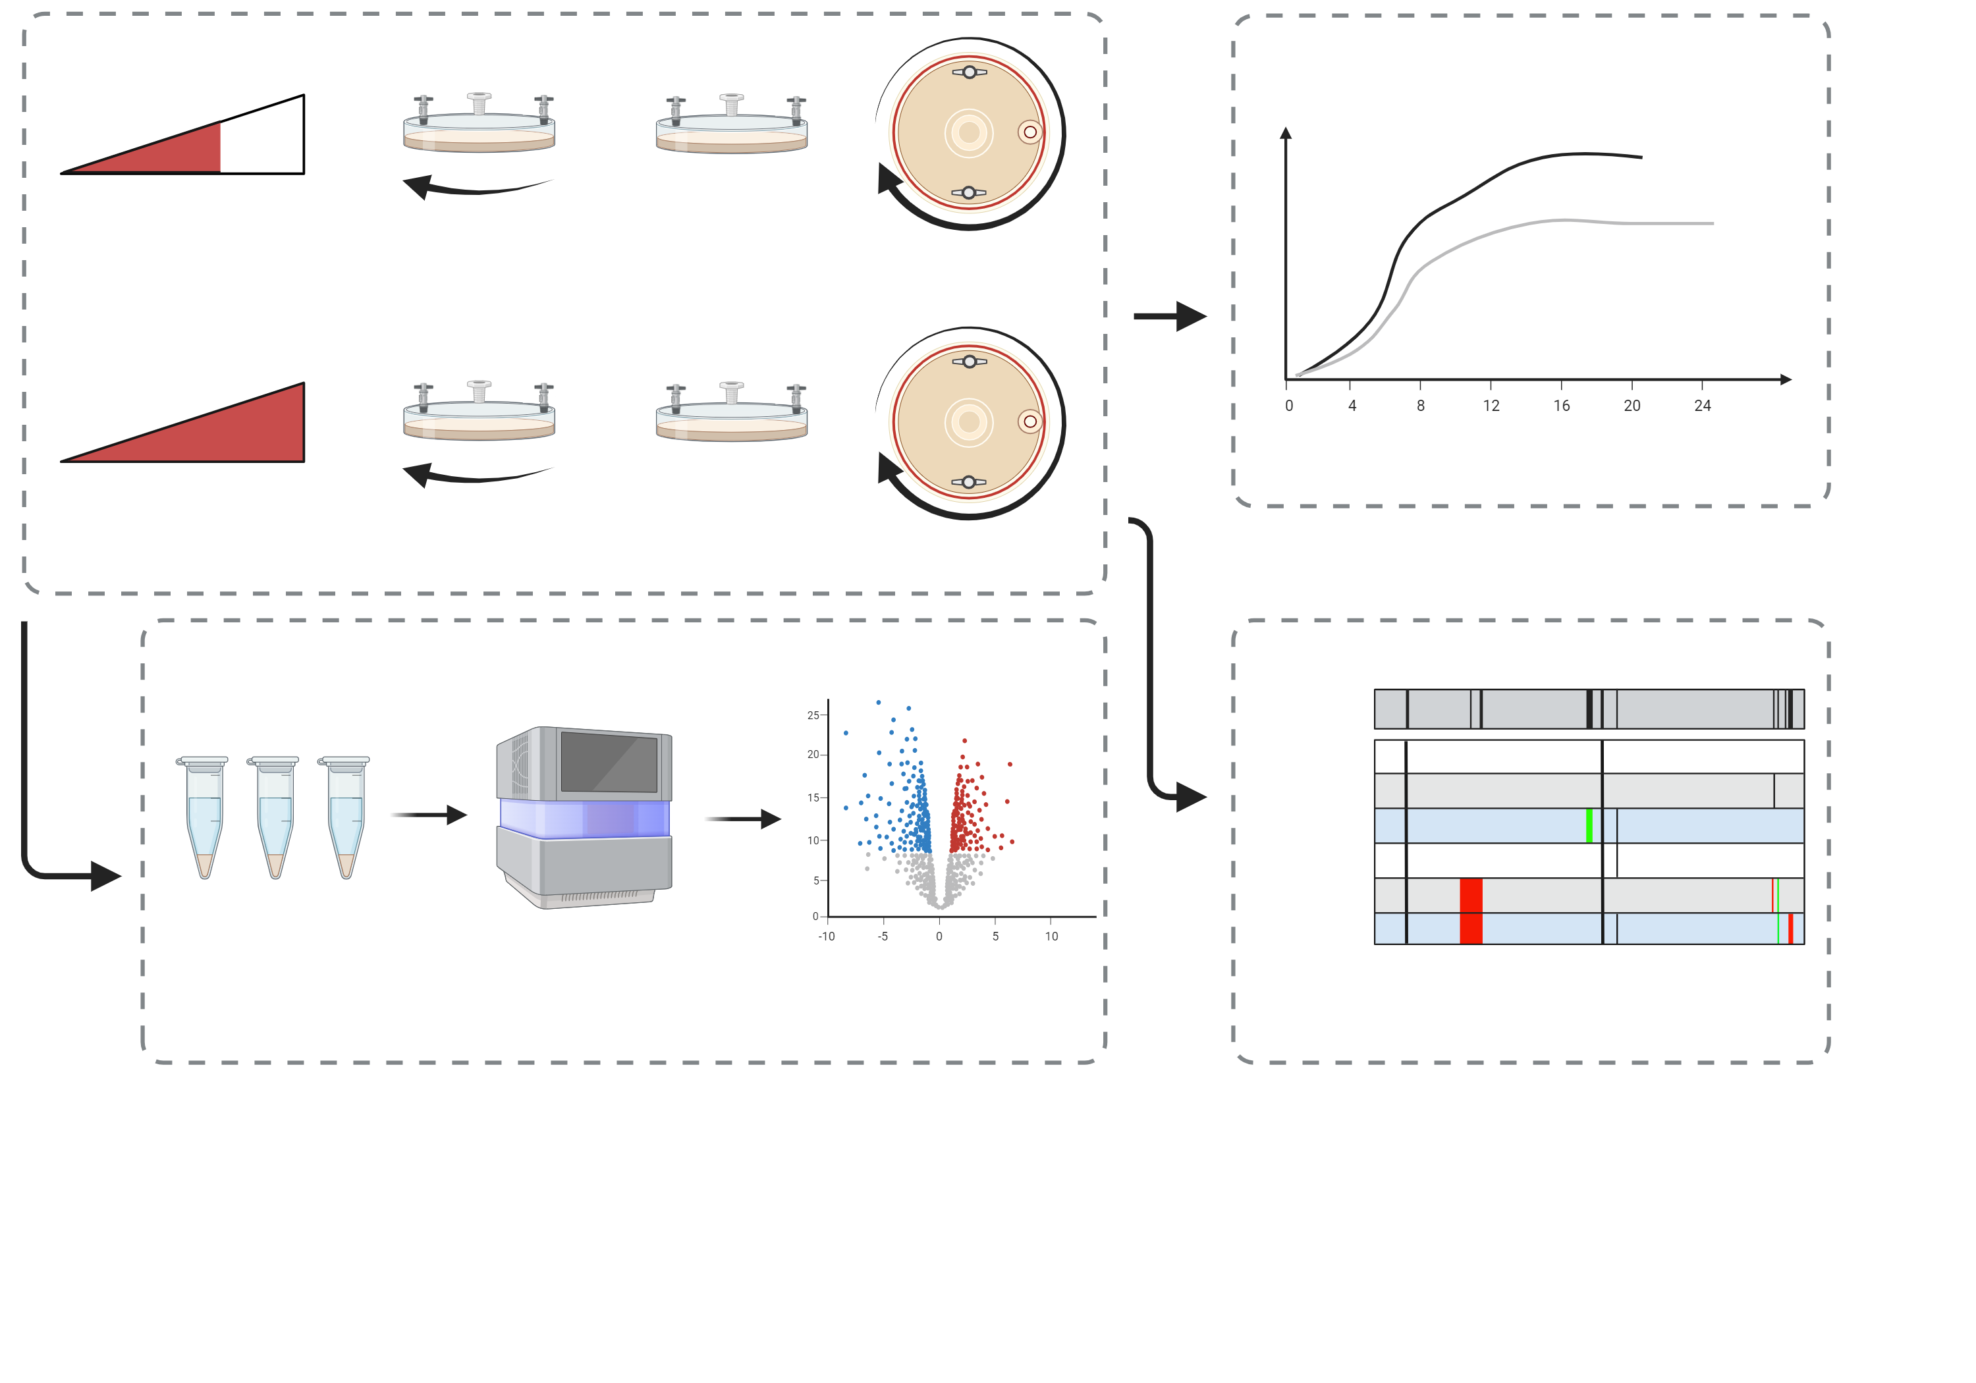
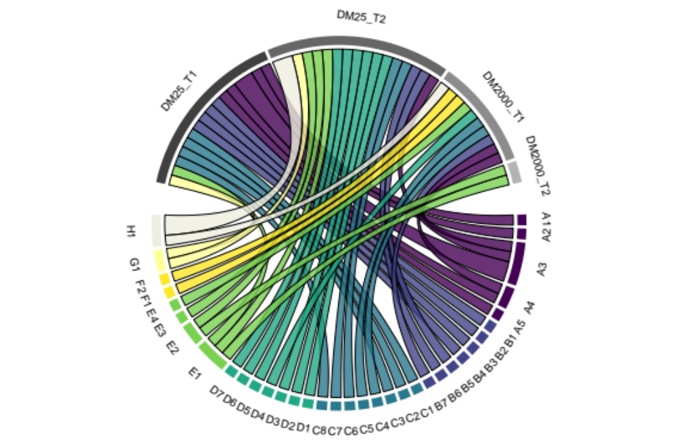
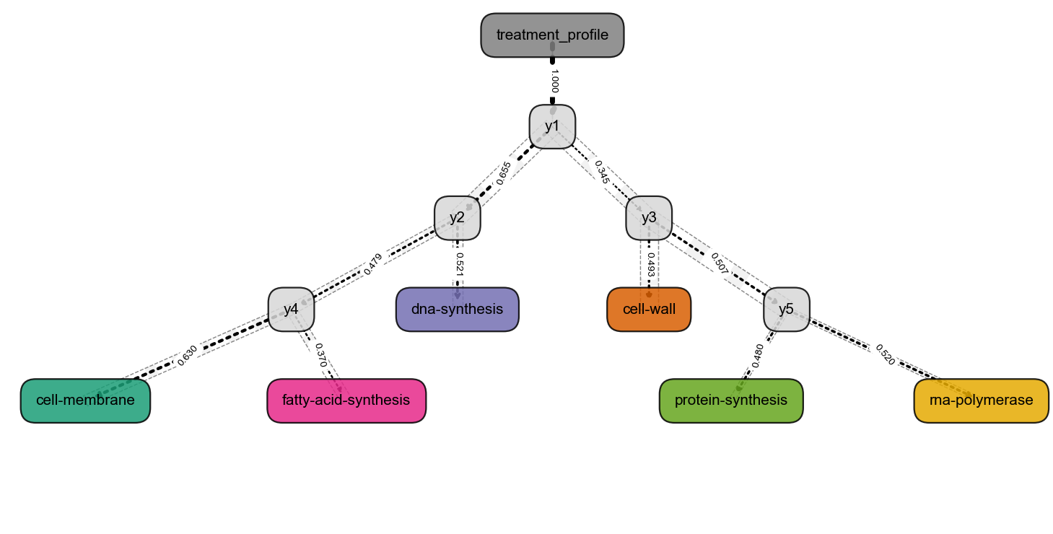
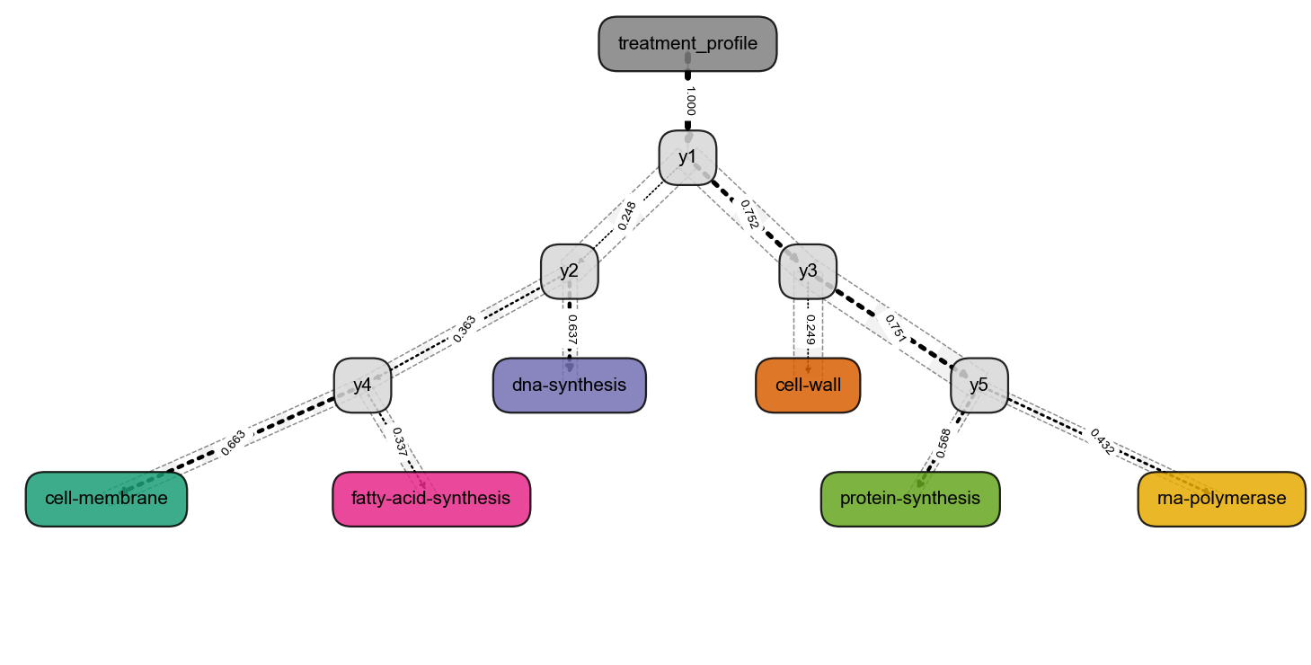
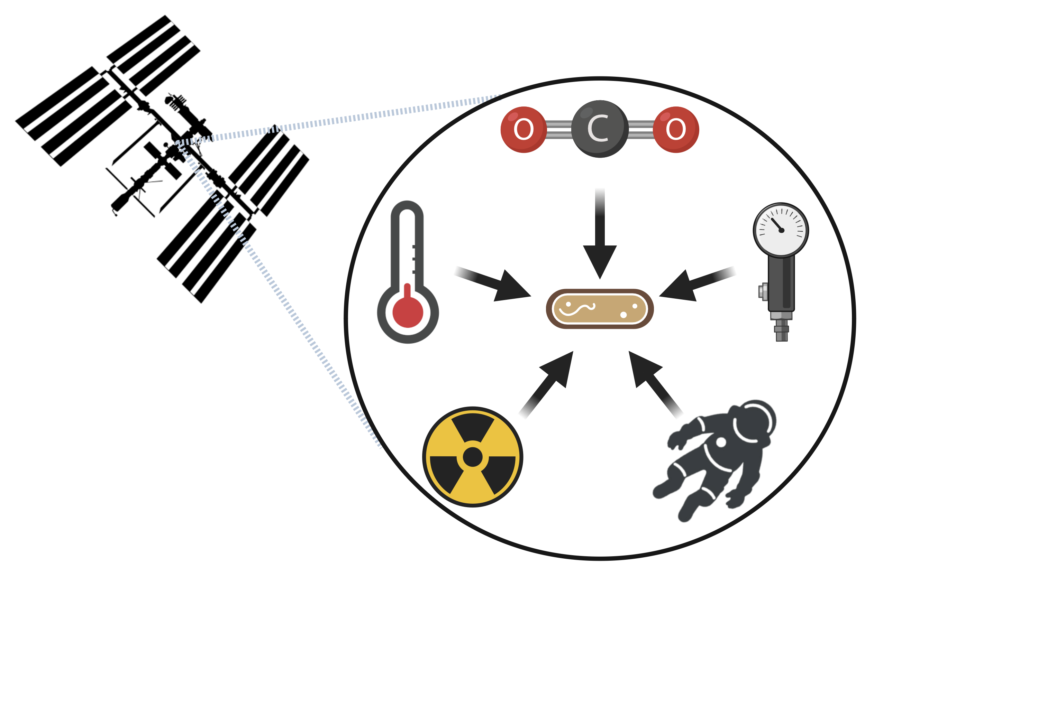
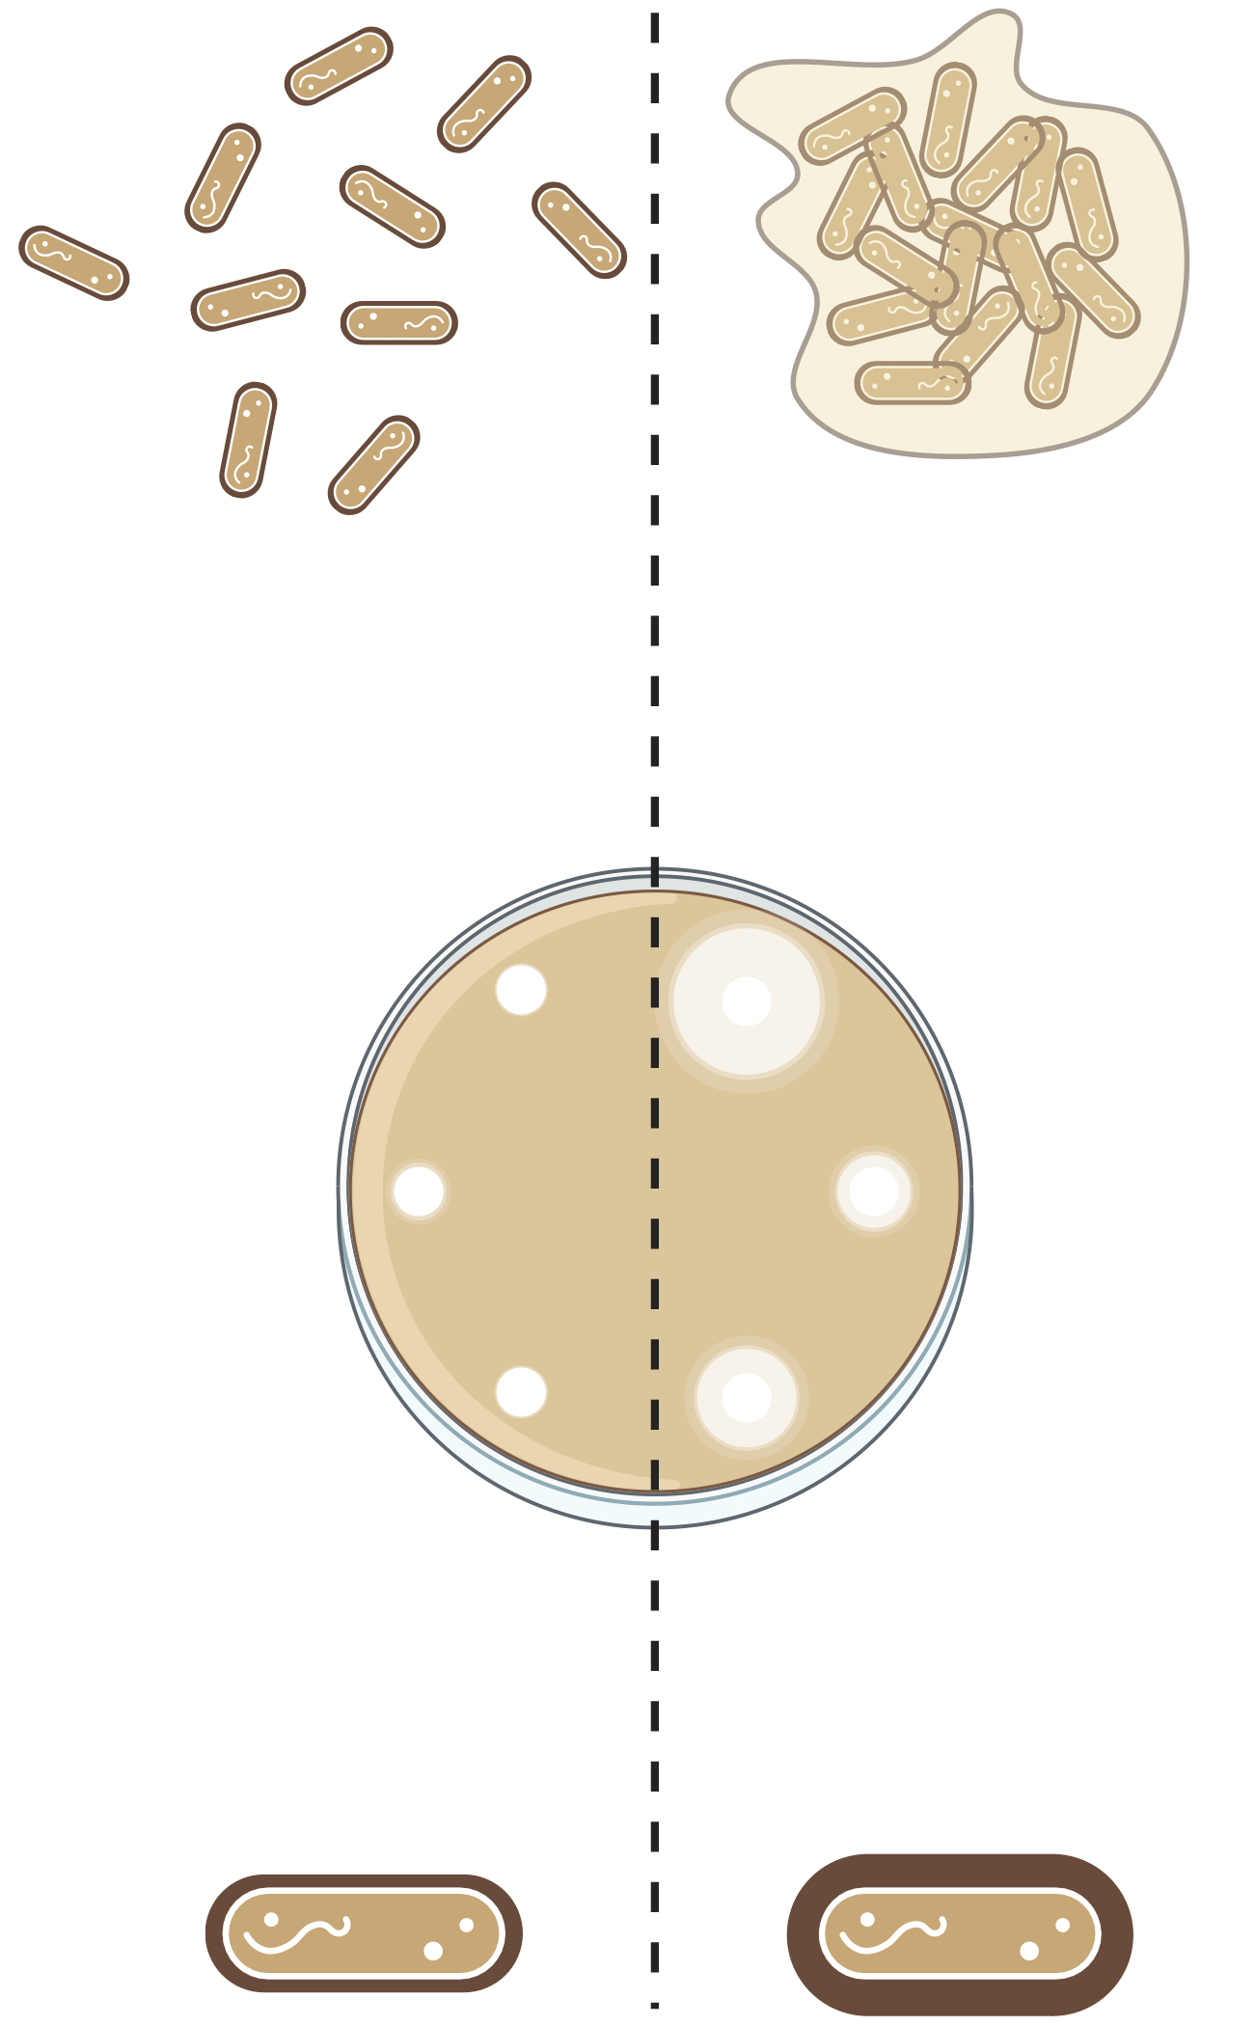
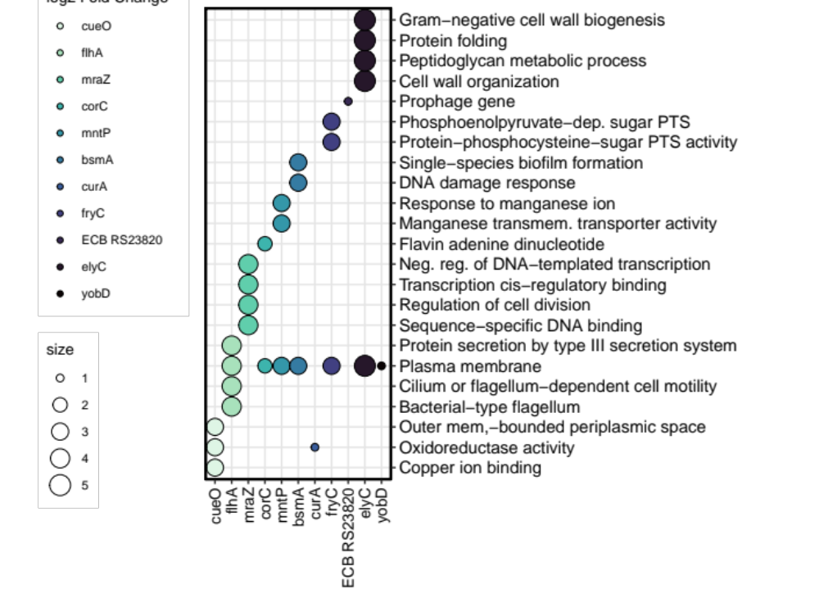
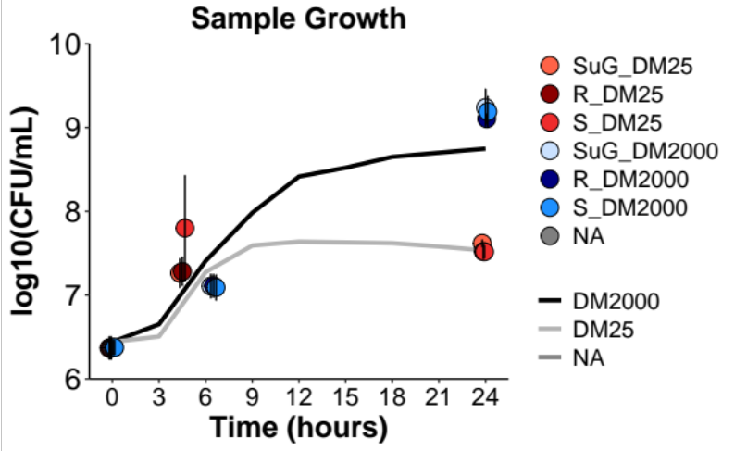
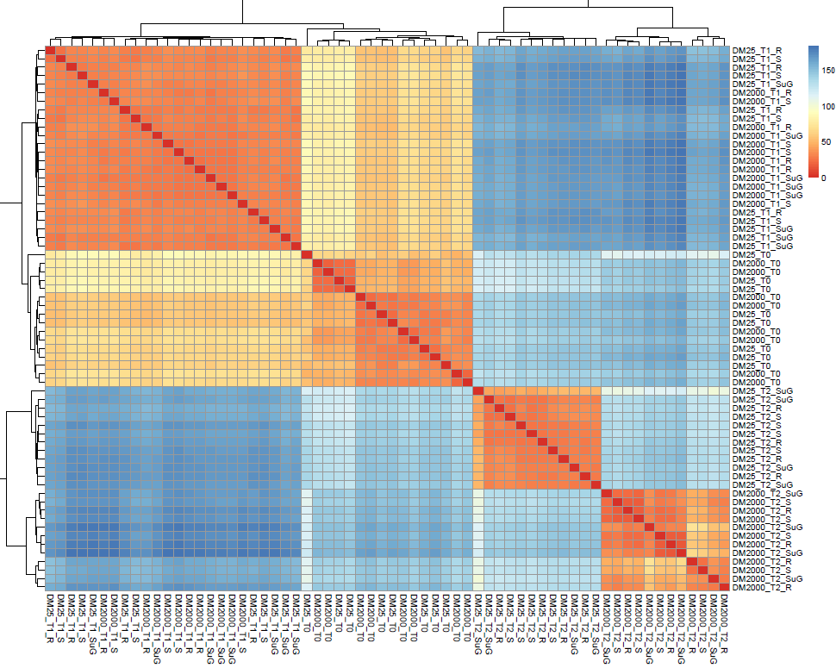
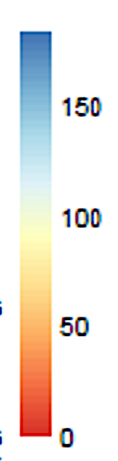
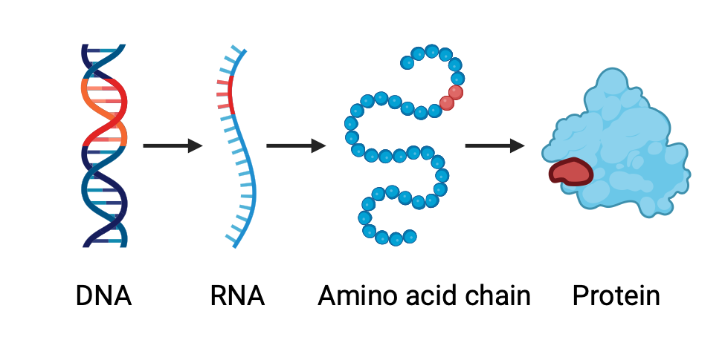
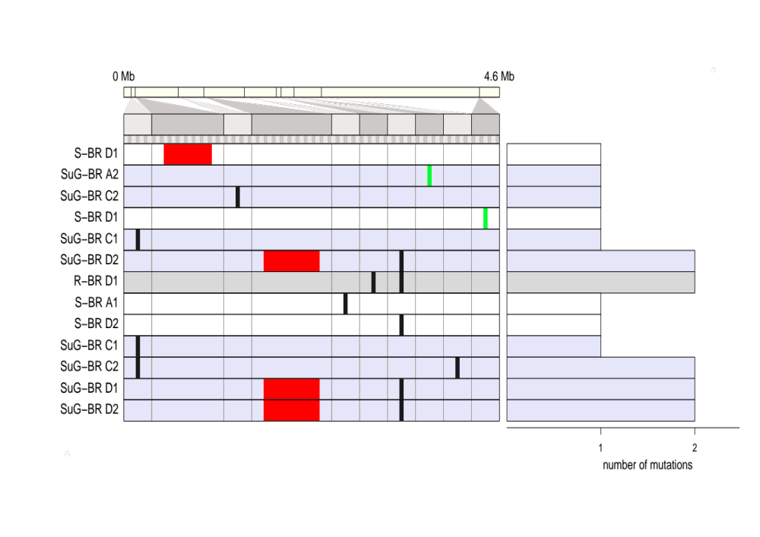

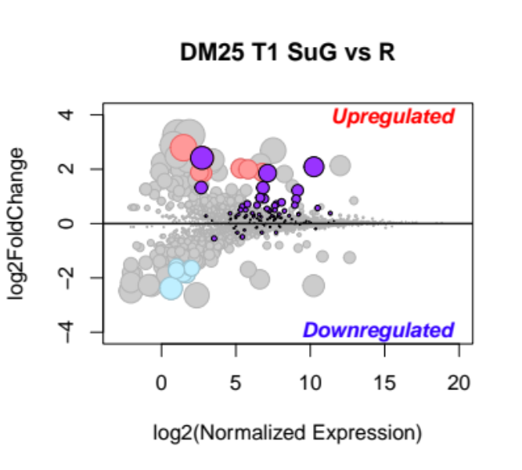
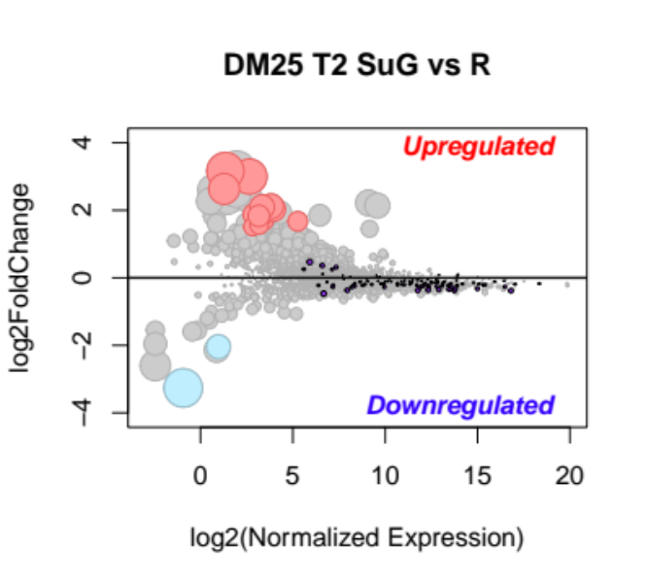
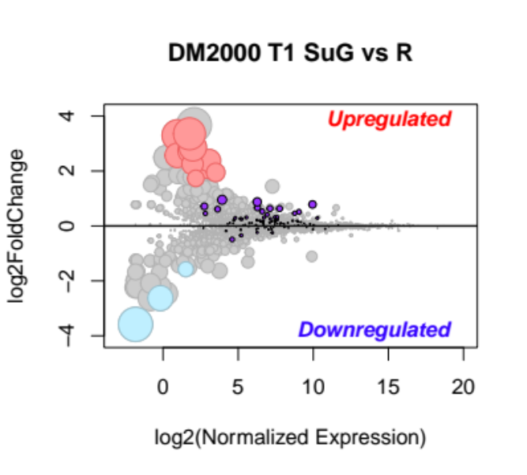
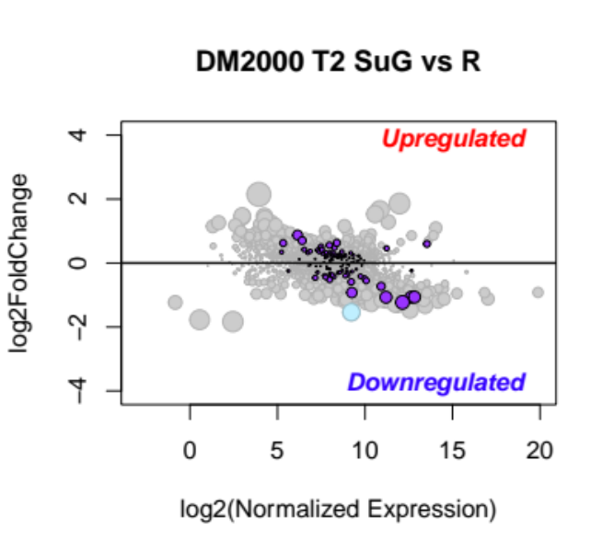
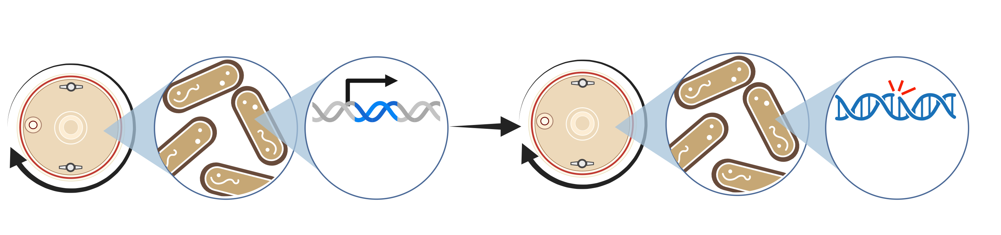
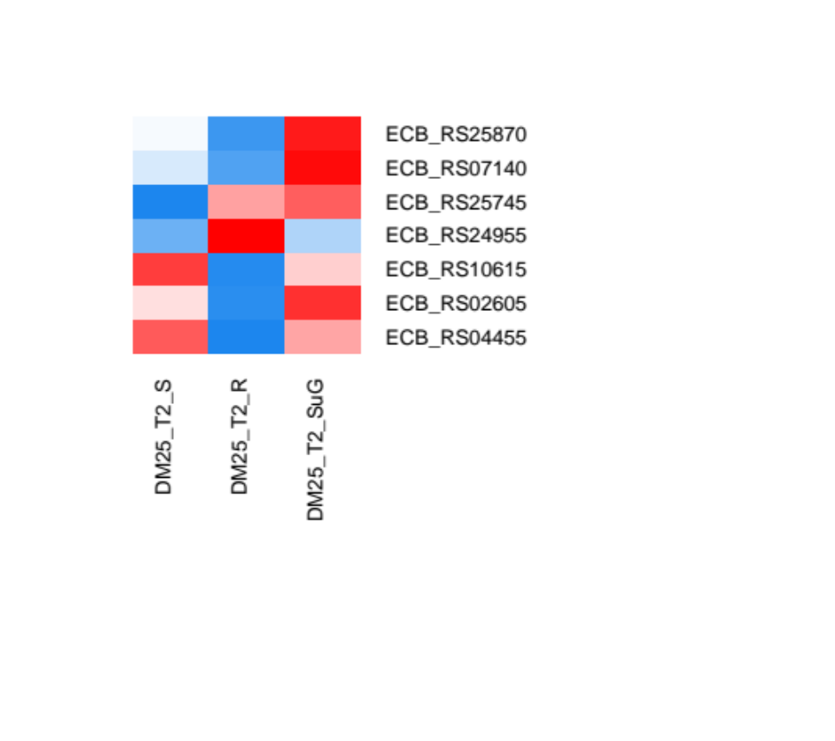
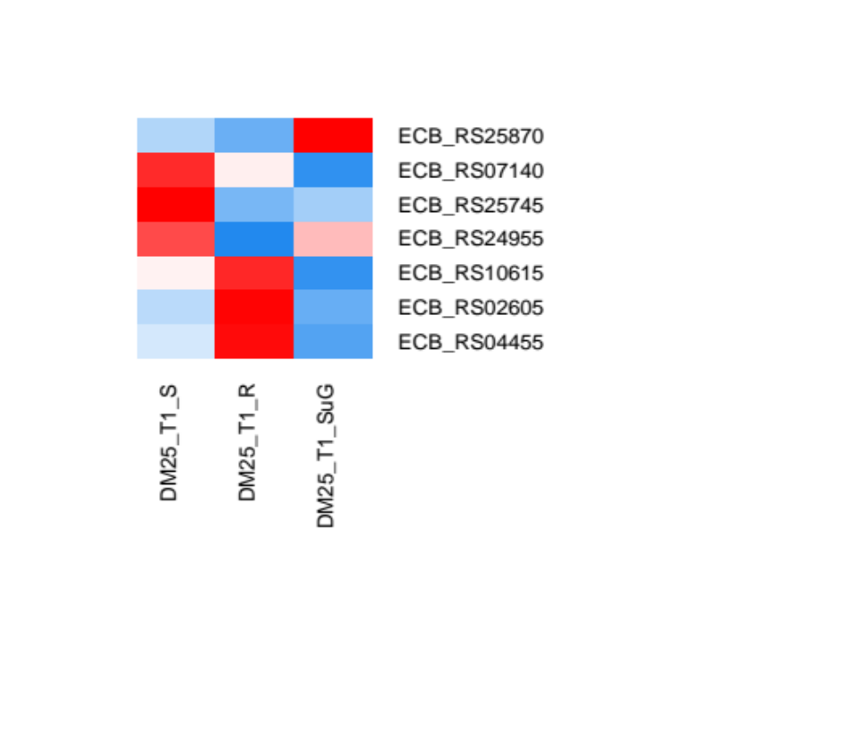

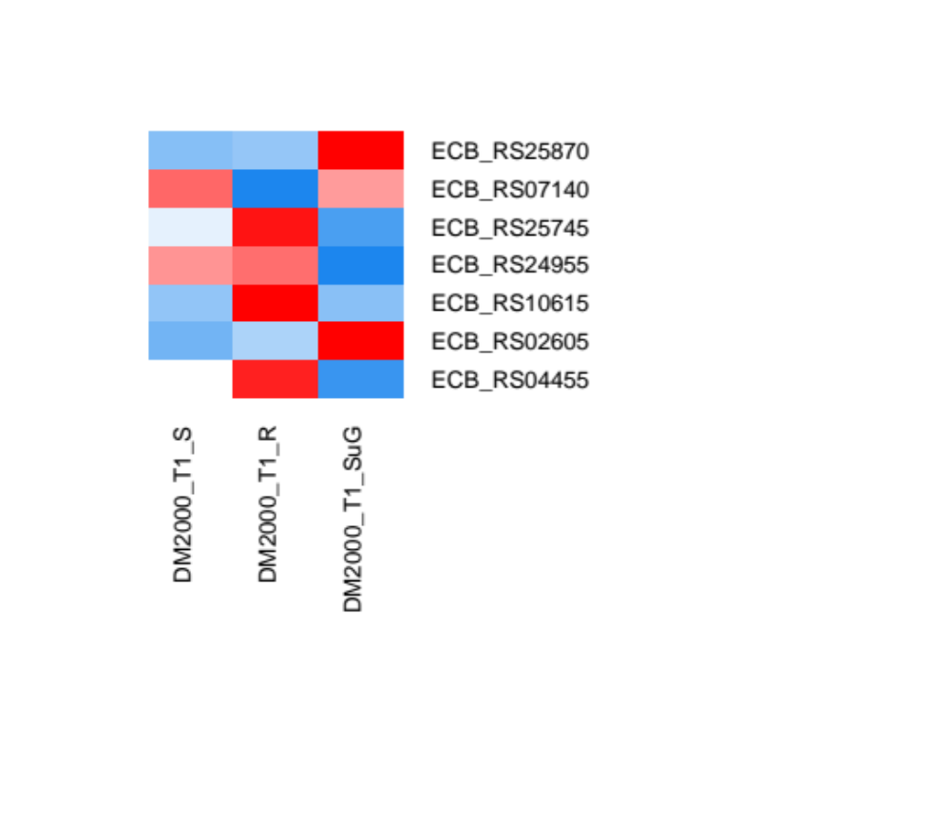
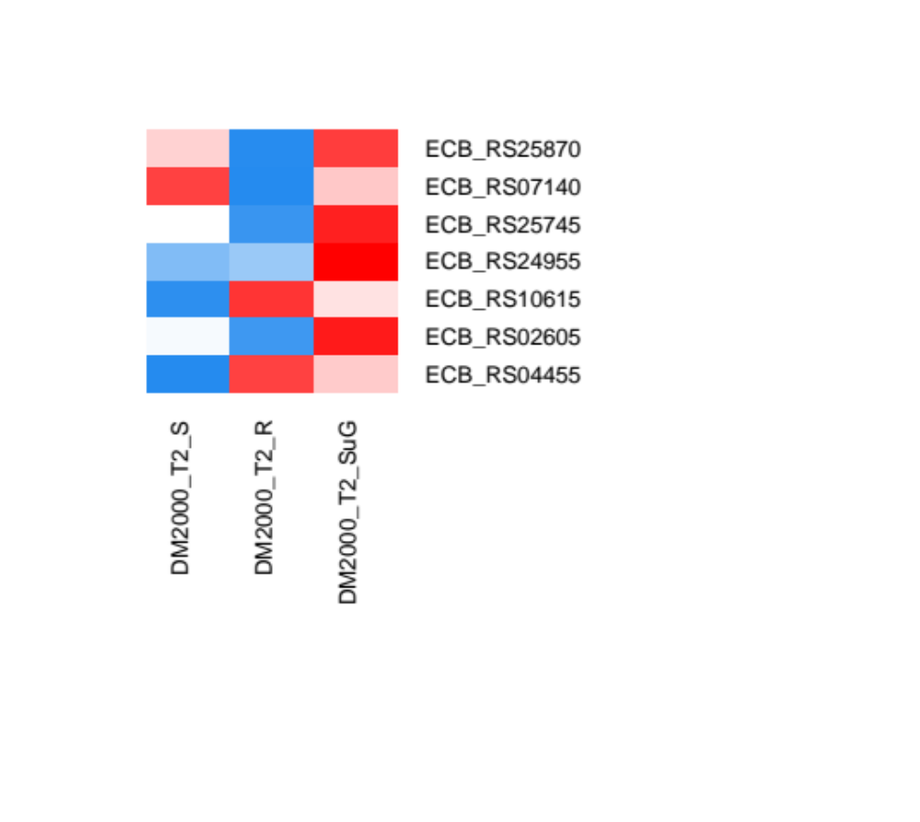
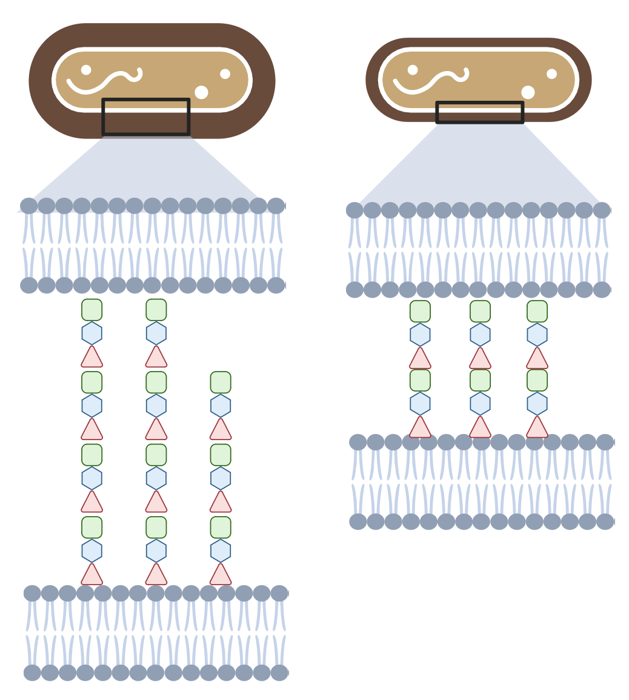
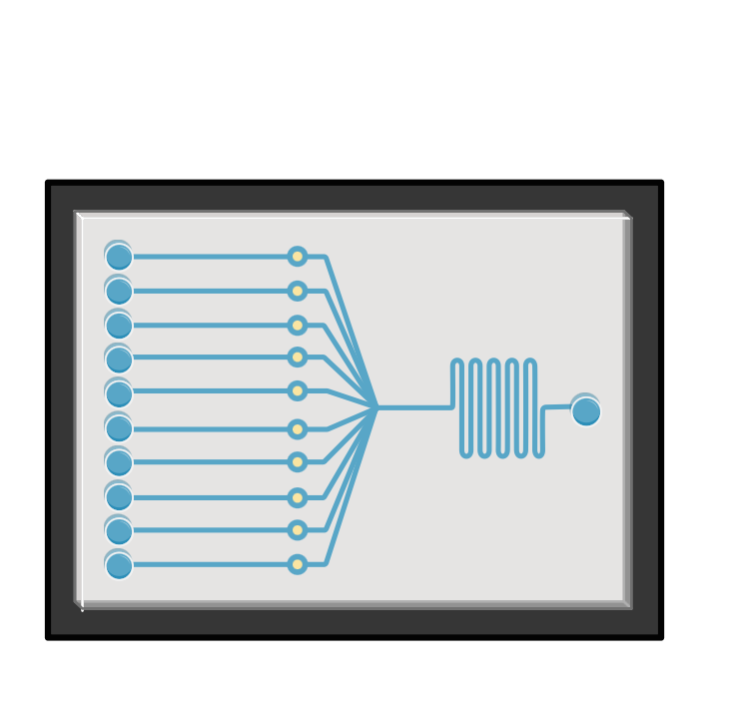





Life finds a way, the dynamics of E. coli evolution in microgravity
Brittney Lozzi^{1,2}, Lea Adepoju^{1,3}, Josh L. Espinoza⁴, Michael Padgen⁵, Macarena Parra⁵, Antonio Ricco⁵, Sarah Castro-Wallace⁶, Jeffrey E. Barrick⁷ and Aubrie O’Rourke⁸
¹NASA Kennedy Space Center Office of STEM Engagement (OSTEM) Intern Program, Kennedy Space Center, FL. ²Program in Genetics and Genomics, Baylor College of Medicine, Houston, TX. ³Earth and Atmospheric Sciences, Georgia Institute of Technology, Atlanta, GA. ⁴Department of Environment and Sustainability, J. Craig Venter Institute, La Jolla, CA. ⁵NASA Ames Research Center, Moffett Field, CA. ⁶Biomedical Research and Environmental Sciences Division, NASA Johnson Space Center, Houston, TX. ⁷Department of Molecular Biosciences, Center for Systems and Synthetic Biology, The University of Texas at Austin, Austin, TX. ⁸NASA Exploration Research and Technology, Kennedy Space Center, FL.
ABSTRACT
APPROACH
RESULTS
Investigating the evolutionary dynamics of Escherichia coli in microgravity offers a unique opportunity to understand microbial adaptation to extreme environments. Here, we explored the effects of simulated microgravity (SµG) on gene expression and genome evolution of Escherichia coli REL606, a strain continuously evolved and documented terrestrially for 35 years. We used transcriptomic profiling over a 24-hour growth cycle to examine how short-term exposure to SµG under glucose-limiting and glucose-replete conditions may influence the genetic adaptations in microbial populations. Pathway analyses of differentially expressed genes suggest that SµG may alter cell membrane structure and function across all conditions, while changes to protein synthesis machinery were uniquely observed in glucose-replete samples. Furthermore, altered expression of several prophage genes across conditions in SµG samples and upregulation of general stress response factors hints at the potential for stress-induced mutagenesis in response to microgravity. We further investigated the impact of long-term exposure to SµG on genome evolution and observed a more rapid accumulation of base substitutions and deletions in SµG sample genomes across time. Specifically, mutations in the mraZ and elyC genes suggest a mechanism for increased production of peptidoglycan in the cell membrane. These findings offer insights into bacterial adaptations in long-term microgravity environments and pave the way for further detailed investigations.
A
B
A
DM25 T2
SµG vs R Gene
Ontology Terms
B
DM25 T2 SµG MOA Predictions
DM2000
DM25 T1
Treatment profile
Low glucose
DM2000 T1
Cell wall structure & function
1.00
Rotating
Static
Simulated microgravity
DM25
Response to stress & stimuli
0.655
0.345
Biosynthesis & enzymatic rxns
0.479
0.521
0.493
0.507
DM2000 T2
Membrane transport & structure
0.630
0.370
DNA synthesis
Cell wall
0.480
0.520
High glucose
Growth analysis
DNA binding & transcription
Cell-membrane
Fatty acid
synthesis
Protein synthesis
RNA polymerase
Growth and media conditions
Translation
C
DM2000 T2 SµG MOA Predictions
C
D
Metal ion binding
Treatment profile
E. coli REL 606 Reference
Protein binding
0.248
1.00
S wk1
0.752
R wk1
0.363
0.637
0.249
0.751
Seq
SµG wk1
(A) Circos plot visualizing Gene Ontology (GO) analysis of respective DEGs from SµG vs R comparison at T1 and T2 in DM25 and DM2000. (B-C) Decision graphs for SuG vs R transcriptomic comparisons from a CoHEC model calibrated to predict the mode of action (MOA) of genome alterations in response to various antibiotic compounds in E. coli. Using DEGs from (B) low-glucose and (C) high-glucose comparisons.
S wk4
DNA synthesis
Cell wall
T0
T1
T2
R wk4
0.663
0.337
0.586
0.432
SµG wk4
Cell-membrane
Fatty acid
synthesis
Protein synthesis
RNA polymerase
BACKGROUND
Transcriptomic analysis
Long-term evolution analysis
Short-term simulated microgravity alters cell membrane and protein synthesis transcriptional programs
1
Schematic of growth, transcriptomics, and genomic integrity effects of simulated microgravity. (A) E. coli REL 606 strains grown in HARVs on RWV for the simulated microgravity (SµG) and rotating (R) control as well as stationary (S) control. Each growth condition assayed in low glucose (DM25) and high glucose (DM2000) media in biological quadruplicate for each condition. (B) Growth analysis of SµG, R, and S in both media types (C) Samples collected at time of inoculation (T0), start of log growth phase (T1), and stationary phase (T2) in each condition. RNA was isolated for sequencing and analyzed for differential gene expression. (D) Samples were passaged each day for 28 days and subjected to whole genome sequencing to assay genomic alterations of each growth condition.
Elevated CO₂
Biofilm formation
A
C
Long-term Evolution Gene Ontology Analysis
Temperature
Space Vacuum
Rotating
100$\text{μ}$l
100$\text{μ}$l
R-BR A1
Lynch, Appl. Environ. Microbiol. (2006)
RESULTS
R-BR A2
Static
S-BR A1
2
Antibiotic resistance
A
B
Simulated microgravity
S-BR A2
S$\text{μ}\text{G}$-BR A1
Radiation
Microgravity
24hrs
S$\text{μ}\text{G}$-BR A2
Different
x28 days
4
RNA and protein expression differences
150
Long-term SμG exposure
Independent clone isolation
Whole Genome Sequencing
Tixador, Prelim. Results of Cytos 2 Exp., (1984)
100
B
WGS Mutation Calling
4.6 Mb
0
3
Cell wall thickening
Similar
Wk 2
No. of GO Terms
(A) Growth curves collected from simulated microgravity samples across 24-hour period in both DM25 minimal media (gray line) and DM2000 rich media (black line). (B) Heatmap of global gene expression. Dominant variables driving sample grouping are timepoint and nutrient availability
Static
Wk 3
Rotating
Zea, Front. Microbiol. (2017)
Simulated microgravity
Arunasri, PLoS ONE. (2013)
Zea, PLoS ONE. (2016)
Tirumalai, mBio. (2019)
Earth control
Microgravity
Wk 4
Insertion
(A) Schematic of long-term evolution experiment in simulated microgravity, rotating control and static conditions. (B) Breseq visualization of mutations found using whole genome sequencing for rotating control, static, and simulated microgravity samples. (C) Dot plot visualizing Gene Ontology terms associated with genes harboring mutations.
Nutrient availability drives divergent transcriptomic profiles in simulated microgravity
Deletion
Bacteria physiology and genetic programs are altered by stress induced from microgravity
cueO
corC
elyC
curA
flhA
fryC
SNP
A
mraZ – fruR
yobD – mntP
bsmA
DM25 T1 SuG vs R
DM25 T2 SuG vs R
DM2000 T1 SuG vs R
DM2000 T2 SuG vs R
ECB RS23820
HYPOTHESIS
log2FoldChange
Long-term exposure to simulated microgravity induces genomic alterations affecting the cell membrane
𝜎^{S} target
𝜎^{S} target
𝜎^{S} target
𝜎^{S} target
Short-term Simulated Microgravity Exposure
Long-term Simulated Microgravity Exposure
Log2(Normalized Expression)
Log2(Normalized Expression)
Log2(Normalized Expression)
Log2(Normalized Expression)
CONCLUSIONS & FUTURE DIRECTIONS
B
T1
DM25
T2
ECB RS25870
High
I
T1
DM2000
T2
ECB RS25870
ECB RS07140
ECB RS07140
Simulated Microgravity Triggers Adaptation to Membrane Stress in E. coli REL606
ECB RS25745
ECB RS25745
ECB RS24955
Expression
ECB RS24955
ECB RS10615
ECB RS10615
Gene Expression Changes
DNA mutations
ECB RS02605
ECB RS02605
S
R
SµG
S
R
SµG
ECB RS04455
Low
S
R
SµG
S
R
SµG
ECB RS04455
Inner Membrane
Ground study of POLARIS/SAMMS CubeSat with culture chamber and sequencer
Transcriptome changes during short-term microgravity exposure influences genomic alterations after long-term exposure
(A) MA plots with upregulated (red) and downregulated (blue) condition specific DEGs from each comparison. General stress response genes targeted by σ^{S} shown in purple. Dot size equivalent to log2FoldChange. DEGs with log2FoldChnage > ±1.5 and p<0.05 and blanked to T0. (B) Normalized expression of significant differentially expressed prophage genes across media types and timepoints.
General stress response genes and prophage elements are upregulated in simulated microgravity
Outer Membrane
Enterobacterial common antigen
FUNDING: Mars Campaign Office (MCO) Early Career funding to Dr. O’Rourke

