Slide 1

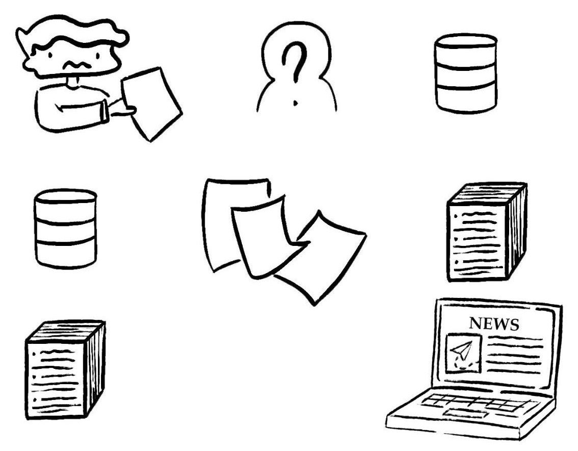
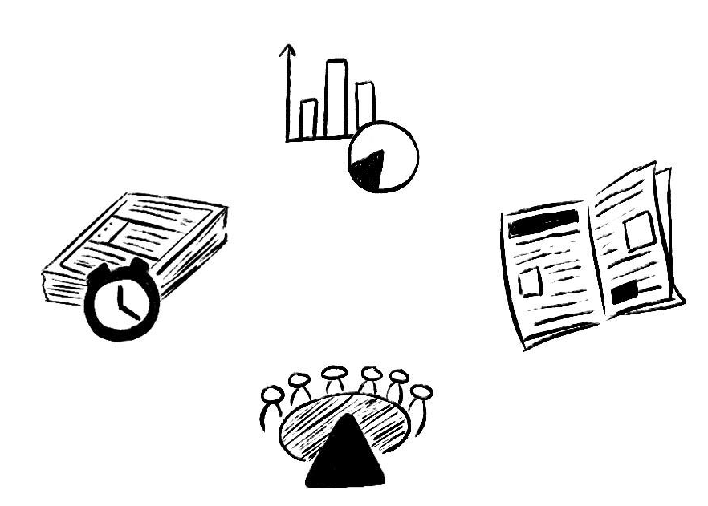
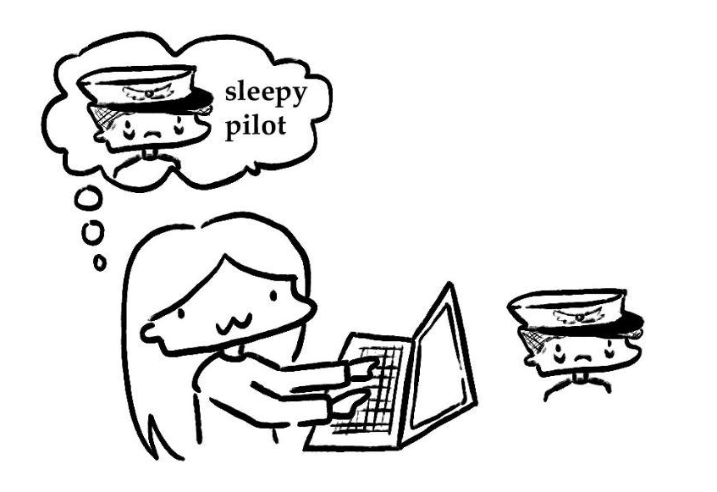
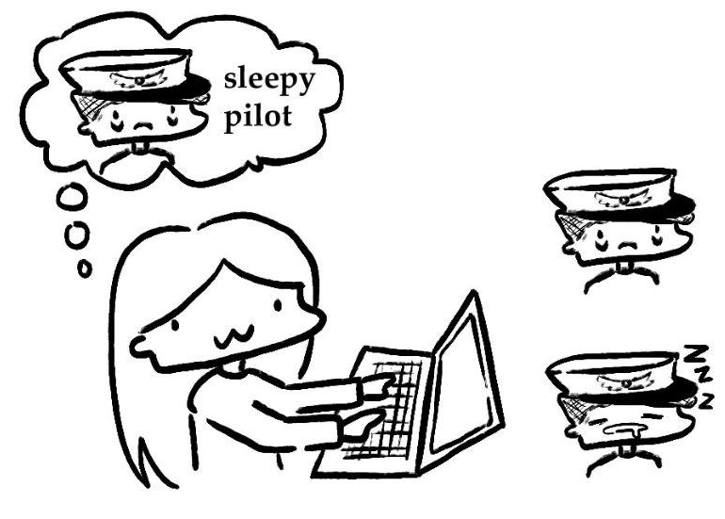

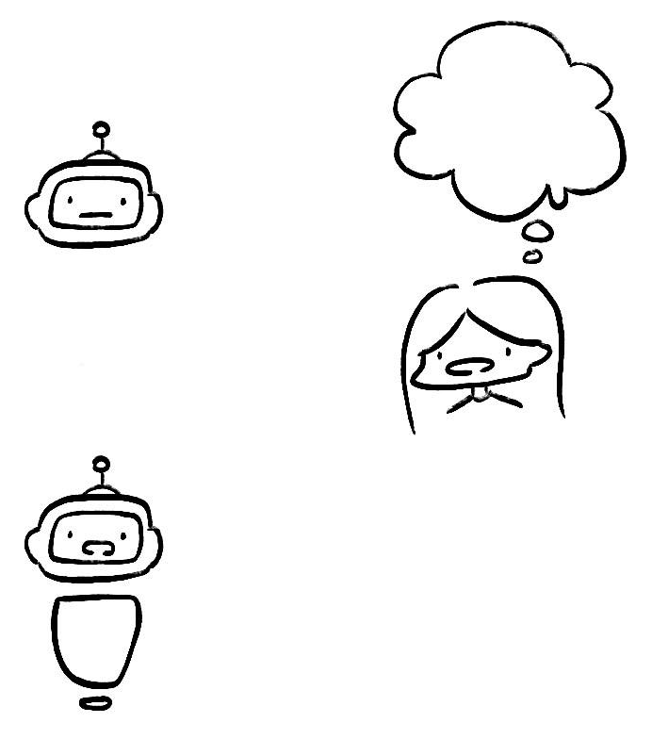
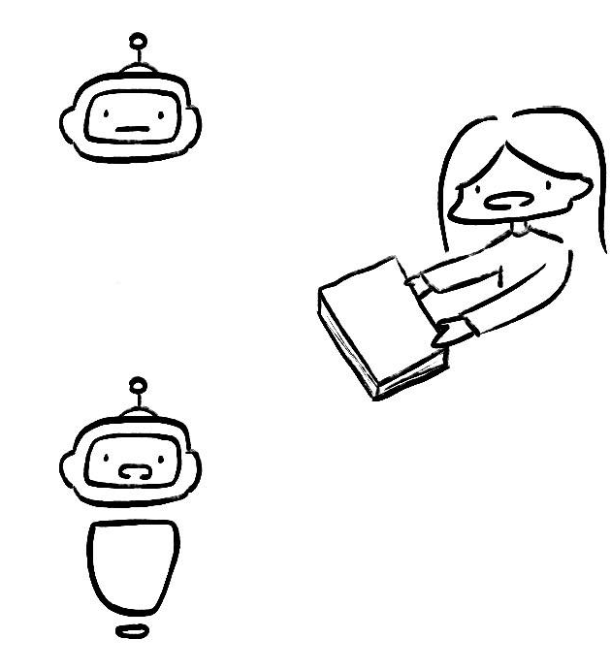
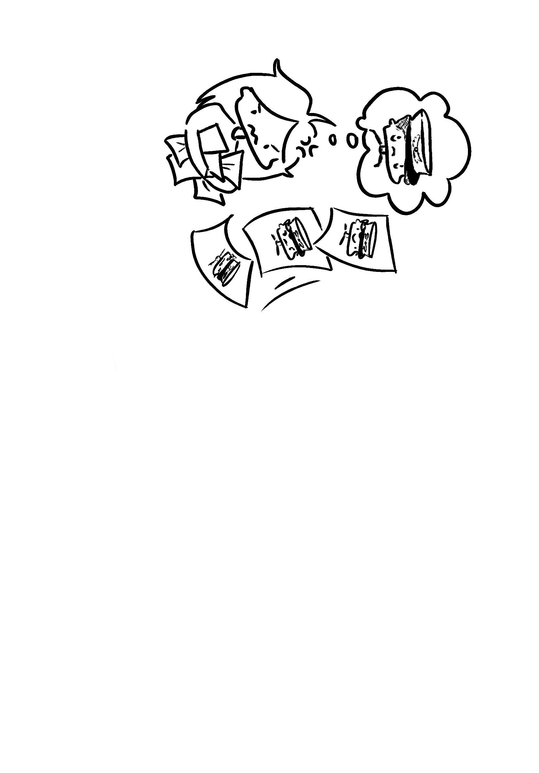




Kaona: Deep Searching and Curating Aviation Safety Reporting Systems
Christopher Hong
Oregon State University
Hailey Pham
University of California, Berkeley
Carlos Paradis, Bryan Matthews
KBR @ NASA Ames Research Center
Misty Davies, Becky Hooey
NASA Ames Research Center
What is NASA’s Aviation Safety Reporting System?
Keyword and Semantic Searching
In our scope, the ASRS is a three-part system in which aviation incidents are reported, de-identified, and stored into a database, later searched for data products.
focused studies
Kaona offers both keyword search (mimicking ASRS) and semantic search to increase discovery of incident reports.
1.
?
drowsy pilot
Keyword Search:
Semantic Search:
alert messages
search results (1)
drowsy pilot
search results (2)
2.
drowsy pilot
quick responses
newsletters
drowsy pilot
CALLBACK
!
sleeping pilot
3.
In addition to the Callback newsletter, ASRS offers a multitude of data products.
Narrative Curation and Search Tasks
Chatting about (curated) narratives
drowsy pilot
search #1
search task
Accumulate multiple searches within a search task
search #2
search #1
search #3
search #2
…
search #4
…
based on these ACN, can you tell me…
⋆
awake!
Can you tell me why pilots get drowsy?
starred docs
angry
based on these ACN …
pilots get drowsy because
based on the reports you gave me …
⋆
ACN: 123
bored
ACN: 123
ACN: 456
search queries
search #1
Data products require multiple searches.
Explicit Curation: Users can ‘star’ relevant narratives and ‘hide’ non relevant narratives within a search task.
Implicit Curation: Non-read searches can be used as signal results are not useful.
In the next search of the same task, curated narratives are marked to avoid redundant work. They are also used to inform deep searches of what is useful or not.
Any search method combination (keyword or semantic) vs metadata can be used to converse with a chatbot.
Alternatively, any search task’s curated narratives can also be used to start a discussion with a chatbot (e.g. to assist with writing a newsletter!).

