Slide 1


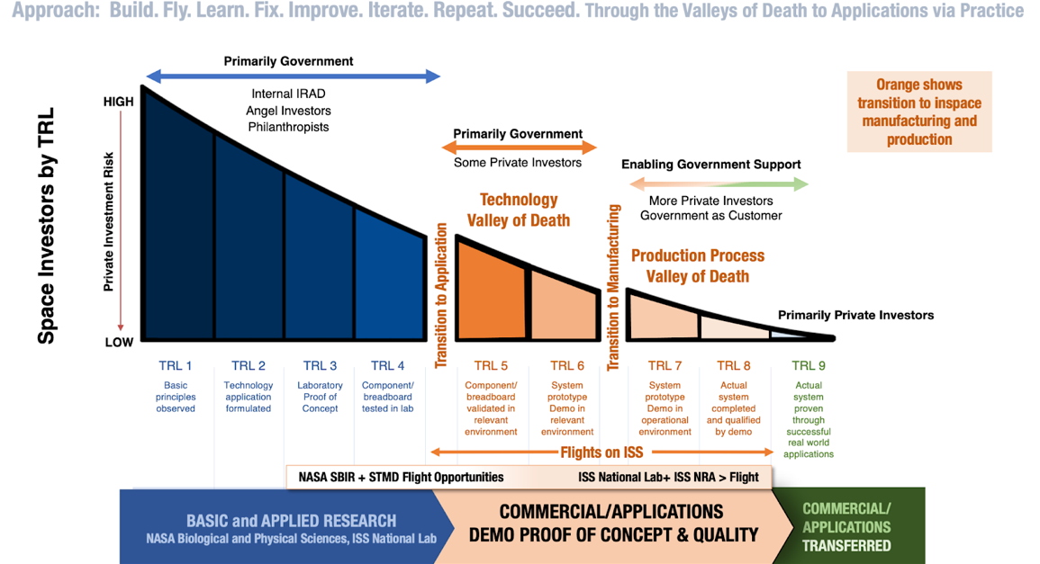
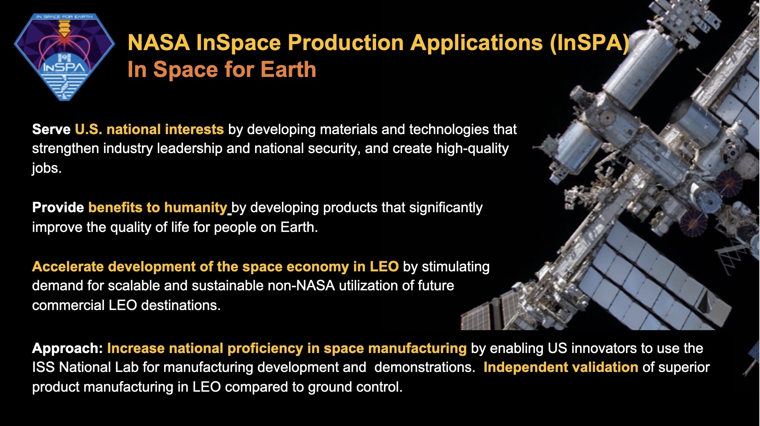
Extraordinary Accomplishments of the
In Space Production Applications Portfolio in 2024
Jon Rask¹, Lynn Harper¹, John Love², Rose Hernandez³, Derek Duflo³,
Davide Marotta³, Kevin Engelbert²
¹Office of the Center Director, Strategic Partnerships Division, NASA Ames Research Center, Moffett Field, CA 94035, jon.c.rask@nasa.gov
²Research Integration Office, ISS Program, NASA Johnson Space Center, Houston, TX 77058
³International Space Station National Laboratory, Melbourne, FL, 32940
Introduction
Microgravity Materials Manufacturing
Microgravity Biomanufacturing
The NASA In-Space Production Applications (InSPA) portfolio, in collaboration with the International Space Station (ISS) National Lab, provides funding and expertise to help brilliant United States innovators and businesses traverse the technology “Valley of Death” (Figure 1) by proving out their concepts for superior in-space manufactured products, biomaterials, and services that will ultimately benefit life on Earth. Scientific and technological advances on the ISS and on Earth coupled with evolving societal needs are collectively enabling InSPA-funded teams to produce data streams and advanced biological, chemical, and physical materials solutions with great economic and humanitarian value. We report on an extraordinary year of accomplishments on the ISS and highlight top InSPA and ISS National Lab results that span historic firsts in cancer research, stem cells, crystal production, optical fiber production, drug discovery, in-space treatments with RNA therapeutics, and production of artificial retinas from space. We assert that the results have enormous potential, are transforming the space exploration ecosystem, and are the “seeds” of a microgravity industrial revolution that are shaping national microgravity strategies.
March 2024. Historic First: Commercial Manufacturing Scale-up in Space Exceeds Reported Terrestrial Commercial Manufacturing Quantities of ZBLAN Fiber. Flawless Photonics (USA CA/MI; Luxembourg/Australia) reports and provides evidence that they have mastered in-space ZBLAN fiber manufacturing by exceeding the longest reported lengths produced on Earth. Flawless Photonics repeatedly demonstrated its ability to manufacture exotic glass fiber on a commercial scale, and produced 11.2 km of ZBLAN fiber over sixteen separate draws in 16 days on the ISS in the Microgravity Sciences Glovebox (MSG). The longest single length was 1141 meters and they achieved over 1 km in their fiber draws three times. Nine out of sixteen manufacturing runs exceeded 700 meters each. This opens the door to wealth generation and manufacturing operations in LEO not only with ZBLAN as the trailblazer glass, but also many other lucrative compositions of exotic glass for high tech applications whose production, quality, and quantity are constrained by gravity. [2]
June 2024. Exceptional Quality Improvement Confirmed for Space Pharmaceutical Class Crystals. Redwire reports and provides evidence that they have mastered the microgravity manufacturing process by delivering world-class crystals from space on their test flights of PILBOX hardware on ISS. They provide strong evidence that space manufactured pharmaceutical crystals can have a number of superior properties over terrestrial crystals such that the quality of certain types of therapeutics can be improved on Earth through microgravity-generated knowledge products. Results were observationally confirmed by Eli Lilly and are consistent with prior reports of microgravity on therapeutic crystals, especially Merck’s cancer drug Keytruda. 80% of 500+ crystals of all types grown in space improve in important features over terrestrial crystals. [3] [4]
Spring 2024. Historic First: LambdaVision and Space Tango have successfully demonstrated and validated microgravity-assisted artificial retina manufacturing methods in space. 200 layer retinas manufactured in space is confirmed. [5] [6]
August 2024. Historic First: 5 to 10X Quality Improvement in Space Manufactured ZBLAN. Apsidal/Axiom (CA/TX) and Flawless Photonics/Visioneering (CA/Luxembourg/Aus/MI) report and provide evidence from prior ISS flights that in-space processing of ZBLAN glass alloys can yield fibers that have 5-10X better transmission properties than ground-manufactured fibers from comparable preforms with the same hardware and processes. Flawless Photonics’ initial results reveal that their Flawless SpaceFiber was about 2x stronger. Apsidal also reports better structure from their space glass. Both confirm significantly suppressed crystallization. Flawless Photonics also reports excellent diameter uniformity. Independent third-party validation is underway with the Navy Research Lab for Flawless Photonics and five other independent labs in the US, Australia, and Europe. Flawless Photonics Preform Manufacturing in Space is in development and may launch in 2026. [7]
February 2024. Compelling Evidence of Accelerated Cancer Cell Growth in Space Could Speed Up Therapeutic Development for Personalized Medicine. Collaborations across teams at University of California San Diego Sanford Stem Cell Institute, Aspera Biomedicines, Axiom Space, Bioserve, and Space Tango found that cancer stem cells grew much faster in low Earth orbit than on Earth, triggered by the activation of the gene that supports tumor growth, survival, and resistance to treatment. [8]
March 2024. Historic First: In-Space Treatment of Space-Induced Neuropathology. Sachi Bioworks (CO) and Space Tango (KY) demonstrated that space-induced neuropathology offers an opportunity for accelerated screening of RNA therapeutics for treating neurodegenerative diseases. Sachi Bioworks’ spaceflight results show that their Nanoligomer technology significantly mitigates the Alzheimer’s Disease (AD), Frontotemporal Dementia (FTD), and Amyotrophic Lateral Sclerosis (ALS) relevant biomarkers in Healthy and Diseased Human Motor (neuromuscular) and Pre-frontal Cortex (cognition) brain organoids. [9]
August 2024. Historic First: Adult Human Fibroblasts Reprogrammed to Induced Pluripotent Stem Cells (iPSCs) in Space. Scientists at Cedars-Sinai (CA)/Axiom (TX) and Bioserve (CO) have made a groundbreaking achievement by successfully reprogramming adult human skin cells into embryonic-type cells called induced pluripotent stem cells (iPSCs) for the first time in LEO. This pioneering experiment, conducted aboard the ISS, leverages the unique environment of microgravity to push the boundaries of stem cell research. The ability to create iPSCs in space holds vast potential for advancing regenerative medicine. This would allow a single patient’s skin cells to be used in space for multiple different organ analyses and different drug tests and iterations without requiring additional flights, thereby significantly accelerating and increasing the quantity and value of results. Evidence requires postflight analyses of samples which return to Earth in November 2024. [10]
August 2024. Historic First: In-Space Metastasis Detection. Encapsulate (CO) / Space Tango (KY) reports and provides evidence that they can distinguish metastatic tumors vs non-metastatic tumors from patients with colon cancer by examining cancer cells’ behavior in microgravity. They provided compelling evidence that gravity prevents subtle but essential features in metastatic cell responses from being seen on Earth, but that these are visible in microgravity. The goal of this project is to provide a device that can evaluate the risk of tumor metastasis for patients on an individualized basis, using the initial tumor biopsy. This In-Space diagnostic device could provide oncologists with a more accurate prediction of patients' fate to inform long-term treatment strategies. [11] [12]
Background and Considerations
The InSPA implementation strategy consists of a multi-phase award process to demonstrate proof-of-concept, advance to high production quality, and ultimately to achieve scalability on a commercial low Earth orbit (LEO) destination or platform (Figure 1). InSPA seeks to identify awardees who propose promising manufacturing efforts in microgravity that will invigorate markets on Earth. These InSPA awards help the selected companies raise the technological readiness level of their products and move them to market, propelling U.S. industry toward the development of a sustainable, scalable, and profitable non-NASA demand for services and products manufactured in the microgravity environment of LEO for use on Earth. [1]
For a commercial space manufacturing product to succeed, it not only must be better than anything we can do on Earth, but so much better that it makes sound business sense to manufacture it in space. All of the exceptional projects described in this poster require more flight samples to obtain the statistics necessary to move these advances into the marketplace. However, the microgravity results from these investigators have been reviewed by many independent experts such that we believe that the microgravity results are being accurately reported by the companies and inventors; their potential is sufficiently important and their techniques sufficiently mature to justify obtaining the rest of the data needed from space as soon as possible. To enable usable applications, each space product will need to be incorporated into devices and pass additional tests, clinical trials, and approvals by government agencies or consumers. The following projects are expected to be high priority candidates for flight on ISS and commercial LEO providers during the rest of the decade. They all successfully overcame in-space manufacturing’s high barriers to entry to deliver extraordinary results from in space manufacturing.
  Figure 1. Technology Readiness Levels (TRL) and their relation to the InSPA implementation approach.
References
[1] https://www.nasa.gov/missions/station/nasa-implementation-strategy/
[2] https://spacenews.com/flawless-photonics-kicking-glass/
[3] https://www.issnationallab.org/release-spxcrs29-redwire-pil-box/
[4] https://www.mdpi.com/2073-4352/14/7/652
[5]https://www.issnationallab.org/lambdavision-space-tango-5-million-award-from-nasa-additional-retinal-research/
[6] https://lambdavision.cmail20.com/t/t-e-sfejt-tyukjjjrlt-yh/
[7]https://www.issnationallab.org/release-ng20-flawless-photonics-fiber-optics/
[8] https://www.biorxiv.org/content/10.1101/2024.01.28.577076v1
[9] https://pubs.acs.org/doi/full/10.1021/acschemneuro.4c00160
[10] https://www.nature.com/articles/s41526-024-00435-y
[11]https://spacetango.com/latest/pressreleases/spacex-crs-30-launches-microtumor-investigation-over-580-biological-samples-and-student-research-to-the-iss/
[12] https://www.issnationallab.org/release-spxcrs30-encapsulate-cancer-research/
  This poster was created for the 2024 American Society for Gravitational and Space Research Conference. For more information see the 2024 ISS National Lab and InSPA Strategic Integration Report posted on the NASA Technical Report Server: https://ntrs.nasa.gov/search?q=20240013491
  Figure 2. Strategic goals of InSPA.
Notes:
1

