Slide 1

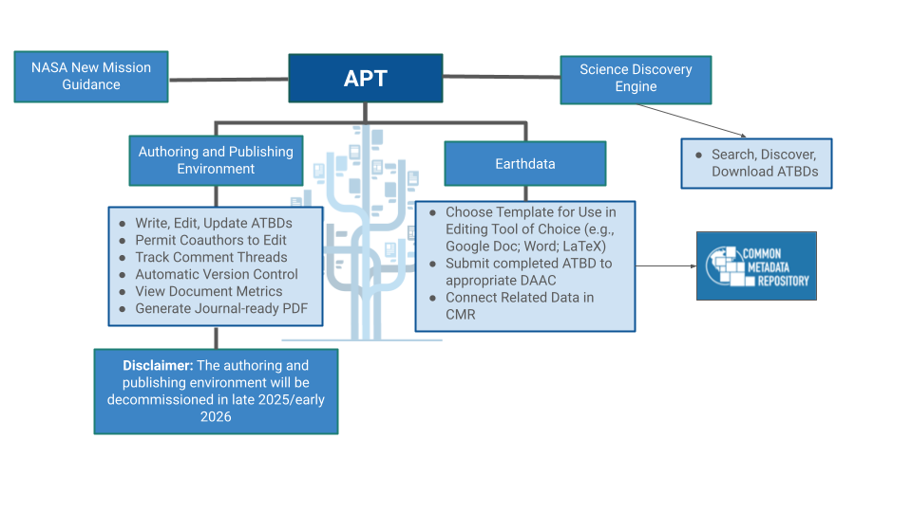

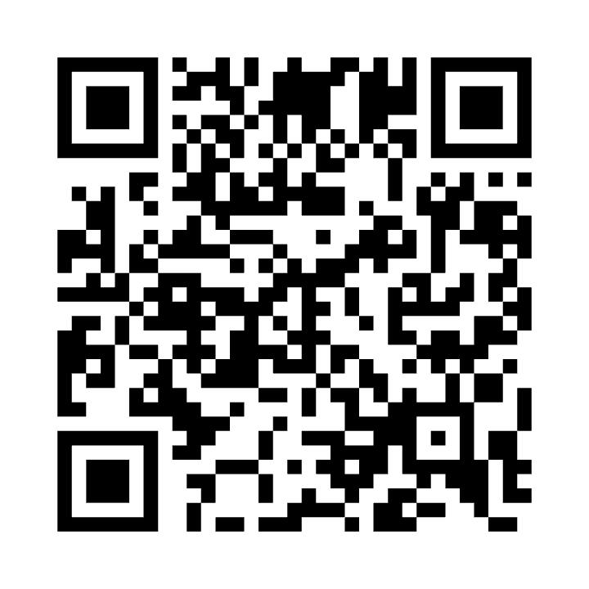

Enhancing accessibility and usability of algorithm theoretical basis documents through the Algorithm Publication Tool
Author: Bradley Baker
The University of Alabama in Huntsville
What is an ATBD and what are the historical problems with these documents?
The Algorithm Publication Tool
The future of APT
The APT authoring environment will be decommissioned in late 2025 or early 2026
The ATBD templates will be provided via Earthdata
From Earthdata, users will be able to download the templates and then submit the completed template to the appropriate NASA Distributed Active Archive Center (DAAC)
The completed ATBDs will be discoverable via the Science Discovery Engine (SDE)
Algorithm Theoretical Basis Document (ATBD)
A document describing the physical theory, mathematical procedures, and assumptions made in algorithms used to convert remotely sensed radiances to geophysical quantities
Required for every NASA Earth Observing System instrument data product
No use of a standard template
ATBDs were difficult to discover and update/maintain once written
What is APT and why is it important?
Apt enables open science by making it easier to write and find key scientific documents using:
a streamlined writing process
user-friendly tools
a direct method to access ATBDs, making them easier to find
APT is important because it
provides a centralized location for ATBDs
ensure the standardization of ATBD content
Use a provided template to
create an ATBD using familiar software/word processor (e.g., Google Docs, Microsoft Word, or LaTeX)
The APT workflow and components. Users have a choice of workflows: the authoring tool or a template in an editing environment of choice. The APT authoring environment consists of an ATBD metadata model, a database, and front-end tool with a dashboard. Both workflows result in a centralized PDF document repository for all users to find and access published ATBDs. Disclaimer: The APT authoring environment will be decommissioned in late 2025 or early 2026 and only the templates will be provided.
Scan here to get started
Acknowledgments
This work by Brad Baker is supported by NASA Grant 80MSFC22M004.
Special thanks to Will Rynearson and Ashley Riddle.
https://www.earthdata.nasa.gov/apt/
Contact: Bradley Baker
bradley.baker@uah.edu

