Slide 1

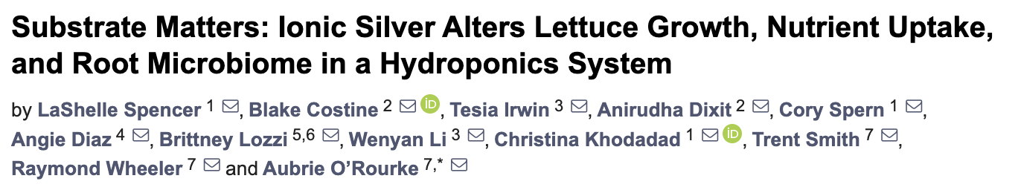
Ionic Silver affects Lettuce Growth, Nutrient Uptake, Microbiome and Metabolome in a Hydroponics System
Aubrie O’Rourke, PhD, NASA KSC

Slide 2
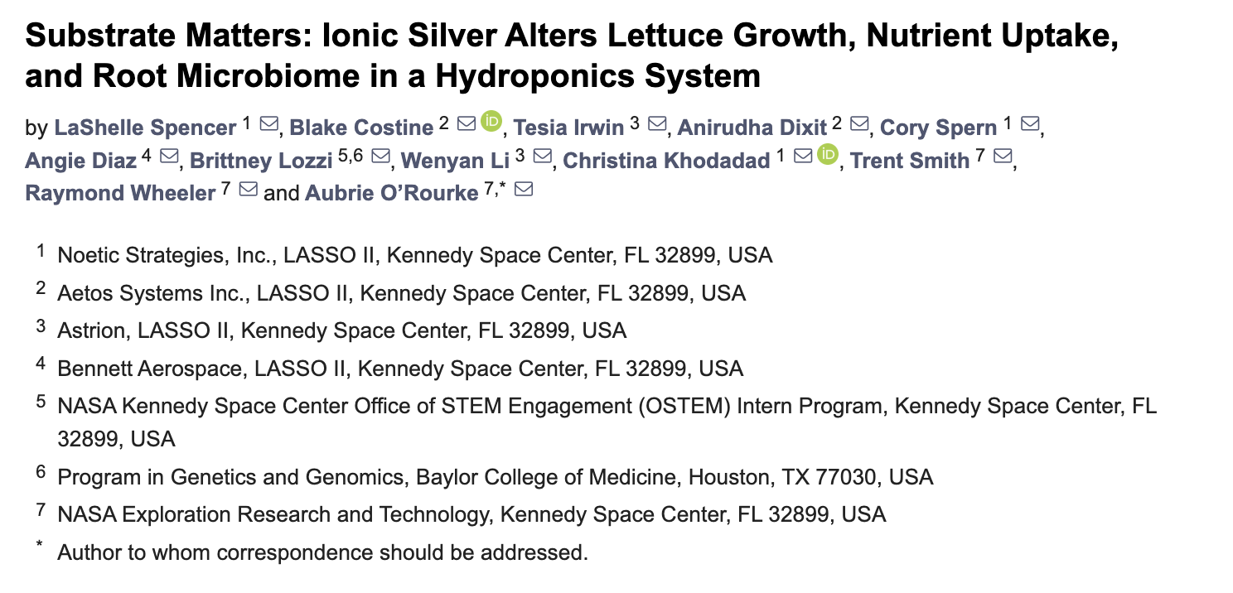

Slide 3
outline
Introduce current water processor assembly and biocides.
01
Introduce current methods for plant growth on ISS.
02
Illustrate how this study is an intersection of two ISS systems.
03
Summarize findings from this ground study.
In vivo – In silico- In vitro.
04

Slide 4
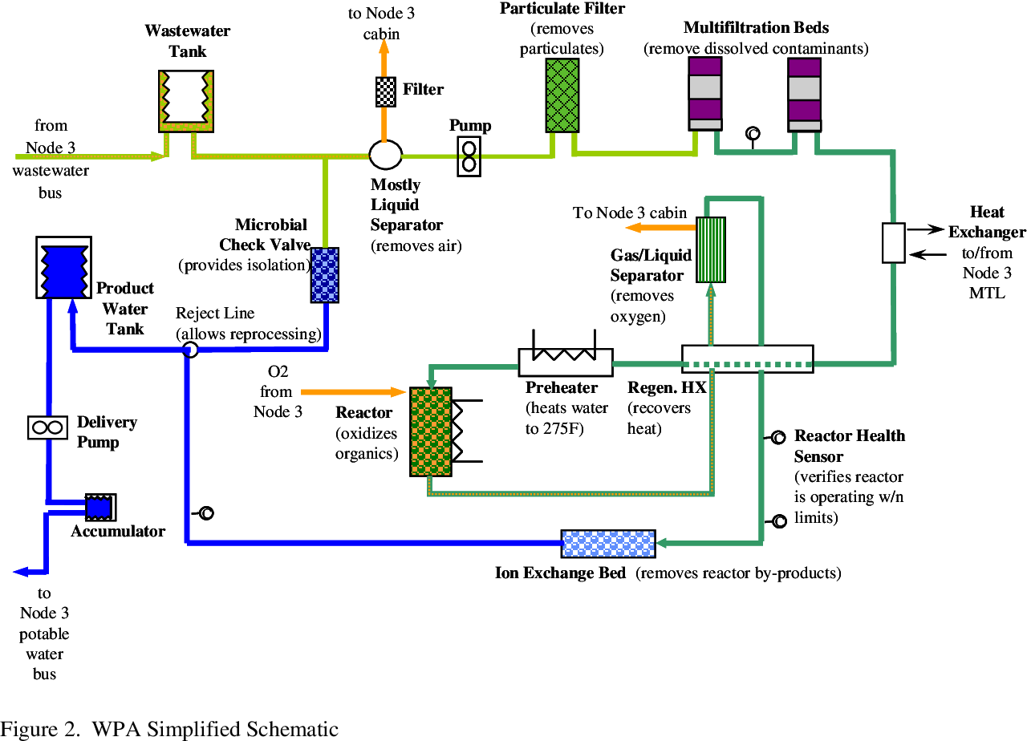
Water Processor Assembly (WPA) on ISS
Microbial Check Valve (MCV) currently employs triiodine in quaternary ammonium anion-exchange resin.
Assists to achieve the allowable microbial limit of 1CFU/100mL in product water.

Slide 5
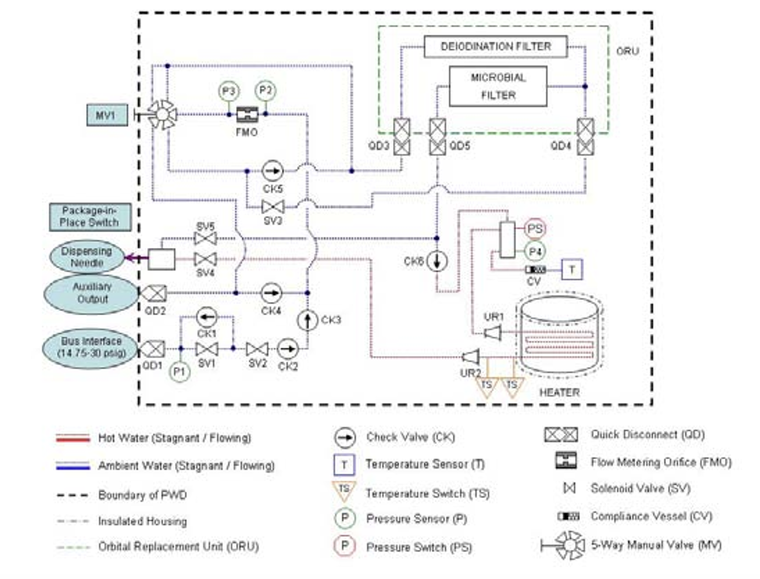
Potable Water Dispenser (PWD) on ISS
Iodine is removed to avoid susceptibility to hyperthyroidism.
Silver as an alternative does not need removal.

Slide 6
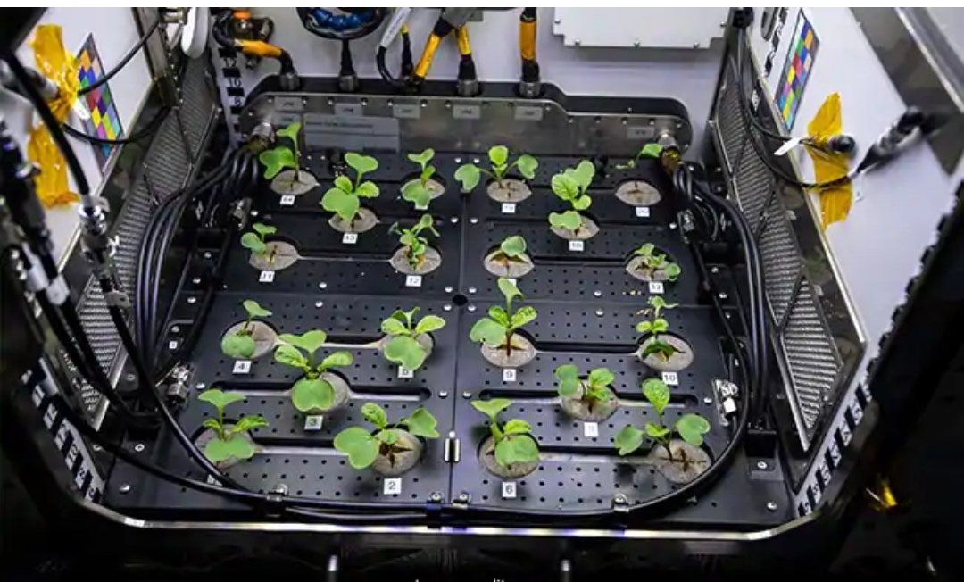

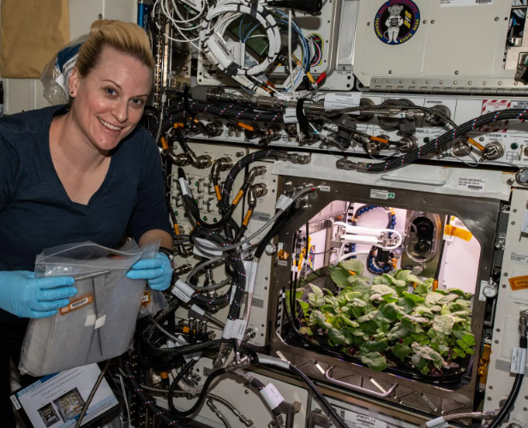
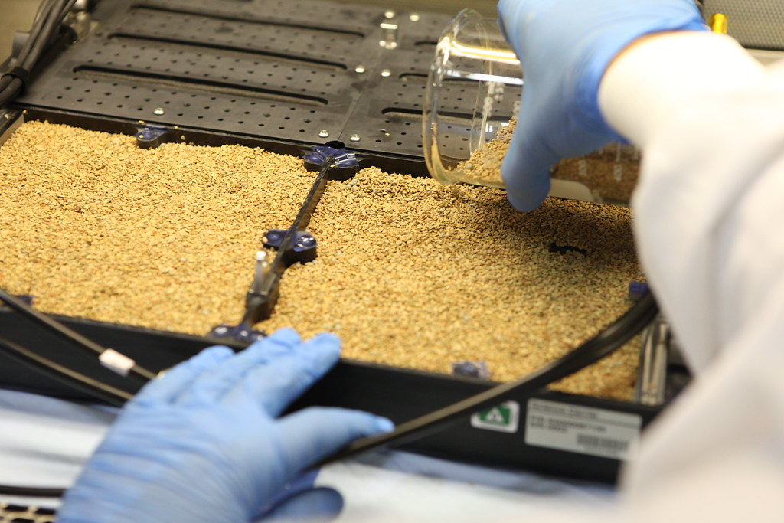
PWD/WPA tops off water reservoirs of the APH
Arcillite is used in the APH growth beds

Slide 7
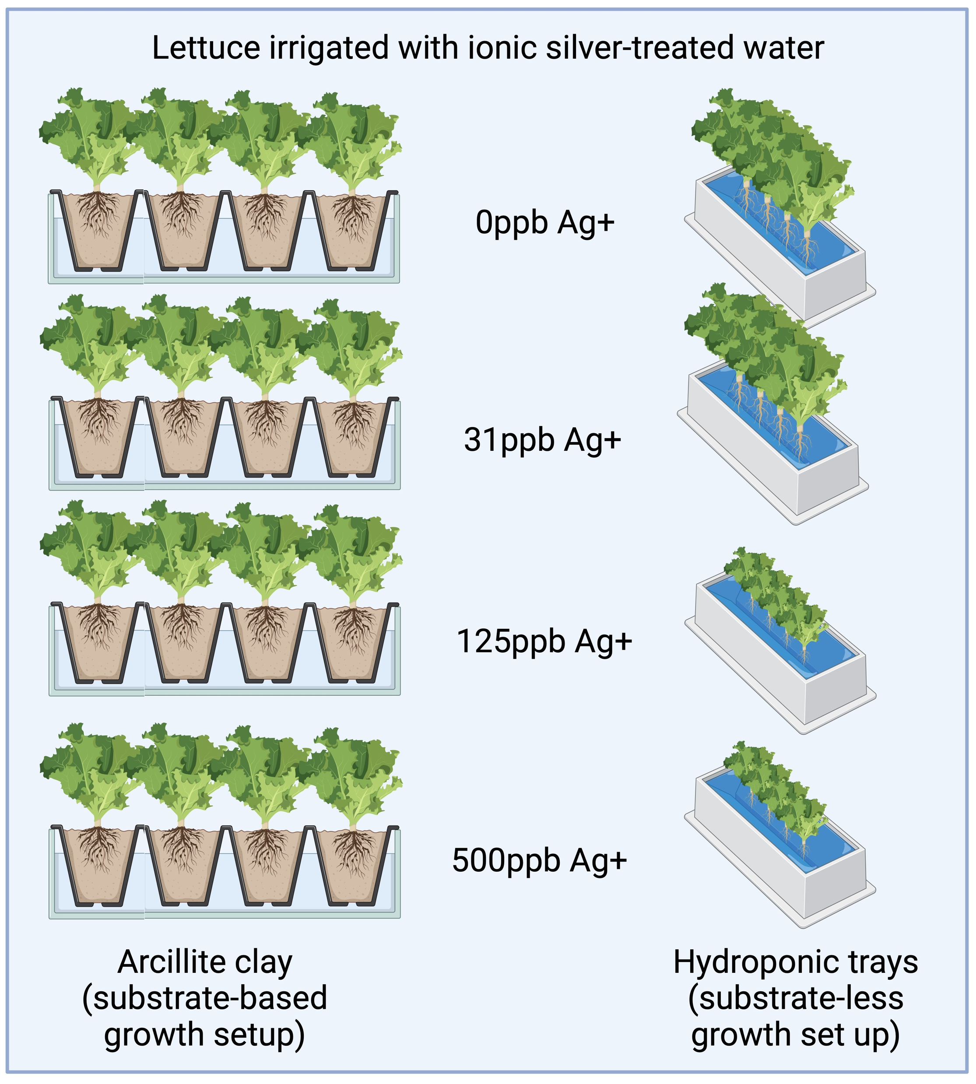
Experiment Overview

Slide 8

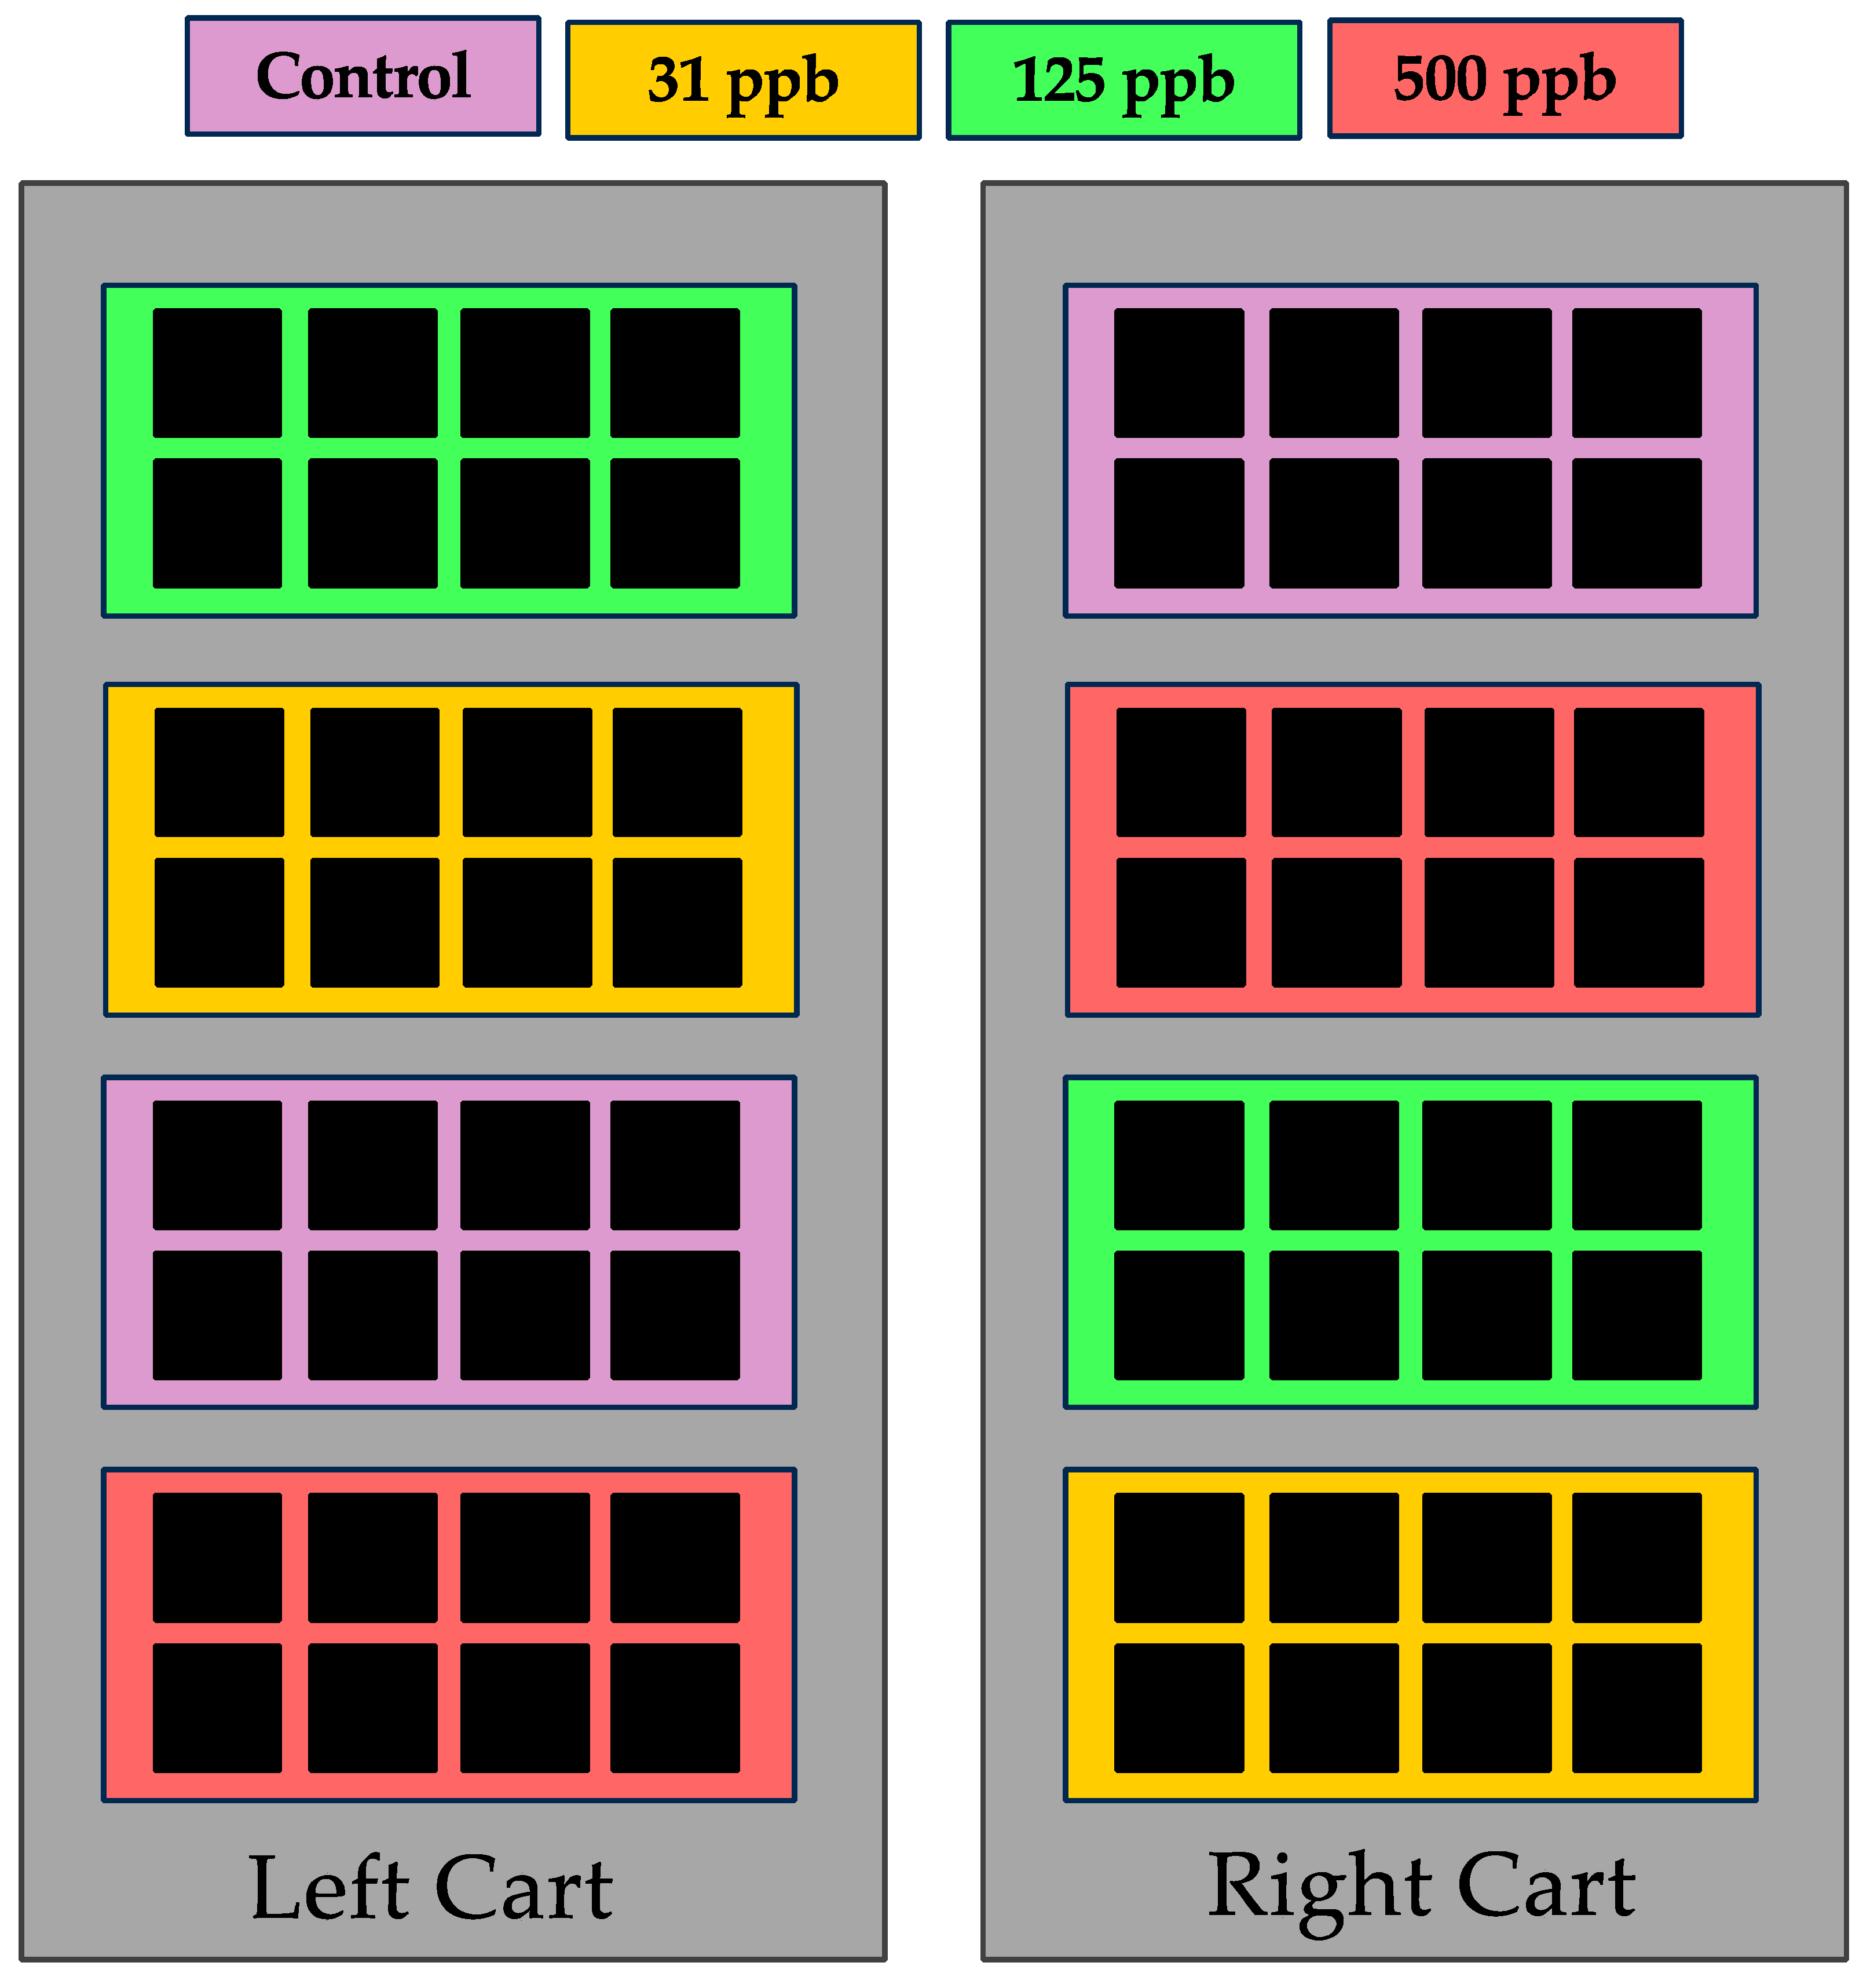
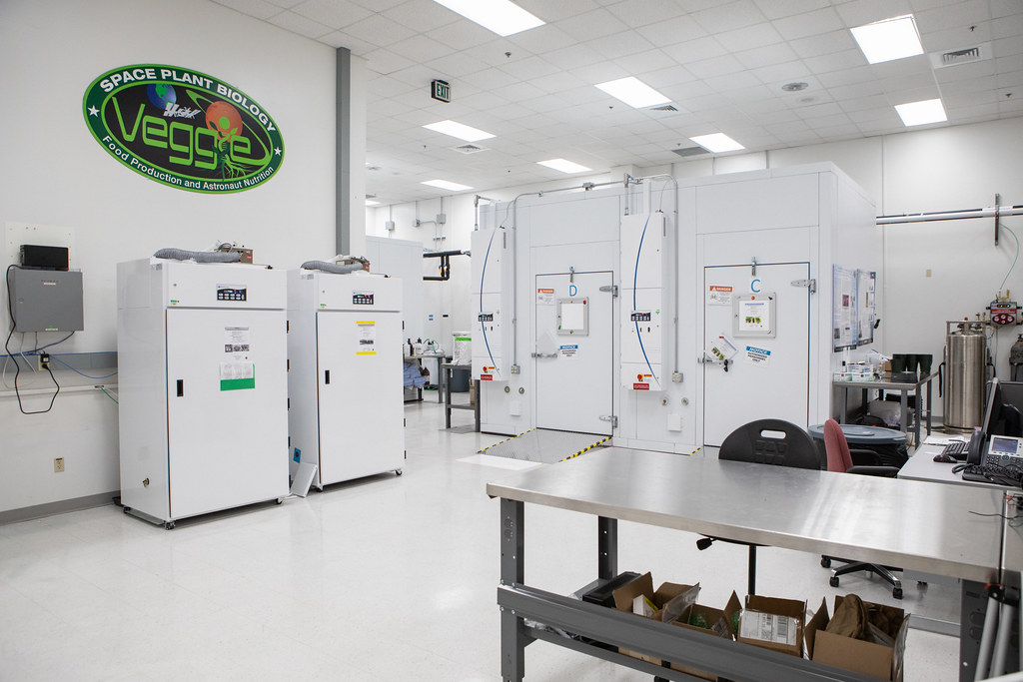
Experimental growth layout
Experiment Location:
KSC; Environmental Control Chamber
60% RH, 25°C, 3000ppm carbon dioxide

Slide 9
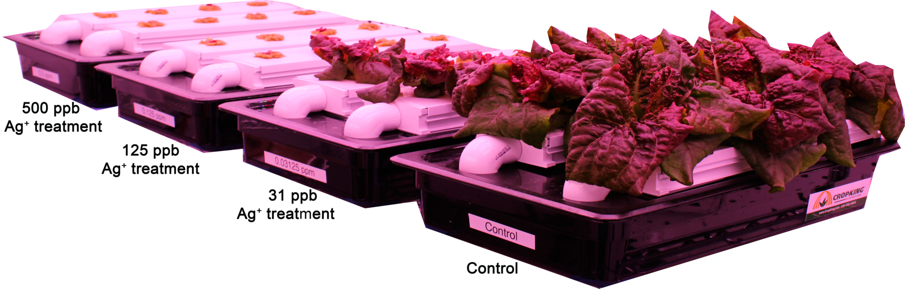
In Vivo- Results Overview
Substrate-based
(arcillite)
Growth metrics: not affected
Silver uptake: none
Root microbiome source: seed
Shoot microbiome source: root
Hydroponic
Growth metrics: affected
Silver uptake: significant
Root microbiome source: water
Shoot microbiome source: root

Slide 10


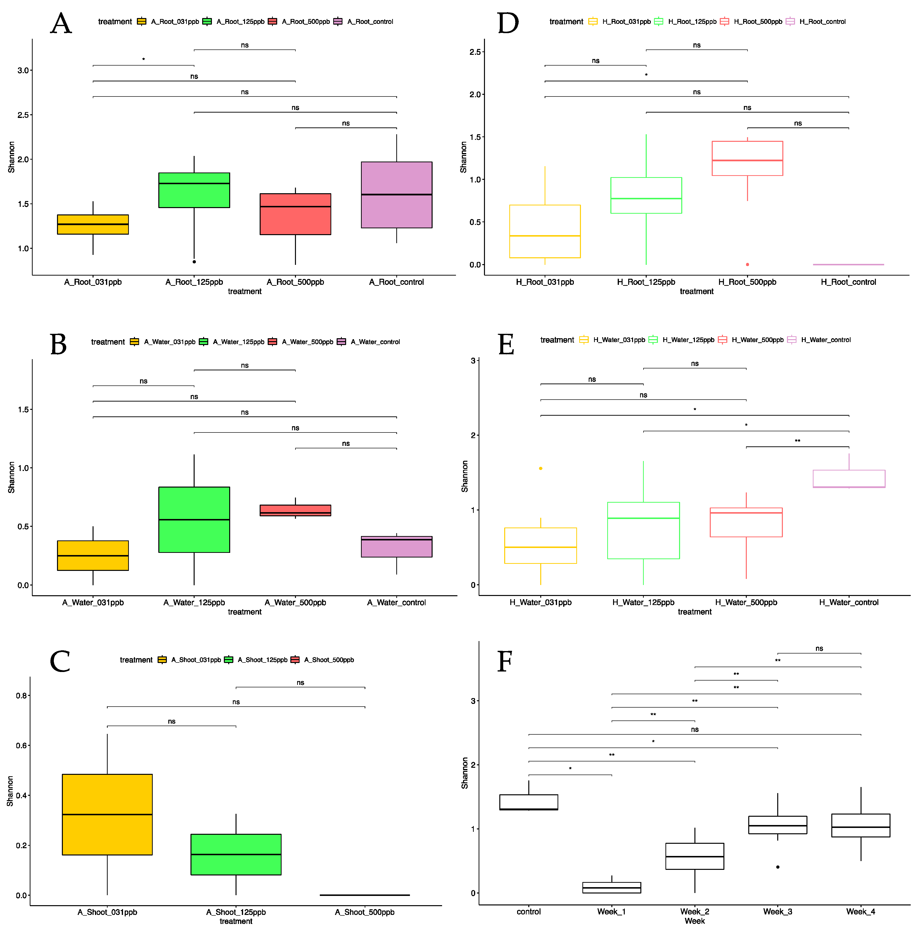


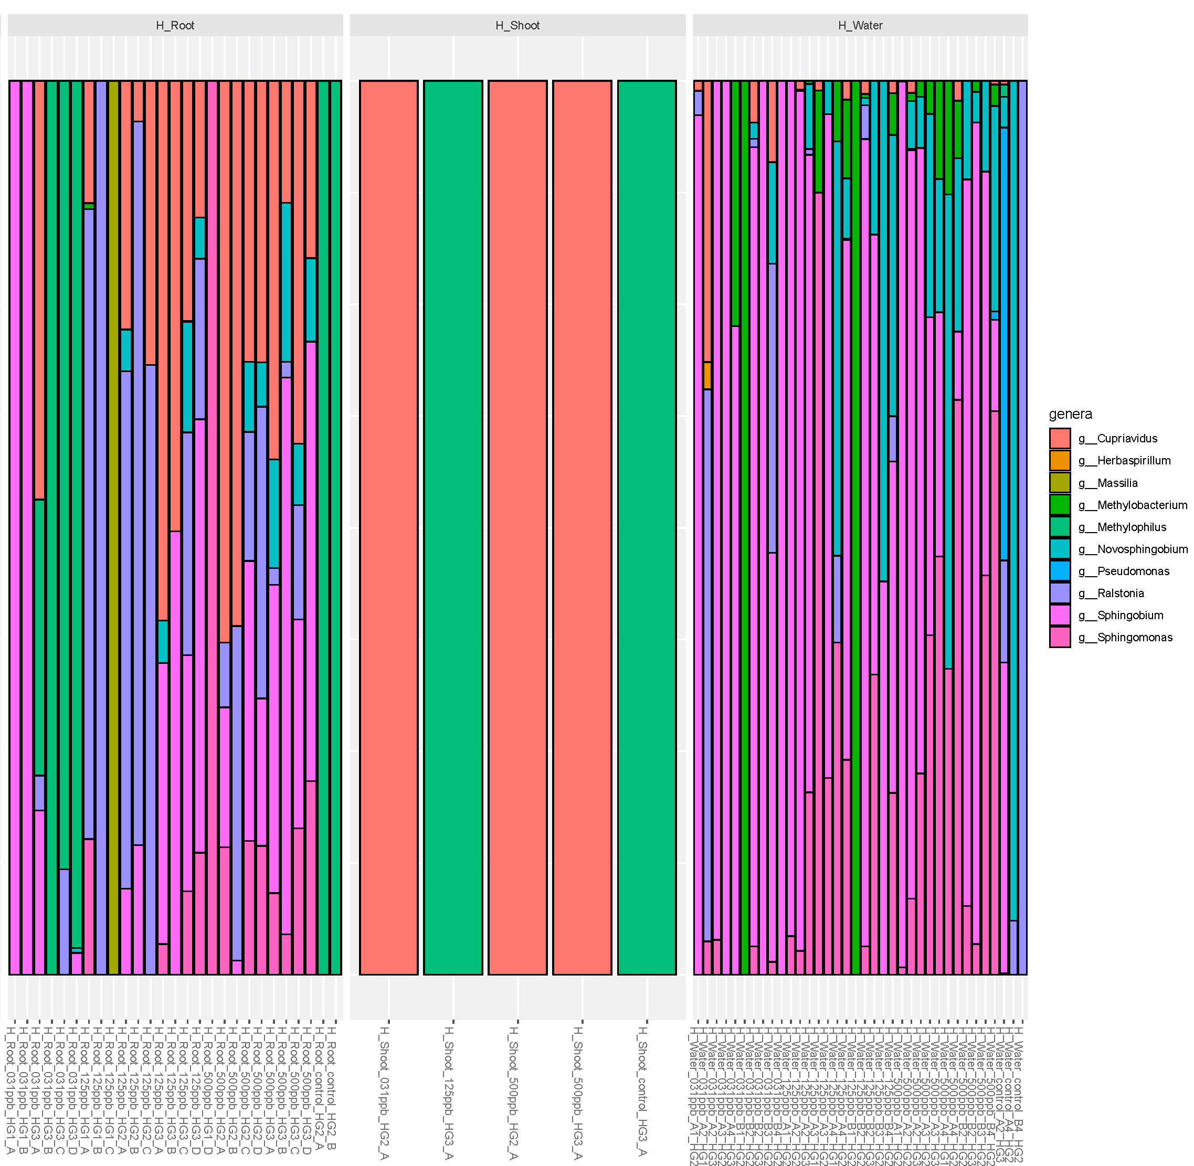

In silico- Hydroponic Results: Relative abundance and alpha diversity of microbially enriched root samples
Alpha diversity between treatments and control is significant for hydroponic water tray samples.
Alpha diversity of the hydroponic water tray increases over time irrespective of silver concentration.
The 125 ppb and 500 ppb ionic silver treatments displayed similar bacteria in the roots and water of the hydroponic water tray but in different relative abundances.

Slide 11
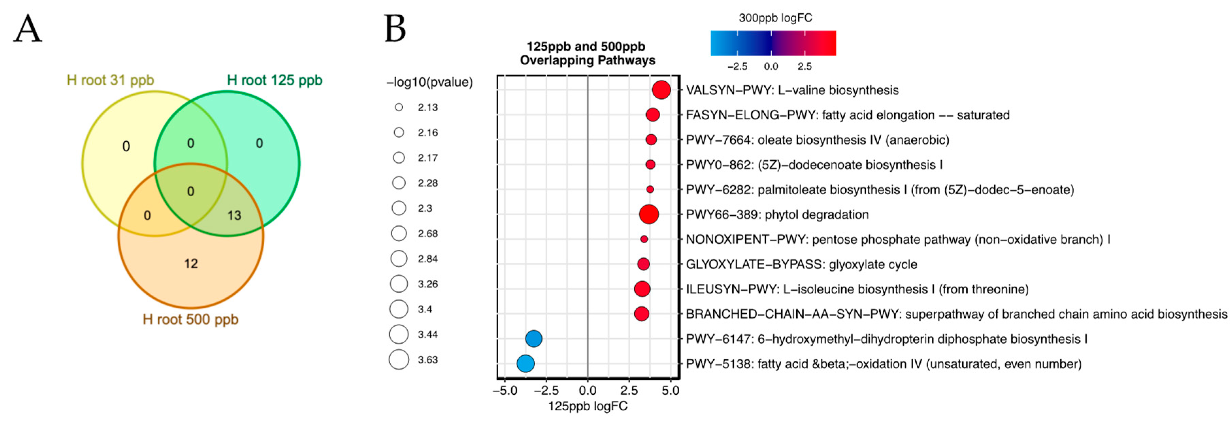
In silico- Hydroponic Results: Differentially expressed metagenomic pathways from microbially enriched root samples
Root
metabolome
5

Slide 12
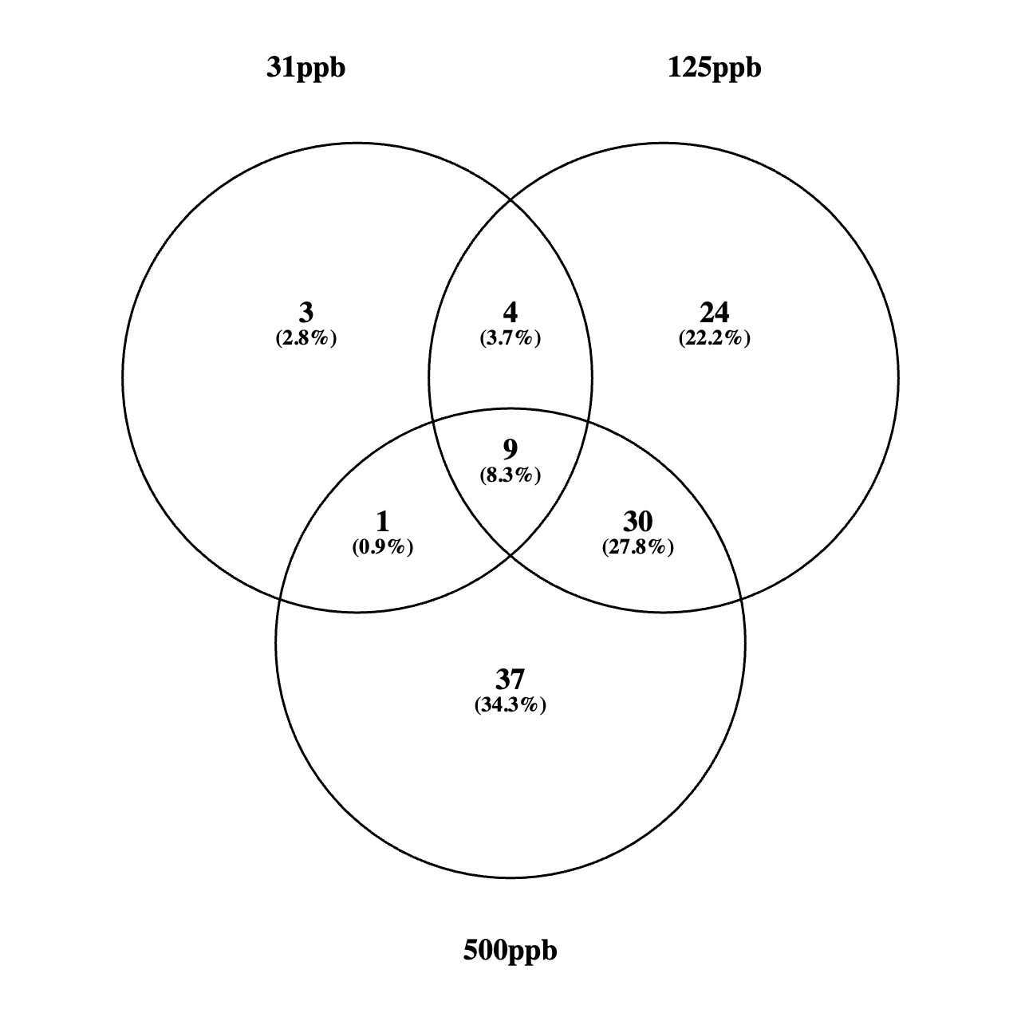
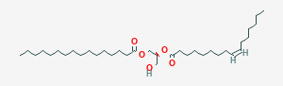
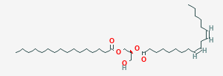
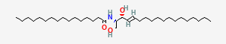
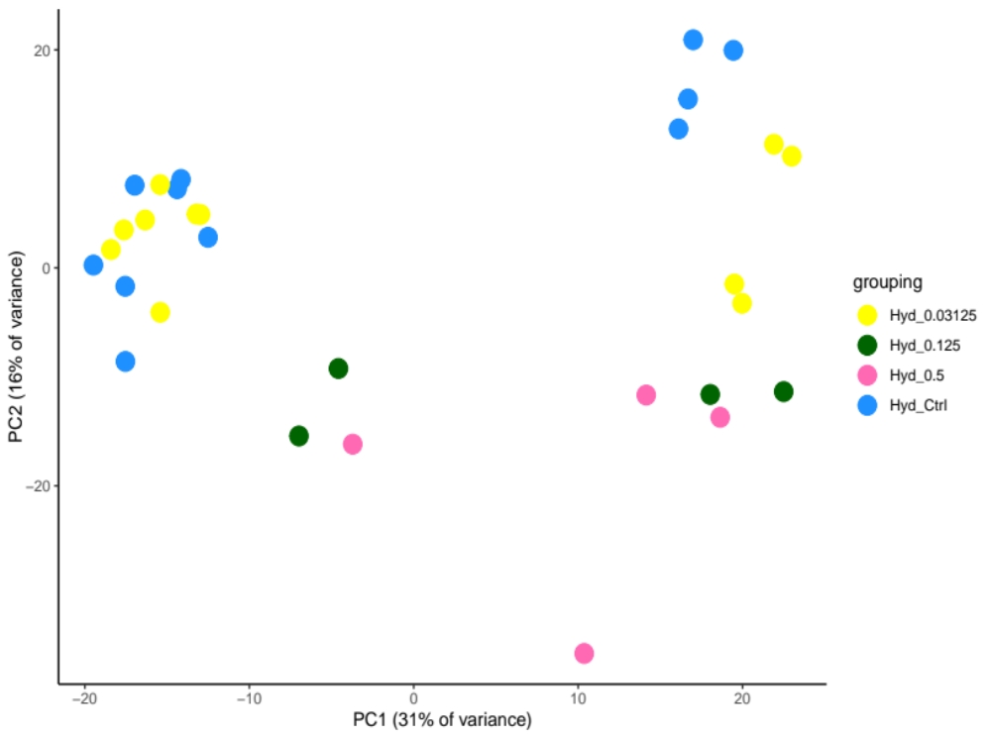
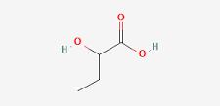
In silico- Hydroponic Results: Differentially expressed metabolites from root samples
Root
metabolome
enriched metabolites
metabolite | occurrence
1-palmitoyl-2-palmitoleoyl-GPE(16:0/16:1)* | up in 500 ppb
palmitoyl-linoleoyl-glycerol (16:0/18:2) | up in 125 ppb
N-palmitoyl-sphinganine | up in 31, 125, 500 ppb
1-palmitoyl-2-linoleoyl-galactosylglycerol | up in 31 and 125 ppb
2-hydroxybutyrate/2-hydroxyisobutyrate | up in 125 and 500 ppb
31ppb
125ppb
500ppb
control

Slide 13
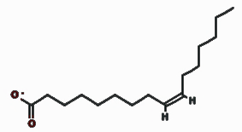
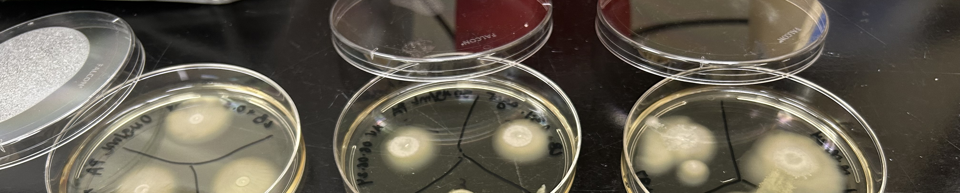
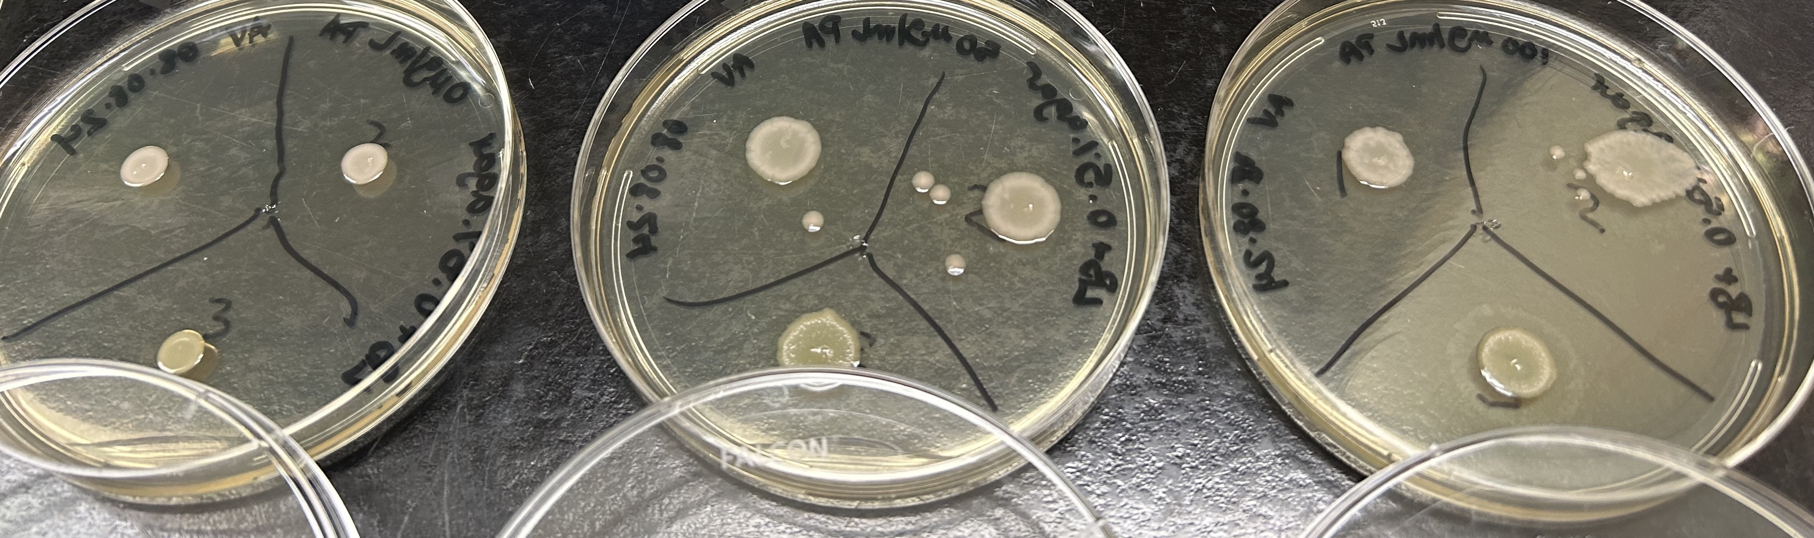
In vitro- The metagenome to the metabolome : Cupriavidus and palmitoleic acid
Representative from metabolome:
Palmitoleic acid (PA)
Representative microbe from metagenome:
ISS Water Processor Assembly (WPA) C. metallidurans
0ug/mL PA
50ug/mL PA
100ug/mL PA
SWIM
0.3% LB agar
SWIM
PA may have an effect on swimming and swarming behavior in C. metallidurans.
SWARM
0.5% LB agar
SWARM
0ug/mL PA
50ug/mL PA
100ug/mL PA

Slide 14
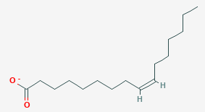
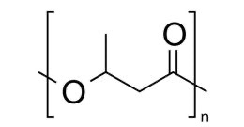
In vitro- The metagenome to the metabolome : Cupriavidus and palmitoleic acid
Representative microbe from metagenome:
ISS Water Processor Assembly (WPA) C. metallidurans
Representative from metabolome:
Palmitoleic acid (PA)
polyhydroxyalkanoates
(PHAs) monomer
Cupriavidus grown on fatty acids such as PA can generate polyhydroxyalkanoates (PHAs), “bioplastics”.
Notes:
Similar characteristics to polypropylene.
3-hydroxybutyrate.

Slide 15
Summary
When grown in arcillite substrate, Lactuca sativa cv. ‘Outredgeous’ lettuce is not affected by irrigation water with as high as 500 parts per billion (ppb) ionic silver.
In a hydroponics system, lettuce plants exposed to silver-treated water showed reduced growth for shoots at 31 ppb silver and severely stunted growth at 125 and 500 ppb.
  Exhibited the accumulation of silver and the reduced uptake of other essential elements.
  Microbial assemblage of the roots reflects that of the water and shoots reflects that of the roots.
Microbial abundance in roots and hydroponic water increased overtime and as the concentration of silver increased.
  The plant root likely served as a protective niche for microbes maintained by lipid signaling.
Ionic silver in amounts less than 31ppb should be achieved in water meant for future exploration hydroponic systems.
  The use of ionic silver will not preclude microbial resistance.

Slide 16
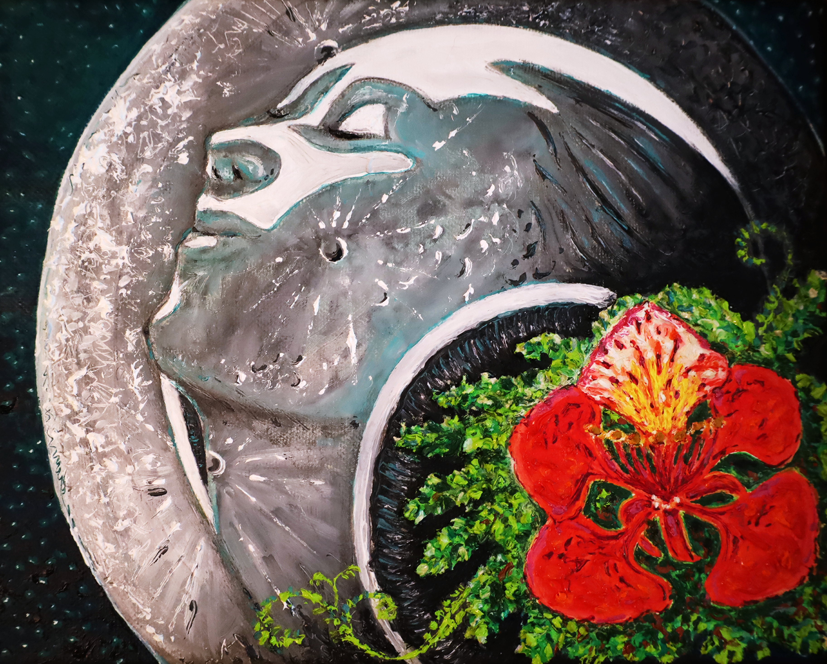
Thank you!
Gracias!

