Slide 1
Vented Fly Box
Hardware Suite
Amy L. Gresser, Ph.D.
December 12, 2024

Slide 2
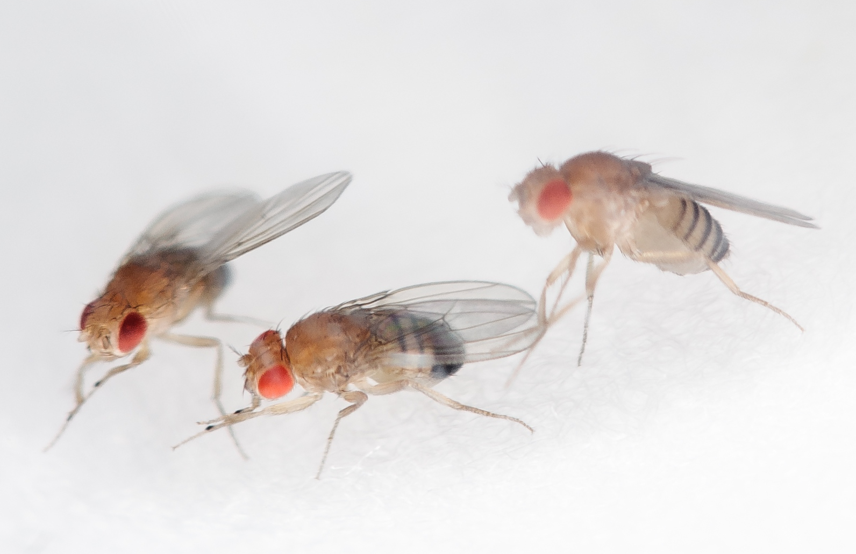


      Robust hardware suite developed at NASA Ames Research Center to accommodate fruit fly (Drosophila melanogaster) investigations in space
Designed to be adaptable to meet a variety of science requirements while minimizing the use of constrained resources (crew time, mass, volume, conditioned stowage)
Full complements of flight- and ground-certified hardware available to support testing, flight and ground control activities
      Flight heritage from successful ISS investigations
      Fruit Fly Lab-02 (CRS-11) characterized the effects of microgravity on cardiac function, structure and gene expression
      Fruit Fly Lab-03 (CRS-14) examined whether spaceflight alters the virulence of a natural parasite of Drosophila
      Planned for use in two upcoming investigations

Slide 3
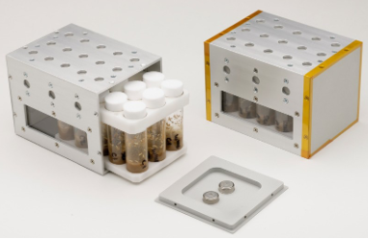
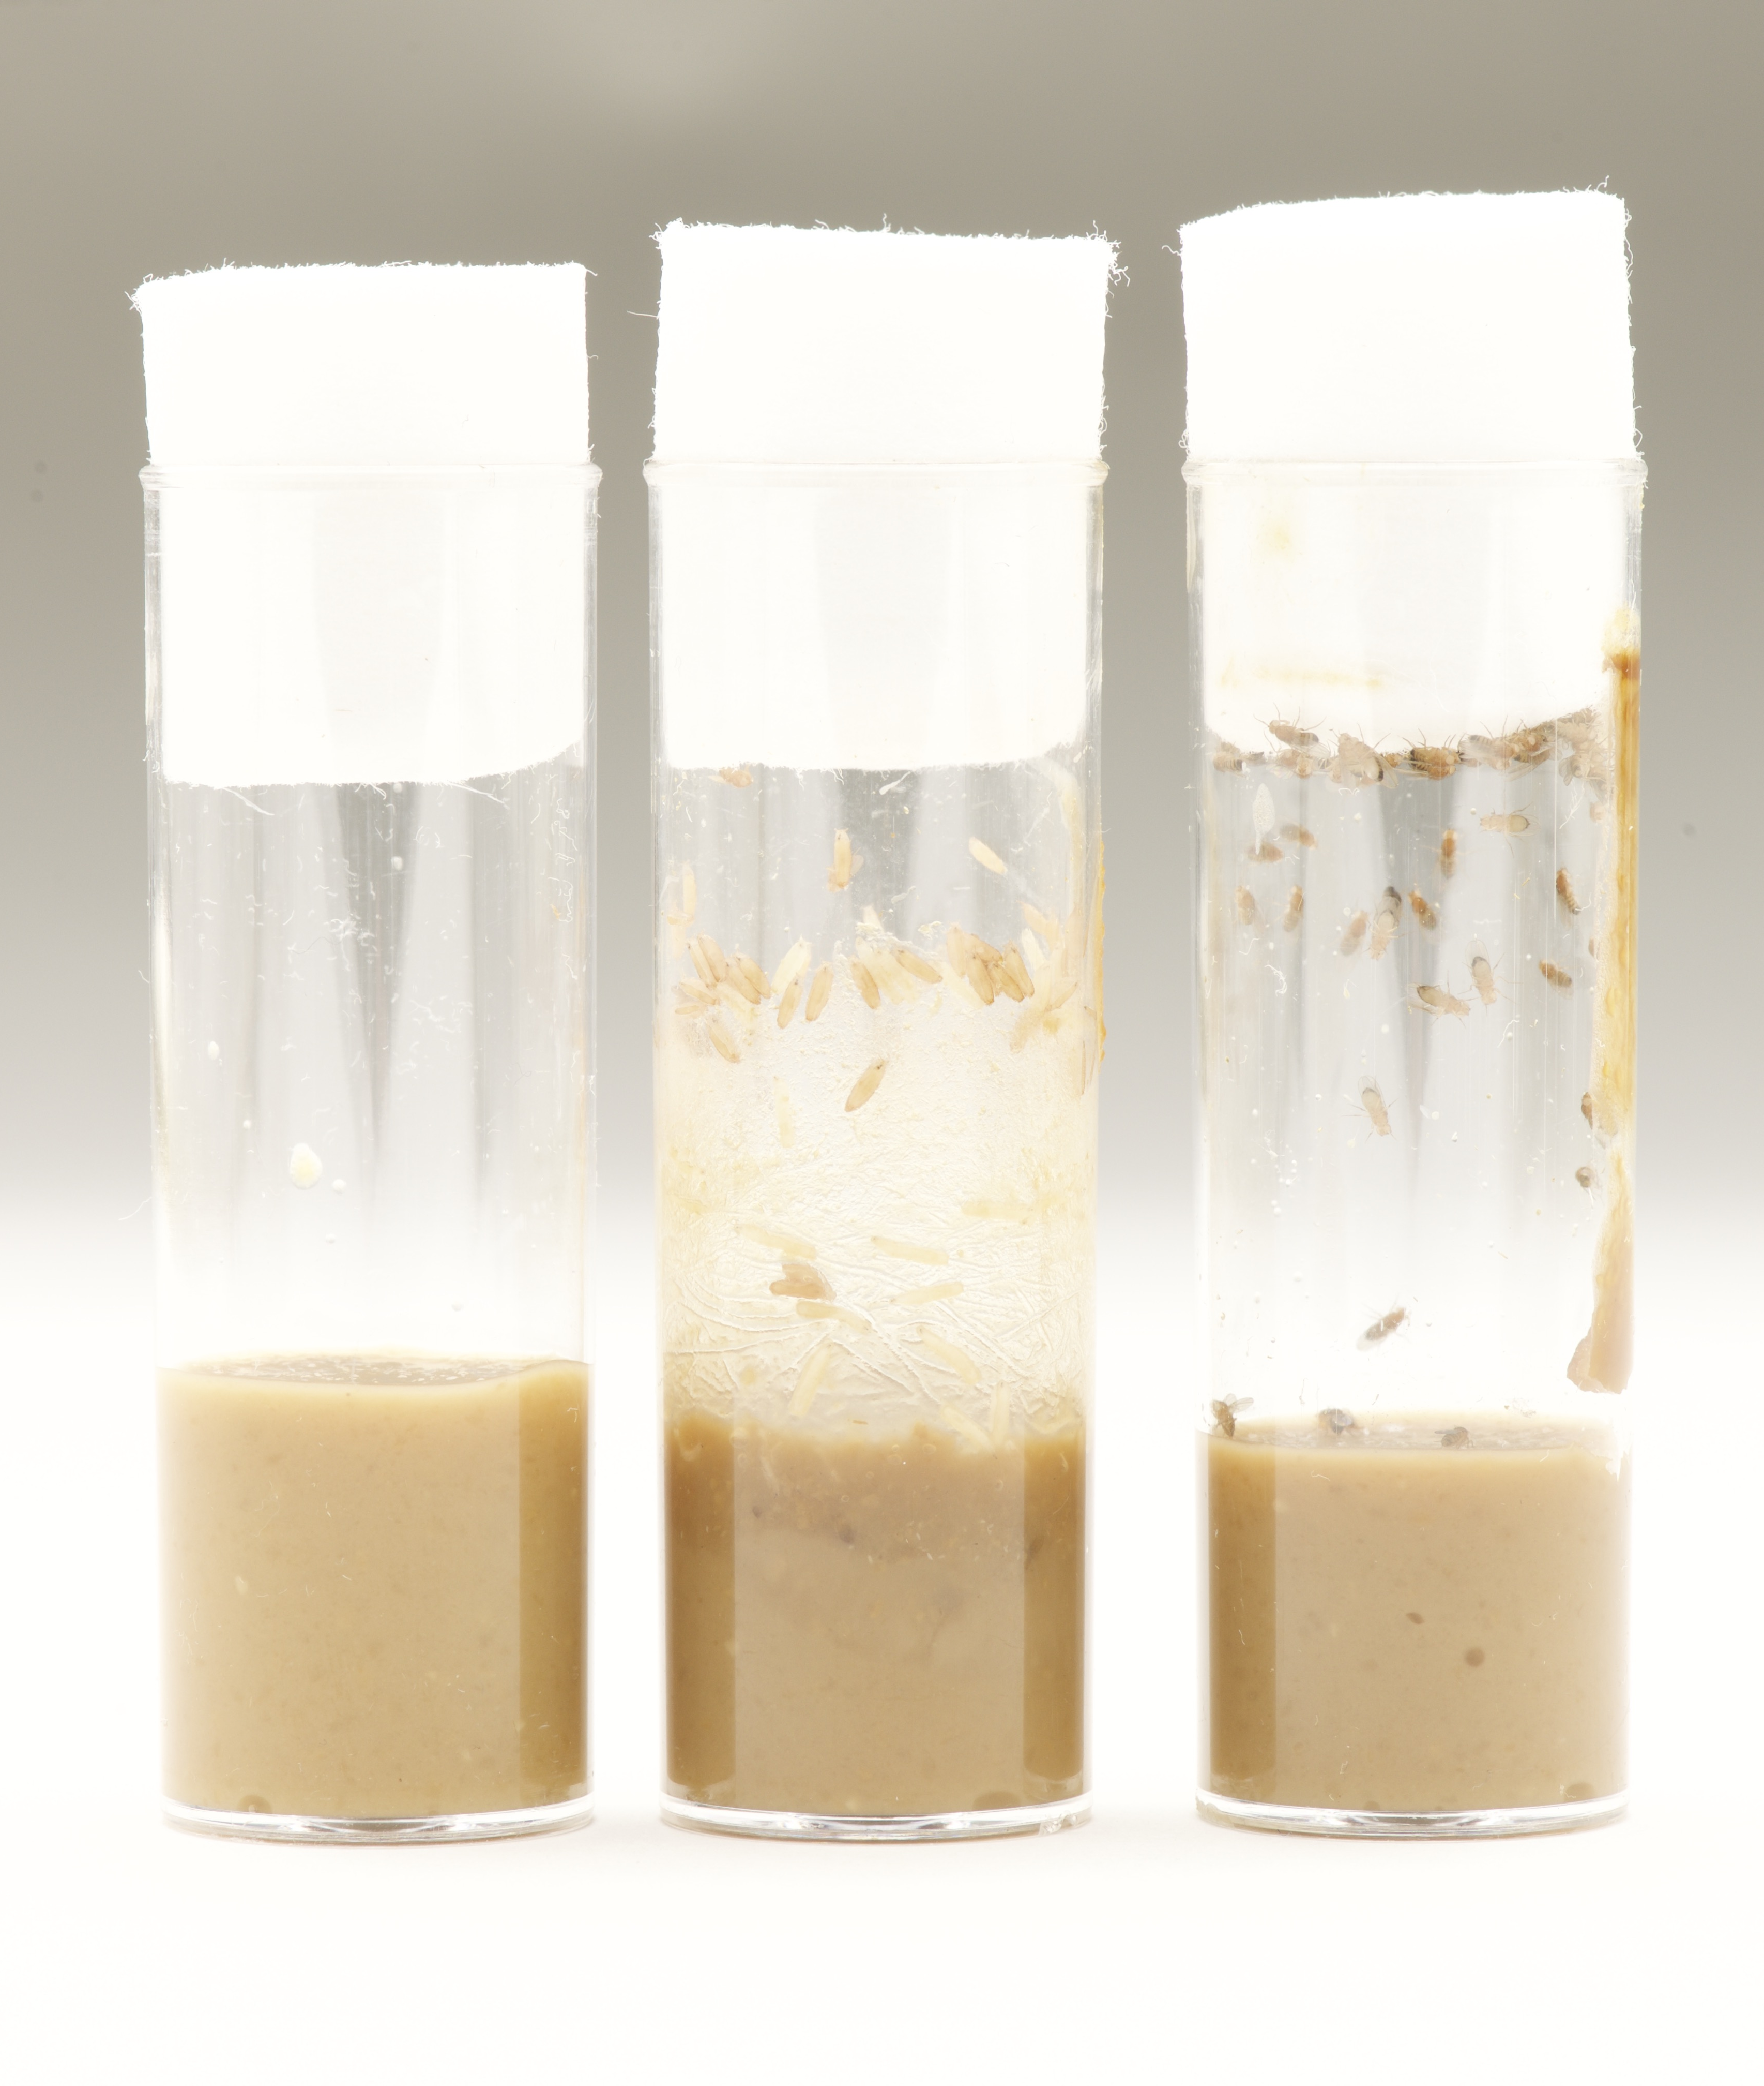
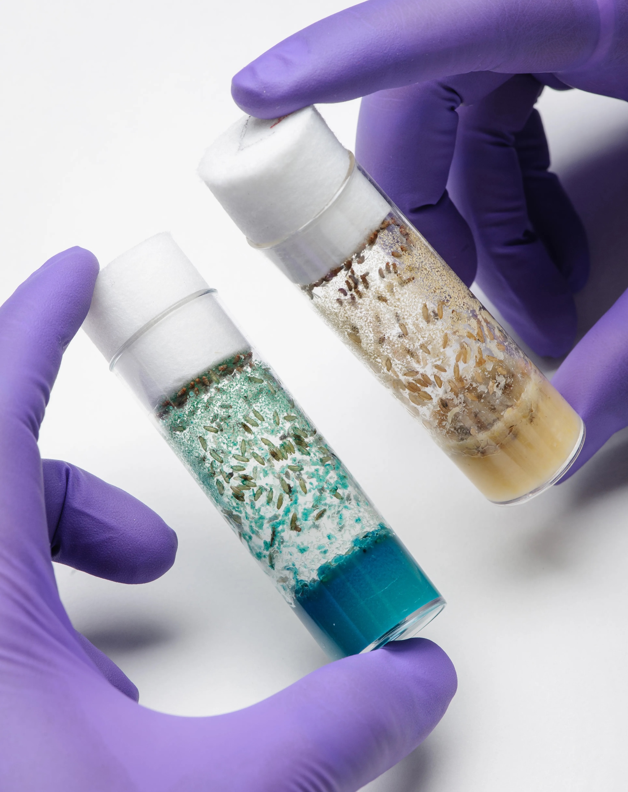
NASA
NASA
Vented Fly Box (VFB)
1.5U anodized aluminum box (10cm x 10cm x 14.2cm)
Vent holes with stainless mesh screens allow for passive gas exchange
Two part foam tray secures vials and prevents movement
Accommodates data loggers to monitor temperature and relative humidity (optional)
Sample Vials
15 polystyrene vials with cellulose acetate plugs (commercially available Drosophila lab standard)
Food composition and initial quantities/ life stages of organisms can be tailored to meet science requirements
Adaptable for other organisms with similar volume and environmental requirements

Slide 4
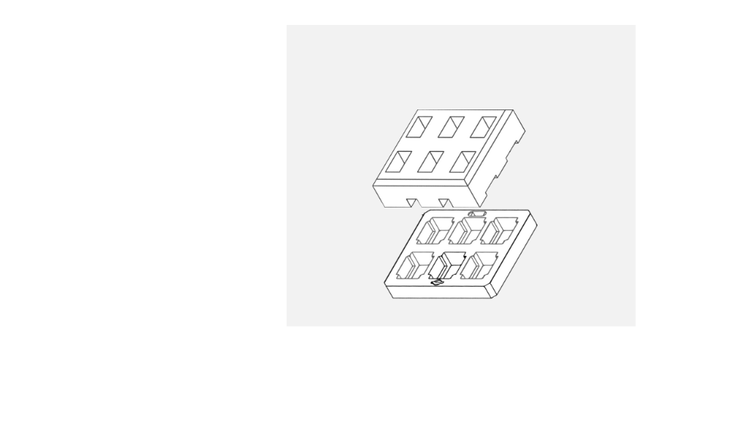
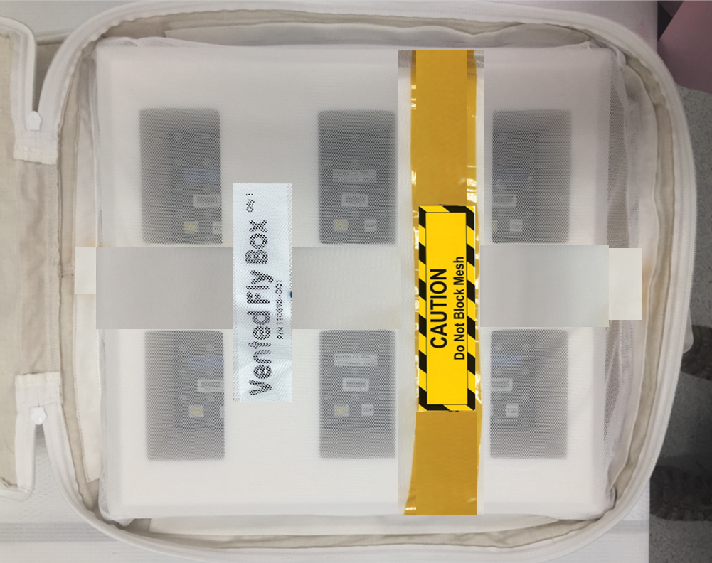
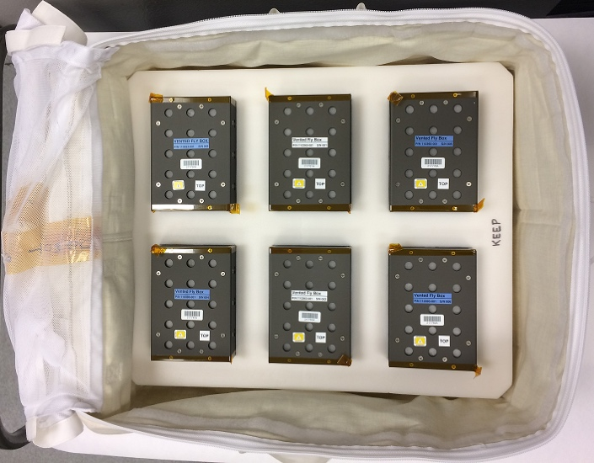
NASA
NASA
Payload Container Foam
Closed cell foam securely stores six VFBs in a 1.0 CTB (or equivalent volume)
Provides interconnected channels to support air-exchange from ambient environment to VFB vent holes
Accommodates passive or active dosimeter to monitor radiation exposure within the payload container (optional)
Customizable to support different VFB quantities or volume constraints

Slide 5
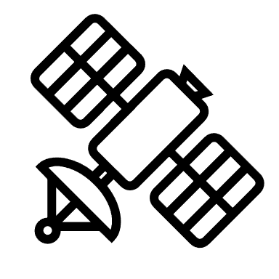

Concept of Operations
Transfer to station,
Unzip CTB lid,
Stow at ambient conditions
(~10 minutes)
Retrieve from stowage,
Zip CTB lid,
Transfer to return vehicle
(~10 minutes)
Optional:
Image deployed payload
(~5 minutes/event)
Flexible
Turnover + ~6d
Undock - ~36h
Turnover for late load soft stowage
Retrieve at early de-stow location
Flight timeline and environmental conditions replicated in ground control
Launch
Return
Return + TBD
Launch - ~30h
Designed for ambient stowage from pre-flight turnover to post-flight return
Manifested with orientation constraint for launch/return vehicle stowage to minimize negative impacts of gravitational loads on organisms
Integration and operations products largely reusable between missions
Operations require minimal crew time (20-25 minutes total) and no advance training

