Slide 1

Language Model Applications to Scientific Tools: Exploring Use Cases in Data Visualization
Presentation Date 12/12/2024
Patrick Maynard (GSFC)

Slide 2
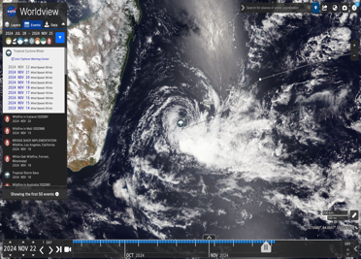
NASA Worldview
Part of NASA’s Earth Science Data and Information System (ESDIS)
Enables Visualization and exploration of satellite-derived data products
In combination with Global Imagery Browse Services, provides service to 100k+ daily users
Hurricane Milton drove a record 400K unique users with 183M tile requests

Slide 3
Statement of Purpose
We demonstrate two use cases for the application of language models to scientific visualization tools
  Content Information Extraction System: a tool to better understand our science user base
  Natural Disaster Visibility Classifier: a classifier that enhances user experience and selectively serves data

Slide 4
Content Information Extraction System

Slide 5
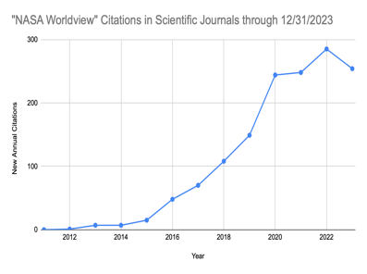
Content Information Extraction System
Context: Each year NASA’s Worldview and Global Imagery Browse Services (GIBS) is used in hundreds of scientific journals and news media articles.
Problem: Manually reading and extracting information on how Worldview contributed to these documents is not practical.
Approach: Apply language models to parse these articles and extract information to track Worldview usage.

Slide 6
Information Extraction
News Article 1
Language Model
Answer 1
Language Model
News Article …
Answer …
News Article D
Answer D
Prompt Instruction
(ex: “Summarize the NASA data products used in this paper.”)
Summary prompt (ex: “Given the extracted information provide some examples of X”)
Aggregate answer across corpus of D Documents.

Slide 7
Performance & Metrics
Open-Source Model
Ground Truth
SIC maps were obtained for the year of 2012-2021. Visible imagery collected by the National Aeronautics and Space Administration (NASA) Aqua, Terra, and Suomi satellites were obtained across the year 2017 from NASA Worldview for the purpose of ground-truthing SIC concentration maps.
MODIS (Moderate Resolution Imaging Spectroradiometer)
AWS (Automatic Weather Station).
GEBCO (General Bathymetric Chart of the Ocean)
DOI: 10.1038

Slide 8
Performance & Metrics
Commercial Model
Ground Truth
SIC maps were obtained for the year of 2012-2021. Visible imagery collected by the National Aeronautics and Space Administration (NASA) Aqua, Terra, and Suomi satellites were obtained across the year 2017 from NASA Worldview for the purpose of ground-truthing SIC concentration maps.
Aqua, Terra, and Suomi satellite visible imagery
ground-truth sea ice concentration (SIC) maps
DOI: 10.1038

Slide 9
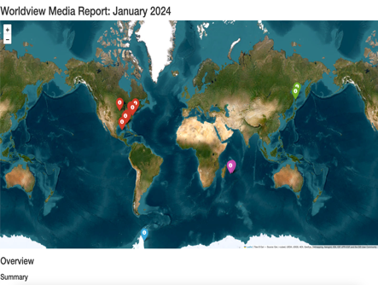
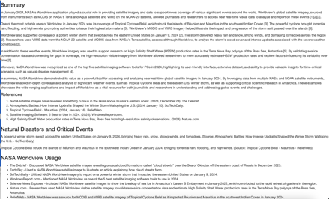
Automatic Insight Reporting

Slide 10
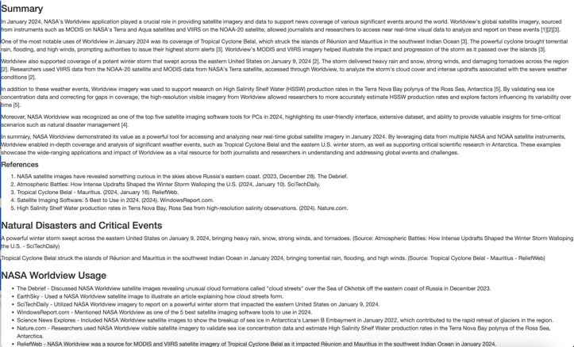
Automatic Insight Reporting

Slide 11
Validating Event Visibility in Satellite Imagery

Slide 12
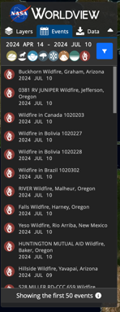
Worldview Natural Event Browser (NEB)
Context: Worldview’s natural events browser consists of satellite imagery selected from the date and location of events such as severe storms, wildfires, volcanic eruptions and sea ice drift.
Problem: Many of these events will not be visible in imagery due cloud cover or the timing of the satellites. Manual review of this is not practical.
Approach: Automate this process by applying vision-language models to classify the visibility of images.

Slide 13




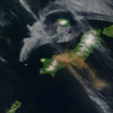
Applying Vision Language Models to Measure Event Visibility
EONET
GIBS API
Image Visibility Scores
MODIS Images of Events
[1/10]
[3/10]
[2/10]
[9/10]
Vision-Language Model
Sorting or Thresholding
Prompt Instruction
“Given a satellite image from MODIS, provide a visibility score out of 10 indicating if a volcanic eruption can be seen.”

Slide 14
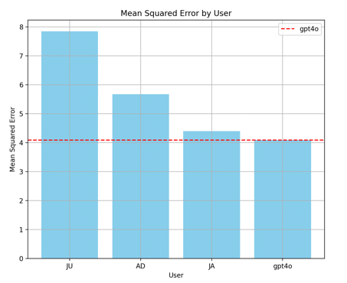
Performance & Metrics
A data labeling app was built to label a subset for performance comparisons
Model performance on identifying volcanic eruptions in MODIS imagery was approximately 59% recall 87% precision
A study was done to compare high school student ability to OpenAI’s GPT-4o in this setting

Slide 15
Thank You

