Slide 1
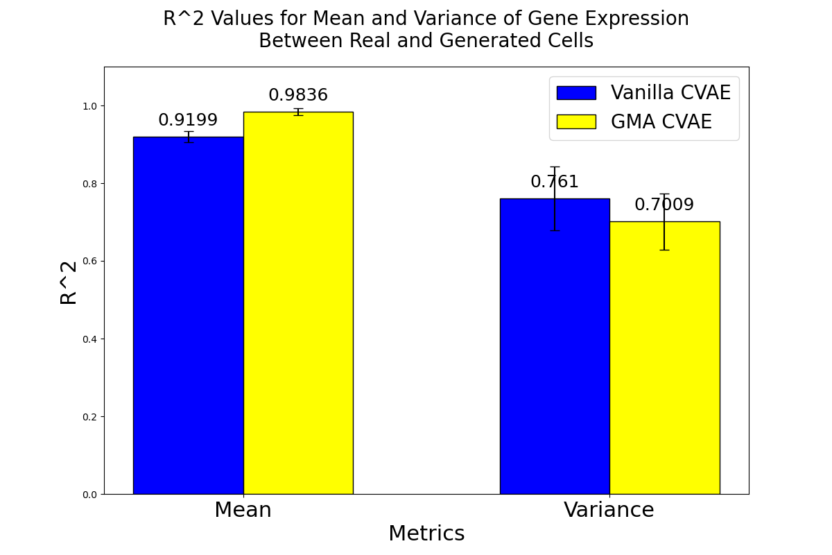
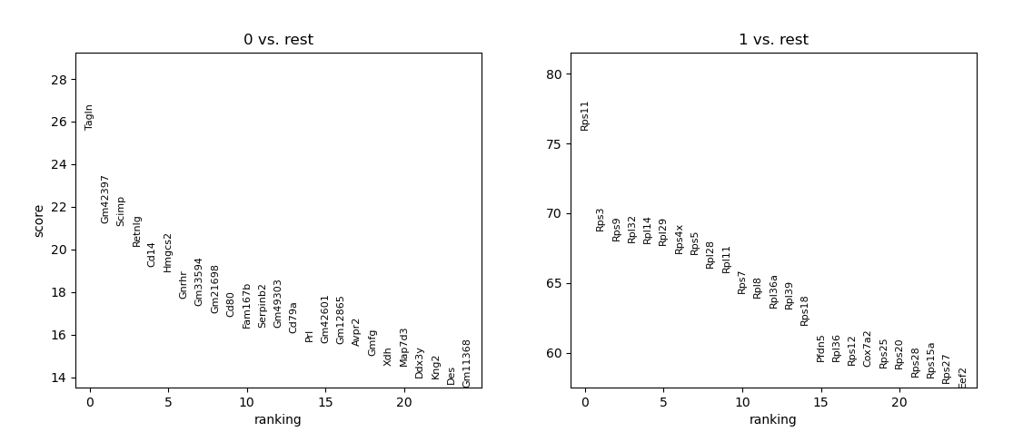
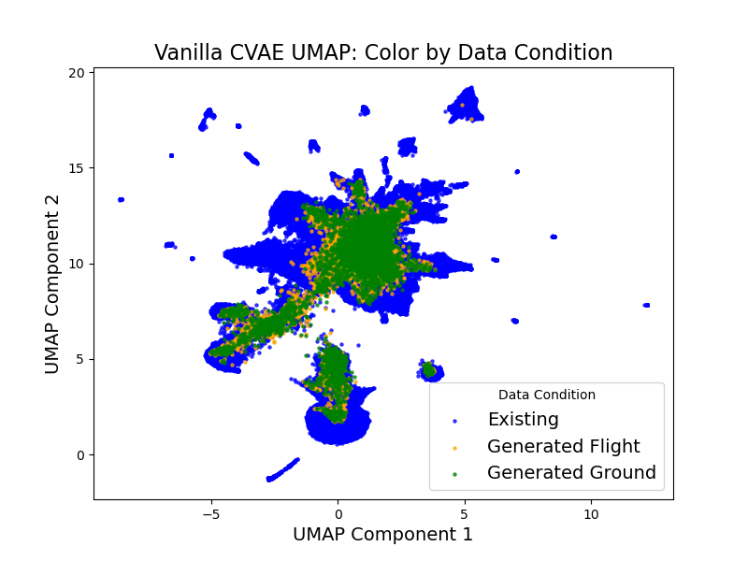
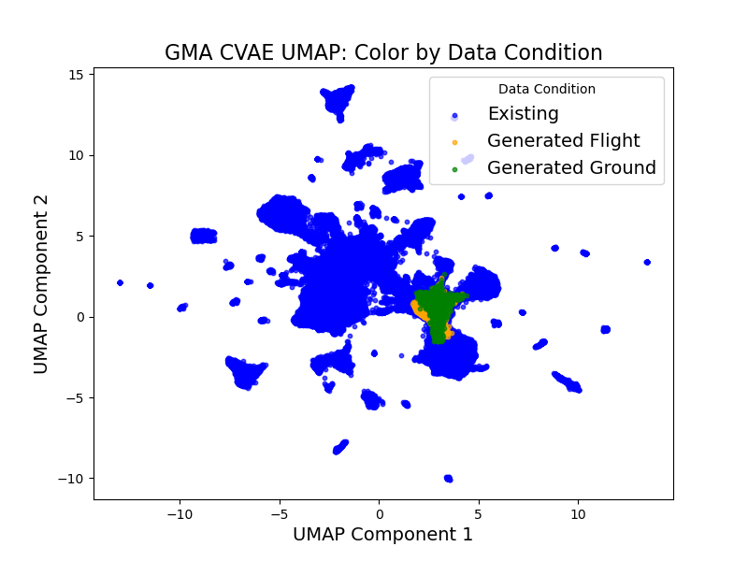
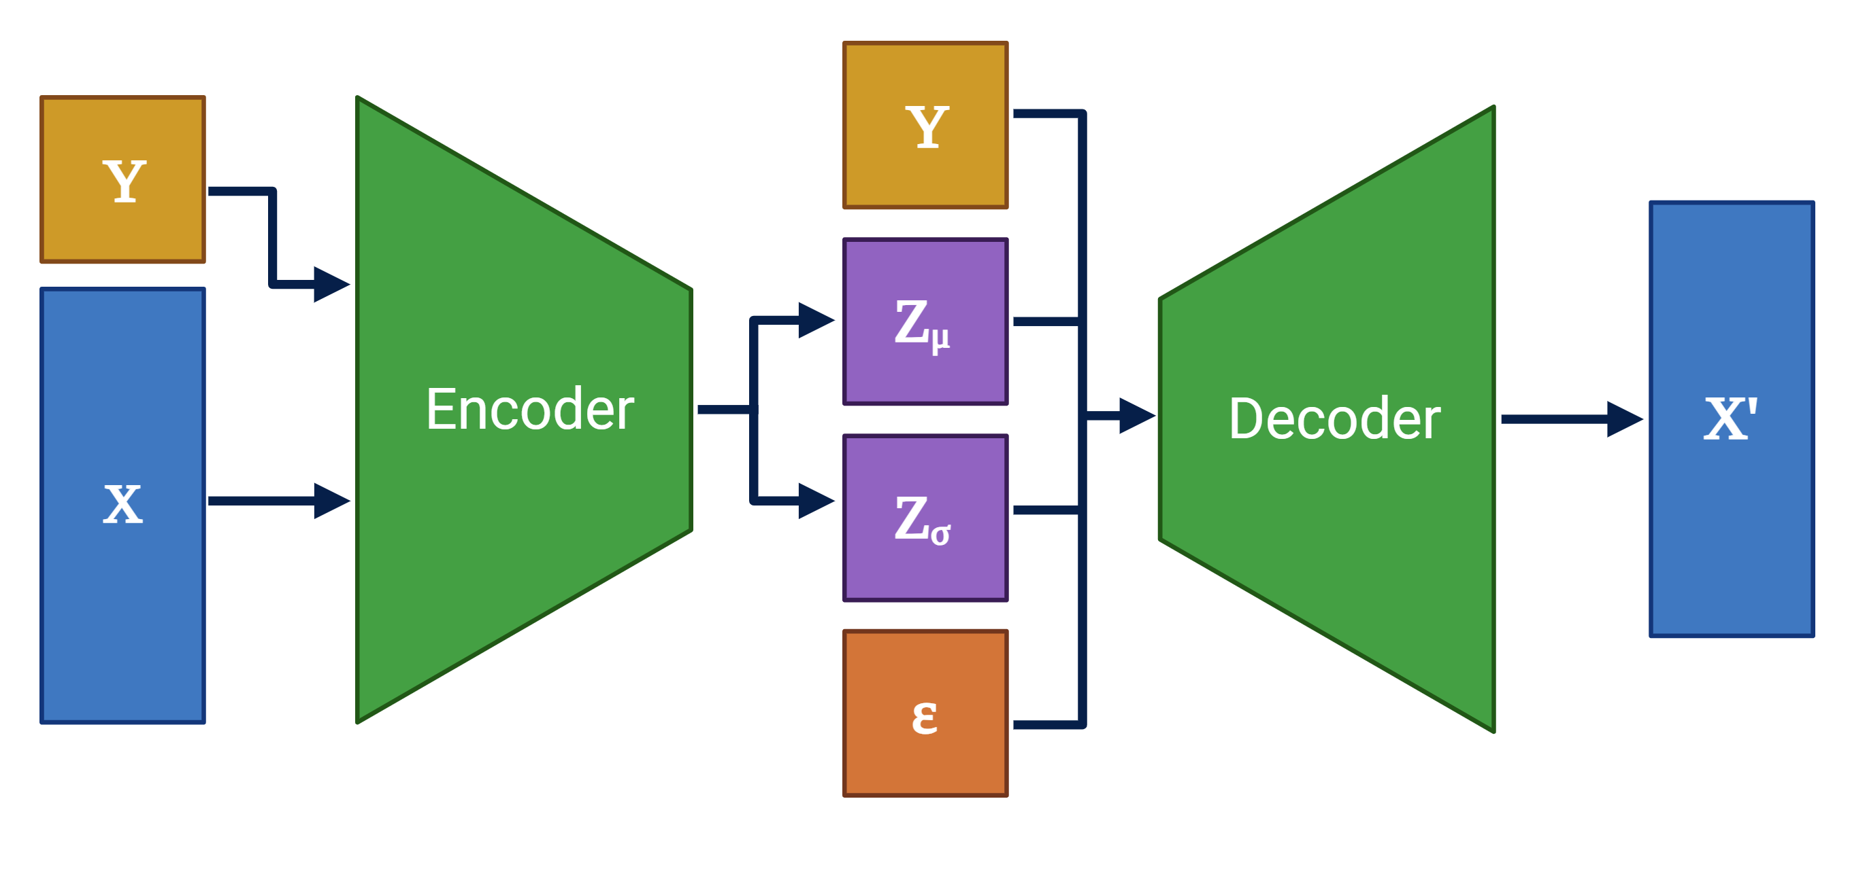
Evaluating the efficacy of conditional variational autoencoders in generating synthetic single nuclei RNA-seq data for space biology research
Sarah Golts¹, James Casaletto², Sylvain Costes²
¹University of Michigan and ⁴NASA Ames Research Center, Moffett Field, CA
Abstract
Results
Potential Applications
Astronauts are subject to unique stressors during spaceflight, leading to changes in their cellular function. However, neither astronauts nor model organisms respond the same to spaceflight, and research implicates a contribution of omics components in differential responses. Understanding how gene expression affects astronaut health is critical for the success of long-term space missions, prompting interest in developing personalized predictive models leveraging artificial intelligence (AI) and machine learning (ML) techniques.
Developing such models requires extensive data, which is challenging to obtain and share. This study explores the use of conditional variational autoencoders (CVAEs) to synthetically generate single-nuclei RNA-seq (snRNA-seq) data. CVAEs build on standard variational autoencoders (VAEs) by conditioning data generation on covariates like sample identity and mission parameters, enhancing the relevance of generated data for specific contexts.
For our work, we built two CVAEs with varying degrees of sparsity to optimize both interpretability and generative power. We train and validate models on existing snRNA-seq data collected from the brain tissue of mice subjected to spaceflight conditions and their ground control counterparts. We evaluate model performance using statistical tests and visualizations to compare synthetic data to real data. We aim to demonstrate that these prototype CVAE architectures could be used in future space biology work and that this is a method worth further exploring.
Background and Introduction
Advances in single cell and single nuclei RNA sequencing technologies (scRNA-seq, snRNA-seq) allow us to understand complex biological systems at higher resolution, enabling a nuanced transcriptomic perspective (Kolodziejczyk et al., 2015). Autoencoders, powerful neural networks known for their flexible design (Hinton & Salakhutdinov, 2006), are particularly well-suited for working with high-dimensional data. They excel in tasks such as dimensionality reduction and clustering, making them versatile tools in data analysis.
A newer aspect of the scRNA-seq landscape is the use of deep generative models, such as generative adversarial networks (Goodfellow et al., 2014) and variational autoencoders (Kingma & Welling, 2022). VAEs attempt to learn the underlying true data distribution which provides more insight into the essential structure of a dataset than a standard AEs latent space. Although scRNA-seq inherently provides a larger number of data points per individual than other transcriptomic analysis methods, space biology data is still sparse. Spaceflight studies generally contain relatively few individuals due to cost, weight, and other practical constraints that uniquely impact space biology. Harnessing the generative powers of VAEs offers a potential solution to this problem.
VAEs of varying levels of complexity have proven successful in generating synthetic scRNA-seq data that align with distribution properties (Way & Greene, 2018). Further, there has been work done to establish methods for generating samples conditional on random latent vectors coupled with categorical conditions using conditional variational autoencoders (CVAEs) (Sohn et al., 2015). As a result, we attempt to demonstrate the efficacy of using CVAEs to generate synthetic snRNA-seq data for space biology data, using three datasets from the National Aeronautics and Space Administration Open Science Data Repository (NASA OSDR). Our primary goal is to establish a robust prototype CVAE architecture for future space biology sample generation while demonstrating the feasibility and potential of this approach to advance research in spaceflight-related biological challenges.
Pearson’s R² values for mean and variance between real data and data generated by Vanilla CVAE and GMA CVAE under three sets of covariates representing average sample covariates for each OSD dataset used for model training.
Differential gene expression performed on synthetic data, (0 being ground control data, 1 being flight data). Signal is low and the majority of highly variable genes are not common between real and synthetic data.
Future Directions
Given the results observed, there is significant reason to investigate the effects of class imbalance in training data on model ability to learn comprehensive latent spaces. It is also worthwhile to investigate the impacts of data integration on the data distribution, and whether integration negatively impacts the representation of rarer expression patterns in the data. Additionally, further and more rigorous validation of generated data quality must be conducted. It is critical to understand how well generated data
corresponds to real data, especially if the goal is to use such generative methods to
augment training data for astronaut health models.
Once the method is more thoroughly investigated, the architectures developed could
be used to construct foundation models for different organisms. For example, a foundation
model could be trained on recount3, a dataset that contains a large collection of scRNA-
seq data for mice (Wilks et al., 2021) and then fine tuned on OSDR data for specific space
biology use. Finally, it is valuable to explore the utility of similar generative models in the context of
related questions, such as imputation of artificial gene expression zeroes or out-of-domain
data generation to answer "what-if" questions about spaceflight.
Materials and Methods
The Vanilla CVAE is a deep generative CVAE (Sohn et al., 2015) that aims to maximize the likelihood of a single-cell dataset X under a generative process. The latent space is modeled as a multivariate normal distribution. The Gene Module Annotated (GMA) CVAE architecture is based on the VEGA architecture (Seninge et al., 2021), which relies on a set of latent variables that explicitly represent gene modules. The encoder takes the same format as that used in the vanilla CVAE, however, the decoder is made up of a single linear layer. The connection between the gene module latent variables and gene features
is specified with a binary mask where there is only a connection if the gene feature is a member of the gene module (Seninge et al., 2021).
References
Goodfellow, I. J., Pouget-Abadie, J., Mirza, M., Xu, B., Warde-Farley, D., Ozair, S., Courville, A., & Bengio, Y. (2014). Generative adversarial networks. https : / /arxiv.org/abs/1406.2661
Hinton, G. E., & Salakhutdinov, R. R. (2006). Reducing the dimensionality of data with neural networks. Science, 313, 504– 507.
Kingma, D. P., & Welling, M. (2022). Auto-encoding variational bayes. https://arxiv.org/abs/1312.6114.
Kolodziejczyk, A. A., Kim, J. K., Svensson, V., Marioni, J. C., & Teichmann, S. A. (2015).The technology and biology of
single-cell rna sequencing. Mol. Cell, 58, 610–620.
Seninge, L., Anastopoulos, I., Ding, H., & Stuart, J. (2021). Vega is an interpretable generative model for inferring biological network activity in single-cell transcriptomics. Nature Communications, 12(5684)
Way, G. P., & Greene, C. S. (2018). Extracting a biologically relevant latent space from cancer transcriptomes with variational autoencoders. Pacific Symposium on Biocomputing, 23, 80–91.
POC: Sarah Golts, sgolts@umich.edu
This research was funded in part by the NASA Biological and Physical Sciences Division (BPS) through the Space Life Science Training Program (SLSTP).
NASA Space Biosciences SLSTP: https://www.nasa.gov/ames/research/space-life-sciences-training-program
NASA Space Biology Program: https://science.nasa.gov/biological-physical/programs/space-biology
Illustrative diagrams of the Vanilla CVAE (left) and the GMA CVAE (right) highlighting differences in architecture. X is input data, Y is input covariates, Zu and Zσ are latent space parameters, ε is random noise, and X’ is reconstructed data.
Structure preserving UMAP visualizations of 10,000 generated flight samples and 10,000 generated ground control samples. Vanilla CVAE (upper) generated data is dispersed across the plot, while GMA CVAE (lower) generated data is much more tightly clustered.

