Slide 1
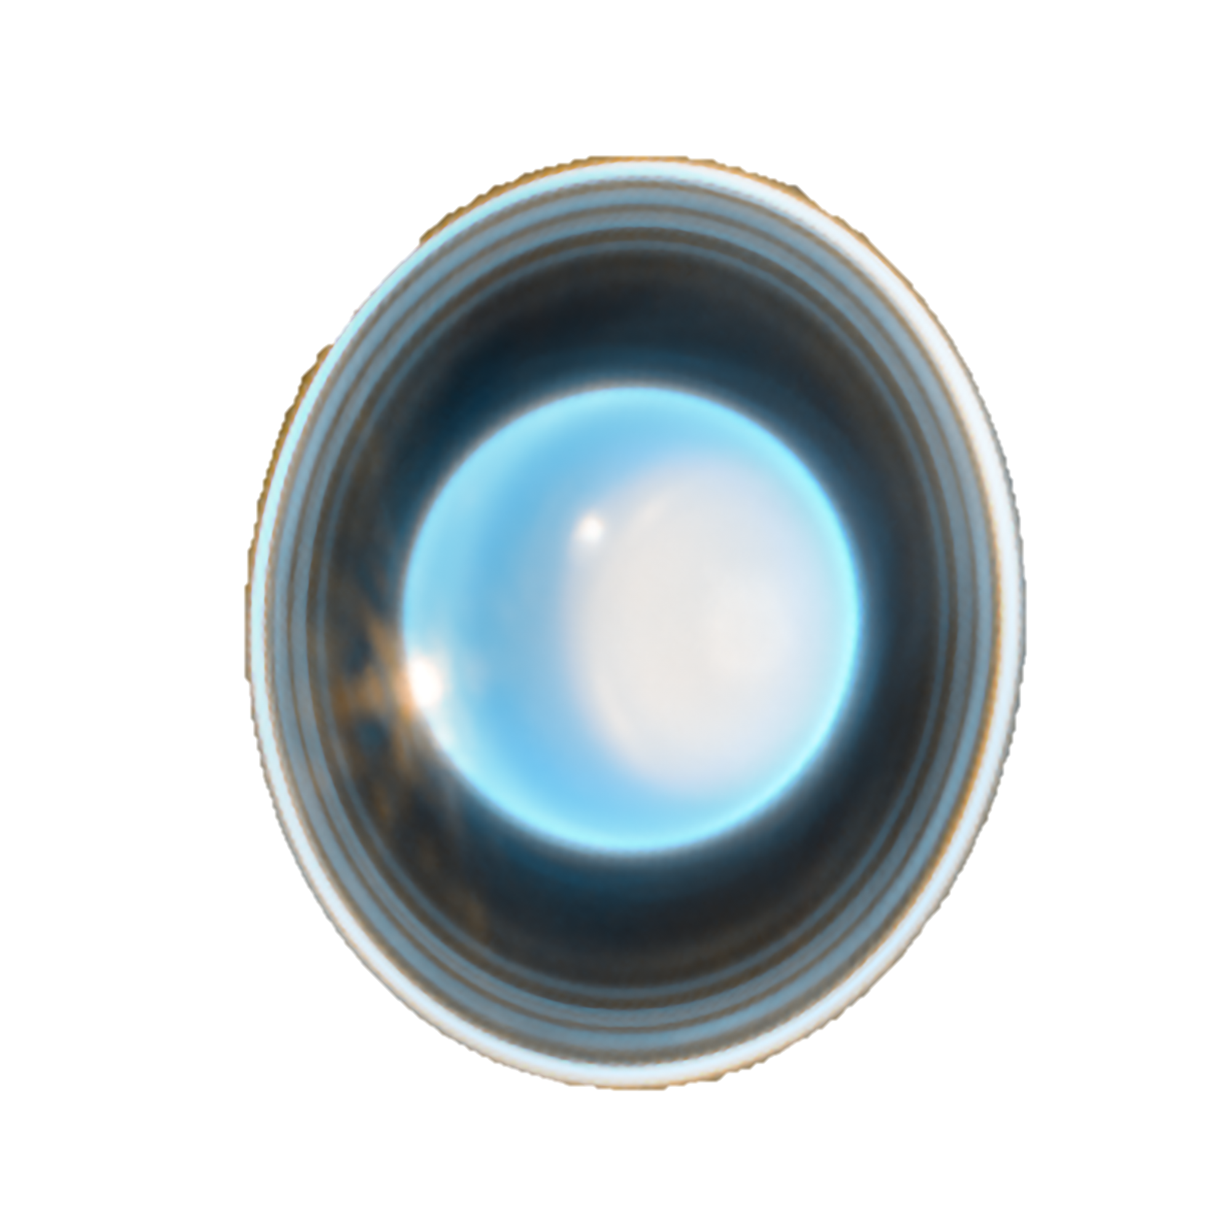
Stellar Occultation Observations to Constrain the Stratosphere of Uranus for Aerocapture
William Saunders^{1,2} (william.r.saunders@nasa.gov),
Kunio Sayanagi¹, Michael Person³, Paul Withers⁴, Richard French⁵, Cindy Young¹, Justin Garland^{1,2,6}, Soumyo Dutta¹, Rohan Deshmukh¹
¹NASA Langley Research Center, ²Analytical Mechanics Associates, ³MIT, ⁴Boston University, ⁵Wellesley College, ⁶Hampton University, ⁷Tufts University
AGU 2024
Images: NASA

Slide 2
Comparative Planetology
Uranus’ profile is unlike every other planet’s.
Stratosphere-thermosphere boundary
Stratosphere-thermosphere boundary
Mueller-Wodarg et al. (2008)

Slide 3
Comparative Planetology
Uranus’ profile is unlike every other planet’s.
“Giant planet energy crisis”
Unexplained hot thermosphere (Voyager 2)
Mueller-Wodarg et al. (2008)

Slide 4
Comparative Planetology
Uranus’ profile is unlike every other planet’s.
“Giant planet energy crisis”
Different remote-sensing measurements return different temperatures.
Unexplained hot thermosphere (Voyager 2)
Mueller-Wodarg et al. (2008)

Slide 5
Cause of the discrepancy?
Points at ~500 K come from unresolved spectra (Herbert et al. 1987).
V2 flyby coincided with atypical conditions at Uranus (Jasinski et al. 2024).
NOT stellar occultation processing (Saunders et al. 2023, 2024).
Strong discrepancy
(Saunders et al. 2024)
Will Saunders | Uranus Atmospheric Temperatures

Slide 6
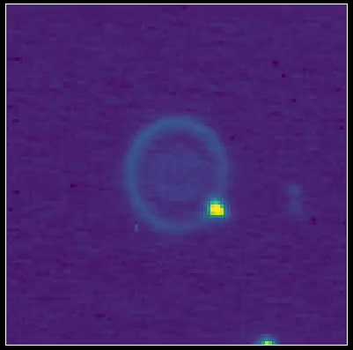
Earth-Based Stellar Occultations
Occurs when a solar system object occults a distant star.
Uses for Uranus: stratosphere / lower thermosphere, rings, astrometry.
Ingress
Egress
Pressure
Density
Temperature
2022 Uranus Occultation from NASA IRTF

Slide 7
Reprocessed stellar occultations (Saunders et al. 2023, 2024)
Original

Slide 8
Heat source: ~20x solar EUV
Reprocessed stellar occultations (Saunders et al. 2023, 2024)
Heat sink: gravity waves, acoustic waves, dynamic coupling?
Original

Slide 9
Comparative Planetology
New 1-D model is consistent with other giant planets.
Stratosphere-thermosphere boundary

Slide 10
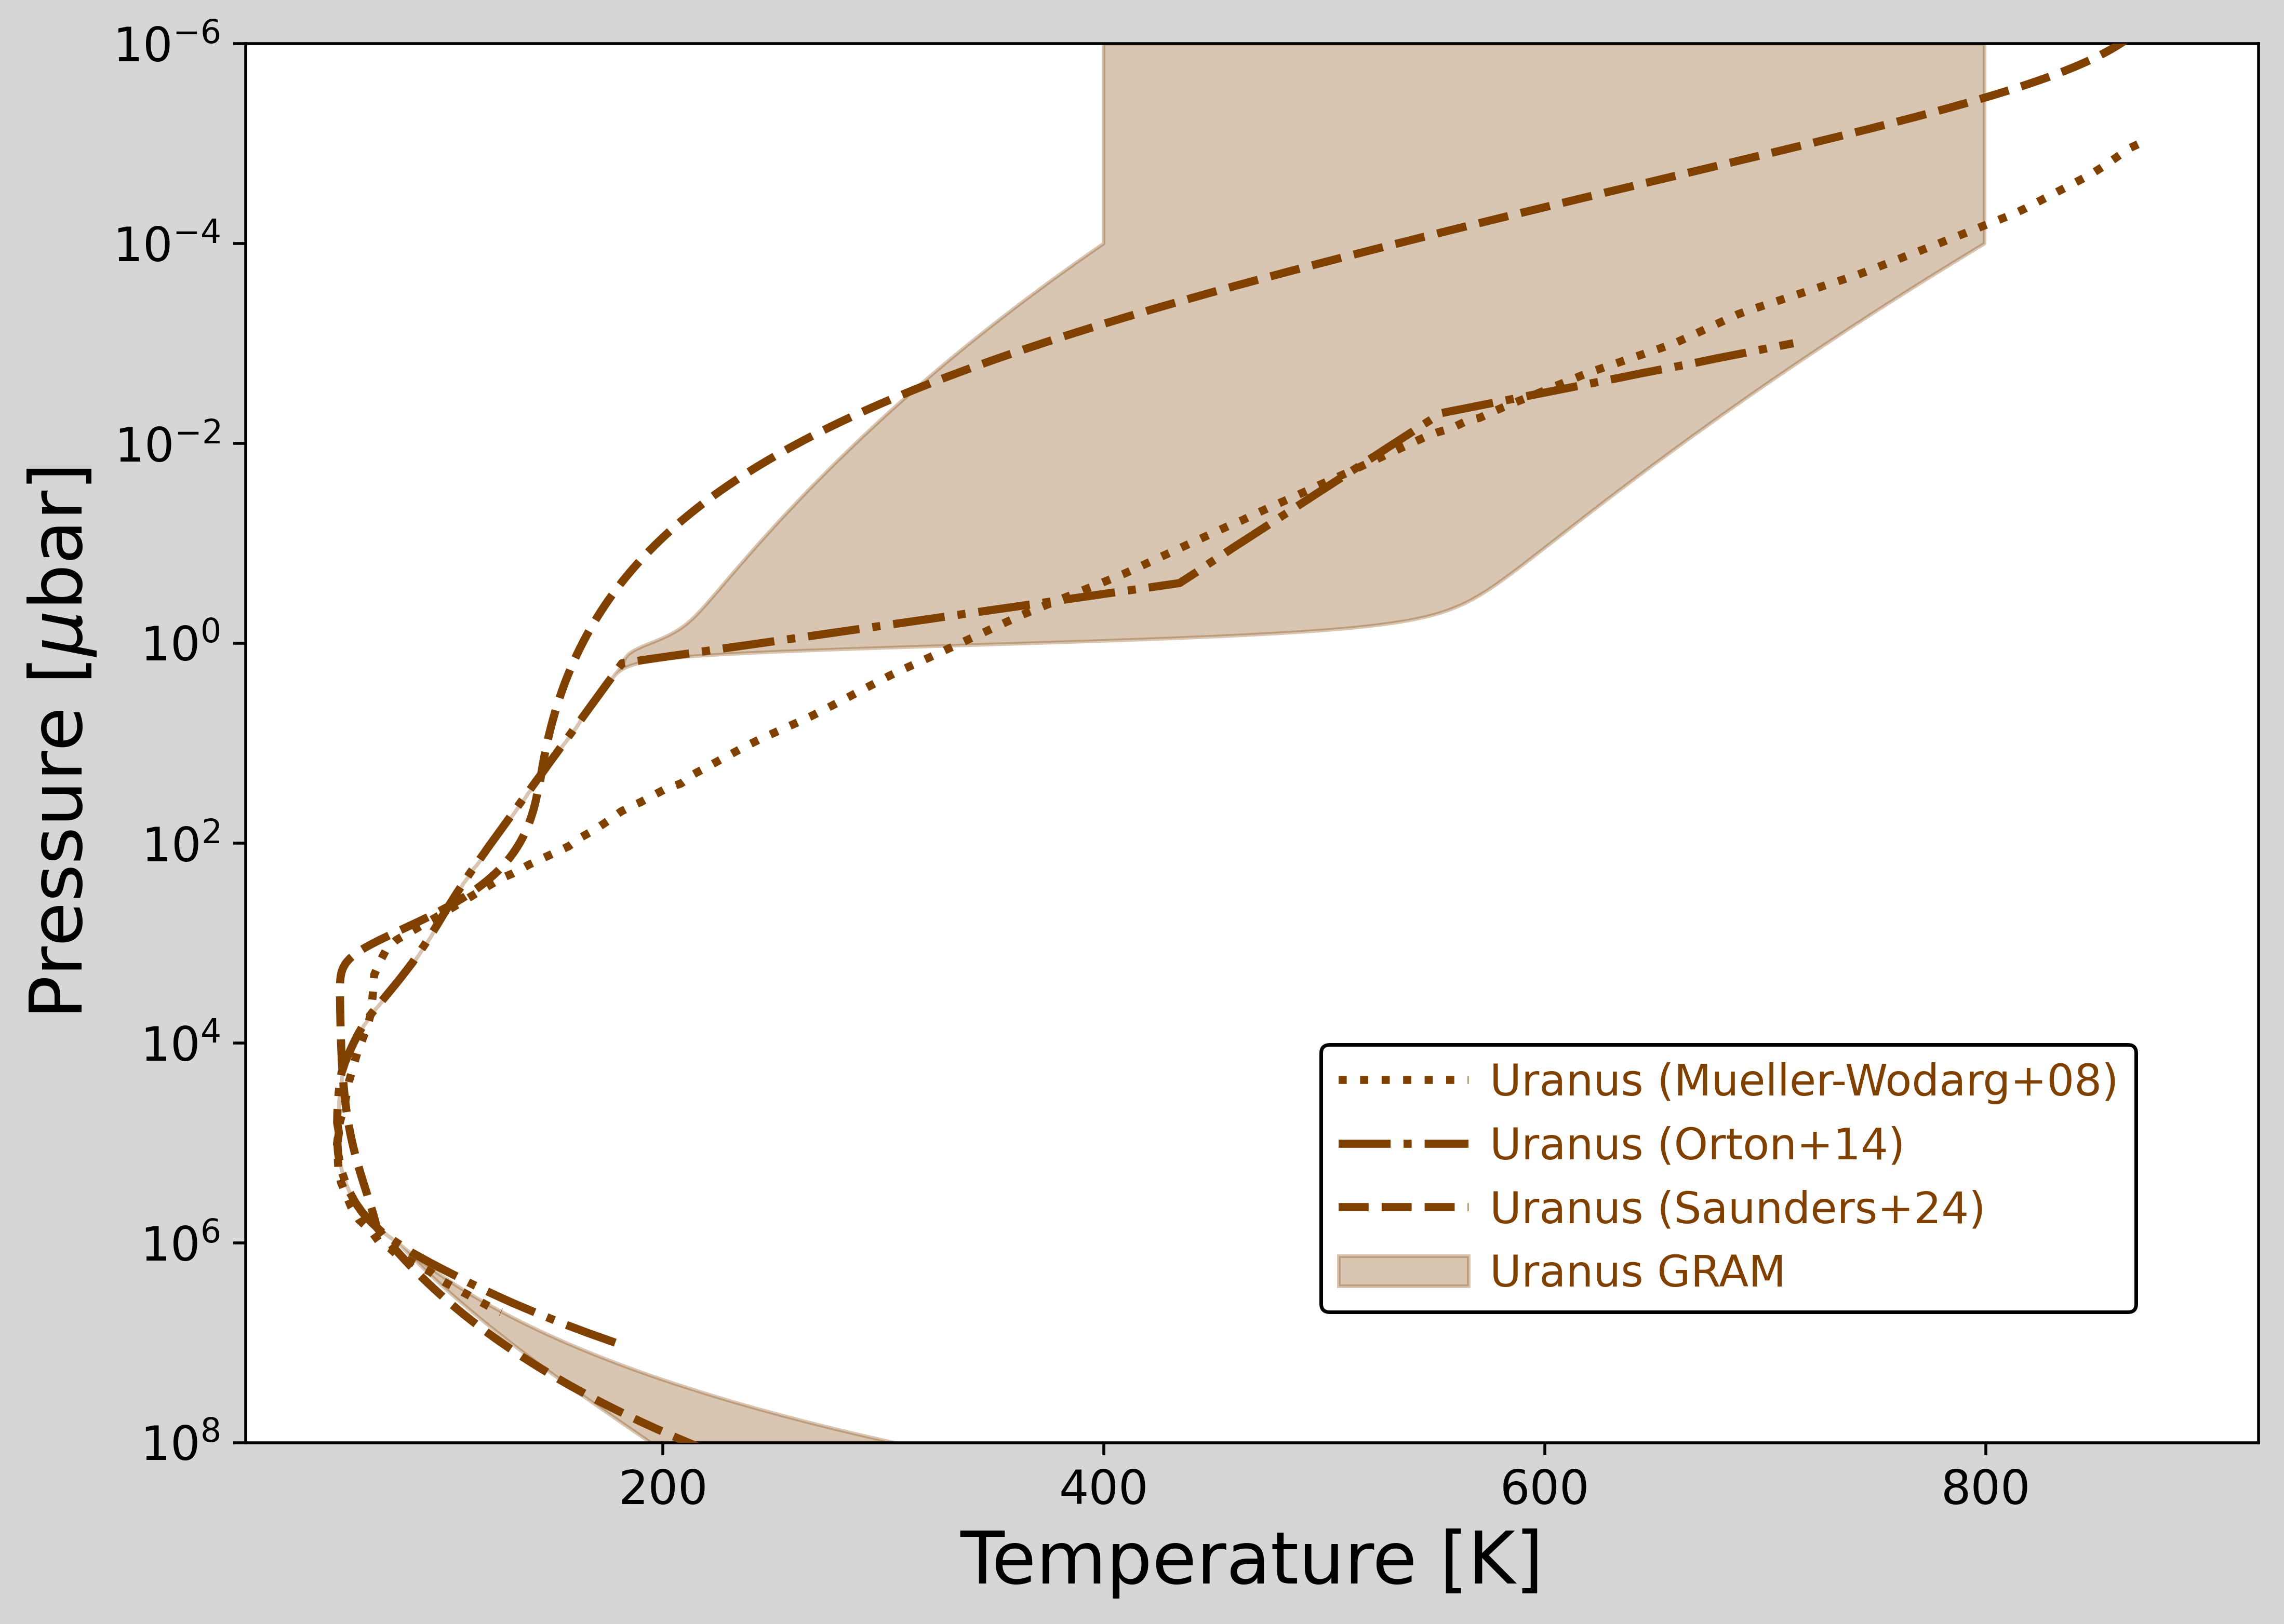
Implications for Aerocapture
Stellar occultations can be used to distinguish between Uranus models, and create an updated model.
Zone of stellar occultations
Periapsis of aerocapture

Slide 11
Upcoming Uranus Occultations
2031-02-15
2031-04-30
2032-02-06
2025-04-08
Saunders et al. (2022, P&SS)

Slide 12
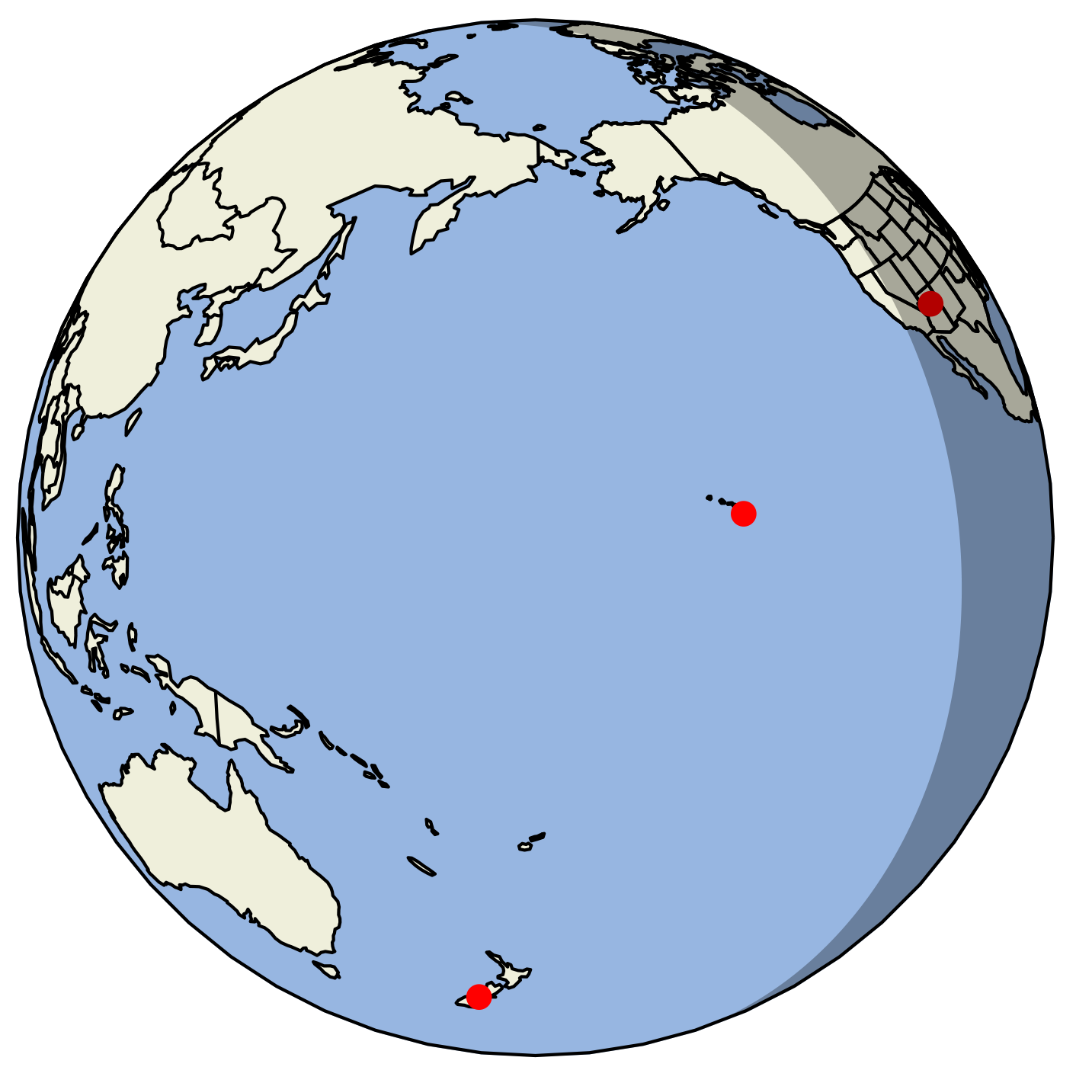
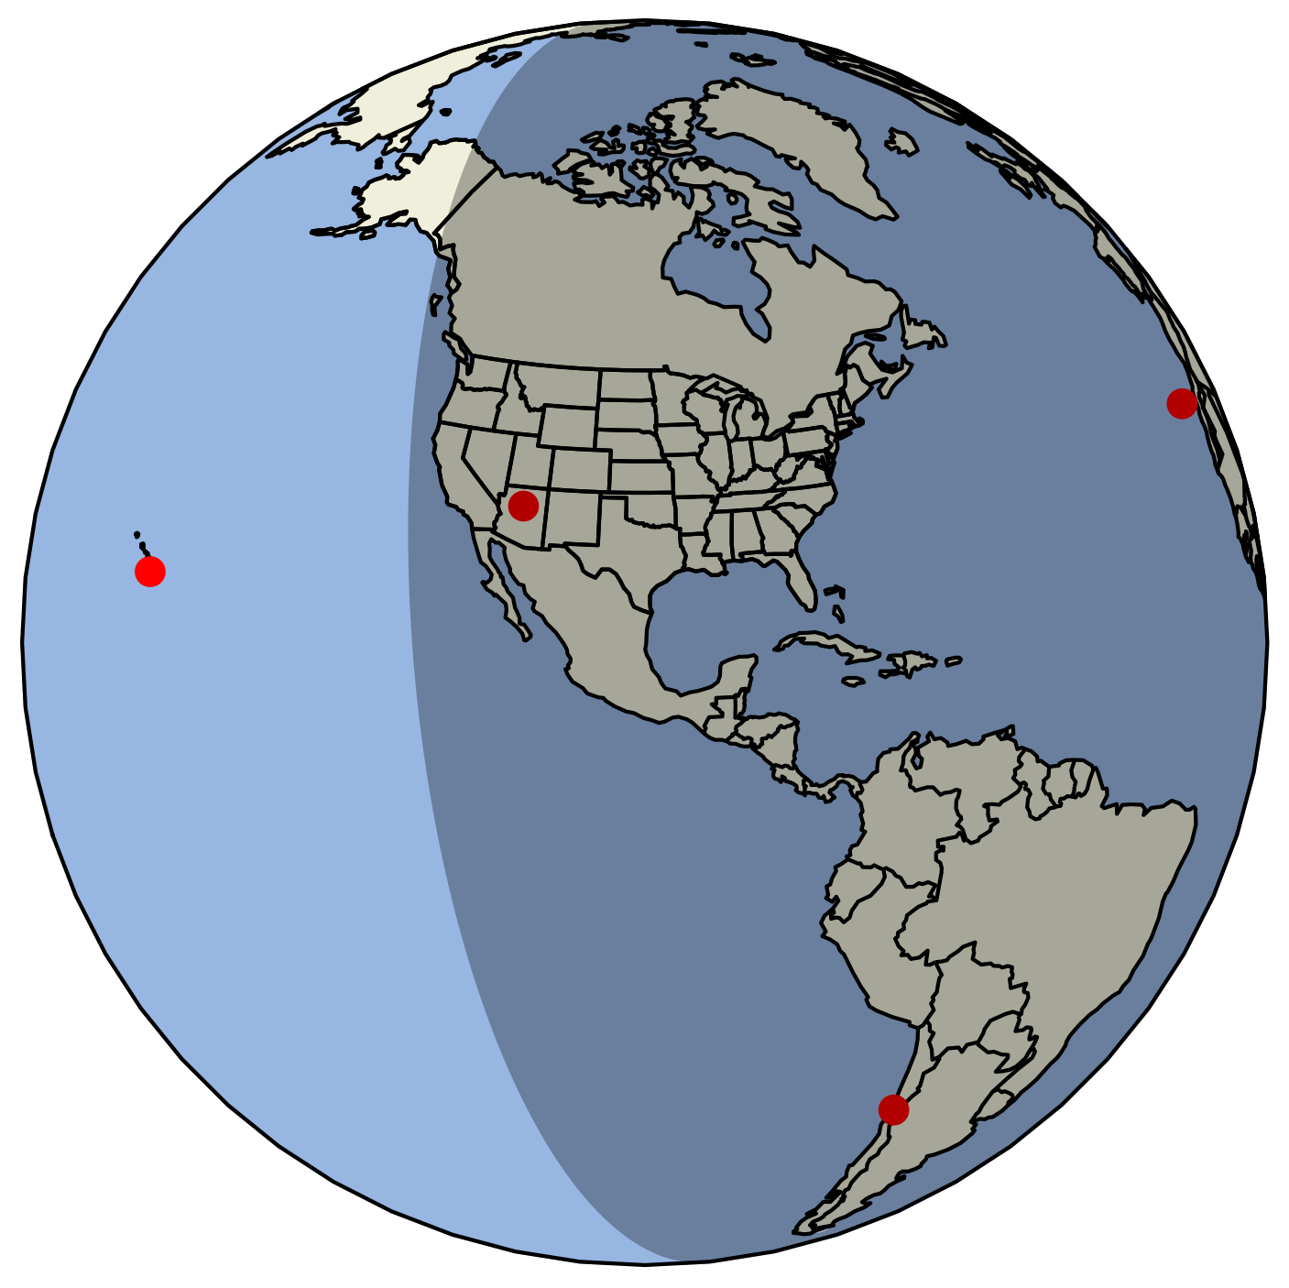
2025-04-08
2031-02-15
R mag: 8.6, K mag: 7.9
35º solar separation
5 observatories planned
R mag: 8.1, K mag: 4.2 (!)
Velocity: 5 km/s (!)
Shadow Chaser: small satellite mission to observe occultations above the atmosphere (Saunders et al. 2022)
See talk P41A-07 by Kunio Sayanagi

Slide 13
New stellar occultation processing methods (Saunders et al. 2023, 2024)
Upcoming Uranus occultations (2025, 2031)
Critical measurements: Constrain the stratospheric density of Uranus
UOP with aerocapture
UOP arrives at Uranus by equinox (2050)
Critical science:
Temperature structure, variations, role of gravity waves, other dynamics, energy transport
Critical TRL:
Earth aerocapture demonstration (led by Soumyo Dutta at LaRC)
2023 ADRAT report: #1 uncertainty for aerocapture at Uranus is stratospheric density
William Saunders | NASA Langley | william.r.saunders@nasa.gov

