Slide 1

National Aeronautics and Space Administration
NASA 2.7%-Scale High Lift Common Research Model (CRM-HL) Test in the National Transonic Facility (NTF)
12/13/2024 High Lift Common Research Model Ecosystem Meeting
Courtney Winski, Melissa Rivers, Miranda Ertsgaard, NASA LaRC

Slide 2
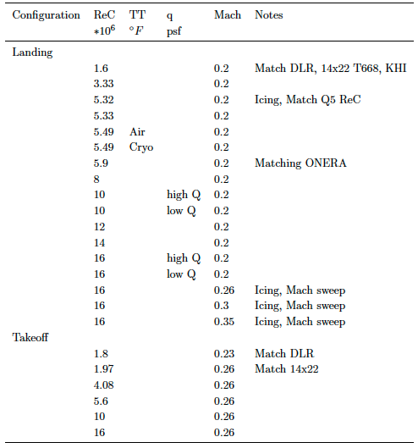
NASA 2.7%-Scale CRM-HL Full-span NTF Test
February 2024 entry
  Forces and moments
  Model pressures
  Wing deformation
Takeoff and landing
Comparison runs with previous tests
Ice shapes
Configuration | Slat | Flap IB | Flap OB | Nacelle | Horizontal Tail | Notes
Landing | 30° | 40° | 37° | on | on
Landing Icing | 30° | 40° | 37° | on | on | Ice shapes
Landing | 30° | 40° | 37° | on | off | Baseline
Takeoff | 22° | 25° | 25° | on | on
Takeoff | 22° | 25° | 25° | on | off | Baseline

Slide 3
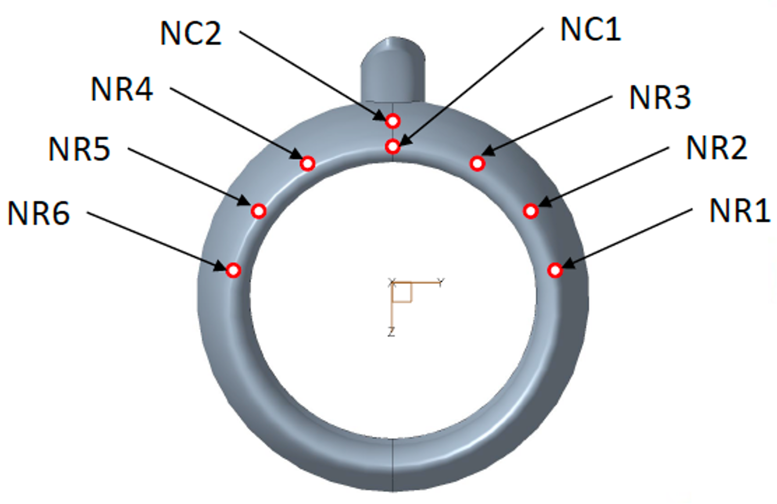
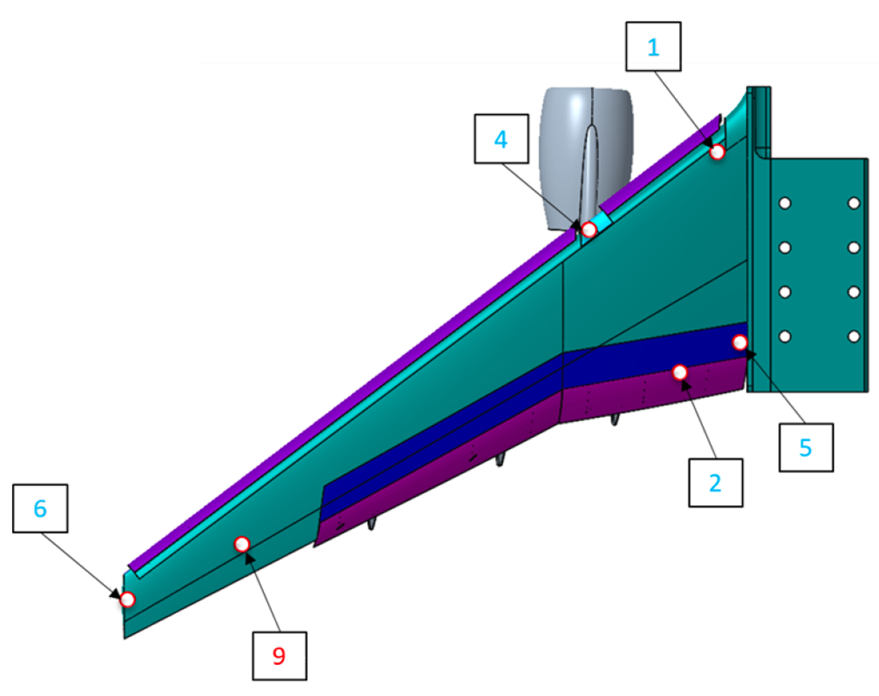
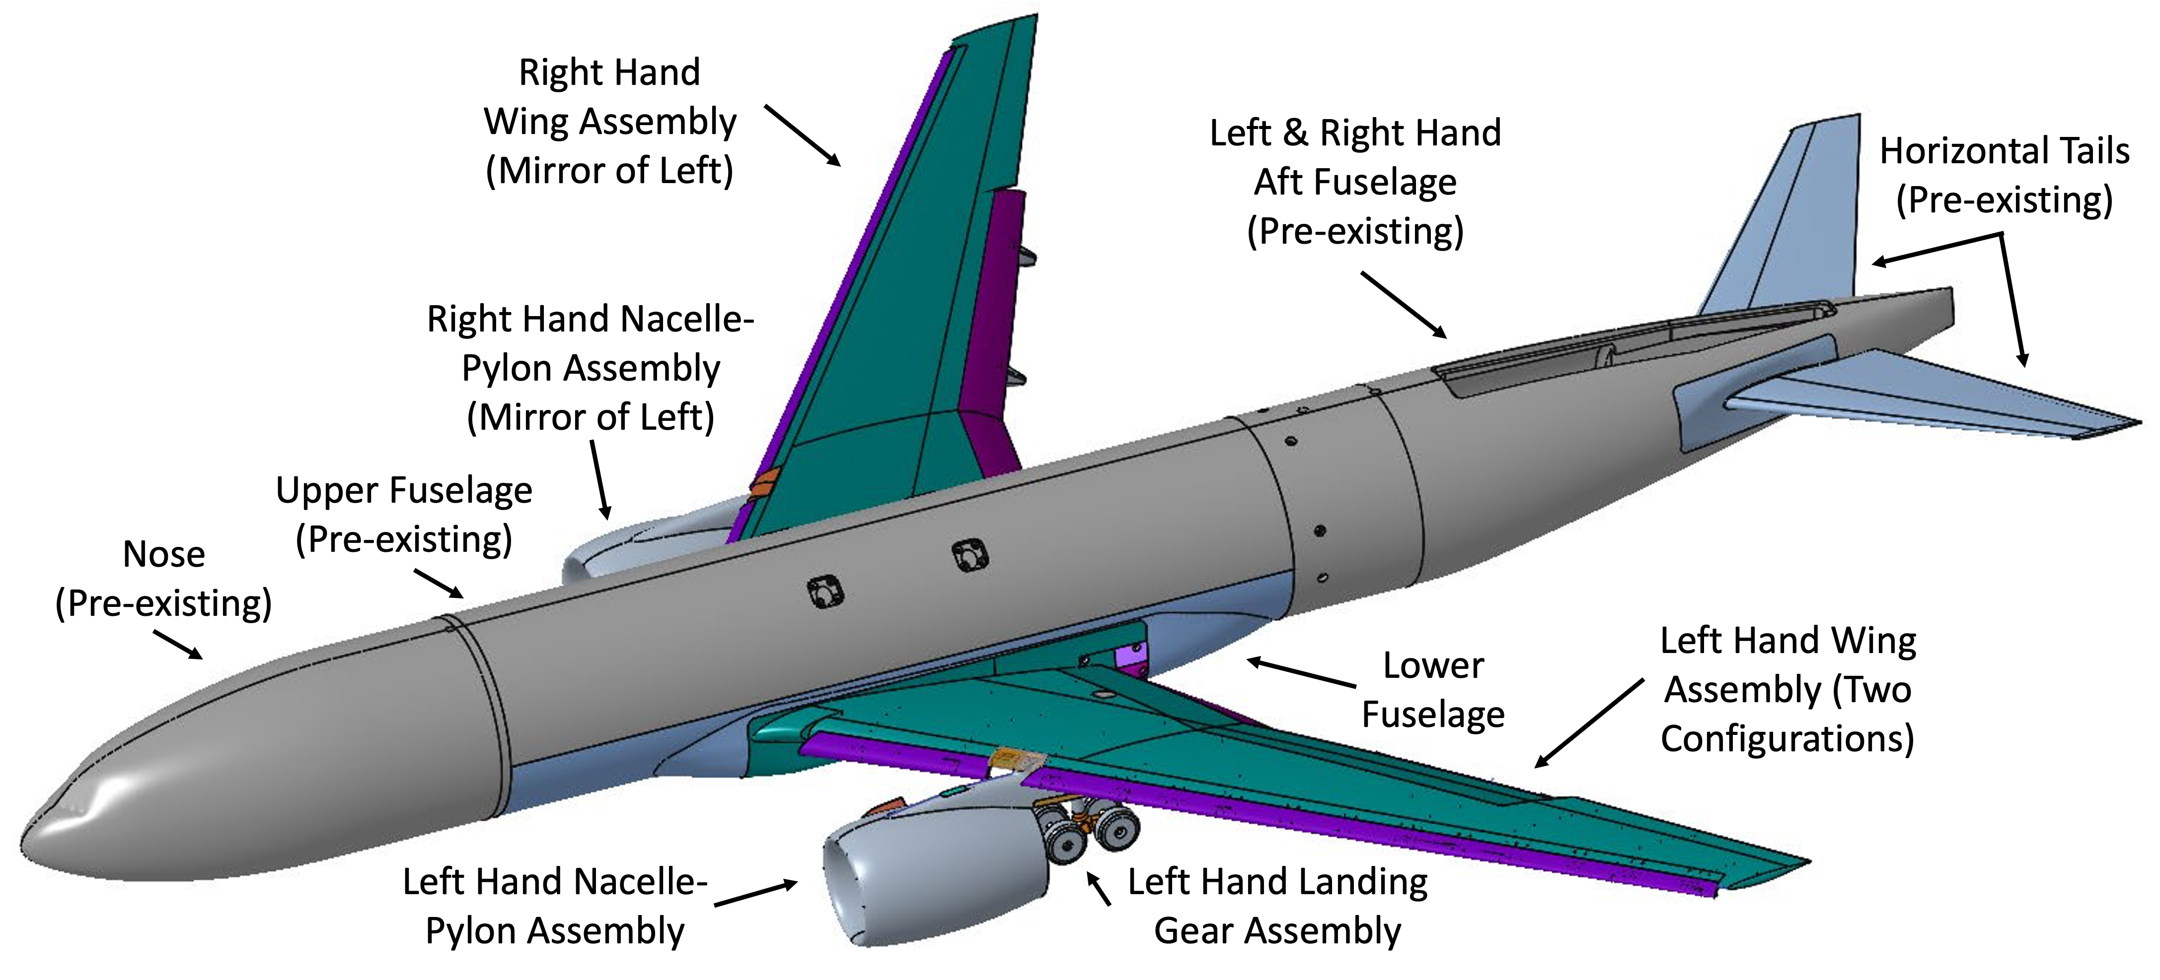
NASA 2.7%-Scale CRM-HL Geometry
2.7%-scale version of the High Lift Common Research Model (CRM-HL) reference geometry
Baseline Ecosystem configurations
  Landing
  Takeoff
Full-span and Semispan model
Designed for the National Transonic Facility (NTF)
  Temperature: -250°F to 120°F
  Max dynamic pressure: 380 psf
  Angle of attack: -4° to 22°
Modular design
  Slat angle
  Inboard and outboard flap angle
  Nacelle
    Chine radial location
  Landing gear
  Allows testing of other nonoriginal parts
3D printed NASA nacelle and landing gear
  8 pressure taps built into the port nacelle design
6 Kulites on each wing
8 pressure ports on port nacelle
3

Slide 4
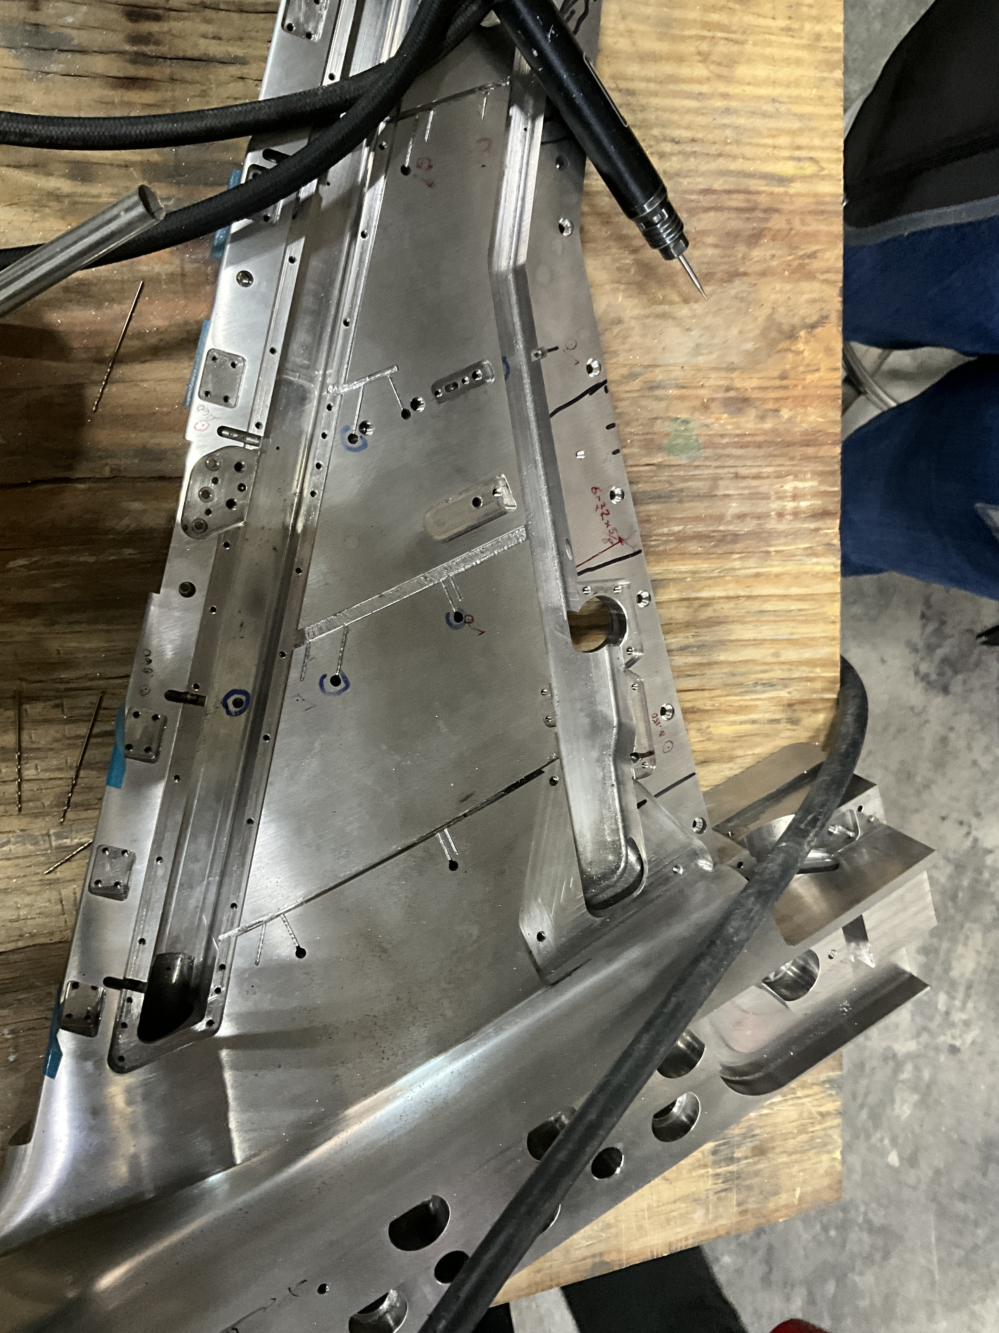
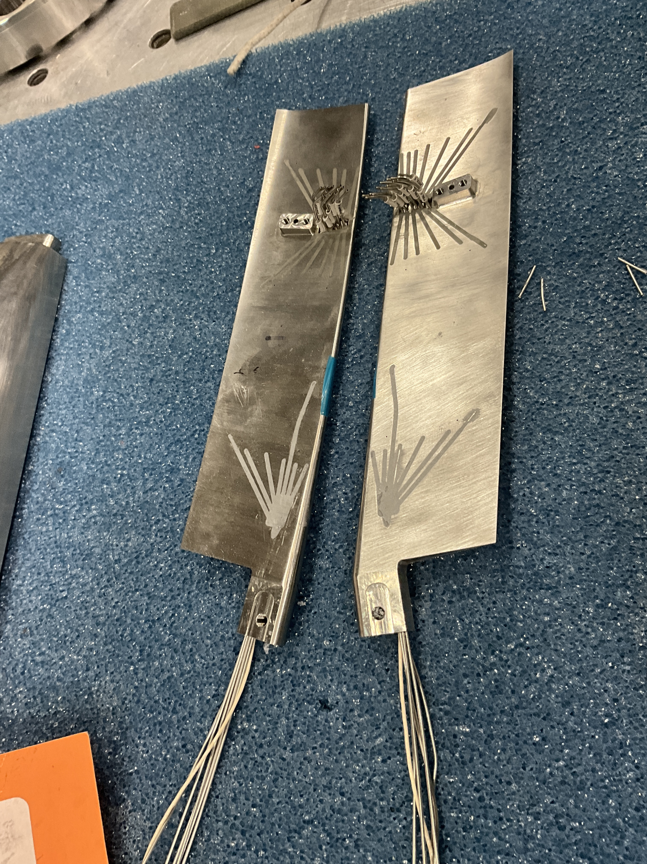
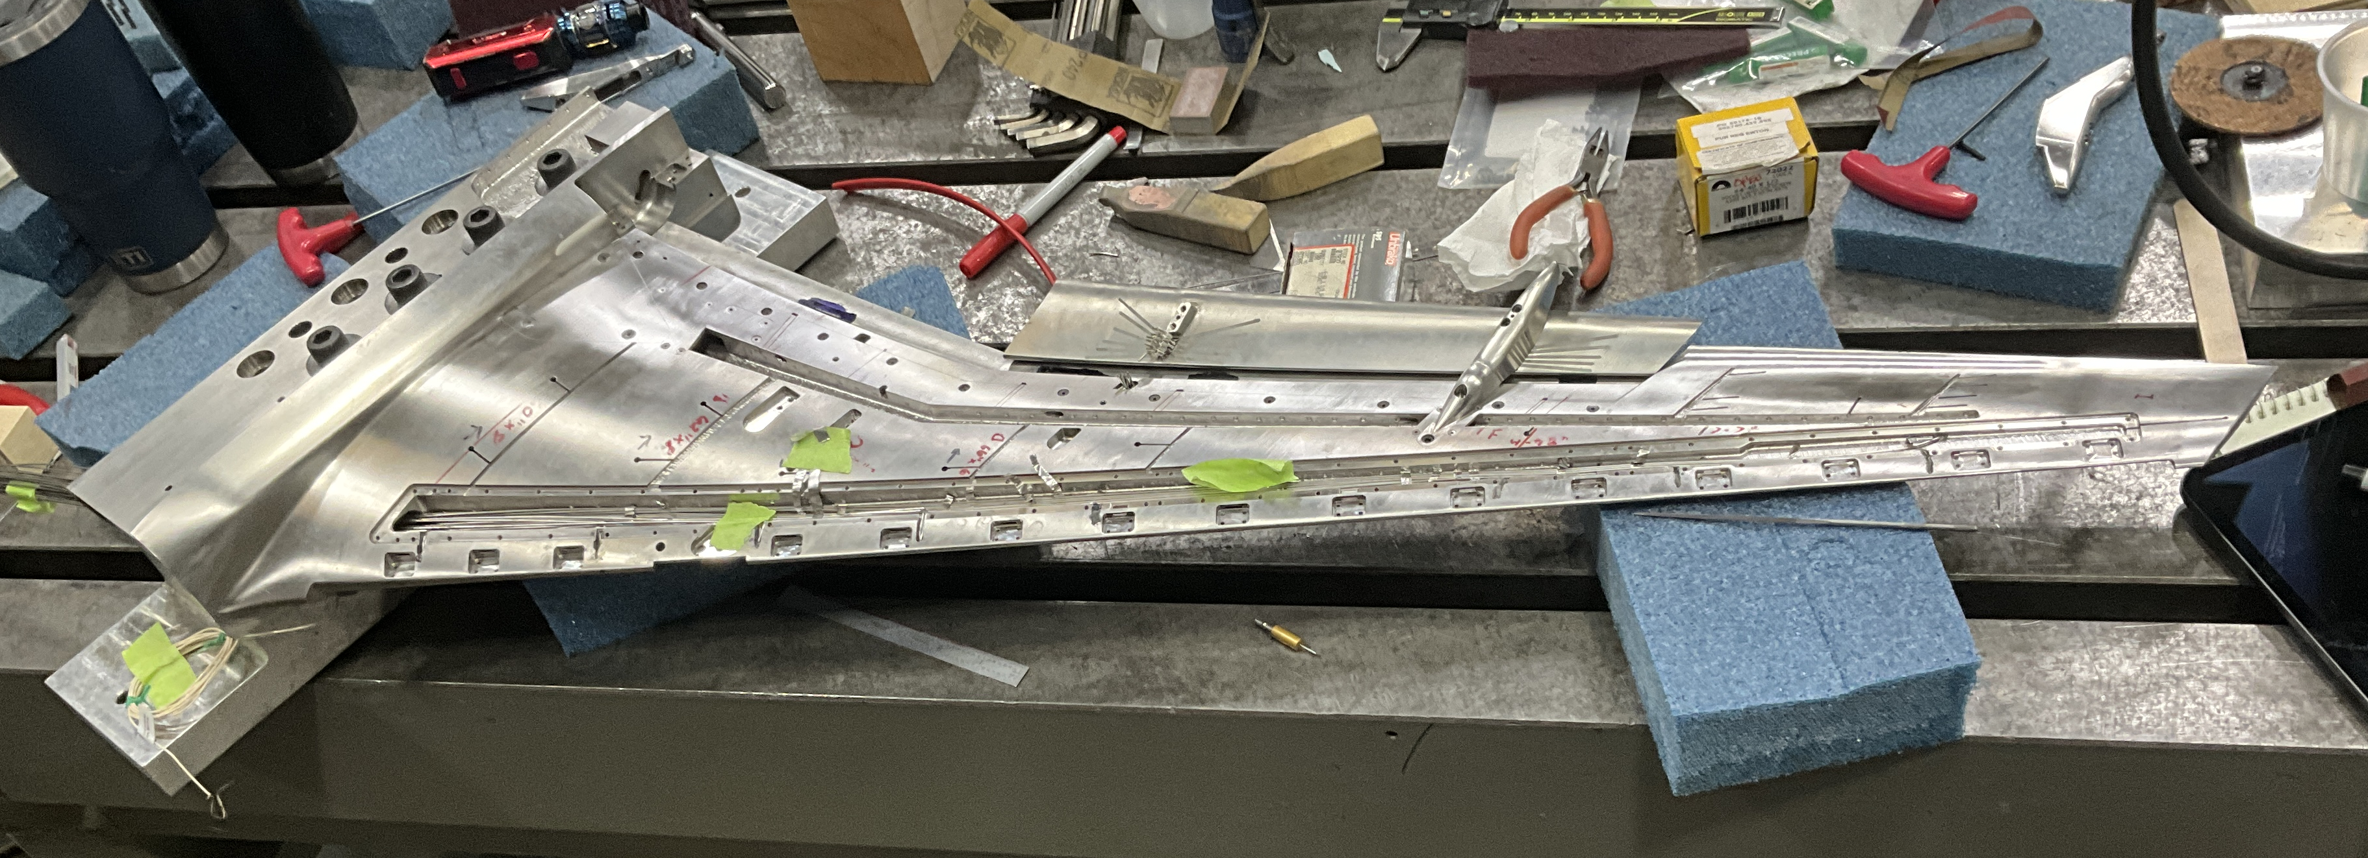
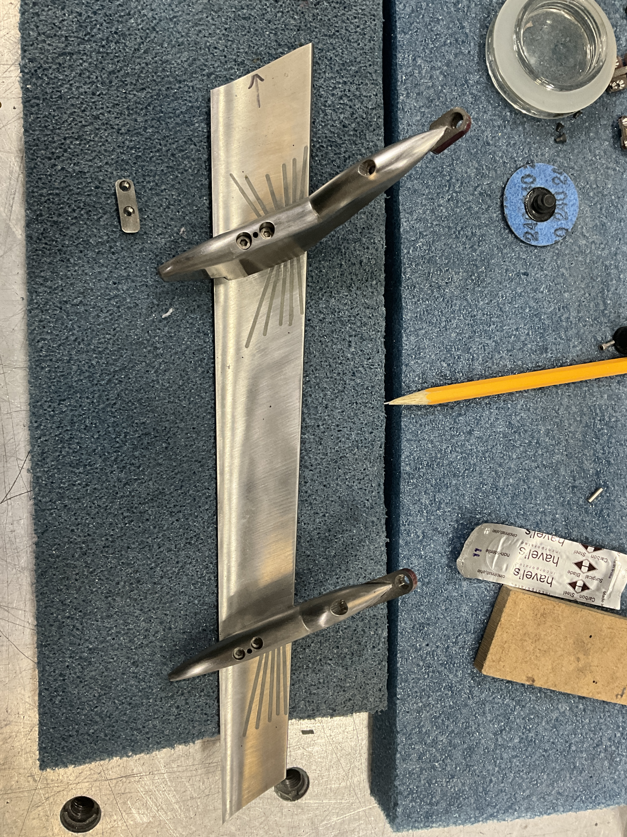
NASA 2.7%-Scale CRM-HL Model Fabrication
Photo Credit: NASA
Photo Credit: NASA
Photo Credit: NASA
Photo Credit: NASA

Slide 5
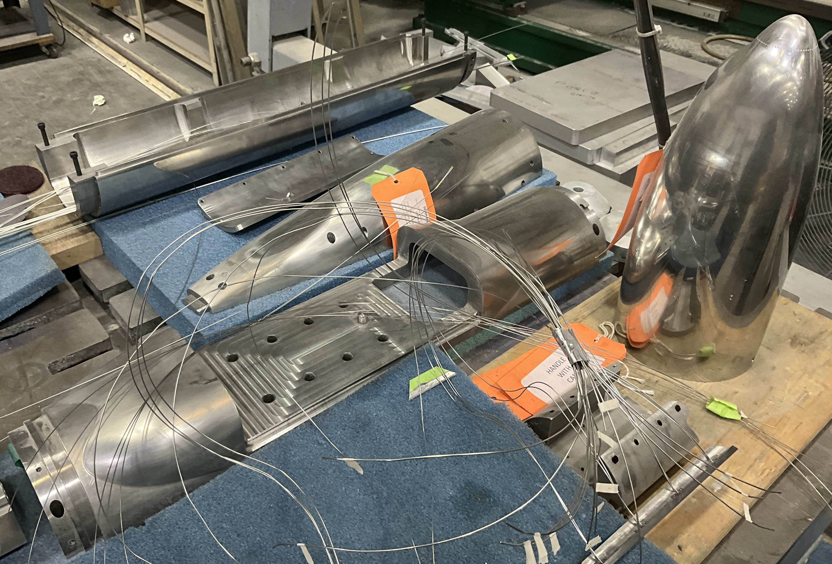
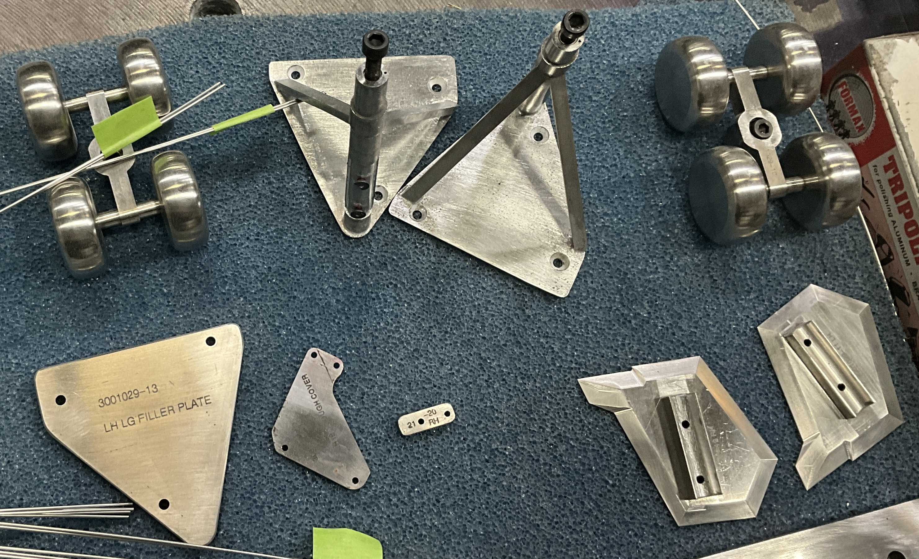
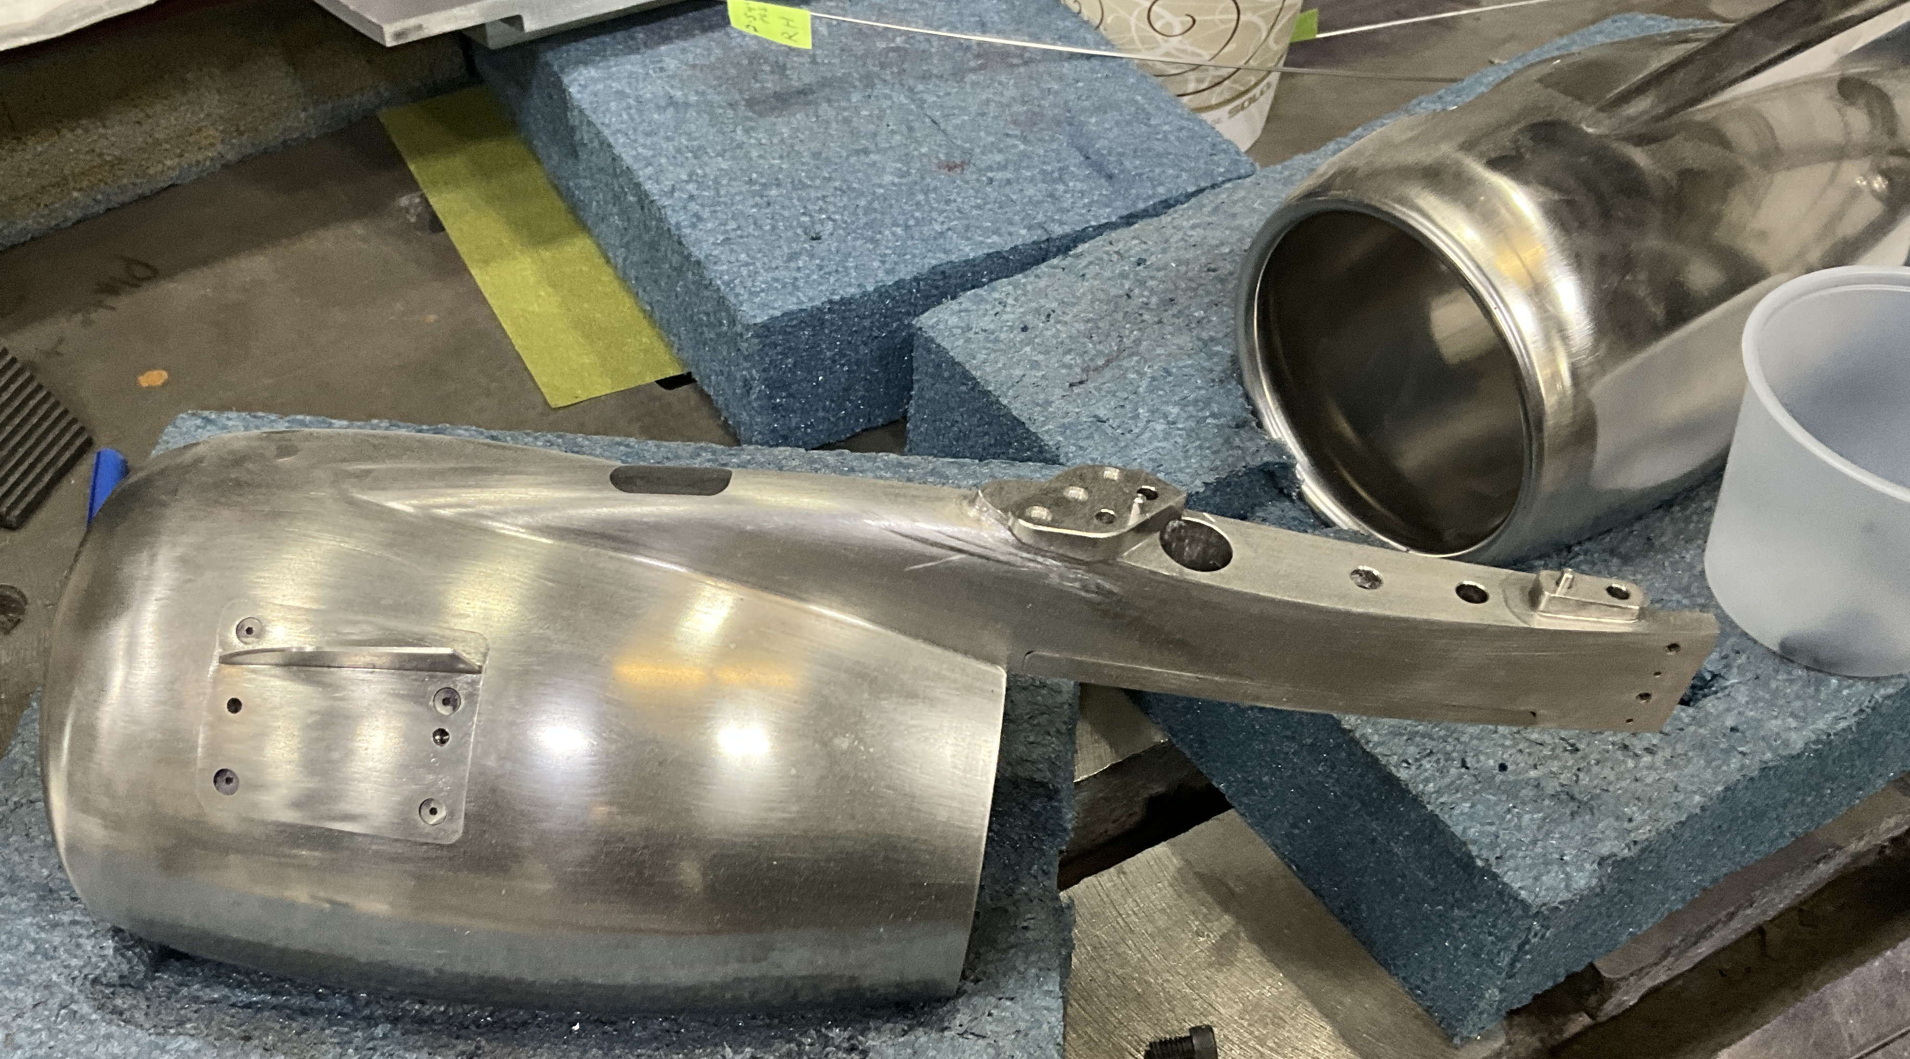
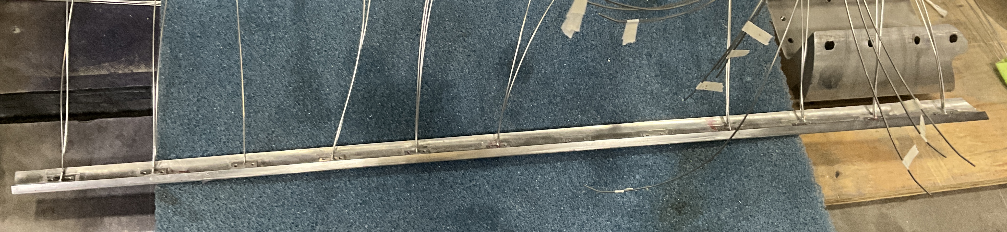
NASA 2.7%-Scale CRM-HL Model Fabrication
Photo Credit: NASA
Photo Credit: NASA
Photo Credit: NASA
Photo Credit: NASA

Slide 6
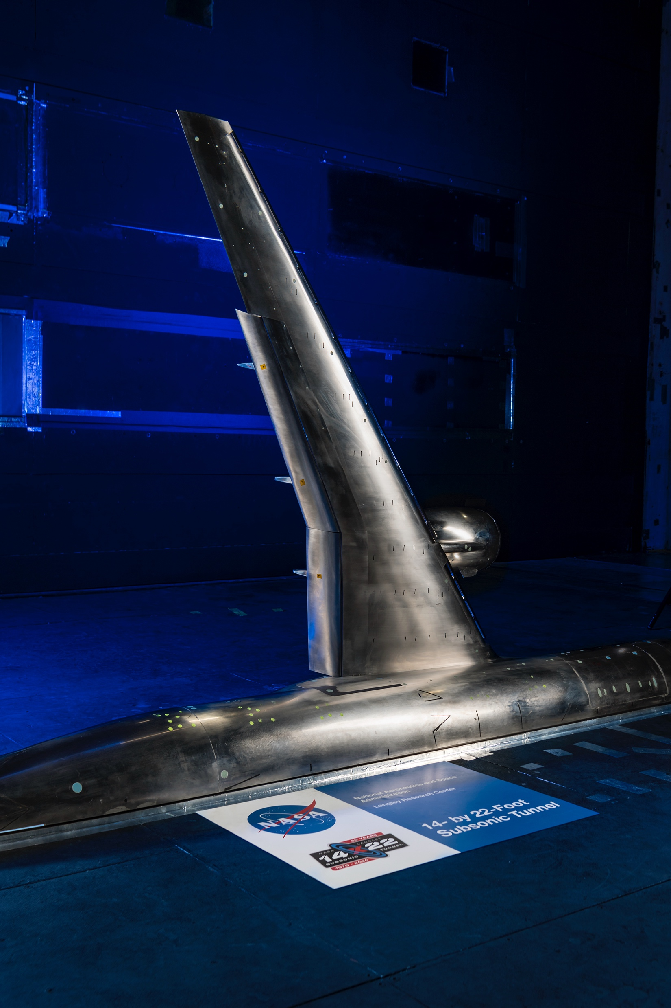
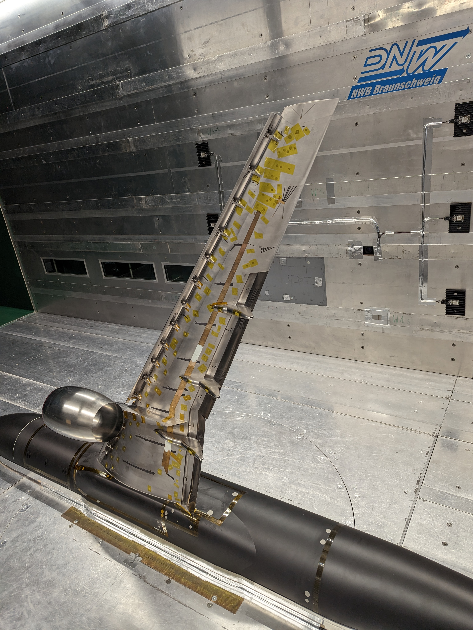
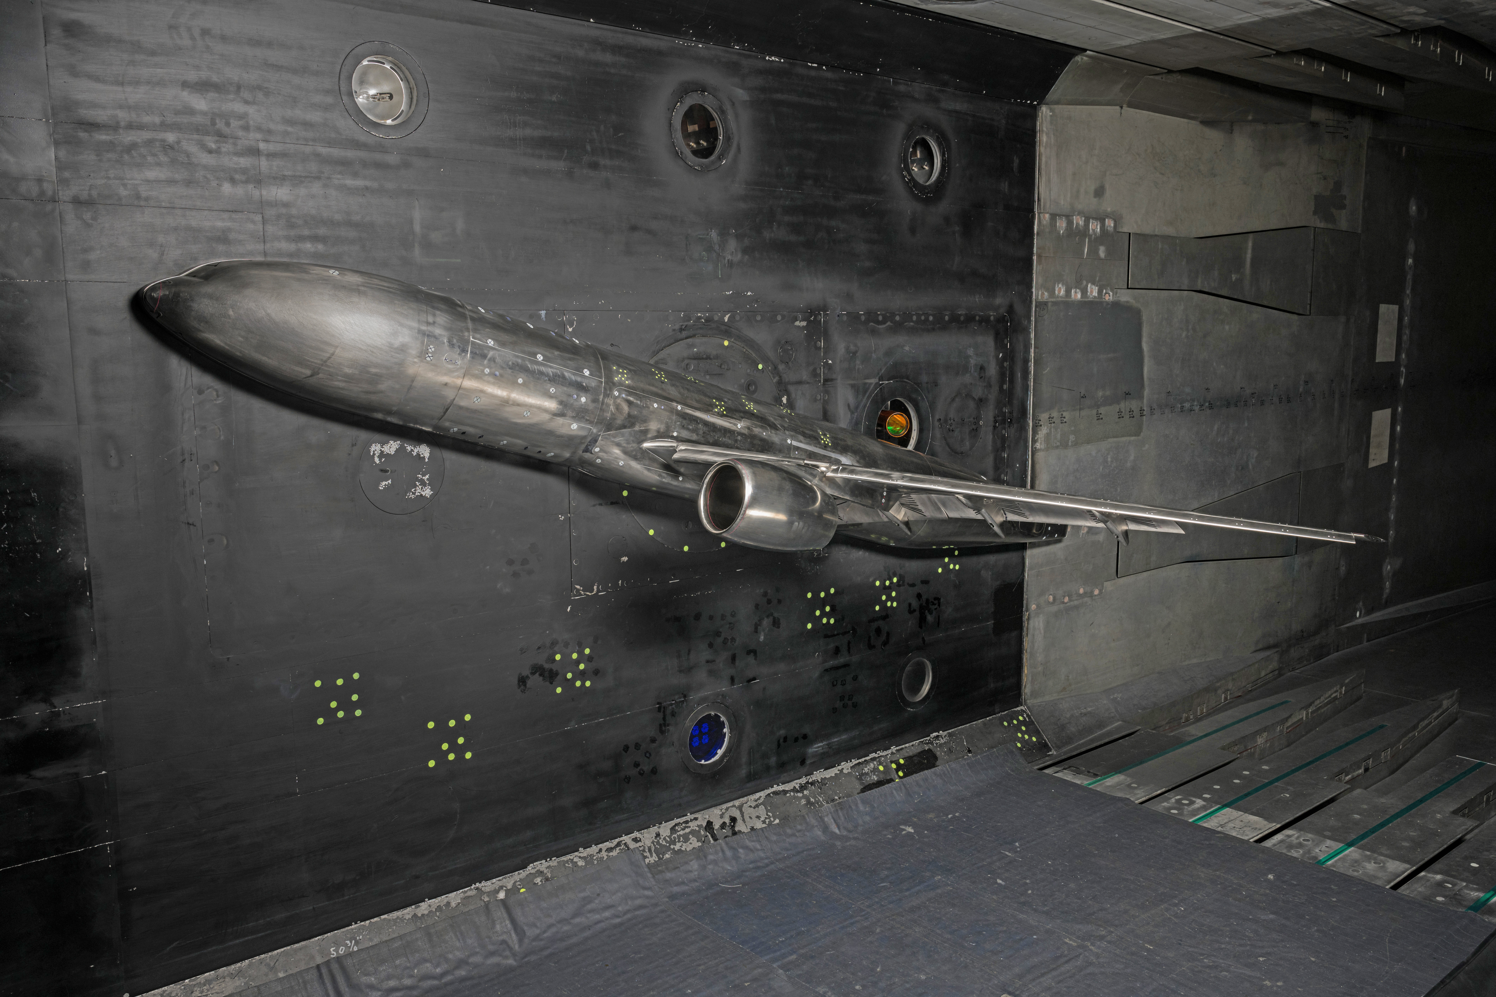
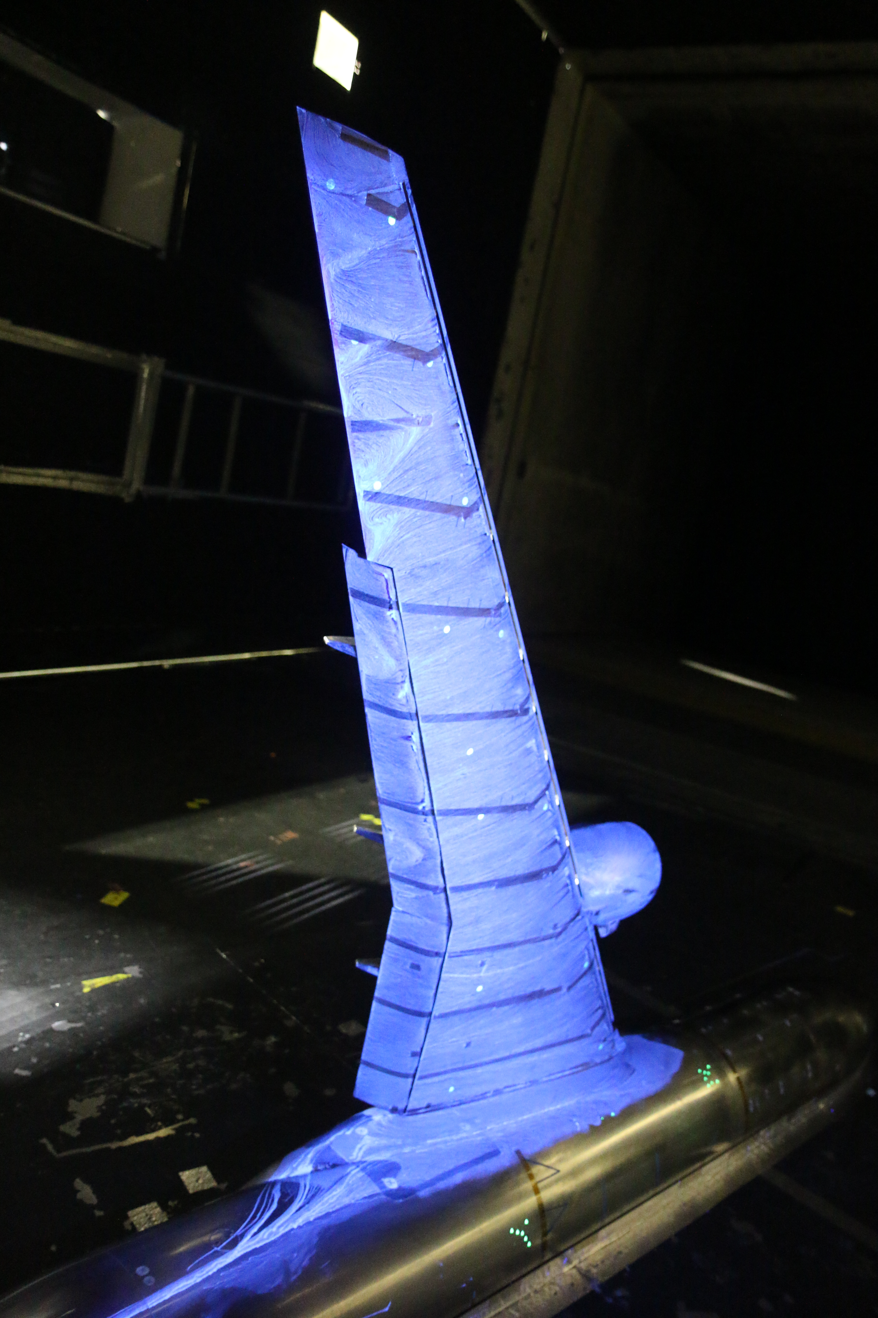
NASA 5.2%-Scale CRM-HL Model Tests
Photo Credit: NASA
High Reynolds number test at the NASA LaRC NTF
Jan. 3 through May 23, 2024
Photo Credit: NASA
Photo Credit: DLR
Model checkout test at the NASA LaRC 14x22 Aug. 15 through Sep. 8, 2022
DLR test at the Low-Speed Wind Tunnel at Braunschweig (NWB)
May 9 through July 6, 2023
Flow visualization test at the NASA LaRC 14x22
Sep. 23 through Sep. 26, 2024
Photo Credit: NASA

Slide 7
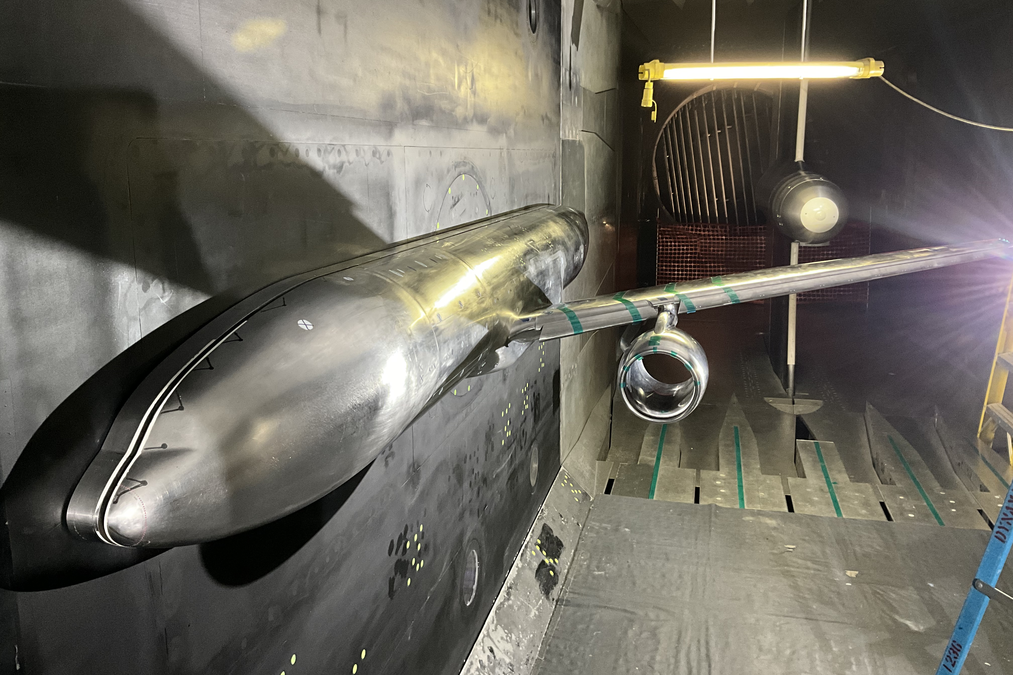
Future NASA CRM-HL NTF Testing
NASA 2.7%-scale full-span model
  February 2024 entry
    Forces and moments
    Model pressures
    Wing deformation
NASA 5.2%-scale semispan model
  Second NTF entry in February 2026
    Surface and off-body flow field measurements
NASA 2.7%-scale semispan model
  August 2026
    Forces and moments
    Model pressures
    Wing deformation
Photo Credit: NASA

Slide 8
Questions?
Photo Credit: NASA
courtney.s.winski@nasa.gov

