Slide 1
Parallel Hybrid Turboprop Performance Modeling and Optimization
Noah Listgarten*
Dahlia Pham*, Carlos Natividad*, Benjamin Margolis*, Kenneth Lyons*, Joseph Garcia*, Jefferey Bowles▴, Catherine Russell★
* NASA Ames Research Center
▴ Ames Associates
★ Rice University

Slide 2
Goals
Goal: model conversion of conventional turboprop into hybrid turboprop
Motivation: Electrified aircraft reduce emissions
Aircraft Selection: DHC-8-400 (Q400)
Until recently, only turboprop flown by major U.S. passenger airline
750nm max-payload mission selected

Slide 3
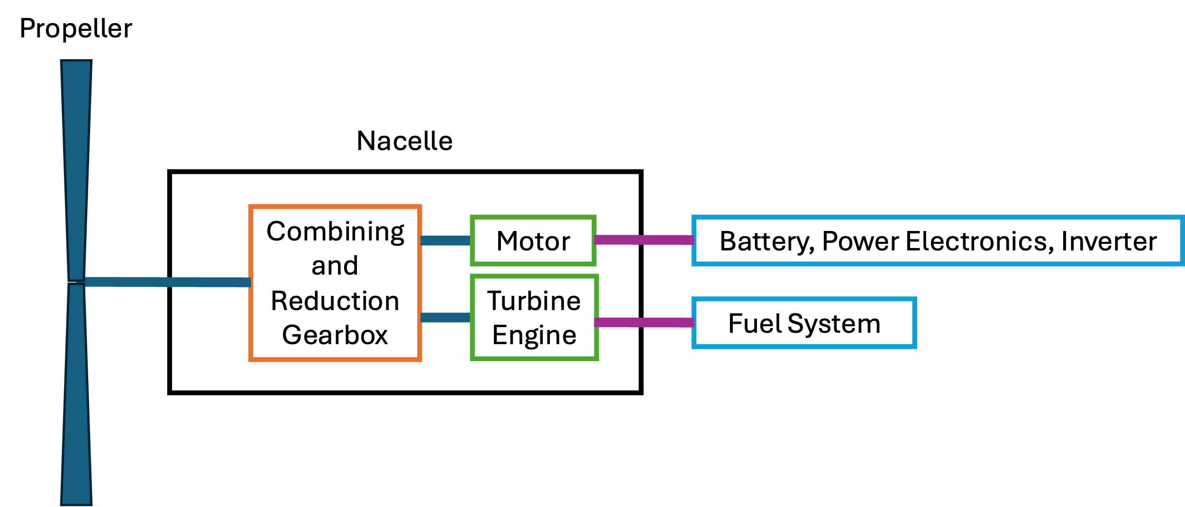
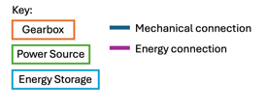
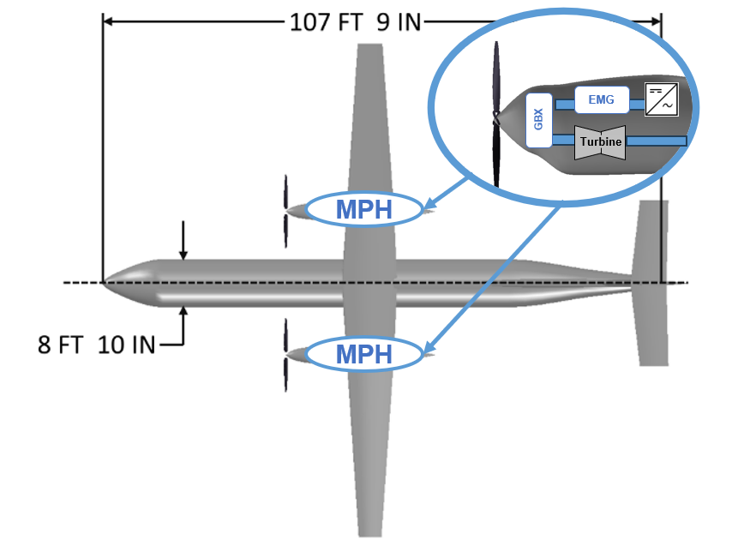
Introduction
Electrified Powertrain Flight Demonstration (EPFD) project
Collaboration between NASA and U.S. industry partners
Enable a new generation of electrified aircraft propulsion (EAP) technologies
Parallel Hybrid DHC-8-400 (Q400) concept development
Moderate hybridization (MW-class)
SOTA/near-term technology (300 Wh/kg)
Maintain 750 NM range at max payload
Trade-off payload (pax capacity) vs battery
Hybrid
Hybrid

Slide 4
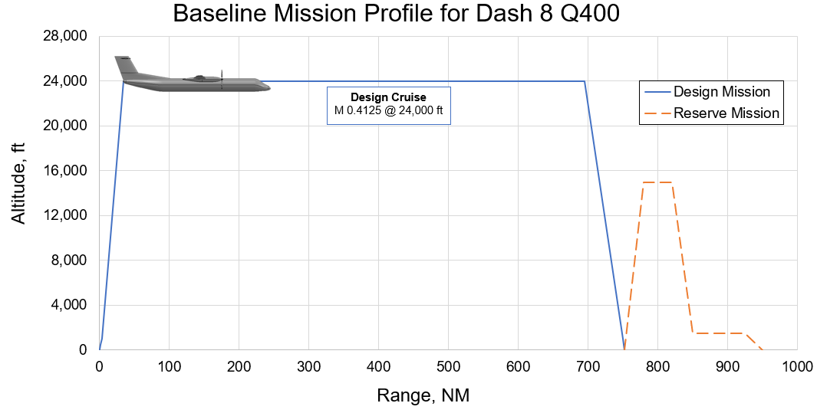
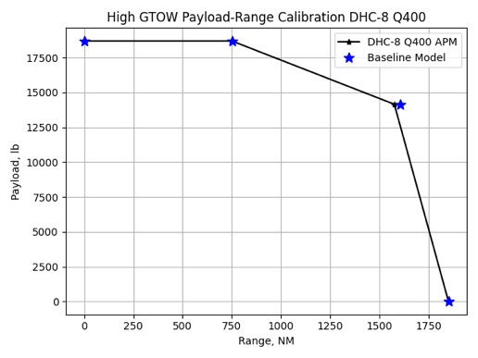
Conventional DHC-8-400 Model
Vehicle Parameter | DHC-8-400 from APM | Gascon DHC-8 Model | Percent Difference
Gross Takeoff Weight, lbf | 63,750 | 63,750 | 0%
Operating Empty Weight, lbf | 37,804 | 38,168 | 0.95%
Max. Payload Weight, lbf | 18,696 | 18,532 | -0.88%
Engine Rated Power, shp Max. Takeoff Max. Continuous | 5,071 5,071 | 5,071 5,071 | 0% 0%
Wing Area, ft² | 680 | 680 | 0%
Wing Span, ft | 93.25 | 93.30 | 0.05%
Total Loaded Fuel (750 NM), lbf | 7,250 | 7,038 | -2.92%

Slide 5
Hybrid DHC-8-400 Model
Preserve
Range capability
Fuel capacity
Study tradeoffs
Battery capacity
Payload weight
Assumptions
Technology levels (SOTA/near-term)
Retrofit-style approach (not new design)
Other assumptions are listed on the right
Parameter | Conventional | Hybrid
Takeoff weight | 63,750 lbm | 63,750 lbm
Range at MTOW | 750 NM | 750 NM
Design payload | 82 passengers | 62 passengers
Battery specific energy | N/A | 300 Wh/kg
Motor size | N/A | 950 kW (1274 hp)
E-boost on altitude | N/A | 15,000 ft
Cruise altitude | 24,000 ft | 21,000 ft (result)
Cruise speed | M=0.4125 (250 KTAS) | M=0.406 (250 KTAS)
Cruise power split | 0 (all power conv) | 0 (all power conv)
E-taxi | No | No
In-air electrical generation | No | No

Slide 6
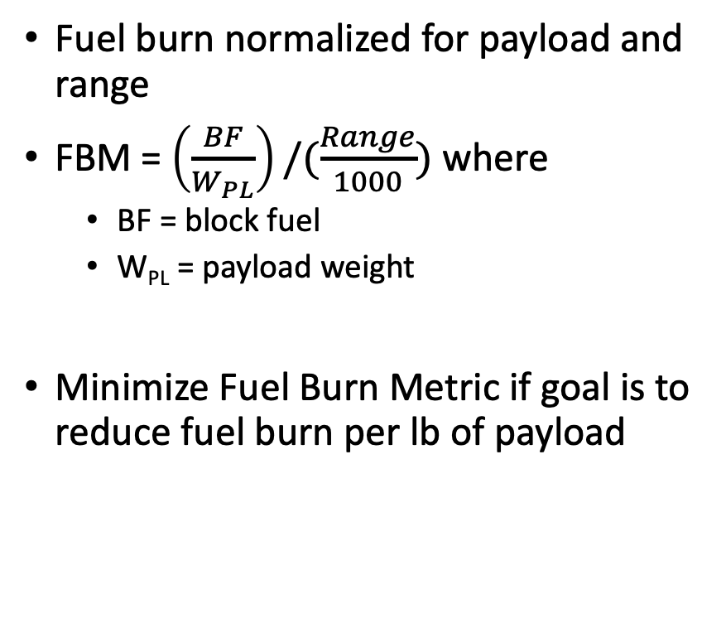
Metrics of success: block fuel and fuel burn metric
Block Fuel (BF)
Fuel Burn Metric (FBM)
Amount of fuel burned for the nominal mission (does not include reserve mission)
Units: lb fuel burned
Minimize Block Fuel if goal is to reduce amount of fuel burned, and payload weight capacity is less important (volume constrained cargo or lighter passenger route)
Fuel burn normalized for payload and range
FBM = $\left(\frac{BF}{W_{PL}}\right)/(\frac{Range}{1000})$ where
BF = block fuel
W_{PL} = payload weight
Minimize Fuel Burn Metric if goal is to reduce fuel burn per lb of payload

Slide 7
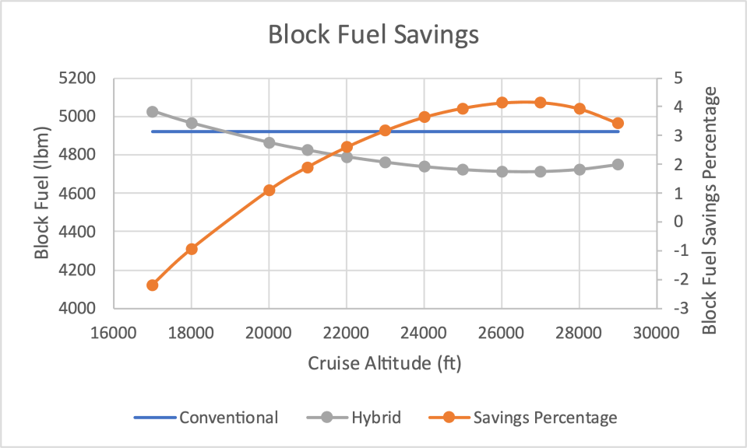
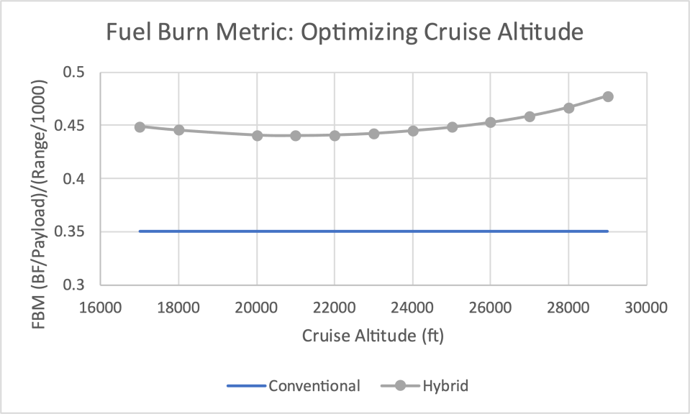
Mission 1: 750 NM mission optimal altitude
Optimal for maximum block fuel savings: 27,000 ft
Optimal for minimum fuel burn metric: 21,000 ft

Slide 8
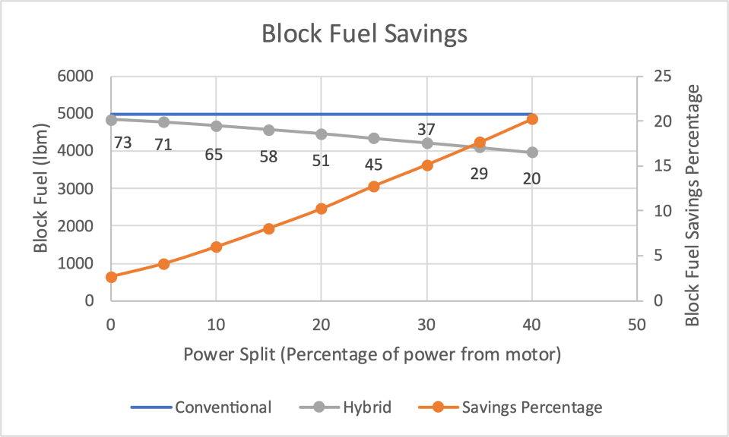
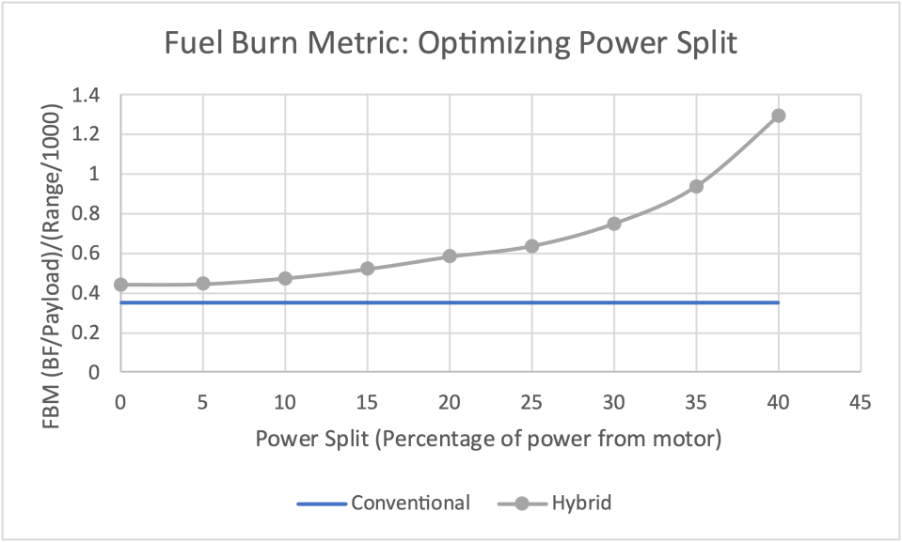
Mission 2: 750 NM cruise power split
40/60 (electric/conventional) power split:
20% Block Fuel Savings
Small payload capacity (20 passengers)

Slide 9
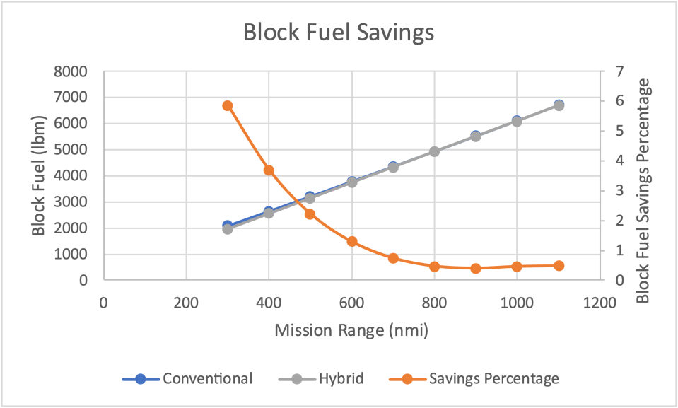
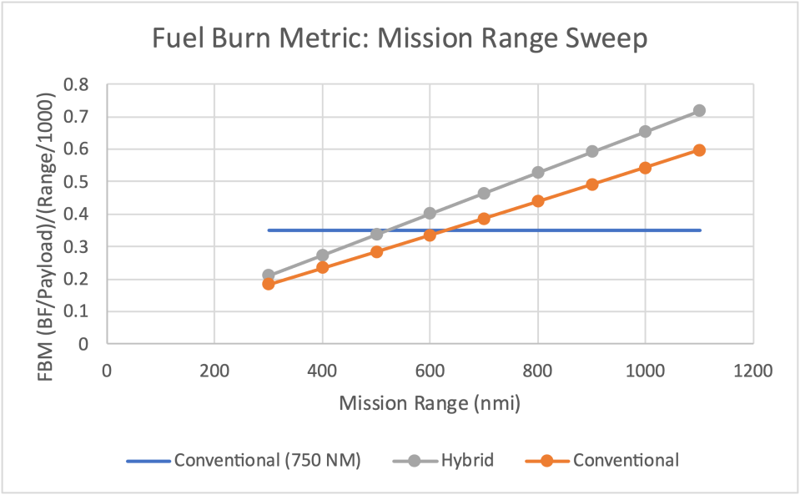
Mission 3: Off-design range sweep
Block fuel savings: up to 6%
Conventional aircraft GTOW is allowed to fluctuate

Slide 10
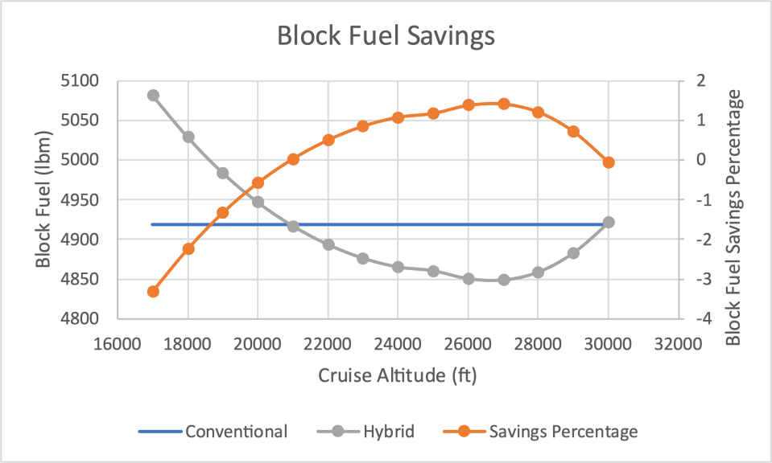
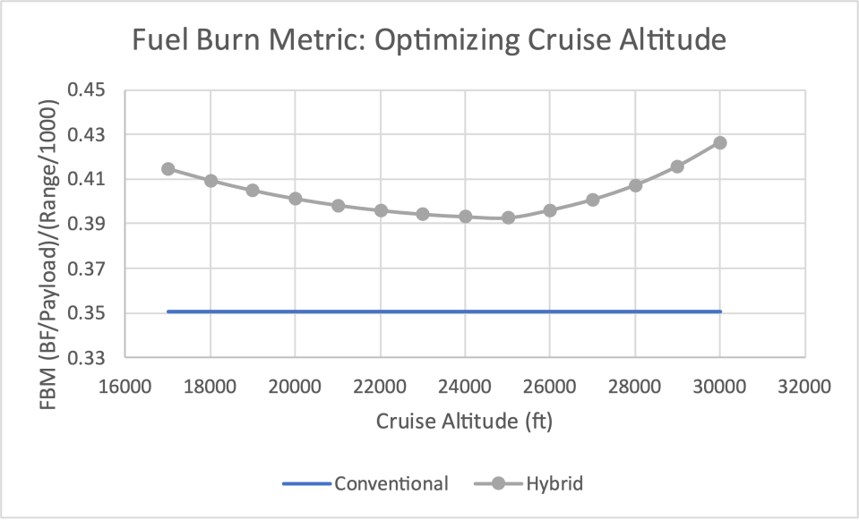
Mission 4: 750 NM mission optimal altitude (high)
Optimal for maximum block fuel savings: 27,000 ft
Optimal for minimum fuel burn metric: 25,000 ft

Slide 11
Conclusions
Mission optimization for parallel hybrid 82 passenger turboprop
20 passengers / 750 NM range: 20% block fuel savings
62 passengers / 300 NM range: 6% block fuel savings
Performance is sensitive to electrical charge management
Solutions: increased battery energy density; optimization of motor usage
E-Boost reduces time to climb and enables higher service ceiling
Increases power available and reduces power lapse rate
Hybridization in climb and cruise saves block fuel and closes the gap in fuel burn metric
Better optimization of hybridization scheme could improve this further
Retrofitting approach likely does not provide commercial benefit
Unless significant sacrifices in payload and/or range are acceptable

Slide 12
Future Work
Future Work On Q400 Concept
Expanded Future Work
Expanded hybrid mission profile
E-taxi
In-air recharging
E-boost for takeoff and low-altitude climb
Improved technologies
Re-sizing conventional engines
Higher battery energy density
Network study
Find an acceptable range penalty for a more competitive design
Ground-up hybrid design
Range of turboprop sizes (14-150 passengers)

Slide 13
Questions

