Slide 1

National Aeronautics and Space Administration
Reynolds Number Effects on a 5.2%-Scale High Lift Common Research Model
Sarah L. Langston, Courtney S. Winski, Melissa B. Rivers
NASA Langley Research Center
AIAA SciTech | Orlando, FL | Jan 6th – 10th , 2025
This material is a work of the U.S. Government and is not subject to copyright protection in the United States.

Slide 2
Outline
Common Research Model (CRM) Ecosystem Overview
5.2%-Scale High Lift Common Research Model (CRM-HL) Wind Tunnel Model
National Transonic Facility Overview and Test Conditions
Force and Moment Results
  Landing configuration presented
  Effects of the nacelle, landing gear, and horizontal tail included in paper
Concluding Remarks

Slide 3
CRM ecosystem has existed for over 15 years
Problem: Need for open-source data that could be used for Computational Fluid Dynamics (CFD) validation and to increase the state-of-the-art in the CFD and applied aerodynamic disciplines
Objective: Create a modern and relevant civil transport aircraft geometry suitable for applied CFD validation
Approach: Design a contemporary supercritical transonic wing and a fuselage that is representative of a wide-body commercial transport aircraft
  Geometry would be open-source with publicly accessible data
  Design would allow for traditional and detailed flow measurements
CRM design has been tested in wind tunnels across the world
Spawned multiple derivatives
Public website with data
  http://commonresearchmodel.larc.nasa.gov/

Slide 4

High Lift CRM (CRM-HL) is one CRM derivative
Problem: Need to explore the modeling and analysis of high-lift devices used in takeoff and landing situations
Objectives:
  Generate high-quality wind tunnel data for use in CFD verification/validation studies
  Utilize and improve advanced wind tunnel test and measurement techniques
  Support research activities in low-speed aerodynamic design, performance enhancement, noise reduction, and/or high-lift system simplification
Approach: Derivative of CRM was designed that had the ability to support interchangeable high-lift devices
NASA contributions to the CRM-HL ecosystem include:
  NASA 5.2%-scale semispan cryogenic capable model <- Focus of this presentation
  NASA 2.7%-scale semispan and full-span cryogenic capable models
  NASA 10%-scale semispan model

Slide 5
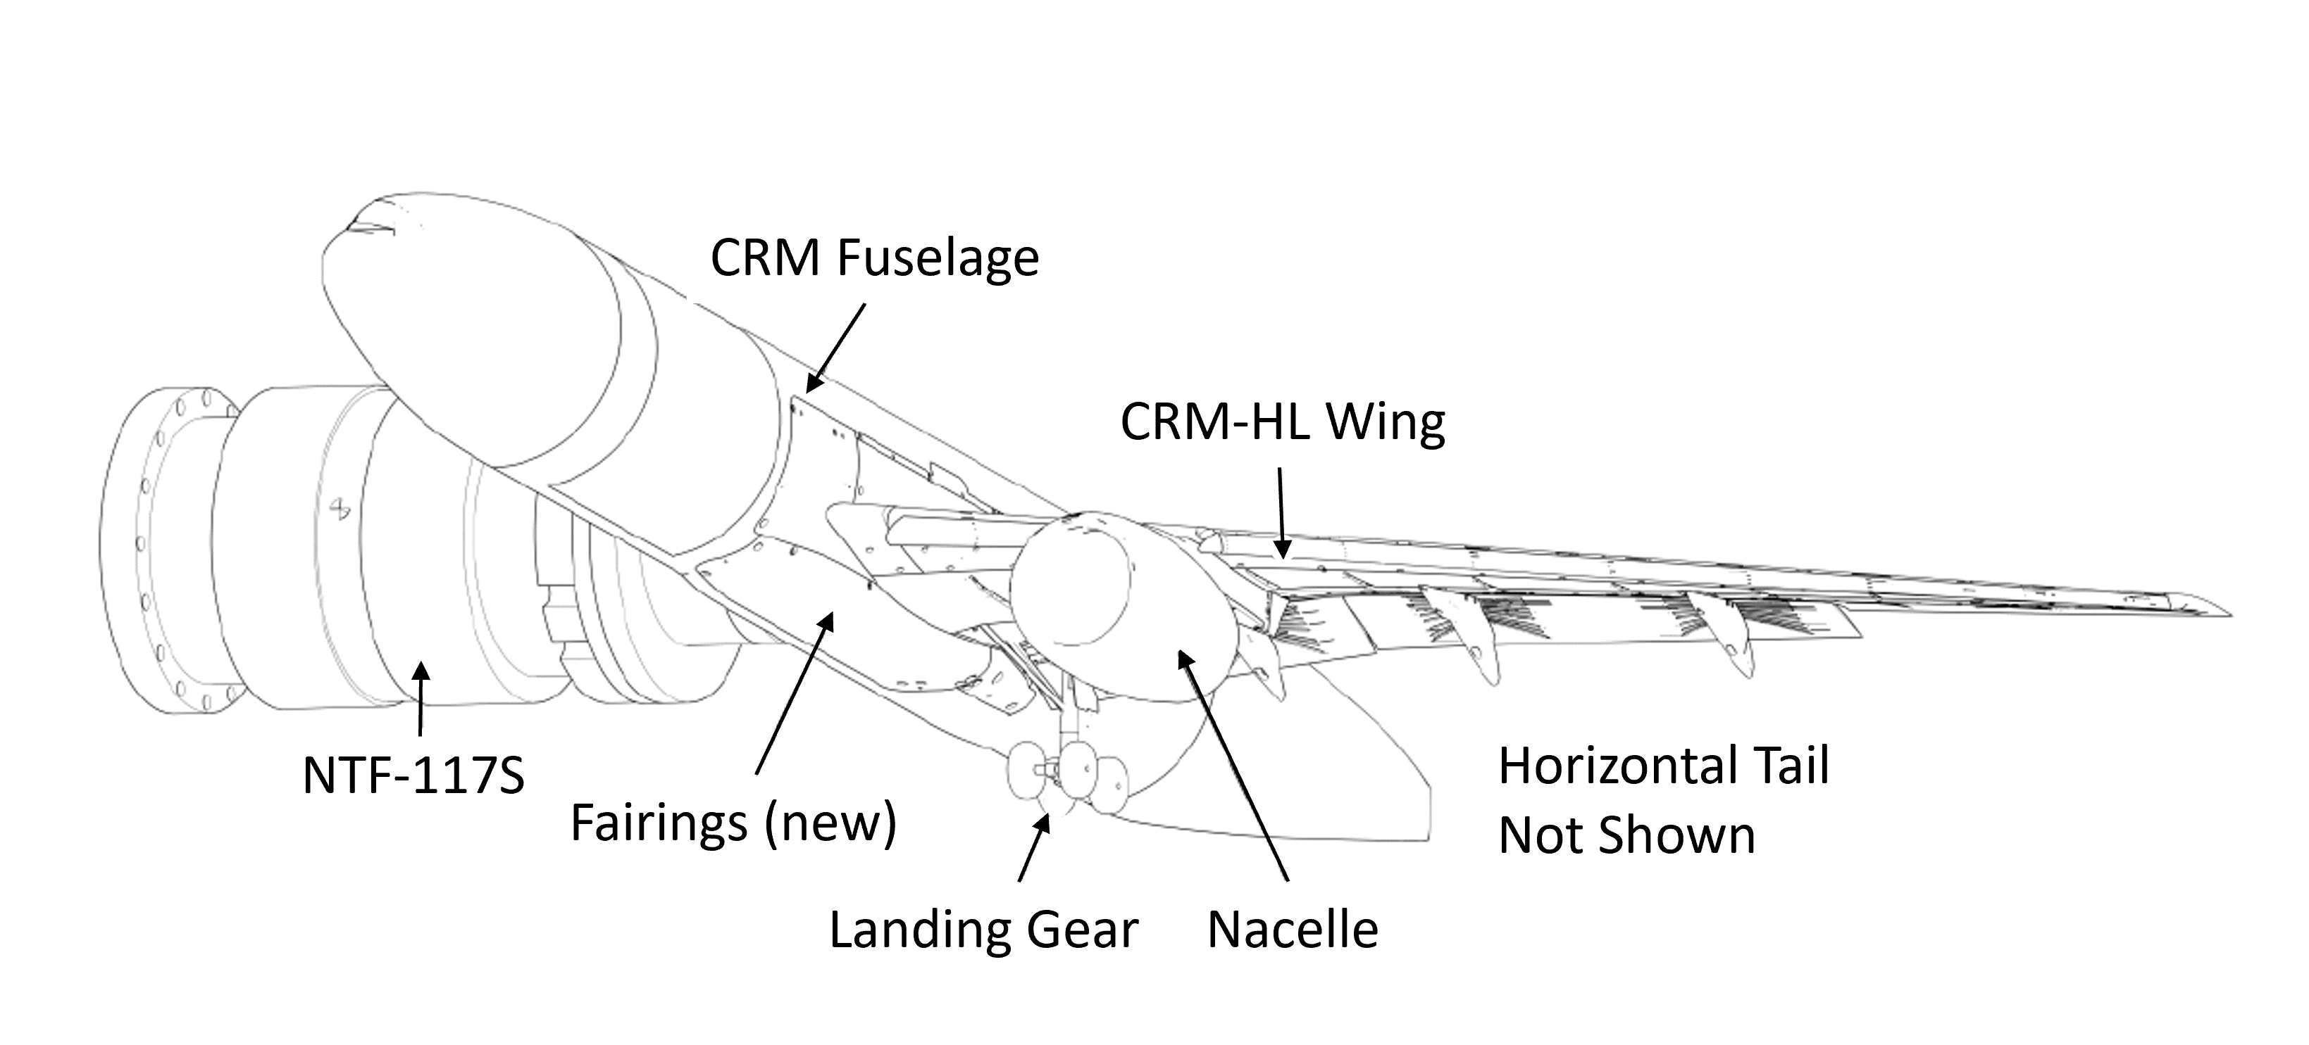
NASA 5.2%-Scale CRM-HL Wind Tunnel Model
Cryogenically rated semispan model
  60.15-inch semispan wingspan
  14.34-inch reference chord
Newly designed and fabricated wing
  Uses existing fuselage with minor modifications
Landing and takeoff configurations tested
  Landing was primary configuration of interest
Configuration | Slat | IB Flap | OB Flap
Landing | 30° | 40° | 37°
Takeoff | 22° | 25° | 25°

Slide 6
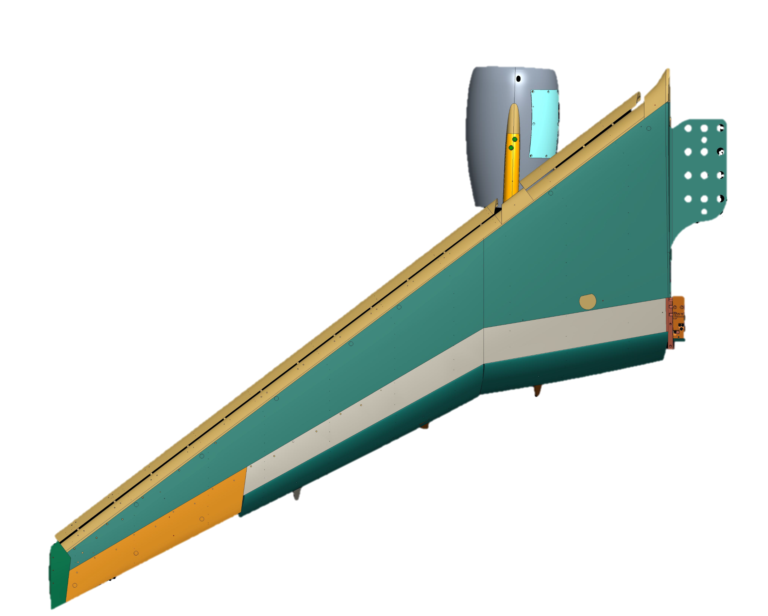
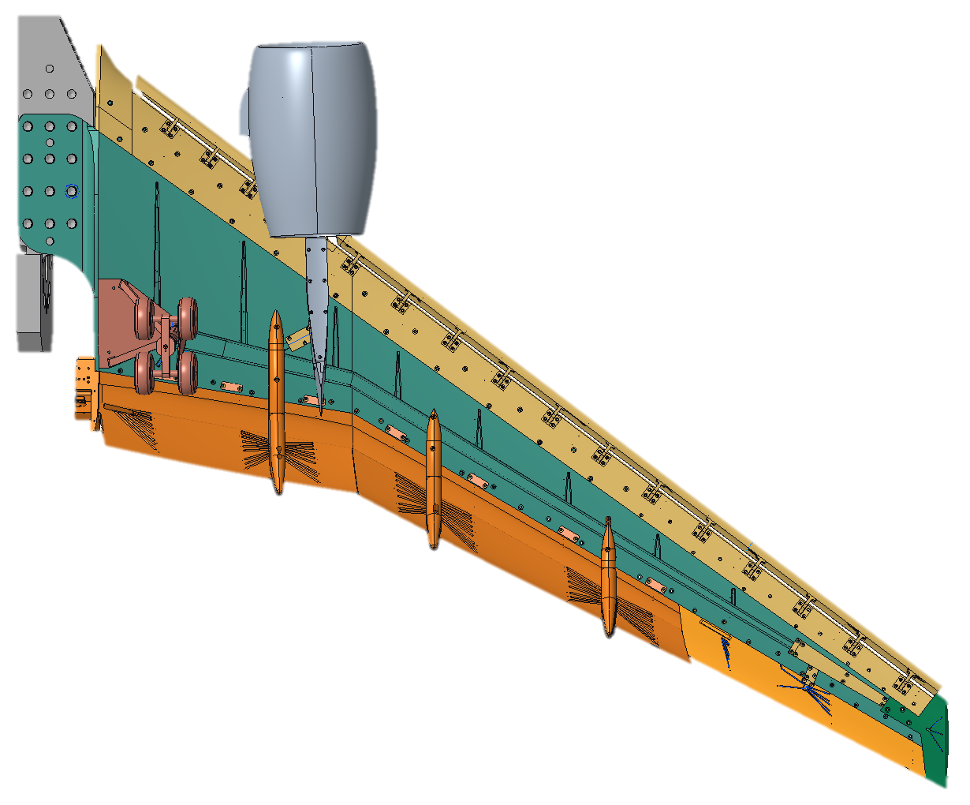
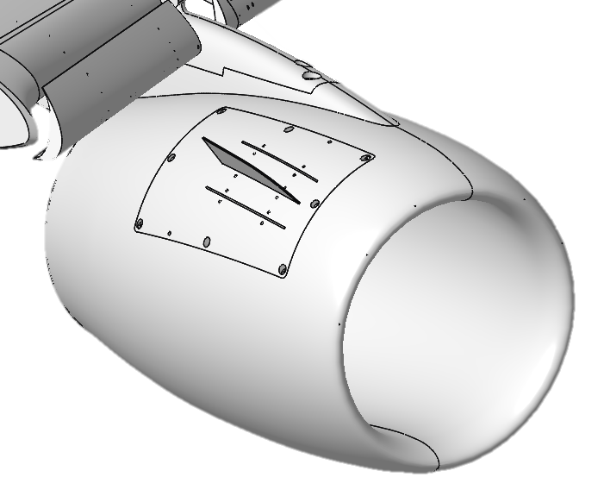
NASA 5.2%-Scale CRM-HL Wind Tunnel Model
Modular design
  Adjustable slat and inboard (IB) and outboard (OB) flap angles
  Removable nacelle-pylon (adjustable chine), landing gear, and horizontal tail
Heavily instrumented
  309 static pressure ports on slat, main element, flap, and nacelle
  12 unsteady pressure transducers on main element and pylon
Leading Edge
Chine Cover Plate
Slat
Nacelle-Pylon
Main Spar
IB Flap
OB Flap
3 Optional Chine Locations
Trailing Edge
Landing Gear
Aileron
Wing Tip

Slide 7
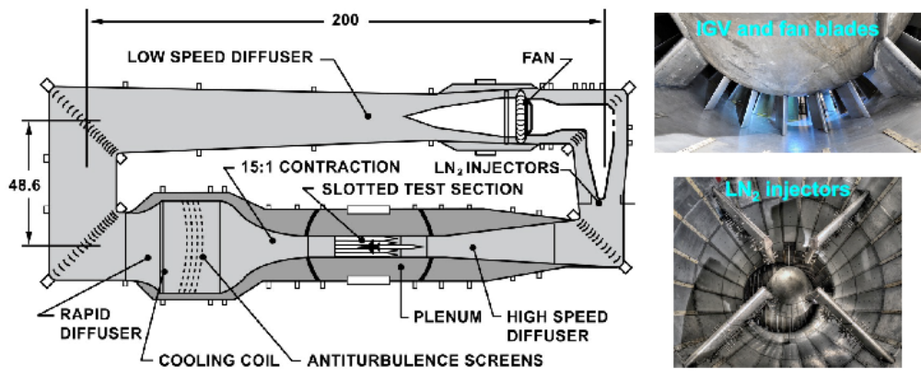
National Transonic Facility (NTF) Test
5.2%-Scale model was designed for testing at the NTF
  Tested in both air and gaseous nitrogen
  Temperatures ranged from -250°F – 120°F
  Dynamic pressure (Q) ranged from 61 – 295 psf
  Mach number ranged from 0.20 – 0.26
  Chord Reynolds numbers (CREYN) tested ranged from 1.61 – 30 million
Photos: NASA
Notes:
Closed circuit, continuous, pressurized, cryogenic wind tunnel: inlet guide vanes

Slide 8
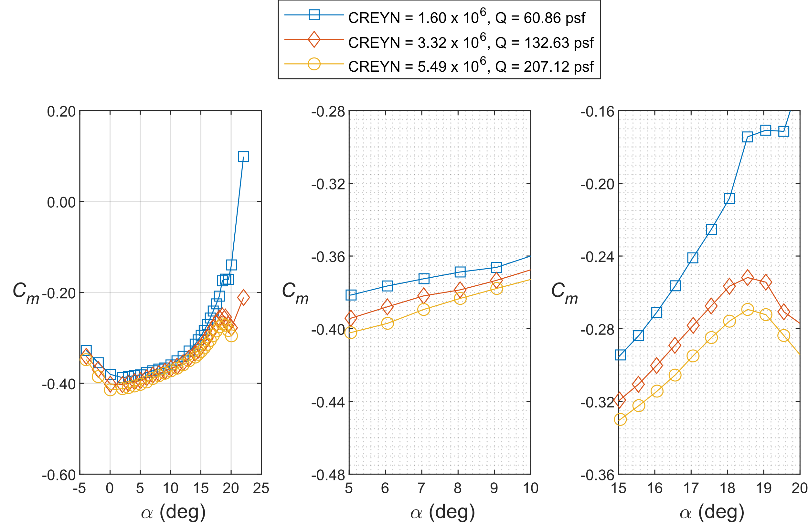
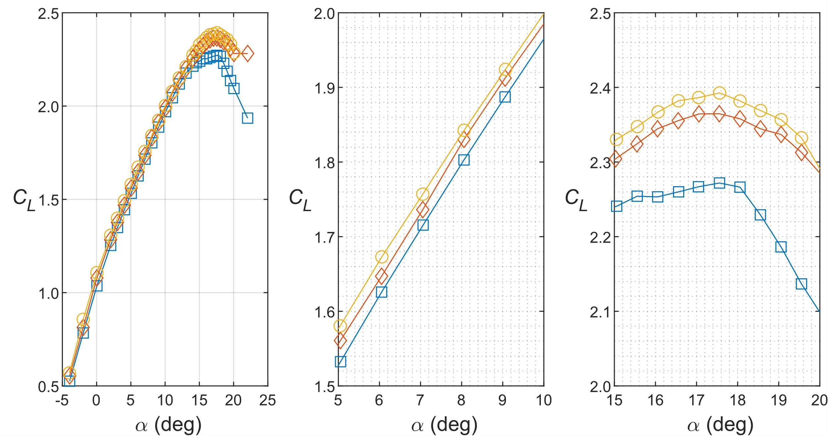
Effect of CREYN on Lift Curves in Air
All results presented have classical wall corrections applied
In air, lift increased with increasing Reynolds number
  Expected trend
1.6 million chord Reynolds number matched prior testing of the 5.2%-scale model in two atmospheric tunnels (results not shown here)
  Lift and drag had excellent agreement with prior testing
Mach = 0.2
Landing config: Slat = 30°
IB Flap = 40°, OB Flap = 37°
Entire Lift Curve
Linear Region
C_{L,max}

Slide 9
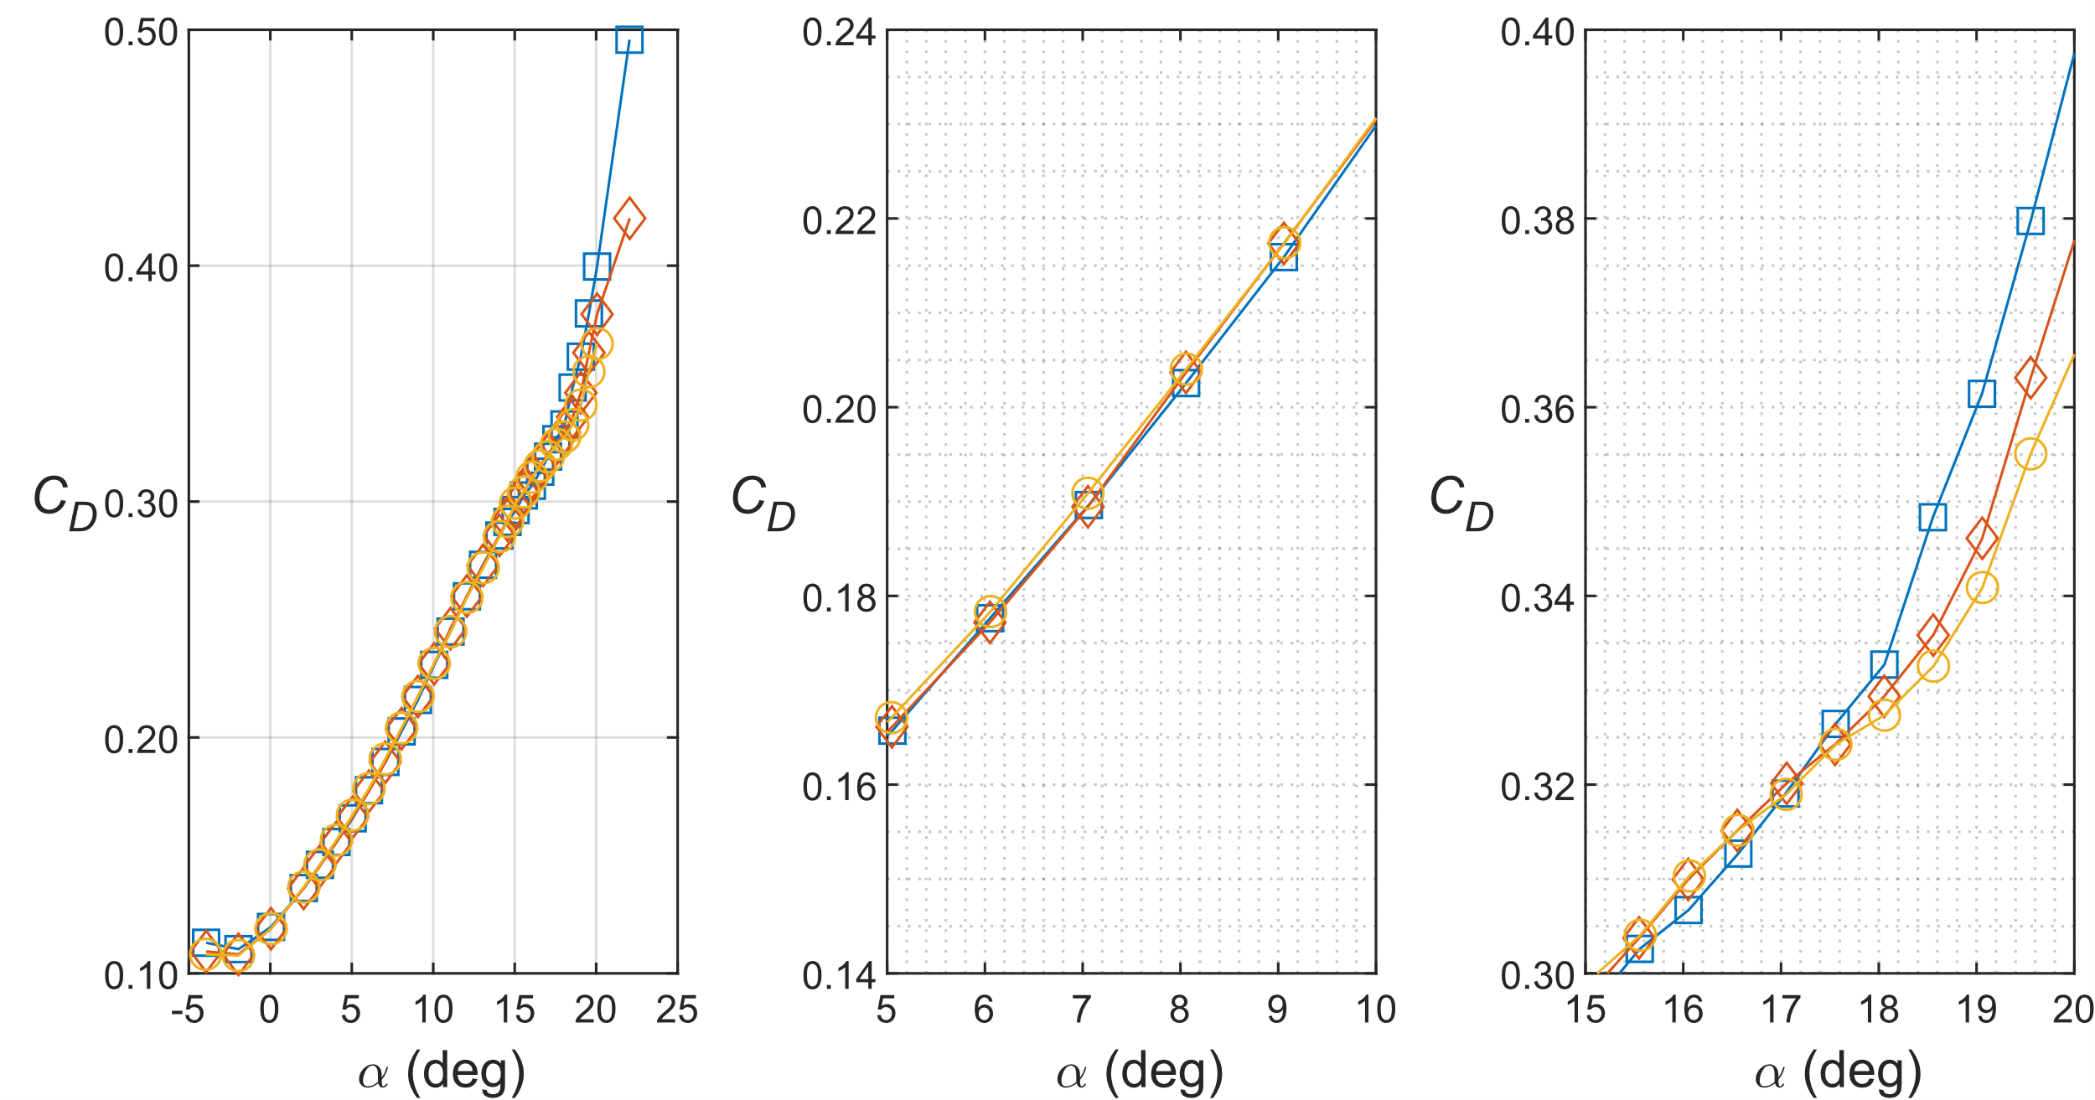
Effect of CREYN on Drag Curves in Air
In air, drag decreased with increasing Reynolds number at negative and high (positive) angles of attack
Lower (positive) angles of attack did not show strong trends between chord Reynolds numbers tested in air
Mach = 0.2
Landing config: Slat = 30°
IB Flap = 40°, OB Flap = 37°
Entire Drag Curve
Linear Region
C_{L,max} Region
9

Slide 10
Effect of CREYN on Pitching Moment Curves in Air
In air, pitching moment decreased with increasing Reynolds number for entire angle of attack range
Clear difference in pitching moment after C_{L,max} between 1.6 million and 3.32 and 5.49 million chord Reynolds numbers
Mach = 0.2
Landing config: Slat = 30°
IB Flap = 40°, OB Flap = 37°
Entire Pitching Moment Curve
Linear Region
C_{L,max} Region

Slide 11
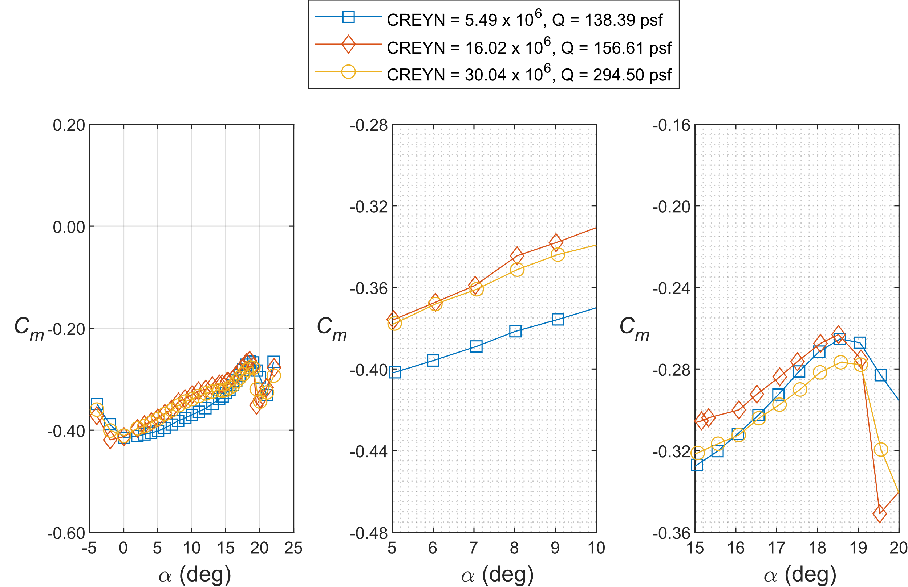
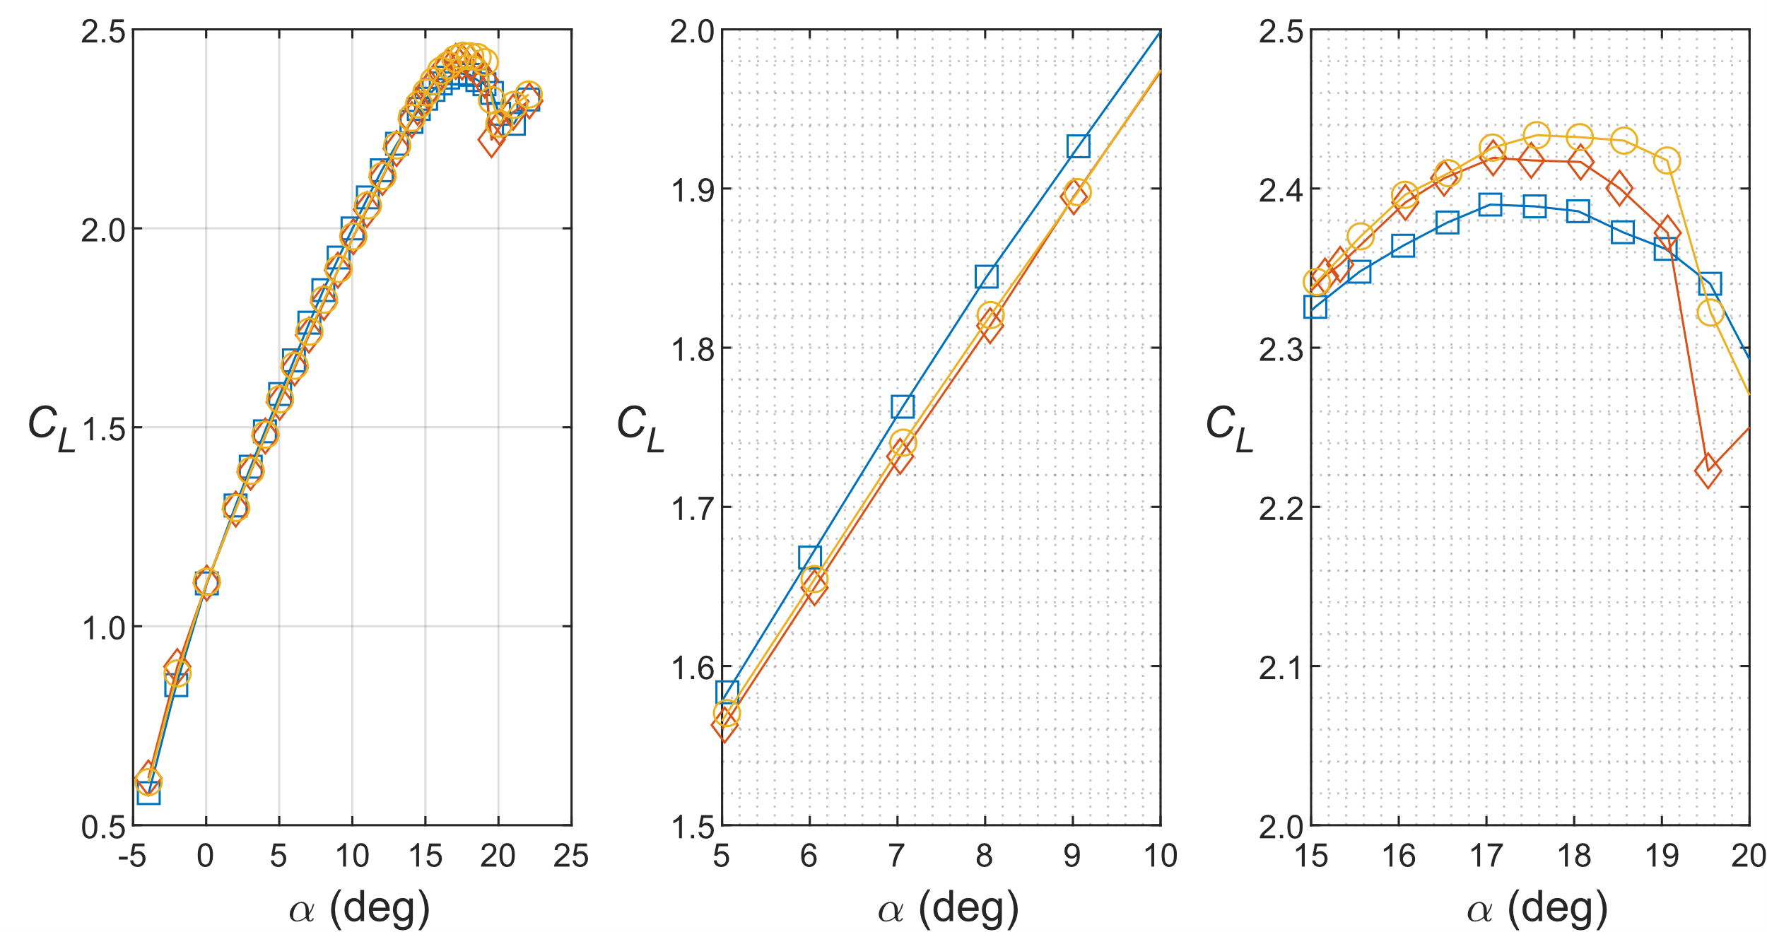
Effect of CREYN on Lift Curves in N₂
In N₂, lift curves did not follow the expected trends
At the higher angles of attack, lift increased with increasing Reynolds number
In the linear range, the 5.49 million chord Reynolds number curve was higher than both the 16 and 30 million chord Reynolds number curves
  Unexpected and merits further investigation
Mach = 0.2
Landing config: Slat = 30°
IB Flap = 40°, OB Flap = 37°
Entire Lift Curve
Linear Region
C_{L,max}

Slide 12
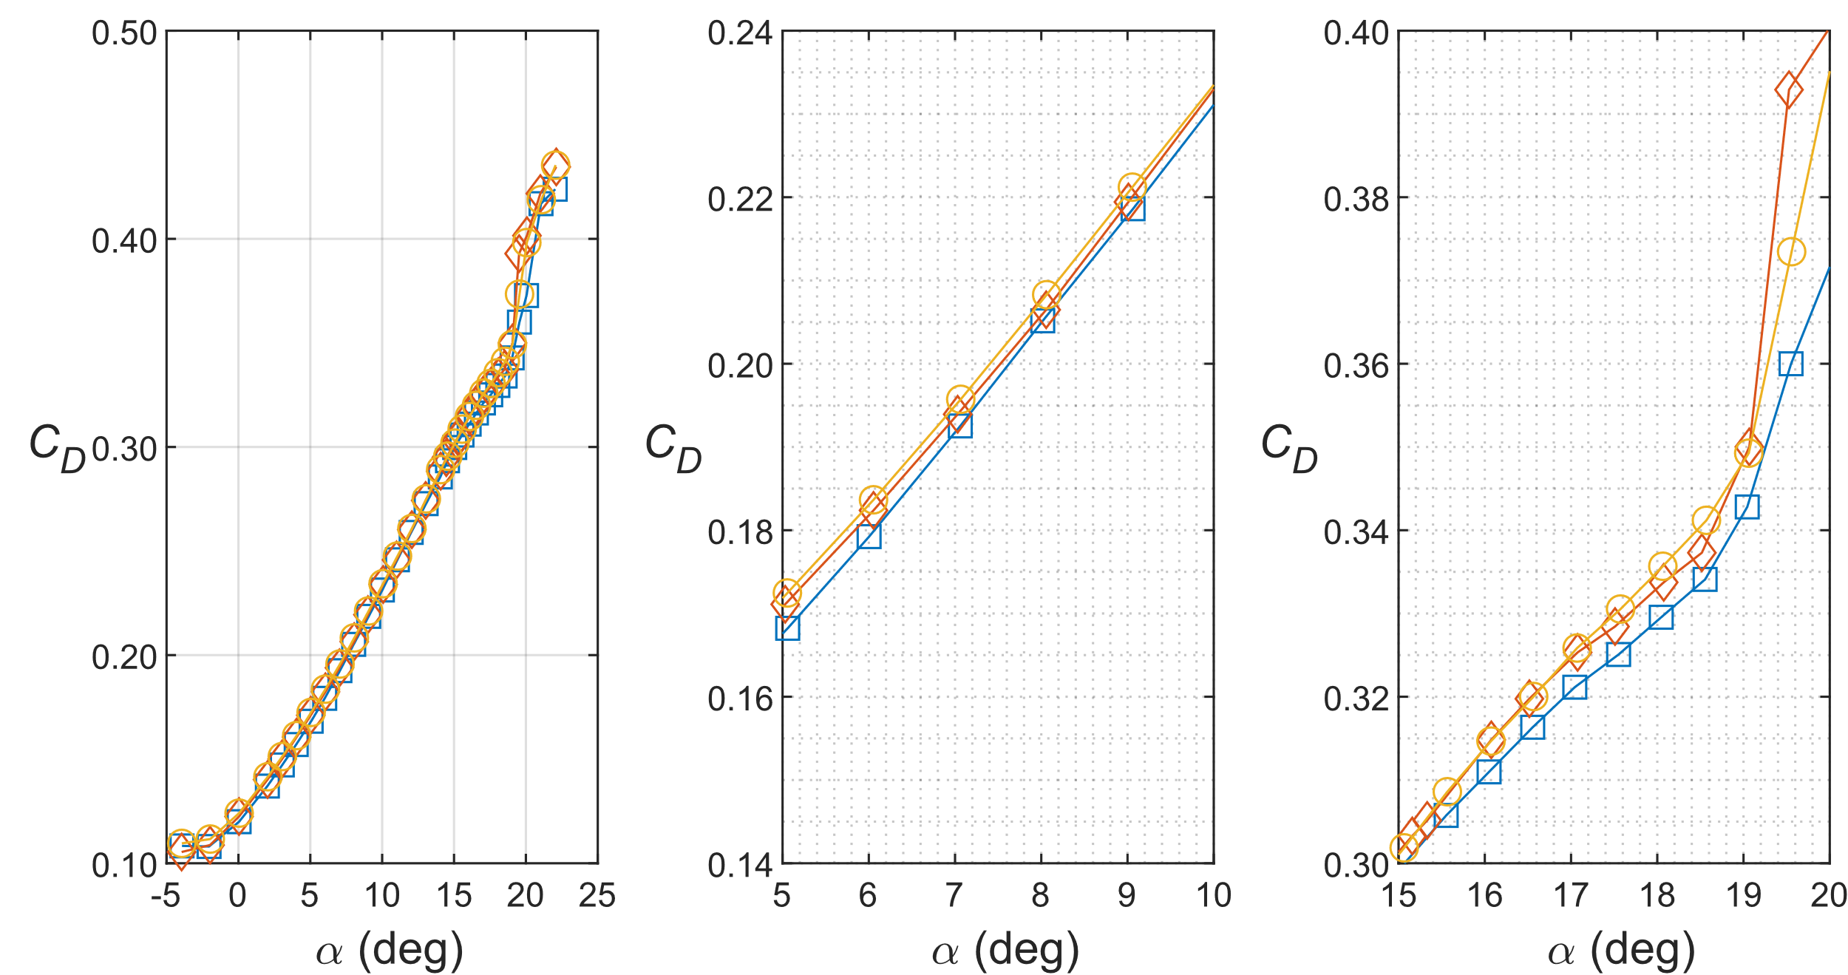
Effect of CREYN on Drag Curves in N₂
In N₂, 5.49 million chord Reynolds number run had lowest drag over almost entire angle of attack range
16 and 30 million chord Reynolds number runs have inconsistent behavior over the angle of attack range
Mach = 0.2
Landing config: Slat = 30°
IB Flap = 40°, OB Flap = 37°
Entire Drag Curve
Linear Region
C_{L,max} Region

Slide 13
Effect of CREYN on Pitching Moment Curves in N₂
In N₂, pitching moment had larger differences over the angle of attack range
Inconsistent trends with Reynolds number over the entire angle of attack range
Unexpected and merits further investigation
In prior CRM testing aeroelastic effects have canceled out Reynolds number effects – possible to explain some of the anomalies seen here
Mach = 0.2
Landing config: Slat = 30°
IB Flap = 40°, OB Flap = 37°
Entire Pitching Moment Curve
Linear Region
C_{L,max} Region
Notes:
Data presented here shows increasing Reynolds number and increasing dynamic pressure.

Slide 14
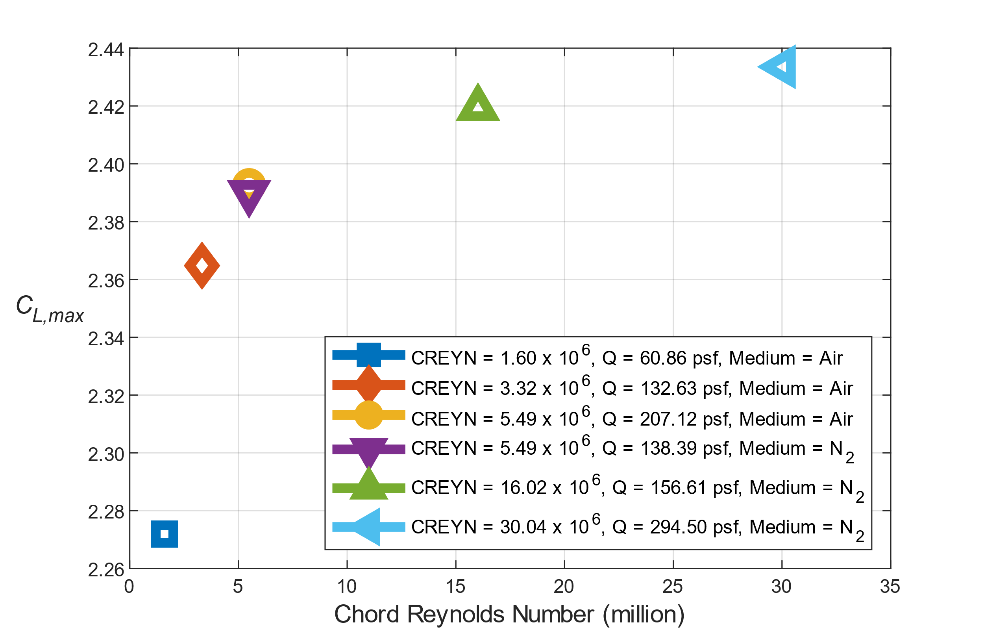
C_{L,max} Trends for All CREYN Tested
Mach = 0.2
Landing config: Slat = 30°, IB Flap = 40°, OB Flap = 37°
C_{L,max} increased with increasing Reynolds number
  Expected trend
Different dynamic pressures at 5.49 million chord Reynolds number had similar C_{L,max} values
  These runs were also in different test mediums (air vs N₂)

Slide 15
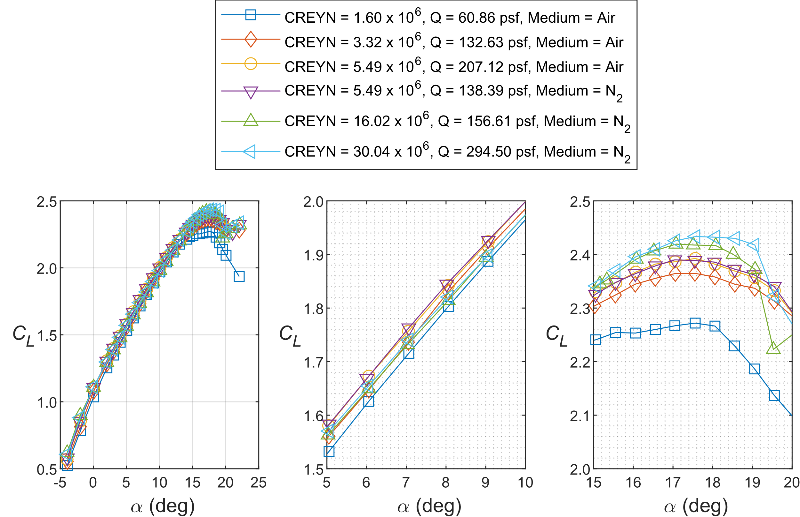
Lift Curves for All CREYN Tested
Comparing lift curves of all Reynolds numbers tested:
  Lift curves for both 5.49 million chord Reynolds number runs compare well indicating aeroelastic effects likely small at this condition
  Increasing C_{L,max} with increasing Reynolds number
  5.49 million chord Reynolds number runs higher than both 16 and 30 million chord Reynolds number runs in linear range shown
Aerodynamic phenomena that would cause the unexpected trends in lift not yet identified
  Preliminary surface pressure results analyzed in paper
  Warrants further study
Mach = 0.2
Landing config: Slat = 30°
IB Flap = 40°, OB Flap = 37°
Entire Lift Curve
Linear Region
C_{L,max}
Notes:
I would point out that the Rec 5.49M cases at the two different Qs compare well together here indicating aeroelastic effects on the wing at these specific conditions were likely small.

Slide 16
Concluding Remarks
5.2%-Scale CRM-HL model was tested at the NTF
Effect of chord Reynolds number on the force and moment data studied
  Lift curves increased with increasing Reynolds number near C_{L,max}
  Up to a chord Reynolds number of 16 million, lift increased and pitching moment decreased with increasing chord Reynolds number
  Lift curves do not follow expected trends in the linear region for chord Reynolds numbers of 16 and 30 million
    Merits further investigation
Effects of the nacelle, landing gear, and horizontal tail included in paper
Preliminary surface pressure results for the landing configuration included in paper
Future work
  Comparison of force and moment results with final tunnel wall interference corrections
  Detailed study of surface pressure results
  Additional wind tunnel entry of 5.2% CRM-HL in NTF

Slide 17
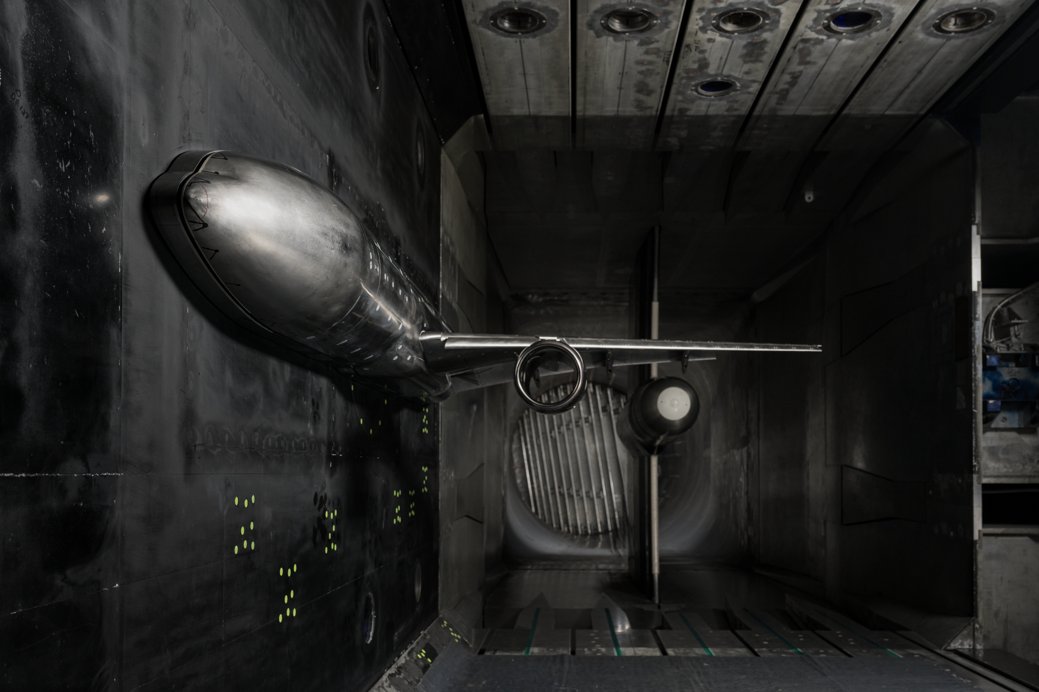
Questions
Thank you to the NASA Transformational Tools and Technologies (TTT) project of the Transformative Aeronautics Concepts Program and the Aerosciences Evaluation and Test Capabilities (AETC) office for their funding and support of this work
Photo: NASA

