Slide 1



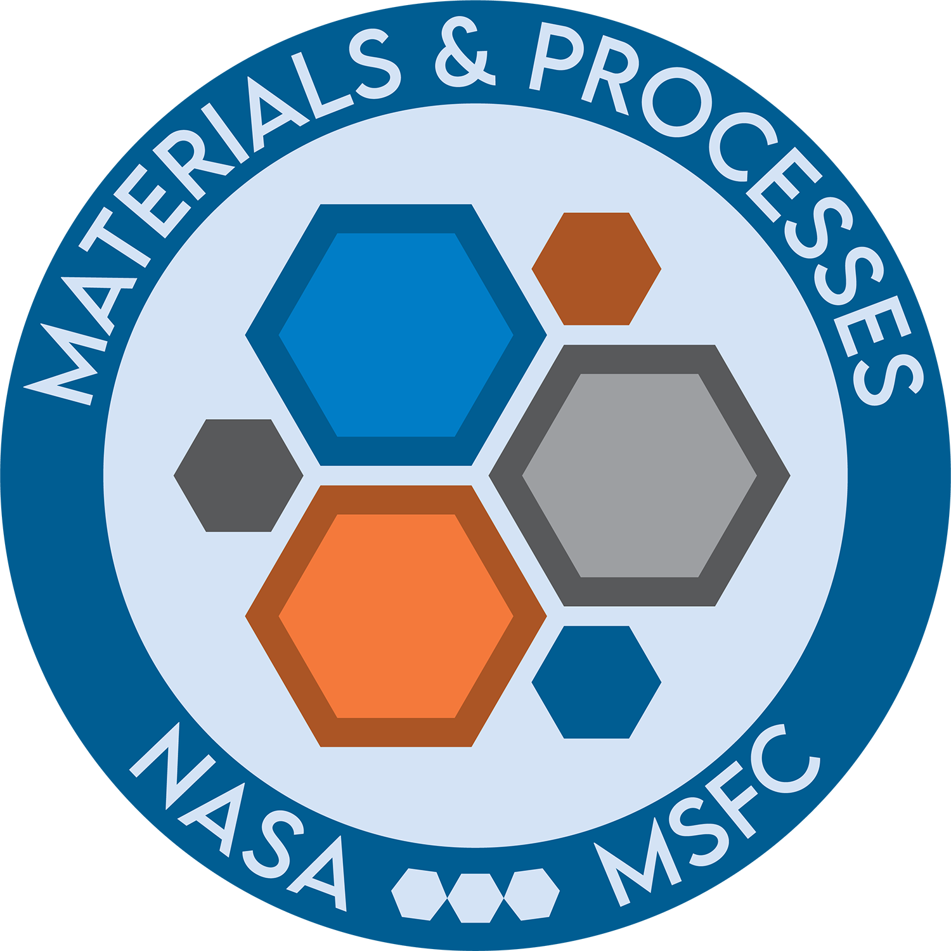
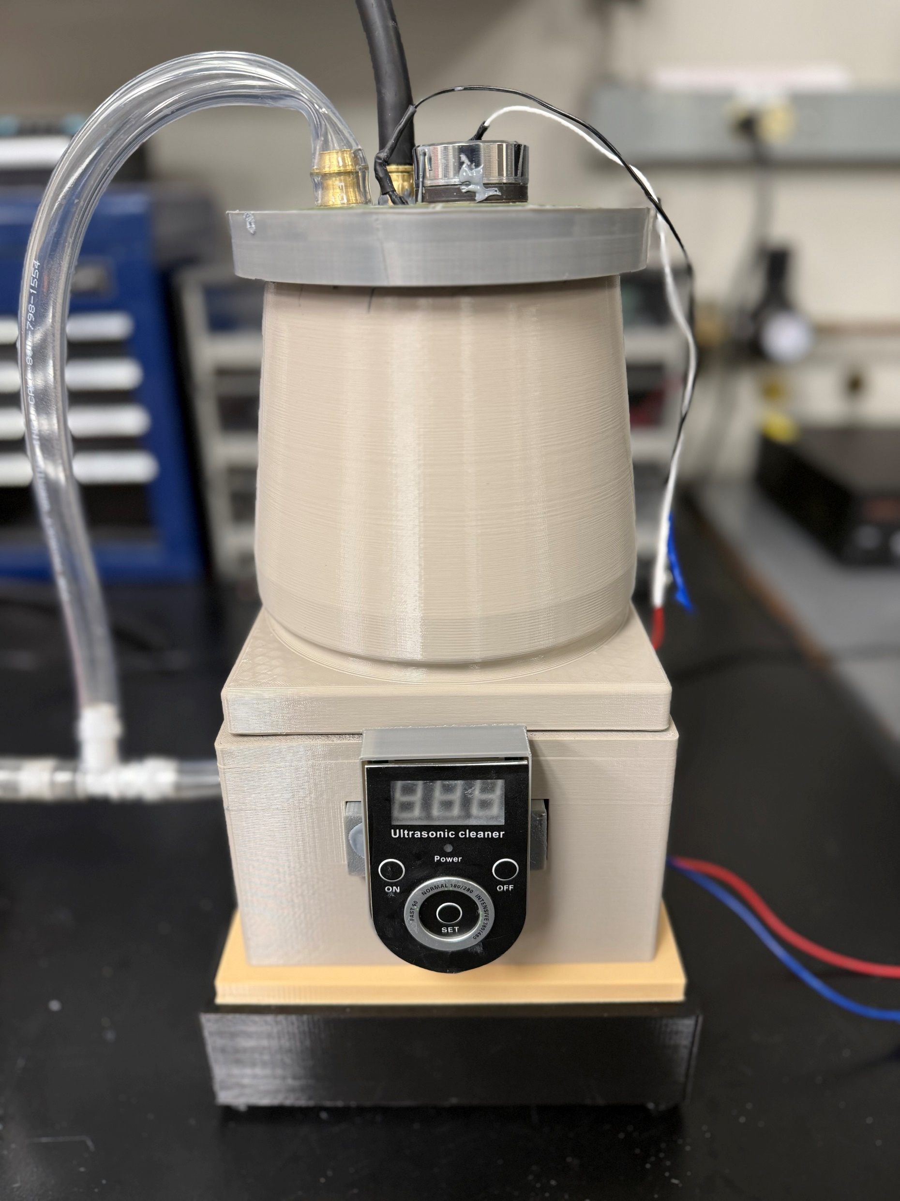
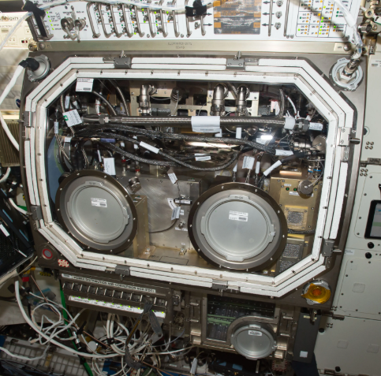
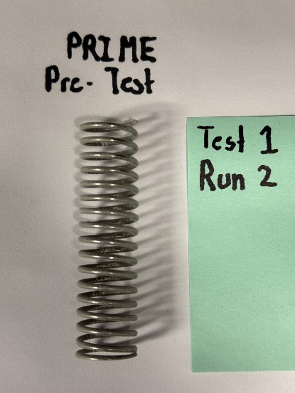
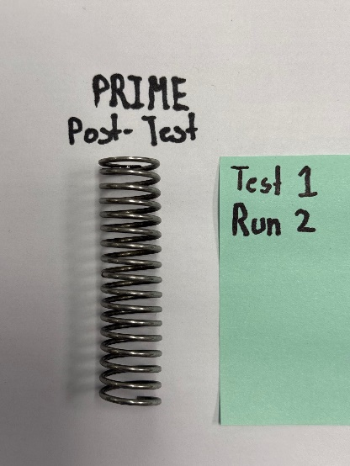
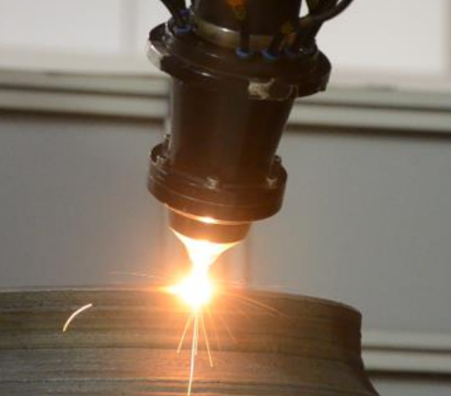
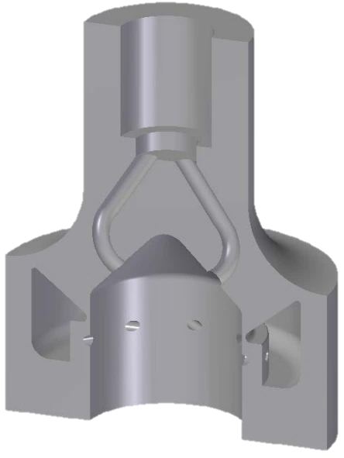
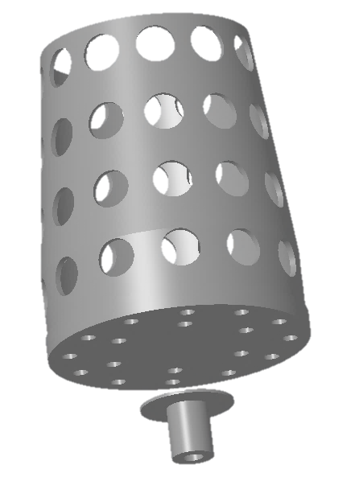
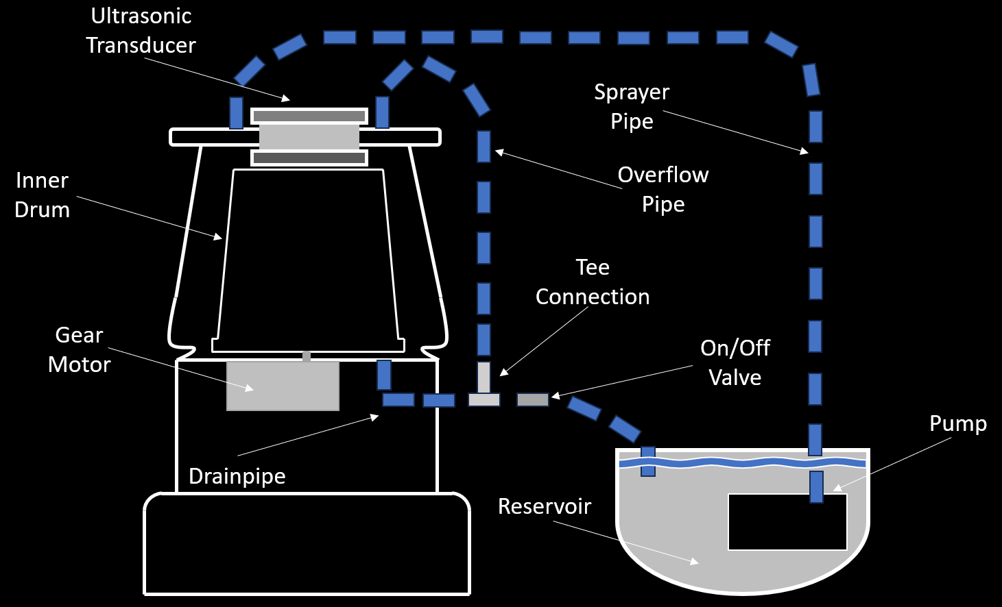
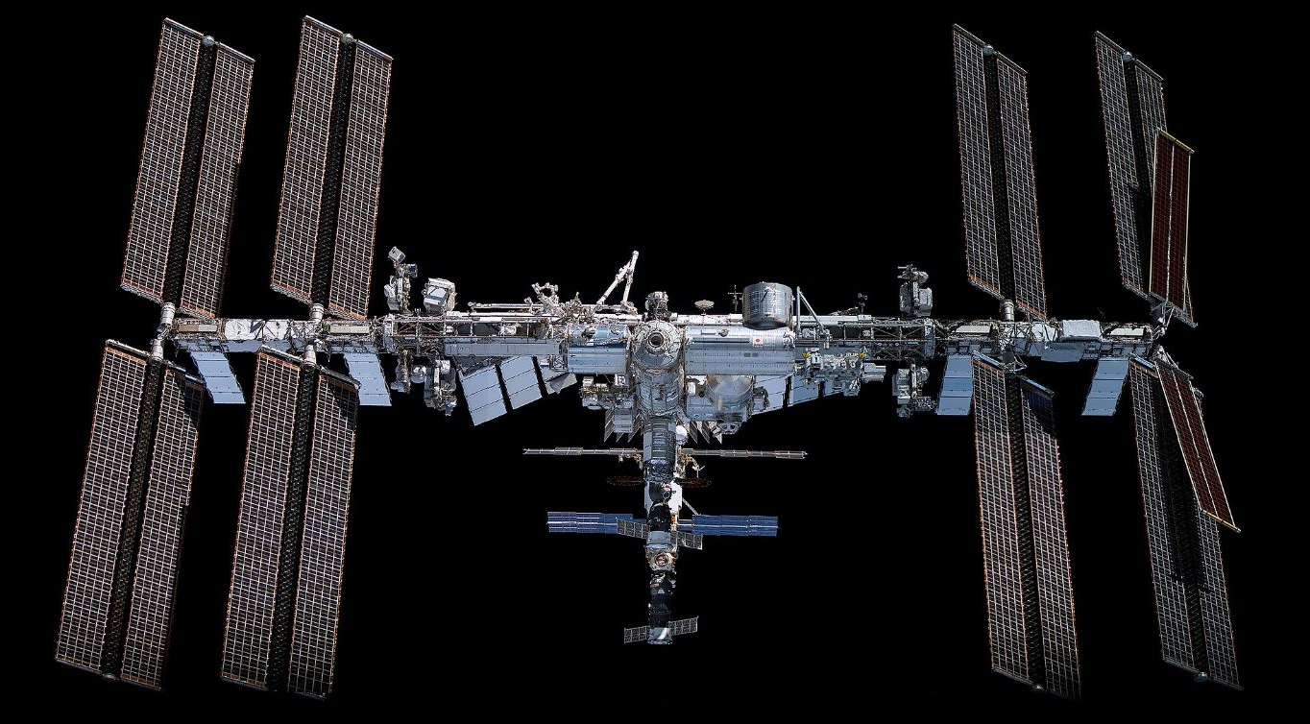
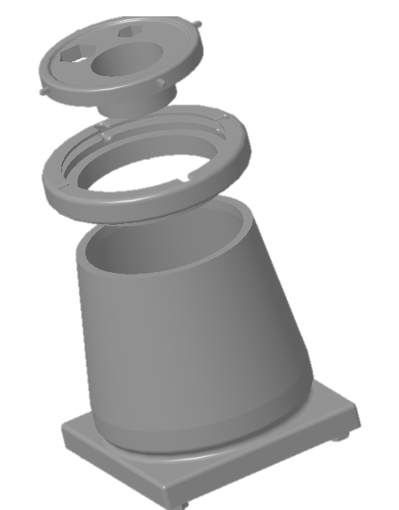
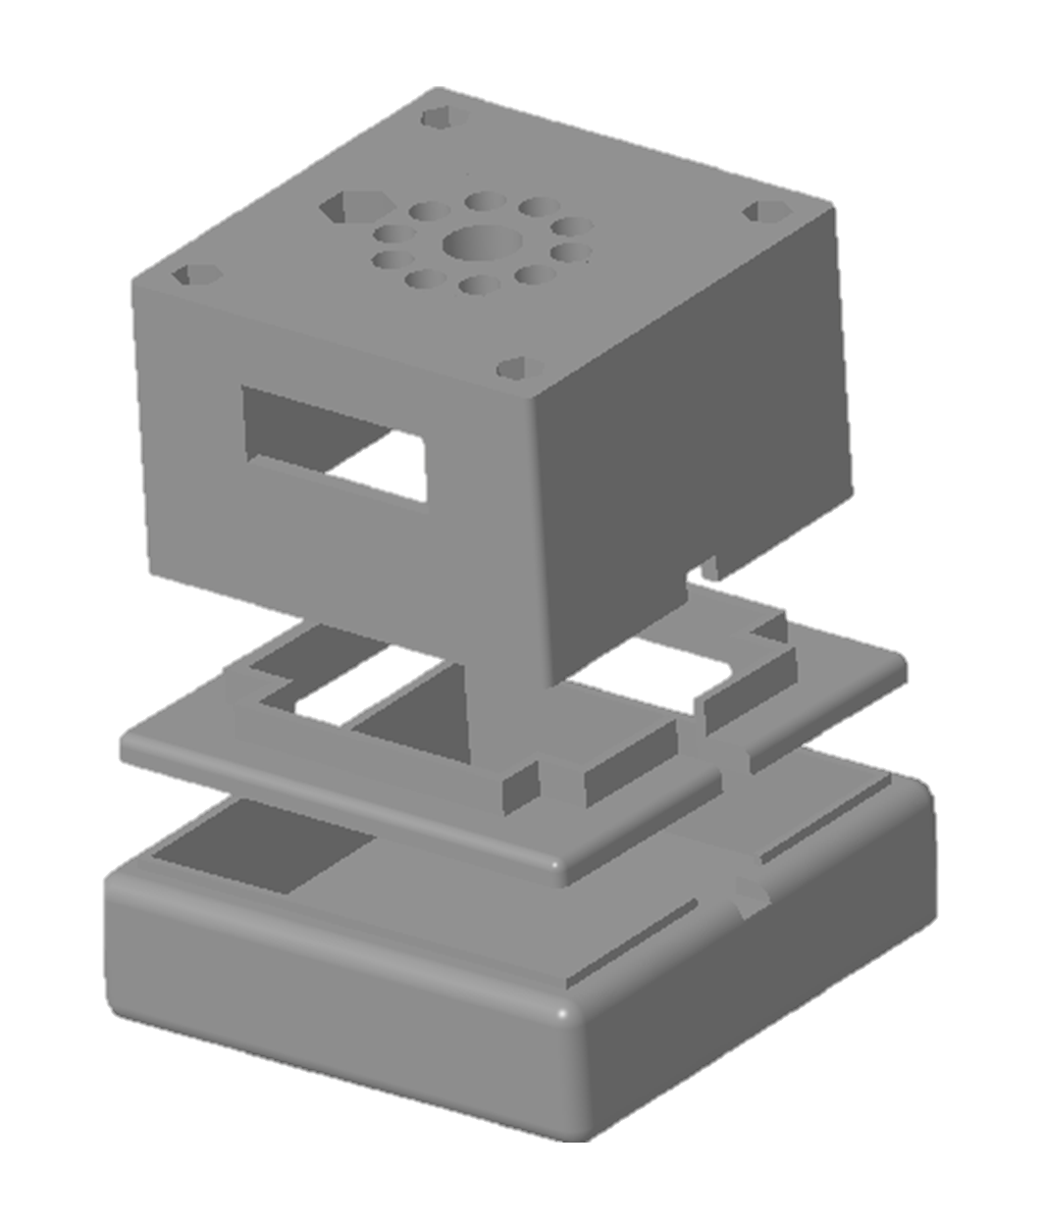
PRIME ISS Ground Prototype
Powder Removal in Microgravity Environments Project
EM22 – Contamination Control Team: Justin McElderry¹, Gabriel Holden², Henry Kaplan³, Julian Turner⁴
¹NASA Marshall Space Flight Center, ²Iowa State University, ³Yale University, ⁴Embry-Riddle Aeronautical University - Prescott
Introduction
Methodology
Testing
In Additive Manufacturing (AM) with metal powders, remnant powder can be trapped and must be removed
Initial testing performed on springs contaminated with NU-LHT-4M simulant
Purpose
Forward Work
Research in cleaning these AM parts for reducing contamination is limited in space habitats
If tested in microgravity, the capability to clean AM parts can further In-Space Manufacturing (ISM)
Continue development of flight ready model
  Parabolic Test Flight
  ISS Microgravity Science Glovebox (MSG) Experiment
Continue testing on more complex geometries
  Partnering with ER13 (Engine Components & Technology Branch) to procure test parts
Ultrasonic cleaning paired with a spinning plate was the selected solution for a prototype capsule
Housing will enclose cleaning operations to mimic ISS payload handled in the Microgravity Science Glovebox (MSG)
A functioning ground prototype and testbed was developed during Fall 2024
CAD Modeling
System Design
Inner Drum Assembly
Acknowledgements
The PRIME team would like to thank the EM42 Additive Manufacturing team for funding support, the Iowa Space Grant Consortium for intern placement, Mike Fiske for project guidance, and all of NASA MSFC’s Contamination Control team for continued support.
Outer Drum Assembly
Main Base Assembly

