Slide 1
The Return of the ICPS:
A Statistical Perspective on Artemis Upper Stage Disposal
W.B. Stein, Amentum Space Exploration Division
A.J. Houin, NASA George C. Marshall Space Flight Center
S.B. Thompson, Troy 7
H.M. Koehler, NASA Langley Research Center
1/19/25

Slide 2
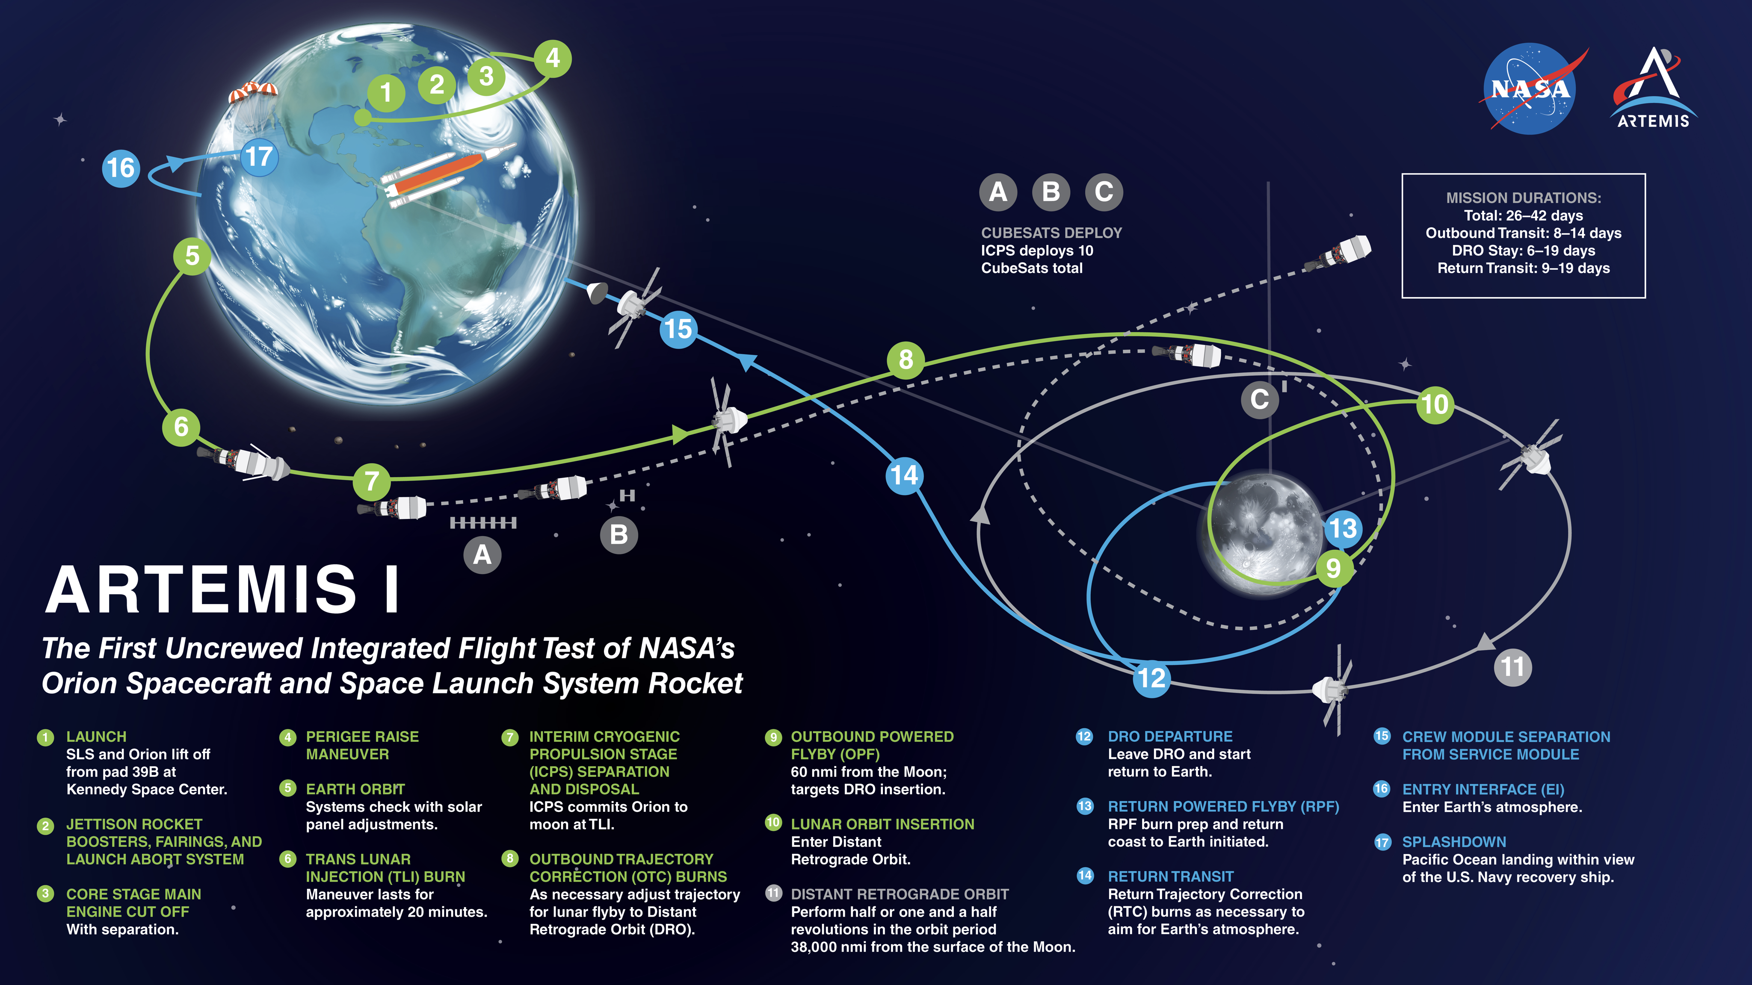
ICPS Disposal
ICPS propulsion capability ends @ TLI, batteries become depleted a few hours after.
Lunar Closest Approach (LCA)
SLS Requirements to Ensure Heliocentric Disposal:
10 days after LCA, Earth relative C3 > 0 km2/s2

Slide 3
Review of Artemis I Return Data
LP | 22 | 23 | 23 | 24 | 24 | 24 | 25 | 25 | 25 | 25 | 26 | 26 | 26 | 27 |  |  | 28
Date (2022) | 6/6 | 7/5 | 7/6 | 8/2 | 8/3 | 8/4 | 8/28 | 9/1 | 9/2 | 9/3 | 9/30 | 10/1 | 10/2 | 10/29 | 10/30 | 10/31 | 11/14 | 11/15
Nominal | 0 | 82 | 0 | 0 | 67 | 0 | 0 | 0 | 32 | 0 | 0 | 46 | 0 | 0 | 6 | 0 | 15 | 0
Monte Carlo | 73 | 4383 | 115 | 5 | 3795 | 1942 | 1 | 368 | 2248 | 1 | 166 | 2775 | 52 | 53 | 2084 | 126 | 3092 | 198
  What is a Return?:
  A Return is defined when the ICPS disposal trajectory intersects an Earth-Centered sphere with a radius of 500,000 km.
    This is outside the distance to the Moon but simplifies filtering since the distance between the Moon and Earth changes.
Observations about Nominally Returning Days:
  A Quick Returning trajectory is where ICPS returns in less than a year.
  Nominally Returning Days occur when a substantial amount of the Nominal Launch Window quickly return.
    These occur with a rough cadence a Lunar Synodic Month. Exceptions are between LP27 and LP28 (half month) and LP22 (no nominal returns).
    The Monte Carlo cases return on days adjacent to Nominally Returning Days even when nominal cases do not.
LP | 29 | 29 | 29 | 29 | 30 | 30 | 30
Date | 12/12 | 12/13 | 12/14 | 12/15 | 1/12 | 1/13 | 1/14
Nominal | 0 | 67 | 0 | 0 | 0 | 67 | 0
Monte Carlo | 29 | 6244 | 849 | 13 | 1019 | 5611 | 584
Nominal Cases
United Launch Alliance (ULA) provides ~120 1-minute check cases that represent the nominal trajectory throughout the mission. Each nominal case starts at a different minute of each LW.
Monte Carlo Cases
ULA also provides ~10,000 Variable Time Monte Carlo cases. These represent an analysis on the mission incorporating various uncertainties like Navigation uncertainties and lunar flyby uncertainties. Initial time in the LW is also sampled.

Slide 4
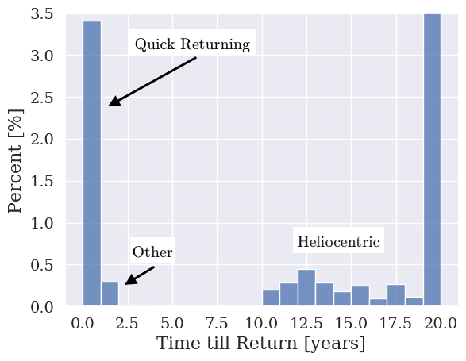
A Statistical Overview of Artemis I Propagations
Initial conditions of Artemis I were propagated 20 years using Astrodynamics and Space Science Enabling Toolkit (ASSET).
  Used to create general statistics of Artemis I trajectories that are representative of the problem.
  ASSET developed by University of Alabama.
  Total 12,885 cases across all Launch Periods.
Three types of return trajectories:
  Desired Heliocentric Orbits:
    Returns greater than 10 years
    ICPS always returns since the disposal orbit crosses Earth’s orbit.
  Quick Returning:
    Returns in less than 1.5 years
    Trajectories resemble the behavior of Three-body Periodic Orbits.
    Primary focus of this paper
  Other Trajectories:
    Returns between 1.5 and 4.5 years.
    Begins like a Quick Returning trajectory but loiters outside the
    Earth-Moon system before eventually returning.
    Do not occur frequently
>20

Slide 5
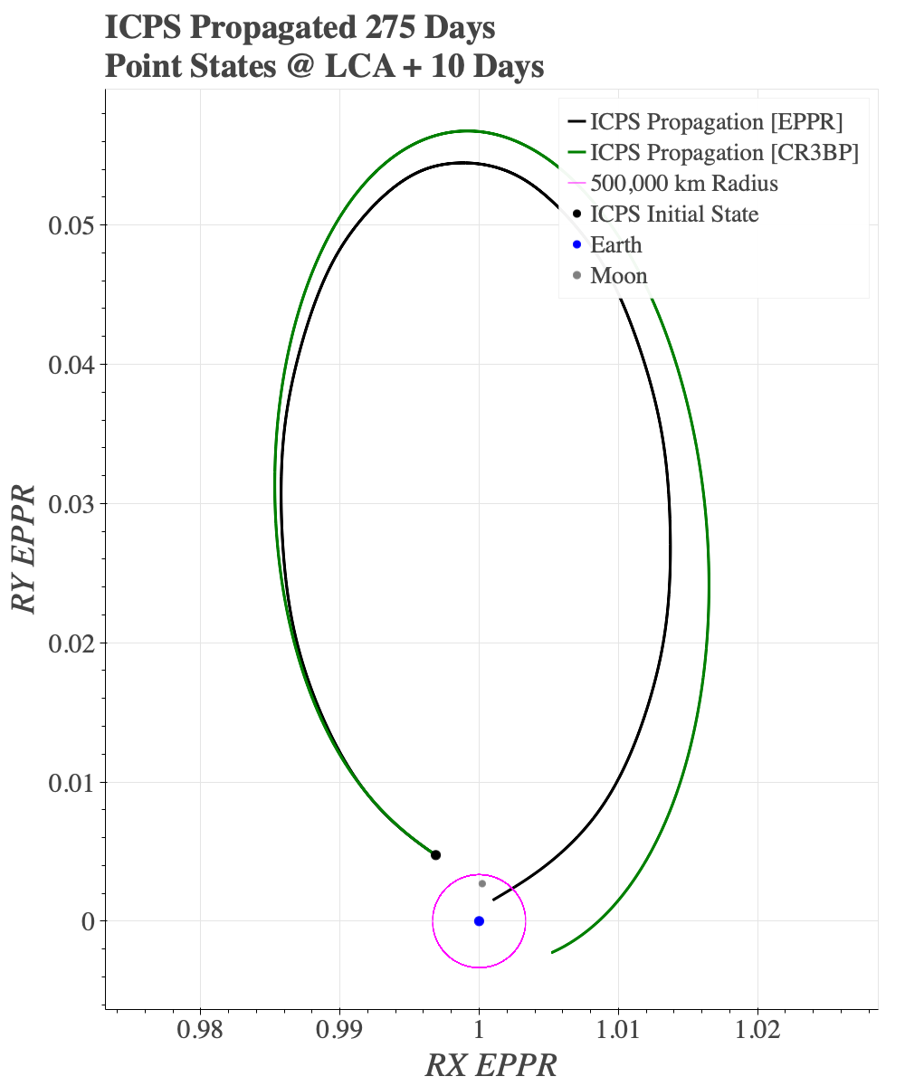
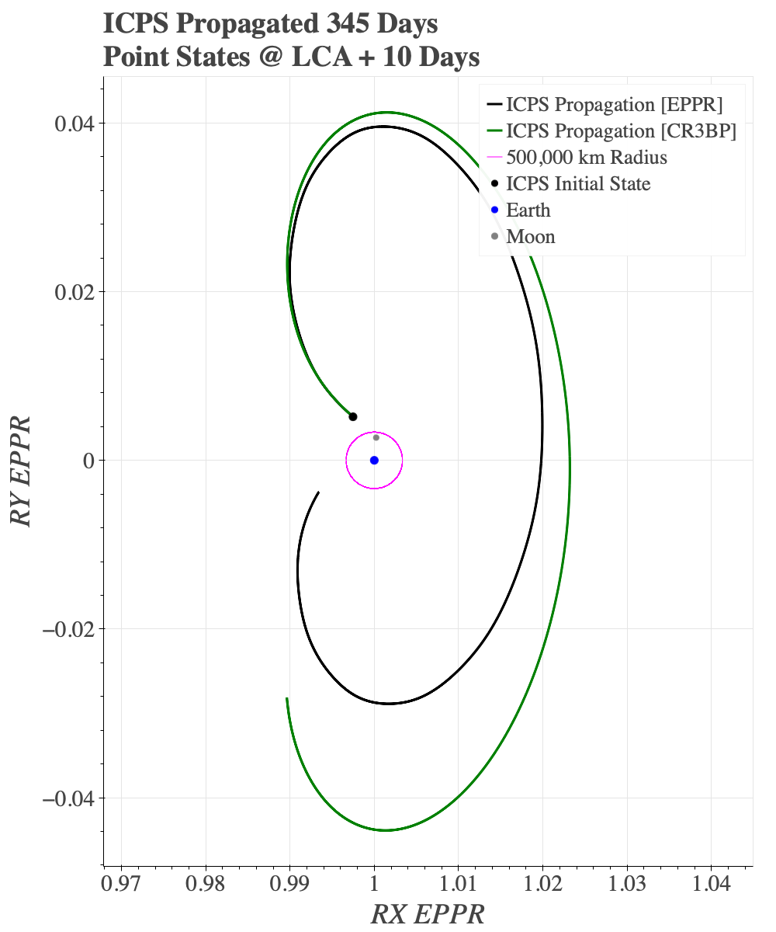
Quick Returning Examples
EPPR (Black):
Depiction of ICPS propagation with additional gravitational bodies and ephemeris.
The ICPS disposal trajectories can mimic the natural behavior of either a Distant Prograde Orbit (left) or a Lyapunov Orbit (right).
Disposal trajectories can also transition between both within the same Launch Window.
CR3BP (Green:)
Three-Body Periodic Orbit corresponding to ICPS initial state.
Oct. 1st,
38th Minute
Oct. 1st,
105th Minute

Slide 6
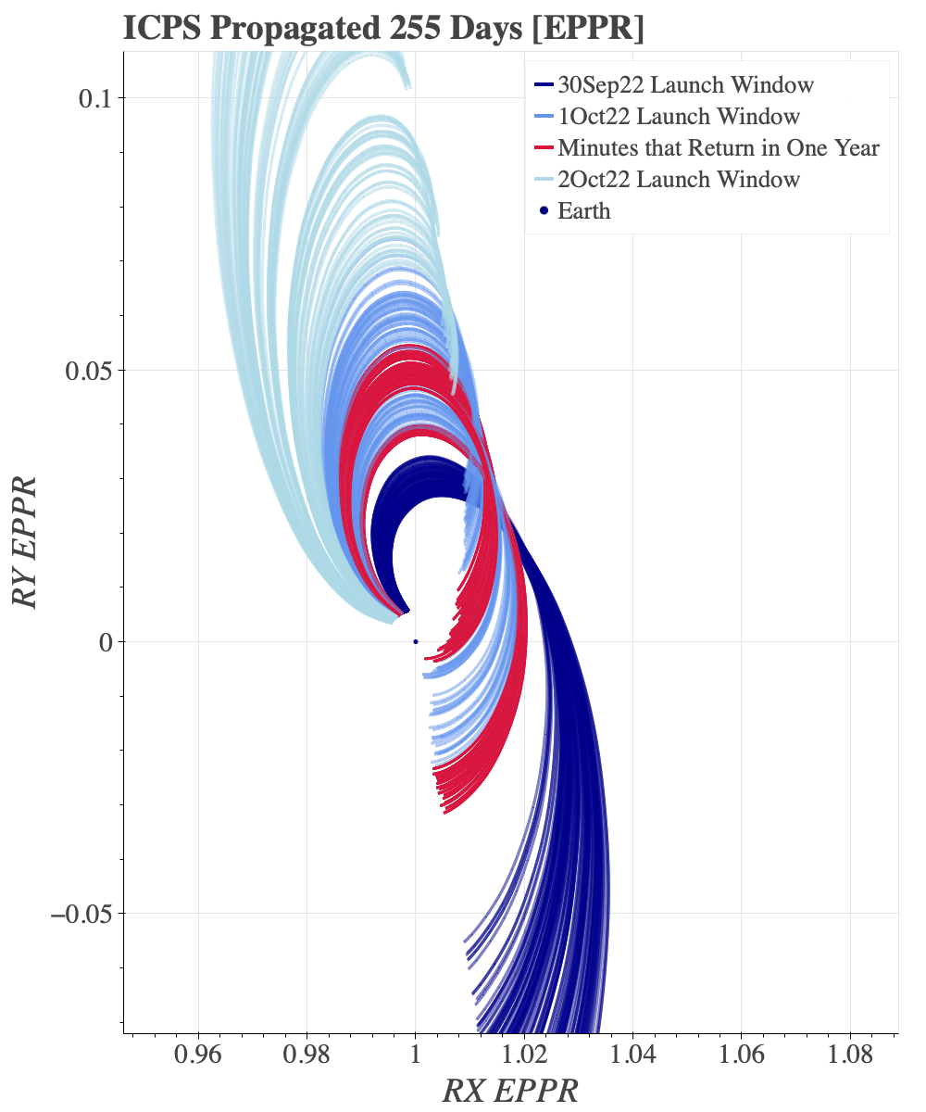
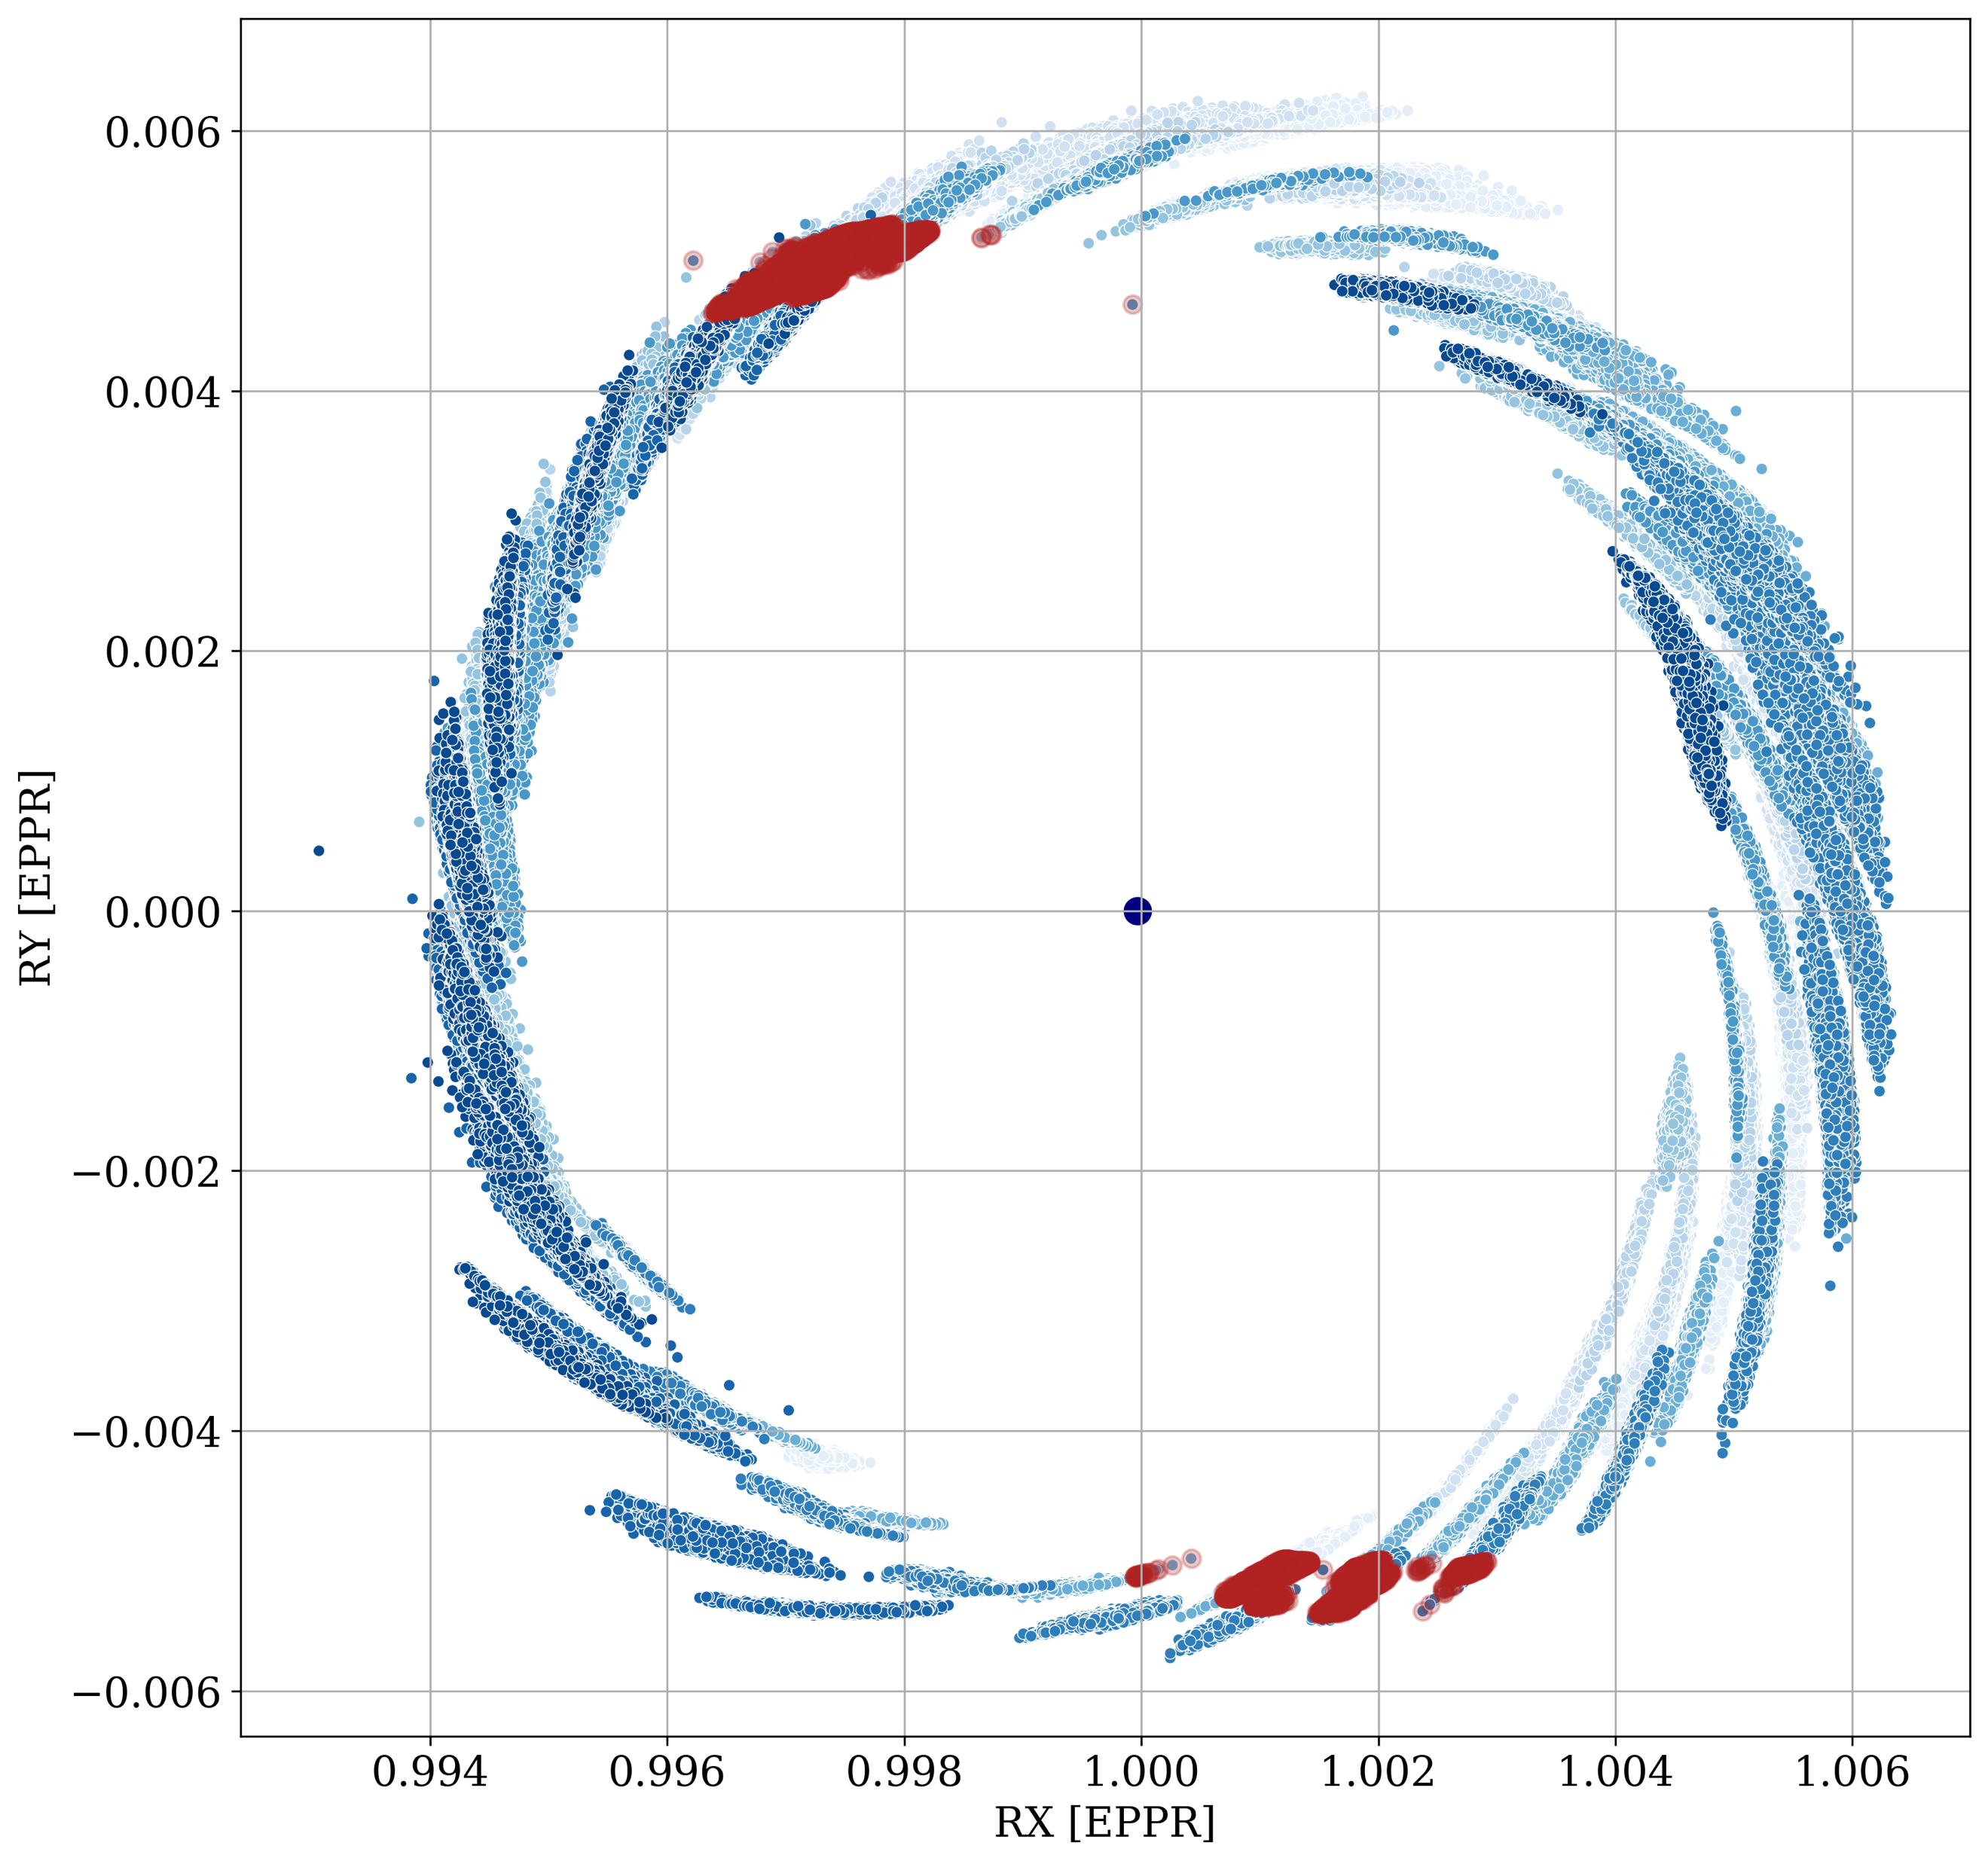
Quick Returning Trajectories Favor Certain Directions
Oct. 2
Notice Banding:
ICPS returns at different times.
The upper band follows a DPO whereas the lower mimics a Lyapunov.
Each line is a single minute of a LW for a given day. Crimson color indicates cases that return.
Oct. 1
Artemis I Propagations:
Locations of all Initial Conditions at LCA+10 days.
LP22-LP30.
Roughly 1.3 million cases.
Coloring indicates each LP, crimson demarking cases that return within a year.
To Sun
To Sun
The orientation of the Quick Returns point in the same two directions in the Sun-Earth frame.
Sept. 30

Slide 7
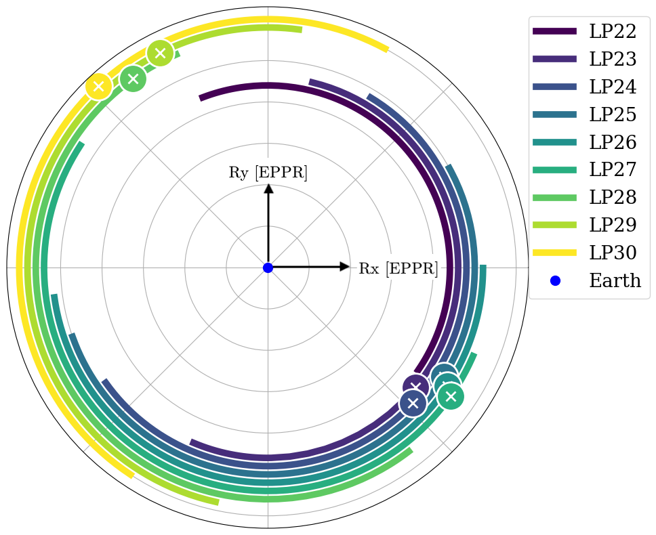
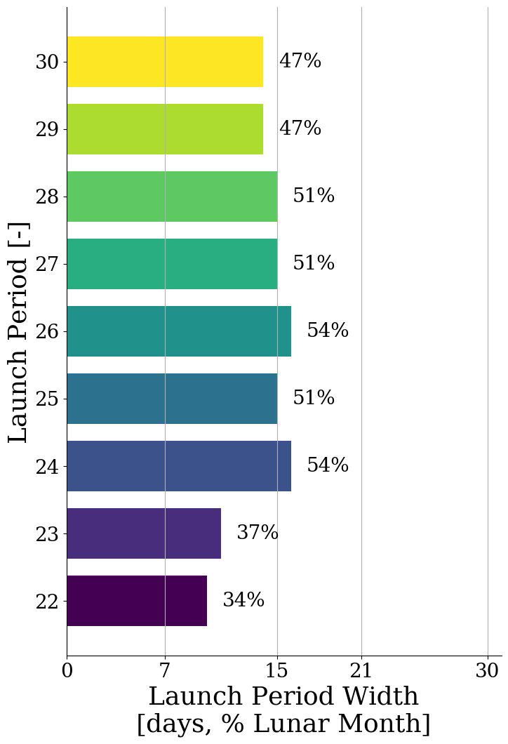
Cadence of Nominally Returning Days
Launch Periods overlap return corridors, dictating which days have nominal returns.
  Return corridors are fixed in the Sun-Earth frame.
  Artemis I mission “fixes” ICPS relative to the Moon.
  Thus, ICPS LCA follows the motion of the Moon.
Days Repeat with the Lunar Synodic Month (~29.5 days)
Artemis I Launch Periods had only one day with Nominal Returns (except LP22).
  Launch Periods vary in width due to mission constraints.
Future missions could have more days that return (or less).
To Sun
Position of the Moon @ LCA in Sun-Earth Frame.
Note: This is rotated from previous Figure which shows LCA+10 days.

Slide 8
Summary
The opportunity exists for ICPS to return within a year in certain Sun-Earth-Moon geometries.
Trajectories that return in Earth-Moon system within a year mimic Lyapunov and Distant Prograde Orbit families.
The Lunar Synodic Month and the width of the Launch Period dictates which days have a substantial portion of the nominal Launch Window return.
Our team would like to thank the NASA Engineering and Safety Center for sponsoring this work.
We would also like to thank the Office of the Chief Engineer for their continued support.

